Slide 1

Techno-economic analysis of SMR deployment in the Estonian power system
R. H. Ivask¹, A. H. Tkaczyk¹, Y. Li², M. Tot², H. Paillere²
1 – University of Tartu, 2 – IAEA Planning and Economic Studies Section
Notes:
Get rid of all caps. UT and IAEA in subscripts

Slide 2
2
Energy mix includes fossil fuels (oil shale) and renewables (solar, wind, biomass).
Being an EU member state, Estonia has to comply with the EU climate target of having a renewable gross final energy consumption share of at least 42.5% by 2030
As of 2023, the net installed capacity of the electricity system in Estonia was 2542 MW (ENTSO-e).
Estonia has historically been reliant on domestically supplied oil shale.

Slide 3
3
Burning of oil shale presents challenges to Estonia for EU initiatives regarding the reduction of GHG emissions.
The country has an internal goal to have gross final consumption of electricity be 100% renewable by 2030 (according to National Energy Climate Plan, NECP).
In order to move away from fossil fuels, Estonia is considering introducing nuclear power into its energy mix (Small modular reactor, SMR).
Non-fossil fuel energy sources are being considered to reduce greenhouse gas emissions.

Slide 4
Nuclear energy in Estonia
4
“Although the construction of a nuclear power plant may initially require larger investments, nuclear energy produces electricity at lower costs in the long term compared to some renewable energy sources (e.g., offshore wind farms).”
- Estonian government’s Nuclear Energy Working Group’s Final Report
June 2024
Dec 2023
Feb 2023
Estonia’s parliament passed a resolution for a legal and regulatory framework development for nuclear
Final report by nuclear energy working group (NEPIO – Nuclear energy programme implementing organisation)
Fermi Energia announced selected design of SMR for potential deployment (GE Hitachi BWRX-300)

Slide 5

MESSAGE is an energy systems optimization tool supported by IAEA
5
Designing optimization models for energy supply systems
  Evaluating capacity expansion
  Assessing related investments
  Analysing environmental impacts
  Formulating policies
Applicable at the national, sub-regional or regional level

Slide 6
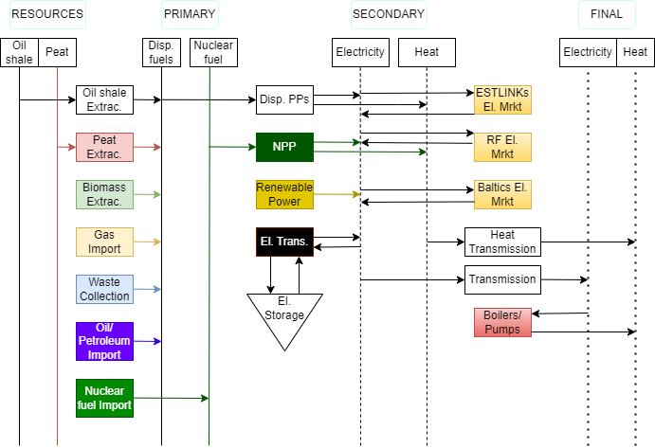
Modelling and analysis
6
Simplified reference energy system (RES) for MESSAGE
We analysed the following aspects of the energy system model:
Capacity and energy mix;
CO₂ emissions and costs;
Power generation, investment, operational costs.
Assumptions:
Base year is 2020;
Time horizon up to 2050 (30 years).

Slide 7
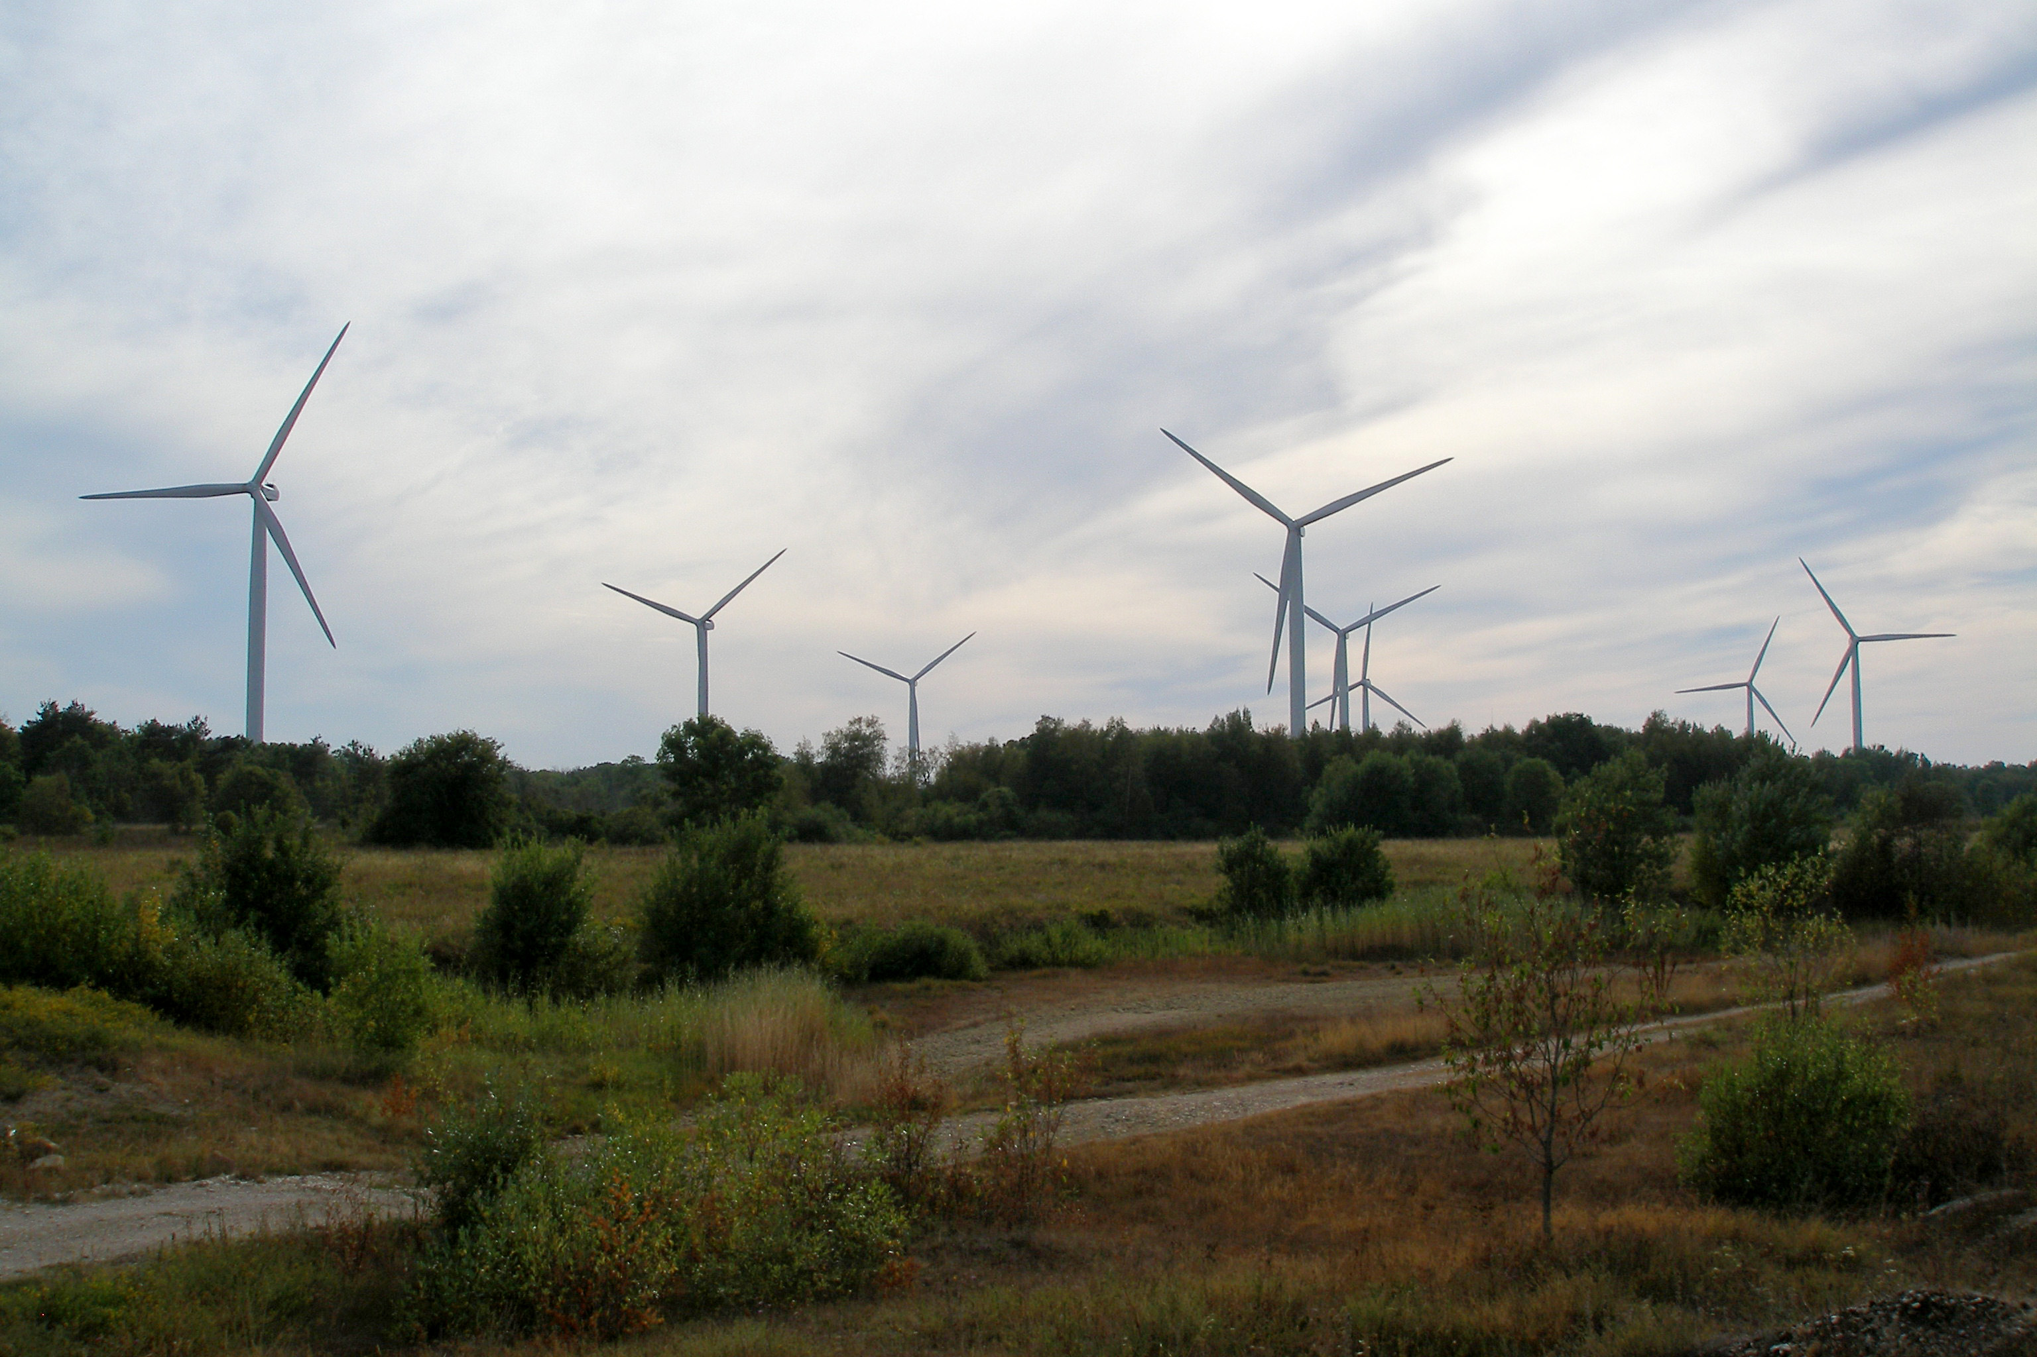

Two scenarios are analysed in this case study
7
Reference scenario
Achieving international and energy policy goals by expansion of currently used low carbon options (e.g. biomass, wind, solar)
Nuclear scenario
Achieving international and internal energy policy goals by introducing nuclear power, specifically 2 SMR units (first in 2035 and second in 2040)
Source: Enefit Green
Source: Fermi Energia
Notes:
Put color box around scenario names. Sources

Slide 8
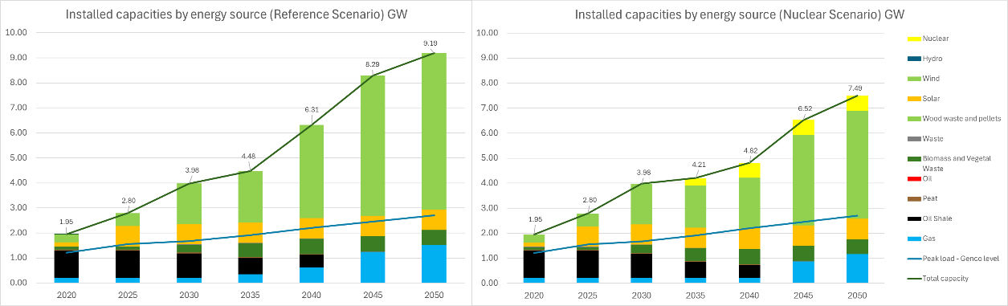
8
Model results - Projected capacities in Estonia
Reference scenario
Nuclear scenario
1
1
In both scenarios wind power capacity dominates as it is the most cost efficient.
Notes:
No all caps. Fonts of the titles and legends. Put into empty space reference and nuclear scenario.

Slide 9
8
Model results - Projected capacities in Estonia
Reference scenario
Nuclear scenario
1
2
1
In both scenarios wind power capacity dominates as it is the most cost efficient.
Oil shale plants are gradually phased out between 2040 and 2045.
2
Notes:
No all caps. Fonts of the titles and legends. Put into empty space reference and nuclear scenario.

Slide 10
8
Model results - Projected capacities in Estonia
Reference scenario
Nuclear scenario
1
2
3
1
In both scenarios wind power capacity dominates as it is the most cost efficient.
Oil shale plants are gradually phased out between 2040 and 2045.
Oil shale is replaced by natural gas plants that serve as reserve capacity.
2
3
Notes:
No all caps. Fonts of the titles and legends. Put into empty space reference and nuclear scenario.

Slide 11
8
Model results - Projected capacities in Estonia
Reference scenario
Nuclear scenario
1
4
2
3
1
In both scenarios wind power capacity dominates as it is the most cost efficient.
Oil shale plants are gradually phased out between 2040 and 2045.
Oil shale is replaced by natural gas plants that serve as reserve capacity.
Installation of SMRs displaces wind capacity (resulting in lower total installed power due to stable power output).
2
3
4
Notes:
No all caps. Fonts of the titles and legends. Put into empty space reference and nuclear scenario.

Slide 12
9
Model results – Average generation costs (AGC) in Estonia
1
Total discounted system cost difference between Reference and Nuclear scenarios is 2.7%
Initial jump after the base year is due to high cost of CO2.
1
Notes:
No all caps. Fonts of the titles and legends. Put into empty space reference and nuclear scenario.

Slide 13
9
Model results – Average generation costs (AGC) in Estonia
1
2
Total discounted system cost difference between Reference and Nuclear scenarios is 2.7%
Initial jump after the base year is due to high cost of CO2.
AGC decreases as less oil shale is being used
1
2
Notes:
No all caps. Fonts of the titles and legends. Put into empty space reference and nuclear scenario.

Slide 14
9
Model results – Average generation costs (AGC) in Estonia
1
2
3
Total discounted system cost difference between Reference and Nuclear scenarios is 2.7%
Initial jump after the base year is due to high cost of CO2.
AGC decreases as less oil shale is being used
Upon deployment of the first SMR, AGC of the nuclear scenario increases creating a divergence between both scenarios.
1
2
3
Notes:
No all caps. Fonts of the titles and legends. Put into empty space reference and nuclear scenario.

Slide 15
9
Model results – Average generation costs (AGC) in Estonia
1
2
3
4
Total discounted system cost difference between Reference and Nuclear scenarios is 2.7%
Initial jump after the base year is due to high cost of CO2.
AGC decreases as less oil shale is being used
Upon deployment of the first SMR, AGC of the nuclear scenario increases creating a divergence between both scenarios.
In both scenarios, investments into sustainable energy infrastructure increase as electricity demand rises.
1
2
3
4
Notes:
No all caps. Fonts of the titles and legends. Put into empty space reference and nuclear scenario.

Slide 16
Limitations of analysis
10
Findings are based on the production cost and capital investments. Cost related to grid investments and balancing need further consideration
Several factors such as system stability and reliability are indirectly considered in the model
Estonia is well interconnected to Nord Pool power market which has a big impact on operation and simulation of the system (careful modelling of import and export is needed)

Slide 17
11
Conclusions
In both scenarios, CO₂ emission reduction targets could be met.
Compared to the Reference scenario, the deployment of two SMR plants in Estonia’s future energy system is marginally more costly by 2.7%.
SMRs are still not commercially available so there are no reliable price estimates at hand. It was assumed that the investment cost is 6000 EUR/kW (in year 2035) for an SMR.
Should additional balancing and flexibility be taken into account, we might expect the cost difference between scenarios to decrease further.
National decisionmakers may consider the relative importance of both economic and non-economic factors in deciding on whether to introduce nuclear power into the energy system.
Notes:
In both scenarios, CO₂ emission reduction targets could be met with the phase out of oil shale and other intensive carbon sources.
Compared to the Reference scenario, the deployment of two SMR plants in Estonia’s future energy system is marginally more costly by 2.7%.
SMRs are still not commercially available so there are no reliable price estimates at hand. It was assumed that the investment cost is 6000 EUR/kW (in years 2035) for an SMR.
Grid and balancing costs are partially covered in the model. Should additional balancing and flexibility be taken into account, we might expect the cost difference between scenarios to decrease further.
National decisionmakers may consider the relative importance of both economic and non-economic factors in deciding on whether to introduce nuclear power into the energy system.

Slide 18
12
After paper submission, many details were added into the model, such as
SMR heat production for district heating is considered;
Market prices for electricity were made dynamic to account for price fluctuations;
Energy flow was rerouted to account for energy storage;
Inputs were checked and updated to be more accurate;
Considering part of the grid investment costs.
Total discounted system cost difference between Reference and Nuclear scenarios in the latest model is 1.3%.
Further development of the model

Slide 19

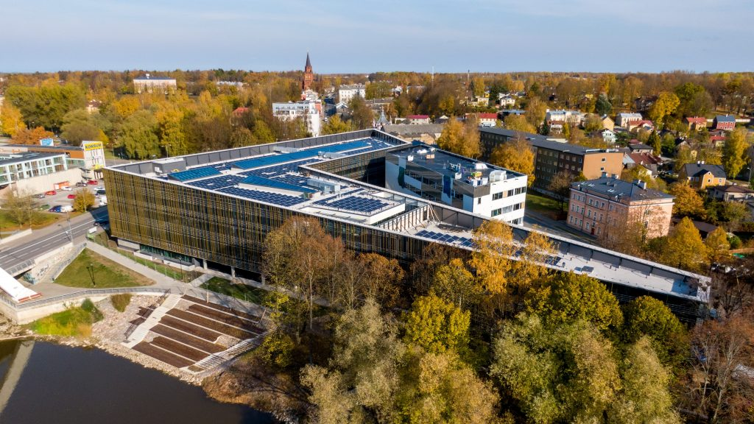
13
Thank you
Roald Heinrich Ivask,
roaldhiv@ut.ee
Alan Tkaczyk,
alan@ut.ee
Yunshu Li
Mario Tot
Henri Paillere

Slide 20
Data Sources
Data type | Source
Hourly electricity demands | Power statistics data by ENTSO-E
Hourly heat demand profiles | Renewables Ninja synthetic (simulated data)
Carbon prices | European Commission’s projection for carbon price

Slide 21
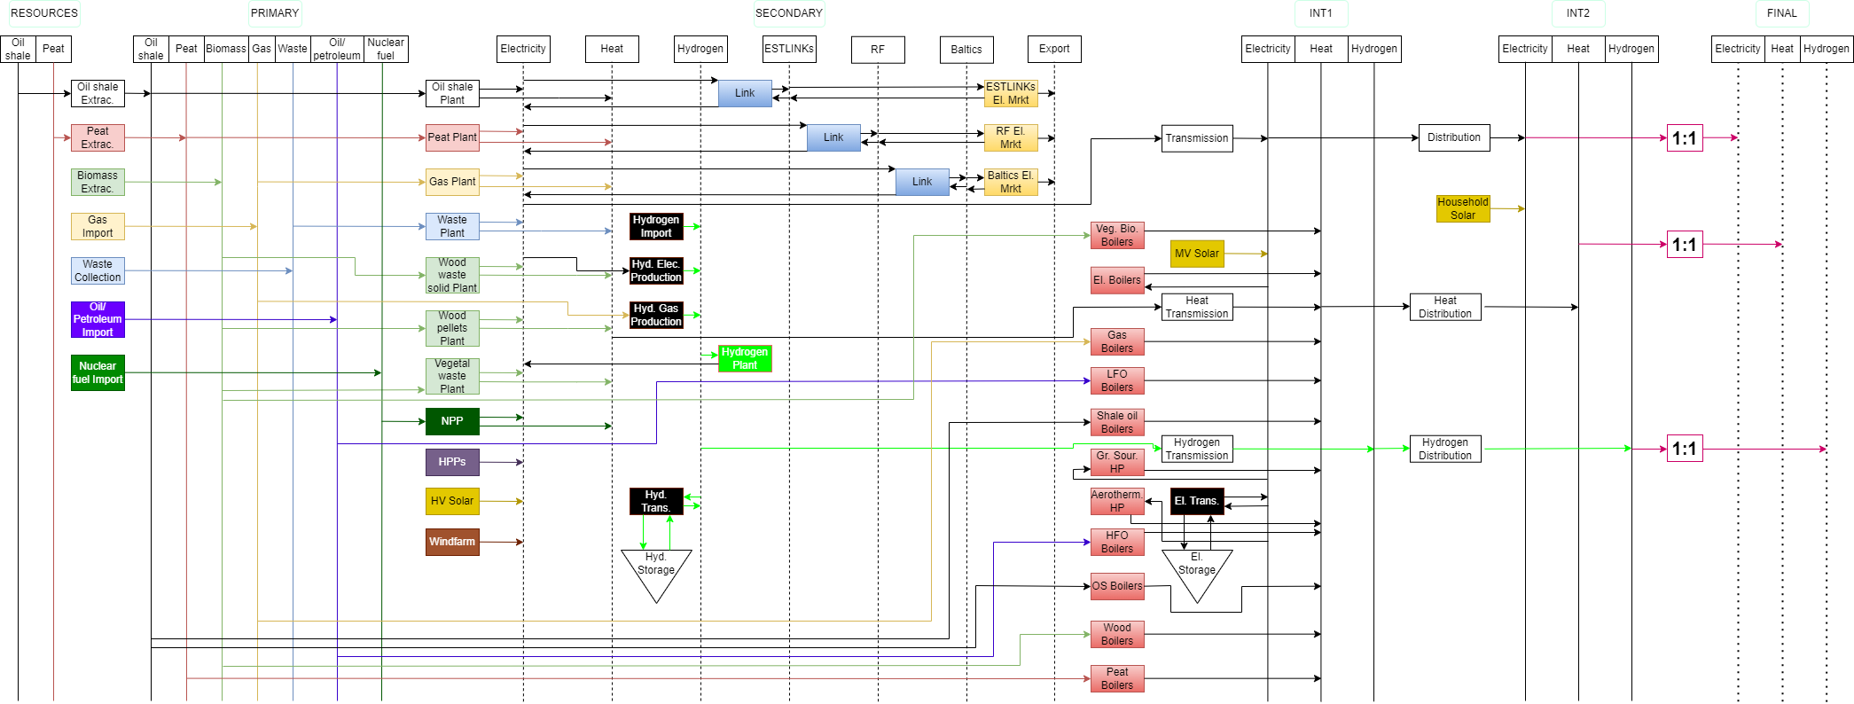

Slide 22
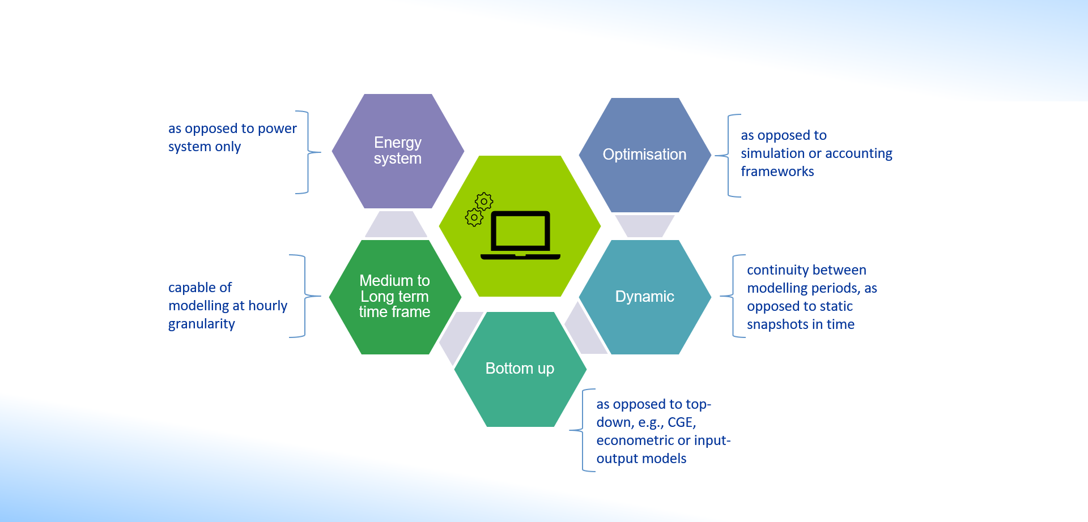
Key characteristics of MESSAGE

