Slide 1
The TANDEM Euratom project to study the integration of SMRs into low-carbon hybrid energy systems: progress status at mid-term
C. Vaglio-Gaudard (CEA, France), S. Crevon (CEA, France),
T. Hollands (GRS, Germany), S. Lorenzi (POLIMI, Italy),
C. Schneidesch (Tractebel-Engie, Belgium)
International Conference on Small Modular Reactors and their Applications, 21–25 October 2024, Vienna, Austria - Track 13.1, paper #89

Slide 2
Outline
Brief description of the project
Main technical outcomes of the project at mid-term

Slide 3
Brief description of the project

Slide 4
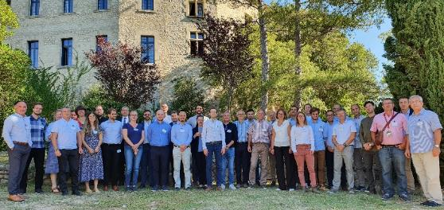
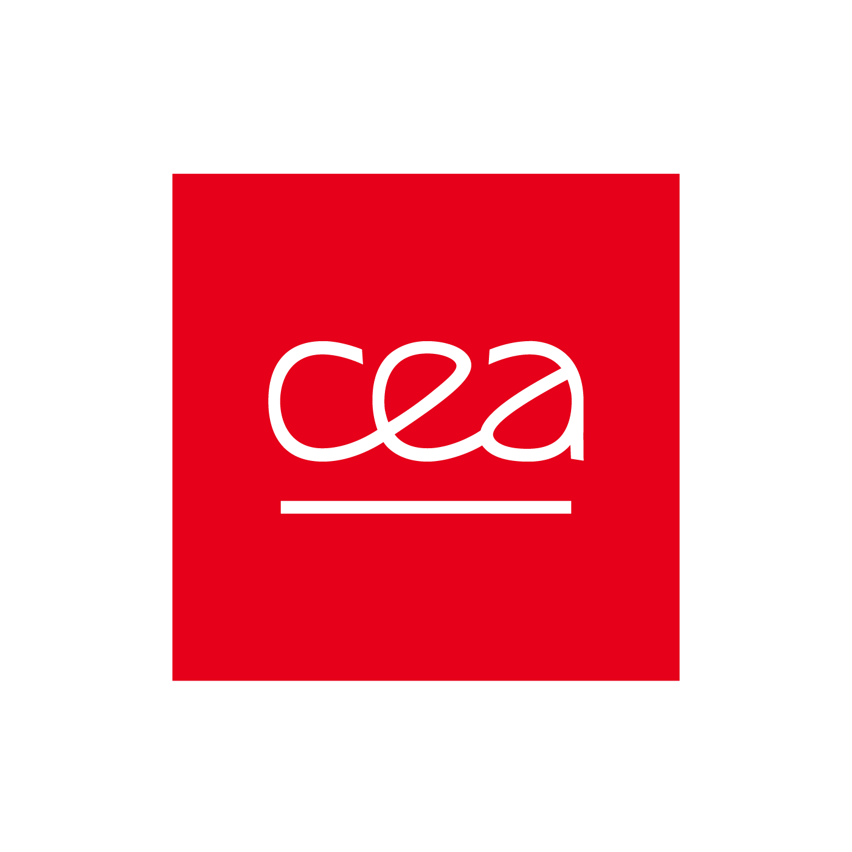
General description of the TANDEM project
Submission of the project in October 2021 to a EURATOM call for EC funding
(topic: NRT01-02 « Safety of advanced and innovative nuclear designs and fuels »)
Project start: September 1, 2022
Project duration: 36 months
Budget: 3.8M€ (including EC grant: 3.4M€)
Organization leading the project: CEA
(French Alternative Energies and Atomic Energy Commission)
For further information :
Browse our website: https://tandemproject.eu/
Follow us: https://www.linkedin.com/company/tandem-project-eu/
4

Slide 5
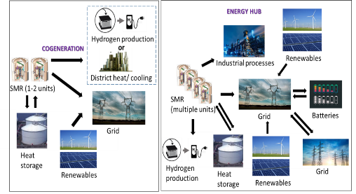
Objectives and ambitions of the TANDEM project
TANDEM: Small Modular ReacTor for a European sAfe aNd Decarbonized Energy Mix
High-level objectives:
- Assess the safety compliance of SMRs to be integrated in the future European energy mix
- Provide guidance in a deployment perspective for the future integration of SMRs and AMRs into well-balanced hybrid energy systems
- Create an enabling environment for the development of hybrid energy systems based on SMRs and AMRs
Ambitions of TANDEM:
- Promote versatile SMRs integrated into hybrid energy systems as reliable, resilient, and affordable clean energy options in Europe
- Become a pioneer initiative in gathering efforts and expertise around the development of SMR integration into hybrid energy systems in Europe
5

Slide 6
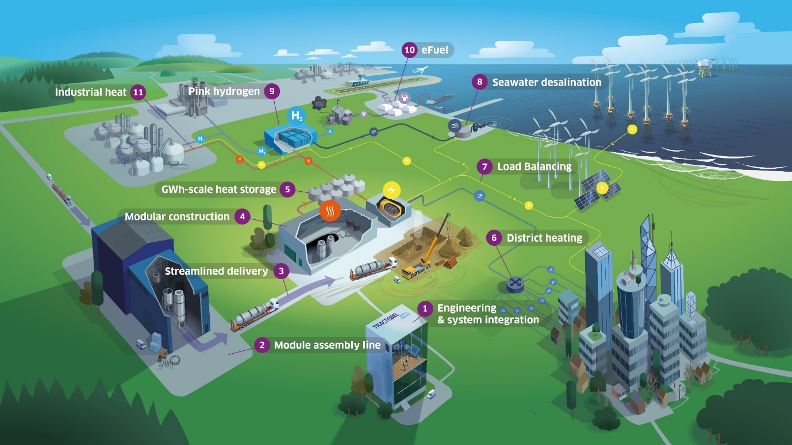
Illustration of Hybrid Energy Systems at a local scale
Courtesy of Tractebel
6

Slide 7
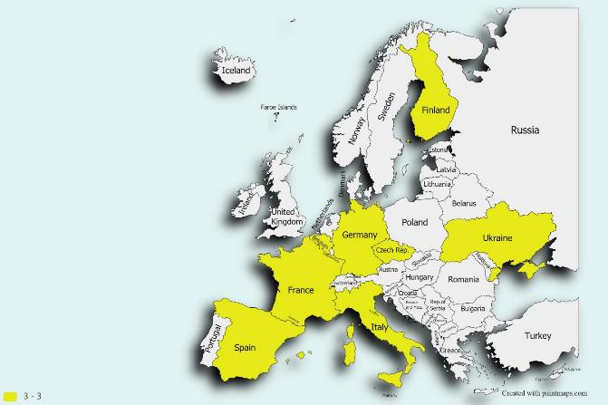















TANDEM consortium
Belgium:
Czech Republic:
Finland:
France:
Germany:
Italy
Spain:
Ukraine:
18 partners from 8 European countries, composed of:
universities, RTO, TSO, industrials and engineering organizations
7

Slide 8
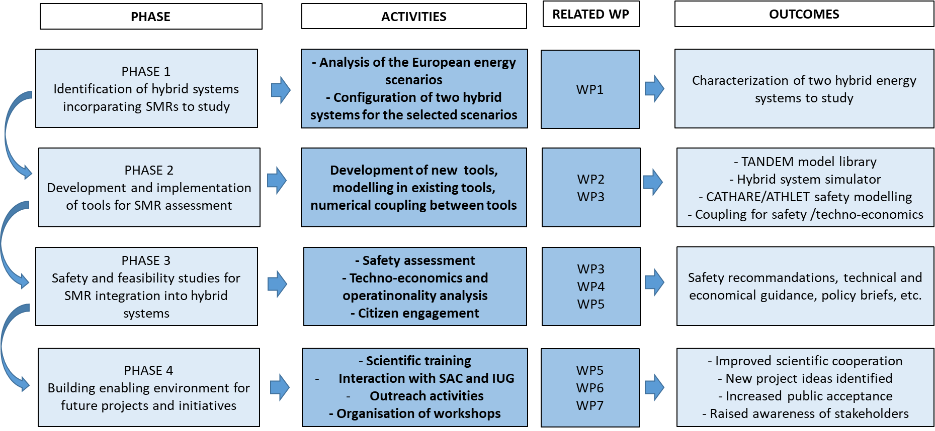
Overall methodology implemented in the project
8

Slide 9
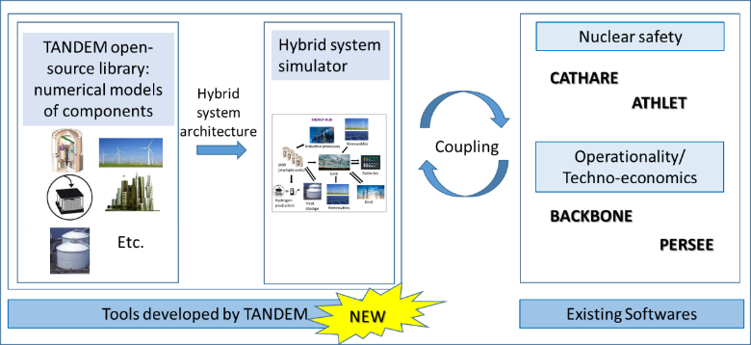
Modeling and simulation strategy in TANDEM
9

Slide 10
Main technical outcomes of the project at mid-term

Slide 11
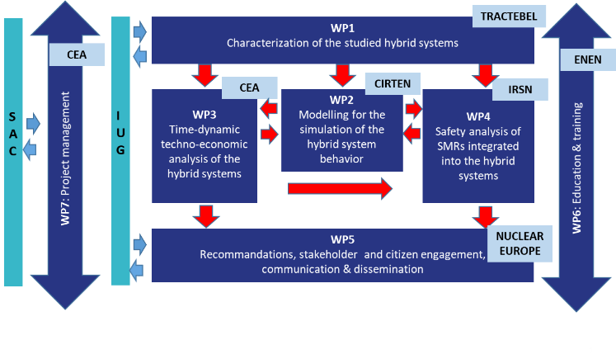
Work Package breakdown
11

Slide 12
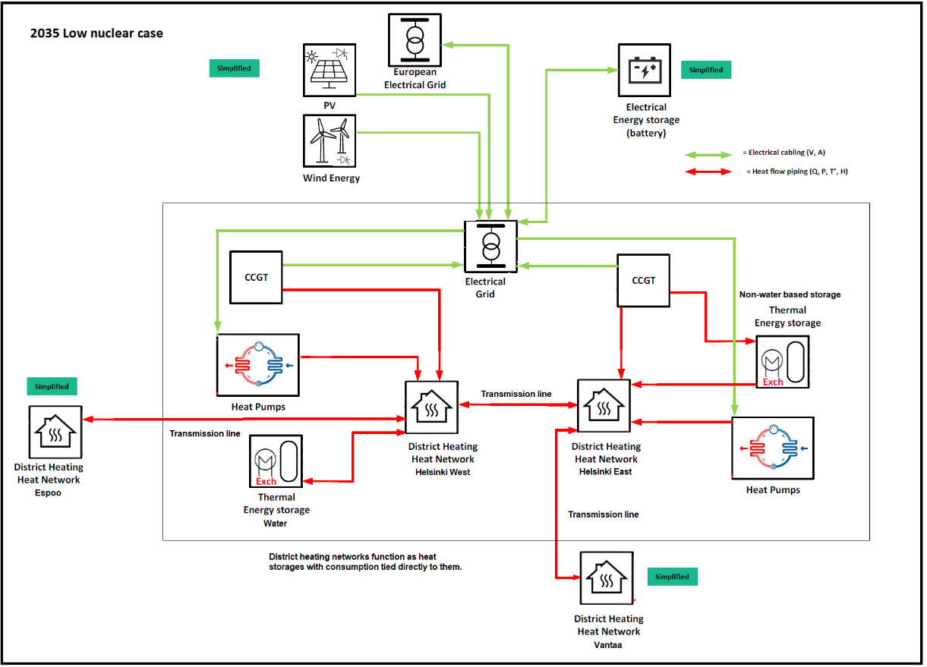
WP1: Generic configurations of HES to be studied
Energy scenario in 2035: start of SMR deployment
Energy scenario in 2050: low-carbon HES
Energy scenario in 2035: Business-as-usual
SMR
SMR
SMR
SMR
12
Source: TANDEM/Deliverable 1.4

Slide 13
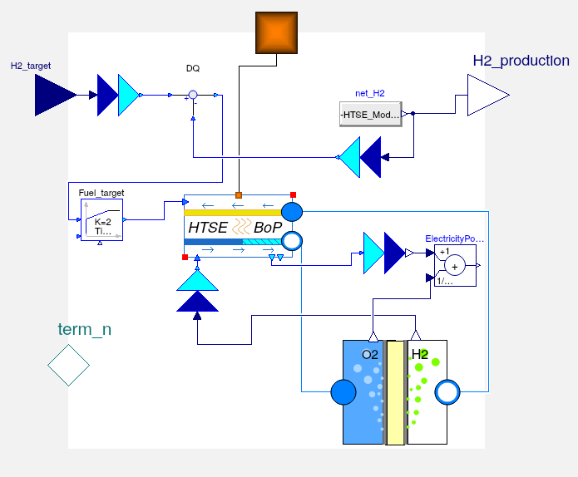
WP2: TANDEM modelica-based library
TANDEM open-source library available at: https://gitlab.pam-retd.fr/tandem/tandem
Documentation: TANDEM/D2.3: Modelica models description for the ‘TANDEM’ library
List of models available in the library
SMR: a) Nuclear Steam Supply System;
b) Balance of Plant and Power Conversion System.
Combined Cycle Gas Turbine (simplified).
Heat pump (simplified).
Electrical Grid.
District Heating Network.
Storage : a) Thermal; b) Electrical (simplified).
Desalination (simplified).
H₂ production:
a) Low temperature electrolizer (simplified);
b) High temperature steam electrolyzer.
Paper #360 “Integrating Small Modular Reactors into Hybrid Energy Systems: the TANDEM Modelica library”, presented by G. Simonini at this conference in Track 5.3, on Friday morning
13

Slide 14
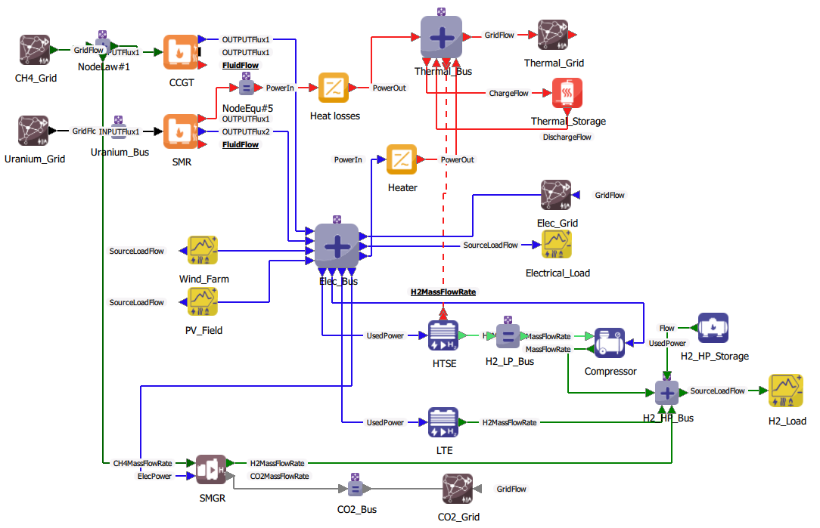
WP3: Illustration of techno-economics studies for the energy hub
Due to the difficulties of accessing the detailed characteristics of the energy fluxes involving several industrials in existing European harbours, it was decided to arbitrarily set an initial architecture involving a CCGT, a photovoltaics field, an offshore wind farm, and energy storage systems, to produce constant hydrogen and electricity loads.
In the study, optimization process implemented in the PERSEE tool: it is based on the optimization of an objective function by finding an optimal sizing of system components.
Study conducted with a 20 year lifetime project with a hourly one-year simulation
Fourteen optimal states have been run by increasingly limiting CO₂ intensity (considering both CO₂ grey and direct emissions).
14
Source: TANDEM/Deliverable 3.2

Slide 15
WP4: Extension of conventional safety approach when SMR integrated into hybrid energy systems
Use of nuclear power plants for cogeneration effective for many years in several countries [IAEA, No NP-T-4.1, 2017], mainly for desalination and district heating applications
Configurations often considered as the juxtaposition of two industrial processes with a customer-supplier relationship and a small number of interfaces. Risks seen as independent, considering the other process as a potential external hazard
Considerable work carried out on safety for reactors operated in cogeneration in the framework of the European Nuclear Cogeneration Industrial Initiative (NC2I), as a pillar of the Sustainable Nuclear Energy Technology Platform (SNETP), for (very) high temperature reactors ((V)HTR)
Useful general safety considerations for nuclear co-/poly-generation
SMR integration into hybrid energy systems induces multiple and more dynamic interfaces between the nuclear reactor and non nuclear components of the hybrid energy system
Need for the development of additional specific guidelines for safety analysis
Definition of “hybridization transients” to be studied in TANDEM
15
Source: TANDEM/Deliverable 4.2

Slide 16
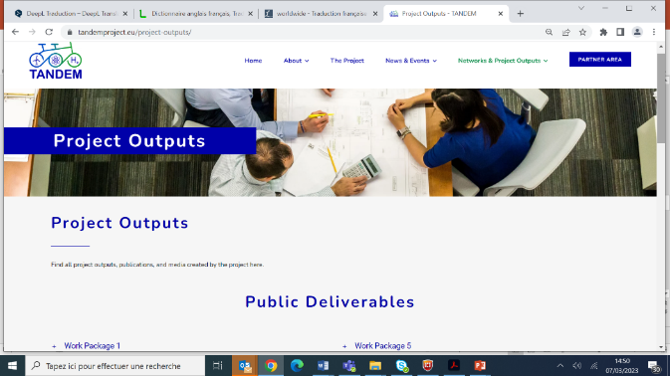
To access TANDEM deliverables
All our deliverables (or almost) for the European Commission are public.
They are available on our website: https://tandemproject.eu/

Slide 17
Conclusion
Constantly evolving energy paradigm and strategy at the international level, EU level and country level => Important for the TANDEM project not to get results that depend on these changes
In the context of the different initiatives promoting the integration of sustainable energy sources to the energy mix, the overall aim of TANDEM:
  to highlight the potential role of SMRs and AMRs in the development of the future European low-carbon energy mix and
  to build an open and long-term community that will ensure expertise in the domain and support the wide acceptance of SMRs and AMRs at different levels
Announcement of the next TANDEM technical workshops (Education & Training framework): ”Modelling and optimization tools to assess hybrid energy systems integrating nuclear reactors” - in Pisa, Italy – February 20-21, 2025
17

Slide 18
Beyond the TANDEM framework: Call for papers in SETA
Launch of a Special Issue « Beyond conventional use of nuclear for new energy needs and net-zero emission » in the Elsevier peer-reviewed journal « Sustainable Energy Technologies and Assessments »
Call for papers: https://www.sciencedirect.com/journal/sustainable-energy-technologies-and-assessments/about/call-for-papers#beyond-conventional-use-of-nuclear-for-new-energy-needs-and-net-zero-emission
Guest Editors:
  Dr. Shannon Bragg-Sitton, INL, USA
  Dr. Michael Fütterer, EC-JRC, Netherlands
  Prof. Dr. Marco Ricotti, CIRTEN, POLIMI, Italy
  Dr. Claire Vaglio-Gaudard, CEA, France
Important dates:
Submission Open Date: 15 July 2024
Manuscript Submission Deadline: 31 August 2025

Slide 19
Beyond the TANDEM framework: Call for papers in SETA
Scope of the special issue:
Some of the major challenges of this century, such as climate change mitigation and space exploration, are directly linked to the development of clean, sustainable and reliable energy systems. Nuclear power and renewable energies form the backbone of these energy systems, which are needed for transport, domestic use and industrial processes.
The aims of this special issue is to investigate the role that nuclear systems has to play in an integrated vision of low-carbon energy or in new applications, beyond its conventional use, i.e. supplying power grid, to meet new energy needs and net-zero emission. The study of such energy systems covers design, operationality (flexibility of the energy production, stability of the power grid, etc), techno-economics, safety considerations resulting from the coupling of sub-systems, and environmental impact. Potential topics include but are not limited to:
Hybridization of existing or innovative nuclear reactors with electric and non electric applications and/or energy storage systems to supply power, heat and feedstocks,
Nuclear cogeneration,
Small Modular Reactors (SMRs) and Micro Modular Reactors (MMRs) for non-electric applications,
Hydrogen and synthetic fuel production with nuclear,
New applications of nuclear for ship propulsion, space exploration, data centers, agriculture, etc.

Slide 21


Claire VAGLIO-GAUDARD
Coordinator of the TANDEM project
      claire.vaglio-gaudard@cea.fr
https://tandemproject.eu/
https://www.linkedin.com/company/tandem-project-eu/

