Slide 1

Integration Of Small Modular Reactors (SMRs) In Ghana's Energy Mix: A Pathway To Sustainable Development
Joshua Gbinu
Ghana Atomic Energy Commission, Nuclear Power Institute
Date: 24th October 2024
Venue: Vienna - Austria

Slide 2

Content
Nuclear Power in Ghana
SMRs and Ghana’s Electricity Generation Mix
Financing of SMRs in Ghana
Assessment of SMR Technologies for Deployment in Ghana.
International Cooperation and Harmonization
Suitability of SMRs for Ghana
Conclusion

Slide 3
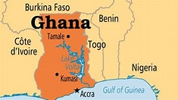
Nuclear Power in Ghana
Map of Ghana
Population- 33.48 million
GDP- 2,363.30 USD
Current Energy mix: hydro 29.1, Thermal 68.9, Renewables 2%
Ghana’s quest to acquire and exploit the peaceful uses of nuclear technology for national development began in the 1960s.
The main pillars for actively pursuing nuclear power agenda are:
  Baseload for Industrialisation
  Meeting the rapid growth in energy demand
  Cheaper Tariff
  Job Creation
  Declining Gas Reserves
  Limited Hydro Resources
  Climate Action

Slide 4
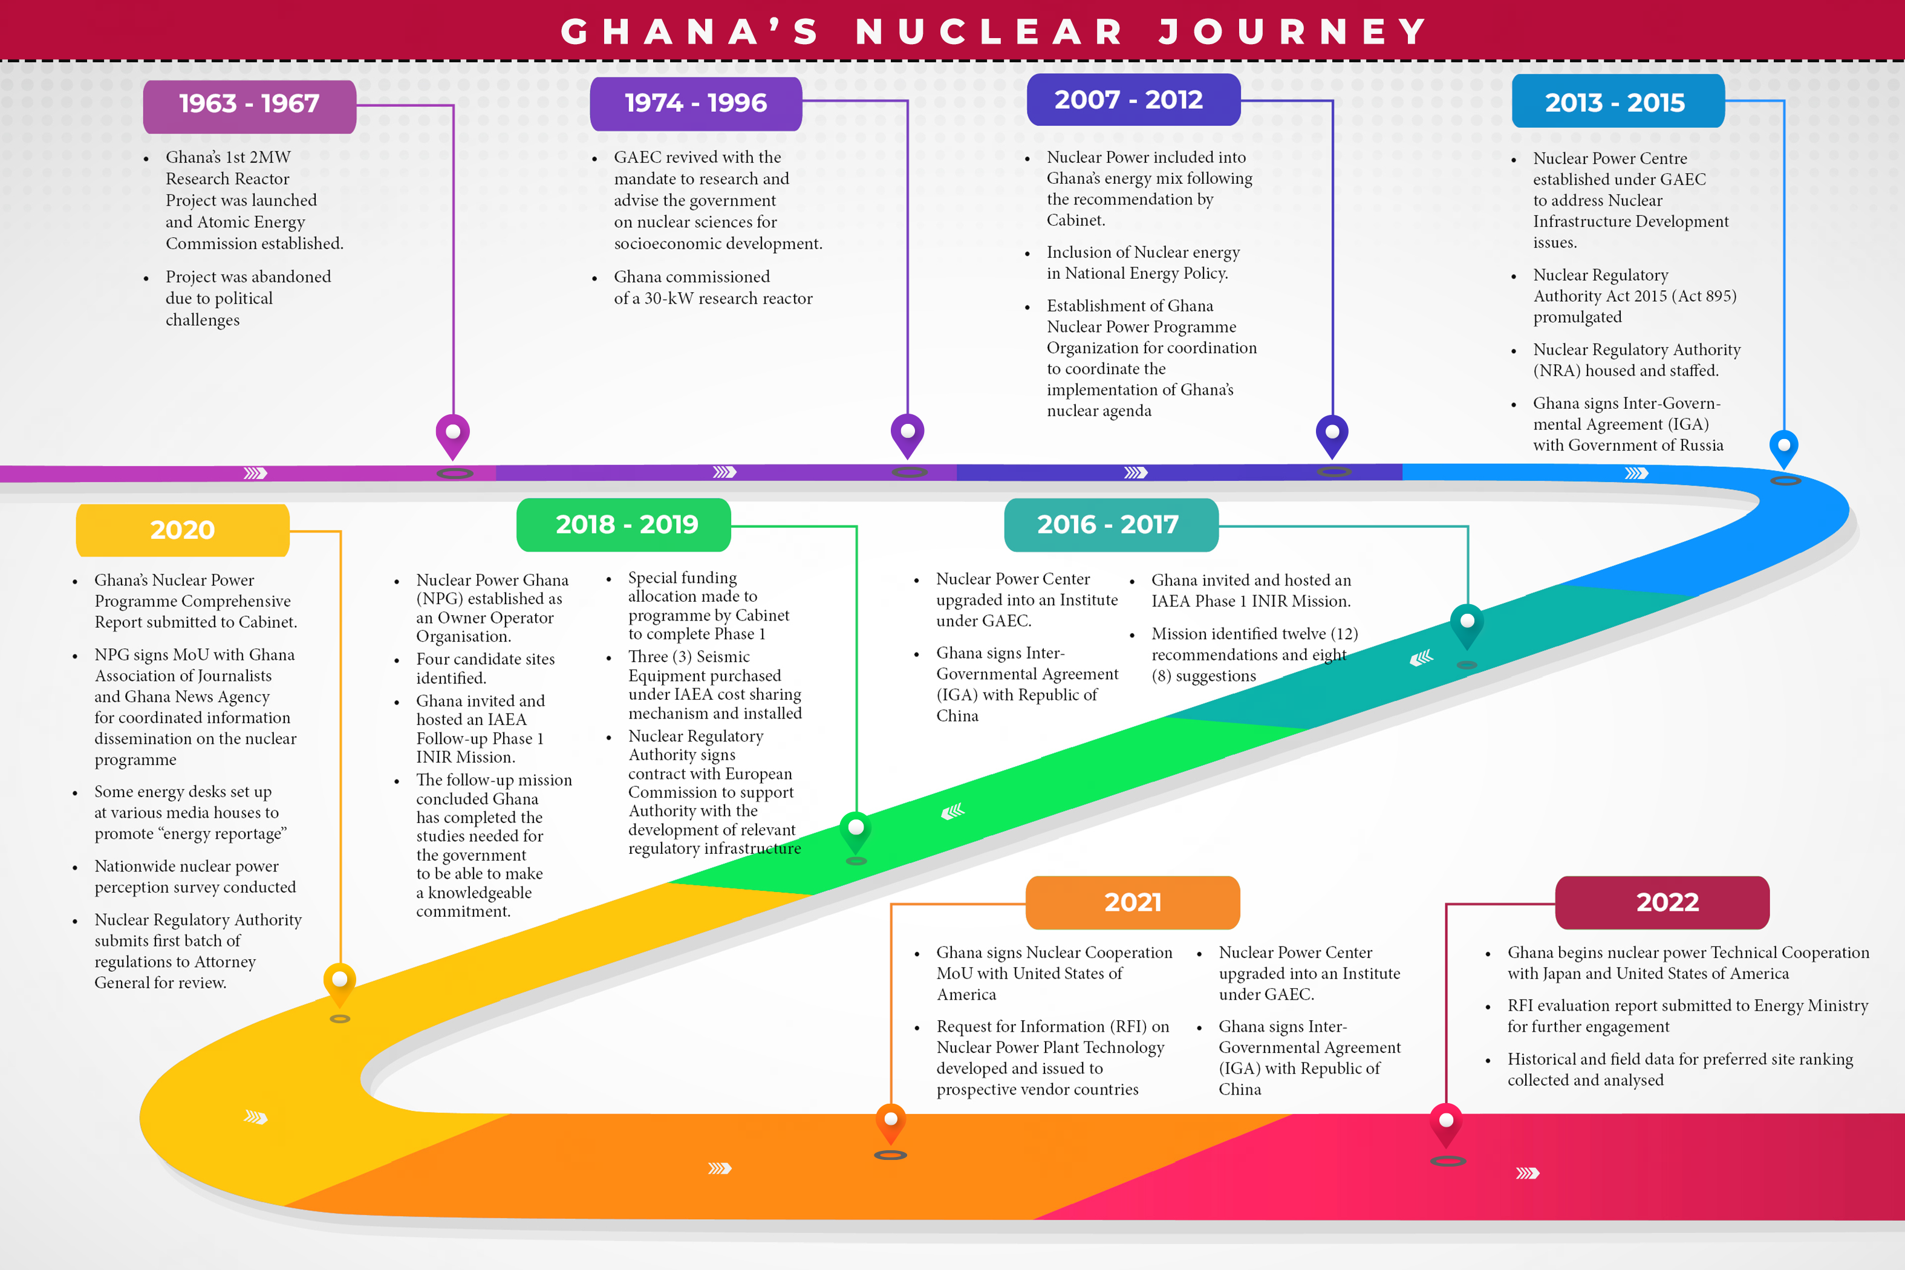
Nuclear Journey so far……..

Slide 5
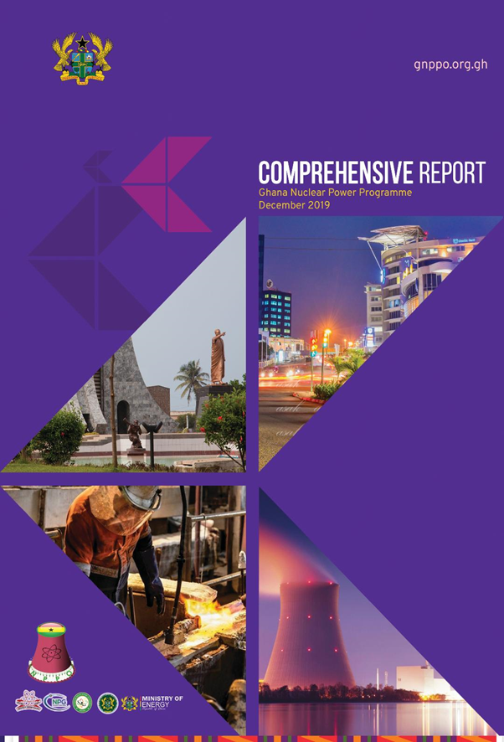
Programme Comprehensive report
All relevant Phase 1 technical considerations for establishment of a Nuclear Power Programme in Ghana have been completed.
The Nuclear Programme Comprehensive Report (PCR) submitted for Cabinet consideration.
It is Ghana’s basis document for a knowledgeable commitment on the inclusion of nuclear energy in the country’s energy mix.

Slide 6
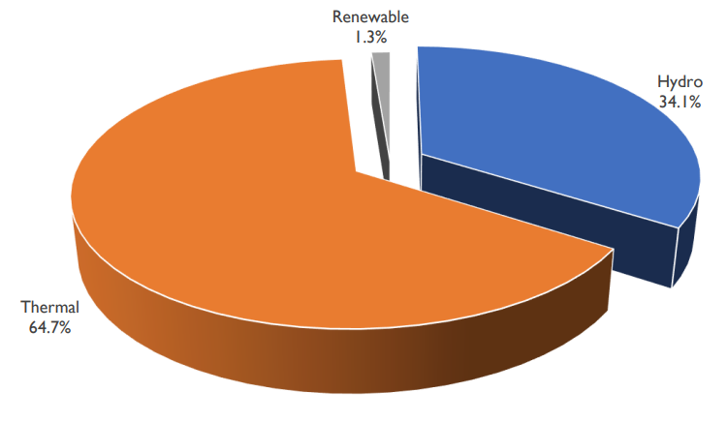
SMRs and Ghana’s Electricity Generation Mix
The planning of energy in Ghana gives priority to streamline energy production with Sustainable Development Goals (SDGs).
Currently, the electrical energy generation sources of Ghana comprised mainly of thermal power plants and hydro-electric plants
Share of Electricity supply by generation type in Ghana as of 2023

Slide 7
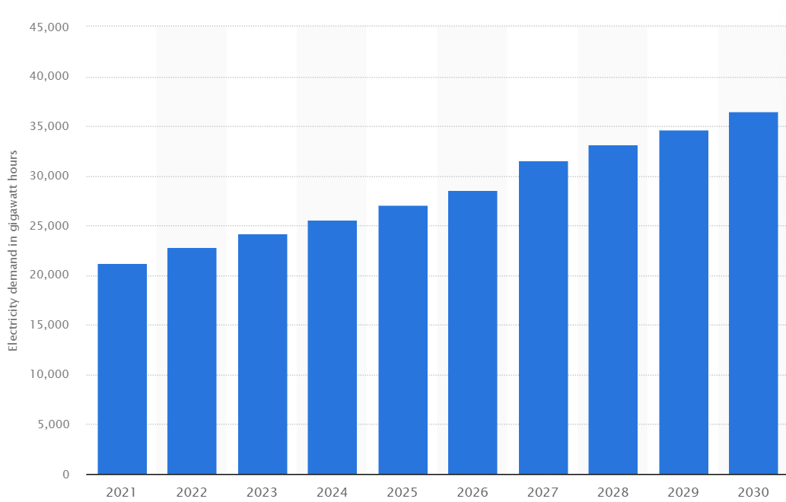
SMRs and Ghana’s Electricity Generation Mix
The country’s energy demand keeps increasing with the current generation sources unable to meet the demands of homes and industries
The consideration of SMRs to be added to Ghana’s electricity generation mix is carefully associated with the country's burgeoning electricity demand.
Ghana’s Electricity Demand from 2021 to 2030. [8]

Slide 8
Financing of SMRs in Ghana
Financing of nuclear power project requires cautious consideration of economic viability and investment opportunities.
The Government of Ghana considers financing model as a major factor in its nuclear power agenda. Various financing models presented by technology holders are been explored to choose the most suitable for Ghana’s socio-economic development.
      Build-Own-Operate (BOO)
      Build-Own-Operate-Transfer (BOOT)
      Turnkey Projects

Slide 9
Assessment of SMR Technologies for Deployment in Ghana.
As Ghana progresses in its nuclear power programme, there is the need to select a suitable Reactor Technology which meets the Country’s nuclear energy policy objectives.
Ghana’s GNPPO begun technical work on Reactor Technology Assessment (RTA) of SMRs
Reactor Technology Assessment (RTA) is a complex and multi-decision making process which requires diverse expertise and careful attention.
Workdone on RTA was with support of the IAEA

Slide 10
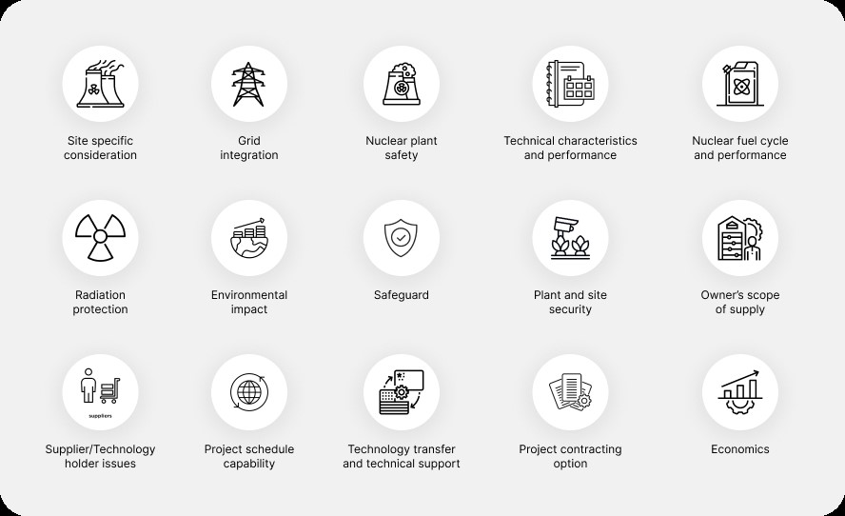
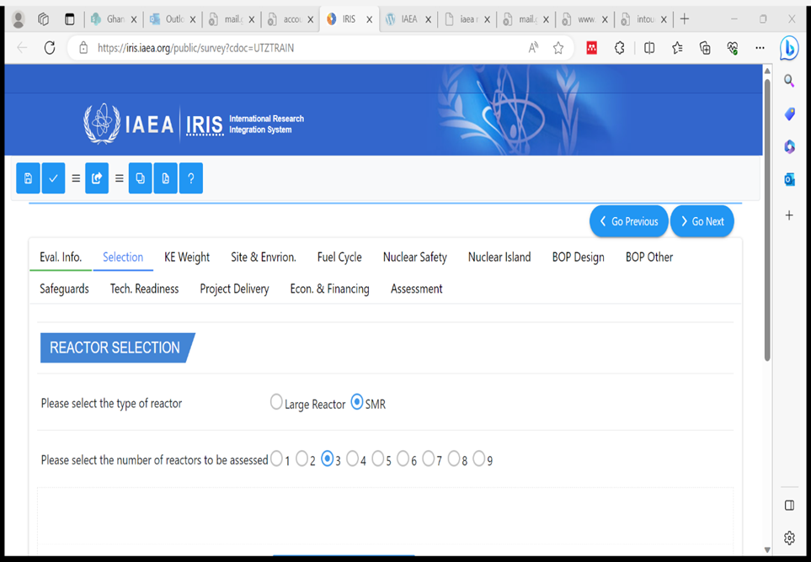
Key Elements used in Reactor Assessment

Slide 11
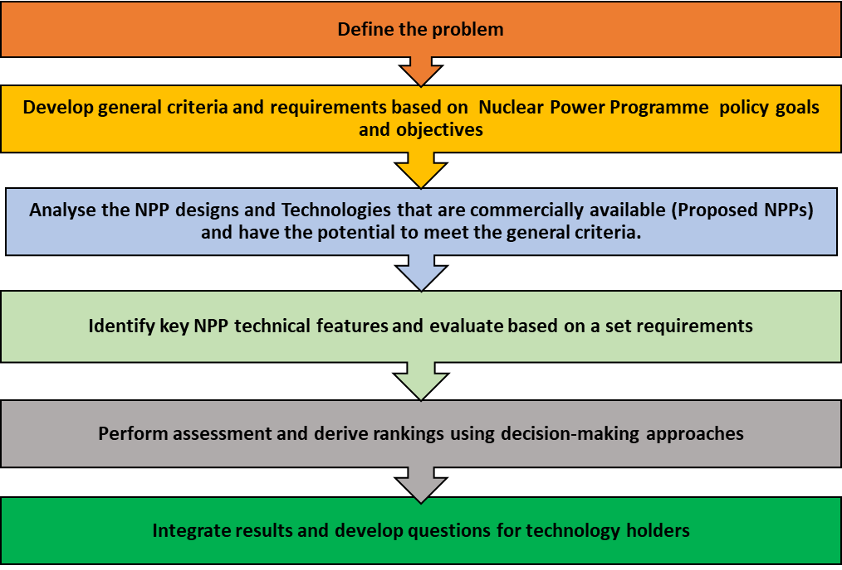
Approach to Ghana’s RTA
Steps of reactor technology selection

Slide 12
International Cooperation and Harmonization
International cooperations has been part of Ghana’s Nuclear agenda since 1960s.
Cooperation with the IAEA
Engagement with other International Partners.

Slide 13
Development in International Cooperation
MOU and contractual agreement with the US for the provision of NuScale Exploration (E2) Center and related services
A cooperation and framework agreement was signed with China Nuclear Corporation Overseas Limited for constructing HPR1000 Technology Nuclear Power Project.
Human Resource Development: Training of young Professionals in countries with advanced nuclear power programmes such as China, USA, Russia South Korea etc

Slide 14
Ghana’s RFI
RFI Overview
The Ministry of Energy initiated RFI process
Six (6) vendor countries were reached
9 large reactors and 6 SMRs were proposed
Key insights Gained
Diversity in Technology
Introduction to business and financing models
Preliminary Vendor Engagement

Slide 15
Suitability of SMRs for Ghana
Investment capability
Plant unit size and grid matching
Remote location consideration
Cogeneration capability
Improved Construction Schedule

Slide 16
Conclusion
A study of Ghana’s energy system shows that, including SMRs into its energy generation mix is achievable.
Provision of conducive atmosphere by government is crucial for SMR deployment in Ghana
Assessment of Reactor technologies and Site selection activities are ongoing for Ghana’s nuclear power programme
Innovative financial strategies are essential for SMR deployment
Ghana is leveraging strategic cooperation with institutions and countries with developed nuclear power programmes in its NPP development

Slide 17




Conclusion
Including SMRs in Ghana’s energy mix will help Sustainable Development Goals (SDGs) 6, 7, 9 and 13.
Thorough energy planning, robust nuclear infrastructure development, strategic technology assessment, innovative financing, active stakeholder involvement and strong international cooperation is crucial for the success of SMR deployment in Ghana

Slide 18


