Slide 2
NAVIGATING THE ENERGY LANDSCAPE: CONSIDERATIONS FOR DEPLOYING SMALL MODULAR REACTORS IN SAUDI ARABIA
King Abdulaziz City for Science and Technology
Riyadh, Saudi Arabia

Slide 3
Outlines
Objectives, Values, and Enablers
Saudi Arabia's Energy Landscape.
Small Modular Reactors (SMRs)
SMRs and Saudi Arabia
SMR Benefits for Saudi Arabia
SMR Challenges
International Cooperation
Phases
Conclusion

Slide 4
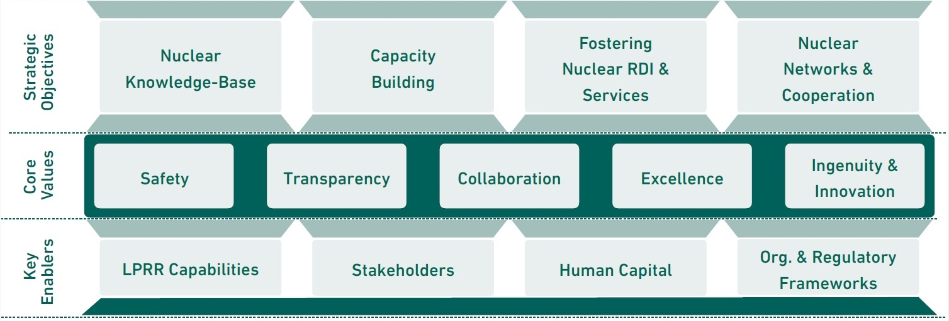
Objectives, Values, and Enablers
Enabling a thriving nuclear sector in the Kingdom of Saudi Arabia through developing a knowledge base, building human capital, fostering nuclear RDI, offering unique services, promoting local and international impactful cooperation, and advocating for sustainable nuclear energy development.

Slide 5
Saudi Arabia's Nuclear Energy Landscape
Ministry of Energy
The Ministry of Energy has the overall responsibility for overseeing energy policy and regulation in Saudi Arabia. This includes nuclear energy. Develops and implements energy policies, including those related to nuclear energy
King Abdullah City for Atomic and Renewable Energy (KA-CARE):
Established in 2010, KA-CARE is the government agency responsible for overseeing nuclear energy and renewable energy projects in Saudi Arabia. It has been working to develop the necessary infrastructure and expertise for the country's nuclear program.
Nuclear Energy Holding Company (SNEHC)
Established in 2022, SNEHC is a state-owned company tasked with developing and implementing Saudi Arabia's nuclear energy strategy.
King Abdulaziz City for Science and Technology
King Abdulaziz City for Science and Technology (KACST) plays a significant role in Saudi Arabia's nuclear energy landscape. It is home to the Nuclear Technologies Institute and Technology (NTI), which is responsible for conducting research and development in nuclear energy and related technologies.
Nuclear and Radiological Regulatory Commission
The NRRC is primarily responsible for the technical regulation of nuclear activities in Saudi Arabia. This includes: Licensing nuclear facilities, conducting safety inspections, ensuring compliance with radiation safety standards, and managing radioactive waste. The NRRC provides safety oversight for nuclear facilities and activities and develops and implements emergency preparedness plans for nuclear accidents.
International Cooperation
Saudi Arabia has been actively seeking international cooperation to develop its nuclear energy program. It has signed agreements with several countries, including the United States, France, South Korea, and Russia, to collaborate on various aspects of nuclear technology.

Slide 6
Saudi Arabia's Nuclear Energy Landscape
The Kingdom of Saudi Arabia is committed to become a global energy leader and introduce nuclear energy in the energy mix. This is formulated by the Saudi National Atomic Energy Project (SNEAP) and part of its ambitions as part of the Circular Carbon Economy (CCE) initiative. The focus of SNEAP as per the recent updates are:
• Building the first nuclear power plant
• Developing the nuclear fuel cycle
The IAEA developed a framework of identifying 19 infrastructural issues and three milestone approach, and based on KSA assessment, KSA has passed the second milestone.

Slide 7
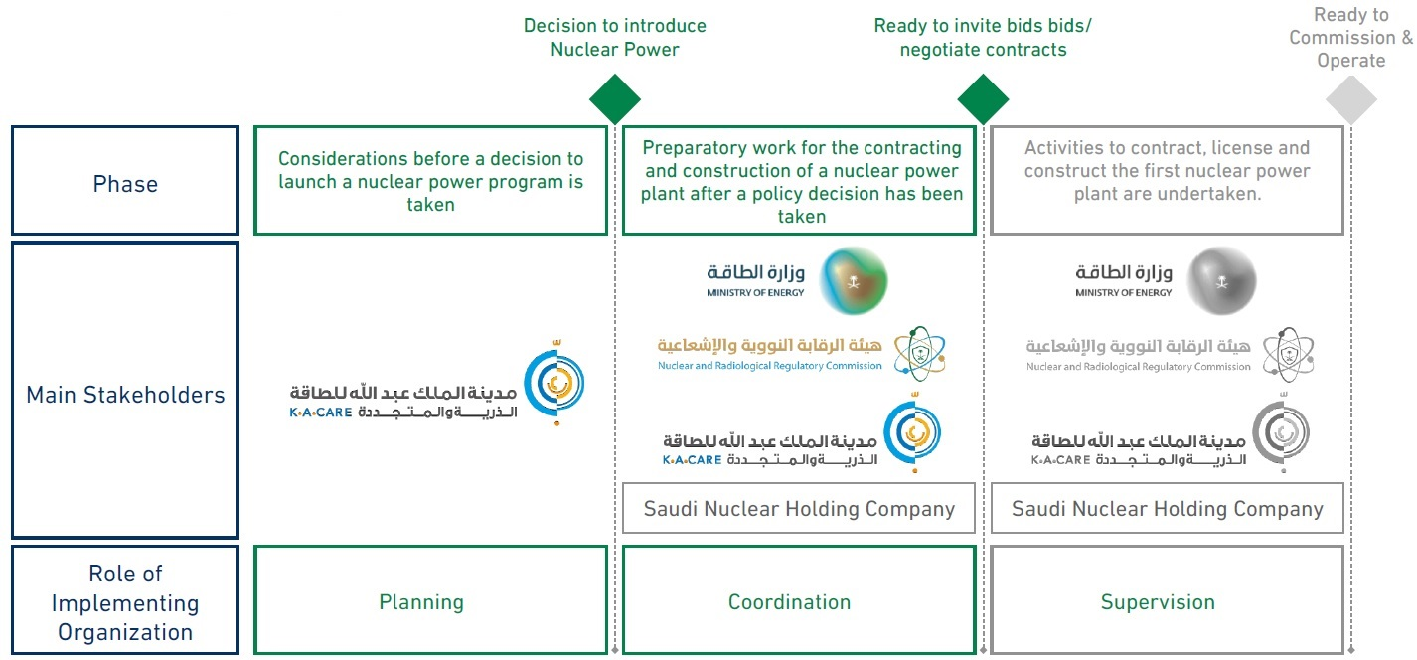
Saudi Status in IAEA's Milestone Approach

Slide 8
What are Small Modular Reactor
Small , factory-built nuclear reactors with a power output up to 300 MW
Key Feature
Compact size: SMRs are significantly smaller than traditional nuclear power plants, making them more suitable for various locations.
Modular design: The reactor is built in sections or modules, which can be manufactured separately and then assembled on-site, reducing construction time and complexity.
Safety features: Many SMR designs incorporate advanced safety features, such as passive cooling systems and containment structures, to enhance safety.
Efficiency: SMRs are often designed to be more efficient than traditional reactors, utilizing nuclear fuel more effectively.

Slide 9
Benefits of SMRs
Economic Advantages:
Lower capital costs due to standardization and factory production.
Shorter construction times.
Flexibility in meeting varying energy demands.
Environmental Benefits:
Reduced carbon emissions.
Lower water consumption compared to traditional power plants.
Improved waste management practices.
Reliability and Safety:
Advanced safety features, including passive safety systems.
Increased resilience to natural disasters.
Potential for remote or off-grid applications.

Slide 10
SMRs and Saud Arabia
Main Players in Saudi
Owner/ Operator
Technical Support
Enabler
Regulator
Enabler
Saudi National Atomic Energy Project (SNAEP) Facilitates the development of nuclear technology, ensuring that SMRs are a strategic option.
Regulator
Nuclear & Radiological Regulatory Commission (NRRC)
Ensures compliance with safety standards and oversees all nuclear-related activities in the Kingdom.
Owner/ Operator Company
Saudi Nuclear Energy Holding Company (SNEHC)
Responsible for owning and operating nuclear power plants in Saudi Arabia, ensuring safe and efficient deployment.
Technical Support
KACST, Universities, Research Centers Provides R&D and technical expertise, supporting the design, construction, and operation of SMRs.
This integrated framework ensures that Saudi Arabia can safely and effectively deploy SMRs in line with its Vision 2030 objectives.

Slide 11
SMRs Benefits for Saudi Arabia
Desalination
SMRs can efficiently power desalination plants, reducing reliance on fossil fuels, contributing to Saudi Arabia's status as the largest desalinated water producer.
Electricity Production
Each 300 MWe SMR unit can power remote regions, industrial projects, or mega-projects like NEOM, while reducing transmission losses in far-distant areas.
Hydrogen Production
SMRs can produce clean hydrogen during non-peak hours, supporting Saudi Arabia's goal of becoming a global hydrogen hub.
Environmental Impact
SMRs help reduce CO2 emissions, moving Saudi Arabia closer to its Vision 2030 and net-zero carbon goals by 2060.

Slide 12
Challenges for SMRs in Saudi Arabia
Small Modular Reactors (SMRs) are seen as a promising technology for the future of nuclear energy. However, there are several challenges that need to be addressed for their large-scale implementation in Saudi Arabia. These challenges can be categorized into:
Regulatory and Licensing:
Establishing a nuclear regulatory framework tailored to SMRs.
Aligning global nuclear standards with Saudi Arabia's specific laws to ensure SMRs meet both international safety requirements and national regulatory needs.
Alignment with the vision of the Kingdom of Saudi Arabia 2030.
Economic Considerations
High Initial Costs for Development and Deployment: Nuclear energy, especially SMRs, requires significant upfront capital investment. The costs of building nuclear infrastructure, ensuring regulatory compliance, and establishing supply chains. etc. can be very high.

Slide 13
Challenges for SMRs in Saudi Arabia
Attracting Investment in Nuclear Technology: Saudi Arabia needs to attract both domestic and international investment in its nuclear projects.
Enhancing Cost Efficiency: Producing enough SMRs to drive down the cost per unit through learning curves, mass production, and improvements in efficiency. It also involves integrating SMRs into Saudi Arabia’s grid and industries in a way that maximizes their utility.
Technical and Infrastructure Challenges
Developing a skilled local Human resources to operate and maintain SMRs.
Building the required supply chain and infrastructure for SMR construction.
Integrating SMRs into Saudi Arabia’s energy grid.

Slide 14
Challenges for SMRs in Saudi Arabia
Public Acceptance
Managing public concerns regarding nuclear energy safety.
Building trust with the public about the benefits of SMRs for the environment and economy.
Addressing concerns over nuclear waste management.
Energy Strategic Objectives
Aligning SMR Building with Vision 2030 goals for reducing reliance on oil.
Balancing renewable energy expansion (solar and wind) with nuclear power as part of a sustainable energy mix.

Slide 15
International Cooperation
International cooperation plays a key role in Saudi Arabia’s pursuit of nuclear energy, especially with the emerging Small Modular Reactors (SMRs) technology. key aspects of Saudi Arabia’s international cooperation in relation to SMRs:
Collaboration with the International Atomic Energy Agency (IAEA)
Saudi Arabia works closely with the International Atomic Energy Agency (IAEA), which is the world’s foremost authority on nuclear energy safety, security, and peaceful use.
Partnerships with Countries and Technology Providers
Saudi Arabia has actively engaged with several countries and companies that have expertise in nuclear energy, particularly in SMR technology such as South Korea, USA and etc.
Regional Cooperation
Saudi Arabia is also working with regional organizations and neighboring countries to promote nuclear energy cooperation in the Middle East.

Slide 16
Proposed Plan to Adopt SMR in Saudi Arabia
Phase 1: Preparatory Stage:
Conduct a comprehensive assessment of energy needs, existing infrastructure, regulatory frameworks, and public acceptance to determine the feasibility of SMR adoption.
Phase 2: Foundation Establishment:
Conduct a thorough assessment of existing capabilities, infrastructure, and regulatory frameworks to identify gaps and requirements for SMR deployment.
Phase 3: Education and Training:
Investment in education programs tailored to nuclear engineering, safety protocols, and reactor operation is imperative. Collaborations with established nuclear powers and educational institutions can facilitate knowledge transfer and skill development.
Phase 4: Research, Development, and Establishing Partnership:
Investment in R&D fosters innovation and adaptation of SMR technology to local contexts. Research initiatives focusing on reactor design optimization, fuel cycle management, and waste disposal enhance efficiency and sustainability.

Slide 17
Conclusion
Navigating the energy landscape with Small Modular Reactors (SMRs) presents a transformative opportunity for Saudi Arabia, aligning seamlessly with the nation's Vision 2030 objectives.
The deployment of SMRs offers a multifaceted approach to achieving a sustainable, resilient, and economically diverse energy future.
These attributes make SMRs particularly well-suited for Saudi Arabia's unique energy needs and geographic considerations.
International collaboration and strategic alliances are key components of Saudi Arabia's SMR strategy.
Engaging with global partners for technology transfer, expertise sharing, and joint research initiatives enhances the Kingdom's capabilities and accelerates the adoption of advanced nuclear technologies.

Slide 18
Thank You
Salman M. Alshehri
King Abdulaziz City for Science and Technology
Riyadh, Saudi Arabia
Email: saalshehri@kacst.gov.sa
Anas M. Alwafi
King Abdulaziz City for Science and Technology
Riyadh, Saudi Arabia
Email: aalwafi@kacst.gov.sa
Salman M. Alzahrani
King Abdulaziz City for Science and Technology
Riyadh, Saudi Arabia
Email: salzahrni@kacst.gov.sa

