Slide 1

International Bank for Nuclear Infrastructure (IBNI) – A comprehensive and multi-dimensional solution to enable accelerated global scaling of SMRs
IBNI Implementation Organisation (IBNI-IO)
24 October 2024, Vienna

Slide 2

Key Points
IBNI is a proposed new multilateral infrastructure bank that will specifically address the challenges and impediments of SMR deployment and scaling in all countries, including embarking MSs.
Target date for IBNI’s establishment is by end of 2026. To be founded by a coalition of policy-aligned member shareholder nations.
IBNI will offer multi-dimensional funding, financing and other supportive resources and solutions (well beyond financial) that will facilitate accelerated deployment of SMRs in embarking MSs.
IBNI to offer critical pathways to enable nuclear/SMRs to scale at the pace necessary to attain global policy objectives such as global energy security, 2050 net zero, just and equitable energy transition and sustainable decarbonisation aims.

Slide 3
Proposed IBNI Capital Structure
Subset of High-Income / Nuclear Industry/Exporter Nations
30+ Member Nation Shareholders
Global Highest Grade Sovereign & Supranational Agency (SSA) Bond Markets¹
7+ Member Nation Donors
Private Sector Donors, Impact Investors and Venture Equity¹
~ US $ 50 bn Equity²
~ US $ 150 bn+ Debt
~US $ 5 bn Donor Funds³
~ US $ 25 bn+ Private Donor, SIBs⁴ & Venture Equity Capital
IBNI Ordinary Operations Fund (Commercial)
IBNI Special Operations Fund (Donor Supported)
Financing & Support at favorable Commercial Terms for Bankable/ Investment-
Ready Commercialized Projects
Financing & Support at favorable Concessionary Terms for Early-
Stage Projects, Programs and Industries
Selected IBNI OOF Support for Projects & Industries
New-Build Commercialized Nth-of-a-Kind (NOAK) technologies
Reactor Life-extensions & Re-starts
Refinancing/ Restructuring
Production and Supply Chains
Nuclear Fuel Cycle
Decommissioning and Nuclear Waste
Selected IBNI SOF Support for Projects, Programs & Industries
First-of-a-Kind (FOAK) and pre-commercialized technologies
Nuclear infrastructure and resources in newcomer countries pursuing nuclear energy programs
Early- and pre-bankable stage risk capital in projects and programs
Emerging technologies: early-stage commercialization accelerators
Sovereign credit / inflation / currency risk solutions
Notes: (1) assumed be funded incrementally over time and after demonstration of certain program successes; (2) it is currently estimated that the initial government shareholder capital requirement of IBNI Ordinary Operations Fund will be US $ 50 billion (of which 50% or US $ 25 billion will be paid-in capital and 50% or US $ 25 billion will be callable capital). Additional debt capital will be raised in the global bond markets. (3) it is currently estimated that a subset of IBNI Member States will elect to initially fund the Special Operations Fund in the amount of US $ 5 billion, which will leverage private sector funding. All funding estimates are subject to further research, analysis and discussions. (4) SIB refers to ‘Social Impact Bonds’ (and Loans) which is a broad category including ‘Climate Impact Bonds’ (and loans) and ‘Sustainability Impact Bond’ (and loan) programs that are envisaged to be supported through the Special Operations Fund.

Slide 4

Key IBNI Funding and Financing Programs for Embarking MS
Competitive grant funding to support earlier-stage nuclear infrastructure developments and readiness within embarking MSs
Competitive concessionary financing (low-cost and/or partially or fully forgivable loans, guarantees and credits) for early-stage nuclear infrastructure developments.
Sovereign risk (partial risk) guarantees.
Enclave financing.
Early-stage equity co-investments and flexible financing in nuclear energy sector companies and enterprises.
Climate and sustainability impact financing through public-private partnership (“PPP”) delivery models.

Slide 5

IBNI Programs Offering Access to and Development of Nuclear-Specific Resources
Access to IBNI sponsored specialised resource/skills pools and aggregator programs aligning to ‘best international practices’.
IBNI arranged procurement of international expertise and resources.
IBNI funded and sponsored regional and/or global pooled technical and nuclear development resource pools are examples of resource bodies that IBNI’s SOF could fund and offer to embarking MSs.
Specific IBNI resources and expertise pools may cover:
  Energy system planning and market designs
  Regulatory and licensing and 3S
  Development, financing and program management
  Procurement, contracting and risk management
  Operations
  Spent fuel management
  Environmental, Social and Governance (ESG) strategy
  Industrial and Public Engagements

Slide 6

IBNI Programs to Manage Risk and Enhance Cost Competitiveness of SMRs in Embarking MSs
Stapled supplemental ‘emerging technologies’ grant and concessionary grant funding.
Stapled IBNI committed senior and/or subordinate financing.
Stapled IBNI committed equity (minority shareholding or other) financing, including early-stage (pre-FID) owner costs.
Stapled IBNI committed contingent debt and/or equity financing (in case of delays and overruns – risk/costs remain with project/program level stakeholders).
Stapled IBNI hedging contracts: interest rate, inflation, currency risks.
Stapled IBNI completion risk insurance (cost overrun and delay risk cover – risks/costs allocated across global insured customer pool).
Stapled IBNI capital markets and transactional advisory services.

Slide 7
Concluding Remarks
Timely establishment of IBNI will impact will extend well beyond providing access to pooled external funding and low-cost, blended financing that the Bank will make available to those MS stakeholders pursuing SMRs.
IBNI will ‘fill gaps’ not only with respect to funding and financing gaps, but also access to ‘best-of-class’ resources and skills necessary to accelerate nuclear infrastructure in embarking MSs.
IBNI will facilitate global demand aggregation, enabling embarking MS customers to participate in regional and global order pools that are enhanced through specialised IBNI funding and finance tools and programs.

Slide 8

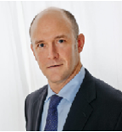
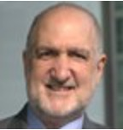
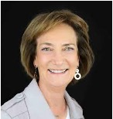
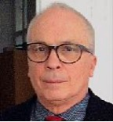
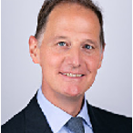
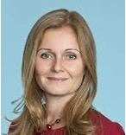
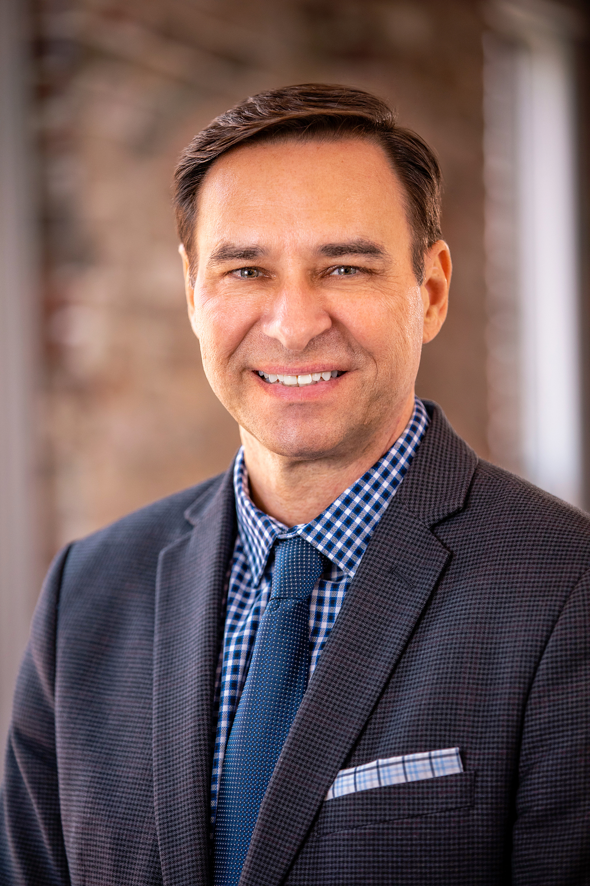
Further Information and Contact
For more information on the IBNI initiative, please review the IBNI Initial Report and Action Plan (IRAP) and the Executive Summary Presentation, which can be downloaded from the IBNI website.
Daniel Dean (Author)
President and CEO, Board Member
IBNI-IO
Telephone: +43 660 794 1445
Email: d.dean@nuclearbank-io-sag.org
Website: www.nuclearbank-io-sag.org
Milton Caplan
Chairman of the Board, Senior Advisor
IBNI-IO
Fabien Pehuet Lucet
Vice Chair of the Board, Senior Advisor
IBNI-IO
Milko Kovachev
Member of the Board, Senior Advisor
IBNI-IO
David Stearns
Treasurer of the Board, Senior Advisor
IBNI-IO
Elina Teplinsky
Member of the Advisory Board
IBNI-IO
Carlos Leipner
Secretary of the Board, Senior Advisor
IBNI-IO

Slide 9
Thank you

