Slide 1


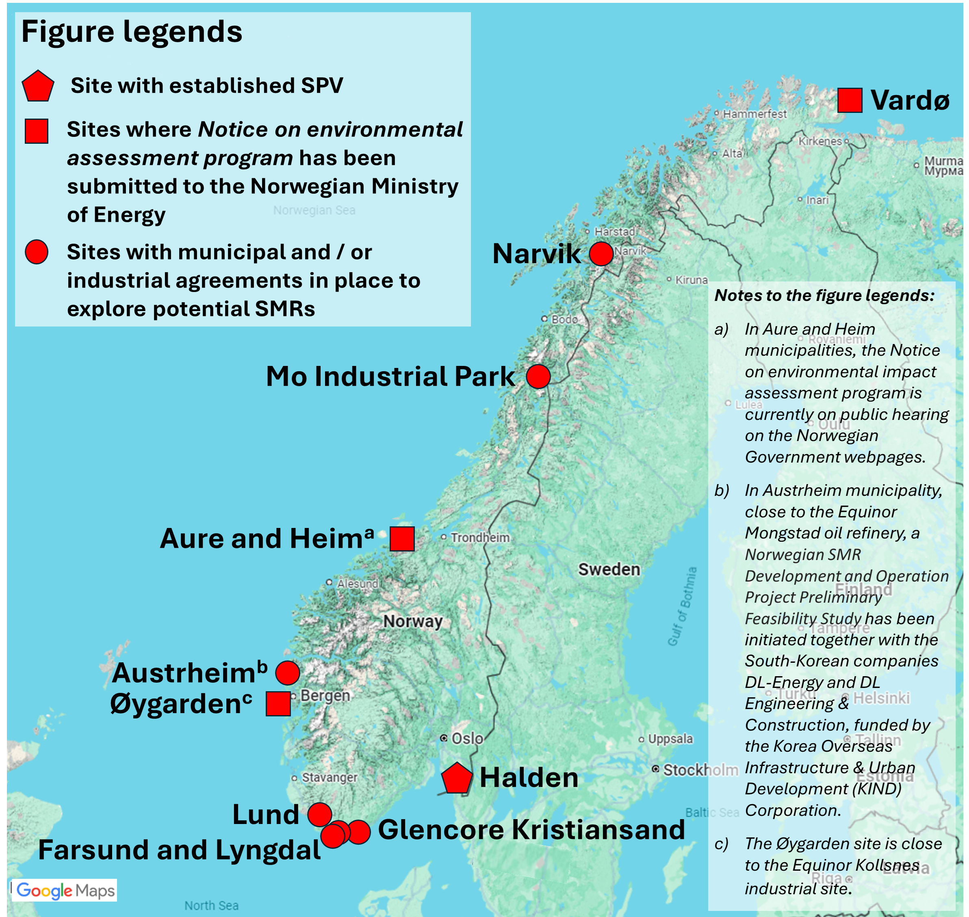
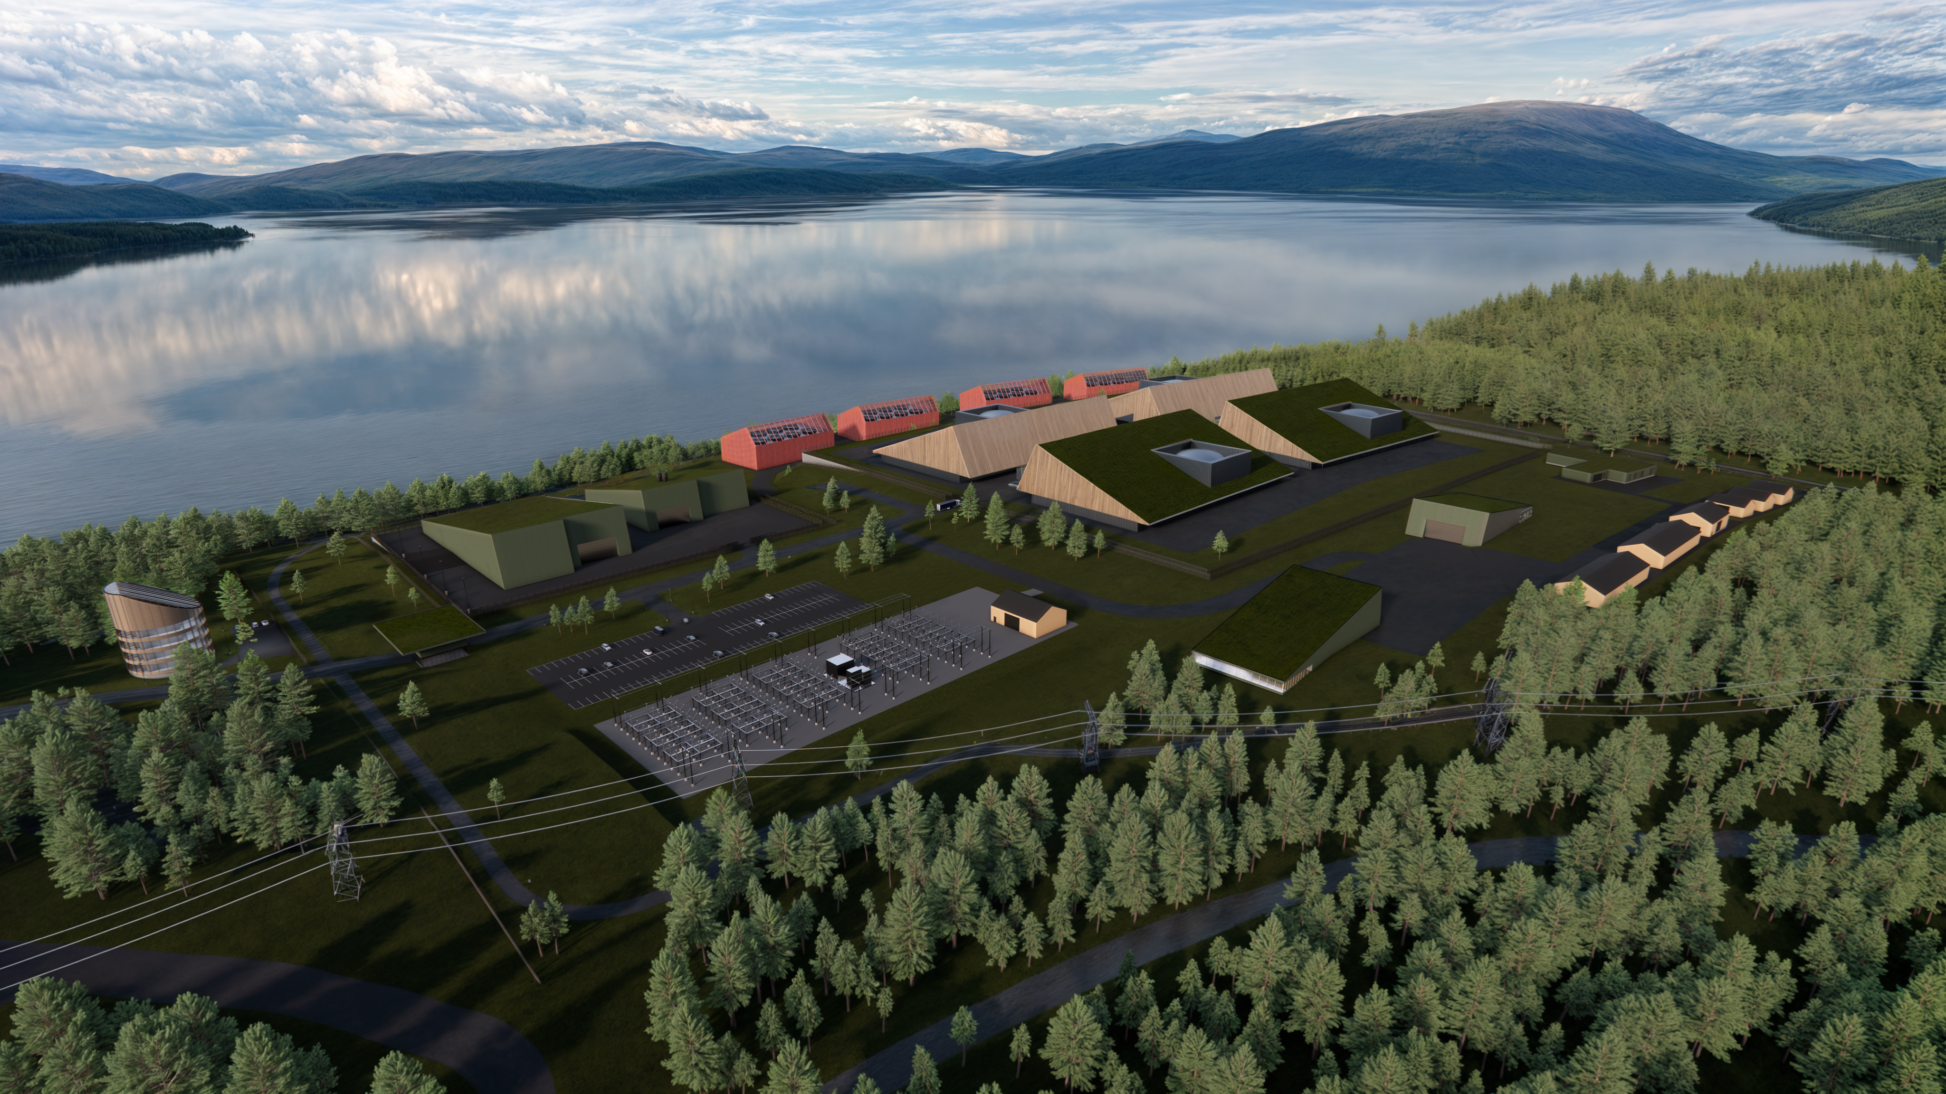
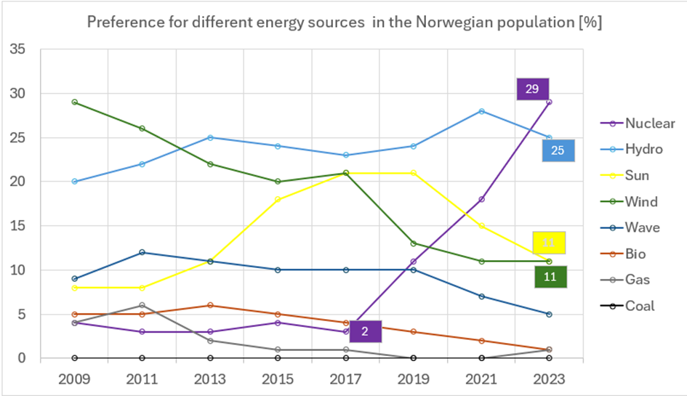


NORSK KJERNEKRAFT AND THE ADVANCEMENT OF NUCLEAR IN NORWAY
IAEA-CN-327-241
O. Aas-Hansen¹*, S. O. Saele¹, S. Rose¹, H. Kristiansen¹, N. Amosova², J. Kickhofel², J. Hesthammer¹.
¹⁾ Norsk Kjernekraft AS, Bergen, Norway. ²⁾ Apollo+, Zürich, Switzerland
^{*)} Email: oyvind.aas.hansen@norskkjernekraft.com
INTRODUCTION:
Norsk Kjernekraft AS (“Norwegian Nuclear Power Inc.”) was established in summer 2022, dedicated to establishing a fleet of SMR NPPs in Norway, copying and building on experience from the Norwegian oil and gas industry. Since then, Norsk Kjernekraft has drawn benefit from a bottom-up approach, building on a positive interest from more than 80 municipalities, alongside a substantial increase in public support for nuclear energy.
Although having never utilized nuclear energy, Norway has legislation and regulation related to nuclear power plant licensing, and the country has decades of experience with nuclear research reactors and associated R&D. In May 2024, the Norwegian Government constituted an expert committee to prepare an Official Norwegian Report exploring potential nuclear power production in Norway.
As of today, Norsk Kjernekraft AS has submitted notice for environmental impact assessment for three sites and established one special purpose vehicle (SPV), aiming for ten sites and SPVs before the next national election in September 2025. Please see Figures 1 - 3 for details.
CONCLUSIONS:
Norway's strong starting point, public support, regulatory foundations, nuclear expertise, financing options, and energy needs together make a compelling case that the country is in an excellent position to move forward with nuclear power successfully.
Political will is the key remaining hurdle to clear, of which much will depend on the outcomes of the September 2025 parliamentary election and the ongoing a planned Official Norwegian Report on the possible deployment of nuclear energy in Norway, as announced by the Norwegian Minister of Energy in May 2024.
Figure 2: Illustration of how a nuclear power plant and waste repository in Halden may look like (Halden Kjernekraft AS).
Figure 3: Preference for different energy sources amongst the Norwegian population (adapted from Ipsos Norsk Monitor 2024).
Figure 1: Sites overview of Norsk Kjernekraft activities in Norway.
The 1st IAEA International Conference on Small Modular Reactors and their Applications. 21–25 October 2024, Vienna, Austria.

