Slide 1
Guohe One Operation Preparations
国和一号生产准备

Slide 2
Contents
I. Introduction to Guohe One
II. Operation Preparation Management Mode of Guohe One
III. Innovation and Practice for Guohe One Operation Preparations

Slide 3
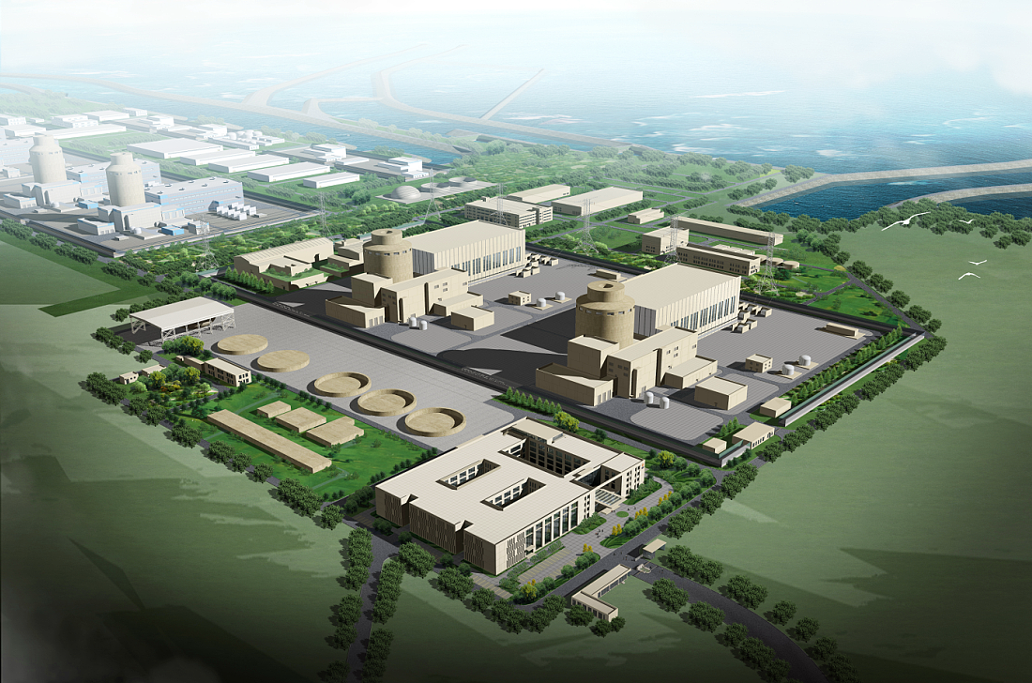
Introduction to Guohe One Project
The Guohe One Project is located in Rongcheng City, Shandong Province, China. The Project is based on the mode of "general contracting of the whole plant under the leadership of the Owner", and State Nuclear Power Demonstration Plant Co., Ltd. is responsible for the construction management and operation. It is planned to build two sets of Guohe One units, with a single-unit generating power of 1.534 million KW, an availability rate of no less than 93%, a design life of 60 years, and an estimated annual energy output of more than 21.5 billion kWh after commercial operation of two units.
As a large-scale advanced third-generation passive PWR with completely independent intellectual property rights independently developed by China, Guohe One serves as a significant project for China's independent development of third-generation nuclear power, as well as for efficient utilization of energy and green development.

Slide 4
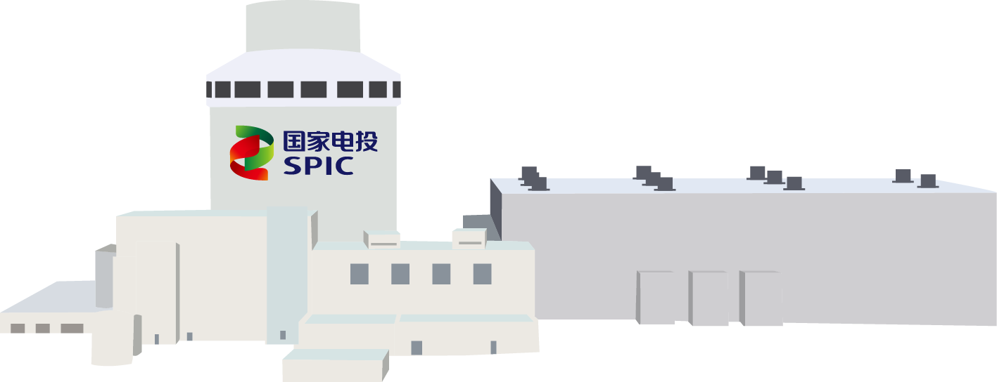

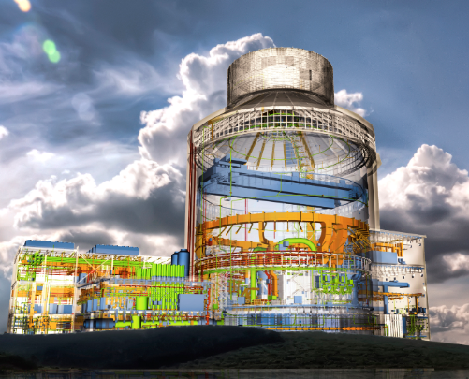
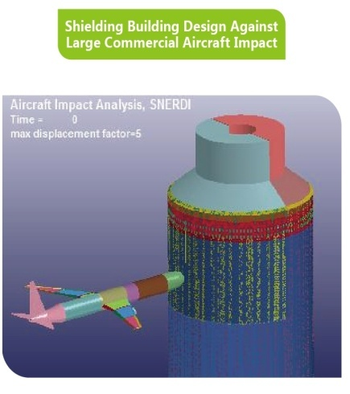
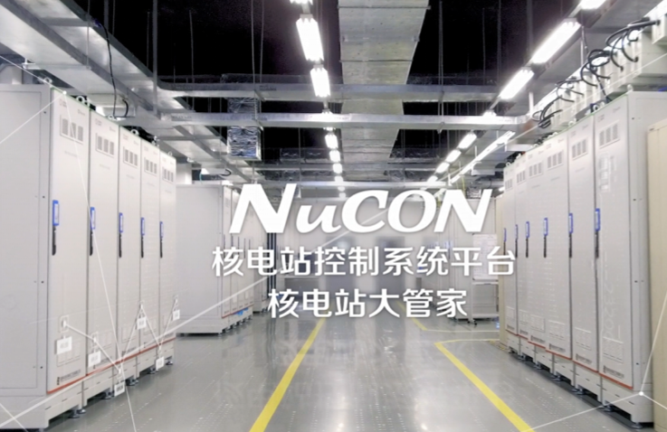
Introduction to Guohe One Project
  Guohe One, among the 16 major science and technology projects in China, is a third-generation passive PWR with completely independent intellectual property rights developed by more than 30,000 technicians from more than 600 nuclear enterprises, scientific research institutes and equipment manufacturing enterprises in China. It is developed with the highest standards on safety, technology and environmental protection in the world, and the safety, economy and environmental compatibility have reached the advanced level of 3G nuclear power technology in the world.
01
Utilization of the passive safety system
02
Extremely high anti-seismic and large aircraft impact resistance
03
Factory prefabrication and modular construction
04
Small work quantities and simplified system
05
Independently developed control and protection systems
06
Independently developed COSINE nuclear power design analysis software
07
Localization rate of more than 90%

Slide 5
Contents
I. Introduction to Guohe One
II. Operation Preparation Management Mode of Guohe One
III. Innovation and Practice for Guohe One Operation Preparations

Slide 6
Operation Preparation Management Mode of Guohe One
As FOAK project, Guohe One, on one hand, focuses on operation preparation management innovation based on practice and improved work quality in various fields by grasping the objective laws of nuclear power construction and combining with peer management experience. On the other hand, in combination with the "Six New" challenges of FOAK project, specific methods and strategies are analyzed on a case-by-case basis to specifically solve the impacts and risks brought by the "Six New" challenges on operation preparation.
Practical experience in nuclear power operation preparation + management innovation
New Technology
Work safety organization construction and capability
New System
Staffing, training and authorization
New Equipment
General management
Infrastructure configuration
Coverage
Preparation of procedure documents
New Manufacturer
Special control
New Construction Contractor
Plant system equipment status
New Construction Methods
License application and handling
Key analysis and solution of TOP risks

Slide 7
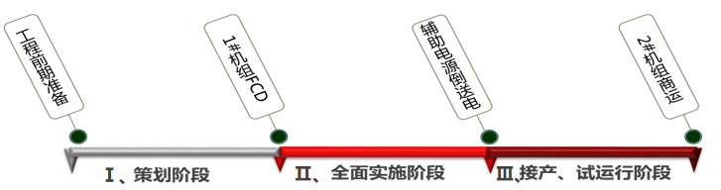
Operation Preparation Management Mode of Guohe One
Guohe One operation preparation is based on the project management mode, and we work out the Operation Preparation Program to determine objectives of operation preparation, and establish a special operation preparation management organization to clarify the work management system.
According to the first-level project schedule and different work priorities in each stage, the operation preparation is carried out in three stages to ensure that the system management and resource allocation meet the requirements of the project progress.
Objectives of operation preparation
I. Planning stage: from the preliminary engineering preparation to pouring the first tank of concrete for the nuclear island foundation of Unit 1 (FCD)
II. Comprehensive implementation stage: from Unit 1 FCD to energization of 220kV auxiliary power supply
III. Takeover and trial operation stage: from energization of the auxiliary power supply to the commercial operation of Unit 2
Cultivate an operation team with a strong nuclear safety cultural quality and excellent technical capabilities;
Establish a sound work safety management system and determine the operation command system suitable for the management of large advanced PWR nuclear power plants;
Establish a standardized operation preparation management system for Guohe One through the construction and operation preparation of PWR demonstration projects.

Slide 8
Operation Preparation Management Mode of Guohe One
1. Organization and management of operation preparation
In terms of organization and management of operation preparation, under the overall management of the Operation Preparation Committee and in combination with the characteristics of the operation preparation stage, the organizational structure of operation preparation management has been continuously optimized to ensure a smooth transition from operation preparation to maintenance.
1) Stages I and II
In the stage of operation preparation planning and full implementation, a three-level organizational structure of Operation Preparation Committee, Operation Preparation Working Group and Operation Departments is established to form a three-level management of decision-making, management and execution. It mainly focuses on operation system planning, organization construction, staff skill training, allocation of documents and materials, involvement, etc. The operation system construction is basically completed before the unit cold test to ensure the unit is qualified for operation with start of transition to daily operation management.
Management level
Operation Preparation Committee
Milestone, overall plan
Decision-making level
Operation Preparation Working Group
Annual plan and indicators
Execution level
Operation Departments
Annual plan, monthly implementation plan

Slide 9
Operation Preparation Management Mode of Guohe One
2) Stage III
In the takeover and trial operation stage, the operation preparation mainly focuses on three main aspects: handover and takeover, license application and unit start-up. Personnel capacity training, technical system construction and material preparation are carried out in an orderly manner and continuously improved according to the commissioning and takeover progress. The verification and optimization of the operation system will be fully completed before fuel loading. All activities of the unit will be incorporated into the operation system to realize the shift from operation preparation to operation and maintenance. The power plant has the ability to fully assume the nuclear safety responsibility of the unit after fuel loading.
In combination with the takeover of systems and sub-projects, a daily operation management team will be set up as early as possible and it is responsible for the overall management of operation activities after the takeover of system equipment, buildings and structures with reference to the operation management mode of commercial power stations. At the same time, it will be responsible for the daily management of operation preparation and coordinate the implementation of operation preparation work.

Slide 10
Operation Preparation Management Mode of Guohe One
2. Operation Preparation Management
For operation preparation plan management, the operation preparation plan and indicator system are established based on the Operation Preparation Program to ensure that the overall progress and quality of operation preparation are under control. In addition, the risk identification and management will be strengthened and implemented in specific special work to ensure that key problems in operation preparation are effectively solved and major risks are prevented and resolved.
Operation Preparation Program
Plan + indicator monitoring
Ensure no deviation in the overall quality and progress
Plans
Indicators
Risks
Operation preparation milestone
Factors influencing operation preparation
Overall plan of operation preparation
Full-scope operation preparation indicators
TOP risk of operation preparation
Feedback transition
Feedback transition
Feedback transition
Special + risk control
Control and resolve major risks
Annual operation preparation plan
Annual indicators of operation preparation
Special risks
Monthly tracking and promotion
Monthly monitoring and evaluation
Monthly measure control

Slide 11
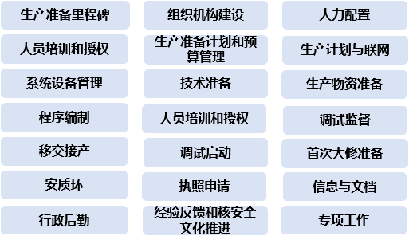
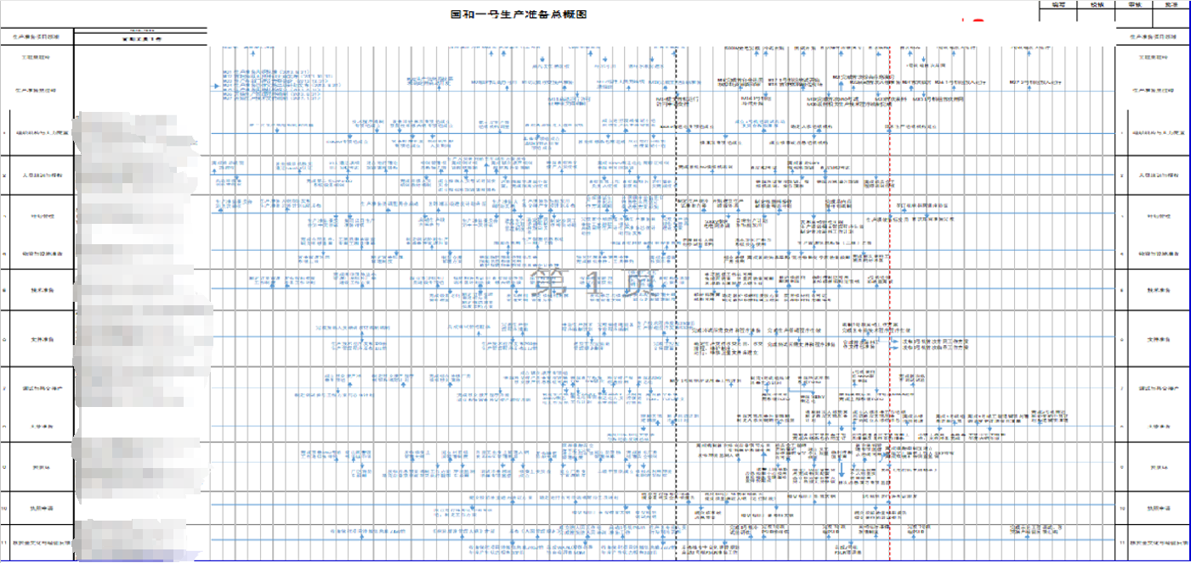
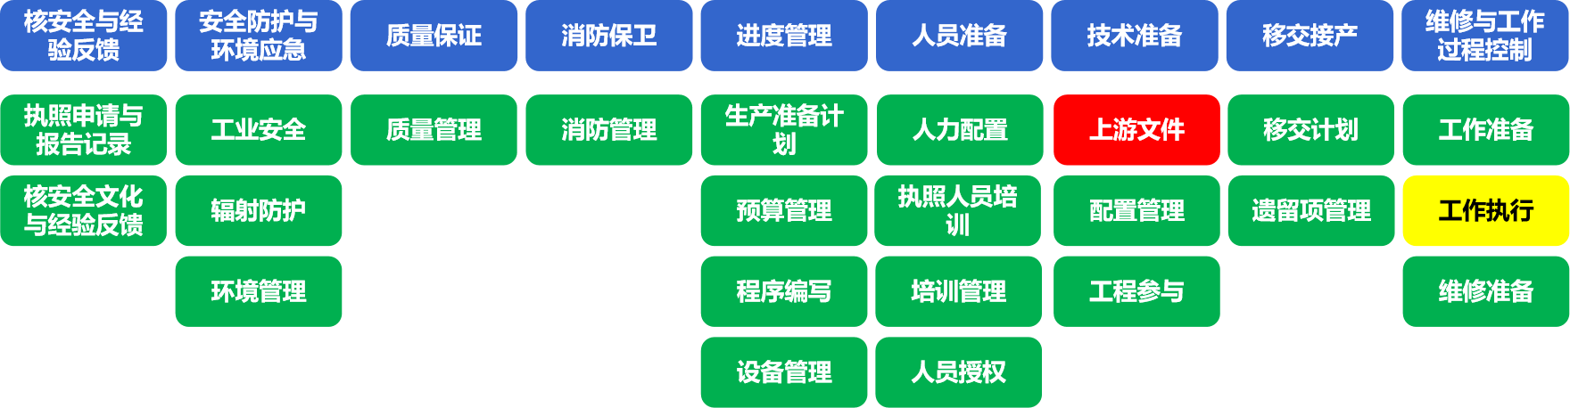
Operation Preparation Management Mode of Guohe One
According to the characteristics of the operation preparation stage and the work tasks in various fields, a vertically and horizontally connected planning network is established, which is divided into three levels: milestone plan, overall plan and execution plan. According to the monitoring and evaluation of operation preparation indicators, it ensures that there will be no deviation in the overall progress and quality of operation preparation work.
Sketch of Operation Preparation
Identification
Milestone
Visualization
Overall plan
Annual + special plan
Highlights
Operation Preparation Indicators
On the basis of the annual operation preparation plan, in order to fully grasp the key preparation period before the joint commissioning of the unit and give full play to the Owner's role in guaranteeing and supporting the joint commissioning of the unit, special plans for cold testing/hot testing/fuel loading startup preparation of the operation line are formulated respectively for cold testing, hot testing, and fuel loading startup as a supplement to the milestone plan and annual plan. It focuses on handover, site entity, risk control, experience feedback, training and authorization, technical preparation and other aspects, so as to support and ensure that the work at key nodes of commissioning is complete and effective.

Slide 12
Operation Preparation Management Mode of Guohe One
In 2019, a comprehensive risk management system was introduced for the Guohe One Project to set risks in the operation preparation business area. TOP risk management is adopted for operation preparation, with two-level risk control: TOP risks of operation preparation and professional TOP risks. Risk identification, risk assessment, risk response, risk supervision and improvement are carried out level by level, all employees are trained on the concept of risk prevention, and risk control is communicated down to all disciplines to ensure that operation preparation risks are effectively prevented.

Slide 13
Operation Preparation Management Mode of Guohe One
Highlight: special risk management for high-quality operation
In the preparation stage of fuel loading and startup, in order to solve problems and difficulties in key areas and improve the ability to prevent and resolve major risks, the Guohe One Project is implemented with the goal of high-quality operation. From five aspects such as handover and takeover quality, loading and startup preparation, equipment reliability, configuration management effectiveness and intrinsic safety level, 38 important special projects are sorted out, focusing on key issues, key links and key nodes. Based on risk classification, risk response measures are developed to solve specific problems by two-level control of high-quality operation project risks and special risks, so as to lay a foundation for high-quality operation.
High-quality operation project
Handover and takeover quality
Handover and takeover
Three simultaneities of environmental protection
Workshop cleaning
......
Preparation for loading and startup
First fuel loading
First grid connection
First criticality and power platform test
......
Equipment reliability
SPV equipment assurance
Water supply guarantee
Heat sink guarantee
......
Configuration management effectiveness
Setting management
TCA/TSD management
Change management after take-over
......
Intrinsic Safety Level
Verification of operating procedures and quality improvement
Fixed safety facilities and signs
Fireproof door and blocking
......

Slide 14
Contents
I. Introduction to Guohe One
II. Operation Preparation Management Mode of Guohe One
III. Innovation and Practice for Guohe One Operation Preparations

Slide 15
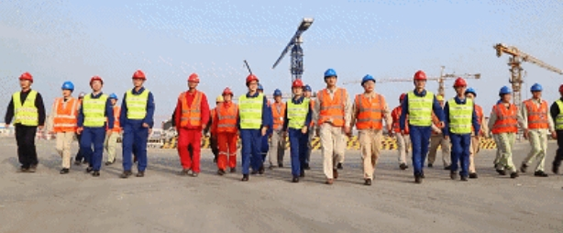
Innovation and Practice for Guohe One Operation Preparations
As “Six New” project, Guohe One demonstration project focuses on active innovation according to the particularity of design and equipment in the actual operation preparation stage. Next, I will introduce and share some innovations and practices in operation preparation of Guohe One from four aspects: cultivation of production personnel, preparation for technical documents, construction of site emergency system and digital nuclear power construction.
Personnel training and promotion
Preparation for technical documents
Construction of site emergency system
Digital nuclear power construction

Slide 16
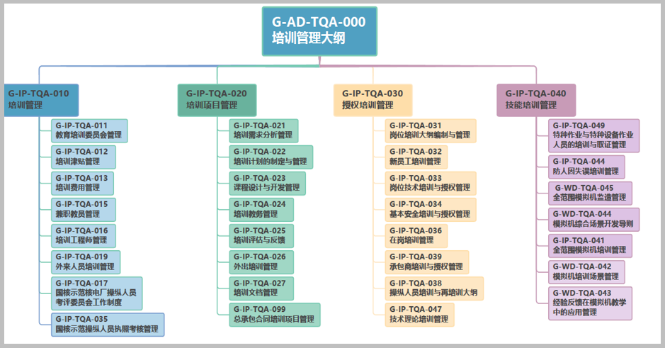
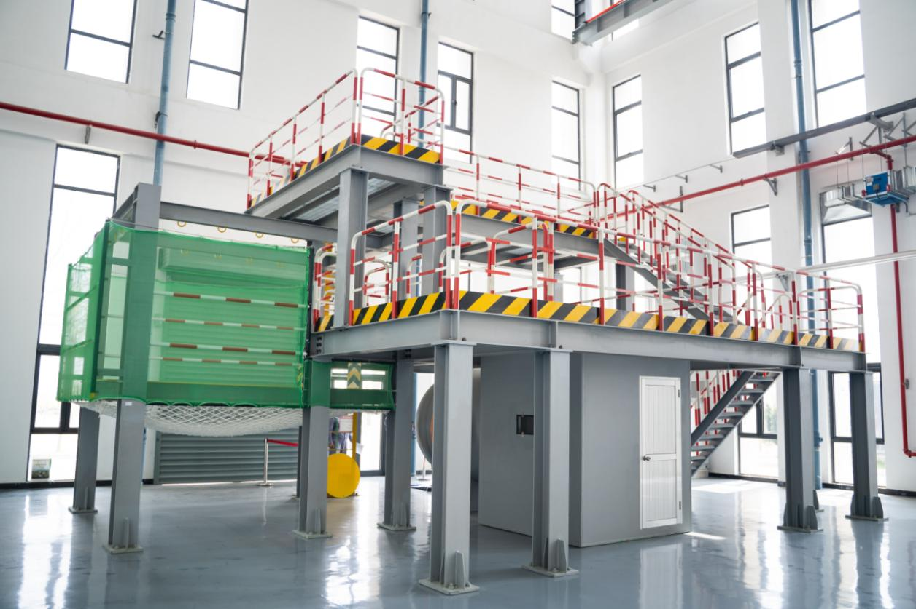
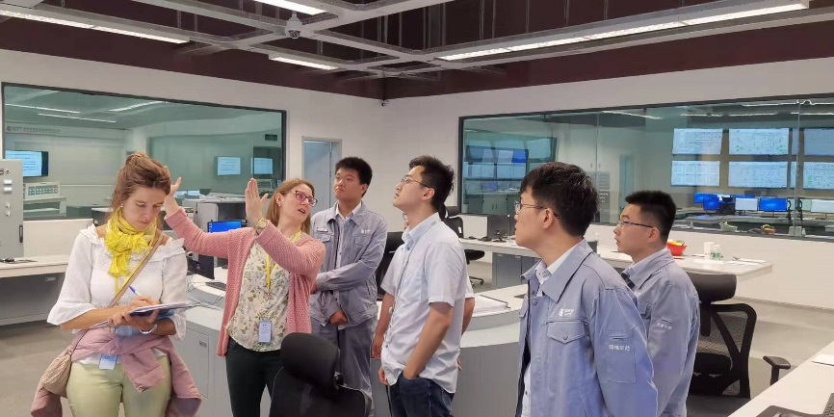
Innovation and Practice for Guohe One Operation Preparations
I. Strengthen the foundation and promote the establishment of plant based on "professional + technology + business"
Taking "professional + technology + business" as the guiding ideology, Guohe One follows the industry-wide SAT to establish a company and professional training and authorization management system. Based on the Three-year Training Plan, it gives full play to the leading role of innovation and scientific research, and promotes personnel ability development according to the overall progress of operation preparation.
349 company-level courses
13 full-time instructors
183 part-time instructors
4 full scope simulators
2 severe accident simulators
20 skills training rooms
1 innovation studio
4 skill studios

Slide 17
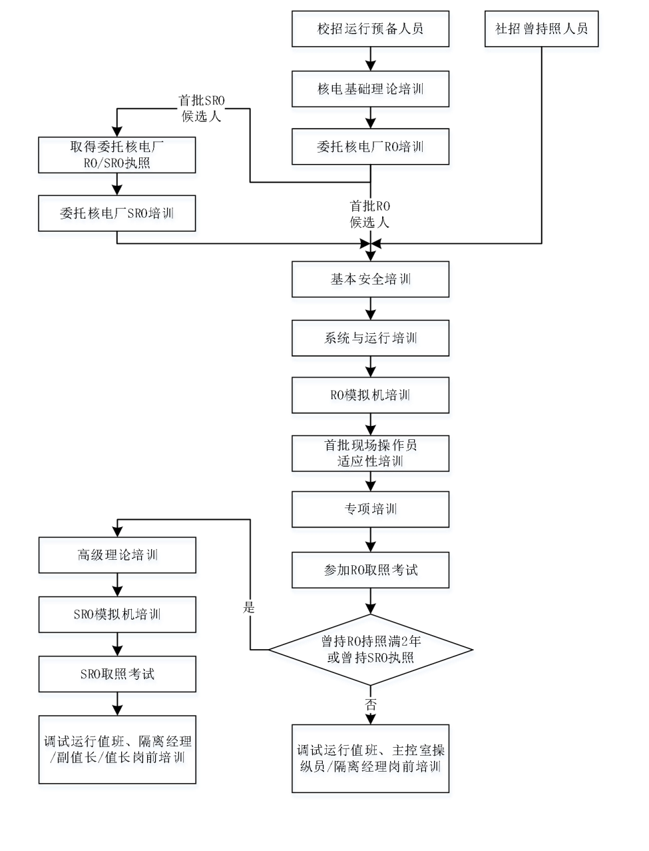
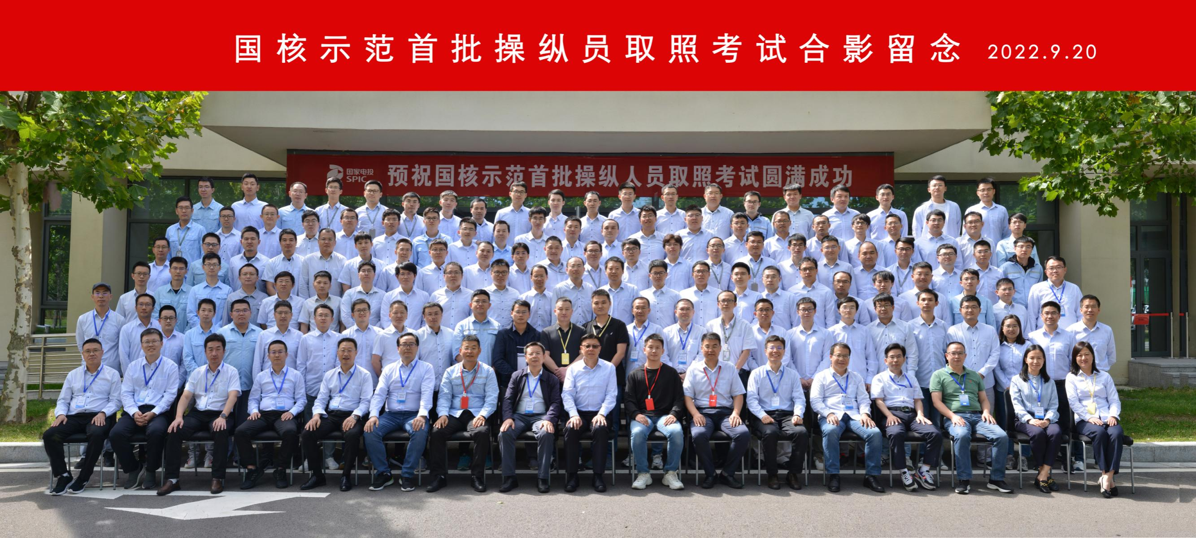
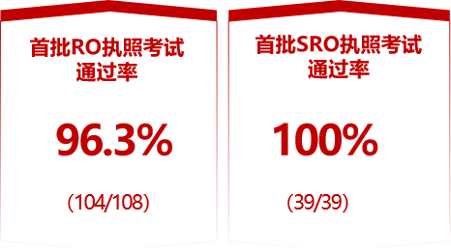
Innovation and Practice for Guohe One Operation Preparations
I. Strengthen the foundation and promote the establishment of plant based on "professional + technology + business"
1. Training for the first batch of RO and SRO
Training path for the first batch of RO and SRO
Entrusted training
The training of the first batch of operators is the focus of operation preparation. A combination of "entrusted training" and "independent training" is adopted to strengthen and improve the technical and nuclear safety cultural quality of operators.
During the preparation for the license examination, in the face of the large load of on-site work and the impact of the epidemic, the "Operator Training and Licensing Pioneer Team" was innovatively established, and a series of measures such as closed training in batches and setting up "service stations" were taken to help the first batch of operators pass the examination. In September 2022 and January 2023, the license examinations for the first batch of Guohe One operators and senior operators were completed with a pass rate of 96.3% and 100% respectively.
Independent training

Slide 18
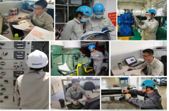
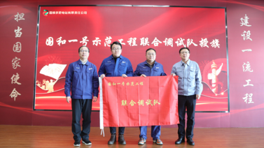
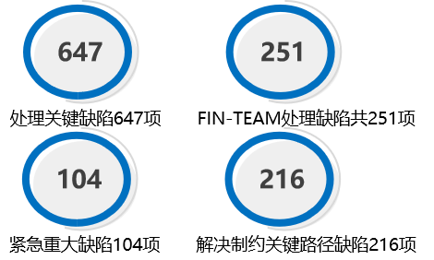
Innovation and Practice for Guohe One Operation Preparations
I. Strengthen the foundation and promote the establishment of plant based on "professional + technology + business"
2. Training of non-licensed personnel
For the training of operation and non-operation personnel, operation personnel will be deeply involved in engineering design review, equipment manufacturing, installation, commissioning and other activities, and get familiar with equipment and system characteristics based on the general principle of "external training + independent training", and according to the characteristics of the operation preparation stage, so as to improve the technical skills of the operation team, and support and guarantee the progress of project construction.
I. Planning Stage
Involved in design and equipment manufacturing
II. Comprehensive Implementation Stage
Involved in installation and commissioning
III. Takeover and Trial Operation Stage
Commissioning engagement and commissioning support
Highlight 1: In the past 10 years, more than 40 I&C personnel have been dispatched to work on the R&D, manufacturing, integration and testing of system and equipment throughout the whole process and chain, helping the first application of NuPAC and NuCON platforms in nuclear power projects.
Highlight 2: Based on the Three-year Training Plan, the "Engagement Plan for Full Cycle Commissioning of Demonstration Project" is prepared, and a joint commissioning team is set up. A total of more than 300 people have joined the general contractor's commissioning team to support works.
Highlight 3: In the case of resource shortage of the General Contractor, considering the urgency of commissioning activities, a joint maintenance team and a joint planning group are set up to integrate resources in all aspects, and support and guarantee project activities.
Defect treatment of joint maintenance team

Slide 19
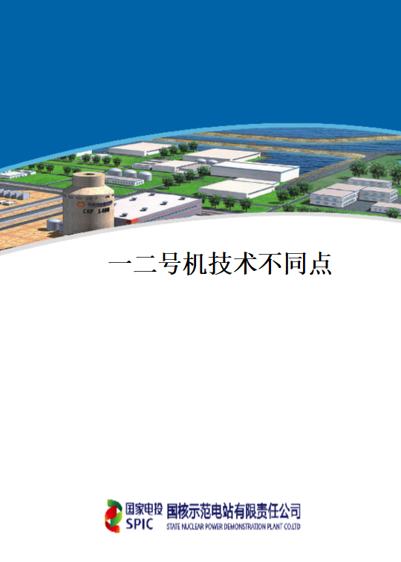
Innovation and Practice for Guohe One Operation Preparations
Innovation and Practice for Guohe One Operation Preparations
II. Deepen the work and consolidate the preparation of technical documents
The construction of technical document system is the key area for operation preparation. The operation personnel of Guohe One have actively explored the design and equipment characteristics, sorted out and analyzed the quality of upstream documents and differences in equipment design, and effectively implemented them in the preparation of procedure documents, thus effectively ensuring the high-quality construction of technical system.
Highlight 1: Analysis of equipment technical differences
The localization rate of equipment in the Guohe One Project is as high as 90%, and there are also differences in equipment and design between two units. The operation personnel are deeply involved in the design and procurement links, carefully sort out and analyze the differences, develop a series of courses of "Technical Differences between Units 1 and 2", analyze the impact on operation and maintenance, and implement them in drawings, procedures, simulators, spare parts procurement, etc.
Equipment differences
Design differences

Slide 20
Innovation and Practice for Guohe One Operation Preparations
II. Deepen the work and consolidate the preparation of technical documents
Highlight 2: Improvement of EOMM quality
EOMM serves as an important basis for the preparation of maintenance procedures and sorting out spare parts, and a special EOMM team for joint operation of the Project has been established to actively communicate with the general contractor for procurement. It invites manufacturer's personnel and sends personnel to the manufacturer for training, to promote the quality and progress of EOMM which can meet the need of operation preparation. Now EOMM acceptance rate is more than 80%.
Operation preparation indicators:
Submission rate of EOMM as planned
EOMM review timeliness rate
EOMM acceptability
1564 reviewed
1356 acceptable
Acceptance rate 86.7%

Slide 21
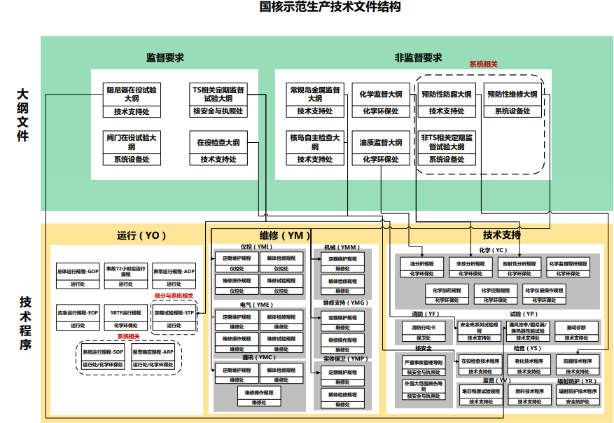
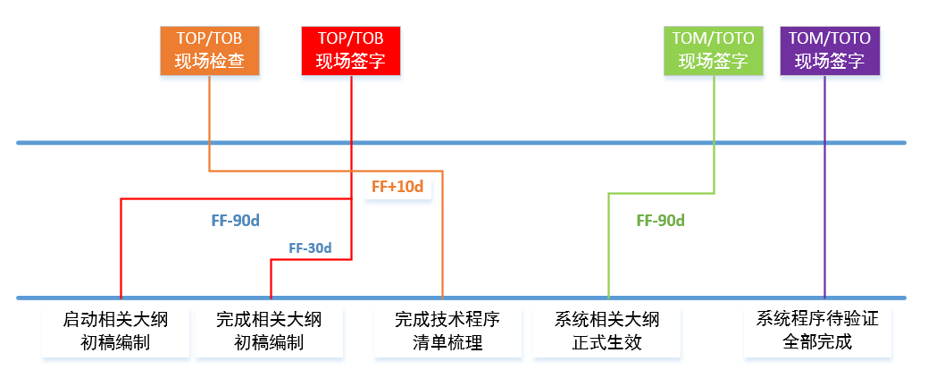
Innovation and Practice for Guohe One Operation Preparations
II. Deepen the work and consolidate the preparation of technical documents
Highlight 3: Preparation of operation technical procedures
For the preparation of operation technical procedures, a special team for the preparation of operation technical procedures is set up to sort out the technical program and operating procedures, work out an overall plan for the preparation of technical procedures, develop the Program and Technical Procedure Preparation Plan in combination with the annual project plan by dynamically linking it with the system 4T handover time, and conduct monthly tracking based on the plan. Now all 4812 operation technical procedures have been prepared.

Slide 22
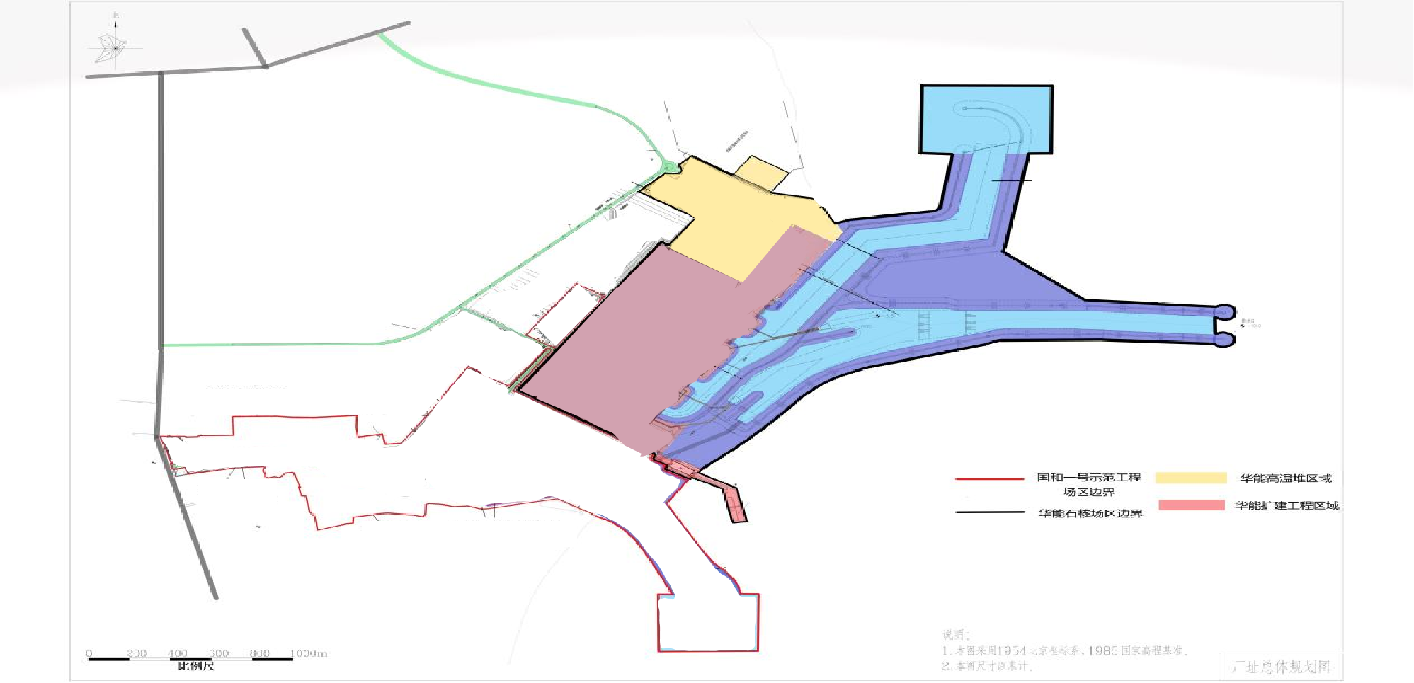
Innovation and Practice for Guohe One Operation Preparations
III. Make overall planning and carry out the construction of unified site emergency system
At the site of Guohe One Project, Huaneng Shandong Shidao Bay Nuclear Power Development Co., Ltd. has implemented a HTGR NPP Demonstration Project and planned to build four 1,000 MW PWR nuclear power units. In view of the particularity of emergency management for multiple nuclear power projects at the same site, a unified site emergency management mode is established in the operation preparation stage for the first time in China after overall consideration and active discussion with regulatory authorities and Shidao Bay Nuclear Power Plant.
Unified site emergency coordination mechanism
Unified site emergency management system
Unified site emergency response
Unified site emergency preparedness

Slide 23
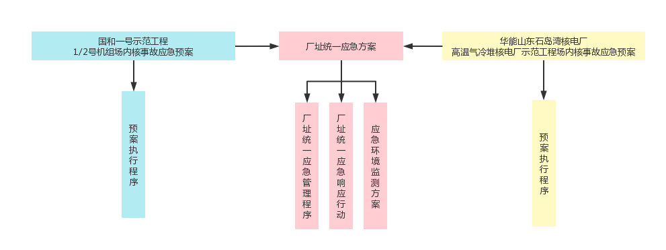
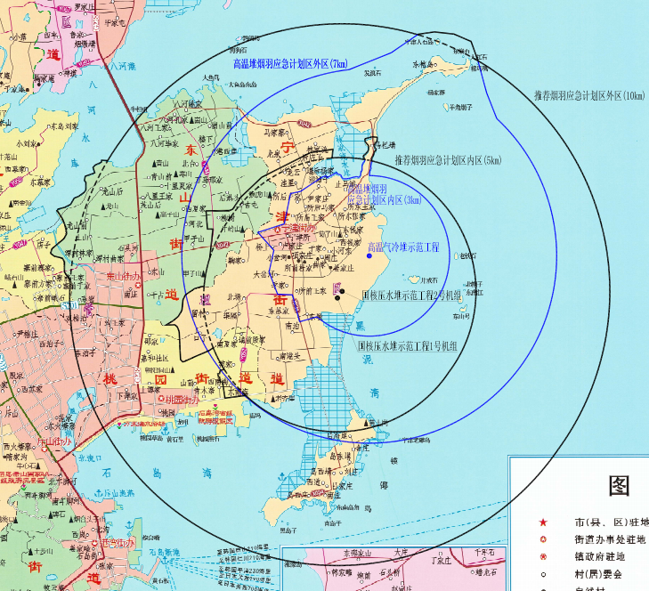
Innovation and Practice for Guohe One Operation Preparations
III. Make overall planning and carry out the construction of unified site emergency system
1. Emergency Coordination Mechanism
2. Emergency Management System
On the basis of on-site nuclear accident emergency plan of each power plant, a Unified Site Emergency Plan and unified site emergency management, response actions and emergency environmental monitoring plans are jointly formulated.
A two-level coordination working group of “decision-making level + execution level” is established, with SPIC and Huaneng group, company leadership and professional engineers of as the main body.

Slide 24
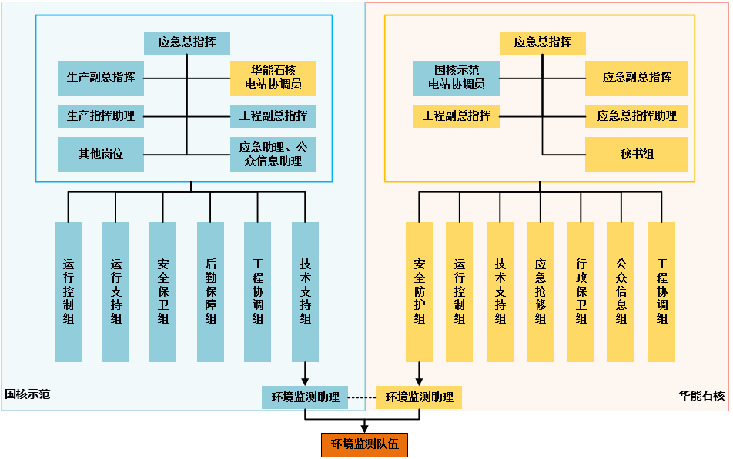
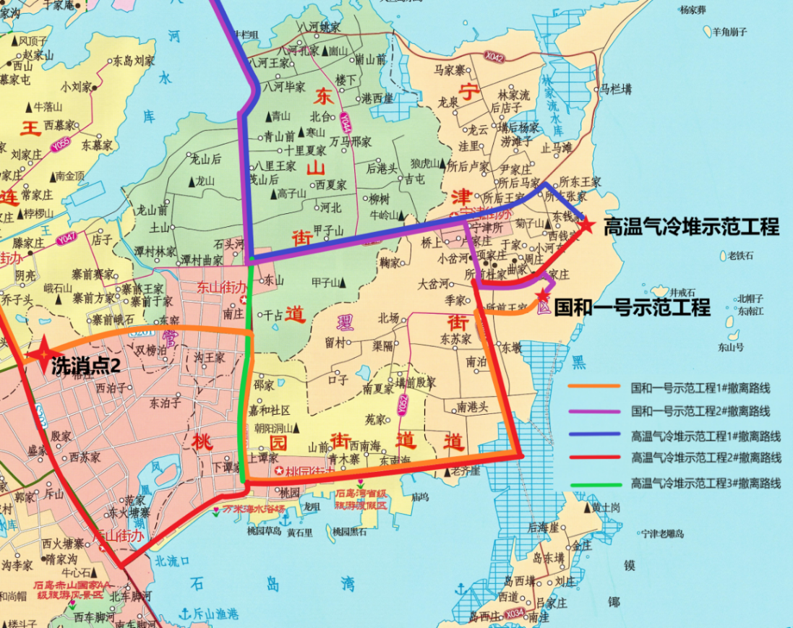
Innovation and Practice for Guohe One Operation Preparations
III. Make overall planning and carry out the construction of unified site emergency system
S/N | Six emergency response principles
1 | Principle for determination of unified site emergency state
2 | Announcement and reporting rules of accident power station and non-accident power station
3 | Implementation of requirements for unified site emergency protective measures
4 | Division of labor and task arrangement for site emergency environmental monitoring
5 | Strategies for safe operation of non-accident units
6 | Requirements for public information and public opinion response
3. Emergency Response
Establish a unified site emergency organization and command mechanism, and clarify 6 emergency response rules.
4. Emergency Preparedness
The unified site emergency preparedness is determined from five aspects: emergency planning area, communication and information system, accident consequence assessment, emergency environmental monitoring and emergency evacuation.
S/N | Emergency preparedness
1 | Unified emergency planning zone covering all power plants on the site
2 | Interconnected communications and information systems
3 | Consequence assessment system for multi-unit accident analysis
4 | Public emergency environmental monitoring facilities and systems
5 | Unified nuclear emergency evacuation route at site

Slide 25
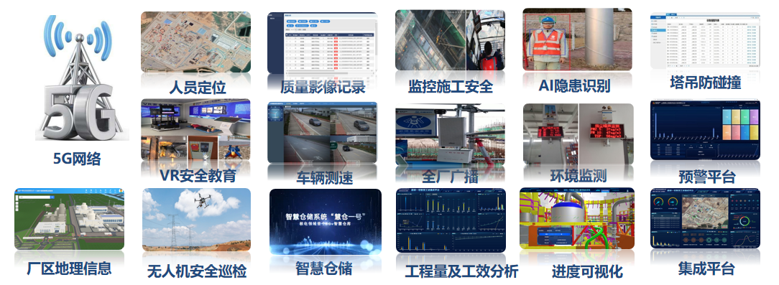
Innovation and Practice for Guohe One Operation Preparations
IV. Digital empowerment to promote the construction of smart nuclear power to help operation and maintenance
At the stage of full implementation of operation preparation, the research on digital transformation and special work of “smart nuclear power" based on the "5G smart construction site" are carried out for Guohe One Project. Based on the principle of combination of permanent and temporary works, key businesses at different stages of nuclear power are integrated with digital technology to consider the needs of nuclear power production and construction as a whole, promote business coordination and management reliability throughout the nuclear power operation, ensure the reliable and safe operation of nuclear power equipment, and create a digital power plant in the digital twin system mode.
Smart construction site

Slide 26
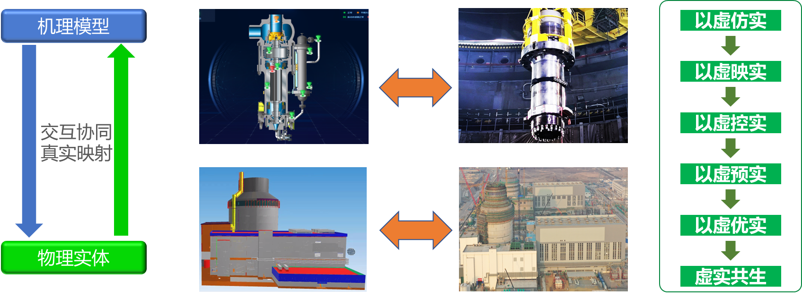
Innovation and Practice for Guohe One Operation Preparations
IV. Digital empowerment to promote the construction of smart nuclear power to help operation and maintenance
With the overall goal of building digital nuclear power plant, a virtual nuclear power plant that matches “Guohe One” physical nuclear power plant is built to create Guohe One smart NPP. It covers all elements of nuclear power operation and maintenance, precipitates intelligent algorithms, establishes mechanism + data fusion models, and implements intelligent applications such as predictive maintenance, situation awareness and simulation to continuously improve production efficiency, move steadily towards “smart operation”, and greatly improve the safety and economy of nuclear power plant, and finally create a lasting competitive advantage for Guohe One.
图片仅为示例后期可自行替换
Images are only examples and can be replaced as appropriate.
虚实映射
Virtual-real mapping
Build a digital twin of nuclear power plant to realize the mapping and integration of virtual-real data such as design data and sensing data
Virtual-real mapping
Complete the twin status synchronization and historical trend analysis of nuclear power plant to realize system health monitoring and diagnosis
监测判断
Monitoring and judgment
Monitoring and diagnosis
Predict the system performance status and evolution trend, analyze and predict the operating conditions using prediction models and algorithms
演化预测
Evolutionary prediction
Evolutionary prediction
Optimized decision
Provide decision support for plant control and design optimization

Slide 27


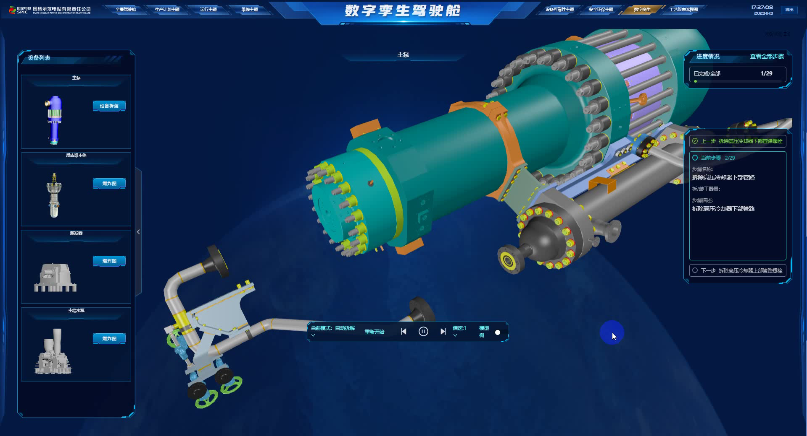
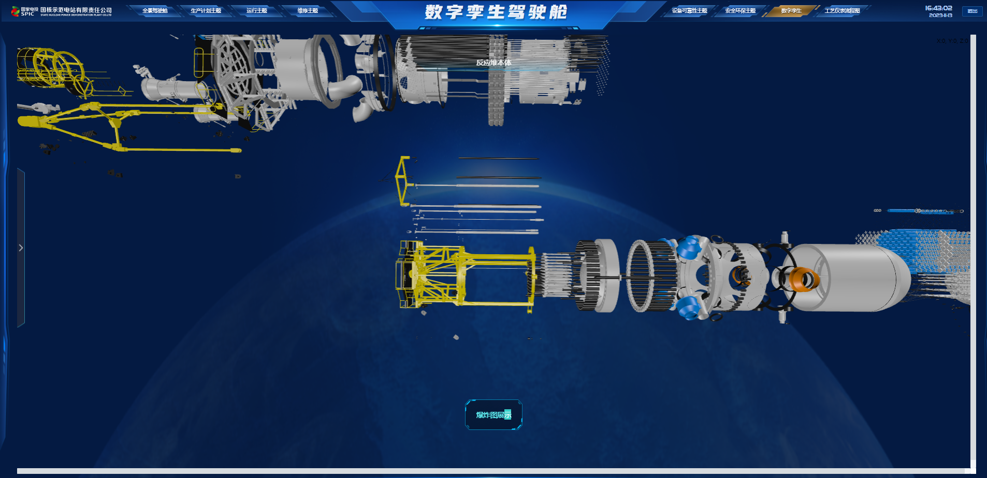
Innovation and Practice for Guohe One Operation Preparations
IV. Digital empowerment to promote the construction of smart nuclear power to help operation and maintenance
In the overall planning of digital and intelligent nuclear power plant, there are six major construction tasks: “digital nuclear power”, “digital twin”, “system equipment health”, “smart operation”, “smart maintenance” and “smart storage”. The digital twin nuclear power is a value embodiment of the deep integration of digital technology and nuclear power business to realize the data-reality integration of Guohe One digital and intelligent nuclear power plant.
Digital nuclear power
Smart operation
Promote the construction of network channels, plant video surveillance and SIS systems as planned, and complete the production requirements related to combination of permanent and temporary works of intelligent site
Realize structured and mobile operation procedures; implement risk management system to support operational decisions; realize electronic application of technical specifications in the main control room
Digital twin
Smart maintenance
Promote the deep integration of digital twin, Internet of Things, big data, artificial intelligence and other technologies with nuclear power business to drive full connection, full perception and predictability of nuclear power plant
Improve maintenance efficiency, team management, contractor management, site safety and quality management, foreign matter prevention management, personnel skills, etc.
System equipment health
Smart storage
Build an intelligent monitoring platform to realize the status monitoring and fault analysis of important systems and key equipment of nuclear power units; build a system health supervision and evaluation system to meet the needs for plant health management, predictive maintenance management and maintenance rule management.
Realize the unified management of automated stereoscopic warehouses and traditional plane warehouses, and realize intelligent operations such as automatic delivery and inventory of goods

Slide 28
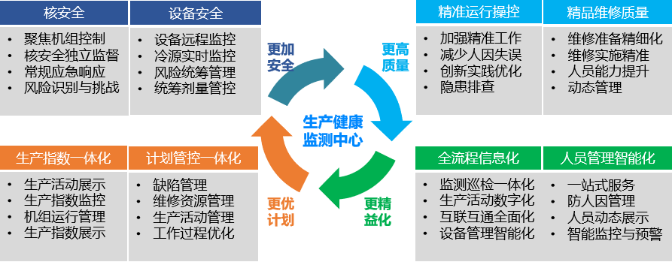
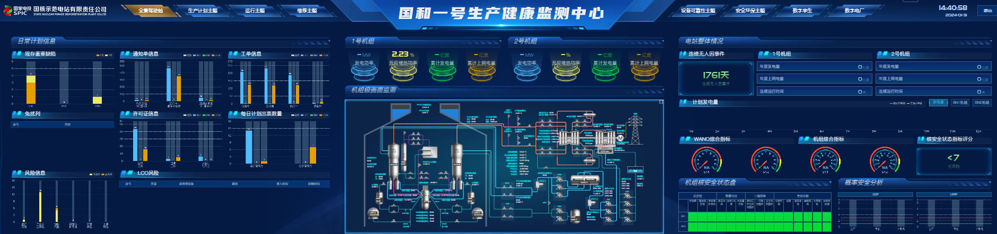
Innovation and Practice for Guohe One Operation Preparations
IV. Digital empowerment to promote the construction of smart nuclear power to help operation and maintenance
Based on the phased results of “smart nuclear power” and the site takeover progress, the daily operation management team makes overall planning to strengthen plan and risk control by focusing on unit operation and aiming at equipment reliability improvement. It establishes an operation health monitoring center in advance, integrates data using data collaboration platform technology, expands applications, monitors real-time performance status, improves the risk prevention ability of the unit, and provides comprehensive and fine visual management, so as to realize effective control and data support for the safe operation status of units.

Slide 29
Conclusion
The operation preparation of nuclear power plant is a long-term systematic project, which is often considered as important but not urgent work and easily neglected in the process of design, construction, installation and commissioning. In terms of Guohe One operation preparation management, we adhere to the core value of "leading as a role model and cohesion with full heart", take "nuclear safety as priority" as the overall principle, grasp the objective laws of nuclear power construction based on the general management mode of the industry, set the objectives and tasks for each stage, strive for innovation and optimization, and continuously explore practical experience, so as to establish an operation preparation management mode that conforms to the characteristics of Guohe series technologies.
Success doesn't have to be on me,
but always with my contribution.

Slide 30
Thank you！

