Slide 1
Proactive Aging Management Practices in Daya Bay NPP
Daya Bay Nuclear Power Operations and Management Co., Ltd. (DNMC)

Slide 2
1
Introduction
2
Proactive Ageing Management Strategy
CONTENTS
3
Life Cycle Ageing Management Planning
4
Systematic Ageing Management Measures
5
Conclusion

Slide 3
Introduction
01
PART

Slide 4
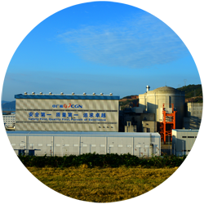
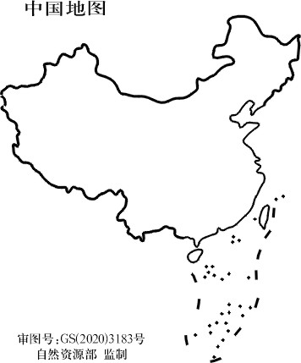

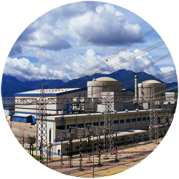
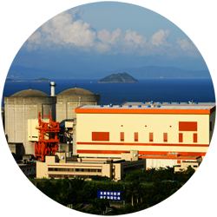

Introduction
Daya Bay Nuclear Power Operations and Management Co., Ltd. (DNMC) is responsible for operating six PWR units at Daya Bay site.
The path to specialization
Fleet management, specialized operation.
BeiJing
Lingao NPP Phase II (2011)
1,086MWe/unit, two units, CPR1000 Demonstration Unit
The journey of self-reliance
Supporting nuclear with nuclear,
progressive development.
Lingao NPP Phase I (2003)
990MWe/unit, two units, M310+ technology improvements
ShenZhen
Starting from a higher point
Introduced French technology,
the first large commercial NPP in China.
Daya Bay NPP (1994)
984MWe/unit, two units, M310 units

Slide 5
Introduction
The issues such as equipment ageing, technological obsolescence and spare parts obsolescence pose potential risks and challenges to the long-term safe operation of nuclear power units.
Adhering to the ideas that“Nuclear Safety Comes First” and “New Plant Every Day”, DNMC implements proactive ageing management to ensure informed and controlled ageing risks and long-term safe operation of the units.
Adopt proactive ageing management strategies, establish a sound ageing management system, and actively engage in industry exchanges and cooperation.
Proactive Ageing Management Practices
Carry out life cycle ageing management planning, make long-term asset management plans and mid- and long-term planning for major equipment.
Implement systematic ageing management measures, continuously improve the safety level of units through technological innovation in terms of ageing research, ageing detection, ageing control, upgrading and modification.

Slide 6
Proactive Ageing Management Strategy
02
PART

Slide 7
Proactive Ageing Management Strategy – Organizational System
With a proactive ageing management strategy, DNMC has established an ageing management programme system and set up a multi-disciplinary organization for ageing management.
It has provided strong support for ageing management in terms of organizational programmes and resource investment.
Management programs
Organizational Management
Plant Health Committee (PHC)
  Plant health committee system
  Plant equipment management
  Ageing and lifecycle management
  Long-term asset management
  Mechanical, Electrical, I&C and Civil Structures ageing management guidelines
  Technical guidelines for ageing management
  Ageing management program
Ageing management group for mechanical equipment
Ageing management group for electrical equipment
Ageing management group for I&C equipment
Ageing management group for civil structures
External supplemental organizations

Slide 8
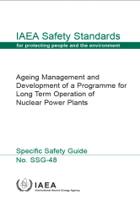
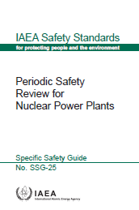
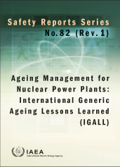
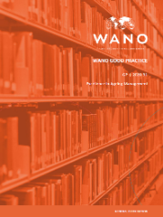
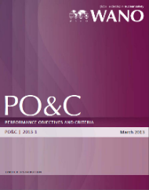
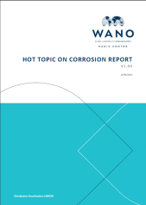
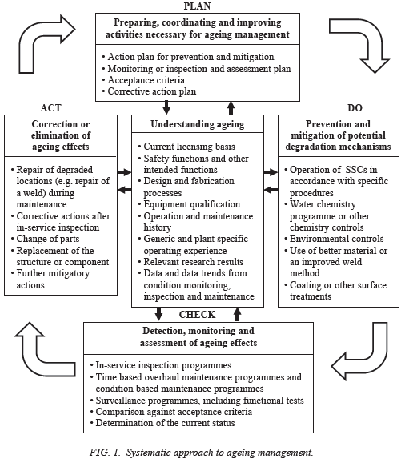
Proactive Ageing Management Strategy – Management Methods
Based on international industry experience, the systematic approach to ageing management (PDCA cycle) recommended by the IAEA has been applied.
Develop ageing management plans based on the understanding of ageing.
Carry out prevention, mitigation, inspection，assessment, maintenance and replacement.
Appropriate management measures have been developed based on the actual conditions of the plant.
Ageing Management Program
Ageing Control Plan
Life Cycle Management Plan

Slide 9
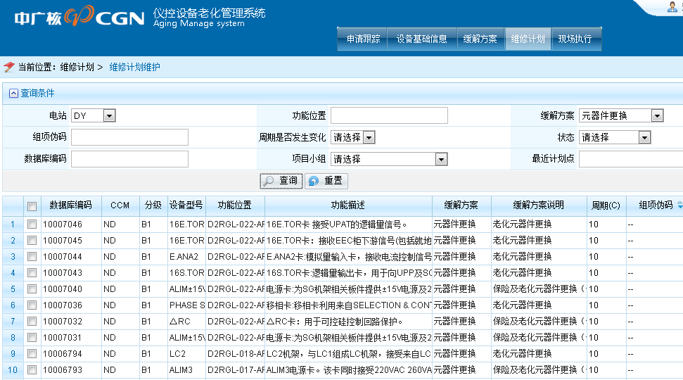
Proactive Ageing Management Strategy – Programs and Plans
Implement proactive preventive management activities by developing ageing management programs (AMPs) and special ageing control plans.
Ageing management programs
Focus on long-life passive equipment components
Systematic ageing management measures, including prevention and mitigation, inspection and monitoring, condition assessment, and corrective actions.
Ageing control plans
Focus on short-life equipment components
Based on aging assessment, adopt a proactive replacement strategy and develop special control plans as a supplement to preventive maintenance programs.
No. | AMPs (for example) | No. | AMPs (for example)
1 | Reactor Pressure Vessel | 7 | Buried Pipes and Tanks
2 | Steam Generator | 8 | Boric Acid Corrosion
3 | Reactor Internals | 9 | Flow Accelerated Corrosion
4 | Main Bolts of Reactor Vessel Head | 10 | Cable
5 | Handling Equipment | 11 | Containment
6 | Fire Protection Water System | 12 | Water-control Structures
I&C equipment ageing control plan（for example）

Slide 10
Proactive Ageing Management Strategy – Industry Exchanges
Adhering to the philosophy of benchmarking against excellent performers and innovative development, DNMC actively engages in technical exchanges on ageing management with the industry by inviting experts from abroad and benchmarking with excellent NPPs to broaden our horizons and enhance our understanding, thereby sharing information and experience and learning from each other.
The plant actively strengthens cooperation with industry organizations such as China Nuclear Energy Association(CNEA), International Atomic Energy Agency (IAEA), World Association of Nuclear Operators (WANO), Electricité de France (EDF) and Framatome Owners Group (FROG) to learn from their experiences, proactively conduct peer reviews, share good practices and develop improvement actions, thereby continuously improving the company's performance.

Slide 11
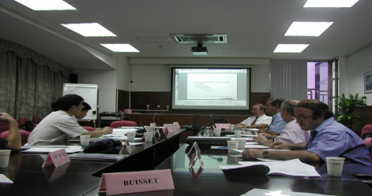
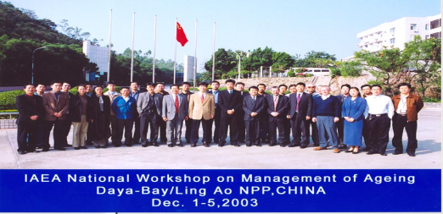
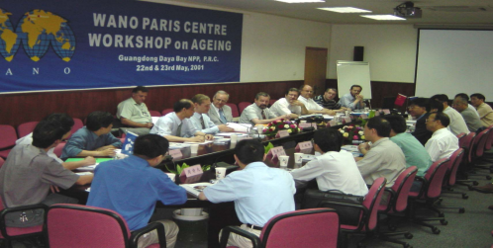
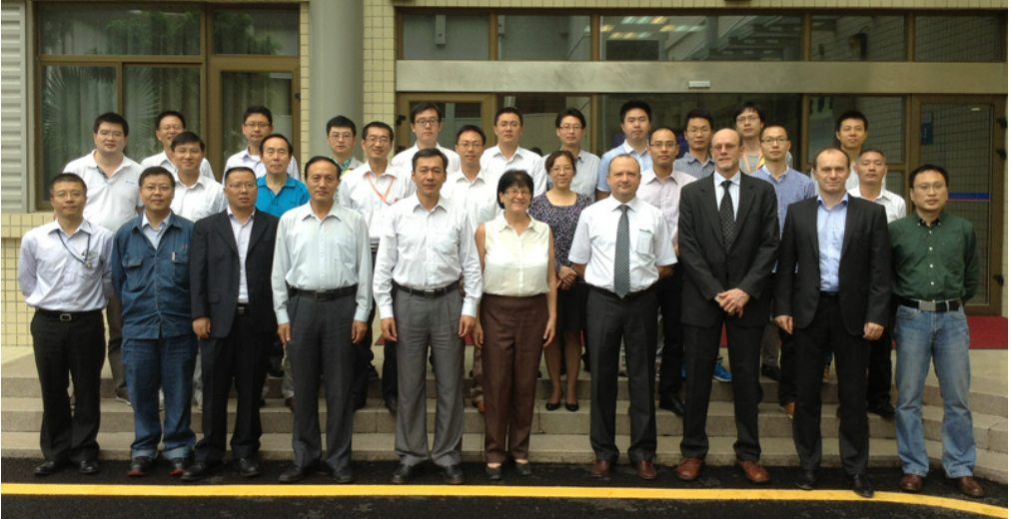
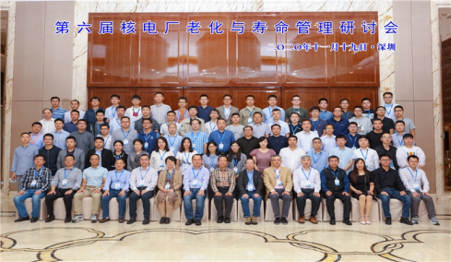
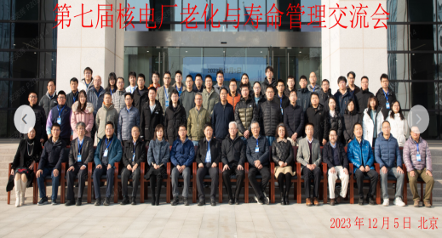
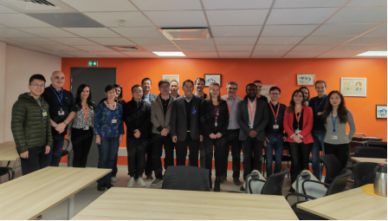
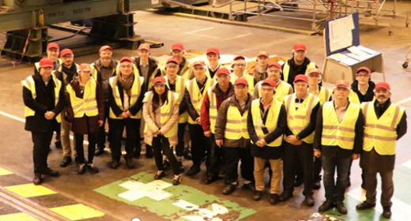
Proactive Ageing Management Strategy – Industry Exchanges
EDF-DNMC Ageing Workshop
（2003.9）
IAEA National Workshop on Ageing and
Life-cycle Management（2003.12）
WANO Workshop on Equipment Ageing Management (2013.5)
IAEA Workshop on Feasibility Analysis of Long-term Operation（2013.11）
CNEA 6th Workshop on Ageing and Life-cycle Management（​2020.11）
CNEA 7th Workshop on Ageing and Life-cycle Management （​2023.12）
Visited EDF Blayais NPP to exchange on ageing management and engineering transformation（​2023.10）
FROG Workshop on Ageing and Corrosion (on a yearly basis since 2008)

Slide 12
Life Cycle Ageing Management Planning
03
PART

Slide 13
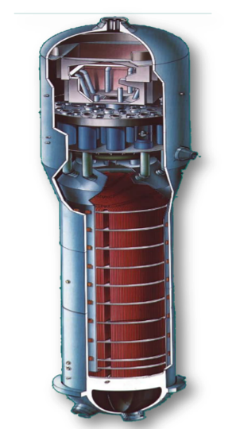
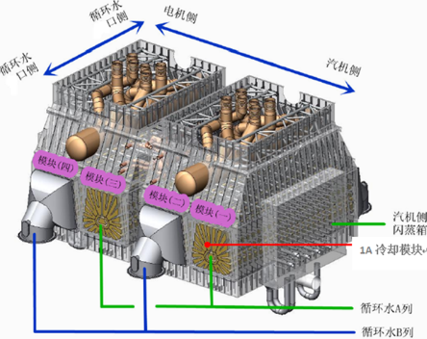
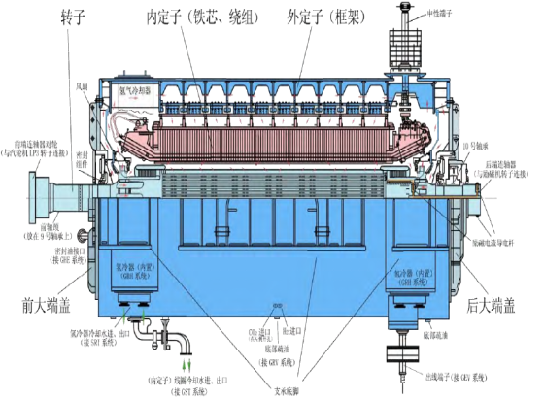
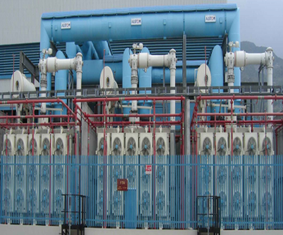
Life Cycle Ageing Management Planning – Scope
By referring to industry practices, lifecycle management plans are developed for important systems and equipment and then integrated into a plant-level long-term asset management plan to make plan for key equipment throughout their life cycle, thereby ensuring their long-term reliability.
The management scope covers key systems and equipment that are crucial to the safety, reliability, and economy of the plant, such as reactor vessels, steam generators, generators, turbines, transformers, condensers and I&C systems.

Slide 14
Life Cycle Ageing Management Planning – Process
A long-term asset management process has been established, which includes lifecycle assessments for key equipment and lifecycle management plans.
Actions arising from the long-term asset management plan are incorporated into online and outage upgrading & modification plans as well as maintenance and inspection plans.
Analyze equipment ageing & failure mechanism
Technical & investment review
Technical review
Determine the scope of asset management
Screening, analysis and risk assessment of concerns
Initial core asset management plan
Core Asset 1 Management Plan
Long-term asset management plan
Screen components of concern
Program optimization
Spare parts procurement Modification
Replacement
Maintenance
Monitoring
Technical research
…
Compreh-ensive project scoring & ranking
Data analysis of actual equipment operation and maintenance conditions
Economy analysis
Core Asset 2 Management Plan
Input
Execution
Production Plan
Implement
Inventory analysis for obsolete parts and spare parts
…
Feedback
Feedback
Core Asset n Management Plan
Analyze laws, regulations and external regulatory requirements
Additional project cost estimates, outage implementation window & duration, project prioritization, and other information
Remaining life assessment on components and equipment of concern
Long-term Asset Management
Core Asset Management

Slide 15
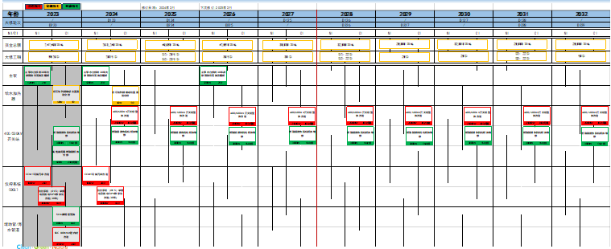
Life Cycle Ageing Management Planning – Output
Steered by long-term asset management, mid- and long-term lifecycle plans for key equipment are developed.
  Forward planning of key maintenance and modification projects.
  Proper planning of outage and optimization of power generation planning.
  Prudent financial planning to leverage capital investment.
Asset Management Program
Strategic Plan
Generation Plan
Outage Plan
Financial Plan
Maintenance Plan
Modification Plan
Procurement Plan
Mid- and long-term plan for key equipment at Daya Bay NPP（diagram）

Slide 16
Systematic Ageing Management Measures
04
PART

Slide 17
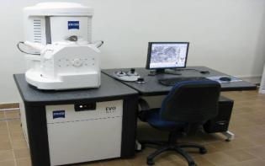
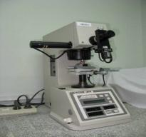
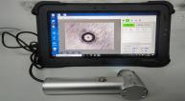
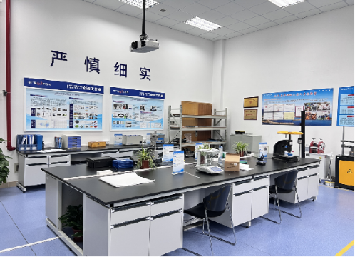
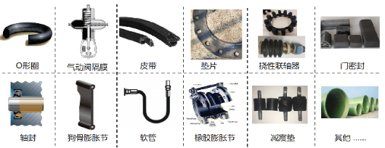


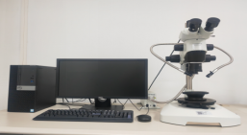

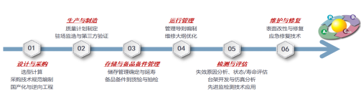
Systematic Ageing Management Measures – Ageing Research
Driven by an internal driving force, DNMC has kept improving technical competences in various fields including mechanical, electrical, I&C and structure engineering. It constructs and develops laboratories and testing systems for metal components, rubber materials and electrical and I&C components in an orderly manner in order to enhance its capabilities in monitoring, detection and analysis of ageing failures.
The metallographic laboratory and rubber laboratory can test and analyze failed components and spare parts on site, providing technical support for optimization of maintenance strategies.
Metallographic laboratory: testing and failure analysis for metal components
Rubber equipment and component reliability testing laboratory

Slide 18
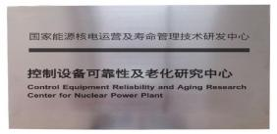
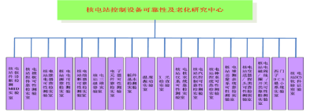
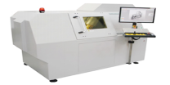
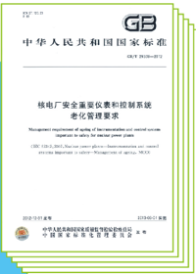
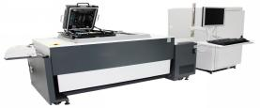
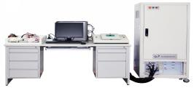
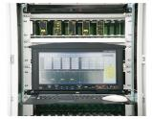
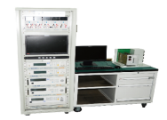
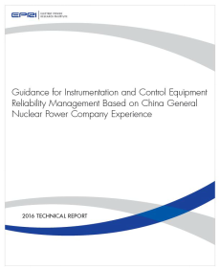
Systematic Ageing Management Measures – Ageing Research
The Control Equipment Reliability and Ageing Research Center can provide a set of technical solutions including ageing mechanism research, ageing identification, failure analysis, ageing detection & monitoring and ageing mitigation to implement lifecycle reliability management on control equipment.
National and energy industry standards were established, and widely promoted and applied at NPPs in China. In collaboration with EPRI, the center’s research results have been transformed into an EPRI technical guideline titled Guidance for Instrumentation and Control Equipment Reliability Management Based on China General Nuclear Power Company Experience, which is now widely promoted in the global nuclear industry.
Control Equipment Reliability and Ageing Research Center

Slide 19
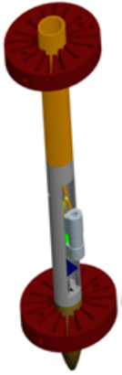
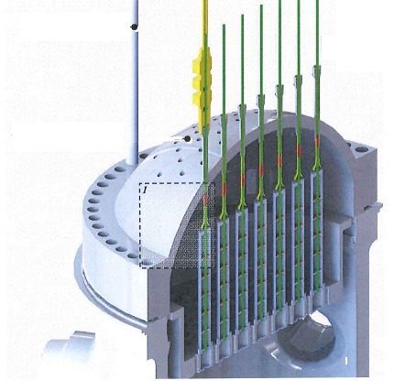
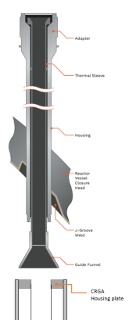
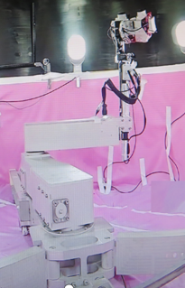
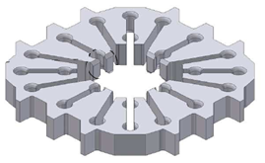

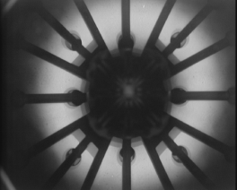
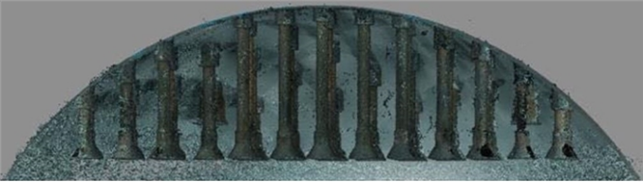
Systematic Ageing Management Measures – Ageing Detection
Based on internal and external operating experience, proactive ageing detection has been carried out on equipment with potential ageing risks for the purpose of prevention.
Specialized inspection devices were developed independently to inspect and assess the wear on control rod guide tubes (CRGT) and control rod drive mechanism (CRDM) thermal sleeves, and actions were taken before equipment failure to prevent the impact of ageing on plant safety.
CRGT Wear Inspection
Thermal Sleeves Wear Inspection

Slide 20
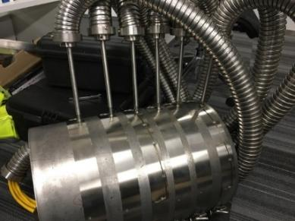
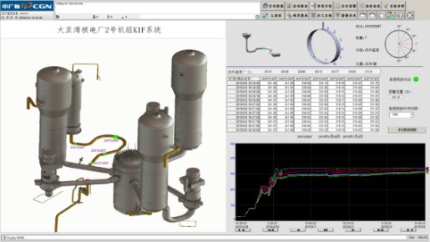





Systematic Ageing Management Measures – Ageing Detection
It has fully leveraged the leading role of scientific and technological innovations to promote the application of new technologies, methods and tools in the area of ageing detection.
By implementing a number of new technology applications, it has improved its abilities to inspect, monitor and assess the ageing of equipment.
Pipeline thermal fatigue monitoring equipment and analysis and evaluation system were put into operation
Application of containment strain monitoring technology
Application of robot in pipeline wall thickness detection
Application of online acid and alkali tank corrosion monitoring device
Application of new technology for ageing detection of medium voltage cables

Slide 21




Systematic Ageing Management Measures – Ageing Control
Special control plans are developed based on the ageing conditions of equipment to eliminate ageing hazards in a timely manner.
A campaign has been launched by using new materials and technologies to address the corrosion issues for pipes on fire protection systems.
Inspect current conditions to timely eliminate deficiencies
Pipeline corrosion control through replacement and modification
Replacement and modification
A
C
Overall Strategy
Inner wall
anti-corrosion
treatment
B
D
Periodic detection & evaluation to have a big picture of corrosion conditions
Water quality improvement
Fire pipeline corrosion control

Slide 22



Systematic Ageing Management Measures – Ageing Control
Development and application of new materials have helped resolve the material ageing issues.
  By using the HDPE (high-density polyethylene) material, the seawater corrosion problem with Circulating Water Filtration System (CFI) pipelines has been solved.
  The long-life EPDM (ethylene propylene diene monomer) lining has been developed for pipeline replacement on Essential Service Water System (SEC) and Circulating Water System (CRF), which has solved the ageing issue with the original lining material. This has not only extended the service life of equipment but also reduced maintenance costs in the future.
SEC pipeline replacement
CRF pipeline replacement
CFI pipeline replacement

Slide 23

Systematic Ageing Management Measures – Upgrading and Modification
In the 3rd 10-year outage of Daya Bay NPP, 97 modification projects were implemented, of which 14 were key ones, including a number of equipment ageing-related upgrading and modification projects (e.g., modifications on digital control system, fuel handling device, polar crane, main turbine and main generator). Power uprate project was also implemented.
As of now, Daya Bay Unit 2 has completed its 3rd 10-year outage with the support of new technologies, processes, methods and tools. Daya Bay Unit 1 is currently undergoing its 3rd 10-year outage, laying a solid foundation for long-term operation in the future.

Slide 24




Systematic Ageing Management Measures – Upgrading and Modification
Independently developed and implemented modifications on digital instrument control system (DCS)
  The original analog instrument control system has been upgraded to a digital one, which solved issues such as equipment ageing and spare parts obsolescence and achieved design optimization and enhancement.
  The strategy of overall planning and phased implementation was adopted to complete the digital upgrading of control systems such as Conventional Island and Nuclear Island Process Instrumentation System group V in the 3rd 10-year outage. It has been planned to complete the digital upgrading of the main control room, instrument protection system, reactor protection system and relay rack in the 4th 10-year outage.

Slide 25






Systematic Ageing Management Measures – Upgrading and Modification
A number of key equipment ageing-related modification projects have been completed, having improved the reliability and long-term safe operation of plant systems.
Low-pressure turbine modification
Generator stator replacement
Main step-up transformer replacement
6.6kV medium voltage switchboard modification
Polar crane control system modification
PMC system modification

Slide 26
Conclusion
05
PART

Slide 27

Conclusion
DNMC has effectively controlled equipment ageing issues by implementing a number of proactive ageing management measures.
Over the past 15 years, no reactor/turbine trips have occurred due to ageing-related problems and the plant safety has improved continuously.
Daya Bay NPP has been operating safely for 30 years since it came into commercial operation in 1994.
30Years
Lingao NPP Unit 1 has been operating safely for over 6300 consecutive days, continuously refreshing the world record for the longest consecutive days of safe operation among similar units globally.
6300Days
In 2023, the total on-grid electricity of the six units reached
46,475,000,000
KWH
In 2023, out of 72 indicators for the six units reviewed by World Association of Nuclear Operators (WANO), 67 have reached the top quartile level in the world.
87.5%
Since 1994, the six units at Daya Bay site have generated on-grid electricity totaling
939,112,000,000
KWH

Slide 28
Conclusion
Safety Risk Control
According to international practices, long-term operation of nuclear power plants is the trend of the industry, and ageing issue is a main challenge for long-term operation.
DNMC will continue to actively engage in international exchanges and cooperation, strengthen development of ageing management system and promote technological innovation and upgrading to ensure the long-term safe and stable operation of nuclear power plants.
Properly identify, prevent and control equipment aging risks by adhering to the idea that nuclear safety comes first, allocating resources and optimizing management strategies.
Application of technological innovations
Based on on-site demands, enhance independent innovation capabilities and promote R&D and application of new technologies, materials and tools.
Outlook
Focus on Long-term Development
From the perspective of long-term operation, develop long-term development plans and carry out R&D of key technologies.
Industry Exchanges and Cooperation
Fully learn from the industry operating experience and strengthen technical exchanges and cooperation.

Slide 29




Thanks！

