Slide 1
Olkiluoto 3 – Inspections by the authority before first critically
Jukka Kallionpää
Resident inspector at Olkiluoto NPP

Slide 2
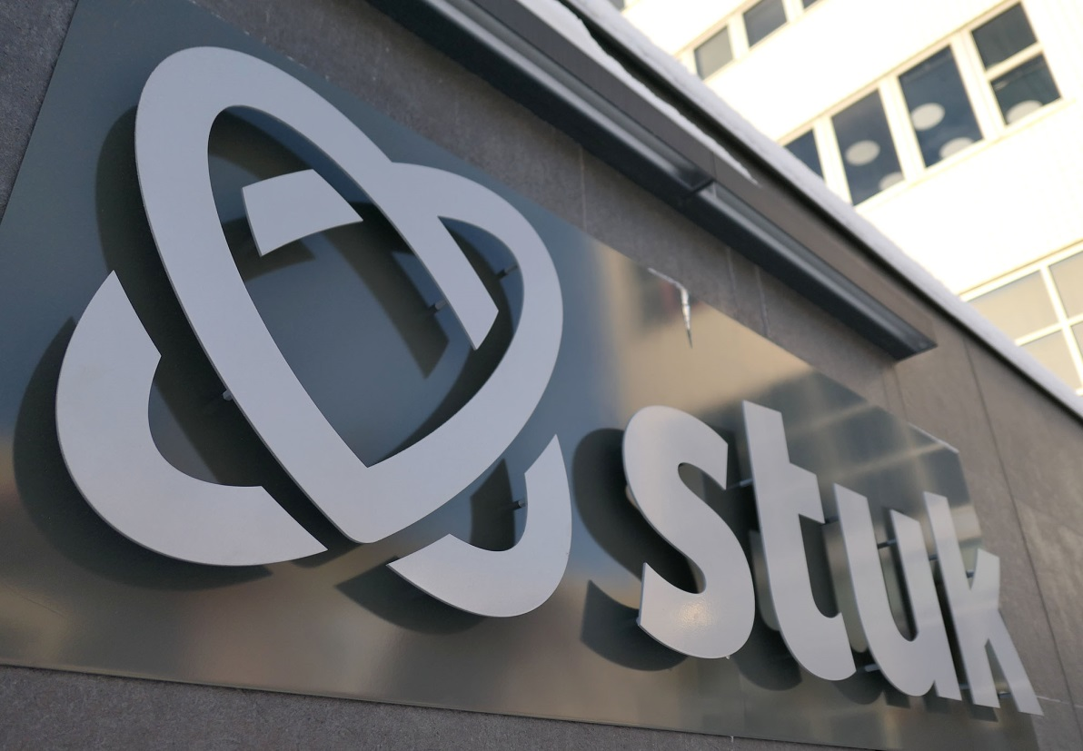
STUK – Radiation and Nuclear Safety Authority
Mission:
Protecting people, society, environment, and future generations from harmful effects of radiation

Slide 3
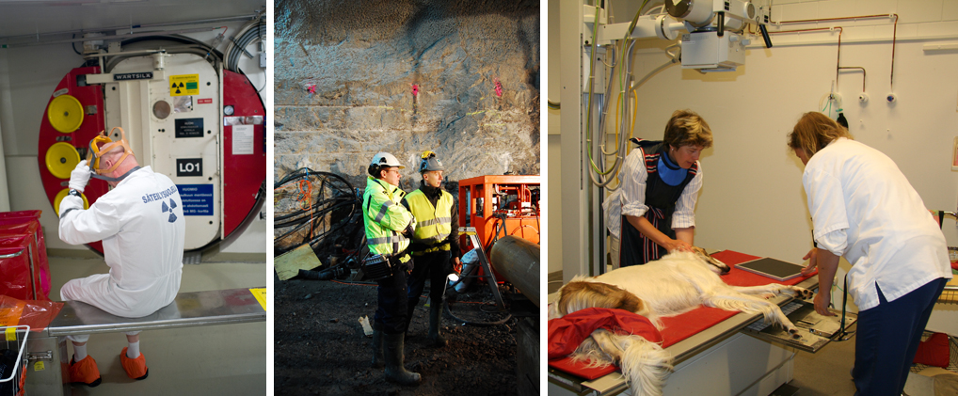
Three roles of STUK:
1. Regulatory Body
* use of nuclear reactors * monitoring environment
* nuclear waste and materials * mining
* use of radiation * non ionising radiation

Slide 4
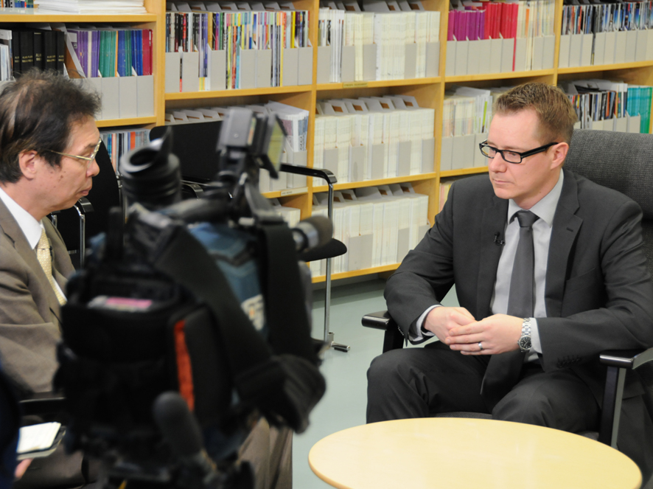
Three roles of STUK:
2. Expert organisation
national preparedness for radiation accidents
training of users of radiation
information and advice to public and other authorities
contracted expert and radiation measuring services

Slide 5
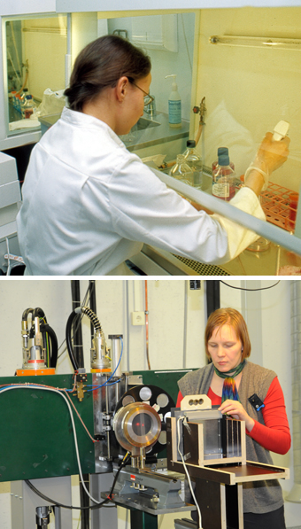
Three roles of STUK: 3.
Research
Radiation safety research produces experts, tools and information for the needs of oversight and emergency preparedness.
Through co-operation with universities we seek to exercise influence on making radiation safety research one of the focus areas for universities and research institutes.

Slide 6
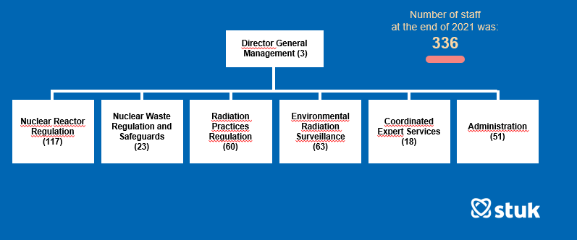

Slide 7
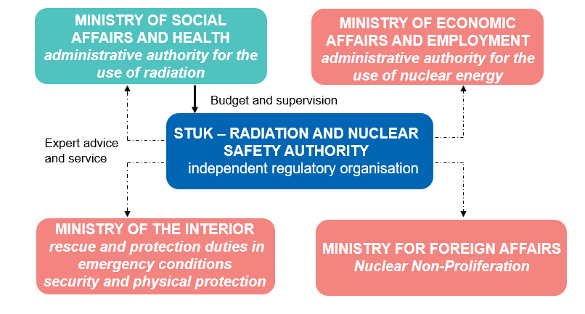
Main contacts between STUK and Ministries

Slide 8
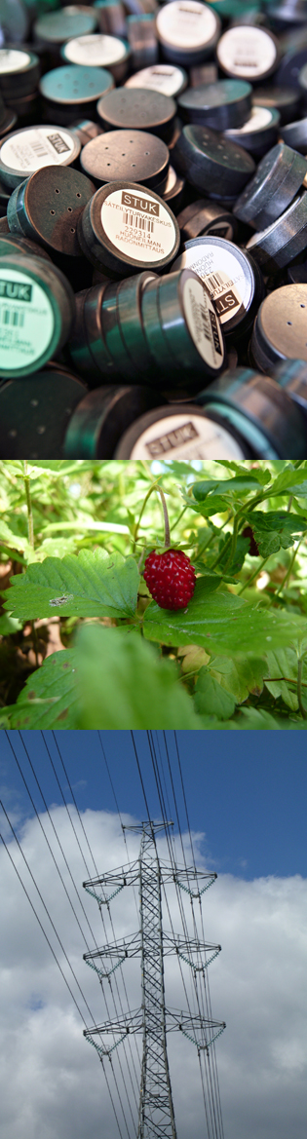
Other important partners in public sector
Ministry of the Environment - radon control in households
Ministry of Defence - emergency preparedness
Ministry of Agriculture and Forestry - emergency preparedness
Ministry of Transport and Communications - protection from electromagnetic radiation
Finnish Meteorological Institute (IL) - transport of radioactive materials in the atmosphere
Customs Authority - border control to avoid illegal import of radioactive and nuclear materials
Finnish Food Authority - control of radioactive contamination of food and drinking water
Technical Research Centre of Finland (VTT) -

Slide 9
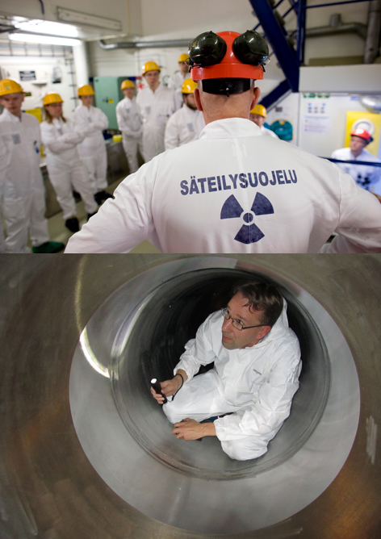
Role of STUK as the national nuclear regulatory body
Licenses for nuclear facilities in Finland are issued by the Government.
Ministry of Economic Affairs and Employment provides administrative support for processing license applications.
STUK’s duties
preparation of national nuclear safety regulations
safety evaluation (necessary prerequisite for issuing a license)
inspections needed to verify the safety state of the facility and the compliance with license conditions over the plant lifetime
inspections on nuclear waste management and nuclear material safeguards
binding orders to the licensees as needed to ensure nuclear safety

Slide 10
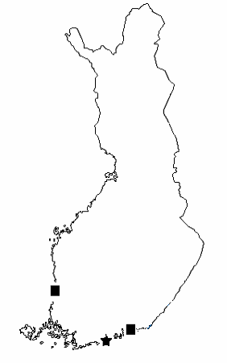
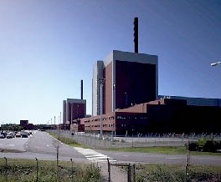
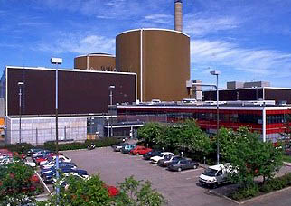
Nuclear power plants in Finland
The construction licence application has been cancelled:
Hanhikivi 1 Nuclear Power Plant.
Olkiluoto Nuclear Power Plant:
Olkiluoto 1, Olkiluoto 2 and Olkiluoto 3
Helsinki
Loviisa Nuclear Power Plant:
Loviisa 1 and Loviisa 2

Slide 11
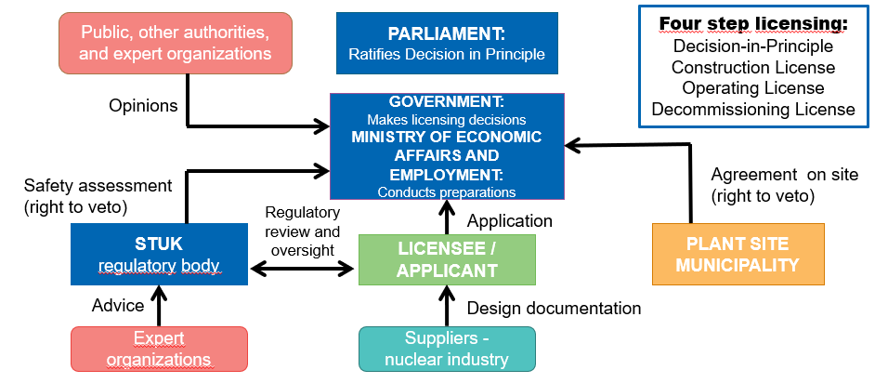
Licensing of nuclear facilities in Finland

Slide 12
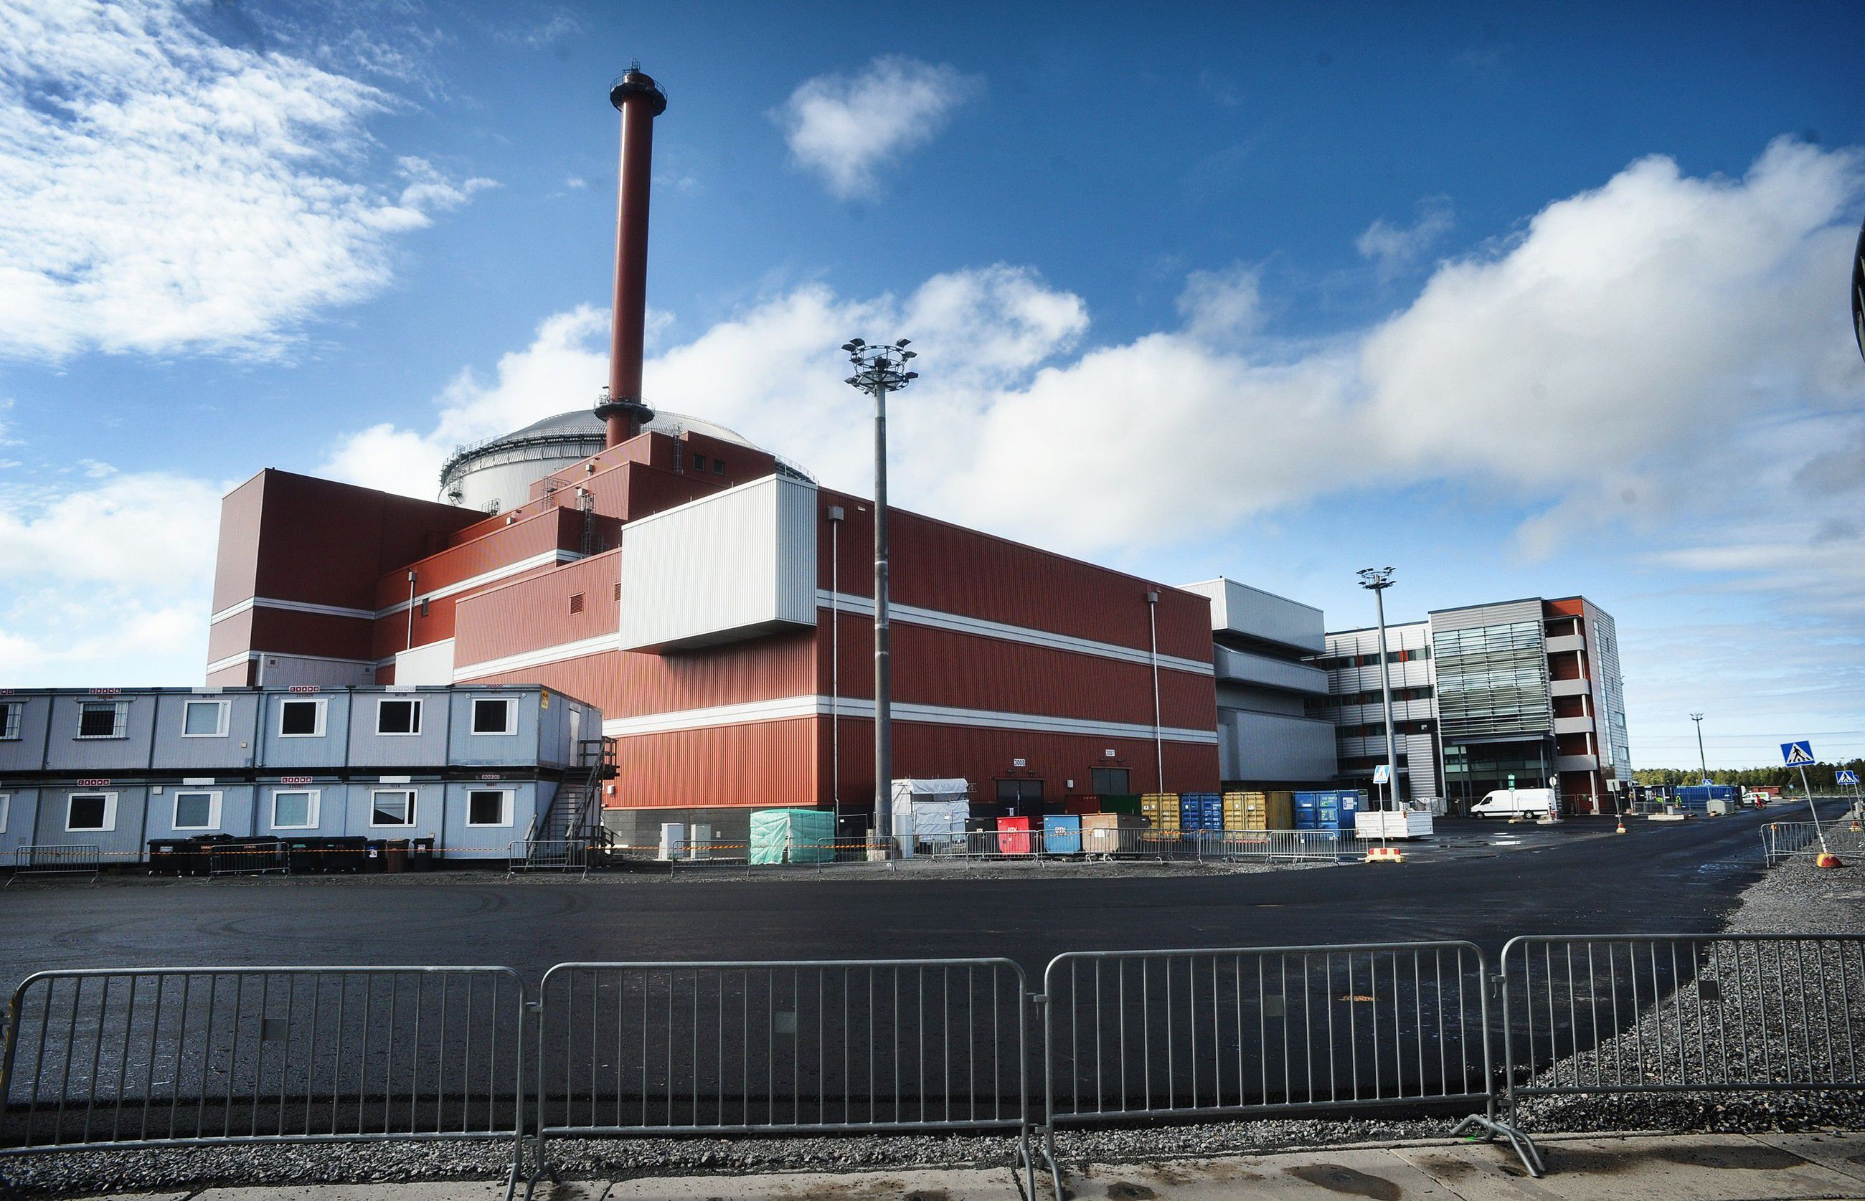
Olkiluoto 3 - Overview
Operated by TeollisuudenVoima Oyj
(TVO) in Olkiluoto Island, Finland
EPR (European Pressurized Water
Reactor) build by consortium AREVA NP-
Siemens
Started its regular electricity production
in April 2023
Core thermal power 4300 MW
Net power output ~ 1600 MW
Reactor coolant system
  4 loops
  Operating pressure 154 barg
  Reactor pressure Vessel inlet/outlet
  temperature 296 / 327 °C
Steam pressure 77 barg
Core
  Fuel assemblies 241
  Control rod cluster assemblies 89

Slide 13
OL3 – permission for startup
The Radiation and Nuclear Safety Authority (STUK) has on 16.12.2021 granted the permission for making the reactor critical.
First time OL3 reactor was found to be critical 21.12.2021
Getting to this stage has required
a lot of work and solutions
from everyone.

Slide 14
STUK inspections before fuel loading
STUK conducted factory inspections related to the OL3 facility in morte than 30 countries
Several thousand factory inspections were carried out
A lot of work done at the NPP site.
STUK resident inspectors and other experts, HQ inspectors, performed more than 10 000 inspections

Slide 15
OL3 – Fuel loading
The fuel loading of the OL3 reactor was completed 01.04.2021
Before starting the fuel loading, STUK made sure that all the necessary checks have been completed and all open points have been recorded.
Open points issues were
managed STUK
commissioning protocols.

Slide 16
OL3 – Fuel loading
Before fuel loadind, STUK performed hundreds of commissioning inspections
  Almost all systems had to be in the commissioning operation phase fuel loading
STUK performed commissioning inspections for systems and devices.
Commissioning inspections at the NPP have two stages

Slide 17
Commissioning inspection - basics
All devides must be included in the system commisssioning inspection
  The number of devices in the NPP is large. So the work has to be divided.
  Knowledge of the facility is a big help in commissioning inspections
In the first step, (KOT1), it is ensured that the installation has been completed and that no open issues have been detected in the inspections that would prevent the commissioning operation from starting. At the same time, it is ensured that the commissioning operation plan has been approved.

Slide 18
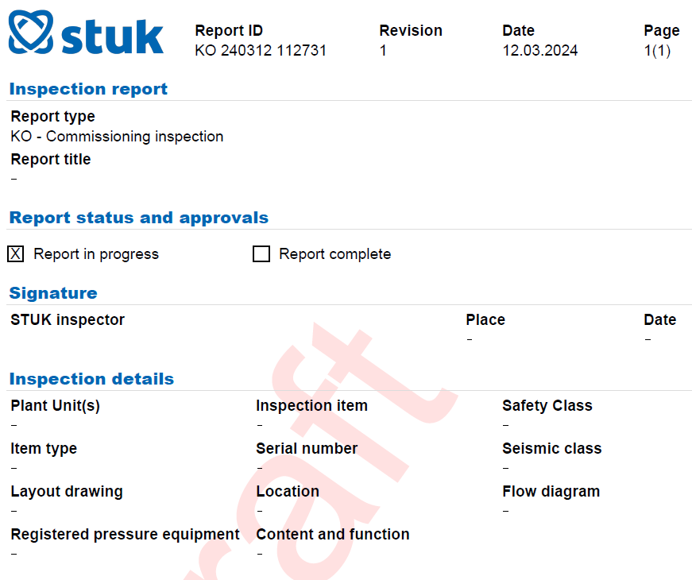
Commissioning inspection - basics
In Finland, STUK is the authority of pressure equipmant in the NPP
  At this KOT1 stage, the introduction of the pressure devices inside the systems.
  *Monitoring of periodic inspections of
  pressure equipmant starts from that day
  *In the KOT1 phase, all test are performed

Slide 19
Commissioning inspection - basics
After the tests are completed, the license holder applies for a license to use the system. This phase is called KOT2.
The result report of the commissioning testing is submitted to STUK for processing.
After the commissioning tests (KOT2) of the systems, tests between the systems are carried out
Cross-system tests are an important step

Slide 20
OL3 - Experiences
The test use phase was long
There were many things to discuss
It is worth investing in the management of open issues
The presence of an authority during the exams must be planned in advance.
Getting the word out is a good thing

Slide 21
OL3 - Experiences
Safety culture is part of construction. It must be taken care of throughout the life cycle of the facility.
By working with people as
a person, the authority gets
a good picture of the level
of the safety culture.

Slide 22
Questions

