Slide 1
Nuclear Safety Governance
over CGN Growing Fleet
CGN
Guo Li Min
April 2024

Slide 2
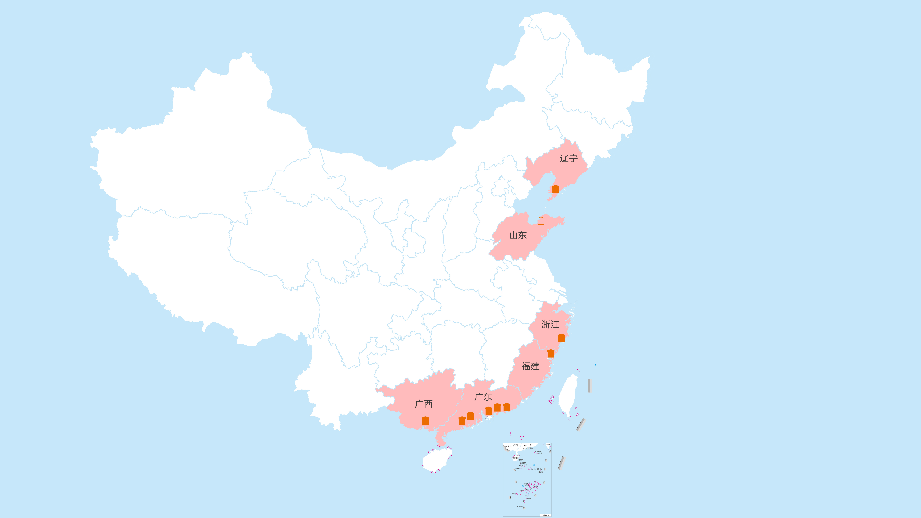
CGN: a Clean Energy Corporation Featuring Nuclear Power
Hongyanhe (HYH) Nuclear Power Site
Zhaoyuan (ZY) Nuclear Power Site
Liaoning
10 Coastal Nuclear Power Sites
27 Operational Units with an
installed capacity of 30.53 GW
11 Units under construciton with an
installed capacity of 13.24 GW
Cangnan (CN) Nuclear Power Site
Ningde (ND) Nuclear Power Site
Shandong
Daya Bay (DYB) Nuclear Power Site
Huizhou (HZ) Nuclear Power Site
Zhejiang
Lufeng (LF)
Nuclear Power Site
Fujian
Guangxi
Guangdong
Taishan (TS)
Nuclear Power Site
Yangjiang (YJ) Nuclear Power Site
Fangchenggang (FCG) Nuclear Power Site

Slide 3
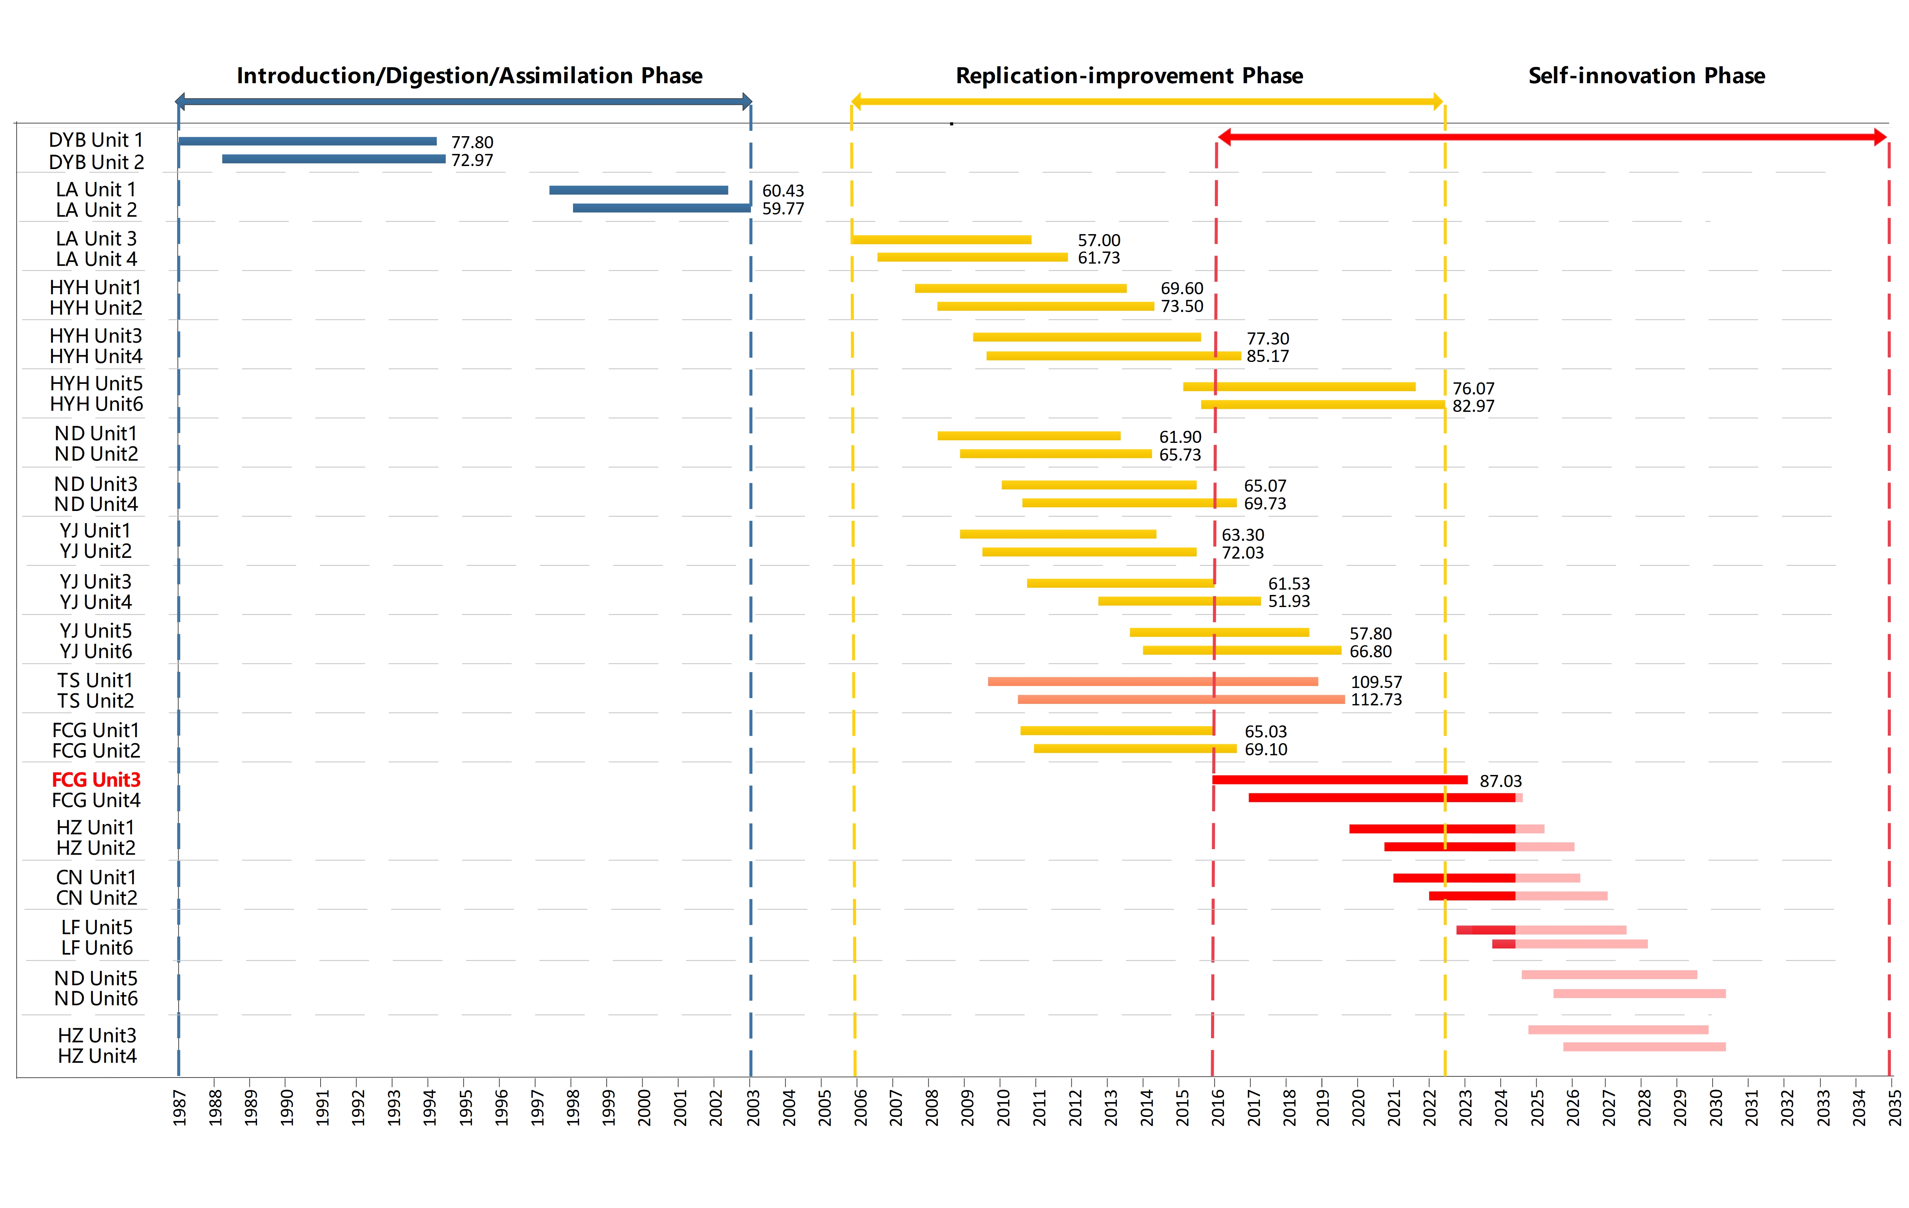
A Path from Technology Introduction to Self-Innovation

Slide 4
Operational Performance for the Units Put into Service
Average Unit Capability Factor
Number of Operation Events Per Unit
Single-Site Two Reactors
Single-Site Multi-Reactors
Multi-Sites Multi-Reactors

Slide 5
Past and Future Construction Fleet

Slide 6
Organizations and Responsibilities
China General Nuclear Power Corporation / CGN Power
Engineering Company
(including Design Company)
Operation Company
(including Independent Supervision )
DNMC
YJ Company
DNMC
YJ Company
ND Company
HYH Company
ND Company
HYH Company
FCG Company
TNPJVC
FCG Company
TNPJVC
HZ Company
CN Company
HZ Company
CN Company
LF Company
ZY Company
LF Company
Research Institute
Uranium Company
Suzhou Institute

Slide 7
Integrated Management System to Satisfy all Requirements
Statutory Requirements
International Standards
Management Responsibility
Safety
Culture
Measure, Assess
& Improve
Resource
Management
Process Implementation
Stakeholders Requirements
Social Responsibility

Slide 8
Lifespan Technical Safety
Operation & Decommissioning
Safety
Economy
Development & Construction
Security | Quality | Environmental Protection
Duration | Technology | Cost
Research & Design

Slide 9
Human Performance Perspective
Commission
Error
Omission
Error
Knowledge based
Rule based
Skill based
Inaction
Mistake
Application
Dereliction
Slip
Lapse

Slide 10
Operation Management Standardization
One site
Multi-sites
Multi-reactor
Management
Nuclear Process
Standardization
Corporate GOSP
Fleet Peer Groups
Operation Preparation

Slide 11
Standard Operation Process
Five-year Business Plan
Electricity Production
Five-year Business Plan
Configuration Management
Marketing
Marketing
Operate Plant
Materials & Services
Work Management
Finance Management
Feedback
Cost
Finance Management
Equipment Reliability
KPI
Human Resources
Human Resources
Information Management
Information Management
Public Relations
Safety Management
Quality Assurance
Human Performance
Experience Feedback
Training
Fuel Management
Public Relations
Internal Audit
Internal Audit
Performance
Cost

Slide 12
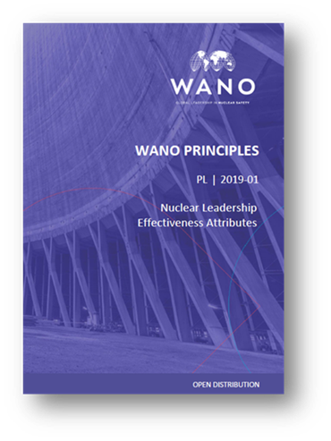
Nuclear Leadership
LE.1 - Establish a vision of excelllence
that prioritises nuclear safety
LE.2 - Engage the workforce
LE.3 - Create an environment of teamwork,
trust and cooperation
LE.4 - Drive for sustainable results
LE.5 - Build leadership capability

Slide 13
Drive for Operational Excellence
Achieving World’s Advanced Level
Proportion of WANO Indicators
Achieving Best Quartile ≥ 80%
Average Unit Capability Factor ≥ 95%
Continuous Improvemen of Human Performance
Health Management for Major Equipments
Platform for
Management of Critical Components
Pursuing Excellence for Outage Management
Leadership
and
Safety Culture
Development

Slide 14
Digitalization for Hualong Fleet Architect Engineering
Engineering Modification
Manufacturing
Commissioning
Erection
Equipement Reliability
3D
Disign
Model
+
Data
Spare Parts
3D Site Layout
Civil Work
3D Site Layout
Tools for better managing muti-sites projects
Platforms for operation

Slide 15
Three Loops Learning to Enhance Safety Culture
Mindset
Objectives
Actions
Results
Single loop
Double loop
Triple loop

Slide 16
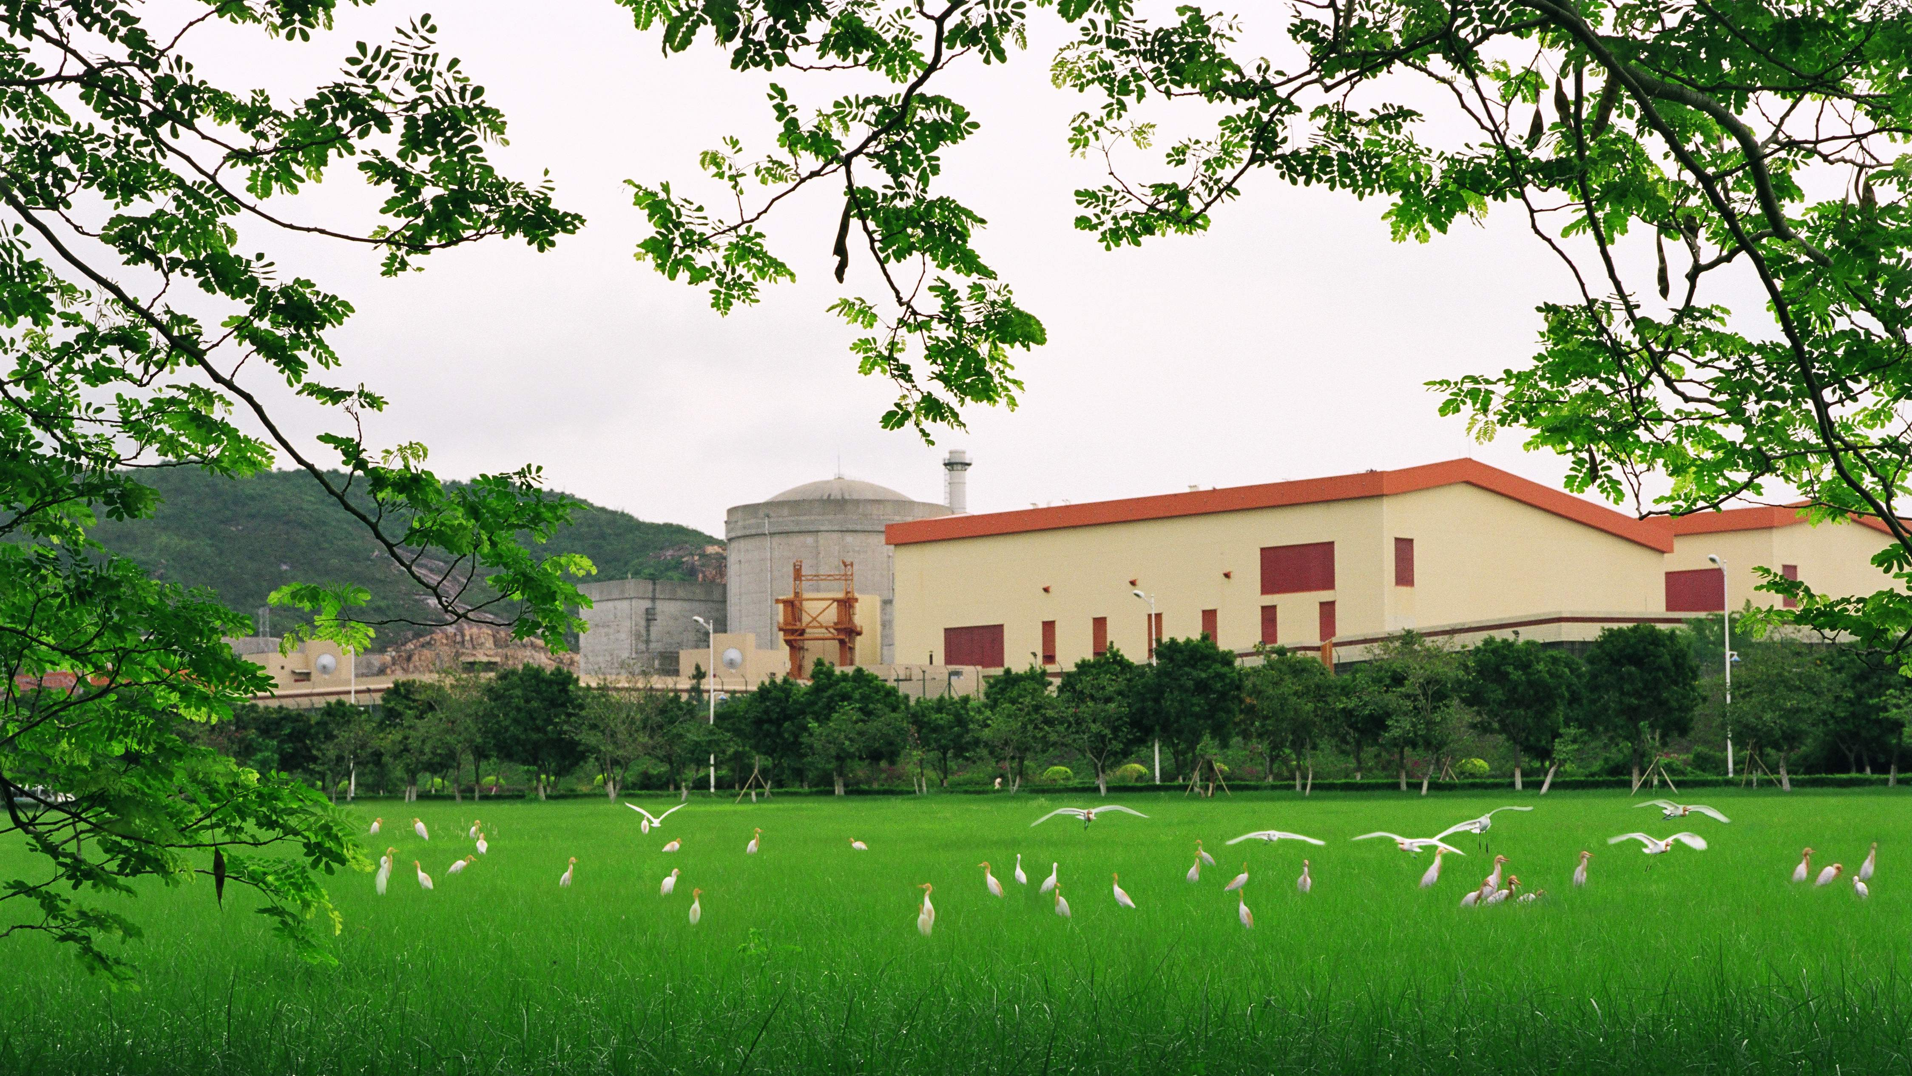
Never Best Only Better

