Slide 1
Insights on Corporate Independent Oversight
Steve Meng
Vice President, International Strategy
Institute of Nuclear Power Operations (INPO)

Slide 2
Evaluation of Corporate Performance
INPO and WANO-AC monitor and evaluate the performance of corporate organizations using the WANO Performance Objectives and Criteria and other applicable INPO standards documents
Strong corporate performance directly contributes to a plant’s ability to sustain high-levels of performance
Both Corporate Oversight and Corporate Independent Oversight directly support improved levels of self-awareness and improved performance

Slide 3
Insights on External Oversight
Evaluations revealed that External Oversight Boards are effective at providing corporate executives and boards with an ongoing perspective of performance at nuclear stations and in the corporate organization.

Slide 4
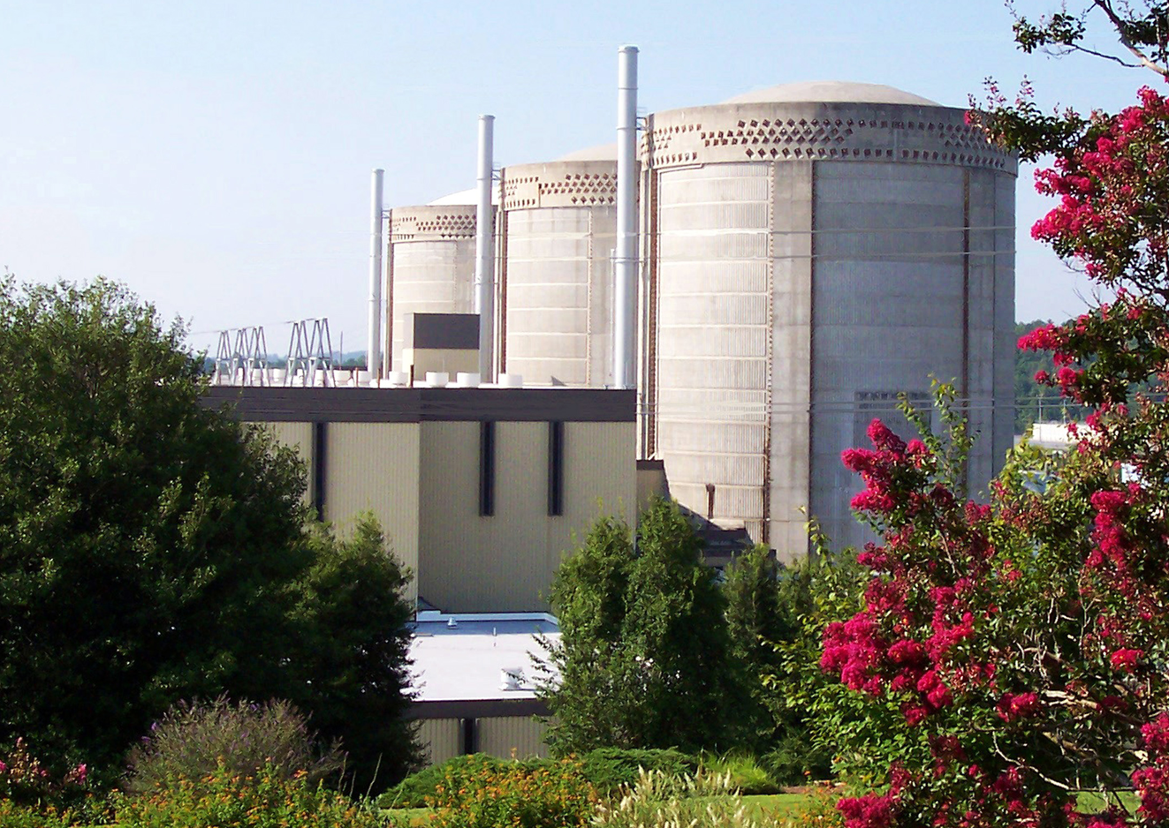
Insights on External Oversight
Gaps found were typically associated with boards accepting a station’s perspective of gap closure without a review that the underlying causes of the gap had been addressed.
Strengths were associated with improved focus on board input, staffing the board with highly experienced nuclear professionals, and coordination during recovery efforts.

Slide 5
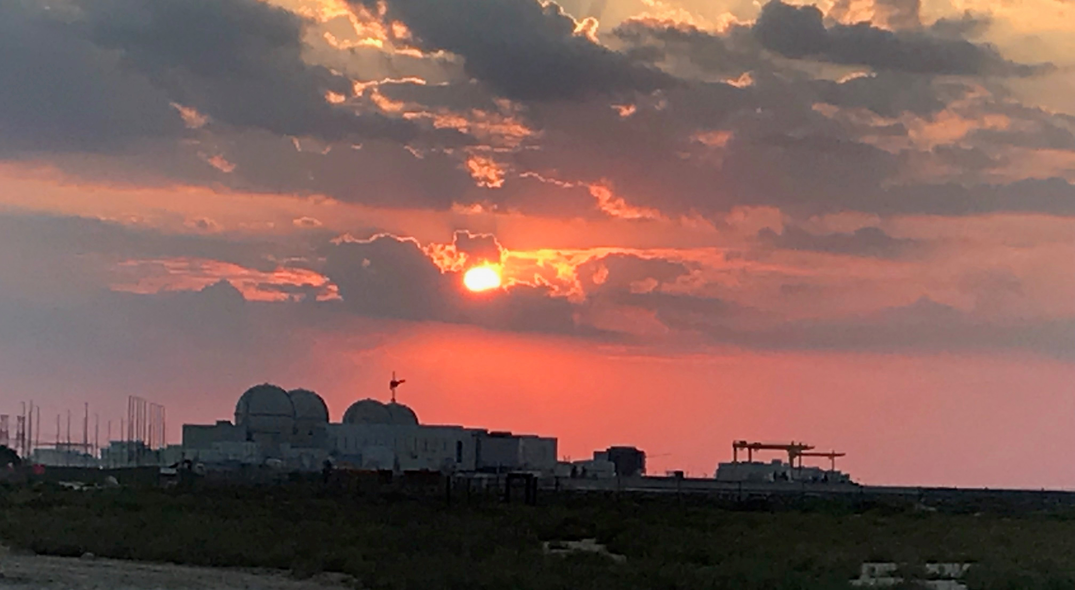
Additional Good Practices
High levels of transparency between stations, corporations, and external oversight boards contributes to improved gap identification and better insights
INPO provides independent reviews of station and corporate performance and periodically provides updates to member utility boards of directors
INPO now hosts an External Oversight Board Chairperson Meeting annually to allow for benchmarking and sharing of best practices

Slide 6
Oversight Organizational Structures (Simplified) – Single Site
Chief Executive Officer (CEO)
External Oversight Board (EOB) Chair
Chief Nuclear Officer (CNO)
External Oversight Board
Station Leadership
Oversight
Corporate Functional Area Managers

Slide 7
Oversight Organizational Structures (Simplified) – Single Site
Chief Executive Officer (CEO)
External Oversight Board (EOB) Chair
Chief Nuclear Officer (CNO)
External Oversight Board
Station Leadership
Oversight
Corporate Functional Area Managers

Slide 8
Oversight Organizational Structures (Simplified) – Multi Site
Chief Executive Officer (CEO)
External Oversight Board (EOB) Chair
Chief Nuclear Officer (CNO)
External Oversight Board
Quality Assurance and Audits
Station 1 Leadership
Corporate Leadership
Station 2 Leadership
Functional Oversight
Station 3 Leadership
Corporate Functional Area Managers

Slide 9
Oversight Organizational Structures (Simplified) – Multi Site
Chief Executive Officer (CEO)
External Oversight Board (EOB) Chair
Chief Nuclear Officer (CNO)
External Oversight Board
Quality Assurance and Audits
Station 1 Leadership
Corporate Leadership
Station 2 Leadership
Functional Oversight
Station 3 Leadership
Corporate Functional Area Managers

Slide 10
External Oversight Board Effectiveness
What do the corporate executives need from their External Oversight Board?
What does the External Oversight Board need from the station or corporation?
How does your External Oversight Board stay current with industry changes?
How frequently does your External Oversight Board provide updates to the CEO and Board of Directors?
Does your External Oversight Board look at broader corporate performance?

Slide 11
Questions?
Notes:
Ask: What questions do you have?

