Slide 1
Developing The Future Safety Conscious Leaders at NRRC
Presented by Sultan Alsagabi
Nuclear and Radiological Regulatory Commission (NRRC)
Saudi Arabia

Slide 2

Agenda
NRRC’s Establishment Strategy Regulatory Framework
1
Human Capacity Building Program
2
Notes:
Good Morning everyone this presentation will present the NRRC by covering 2 main topics starting from Establishment of The NRRC – its Objectives - National Nuclear Legal Regulatory Framework – the Strategy – and the Activities

Slide 3
NRRC’s Establishment Strategy Regulatory Framework
1

Slide 4



1
POLICY FOR HUMAN CAPACITY BUILDING AND LEADERS’ PROGRAM
25/6/1439AH
15/5/1440AH
15/1/1441AH
مقدمة عن الهيئة
The completion of the separation of the Commission from the K.A.CARE and the practical commencement of its work
Cabinet decision assigning chairman of the Board of Directors
Cabinet decision to form the board of directors
القوى العاملة
Cabinet decision assigning His Royal Highness Prince Abdulaziz bin Salman as Chairman of the Board of Directors
Cabinet decision (334) dated 06/25/1439 AH to establish the NRRC
Designation
CEO of the NRRC
21/1/1440AH
21/1/1440AH
4/6/1443AH
Notes:
Establishment - appointing the Chairman the CEO the Start of Work and the Appointment of the HRH Prince Abdulaziz as the Chairman of the NRRC

Slide 5




1
NRRC’s Employees
Growth Rate 33%
Growth Rate 63%
Growth Rate 11%
Growth Rate 48%
2023
2022
2021
2020
2019
NRRC began its work
01/07/2019
252
213
160
145
98
The current average age of the NRRC’s employees (2023)
Average age of employees of similar bodies in other countries
35 years
44 years
Average age in 2020 for NRRC employees
30 years
Notes:
The NRRC started its work with around a 100 employees and as part of building its competence the NRRC worked on increasing its human capabilities to reach now around 220 employees

Slide 6
1
Objectives of the NRRC
The Statue of the NRRC was approved by Cabinet Decision No. (334) in 2018, as the NRRC enjoys public legal personality, and financial and administrative independence, and is organizationally linked to the Prime Minister
Objectives of the NRRC:
Protecting humans and the environment against any actual or potential exposure to radiation, including exposure to natural radiation.
Regulating activities, practices and facilities involving the peaceful uses of nuclear energy and ionizing radiation.
implement the Kingdom’s obligations under relevant treaties and conventions related to its mandate.
Notes:
The NRRC, according to its mandate , aims to:
Protecting humans and the environment from the harmful effects of exposure to ionizing radiation, including exposure to natural radiation.
Regulating activities, practices and facilities involving the peaceful uses of nuclear energy and ionizing radiation
Implementation of the Kingdom's obligations under treaties and agreements related to its competence

Slide 7



1
National Nuclear Legal Regulatory Framework
​National Policy for the Atomic Energy Program​​
National Policy for Radioactive Waste Management
National Policy for Occupational Health and Safety
National
Policies
Royal Decree or Council of Ministers’ Decision
Law on Nuclear and Radiological Control​
Law on Civil Liability for Nuclear Damage
Law for Counter-Terrorism and its Financing
Statute of the Nuclear and Radiological Regulatory Commission
Nuclear Laws
Board of Directors of the NRRC
Regulations
Nuclear and Radiological Regulatory Commission
Saudi Arabian Standards Organization
Specific Regulations and Standards
Nuclear and Radiological Regulatory Commission
Guidance Documents
Notes:
This hierarchy represents the regulatory legal framework:
At the top of the pyramid are the national policies, which are the National Atomic Energy Policy, the National Radioactive Waste Management Policy, and the National Policy for Occupational Safety and Health - these policies were issued by decisions of the Council of Ministers.
The NRRC’s various Laws were also issued, which are:
Nuclear and Radiological Control
Civil Liability for Nuclear Damage
Counter-Terrorism and its Financing
Statute of the NRRC
The NRRC has worked to develop national (and Gulf) standards system - by recommending Standards to SASO(according to their mandate) to adopt them as a national standards

Slide 8
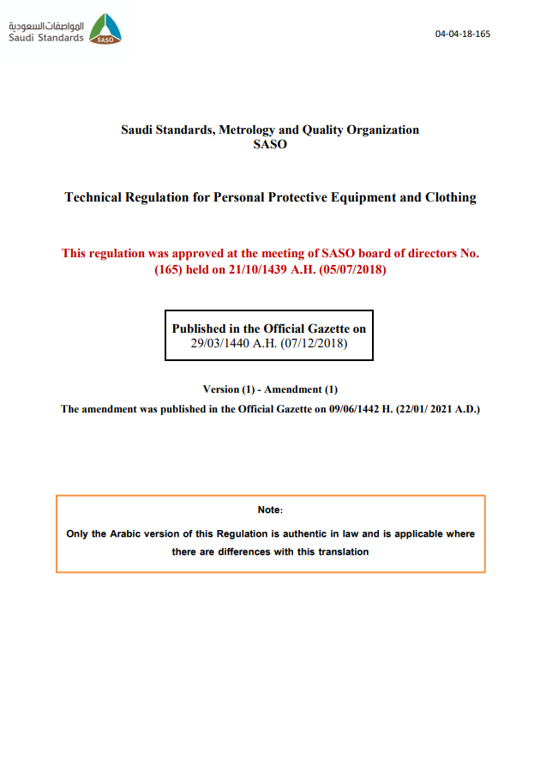
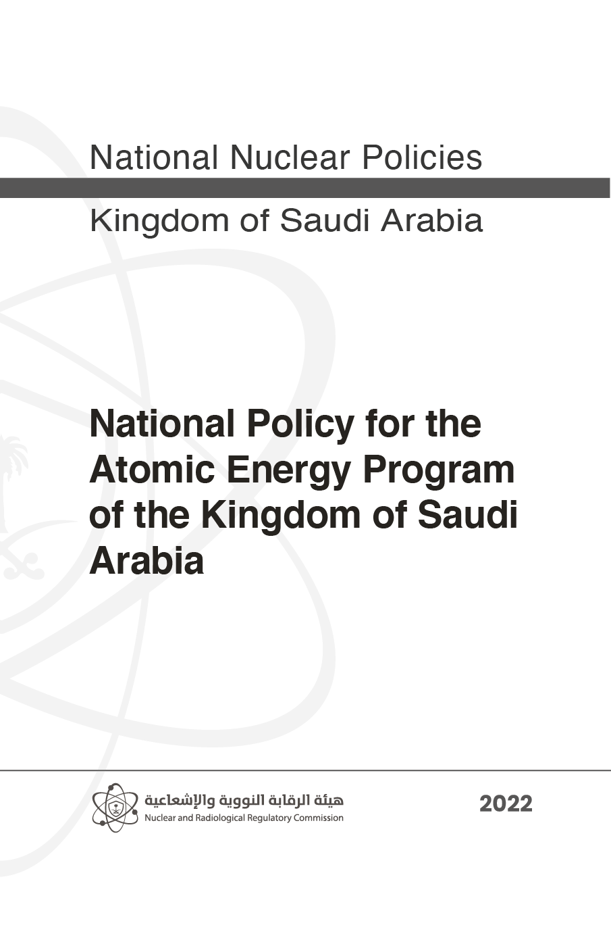
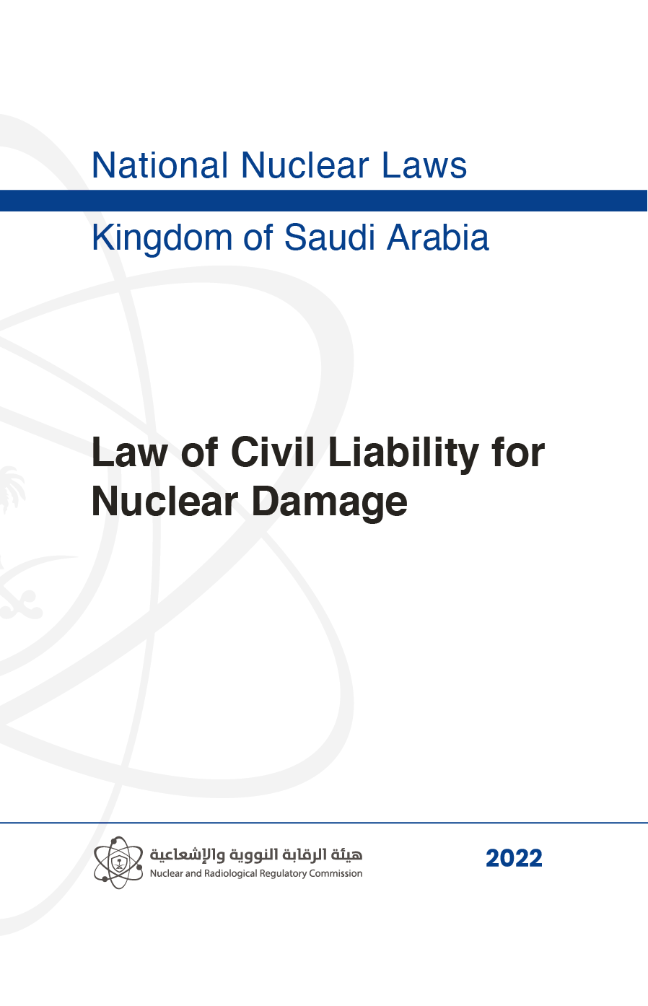
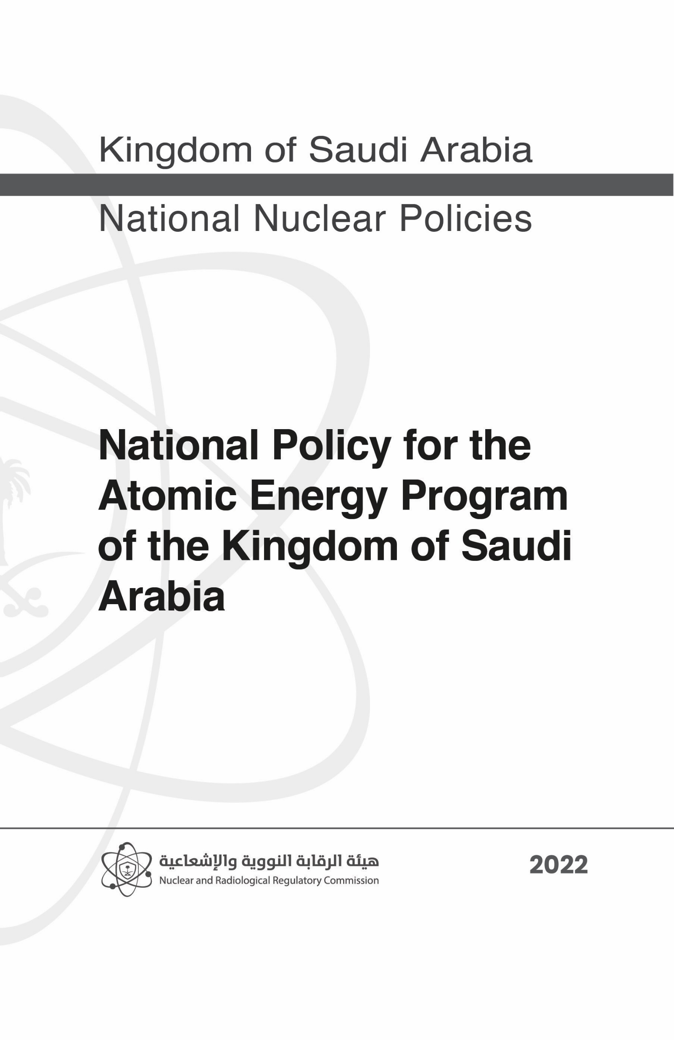
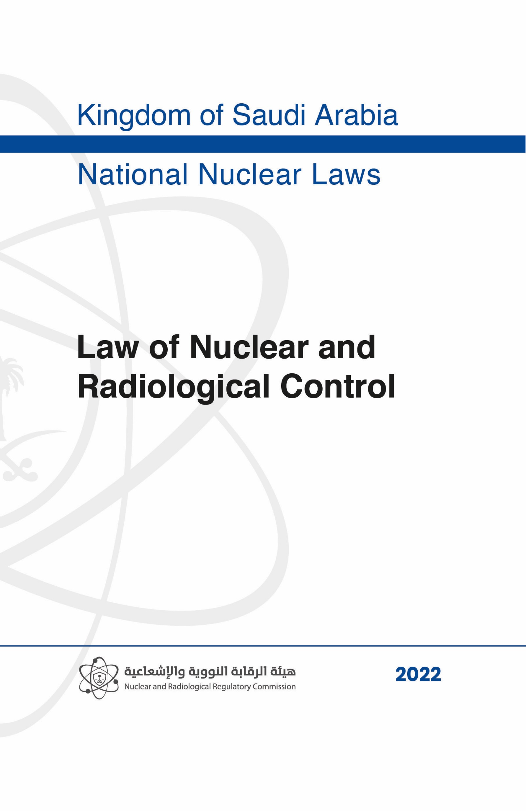
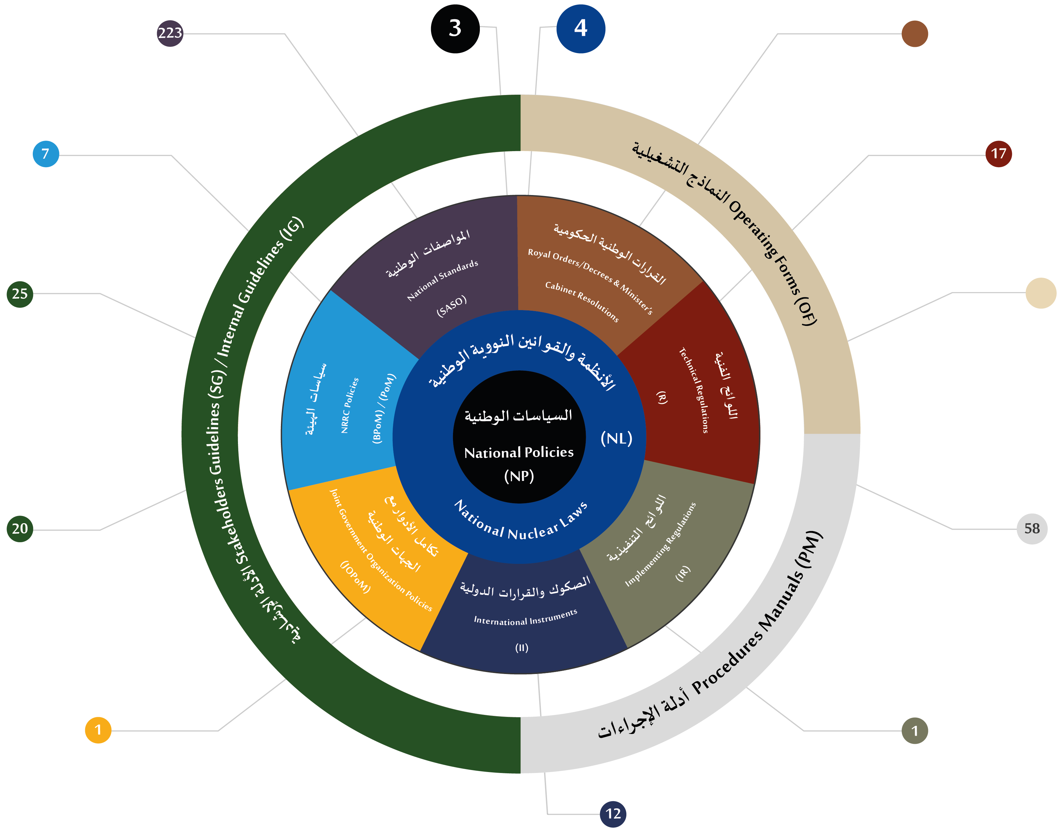
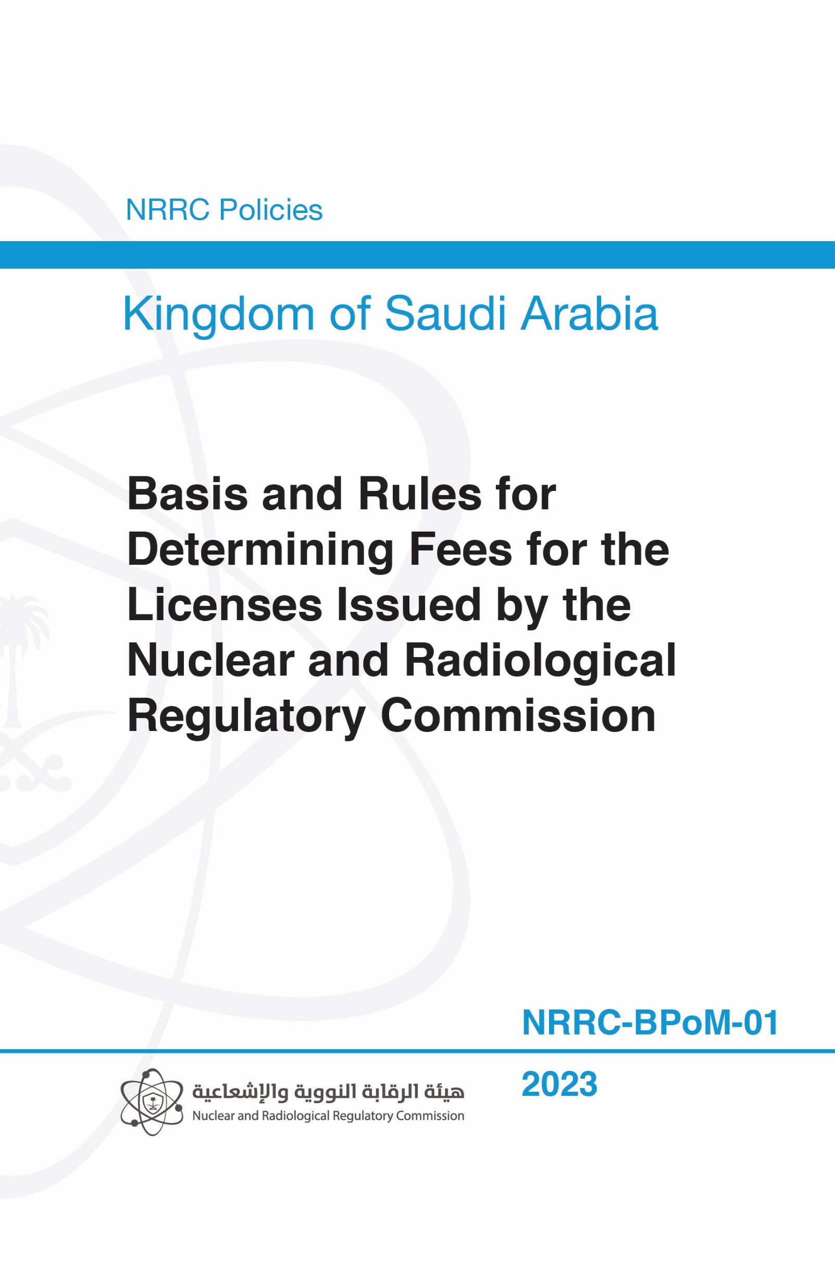
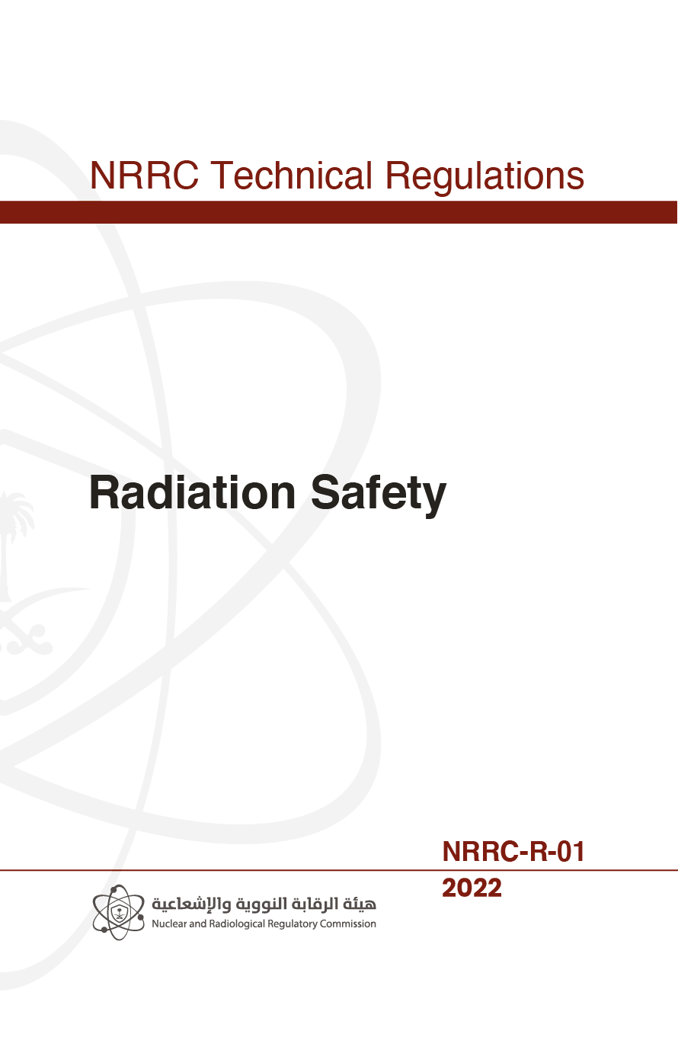
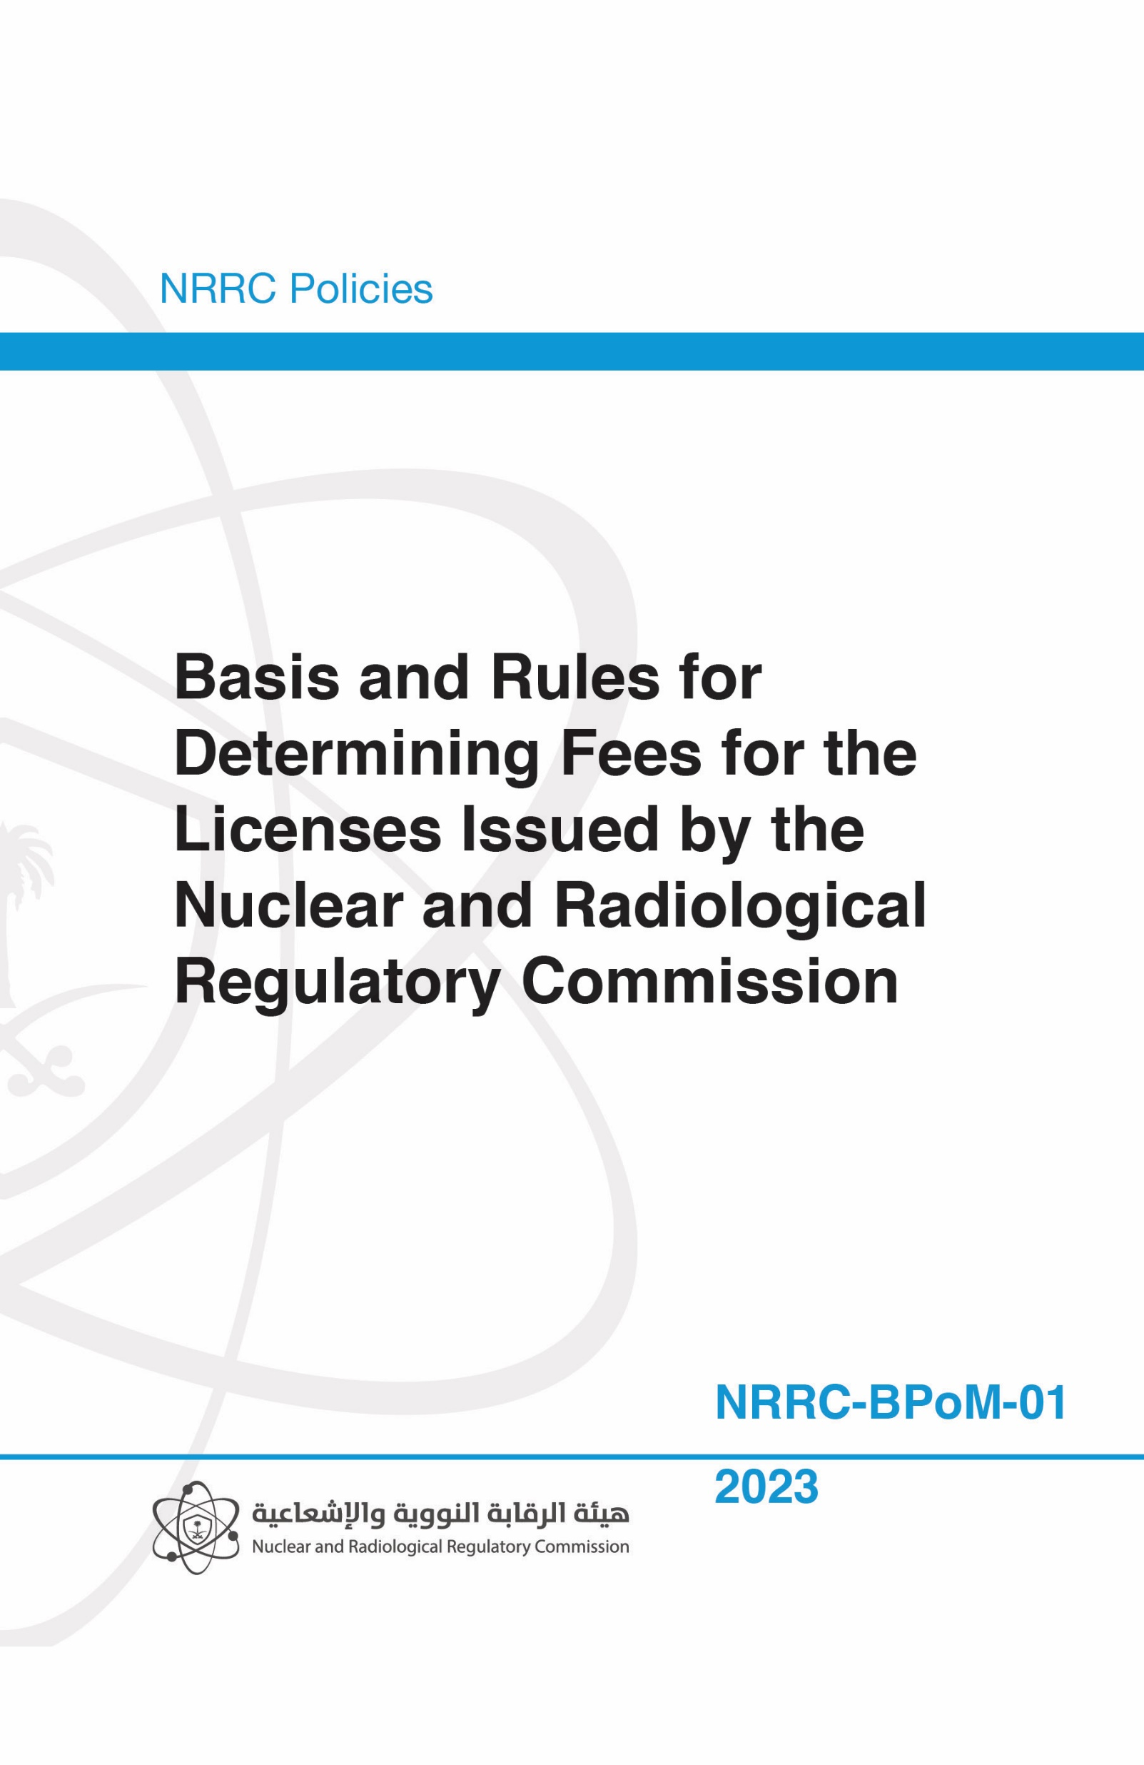
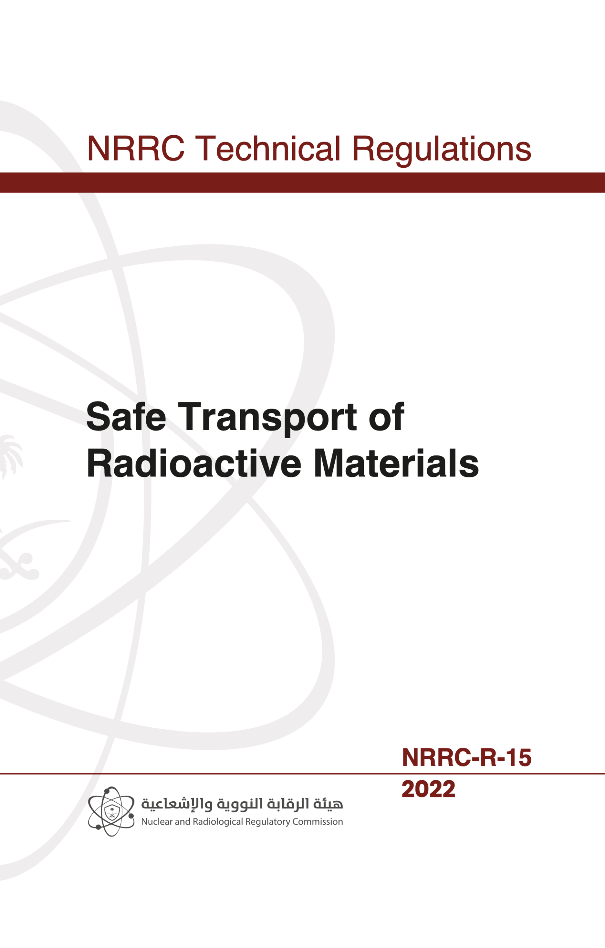
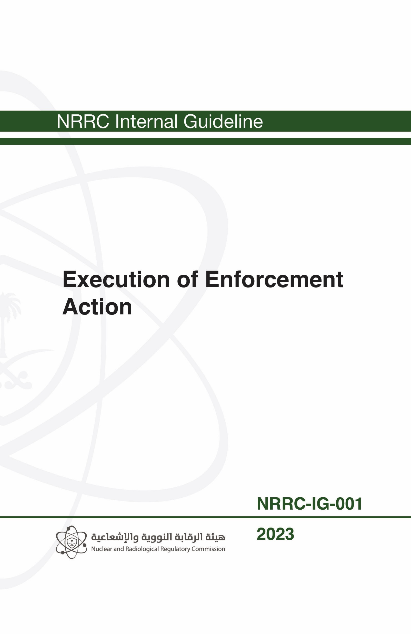
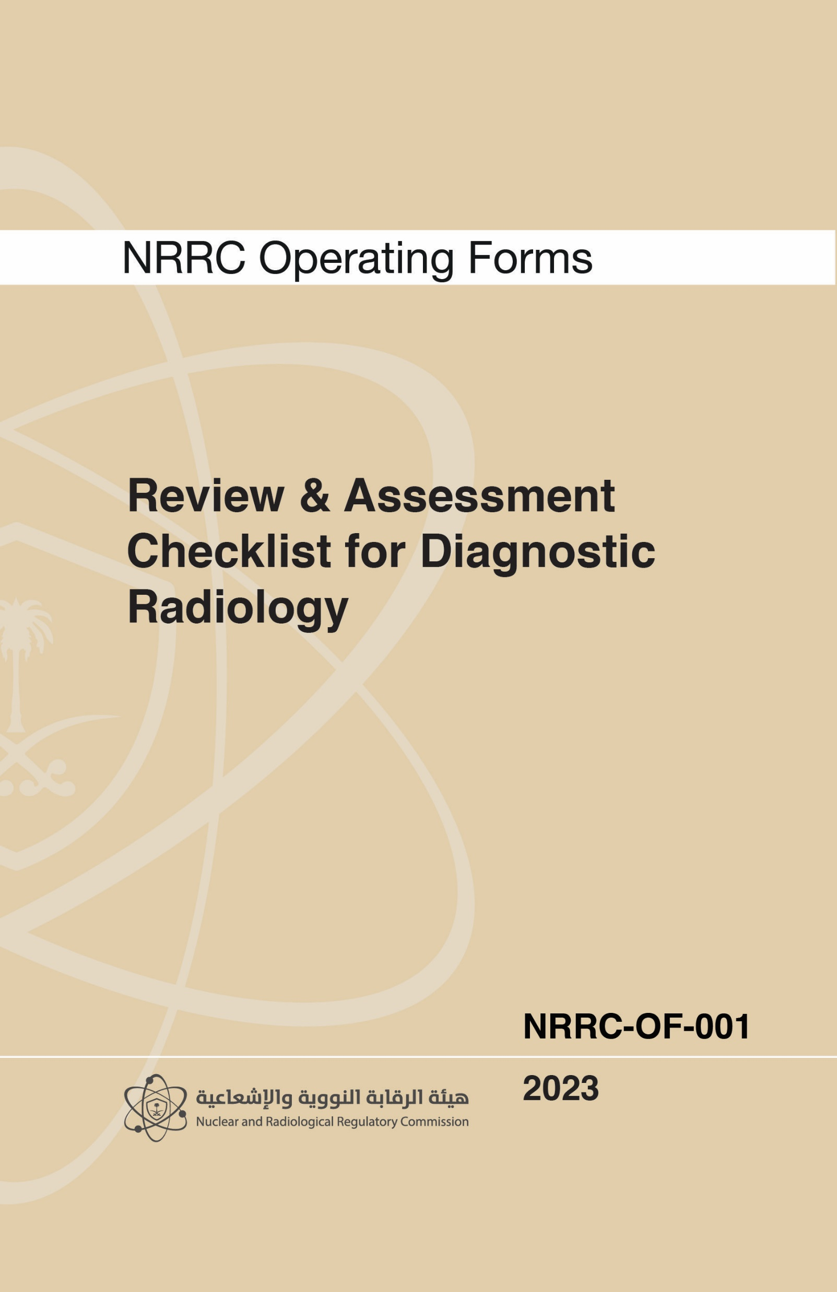
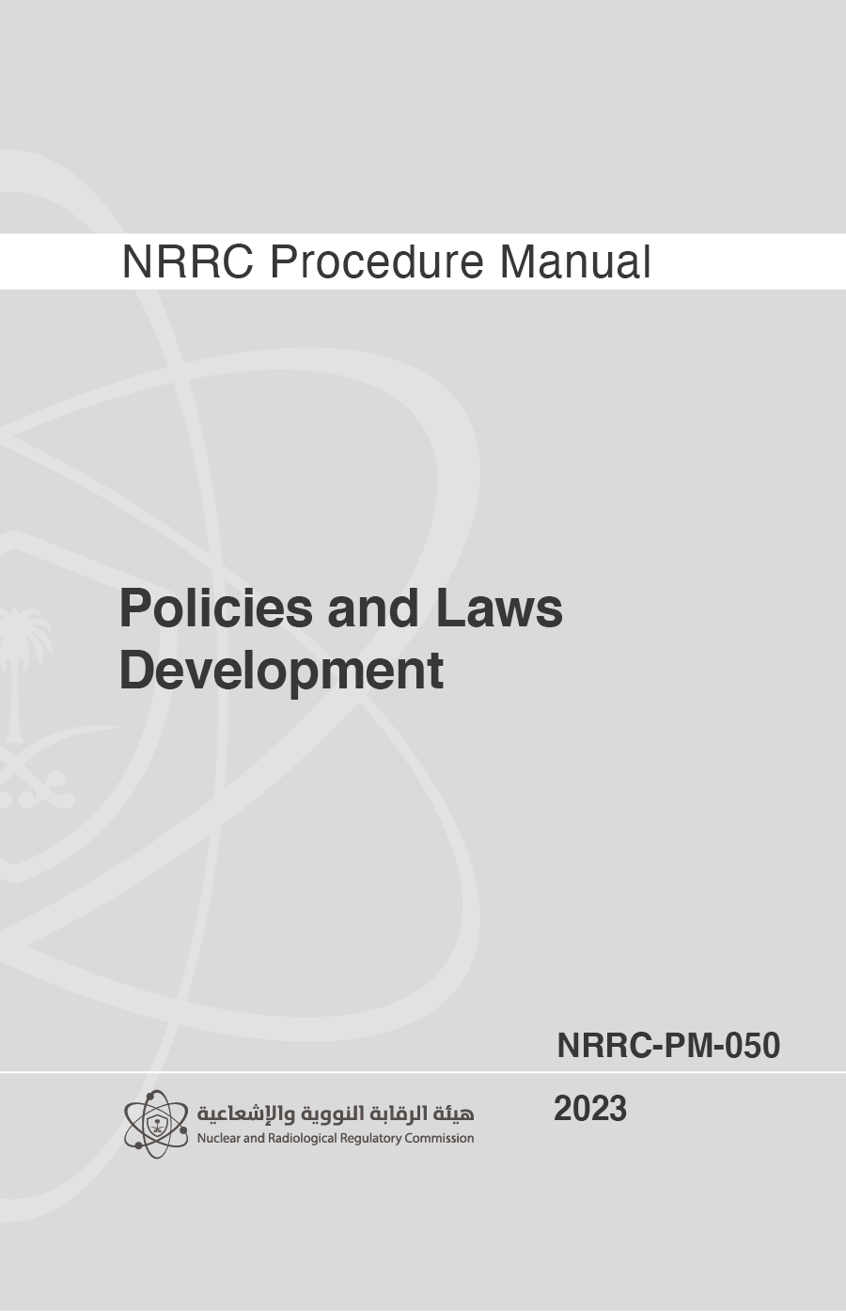
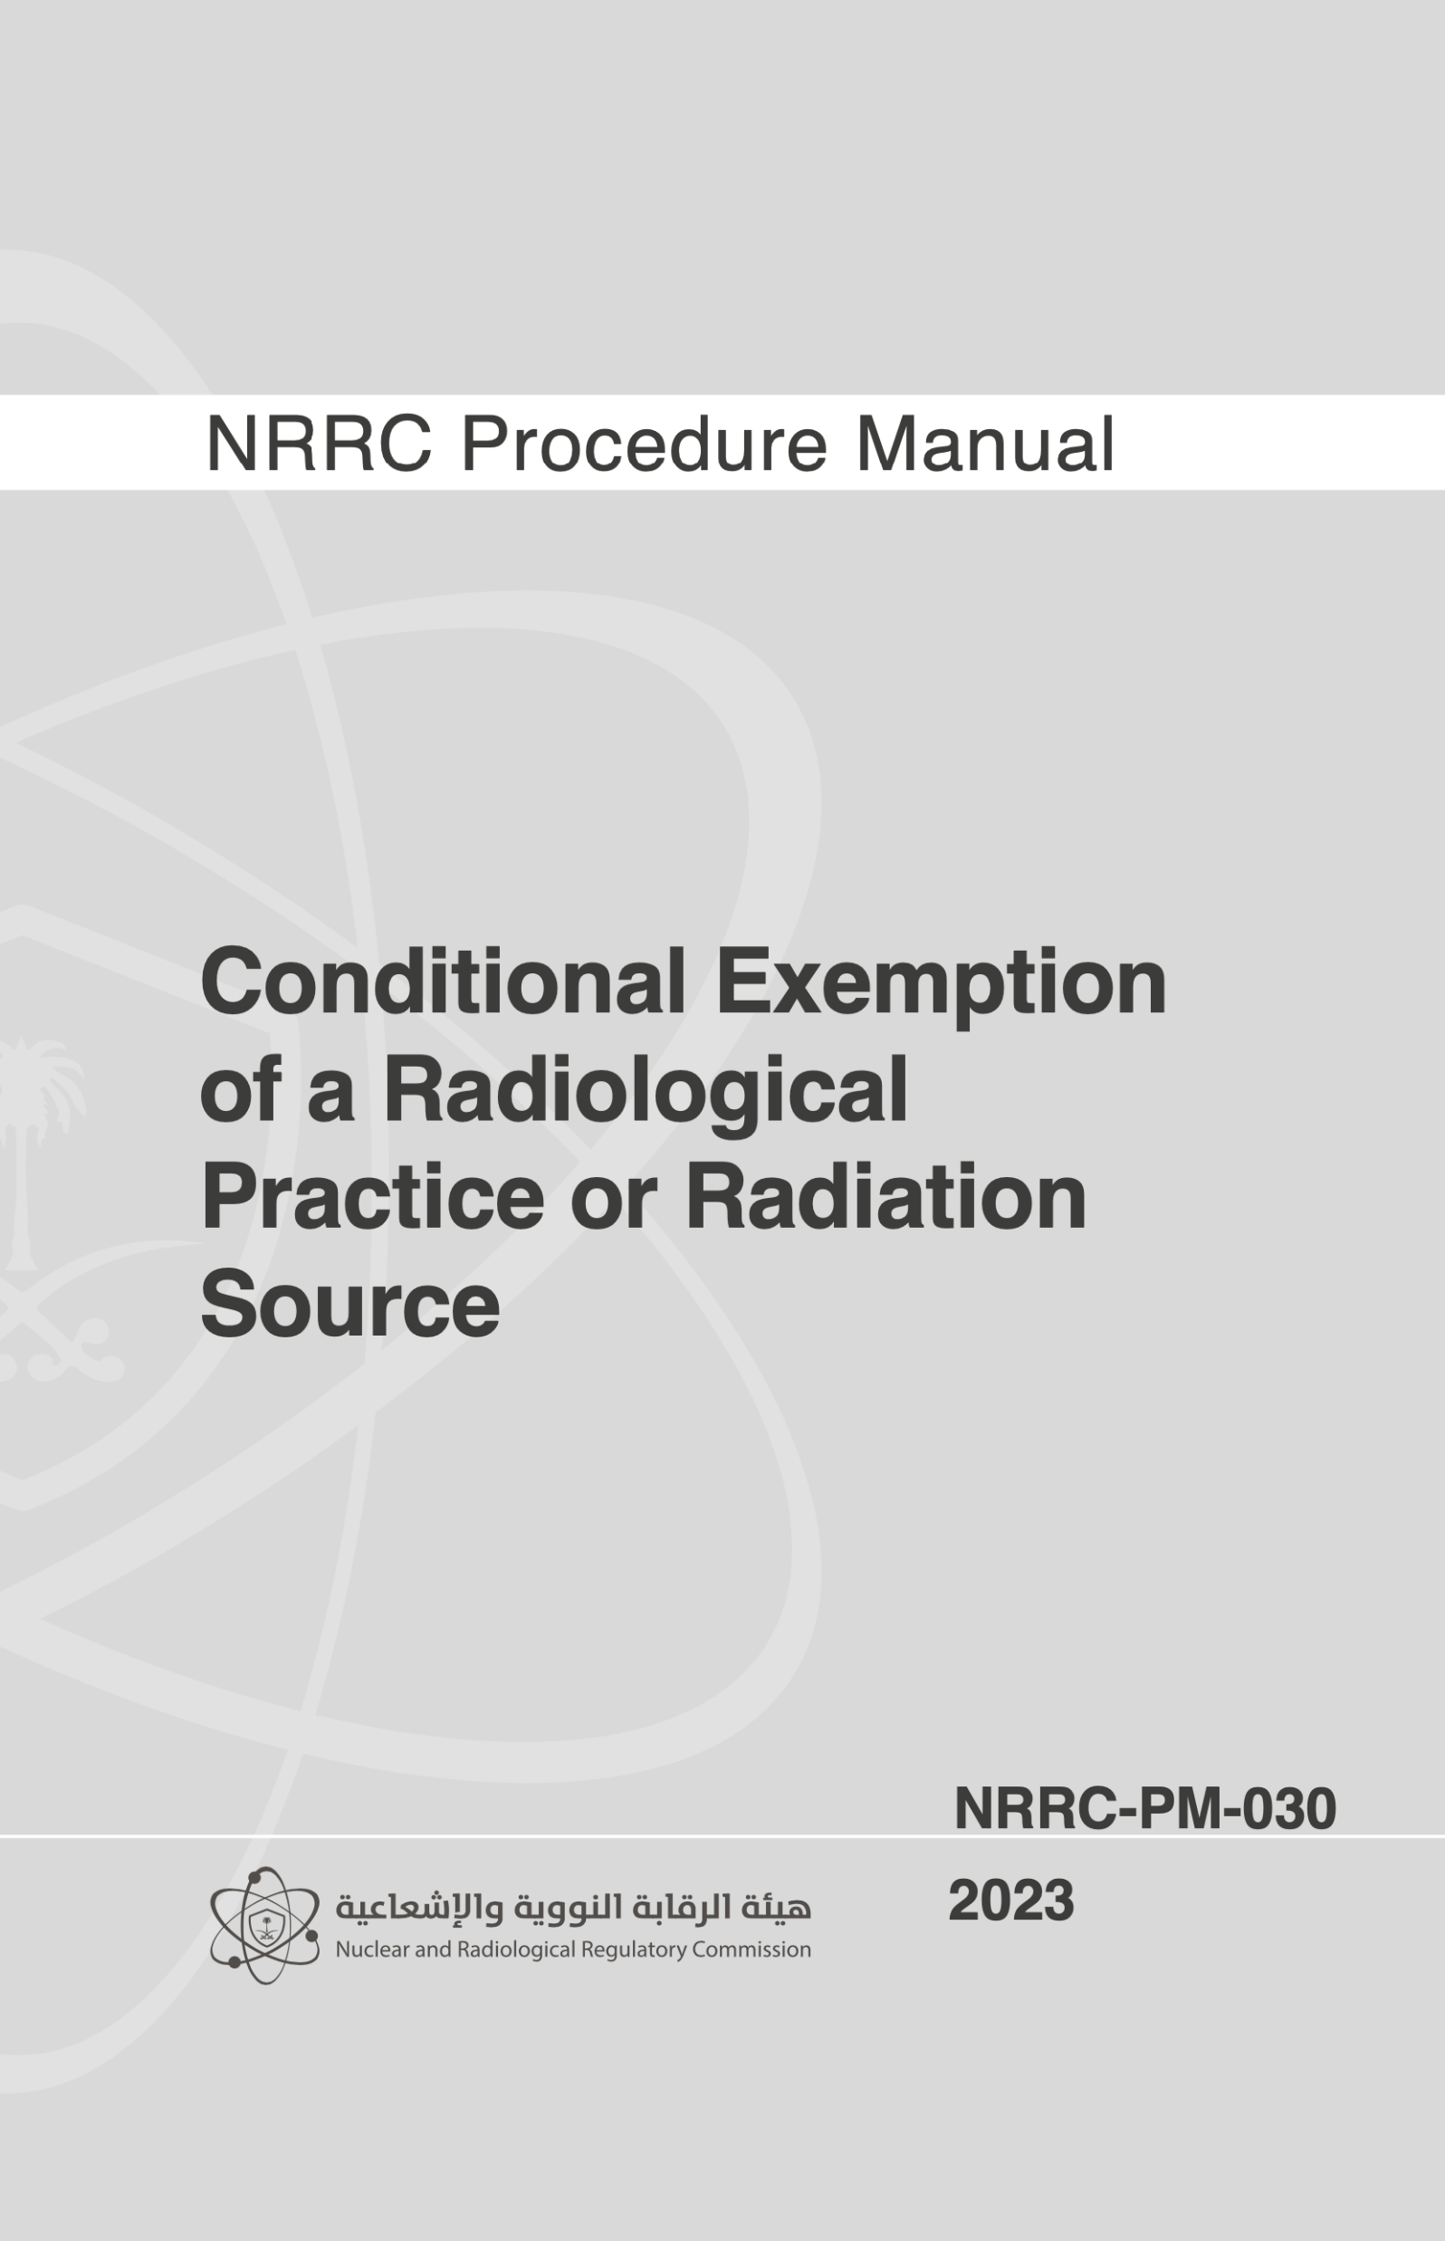
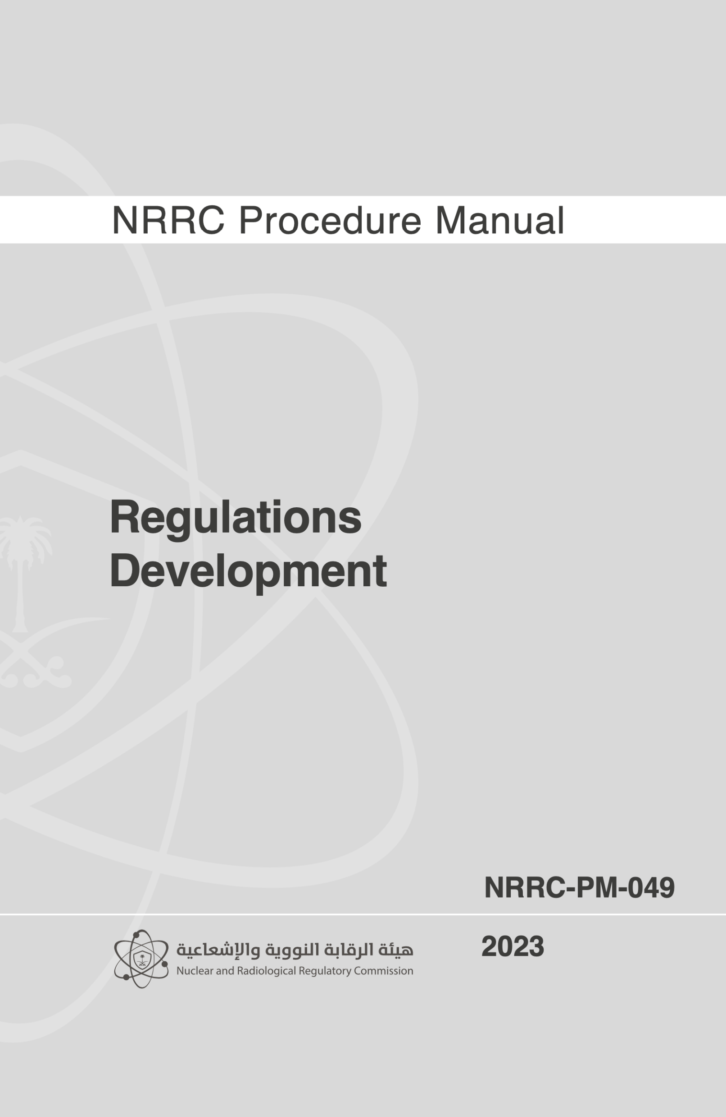
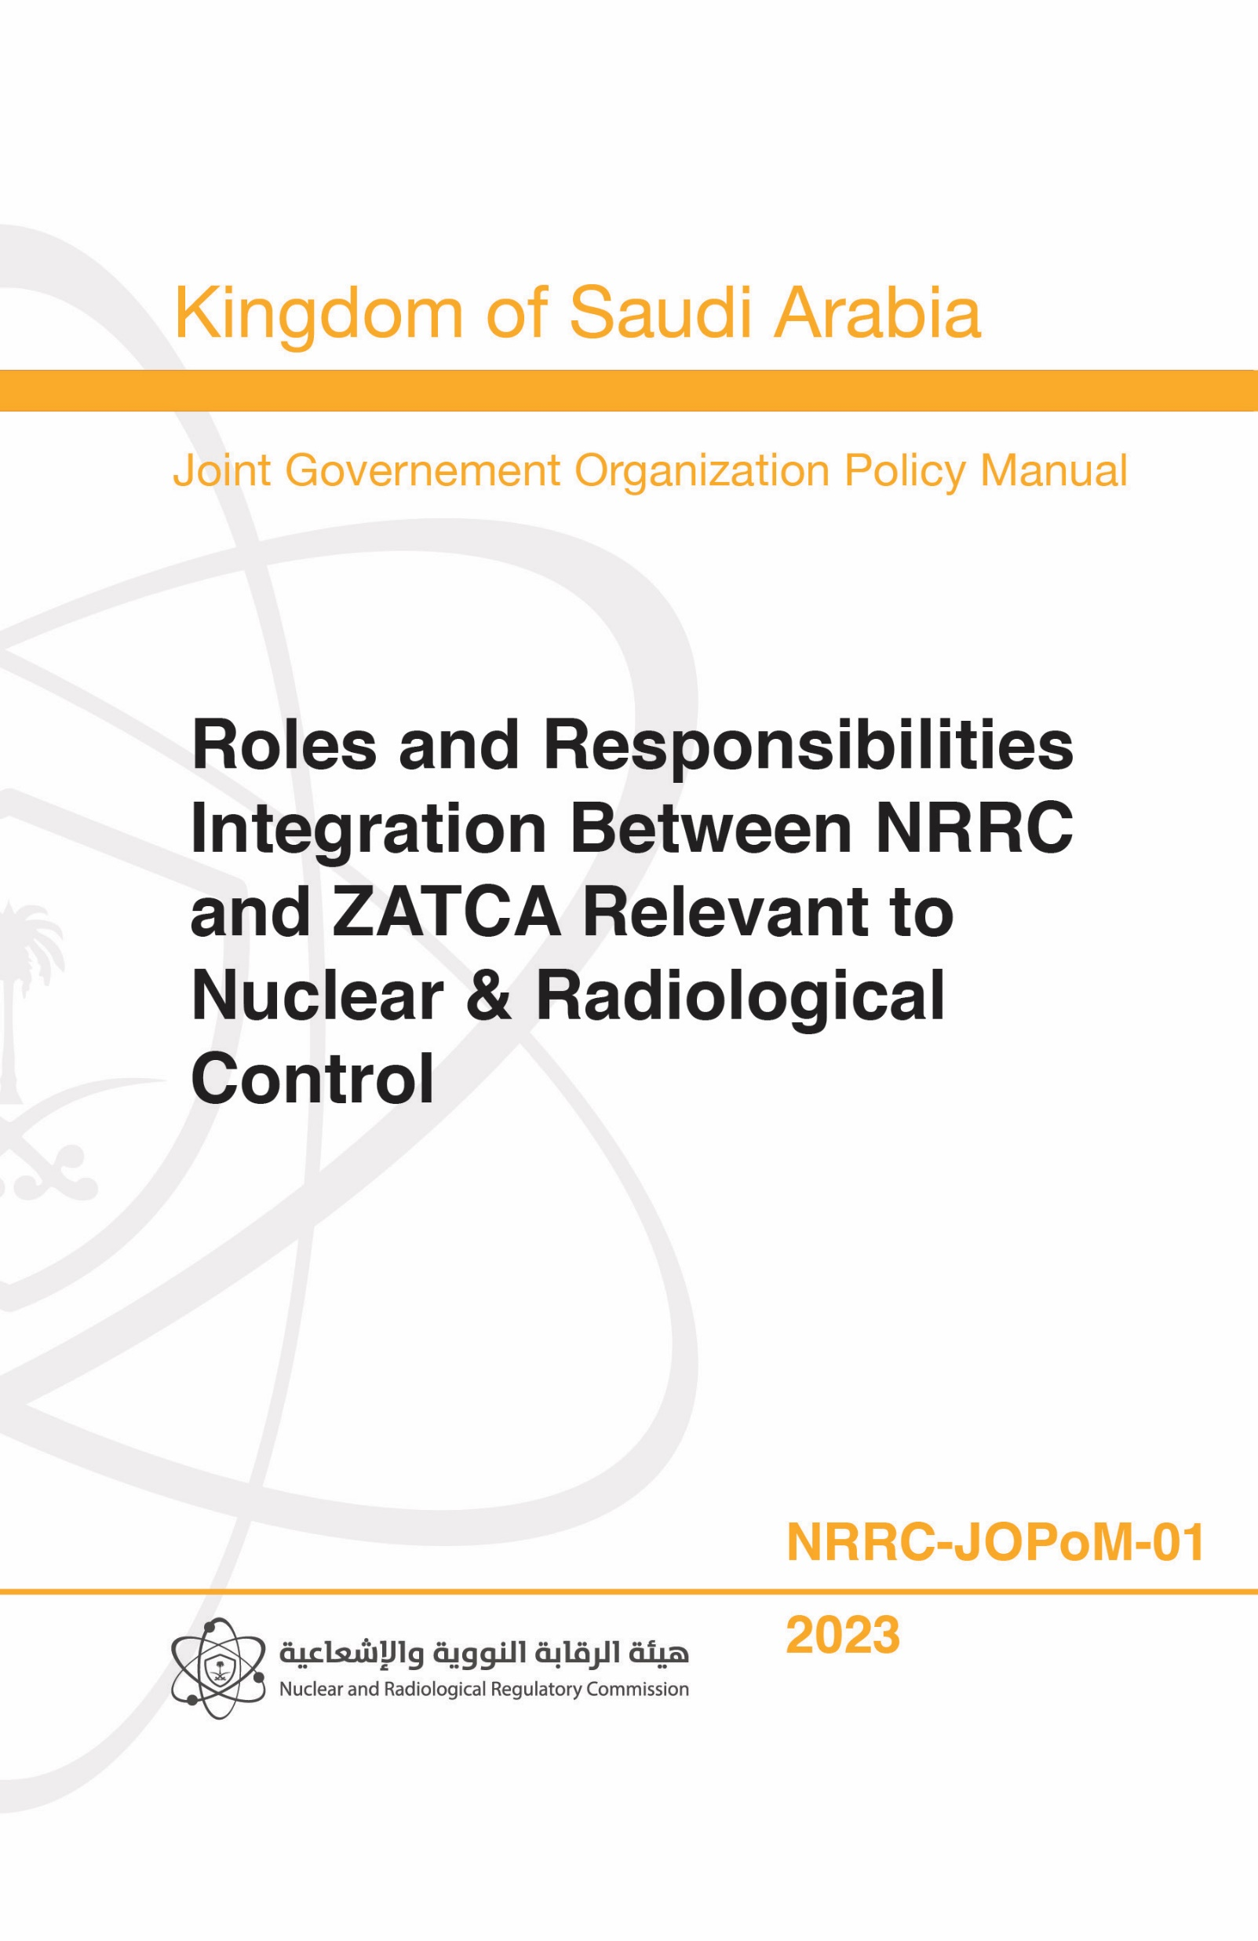
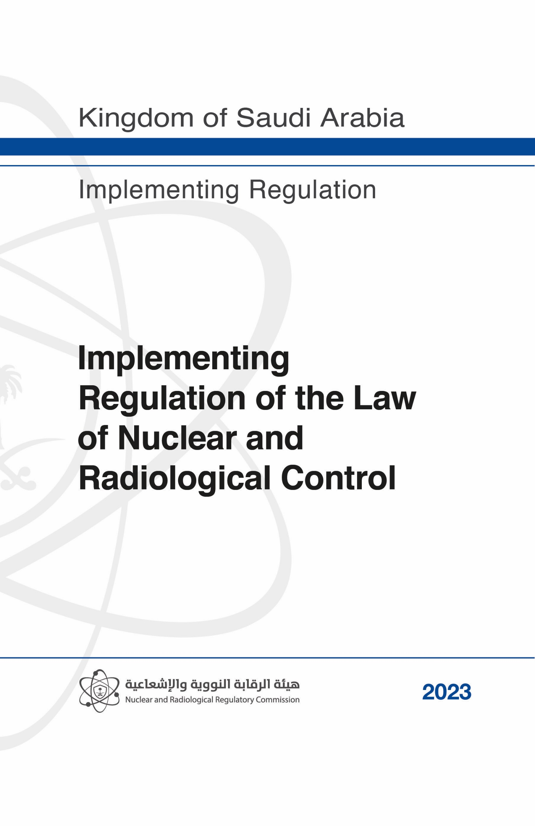
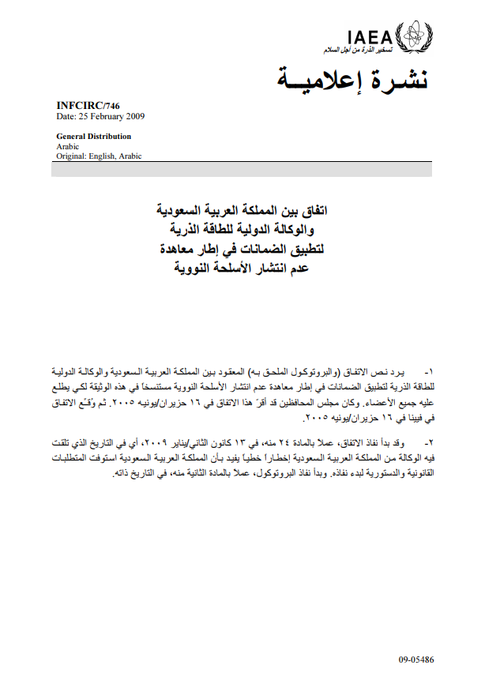
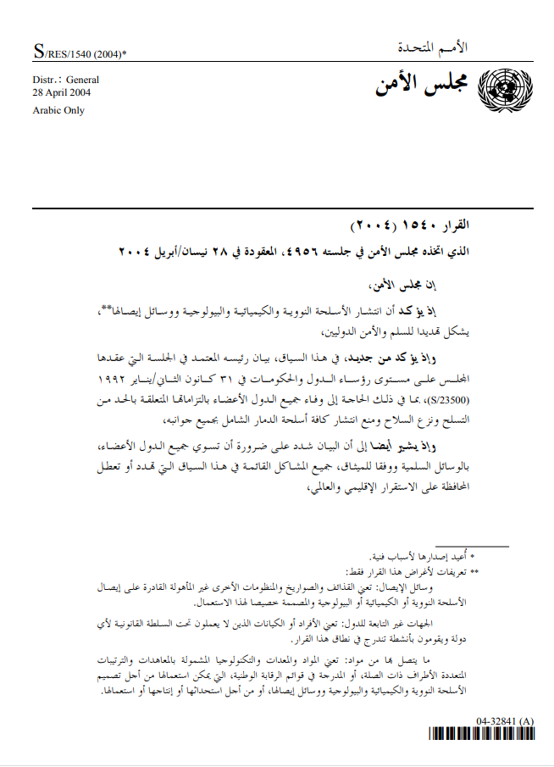
1
National Nuclear Legal Regulatory Framework

Slide 9
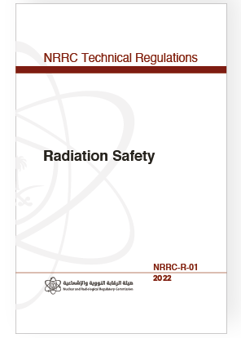
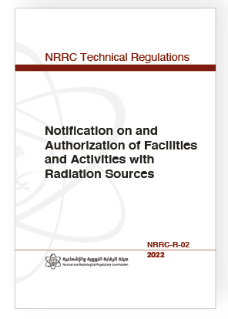
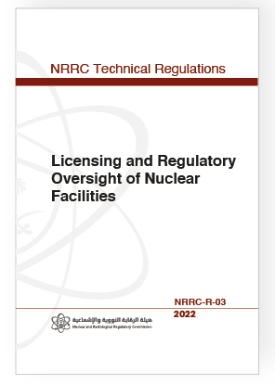
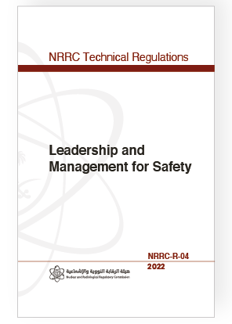
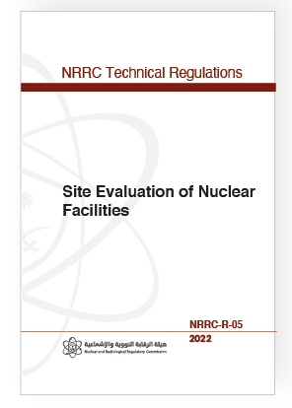
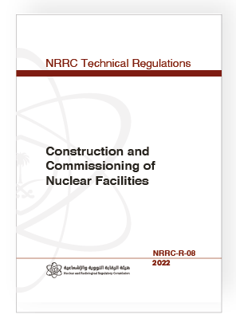
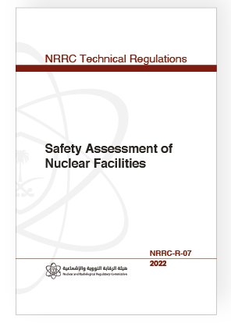
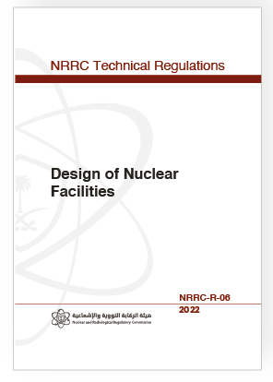
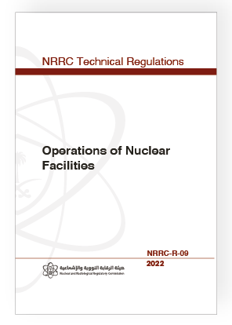
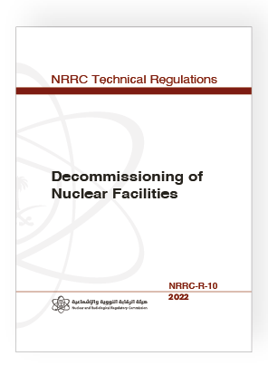
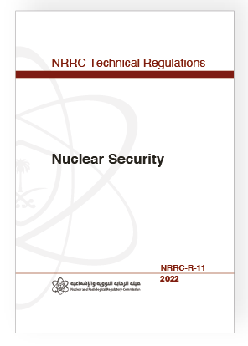
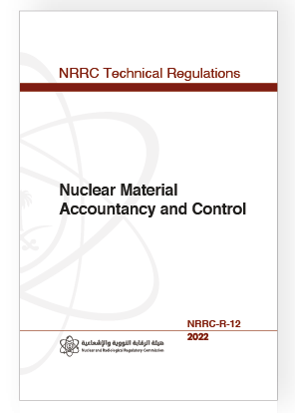
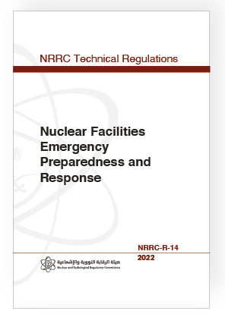
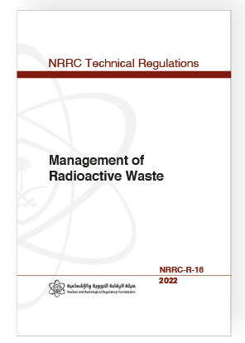
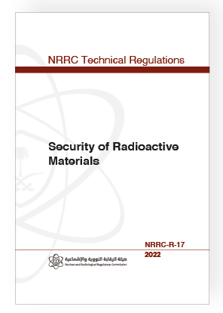
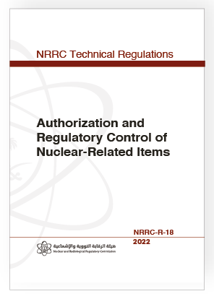
1
National Nuclear Legal Regulatory Framework
Notes:
In accordance with NRRC’s Laws, the NRRC has issued its technical regulations and approved them by its board of directors, - all of which are legally binding.
The NRRC is working on developing illustrative guides for its requirements - all of which are illustrative and not legally binding

Slide 10
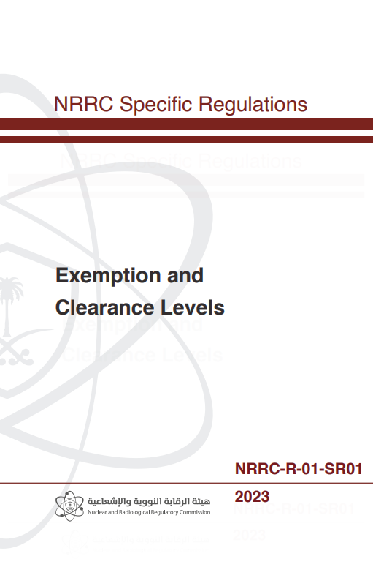
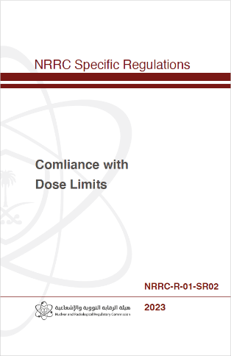
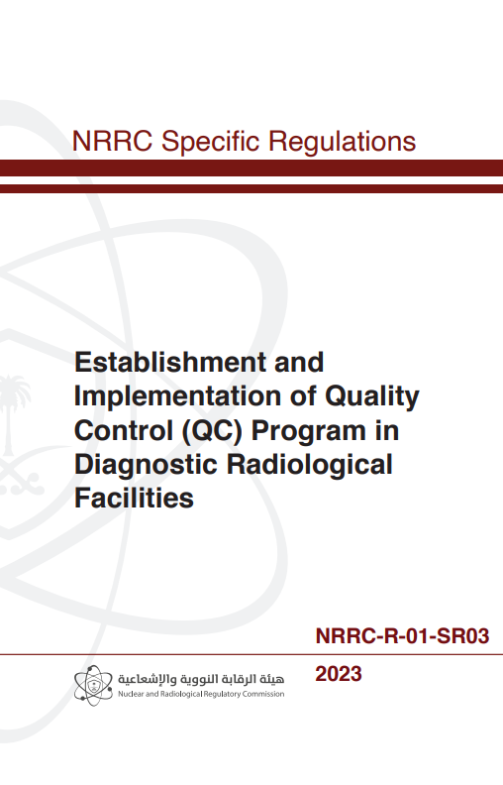
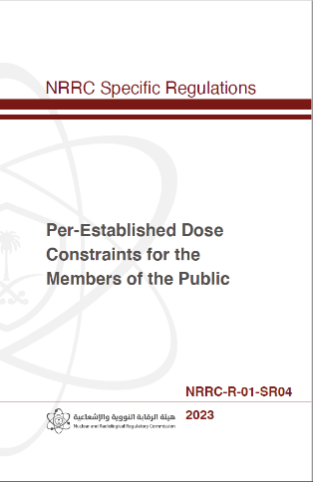
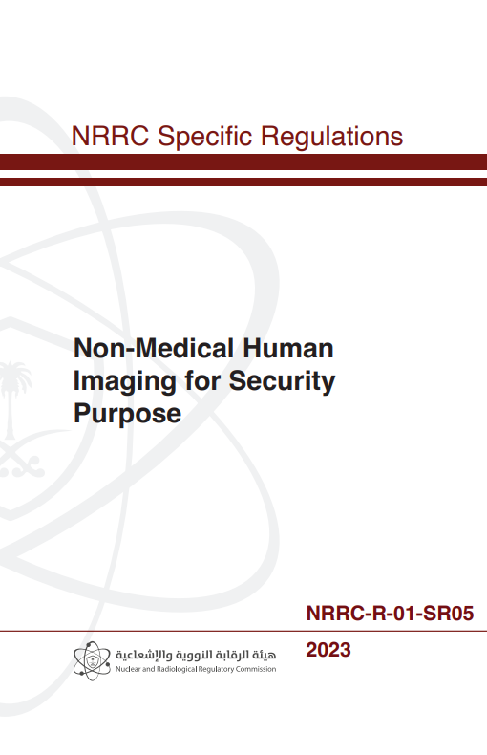
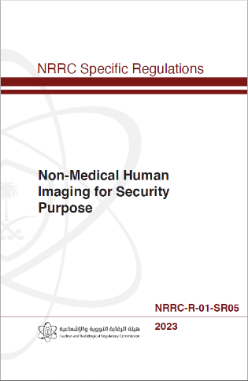
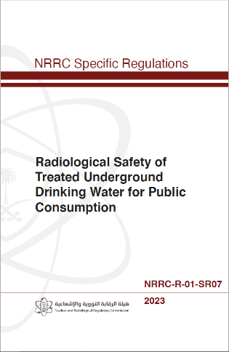
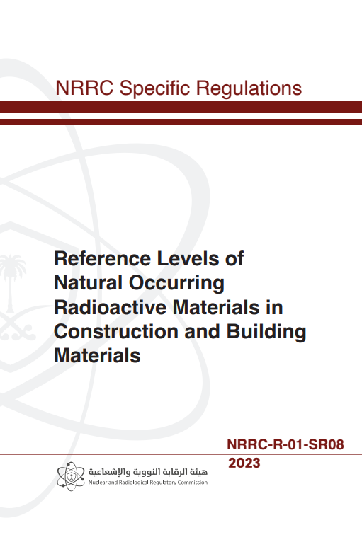
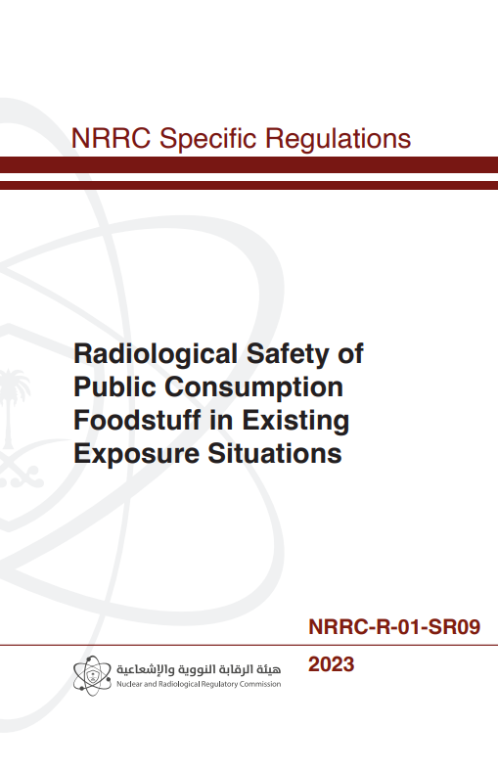
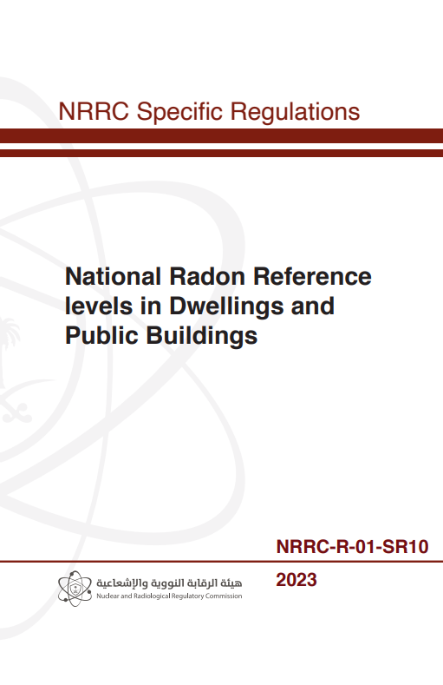
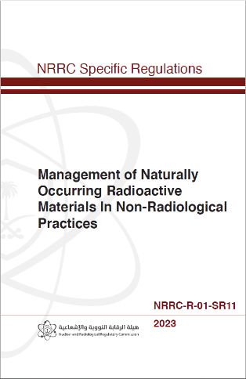
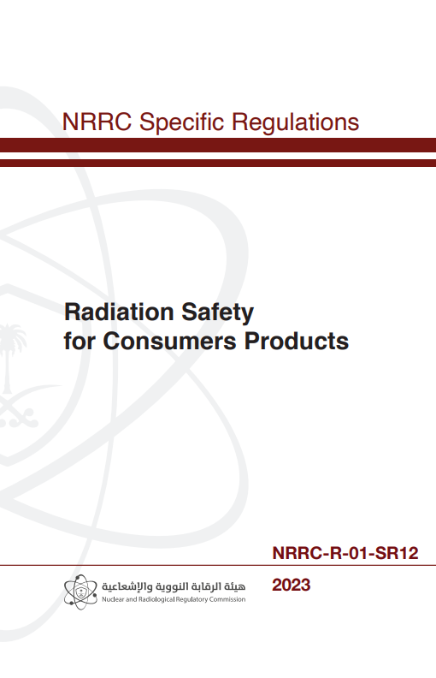
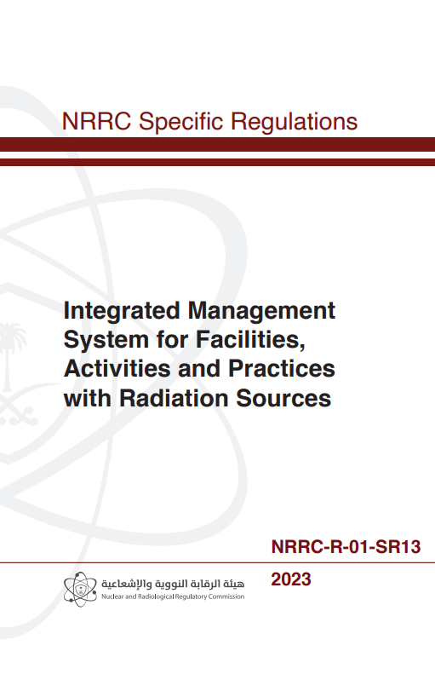
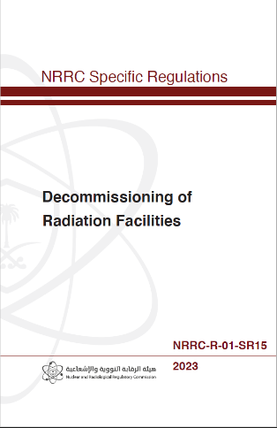
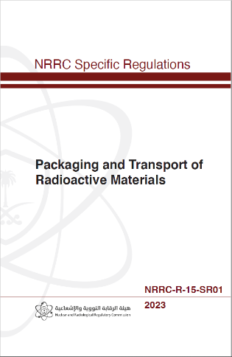

1
National Nuclear Legal Regulatory Framework
Notes:
In accordance with NRRC’s Laws, the NRRC has issued its technical regulations and approved them by its board of directors, - all of which are legally binding.
The NRRC is working on developing illustrative guides for its requirements - all of which are illustrative and not legally binding

Slide 11


















1
National Nuclear Legal Regulatory Framework
Notes:
In accordance with NRRC’s Laws, the NRRC has issued its technical regulations and approved them by its board of directors, - all of which are legally binding.
The NRRC is working on developing illustrative guides for its requirements - all of which are illustrative and not legally binding

Slide 12
Human Capacity Building Program
2

Slide 13


2
HUMAN CAPACITY BUILDING PROGRAM WITHIN NRRC
1
National organized programmes to build national capacities in nuclear and radiological regulatory work
8 Events
300⁺ National Participations
2
NRRC's participations in capacity building programmes in nuclear and radiological regulatory work
155 ⁺
Events
1100⁺ Participations
3
NRRC's participations in the other organizations
7 Events
15⁺ Participations

Slide 14







2
HUMAN CAPACITY BUILDING PROGRAM WITHIN NRRC
Developing safety-conscious leaders within the NRRC is considered an ongoing process. This can be achieved by adopting the IAEA’s systematic approach and cultivating a culture that promotes safety-conscious leadership via the following methodologies:
2. DRAFTING OF NRRC TECHNICAL REGULATIONS
3. NRRC APPROACH TO DEVELOP LEADERSHIP AND MANAGEMENT FOR SAFETY
4. THE NRRC PERSONAL SKILLS DEVELOPMENT PROGRAM
5. DRAFTING A SERIES OF INTERNAL PROCEDURES
6. NRRC PROFICIENCY INSPECTION AND ENFORCEMENT PROGRAM
7. REVIEWING THE NATIONAL REPORTS IN THE NUCLEAR SAFETY CONVENTIONS
1. POLICY FOR HUMAN CAPACITY BUILDING AND LEADERS’ PROGRAM

Slide 15
1
POLICY FOR HUMAN CAPACITY BUILDING AND LEADERS’ PROGRAM
The purpose of the Kingdom’s Human Capability Development Program (HCDP) is to contribute to defining an approach for human capability development by enhancing the NRRC and the capacity of its resources to establish, implement, and maintain regulatory functions.
The policy is formulated to achieve the following objectives:
Provide qualified, capable, and competent members
Produce a high quality of work
Improve competence and productivity
Inculcate the organizational values and positive attitudes
Create value creation and value added
Provide direction for career advancement and motivation
Notes:
Establishing the NRRC policy for human capacity building and leaders’ program from Human Resources Department. The purpose of Policy of Human Capability Development Program to Perform an Effective Regulatory Functions is to define an approach for human capability development by enhancing NRRC’s and its individual resources’ capacity to establish, implement, and maintain regulatory functions to ensure the safety, security, and 6 Policy Manual for Human Capability Development Program to Perform an Effective Regulatory Functions safeguarding of peaceful nuclear applications in the Kingdom of Saudi Arabia. The scope of this policy manual is limited to human resource development framework implemented through the defined competency building program that contributes to overall effectiveness of regulatory functions of the NRRC. The competency building is developed based on systematic approach to training (SAT), implementation of effective knowledge management and recognition of Subject Matter Expert (SME) to ensure that the NRRC possess the capability and sustainable competencies required to carry out its responsibilities under the Commission Laws. Capacity building activity is a critical element in an NRRC since it determines the quality of human resources in accordance with the needs of economic development and nation building of the State. In line with the goal of the Human Capability Development Program (HCDP) [2] of the Kingdom, this Policy is formulated to achieve the following objectives:
Provide qualified, capable, and competent members.
Produce quality or high quality of work.
Improve competence and productivity.
Inculcate pure values and positive attitudes.
Creating value-creation and value-added.
Provide direction for career advancement and motivation.
The NRRC’s human resources department are the NRRC’s most valuable assets that can be increased in value through a well-defined and planned capacity building program. Every NRRC’s member needs to equip himself with the appropriate attitude, skills, and knowledge, through a planned competency development and continuous learning program activities. This Policy. outlines the strategic approach developed to assist NRRC in achieving the goals stated in its mission and vision in the field of nuclear and radiological safety, security, and safeguards.

Slide 16
2
DRAFTING OF NRRC TECHNICAL REGULATIONS
Notes:
NRRC staff participation in drafting of NRRC safety technical regulations pertaining to nuclear and radiological safety, and leadership and management for safety. The NRRC formed technical teams consisting of its employees to develop these regulations, taking into consideration the IAEA’s requirements. The NRRC then prepared an initial draft of each regulation through a strategic partnership with radiation and nuclear regulatory bodies in Finland (STUK) and South Korea (KINS). Each regulation was subsequently reviewed by international and local experts. After that, the NRRC communicated with relevant national authorities to discuss their opinions on these regulations. These authorities included, but were not limited to, the Ministry of Environment, Water and Agriculture, King Abdulaziz City for Science and Technology, King Abdullah City for Atomic and Renewable Energy, the National Meteorology Center, Saudi Aramco, and others. Moreover, NRRC staff participation in drafting The NRRC Leadership and Management for Safety Technical Regulation (NRRC-R-04) [3] which embodies a strong safety culture aimed to be developed and sustained across NRRCs involved in various stages of nuclear facilities, including their site evaluation, design, construction, commissioning, operation, and decommissioning.

Slide 17
2
DRAFTING OF NRRC TECHNICAL REGULATIONS
NRRC Regulations Development and Approval Process
Formation of technical teams from the NRRC to develop the technical regulations, considering IAEA Safety Standards Series, IAEA Nuclear Security Serie, IAEA Safeguards Information Series
Developing the primary documents for each technical regulation (Document Preparation Profile - DPP)
Many international partners have contributed to the development of technical regulations, including similar regulatory bodies in other countries: STUK, NSSC, KINS, HAEA
IAEA expert review of the drafted technical regulations
Sharing drafts of technical regulations with many national agencies and stakeholders
The contribution of the international business sector to reviewing the technical regulations
The NRRC has published the technical regulations on the public consultation platform to enable national entities/stakeholders and individuals to express their views and observations
As final stage: NRRC Board of Directors to approve the regulations

Slide 18
3
NRRC APPROACH TO DEVELOP LEADERSHIP AND MANAGEMENT FOR SAFETY
NRRC ensures a systemic approach to leadership and management for safety, encouraging a strong and sustainable safety culture.
Everyone within the NRRC is expected to contribute to this robust safety culture.
Capacity building refers to a systematic approach to the use of education, training, exercises, awareness raising, workforce management, knowledge management and knowledge networks to develop and continuously improve the competences and capabilities necessary for establishing, implementing and sustaining an effective nuclear regulatory body competency and capability.
Notes:
NRRC ensures a systemic approach to leadership and management for safety, encouraging a strong and sustainable safety culture. Everyone within the NRRC is expected to contribute to this robust safety culture, where Capacity building refers to a systematic approach to the use of education, training, exercises, awareness raising, workforce management, knowledge management and knowledge networks to develop and continuously improve the governmental, organizational and individual Classification: Unclassified competences and capabilities necessary for establishing, implementing and sustaining an effective nuclear regulatory body competency and capability.

Slide 19






4
THE NRRC PERSONAL SKILLS DEVELOPMENT PROGRAM
NRRC adopts personal skills’ development programs
Several entities have been engaged in the development program as a partners
Developed primarily in accordance with the IAEA Safety Standards and with the specialized advanced courses
Objective: to enhance NRRC Theoretical and Practical knowledge and capabilities to independently regulate NRRC’s activities as well as enhancing the concept of developing conscious leaders
Notes:
The NRRC personal skills development program (i.e. NRRC 18-month training program). Developed primarily in accordance with the IAEA Safety Standards and with the specialized advanced courses. The program has been divided into three main levels which are:
Introductory Level:
Basic Course for Nuclear and Radiation Safety
Intermediate Level:
Intermediate Course for Nuclear and Radiation Safety
Advance Level:
Advanced Course for Nuclear and Radiation Safety OJT/OJP
Review & Assessment
Inspection
Therefore, the program main objective was to enhance NRRC Trainees’ theoretical and Practical knowledge and capabilities to independently regulate NRRC’s activities as well as enhancing the concept of developing conscious leaders.

Slide 20
4
THE NRRC PERSONAL SKILLS DEVELOPMENT PROGRAM
NRRC adopts a personal skills development program.
Several entities has been engaged in the development program as a partners.
Developed primarily in accordance with the IAEA Safety Standards and with the specialized advanced courses
Objective: to enhance NRRC Trainees’ Theoretical and Practical knowledge and capabilities to independently regulate NRRC’s activities as well as enhancing the concept of developing conscious leaders.
Examples are given:
Nuclear Industry College-IAEA Basic Safety in Nuclear Power Plants for Regulatory Authorities
IAEA Training Course on Leadership, Management and Culture for Safety
IAEA Interregional Training Course on safety aspects of Small Modular Reactors (SMRs)
KINS-IAEA Inter-Continental Workshop on the Safety of Research Reactor
IAEA International Conference on Topical Issues in Nuclear Installation Safety: Strengthening Safety of Evolutionary and Innovative Reactor Designs
KINS-IAEA Workshop in Support of Developing and Enhancing the Safety Infrastructure for a Nuclear Power Programme
IAEA TM on Digital Instrumentation and Control Systems for Research Reactors
IAEA TM on Operation, Maintenance and Ageing Management for Research Reactors
et cetera…
Notes:
The NRRC personal skills development program (i.e. NRRC 18-month training program). Developed primarily in accordance with the IAEA Safety Standards and with the specialized advanced courses. The program has been divided into three main levels which are:
Introductory Level:
Basic Course for Nuclear and Radiation Safety
Intermediate Level:
Intermediate Course for Nuclear and Radiation Safety
Advance Level:
Advanced Course for Nuclear and Radiation Safety OJT/OJP
Review & Assessment
Inspection
Therefore, the program main objective was to enhance NRRC Trainees’ theoretical and Practical knowledge and capabilities to independently regulate NRRC’s activities as well as enhancing the concept of developing conscious leaders.

Slide 21



5
DRAFTING A SERIES OF INTERNAL PROCEDURES
The NRRC initiated and drafted a series of internal procedures to train and enhance the performance and skills of its staff, in accordance with the (IAEA) guidance and leading regulatory authorities.
Notes:
The NRRC initiated and drafted a series of internal procedures to train and enhance the performance and skills of its staff. The plans involved identifying the training needs of the employees, establishing training protocols, and devising a comprehensive training plan focusing on technical, specialized, and personal skills development at the International Atomic Energy Agency (IAEA) and leading regulatory authorities in other countries. This further aids in expanding their competence and skill set as a Future Safety-Conscious Leaders.

Slide 22

6
NRRC PROFICIENCY INSPECTION AND ENFORCEMENT PROGRAM
The NRRC has bolstered its proficiency in inspection and enforcement by launching a comprehensive training program.
Developed in collaboration with various experts.
Combines academic lectures with hands-on experiences to sharpen the skills of inspectors.
The approach empowers them to achieve top-tier expertise in the field of nuclear and radiological inspections.
Notes:
The NRRC has bolstered its proficiency in inspection and enforcement by launching a comprehensive training program. Developed in collaboration with various experts, this three-tiered program combines academic lectures with hands-on experiences to sharpen the skills of inspectors. This approach empowers them to achieve top-tier expertise in the field of nuclear and radiological inspections.

Slide 23

7
REVIEWING THE NATIONAL REPORTS IN THE
CONVENTION OF NUCLEAR SAFETY
The NRRC staff has participated in drafting and reviewing the national and other Member States’ reports in relation to the Convention of Nuclear Safety and The Joint Convention on the Safety of Spent Fuel Management. The NRRC presented the national reports for the Kingdom of Saudi Arabia and reviewed the efforts of other states to fulfill Saudi Arabia’s obligation as a Contracting Party.
Notes:
The NRRC staff has participated in drafting and reviewing the national and other Member States’ reports in relation to the Convention of Nuclear Safety. The NRRC presented the national report for the Kingdom of Saudi Arabia and reviewed the efforts of the Kingdom and its actions to fulfill its obligations as a contracting party to the Nuclear Safety Convention. The presentation included the following achievements:
Review of the regulatory and legislative framework for the national nuclear program within the National Atomic Energy Project.
Review of the national policies in the nuclear and radiation field, and the regulatory technical regulations adopted by the NRRC within its regulatory framework.
Review the effective role of the NRRC as an independent regulatory body within the National Atomic Energy Project.
Review of the current stage of the National Atomic Energy Project which submitted to the NRRC by Duwayhin Nuclear Energy Company (the owner/operator of the nuclear power plant), and the efforts made by the NRRC to verify compliance with nuclear safety requirements.
Review of the capabilities of the Nuclear and Radiological Regulatory Commission in preparedness and response to nuclear emergencies and radiation monitoring, and the Kingdom's participation in the international exercise ConvEx-3, organized by the International Atomic Energy Agency for a severe nuclear emergency scenario.
Review of the technical missions of the International Atomic Energy Agency to the Kingdom, which included the Integrated Regulatory Review Service (IRRS) and the Integrated Nuclear Infrastructure Review (INIR), and the technical efforts of the Kingdom to enhance and improve the effectiveness of its nuclear and radiation safety regulatory infrastructure.

Slide 24
Conclusion
The development of future safety-conscious leaders at the NRRC is governed via a policy for human capacity building and leadership programs from the human resources department that take into consideration the IAEA’s systematic approach.
This approach involves implementing specific strategies and practices that contribute to leaders’ personal growth and awareness.
Safety-Conscious leaders have engaged in drafting the NRRC’s safety technical regulations and have participated in a series of internal procedures to train and enhance their performance and skills through a strategic partnership with world-leading institutes and regulatory bodies. Moreover, targeted training aspects in nuclear leadership for safety were utilized as well.
Taking into consideration that this is a continuous process, the NRRC is engaging its safety-conscious leaders in other relevant activities such as participating at developing the national safety reports with NRRC expertise to ensure that they gain the needed knowledge.
Notes:
The NRRC staff has participated in drafting and reviewing the national and other Member States’ reports in relation to the Convention of Nuclear Safety. The NRRC presented the national report for the Kingdom of Saudi Arabia and reviewed the efforts of the Kingdom and its actions to fulfill its obligations as a contracting party to the Nuclear Safety Convention. The presentation included the following achievements:
Review of the regulatory and legislative framework for the national nuclear program within the National Atomic Energy Project.
Review of the national policies in the nuclear and radiation field, and the regulatory technical regulations adopted by the NRRC within its regulatory framework.
Review the effective role of the NRRC as an independent regulatory body within the National Atomic Energy Project.
Review of the current stage of the National Atomic Energy Project which submitted to the NRRC by Duwayhin Nuclear Energy Company (the owner/operator of the nuclear power plant), and the efforts made by the NRRC to verify compliance with nuclear safety requirements.
Review of the capabilities of the Nuclear and Radiological Regulatory Commission in preparedness and response to nuclear emergencies and radiation monitoring, and the Kingdom's participation in the international exercise ConvEx-3, organized by the International Atomic Energy Agency for a severe nuclear emergency scenario.
Review of the technical missions of the International Atomic Energy Agency to the Kingdom, which included the Integrated Regulatory Review Service (IRRS) and the Integrated Nuclear Infrastructure Review (INIR), and the technical efforts of the Kingdom to enhance and improve the effectiveness of its nuclear and radiation safety regulatory infrastructure.

Slide 25
References
IAEA, Systematic Approach to Training for Nuclear Facility Personnel: Processes, Methodology and Practices, VIENNA: The International Atomic Energy Agency, 2021.
NRRC, Policy Manual for Human Capability Development Program to Perform an Effective Regulatory Functions, Riyadh, Kingdom of Saudi Arabia: Nuclear and Radiological Regulatory Commission (NRRC), 2023.
NRRC, Leadership and Management for Safety, Riyadh, Kingdom of Saudi Arabia: Nuclear and Radiological Regulatory Commission (NRRC), 2022.
Notes:
The NRRC staff has participated in drafting and reviewing the national and other Member States’ reports in relation to the Convention of Nuclear Safety. The NRRC presented the national report for the Kingdom of Saudi Arabia and reviewed the efforts of the Kingdom and its actions to fulfill its obligations as a contracting party to the Nuclear Safety Convention. The presentation included the following achievements:
Review of the regulatory and legislative framework for the national nuclear program within the National Atomic Energy Project.
Review of the national policies in the nuclear and radiation field, and the regulatory technical regulations adopted by the NRRC within its regulatory framework.
Review the effective role of the NRRC as an independent regulatory body within the National Atomic Energy Project.
Review of the current stage of the National Atomic Energy Project which submitted to the NRRC by Duwayhin Nuclear Energy Company (the owner/operator of the nuclear power plant), and the efforts made by the NRRC to verify compliance with nuclear safety requirements.
Review of the capabilities of the Nuclear and Radiological Regulatory Commission in preparedness and response to nuclear emergencies and radiation monitoring, and the Kingdom's participation in the international exercise ConvEx-3, organized by the International Atomic Energy Agency for a severe nuclear emergency scenario.
Review of the technical missions of the International Atomic Energy Agency to the Kingdom, which included the Integrated Regulatory Review Service (IRRS) and the Integrated Nuclear Infrastructure Review (INIR), and the technical efforts of the Kingdom to enhance and improve the effectiveness of its nuclear and radiation safety regulatory infrastructure.

Slide 26


Thank you

