Slide 1
Leadership, safety culture and project dynamics in Finnish nuclear new builds
Kaupo Viitanen (VTT)
Teemu Reiman (Lilikoi)
Sami Karadeniz (VTT)

Slide 2
Content
Finnish nuclear new builds
Background
Project dynamics, leadership and safety culture
Illustrative findings from SAFER2028 SCALA research project

Slide 3
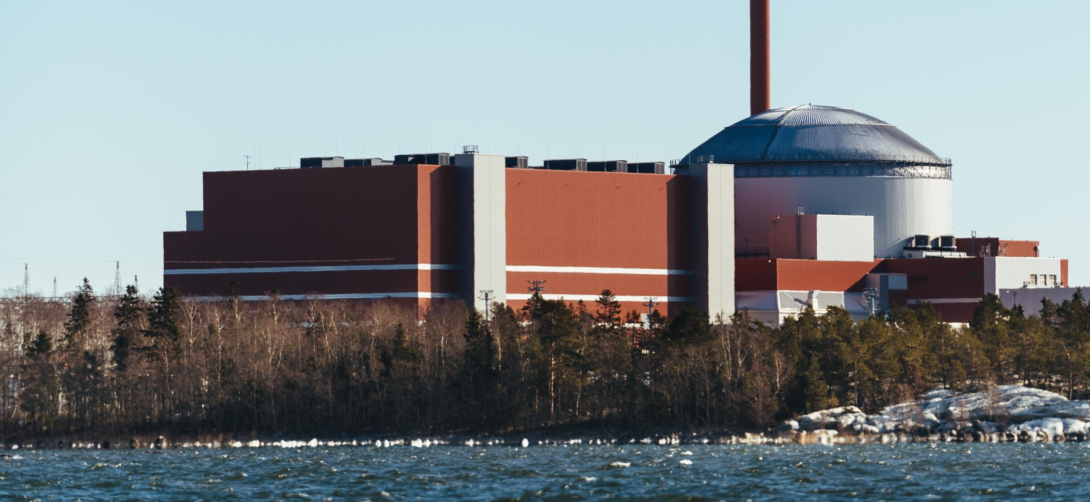
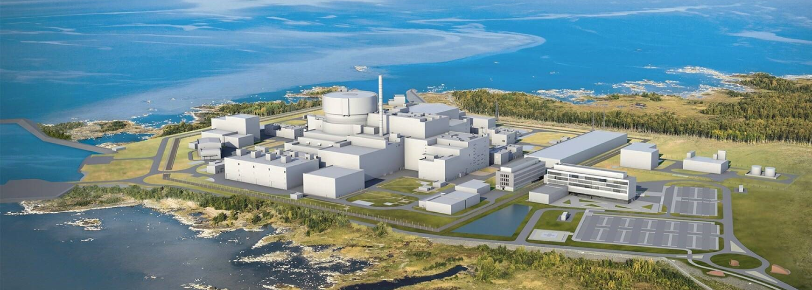
Recent Finnish new build projects
Picture © TVO
TVO Olkiluoto 3 nuclear power plant project (Framatome EPR 1600 MW) started in 2000 and was brought to commercial operation in 2023
5th Finnish nuclear power reactor
Fennovoima Hanhikivi 1 nuclear power plant project (Rosatom VVER-1200) started in 2009 but was terminated in 2022
Picture © Fennovoima

Slide 4
SAFER2028 SCALA Safety Culture and Leadership in Sociotechnical Changes and Transitions
This presentation is based on our ongoing research study, implemented as part of the Finnish National Nuclear Safety and Waste Management Research Programme SAFER2028
SCALA is implemented by VTT Technical Research Centre of Finland and Lilikoi
SAFER2028 SCALA (2023-2025) studies safety culture and leadership during sociotechnical changes and transitions
Goal is to identify organizational, leadership, safety culture and regulatory lessons learned
In-depth qualitative case study in Olkiluoto 3 commissioning

Slide 5
Background
IAEA and other nuclear industry organizations have identified generic dimensions of safety culture in their guidance documents or requirements
“Good safety culture” can be challenging to define and achieve in different lifecycle phases, because the organization’s core task is constantly changing
→ As the nuclear organization develops and transitions from one lifecycle stage to another, the demands, constraints, and possibilities for safety culture and how it can or should be developed, change

Slide 6
How new build project dynamics are linked to leadership and safety culture?

Slide 7
Project dynamics
Types of project dynamic factors
Sequential factors: predetermined lifecycle phases and substages
Parallel factors: temporal and spatial overlaps
Project dynamics involve, and may be driven by, any of the levels of the sociotechnical system
Technological
Individual
Group
Organizational
Interorganizational
Regulatory
Societal

Slide 8
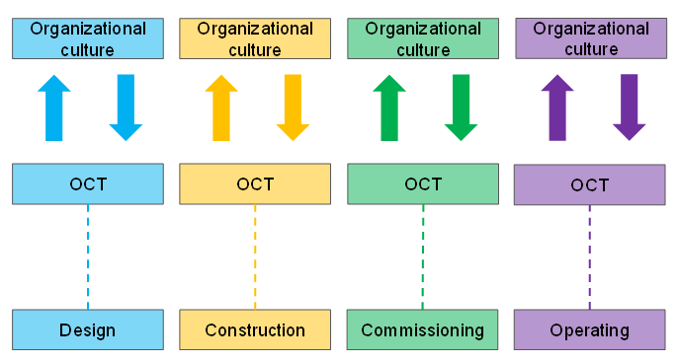
Sequential factors
Each lifecycle phase, substage and milestone can be seen as sequential – one follows another in timeline
They are associated with a unique organizational core task, which reflects the sociotechnical system at a certain time
Different organizational core tasks are associated with different safety culture challenges

Slide 9
Sequential factors – Cultural considerations
Organizational culture changes slowly and is usually resistant to attempts to influence it
When the technological transition from one lifecycle phase or substage to another takes place, it is already too late to start changing the culture, mindsets and working practices
Cultural transition should commence well in advance of the technological transition

Slide 10
Sequential factors – EXAMPLE
Fuel arrival and loading at Olkiluoto 3 site
Change of status of to a nuclear facility
A significant transition for the operations unit
Demanding for the overall project network
Effective communication forums as a key to manage the transition

Slide 11
Sequential factors – EXAMPLE
Turnkey contracts
Both Olkiluoto 3 and Hanhikivi 1 were implemented as turnkey or EPC projects
Tension of balancing involvement and independence
Hands-on involvement is desirable for the next lifecycle phase, but may be difficult to implement in practice in the current life cycle

Slide 12
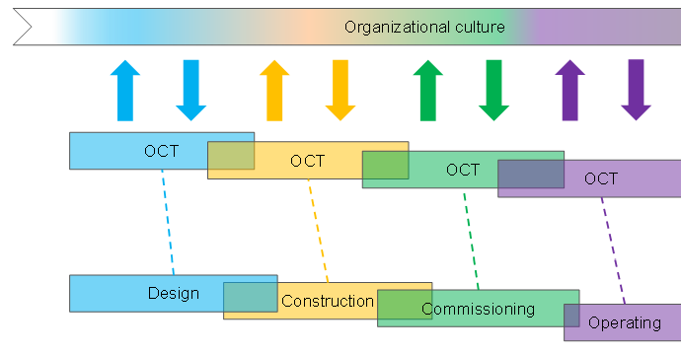
Parallel factors
The reality of new builds is often much more complex than the sequential ideal
Temporal and spatial overlaps increase the ambiguity of the organizational core task
Overlaps make it harder to understand what the demands, constraints and possibilities for leadership and safety culture development are, and to create a unified approach

Slide 13
Parallel factors – EXAMPLE
Life in two lifecycle phases simultaneously in OL3 commissioning
Operators prepared for the working practices and culture of the operating phase throughout the project
Outside, in “real life”, there was a complex and dynamic project environment with tight schedules and various pressures
Challenging environment culturally and psychologically, to create a conservative and serene modus operandi for the operating phase, while the rest of the organization is in project mode

Slide 14
Parallel factors – EXAMPLE
Organizational context
Fennovoima Hanhikivi 1 and TVO Olkiluoto 3 projects had very different organizational contexts. The established nuclear power company TVO had a ”head start” – Fennovoima had to build their organization from ground up
→ History-dependence and a tension between the old and the new
Established organization needs to integrate old and new practices and mindsets, new organization needs to integrate people with differing background and histories

Slide 15
Conclusions and food for thought
New build project dynamics create challenges for leadership and safety culture
The organizations need to continuously monitor and redefine their target safety culture, and revise their leadership approach if needed
THINK
How adaptive is the new-build organization’s culture to change its assumptions and beliefs in anticipation of the upcoming transitions?
When should the safety culture transition start?
When is it too early (to maintain proper culture in current phase)?
When is it too late (to change the culture for the next phase)?
What temporal and spatial overlaps exist? Which can be (or have been) anticipated, and which cannot be anticipated?

Slide 16
THANK YOU
Kaupo Viitanen
kaupo.viitanen@vtt.fi

