Slide 1
Nuclear safety culture

Slide 2


Nuclear safety
Nuclear safety culture
human & organisational factors
Framework
Nuclear Safety Perception Questionnaire
Nuclear Safety Culture Roadmap – Site, Department
… towards HO Levers & competences

Slide 3

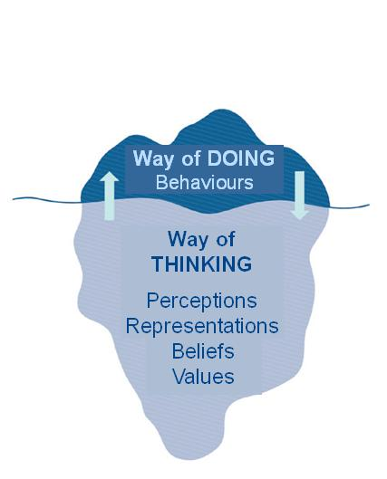

Nuclear safety culture…
and Performance
ORGANISATION
Ambition, rules, IMS, means, resources…
The responsibility of the Direction team
Nuclear Safety
Performance
Perceptions
What is expected
What we do
Organisation
Behaviours
BEHAVIOURS
Attitude, HU Tools, Operational decision making,…
Everyone’s responsibility but encouraged by each manager
PERCEPTIONS
Beliefs, values,…
Based on group history, original choices and personal experience
What I think
From Edgar H. Schein
Nuclear Safety Culture as:
The way to obtain sustainable performances
“2 Faces of the same coin”
“Way of Doing / Way of Thinking”
Results of the interaction of 3 elements
Notes:
A very short introduction on our model of NSC.
We adopt the iceberg model, you know it, of course.
That means for us : …
That means that we have to play, to act on 3 drivers…
As you see, it is not only matter of behaviors, and that introduces the interest of using a perception survey in addition to the analysis of performances and the analysis of what we see in the field.

Slide 4

1. framework

Slide 5

NPP’s nuclear safety management accountability, with an oversight by the national level
Pilotage des 4 majeurs
AAR, NCSTE, MR, F2M
NS Culture Roadmaps
Site & departments
Post Combined Peer review Actions plan
Leadership
Program
Annual Nuclear Safety Diagnosis
DPN Performance review
Local specificities
Plant manager’s vision: the NS Compass
4 factors of decline :
  NPP Leadership
  Operation Leadership
  Medium/long term focus
  insularity
Robustness and listen of the Independant Safety Line
Use & lessons learned from the SPQ & self-assessment Leadership (in alternance)
NSC Roadmap, site & departments
Mid-year exchange NS site director / National experts
Nuclear Safety
&
NS Culture
Nuclear Leadership among Professioetwonnals: Safety Inputs innetworks & Leadership Program
Managers in the field
Anticipation & support of change – SOH/INSAG 18 approaches
Heart of the site’s Annual Contract
Nuclear Inspection feedback on the actions plan
WANO support : TSM, AFE/ePM, WANO REP
National support UNIE & EM DPN

Slide 6
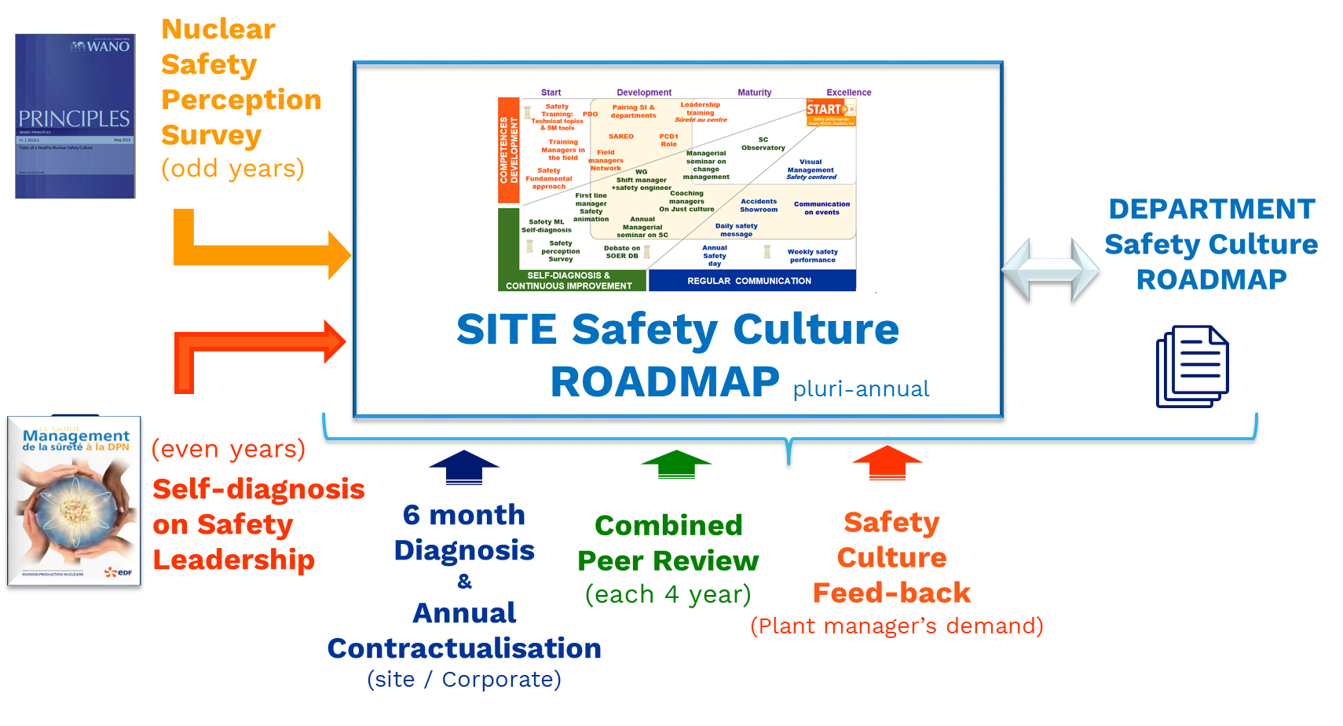
NSC Current Framework… SITE’s view
SITE
CORPORATE
Site Visits
Corporate Oversight
Annual NS Diagnosis Plant Manager / NS Director
Annual Contract Plant manager/CNO

Slide 7
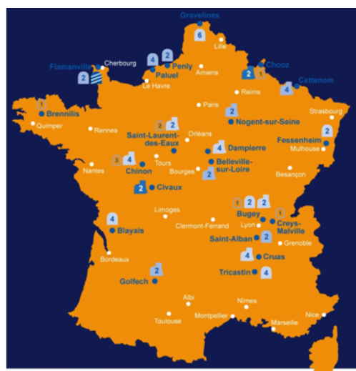
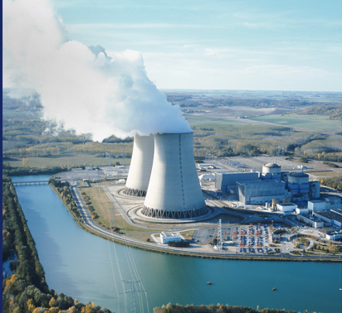
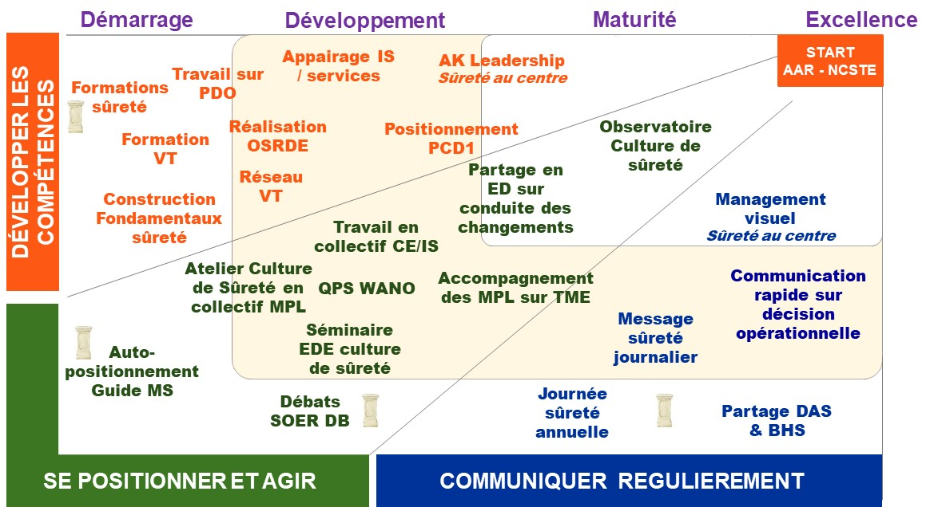

NSC Current framework… Corporate’s view
Sites
Fleet
Review
Corporate
SP Questionnaire
(odd years)
Corporate NS Committee
SELF ASSESMENT
(even years)
Fleet Nuclear Safety
Road map
DPN
Direction Team
Alternatively
each 6 month
NS Exchange
Annual NS Diagnosis
Corporate
Nuclear Officer
NS Director
Identification of site in difficulty
Each 6 month
Annual Site
Contract
NS Roadmap
Site & Departments
Each
6 month
Site Visits
Corporate Oversight

Slide 8
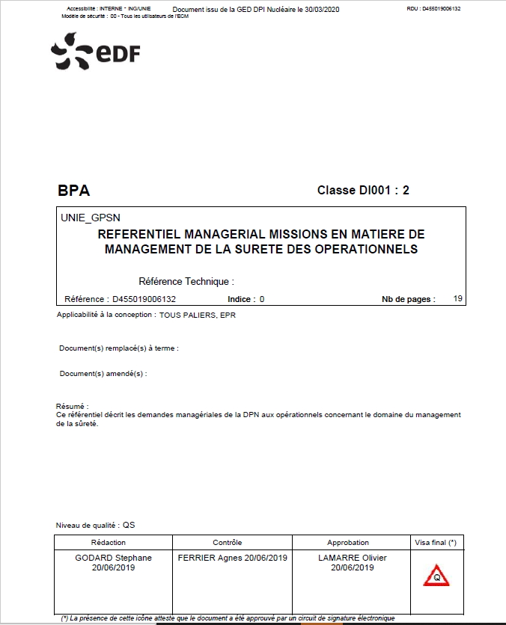
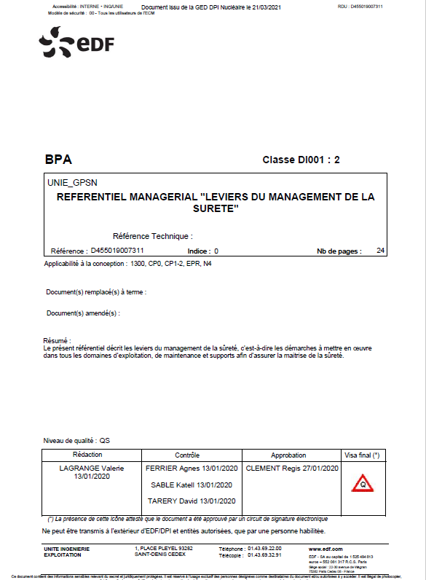
2 managerial requirements on Nuclear Safety Culture
Missions, Responsabilities for managers & operationnals in Nuclear Safety Management
Nuclear Safety Management Levers
Requirements used for contractualisation between site & Corporate
Different Guidelines, Trainings & Supports in order to implement on site
Requirements used by Nuclear inspectorates to assess sites

Slide 9

Specific Topics of the nuclear safety culture diagnosis
Mid-year : exchange with Safety director and different pilotes
End-year : exchange between Plant manager & NS director
Nuclear Safety leadership, Safety culture Roadmap site & Department:
Use and lessons learned from the SPQ
Use and lessons of self-assessment on safety Leadership
Dynamics around NSC site and department roadmaps
Efficiency of the base actions
New actions related to the diagnosis
Place of safety on the site:
Independent Safety Line (ISL): skills, listening, matched Safety engineer
Annual Safety Diagnosis use
Quality Event Analysis (report and process)
Awareness on the site: results indicators, notable safety events,
service diagnosis with ISL feed back, external evaluation results
Link with the site’s leadership project:
Safety contributions in professional and management
networks and in the Leadership project
Anticipation and support of changes - SOH/INSAG 18
Cooperation
Management line Coherence
Proximity field
Safety first
Dynamic of Safety Leadership
Leadership & Culture… not Compliance

Slide 10

2. Nuclear Safety Perception Questionnaire

Slide 11
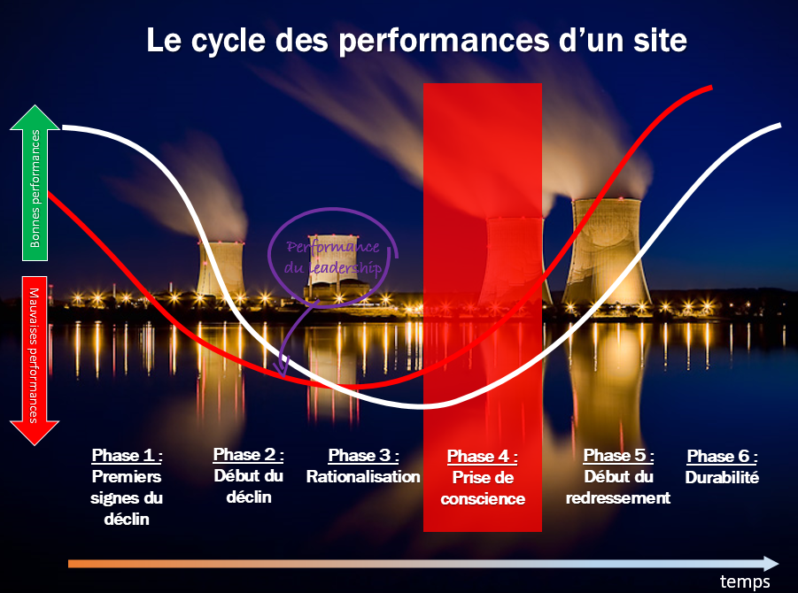
NSC Questionnaire can be used in anticipation, to identify
weak signals of decline
 | T1. Responsabilité personnelle | T2. Attitude interrogative | T3. Communication sur la sûreté | T4. Responsabilisation du leadership | T5. Prise de décision | T6. Un environnement de travail respectueux | T7. Apprentissage continu | T8. Identification et résolution de problèmes | T9. Environnement permettant de remonter ses préoccupations | T10. Processus d’intervention
2021 | 5,9 | 6,8 | 6,3 | 5,8 | 6,0 | 6,0 | 6,3 | 6,2 | 6,6 | 6,0
Equipe de direction | 4,4 | 5,6 | 6,3 | 6,5 | 6,6 | 6,6 | 6,5 | 5,8 | 7,3 | 5,6
Chef de service, délégué, de projet | 5,3 | 6,7 | 6,9 | 6,3 | 6,3 | 6,7 | 6,6 | 6,2 | 7,2 | 6,2
MPL, … RE | 5,5 | 6,9 | 6,4 | 6,1 | 6,1 | 6,3 | 6,3 | 6,1 | 6,7 | 5,8
Autres cadres | 6,0 | 6,6 | 6,4 | 5,6 | 5,9 | 5,9 | 6,1 | 6,0 | 6,3 | 6,0
Maîtrise | 6,1 | 6,9 | 6,2 | 5,7 | 5,9 | 5,7 | 6,3 | 6,3 | 6,5 | 6,1
Exécution | 6,4 | 6,8 | 6,2 | 6,0 | 6,1 | 6,1 | 6,3 | 6,2 | 6,8 | 6,0
Site in degradation
with very degraded safety results
Mistrust of the management line
On employee-related traits
Employee dissatisfaction with managers' actions
Profile marked by dissatisfaction / mistrust
 | T1. Responsabilité personnelle | T2. Attitude interrogative | T3. Communication sur la sûreté | T4. Responsabilisation du leadership | T5. Prise de décision | T6. Un environnement de travail respectueux | T7. Apprentissage continu | T8. Identification et résolution de problèmes | T9. Environnement permettant de remonter ses préoccupations | T10. Processus d’intervention
2021 | 6,8 | 7,3 | 6,8 | 6,4 | 6,6 | 6,0 | 6,8 | 6,8 | 6,8 | 6,6
Equipe de direction | 6,6 | 7,6 | 7,6 | 7,7 | 8,1 | 7,4 | 7,8 | 7,4 | 8,2 | 6,9
Chef de service, délégué, de projet | 6,9 | 7,2 | 7,0 | 6,8 | 6,8 | 6,5 | 7,0 | 6,8 | 7,4 | 6,6
MPL,… RE | 6,8 | 7,4 | 6,9 | 6,7 | 6,8 | 6,3 | 6,9 | 6,8 | 7,1 | 6,6
Autres cadres | 6,6 | 6,8 | 6,7 | 6,2 | 6,4 | 6,0 | 6,8 | 6,7 | 6,7 | 6,7
Maîtrise | 6,8 | 7,5 | 6,6 | 6,2 | 6,4 | 5,9 | 6,7 | 6,8 | 6,5 | 6,6
Exécution | 7,0 | 7,6 | 6,7 | 6,2 | 6,4 | 5,8 | 6,6 | 6,8 | 6,8 | 6,5
Sites with good or very good safety performance (or even overall), but which show weak signals of degradation
 | T1. Responsabilité personnelle | T2. Attitude interrogative | T3. Communication sur la sûreté | T4. Responsabilisation du leadership | T5. Prise de décision | T6. Un environnement de travail respectueux | T7. Apprentissage continu | T8. Identification et résolution de problèmes | T9. Environnement permettant de remonter ses préoccupations | T10. Processus d’intervention
2021 | 6,2 | 7,0 | 6,6 | 6,2 | 6,4 | 6,0 | 6,5 | 6,4 | 6,7 | 6,6
Equipe de direction | 5,9 | 7,0 | 6,7 | 6,9 | 6,8 | 7,1 | 6,4 | 6,1 | 8,2 | 6,7
Chef de service, délégué, de projet | 5,8 | 7,0 | 7,2 | 7,0 | 7,1 | 6,9 | 6,7 | 6,3 | 7,6 | 6,4
MPL, … RE | 6,1 | 7,3 | 6,9 | 6,5 | 6,8 | 6,5 | 6,5 | 6,4 | 7,3 | 6,7
Autres cadres | 6,0 | 6,9 | 6,5 | 6,1 | 6,4 | 6,1 | 6,3 | 6,2 | 6,5 | 6,5
Maîtrise | 6,4 | 7,0 | 6,5 | 5,9 | 6,2 | 5,6 | 6,5 | 6,5 | 6,4 | 6,5
Exécution | 7,1 | 7,2 | 6,5 | 6,3 | 6,1 | 5,9 | 7,0 | 6,7 | 6,6 | 6,6
Sites whose profile is beginning
to show weak signals

Slide 12
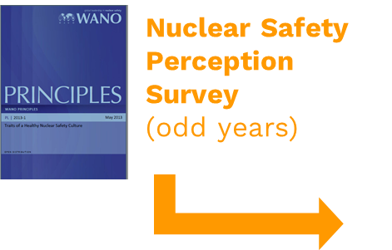
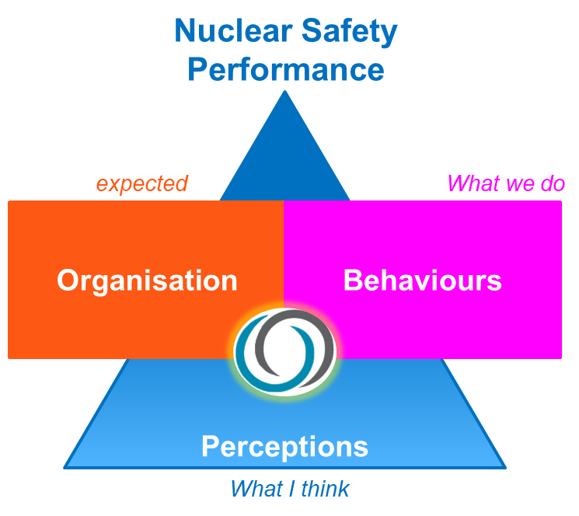
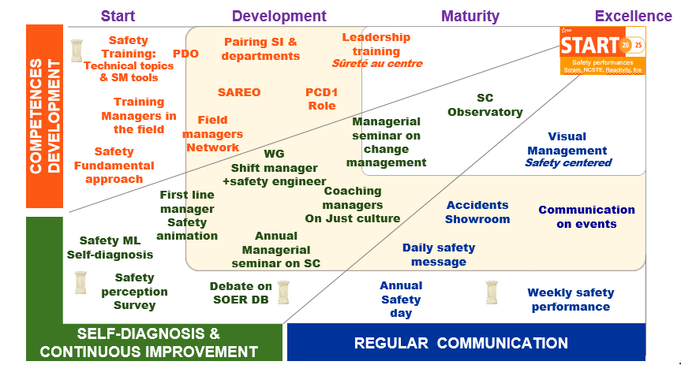
efficiency of the use of NSP questionnaire for a site
Conditions for success resulting from 5 years of implementation:
A minimum response rate of 65% with 50% Operation department
An appropriation of the site data with sharing in the executive team, then with heads of department group
An appropriation of the service data with sharing in each head of department
Sharing differences in perceptions within the management line
Sharing the data in each team with an exchange
Using verbatim reports or conduct collective interviews on major themes
A need for statistical robustness, but a requirement for "heads up" qualitative analysis at the end
Confront
diagnosis with facts :
Use the analysis to update
NS Roadmap Site & Departments & Other NS actions plan Leadership Project

Slide 13
3. Nuclear Safety Culture Roadmap – Site, Department

Slide 14
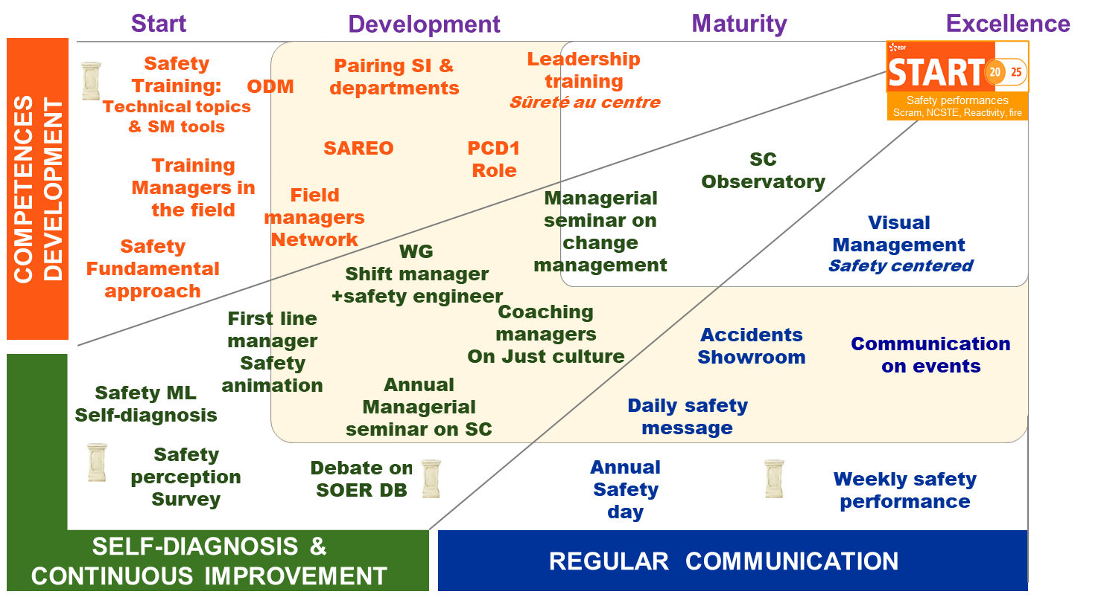
Example of a site NSC roadmap…

Slide 15
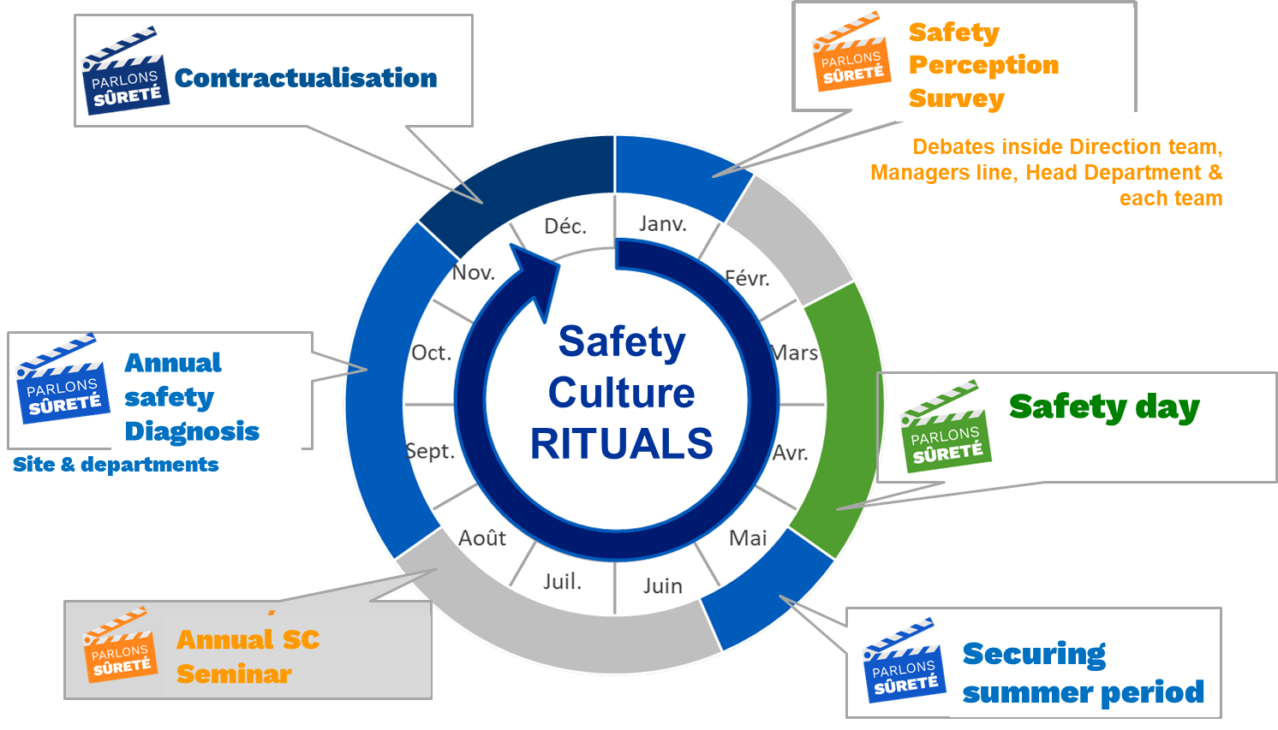
Example of a site NSC roadmap… Rituals

Slide 16
…towards Human and Organisational Levers & competences

Slide 17
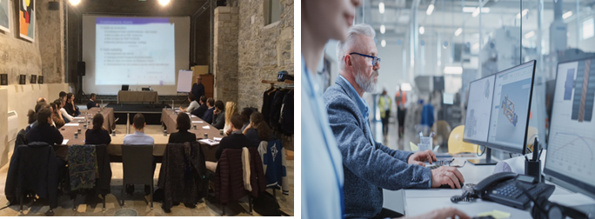
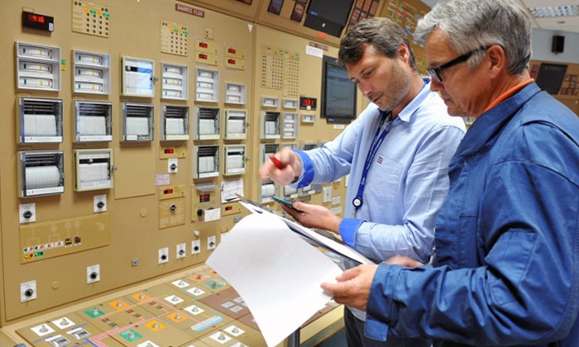

Human & Organisational approach
Work situations in the field
Academic knowledge
Annual safety diagnosis
HO change approach
Sel-assessment in Leadership
INSAG 18
Field presence
NS Culture roadmaps
NS Culture Questionnaire
Organisation
Decision making
SAREO
Risk analysis
CAP
Technical check
Independant safety view
Collective
Standards
NS Debate
Risk analysis
Human
tools error reducing
Root cause analysis
Appropriation
Anticipation
Continous improvment
Preparation
Realisation
Operating feed back
Weack signals
Skills development
Just in time
Individual

