Slide 1
How To Effectively Prevent Erosion of Your NPP’s Safety Performance - Finding Your Flashlight
Fuming JIANG
IAEA

Slide 2
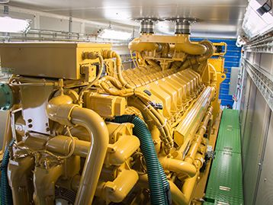
Diesel Generators

Slide 3
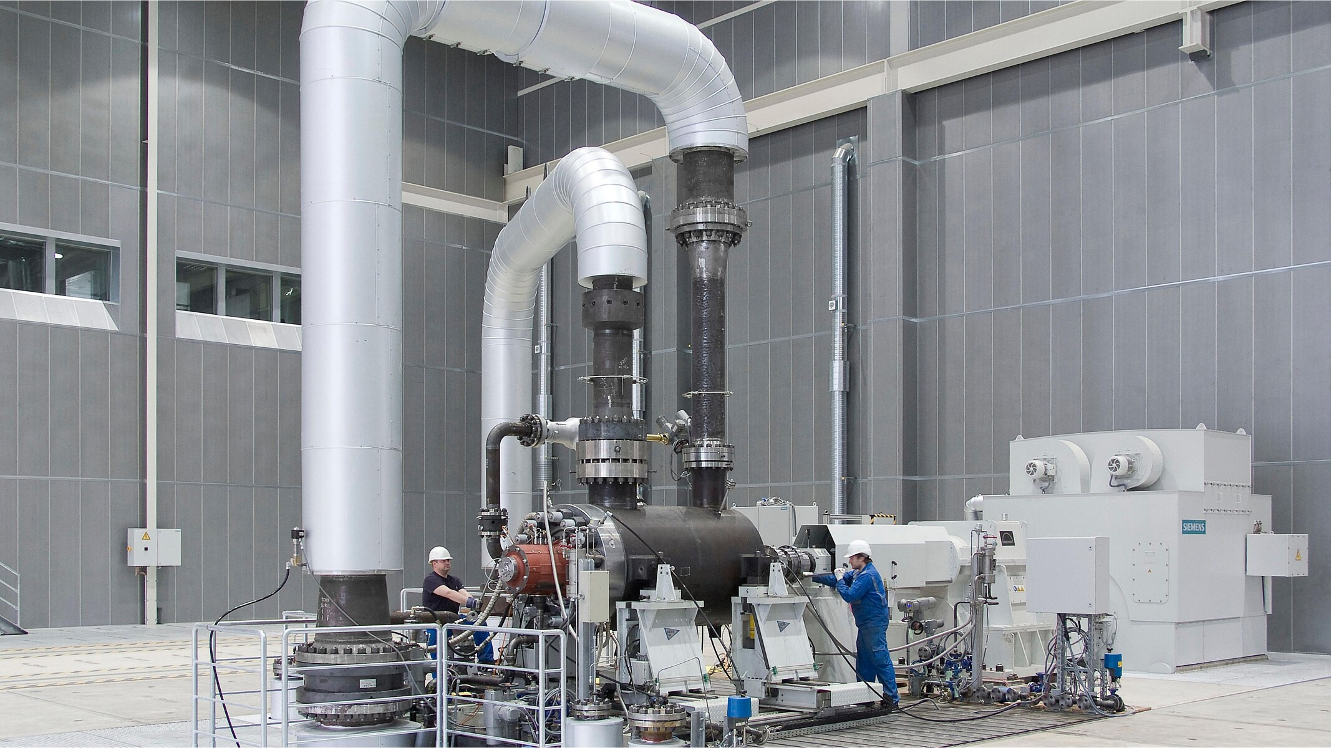
Configuration control of plant equipment

Slide 4
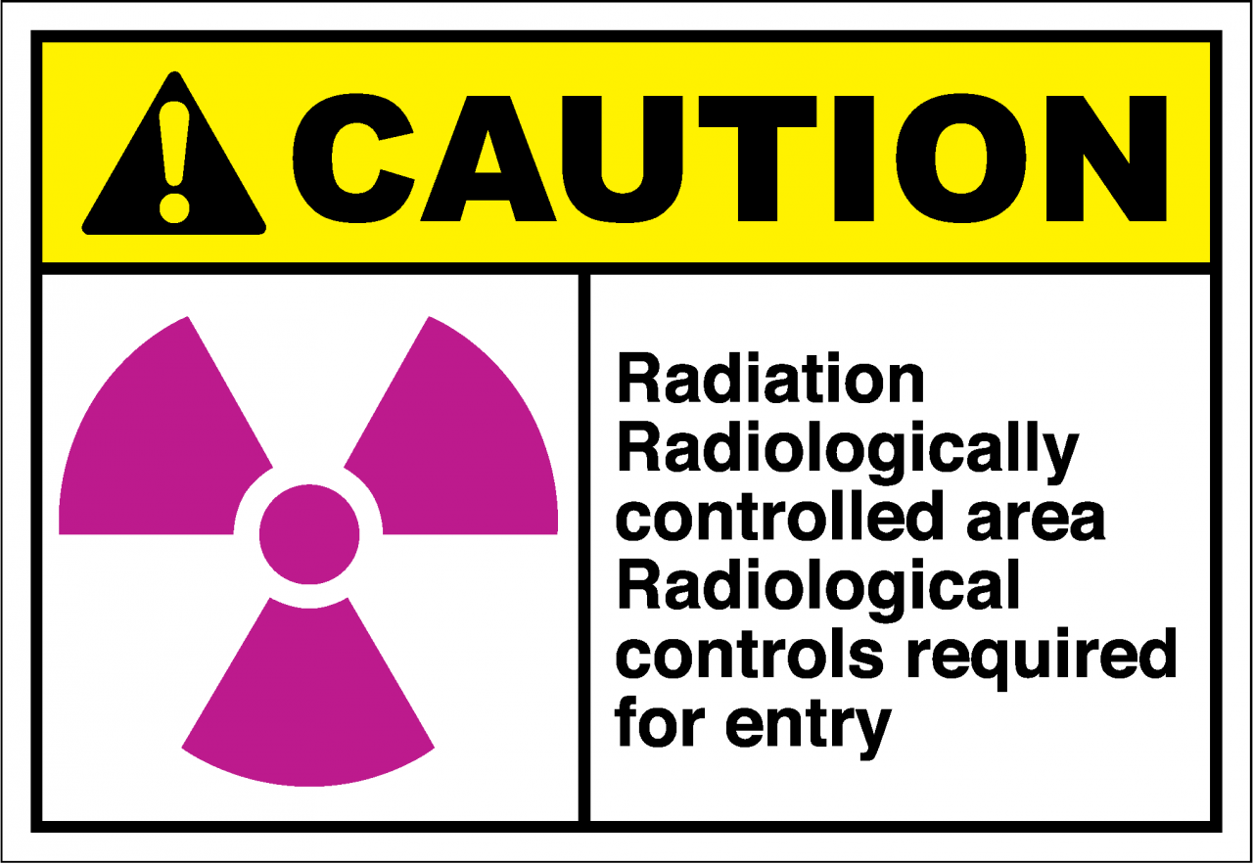
Senior Managers’ time in RCA

Slide 5
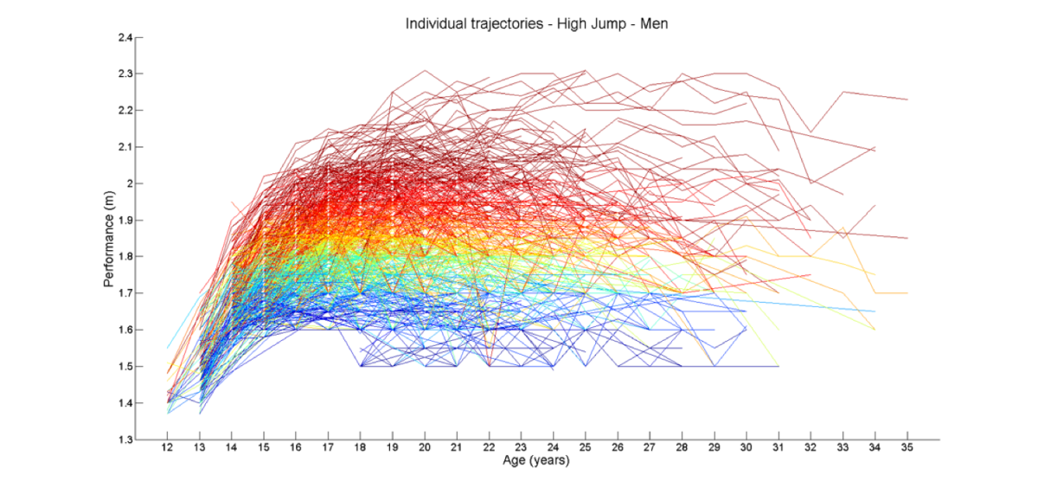
Plant’s Assessment of Trajectory
Review Team’s Findings
Senior Managers’ view of plant trajectory

Slide 6
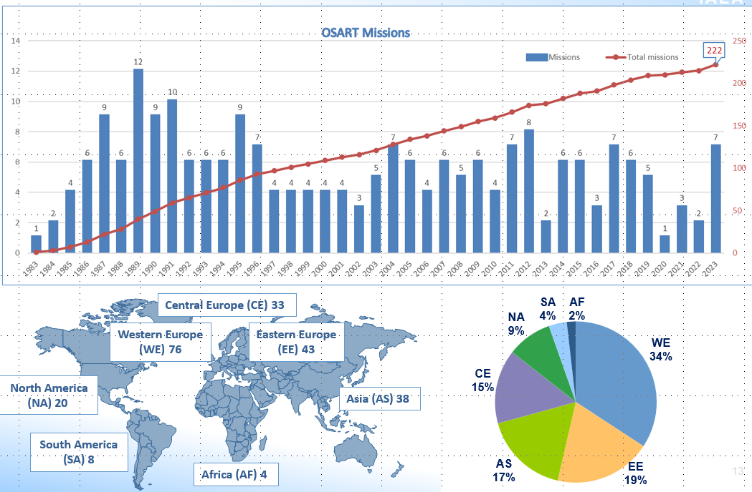
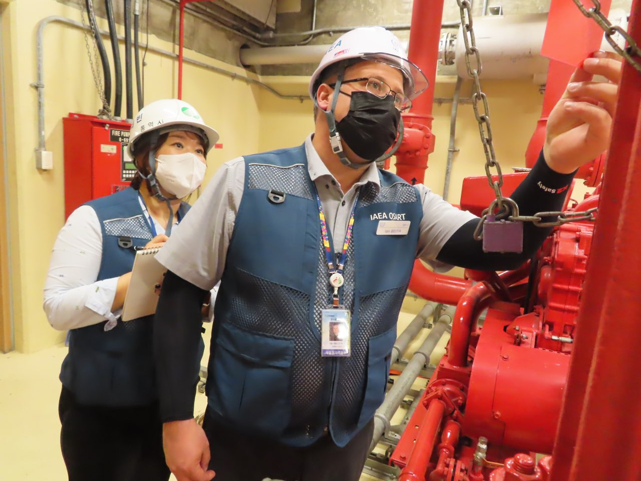
What have we seen in Member States?
Leadership & Culture
People
Equipment
6

Slide 7
Are these gaps difficult to identify?

Slide 8
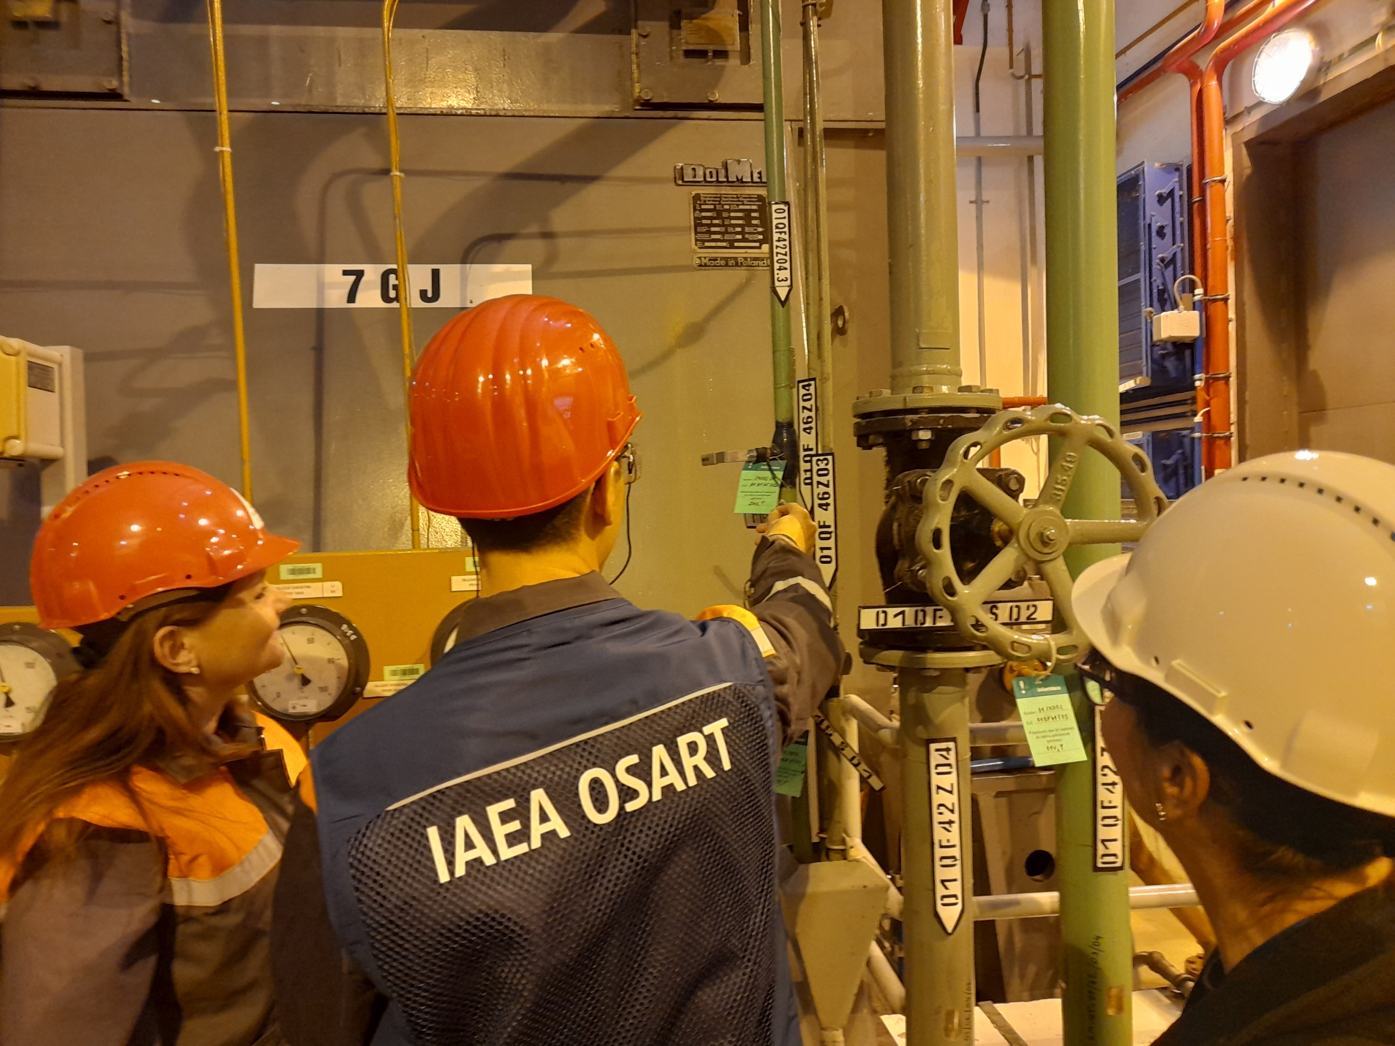
Who are FINDING and USING the Flashlight Successfully?

Slide 9
Find the Turnip and Swallow Willingly

Slide 10
Our Leverages 98.8%
Notes:
We work with the hosts on using flashlight to self-identify before issues become self-revealing

Slide 11
Finding Your “Flashlight”
11

Slide 12
How To Effectively Prevent Erosion of Your NPP’s Safety Performance - Finding Your Flashlight
Fuming JIANG
IAEA

