Slide 1
Generation IV Nuclear Power Plant Construction, Operation and Maintenance of HTR-PM
Huaneng Shandong ShidaoBay Nuclear Power Co., Ltd.
Zhang Yanxu
April 16, 2024
Notes:
尊敬的布拉德富德女士，核能行业的各位伙伴，大家上午好。

Slide 2
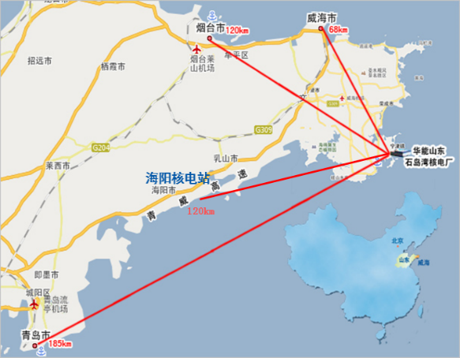
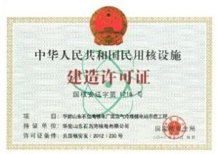
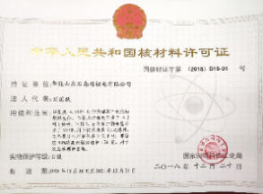
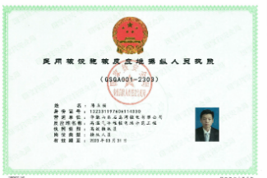
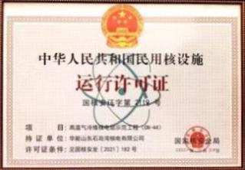
Company Profile
Import
Huaneng Shandong ShidaoBay Nuclear Power Co., Ltd.
Site Location
Established in 2007
China Huaneng Group, CNNC and Tsinghua University have made respective contributions of 47.5%, 32.5%, and 20%.
Rongcheng City，Shandong Province
Huaneng Shandong ShidaoBay Nuclear Power Plant
Huaneng Shandong Shidao Bay Nuclear Power Plant
Huaneng Nuclear Power Development Co., Ltd.
China Nuclear Engineering & Construction Group Corporation Limited
Tsinghua Holdings Co., Ltd.
Construction License
Nuclear Material License
Operator License
Operation Licence
Notes:
华能山东石岛湾核电有限公司（简称石岛湾核电）隶属于中国华能集团，负责厂址位于山东省荣成市的200MWe球床模块式高温气冷堆（简称HTR-PM）核电站示范工程的建设和运营。历经12年完成HTR-PM示范工程的建设和商运投产，在第四代核电--高温气冷堆的建设和运维方面积累了大量的经验。
HTR-PM示范工程的商运，引起了各界的广泛关注，那么高温堆与前代堆型相比有哪些优势？在建设和运维方面又有哪些难点？
下面由我做主题报告“第四代核电-高温气冷堆的建设和运维”，为大家解答。

Slide 3
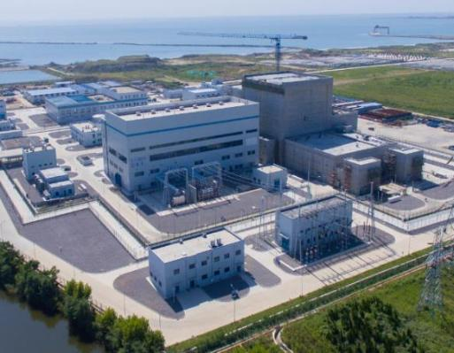
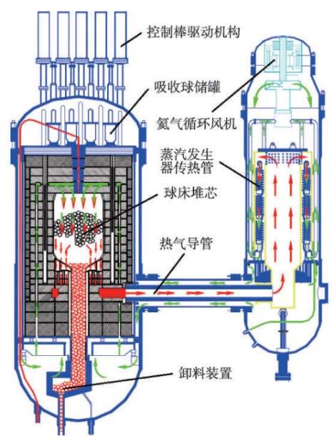
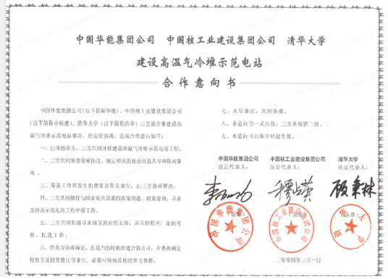
Foreword
Development of HTR-PM
1940
1950
1960
1970
1980
1990
2000
2010
2020
USA
UK
Germany
China
Peach Bottom, Fort Saint-Vrain
Suspension for technical or non-technical reasons
Magnox Gas Cooled Reactors, Dragon Reactors
AVR Reactors, Thorium Fuelled High Temperature Gas Cooled Reactors
HTR-PM
High Temperature Reactor Preliminary Study | Construction and Verification of HTR-10 Test Reactor | HTR-PM Construction | HTR-PM Operation
Control rod drive mechanism
Absorber spheres tank
On December 6, 2023, the HTR-PM Demonstration Project was officially put into commercial operation
Helium circulator
Steam generator tube
China Huaneng Group Co., Ltd. China Nuclear Engineering & Construction Group Corporation Limited Tsinghua University
Construction of HTR-PM Demonstration Plant
Letter of Intent for Cooperation
Pebble bed reactor core
Hot gas conduit
2007
Huaneng Shandong Shidao Bay Nuclear Power Co., Ltd. (HSNPC) was established with the purpose of the construction, operation and maintenance of 200MWe pebble-bed modular high temperature gas cooled reactor (HTR-PM)
Unloading device
Schematic Diagram of HTR-10 Reactor Body
Notes:
20世纪60年代开始，美国、英国、德国先后开展了球床式、棱柱式高温气冷堆试验堆、原型堆示范电站的研究与建设，但进入80年代后期，由于技术和非技术的原因相关试验堆和示范电站建设相继暂停。
中国的高温气冷堆研发，始于20世纪70年代后期。经过早期探索和研究，清华大学于2000年建成10MW高温气冷堆试验堆（HTR-10），2003年满功率发电。在HTR-10的基础上，中国华能集团、清华大学、中核集团注资成立华能山东石岛湾核电有限公司，开展首座HTR-PM核电站示范工程的建设。
HTR-PM核电站示范工程于2012年12月开工，2023年12月正式投入商业运行。

Slide 4
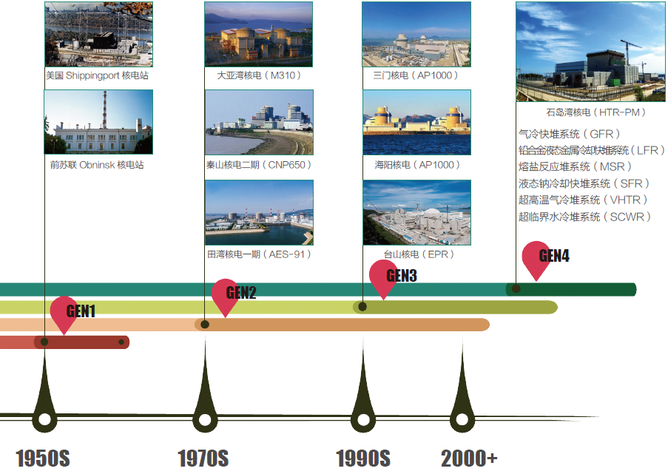
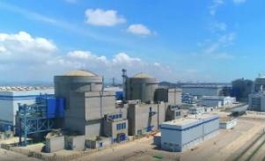
Foreword
Generation IV Nuclear Power Plant
Shippingport Atomic Power Station
Daya Bay Nuclear Power Plant (M310)
HPR1000
Shidao Bay Nuclear Power Plant (HTR-PM)
Gas cooled fast reactor system (GFR)
Lead-cooled fast (liquid-metal-cooled) reactor system (LFR)
Molten salt reactor system (MSR)
Sodium-cooled fast reactor system (SFR)
Very high temperature reactor/high temperature gas cooled reactor (V/HTR)
Supercritical water cooled reactor system (SCWR)
Obninsk Nuclear Power Plant (Soviet Union)
Qinshan Nuclear Power Plant Phase II (CNP650)
Haiyang Nuclear Power Plant (AP1000)
Tianwan Nuclear Power Plant Phase I (AES-91)
Taishan Nuclear Power Plant (EPR)
Advantages of HTR-PM VS First Three Generations
Generation I Nuclear Power Plant
Generation II Nuclear Power Plant
Generation III Nuclear Power Plant
Generation IV Nuclear Power Plant
Inherent safety
Wide application field
Environment-friendly
Notes:
HTR-PM核电站示范工程是国际公认的第四代核电站，与前三代机组相比具有固有安全性等特征，这些特征源于对反应堆及其辅助系统的特殊设计。
这些特殊设计如何成功地从图纸转变为实体，以及这些实体如何成功的运行、维护，这是HTR-PM建设和运维需要面对的重要问题。
对于该问题，石岛湾核电积累了大量的实践经验，本次报告将聚焦于HTR-PM的固有安全性特征，简略阐述中国高温气冷堆技术在固有安全性的实现和保持方面遇到的问题，并简要介绍解决方案。

Slide 5
PART 1 Inherent Safety of HTR-PM Nuclear Power Plant
Inherent Safety refers to the capability of a reactor to shut down automatically under any accident conditions throughout its entire operating lifetime.
The residual heat generated within the core can be effectively transferred to the external environment through passive natural convection and radiation heat transfer mechanisms. This ensures that the temperature of the fuel elements remains below the maximum allowable limit.
Consequently, the risk of severe accidents, such as core and fuel element melting, is eliminated, and the occurrence of radioactive releases that pose threats to public safety and the environment is prevented.
Notes:
固有安全性是指能够保证在反应堆的整个运行寿期内，在任何事故下，反应堆都具有自停堆能力，堆芯的剩余发热可以借助于非能动的导热、自然对流和辐射换热等自然机理由堆芯传出堆外，保证燃料元件温度不超过最高温度限值，从而可排除堆芯和燃料元件发生熔化的严重事故，不会发生威胁公众和环境安全的放射性释放。

Slide 6
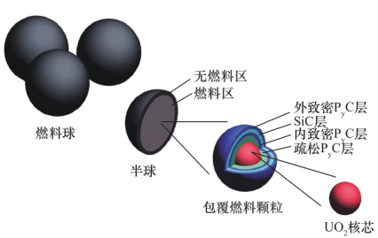
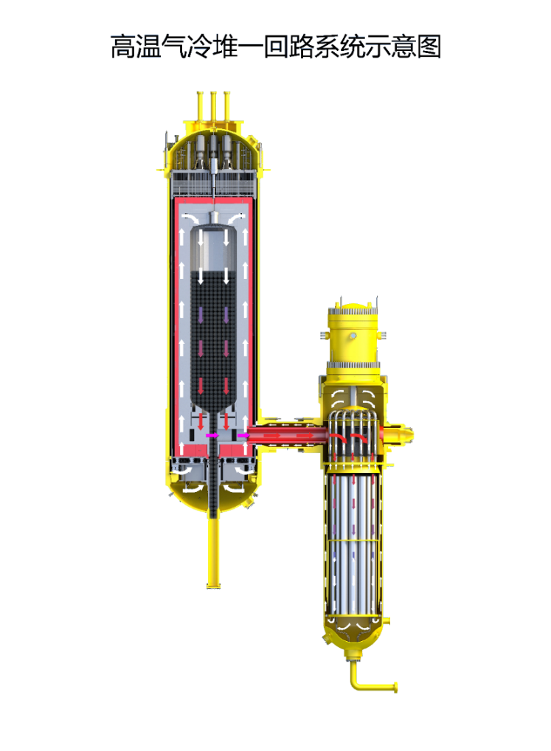
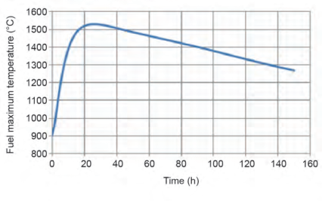
Inherent Safety of HTR-PM
Inherent Safety Design
High-Temperature Resistant Spherical Coated Particle Fuel
HTR-10 Inherent Safety Verification
All-ceramic core
7g uranium
12,000 particles
Withstanding 1,650℃ without damage
Loss of off-site power
Shutdown of helium circulator
Control rod No rod drop
Automatic shutdown of reactor
Intact core
No-fuel area
High temperature of 3000℃ without melting Large heat capacity and high heat transfer coefficient Thoroughly preventing the fuel element temperature from exceeding 1650℃
Fuel area
Outer tight P_{y}C layer
Fuel sphere
SiC layer
Innder tight P_{y}C layer
Hemisphere
Buffer P_{y}C layer
Coated fuel particle
Kernel UO2
Low volumetric power density of reactor core
Average volumetric power density of reactor core 3.3 MW·m^{–3}
Modular design
Splitting a large reactor into two smaller modules Thermal power of a single reactor module: 250 MWth
About 1/30 of that found in a PWR nuclear power plant
Notes:
HTR-PM的固有安全特性首先源于球形包覆颗粒燃料和全陶瓷堆芯结构设计。该包覆颗粒燃料将7克铀分散在12000个颗粒中，每个颗粒采用三层陶瓷包覆，并与石墨一起被填充在1个直径60mm的燃料球中，可耐1650℃不破损；
全陶瓷堆芯结构由石墨和炭砖组成，能耐3000℃的高温而不融化，具有大热容和很好的传热系数，可以吸纳衰变热。瘦长的堆芯设计，有利于余热通过热传导等方式自然导出，可避免燃料元件超过1650℃。凭借负反应性温度系数和较大的温升裕度，在升温的事故工况下，可实现自停堆。
HTR-PM固有安全性其次源于较低的反应堆堆芯体积功率密度和模块化的设计。正常运行时平均体积功率密度是3.3兆瓦每立方米，约为压水堆的1/30，同时将一个大反应堆分解为两个模块，单个反应堆模块的热功率减小为250 MW，进一步增加了安全裕度。

Slide 7
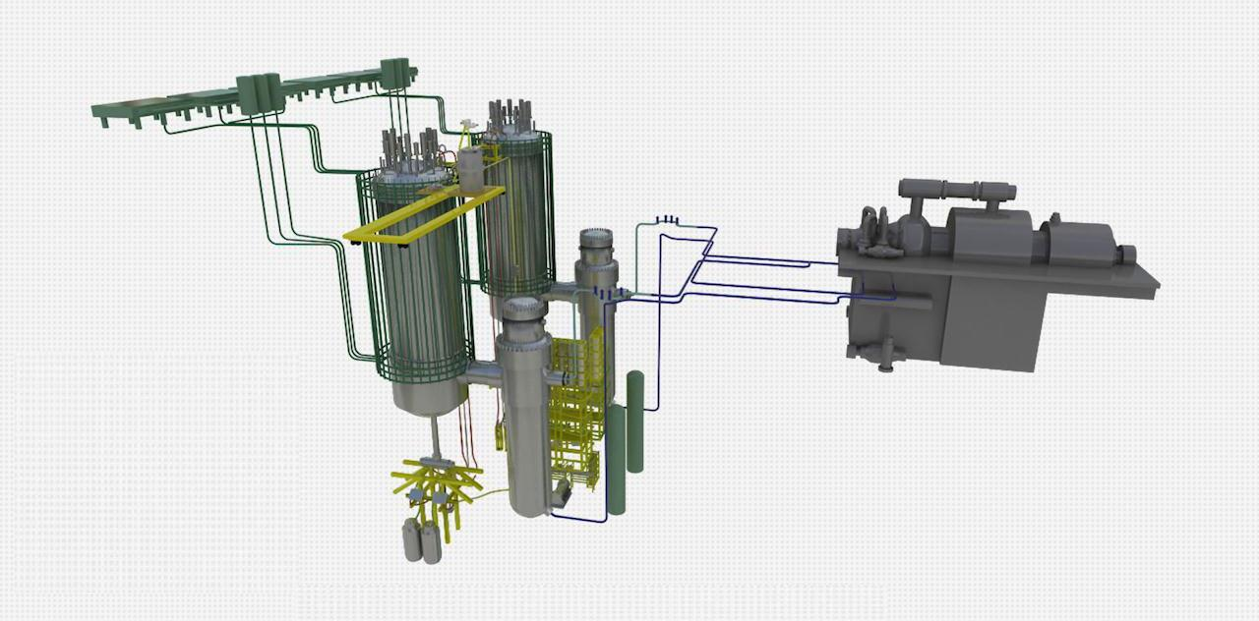
Inherent Safety of HTR-PM
Matching Design of Inherent Safety
Construction and O&M Challenges
Contl rod system
Absorber sphere shutdown system
Ceramic internals
These designs make the HTR-PM a Generation IV nuclear energy system that is resistant to core meltdown.
However, they also present challenges in terms of the construction, operation, and maintenance of HTR-PM.
Spherical coated particle fuel
Helium circulator
For example:
How can large-scale manufacturing of spherical coated particle fuel be achieved?
How is the nuclear material accounting of spherical fuel carried out in operation stage?
How can the installation error be controlled when stacking the internals composed of graphite and carbon bricks?
All the above questions can be summarized into a single inquiry:
How can a HTR-PM nuclear power plant be successfully constructed, operated, and maintained?
Passive residual heat removal system
Hot gas conduit
Reactor vessel
Steam generator
Fuel handling system
Notes:
为了与上述固有安全性的设计相匹配，HTR-PM设计了用于球形燃料元件装换料的燃料装卸系统，用于容纳陶瓷堆内构件的反应堆压力容器，用于反应性控制的控制棒系统和吸收球停堆系统，用于驱动氦气循环换热的电磁轴承式主氦风机，用于隔离一二回路并与氦气进行换热的螺旋盘管式蒸汽发生器等一些列配套系统和设备。
基于这些设计，HTR-PM成为了不会发生堆芯熔毁的第四代核能系统，但同时这些设计也为HTR-PM的建设和运维带来了挑战。
例如球形包覆颗粒燃料如何实现规模化制造？
石墨和碳砖组成的堆内构件堆砌时如何控制安装误差？等。
这些问题，均可归纳为一个问题，既如何成功建设、运行和维护HTR-PM核电站？

Slide 8
PART 2 Construction of HTR-PM Nuclear Power Plant
The primary challenge in the construction of a HTR-PM nuclear power plant lies in effectively transforming the inherent safety depicted in design drawings into physical structures.
Notes:
固有安全性的设计如何成功地从图纸转变为实体，是HTR-PM核电站建设需要解决的主要问题。
耐高温的球形包覆颗粒燃料、全陶瓷堆芯和较低的反应堆堆芯体积功率密度是固有安全性的基础，上述设计在建设过程中出现了制造、安装方面的难题。

Slide 9
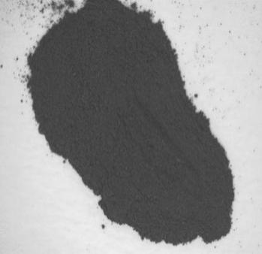
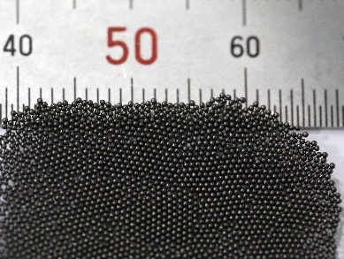
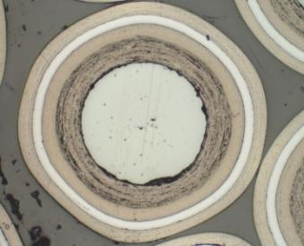
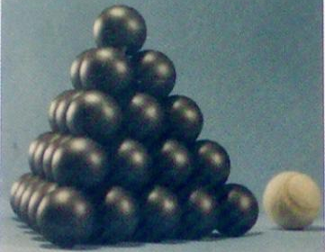
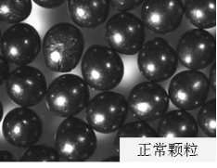
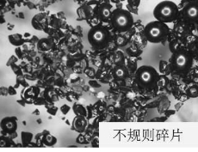
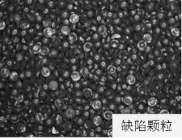
Construction of HTR-PM Nuclear Power Plant
Spherical coated particle fuel
The main process for manufacturing spherical fuel elements includes:
U₃O₈ powder
Preparation of UO₂ kernel
Preparation of coated particle
Preparation of fuel sphere
Spherical fuel elements
Preparation of matrix graphite powder
Solution
Main Challenges
In mass production, the overall pass rate of UO2 kernel is low and exhibits significant fluctuations.
Irregular fragments and unqualified particles exists.
Through testing and exploration, this is achieved by optimizing the reduction process parameters of UO₃ in the production of UO₂ kernel.
Irregular fragments
Defective particles
Normal particles
Notes:
耐高温的球形包覆颗粒燃料制造主体工艺流程包括：U₃O₈化工转化、UO₂核芯制备、包覆颗粒制备、基体粉制备、球形燃料元件制造等过程。
球形包覆颗粒燃料在批量生产中遇到UO₂核芯颗粒总体合格率偏低，存在不规则碎片和不合格颗粒等问题。
针对该问题，经过试验和摸索，通过优化UO₂前体的UO₃还原工艺参数后解决。

Slide 10
Construction of HTR-PM Nuclear Power Plant
Spherical Coated Particle Fuel
Main Challenges
The on-power refueling and fuel handling system, derived from the spherical coated particle fuel, enables on-power handling of the fuel spheres.
The inner wall of the pipe needs to have a smooth transition after welding, without any welding reinforcement, to prevent blockage and scratches to the fuel spheres during the sphere flow process.
During the installation process, controlling and detecting the internal reinforcement of pipe welds poses challenges.
Internal reinforcement of pipe weld
Spherical coated particle fuel
Fuel handling system pipe
Solution
Developed the complex pipe equipment installation technology for fuel handling system, including:
Control method of internal reinforcement of equipment and pipe
Internal reinforcement detection method, etc.
Notes:
球形包覆颗粒燃料衍生球床式高温气冷堆特有的不停堆换料燃料装卸系统。
该燃料装卸系统输送的是固体的燃料球，管道焊接后内壁要保证平顺过渡，无焊接余高，以避免在球流过程中造成划伤、卡堵等问题。
在安装过程中，燃料装卸系统遇到管道焊缝内部余高控制难、检测难的问题。
针对该问题，经过上百次试验和摸索后，探索出一整套燃料装卸系统复杂管路设备安装技术，包含设备、管道焊缝内部余高控制方法，内部余高检测方法等，成功解决HTR-PM球路管道的安装难题。

Slide 11
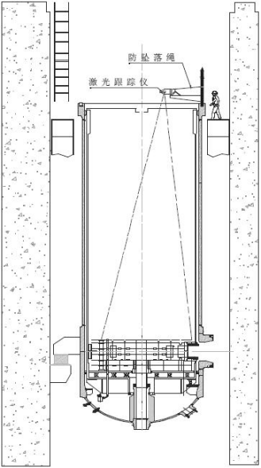
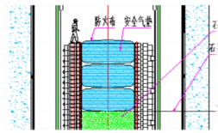
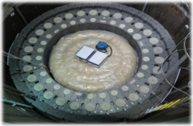
Construction of HTR-PM Nuclear Power Plant
All-ceramic Core
Main Challenges
Anti-falling safety rope
The all-ceramic core is composed of more than 200 types of graphite internals and carbon bricks, including tens of thousands of accessories such as tenons, pins, keys and sleeves, resulting in a complex structure with a large quantity of installation components. Thus, it is difficult to exclude foreign materials, protect safety, and perform cleaning and installation;
The graphite internals feature control rod ports, absorber sphere ports, cold helium ports, etc. And the masonry process requires extremely high installation accuracy, including precise positioning and verticality of each hole, levelness of each layer of masonry, and proper gaps between brick joints. It is important to note that the top section of the structure is a cantilever structure, making it susceptible to settling issues.
Laser tracker
Solution
In response to installation challenges, developed a precise installation technology for the mortise and tenon structure of ceramic internals, including:
Control method for installing clean rooms;
Pre-assembly process of graphite and carbon internals;
Safety gas cushion protection method of core cavity;
Horizontal and vertical conveying devices;
Cumulative error control method utilizing laser tracker for monitoring
Fireproof fabric
Safety gas cushion
Notes:
全陶瓷堆芯由200多种类型石墨构件和碳砖组成，其榫、销、键等附件达上万件，结构复杂，工程量大，安装过程中，遇到防异物难、安全防护难、清洁安装难问题；
同时石墨堆内构件上有控制棒孔道、吸收球孔道等，砌体对各孔的位置、垂直度，砌体水平度，砖缝间隙等要求高，存在安装精度控制难问题。
针对上述难题，开发陶瓷堆内构件榫卯结构精确安装技术，采用激光跟踪仪控制累计误差，最终成功完成陶瓷堆芯安装。

Slide 12
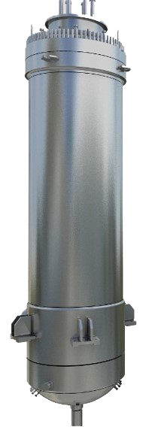
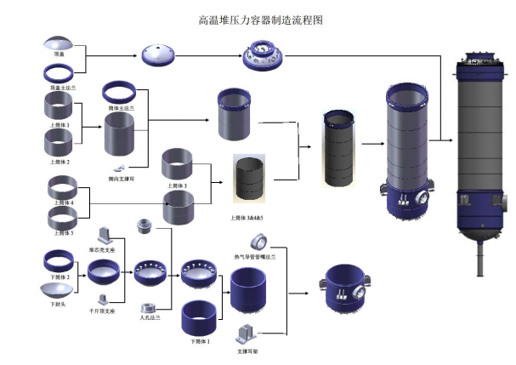
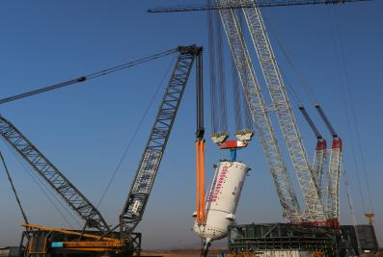
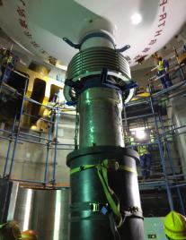
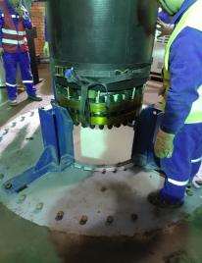
Low Volumetric Power Density of Reactor Core
Construction of HTR-PM Nuclear Power Plant
Main Challenges
Manufacturing Process Diagram of HTR-PM Pressure Vessel
The low volumetric power density of reactor core, the limited moderation capability of graphite, and the slender design that facilitates heat removal, result in the HTR-PM pressure vessel having large dimensions and a heavy weight.
It is difficult to manufacture oversized forgings and process large-diameter seal faces;
The distance between the unloading nozzle and the tilting lug spans up to 7 m, while the gap between the unloading tube and the penetration is only 25 mm. This makes it challenging to tilt and adjust the reactor pressure vessel during installation.
Outer diameter of main flange 6.4 m
Total height
24.9 m
Total weight 640 t
Solution
Inner diameter: 5.7 m
In response to the challenges of reactor pressure vessel manufacturing and installation, developed the manufacturing technology specific to the HTR-PM pressure vessel, and the double-crane lifting and tilting technology
Tracked the lifting process to ensure that the maximum deviation in verticality adheres to the required accuracy for unloading tube perforation
Employed a customized guide device to facilitate and restrict the passage of the unloading tube through the penetration, thereby preventing any collisions or impact
The largest and heaviest reactor pressure vessel in the world
Notes:
较低的堆芯体积功率密度、石墨慢化能力弱等因素，衍生HTR-PM的反应堆压力容器尺寸大、吨位重特征。
单个HTR-PM反应堆压力容器总重量640吨，总高度24.9m，主法兰外径6.4米，筒体内径5.7m，是现今为止世界最大、最重的反应堆压力容器，制造过程中面临锻件制造技术难、大直径密封面加工难；安装过程中面临反应堆压力容器翻转难、调整难度大等问题。
针对这些问题，开发了高温气冷堆反应堆压力容器制造工艺、双机抬吊翻转工艺。安装过程中进行跟踪测量，保证垂直度最大偏差满足卸料管穿孔精度需求，同时定制了导向装置，用于卸料管穿过贯穿件过程中的导向和限位，最终顺利完成超大超重反应堆压力容器吊装。

Slide 13
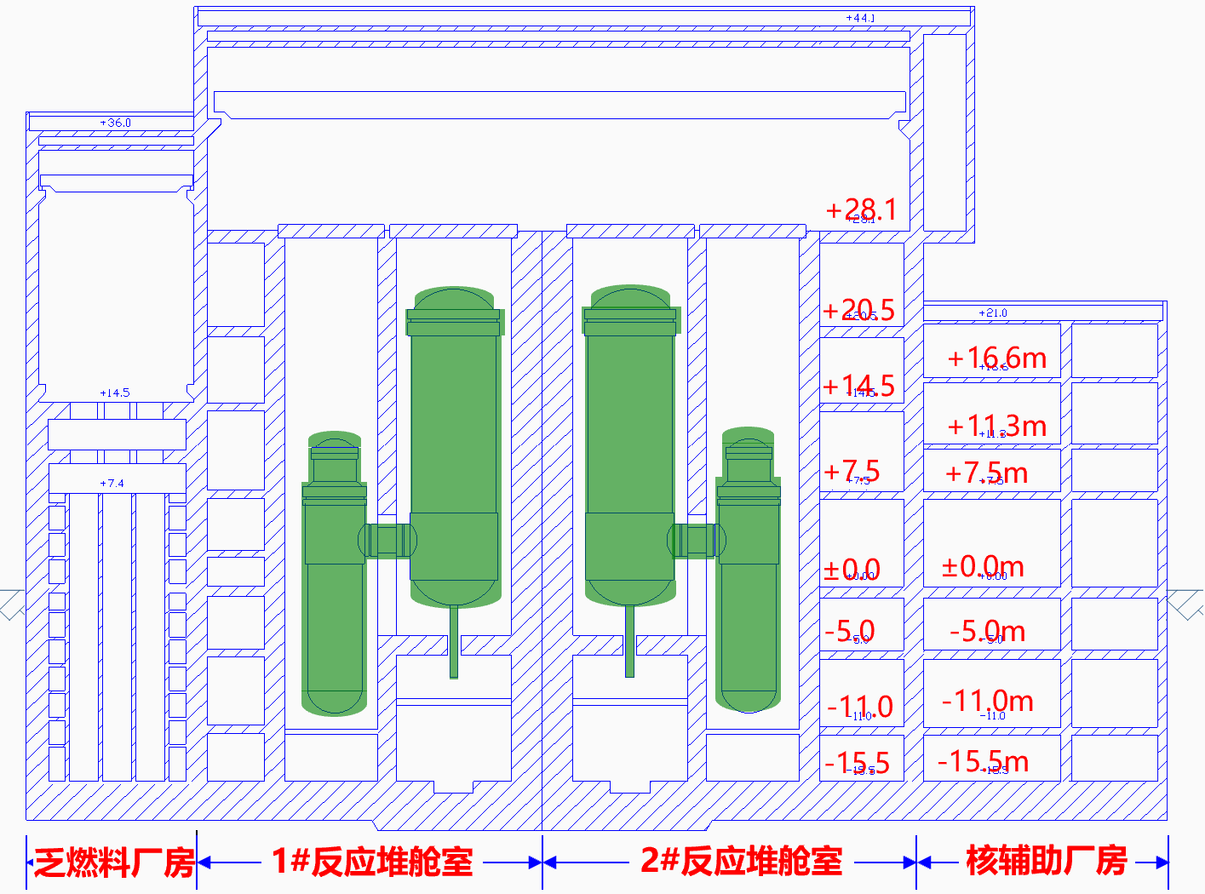
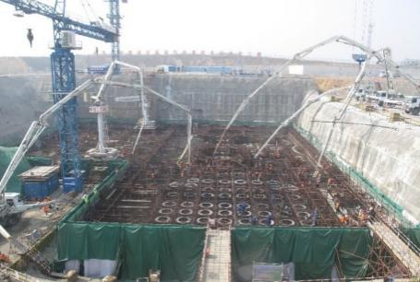
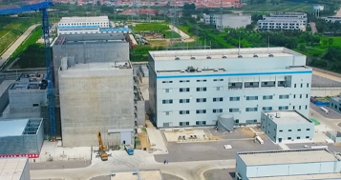
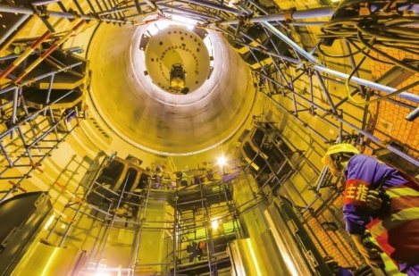
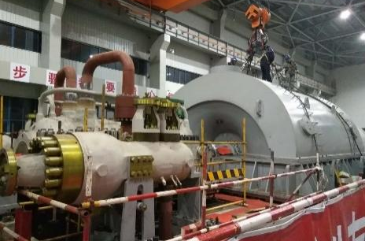
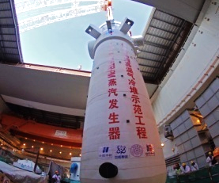
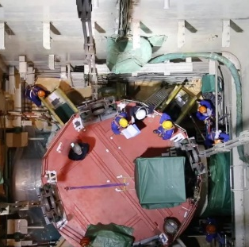
Construction of HTR-PM Nuclear Power Plant
Preliminary Summary
Modular Construction Technology of HTR-PM
Complex pipe equipment installation technology for fuel handling system
Precise installation technology for the mortise and tenon structure of ceramic internals
Double-crane lifting and tilting technology
Integrated modular construction technology of steam generator corbels
Automatic alignment device
Overcame more than 300 similar challenges, and completed 47 NI systems and 31 CI systems
Totally over 27,000 equipment installed
Spent fuel building
1# reactor cabin
2# reactor cabin
Nuclear auxiliary building
Completion of construction and installation
First reinforced concrete
Capping of main building
Hoisting of the first pressure vessel
Buckling of turbine cylinder
Hoisting of the first evaporator
Pairing of steam generator shell, hot gas duct shell and reactor pressure vessel shell of two reactors
December 2012
October 2015
March 2016
March 2017
January 2019
April 2020
Notes:
第四代核电固有安全性及其相关设计如何成功地从图纸变为实体，是HTR-PM核电站建设需要攻克的主要问题。
为解决该问题，石岛湾核电联合上下游企业，首创燃料装卸系统复杂管路设备安装技术、陶瓷堆内构件榫卯结构精确安装技术、超大超重反应堆压力容器双机抬吊翻转工艺等五大特有建安关键技术，累计攻克类似建设难题300 余项，研发整套高温气冷堆模块化建安技术，高质量完成高温气冷堆模块化建造施工，完成47个核岛系统，31个常规岛系统，总计2.7万余台套件设备安装。

Slide 14
PART 3 O&M of HTR-PM Nuclear Power Plants
How to solve the O&M challenges brought by the inherent safety-related design is the main concern of HTR-PM nuclear power plants in operation and maintenance.
Notes:
固有安全性相关设计带来的运行和维护挑战如何解决，是HTR-PM核电站运维需要面对的主要问题。球形包覆颗粒燃料、全陶瓷堆芯、低反应堆堆芯体积功率密度及其相关设计为高温气冷堆的运行和维护带来了挑战。

Slide 15
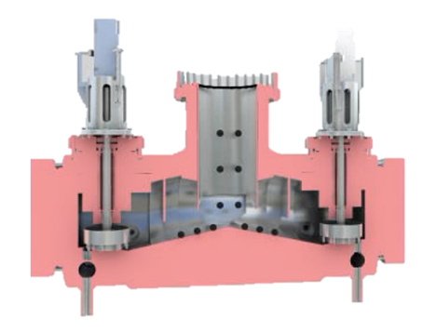
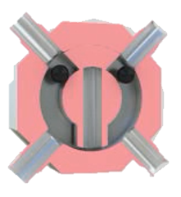
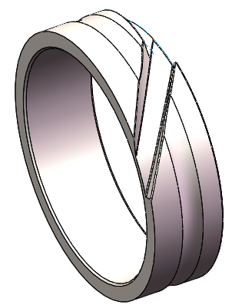
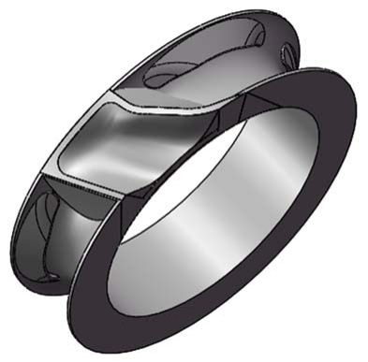
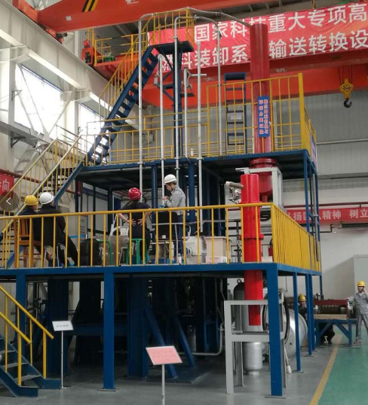
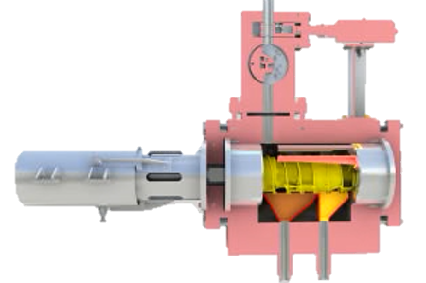
O&M of HTR-PM Nuclear Power Plants
Spherical Coated Particle Fuel
Main Challenges
Solution
As many sets of first-of-a-kind equipment in the fuel handling system have no mature O&M technologies, in the commissioning and trial operation stages, the unloading device, failed fuel separator, bridge coupler, counter and other equipment are easy to malfunction, which greatly affects the handling process of spherical coated particle fuel.
The optimization and modification of fuel handling system were carried out in three phases. Upon the completion of the third phase, around 450,000 fuel spheres were refueled cumulatively, during which the system was in normal operation and the equipment operation reliability was considerably improved.
Additionally, the multi-point linkage control technology for continuous loading and unloading of HTR-PM, the guarantee technology for key equipment for operation reliability of HTR-PM, and the maintenance technology for fuel handling systems and equipment have been developed to support safe and stable operation of HTR-PM nuclear power plants.
Notes:
球形包覆颗粒燃料衍生的燃料装卸系统包含较多首台套设备，在调试与试运行阶段，碎球分离器、桥联器、计数器等设备故障率较高，燃料循环装卸过程受到较大影响。
针对该问题，开展三次燃料装卸系统优化改造。改造后系统运行良好，设备运行可靠性显著提升。
此外，针对性开发反应堆持续装卸料多点联动控制技术，高温气冷堆运行可靠性关键设备保障技术、燃料装卸系统设备维修技术，有效保障了燃料装卸系统的平稳运行。

Slide 16
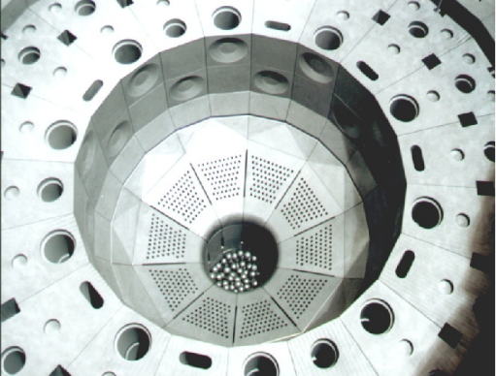
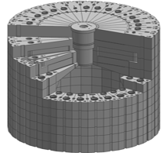
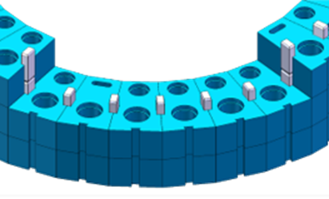
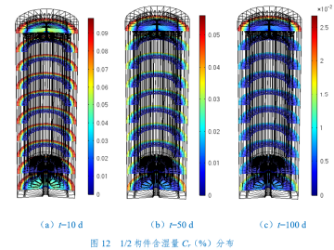
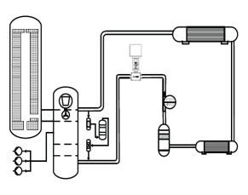
O&M of HTR-PM Nuclear Power Plants
All-ceramic Core
O&M Issues
O&M Issues
Graphite and carbon bricks will adsorb moisture in the air during production, transportation and installation
In the high temperature environment when the reactor is in operation, water vapor will chemically react with carbon materials, causing corrosion of equipment.
There is no mature dehumidification technology available
There are gaps between carbon bricks and graphite components, leading to a certain degree of helium bypass
Excessive helium bypass flow in the core, limiting the increase of reactor power
Solution
Solution
Developing the optimal heating and dehumidification scheme of primary circuit;
Variation characteristics of water diffusion coefficient of nuclear graphite
Vacuum pumping, separation by heating and dehumidification by heating and adsorption
Developing a hot gas humidity sampling device
New operating mode at W platform in transition core stage:
48 tests to explore core characteristics under new conditions
Determining the stable operating power platform (W platform) and key operating parameters by core physics, thermal hydraulic, and safety analysis & calculation
W platform running stably, and continuously refueling till equilibrium core, so as to further improve the power
Notes:
全陶瓷堆芯也带来两方面的挑战。
首先石墨和碳砖在生产、运输、安装过程中，吸附空气中的水分，在高温运行环境下，水蒸气会腐蚀设备，如何对HTR-PM一回路进行除湿，这是HTR-PM运行前需要解决的重要问题。
针对该问题，开展一回路加热除湿方案研究，确定了核级石墨水分扩散系数变化特性，首创抽真空除湿、加热分离除湿、加热吸附除湿相结合的除湿方法，研发一回路高温气体湿度取样装置，顺利完成HTR-PM一回路加热除湿。
其次，构成陶瓷堆芯的碳砖和石墨构件之间存在缝隙，存在一定程度的氦气旁流，堆芯氦气旁流过大时，会限制反应堆功率的提升。
针对该问题，开展48项试验探索新条件下堆芯特点，并结合堆芯物理计算等确定了过渡堆芯阶段机组可以稳定运行的功率平台（W平台）及关键运行参数，创新增加过渡堆芯阶段W平台运行模式，通过在该模式下持续换料至平衡堆芯，解决功率提升受限问题。

Slide 17
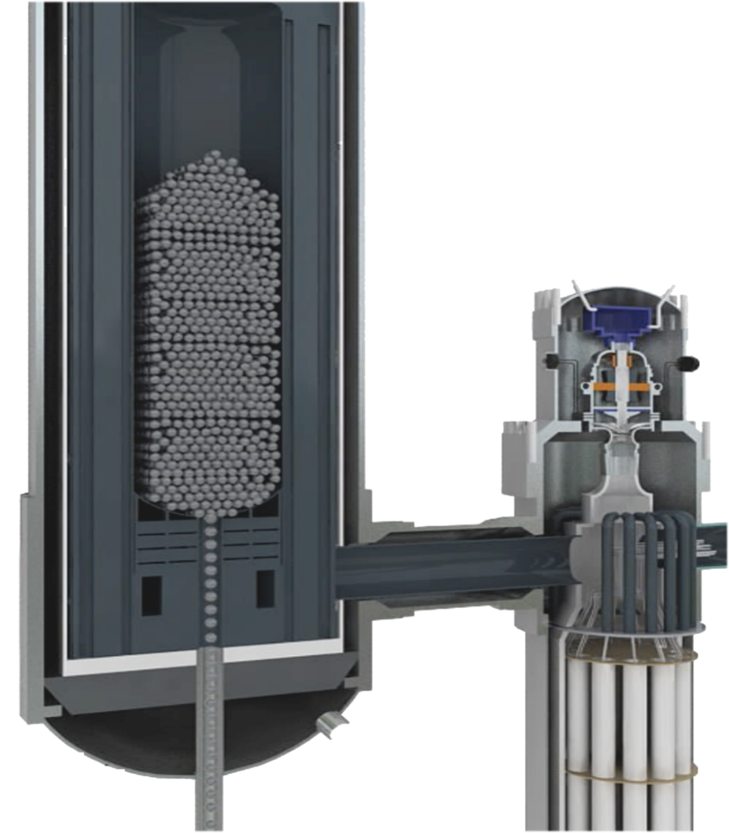
Low volumetric power density of reactor core
O&M of HTR-PM Nuclear Power Plants
Challenges of Primary Pressure Test in Nuclear Power Plants
Solution
Development of strength sealing and heating technology for large-volume dual modular reactor loops
Segmented control of pressure relief in primary pressure test
Temperature difference between the inner and outer walls of the vessel during the pressure reduction test by internal and external heating
Comprehensive leakage detection strategy: the combination of bubble method, ultrasonic method for general inspection, and leakage detection method using helium for verification under low pressure
The combination of patrol inspection in the area where the leakage detection method using helium is applied and ultrasonic inspection/infrared imager under high pressure
Ultra-large volume
Oversized and overweight reactor pressure vessel
The volume of the primary system is 520m³, the target pressure of the test is up to 9MPa, and the cold test risk is high.
High sealing requirements
There are 118 flange sealing surfaces, with the primary leak rate required not exceeding 5 ‰/d, making it difficult to conduct primary cold test.
01
PREREQUISITE
Check and eliminate leaks in advance
02
TEMPERATURE
Difficult temperature control
Multi-means to control temperature
The helium circulator can only start to heat the primary circuit at the low pressure stage, and no sustainable heating means are adopted during the long-term pressure rise and fall process, so it is difficult to guarantee the temperature during the primary circuit cold test.
03
DURATION
Innovative primary boosting method
Notes:
低堆芯功率密度衍生的大体积反应堆压力容器，对于核电站的一回路压力试验来说是一个挑战。
主要有大容积、高气压压力试验的升降压速率控制难度大；一回路无持续热源，降压过程中的金属冷脆温度难以保证；氦气分子小、一回路法兰多，泄漏检查实施难度大等问题。
针对该问题，开发大体积双模块化反应堆回路强度密封及升温技术。实现一回路压力试验排气降压分段控制，有效降低气压试验期间容器的内外壁温差，解决一回路压力容器泄漏率测量、计算难题，首次提出低压下气泡法加超声波法普查与氦检法标记核查相结合，高压下氦检法区域巡检与超声波/红外线成像仪检查相结合的一回路气压试验综合检漏策略，最终顺利完成HTR-PM一回路压力试验。

Slide 18
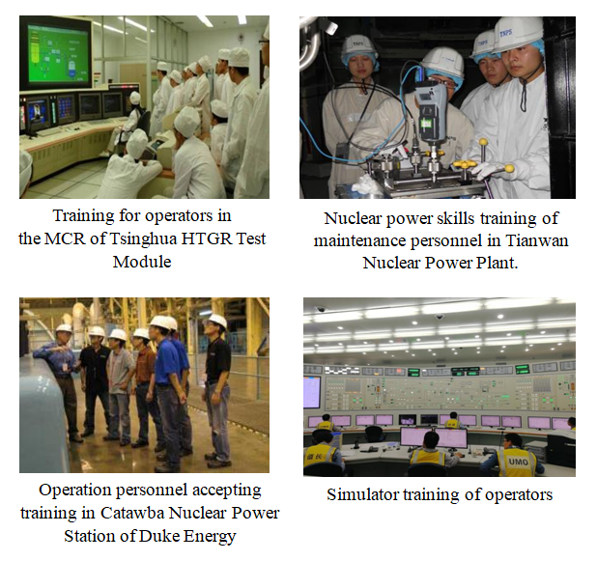
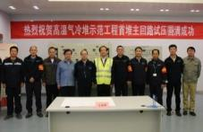
O&M of HTR-PM Nuclear Power Plants
Preliminary Summary
Developing Commissioning, Operation and Maintenance Technology of HTR-PM
Establishing a Talent Team and Collaborative Operation and Maintenance System
Inherent safety performance verification technology for reactors with low power density
Multi-point linkage control technology for continuous loading and unloading of reactors
Strength sealing and heating technology for large-volume dual modular reactor loops
Operation mode of W platform in transition core stage
Joint commissioning, startup, shutdown and operation technology for dual reactors and one turbine
Dynamic radiation protection technology
Safeguards technology for operational reliability-related critical equipment
In-service inspection technology, fuel handling system maintenance technology…
More than 330
66
(29 senior operators)
More than
240
industrial chain units
Senior Engineer
Obtained HTR-PM Operator License
Collaborative Operation and Maintenance System
Completing twin reactor cold test
Completing twin reactor hot test
First fuel load
First criticality
Initial synchronization to the grid
Initial full power
168h assessment test
November 2020
December 2020
August 2021
September 2021
December 2021
December 2022
November 2023
Notes:
固有安全性及其相关设计带来的运行和维护挑战如何解决，是HTR-PM核电站运维需要面对的主要问题。
针对该问题，石岛湾核电开发了大体积双模块化反应堆回路强度密封及升温技术、反应堆持续装卸料多点联动控制技术等六大关键核心技术。同步开发高温气冷堆运行可靠性关键设备保障技术、运行概率安全分析技术等保障性技术。
此外，通过组织人员前往国内外核电基地培训，形成了一支能够满足HTR-PM运维需要的人才队伍；通过与清华大学、西安热工院等内外部单位合作，建立了HTR-PM的协作运维体系，能够有效应对固有安全性相关设计带来的运行和维护挑战。

Slide 19
Conclusion and Outlook
Steam supply
It can provide high temperature and high pressure steam above 9.8 MPa and 510 ℃
Meet all kinds of industrial steam demand.
Special design
Spherical coated particle fuel
All-ceramic core
Low volumetric power density of reactor core
Modular design
Inherent safety
Challenges in construction, operation and maintenance
Successful commercial operation of HTR-PM
High-temperature process heat
Hydrogen supply
Industry
Decomposition
Hydrogen production from high temperature solid oxide electrolysis cells (SOEC)
Hydrogen production and storage
Zero-carbon city
Comprehensive utilization of nuclear energy
Integrated intelligent energy for nuclear, wind, solar energy and energy storage
Traffic
Power supply
Solve properly
Grid
Verified by
Heating
Urban heating network
HTR-PM Demonstration Project will supply 200,000 m2 heating to the street where it is located this year.
Commercial Operation Feasibility of HTR-PM Technology
Water supply
Seawater desalination
The water supply capacity of the desalination project phase I is 10,000 tons/day, meeting the water demand for project operation.
Household consumption
Notes:
本次报告聚焦于高温气冷堆作为第四代核能系统区别于前三代核能系统的显著特征--固有安全性。
将固有安全性分解至球形包覆颗粒燃料、全陶瓷堆芯、低反应堆堆芯体积功率密度等四个特殊设计，简略阐述了上述设计在HTR-PM核电站示范工程建设和运维过程中产生的难点，并简要介绍解决方案。
可以看到，虽然高温气冷堆的固有安全性设计为高温堆的建设和运维带来了一些挑战和问题，但这些问题都已经妥善解决，HTR-PM核电站示范工程也已顺利商运投产。
HTR-PM核电站的商运投产，全面验证了高温气冷堆技术商业应用的可行性，积累了大量的高温气冷堆建设和运维经验，打开了第四代核能技术从实验堆迈向商用市场的大门，未来将助力高温气冷堆技术在核能制氢、发电、热电汽联产及高温工艺热等领域发挥作用，为环境保护和应对气候变化作出重要贡献。

Slide 20
End of Report
Notes:
主题报告完毕

