Slide 1
INPO’s Influence on the Safe and Reliable Operation of Nuclear Power Plants
Steve Meng
Vice President, International Strategy
Institute of Nuclear Power Operations (INPO)

Slide 2
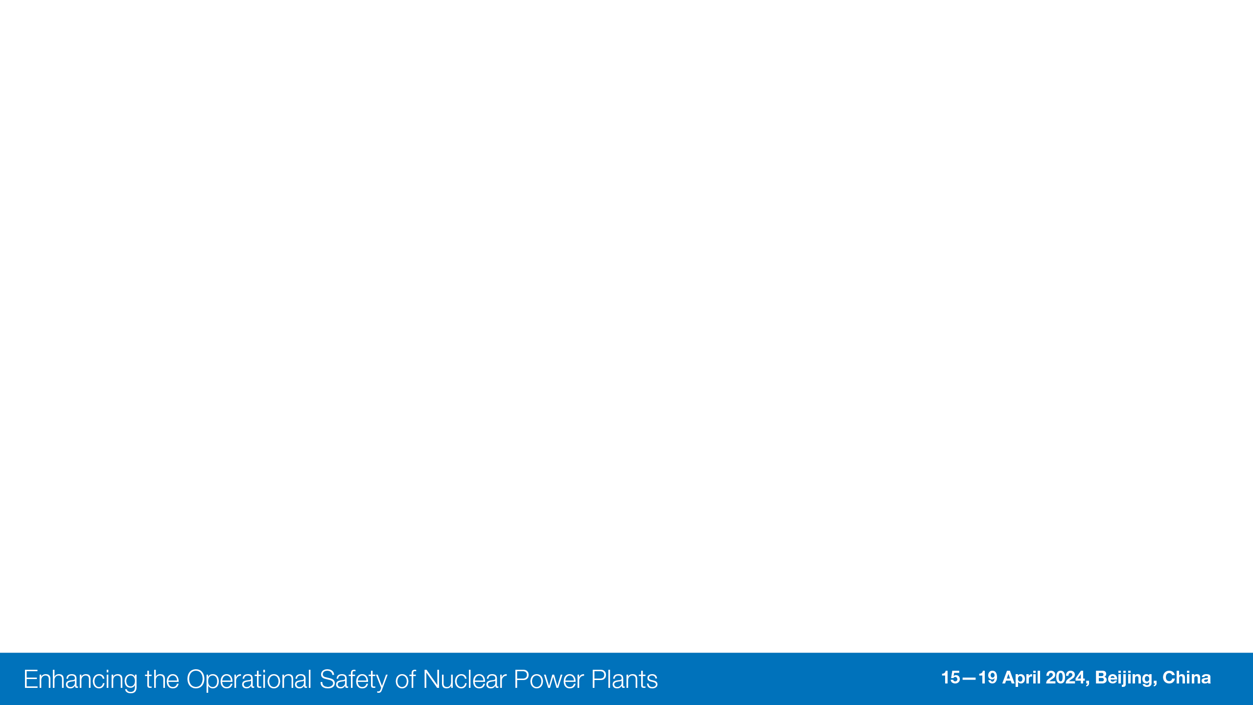








To promote the highest levels of safety and reliability – to promote excellence – in the operation of commercial nuclear power plants.
2
2

Slide 3




Institute of Nuclear Power Operations
National Academy for Nuclear Training
World Association of Nuclear Operators
3
Notes:
Different – decay heat / radiological consequences

Slide 4




INPO and WANO-AC Today
29 Members (21 US)
66 Stations (56 US)
124 Reactors (94 US)
1 Under Construction (US)
1 being restarted (US)
26 Supplier Participants
Providing guidelines and standards directly applicable to nuclear suppliers.
~300 Employees
+ 60 Loaned
$110 Million Budget
Includes WANO-AC
4

Slide 5




Membership
Member Utilities
Supplier Participants
Special Collaboration
U.S. Nuclear Regulatory Commission (NRC)
Partners/Alliances
American Nuclear Insurers (ANI)
Electric Power Research Institute (EPRI)
International Atomic Energy Agency (IAEA)
Japan Nuclear Safety Institute (JANSI)
Nuclear Energy Institute (NEI)
Nuclear Energy Insurers Limited (NEIL)
Councils and Advisors
Advisory Council
Executive Advisory Group
National Nuclear Accrediting Board
Supplier Participant Advisory Committee
INPO
Relationships

Slide 6
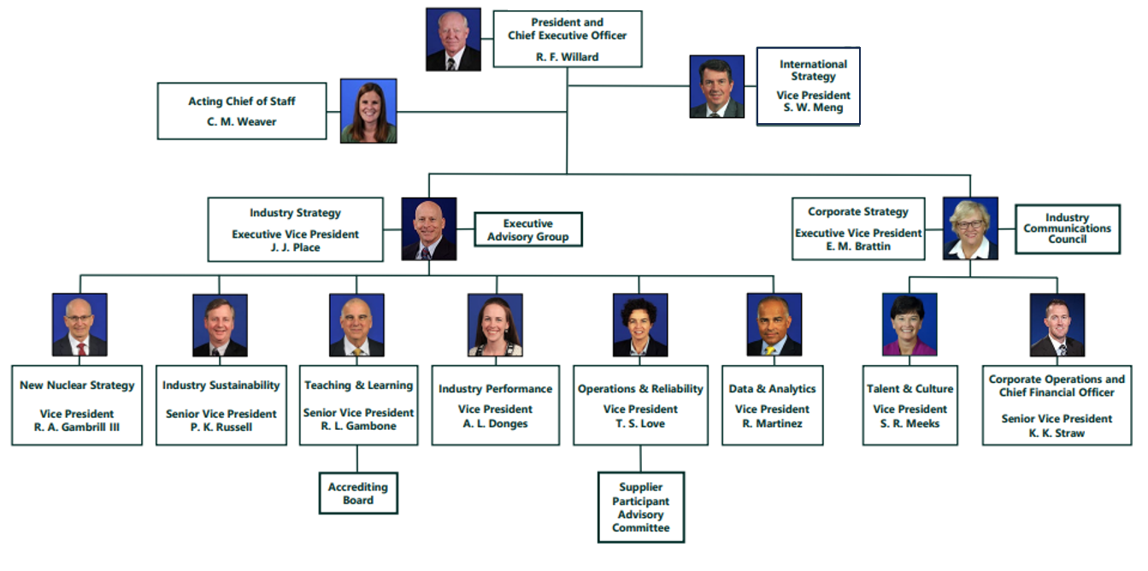

Slide 7




Strategic Design 2021 – 2030
Industry Strategy
Station Performance
Continuous Improvement Culture
Data Science Tools
Teaching and Learning
International Strategy
WANO’s Success
New Nuclear
The Nuclear Community
INPO’s Workforce and Programs
Proven Deployment Results
Corporate Strategy
Optimum Workforce
IT and Data

Slide 8






Keys to INPO’s Success
CEO
accountability
Industry Collaboration
Confidentiality
Safety and Reliability Focus
Independence
Self-regulatory Authority

Slide 9
Performance Continuum Cycle
WANO
Peer Review
(4 Years)
WANO Peer Reviews
Operator
Evaluation
Training Accrediting Boards
Operator Evaluation
Continuum Leader Visit
(CLV)
Continuum Leader Visit
(CLV)
Data
Observations
Assistance
Assessment
Chief Executive Officer (CEO) Briefings
Accrediting Board
(6 Years)
Operator Evaluation
Continuum
Site Visit
(CSV)
Continuous OE and data review, analytics & onsite engagement as needed
Corporate Evaluation
(6 Years)
Notes:
Here it is…for some a new graphic…
As I said the activities within the Continuum are part of the change, but that change in approach & behaviors is key.
Starting at the top is one of the things that will not change – and will function as a guardrail – the WANO Peer Review.
Upon its completion, the Continuum Leader takes over and begins their collaborative relationship with the member.
The collaboration between the station, corporate, and INPO is central to the success of the performance continuum. It calls for transparency between our organizations, the ability to see what each of us is doing & thinking, as well as the results being achieved.
Another important change is an accountability shift that will occur as the performance continuum is implemented. This shift places shared accountability between the member AND the continuum leader to sustainably improve performance. This does not alter the stations accountability for continuous improvement but it does place increased emphasis on continuum leaders to influence sustainable continuous improvement.
How this relationship plays out in terms of interactions will depend on the station’s level of performance and sustainability. A measure of this is what engagement category they are in – which reflects what level of resource we need to devote. The goal is to focus INPO’s resources more on lesser performing stations and corporations and rely on the ability of higher performers to self-identify and self-correct small performance gaps, prior to those issues becoming impactful.
Those interactions will come via data review, observations, assistance and Continuum leader visits. During those observations and interactions we will look for opportunities to monitor where you are at in your journey as well as provide real time help. We also intend to make the observations more fully rounded in that we will be seeking to understand how training is being leveraged and the extent to which corporate is helping.
Then at the 2 year point will conduct a Continuum Site Visit which will ultimately result in a report out to your CEO along with an assessment.

Slide 10
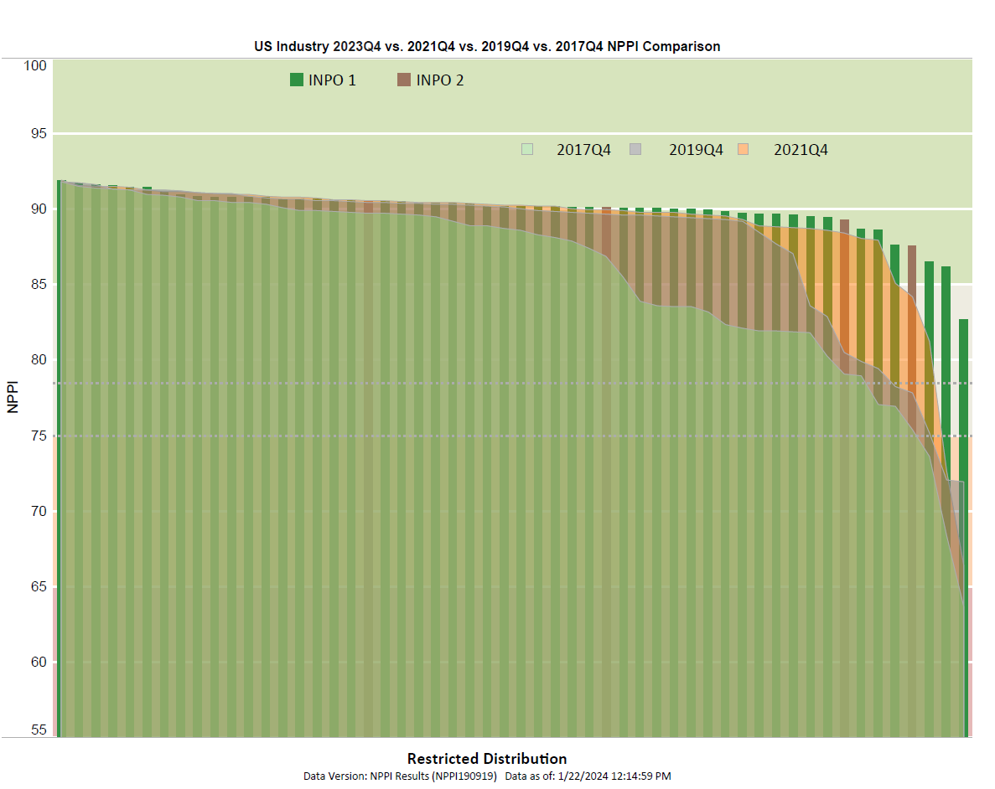
Good Performance

Slide 11

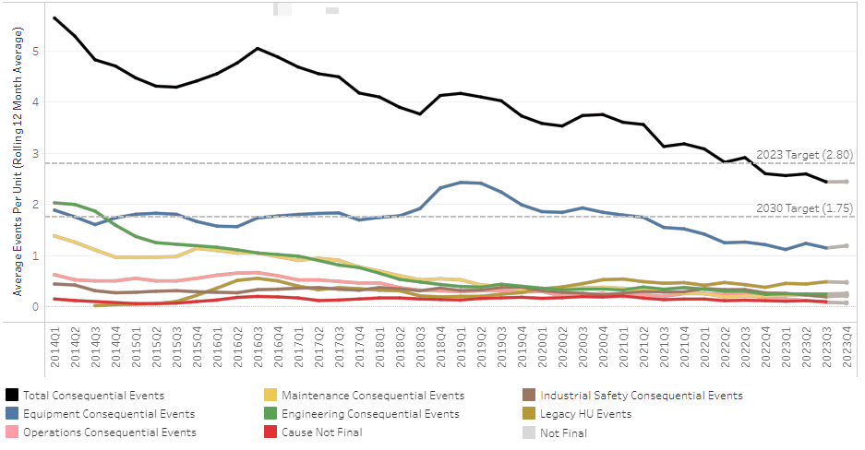
Good Performance

Slide 12
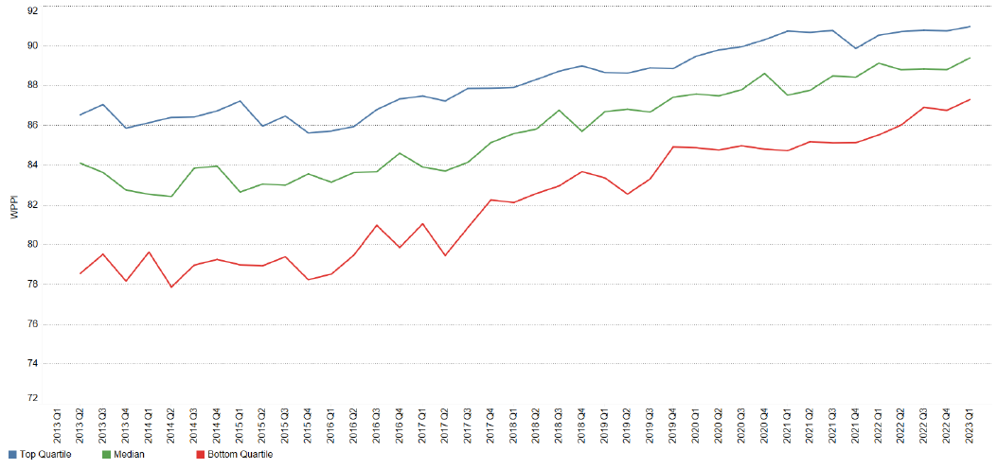
10 Years - WPPI
Good Performance

Slide 13
Questions?
Notes:
Ask: What questions do you have?

