Slide 1
IAEA Support for the Enhancement of Operational Safety of NPPs
Ms Anna Hajduk Bradford
IAEA Director Division of Nuclear Installation Safety

Slide 2
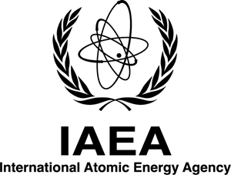
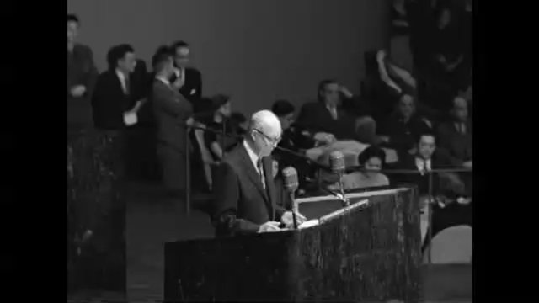
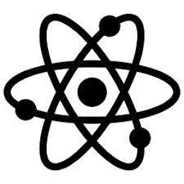
The International Atomic Energy Agency
Established in 1957
178 Member States
With a vision to harness the power of the atom for the benefit of humankind
It works with partners worldwide to promote the safe, secure and peaceful use of nuclear technologies
Safety & Security,
Safeguards, TC, Nuclear Energy, Nuclear Applications, Management
Publications, review missions, forums & conferences, capacity building, TC projects, lab services, networks,…
2

Slide 3
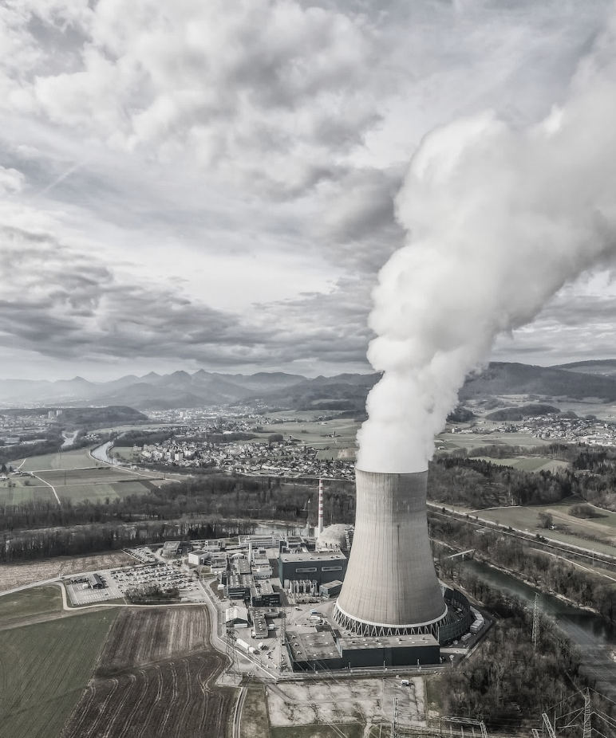
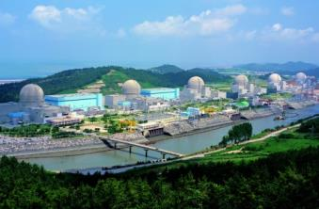
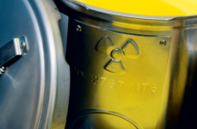
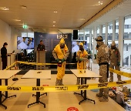
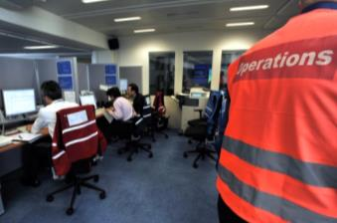
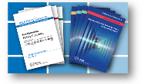
“Strengthening nuclear safety and security worldwide through international cooperation”
The Department of Nuclear Safety and Security
Nuclear Installation Safety
The Division of Nuclear Installation Safety supports Member States in establishing the appropriate safety infrastructure and in continuously improving the safety of nuclear installations during site evaluation, design, construction and operation.
Radiation, Waste and Transport Safety
Nuclear Security
Incident and Emergency Center
Nuclear Safety and Security Coordination Office
3

Slide 4
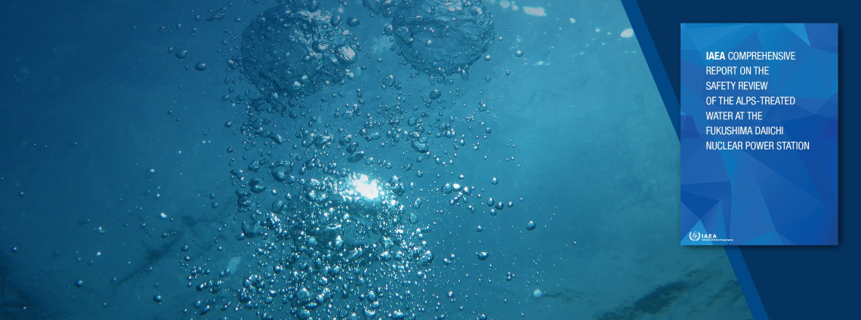
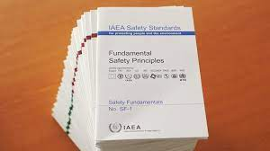
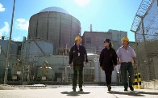
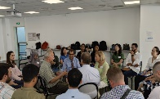
IAEA Support to MSs to enhance operational safety
Via
Ensuring the safe and reliable operation of the existing nuclear power plants, including the activities during commissioning and the preparations for decommissioning.
Ensuring the safe and reliable operation beyond the originally licensed plant life ‘Long-Term Operation’.
Sharing operating experience between various organizations in the Agency’s Member States via the Incident Reporting System.
Safety Standards
Peer Reviews
Advisory Services
Support Missions
Capacity Building
Knowledge and experience Sharing
4

Slide 5
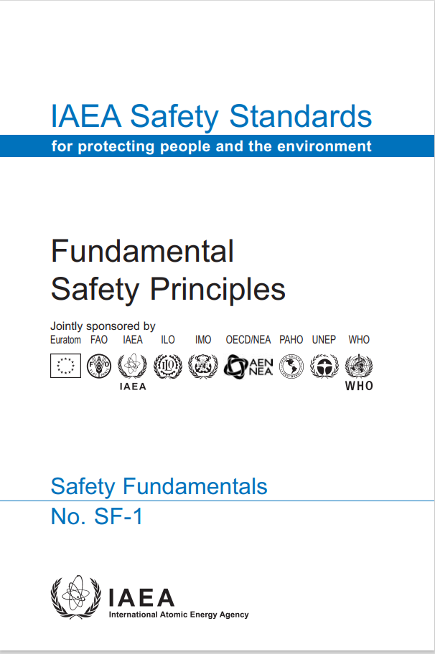
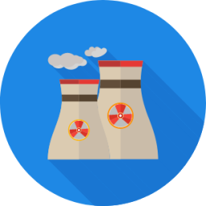
Fundamental Safety Principles
The Fundamental safety objective is to protect people and the environment from the harmful effects of ionizing radiation.
Principle 1: Responsibility for safety
Principle 2: Role of Government
Principle 3: Leadership and management for safety
Principle 4: Justification of facilities and activities
Principle 5: Optimization of protection
Principle 6: Limitation of risks to individuals
Principle 7: Protection of present and future generations
Principle 8: Prevention of accidents
Principle 9: Emergency preparedness and response
Principle 10:Protective actions to reduce existing or unregulated radiation risks.
10 Fundamental Safety Principles
Basis on which safety requirements are developed and safety measures are implemented to achieve the fundamental safety objective
5

Slide 6
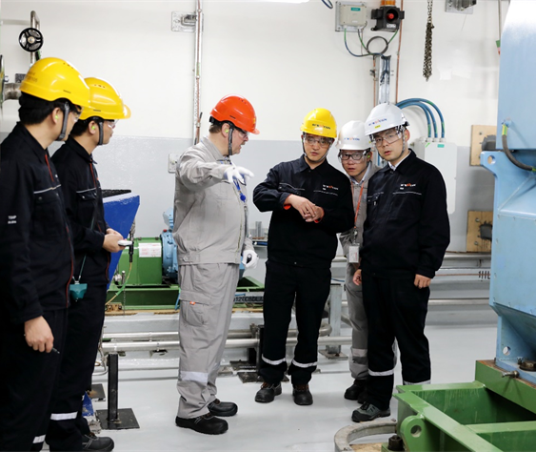
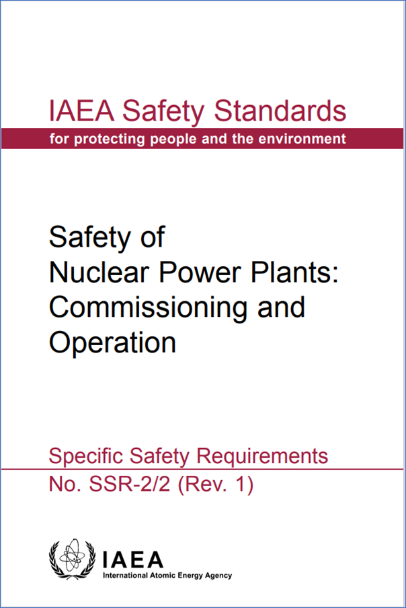
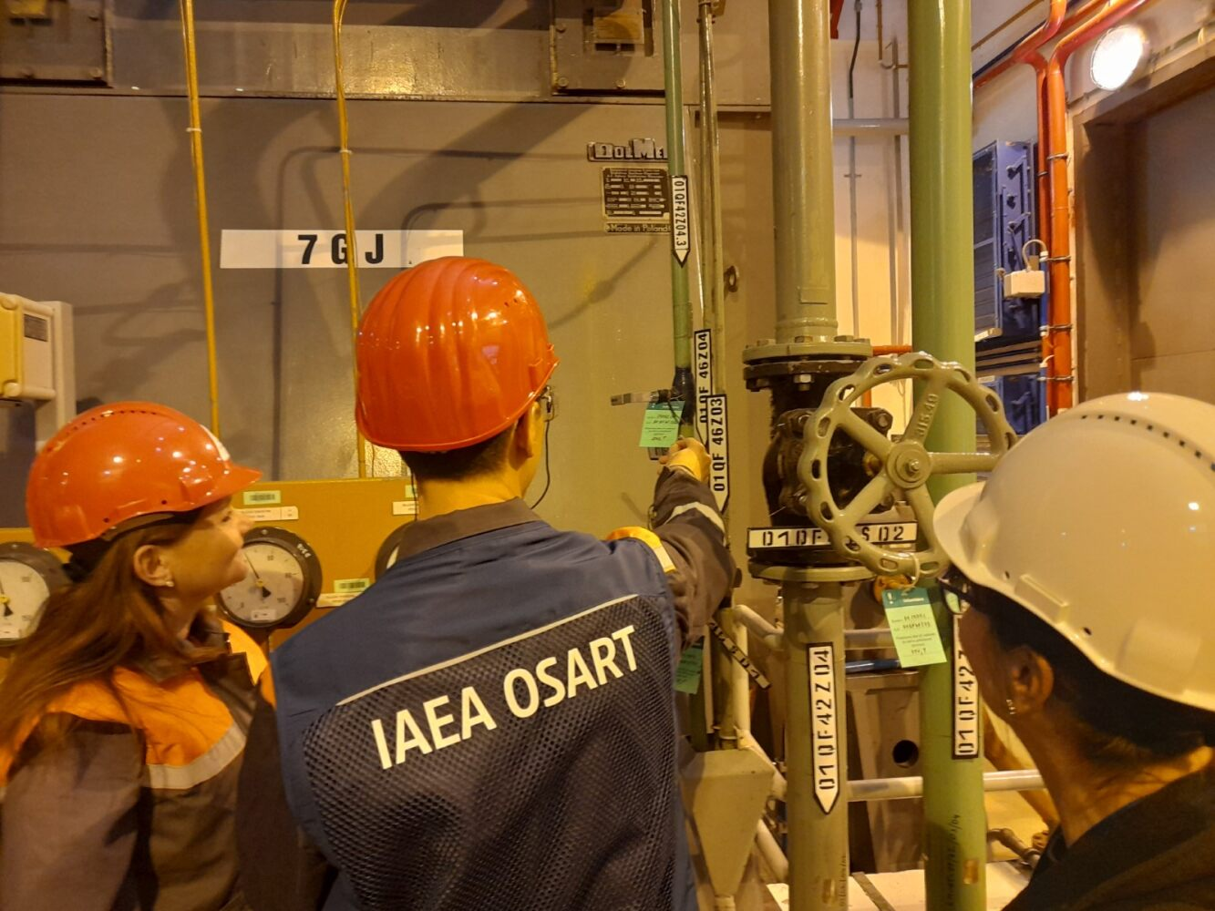
Peer reviews to enhance operational safety 1/2
Operational Safety Review Missions (OSART)
The OSART service provides Member States with an objective and independent assessment on the status of nuclear power plants operational safety with respect to the IAEA Safety Standards.
We also provide technical assistance, seminars and support missions.
40 Years of OSART Missions
219 missions: 118 sites, 37 countries
187 OSART missions to operational plants
29 OSART missions to plants under construction
3 corporate missions
161 follow-up missions (started in 1989)
6

Slide 7
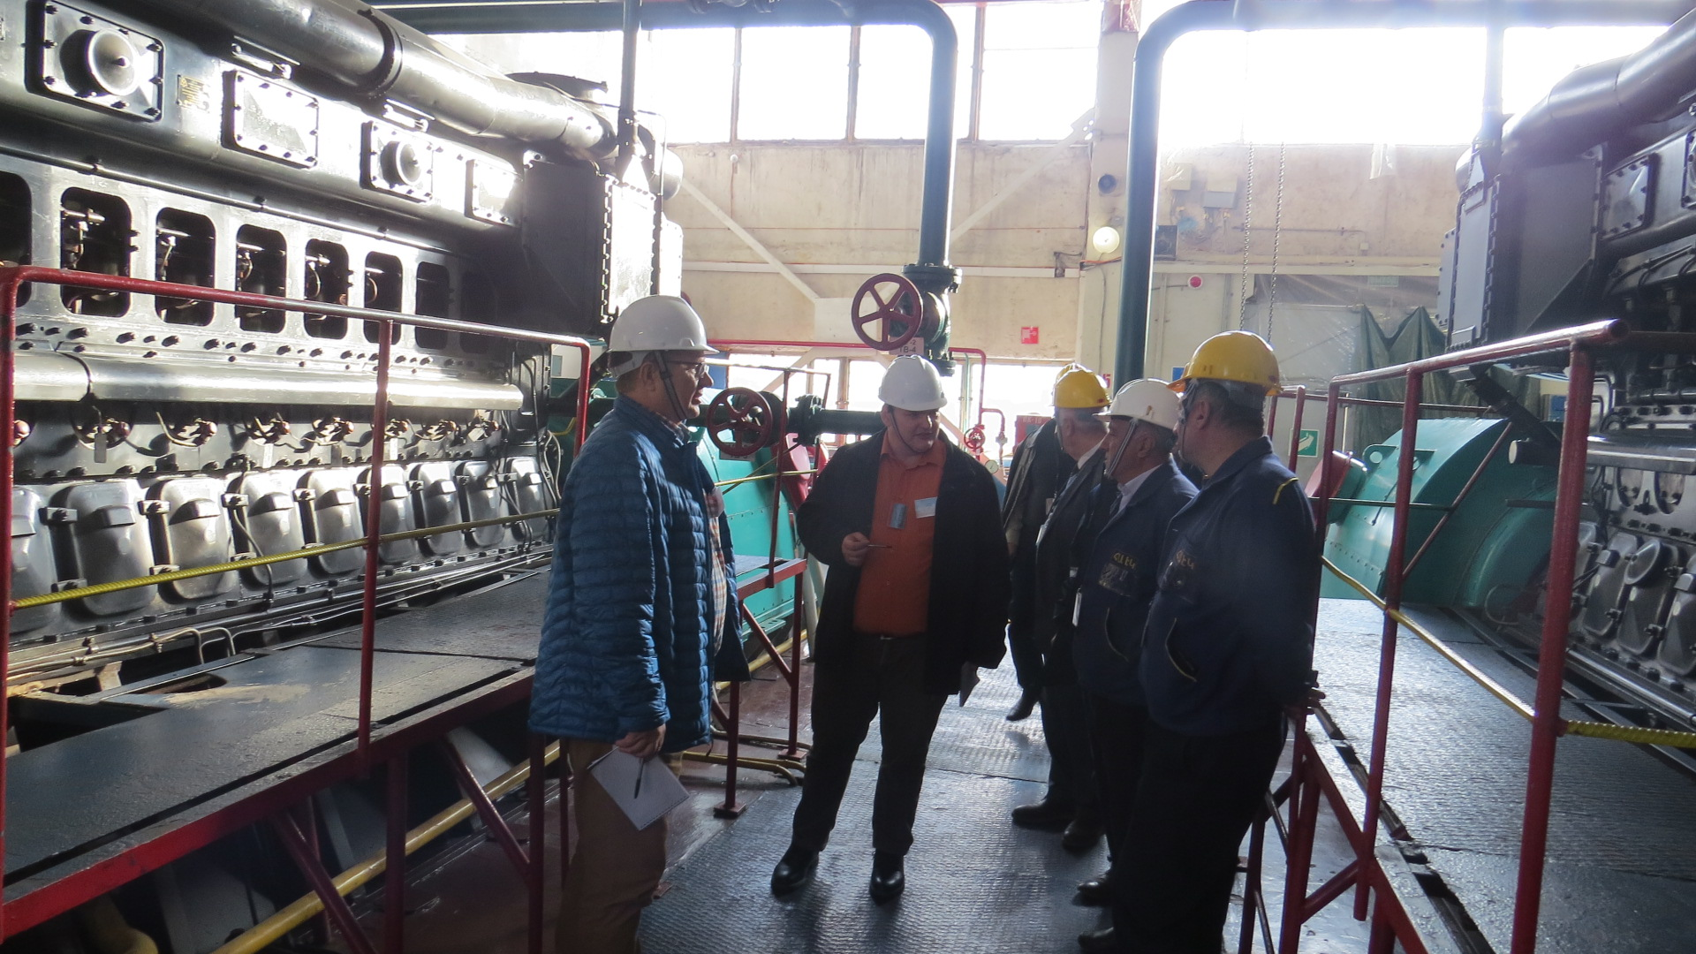
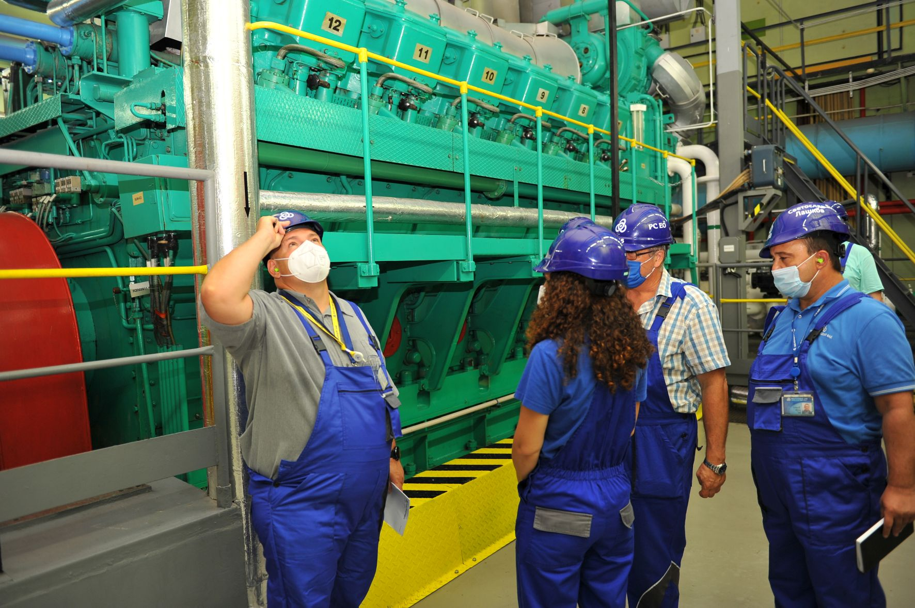
Peer reviews to enhance operational safety 2/2
Safety Aspects of Long-Term Operation (SALTO)
The SALTO peer review service provides advice and assistance to Member States embarking on long term operation (LTO) in enhancing the safety of nuclear power plants (NPPs).
A SALTO mission is often preceded by a pre-SALTO mission to ensure that preparatory work is focused on those areas that will add most safety value.
So far, 56 SALTO missions have been conducted in 20 countries since its establishment in 2007.
7

Slide 8
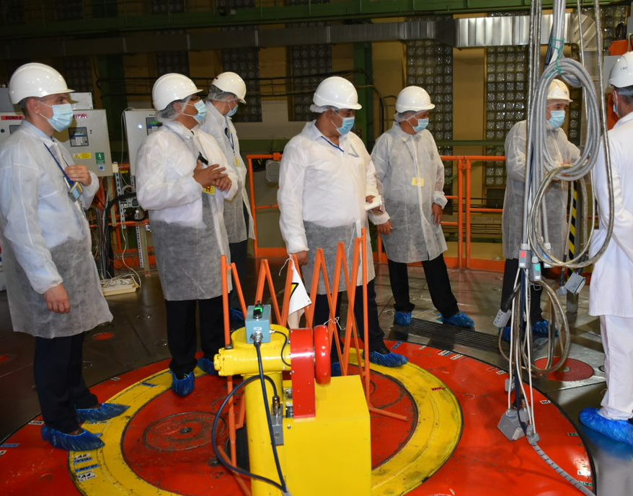
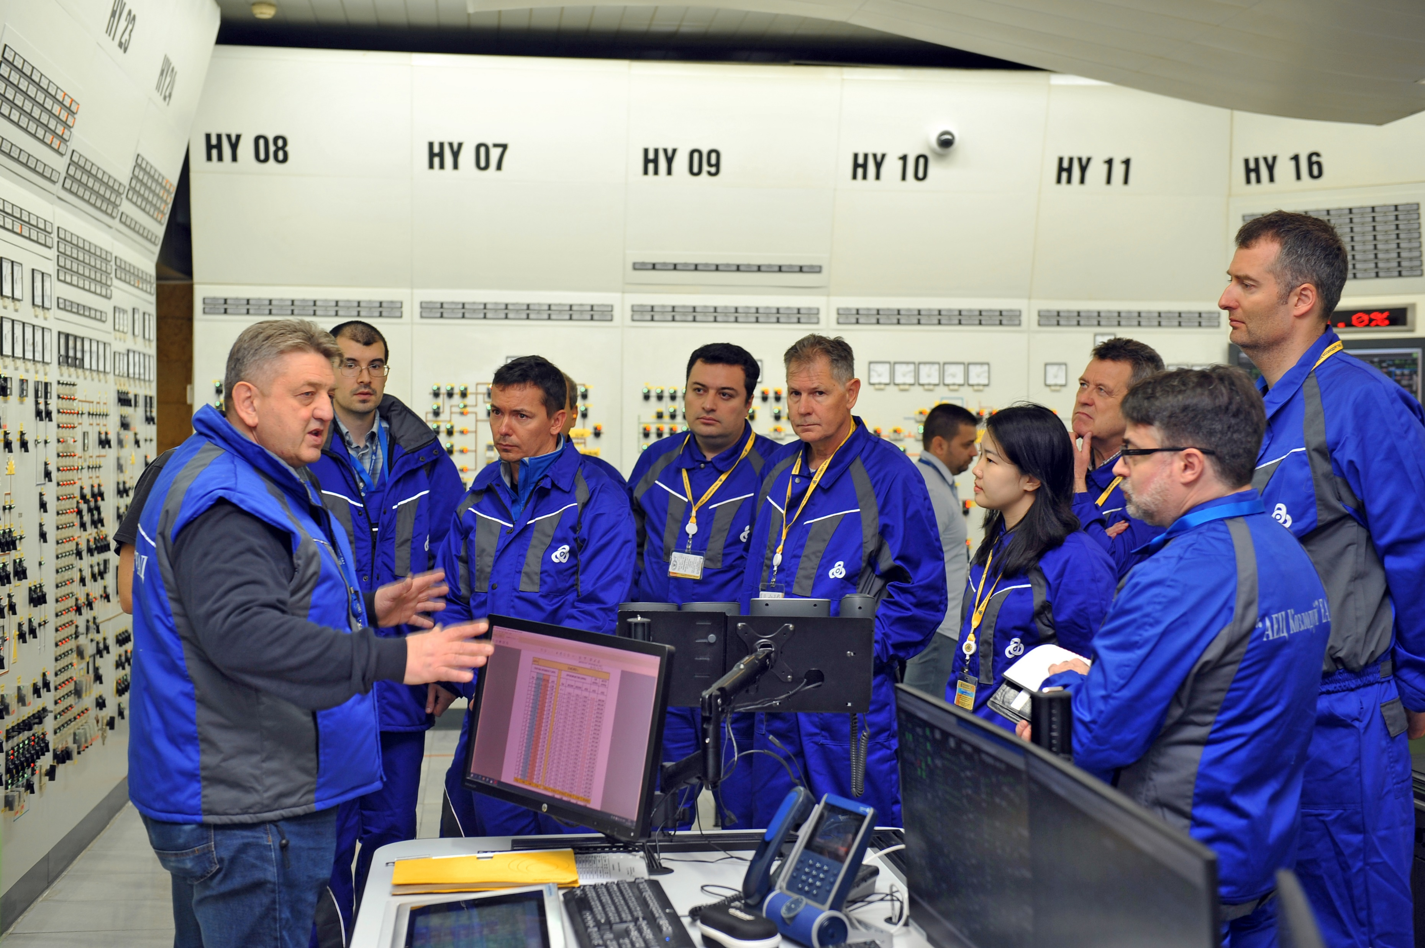
Other IAEA peer reviews and advisory services
Peer Review of Operational Safety Performance Experience (PROSPER)
Independent Safety Culture Assessment (ISCA)
Integrated Regulatory Review Service (IRRS)
Safety Evaluation of Fuel Cycle Facilities During Operation (SEDO)
Site and External Events Design (SEED)
Technical Safety Review (TSR)
Integrated Safety Assessment of Research Reactors (INSARR)
8

Slide 9
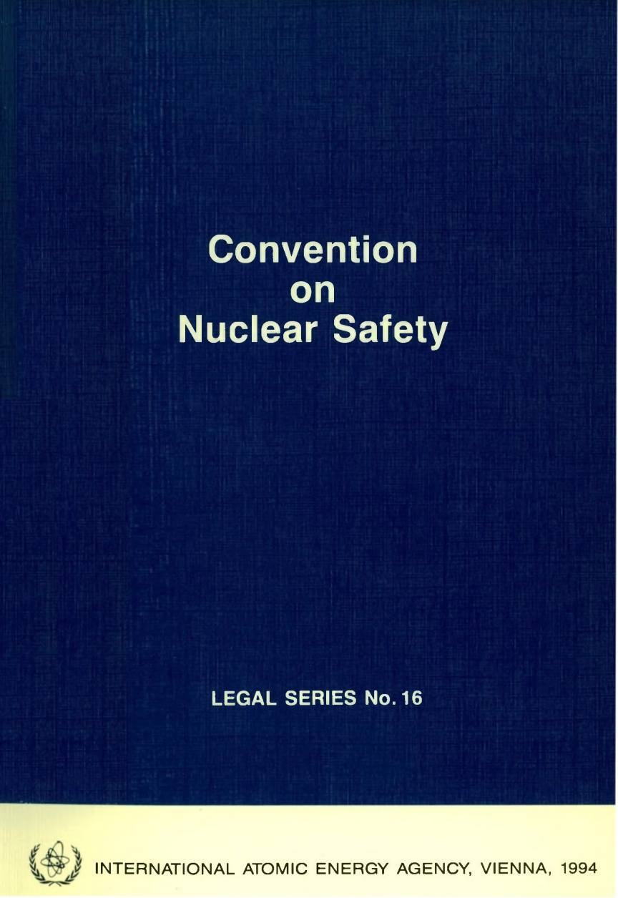
Incident Reporting System for Nuclear Installations
Incident Report System (IRS) is currently the only global mechanism to satisfy Article 19 of the Convention on Nuclear Safety:
…each contracting Party shall… have existing mechanisms… to share important operating experience …….. with international bodies…
IRS Platform is Jointly operated by the IAEA and the OECD/NEA
37 participating Member States with over 1300 users.
Fundamental Objective: contribute to improving the safety of commercial NPPs and facilitate the exchange of operational experience between participating Member States (MS).
Members States share event reports on safety significant events and lessons learned to prevent similar events……Events from Commissioning, Construction, Operation and Decommissioning (more than 4800 events report available) for MS.
9

Slide 10
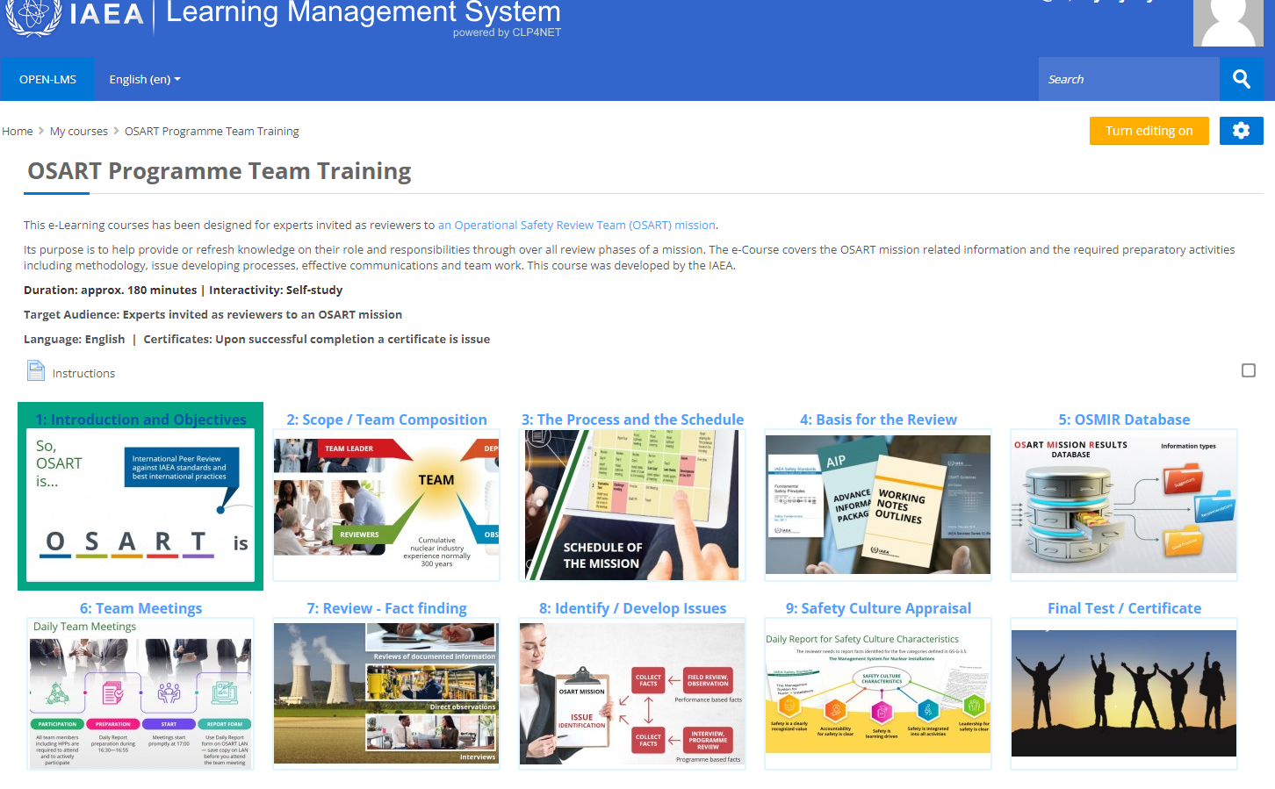
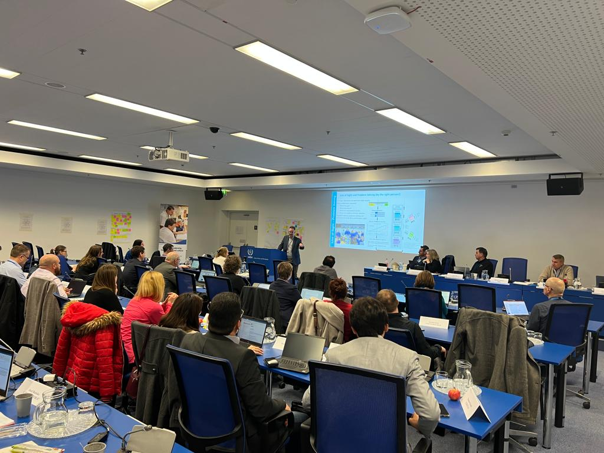
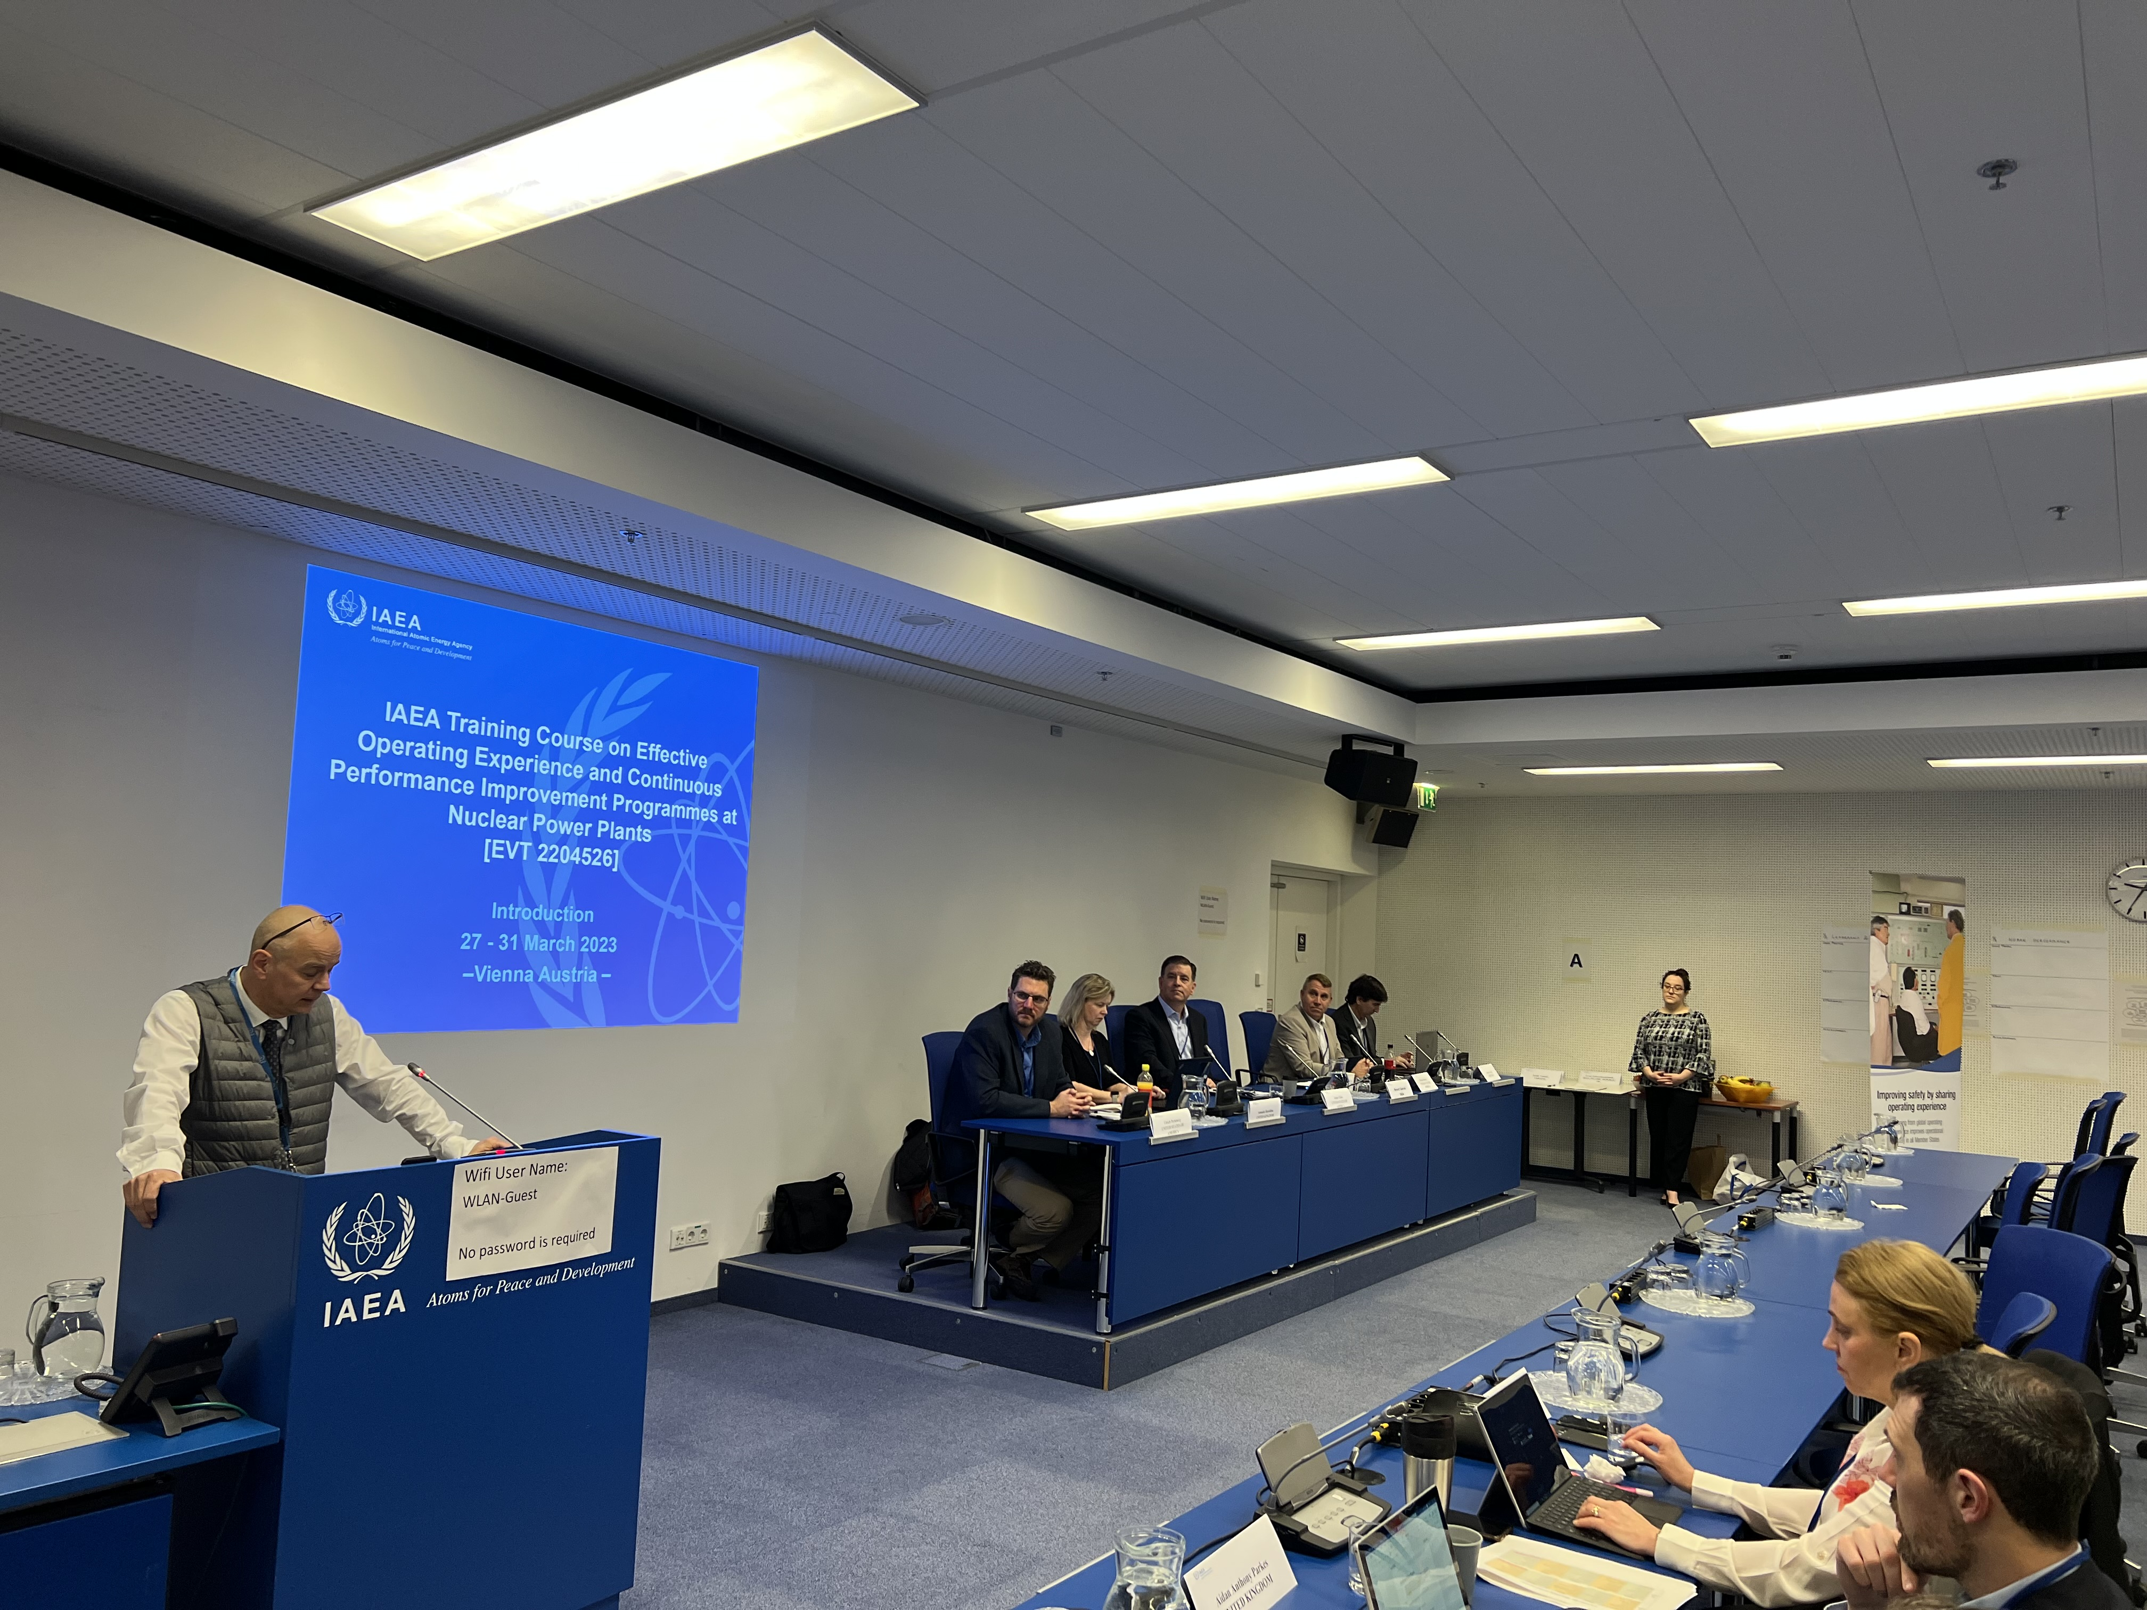
Capacity Building
The IAEA regularly organizes many workshops, training events and webinars to support Member States building their capabilities in areas such as operational safety, management for safety and safety culture.
For example, this week the IAEA is conducting a workshop on Leadership and management and safety culture in the Armenian NPP (Metsamor).
We also provide training courses and e-learning modules for OSART and SALTO reviewers.
10

Slide 11
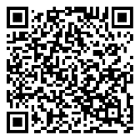
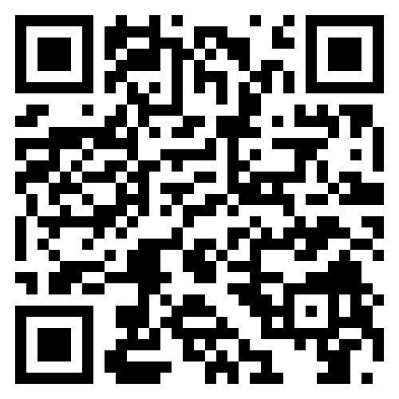
IAEA activities in SMRs and advanced reactors
SMR Platform coordinates the Agency’s activities in the field of SMRs and provides a ‘one‑stop shop’ for Member States and other stakeholders.
The Nuclear Harmonization and Standardization Initiative (NHSI) was initiated in 2022 with the goal of enabling the effective global deployment of safe and secure advanced nuclear reactors.
Recently the IAEA concluded a review for safety standards for Applicability to Non-Water-Cooled Reactors and SMRs, the review is documented in the safety report SR-123.
The IAEA is organizing its first International Conference on Small Modular Reactors and their Applications which will be held from 21 to 25 October 2024 at the IAEA Headquarters in Vienna, Austria.
11

Slide 12
In Conclusion…
The IAEA will continue supporting Member States in enhancing operational safety of NPPs via providence of peer reviews, safety standards and capacity building activities.
The Agency will also continue assisting Member States planning to operate their NPPs beyond its’ design life, through activities such as the SALTO peer review service.
The IAEA is fully committed to enabling the effective, safe and secure global deployment of advanced nuclear reactors.
The Agency encourages Member States to share their operating experience via the Incident Reporting System, in order to enhance the global operational safety of NPPs.
12

Slide 13
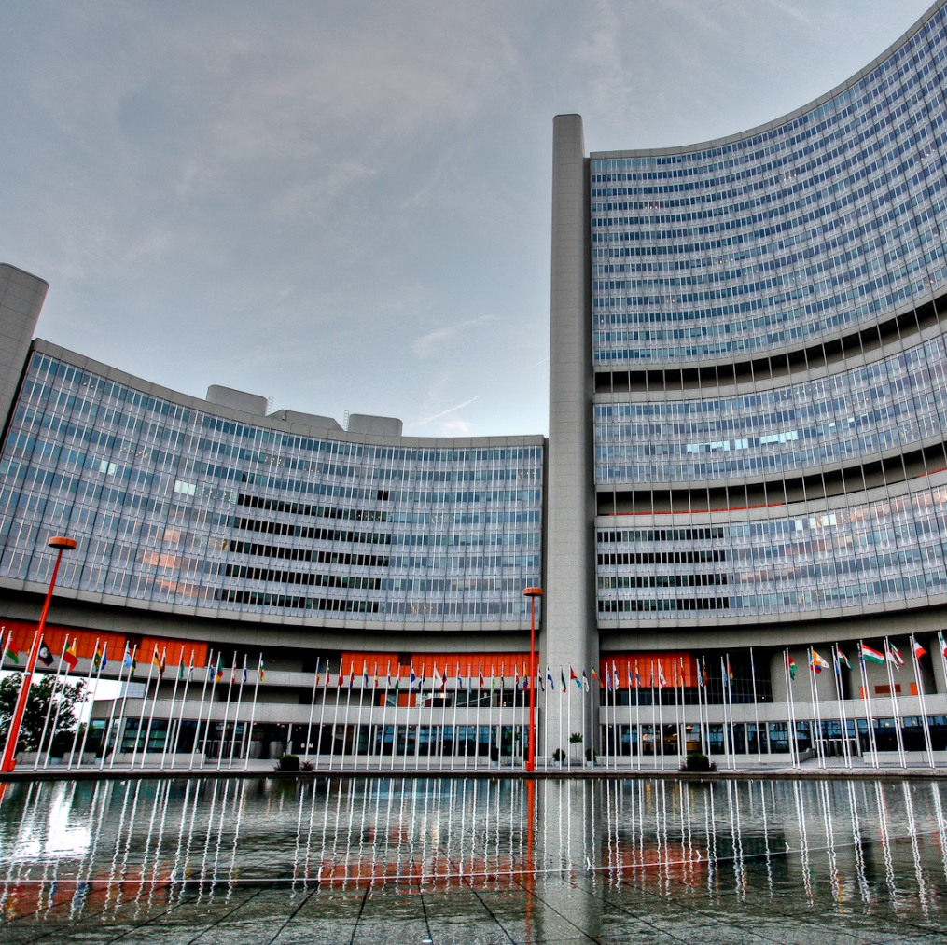
Thank you !

