Slide 1
Jointly Promoting the Safety and Performance of Nuclear Power Operation
ZHANG Tingke
Vice Chairman and Secretary General
China Nuclear Energy Association
15 May 2024, Beijing China
Notes:
协力推动核电运行安全改进与绩效提升

Slide 2
01
Status and prospects of nuclear power development in Chinese Mainland

Slide 3
Nuclear power development in Chinese Mainland has made remarkable achievements
55
Ranking third in the world
Nuclear power units in commercial operation：55
Total installed capacity: 57 million kilowatts
Total reactor years of operation: 577.37 reactor years
26
Stay first in the world
Nuclear power units under construction: 26
Total installed capacity: 303 million kilowatts
By the end of March 2024
Notes:
协力推动核电运行安全改进与绩效提升

Slide 4
Important breakthrough in nuclear power technology innovation in Chinese Mainland
HPR1000
Put into generation: 5 units
Under construction: 12 units
CAP1400
Major scientific and technological project for the large advanced PWR NPP
Notes:
协力推动核电运行安全改进与绩效提升

Slide 5
Prospects for Nuclear Power Development in Chinese Mainland
10% The proportion of nuclear power generation in China's electricity structure
2060
2024
2035
18% The ratio of nuclear power generation expected
Notes:
协力推动核电运行安全改进与绩效提升

Slide 6
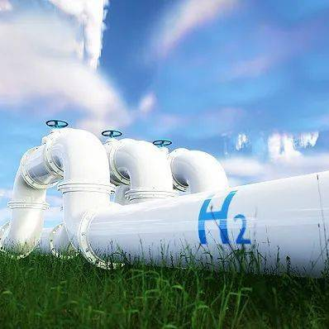
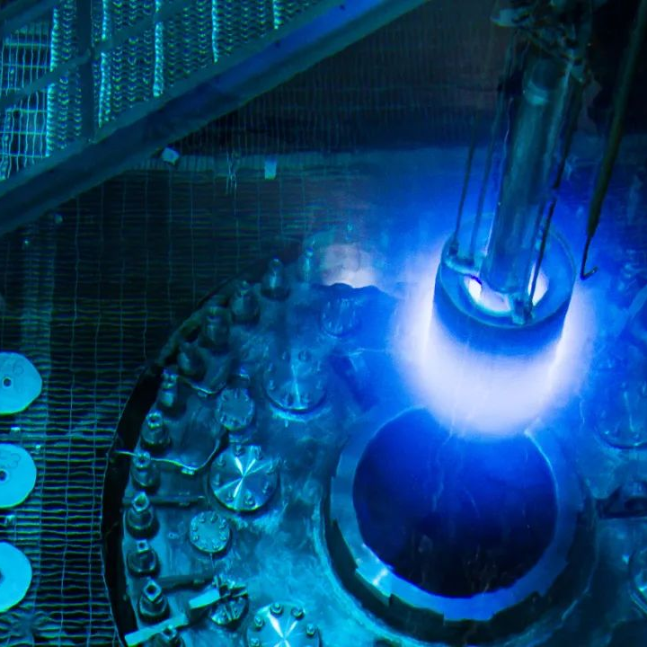
A wide range of nuclear energy application scenarios in Chinese Mainland are expected
CARBON NEUTRALITY
Notes:
协力推动核电运行安全改进与绩效提升

Slide 7
Ensuring the operation safety of nuclear power is the common responsibility of the international community
02

Slide 8
Ensuring the safe operation of nuclear power is an essential premise for achieving a sustainable development of nuclear energy in the world
SAFETY
Decision and Deployment
Actively and Safely Develop Nuclear Power in An Orderly Manner
Policy
Concept
Adhere to the “Safety First"
Everyone acts as the last barrier
SAFETY
Notes:
协力推动核电运行安全改进与绩效提升

Slide 9
The NPPs operation safety in Chinese Mainland is in good condition
Full score of composite index
Units with a comprehensive index of full marks account for 65% of the total number of operating nuclear power units in China.
Units with a comprehensive index of full marks account for over 40% of the world's total full score units.
Source: the statistics of the performance indicators for the third quarter of 2023 released by WANO.
Notes:
协力推动核电运行安全改进与绩效提升

Slide 10
Problems and challenges in the area of NPPs operation safety in Chinese Mainland
NO.1
How to ensure the safe and stable operation of the new unit?
NO.2
CHALLENGE
The whole industry should pay close attentions to the problems existed for a long time and demanding continuous consideration.
NO.3
Advocate the integrity and transparency of the nuclear power industry, and furtherly establish the events feedback mechanism.
Notes:
协力推动核电运行安全改进与绩效提升

Slide 11
Collaborate to promote the safety improvement and performance enhancement in nuclear power operations
03

Slide 12
Collaborate to promote safety improvement and performance enhancement in nuclear power operations
Regularly organize the activities such as nuclear power peer evaluation and member support.
Continuously optimize the nuclear power operation experience exchange and information sharing mechanism.
Try to establish a special working mechanism for improving the performance of nuclear power operations.
Deepen the Special Collaborative and Shared Services for Nuclear Power Operations.
Notes:
协力推动核电运行安全改进与绩效提升

Slide 13
Close cooperation, mutual support, exchange and mutual learning
Build a community of shared future for the safe development of nuclear energy.
Promote global nuclear power operation safety improvement and performance enhancement
Notes:
协力推动核电运行安全改进与绩效提升

Slide 14
THANK YOU

