Slide 1
Technical Secretary Summary
S Morgan
K Maekelae

Slide 2
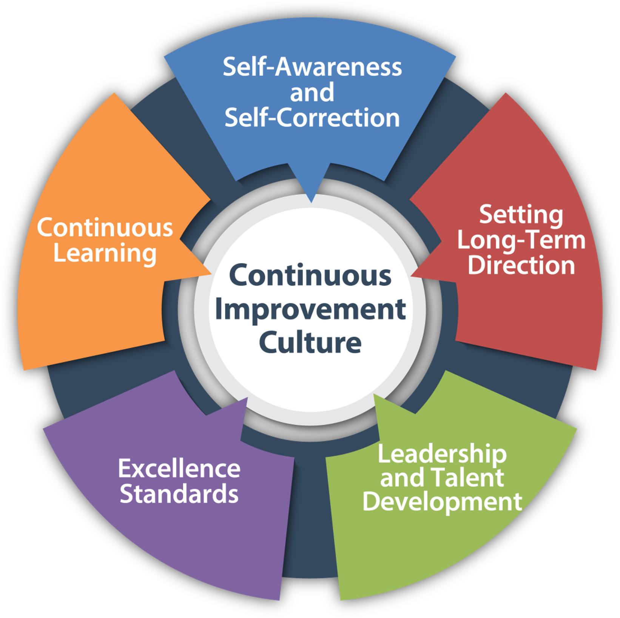
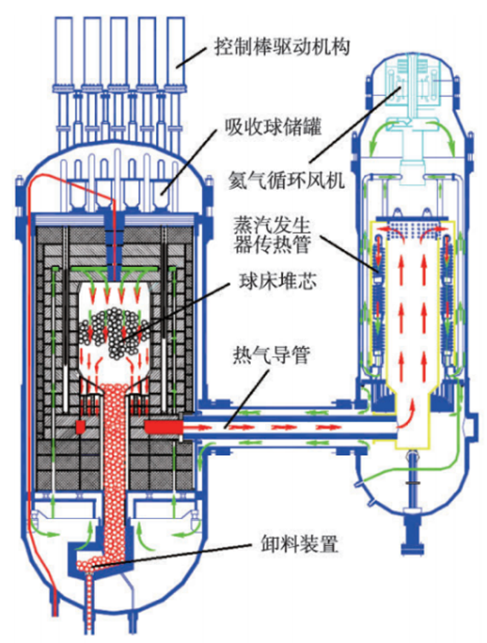
Operational Performance Improvement – Getting Better at What We do
Importance of being able to self-identify issues
Become more self-aware & being able to resolve issues before consequences are felt
Impact of supporting organizations in early identification of declining performance
ePM initiative
“Staying on Top” – “As an Industry we are Only as Strong as our Weakest Link”
One of keys to sustaining high operating standards - effective operating experience process – “Don’t be a Bystander”….
Innovations providing additional levels of operational safety
Advanced Reactor Designs - High Temperature Gas Cooled Reactor, SMRs

Slide 3
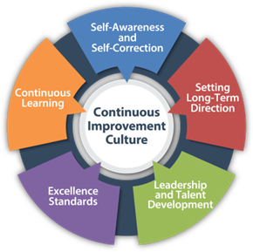
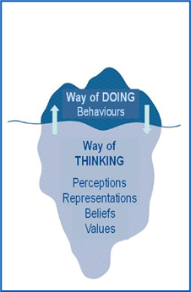
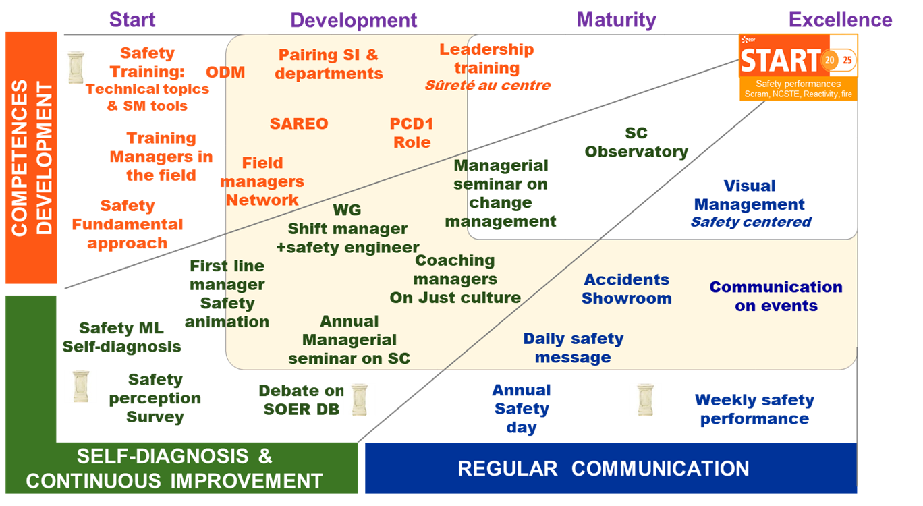
Leadership and Safety Culture – Striving for Excellence
Sustaining high performance by having strong safety culture
Five Core Values - behaviours which sustains high performance while also continuously improving
Safety Culture encompasses - organization, behaviours, perceptions (beliefs & values)
Creating a strong safety culture in operational & new built nuclear power plants
Impact culture on type organization – established/new/transitional
“Human Performance Events are preventable….learn the lessons”
Leadership’s role in strong safety culture
Seven Behaviour Habits of Excellent Nuclear Professional Leadership
Vision - “Becoming a World Class Enterprise”
Importance diverse methods assess safety culture
Avoidance of Blind Spots – Importance of Benchmarking
Complacency breeds mediocrity….and steals potential

Slide 4
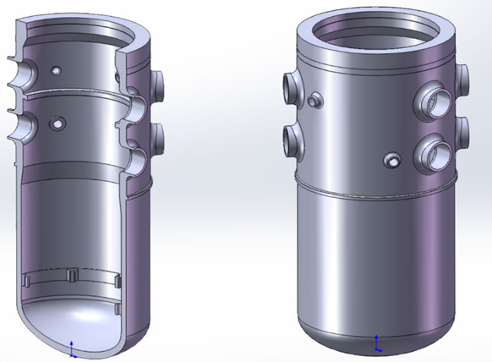
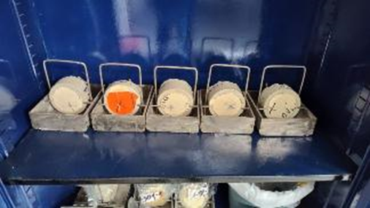
Long Term Operations – Extended Operations
Technical Aspects of LTO programmes
Impact radiation on non-replaceable parts such as RPV and core baffle
Optimalization of fuel arrangements extend life non-replaceable parts reduce radiation embrittlement
Examples of Time Limited Ageing Analyses – EQ for Epoxy Coating, cables non-compliant with environmental qualification……
Internal organizational challenges
Regulations, Organization & Public Acceptance
Early engagement with regulator (5 years)
Environmental Licensing Process (4 years)
Use independent peer reviews
Public and governmental acceptance of nuclear power programmes

Slide 5
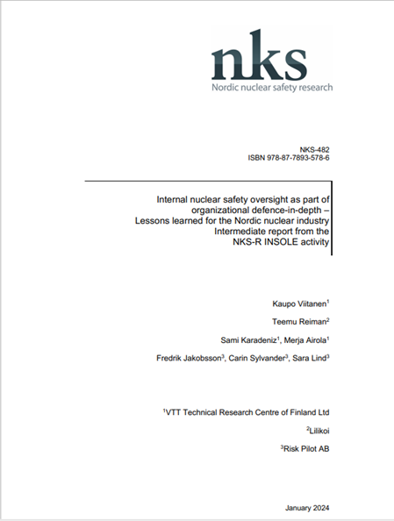
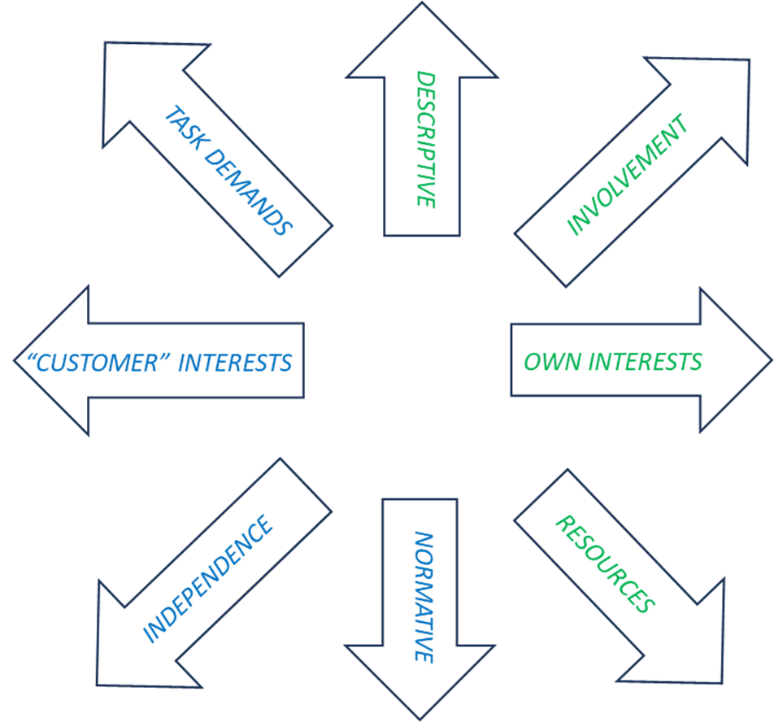
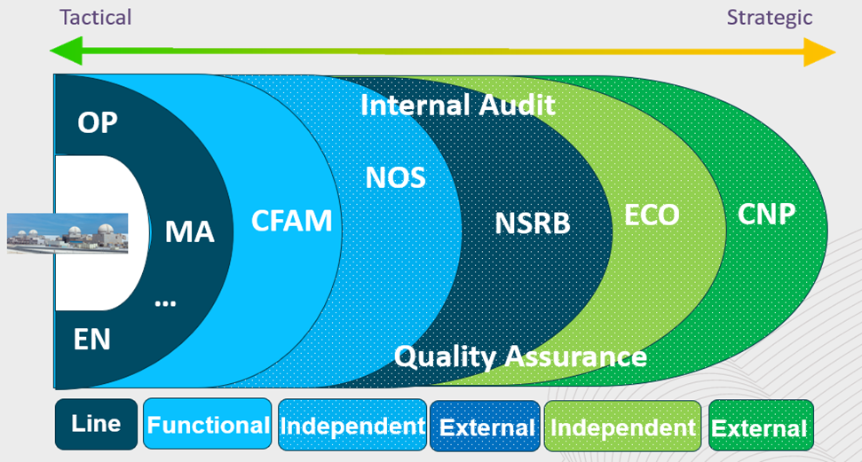
Oversight – Influencing Behaviours
Identification of Gaps Impacting on Performance
Safety consequence, identification causes & fixes
Variety Oversight Models
Criteria – meet CEOs expectations, driven by demand
Independent vs Involvement
The primary focus of Corporate Oversight to perform independent oversight of operating organization.
Measuring Efficiency Oversight – Difficult
INSO works best in organizations with effective safety culture
Effective Oversight relies on transparency
Identify gaps together with causes
INSO

Slide 6
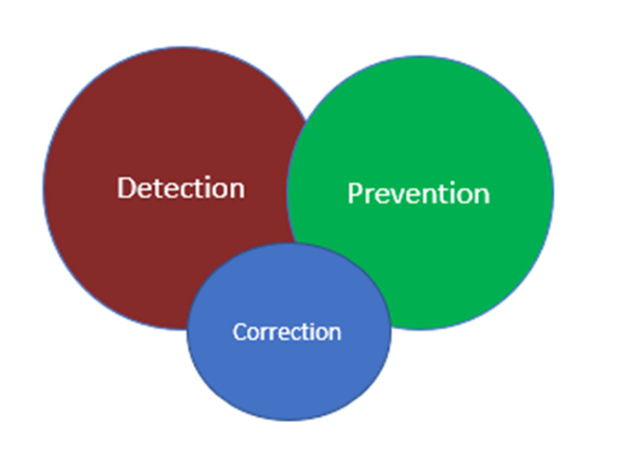
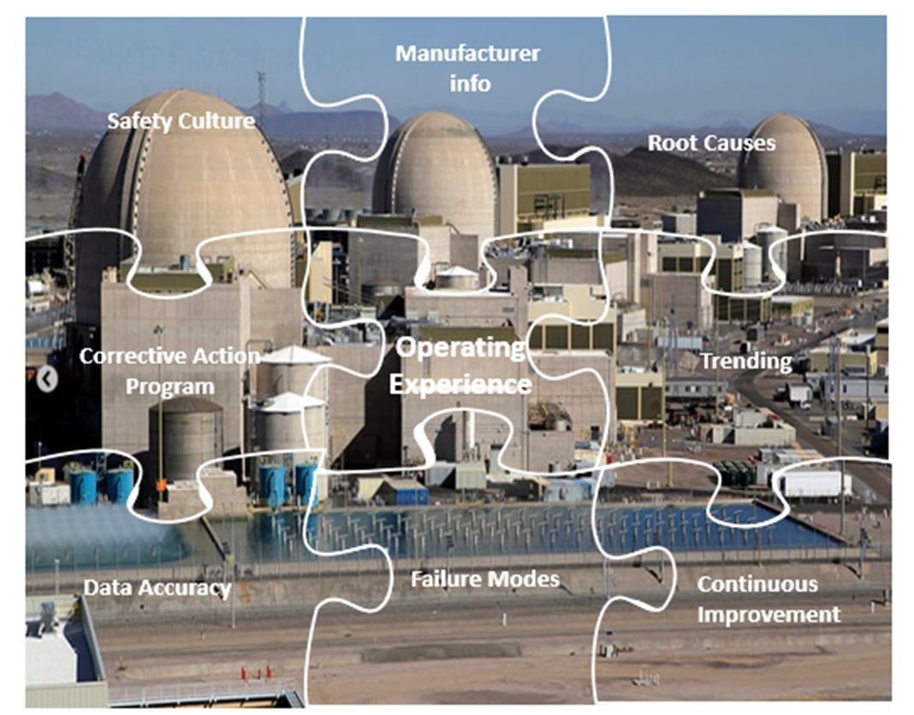
Operating Experience – Completing the Learning Cycle
Benefits and Importance of OE
Detection and Prevention better than Correction
Prevent events are being reported with previously known causes
Learning culture within organization strongly depends on commitment of leadership
Accuracy of Information in OE Databases
Inaccurate cause evaluation and inaccurately reported conclusions
Inadequate information reported to provide enough details for the OE to be useful
Data Quality Attributes – Accurate, Complete, Correct
Artificial Intelligence
Great tool to help evaluate a lot of data quickly
Usefulness is a direct function of how much involvement of a plant SME
“Those who cannot remember the past are condemned to repeat it.” -George Santayana

Slide 7
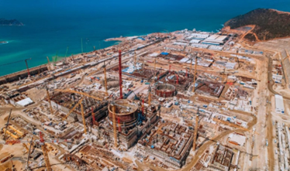
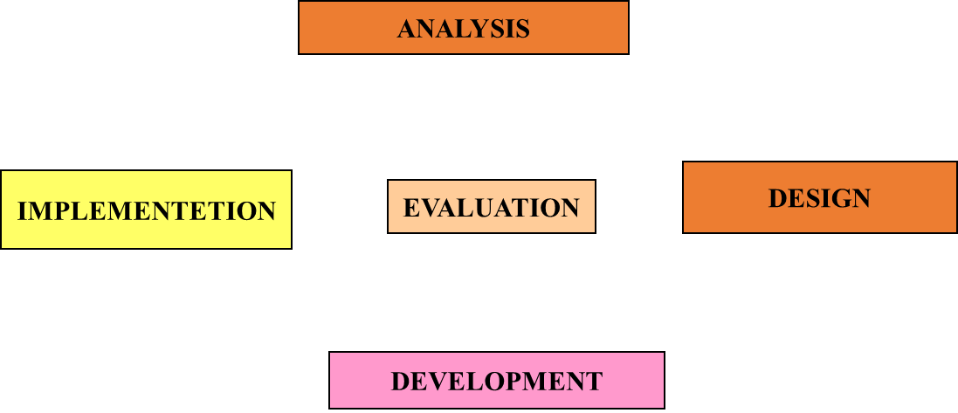
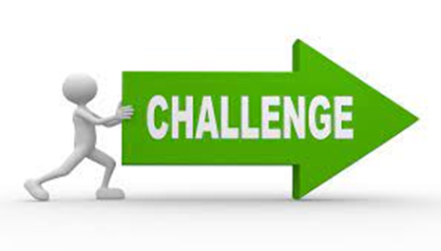
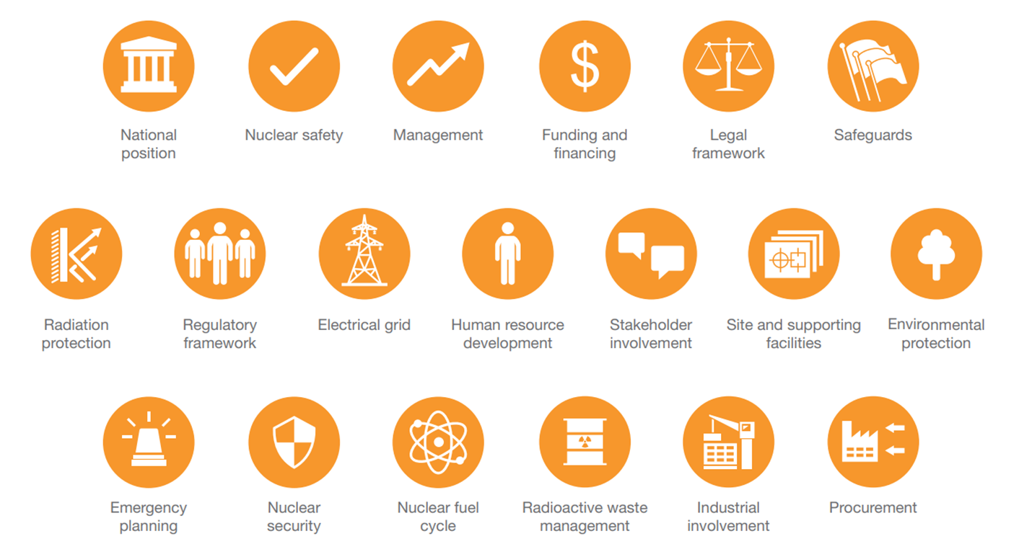
New Build – Challenges & Opportunities
Process of New Build
Construction Phase – nuclear safety focused workmanship, strong safety culture, strict adherence configuration control
Safety culture begins at construction and must be taken care of throughout the life cycle of the facility.
Develop and implement safety culture programmes promoted by senior leadership (empower staff to raise safety concerns, extend to TSOs
Importance of comprehensive Training & Qualification programmes
Expect some Suprises: Margins are always helpful
FOAK Systems challenging
Significant number of inspections carried out by regulator and associated management of open issues

Slide 8
Describe in one or two sentences what you have learnt from being at this conference…….
请用一到两句话描述你从这次会议中学到了什么

Slide 9
Thank You

