Slide 1
Improving Nuclear Plant Safety and Reliability by using New Methods for Predicting and Preventing Significant Equipment Failures
Pat Murray
EQRPI, Inc.

Slide 2
Goal = Reduce impactful unplanned equipment failures through better use of internal and external Operating Experience

Slide 3
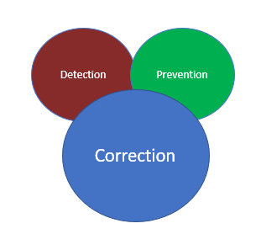
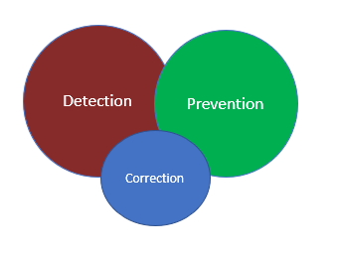
Continuous Improvement

Slide 4
Barriers to Successful Use of OE to Prevent Equipment Failures
Too much data to evaluate effectively to identify the relevant OE
Inadequate information reported to provide enough details for the OE to be useful
Lack of reporting of low-level events or near misses by other plants
Inaccurate cause evaluation and subsequent inaccurately reported conclusions
Digitization errors that occur during data conversion or migration
Overall data quality is poor

Slide 5
Important Questions to Ask After Significant Equipment Failure
Why didn’t we see this unplanned failure coming?
Should evaluate this for every unplanned important equipment failure
Was the equipment properly classified as critical (important)?
Two main types of important equipment
Nuclear Safety/Critical
Plant Reliability/Critical

Slide 6
Non-Safety Critical (Important) Equipment
Highest probability of components that will put the plant at risk
Include SPVs and others that can affect reactivity when they fail
These failures are not always reportable to the Regulator yet highly impactful to the plant
Failure may not be classified as a “significant event”
Only added to the PM program recently if at all at many plants
Did not have the same rigor at the time of purchase or storage
Lack of regulatory guidance on how to evaluate the various processes involving non-safety important equipment to maintain plant reliability

Slide 7
Data Quality Attributes
Accurate
Complete
Correct
Digitization accuracy x Information completeness x Information correctness = Final Product
90 %
x
80 %
x
80 %
=
57.6 %

Slide 8
Artificial Intelligence
Aura of mysticism around it as if it were an animate entity
Great tool to help evaluate a lot of data quickly
Can not effectively be used on non-digitized data
Vulnerable or Prone to Issues that are hard to detect including:
Programming Bias
Data Bias
Evolving Continuously – Continuously Taught and Self Learning
Data Scientists with no nuclear plant experience generally are developing
Usefulness is a direct function of how much involvement of a plant SME

Slide 9
Should We Blindly Trust the Results of Artificial Intelligence?
Can you tell me why the green light on the pier was significant to Atticus Finch in F. Scott Fitzgerald’s novel “The Great Gatsby”?
In the novel “The Great Gatsby”, the green light on the pier represents Gatsby’s longing and yearning for his lost love Daisy. Atticus Finch, being a moral compass, recognizes the green light represents the unattainable dreams and desires of Gatsby.
Artificial Intelligence makes assumptions based on available data, patterns, programming, frequency, and recent inquiries

Slide 10
Information Objects
Information Objects are individual elements that data sources can be broken down into to facilitate information automation
Allow for an “apples to apples” comparison of data sources
Some NPP data sources that should be broken down into information objects include:
Event Reports (Condition Reports)
Work Management Data
External Operating Experience
Equipment/Inventory Data
Plant sensors and recorders
Virtually any data source

Slide 11
Important Event Information Objects
Process/Sub-Process
Causes (direct, contributing, root)
Human and Performance Shaping Factors
Causing or Responsible Organization
Failed Barriers/Defenses
Significance or Consequence
Others

Slide 12
Important Equipment Information Objects
Component Type
Manufacturer
Model#
Manufacture Date
Critical Characteristics
Potential Failure Modes
Others as specified by Engineering

Slide 13
Training AI to Create Equipment Information Objects
Component Type
Convert the thousands of component types into a concise and consistent list that you can use for all comparisons internal and external
Manufacturer
Train the AI to recognize the correct manufacturer
Model Number
Train the AI to select key characters from the model number to facilitate in equipment model number comparison

Slide 14
Training AI to Create Equipment Information Objects
Manufacture Date
One of the most important information objects for event comparison
The older a piece of equipment is, the more failure modes
Critical Characteristics
Physical attributes of a piece of equipment that can impact the ability of it to meet its fit/form/function
Potential Failure Modes
Ways in which a component or part can fail

Slide 15
Hierarchy of Information Objects for AI Evaluation
Least
Basic Component Information
Direct Cause of Event
(Root) Cause of Failure
Contributors,
Extent of Condition
Useful
Failure Mode
Manufacturer Model#
Manufacture Date, Storage Years, How Long Installed, Plant Conditions,
Repaired or Issued to Maintenance
Most

Slide 16
Training AI to look for similar Internal/External OE
Break equipment information and internal and external events down into information objects
Only assign information objects that exist (do not interpolate)
Compare data sources by looking for information object matches
When enough of the information objects match up then you have started to identify similar OE
The more dimensions that match-up, the more similar an event is
Note: Most plants will not identify repeat events even when they are repeat events

Slide 17
Practical Application (INPO IER 21-4)
Data at many US plants harmonized into one large database
Tens of thousands of event reports evaluated, and component/parts testing data bases broken down into information objects
Hundreds of potential poor quality SPVs and critical parts identified and removed from plant and inventory before they failed unexpectedly

Slide 18
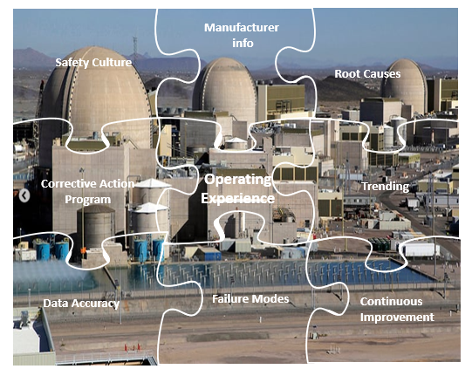
Improving Safety and Plant Performance Through Better Use of OE

Slide 19
Thank You!

