Slide 1
Exploration and Practice on Life Extension of Nuclear Power Plants in China
CNNO, Xianhe Shang

Slide 2
CONTENTS
1
Overview of China Nuclear Energy
2
Life Extension of Qinshan QNPP-I
3
Conclusion

Slide 3
1
Overview of China Nuclear Energy

Slide 4
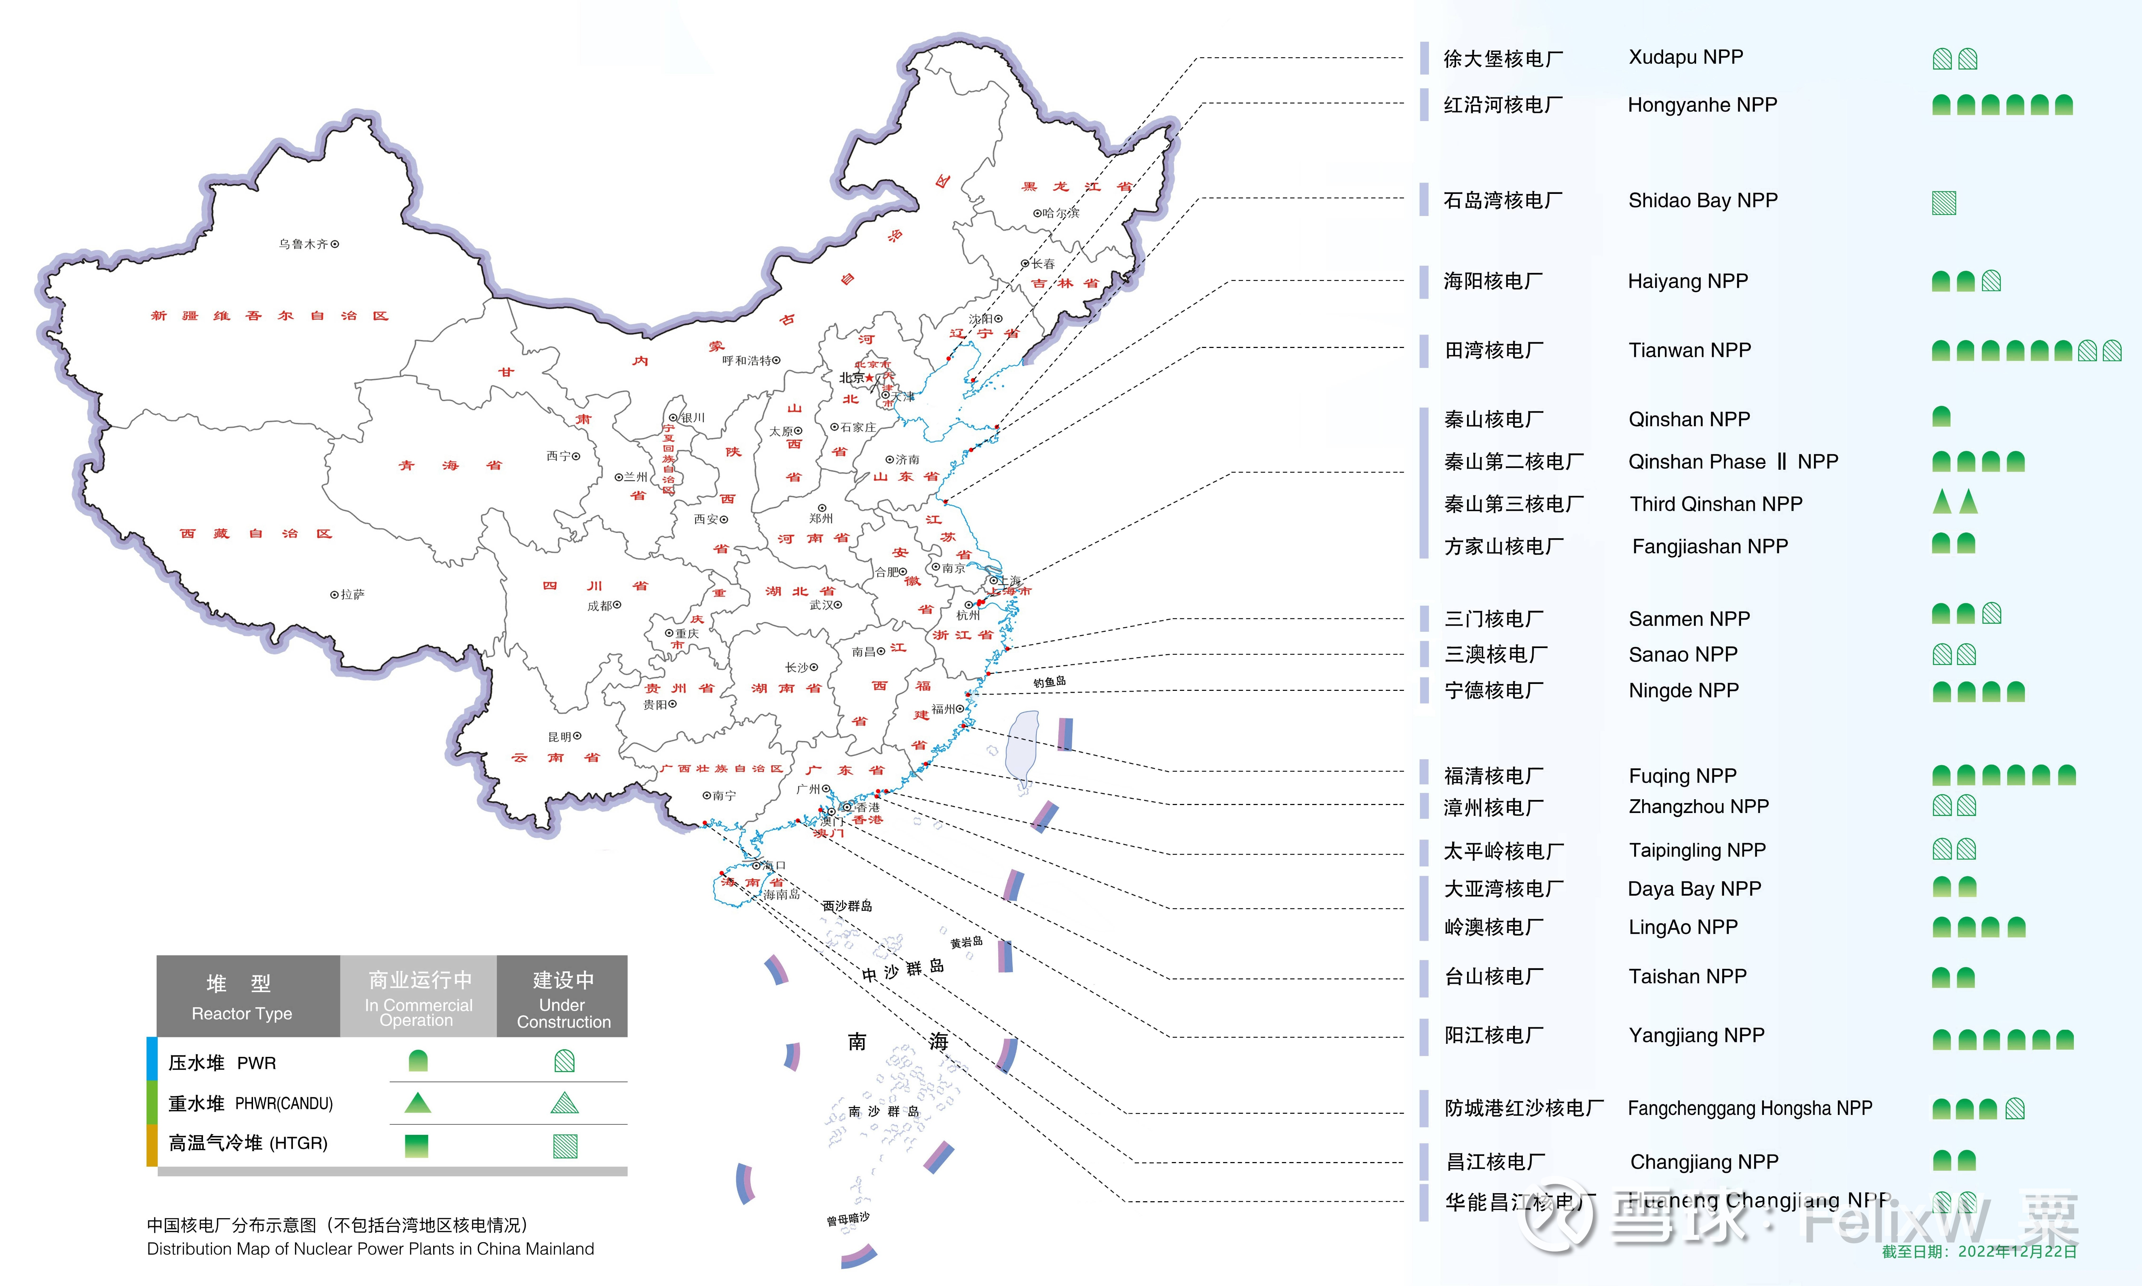
The Strategy and Distribution of China Nuclear Energy
China is a party to the The Paris Agreement, and is committed to achieve carbon neutrality and emission peak.
Nuclear power is an important part of China's green and low-carbon energy system
By December 31, 2023,China’s mainland had 55 nuclear power units in operation with an installed capacity of 57,031.34MWe, and 26 units under construction.

Slide 5
Operation Performance of China's Nuclear Energy
The proportion of nuclear power is increasing year by year.
In 2023, the generation of nuclear power was 433 billion kWH, with an increase of 3.98% than 2022.
The nuclear power plant operated safely and high performance, the average capacity factor was 91.25%

Slide 6
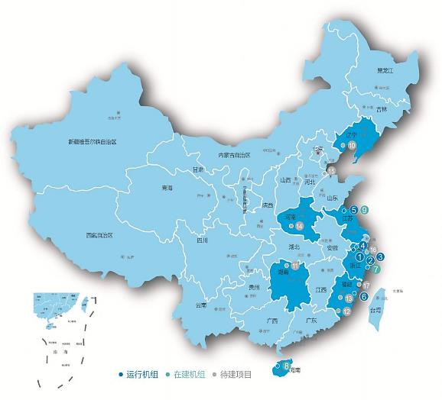
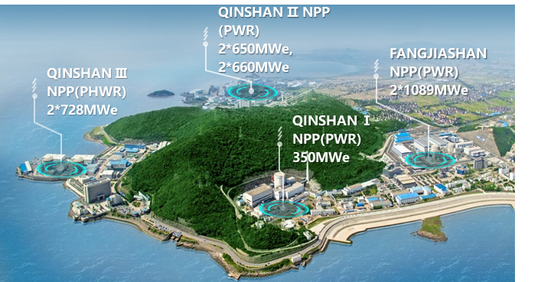
Qinshan Nuclear Power Base
QNPP-I is the first PWR constructed in China’s mainland, initial grid connection in Dec.15, 1991 with a capacity of 320MWt
QNPP-I is the first NPP that accomplish life extension in China.
Qinshan Nuclear Power base is located in Haiyan County, Zhejiang Province.
The cradle of nuclear power in China’s mainland

Slide 7

Performance of Qinshan Nuclear Power Base
2
0
2
2
年9台机组“零非停”
8
连
增
532.93
535.64
535
520.38
521.81
523.02
Operating
performance
503.6
510.56
492.6
Annual Electricity Generation
亿千瓦时
2015年
2016年
2017年
2018年
2019年
2020年
2021年
2022年
近3年22台次满分机组
Capability factor 93.00%
Load factor 92.31%
WANO
Index
95.19%
92.40%
92.31%
91.69%
91.71%
93.18%
93.00%
90.38%
90.50%
90.47%
90.44%
2022年 7台
2021年 7台
2020年 8台
89.68%
90.39%
87.22%
2016年
2017年
2018年
2019年
2020年
2021年
2022年
2016年
2017年
2018年
2019年
2020年
2021年
2022年

Slide 8
2
Life Extension of Qinshan QNPP-I

Slide 9
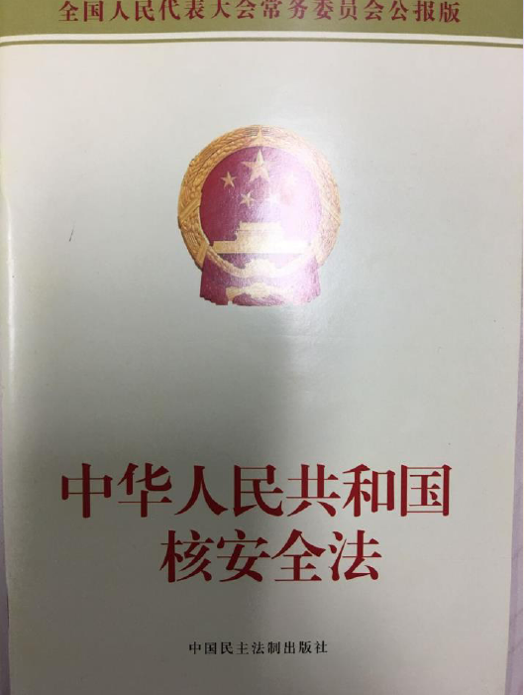
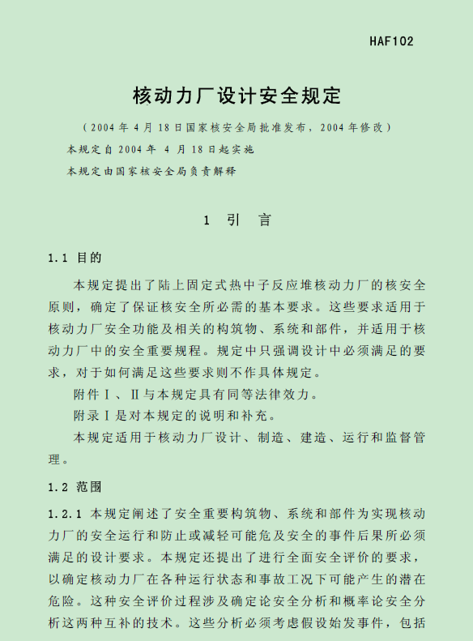
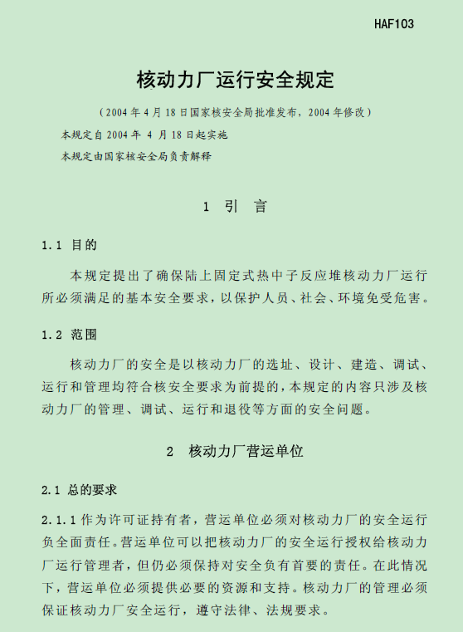
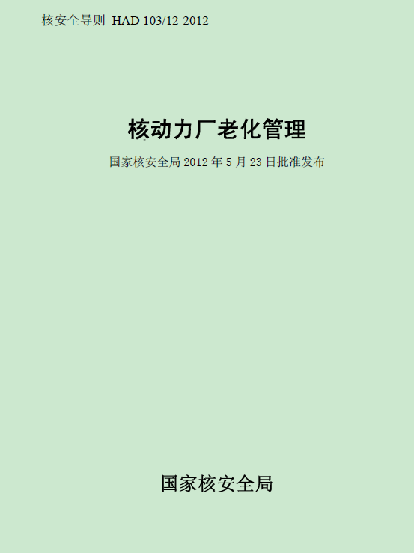
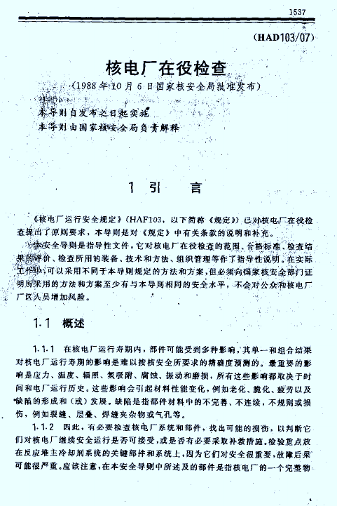
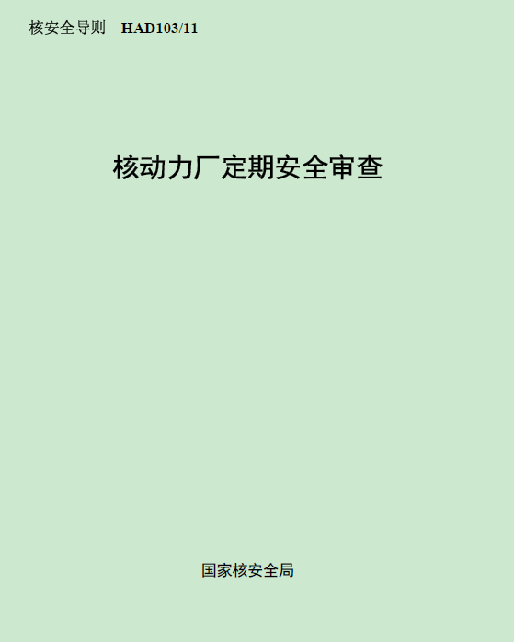
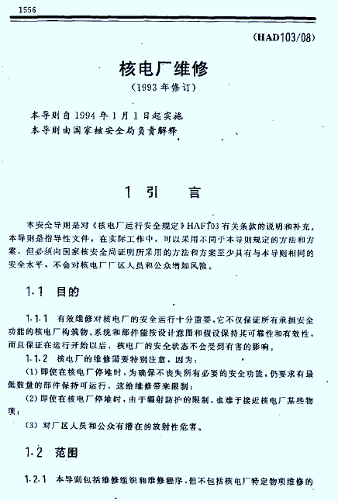
China Nuclear Safety Regulatory System
Nuclear Safety Law
Nuclear Safety Law
Safety Requirement
HAF 102
Safety Requirement for NPP Design
HAF 103
Safety Requirement for NPP Operation
Safety Guidance
HAD 103/12
Aging management
HAD 103/07
In-service inspection
HAD 103/11
PSR
HAD 103/08
Maintenance
9
Notes:
为保证核电厂长期安全运行，中国建立了完善的核安全监管体系，该体系包括三个层次，分别是nuclear safety law, safety requirement and safety guidance.在核电业主和监管部门的共同努力下， 中国核电厂保持长期安全稳定运行，为延寿运行打下了基础。
To ensure the long term safety operation of NPP, China has established nuclear safety regulatory system, this system contains three level, nuclear safety law, safety requirement and safety guidance. In the joint efforts of nuclear power owner and regulators, the NPPs maintain safety and high performance operation, and established the basis of life extension.

Slide 10
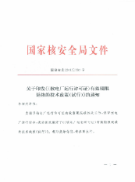
Technical Policy of NPP Life Extension
The National Nuclear Safety Administration (NNSA) officially released the Technical Policy for Life Extension of NPP in December 2015，which gives the policy and detail requirements.

Slide 11
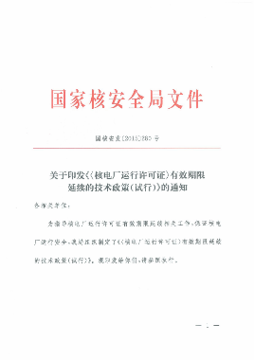
Regulator Requirements of NPP Life Extension
Requirement of Chinese Regulatory
The NPP should submit the LTO application at least 5 years in advance.
Safety assessment basis: the standards in FSAR and other standards approved by NNSA
The files should contain: Safety assessment report, ER supplement, FSAR supplement.
Continuous improvement (including the weakness form PSR)

Slide 12
Life Extension of QNPP-I
Under the instruction of of Chinese Regulatory, Qinshan carried out the OLE(OPERATING LISCENCE EXTENSION) project.
2016.12
Submit the license renewal application
2021.12
NNSA approval
Operation license extension to 2041
NNSA review
2017-2021.12
OLE preparation work
2006-2014
OLE SAFETY ASSESSMENT
2015-2016
执行承诺
2006
2014
2015
2016
2017
2018
2019
2020
2021
2041
OLE feasibilities study
R18
2018.4～2019.4
Modification

Slide 13
Main works of OLE project
A
B
C
D
Integrated plant assessment
Scoping
Screening
Evaluation the aging effects
Demonstrate that the effects of aging are managed
Time Limited Ageing Analyses
Identify generic TLAA issues
Exemptions
TLAA review
Identify the exemptions in effect
FSAR update
FSAR supplement
Technical Specification changes
Environmental Report
Modification

Slide 14
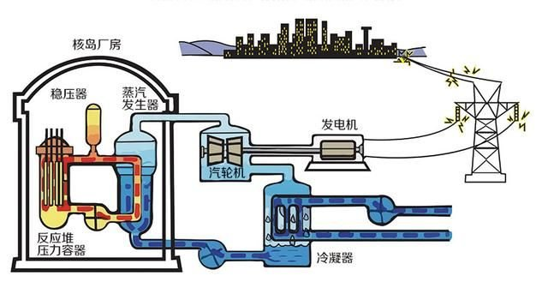
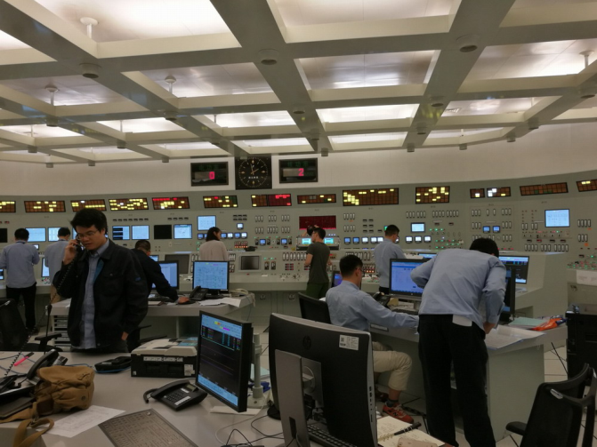
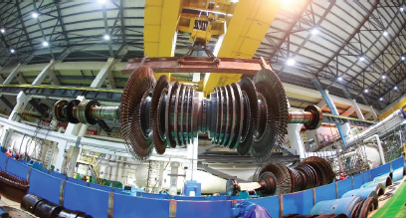
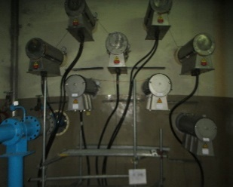
Major Modification
Overlay of pressurizer nozzle welds
Renovation of Main Generator
Main control room I&C modernization
Renovation of Main Turbine
Electrical penetrations replacement

Slide 15
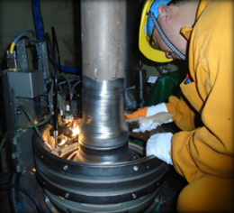
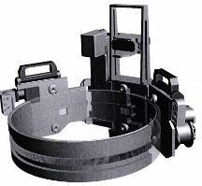
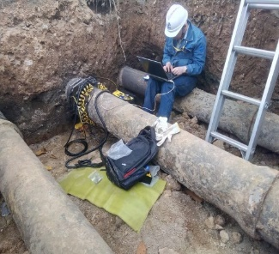
Researches related to OLE
Aging diagnosis and residual life assessment for electrical and I&C components
Technology for evaluating the life of reactor pressure vessels
Maintenance technology and equipment used for high radiation and harsh environment
Nonlinear creep model of fully grouted containment concrete material under high-pressure stress
Multi-axis creep real-time testing device

Slide 16
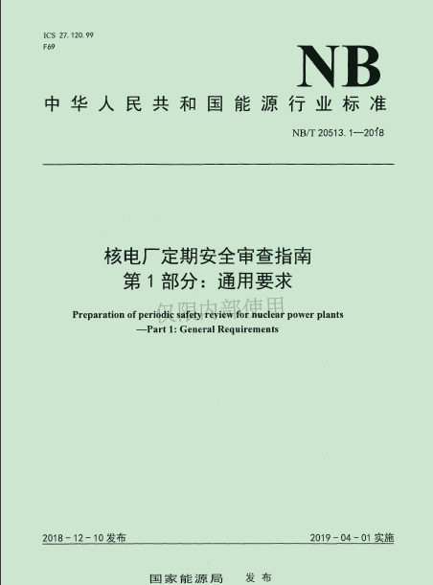
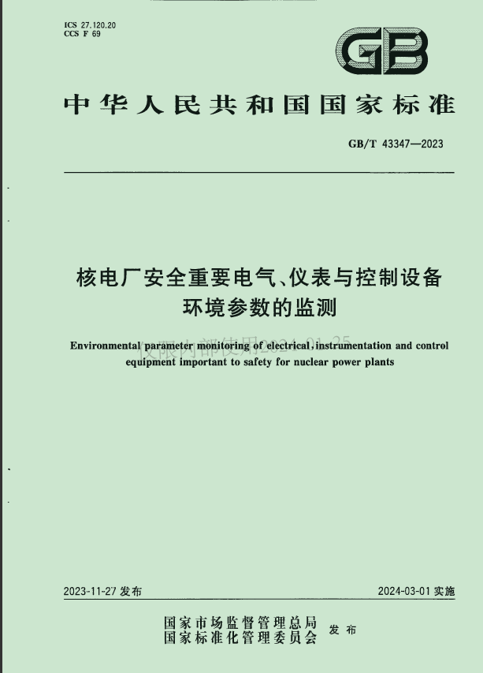
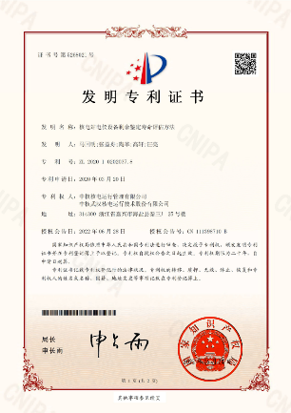
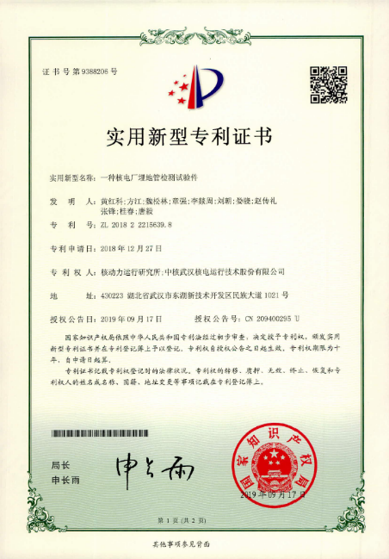
Output of Qinshan LTO
Patents: 34
National Standards: 1
Energy Section Stands: 12

Slide 17
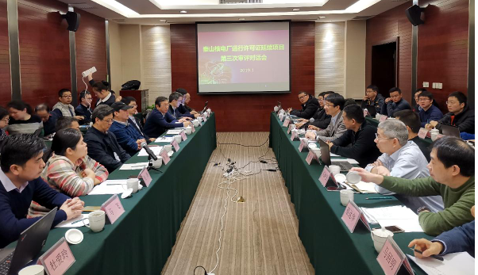
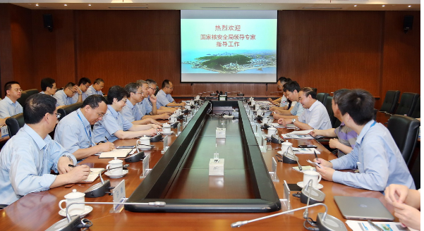
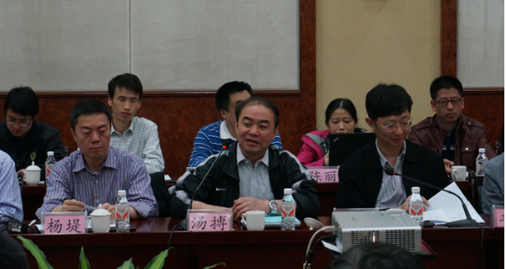
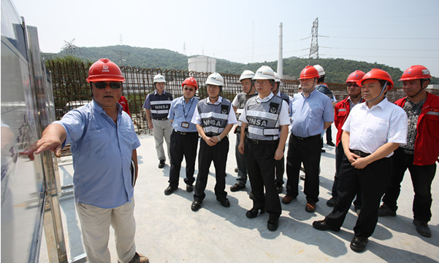
Communication with Regulatory body
Timely get guidance from Regulatory body during OLE process
Facilitate Regulatory body to understand the specific process of NPP OLE
Reduce the amount of additional information required by Regulatory body for OLE review
Strengthening of Regulatory body confidence to OLE

Slide 18
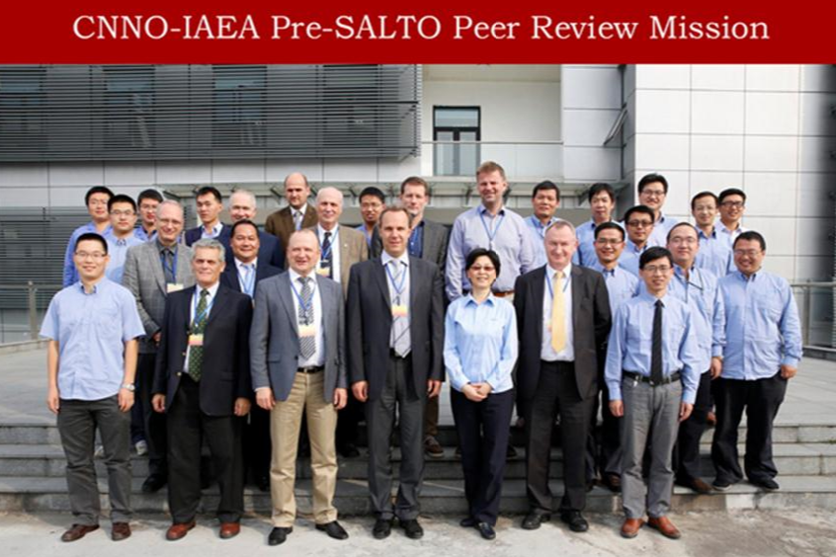
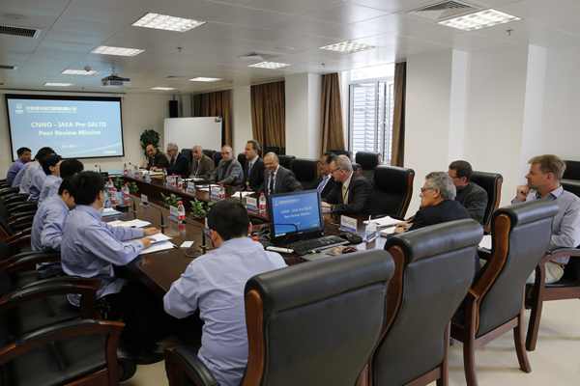
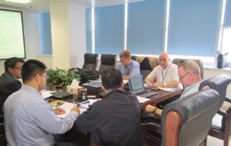
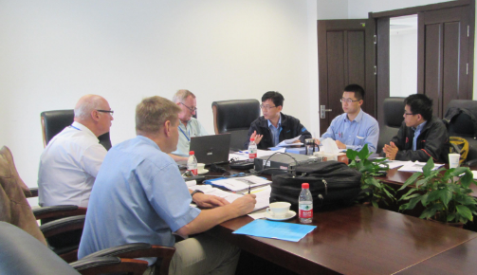
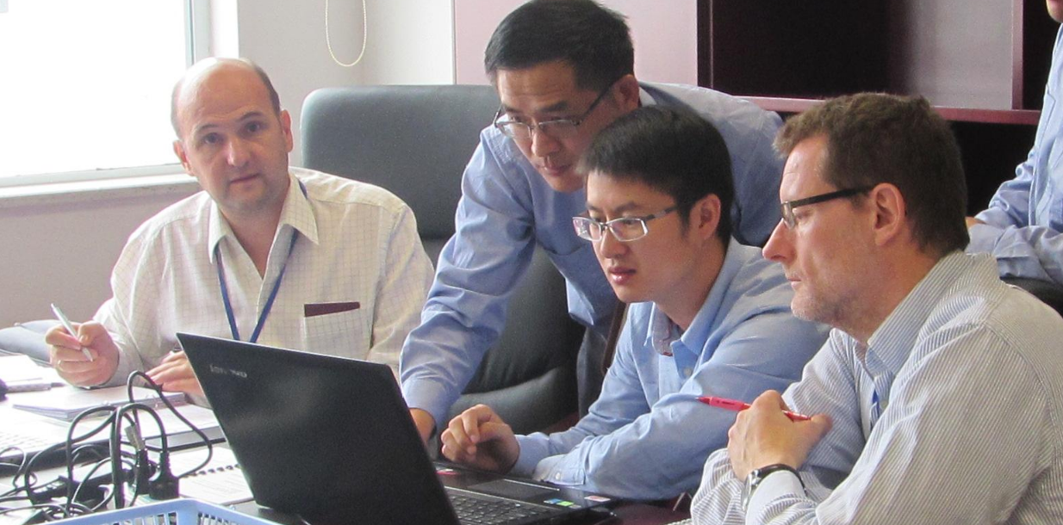
Peer Review
Salto Peer Review
Review of compliance with IAEA stands
Recommendation for improvement in all 6 area related with LTO
Opportunity to learn good practices in other NPPs
Strengthening of public confidence to NPP

Slide 19
Operating Performance After OLE
Keep good operating performance during LTO period
No unplanned shutdown event occurred
Power generation 0.822 billion KWh, average load factor is 92.86% in past 3 years
The first complete natural year into LTO (2022), WANO index is 100

Slide 20
Conclusion
3

Slide 21
Qinshan OLE is a Demonstration Project
OLE is a good way for achieving sustainable using nuclear power. OLE in Qinshan NPP serves as a demonstration project in China, and the benefit that we can get form this project included:
Establish the OLE approach suitable for China.
Develop the OLE related standards, evaluation methods used in China.
Promote the establishment of OLE related rules
Cultivate and establish an OLE team.

Slide 22
Good Practice of OLE Project
Involve the Regulatory body in OLE process as early as you can.
Close cooperation between the plant operator and the regulatory agency during the OLE process.
Peer review and expert support is crucial for the success of OLE projects.
Do not forget the importance of training and qualifying personnel to perform OLE evaluation .

Slide 23
THANK YOU FOR YOUR ATTENTION!

