Slide 1
ISSUES OF SCIENTIFIC TUTOR IN PROCEDURE OF EXTENDING WWER OPERATION
Semenov S.V., Pekshev A.N., Musikhin A.M., Erak D.Yu., Sumarokov M.A. and others
NRC «Kurchatov institute», Moscow, Russia

Slide 2
Contents & Task
Base of extended operation in Russia
Scientific Tutor tasks
Contemporary state of issues resolving
Short overview of NRC “Kurchatov institute” research directions in resolving NPPs power units procedure for extending operation

Slide 3
Background of extended operation in Russia
- There are 11 NPPs operating NPP in Russia (38 power units, 22 WWER). It is hard task to maintain their operation
Nuclear energy takes about 20 % from total electric energy releasing in Russia
Annual energy consumption is increased
Contemporary strategy for Nuclear Energy in Russia is increasing the part of Nuclear energy by 25% till 2045 – New power units are constructed. Period of operation of power units which have already been constructed extends to ensure energy release increasing and saving contemporary percentage of NPPs energy in Russia
In accordance with President’s Decree No. 270 which was issued in April 16, 2020, the comprehensive program “Development of equipment, technologies and scientific research in the area of the atomic energy usage in the Russian Federation until 2024” was developed. Decree of the President No. 202 which was issued in April 14, 2022 this program was extended until 2030. National Research Center "Kurchatov Institute" is the scientific tutor organization of the comprehensive program

Slide 4
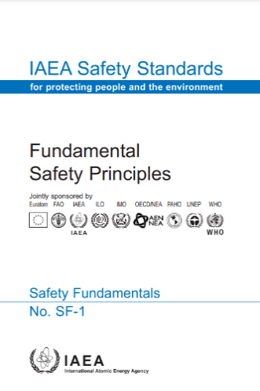
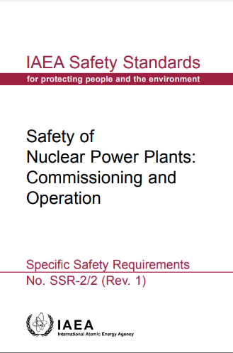
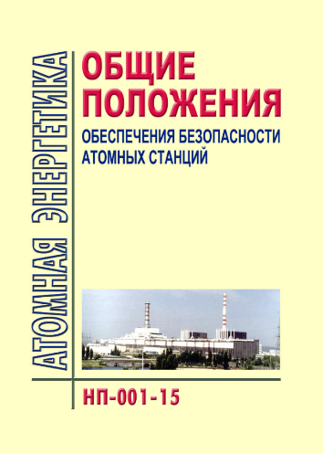
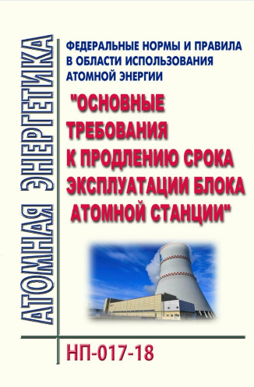
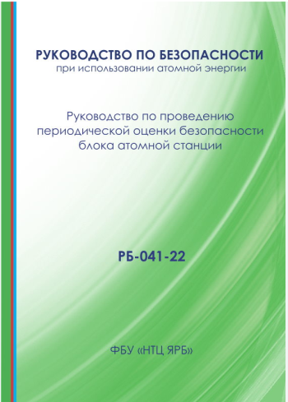
Legal basis of extended operation
…
…
Rules and regulations
“Federal standards and rules -001-15 (General provisions Ensuring the safety of NPP)” par.
4.1.17 – Every 10 years, in accordance with the established procedure, a periodic safety assessment of the NPP unit must be carried out, taking into account changes in the characteristics of the NPP site, the aging processes of NPP equipment, as well as changes in the requirements of regulatory NPPs;
par. 4.1.18 – The operating organization may raise the issue of extending operation period of the NPP unit beyond its original period designated by the design.
“safety guide-041-22 (Elaboration of periodic safety assessment)” … the operating organization develops and coordinates with the design organizations of the reactor plant and nuclear power plants, one of which is NRC «Kurchatov institute»

Slide 5
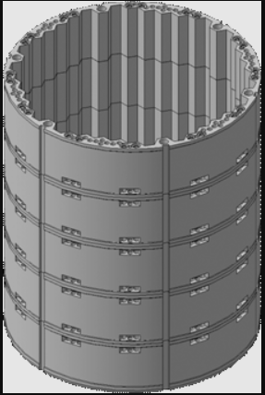
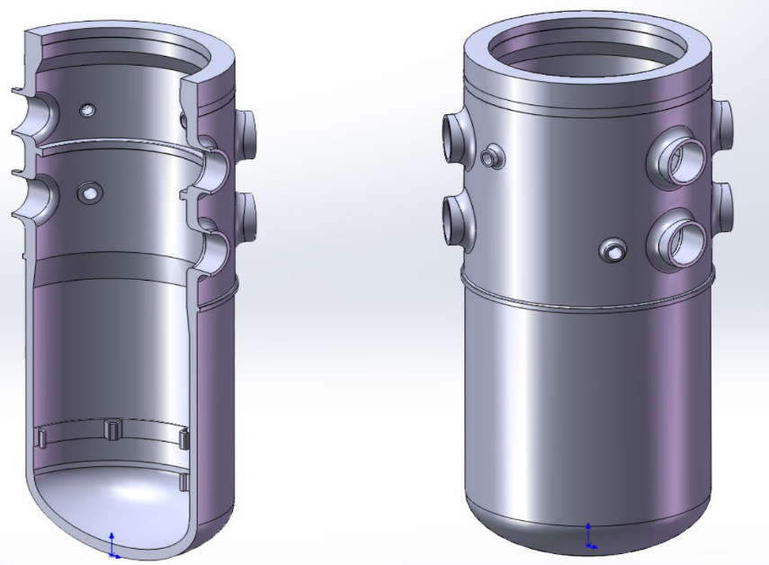
Residual life estimation
During extended operation procedure residual life estimation is carried out.
1) Replaceable equipment 2) Non-replaceable equipment
Core internals
Reactor pressure vessel

Slide 6
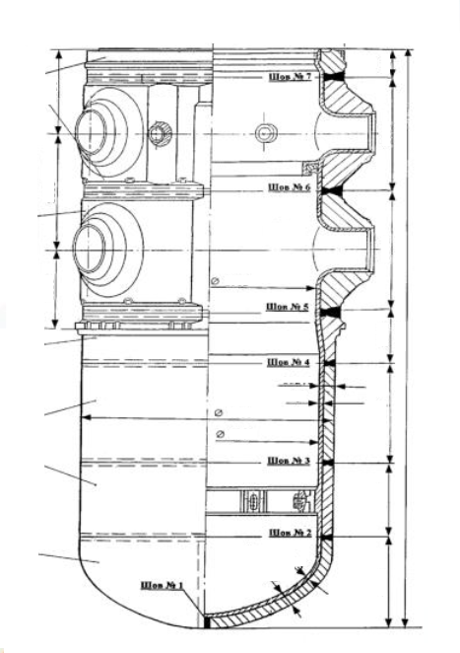
Reactor pressure vessel(RPV)
Reactor pressure vessel is the main non-replaceable equipment. RPV is welded.
For each WWER RPV National research center «Kurchatov Institute» has elaborated programs of metal changes control during operation in accordance with extended operation conditions (surveillance specimens testing, neutron loading monitoring)
Based on the test results of surveillance specimens, individual dependences of radiation embrittlement of the reactor vessel material are developed, on the basis of which the vessel service life is justified.
If it necessary, recovery annealing is performed to ensure extended service life of the reactor vessel.

Slide 7
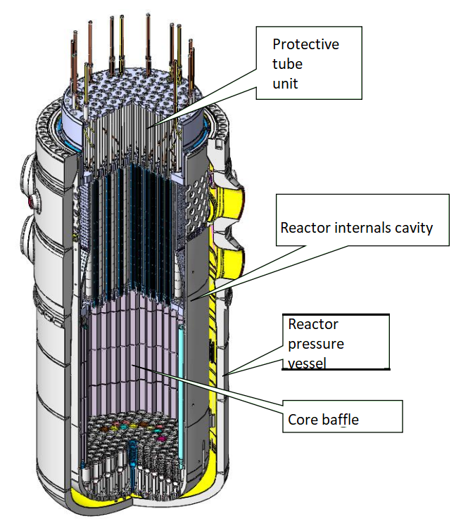
Core internals (CI)
The radiation load of the core baffle during operation is recorded.
For reactor plants with WWER periodic monitoring of the geometry of the core baffle is performed.

Slide 8
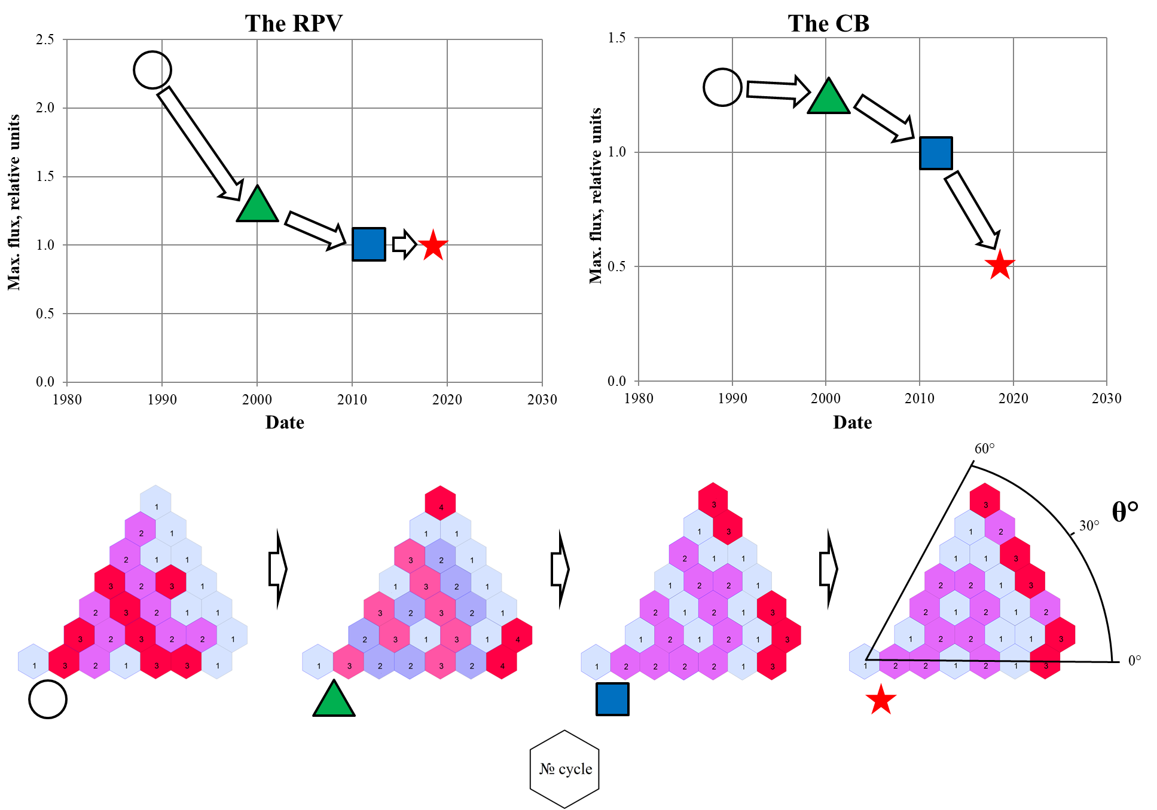
Conversion to an optimized fuel cycle
Optimization of fuel loads to reduce fast neutron leakage to the reactor pressure vessel and core baffle.
There are no zero burnup fuel assemblies at the periphery of the core in stationary fuel loads.
12 month, 100% Nnom
18 month, 104% Nnom
Main objective – optimized fuel cycle for each WWER NPP

Slide 9
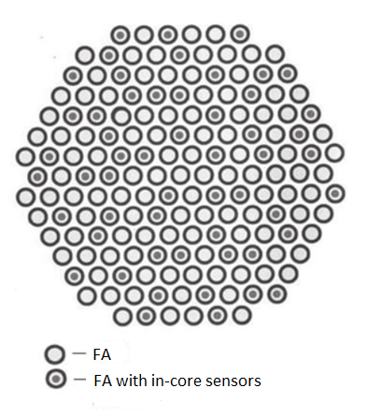
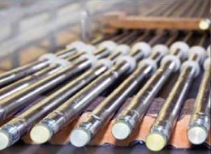
In-core instrumental system (ICIS)
NRC «Kurchatov Institute» is a developer of ICIS for the most of Russian NPPs with WWER-type power units.

Slide 10
Safety analysis 1
- Requirement: The safety analysis must comply with contemporary rules and regulations
- Periodic safety assessment leads to events in license conditions
Computational codes have been developed, verified and certified for conducting safety analysis in accordance with modern standards and regulations
- Balakovo NPP power unit No. 4 has successfully passed safety evaluation, It was a pilot project with modern safety analysis

Slide 11
Safety analysis 2. Prospects
License conditions
Safety analysis on NPP with simultaneous accidents on several power units is being researched. Contemporary stage is methodology elaboration.

Slide 12
Emergency response documentation. Prospects
Safety analysis is
the key for elaboration emergency response documentation
Digital emergency response documentation – NRC «Kurchatov institute» carries out calculations for accident management manuals and emergency response instructions.
NRC «Kurhcatov institute» is the participant of emerge help group.
The task of digitalization and information support for the operator.

Slide 13
Emergency control and measuring instrumentation. Prospects
Global experience
License conditions requires equipping WWER power units with emergency control and measuring instrumentation
Design documents was elaborated
List of control parameters was determined
Requirements for external influencing factors was determined
Equipment was partially implemented
1
2
3
Design decisions

Slide 14
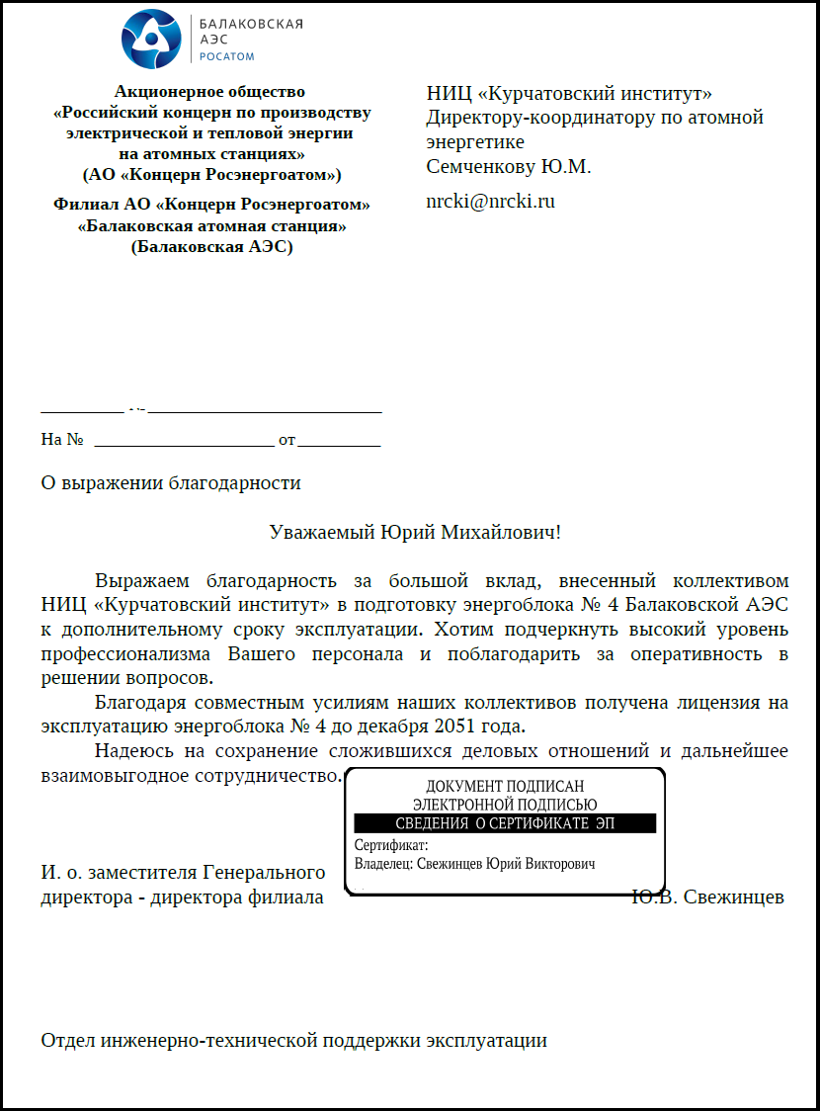
Conclusions
Currently, 12 extended power units with WWER reactors are in operation in Russia
There are programs to study the possibility of re-extending the power units operation. Feasibility studies are currently underway
Power unit No. 4 of Balakovo NPP has successfully passed the safety evaluation in regulatory body. License for extended operation for 28 years beyond design received

Slide 15
Acknowledgment
Balakovo Nuclear Power Plant
JSC OKB “Gidropress”
JSC “Atomenergoproekt”
NRC “Kurchatov institute
Kurakin K.Yu.
Kotsarev A.V.
Pinegin A.A.
Zverkov Yu.A.
Kalinushkin A.E.
Suslov A.I.
Pakhalkov S.V.
Vukolova A.-N. V.
Shmelkov Yu. B.

Slide 16
Thank you for your attention!

