Slide 1
Challenges and lessons learned during the implementation of Ageing Management Programmes. BRAZIL Mr. Túlio Pereira Energy Engineer at Amazul

Slide 2
Topics
1 – Brazil and its nuclear energy context
2 – Brazilian NPP Angra 1 Licensing Context
3 – About Ageing Management Department
4 – Ageing Management Programmes (AMP)
5 – Challenges during implementation AMP
6 – Lessons learned during implementation AMP
7 – AMP Implementation – General Status

Slide 3
1.1 Brazil
Population is made up of many racial and ethnic groups. They are descendant of indigenous peoples, Portuguese colonists, enslaved African and, since the 19th century, groups of immigrants from Europe and Asia. Portuguese is spoken by all the population and Brazil is the only Portuguese speaking nation in the Americas.
Population: 216 millions inhabitants ( 7th in the world).

Slide 4
1.2 Brazilian Energy Matrix

Slide 5
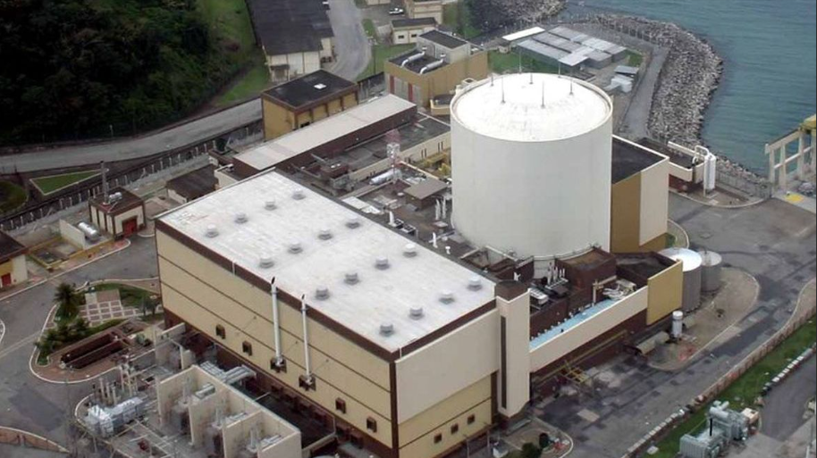
1.3 Angra 1
Net electrical power: 640 MWe
First criticality: 1982
Commercial operation: 1985
Design: Westinghouse
PWR - 2 loops

Slide 6
1.4 Brazilian Nuclear Industry
PRESIDENCY OF THE REPUBLIC
INSTITUTIONAL SECURITY OFFICE
MINISTRY OF SCIENCE, TECHNOLOGY, INNOVATIONS AND COMMUNICATIONS
MINISTRY OF THE ENVIRONMENT
DEFENSE MINISTRY
MINISTRY OF MINES AND ENERGY
MINISTRY OF EDUCATION
MINISTRY OF HEALTH
MINISTRY OF FOREIGN AFFAIRS
Regulatory Body (CNEN)
Brazilian Institute of the Environment (IBAMA)
Navy Nuclear Safety and Quality Agency - AgNSNQ
ENBPar (Eletronuclear and Itaipu)
Universities
Various Organizations
Navy Technological Center in São Paulo and Itaguai
ELETRONUCLEAR
AMAZUL
Brazilian Nuclear Industries (INB)
Nuclebrás Heavy Equipment (NUCLEP)

Slide 7
2. Angra 1 – Licensing Timeline
Current License →
Extended Life→
1985
2019
2024
2044
License Renewal
Process
1985 – Start of commercial operation
2019 – License Renewal Application
2024 – Expiration of current license and beginning of extended life for 20 Years
2044 – Expiration of renewed license

Slide 8
3. DGE.O – Ageing Management Department
Department Head
Mechanical Team
Administrative Support
RPS
Westinghouse
Eletronuclear and Amazul Interface
Electrical Team
Civil Team

Slide 9
4. Ageing Management Programmes (AMP)
Set of programs, procedures and plans that aim to guarantee the integrity and functional capacity of structures, systems and components important for safety, through actions that control the effects of aging, in such a way that the bases of licensing are maintained for the period of validity of the license for current operation as well as for the intended period of plant life extension.
SSC
Exist at Angra 1 since year 2000
Passive
Active
Long lived
Non long lived (replaceblae)
AMP
Replacement Programme
Maintenance Effectiveness Monitoring Program (Maintenance Rule 10 CFR 50.65)

Slide 10
5. Challenges
Execution of Aging Management Program inspections
DMU (Maintenance Department)
DTU (Planning Department)
DDU (Engineering Department)
DGS (Spares and Materials Management Department)
DGE
(Ageing Management Department)
Lack of synergy among the departments at Angra 1;
Lack of understanding regarding the implementation of AMPs by other departments;
Not being a priority for other departments.
Lack of spares parts (hindering the completion of inspections to meet the Ageing Management Programmes).

Slide 11
5.1 Responsibility of departments taking into account the AMPs
5.1.1 DDU - Engineering Department
Responsible for the field inspection team;
Responsible for overseeing inspections;
Assess technical conditions to determine if specific equipment can be opened and inspected.
5.1.2 DTU - Planning Department
Responsible for scheduling work requests;
Contact maintenance to verify if equipment associated with a work request can be inspected (internally or externally, depending on the Aging Management Programmes requirements);
Responsible for maintaining an organized workflow without activity overlap.

Slide 12
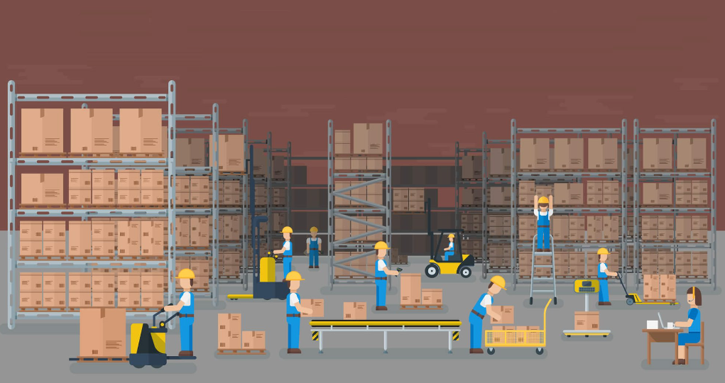
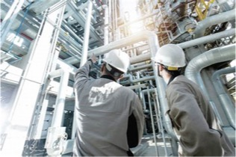
5.1.3 DGS (Spares and Materials Management Department)
Responsible for spare parts management;
Inform the engineering department about the availability of spare parts for specific equipment that needs to be opened for inspection.
5.1.4 DMU (Maintenance Department)
Responsible for the Plant Maintenance Program;
Provide support to DGE.O when AMP inspections coincide with maintenance inspections.

Slide 13
5.1.5 DGE - Ageing Management Department
Open work requests for components that need to be inspected within the scope of Ageing Management Programmes;
Coordinate inspection activities, providing support to engineering (inspectors) during inspections;
Schedule new work requests to meet the scope deadlines of each Ageing Management Program;
Prepare an annual technical evaluation report to plan activities for subsequent years;
Possible revisions of internal procedures related to Ageing Management Programmes.

Slide 14
6. Lessons Learned
Conducting a Technical Assessment Report of each AMP annually;
Scheduling inspections upfront;
Actively coordinating each AMP;
Holding weekly meetings with other departments of the Plant to discuss inspections to be conducted to meet the AMP requirements.

Slide 15
6.1 Technical Assessment Report
Technical Assessment Report
Inspections Results
Monitoring and trending inspections
Operational Experience
Corrective Actions

Slide 16
6.2 Workflow scheduling inspections upfront
Work request opening
Planning and Engineering Department Analysis
Inspection follow-up on the scheduled date

Slide 17
6.3 Actively coordinating each AMP
Scheduling ESC inspections within scope
liaising with other departments to facilitate inspections
seeking alternatives to reschedule inspections when necessary.
Active coordination for each AMP

Slide 18
6.4 Weekly meetings between Plant departments
Discuss the feasibility of conducting inspections to meet the AMP requirements
Check if there are any SSC within the scope of any AMP
Discuss scheduled inspections within the context of the plant
Carry out workflow of the work request.

Slide 19
7. Ageing Management Program Implementation after 1P28 (2023)
1P29 has been moved from the end of 2024 to the 1st quarter of 2025 due to the cycle extension project

Slide 20
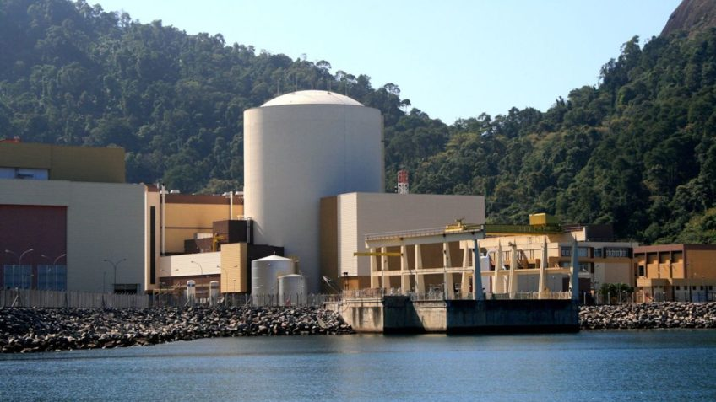
THANK YOU!

