Slide 1
Nuclear Data Section in 12 minutes
Arjan Koning, Head of Section
Nuclear Data Section, International Atomic Energy Agency
nds.contact-point@iaea.org

Slide 3
IAEA Nuclear Data Section
The Nuclear Data Section (NDS) supports nuclear research activities in Member States by providing essential nuclear data and serving as the IAEA centre for the collection and dissemination of data from laboratories worldwide.
Web Service Developments
- Live Chart of Nuclide
- EXFOR, ENDF, CINDA, IBANDL, TALYSworld
Data Dissemination
- RIPL-3, CONDERC, Stopping Power,…
- IRDFF, Photonuclear, FENDL,…
NSDD (Nuclear Structure and Decay Data Evaluators)
NRDC (Nuclear Reaction Data Centers)
INDEN (International Nuclear Data Evaluation Network)
Nuclear Data Dissemination
Training & Workshops
International Network
Coordination
Joint ICTP-IAEA Workshops
Simulation of Nuclear Reaction Data with the TALYS Code
Nuclear Structure and Decay Data
AI for Nuclear, Plasma and Fusion Science
Nuclear Data Development
CRP (Coordinated Research Project)
DDP (Data Development Project)
Consultant Meetings and Technical Meetings

Slide 4
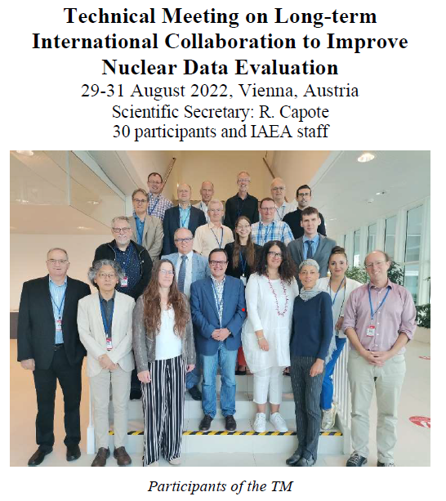
International Nuclear Data Evaluation Network (INDEN)
Roberto Capote
Vivian Dimitriou
Georg Schnabel

Slide 5
Nuclear Structure and Decay Data Network (NSDD)
Vivian Dimitriou

Slide 6
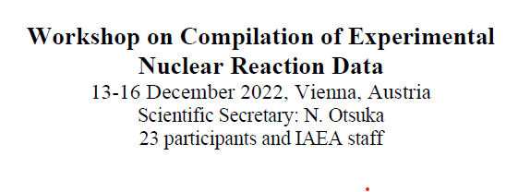
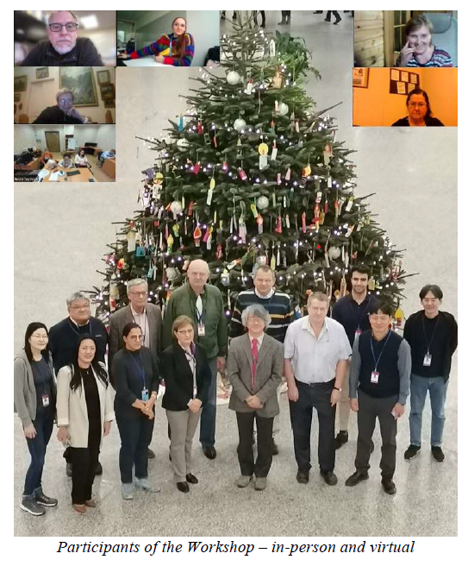
Nuclear Reaction Data Centers and EXFOR (Naohiko Otsuka, Lidija Vrapcenjak + Viktor Zerkin (retired))

Slide 7
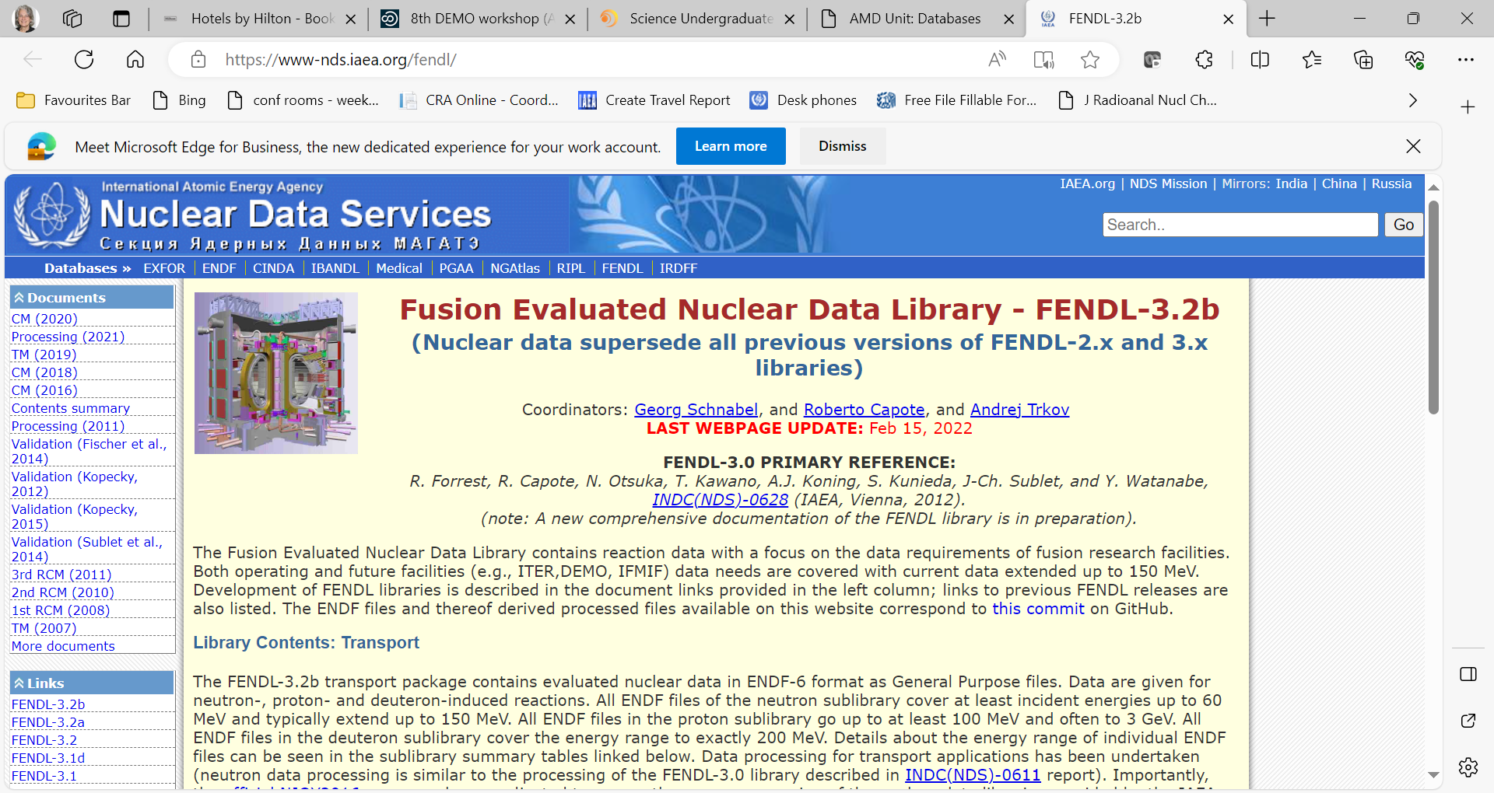
NDS Fusion Databases and Networks
Christian Hill
Kalle Heinola
Dipti
Georg Schnabel
4300 pageviews & 1300 unique users each month
Atomic and Molecular Databases and Networks
FENDL Fusion Evaluated Nuclear Data Library
AMBDAS
ALADDIN
CollisionDB
CascadesDB
DefectDB
Data Centres Network
Code Centres Network
Global Network for the Atomic and Molecular Physics of Plasmas
https://nds.iaea.org/fendl/
https://amdis.iaea.org/
Notes:
Atomic and Molecular Data Unit maintains several databases of fundamental data relevant to fusion energy research, including AMBDAS (a bibliographic database) and the new CollisionDB database of plasma collisional processes with over 120,000 entries. CascadesDB and DefectDB hold simulations of neutron-induced primary radiation damage in a variety of materials including iron and tungsten.
There are 3 networks important for assuring the extent and quality of shown here on this slide.
The nuclear data section in its development unit also provides access to and curates data for nuclear Fusion reaction data for neutron, proton, and deuteron reactions typically up to energies of 150 MeV in its Fusion evaluated nuclear data library, FENDL.
Not shown here but there is also another IRDFF-II library of data important to neutron dosimetry for fusion facilities.

Slide 8
Some of our Databases and Web Applications
Application | URL | Contents
Live Chart of Nuclides/Isotope browser Mobile App | https://nds.iaea.org/relnsd/vcharthtml | Nuclear structure and decay data, user-friendly graphical interface, Python API, mobile apps
Decay Portal | https://nds.iaea.org/relnsd/vcharthtml/decay_libs.html | Decay Data Library Comparison
Atomic Mass Data, AME & Nubase | https://nds.iaea.org/amdc | Nuclear properties: mass, isomeric excitation energy, half-life, spin, parity, decay modes and intensities
Electronic Stopping Power of Matter for Ions | https://nds.iaea.org/stopping | Collection of stopping power measurements
Nuclear Electromagnetic Moments Database | https://nds.iaea.org/nuclearmoments | experimental information on nuclear magnetic dipole and electric quadrupole moments
Neutron Standards | https://nds.iaea.org/standards | The neutron cross section standards
EXFOR | http://nds.iaea.org/exfor | Experimental nuclear reaction database
Nuclear Reaction Data Explorer | https://nds.iaea.org/dataexplorer | Experimental and evaluated cross section and fission yield viewer
TALYS World | https://nds.iaea.org/relnsd/talys/talys.html | Nuclear reaction simulation online
Prompt Gamma-ray Neutron Activation Analysis | https://nds.iaea.org/pgaa | Prompt Gamma-ray Neutron Activation Analysis (PGAA) database and evaluated Gamma-ray Activation File (EGAF) for non-destructive nuclear method
Beta-Delayed Neutron Emission Database | https://nds.iaea.org/beta-delayed-neutron | Experimental beta-decay half-lives, beta-delayed neutron emission probabilities, and emission spectra
Compilation of Nuclear Data Experiments for Radiation Characterisation (CoNDERC) | https://nds.iaea.org/conderc/ | Decay Heat, incident particle spectra used world wide, origen Input for shielding calculation, thermal resonane data
Medical Radioisotopes Production Portal | http://nds.iaea.org/medportal | Therapeutic Radionuclides, Gamma Emitters, Positron Emitters
Medical Isotope Browser | http://nds.iaea.org/mib | Medical radioisotopes production simulator
International Database of Reference Gamma Spectra (IDB) | https://nds.iaea.org/idb | In collaboration with IAEA-SG
IAEA Handbook of Nuclear Data for Safeguards | https://nds.iaea.org/sgnucdat | A set of recommended nuclear data for safeguard (decay data, thermal neutron capture cross section, resonance integrals, fission product yield ..etc)
Nuclear Structure and Radioactive Decay
Nuclear Reactions
Nuclear Science and energy applications
Nuclear energy
Medical
Safeguards
Various codes are available on https://github.com/IAEA-NDS

Slide 9
Live Chart of Nuclides
(Marco Verpelli)
Nuclear structure and decay data (ENSDF) viewer
Available online and mobile app
Levels, decay radiation scheme, schema plot, gamma lines and energies, fission yields
Livechart API + Data Science packages now also available

Slide 10
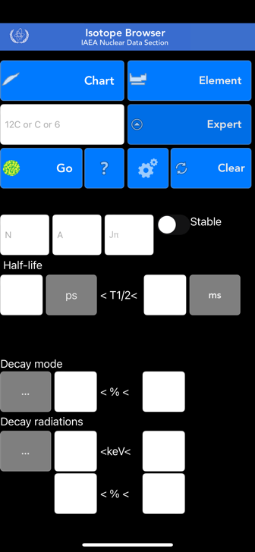
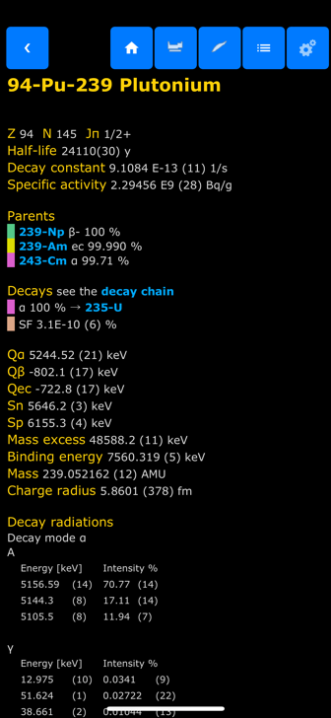
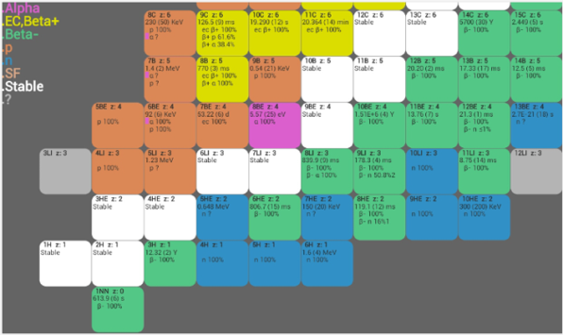
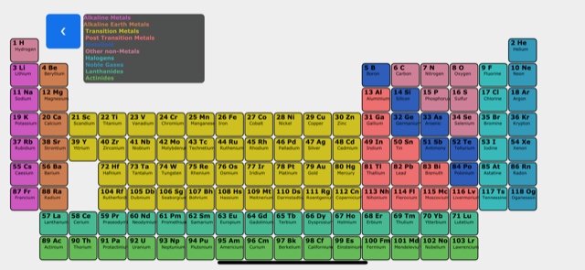
Isotope Browser – for Mobile Devices (Marco Verpelli)
App for Mobile Devices
Properties of over 4,000 isotopes
No internet connection needed
~180,000 downloads, 4.8 ⭐️
11 languages (Arabic, Chinese, English, French, Spanish, Russian, Japanese, Slovenian, Italian, Trad. Chinese, German)
Regularly updated with new features and data
Available for both
- Android
- Apple

Slide 11
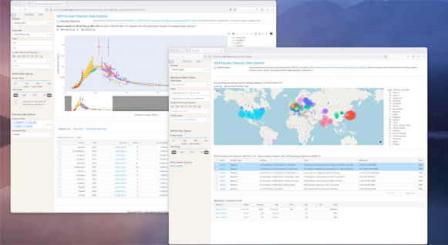
EXFOR tools: IAEA Nuclear Reaction Dataexplorer (Shin Okumura)
Reaction based data plotter
https://nds.iaea.org/dataexplorer
Input target and reaction to get evaluated and experimental datasets
Cross section
Thermal neutron cross section
Residual production cross section
Fission yield
Python 3 based, Open sourced project
💫 New!
EXFOR entry viewer
Easy access without understanding of EXFOR format
Search by reactions
Entry viewer
Geographical analysis
💫 New!
RESTful APIs
Easy computational access
Reaction, EXFOR entry and definition of EXFOR keywords, RIPL-3 levels

Slide 12
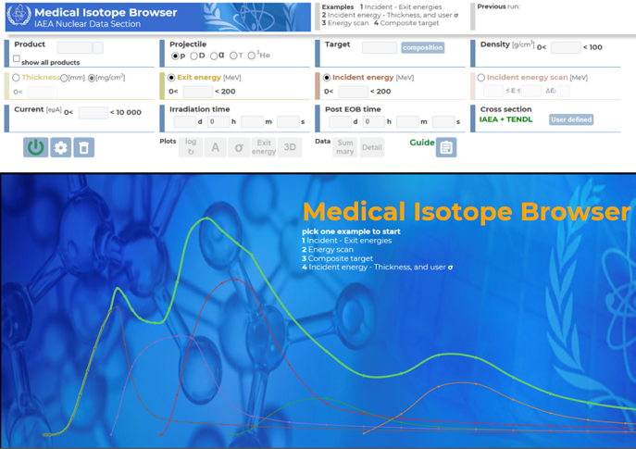
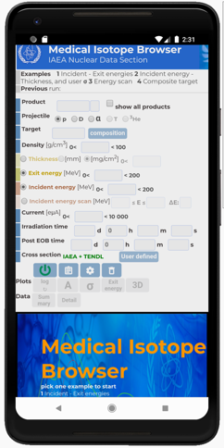
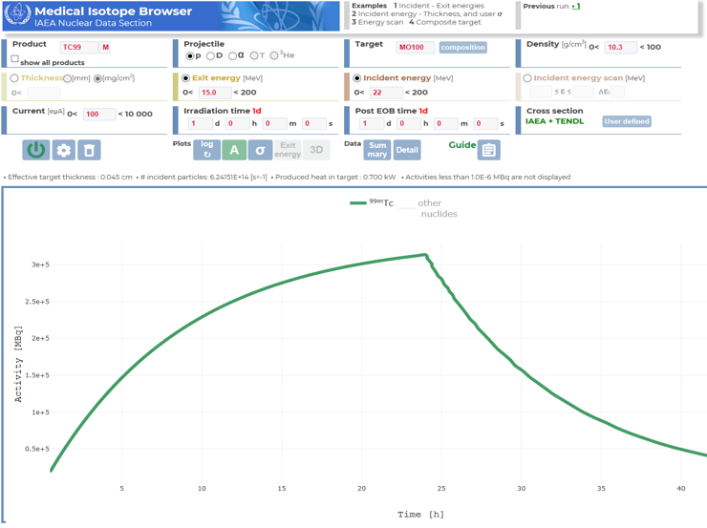
WebApp: Medical isotope browser (Marco Verpelli and Arjan Koning)
Medical isotope production simulator
Run the simulation online (accessible from any browser)
Setup target, projectile, the intensity and duration of irradiation, cooling time
p + ¹⁰⁰Mo → ^{99m}Tc
Neutrons (reactors) and
photons to be done

Slide 13
TALYS-2 + satellite software released (Ludmila Marian, Arjan Koning)

Slide 14
Running TALYS online (Marco Verpelli)

Slide 15
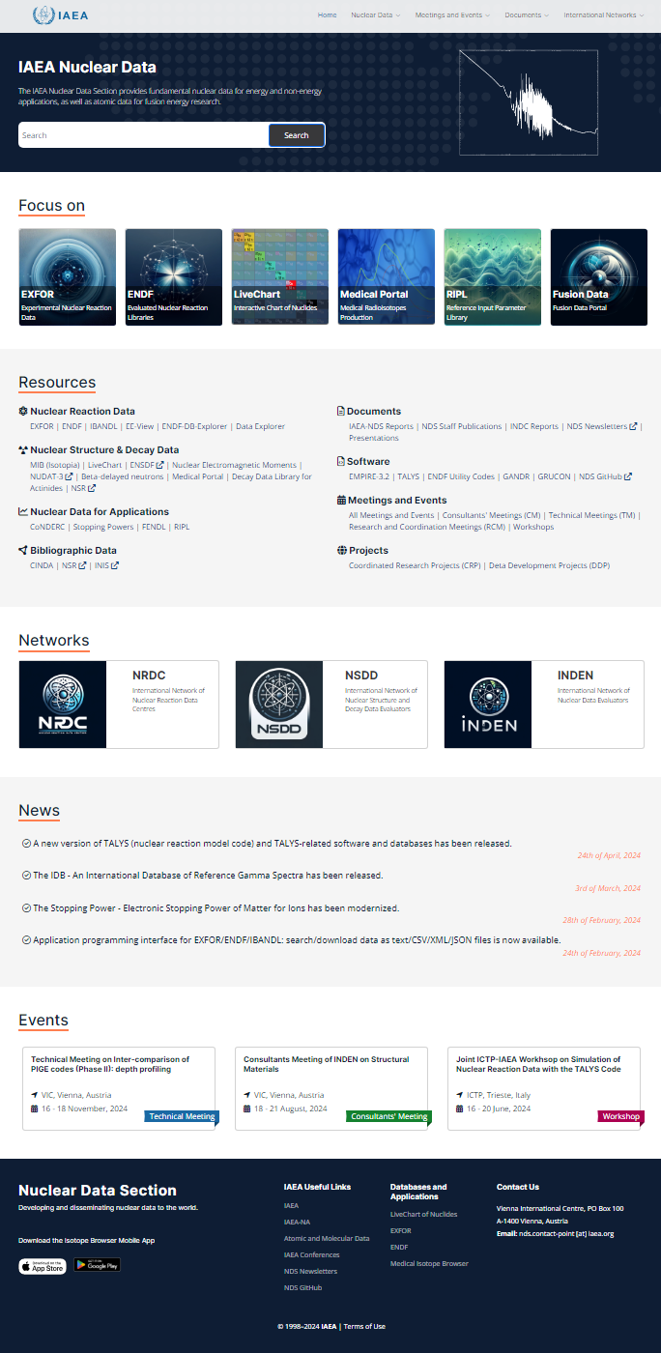
NDS website development (Ludmila Marian and Shin Okumura)
Still subject to changes!!!

Slide 16
Summary
Currently, NDS is stable in terms of funding and position in the IAEA
Response to worldwide requests for more computational access to nuclear data via API’s etc.
Making transition to newer IT technology, adopting global (open source) standards: git, JSON, python, plotly, Invenio, etc.
Increase in use of our products, more downloads than ever
Consistent software dissemination via https://github.com/IAEA-NDS, many new tools
Ongoing impact on major nuclear reaction data libraries in the world through nuclear data development:
INDEN collaboration
New CRP on level densities
Bring the world’s nuclear reaction specialists together, like at CNR!

Slide 17
Thank you!
Notes:
Thank you!

