Slide 1
Open issues on scattering kernels of compound nuclear reactions
KIT- Karlsruhe Institute of Technology, INE-Institute for Nuclear Waste Disposal,
Hermann-von-Helmholtz-Platz 1, 76344 Eggenstein-Leopoldshafen
Rensselaer Polytechnic Institute, 110 8th St. Troy, NY 12180, USA
KIT- Karlsruhe Institute of Technology, INR-Institute for Neutron Physics and Reactor Technique,
Hermann-von-Helmholtz-Platz 1, 76344 Eggenstein-Leopoldshafen
E. Wigner (to EPR Paradox, quantum Entanglement):
“Any Theory of “hidden Variables” …and locality is in conflict with quantum mechanics.”

Slide 2
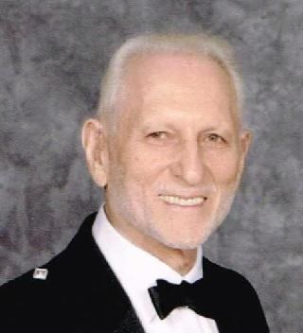
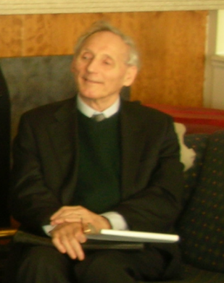
Which way should nuclear data go (classic – QM)??
Can the scattering kernels follow it ???
Cecil R. Lubitz (1925-2021)
“…He and I often disagree when it comes to whether processing codes (i.e., NJOY) should invent cross sections or simply translate what the evaluators already invented,, .
John Rowlands (1929-2011)
“…and now we will see that all what we have done is wrong” … by presenting a new speaker on a new scattering theory (…he himself was part of it.)
Stephen Hawking
”: “Any physical theory is always provisional, in the sense that it is only a hypothesis: You can never prove it. No matter how many times the results of experiments agree with some theory, you can never be sure that the next time the result will not contradict the theory.

Slide 3
Open Issues (I)
Energy and angular variables are:
In RDDB: independent
Blatt Biedenharn (BB): dependent
OMP: dependent
Pre equilibrium Kalbach systematics (semiempirical): formally independent
Is the moments in Legendre polynomials physical (l=o) isotropic scattering (BB) or only mathematical solution (RDDB), (OMP)?
Generating total resonance cross sections from differential cross sections via spin?
The azimuth angle is a dependent variable in Resonant scattering but not in Blatt Biedenharn or OMP kernel

Slide 4
Open Issues (II)
Can chemical binding and resonant scattering be combined?
How important are the Maxwell Boltzman distribution and the temperature effect?
Are scattering kernels local or is there something concerning quantum entanglement concerning neutrons or other particles
Surface effects by Photovoltaic : SANS (Small Angle Neutron scattering). When are surface effect important?
Is there a Physical basis explanation for scattering from 0 to high MeV range (Kalbach systematics) (paper Chadwick , Oblozinsky)

Slide 5
Quantum entanglement
Photons “scattering kernels” seems to be non local and complete according to QM considerations which could lead to velocities larger than the speed of light.
The temperature treatment is not an issue. Missing in the Schrödinger basic equation (incomplete for the neutron scattering kernel process)
Based on John Bell inequality rule:
Quantum mechanic polarization of correlated photons are based on
where the angle is between two arbitrary direction of spin measurements
The spin entanglement measurements were successfully performed (Alain aspect) leading to non locality effects of Light.
Quantum entanglement at distance does not apply for neutrons.
What does it says about using QM parameters for Neutron scattering interaction?

Slide 6
Proof of “Classical” entanglement
Rothenstein, Dagan, DANON Becker (RDDB) assumptions:
  Classical neutron scattering kernels seems to be local embedding some
  ”hidden QM based variables“ (resonances)
  temperature treatment based on free gas model based target agitation.
  The azimuth angle is part of the momentum conservation.
    Assures the correct integration of the differential angular kernel
    connected to the polar angle for exact definitions of tables
    chosen isotropic in MCNP scheme
  rejection techniques can be applied for MC codes
The connection to angular momentum of the compound nucleus is via the idea of isotropy in the COM system.
Fits in general to S waves.
In the laboratory system the scattering is not completely isotropic and the azimuth angle is a dependent parameter on the polar angle
Experimental proof by Y. Danon RPI

Slide 7
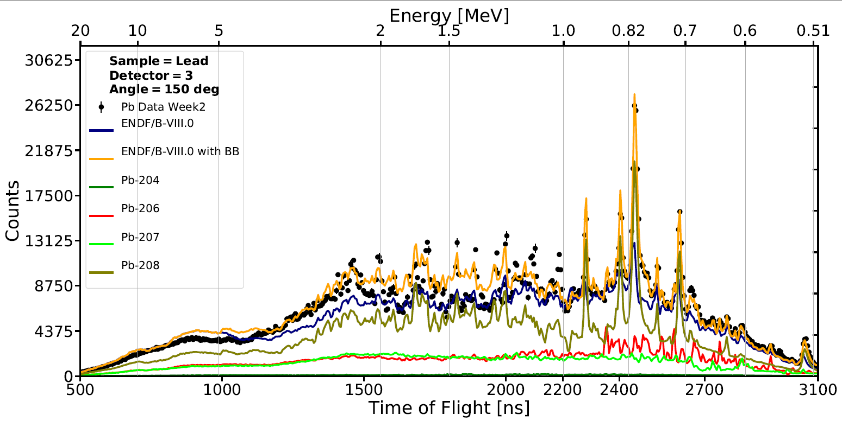
Generating resonances parameters by scattering kernels
now resonances in Pb-208 go to 1.5 MeV
BB impact energies

Slide 8
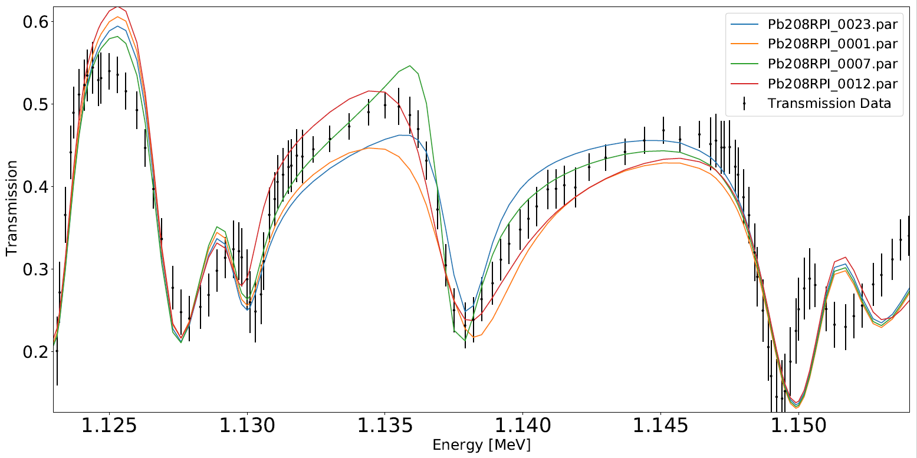
Four different spins could be used to fit the 1.137 MeV resonance
Notes:
EXPLAIN PLOT/FLOWCHART

Slide 9
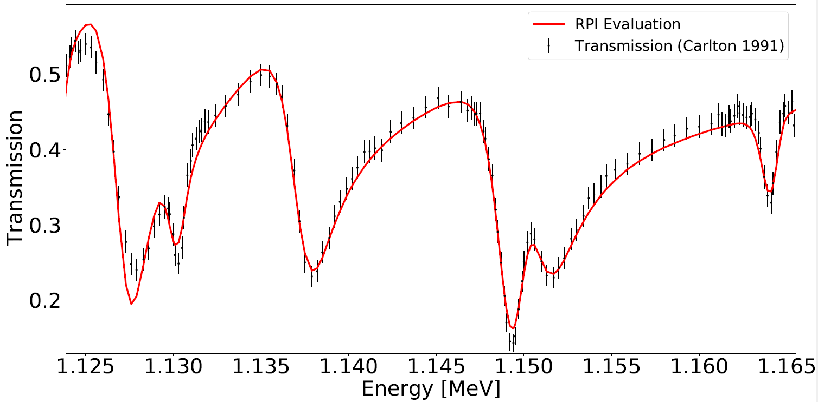
Picking spin from par012 (RED) and refitting in SAMMY…
Notes:
EXPLAIN PLOT/FLOWCHART

Slide 10
Angular distribution experiment in RPI

Slide 11
Experimental evidence for the RDDB approach

Slide 12


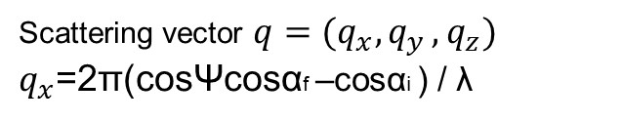
Schematic of the scattering geometry used in GISANS (Grazing incidence small Angle neutron scattering)
The sample is placed in the (x, y) plane, and the incident neutron beam is along the x axis.
The resulting scattering pattern is anisotropic and typically exhibits a Yoneda peak (marked with Y) and a specular peak (marked with S)
The scattering kernel approach is based upon Fresnel transmission and reflection coefficients
Reference: Grazing incidence small-angle neutron scattering: challenges and possibilities,
Source: P. Müller-Buschbaum, Polymer Journal (2013) 45, 34–42
Scattering vector $q=(q_{x}{, q}_{y}, q_{z})$
$q_{x}$=2π(cosΨcosαf –cosαi ) / λ
$q_{y}$=2π(sinΨcosαf ) / λ
$q_{z}$=2π(sinαi +sinαf ) / λ

Slide 13
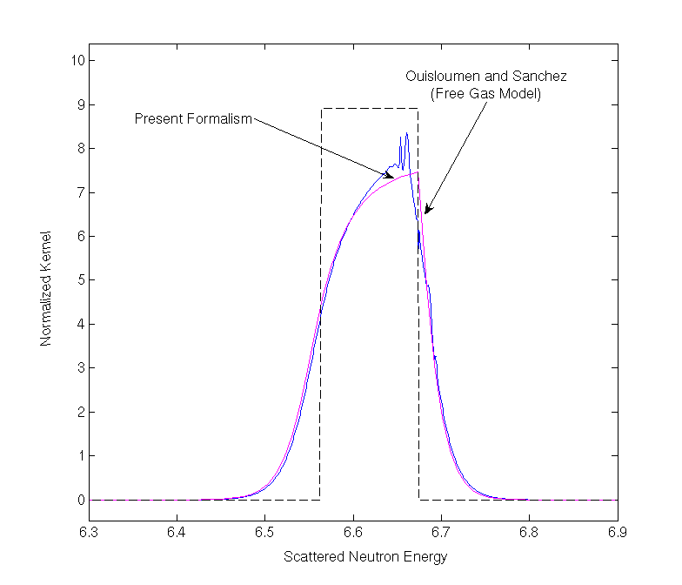
A “success” concerning the “theory” of Energy dependent Solid state effect
Word and Trammel equation was never solved directly due to mathematical complexity. A. Courcelle and John Rowlands suggested a new formalism (Courcelle, Rowlands 2007)
It combined the free gas resonance solver approach with a crystal lattice model for the inclusion of the solid state effect.
The solution of Courcelle and Rowlands
was the most advanced milestone
before a direct solution for the very
oscillating Word and Trammel expression.
The range of solid state effect
and Resonances “luckily” do not fall together..
Can also one theory contain the keV range??

Slide 14
C. Kalbach, F.M. Mann „Phenomenology of continuum angular distributions” Phys. Rev. C, 1981
Kalbach or Kalbach-Mann systematics is associated with two publications
Obtained using experimental data for projectiles n, p, d, t, 3He, 4He,
Projectile energy 18—80 MeV
Ejectile energy 4—60 MeV
and
C. Kalbach „Systematics of continuum angular distributions: Extensions to higher energies”, Phys. Rev. C, 1988
The double differential cross-section:
: fitting parameter
a= projectile
b =ejectile
If pre-equilibrium emission is negligible, f_{MSD} = 0

Slide 15
Conclusions
several different scattering kernels are presented which are based on different approaches using completely different characters. Temperature, optical phenomena, chemical binding, QM parameters ab to particular effects defined for Kalbach Systematics.
The main scattering kernels dealt are the RDDB and the BB kernels.
The RDDB kernels causes to some extent a justification to the EPR paradox (as far as neutrons are concerned) as the QM effects and uncertainties are only within the nucleus radius but the kernel is otherwise handled completely classical, albeit with explicit dependence of the azimuth angle which is not included generally in a QM approach.
The presented BB kernel is shown in energies well above the relevant range for RDDB and are based on adjusting angle dependent measurements correct parameters which enable the generation of resonant structured total cross sections not defined before.
The overlapping energy range between the two methods above is yet to be explored

