Slide 1
Progress in the measurement of the neutron-induced fission cross-section at CSNS Back-n
Yonghao CHEN (陈永浩)
Institute of High Energy Physics(IHEP), Chinese Academy of Sciences (CAS)
Spallation Neutron Source Science Center

Slide 2
Outline
1. CSNS & Back-n facility
2. Progress in the fission XS measurement
3. Prospects
4. Summary

Slide 3
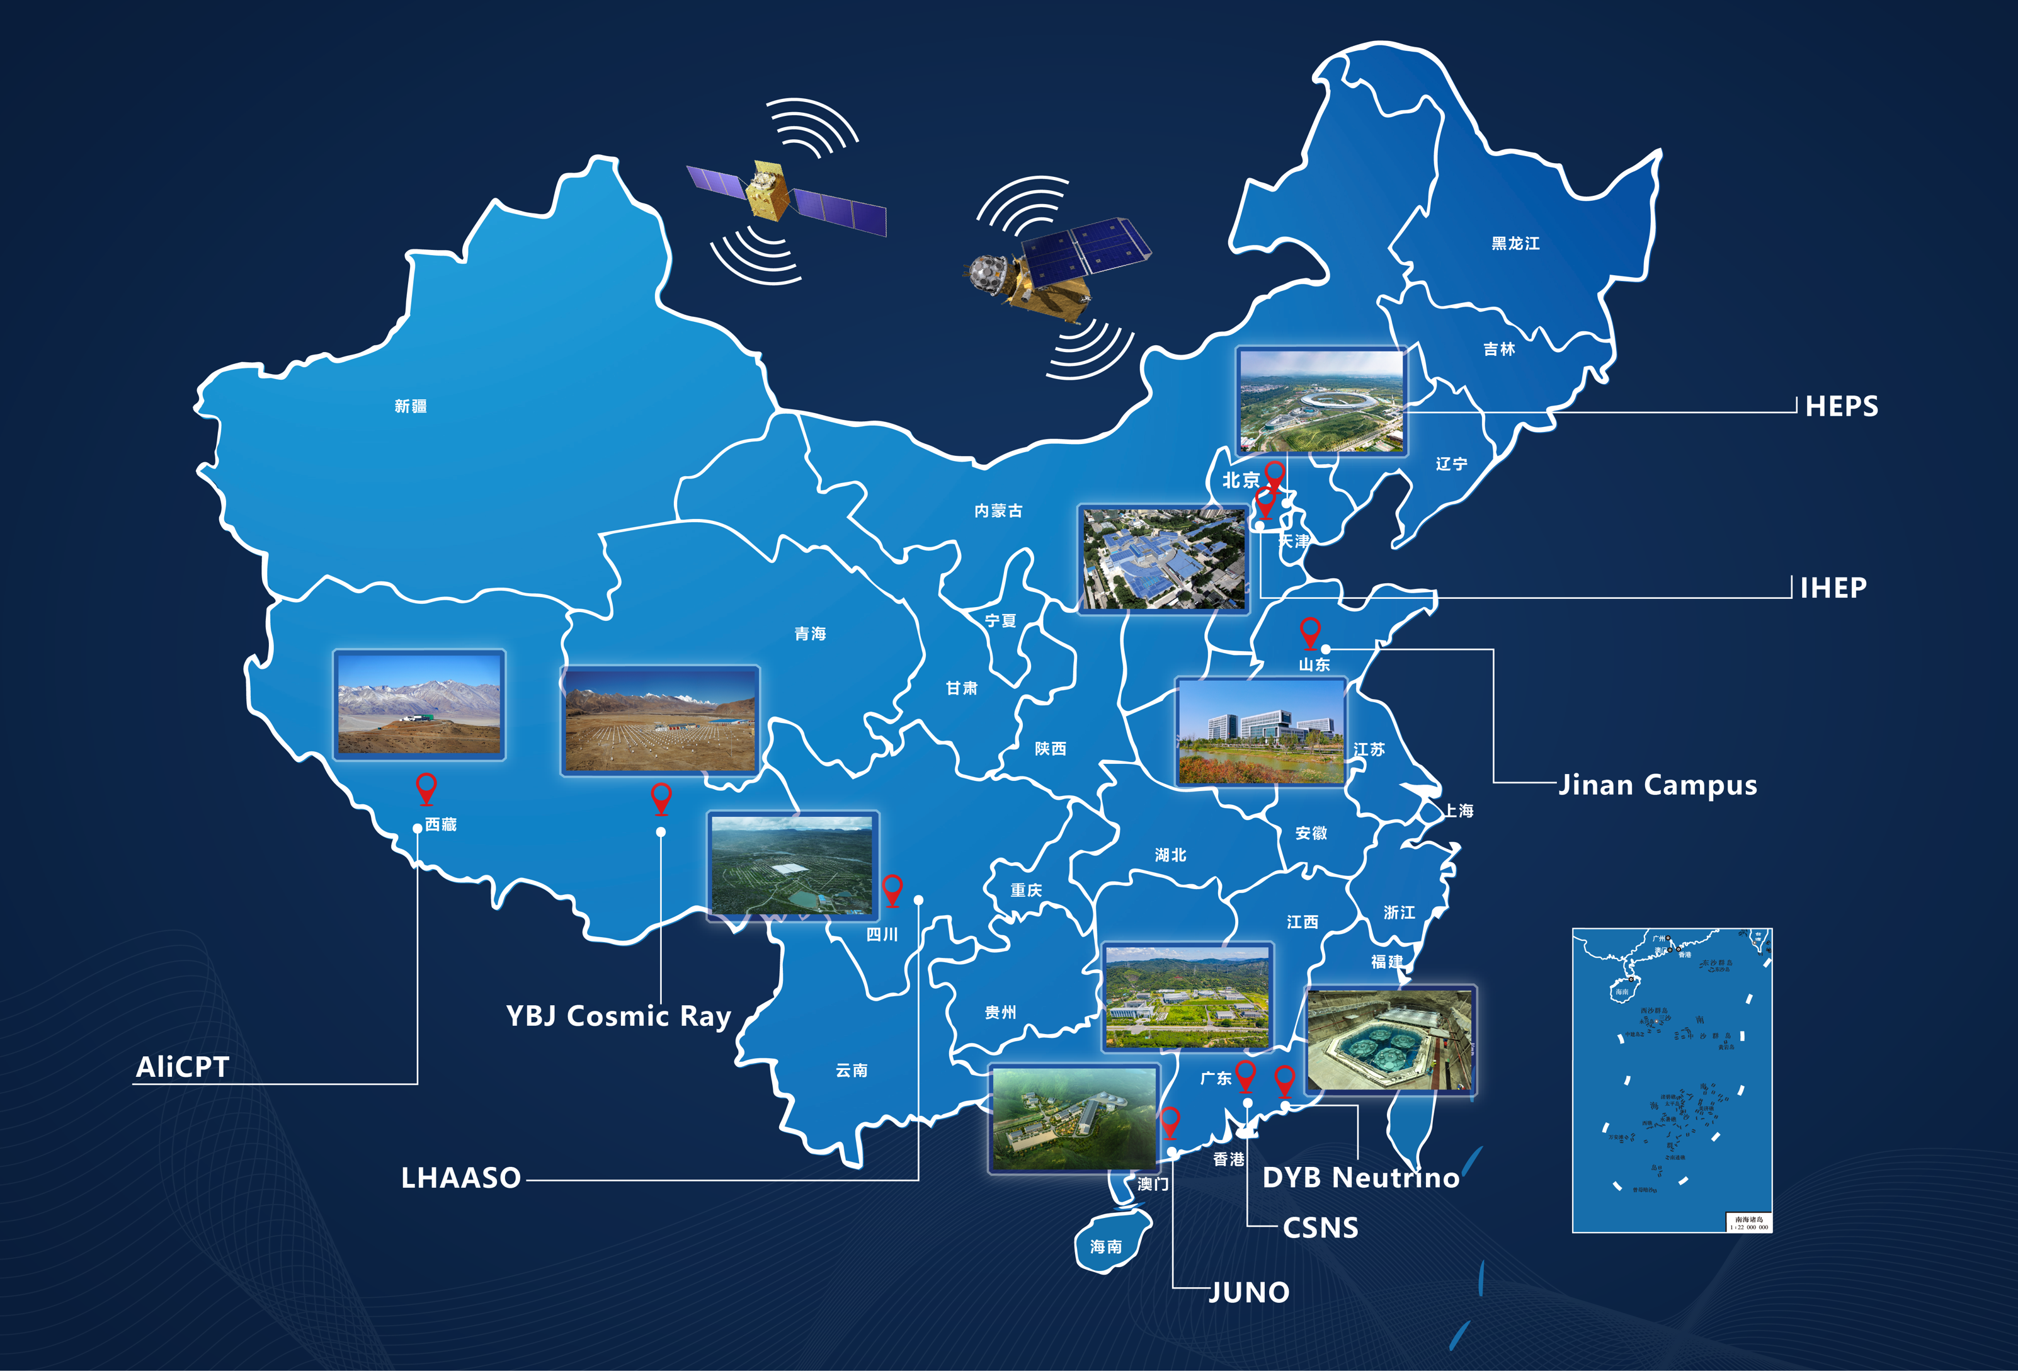
IHEP facilities
Facilities built and operated by Institute of High Energy Physics (IHEP), Chinese Academy of Sciences (CAS)
China Spallation Neutron Source (CSNS) is one of the facilities of IHEP for multidisciplinary research
CSNS is located at Dongguan, Guangdong Province
CSNS-I completed its construction and started commissioning in 2018
CSNS-II upgrading project was initiated in March 2024

Slide 4
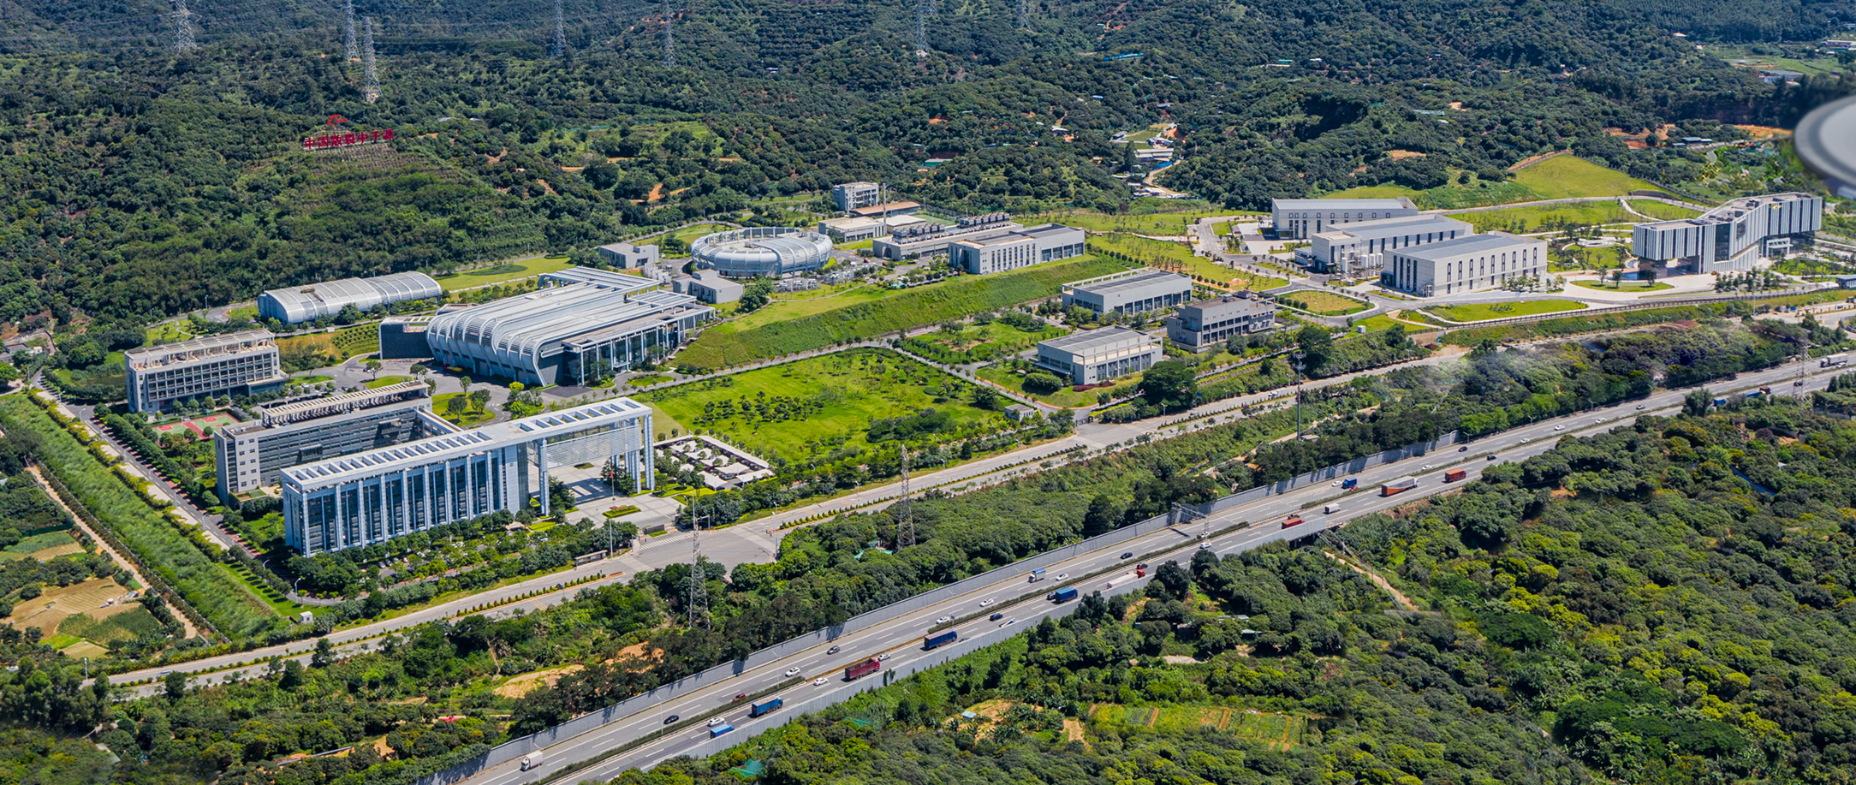
CSNS Campus, Aug. 2022

Slide 5
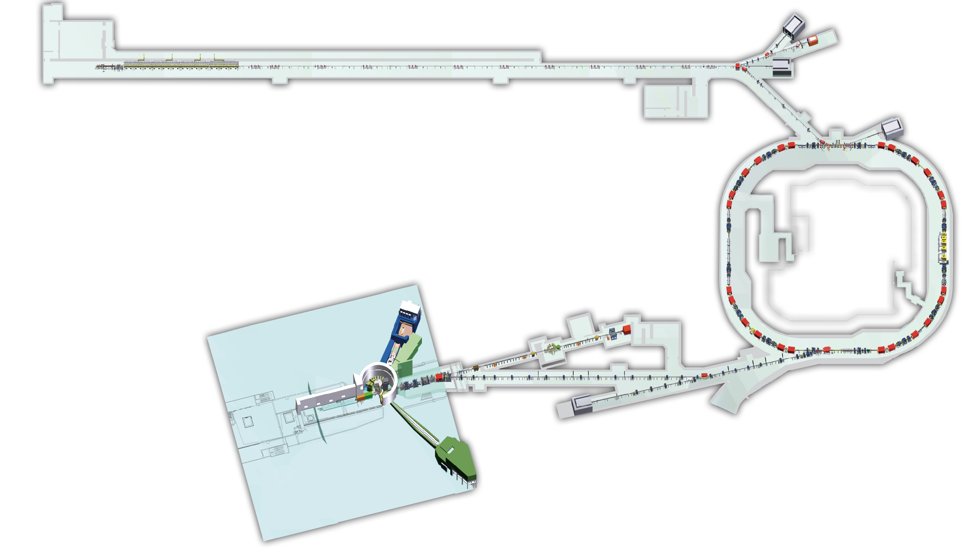
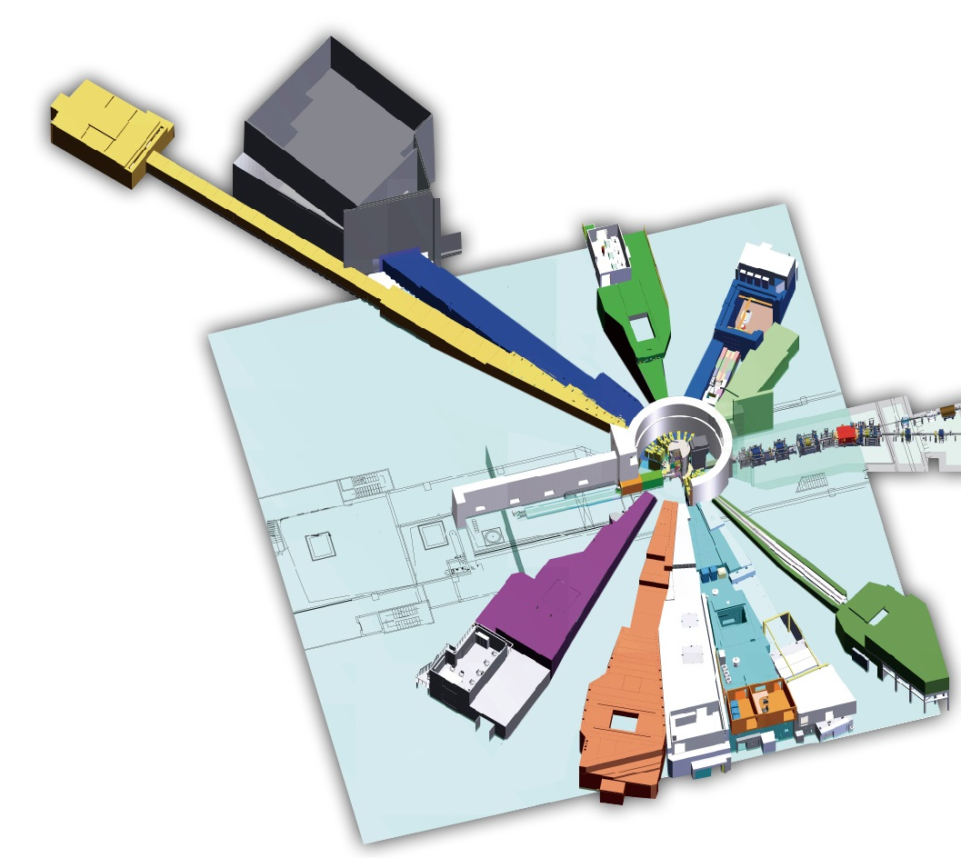
CSNS layout
80 MeV H⁻ DTL
1.6 GeV protons bombard tungsten target
Pulsed beam with 25 Hz repetition frequency
Current beam power: ~160 kW (2.5×10¹³ p/pulse)
Double-bunch/Single-bunch commissioning
Spectrometers
RCS
1.6 GeV
Proton
25 Hz
Target station
CSNS is Mainly used for material study based on neutron scattering technique, but expanded applications of the beam are involved: white neutron beam, proton beam, muon beam, etc.
Back-streaming neutron (Back-n) beamline

Slide 6
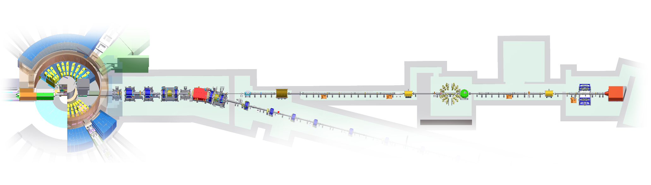
Back-n facility
CSNS tungsten target
End station 1 (ES#1)
@ 54-58 m
End station 2 (ES#2)
@ 74-78 m
Back-n beamline
1.6 GeV p
1.6 GeV p
Bending magnet for incident proton beam
(Sweeping magnet for back-streaming beam)
Time-of-flight (TOF) technique
Two end stations: ES#1 (~56 m) and ES#2 (~76 m)
Wide neutron energy range (from thermal to ~300 MeV)
Weak γ-flash due to back-streaming design

Slide 7
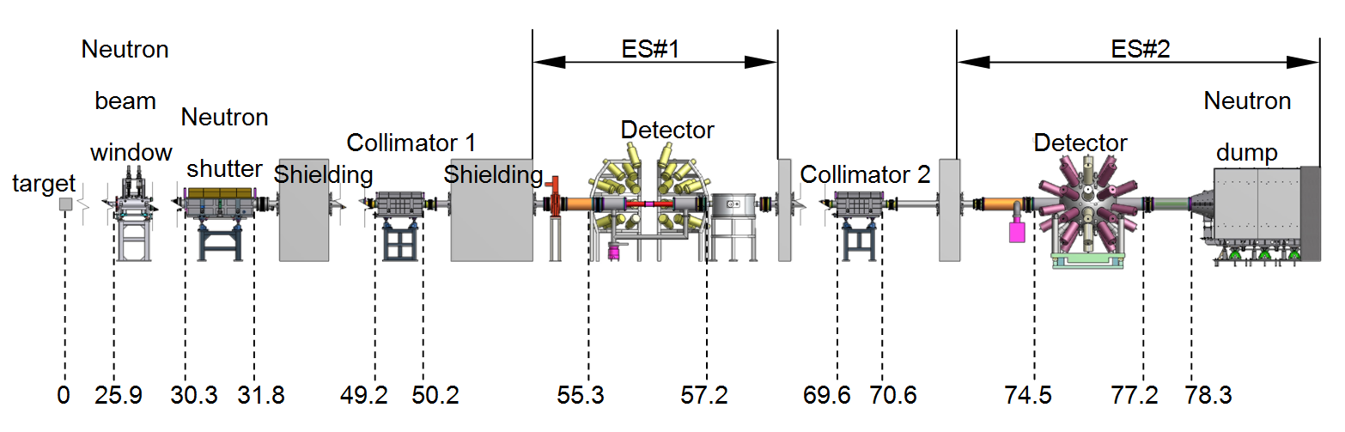
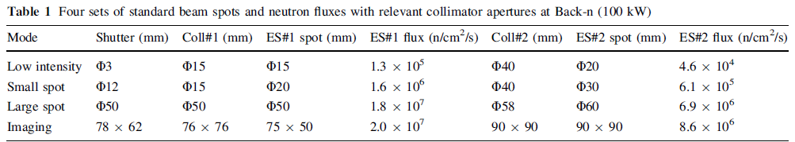
Back-n facility
A neutron shutter and two collimators are used together to configure the beam by adjusting their apertures:
Jingyu Tang et al., Nucl. Sci. Tech. (2021) 32: 11
─ Simulated data

Slide 8
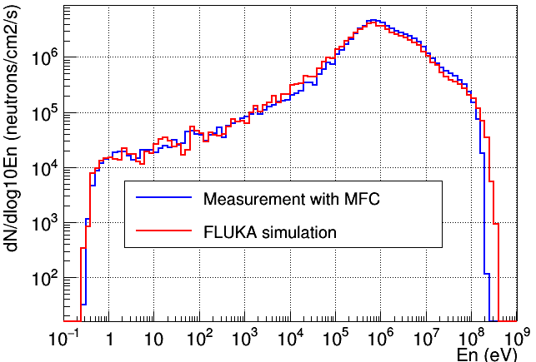
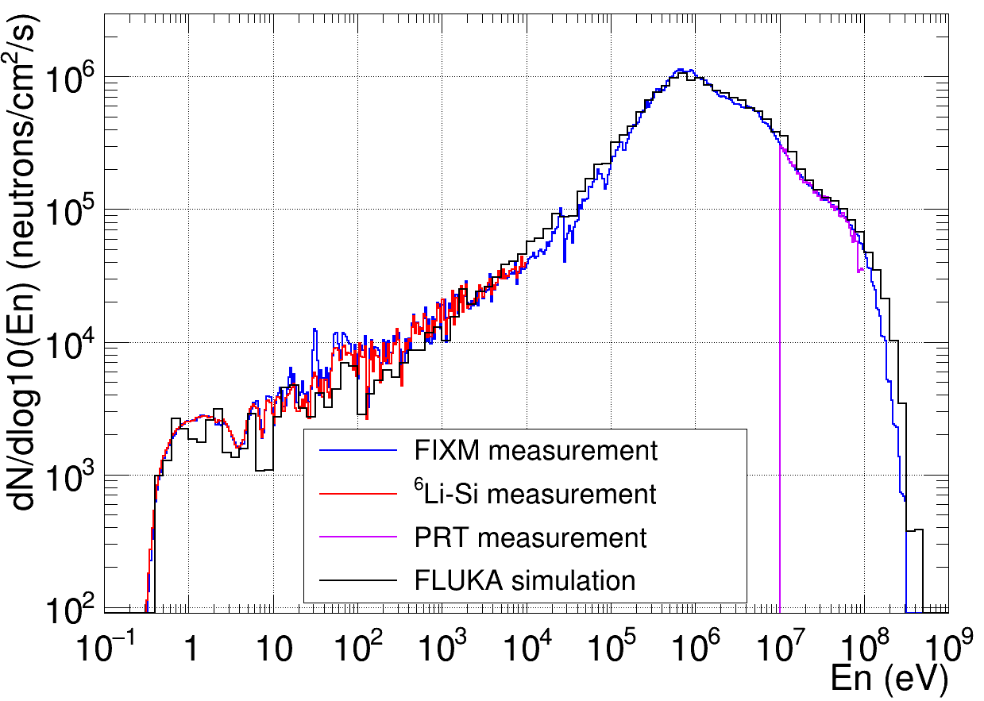
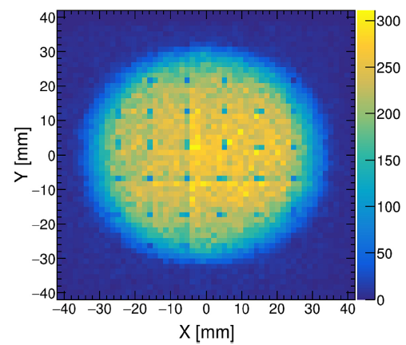
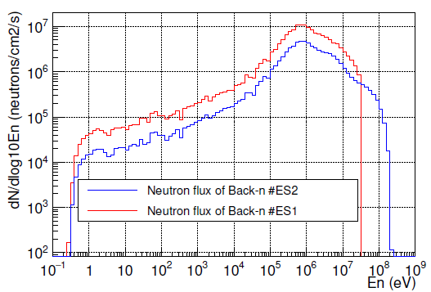
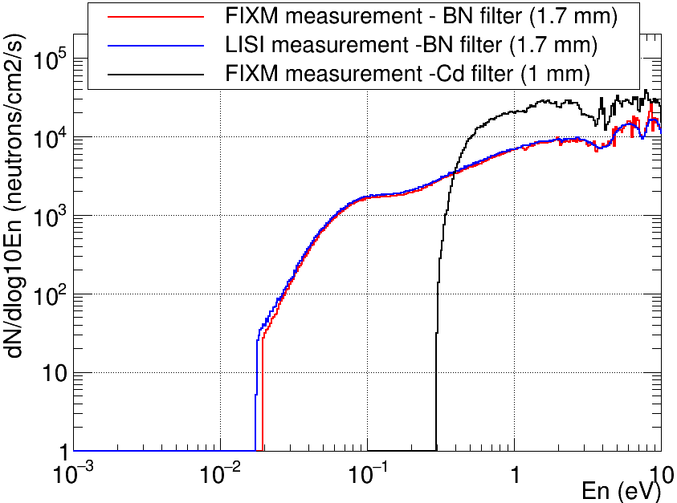
Back-n facility
Flux of ES#2 ─ Big collimators
Flux of ES#1 ─ small collimators
Beam profile of ES#2 ─ big collimators
Flux comparison of ES#1 and ES#2
Thermal neutron Flux of ES#2
Yonghao Chen et al., Eur. Phys. J. A (2019) 55: 115
Yonghao Chen et al., EPJ Web of Conf. (2020) 239: 17018
Yonghao Chen et al., Eur. Phys. J. A (2024) 60: 63
Binbin Qi et al., NIMA (2020) 957: 163407

Slide 9
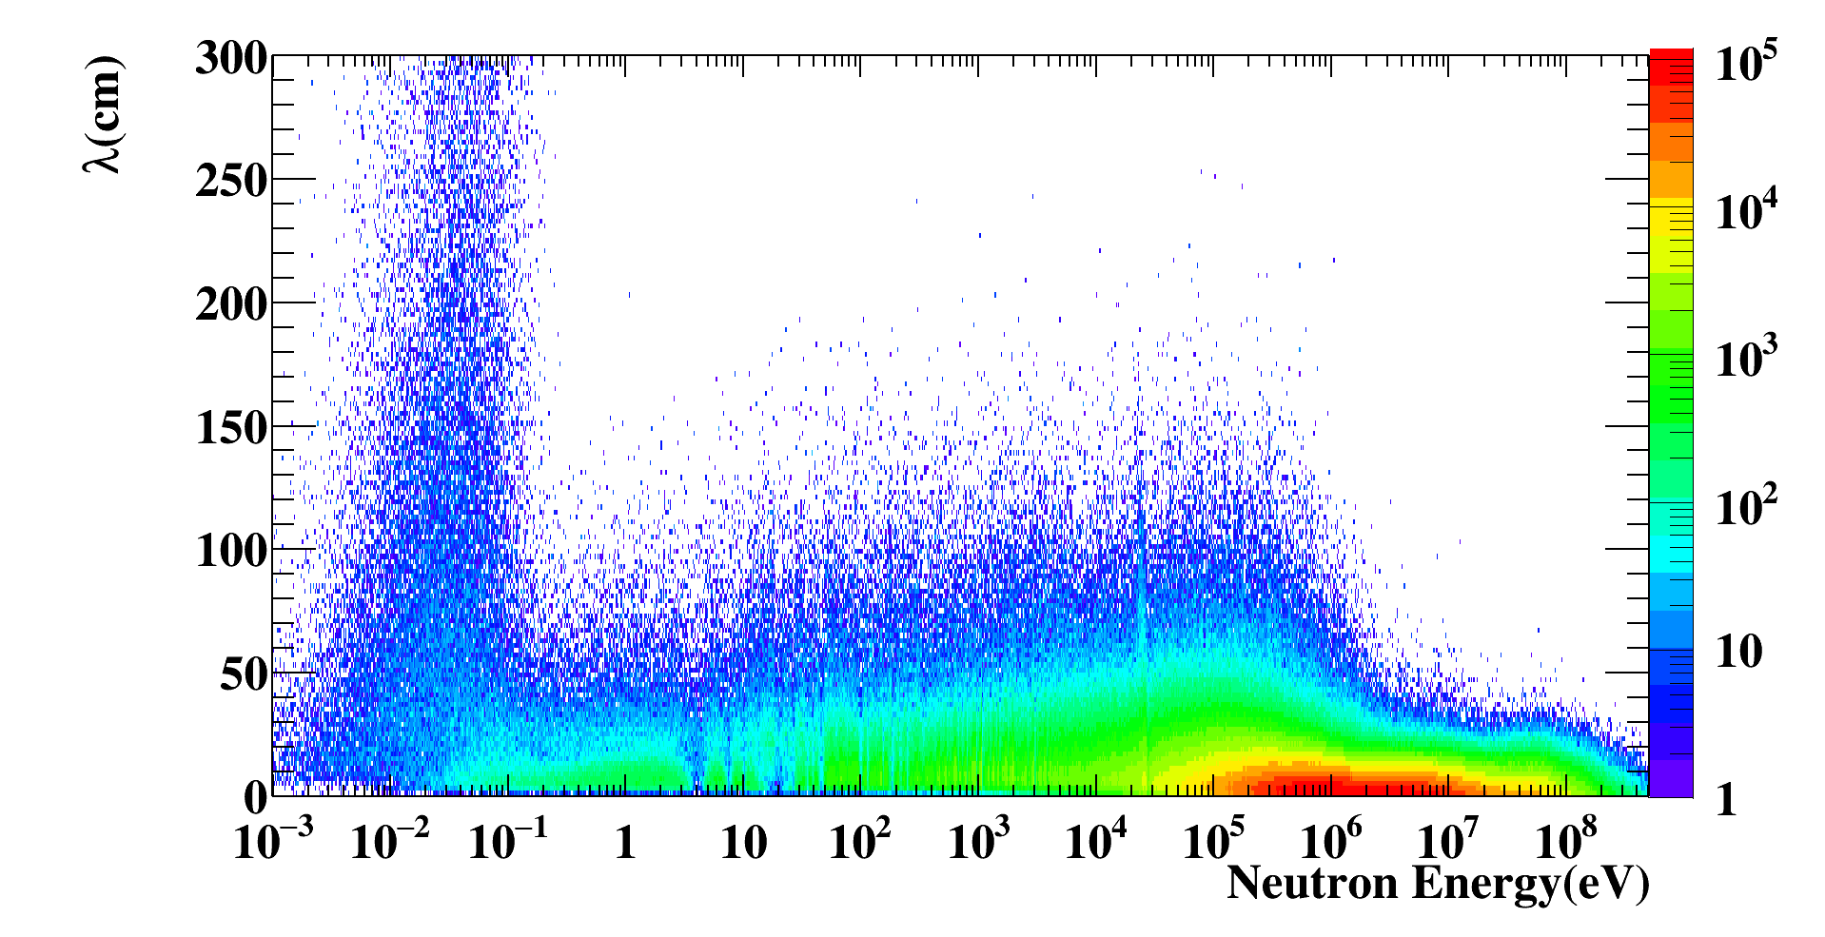

Back-n facility
Simulation of the neutron moderation distance in the spallation target
Energy resolution at Back-n ES#2
Energy (eV) | ΔT (ns) | ΔL (cm) | ΔE/E
1 | 25.5 | 14.5 | 3.8×10⁻³
10 | 25.5 | 17.4 | 4.5×10⁻³
1×10² | 25.5 | 15 | 3.9×10⁻³
1×10³ | 25.5 | 13.6 | 3.5×10⁻³
1×10⁴ | 25.5 | 13.3 | 3.6×10⁻³
1×10⁵ | 25.5 | 9.8 | 3.9×10⁻³
1×10⁶ | 25.5 | 4.2 | 9.2×10⁻³
1×10⁷ | 25.5 | 3.6 | 2.9×10⁻²
1×10⁸ | 25.5 | 4.4 | 9.9×10⁻¹
3×10⁸ | 25.5 | 4.1 | 19.8×10⁻¹

Slide 10
Outline
1. CSNS & Back-n facility
2. Progress in the fission XS measurement
3. Prospects
4. Summary

Slide 11
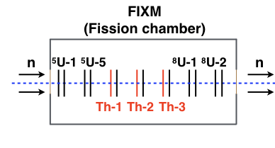
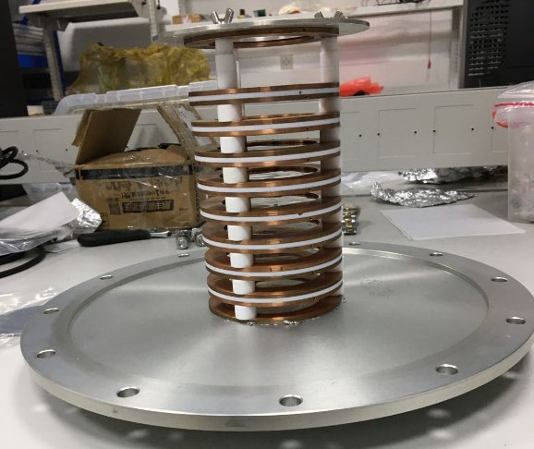
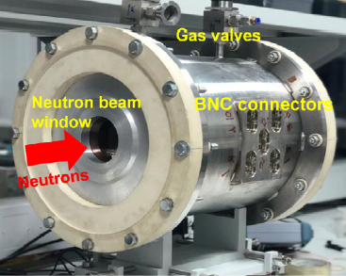

Fission XS measurement at Back-n
Fission cross-section measured at Back-n
$$σ_{x}(En)=\frac{R_{x}(En)ε_{s}N_{s}}{R_{s}(En)ε_{x}N_{x}}σ_{s}(En)$$
Year | Nucleus | Detector | Reference/Comment
2018 | ²³⁵U | FIXM | ANE (2020) 140: 107301 (⁵U/⁸U ratio)
2018 | ²³⁸U | FIXM | EPJA (2023) 59: 5 (⁵U/⁸U ratio)
2018 | ²³⁶U | FIXM | PRC (2020) 102: 034604
2019 | ²³²Th | FIXM | NST (2023) 34: 115
2019 | ²³⁹Pu | FIXM | PRC (2023) 107: 024606
2020 | ²³²Th | FIXM+PRT | PLB (2023) 839: 137832
2021 | ²³⁵U | FIXM+PRT | EPJ Web of Conf. (2023) 284: 01013
2021 | ²³⁸U | FIXM+PRT | EPJ Web of Conf. (2023) 284: 01013
2023 | ²³⁶U | FIXM | Analysis in progress
2024 | ²⁴³Am | FIXM | To be measured very soon
(x-Target，s- Ref.)
E_{n} Neutron energy
R Fission rate
ε Efficiency
N Sample quantity
Ref. sample
Ref. sample
Target sample

Slide 12
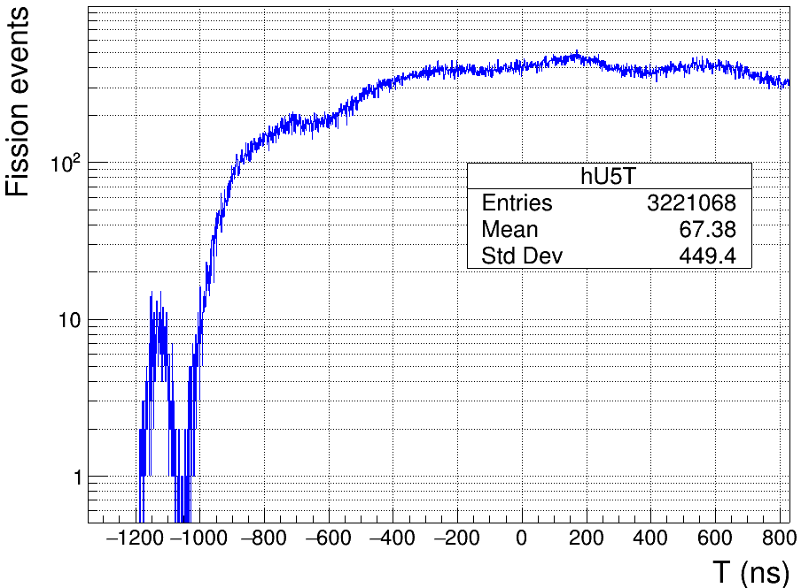
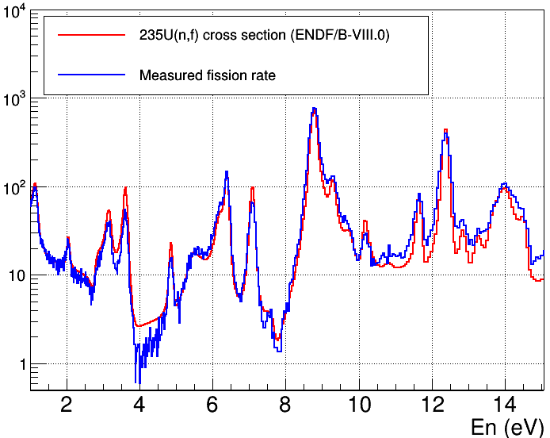
Fission XS measurement at Back-n
TOF method for calibrating neutron energy
L is determined by the resonance peaks of ²³⁵U sample
T₀ is determined by the γ-flash events
Time distribution of fission events
Comparison of fission rate and cross-section
Photon-induced fission events

Slide 13
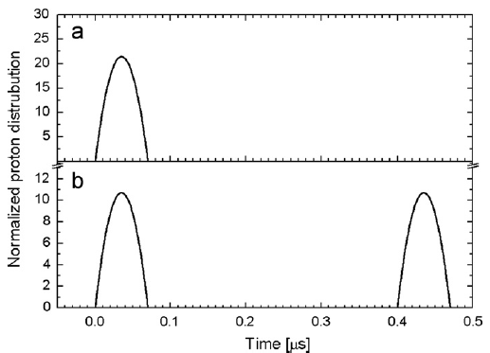
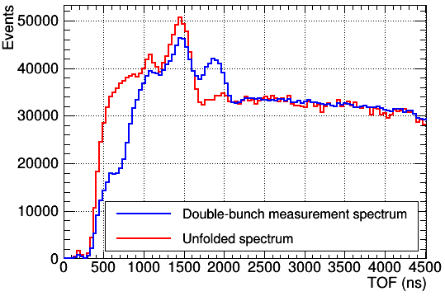
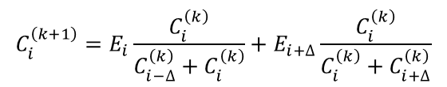
Fission XS measurement at Back-n
Double-bunch unfolding for TOF correction
Double-bunch mode: two identical proton bunches with a well-defined interval (410 ns) in one proton pulse
An uncertainty of 410 ns in TOF measurement is negligible for slow neutrons, but it is not the case for high energy neutrons
An iterative algorithm based on Bayes’ theorem is developed for unfolding the TOF spectrum (Han Yi et al, JINST (2019) 14: 02011)
$$C_{i}^{\left(k+1\right)}=E_{i}\frac{C_{i}^{\left(k\right)}}{C_{i−∆}^{\left(k\right)}+C_{i}^{\left(k\right)}}+E_{i+∆}\frac{C_{i}^{\left(k\right)}}{C_{i}^{\left(k\right)}+C_{i+∆}^{\left(k\right)}}$$
TOF spectrum before and after unfolding
Single-bunch mode
Double-bunch mode

Slide 14
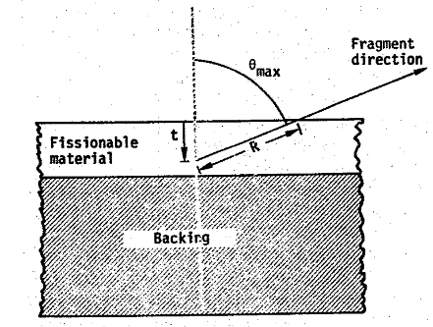
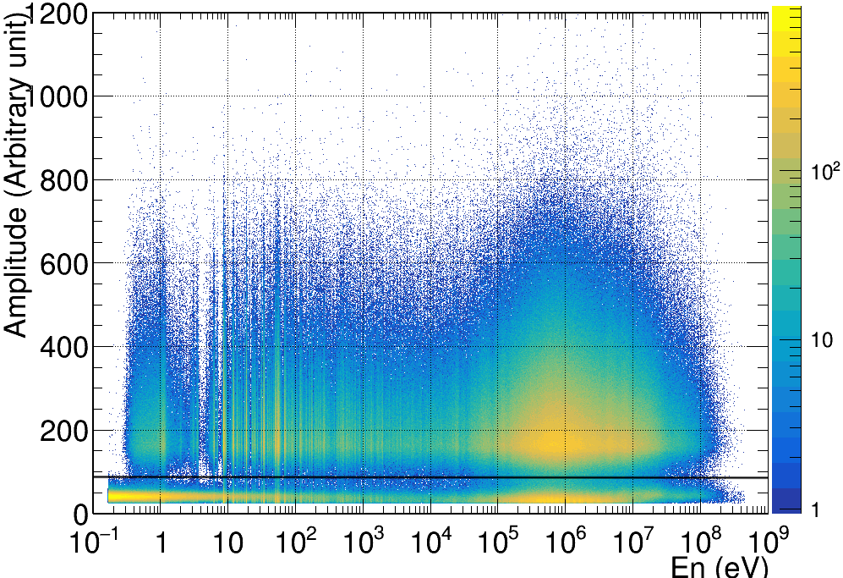
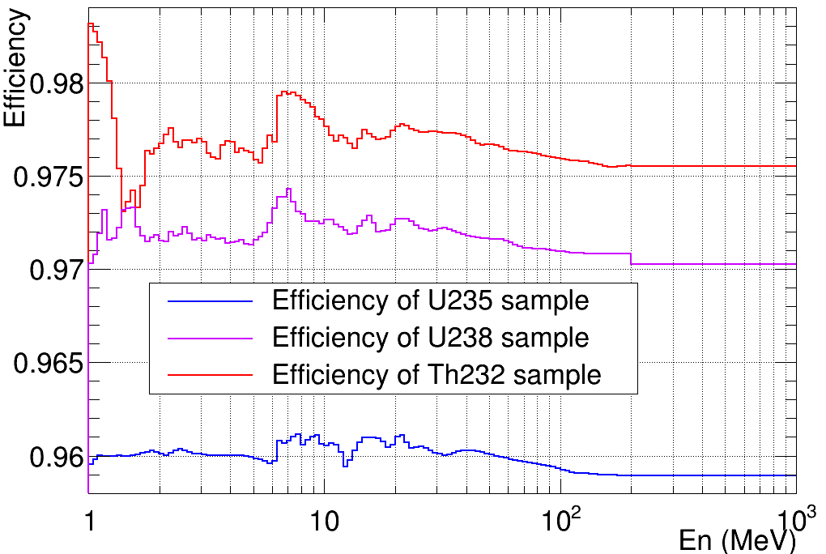
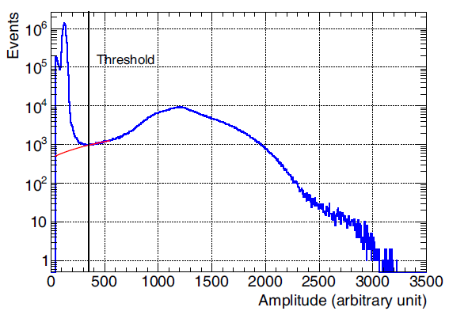



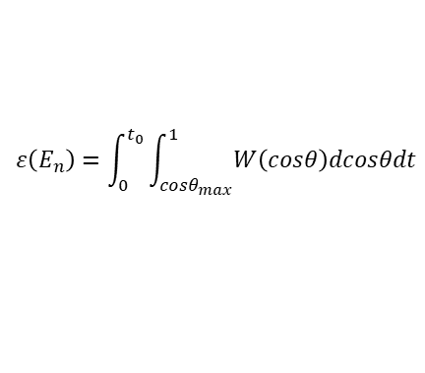
Fission XS measurement at Back-n
Efficiency determination
Efficiency is usually determined based on the amplitude distribution
$$ε\left(E_{n}\right)=\int_{0}^{t_{0}}{\int_{cosθ_{max}}^{1}{W\left(cosθ\right)dcosθdt}}$$
t₀
$$W\left(cosθ\right)=1+\left(A−1\right)cos2θ$$
$$A=\frac{W(cos0°)}{W(cos90°)}$$
$$cosθ_{max}=\frac{t}{R}$$
Efficiency determination taking into account the angular distribution of the FFs: the variation due to the anisotropy is less than 1%

Slide 15
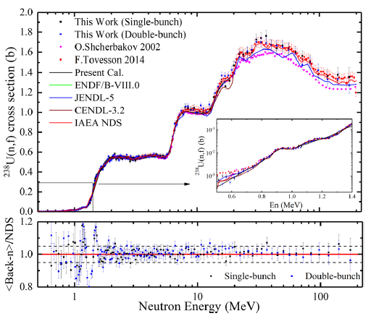
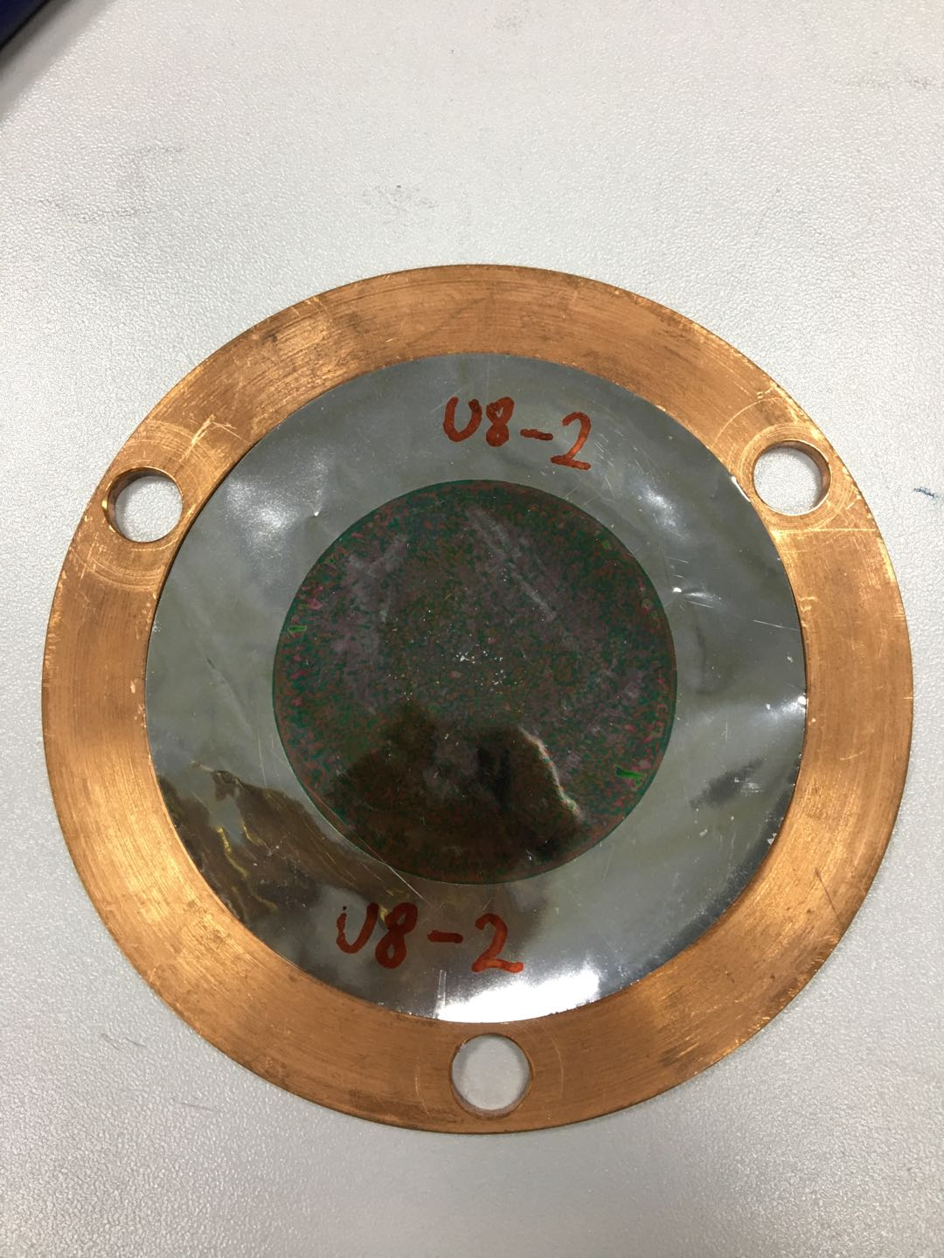
Fission XS measurement at Back-n
²³⁸U(n, f) XS measurement from 0.5 to 200 MeV
Measurement relative to ²³⁵U(n, f) up to 200 MeV
Important measurement reference in high energy region
The measurement shows better agreement with IAEA standard and ENDF/B-VIII.0 than JENDL-5 and CENDL-3.2
Jie Wen et al., Annals Nucl. Energy (2020) 140: 107301
Zhizhou Ren et al., Eur. Phys. J. A (2023) 59: 5

Slide 16
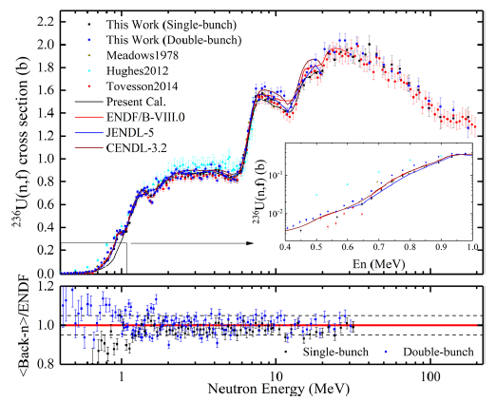
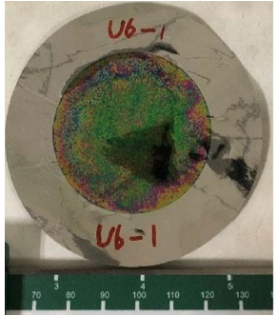
Fission XS measurement at Back-n
²³⁶U(n, f) XS measurement from 0.4 to 200 MeV
Zhizhou Ren et al., Phys. Rev. C (2020) 102: 034604
Zhizhou Ren et al., Eur. Phys. J. A (2023) 59: 5
²³⁶U is of interest because of its build-up in the equilibrium fule composition in the Th/U cycle
Measurement relative to ²³⁵U(n, f) up to 200 MeV
Important measurement reference in high energy region

Slide 17
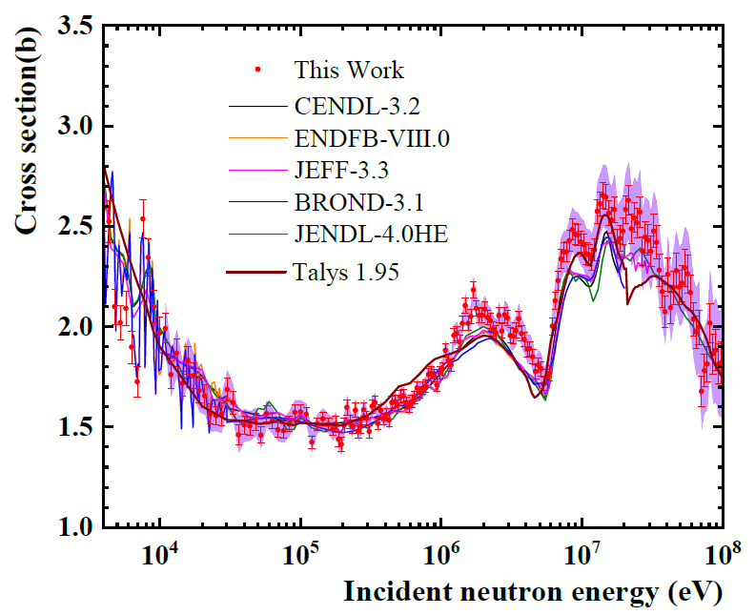
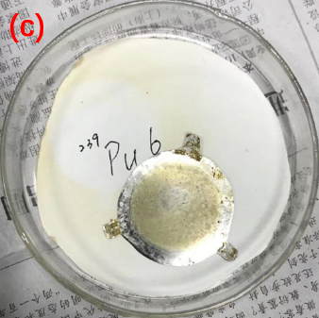
Fission XS measurement at Back-n
²³⁹Pu(n, f) XS measurement from 4 keV to 100 MeV
²³⁹Pu is very important isotope in the U/Pu cycle
Measurement relative to ²³⁵U(n, f) from 4 keV to 100 MeV
Large systematic uncertainties due to several reasons (sample, beam configuration, etc.)
An improved measurement is expected to be performed in the future
Yijia Qiu et al., Phys. Rev. C (2023) 107: 024606

Slide 18
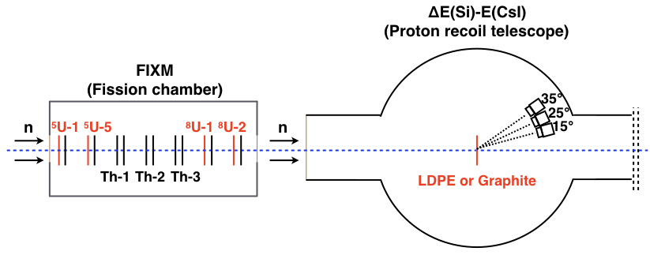
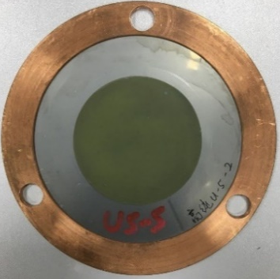
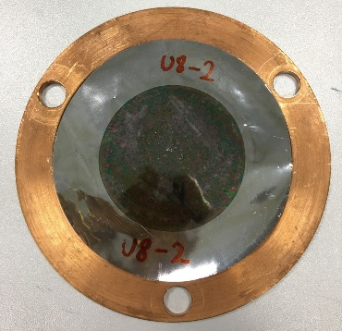
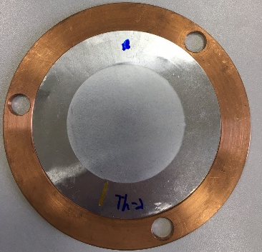
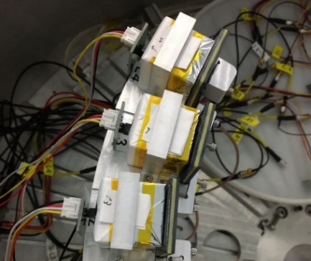
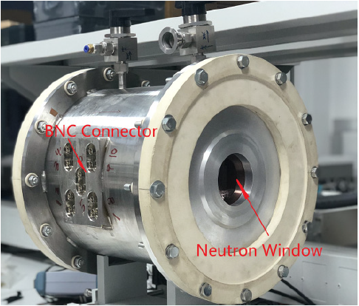
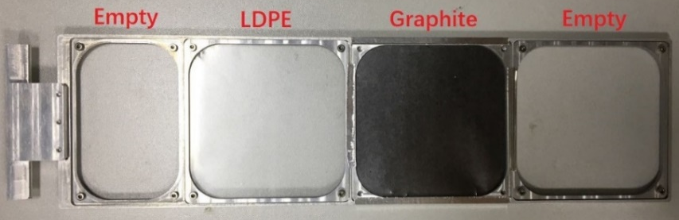
Fission XS measurement at Back-n
Measurement combining fission chamber and ΔE-E telescope by taking H(n, n) as reference
A fission chamber (FIXM) is used for measuring the fission events
Proton recoil telescope (PRT) is used for measuring the scattering protons
U5
U8
Th232
FIXM
PRT: Si (300 μm)+ CsI (3 cm)
CsI
Si

Slide 19
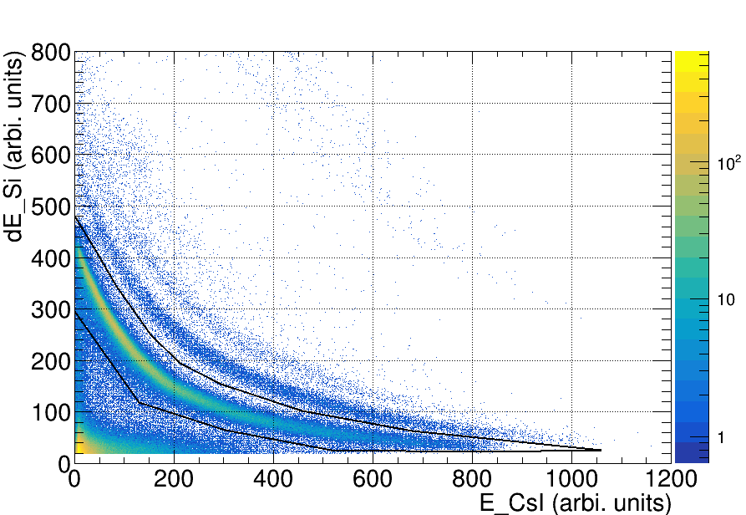
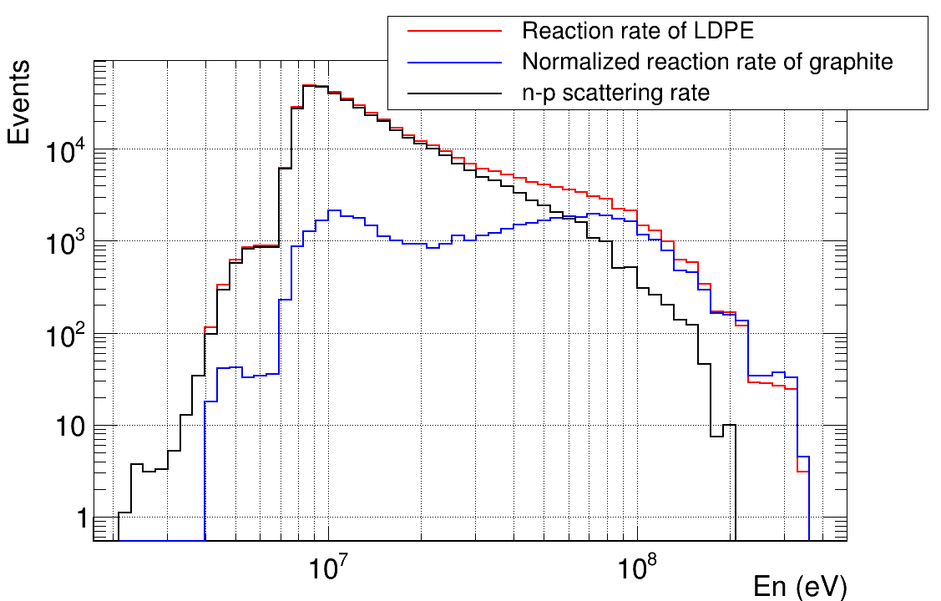
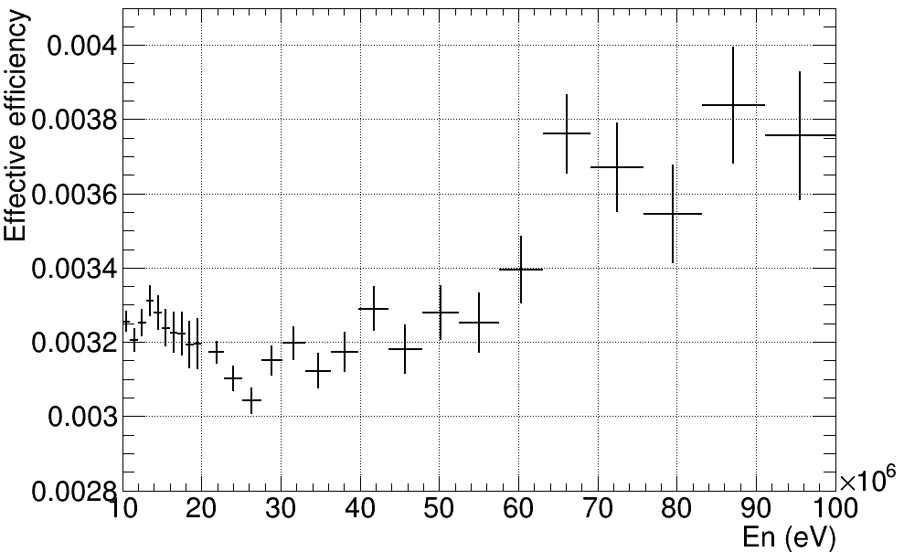
Fission XS measurement at Back-n
ΔE-E distribution is applied for identifying proton events
The contribution from ¹²C(n, p) reaction is quantified by measuring a graphite sample
The effective efficiency of PRT is obtained by Geant4 simulation
ΔE-E particle identification
Background subtraction
Efficiency simulation
t
d
p

Slide 20
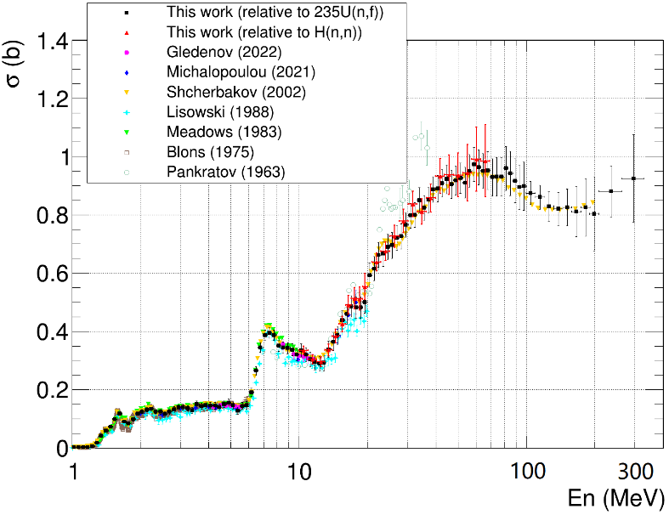
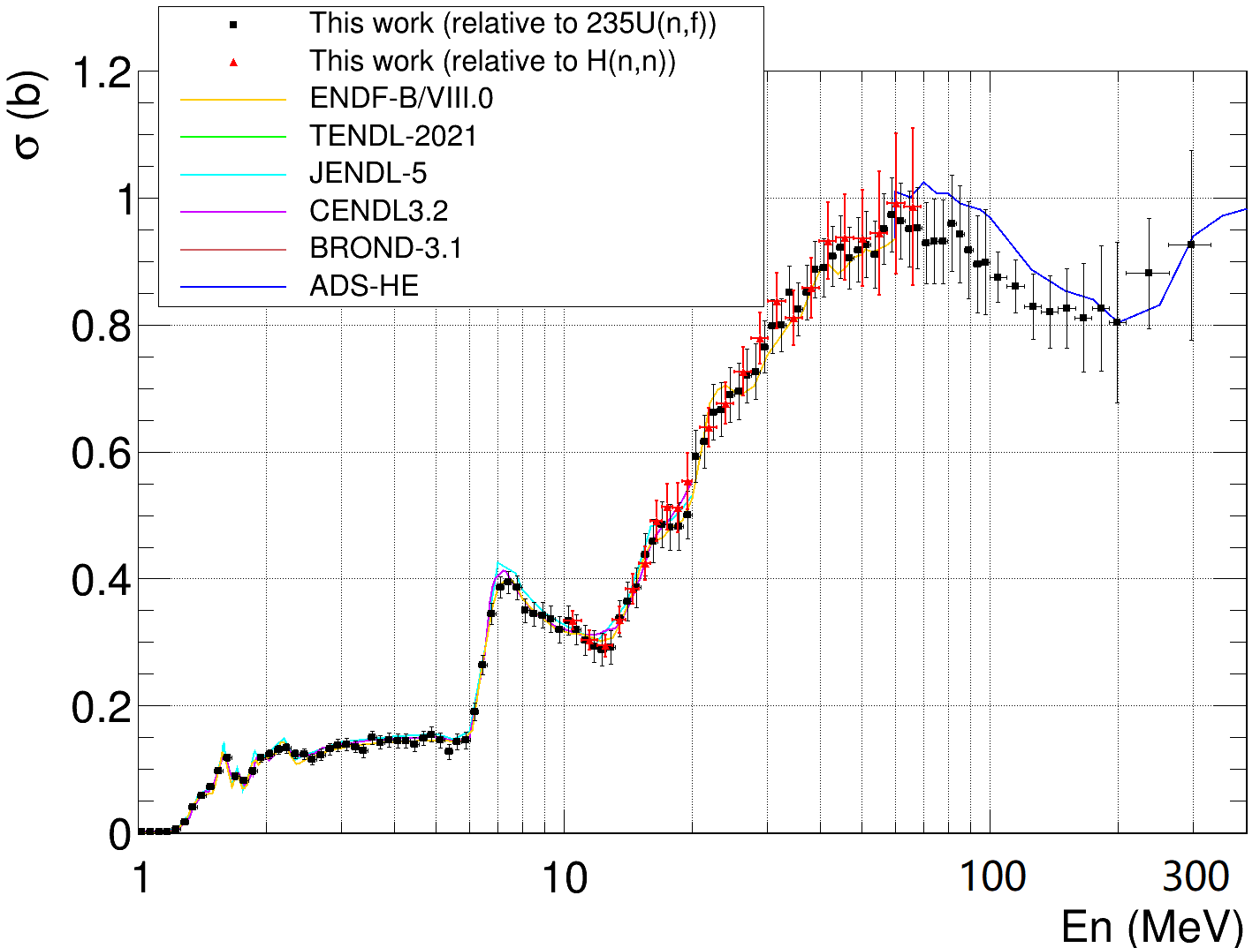
Fission XS measurement at Back-n
²³²Th(n, f) XS measurement from 1 to 300 MeV
Yonghao Chen et al., Phys. Lett. B (2023) 839: 137832
Comparison with other measurements
Comparison with evaluations
Measurement respectively relative to ²³⁵U(n, f)【1-300 MeV】and H(n, n)【10-70 MeV】
Results obtained by two approaches/references agree with each other within uncertainties
Provide very scarce data in 200-300 MeV region

Slide 21
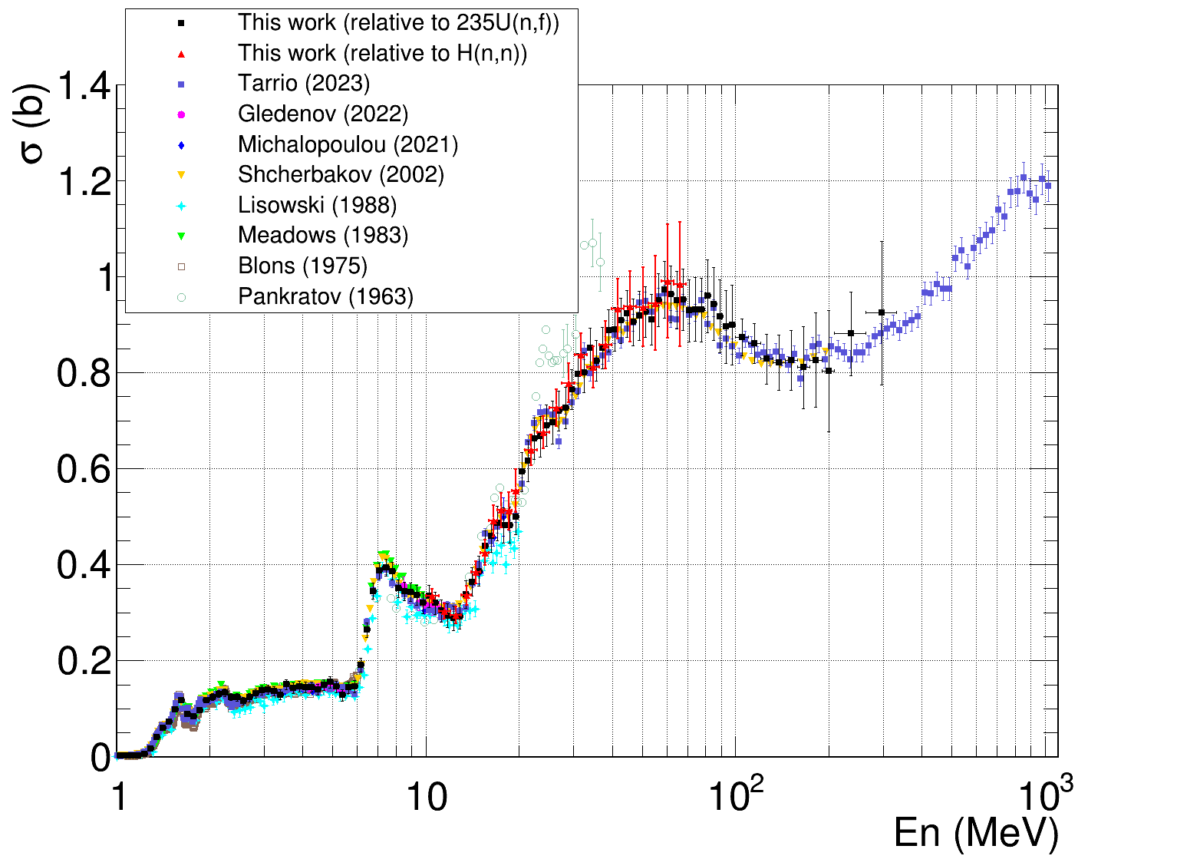
Fission XS measurement at Back-n
²³²Th(n, f) XS measurement
Coincide with CENR n_TOF data in 200 – 300 MeV region
(D. Tarrio et al., Phys. Rev. C (2023) 107: 044616)
One of the two datasets above 200 MeV
Very important references for evaluation in high energy region

Slide 22
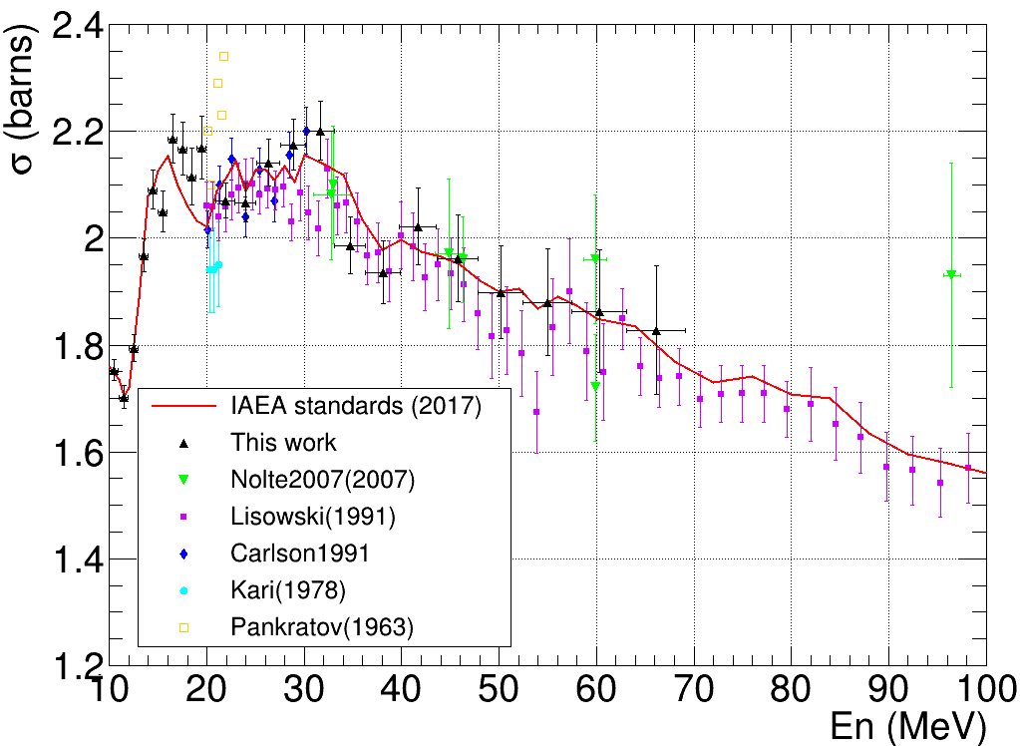
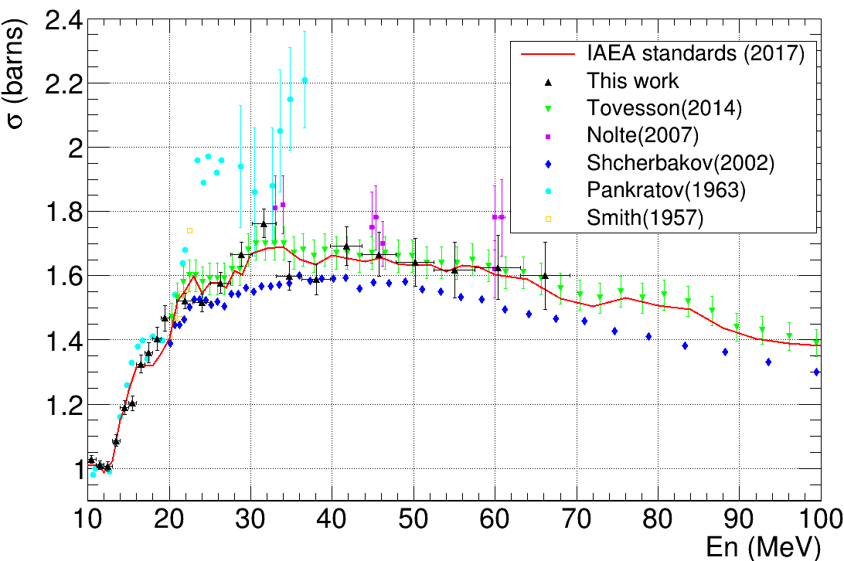
Fission XS measurement at Back-n
^{235,} ²³⁸U(n, f) XS measurement from 10 to 70 MeV relative to n-p scattering
Yonghao Chen et al., EPJ Web Conf. (2023) 284: 01013
²³⁵U(n, f) XS
²³⁸U(n, f) XS
Preliminary
Very meaningful data for neutron data standards
The energy range might be extended in the future by upgrading the experimental setup (10-70 MeV -> 7-100 MeV)

Slide 23
Outline
1. CSNS & Back-n facility
2. Progress in the fission XS measurement
3. Prospects
4. Summary

Slide 24
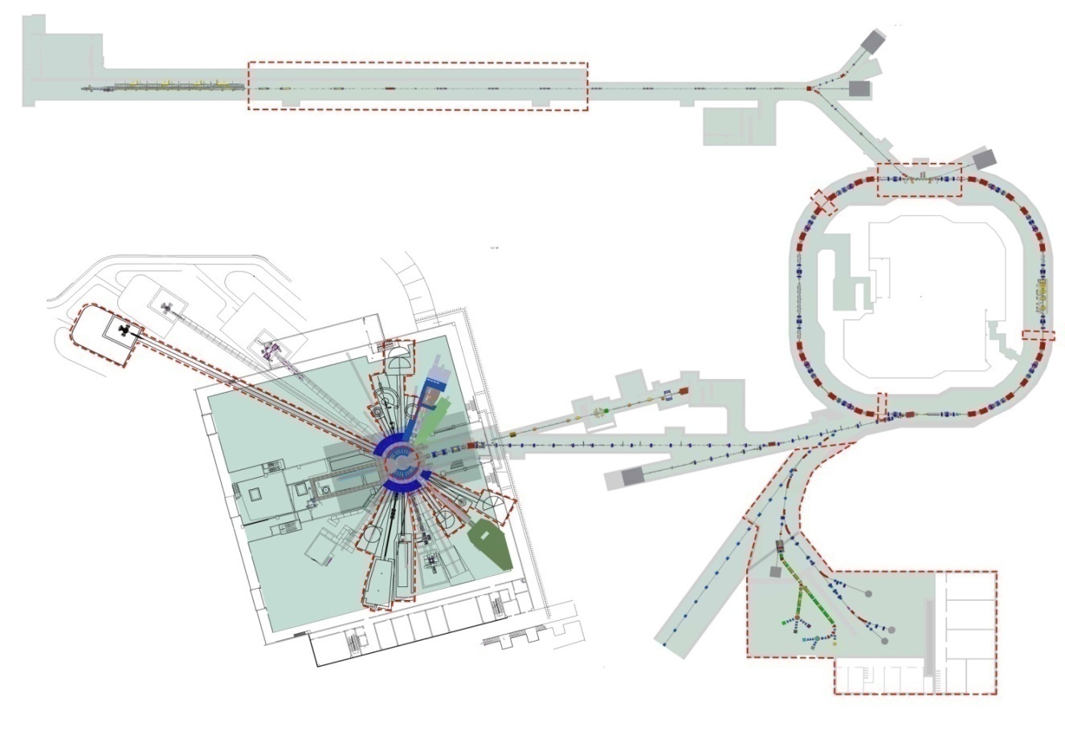
Future prospects
CSNS-II upgrading project: increase the beam power and built new instruments
Linac
Project Budget: 2.9 BCNY (~380 MEUR)
Funded by central and local government
Design and R&D completed
Construction duration (~6 years): 2024.3~2029.12
User operation will be almost unaffected during CSNS-II construction (beam availability ~5000 h/year)
Linac upgrade from 80 MeV to 300 MeV
Beam power upgrade to 500 kW
Rapid Cycling
Synchrotron
Back-n beam line
For Back-n beam line: flux will be increased by a factor of 5, which is advantageous for measurements involving small cross-sections and/or small sample quantities.
Replacement of Target for 500 kW
9 new neutron instruments
Proton & muon
Experimental station

Slide 25
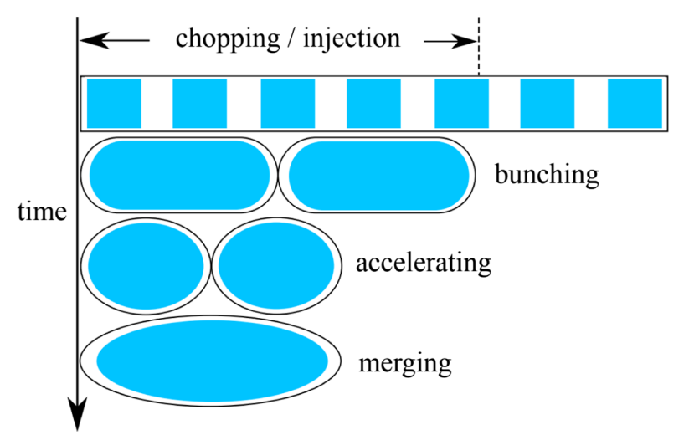
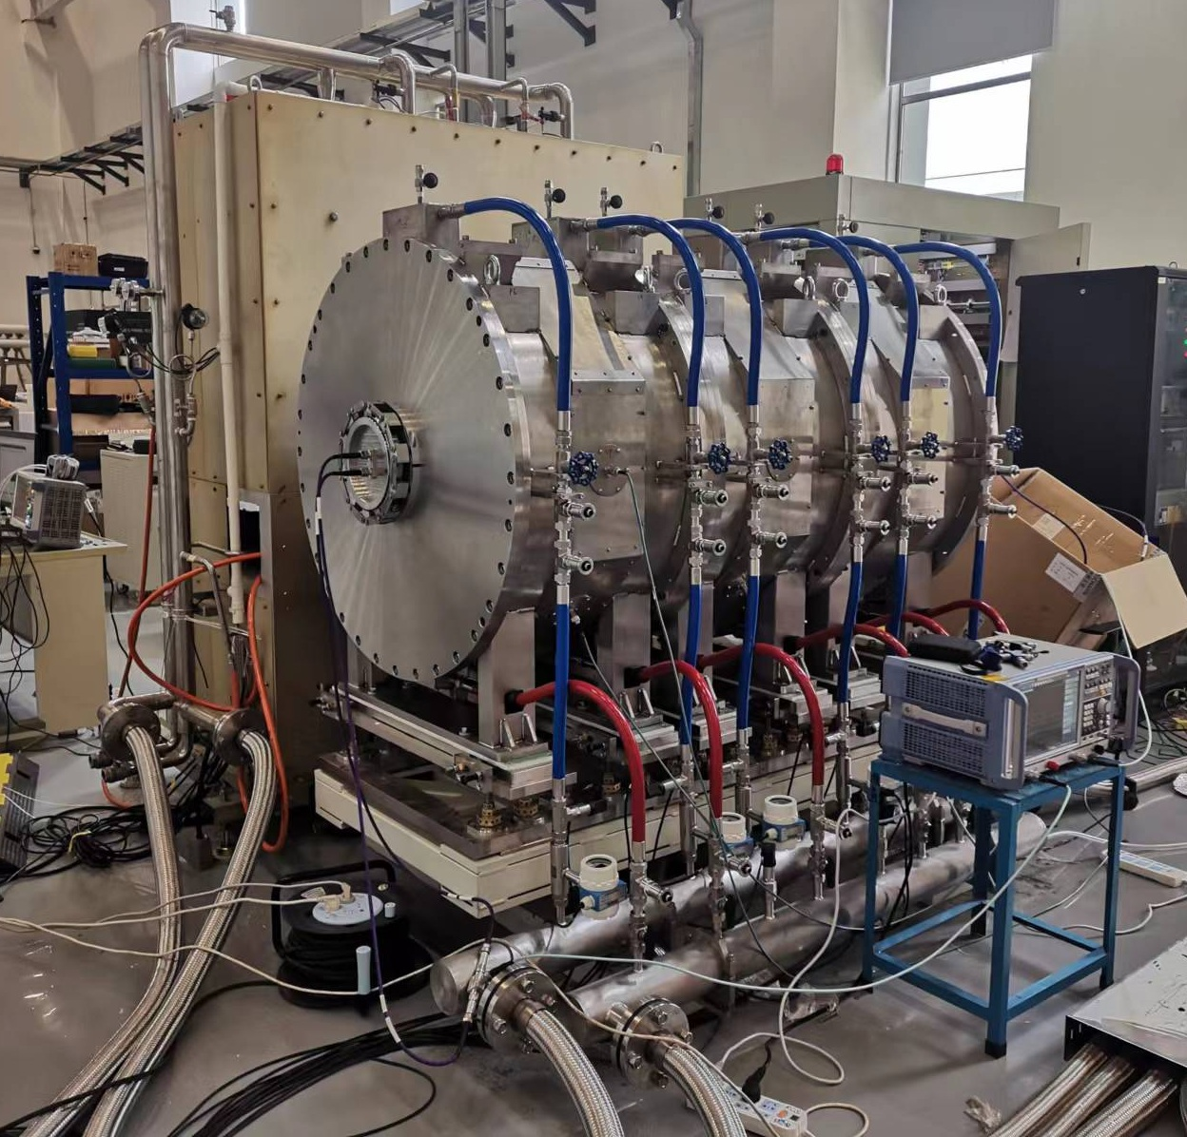

Future prospects
Accelerator bunch merging study @ CSNS/RCS: merge two bunches into one
Double-bunch mode: two identical proton bunches with a well-defined interval (410 ns) in one proton pulse
Unfolding method works but inevitably introduces systematic error
Bunch merging (without reducing flux) is extremely important for the measurement of the high energy neutrons
The newly-installed magnet alloy rf cavity for the CSNS-II (Sep. 2022)
Challenges for bunch-merging in the high intensity RCS
Strong high-intensity effect → beam dipole oscillation
Very short merging time → emittance growth
Beam loss
A fast bunch merging has been proposed
Desynchronization between the dipole and rf system →
increasing the limited merging time
Optimization/adjustment of the rf phase →
compensation of the high-intensity effects
Ref.: Yaoshuo Yuan et al., Phys. Rev. Accel. Beams (2023) 26: 024201
Courtesy of Dr. Yaoshuo Yuan (IHEP, CAS)

Slide 26


Future prospects
More kinds of samples will be measured, and more types of detectors will be developed
Small cross-sections
Small sample quantities
… …
Thanks to the increase of the neutron flux, we will be able to measure more kinds of samples like:
For example, minor actinides with small quantities.
An ADS project is under construction in China. The data of the minor actinides are of great importance.
PPAC (Parallel Plate Avalanche Counter) is a good candidate that aligns with the future direction of fission measurement at Back-n, due to its good performance (fast signal, position sensitivity, and high counting rate, etc.)
PPAC @ IPN Orsay/ CERN n_TOF

Slide 27
Future prospects
Isotope generation project is being strongly pushed forward at CSNS based on its proton beam, which offers the potential to explore more possibilities in nuclear data measurement.
The Isotope Generation Experiment Platform in the APEP, CSNS-II
 | Performance | Expected Value
APEP Beam | Power : | 12 W – 10 kW
 | Frequency : | 25 Hz
 | Intensity: | 10¹¹ – 10¹⁴ p/s
 | Energy: | 300 MeV
 | Beam size: | ϕ 3 cm
Test Point | Energy | 50 - 300 MeV
 | ΔE (FWHM) : | Average 5%
 | Spot Size : | 0.5×0.5 – 5×5 cm²
 | Spot Uniformity : | > 90%
4 m
8 m
ΔE-E / PSD Charged Particle Identification and Counting
HPGe
γ Detector
Scatterer
Degrader
CT
Beam
Dump
Vacuum
Tank
Laser
Setup
6 m
Quadrupoles
Beam Window
Other Potential Applications:
Proton Nuclear Reaction Cross Section and Production Measurements
Irradiation Test for Electronic Devices, i.e., Soft error Acceleration Test
Material Irradiation Test

Slide 28
Outline
1. CSNS & Back-n facility
2. Progress in the fission XS measurement
3. Prospects
4. Summary

Slide 29

Summary
A series of fission cross-sections have been measured at CSNS Back-n, and we continue to make contributions to nuclear data community
The Back-n facility performance (flux, energy resolution) will be largely improved with the CSNS-II upgrading project
More kinds of samples and more types of detectors will be developed, adapting to the improvement of the facility
Thanks a lot!
We appreciate the support by: National Natural Science Foundation of China (Grant No. 11905031)
National Key Research and Development Program of China (Grant No. 2023YFA1606602)
Youth Innovation Pro-motion Association CAS (Grant No. 2023014)
Guangdong Basic and Applied Basic Research Foundation (Grant No. 2022B1515120032)

