Slide 1
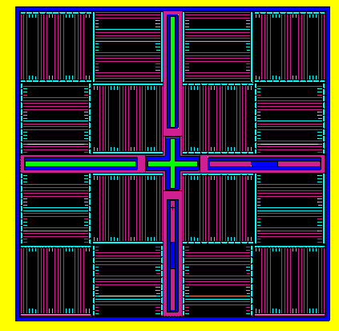
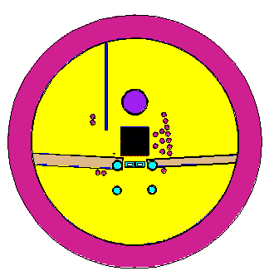
Technical Meeting on Compound Nuclear Reactions and Related Areas
IAEA Headquarters, Vienna, Austria, 8 - 12 July 2024
Accuracy Evaluation of the Available Fission Yields
in the ENDF/B-VII.1, ENDF/B-VIII.0 and JEFF 3.3 data libraries
Nader M. A. Mohamed , Mohamed A. Elsaied
Reactors Department, Egyptian Atomic Energy Authority, Egypt
Introduction
Accuracy of fission yield data is important for different activities of nuclear fuel cycle.
The International Atomic Energy Agency (IAEA) has launched a Coordinated Research Project (CRP) titled: “updating fission yield data for applications” with main objective of updating the evaluated independent and cumulative fission yield data for U-235, U-238, and Cf-252.
The Egyptian Atomic Energy Authority (EAEA) has participated in this project with a research contract under the title of “accuracy evaluation of available fission yield data and updating”. One of the main objectives in this CRP is to evaluate the accuracy of the available fission yield data by simulation of a series of benchmarks in the areas of nuclear reactors calculations.
Aim
As part of the CRP project, the latest ENDF/B-VIII.0 and JEFF3.3 data libraries that released on 2018 and 2017, respectively, as well as the ENDF/B-VII.1 data library were tested on two research reactors (ETRR-2 and OPAL) using two different classes of computational codes: MCNPX V2.7.0 and WIMS-5B/CITVAP codes.
Since the reactor criticality calculations are very sensitive to the data library accuracy, criticality benchmarks were selected in the work for the evaluation of these data libraries.
This presentation focuses on the results of the OPAL research reactor benchmark.
OPAL Benchmark
The Open Pool Australian Light Water (OPAL) Reactor is a 20 MW, open pool type research reactor. It is composed of a compact core surrounded by a heavy water reflector.
the benchmark provided: (1) The power history and the control rod positions, (2) The heavy water reflector purities during the operational cycles and (3) fuel management strategy and loading for the operational cycles: 07 -12.
Reactor Fuel
The reactor core contains 16 (4 × 4) fuel assemblies and four control plates and one regulating plate (CRPs).
The fuel is flat plate U₃Si₂-Al dispersion with aluminum clad and enrichment of 19.8wt% U-235. Each fuel assembly has 2 aluminum side plates, each with 21 slots to hold 21 fuel plates. Three different types of fuel assembly with different uranium densities were used for the first operating cycle.
Modeling
The Monte Carlo N-Particle (MCNPX2.7.0) code is used in modelling the benchmark and calculations.
The reactor have been modeled using the reactor specifications and data given in the benchmark.
In MCNPXV2.7.0 code, BURN card were used with a criticality calculation (KCODE calculations) to calculate the system criticality and the fuel burnup and material inventories after each time interval (defined in the BURN cards).
The decay time between core cycles were considered. All nuclear cross sections were recalled at cold state (~20 °C).
A total of about 300 cycles of which 50 were skipped and 10000 histories per cycle were employed.
The material inventories from cycle n were inputted in the simulation of cycle n+1 .
MCNP model of the reactor core
MCNP model of the reactor
Results
Cycle 12
Average discrepancies between calculations and measurements (cycles 07 -12)
Cycle 07
Cycle No. | Average discrepancy (pcm)
 | ENDF/B-VII.1 | ENDF/B-VIII.0 | JEFF 3.3
007 | 120 | 80 | 90
008 | 210 | 100 | 240
009 | 215 | 150 | 290
010 | 290 | 150 | 270
011 | 250 | 130 | 270
012 | 220 | 110 | 330
Average | 218 | 120 | 248
Not only the uncertainties in data libraries lead to these discrepancies but also, the approximations in the model and the uncertainties in the measured control rod positions.
In the calculations, same models and same data of control rod positions were used for the evaluation of the three data libraries, therefore the discrepancies between the calculation results are due to the uncertainties in the nuclear data
The differences between the reactivity calculation results of burnt cores and fresh core can be attributed to the effect of the fission products data.
As shown in the Figures and the Table , ENDF/B-VIII.0 resulted in highest accuracy with average deviations of 100 and 130 pcm between its results and that of ENDF/B-VII.1 and JEFF 3.3, respectively. ENDF/B-VII.1 and JEFF 3.3 results are close with average deviation between them of around 30 pcm.
To investigate the reasons of these deviations, special attention is paid to the concentrations of generated Xe-135 and Sm-149.
Xe-135 in Cycle 07
Xe-135 in Cycle 12
Generated Xe-135at the end of core cycles (cycles 07 -12)
Cycle | End of cycle power (MWth) | Mass of generated Xe-135 (g)
 |  | ENDF/B-VII.1 | ENDF/B-VIII.0 | JEFF 3.3
007 | 18.70 | 0.0311 | 0.0358 | 0.0266
008 | 19.79 | 0.0317 | 0.0367 | 0.0267
009 | 19.58 | 0.0339 | 0.0389 | 0.0289
010 | 18.21 | 0.035 | 0.0400 | 0.0300
011 | 18.19 | 0.0349 | 0.0409 | 0.0309
012 | 18.79 | 0.0349 | 0.0409 | 0.0309
Sm-149 in Cycle 07
Sm-49 in Cycle 12
Generated Sm-149 at the end of core cycles (cycles 07 -12)
Cycle | End of cycle power (MWth) | Mass of generated Sm-149 (g)
 |  | ENDF/B-VII.1 | ENDF/B-VIII.0 | JEFF 3.3
007 | 18.70 | 0.236 | 0.271 | 0.211
008 | 19.79 | 0.249 | 0.299 | 0.221
009 | 19.58 | 0.262 | 0.322 | 0.232
010 | 18.21 | 0.275 | 0.331 | 0.238
011 | 18.19 | 0.280 | 0.335 | 0.242
012 | 18.79 | 0.287 | 0.339 | 0.250
Xenon-135 is the most important fission product poison, whose thermal absorption cross section is 2.66 x 10⁶ b.
The fission product Sm-149 has thermal absorption cross section of 4.1 x 10⁴ b.
Unlike Xe-135, which has a half-life of 9.14 h, Sm-149 is stable and accumulated in the fuel and the only way of its depletion is through neutron absorption.
The reactor powers were not constant during the whole period of the core cycle, therefore the concentrations of the two poisons did not change smoothly with time as show in the figures.
Significant differences in the concentrations of Xe-135 and Sm-149 resulted from the three data libraries can be observed from the figures and the table.
ENDF/B-VIII.0 resulted in higher concentrations of the two poisons than the other two libraries while ENDF/B-VII.1 resulted in higher concentrations of the two poisons than that of JEFF 3.3.
This of course can explain why ENDF/B-VIII.0 resulted in lower core reactivity of OPAL benchmark than the other two libraries. .
Conclusions
MCNPX V2.7.0 calculations based on ENDF/B-VII.1, ENDF/B-VIII.0, or JEFF 3.3 data libraries gave good agreements with the measurements of OPAL multi-cycles criticality benchmark in which ENDF/B-VIII.0 library resulted higher accuracy.
The average deviations between ENDF/B-VIII.0 library and ENDF/B-VII.1 and JEFF 3.3 libraries were around 100 and 130 pcm, respectively.
Considerable differences in the concentrations of Xe-135 and Sm-149 (the dominant generated poisons) resulted from the three data libraries were observed.
ENDF/B-VIII.0 resulted in higher concentrations of the two poisons than the other two libraries while ENDF/B-VII.1 resulted in higher concentrations of the two poisons than that of JEFF 3.3.

