Slide 1
Extending the Dispersive Optical Model to β-unstable systems
Compound Nuclear Reactions and Related Topics (CNR*24)
Cole D. Pruitt, Jutta Escher, Oliver Gorton, S. Simone Perrotta
Lawrence Livermore National Laboratory
IAEA Headquarters, Vienna
8 July 2024

Slide 2
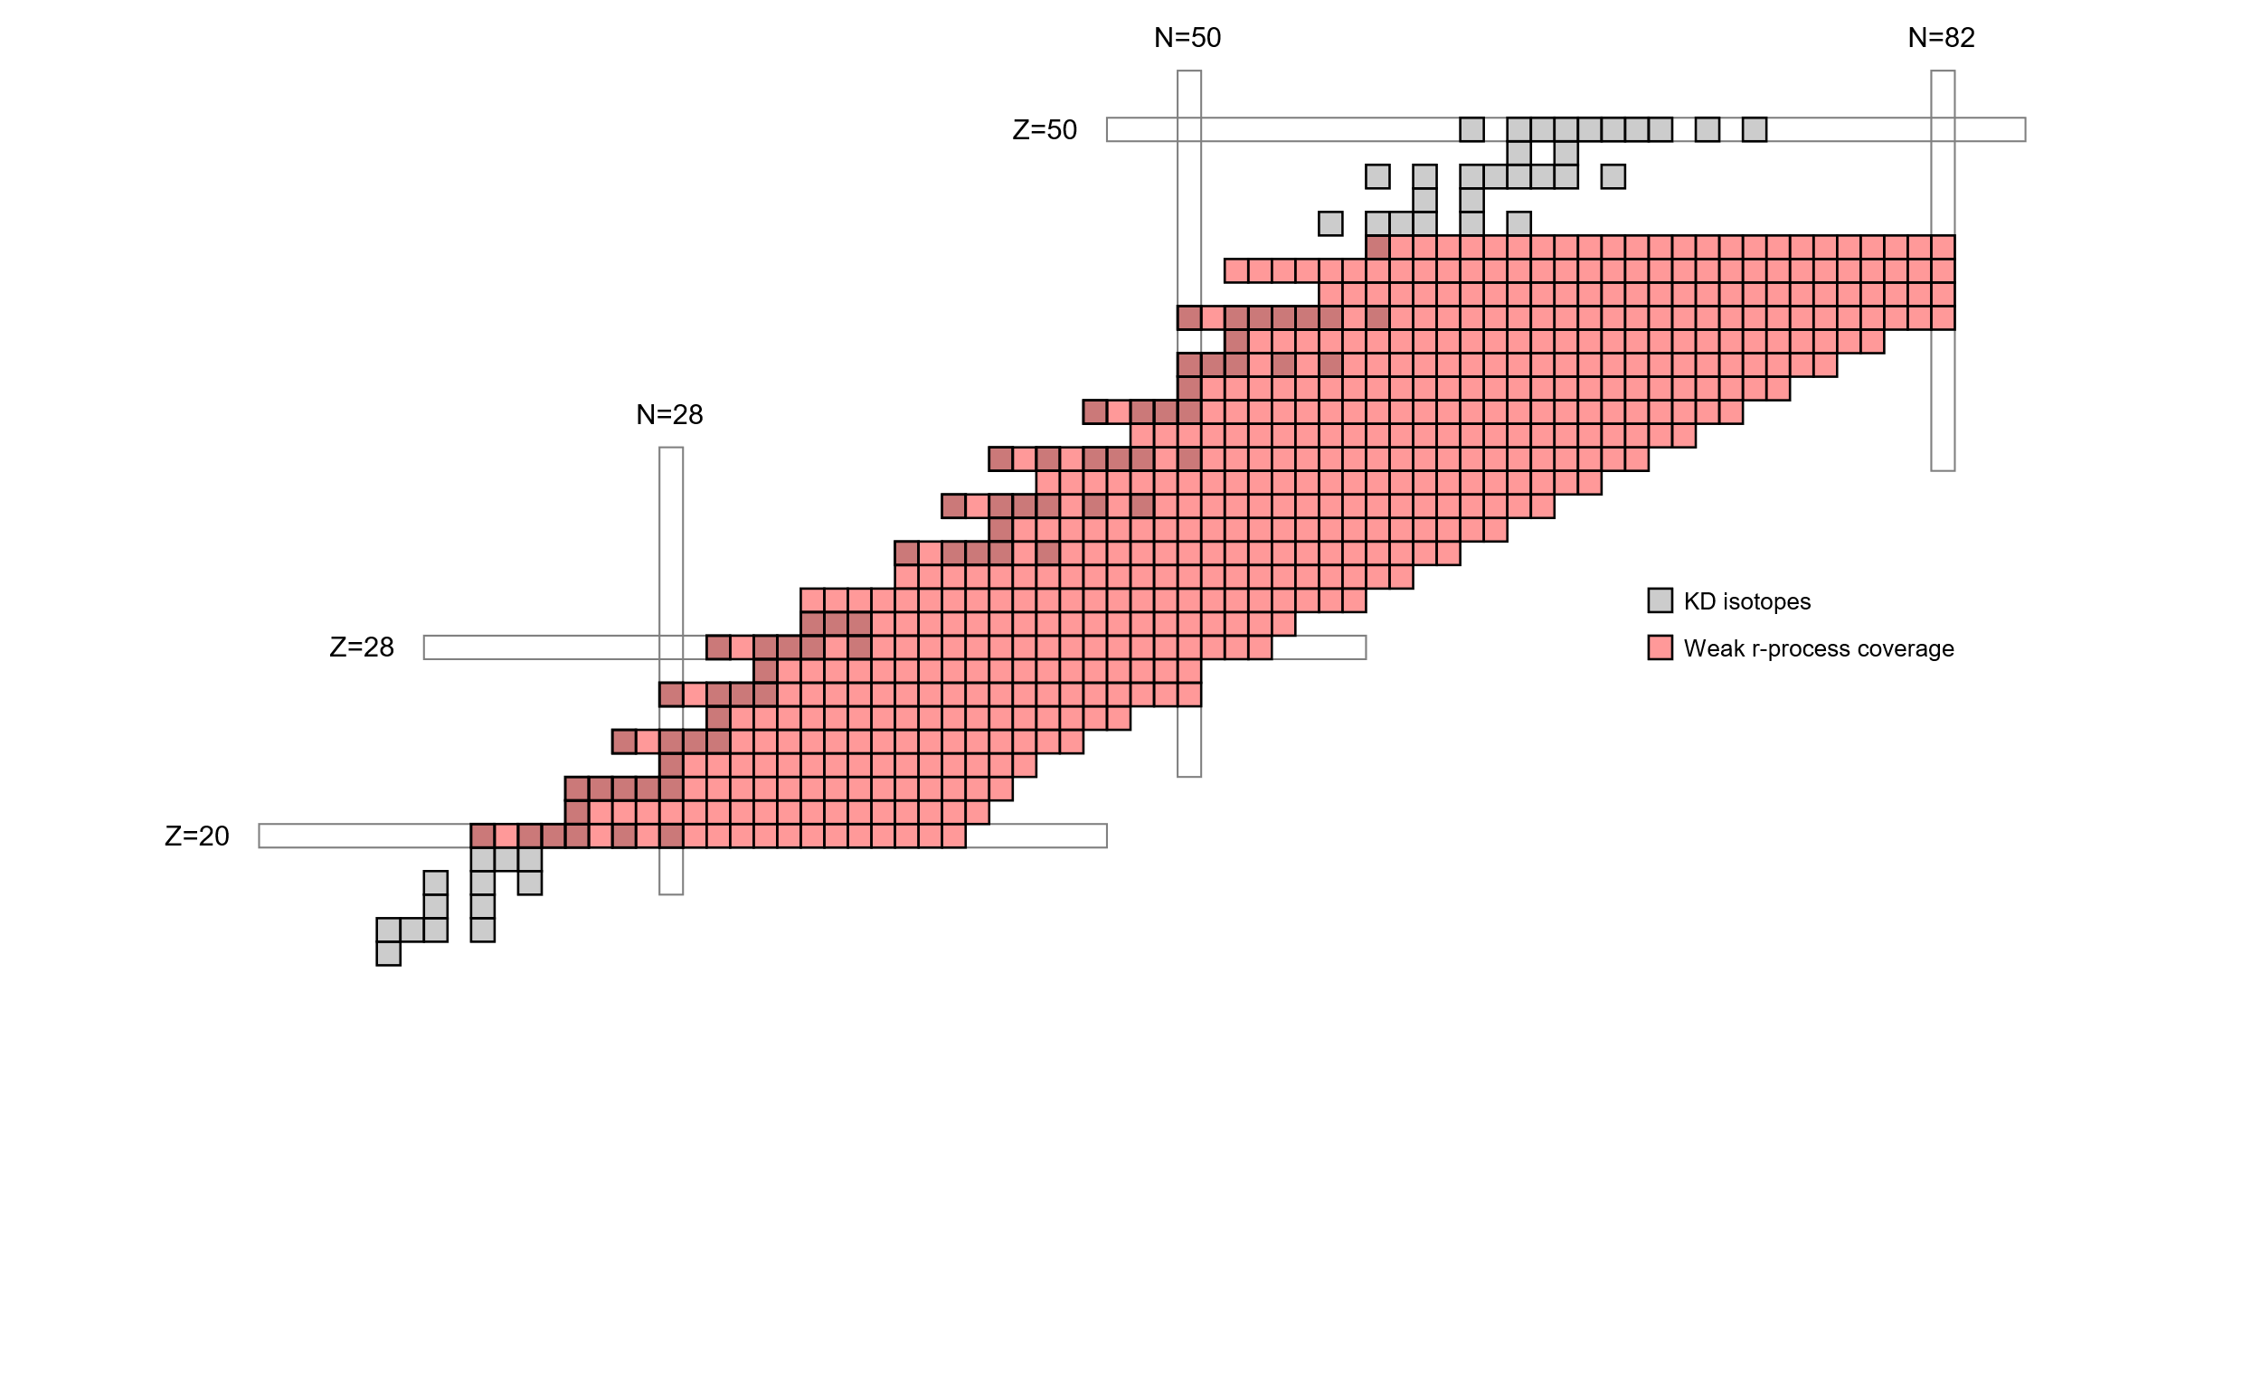
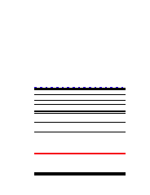
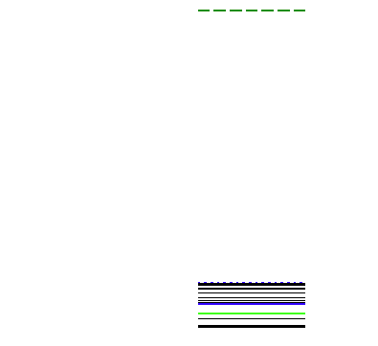
Nucleosynthesis simulations need optical potentials far from stability, where no experimental scattering data are known
CN
populated
OMPs provide transmission coefficients
for CN formation and particle-evaporation
For (n,γ) cross sections on β-unstable targets with
λ_{1/2} ~ years (or less), theory is the only game in town
CN
reached by
n emission
n
S_{n}
n+⁹⁰Zr
γ
E_{ex}
E_{top}
KD isotopes:
Koning and Delaroche, Nucl. Phys. A 713 (2003) 231-310
Weak r-process:
R. Surman et al., AIP Advances 4 (2014) 041008
⁹¹Zr
Figure courtesy J. Escher
OMP extrapolation away from training data is necessary, but requires caution –
you may be missing physics or over/underfitting!

Slide 3
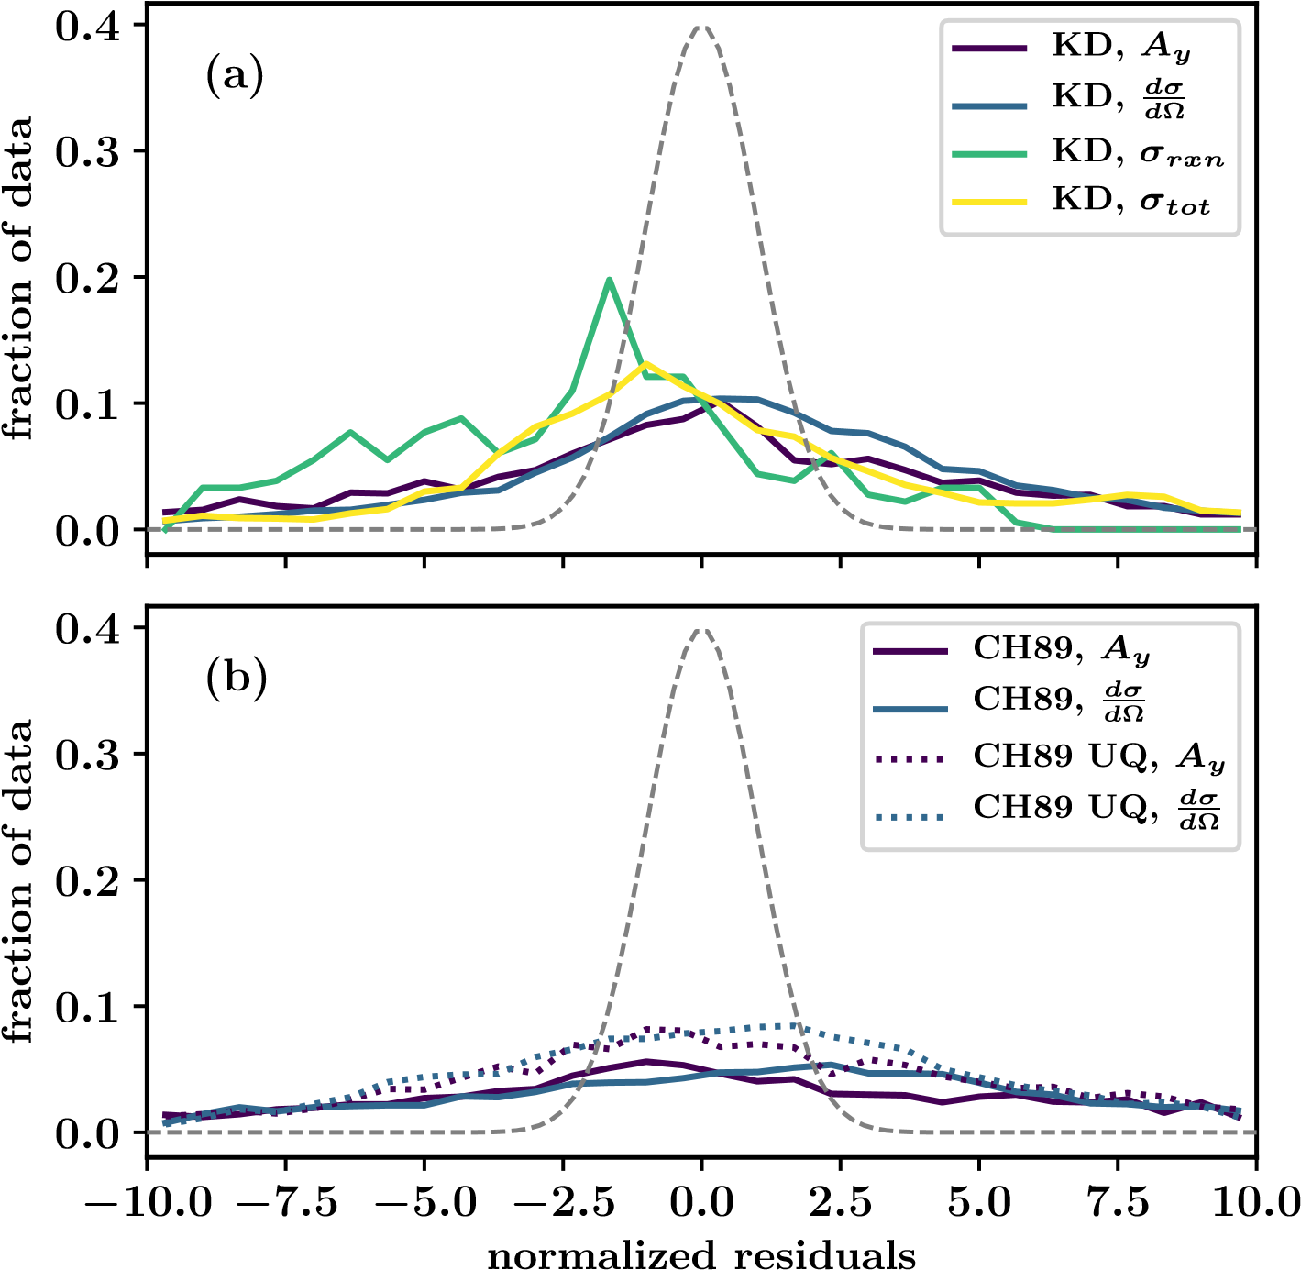
We equipped the KD OMP with uncertainties (KDUQ), enabling extrapolation consistent with known scattering data
BEFORE
If you use the KD OMP, KDUQ is a drop-in extension providing model uncertainties (including correlations)

Slide 4
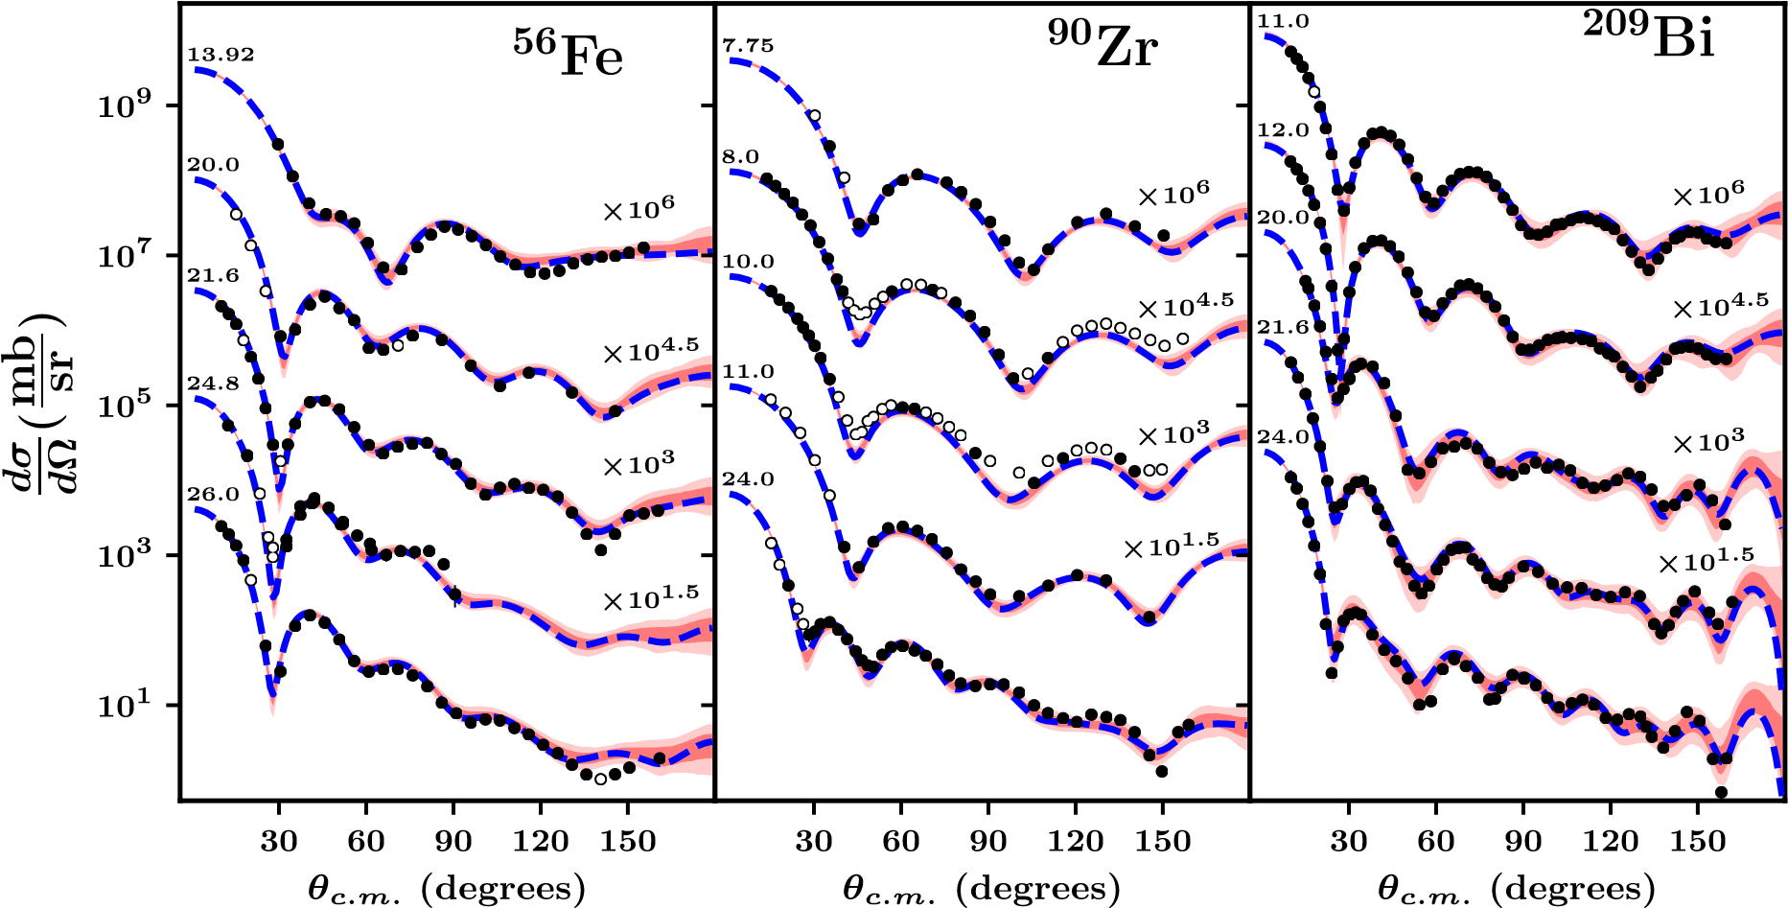
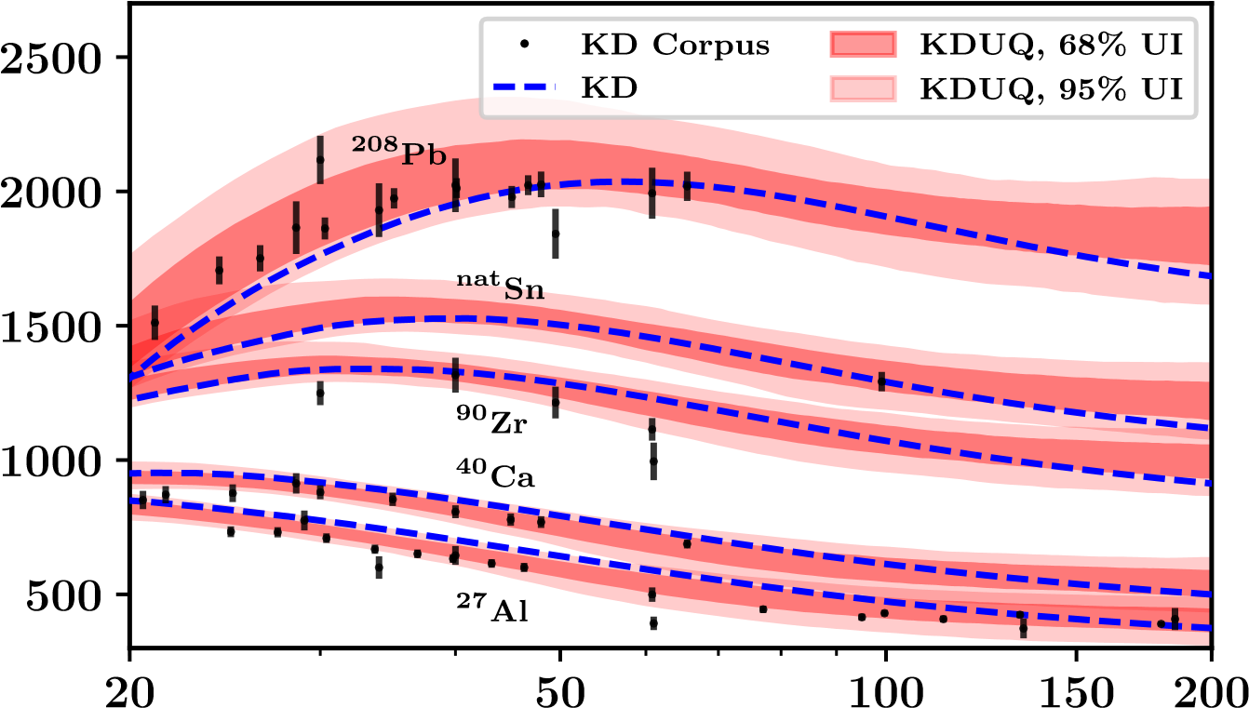
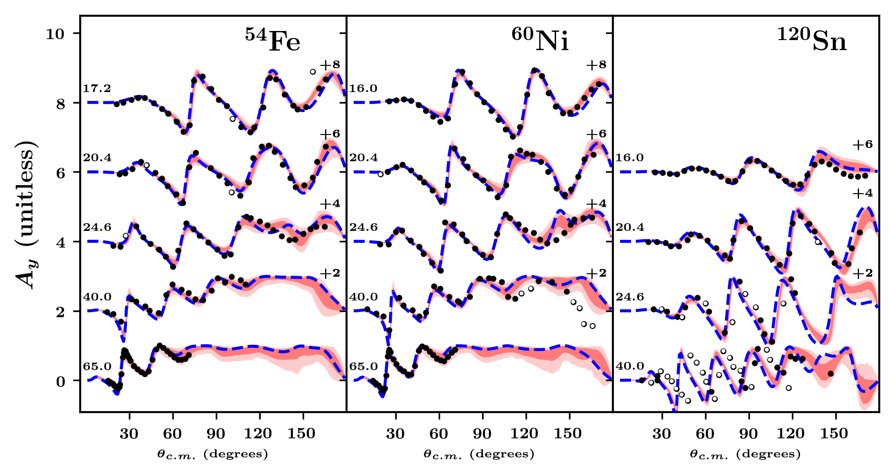
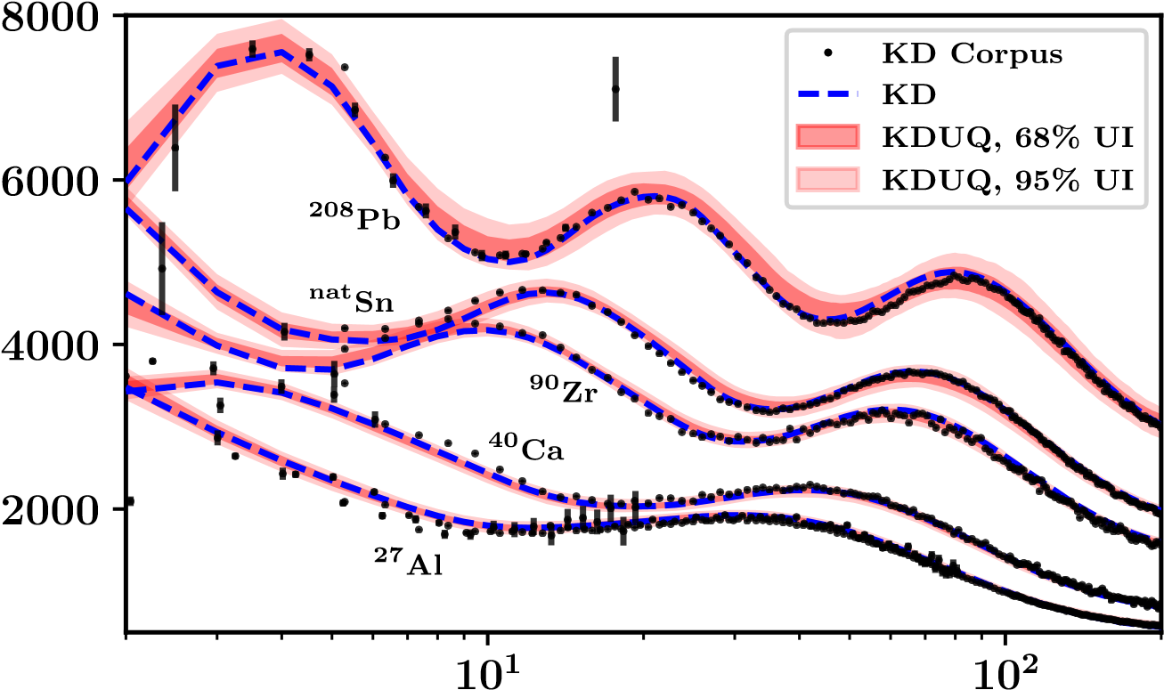
We equipped the KD OMP with uncertainties (KDUQ), enabling extrapolation consistent with known scattering data
BEFORE
(mb)
rxn
σ
Energy (MeV)
(mb)
tot
σ
C. D. Pruitt, J. E. Escher, R. Rahman, Phys. Rev. C 107 (2023) 014602
Energy (MeV)
If you use the KD OMP, KDUQ is a drop-in extension providing model uncertainties (including correlations)

Slide 5
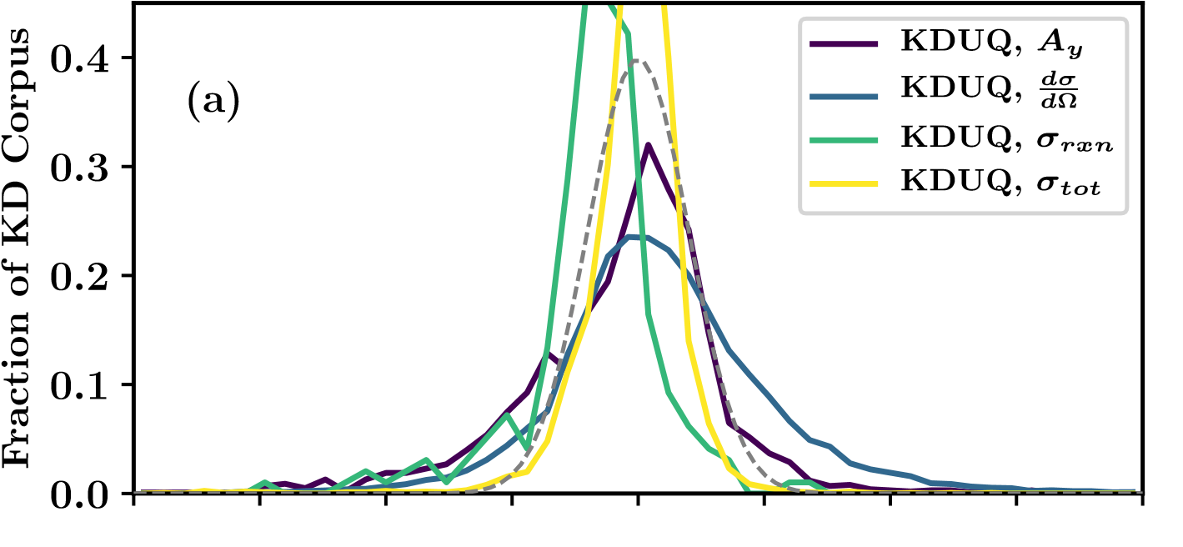
We equipped the KD OMP with uncertainties (KDUQ), enabling extrapolation consistent with known scattering data
BEFORE
(mb)
rxn
σ
Energy (MeV)
AFTER
(mb)
tot
σ
C. D. Pruitt, J. E. Escher, R. Rahman, Phys. Rev. C 107 (2023) 014602
Energy (MeV)
If you use the KD OMP, KDUQ is a drop-in extension providing model uncertainties (including correlations)

Slide 6
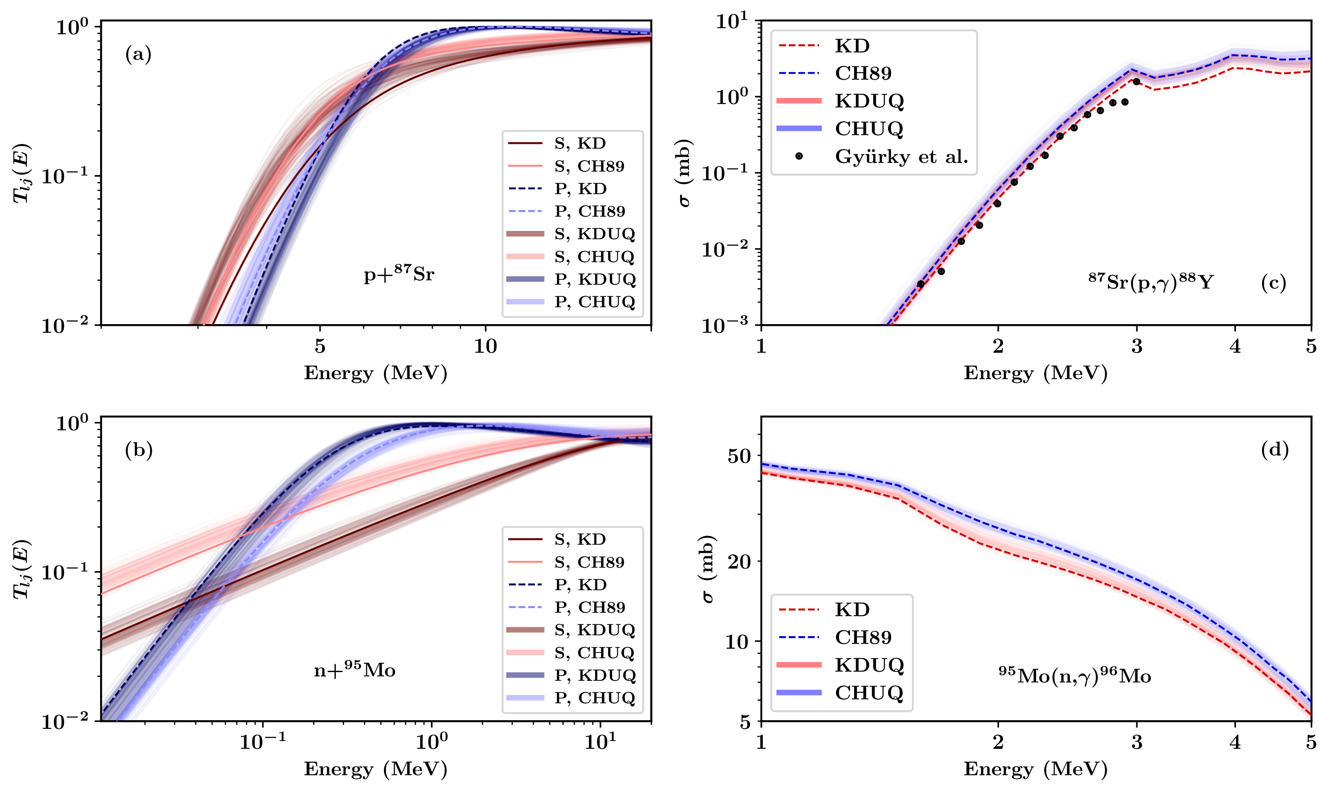
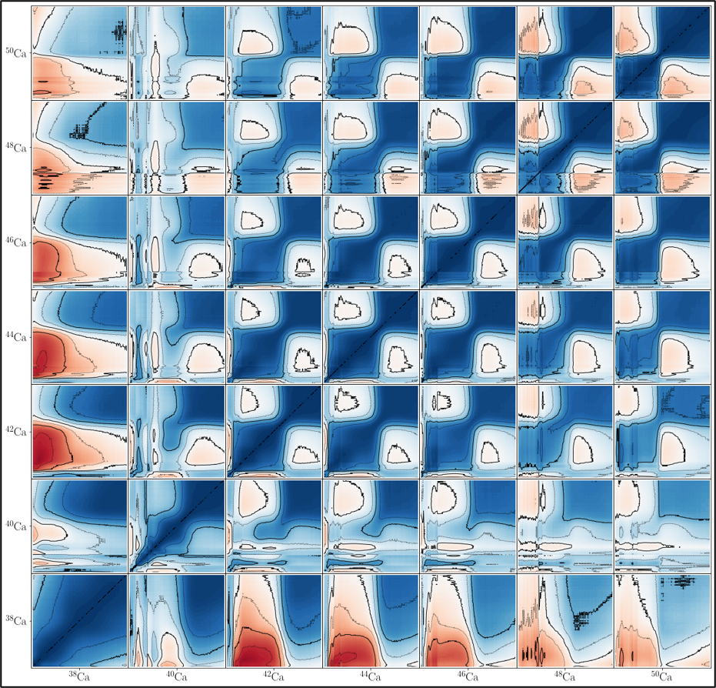
OMP uncertainties can be propagated into radiative capture cross sections relevant for astrophysical nucleosynthesis
Cross-energy and -isotope correlation between the cross sections for ^{A}Ca(n,γ)^{A+1}Ca with A = 38, 40, 42, 44, 46, 48, 50
(figure and Hauser-Feshbach calculations courtesy J. Berryman)
C. D. Pruitt, J. E. Escher, R. Rahman, Phys. Rev. C 107 (2023) 014602
We are moving beyond the old paradigm of “flipping switches” for compound-nucleus de-excitation UQ

Slide 7
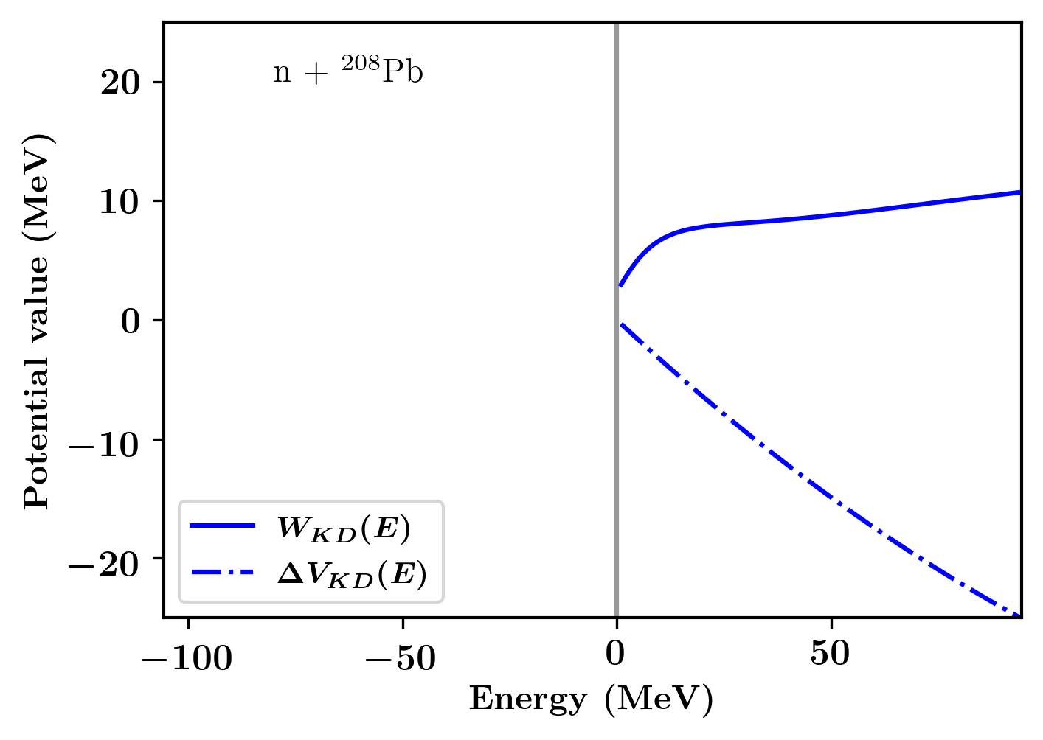
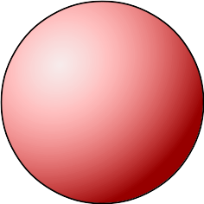
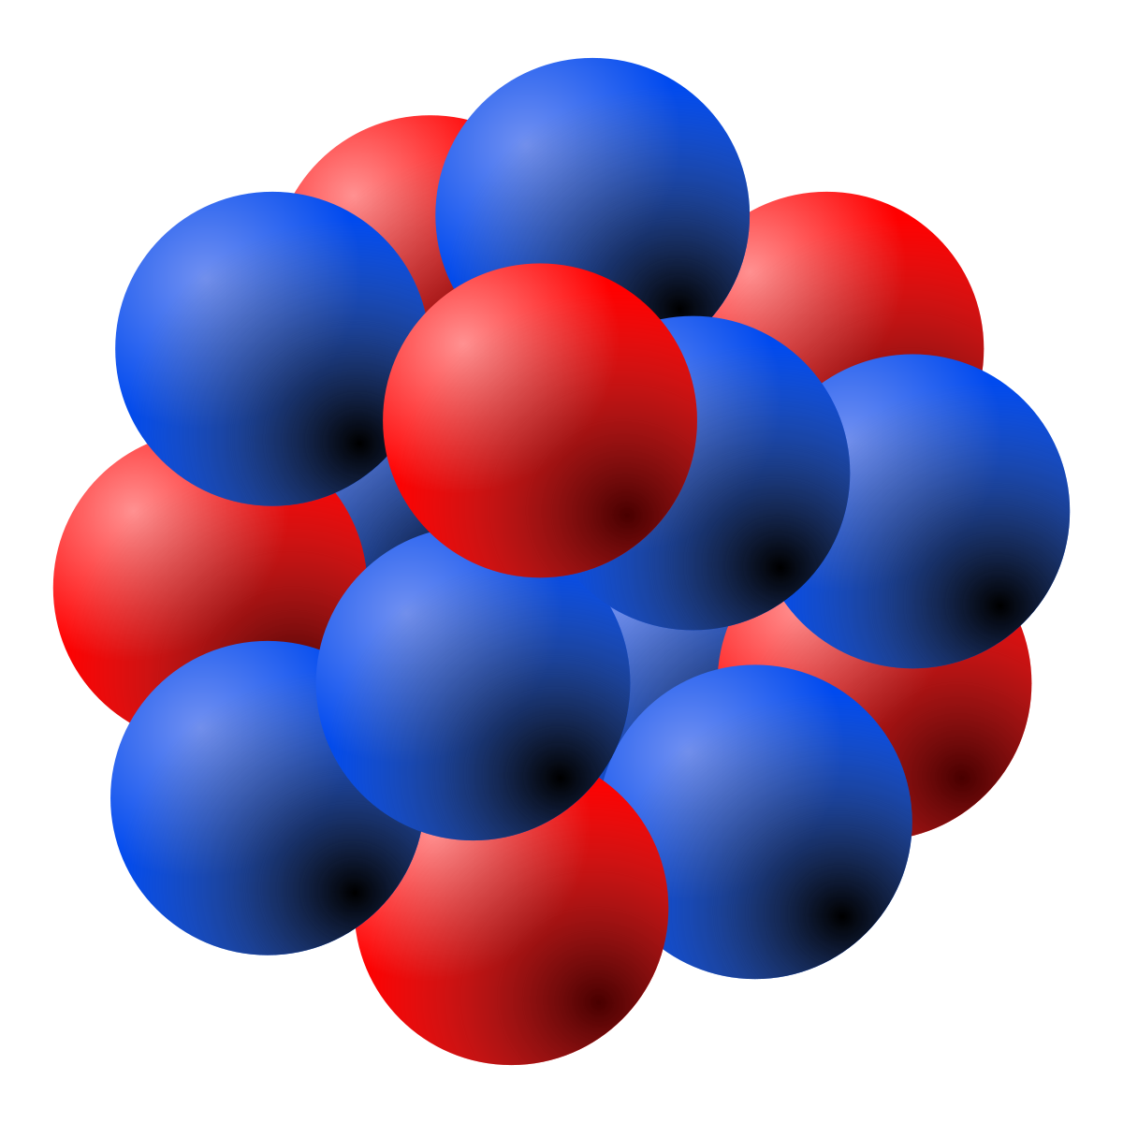

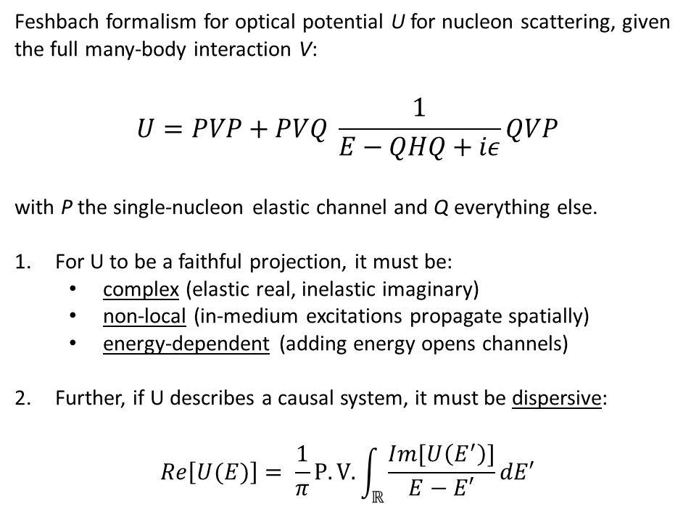
The Dispersive Optical Model connects reactions to structure by enforcing dispersivity and non-locality physical constraints
Feshbach formalism for optical potential U for nucleon scattering, given the full many-body interaction V:
$$U=PVP+PVQ \frac{1}{E−QHQ+iε}QVP$$
with P the single-nucleon elastic channel and Q everything else.
For U to be a faithful projection, it must be:
  complex (elastic real, inelastic imaginary)
  non-local (in-medium excitations propagate spatially)
  energy-dependent (adding energy opens channels)
Further, if U describes a causal system, it must be dispersive:
$$Re\left[U(E)\right]= \frac{1}{π}P.V.\int_{ℝ}{\frac{Im[U\left(E^{′}\right)]}{E−E′}dE′}$$
By enforcing nonlocality and extending to negative energies, we respect the physics and access structure

Slide 8
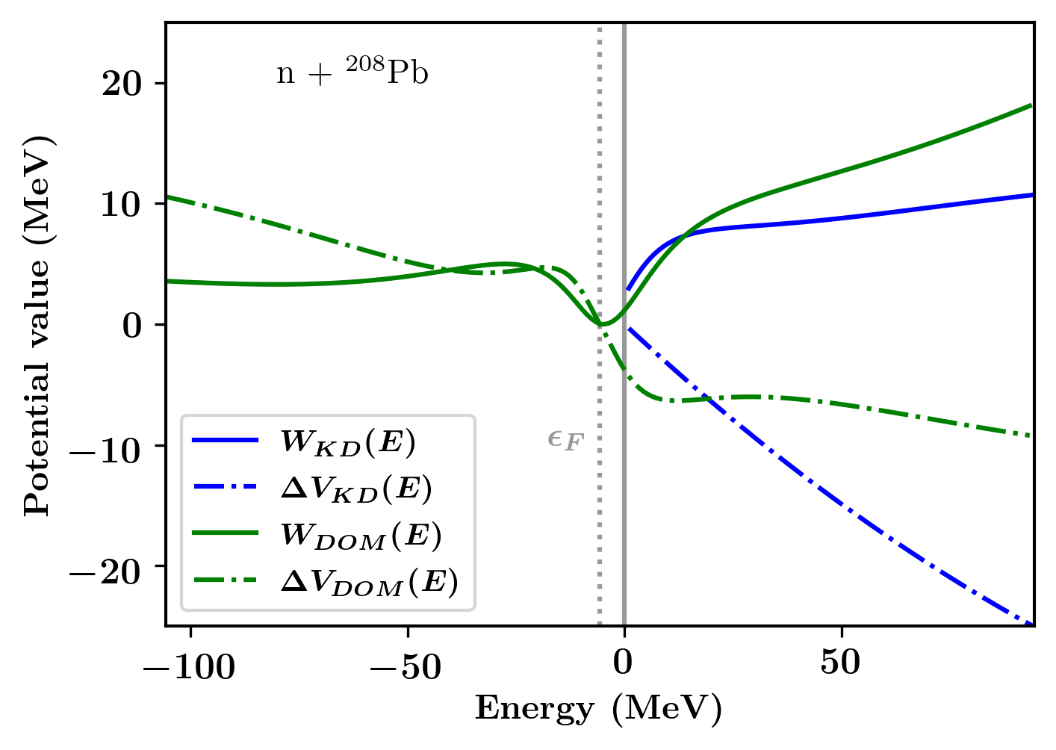
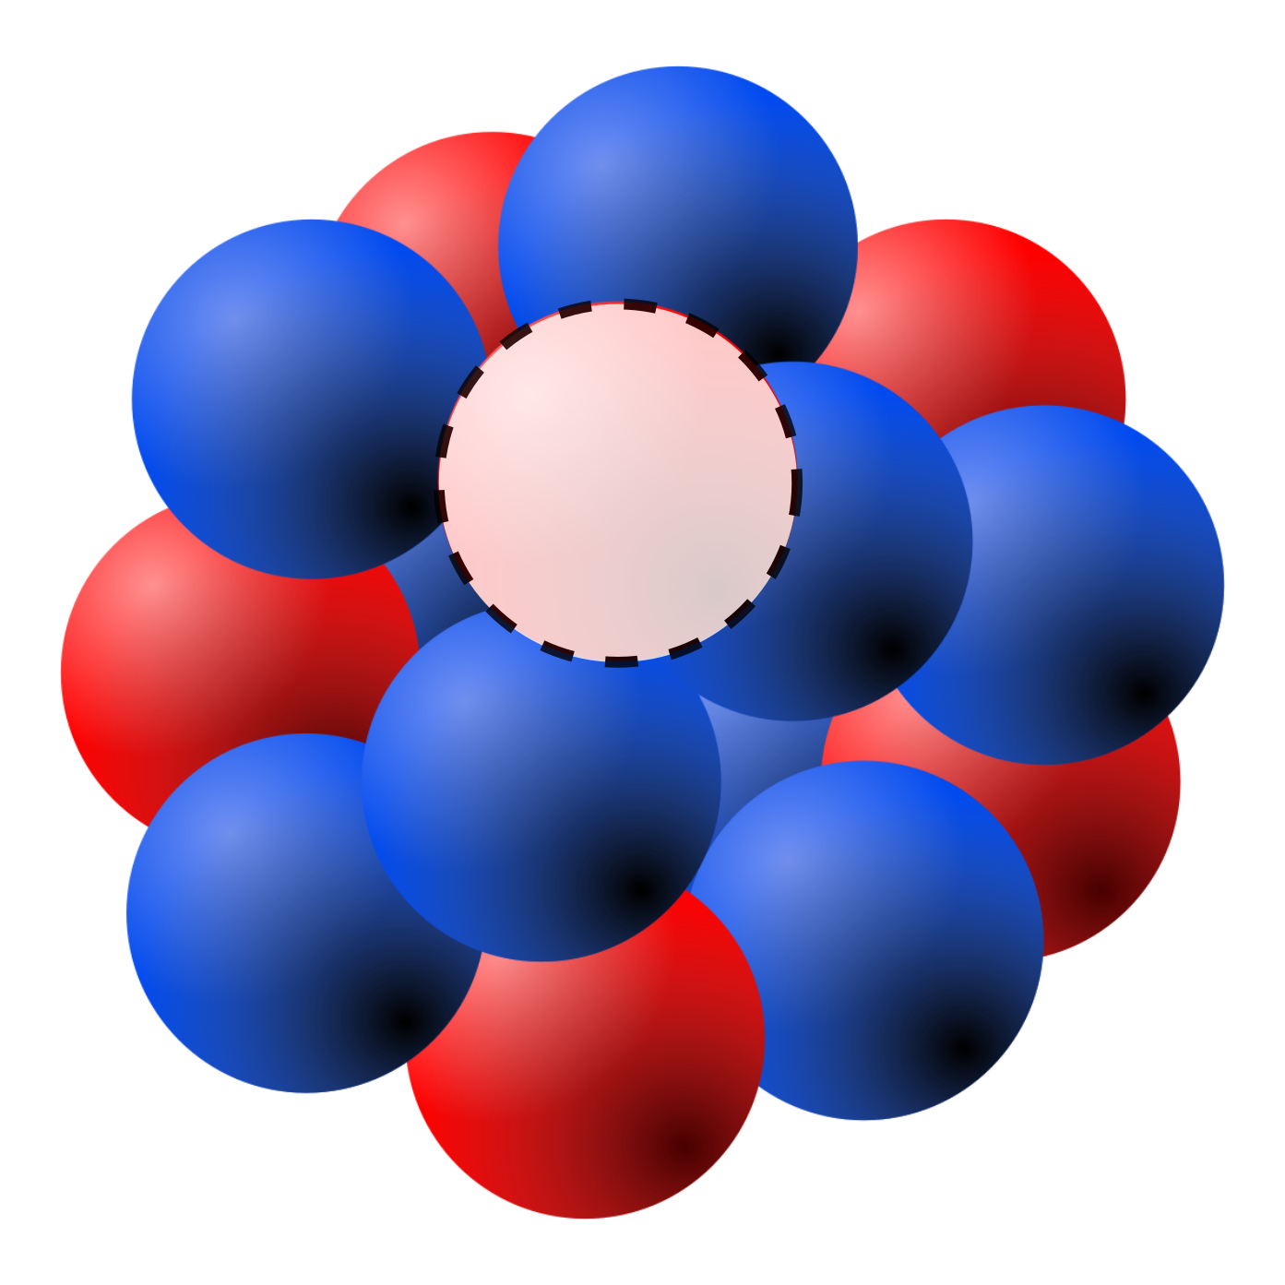
The Dispersive Optical Model connects reactions to structure by enforcing dispersivity and non-locality physical constraints
Feshbach formalism for optical potential U for nucleon scattering, given the full many-body interaction V:
$$U=PVP+PVQ \frac{1}{E−QHQ+iε}QVP$$
with P the single-nucleon elastic channel and Q everything else.
For U to be a faithful projection, it must be:
  complex (elastic real, inelastic imaginary)
  non-local (in-medium excitations propagate spatially)
  energy-dependent (adding energy opens channels)
Further, if U describes a causal system, it must be dispersive:
$$Re\left[U(E)\right]= \frac{1}{π}P.V.\int_{ℝ}{\frac{Im[U\left(E^{′}\right)]}{E−E′}dE′}$$
Formal and computational methods
Mahaux and Sartor, Nucl. Phys. A 503 (1989) 525-559
Quesada et al., Comp. Phys. Comm. 153 (2003) 97-105
J. M. VanderKam et al., J. Phys. G 26 (2000) 1787
A few DOMs trained to data
B. Morillon et al., Phys. Rev. C 109 (2024) 044611
M. C. Atkinson et al., Phys. Rev. C 101 (2020) 044303
C. D. Pruitt et al., Phys. Rev. Lett. 125 (2020) 102501
By enforcing nonlocality and extending to negative energies, we respect the physics and access structure

Slide 9
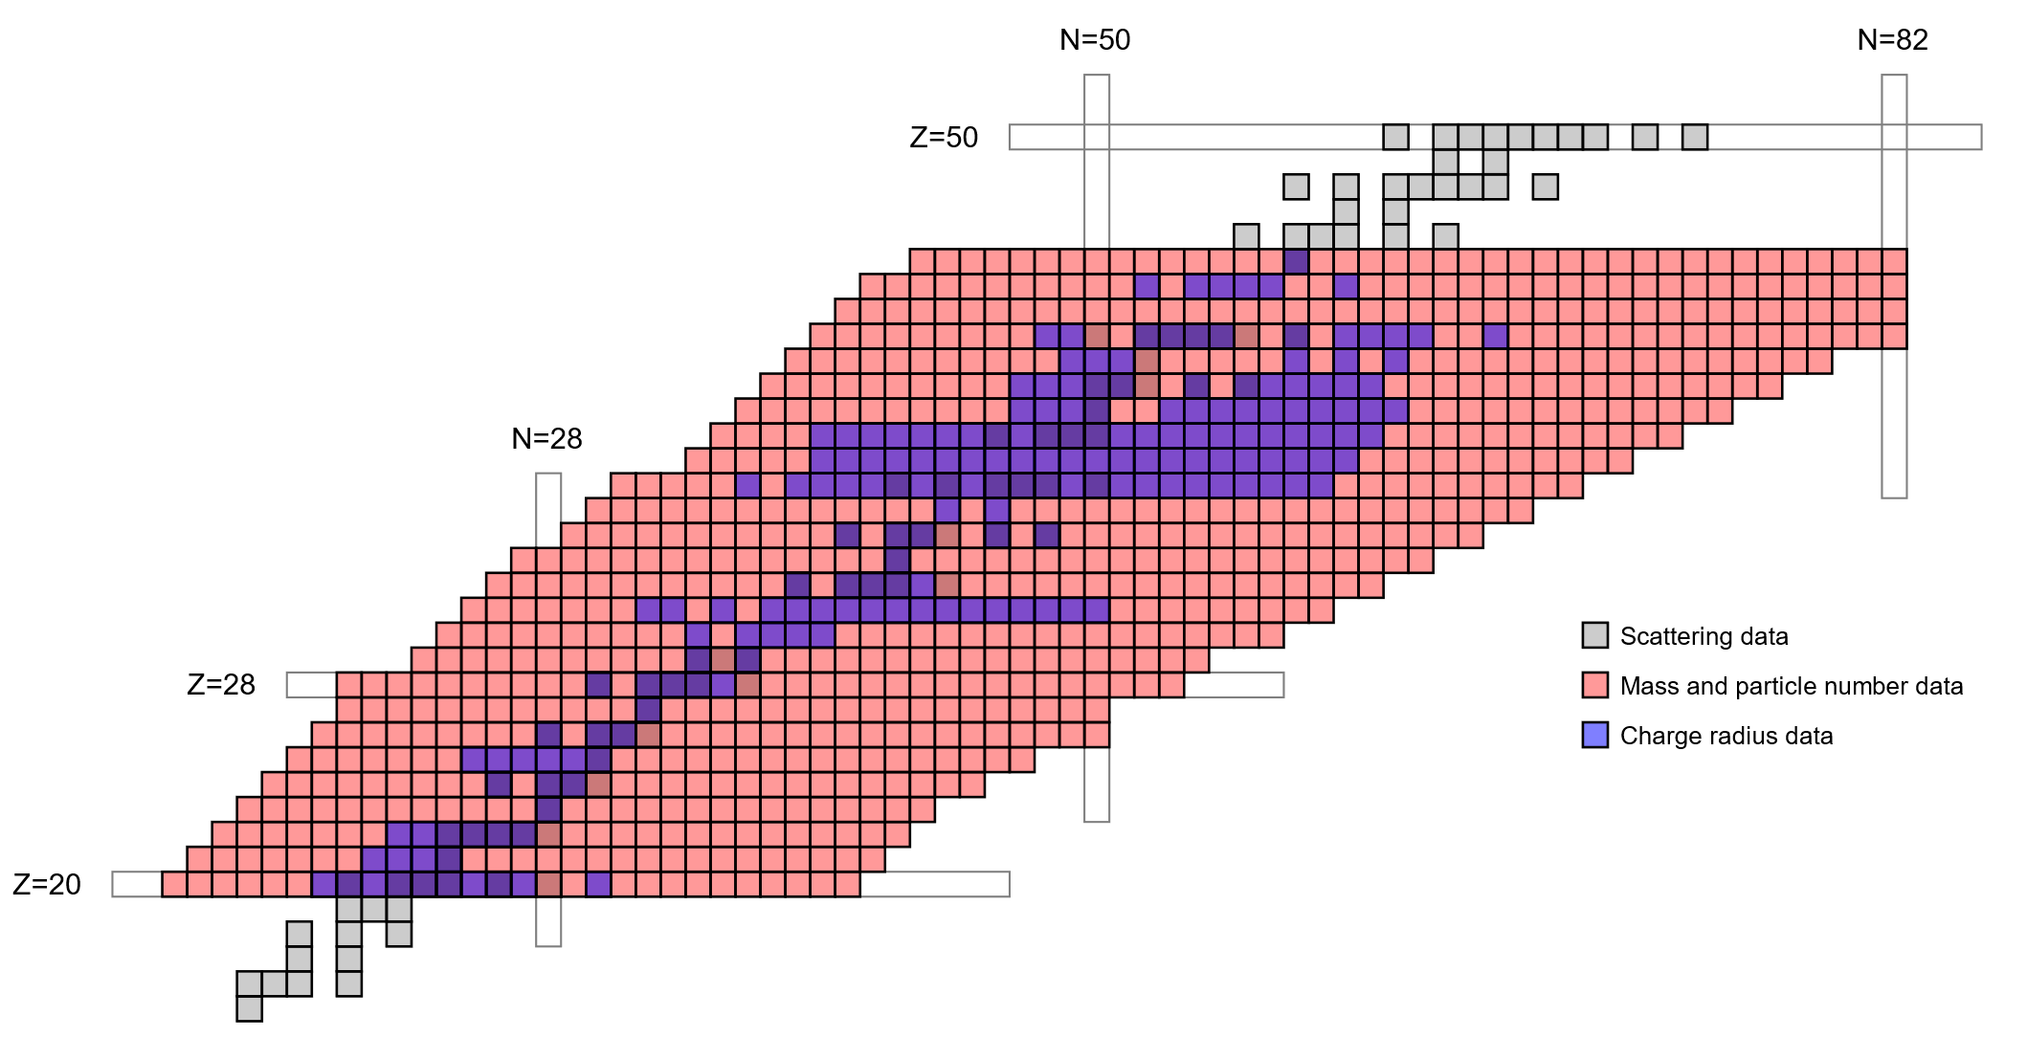
Particle number, binding energy, and valence single-particle energies are universally available experimental constraints
From a non-local DOM, the hole propagator provides the one-body density and structural observables:
Particle number (most important overall!)
Binding energy (dictates deep-hole properties)
Charge radius (dictates geometry)
Single-particle energies (dictates geometry and shallow-hole properties)
The propagator also enables self-consistent treatment of reactions combining structure and scattering:
(e,e’p) cross sections
(p,2p) cross sections
(p,n) and (n,p) cross sections
parity-violating electron scattering (neutron skins)
Charge radius data range from IAEA database
Depicted mass data range is notional only
On (e,e’p) and the DOM: Atkinson et al., Phys. Rev. C 98 (2018) 044627
On (p,2p) and the DOM: Yoshida et al., Phys. Rev. C 105 (2022) 014622
On neutron skins and the DOM: Mahzoon et al., Phys. Rev. Lett. 119 (2017) 222503
Structure data can provide meaningful constraints on scattering, even in the absence of experimental data

Slide 10
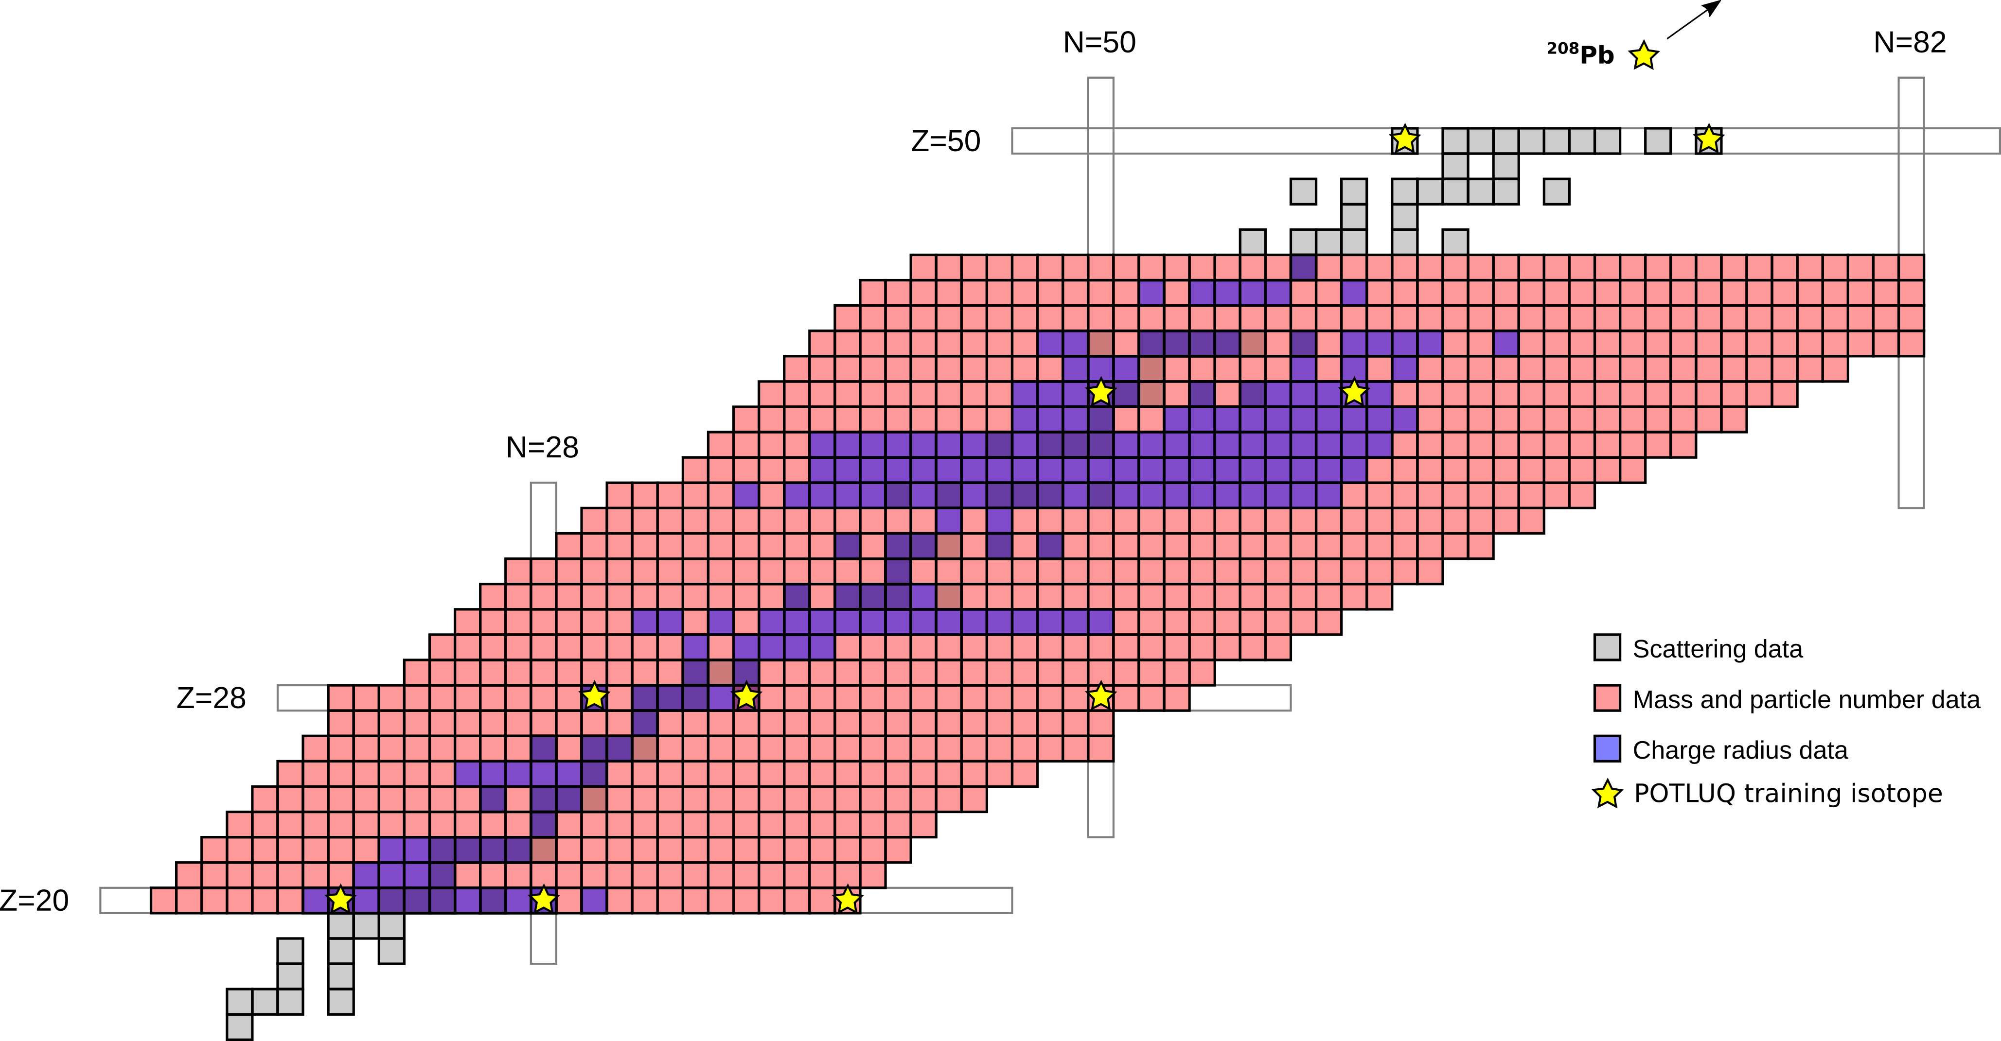
Toward a spherical global UQ DOM: training results with
^{40,48,60}Ca, ^{58,64,78}Ni, ^{90,100}Zr, ^{112,124}Sn, ²⁰⁸Pb
Training data
Available everywhere:
Particle number (N and Z)
Binding energy
Valence single-particle energies (not yet used)
Available not too far from β-stability:
RMS charge radius
Available at β-stability:
Neutron total cross section (5-200 MeV)
Proton reaction cross section (5-200 MeV)
Neutron elastic cross section (10-60 MeV*)
Proton elastic cross section (10-200 MeV*; not yet used)
Neutron analyzing power (10-60 MeV; not yet used)
Proton analyzing power (10-200 MeV*; not yet used)
Charge radius data range from IAEA database
Depicted mass data range is notional only
Our approach: choose simplest plausible potential form, train to “anchor” nuclei, then add data incrementally.
Add parameters only when the data demand it!

Slide 11
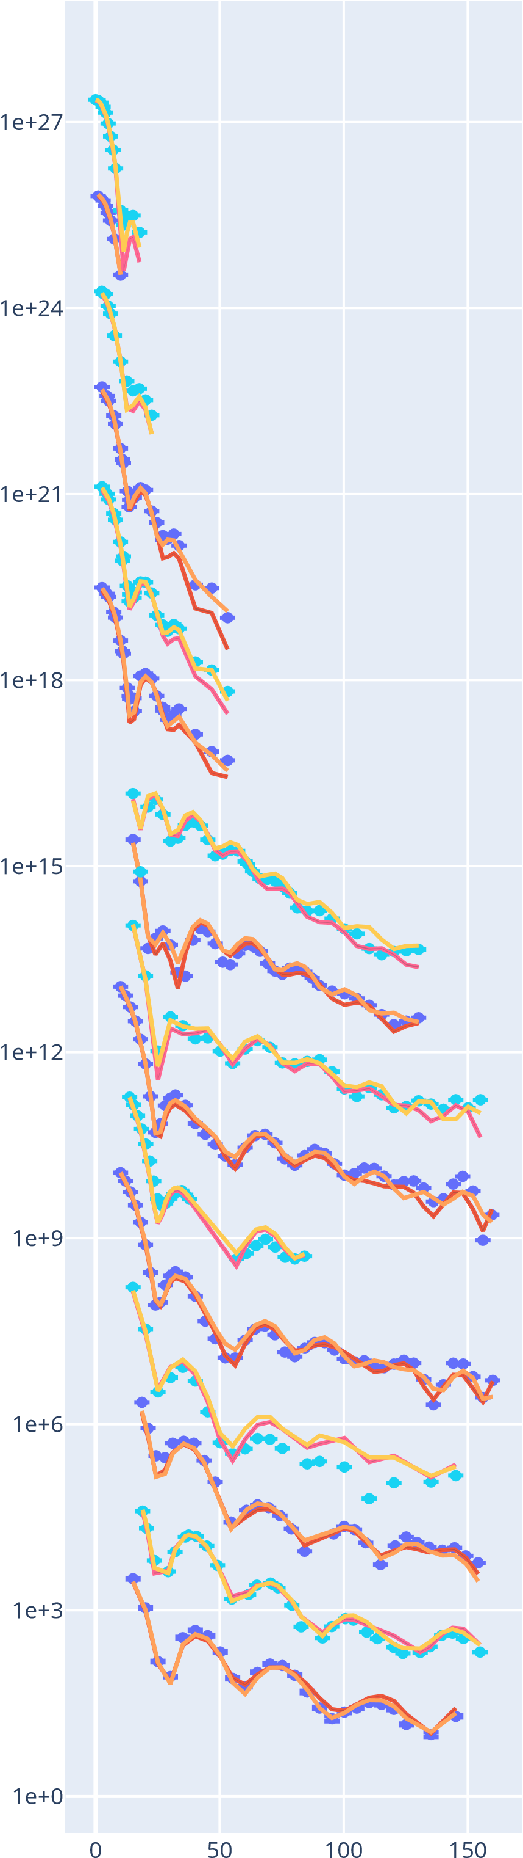
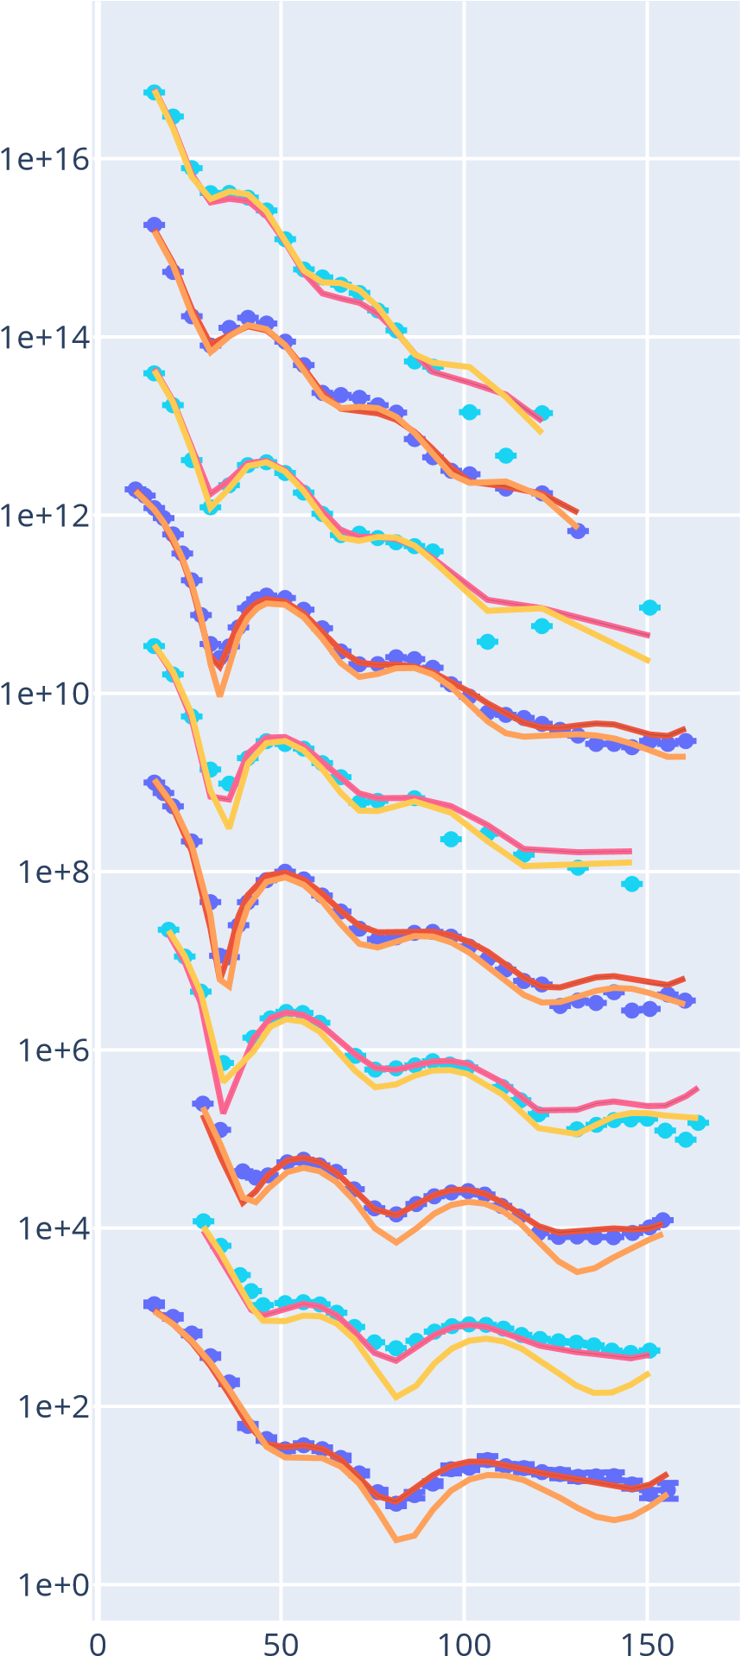
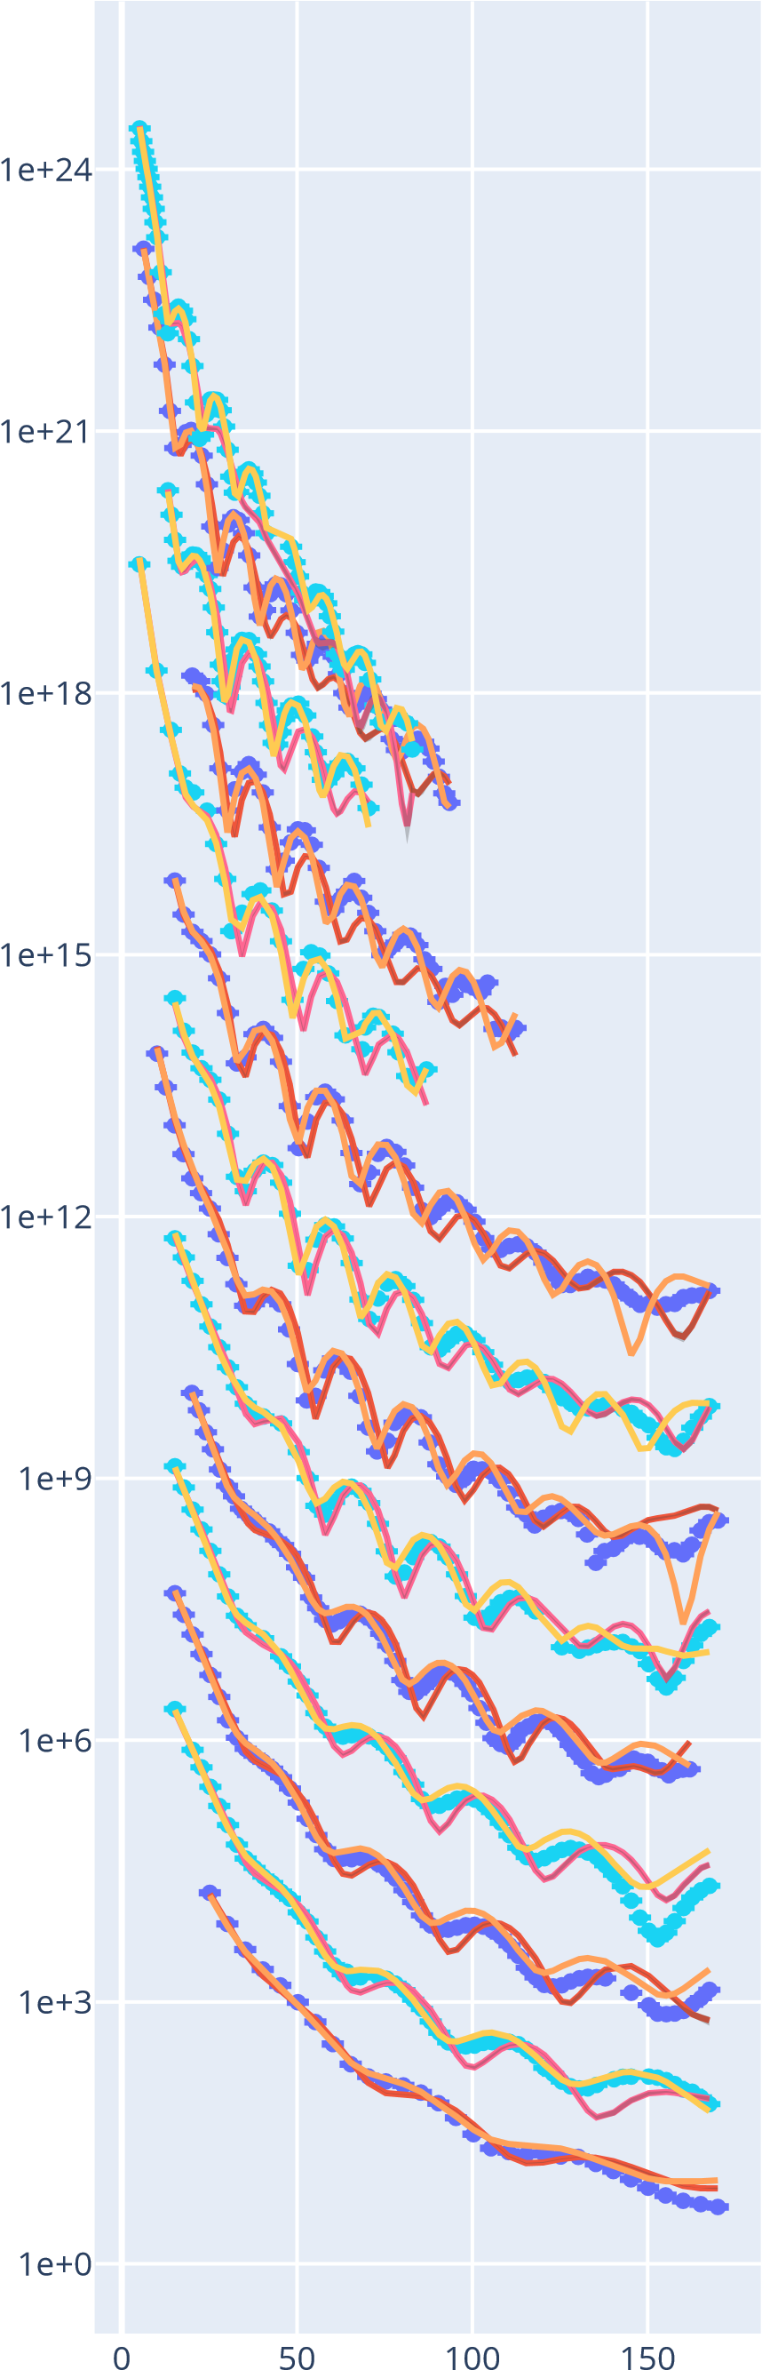
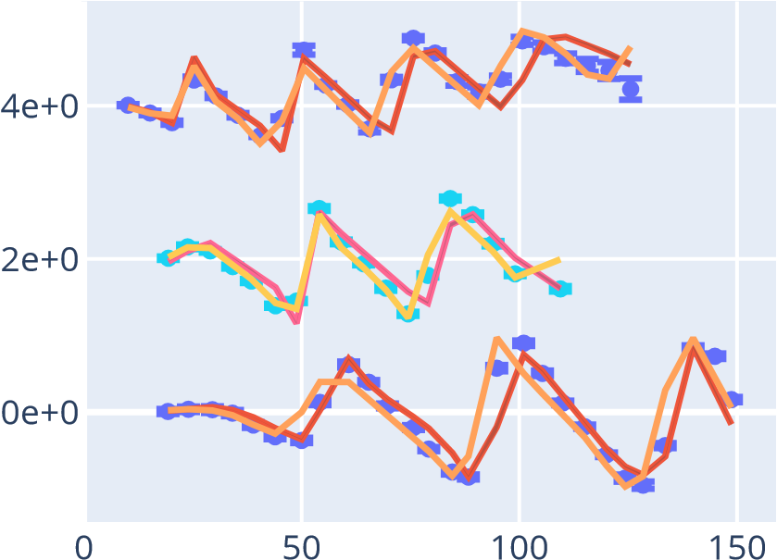
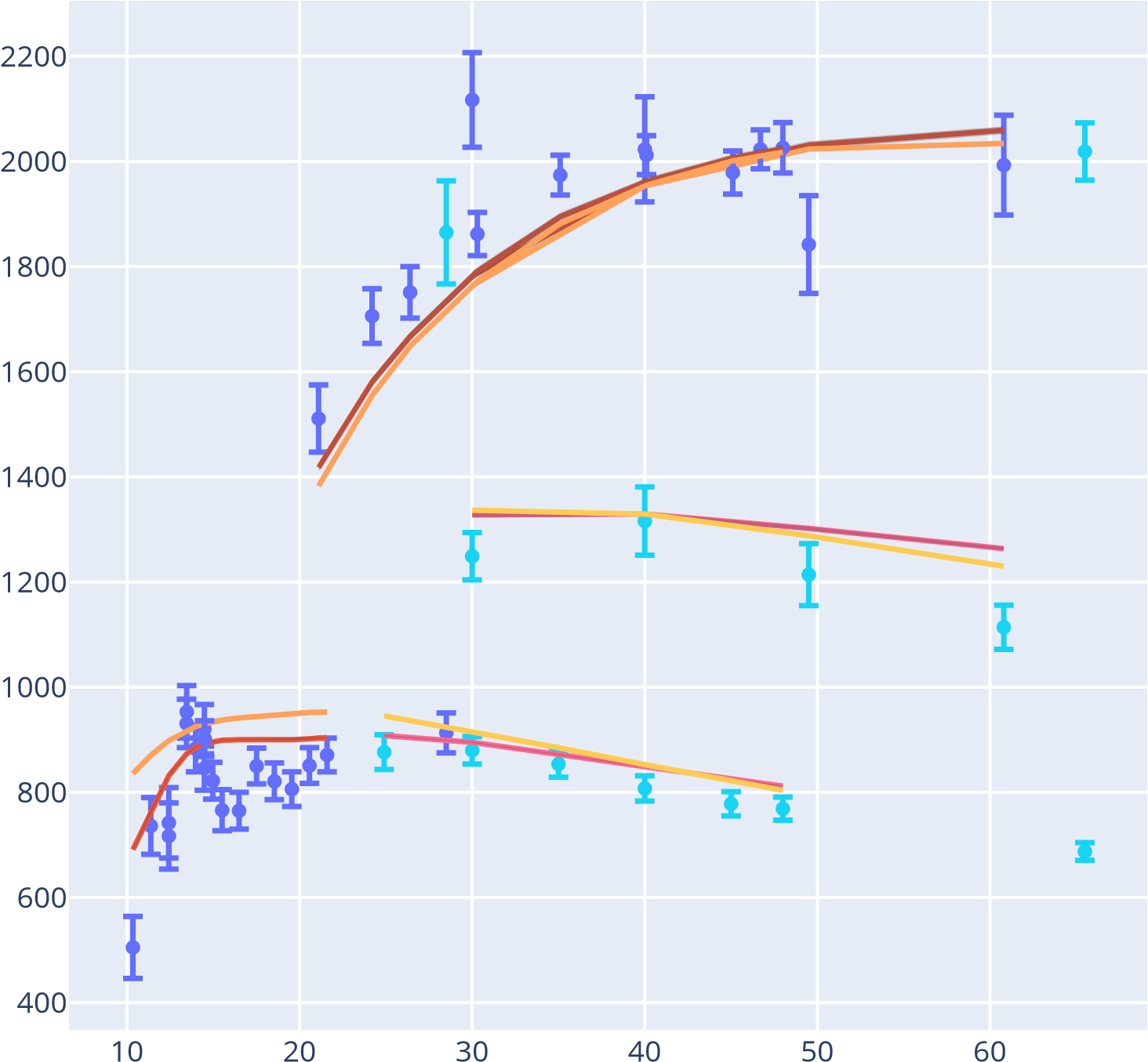
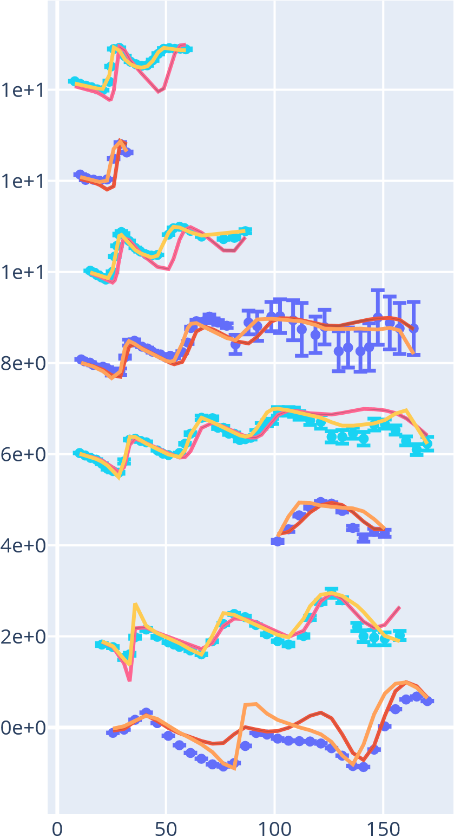
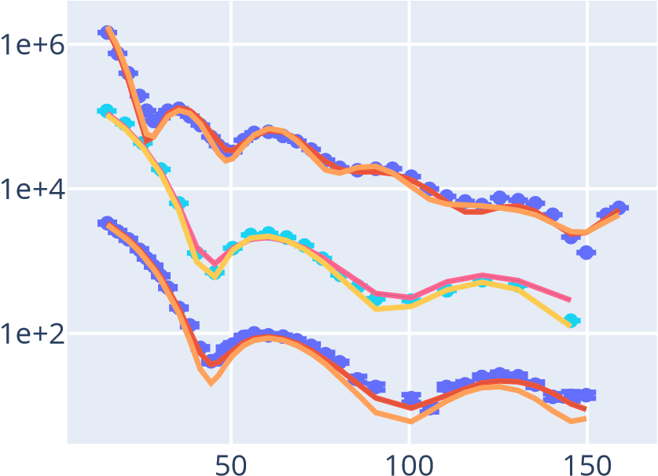
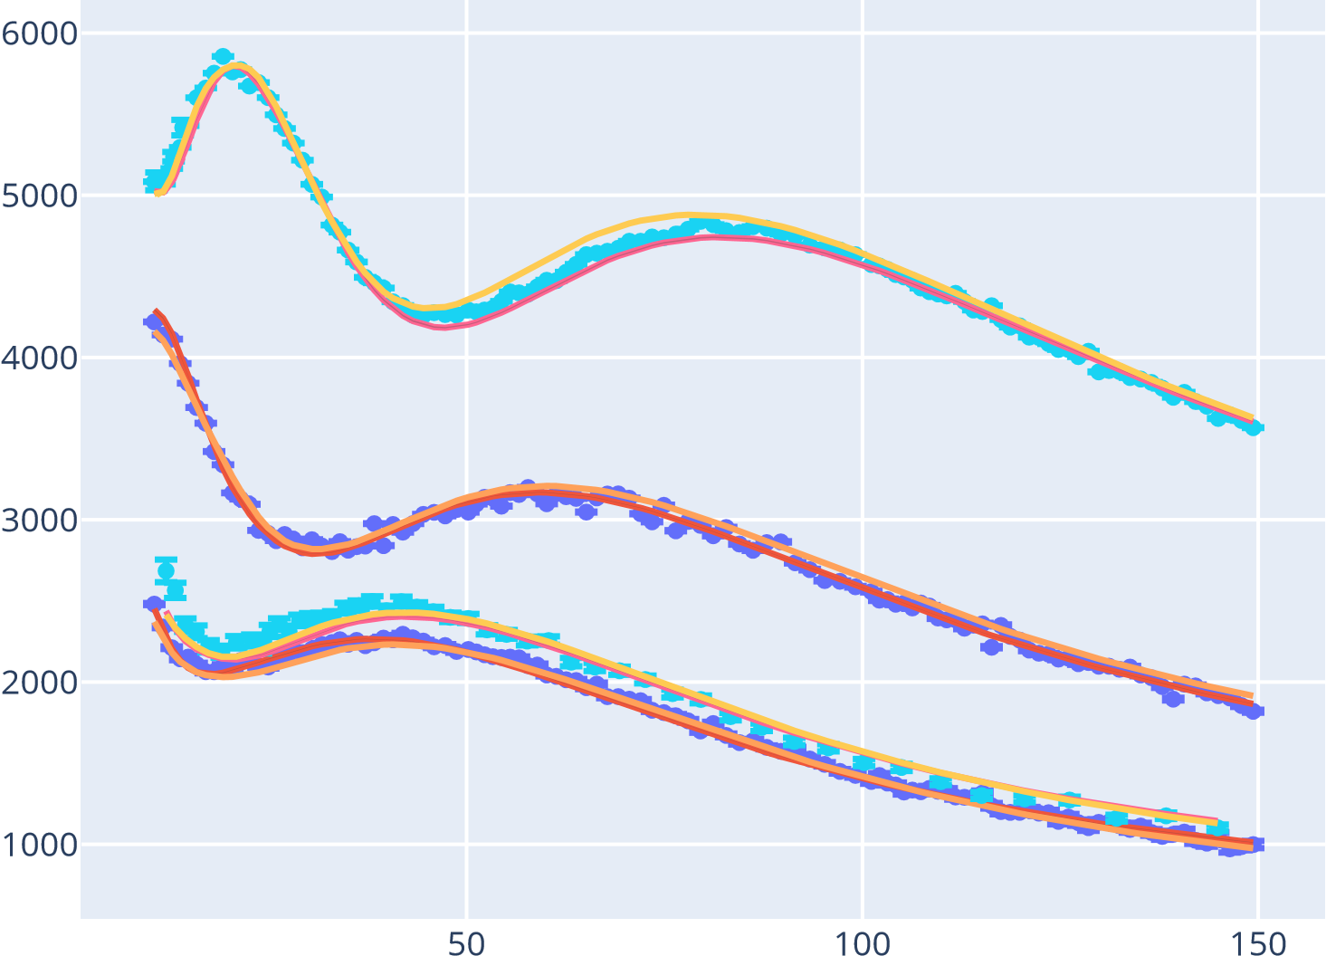
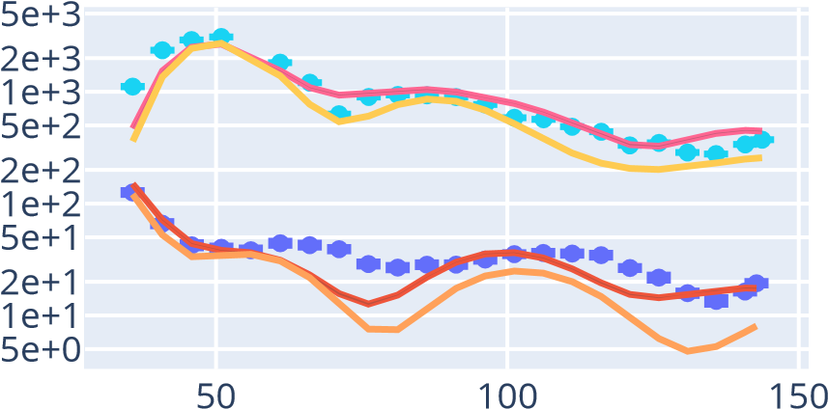
Preliminary spherical global UQ DOM results: ^{40,48}Ca, ⁹⁰Zr, ^{112,124}Sn, ²⁰⁸Pb
Bound properties (binding energy particle number, RMS charge radii): 2%-level agreement for all 6 systems
Proton σ_{rxn} and neutron σ_{tot} : KD-level agreement on all 6 systems
Neutron differential cross sections: KD-level agreement on all 6 systems
Proton differential cross sections and proton/neutron analyzing powers: near-KD-level agreement, even without fitting.
n+⁴⁰Ca
n+²⁰⁸Pb
²⁰⁸Pb
p+⁹⁰Zr
p+²⁰⁸Pb
Analyzing power (unitless)
σ_{rxn} (mb)
⁹⁰Zr
dσ/dΩ (arb. units)
θ_{c.m.} (degrees)
Preliminary
Preliminary
⁴⁸Ca
dσ/dΩ (arb. units)
⁴⁰Ca
p+⁴⁰Ca
dσ/dΩ (arb. units)
E_{lab} (MeV)
θ_{c.m.} (degrees)
Analyzing power (unitless)
 | ⁴⁰Ca | ⁴⁸Ca | ⁹⁰Zr | ¹¹²Sn | ¹²⁴Sn | ²⁰⁸Pb
Z | 19.8 | 19.8 | 40.0 | 49.9 | 50.0 | 83.3
N | 19.8 | 27.5 | 49.6 | 62.1 | 74.8 | 126.2
BE | 342 | 425 | 785 | 932 | 1053 | 1633
n+⁹⁰Zr
²⁰⁸Pb
σ_{tot} (mb)
⁹⁰Zr
θ_{c.m.} (degrees)
⁴⁸Ca
n+⁴⁸Ca
⁴⁰Ca
E_{lab} (MeV)
θ_{c.m.} (degrees)
θ_{c.m.} (degrees)
θ_{c.m.} (degrees)
θ_{c.m.} (degrees)
Excellent agreement (at the 1% level) appears possible, for both binding and integral scattering data, across the chart

Slide 12
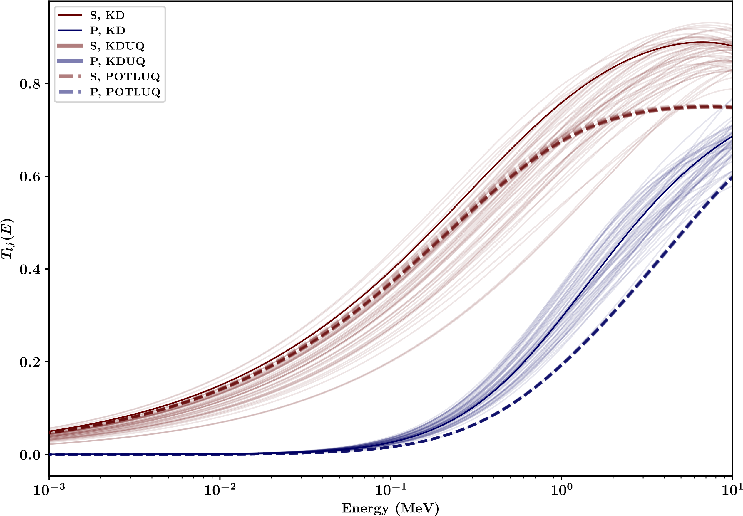
Preliminary spherical global UQ DOM results: ^{40,48,54,58}Ca isotopic chain
Very preliminary:
  At low asymmetries (^{40,48}Ca), DOM neutron transmission coefficients are largely consistent with KD/KDUQ at astrophysical energies
  At high asymmetries ^{(54,58}Ca), transmission coefficients drop off dramatically, likely driven by particle-number constraint (DOM fit accurately recovers N=40 for ⁶⁰Ca)
  Isovector surface strength may be much stronger than assumed by non-dispersive models trained to β-stable scattering data
  Spectral functions indicate considerable broadening of deep holes, consistent with (e,e’p) understanding
⁴⁰Ca
Preliminary
Preliminary results show much larger isovector surface dependence compared to non-dispersive models:
this would reduce dripline (n,γ) cross section predictions by a factor of 5-10

Slide 13
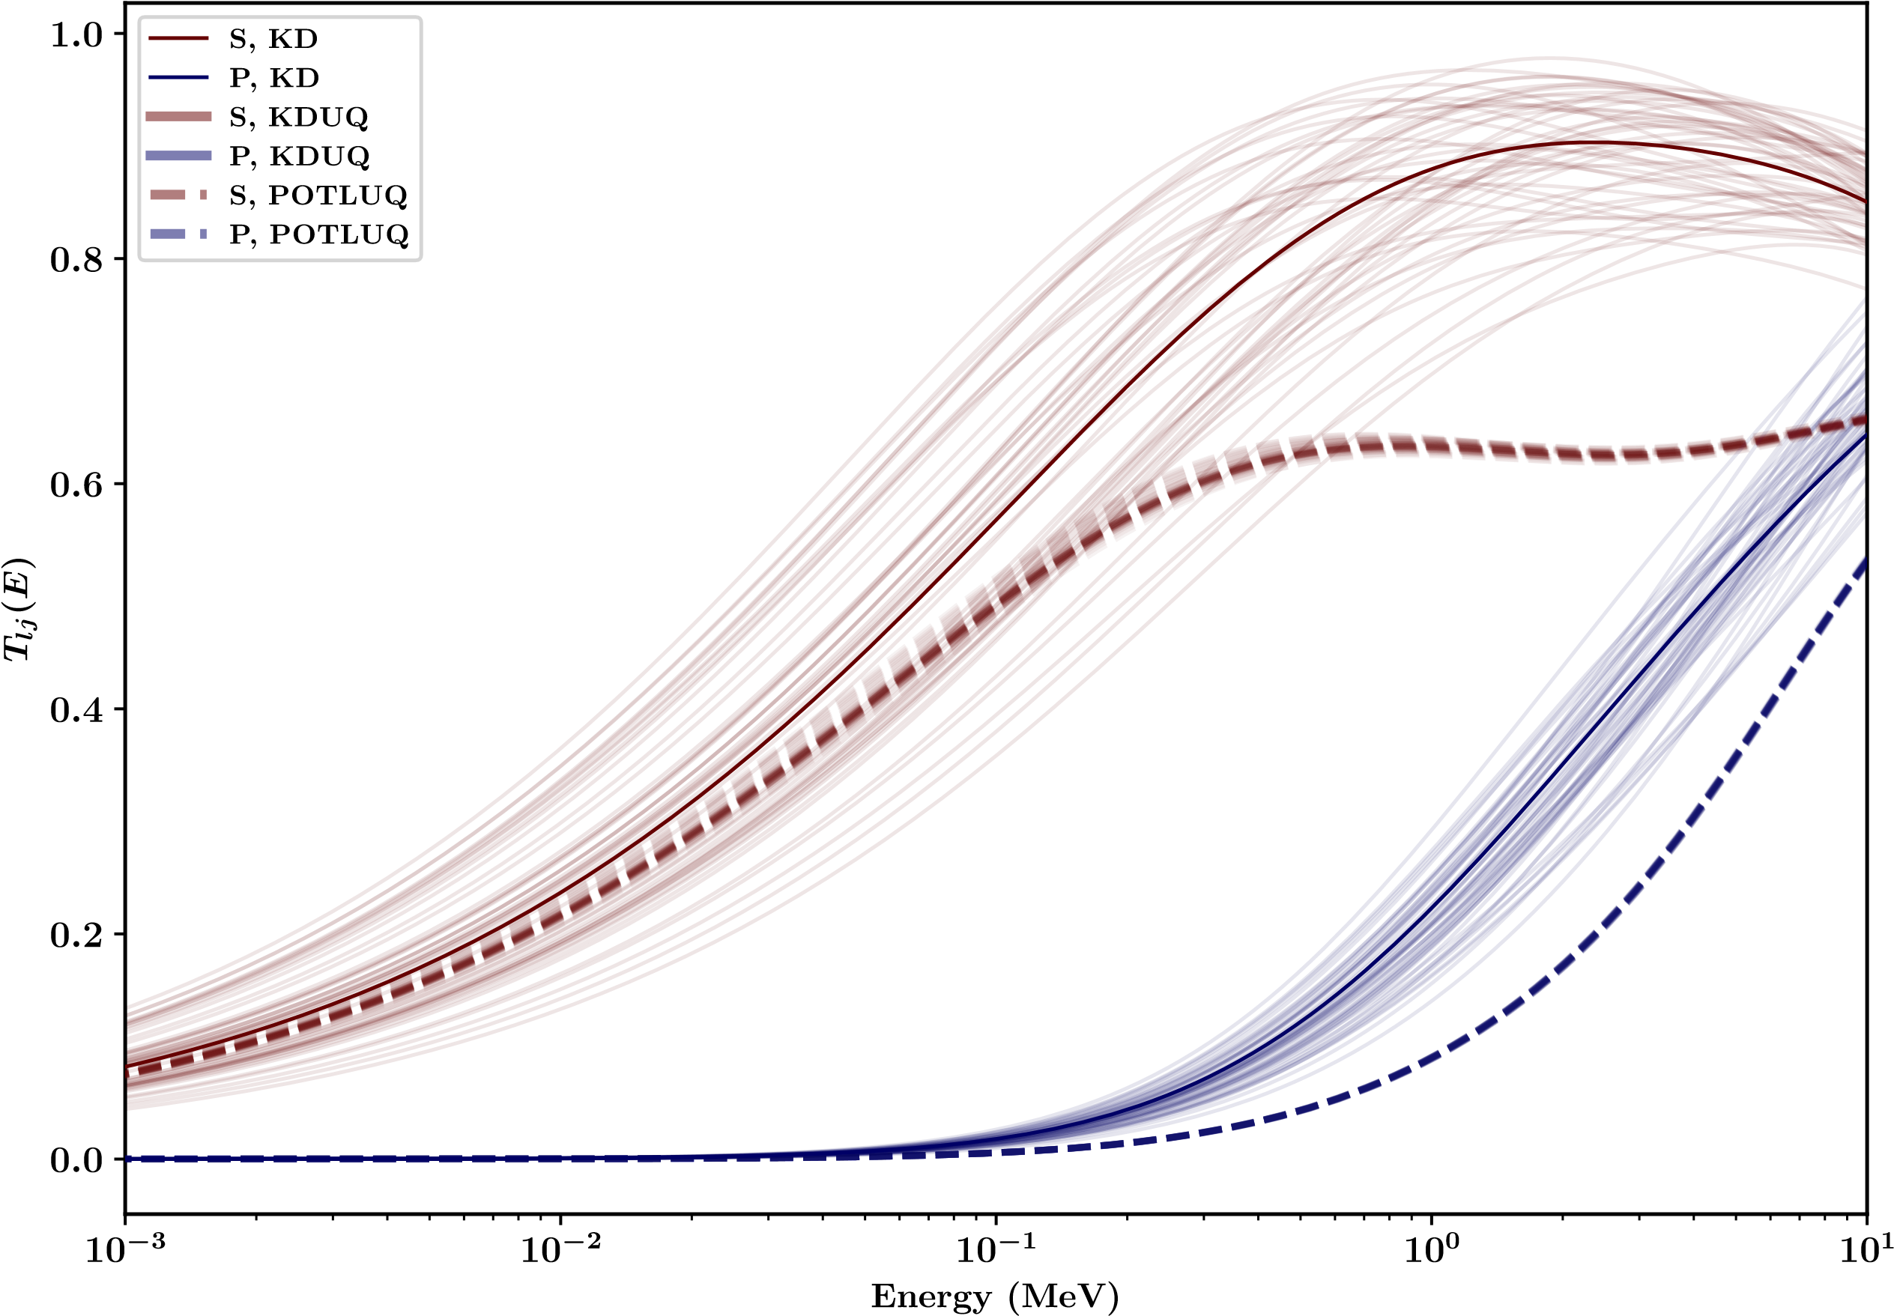
Preliminary spherical global UQ DOM results: ^{40,48,54,58}Ca isotopic chain
Very preliminary:
  At low asymmetries (^{40,48}Ca), DOM neutron transmission coefficients are largely consistent with KD/KDUQ at astrophysical energies
  At high asymmetries ^{(54,58}Ca), transmission coefficients drop off dramatically, likely driven by particle-number constraint (DOM fit accurately recovers N=40 for ⁶⁰Ca)
  Isovector surface strength may be much stronger than assumed by non-dispersive models trained to β-stable scattering data
  Spectral functions indicate considerable broadening of deep holes, consistent with (e,e’p) understanding
⁴⁸Ca
Preliminary
Preliminary results show much larger isovector surface dependence compared to non-dispersive models:
this would reduce dripline (n,γ) cross section predictions by a factor of 5-10

Slide 14
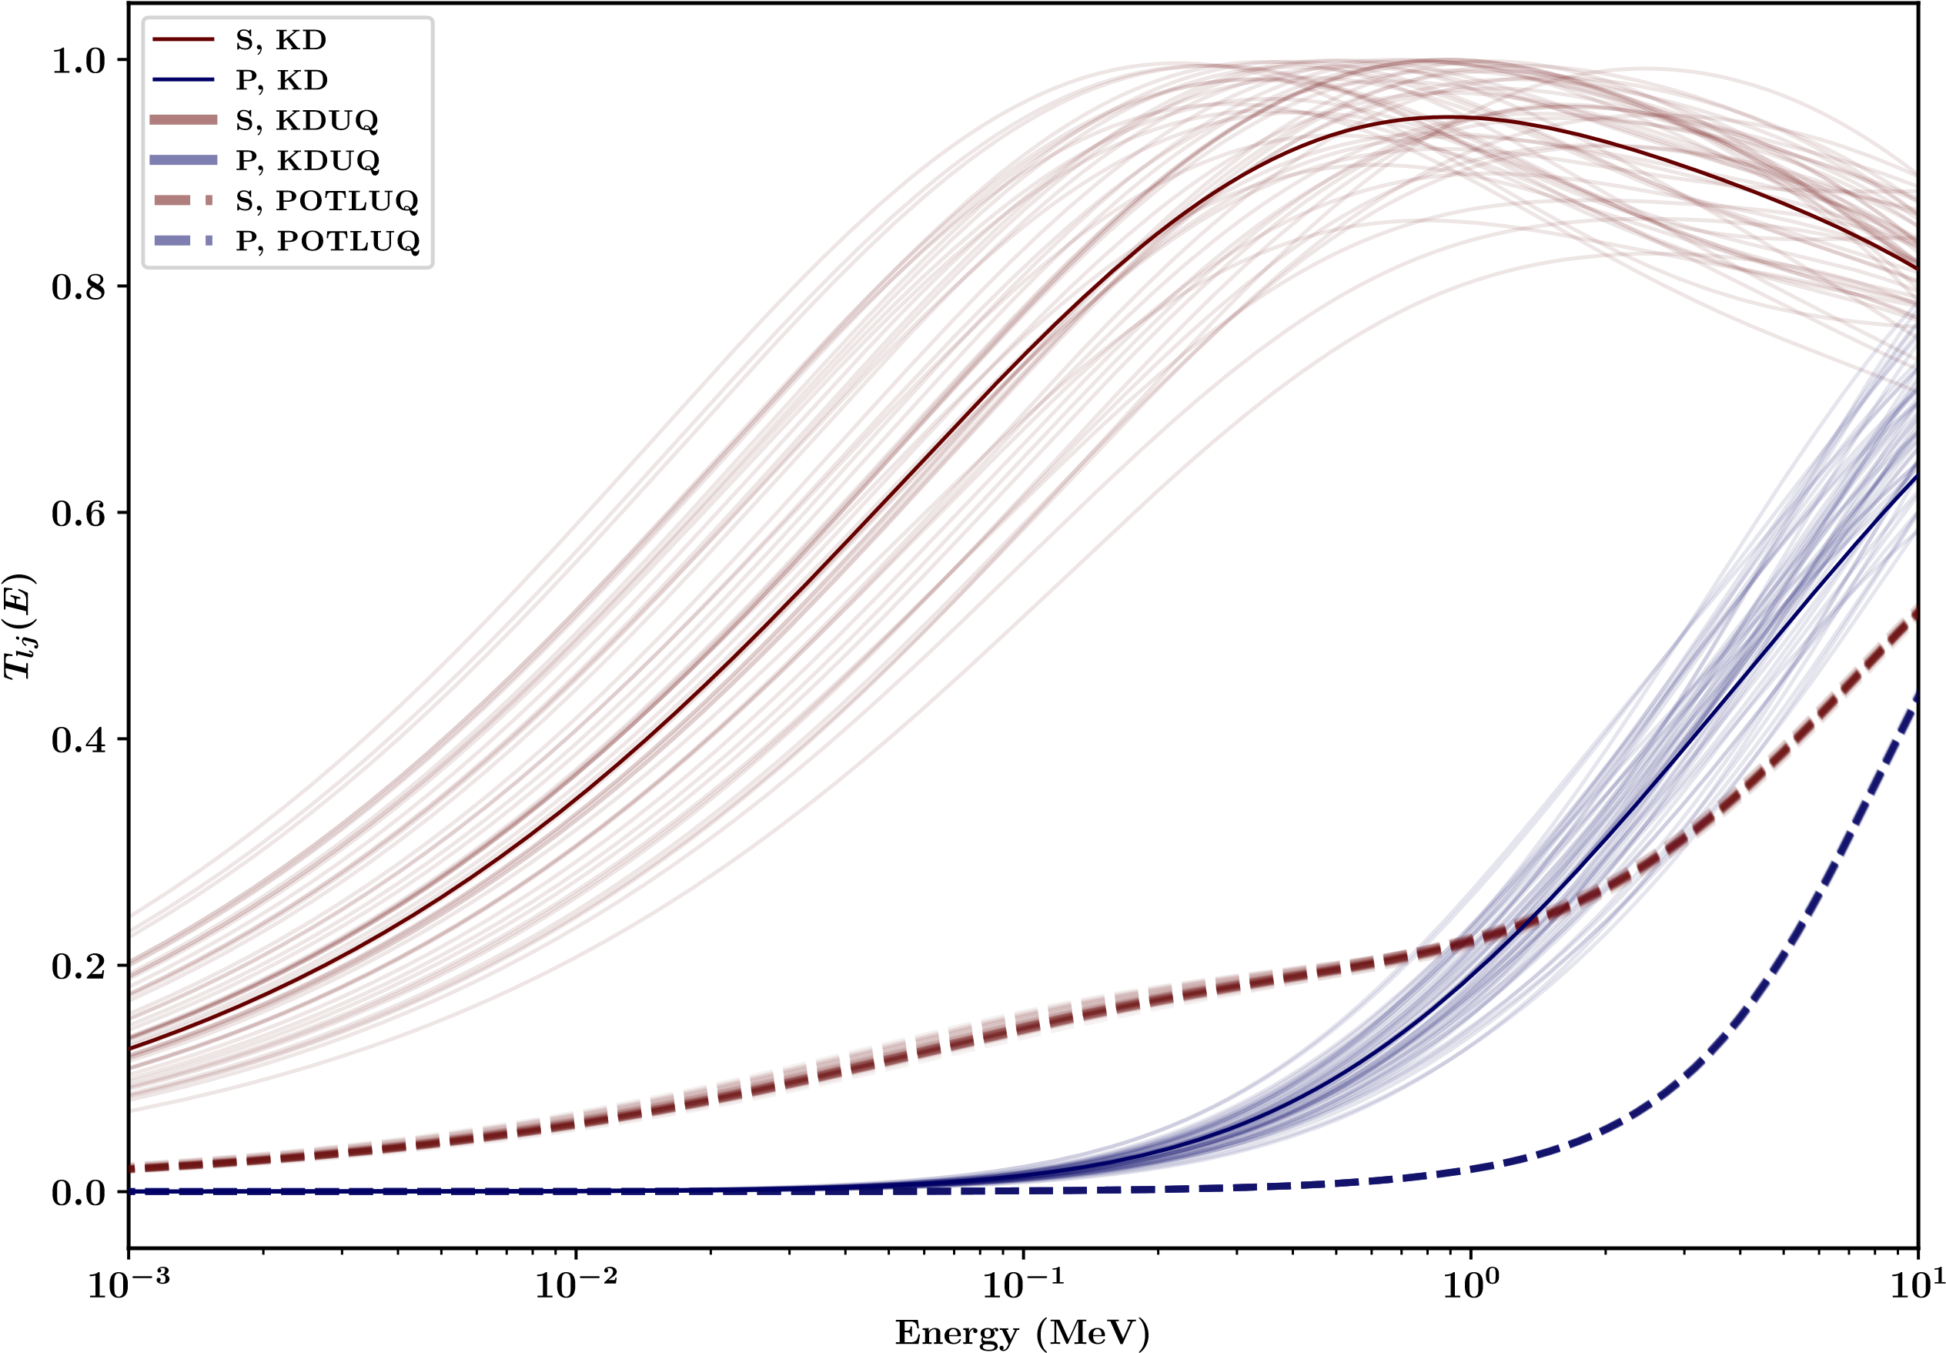
Preliminary spherical global UQ DOM results: ^{40,48,54,58}Ca isotopic chain
Very preliminary:
  At low asymmetries (^{40,48}Ca), DOM neutron transmission coefficients are largely consistent with KD/KDUQ at astrophysical energies
  At high asymmetries ^{(54,58}Ca), transmission coefficients drop off dramatically, likely driven by particle-number constraint (DOM fit accurately recovers N=40 for ⁶⁰Ca)
  Isovector surface strength may be much stronger than assumed by non-dispersive models trained to β-stable scattering data
  Spectral functions indicate considerable broadening of deep holes, consistent with (e,e’p) understanding
⁵⁴Ca
Preliminary
Preliminary results show much larger isovector surface dependence compared to non-dispersive models:
this would reduce dripline (n,γ) cross section predictions by a factor of 5-10

Slide 15
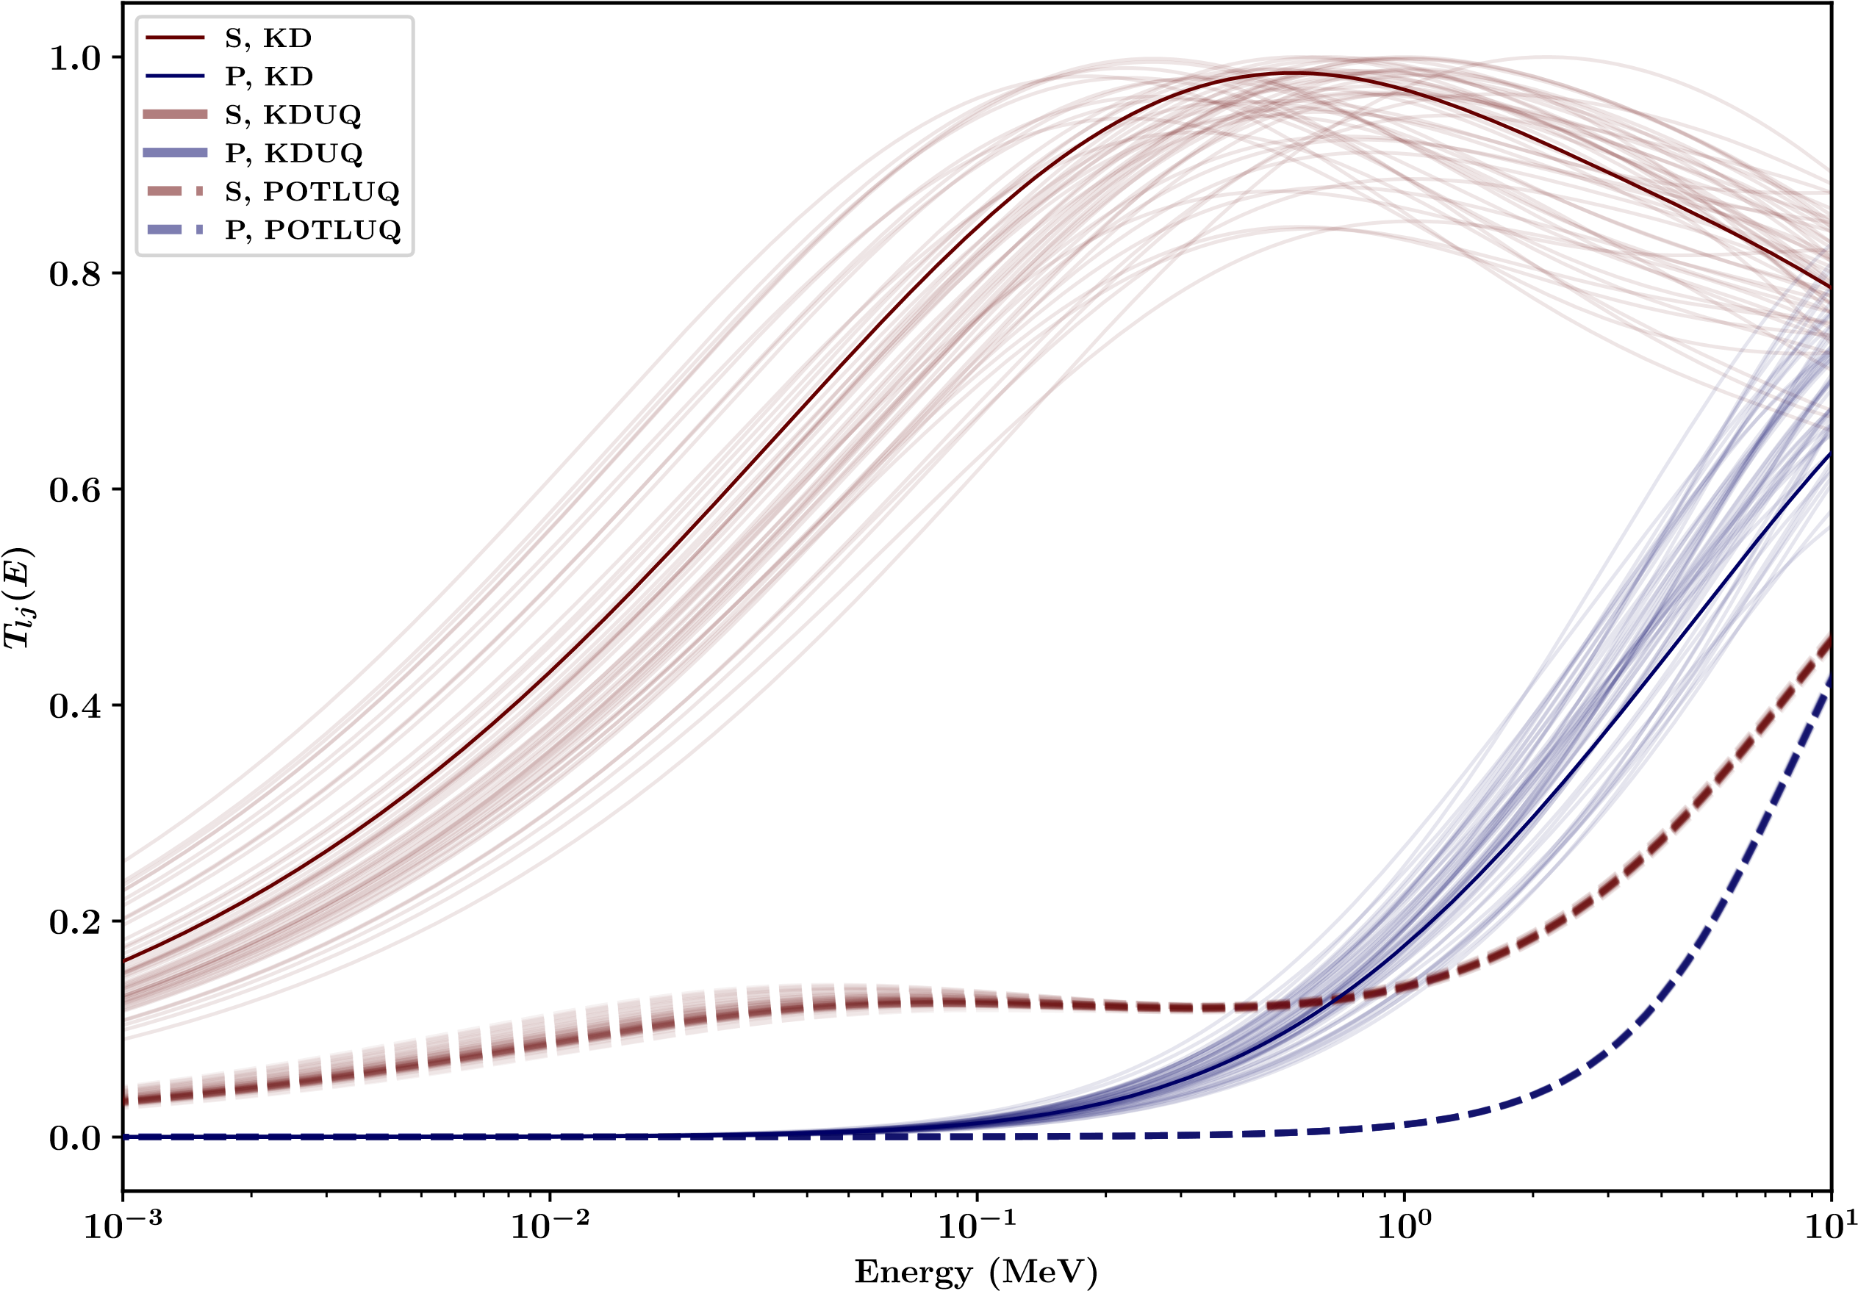
Preliminary spherical global UQ DOM results: ^{40,48,54,58}Ca isotopic chain
Very preliminary:
  At low asymmetries (^{40,48}Ca), DOM neutron transmission coefficients are largely consistent with KD/KDUQ at astrophysical energies
  At high asymmetries ^{(54,58}Ca), transmission coefficients drop off dramatically, likely driven by particle-number constraint (DOM fit accurately recovers N=40 for ⁶⁰Ca)
  Isovector surface strength may be much stronger than assumed by non-dispersive models trained to β-stable scattering data
  Spectral functions indicate considerable broadening of deep holes, consistent with (e,e’p) understanding
⁵⁸Ca
Preliminary
Preliminary results show much larger isovector surface dependence compared to non-dispersive models:
this would reduce dripline (n,γ) cross section predictions by a factor of 5-10

Slide 16
New bridges from compound-nucleus physics to structure and reactions
🚧 A global, UQ DOM is under construction 🚧
Goals:
Reproduce structural data (particle number, charge radius, and binding energy) to <1% model uncertainties
Reproduce integral scattering data (proton reaction and neutron total cross sections) to experimental uncertainties (1-10%)
Reproduce differential scattering data (proton and neutron elastic cross sections, analyzing powers) to systematic uncertainties (~25%)
Predict transmission coefficients for (n,γ) for astrophysical applications
Generate scattering-aware level densities from DOM spectral functions
Predict neutron skins and (e,e’p), (p,n) cross sections across the chart
Disambiguate KD/KDUQ and DOM predictions as a function of asymmetry
Combine lessons from microscopic, nuclear matter, and phenomenological DOM to constrain extrapolation along asymmetry
n
S_{n}
n+²⁰⁸Pb
γ
E_{ex}
E_{top}
²⁰⁹Pb
Structure information is a major untapped resource for constraining reaction models

