Slide 1
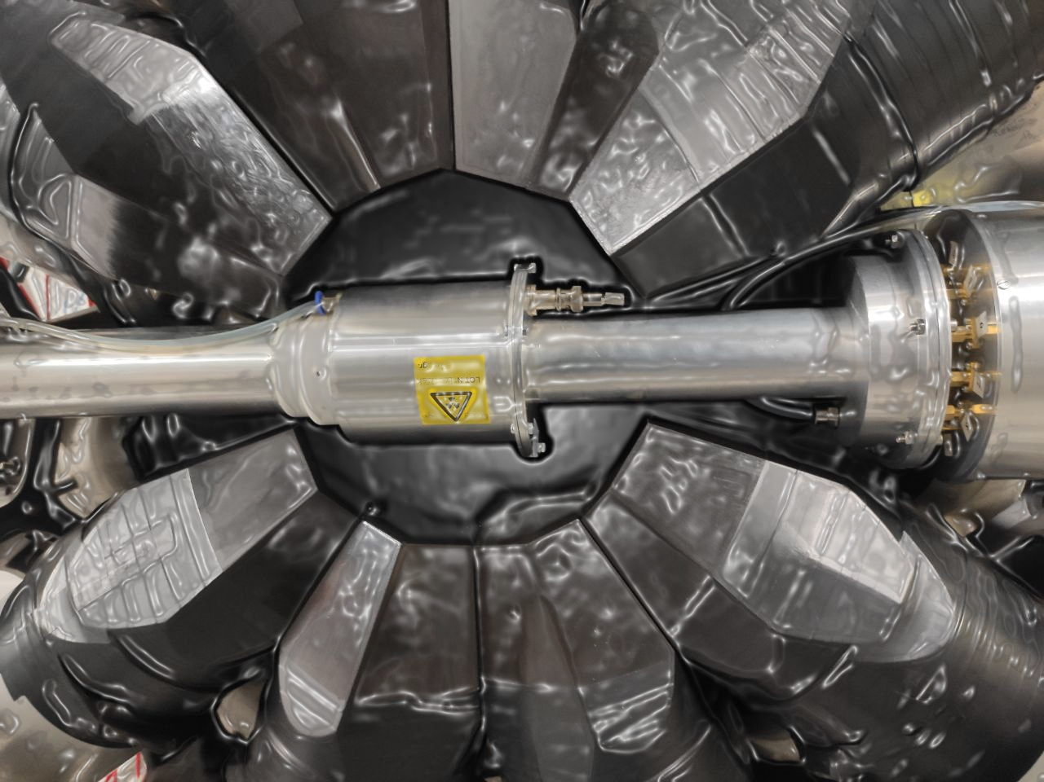




The ²³⁹Pu neutron capture and fission
cross-section measurements
at n_TOF, CERN
A. Sanchez-Caballero¹, V. Alcayne¹, J. Andrzejewski², D. Cano-Ott¹, J. García-Pérez¹, E. Gónzalez-Romero¹, J. Heyse³, T. Martínez¹, E. Mendoza¹, J. Perkowski², J. Plaza del Olmo¹, A. Plompen³, P. Schillebeeckx³, G. Sibbens³
¹CIEMAT, Spain
²University of Lodz, Poland
³JRC-Geel, Belgium

Slide 2
Contents
Context and motivation of the measurement.
²³⁹Pu measurement at n_TOF. Experimental setup.
Data analysis.
Experimental yields.
Summary.

Slide 3
1
Motivation and experimental context

Slide 4
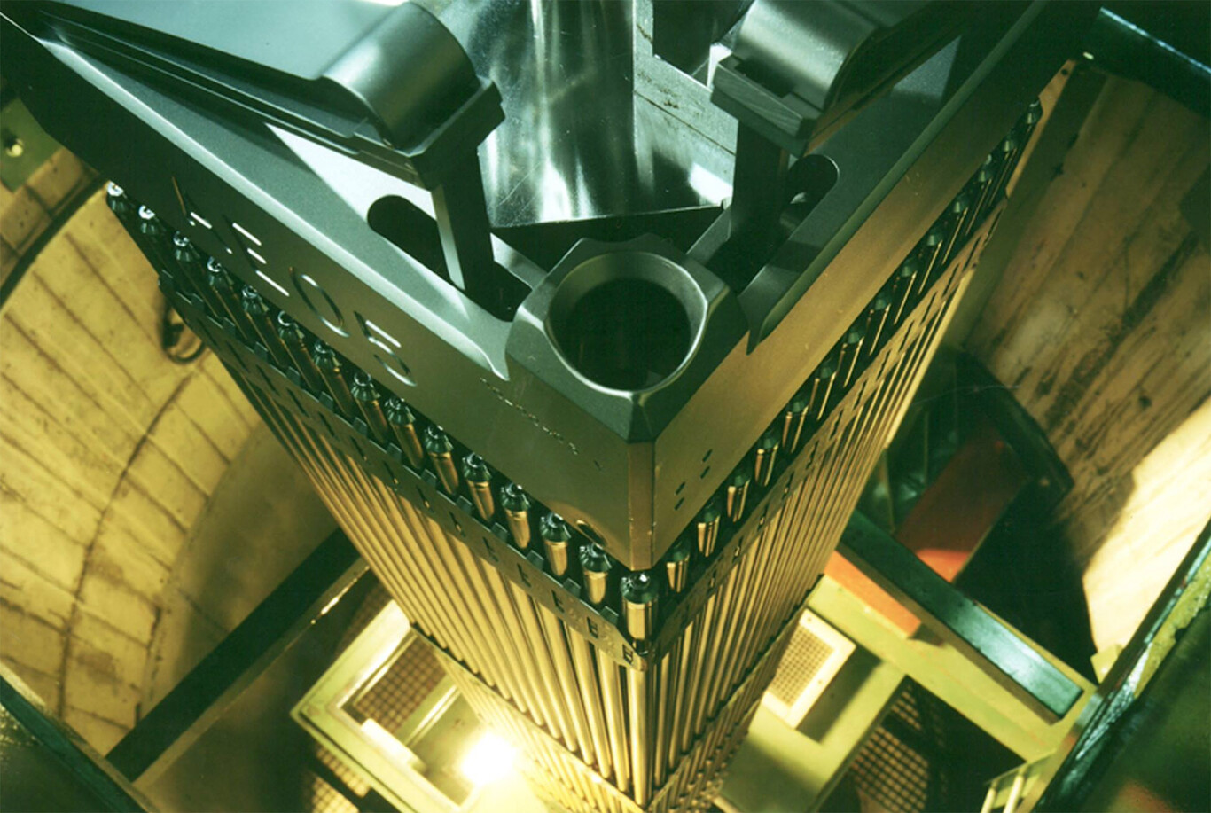
1.1 Motivation and context
More accurate ²³⁹Pu capture and fission cross-section data are required for:
Design of advanced nuclear devices (Gen IV reactors).
Optimization of nuclear waste management strategies of current reactors.
Operation of fast and thermal reactors that use MOX fuels.
Nuclear data evaluations for ²³⁹Pu(n,g) and (n,f)
Main evaluations for capture cross-sections show significant discrepancies.
Only two existing measurements for ²³⁹Pu(n,g) cross-section exist, due to the intrinsic complexity of measuring a fissile sample.
²³⁹Pu capture and fission cross-sections are included in the NEA/OECD High Priority Request List.

Slide 5
2
²³⁹Pu measurement at n_TOF

Slide 6
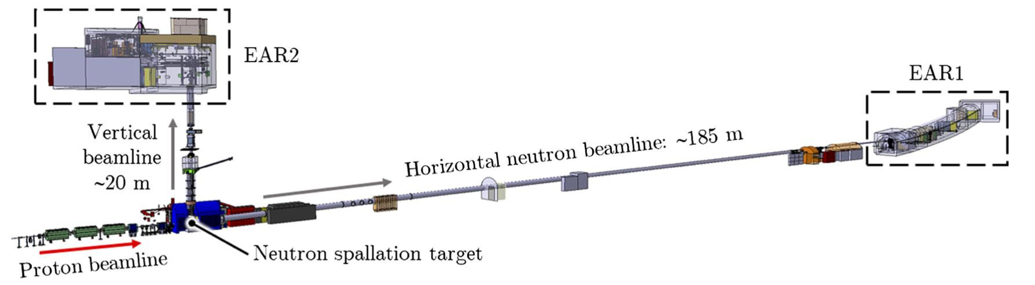
2. ²³⁹Pu measurement at n_TOF
Objectives
Measuring the neutron capture-to-fission ratio (alpha-ratio), the fission and the capture cross sections of ²³⁹Pu at the n_TOF EAR-1.
To provide an overall uncertainty ~3% in the range from thermal energies to 10 keV.
To provide an absolute alpha-ratio, thanks to the accurate determination of the fission and capture detection efficiencies (experience from previous measurements, e.g. ²³⁵U(n,g)).
Why at n_TOF?
A 185 m flight path (10 times larger than in previous measurements) will provide better energy resolution to improve significantly the resonance analysis.

Slide 7
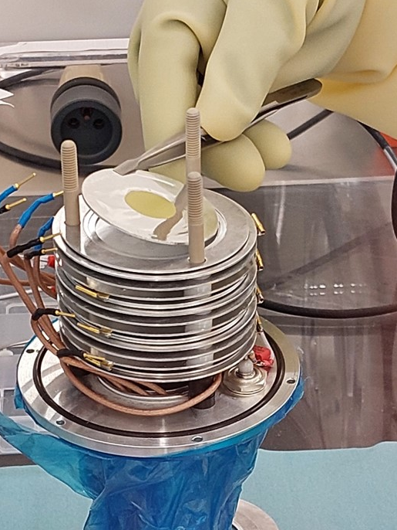
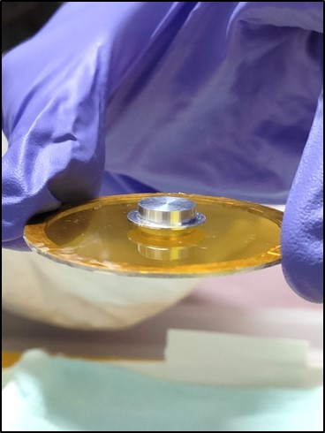
2.1 Overview of the experiment and samples
The experimental campaign took place in the last quarter of 2022, with 2 months of beam time (~5·10¹⁸ protons).
The campaign was divided in two different configurations:
The ²³⁹Pu targets
The PuO₂ (99.90% purity) 10 thin samples (~1 mg each) and the thick sample (~100 mg) were produced, deposited and encapsulated by JRC-Geel+SCK·CEN.
1. FC config.
2. TS config.
- 10 thin Pu samples (< 1 mg).
- Use FICH + TAC simultaneously.
- Measure fission and capture (up to 1 keV).
- 1 thick sample (~100 mg).
- Use only TAC.
- Measure capture above 1 keV.

Slide 8
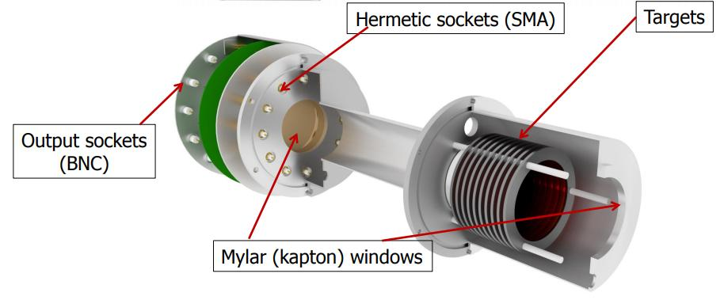
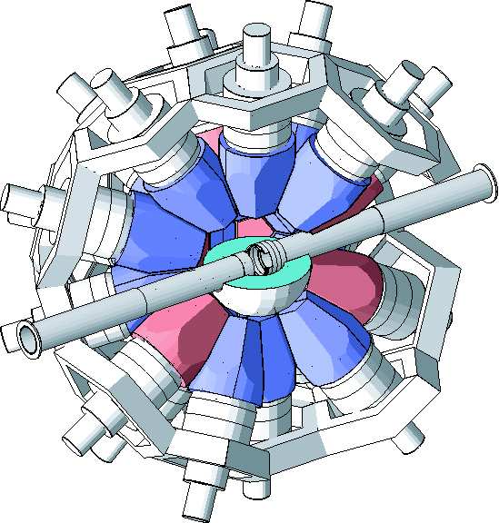
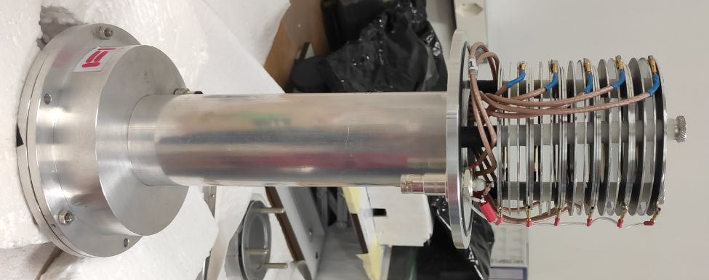
2.2 Main detectors
Fast fission detector
To perform fission tagging with the TAC and to measure fission cross-section.
Housing of 10 parallel targets of PuO₂ deposited in 10 µm aluminum backing.
Fast pre-amplifiers.
Filled with Ar+CF₄ gas. Efficiency of ~90%.
Total Absorption Calorimeter (TAC)
To detect capture and fission γ-rays
Composed of 40 BaF₂ crystals.
Fast response, high efficiency and low neutron sensitivity.

Slide 9
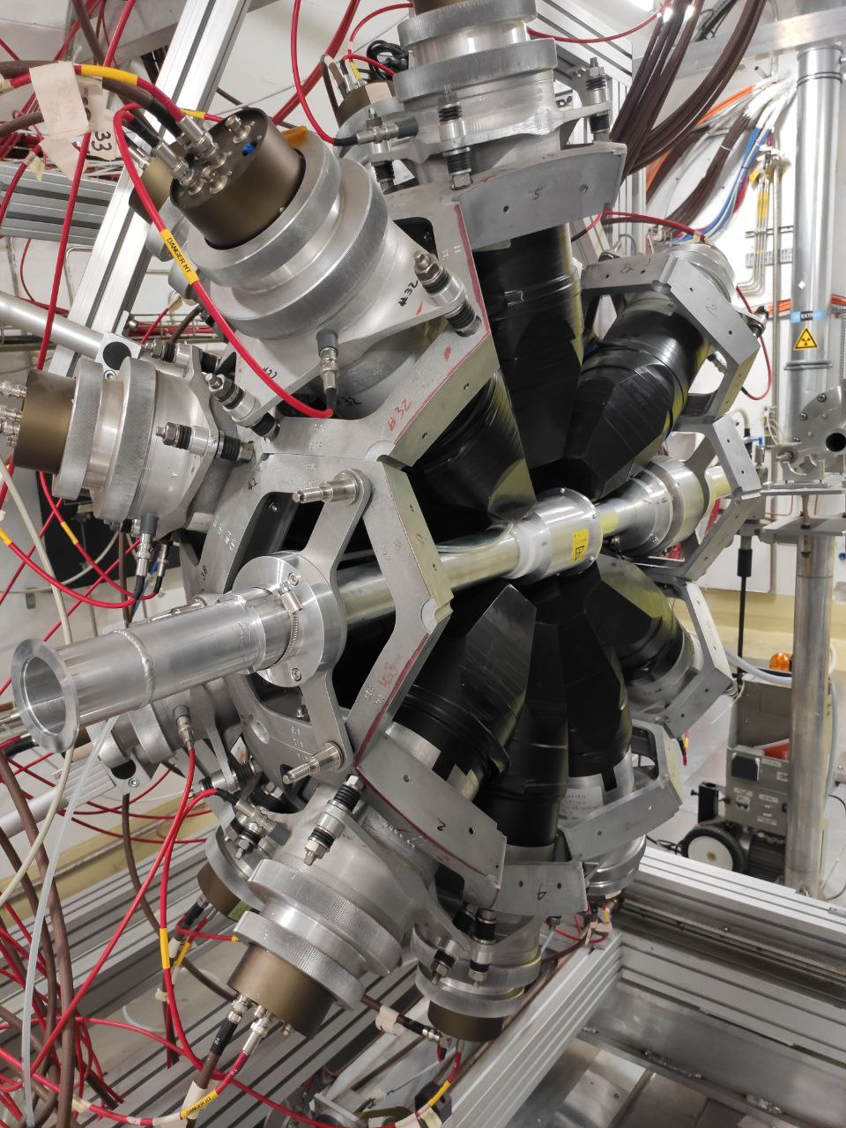
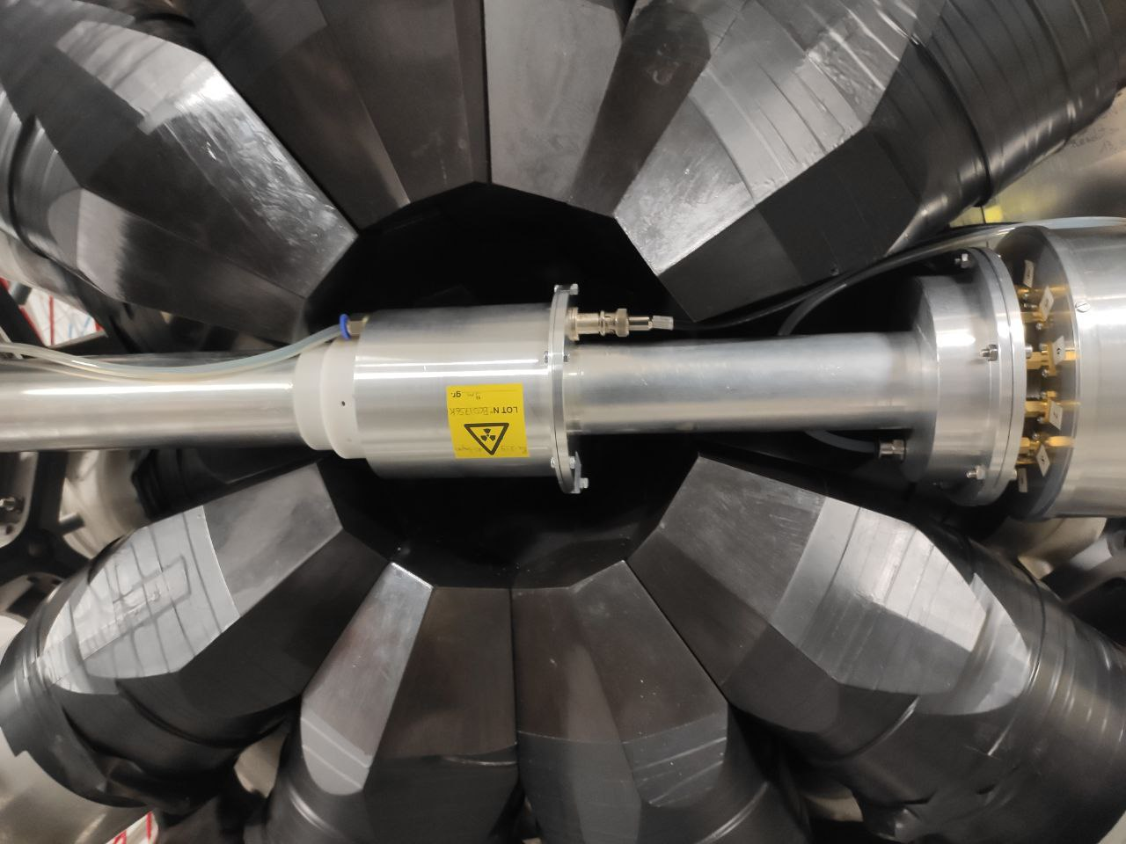
2.3 Experimental setup: mounting
Mounting of the fission chamber inside the TAC. The targets in the chamber are placed around the center of the TAC.

Slide 10
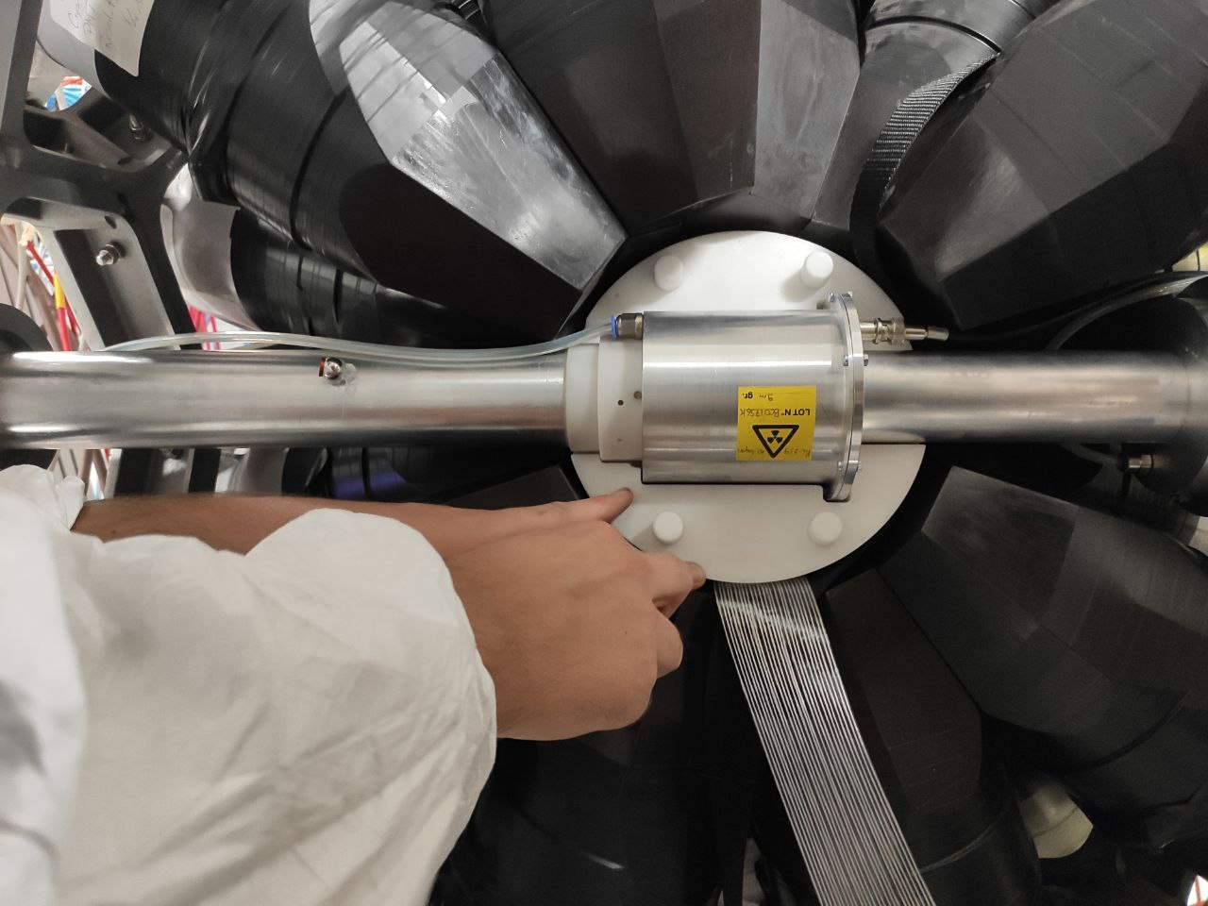
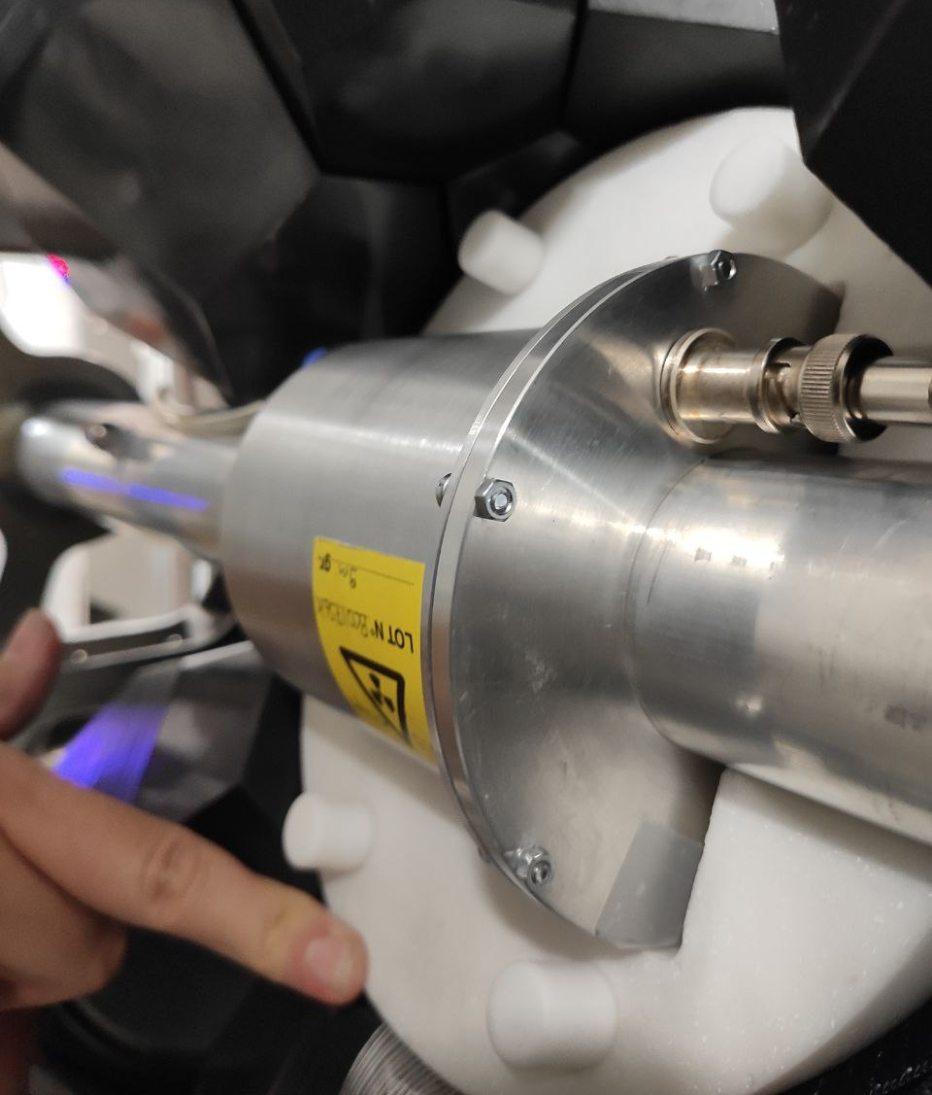
2.3 Experimental setup: mounting
Placement of the Li-doped polyethylene neutron absorber to reduce the number of neutrons reaching the BaF₂ crystals.

Slide 11
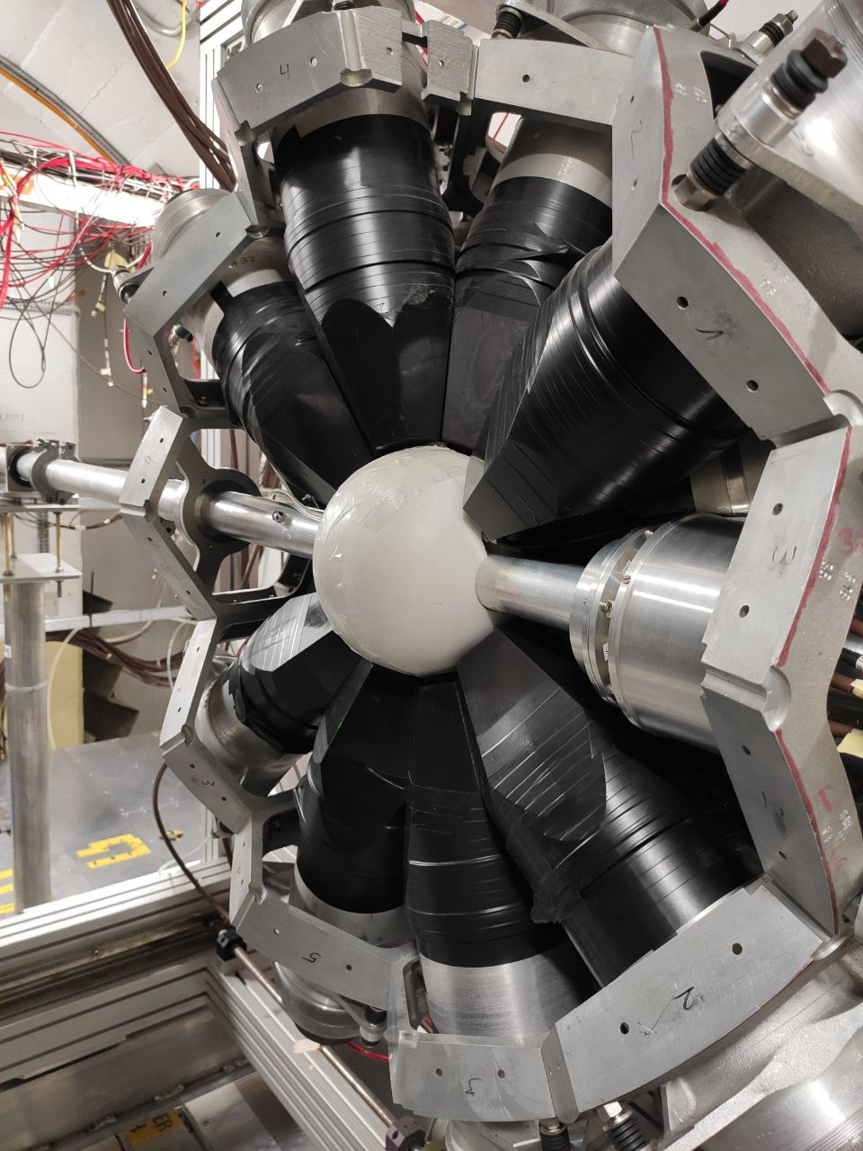
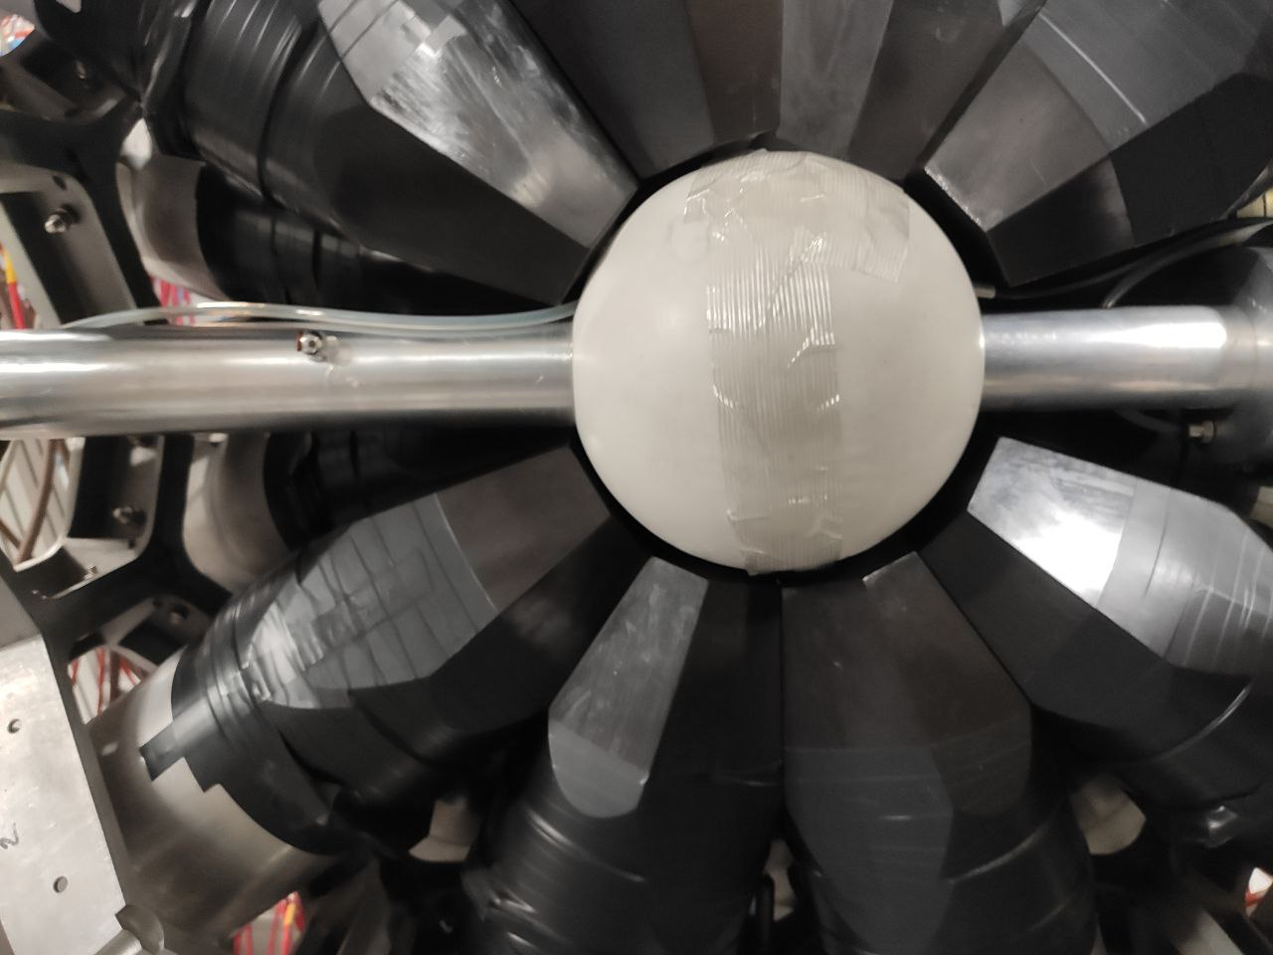
2.3 Experimental setup: mounting
Final setup after closing the neutron absorber and before closing the TAC.

Slide 12
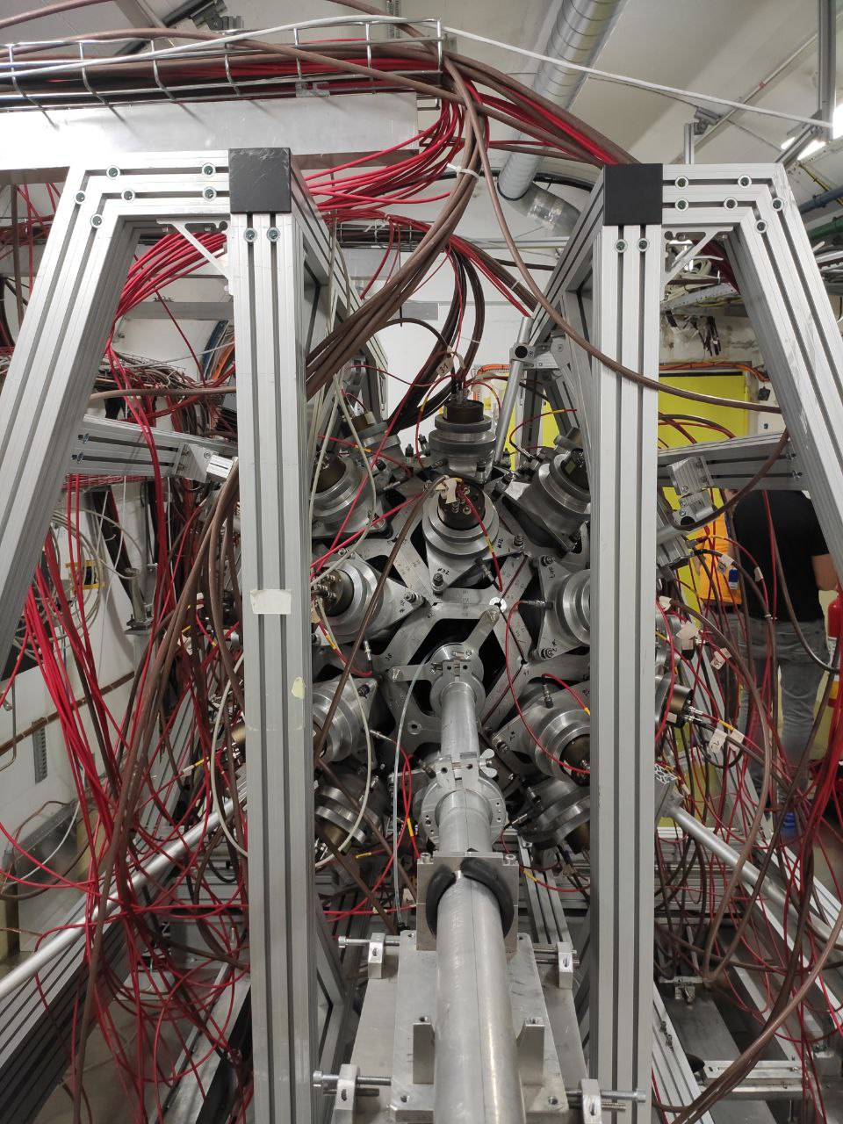
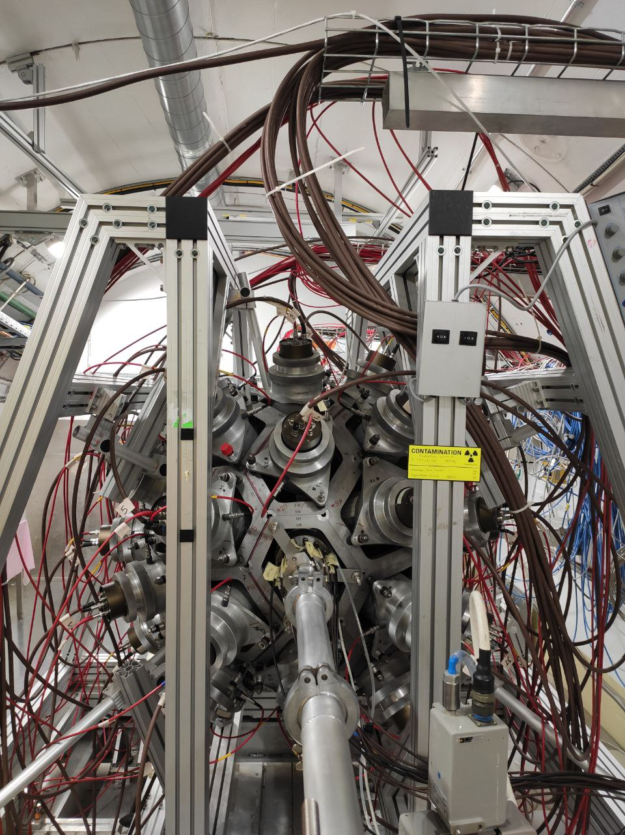
2.3 Experimental setup: mounting
Experimental setup (TAC closed)
UPSTREAM VIEW
DOWNSTREAM VIEW

Slide 13
3
Data analysis

Slide 14
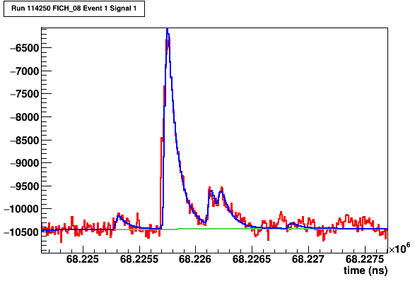
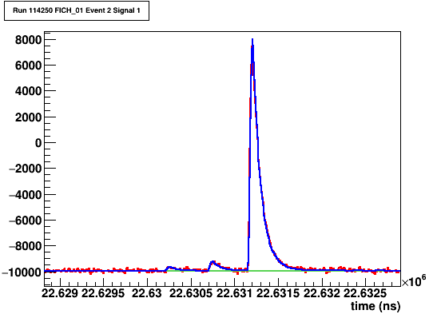
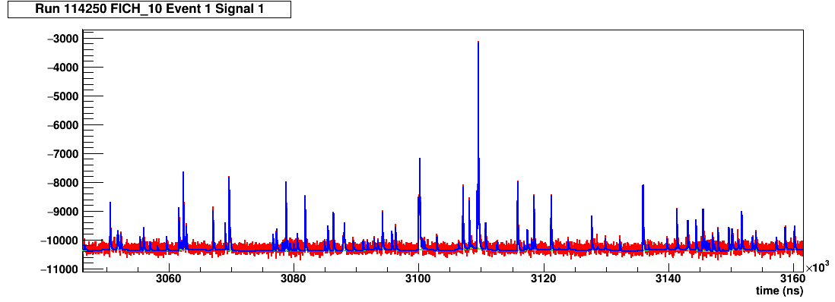
3.1 New dedicated Pulse Shape Analysis routine
Signal reconstruction examples with the new dedicated Pulse Shape Analysis routine.
Fission Chamber
RAW SIGNAL
FIT
RAW SIGNAL
FIT

Slide 15
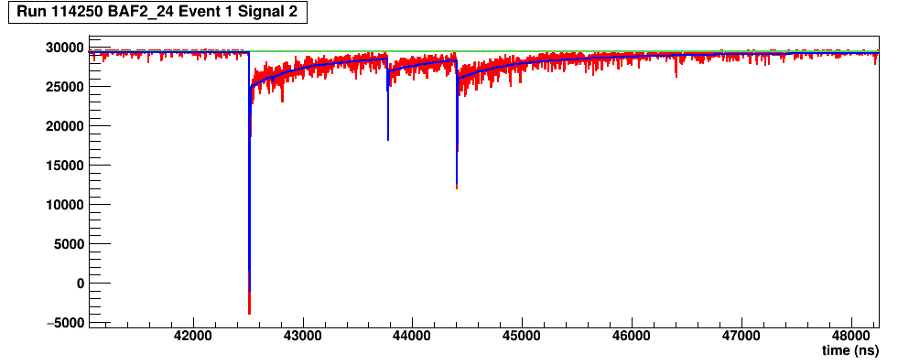
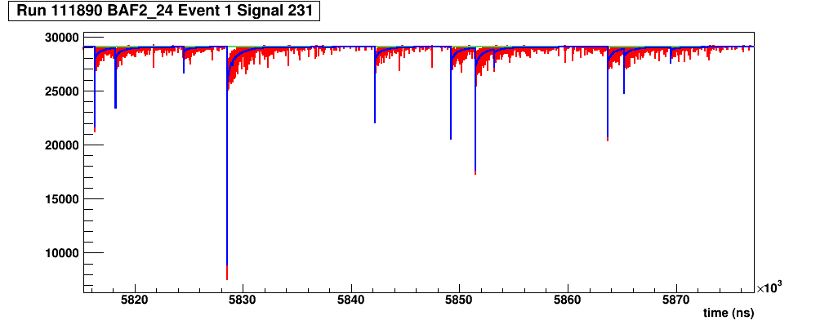
3.1 New dedicated Pulse Shape Analysis routine
Signal reconstruction examples with the new dedicated Pulse Shape Analysis routine.
TAC
RAW SIGNAL
FIT
RAW SIGNAL
FIT

Slide 16
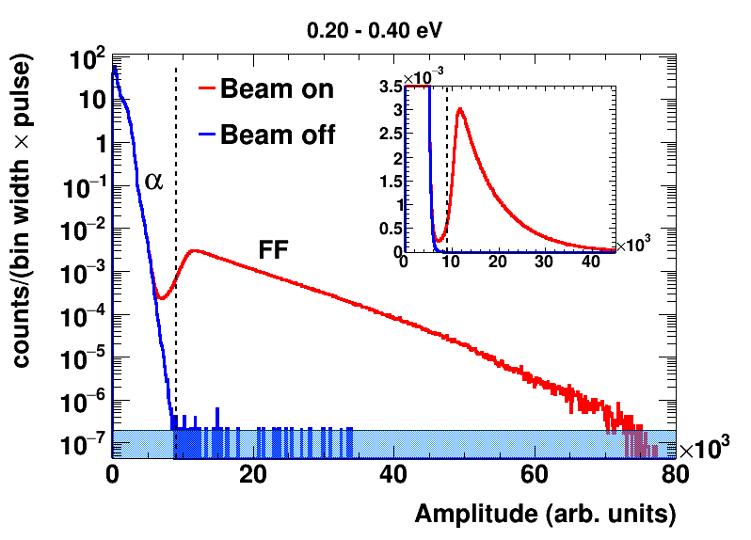
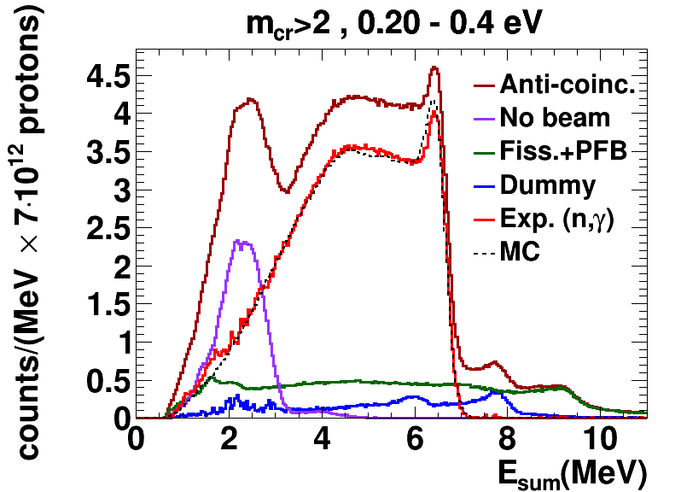
3.2 Amplitude/E_{sum} spectra
FFD
Amplitude spectra in the fast fission detector.
FF = Fission Fragment
Vertical line: selected α-FF threshold.
1 FF per >2000 alphas.
TAC
Sum energy spectra with the different background components, for the first resonance at 0.3 eV.
MC = Monte Carlo simulation of ²³⁹Pu(n,γ).
E. Mendoza et al. NuDEX: a new nuclear γ-ray cascade generator. EPJ Web of Conferences 239, 17006 (2020)
E. Mendoza et al. Study of photon strength functions of ²⁴¹Pu and ²⁴⁵Cm from neutron capture measurements. EPJ Web of Conferences 239, 01015 (2020)

Slide 17
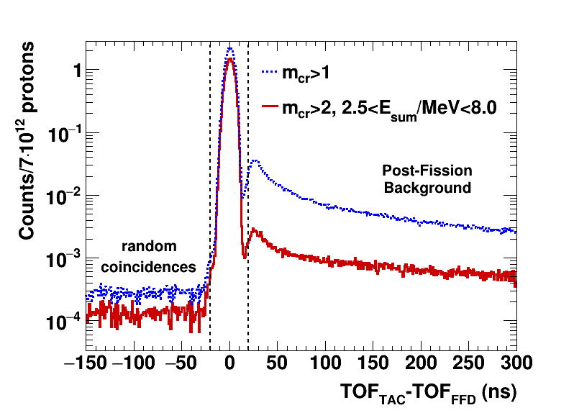
3.3 Coincidence analysis
Time coincidences between TAC events and fission chamber (FICH) signals in the energy region close to the 0.3 eV ²³⁹Pu resonance.
Coincidence window (-20,+20) ns.

Slide 18
4
Experimental yields

Slide 19
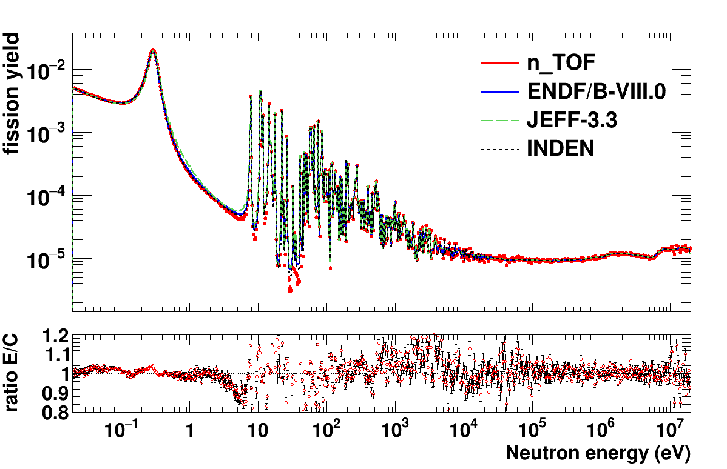
4.1 ²³⁹Pu(n,f) yield compared to evaluations
Fission yield normalized to the recommended value for fissile targets in: Durán, I., Capote, R., & Cabanelas, P. (2024). Normalization of ToF (n, f) Measurements in Fissile Targets: Microscopic cross-section integrals. Nuclear Data Sheets, 193, 95-104.
Integrated fission yield: 100 bins per decade
An overall good agreement with evaluations for 9 orders of magnitude in one-single-measurement!
Ratios are calculated using the INDEN evaluation published in July 2023.
https://www-nds.iaea.org/INDEN/

Slide 20
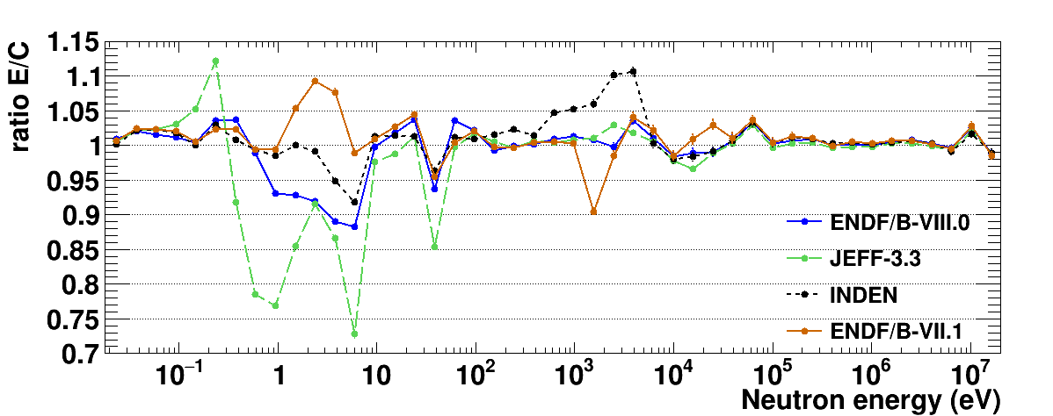
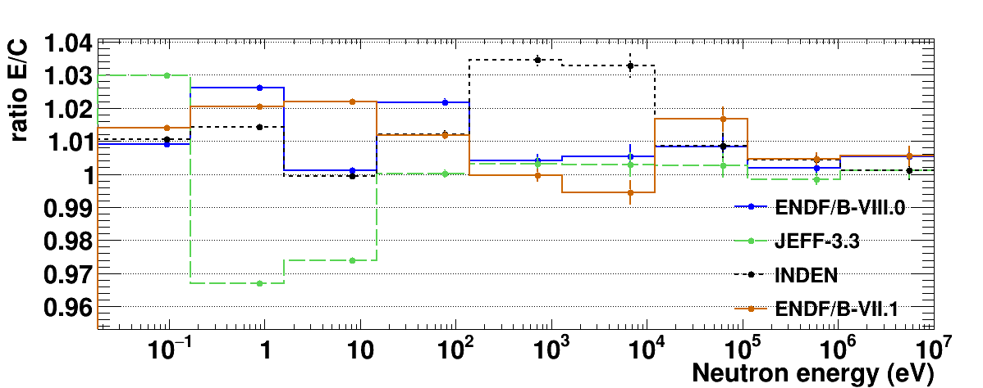
4.1 ²³⁹Pu(n,f) yield compared to evaluations
5 bins per decade
1 bin per decade

Slide 21
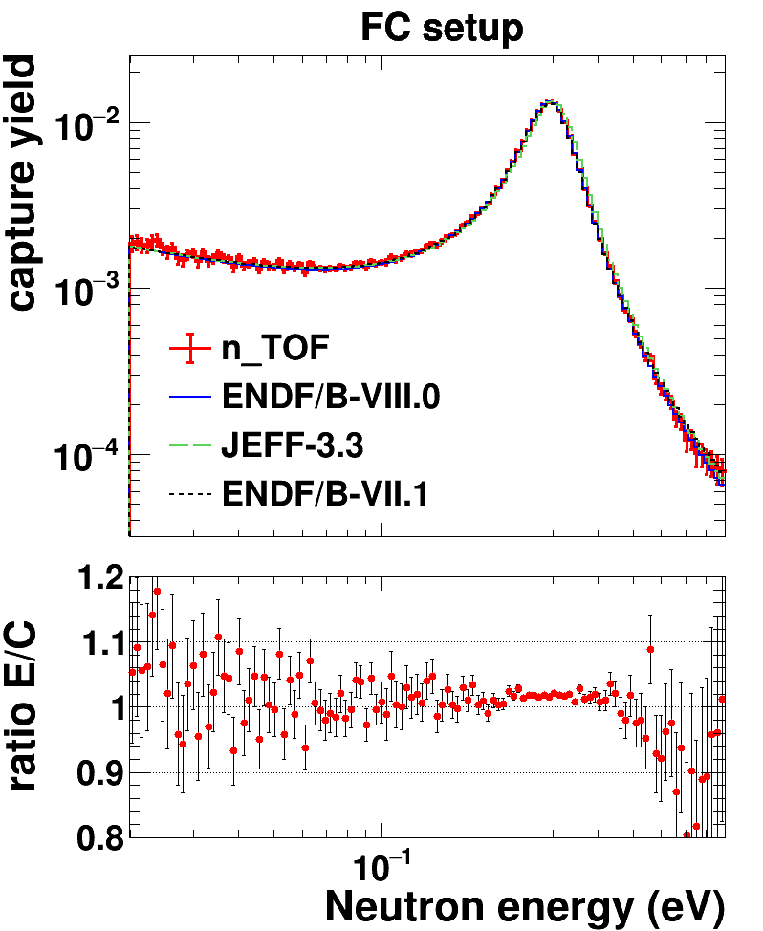
4.3 ²³⁹Pu(n,$γ$) yield compared to evaluations
Capture in FC setup has been normalized using the ²³⁹Pu(n,f) yield normalization.
Ratios are calculated relative to ENDF/B-VII.1. Only statistical uncertainties are shown.

Slide 22
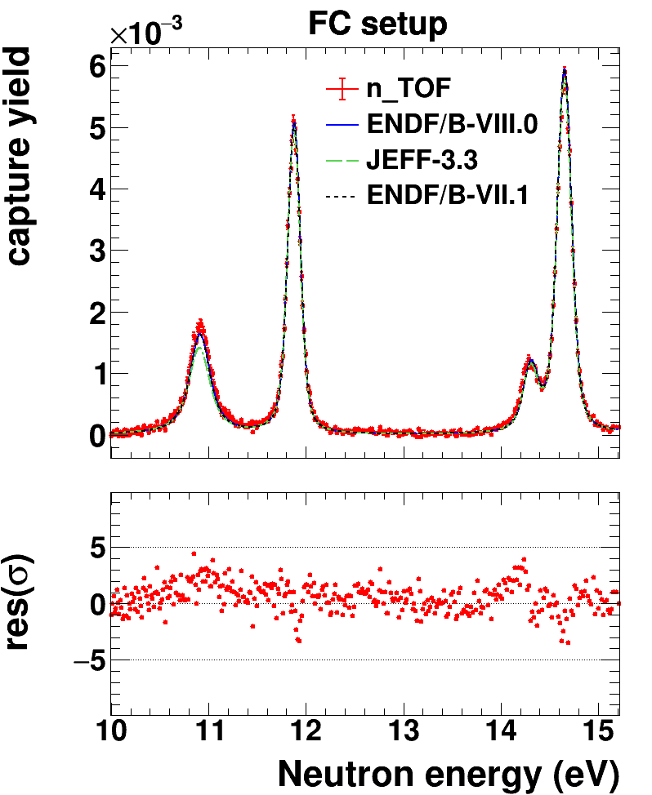
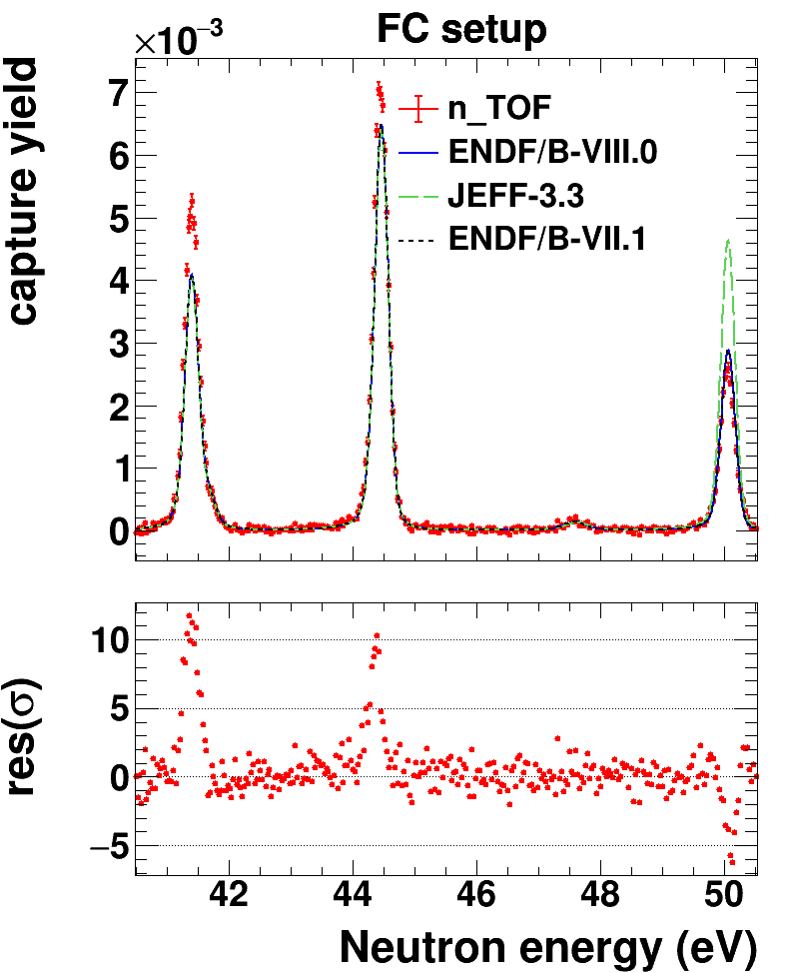
4.3 ²³⁹Pu(n,$γ$) yield compared to evaluations
Capture in FC setup has been normalized using the ²³⁹Pu(n,f) yield normalization.

Slide 23
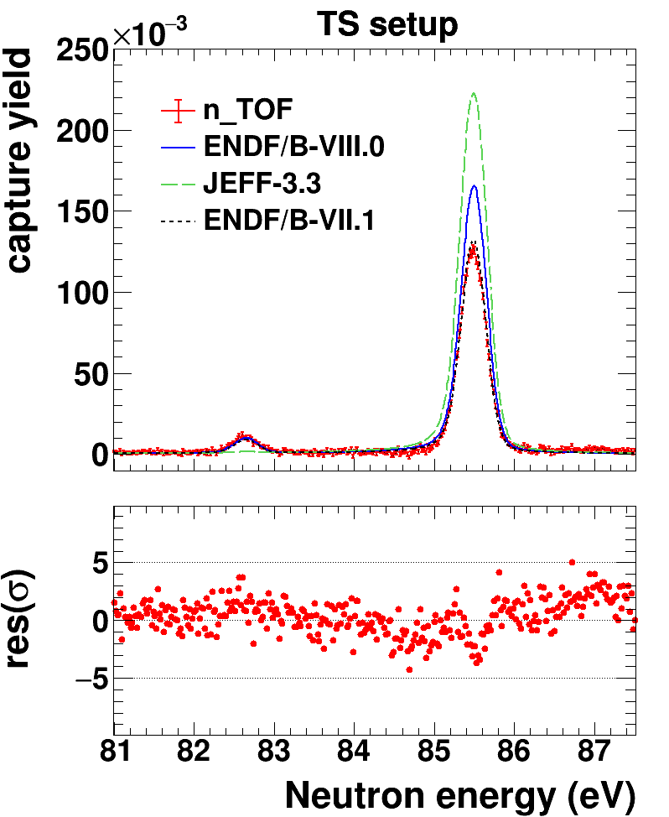
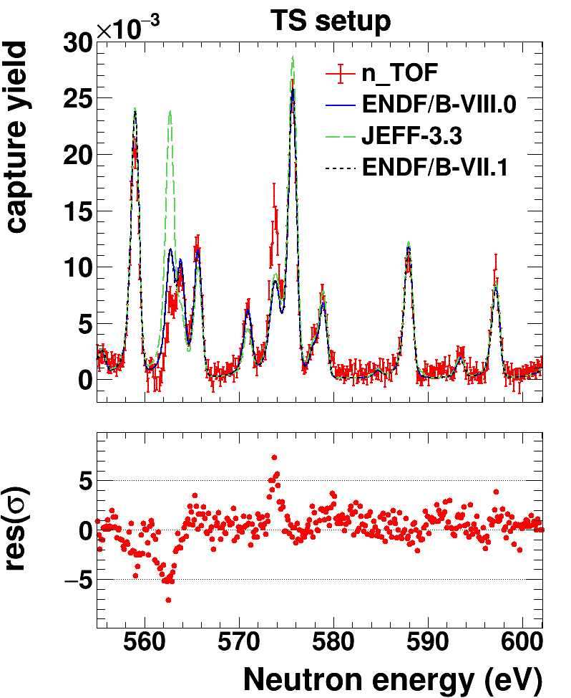
4.3 ²³⁹Pu(n,$γ$) yield compared to evaluations
Capture in TS setup.

Slide 24
5
Summary

Slide 25
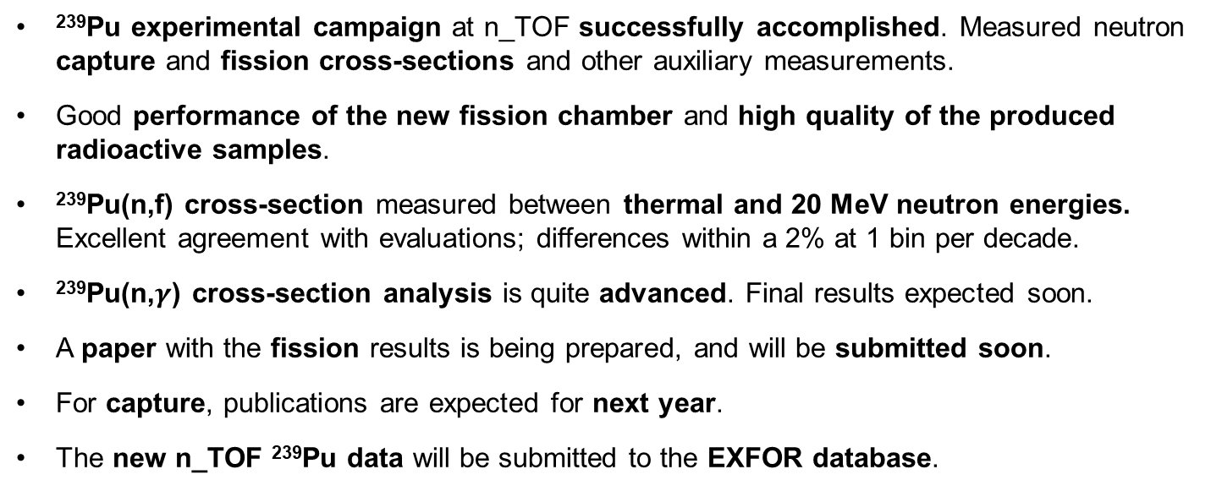
5. Summary
²³⁹Pu experimental campaign at n_TOF successfully accomplished. Measured neutron capture and fission cross-sections and other auxiliary measurements.
Good performance of the new fission chamber and high quality of the produced radioactive samples.
²³⁹Pu(n,f) cross-section measured between thermal and 20 MeV neutron energies. Excellent agreement with evaluations; differences within a 2% at 1 bin per decade.
²³⁹Pu(n,$γ$) cross-section analysis is quite advanced. Final results expected soon.
A paper with the fission results is being prepared, and will be submitted soon.
For capture, publications are expected for next year.
The new n_TOF ²³⁹Pu data will be submitted to the EXFOR database.

Slide 26

Acknowledgments
This project has received funding from the Euratom research and training programme 2011-2018 under grant agreement No 847595 (ARIEL)
This activity is part of the scientific program approved by the European Commission H2020 Supplying Accurate Nuclear Data for energy and non-energy Applications – SANDA project (WP2, Task 2).
2021-1-RD EUFRAT-GELINA project funding for the stay at JRC-Geel.
Spanish national projects PGC2018-096717-B-C21, PID2021-123100NB-I00 and PDC2021-120828-I00.
 | EUROPEAN COMMISSION JOINT RESEARCH CENTRE Directorate G - Nuclear Safety and Security Standards for Nuclear Safety, Security and Safeguards

Slide 27
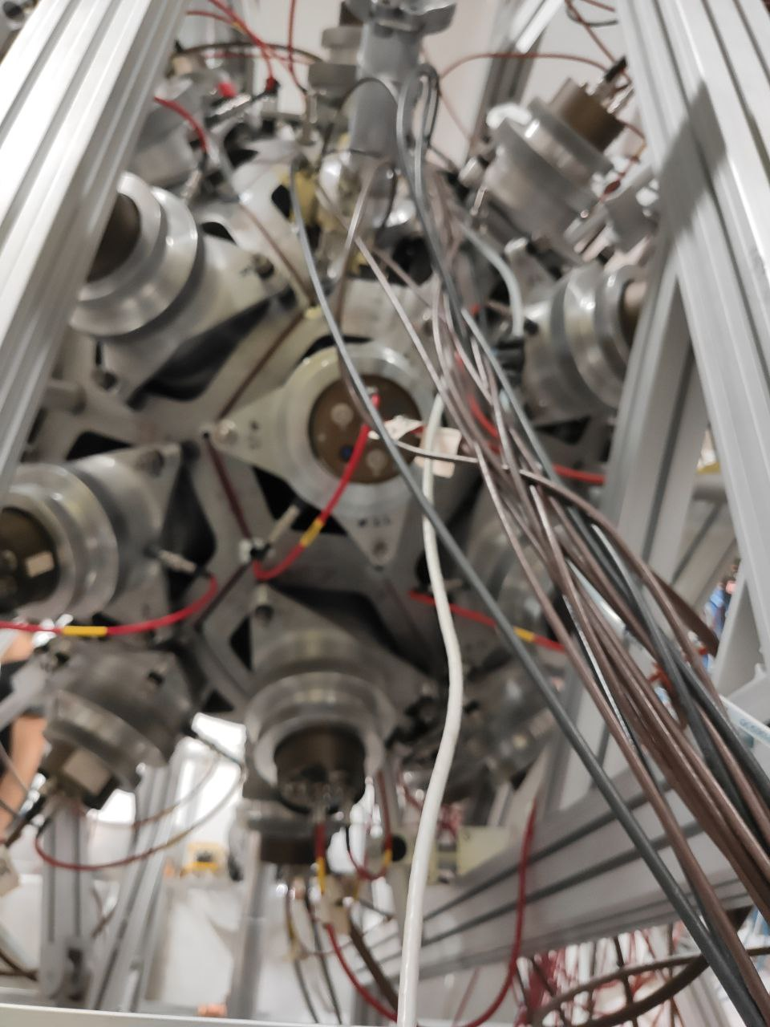
THANK YOU!

Slide 28
Extra slides

Slide 29
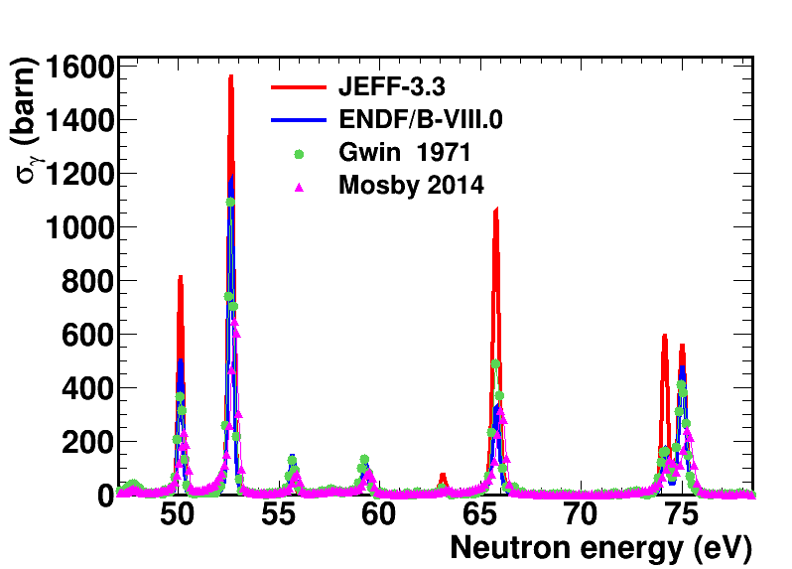
1.2 Previous measurements
Previous ²³⁹Pu capture measurements with high energy resolution in EXFOR
Gwin et al. (1971). For neutron energies between 0.02 eV and 30 keV.
Mosby et al. (2014) at LANSCE (Los Alamos, USA) in the neutron energy range from 10 eV to 1.3 MeV. Only the shape of the cross-section was measured (normalized to ENDF/B-VII.0 cross-section).

Slide 30
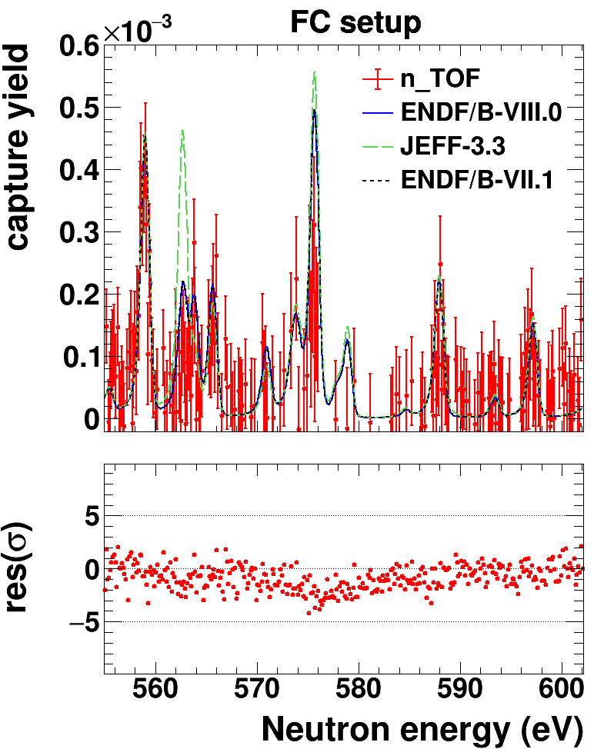
4.3 ²³⁹Pu(n,$γ$) yield compared to evaluations
Capture comparison FC vs TS setup.

Slide 31
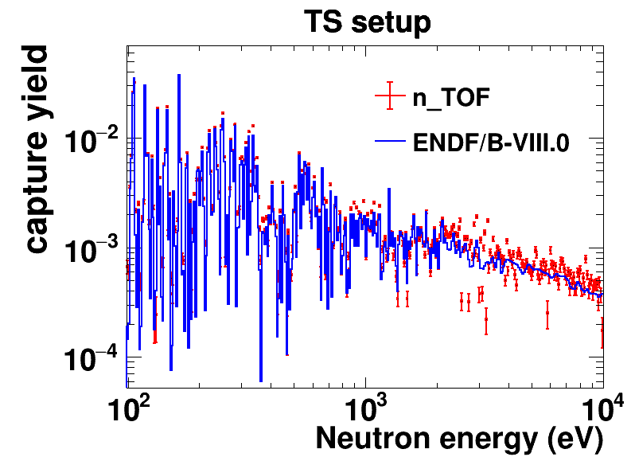
4.3 ²³⁹Pu(n,$γ$) yield compared to evaluations
Capture in TS setup.

Slide 32
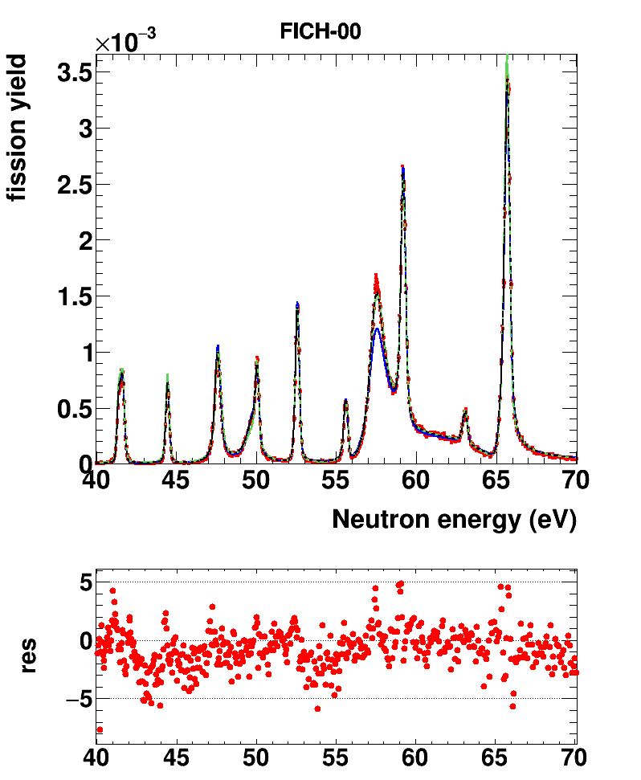
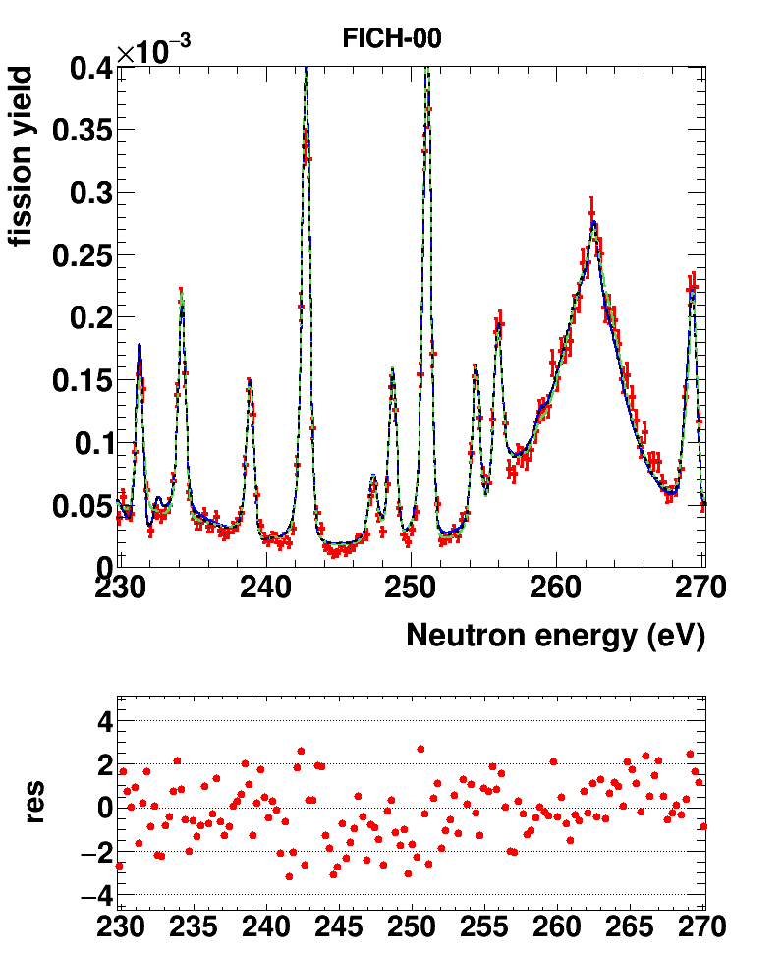
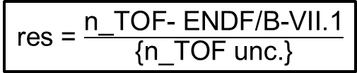
Fission Chamber configuration
Preliminary results: fission yield compared with evaluated libraries
res = $\frac{\text{n}\text{_}\text{TOF}\text{− }\text{ENDF}\text{/}\text{B}\text{−}\text{VII}\text{.1}}{\text{\{}\text{n}\text{_}\text{TOF} \text{unc}\text{.\}}}$
n_TOF
ENDF/B-VIII.0
JEFF-3.3
ENDF/B-VII.1
n_TOF
ENDF/B-VIII.0
JEFF-3.3
ENDF/B-VII.1

Slide 33
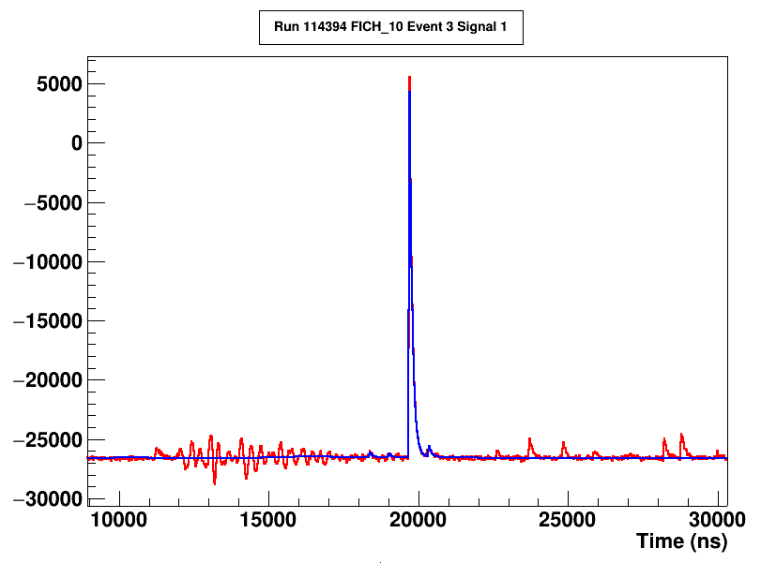
Max. E_{n} in fission yield
Inspecting the data buffers, we can estimate the width of the gamma flash, thus obtaining the maximum valid neutron energy for the fission yield that we could potentially reach.
Plot taken from file run114394_0_s1.raw.finished. The Tflash has been obtained from Baf2 #18 from the same pulse. TOFD = 185.59 m.
Start g-flash (11,196 ns)
Signal
Fit
Signal at 2.2 MeV
End g-flash (~18,000 ns)
3.3 MeV
Alphas
According to this, we could measure fission without being affected by the gamma-flash up to ~3 MeV.

Slide 34
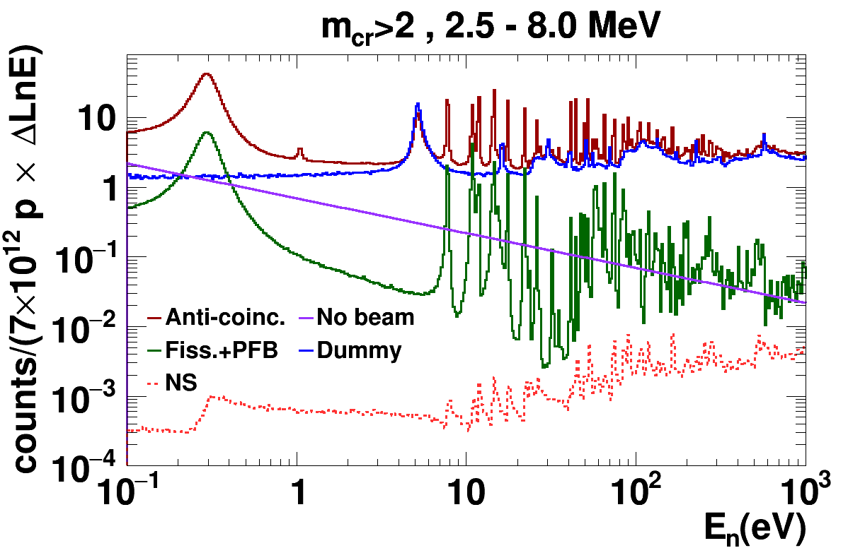
Fission Chamber configuration
Preliminary results: background contributions
TAC neutron energy spectra with the standard cuts for a capture measurements.

Slide 35
Targets description
Number of electronic output from preamplifiers | Target position in the FC chamber | Pu-239 samples | Pu-239
Number of electronic output from preamplifiers | Target position in the FC chamber | TP number | Activity [μg/cm²] | Mass [μg] | Areal density [μg/cm²]
6 | 1 | 2020-006-15 | 2.24E+06 | 975 | 310
1 | 2 | 2020-006-02 | 2.22E+06 | 965 | 307
7 | 3 | 2020-006-04 | 2.20E+06 | 959 | 305
2 | 4 | 2020-006-06 | 2.09E+06 | 911 | 290
8 | 5 | 2020-006-14 | 2.81E+05 | 122 | 39
3 | 6 | 2020-006-07 | 1.94E+06 | 844 | 268
9 | 7 | 2020-006-08 | 2.19E+06 | 953 | 303
4 | 8 | 2020-006-10 | 2.11E+06 | 920 | 293
10 | 9 | 2020-006-12 | 2.09E+06 | 912 | 290
5 | 10 | 2020-006-13 | 2.25E+06 | 982 | 312

Slide 36
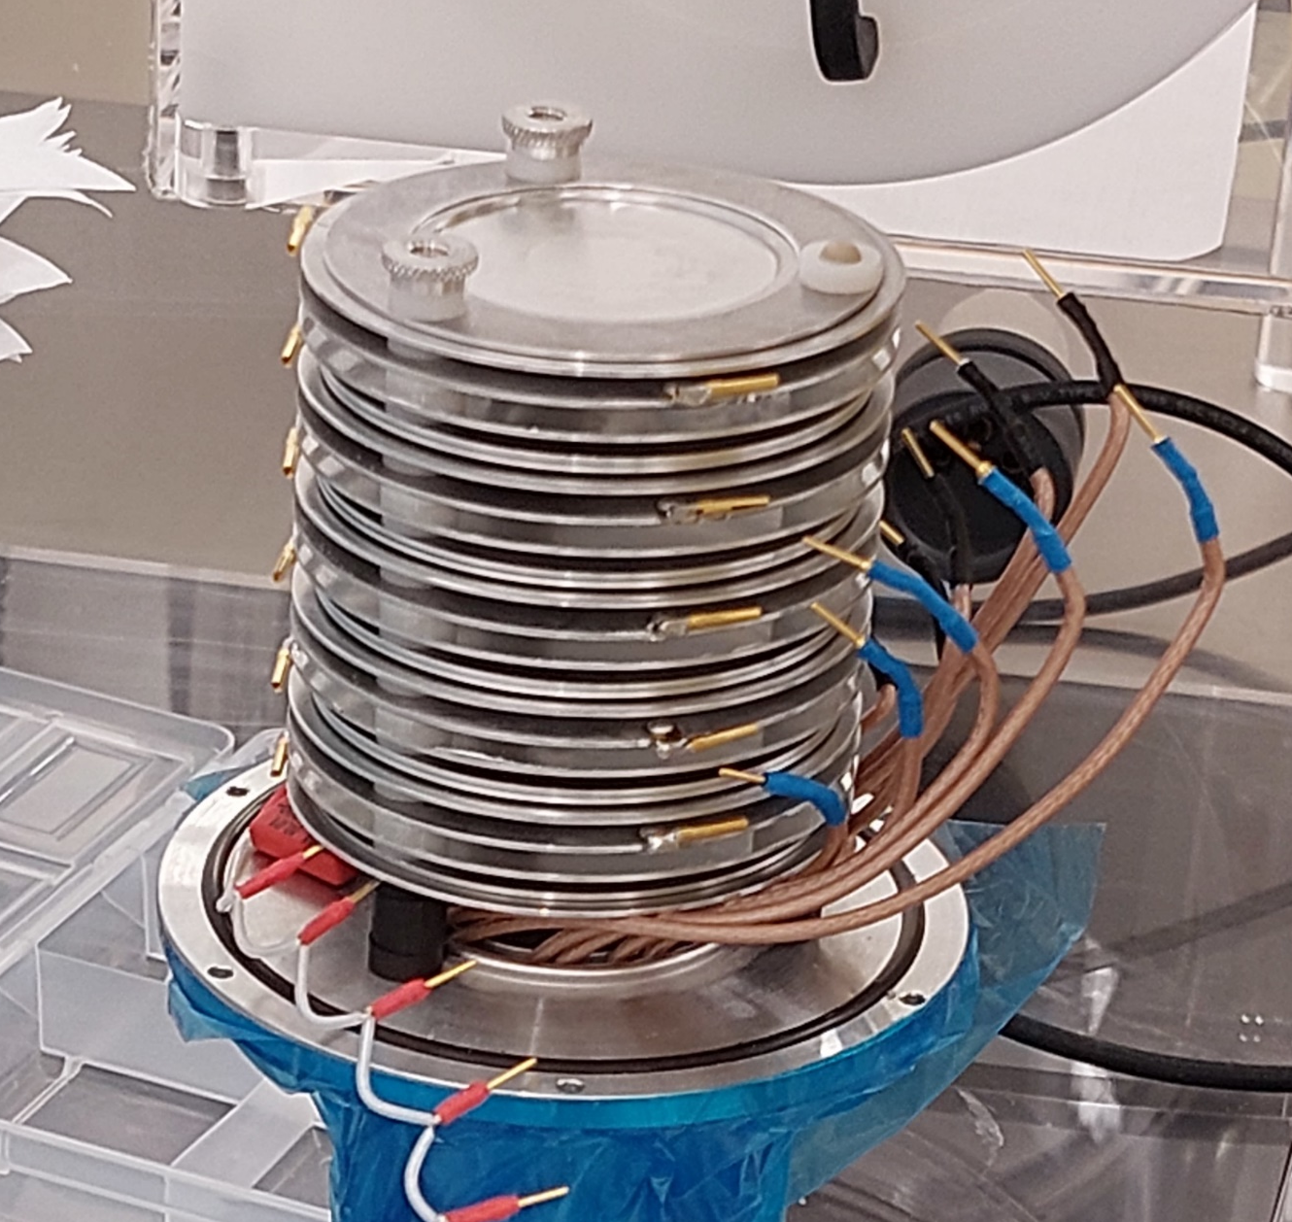
Targets description
CLOSER TO NEUTRON SOURCES
Target position-10
Target position-9
Target position-8
Target position-7
Target position-6
Target position-5
Target position-4
Target position-3
Target position-2
Target position-1

