Slide 1


Nucleon-Nucleus Optical Potentials for
Soft Deformed Nuclei
Dmitry Martyanov*, Roberto Capote, Jose Manuel Quesada
*Joint Institute for Power and Nuclear Research – Sosny, Minsk, Belarus;
IAEA, Vienna
CNR*2024, July 2024, Vienna, IAEA

Slide 2
Coupled channels optical model
target
direct elastic
nucleon
direct inelastic
total
cross
section
compound nucleus
Better target dynamics description → less is left for compound nucleus
Essential for description of experimental data for deformed nuclides

Slide 3
Model components
Dispersive Lane-consistent macroscopic potential:
  Physically realistic
  Better constrained
  Describe more experimental data with single parameters set
Nuclear structure model:
  Description of low-energy collective excited states of a target – both rotational and vibrational (soft-rotator model)
  Go beyond main rotational band
Proper expansion of the deformed optical potential:
  More details later

Slide 4
Are other bands important? (proton inelastic)
No nucleon scattering data for other-than-GS band in EXFOR for actinides
…
but there are clear evidences of levels from
other bands in some proton inelastic scattering
experimental works
E_{p}=35 MeV
E_{p}=26 MeV
²³⁸U(p,p’)
L. F. Hansen et al, PRC 25 (1982) 189
C. H. King et al, PRC 20 (1979) 2084

Slide 5
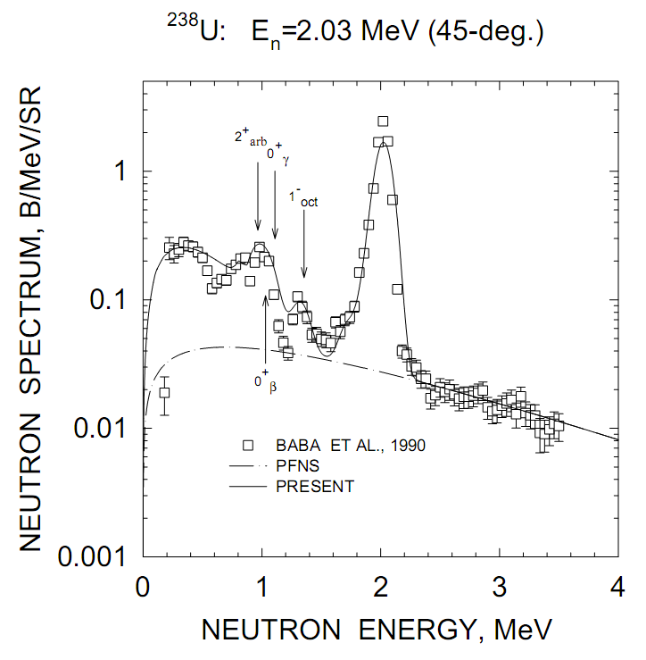
Are other bands important? (²³⁸U neutron emission spectrum)
Also evidence of levels from other bands
n,n’X

Slide 6
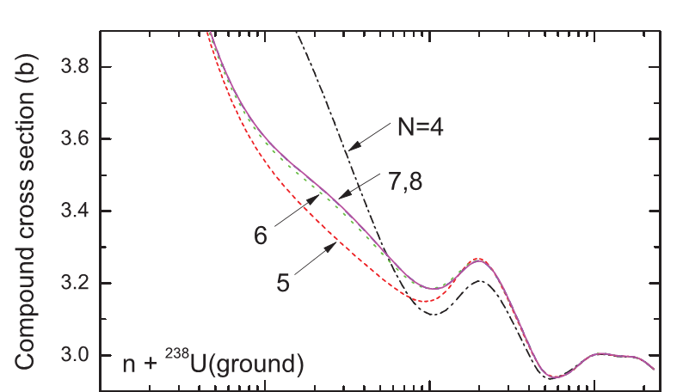
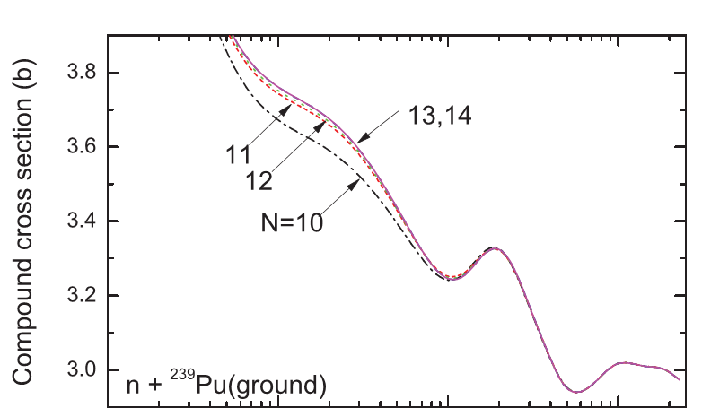
Saturation of the coupling scheme
Saturation – predicted cross
sections do not change upon
addition of new levels
Along GS band to saturate we need:
6 levels for even-even
11 levels for odd
But what about other bands?
F. S. Dietrich et al., Phys. Rev. C 85, 044611 (2012)

Slide 7
Is softness important?
GS band levels energies deviate from rigid rotor level sequence for high spins due to nuclear stretching form centrifugal forces.
Soft-rotor model describes experimental energies and other bands as well.
²³⁸U

Slide 8
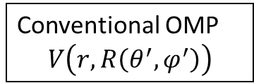
Coupled channels for soft deformed nuclei
Conventional OMP
$$V\left(r,R\left(θ^{′},φ^{′}\right)\right)$$
Soft spherical nucleus
(vibrational excitations)
Rigid deformed nucleus
(rotational excitations)
Taylor expansion near sphere
Static multipolar expansion
Explicit deformations → vibrations
bad convergence for big deformations
Good convergence for big static deformations
no explicit deformations → no vibrations!
But actinides are both considerably deformed in GS and soft for vibrations

Slide 9
Theory
Optical potential for soft deformed nuclei

Slide 10
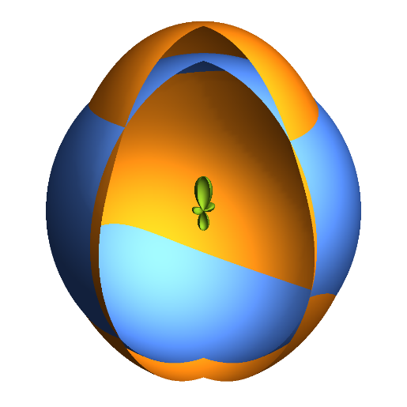
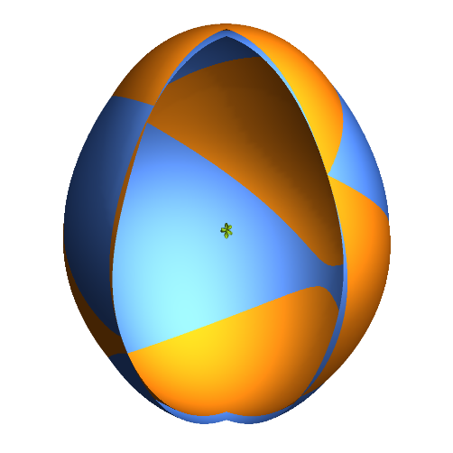


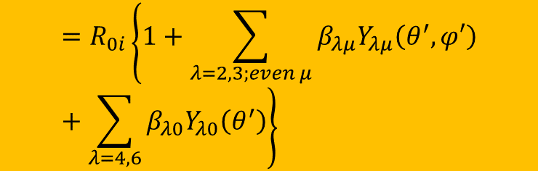
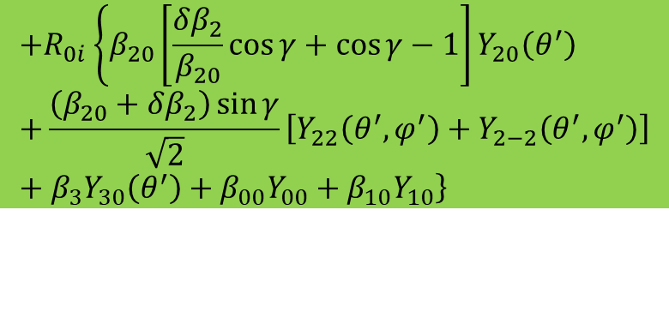
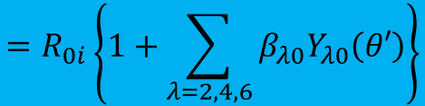
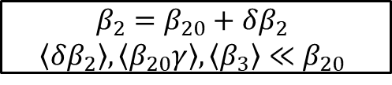

Solution: Taylor expansion near axial static form
$$R_{i}\left(θ^{′},φ^{′}\right)$$
$$=R_{0i}\left\{1+\sum_{λ=2,3;even μ}{β_{λμ}Y_{λμ}\left(θ^{′},φ′\right)}+\sum_{λ=4,6}{β_{λ0}Y_{λ0}\left(θ^{′}\right)}\right\}$$
Near sphere
$$=R_{i}^{zero}\left(θ^{′}\right)+$$
$$δR_{i}\left(θ^{′},φ^{′};δβ_{2}, γ, β_{3}\right)$$
$$β_{2}=β_{20}+δβ_{2}$$
$$\left\langle δβ_{2}\right\rangle ,\left\langle β_{20}γ\right\rangle ,\left\langle β_{3}\right\rangle ≪β_{20}$$
$$=R_{0i}\left\{1+\sum_{λ=2,4,6}{β_{λ0}Y_{λ0}\left(θ′\right)}\right\}$$
$$+R_{0i}\left\{β_{20}\left[\frac{δβ_{2}}{β_{20}}\cos{γ}+\cos{γ}−1\right]Y_{20}\left(θ^{′}\right)+\right.\frac{\left(β_{20}+δβ_{2}\right)\sin{γ}}{\sqrt{2}}\left[Y_{22}\left(θ^{′},φ^{′}\right)+Y_{2−2}\left(θ^{′},φ^{′}\right)\right]+\left.β_{3}Y_{30}\left(θ^{′}\right)+β_{00}Y_{00}+β_{10}Y_{10}\right\}$$
Near axially deformed

Slide 11
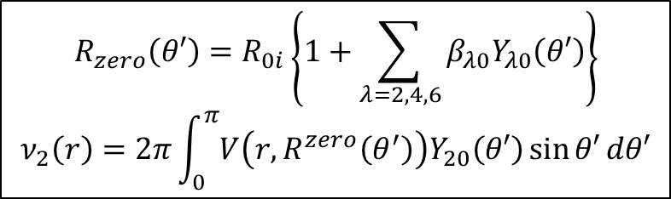
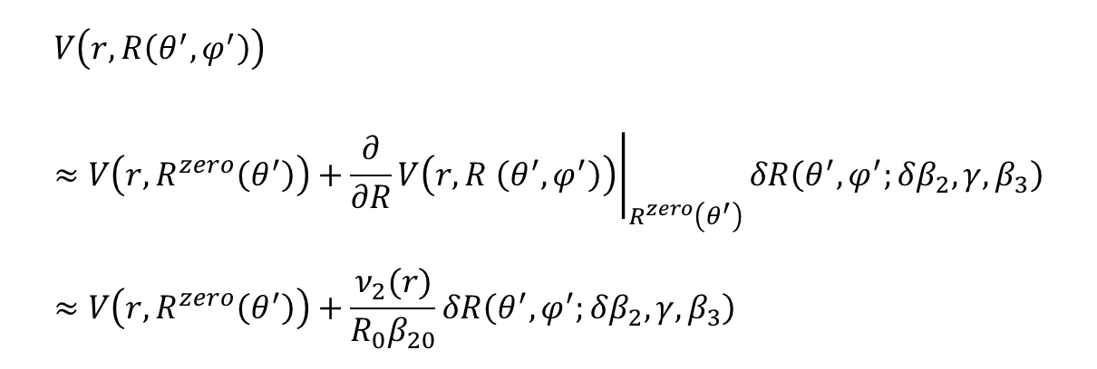
Potential expansion near axially deformed shape
$$V\left(r,R\left(θ^{′},φ^{′}\right)\right)≈V\left(r,R^{zero}\left(θ^{′}\right)\right)+{\left.\frac{∂}{∂R}V\left(r,R \left(θ^{′},φ^{′}\right)\right)\right|}_{R^{zero}\left(θ^{′}\right)}δR\left(θ^{′},φ^{′};δβ_{2}, γ, β_{3}\right)≈V\left(r,R^{zero}\left(θ^{′}\right)\right)+\frac{ν_{2}(r)}{R_{0}β_{20}}δR\left(θ^{′},φ^{′};δβ_{2}, γ, β_{3}\right)$$
$${R_{zero}\left(θ′\right)=R}_{0i}\left\{1+\sum_{λ=2,4,6}{β_{λ0}Y_{λ0}\left(θ′\right)}\right\}$$
$$ν_{2}\left(r\right)=2π\int_{0}^{π}{V\left(r,R^{zero}\left(θ^{′}\right)\right)Y_{20}\left(θ′\right)\sin{θ′}dθ′}$$
Rigid rotor
Softness
E.S. Soukhovitskiĩ et al, PRC 94 (2016) 64605

Slide 12
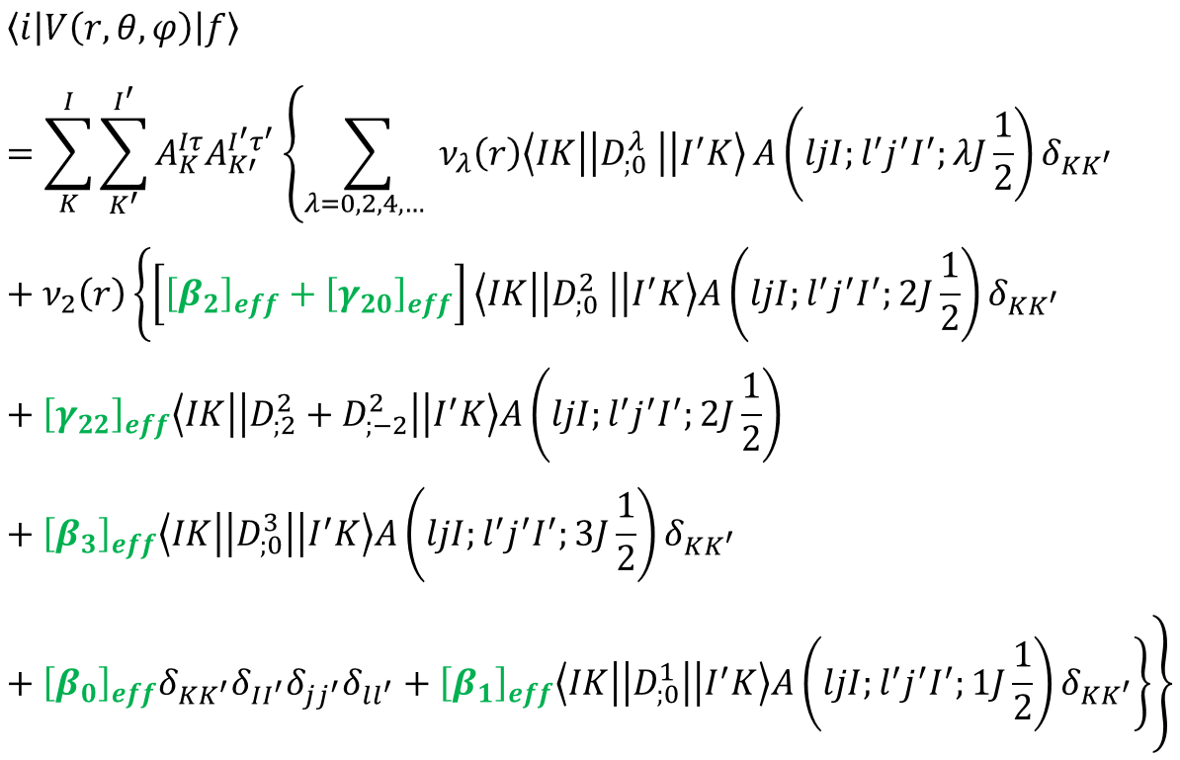
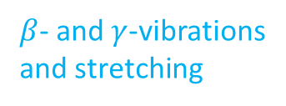

Coupled channels matrix elements
Rigid rotor
$β$- and $γ$-vibrations
and stretching
$K=2$ band coupling
Octupole coupling
(negative parity band)
Volume and center-of-mass position conservation corrections

Slide 13
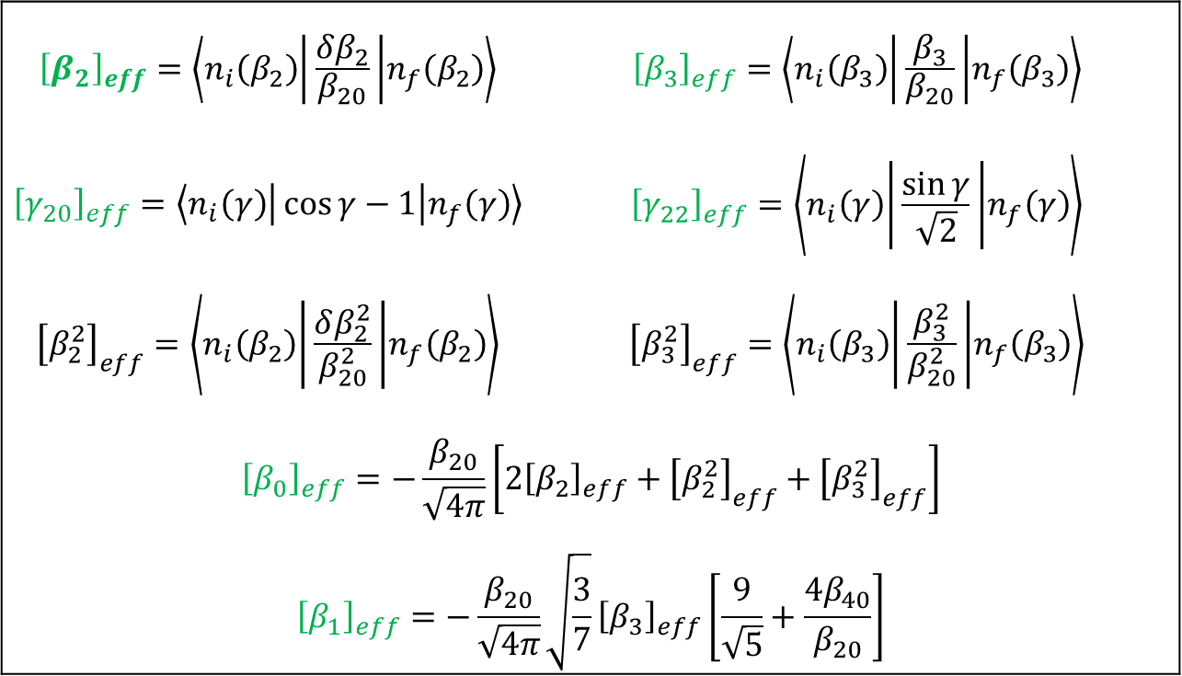
Effective deformations
$${\left[β_{2}\right]}_{eff}=\left\langle n_{i}\left(β_{2}\right) | \frac{δβ_{2}}{β_{20}} | n_{f}\left(β_{2}\right)\right\rangle$$ | $${\left[β_{3}\right]}_{eff}=\left\langle n_{i}\left(β_{3}\right) | \frac{β_{3}}{β_{20}} | n_{f}\left(β_{3}\right)\right\rangle$$
$${\left[γ_{20}\right]}_{eff}=\left\langle n_{i}\left(γ\right) | \cos{γ}−1 | n_{f}\left(γ\right)\right\rangle$$ | $${\left[γ_{22}\right]}_{eff}=\left\langle n_{i}\left(γ\right) | \frac{\sin{γ}}{\sqrt{2}} | n_{f}\left(γ\right)\right\rangle$$
$${\left[β_{2}^{2}\right]}_{eff}=\left\langle n_{i}\left(β_{2}\right) | \frac{δβ_{2}^{2}}{β_{20}^{2}} | n_{f}\left(β_{2}\right)\right\rangle$$ | $${\left[β_{3}^{2}\right]}_{eff}=\left\langle n_{i}\left(β_{3}\right) | \frac{β_{3}^{2}}{β_{20}^{2}} | n_{f}\left(β_{3}\right)\right\rangle$$
$${\left[β_{0}\right]}_{eff}=−\frac{β_{20}}{\sqrt{4π}}\left[{2\left[β_{2}\right]}_{eff}+{\left[β_{2}^{2}\right]}_{eff}+{\left[β_{3}^{2}\right]}_{eff}\right]$$
$${\left[β_{1}\right]}_{eff}=−\frac{β_{20}}{\sqrt{4π}}\sqrt{\frac{3}{7}}{\left[β_{3}\right]}_{eff}\left[\frac{9}{\sqrt{5}}+\frac{4β_{40}}{β_{20}}\right]$$
Effective deformations are defined by collective nuclear wavefunctions

Slide 14
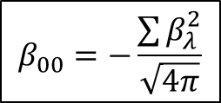

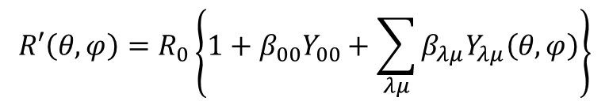

Volume conservation term
$$R′\left(θ,φ\right)=R_{0}\left\{1+β_{00}Y_{00}+\sum_{λμ}{β_{λμ}Y_{λμ}\left(θ,φ\right)}\right\}$$
$$R\left(θ,φ\right)=R_{0}$$
Compensation term
$$β_{00}=−\frac{\sum{β_{λ}^{2}}}{\sqrt{4π}}$$
Incompressible nuclear matter:
$$V=V′$$

Slide 15

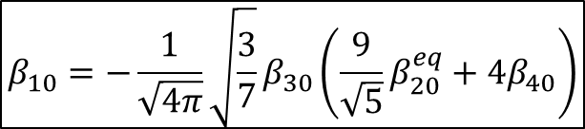
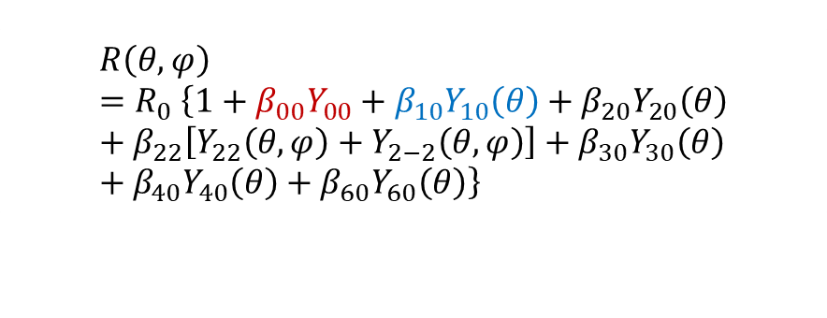

Center-of-mass immobility term
$$R\left(θ,φ\right)=R_{0}$$
$$R\left(θ,φ\right)=R_{0} \left\{1+β_{00}Y_{00}+β_{10}Y_{10}\left(θ\right)+β_{20}Y_{20}\left(θ\right)+β_{22}\left[Y_{22}\left(θ,φ\right)+Y_{2−2}\left(θ,φ\right)\right]+β_{30}Y_{30}\left(θ\right)+β_{40}Y_{40}\left(θ\right)+β_{60}Y_{60}\left(θ\right)\right\}$$
Compensation term
$$β_{10}=−\frac{1}{\sqrt{4π}}\sqrt{\frac{3}{7}}β_{30}\left(\frac{9}{\sqrt{5}}β_{20}^{eq}+4β_{40}\right)$$
Immobile center of mass:
$${\vec{r}}_{cm}={\vec{r}}_{cm}^{′}$$

Slide 16
Approaches to effective deformations
Effective deformations as fitting parameters
Calculation based on structure Hamiltonian
Rough model to keep minimal number of parameters, only multiband coupling accounted (rigid rotor coupling within each band)
One coupling param. per band
Ambiguous description for nuclides with poor experimental data
No additional knowledge needed
Nuclear structure model for soft deformed nuclei is needed
More consistent result
Gives all model effects
For even-even nuclides using SRM:
E.S. Soukhovitskiĩ et al, PRC 94 (2016) 64605
D. Martyanov et al, EPJ Web Conf. 146 (2017) 12031 (ND2016)

Slide 17
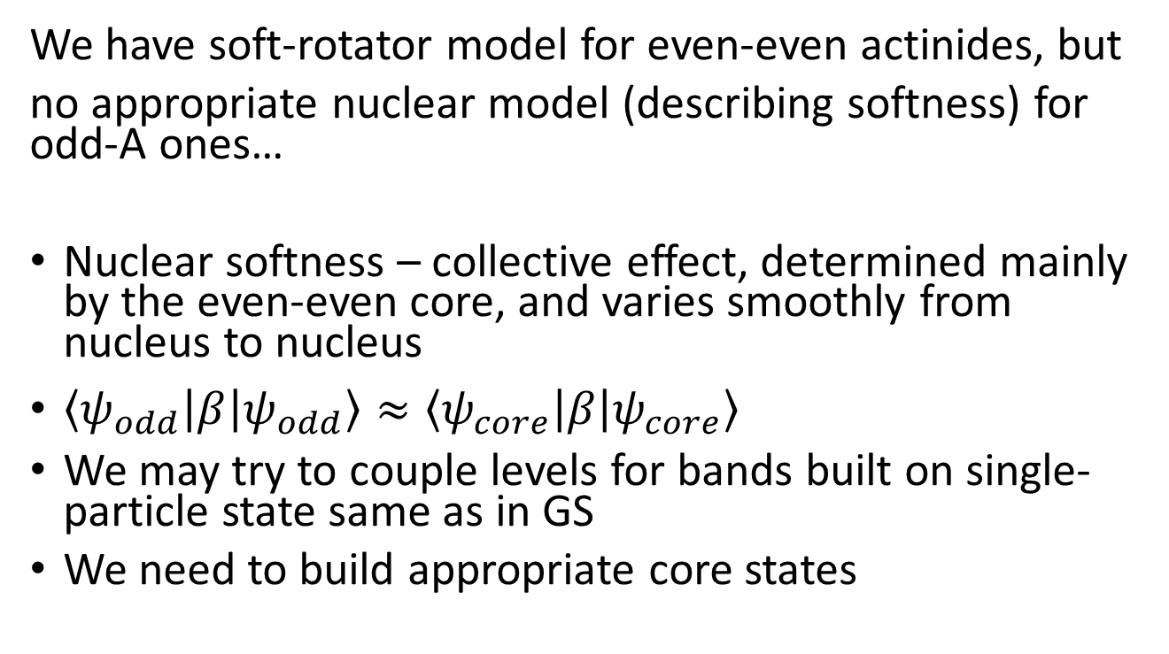
Towards odd nuclides
We have soft-rotator model for even-even actinides, but
no appropriate nuclear model (describing softness) for odd-A ones…
Nuclear softness – collective effect, determined mainly by the even-even core, and varies smoothly from nucleus to nucleus
$\left\langle ψ_{odd} | β | ψ_{odd}\right\rangle ≈\left\langle ψ_{core} | β | ψ_{core}\right\rangle$
We may try to couple levels for bands built on single-particle state same as in GS
We need to build appropriate core states

Slide 18

Odd-A matrix elements
$|\left.ψ_{odd}\right\rangle \sim φ_{sp}|\left.ψ_{even core}\right\rangle$ no particle-core interaction
$\left\langle ψ_{odd} | β | ψ_{odd}^{′}\right\rangle ≈\left\langle ψ_{core} | β | ψ_{core}^{′}\right\rangle$, if $φ_{sp}=φ_{sp}^{′}$
$\left\langle ψ_{odd} | β | ψ_{odd}^{′}\right\rangle ≈0$, if $φ_{sp}≠φ_{sp}^{′}$

Slide 19
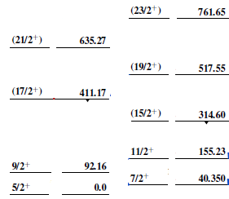
Core states assignment (²³³U states from ENSDF)
Core I^{π}
Band (A): 5/2[633],
α=+1/2 band
Band (a): 5/2[633],
α=-1/2 band
2+
In fact we have also
2 subbands here!
Core I^{π}
Core I^{π}
8+
Core I^{π}
8+
2+
6+
6+
4+
0+
4+
(13/2⁺)
2+
2+
0+
0+
0+
GS band
Octupole band
Core state: no vibrational excitation,
only rotation
Core state: first octupole excitation,
rotation

Slide 20
Regional potential for actinides
Algorithm,
coupling schemes,
parameters, etc.

Slide 21
²³⁸U coupling scheme
Saturated coupling scheme:
almost all low-lying levels
are coupled (and described by SRM)

Slide 22
²³³U coupling scheme
Only a few bands coupled: those that correspond to vibrational excitation of the core and sp-wavefunction same as in GS (ENDSF)
Can not speak about saturation, but bands based on other sp-states are assumed to be weakly coupled.
Better than only main rotational band!

Slide 23
Calculation algorithm
Exp. data
Models
Fitting parameters
Levels’ energies/spins/parities
of even-even nuclide or
equivalent core of odd-A nuclide
Soft rotor nuclear model
SRM parameters
Effective deformations
²³⁸U and ²³²Th
exp. scattering data
and coupling scheme
OMP parameters
and nuclear
deformations
Predictions
Optical
model
predictions
Coupled channels optical model
Other actinide’s
exp. scattering data
and coupling scheme
Nuclear
deformations

Slide 24
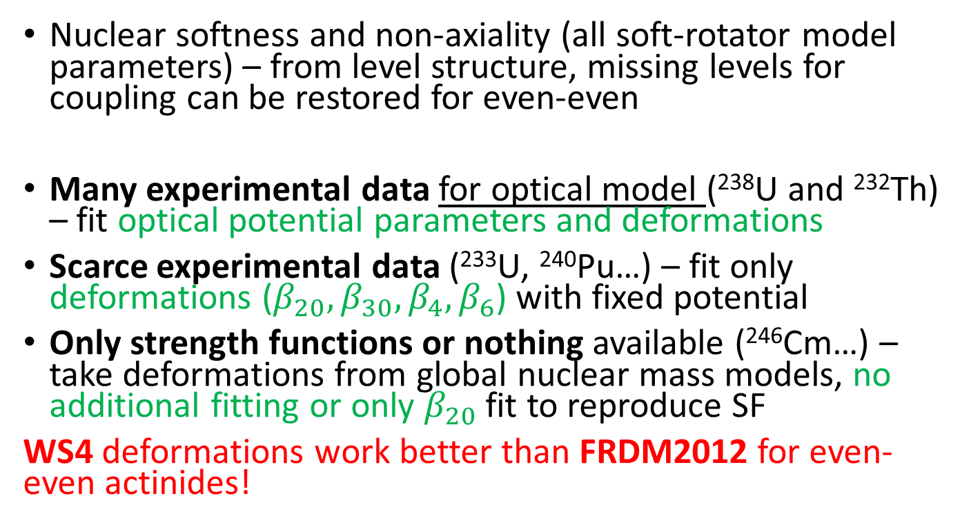
Fitting parameters
Nuclear softness and non-axiality (all soft-rotator model parameters) – from level structure, missing levels for coupling can be restored for even-even
Many experimental data for optical model (²³⁸U and ²³²Th) – fit optical potential parameters and deformations
Scarce experimental data (²³³U, ²⁴⁰Pu…) – fit only deformations ($β_{20},β_{30},β_{4},β_{6}$) with fixed potential
Only strength functions or nothing available (²⁴⁶Cm…) – take deformations from global nuclear mass models, no additional fitting or only $β_{20}$ fit to reproduce SF
WS4 deformations work better than FRDM2012 for even-even actinides!

Slide 25
Comparison with other potentials
CN XS changes up to 0.3 barn between models fitted to the same data
²³⁸U
²³³U
parametric
multiband
rigid
soft

Slide 26
Softness effects
Multiband coupling (for bands, corresponding to collective excitations)
Nucleus stretching due to rotation (centrifugal forces)
Additional monopole coupling due to account of volume conservation in vibrating nucleus

Slide 27
Multiband coupling:
Direct level excitation XS
Other bands’ impact is comparable to one from 2nd/3rd excited GS band level
²³⁸U
²³³U

Slide 28
Multiband coupling:
CN XS change due to bands removal
Large impact of $β$-vibrational states in the coupling scheme
²³⁸U
²³³U

Slide 29
Nucleus stretching: CN XS change
Nucleus stretching gives large impact even then only GS-band levels are coupled
Only GS band is
coupled here, no
non-axiality or
volume conservation
is accounted

Slide 30
Volume and center-of-mass position corrections: CN XS change
Volume conservation may be considered, center-of-mass correction is small

Slide 31
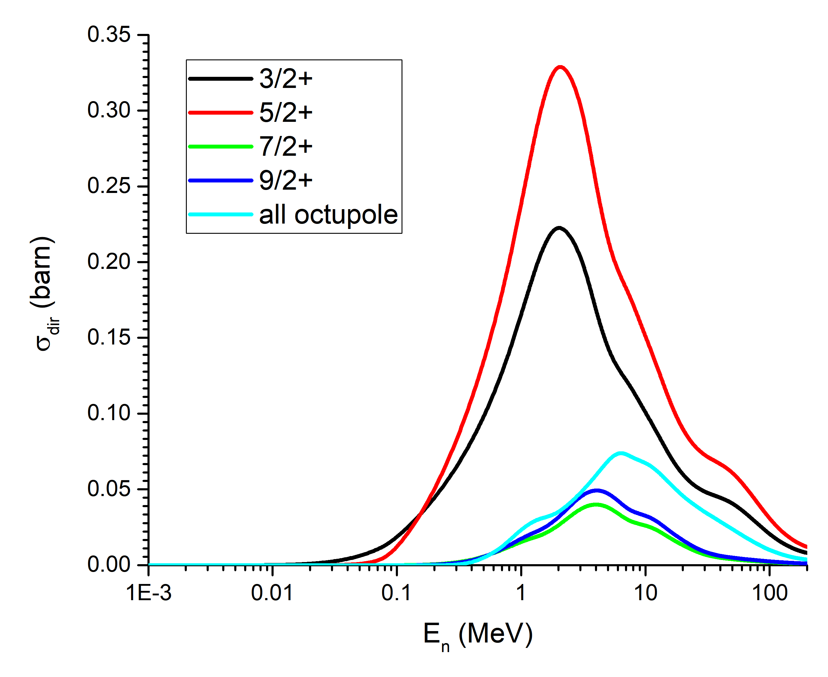
²³⁹Pu: direct level excitation
Other bands’ impact is comparable to one from 2nd/3rd excited GS band level

Slide 32
²³⁵U and ^{235m}U: change of CN cross section
Only one band coupled for ²³⁵U but softness is still important
Isomeric state has other coupled levels → cross section changed
²³⁵U
^{235m}U

Slide 33
²⁴¹Pu: total CS
We fit only $β_{2}$ to reproduce S₀ value, but scarce URR total CS is fairly reproduced

Slide 34
Summary
Extended coupling is important for optical model calculations in even-even and odd-A actinides
Obtained CCOMP for actinides:
  Dispersive and Lane-consistent
  Coupling to levels from multiple bands
  Softness important even when single band is coupled
  Saturation for even-even nuclei
  Account of quadrupole triaxiality, octupole shape, volume and center-of-mass conservation

Slide 35
Thank you for the attention!

Slide 36
Software
All calculations performed by two FORTRAN codes which have been being developed by E. Soukhovitskii and coworkers for many years:
optical model code OPTMAN (optical potential fitting, cross-section calculations) with dispersive corrections as discussed with Quesada, Capote, Chiba et al.
nuclear structure code SHEMMAN (soft-rotator model parameters fitting and levels prediction)
OPTMAN
recommended to use for SRM potentials compiled in the IAEA reference input parameter library (RIPL-3) for nuclear data evaluation
used with the EMPIRE nuclear reaction model code for basic research and nuclear data evaluation (e.g. recent Fe-56 CIELO evaluation)
New model implementation is validated by comparison with FRESCO
RIPL-3: Capote, R. et al., Nucl. Data Sheets 110, 3107–3214 (2009)
OPTMAN and SHEMMAN: E. Sh. Sukhovitski et al., JAERI-Data/Code 2005-002 (2005)
Dispersive corrections: Soukhovitski, E. Sh. et al, JAEA-Data/Code--2008-025 (2008)
Soft description of Fe56: W. Sun et al, Nucl. Data Sheets 118, 191-194 (2014)

Slide 37
Soft rotator model
$$\hat{H}=\frac{ℏ^{2}}{2B}\left\{{\hat{T}}_{β_{2}}+\frac{1}{β_{2}^{2}}{\hat{T}}_{γ}\right\}+\frac{ℏ^{2}}{2}{\hat{T}}_{r}+\frac{ℏ^{2}}{2B_{3}}{\hat{T}}_{β_{3}}+\frac{β_{20}^{4}}{β_{2}^{2}}V\left(γ\right)+V\left(β_{2}\right)+V\left(β_{3}\right)$$

Slide 38
Comparison with other potentials 2
²³⁹Pu
rigid with more GS band levels (11)
Simple addition of GS band levels to the coupling scheme is not enough
rigid (5 levels)
soft

Slide 39
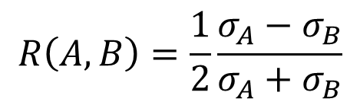
OMP figure of merit: symmetrized total XS ratio for different nuclei
$$R\left(A,B\right)=\frac{1}{2}\frac{σ_{A}−σ_{B}}{σ_{A}+σ_{B}}$$
Many other data is fitted: total XS, (in)elastic angular
distributions, (p,n), strength functions and scattering radii
²³²Th to ²³⁸U
²³³U to ²³⁸U

