Slide 1
Transitions To Door-way States And Nuclear Responses Against 2-body External Fields
Futoshi Minato
Kyushu University
Contents
Introduction of Particle Emission
Nuclear Collective Motions
Nuclear Response to 2-body External Fields
Summary and Perspectives
This work was supported by JSPS KAKENHI Grant Numbers JP23K03426 and JP24K00647.
July 8, 2024@IAEA
Notes:
原子核ダブルフォノン励起の集団運動

Slide 2

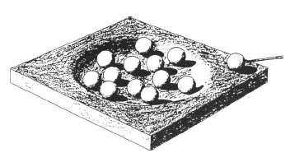
Bohr’s hypothesis for compound nuclei
(low energy)nucleon-nucleus reaction
continuum
state
forward
forward
backward
backward
1p1h
2p2h
mpmh
Thermally equilibrium
(Compound state)
Particle Emission
Initial State

Slide 3
Preequilibrium Process
Hit incident particle strongly!
if incident energy is high,
Initial State
nucleon may escape after a few scatterings
continuum
state
forward
forward
backward
backward
1p1h
2p2h
mpmh
Thermally equilibrium
(Compound state)
Particle Emission from Compond
Particle Emission Before Reaching Equilibrium State
Competition between particle emission, simpler and more complicated states
c.f. Never-Come-Back Approximation

Slide 4
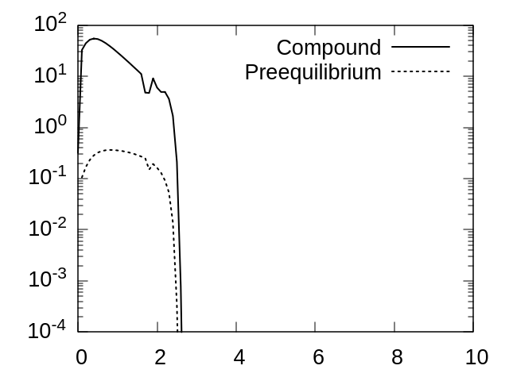
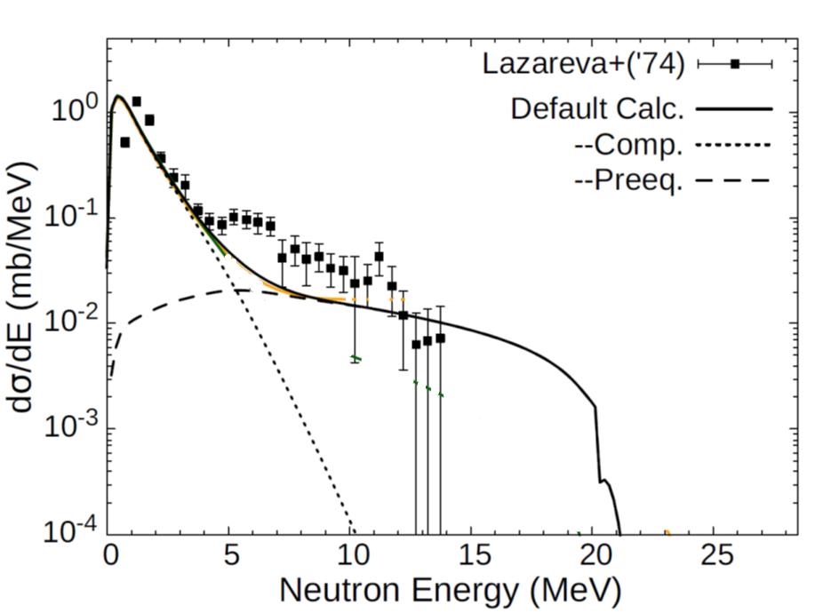


Particle Emission from Compound & Preequilibrium
$$181Ta\left(γ,xn\right)@E_{γ}=28.5 MeV$$
$$181Ta\left(γ,xn\right)@E_{γ}=28.5 MeV$$
10 MeV
preequilibrium
compound
Compound state: Hauser-Feshbach statistical model
Preequilibrium state: Two-component exciton model

Slide 5
Initiate from 2p2h States
Initial State
forward
backward
1p1h
2p2h
mpmh
Thermally equilibrium
(Compound state)
Particle Emission
Particle Emission
Go back to 1p1h? Go for 3p3h? Or Particle Emission?

Slide 6
Meson Exchange Current (MEC)
ー Higher-Order effect on nuclear currents mediated by Mesons －
A. De Pace, et al., Nuclear Physics A 726 (2003) 303–326
2 nucleons are excited simultaneously for negative muon-capture
nucleons=p₁,p₂,p₁’,p₂’, meson=k₁,k₂
meson
meson
neutron
proton
2 neutrons
ext. field
meson
meson
High energy proton!
considered in chiral effective field theory & relativistic mean field models
Important for Excitation Energy around 50 MeV

Slide 7
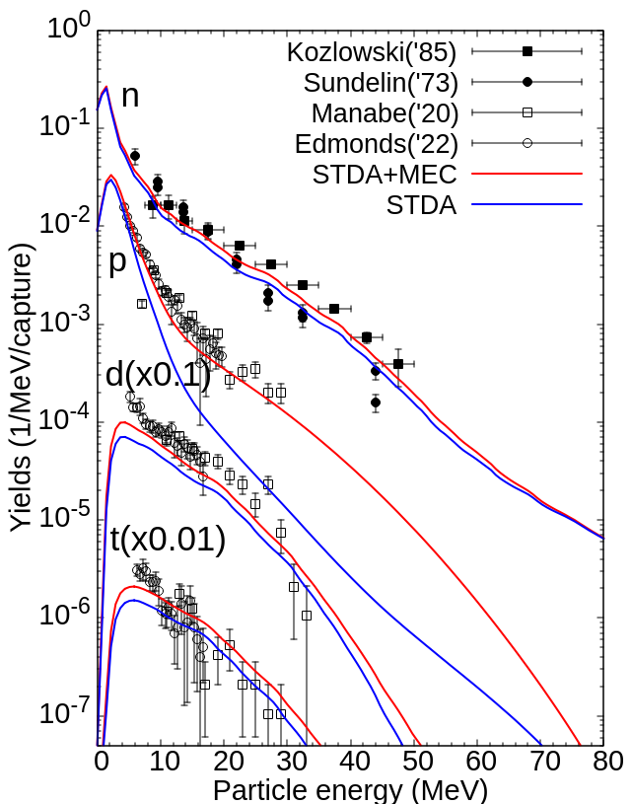
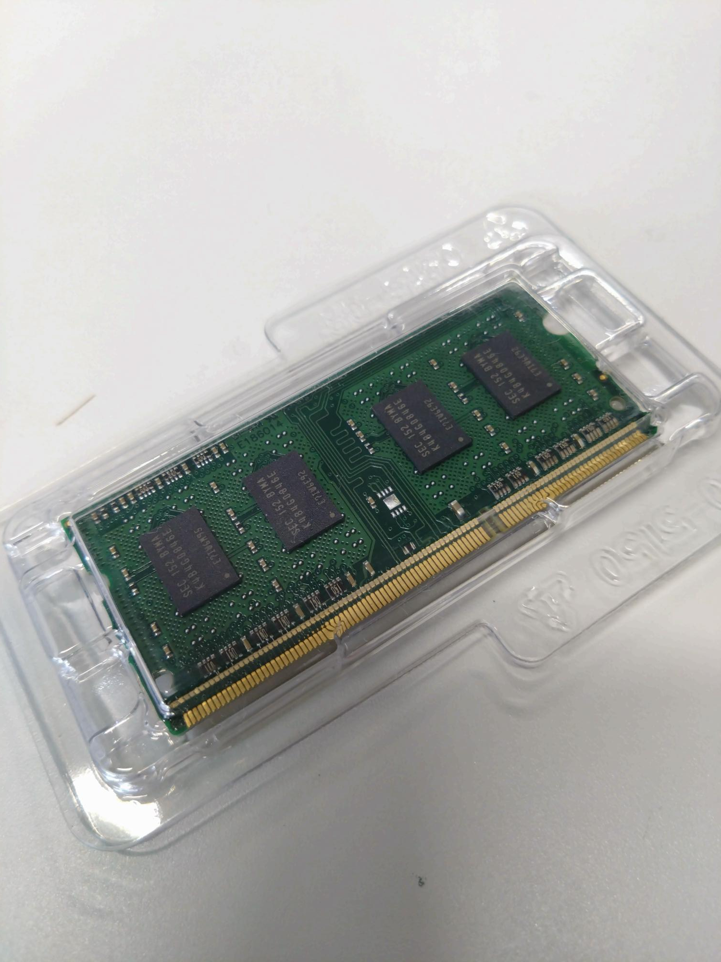
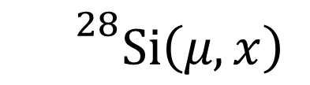

Impact of MEC for SOFT ERROR UPSETS
Secondary cosmic muon induces SOFT ERROR UPSETS in memory devices
FM, TN, OI, Phys. Rev. C 107, 054314 (2023)
$$μ$$
SOFT ERROR UPSETS
$${}^{28}Si\left(μ,x\right)$$
Si
MEC
MEMORY DEVICE
Reproduce reasonably particle yields following muon capture with PHENOMENOLOGICAL MEC effect
Poster Presentation: Shoichiro Kawase (No. 39), Megumi Niikura (No. 54)
Figure: neutron & proton emission spectra following muon capture

Slide 8
Purpose of Our Research
Microscopic understanding of MEC in Nuclei
Initial State A
Initial State B
forward
forward
backward
backward
1p1h
2p2h
mpmh
Particle Emission
This Talk Discusses Transitions Between 1p1h and 2p2h States with Random Phase Approximation

Slide 9



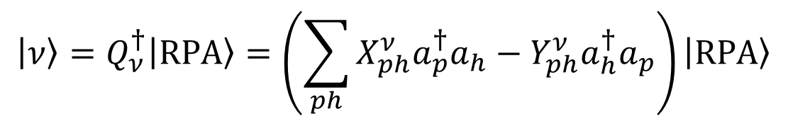





Random-Phase Approximation (RPA)
ー Superposition of 1-particle 1-hole (1p1h) excitations ー
$$\left|ν\right\rangle =Q_{ν}^{†}\left|RPA\right\rangle =\left(\sum_{ph}{X_{ph}^{ν}a_{p}^{†}a_{h}}−Y_{ph}^{ν}a_{h}^{†}a_{p}\right)\left|RPA\right\rangle$$
✓Excited State
Phonon (vib. mode) creation
coefficients
Correlated Ground State by residual interactions
✓Amplitude of specific 1p1h state
$$P_{ph}^{ν}={\left(X_{ph}^{ν}\right)}^{2}−{\left(Y_{ph}^{ν}\right)}^{2}$$
✔︎Schematic
Figure
+
+
+
+…
$$a_{p_{5}}^{†}a_{p_{3}}$$
$$a_{p_{6}}^{†}a_{p_{3}}$$
$$a_{n_{5}}^{†}a_{n_{3}}$$
$$a_{n_{6}}^{†}a_{n_{3}}$$
$${\left(X_{p_{5}p_{3}}^{ν}\right)}^{2}−{\left(Y_{p_{5}p_{3}}^{ν}\right)}^{2}$$
$${\left(X_{p_{6}p_{3}}^{ν}\right)}^{2}−{\left(Y_{p_{6}p_{3}}^{ν}\right)}^{2}$$
$${\left(X_{n_{5}n_{3}}^{ν}\right)}^{2}−{\left(Y_{n_{5}n_{3}}^{ν}\right)}^{2}$$

Slide 10
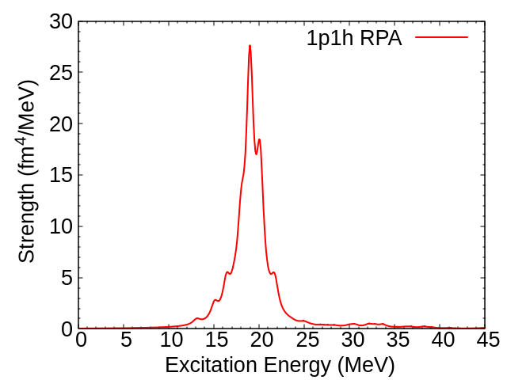
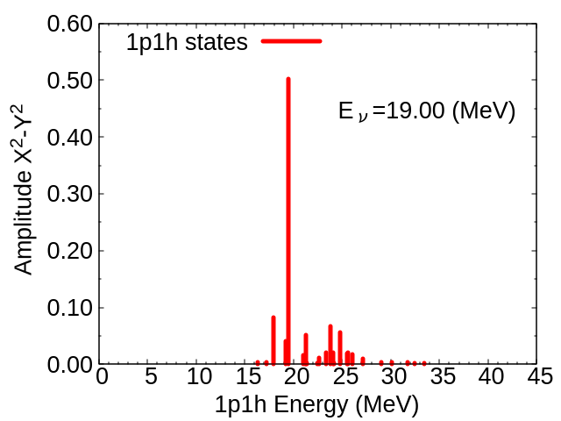

Nuclear Responses against External Fields
Isoscalar quadrupole resonance of ¹⁶O
Collective Oscillation
$${\left(X_{ph}^{ν}\right)}^{2}−{\left(Y_{ph}^{ν}\right)}^{2}$$
GQR@19.00 MeV
1p1/2–>2f5/2
1p1h states in a wide energy region contribute Resonances
[SkM* interaction]
10

Slide 11
Extend to 2p2h States
Low Energy
1-particle 1-hole (1p1h)
2-particle 2-hole (2p2h)
High Energy

Slide 12

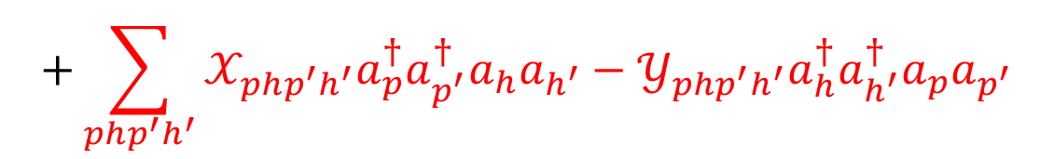

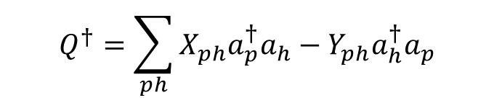




Second Random-Phase Approximation (SRPA)
ー Higher Order Correlations for Nuclear Collective Motions ー
FM, Phys. Rev. C 93, 044319 (2016)
✓Excited State W.F.
$$Q^{†}=\sum_{ph}{X_{ph}a_{p}^{†}a_{h}}−Y_{ph}a_{h}^{†}a_{p}$$
$$+\sum_{php^{′}h^{′}}{𝒳_{php^{′}h^{′}}a_{p}^{†}a_{p^{′}}^{†}a_{h}a_{h^{′}}−𝒴_{php^{′}h^{′}}a_{h}^{†}a_{h^{′}}^{†}a_{p}a_{p^{′}}}$$
✓Amplitude of specific 1p1h state
$$P_{ph}^{ν}={\left(X_{ph}^{ν}\right)}^{2}−{\left(Y_{ph}^{ν}\right)}^{2}$$
✓Amplitude of specific 2p2h state
$$P_{php^{′}h^{′}}^{ν}={\left(𝒳_{php^{′}h^{′}}^{ν}\right)}^{2}−{\left(𝒴_{php^{′}h^{′}}^{ν}\right)}^{2}$$
1p1h states
many combinations
2p2h states
many many combinations
✔︎Schematic
Figure
+
+…
+
+
+…
$$a_{p_{5}}^{†}a_{p_{3}}$$
$$a_{n_{5}}^{†}a_{n_{3}}$$
$$a_{p_{6}}^{†}a_{p_{5}}^{†}a_{p_{3}}a_{p_{2}}$$
$$a_{n_{6}}^{†}a_{n_{5}}^{†}a_{n_{3}}a_{n_{2}}$$

Slide 13
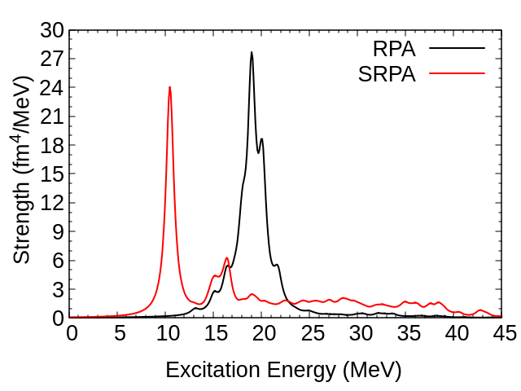
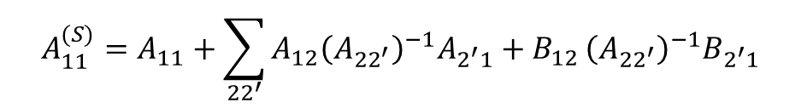


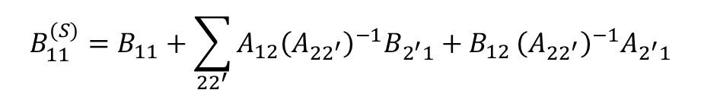
Subtracted SRPA (SSRPA)
V.I. Tselyaev, PRC 88, 054301 (2013)
D. Gambacurta, M. Grasso, J. Engel, PRC 92, 034303 (2015)
M.J. Yang et al., PRC 103, 054308 (2021)
IS Quadrupole of ¹⁶O
Resonances are shifted to too lower energy
Origin of problem may be
1) Double-counting of higher order effect
2) Skyrme-EDF parameters
Prescription to avoid double counting
New $A_{11} \& B_{11}$ matrices
$${A_{11}^{(S)}=A}_{11}+\sum_{{22}^{′}}{A_{12}{\left(A_{{22}^{′}}\right)}^{−1}A_{2^{′}1}+B_{12}}{\left(A_{{22}^{′}}\right)}^{−1}B_{2^{′}1}$$
$${B_{11}^{(S)}=B}_{11}+\sum_{{22}^{′}}{A_{12}{\left(A_{{22}^{′}}\right)}^{−1}B_{2^{′}1}+B_{12}}{\left(A_{{22}^{′}}\right)}^{−1}A_{2^{′}1}$$
This ensures $V_{res}^{SRPA}\left(ω=0\right)=V_{res}^{RPA}\left(ω=0\right)$
Diagonal approximation is adopted in this work

Slide 14
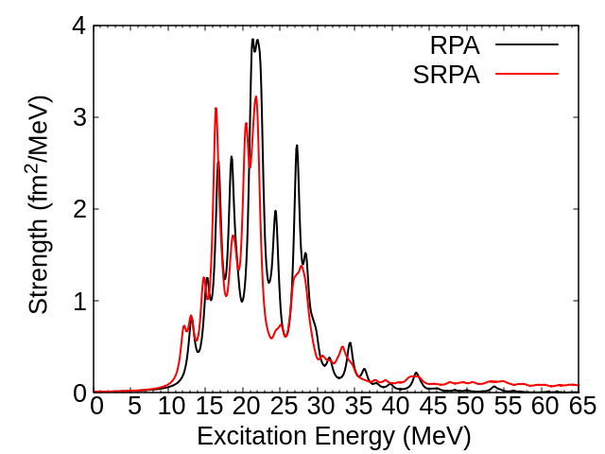
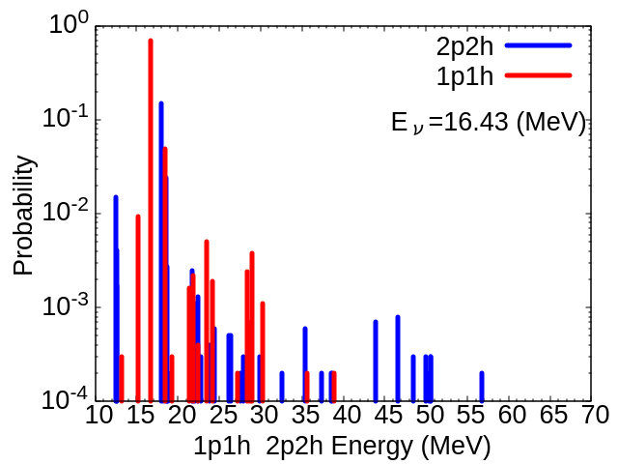
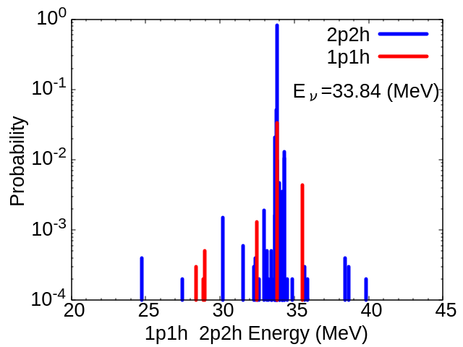

Collectivity of Monopole Excitation
¹⁶O
Hole Particle
p1/2->p1/2
①
②
$$O={\left[r^{2}Y_{0}\right]}^{J=0}$$
@16.43 MeV
①
②
@33.84 MEV
Amplitude
SRPA
Amplitude
SRPA
broad range collectivity!
➔
1p1h
2p2h

Slide 15
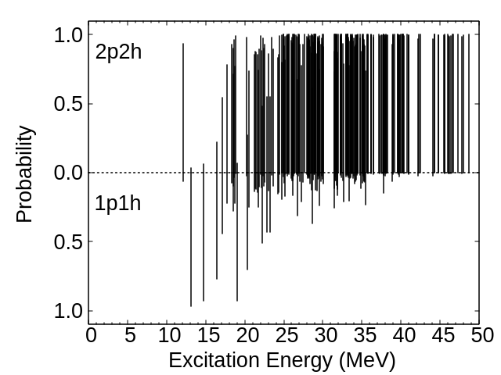
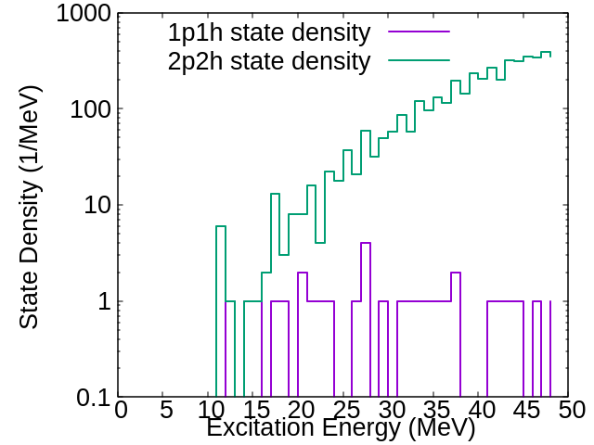

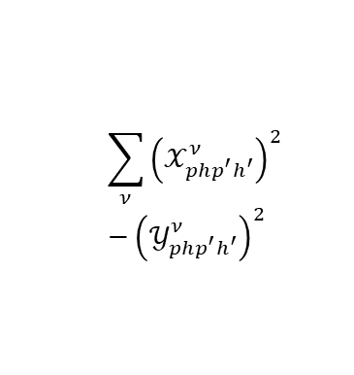
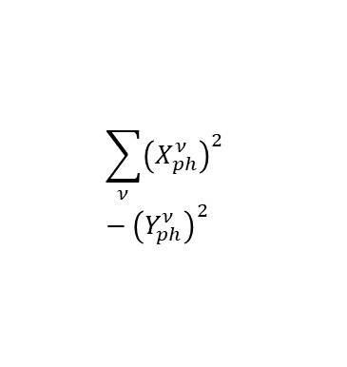
Collectivities of Resonances
State Densities of 1p1h & 2p2h for ¹⁶O(J=0⁺)
only for ${\left|\left\langle ν\left|r^{2}Y_{0}\right|0\right\rangle \right|}^{2}>0.01$
$$\sum_{ν}{{\left(𝒳_{php^{′}h^{′}}^{ν}\right)}^{2} −{\left(𝒴_{php^{′}h^{′}}^{ν}\right)}^{2} }$$
exponential
Amplitude
constant
$$\sum_{ν}{{\left(X_{ph}^{ν}\right)}^{2} −{\left(Y_{ph}^{ν}\right)}^{2} }$$
When 2p2h level density exceeds 1p1h one, its collectivity becomes significant

Slide 16
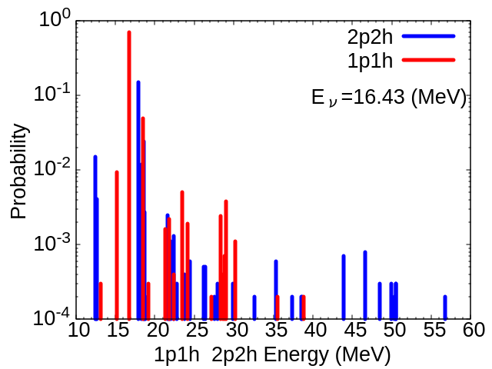
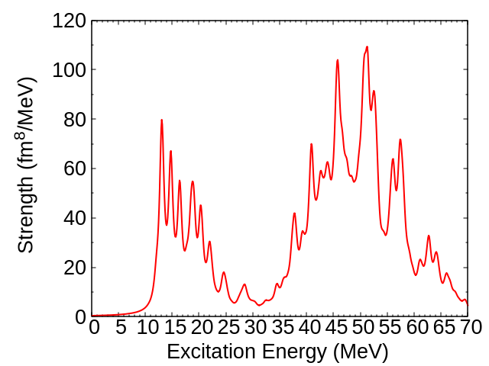
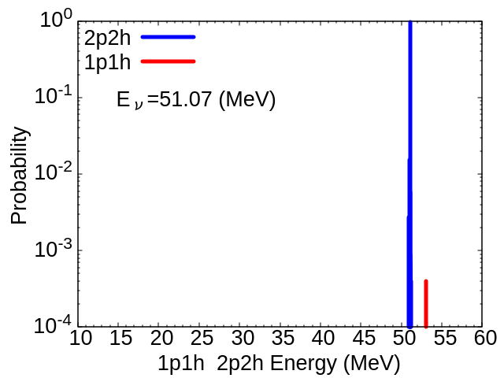





Nuclear Response to 2-body External Fields
Double IS monopole transition (J=0)
$${\left(𝒳_{php^{′}h^{′}}^{ν}\right)}^{2} −{\left(𝒴_{php^{′}h^{′}}^{ν}\right)}^{2}$$
$$T={\left[\left[r^{2}Y_{0}\right]\left[r^{2}Y_{0}\right]\right]}^{J=0}$$
$${\left(X_{ph}^{ν}\right)}^{2} −{\left(Y_{ph}^{ν}\right)}^{2}$$
①
Strength
¹⁶O
Amplitude
Strength
(mainly 2step)
①
②
@16.43 MeV
@51.07 MeV
$${\left(𝒳_{php^{′}h^{′}}^{ν}\right)}^{2} −{\left(𝒴_{php^{′}h^{′}}^{ν}\right)}^{2}$$
$${\left(X_{ph}^{ν}\right)}^{2} −{\left(Y_{ph}^{ν}\right)}^{2}$$
Amplitude
②
2p2h Transition is weak at low energy, and dominant at high energy
Strength
(mainly 2p2h)
narrow!
E_{2p2h}(cutoff)=70 MeV

Slide 17
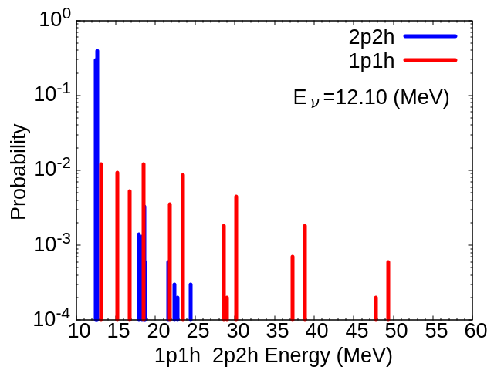
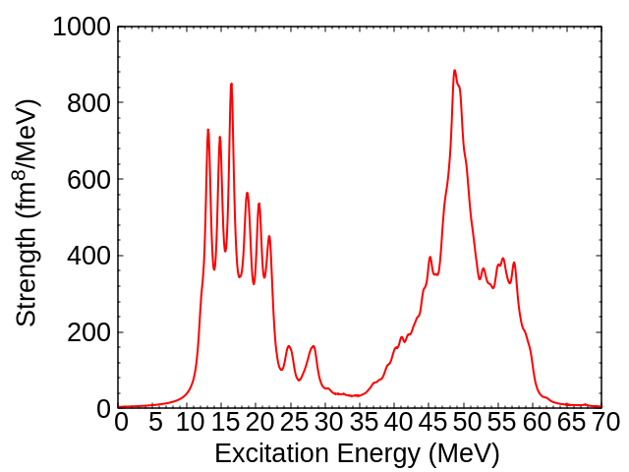
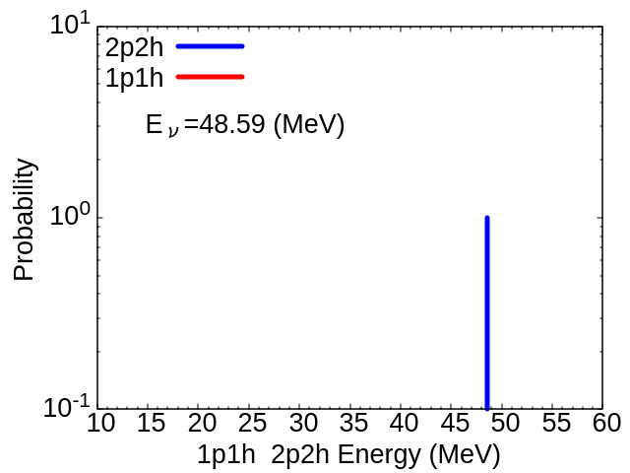

Nuclear Response to 2-body External Fields
Double IS quadrupole transition (J=0⁺)
$${\left(𝒳_{php^{′}h^{′}}^{ν}\right)}^{2} −{\left(𝒴_{php^{′}h^{′}}^{ν}\right)}^{2}$$
$$T={\left[\left[r^{2}Y_{2}\right]\left[r^{2}Y_{2}\right]\right]}^{J=0}$$
$${\left(X_{ph}^{ν}\right)}^{2} −{\left(Y_{ph}^{ν}\right)}^{2}$$
¹⁶O
①
②
Strength
@48.59 MEV
Amplitude
①
@12.10 MEV
$${\left(𝒳_{php^{′}h^{′}}^{ν}\right)}^{2} −{\left(𝒴_{php^{′}h^{′}}^{ν}\right)}^{2}$$
$${\left(X_{ph}^{ν}\right)}^{2} −{\left(Y_{ph}^{ν}\right)}^{2}$$
②
Amplitude
Strength
2p2h Transition is weak at low energy, and dominant at high energy
narrow!
Less possibility to go back to 1p1h state
E_{2p2h}(cutoff)=60 MeV

Slide 18
Summary
Investigate transitions between 1p1h & 2p2h states and resonance collectivity within Second Random Phase Approximation (SRPA)
✓With increasing energy, 1p1h states strongly couples with 2p2h states
✓Less collectivity for 2p2h state at highly excited states
→Important insight to understanding complicated reaction mechanisms
Future Perspectives
(1) Study for heavy nuclei with a high level density
(2) Application of Second RPA to MEC
(3) Coupling with Particle Emission Channels and More Complicated States

Slide 19




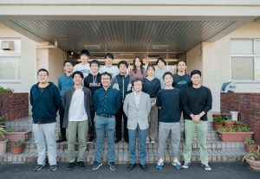
Acknowledgement
M. Niikura
RIKEN
S. Abe
Japan Atomic Energy Agency
Tomoya Naito
RIKEN iTHEMS & University of Tokyo
R. Mizuno
Univ. Tokyo
Osamu Iwamoto
Japan Atomic Energy Agency
Y. Watanabe & S. Kawase
Kyushu University
Thank you for your attention!!
This work was supported by JSPS KAKENHI Grant Numbers JP23K03426

Slide 20
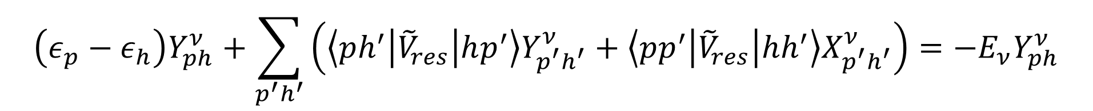
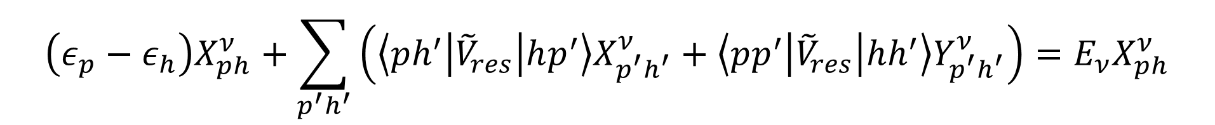
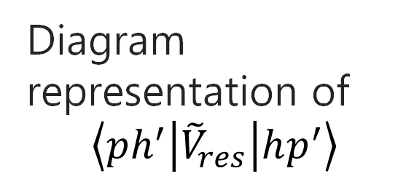


Random-Phase Approximation (RPA)
ー Superposition of 1-particle 1-hole (1p1h) excitations ー
$$\left(ε_{p}−ε_{h}\right)X_{ph}^{ν}+\sum_{p^{′}h^{′}}{\left(\left\langle ph^{′}\left|{\tilde{V}}_{res}\right|hp^{′}\right\rangle X_{p^{′}h^{′}}^{ν}+\left\langle pp^{′}\left|{\tilde{V}}_{res}\right|hh^{′}\right\rangle Y_{p^{′}h^{′}}^{ν}\right)}=E_{ν}X_{ph}^{ν}$$
$$\left(ε_{p}−ε_{h}\right)Y_{ph}^{ν}+\sum_{p^{′}h^{′}}{\left(\left\langle ph^{′}\left|{\tilde{V}}_{res}\right|hp^{′}\right\rangle Y_{p^{′}h^{′}}^{ν}+\left\langle pp^{′}\left|{\tilde{V}}_{res}\right|hh^{′}\right\rangle X_{p^{′}h^{′}}^{ν}\right)}=−E_{ν}Y_{ph}^{ν}$$
p’
h’
p’
h’
Diagram representation of
$$\left\langle ph^{′}\left|{\tilde{V}}_{res}\right|hp^{′}\right\rangle$$
$$V_{res}$$
$$V_{res}$$
p
h
p
h
direct part
exchange part
Residual Interaction $V_{res}$ couples different pairs of 1p1h States!

Slide 21


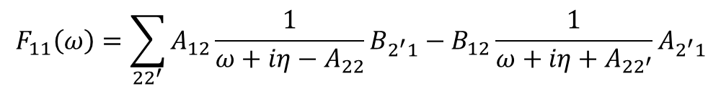

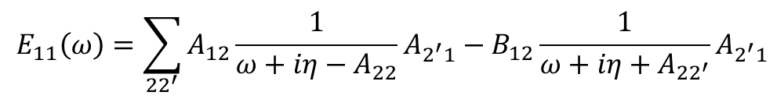
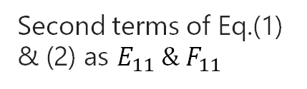
SRPA with a subtraction method
D. Gambacurta, M. Grasso, J. Engel, PRC 92, 034303 (2015)
$$A_{11}\left(ω\right)=A_{11} + \sum_{{22}^{′}}{A_{12}\frac{1}{ω+iη−A_{22}}A_{2^{′}1}}−B_{12}\frac{1}{ω+iη+A_{{22}^{′}}}B_{2^{′}1}=A_{11}+E_{11}\left(ω\right)⋯(1)$$
$$B_{11}\left(ω\right)=B_{11} + \sum_{{22}^{′}}{A_{12}\frac{1}{ω+iη−A_{22}}B_{2^{′}1}}−B_{12}\frac{1}{ω+iη+A_{{22}^{′}}}A_{2^{′}1}=B_{11}+F_{11}\left(ω\right)⋯\left(2\right)$$
Higher-order correlations from the coupling with 2p2h states
Second terms of Eq.(1) & (2) as $E_{11} \& F_{11}$
$$E_{11}\left(ω\right)=\sum_{{22}^{′}}{A_{12}\frac{1}{ω+iη−A_{22}}A_{2^{′}1}}−B_{12}\frac{1}{ω+iη+A_{{22}^{′}}}A_{2^{′}1}$$
$$F_{11}\left(ω\right)=\sum_{{22}^{′}}{A_{12}\frac{1}{ω+iη−A_{22}}B_{2^{′}1}}−B_{12}\frac{1}{ω+iη+A_{{22}^{′}}}A_{2^{′}1}$$
New $A_{11} \& B_{11}$ matrices
$${A_{11}^{(S)}=A}_{11}−E_{11}(ω=0)$$
This ensures $V_{res}^{SRPA}\left(0\right)=V_{res}^{RPA}\left(0\right)$
$${B_{11}^{(S)}=B}_{11}−F_{11}(ω=0)$$

Slide 22
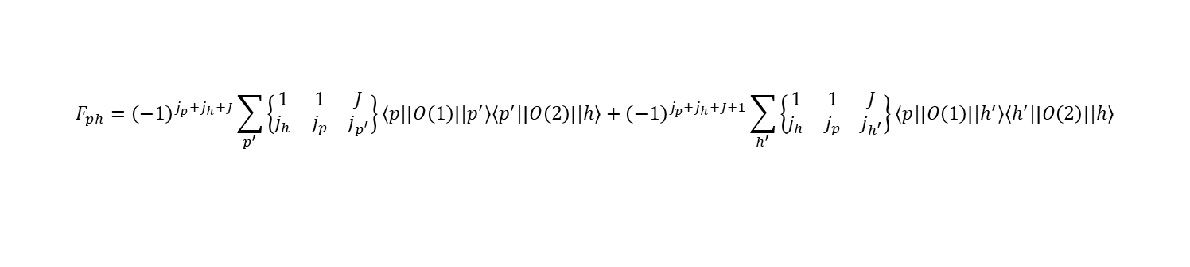
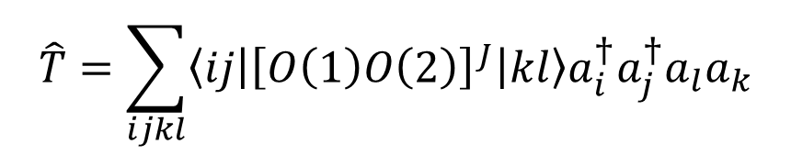
Transition Strength of Two-body External Field
$$\hat{T}=\sum_{ijkl}{\left\langle ij\left|{\left[O\left(1\right)O\left(2\right)\right]}^{J}\right|kl\right\rangle a_{i}^{†}a_{j}^{†}a_{l}a_{k}}$$
2-body operator
Transition amplitude
P. Papakonstantinou, R. Roth, PRC 81, 024317 (2010)
$$\left\langle ν\left|{\left[O\left(1\right)O\left(2\right)\right]}^{J}\right|0\right\rangle =\sum_{ph}{\left(X_{ph}^{ν}+{\left(−1\right)}^{J}Y_{ph}^{ν}\right)F_{ph} }+\sum_{p_{1}h_{1}p_{2}h_{2}}{\left(𝒳_{p_{1}h_{1}p_{2}h_{2}}^{ν}+𝒴_{p_{1}h_{1}p_{2}h_{2}}^{ν}\right)F_{p_{1}h_{1}p_{2}h_{2}}}$$
$$F_{ph}={\left(−1\right)}^{j_{p}+j_{h}+J}\sum_{p^{′}}{\left\{\begin{matrix}1 & 1 & J \\ j_{h} & j_{p} & j_{p^{′}}\end{matrix}\right\}⟨p|\left|O\left(1\right)\right||p^{′}⟩⟨p^{′}|\left|O\left(2\right)\right||h⟩}+{\left(−1\right)}^{j_{p}+j_{h}+J+1}\sum_{h^{′}}{\left\{\begin{matrix}1 & 1 & J \\ j_{h} & j_{p} & j_{h^{′}}\end{matrix}\right\}⟨p|\left|O\left(1\right)\right||h^{′}⟩⟨h^{′}|\left|O\left(2\right)\right||h⟩}$$
$F_{p_{1}h_{1}p_{2}h_{2}}=2\sqrt{\frac{\left(2J_{p}+1\right)\left(2J_{h}+1\right)}{\left(1+δ_{p_{1}p_{2}}\right)(1+δ_{h_{1}h_{2}})}}\left[\left\langle p_{1}|\left|O\left(1\right)\right||h_{1}\right\rangle \left\langle p_{2}\left|\left|O\left(2\right)\right|\right|h_{2}\right\rangle \left\{\begin{matrix}j_{p_{1}} & j_{h_{1}} & 1 \\ j_{p_{2}} & j_{h_{2}} & 1 \\ J_{p} & J_{h} & J\end{matrix}\right\}+{\left(−1\right)}^{j_{h_{1}}+j_{h_{2}}+J_{h}+1}\left\langle p_{1}|\left|O\left(1\right)\right||h_{2}\right\rangle \left\langle p_{2}\left|\left|O\left(2\right)\right|\right|h_{1}\right\rangle \left\{\begin{matrix}j_{p_{1}} & j_{h_{2}} & 1 \\ j_{p_{2}} & j_{h_{1}} & 1 \\ J_{p} & J_{h} & J\end{matrix}\right\}\right]$

Slide 23
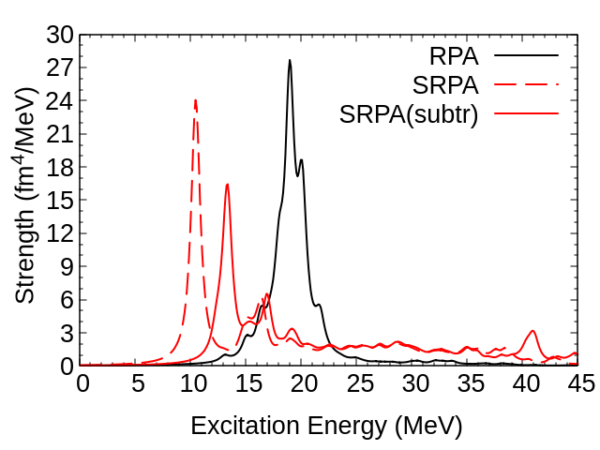
SRPA with a subtraction method
IS Quadrupole of ¹⁶O
with E_{2p2h}(cutoff)=35 MeV

Slide 24
What to extend are 1p1h pictures valid in energy?
Nuclear Level Density of ⁶³Ni
Low Energy
1-particle 1-hole (1p1h)
2-particle 2-hole (2p2h)
3-particle 3-hole (3p3h)
Large Scale Shell Model (LSSM) up to 4p4h
Mean Field + Statistical Model (MFSM)
4-particle 4-hole (4p4h)
0
1
2
3
4
5
6
7
High Energy
M. Oshima, T. Kin, S. Nakamura, M. Honma, F. Minato, T. Hayakawa, K.Y. Hara, A. Kimura, M. Koizumi, H. Harada, J. Goto, Y. Murakami, J. Phys. Soc. Japan 81 (2012) 084201.

Slide 25
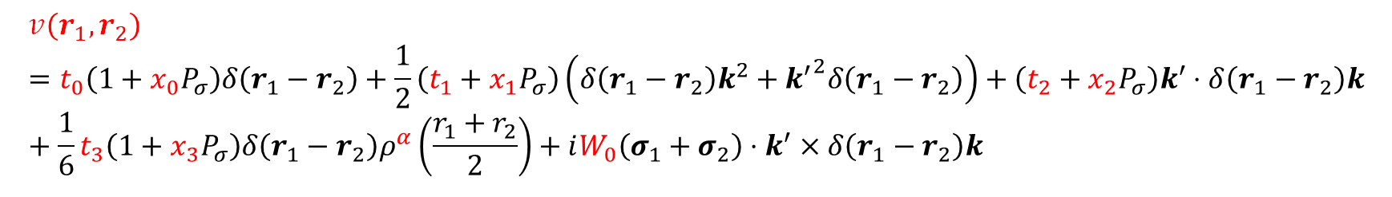
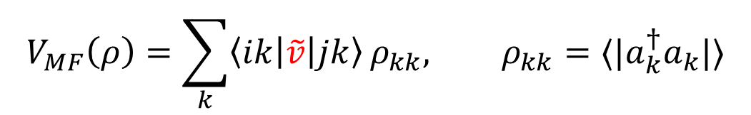
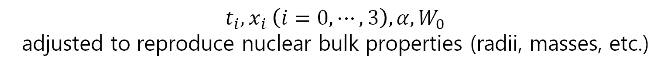
Skyrme interaction
$$V_{MF}\left(ρ\right)=\sum_{k}{\left\langle ik\left|\tilde{v}\right|jk\right\rangle }ρ_{kk}, ρ_{kk}=⟨|a_{k}^{†}a_{k}|⟩$$
$$v\left(r_{1},r_{2}\right)=t_{0}\left(1+x_{0}P_{σ}\right)δ\left(r_{1}−r_{2}\right)+\frac{1}{2}\left(t_{1}+x_{1}P_{σ}\right)\left(δ\left(r_{1}−r_{2}\right)k^{2}+{k^{′}}^{2}δ\left(r_{1}−r_{2}\right)\right)+\left(t_{2}+x_{2}P_{σ}\right)k^{′}⋅δ\left(r_{1}−r_{2}\right)k+\frac{1}{6}t_{3}\left(1+x_{3}P_{σ}\right)δ\left(r_{1}−r_{2}\right)ρ^{α}\left(\frac{r_{1}+r_{2}}{2}\right)+iW_{0}\left(σ_{1}+σ_{2}\right)⋅k^{′}×δ\left(r_{1}−r_{2}\right)k$$
$t_{i}, x_{i} \left(i=0,⋯,3\right), α, W_{0}$
adjusted to reproduce nuclear bulk properties (radii, masses, etc.)
↑
experimental data
We discuss results calculated with the SkM* interaction
SkM*: J. Bartel et al, Nuclear Physics A386 (1982) 79-100

Slide 26
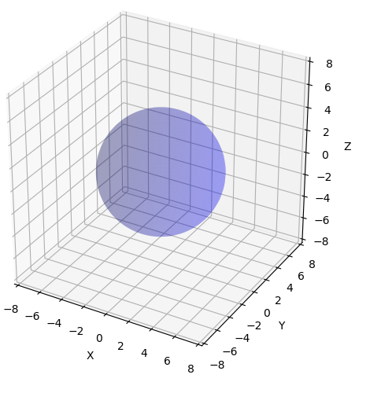





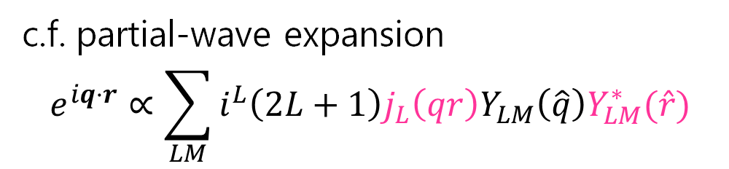
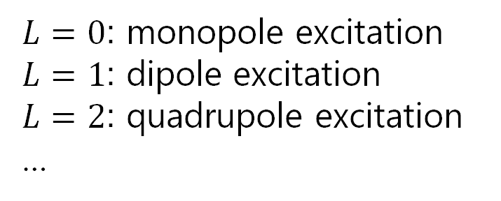

How to excite (touch) nucleus?
External fields (electromagnetic, weak, neutron, proton, etc.) has a various kinds of “touching way”
External Fields
$$\hat{O}$$
Nucleus
c.f. partial-wave expansion
$$e^{iq⋅r}∝\sum_{LM}{i^{L}\left(2L+1\right)j_{L}\left(qr\right)Y_{LM}\left(\hat{q}\right)Y_{LM}^{∗}(\hat{r})}$$
expanding with $L \& M$
$q:$ momentum transfer
$L=0$: monopole excitation
$L=1$: dipole excitation
$L=2$: quadrupole excitation
…

Slide 27
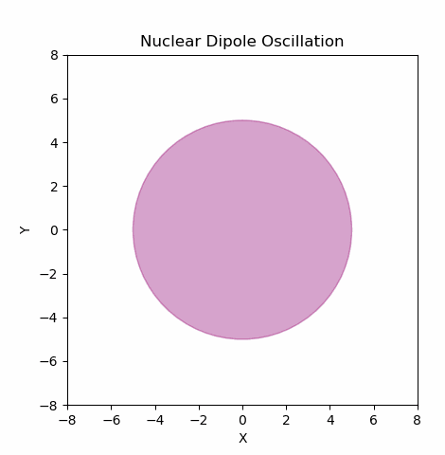
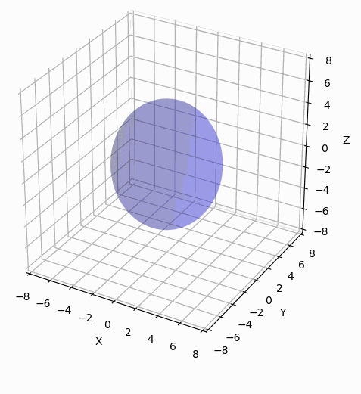






Nuclear Collective Motions
ーSurface vibrations ー
$$\left|Dipole\right\rangle$$
$$\left|Quadrupole\right\rangle$$
$$\hat{O}=\sum_{i}{r_{i}^{2}Y_{20}\left({\hat{r}}_{i}\right)}$$
$$\hat{O}=\sum_{i}{r_{i}Y_{10}\left({\hat{r}}_{i}\right)τ_{3i}}$$
resulted from the fact that nuclei are many-body system!
Dipole Oscillation
(Isovector)
Quadrupole Oscillation
(Isoscalar)
Group Action

Slide 28

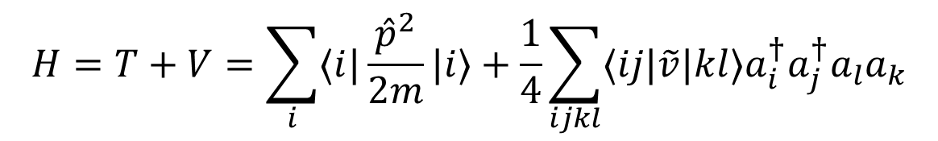
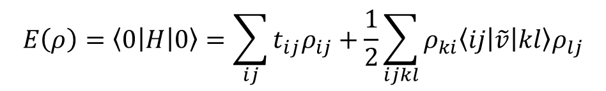
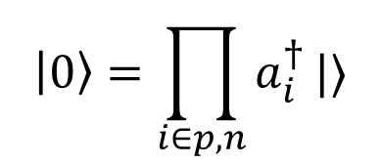



Mean Field Approximation & Shell Structure
Nuclear Hamiltonian
$$H=T+V=\sum_{i}{⟨i|\frac{{\hat{p}}^{2}}{2m}|i⟩}+\frac{1}{4}\sum_{ijkl}{⟨ij|\tilde{v}|kl⟩a_{i}^{†}a_{j}^{†}a_{l}a_{k}}$$
Mean Field Approximation
Nuclear Many-Body Wave Function
$$\left|0\right\rangle =\prod_{i∈p,n}{a_{i}^{†}}|⟩$$
Filling nucleons from the bottom
Energy is
density functional
$$E\left(ρ\right)=\left\langle 0\left|H\right|0\right\rangle =\sum_{ij}{t_{ij}ρ_{ij}+\frac{1}{2}\sum_{ijkl}{ρ_{ki}\left\langle ij\left|\tilde{v}\right|kl\right\rangle ρ_{lj}}}$$
Variation with respect to density
$$h_{ij}\left(ρ\right)=\frac{∂E\left(ρ\right)}{∂ρ_{ij}}$$
$$V_{MF}(ρ)$$
1body Hamiltonian
$$=t_{ij}+V_{MF}\left(ρ\right)=ε_{i}δ_{ij}$$
Independent Particle Picture
Mean-Field potential
$$V_{MF}(ρ)=\sum_{k}{\left\langle ik\left|\tilde{v}\right|jk\right\rangle }ρ_{kk}$$

Slide 29








New Physics Involving Nuclei
Muon Beam Facility
LINIAC
High Sensitivity Neutrino Detection
Developing Muon Nuclear Data Library
Developing LINIAC for Medical Purpose
Super-Kamiokande-Gadrinium
J-PARC
highest intense proton beam in the world
Figure from Univ. Tokyo
https://www.u-tokyo-rad.jp/equipment/linac/
Supernovae
(Figure from NAOJ)
Muon Nuclear Data
From Yokoyama-Nakajima Group@Univ. of Tokyo
Inclusive reaction cross sections are studied well, but
Lack of exclusive neutrino-nucleus, muon-capture, and γ-disintegration cross sections
$$A\left(ν,X\right)B$$
$$A\left(μ,X\right)B$$
$$A\left(γ,X\right)B$$
What kind of particles emitted???→Radioactive protection, mitigate background,

