Slide 1





A new evaluation of ¹⁷O system
Zhenpeng Chen¹, Han Xu², Tao Ye³
1 Physics Department, Tsinghua University, Beijing, China
2 Graduate School, China Academy of Engineering Physics, Beijing, China
3 Institute of Applied Physics and Computational Mathematics, Beijing, China
IAEA meeting, 27 Nov. to 1 Dec.，2023
1/40

Slide 2
THE MAIN CONTENTS
1.Introduction
2.The reaction channels
3.Current situation of data fitting
4.Conclusion
2/40

Slide 3
1
INTRODUCTION

Slide 4
01
INTRODUCTION
Theoretical foundation
The classical reduced R-matrix theory^{[1]}, covariance statistics^{[2]} and the corresponding program RAC^{[3]} are used to complete these work. Which has been introduced before, and not be repeated here. Which has been introduced in detail in INDC(NDS)-0791.pdf.
[1] A.M. Lane, R.G. Thomas, Rev. Mod. Phys. 30, 257 (1958)
[2] D.L. Smith, Probability, Statistics, and Data Uncertainties in Nuclear Science and Technology (ANS, Chicago, 1991)
[3] Z.P. Chen, R. Zhang, Y.Y. Sun, T.J. Liu, Science in China (Series G) 46, 225
4/40

Slide 5
2
The reaction channels

Slide 6
02
Reaction channels
n+¹⁶O
α+¹³C
For n+¹⁶O, include 9 channels:
‘ ¹⁶O(n,n₀)¹⁶O₀ ’ ‘ ¹⁶O(n,n₁)¹⁶O₁ ’
‘ ¹⁶O(n,n₂)¹⁶O₂ ’ ‘ ¹⁶O(n,n₃)¹⁶O₃ ’
‘ ¹⁶O(n,n₄)¹⁶O₄ ’
‘ ¹⁶O(n,α₀)¹³C₀ ’ ‘ ¹⁶O(n,α₁)¹³C₁ ’
‘ ¹⁶O(n,α₂)¹³C₂ ’ ‘ ¹⁶O(n,α₃)¹³C₃ ’
For α+¹³C, include 9 reverse channels:
‘ ¹³C(α,α₀)¹³C₀ ’ ‘ ¹³C(α,α₁)¹³C1 ’
‘ ¹³C(α,α₂)¹³C₂ ’ ‘ ¹³C(α,α₃)¹³C3 ’
‘ ¹³C(α,n₀)¹⁶O₀ ’ ‘ ¹³C(α,n₁)¹⁶O₁ ’
‘ ¹³C(α,n₂)¹⁶O₂ ’ ‘ ¹³C(α,n₃)¹⁶O₃ ’
‘ ¹³C(α,n₄)¹⁶O₄ ’
6/40

Slide 7
02
Reaction channels
Reduced channels
And a reduced channel(used for 8 to 30 MeV),which represents the total contribution of other channels.
for inelastic scattering, the reduce channel represents these channels:
  ¹⁶O(n,n_{k})¹⁶O_{k}, k = 5,6,7...
for (n,α), the reduce channel represents these channels:
  ¹⁶O(n,α_{k})¹³C_{k,} k = 4,5,6...,which emits only one α
for the rest channels:
  (n,p), (n,d), (n,2n), (n,t), &(n,others)
7/40

Slide 8
02
Reaction channels
The relationship of cross section
(n,tot)=(n, el)+(n, inl)+(n, α)+(n, Redu-rest), which can be used to describe the experimental data of (n, tot);
(n,el)= (n, el), which can be used to describe the experimental data of neutron elastic scattering;
(n,inl)=(n,n₁)+(n,n₂)+(n,n₃)+(n,n₄)+(n, Redu-inl), which can be used to describe the experimental data of neutron total inelastic scattering, in EXFOR, only has this kind of data. (n, Redu-inl) represents inelastic scattering part in (n, Redu-all);
(n,α)=(n,α₀)+(n,α₁)+(n,α₂)+(n,α₃)+(n, Redu-α), which can be used to describe the experimental data of total (n,α), in EXFOR, only has this kind of data. (n, Redu-α) represents (n,α) part in (n, Redu-all);
8/40

Slide 9
02
Reaction channels
The relationship of cross section
(n, Redu-all)=(n, Redu-inl)+(n, Redu-α)+(n, Redu-rest)， this formula explains that the total contribution of the reduced channel can be divided into three parts on the right; (n, Redu-all) is determined by fitting all data, (n, Redu-inl) is determined by fitting total non-elastic scattering data, and (n, Redu-α) is determined by fitting total (n, α) data.
(n, Redu-rest)=(n, p)+(n, d)+(n, 2n)+(n, t)+(n, other), in EXFOR, (n, p), (n, d), (n, 2n), (n, t) has a few data respectively, and the value of them are very small;
(α, n)= (α, n₀)+ (α, n₁)+ (α, n₂)+ (α, n₃)+ (α, Redu), which can be used to describe the experimental data of total (α, n), in EXFOR, only has this kind of data.
9/40

Slide 10
3
Current situation of data fitting

Slide 11
03
Fitting result
All the levels of ¹⁷O listed in ‘Table (1993TI07): Energy levels of ¹⁷O’ have been used. A total of 207 energy levels were used, and the parameters of all energy levels were determined by fitting experimental data.
We use new experimental data in the energy range of 0.233 to 11.67 MeV. The current fitting for experimental data looks good.
(α,n) integral cross section
  1.P.S.Prusachenko+ 2022 4.Luna+2021
  2.G.F.Cian+ 2021 5.Juna+2022
  3.B.Gao+ 2022 6.Deboer+2023
(n,α₀) integral cross section
  1.Peking+2022
(α,n) differential cross section
1.M.Febbraro+ 2020
2.E.M.Gazeeva+ 2020
3.P.S.Prusachenko+ 2022
(n, α₀) differential cross section
1.1. Deboer+2020
11/40

Slide 12
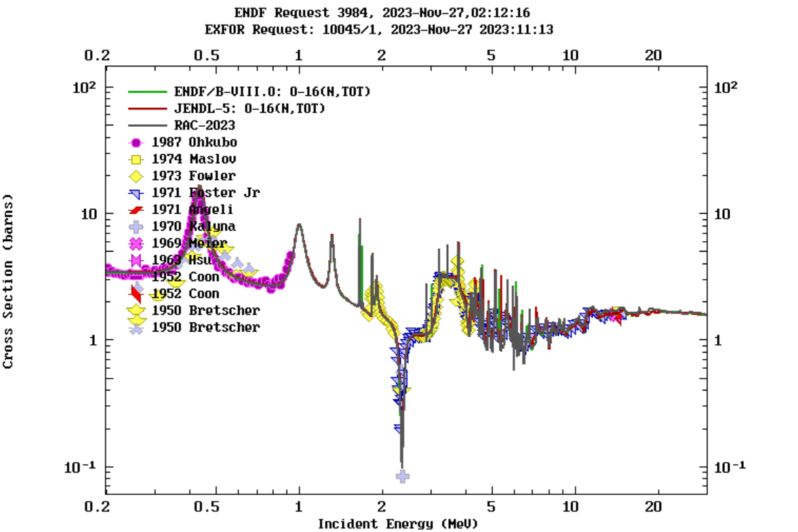
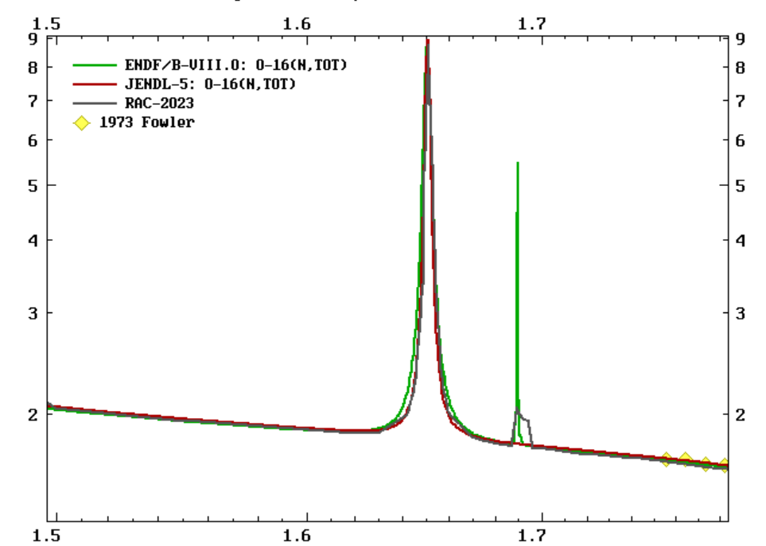
03
¹⁶O(n,tot)
Figure1.
The (n, tot) cross section, green line represents ENDF/B-VIII.0, red line represents JENDL-5,grey line represents RAC-2023. They are very close.
In this comprehensive fitting, the data of (n, tot) plays a dominant function.
In 0.2 to 6.2 MeV, the white source measurements of KFK were carefully smoothen to take into account more neutron elastic scattering differential cross sections ;It can compensate for the absence of experimental neutron total cross section values in the 0.9 to 1.8 MeV energy region.
12/40

Slide 13
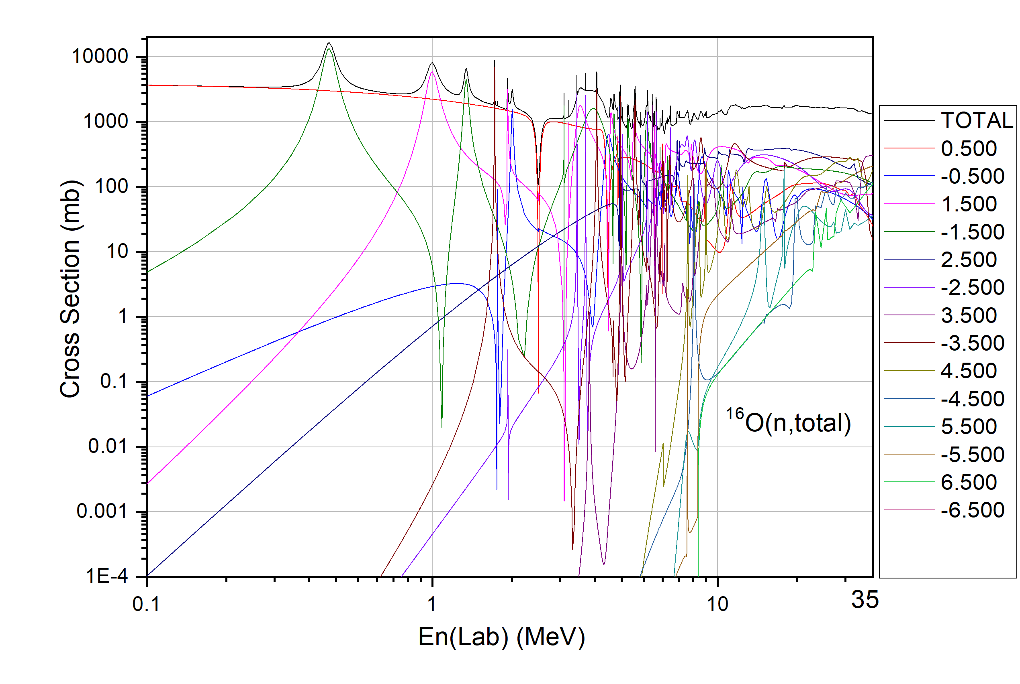
03
¹⁶O(n,tot)
Figure2.
This figure shows the wave splitting of the (n,tot) cross section.
In the figure, 0.5 represents the level with parity + and total spin 0.5, and -0.5 represents the level with parity - and total spin 0.5. And so on for the other numbers.
The first three discrete energy levels are -0.5，+1.5，-1.5.
13/40

Slide 14
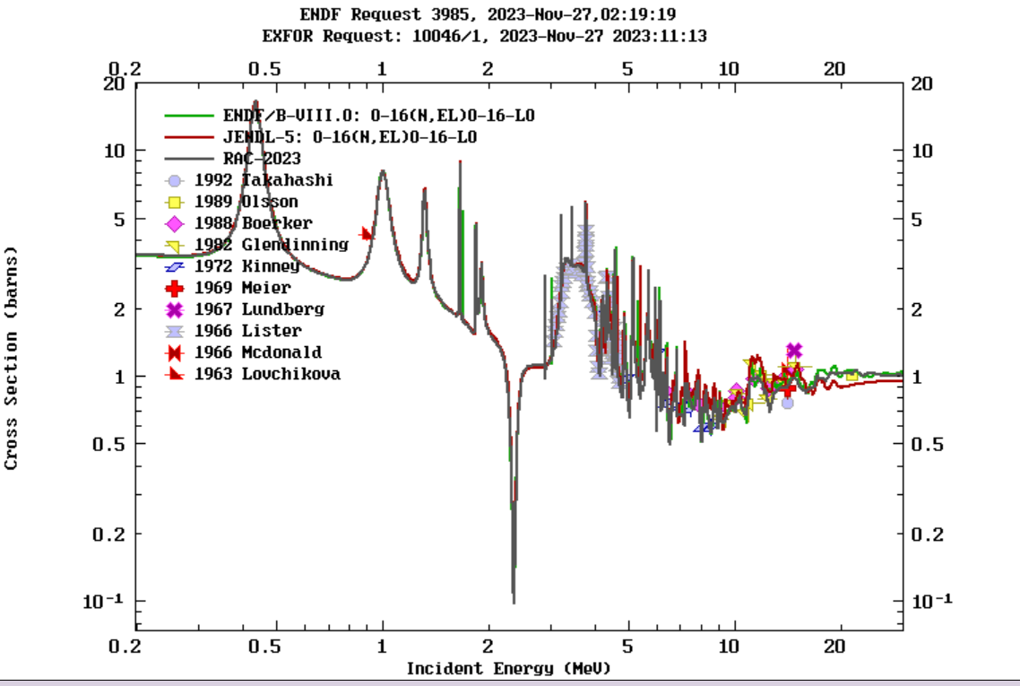
03
¹⁶O(n,el)
Figure3.
The (n, el) cross section, green line represents ENDF/B-VIII.0, grey line represents RAC-2023. red line represents JENDL-5.
Below 18 MeV, they are very close. In this region, the elastic scattering differential cross section plays the decisive role.
Above 18 MeV， ENDF/B-VIII.0 and RAC-2023 are very close，but JENDL-5 looks lower.
From 0.0125 to 30 MeV, the elastic scattering differential cross section at 195 energy points are used.
14/40

Slide 15
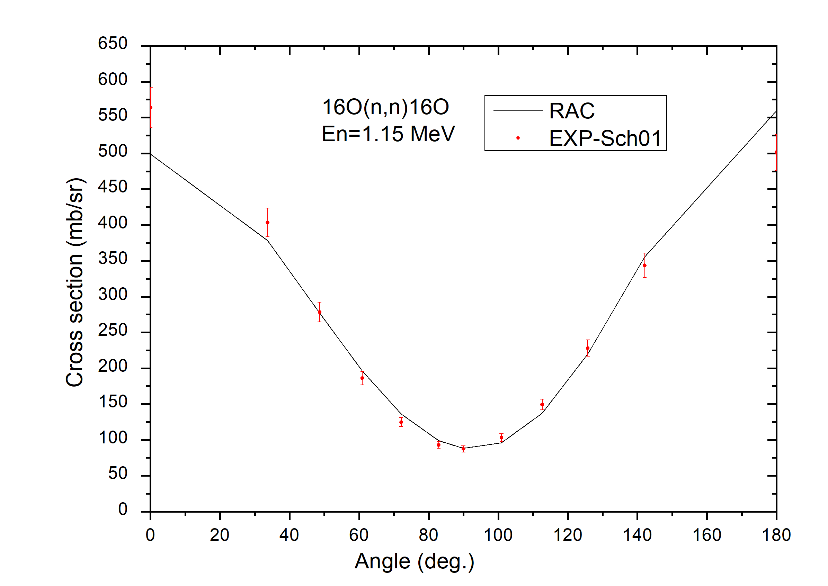
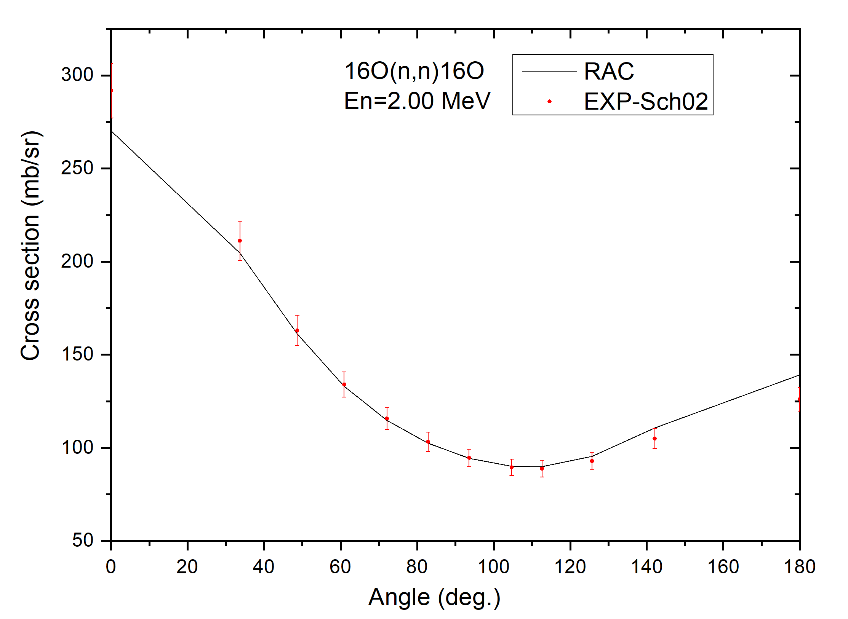
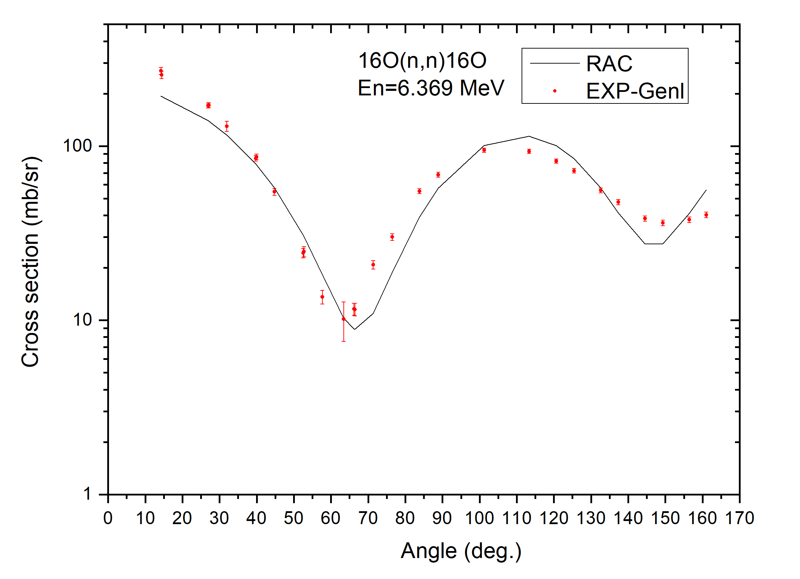
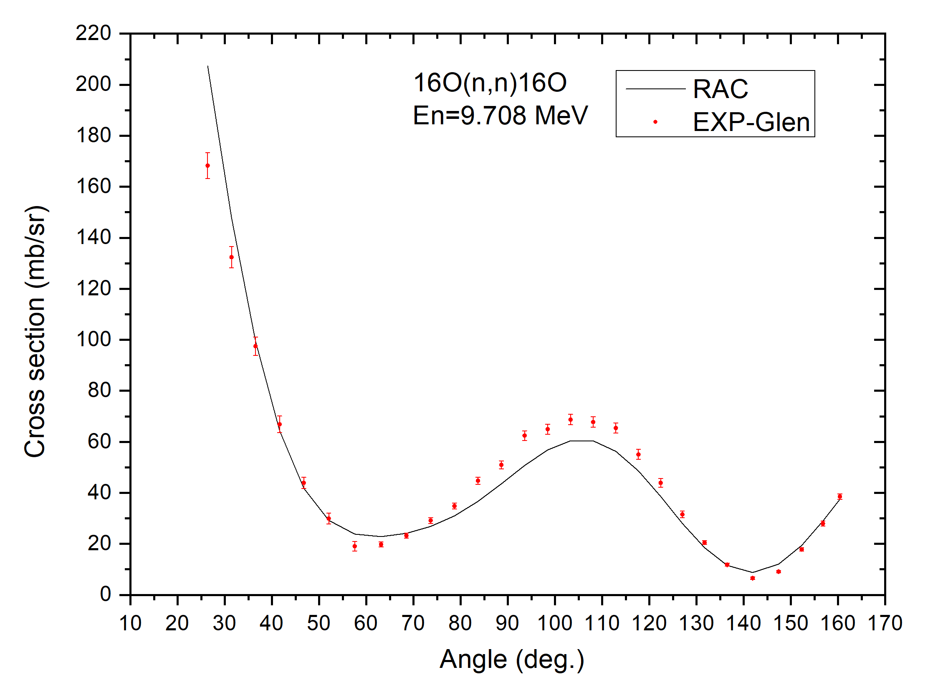
03
¹⁶O(n,el)
Figure4.
These figures show calculations of differential cross sections for neutron elastic scattering
We can see that the compliance with the experimental data is still relatively good
15/40

Slide 16
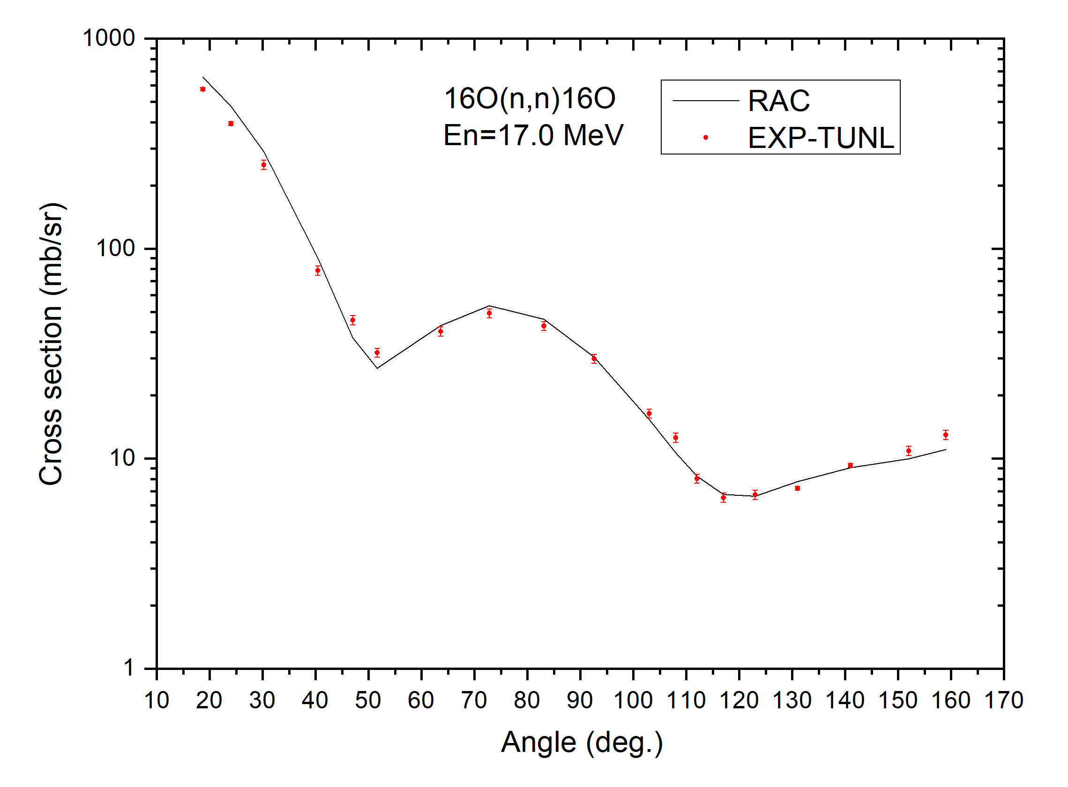
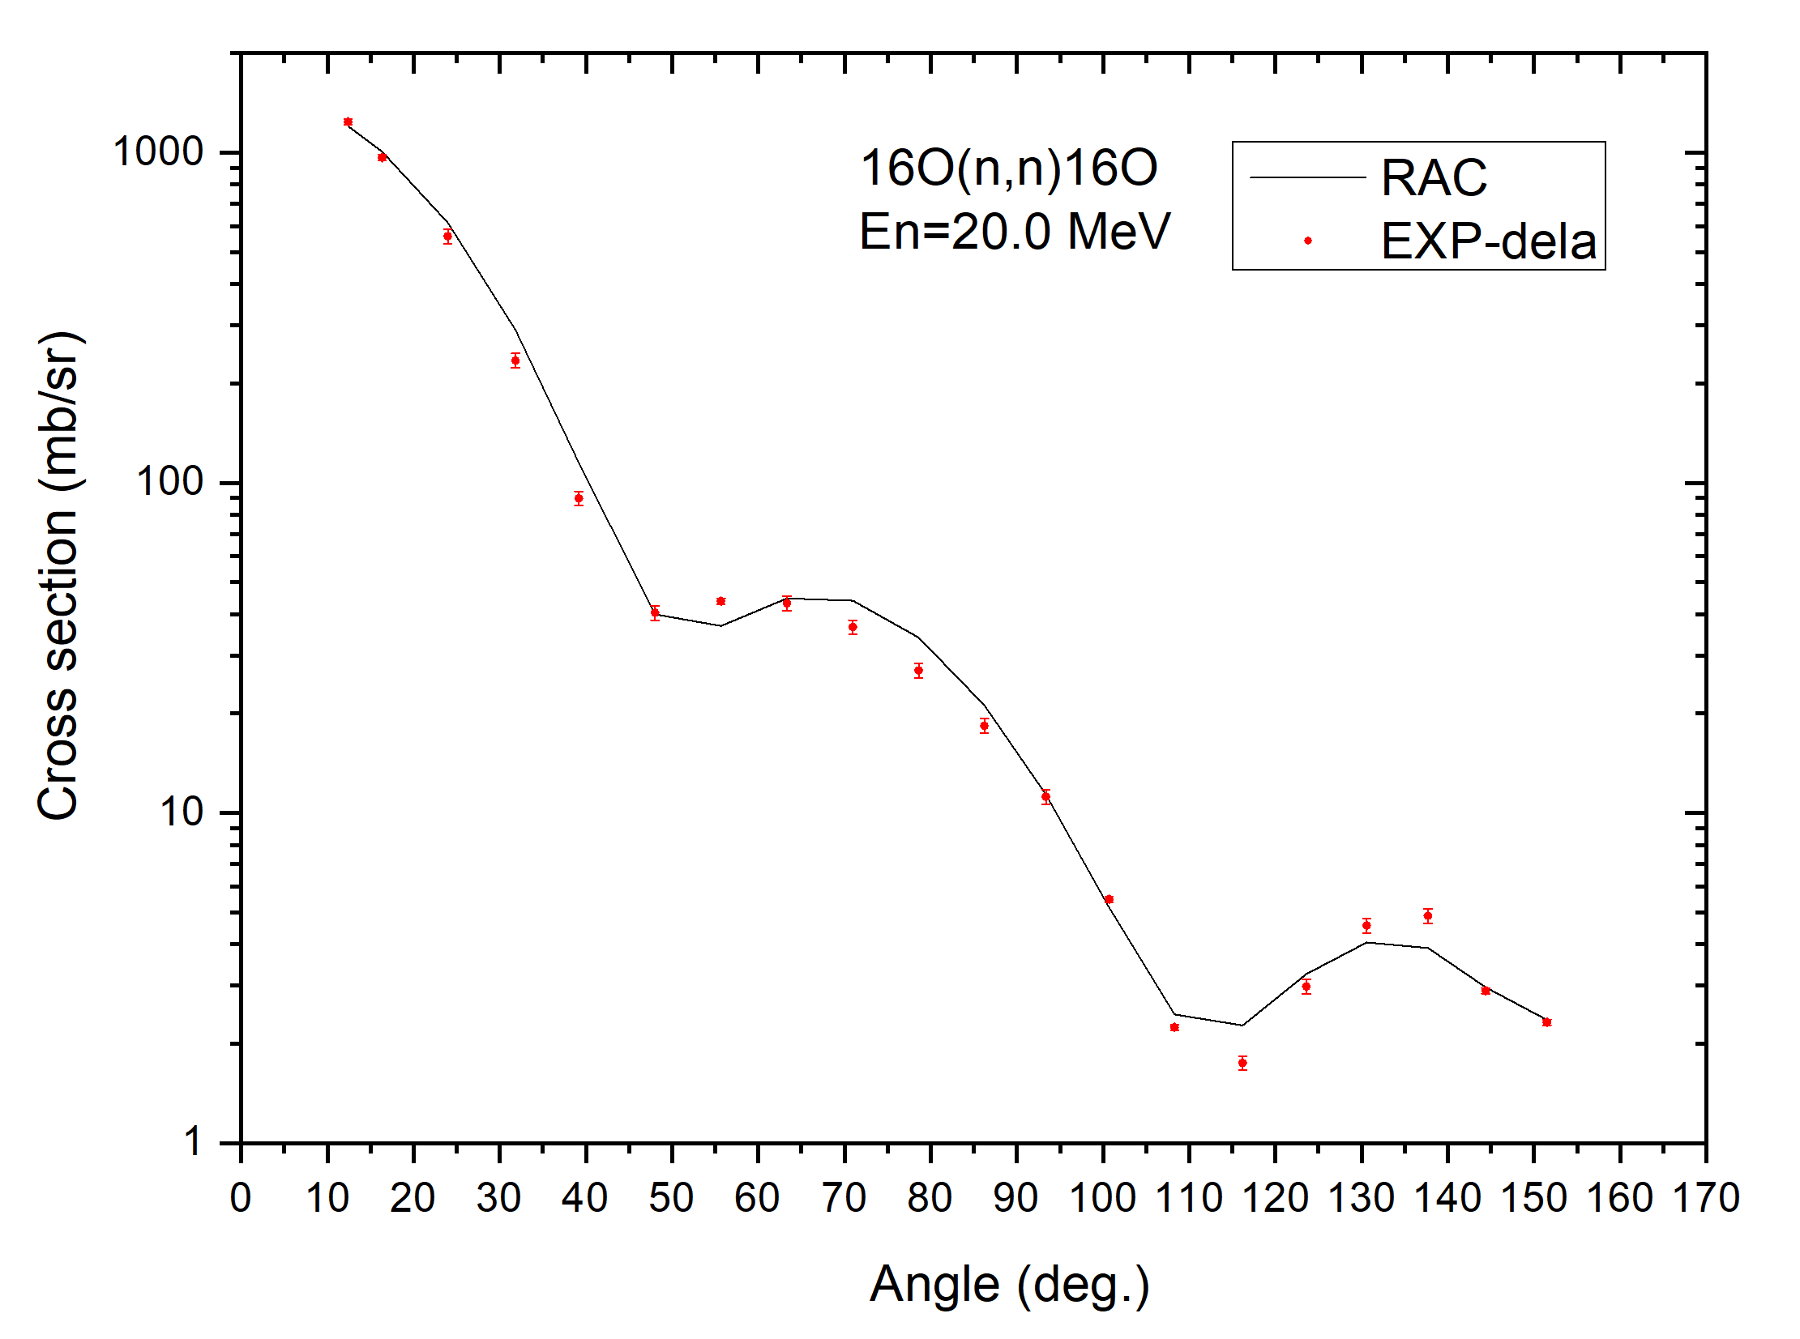
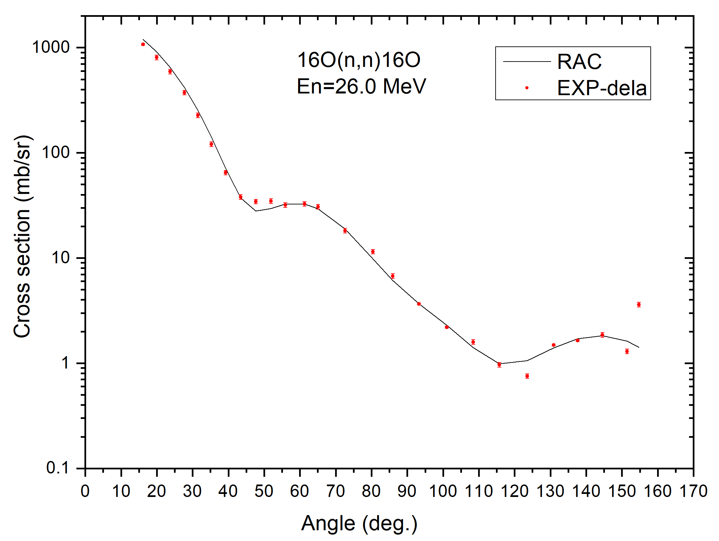
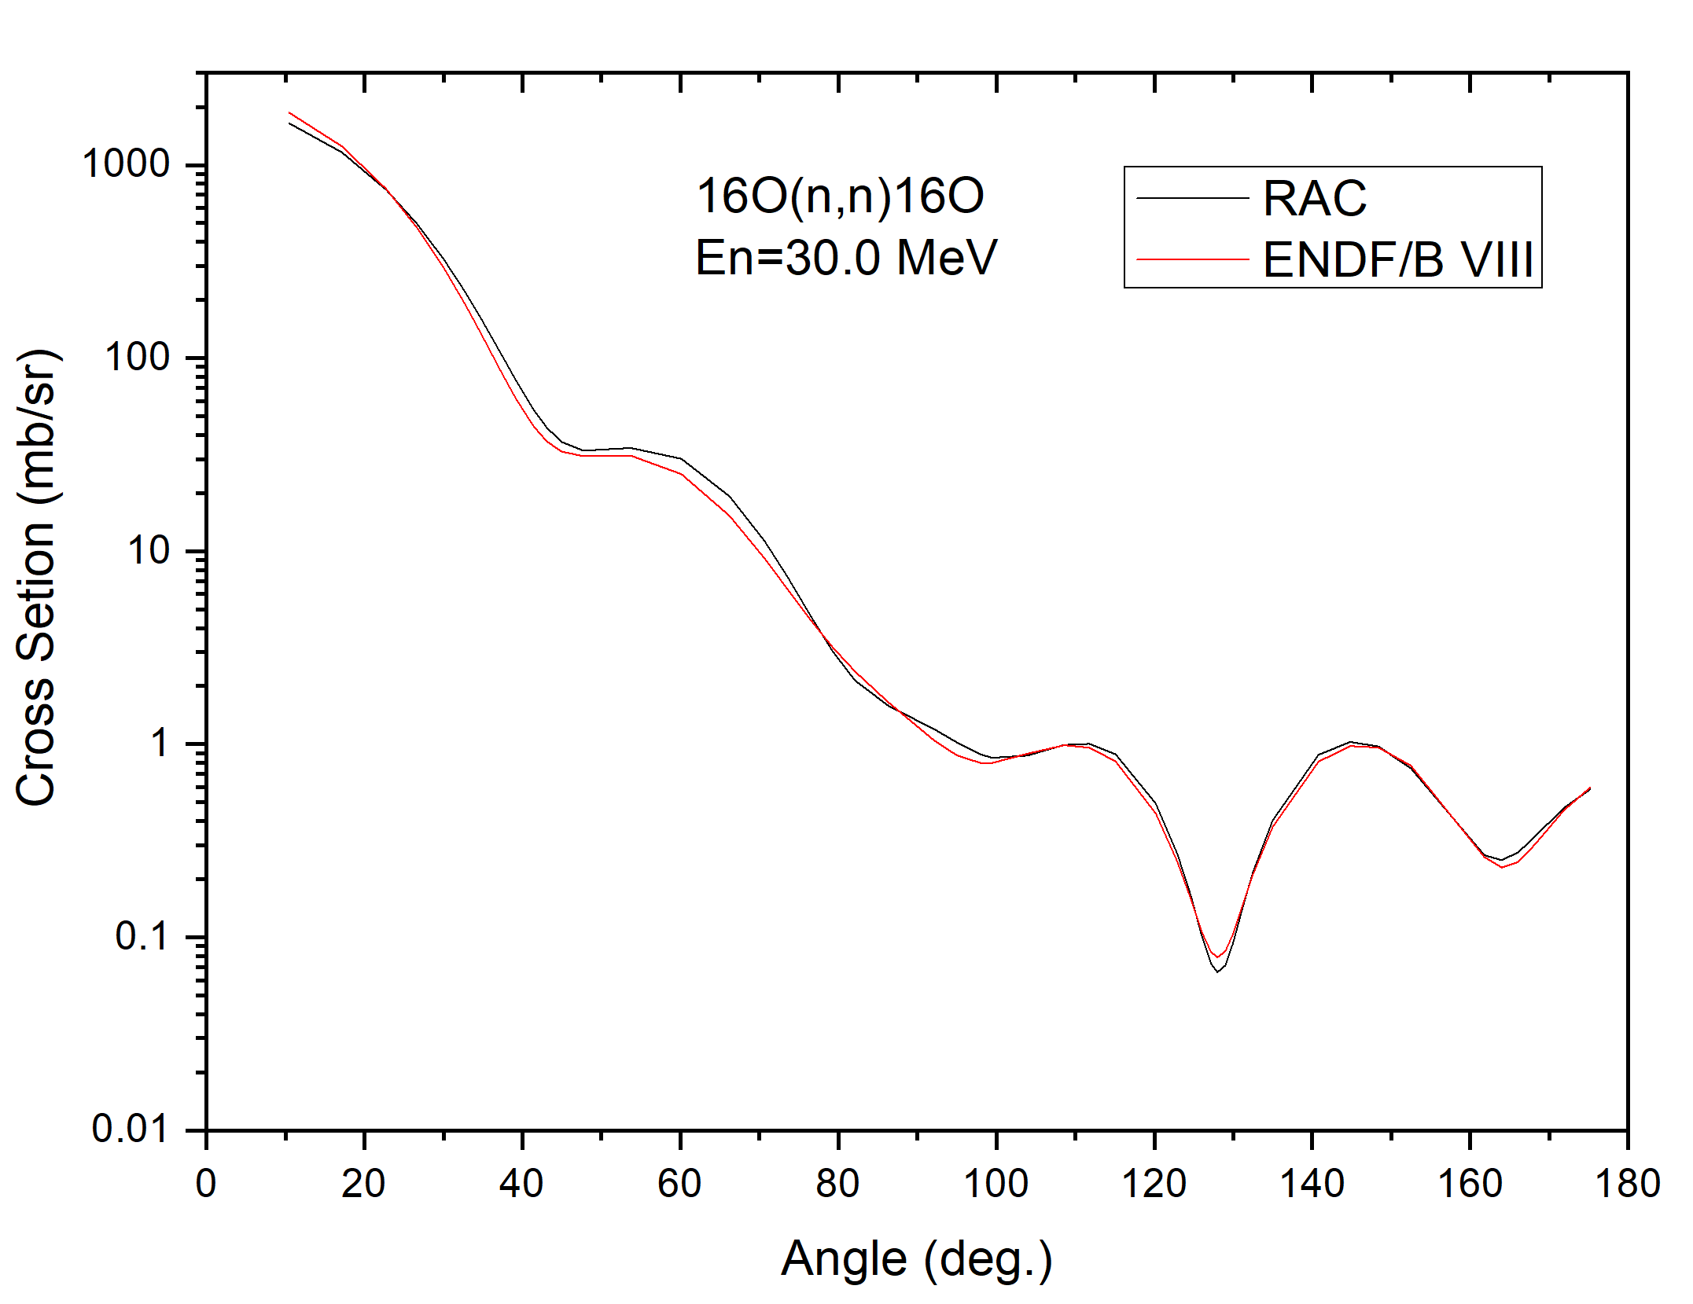
03
¹⁶O(n,el)
Figure5.
These figures also show calculations of differential cross sections for neutron elastic scattering
We can see that the compliance with the experimental data and ENDF/B-VIII.0 is still relatively good
16/40

Slide 17
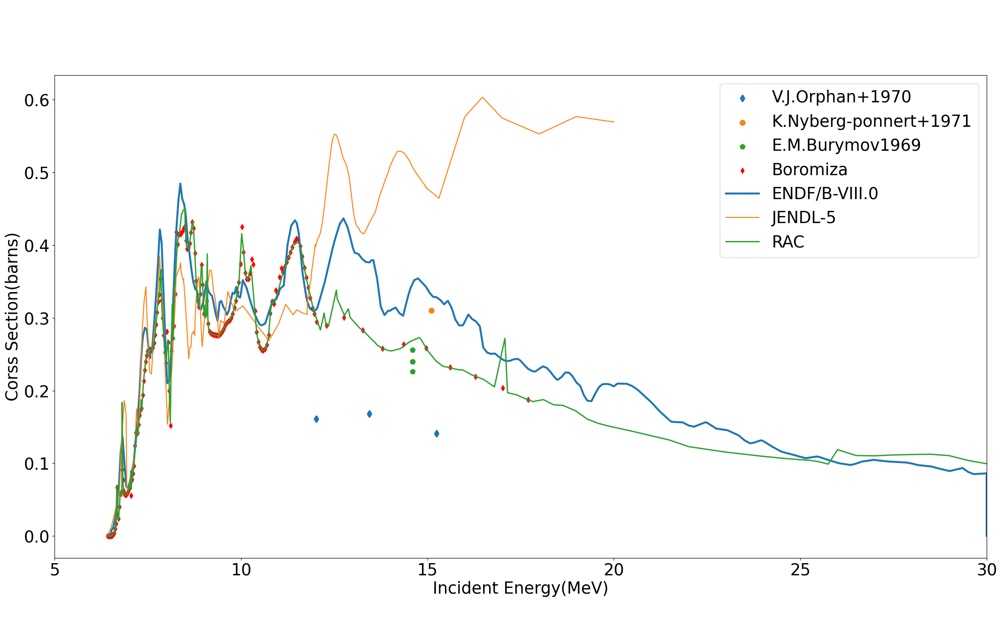
03
¹⁶O(n,inl)
Figure6.
The (n, inl) cross section, blue line represents ENDF/B VIII.0, orange line represents JENDL-5,green line represents RAC-2023.
Below 12 MeV, they are very close. Above the 12MeV, there is a significant difference, but RAC is closer to the latest experimental data (red points), that is from Boromiza on (n, inl), which play a positive role of constraint and obvious improvement. It may have a positive effect on (n,α) and (α,n) evaluation improvement.
17/40

Slide 18
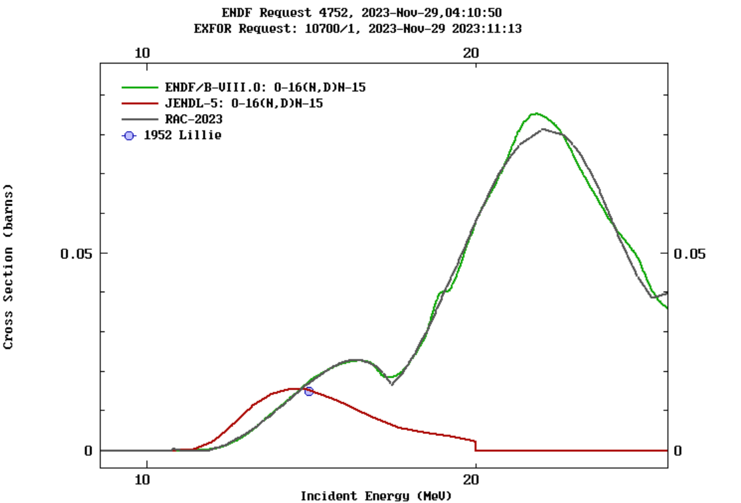
03
¹⁶O(n,d)
Figure7.
The (n, d) cross section, green line represents ENDF/B VIII.0, red line represents JENDL-5,grey line represents RAC-2023.
RAC current calculations are closer to ENDF/B-VIII.0, and there is a larger different between JENDL-5 results and RAC
18/40

Slide 19
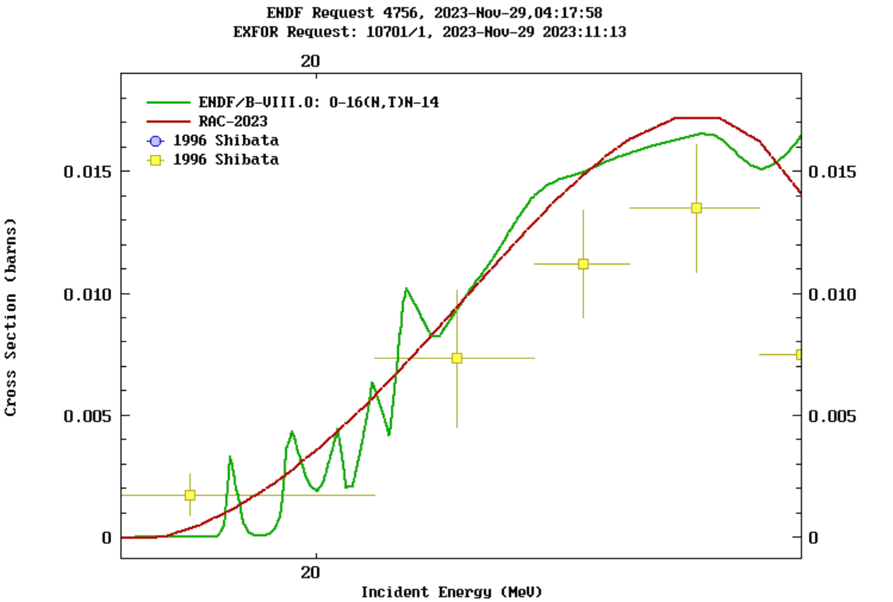
03
¹⁶O(n,t)
Figure8.
The (n, t) cross section, green line represents ENDF/B VIII.0, red line represents RAC-2023.
Theoretically, it is not well understood that (n,t) appears to have many very narrow resonances in the high energy region. The RAC program can't achieve this result.
19/40

Slide 20
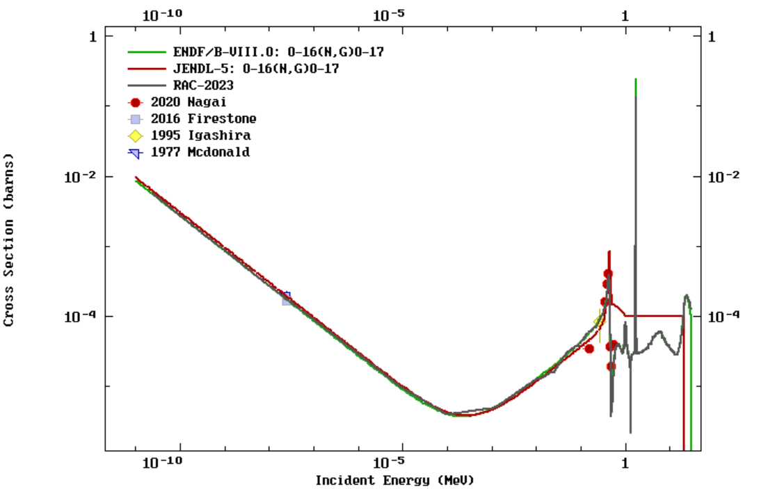
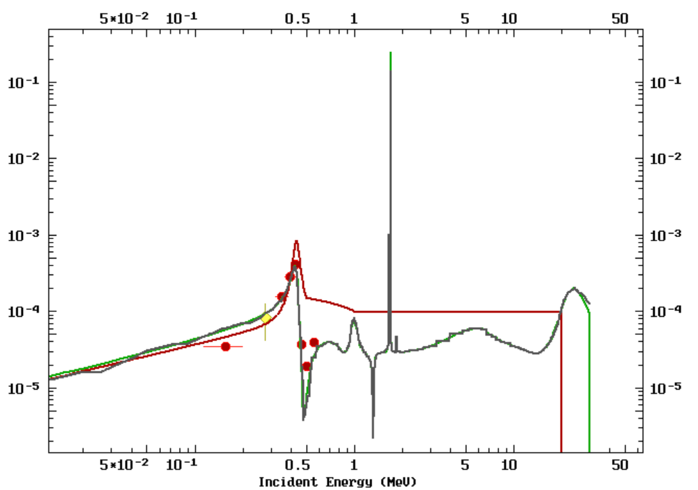
03
¹⁶O(n,g)
Figure9.
The (n, g) cross section, green line represents ENDF/B VIII.0, red line represents JENDL-5,grey line represents RAC-2023.
RAC current calculations are closer to ENDF/B-VIII.0, and there is a larger different between JENDL-5 results and RAC
20/40

Slide 21
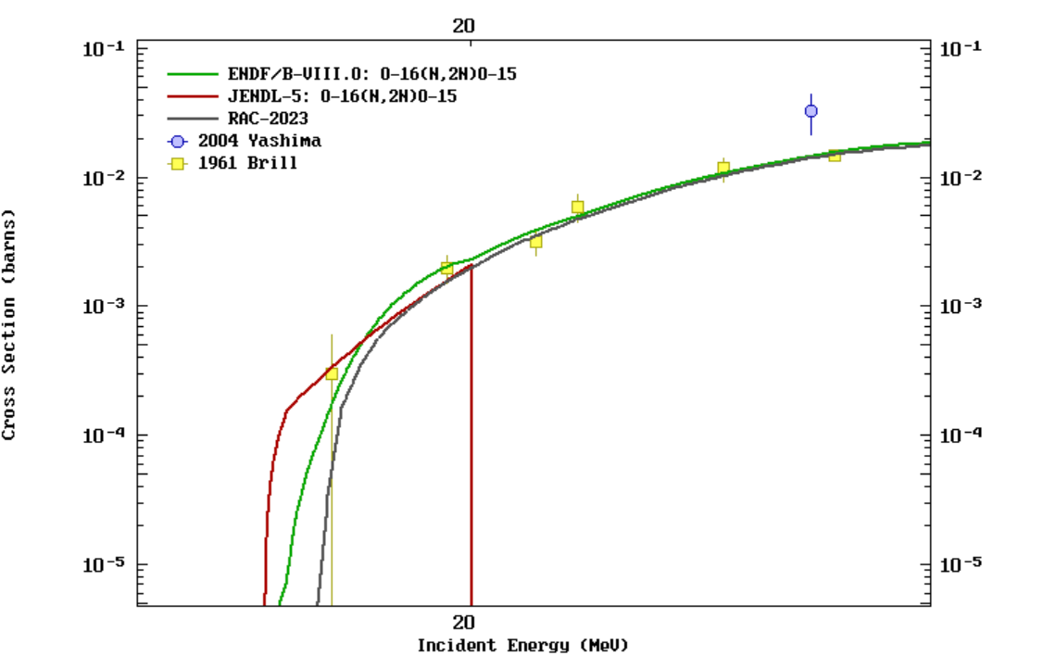
03
¹⁶O(n,2n)
Figure10.
The (n, 2n) cross section, green line represents ENDF/B VIII.0, red line represents JENDL-5,grey line represents RAC-2023.
Our results have the highest threshold and the smallest results near the threshold, which is somewhat different from the experimental data.
21/40

Slide 22
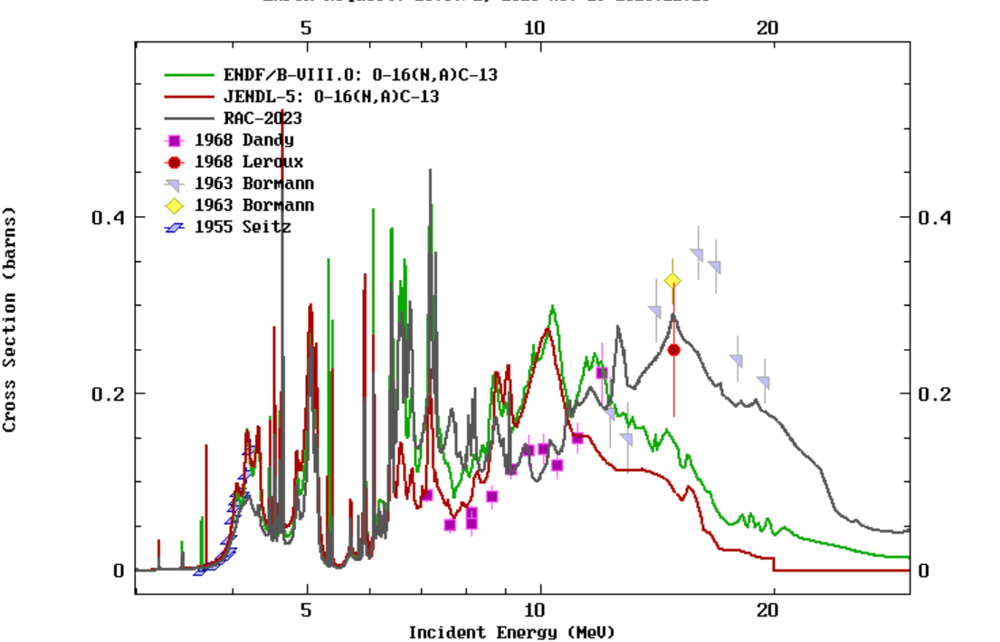
03
¹⁶O(n,α)
Figure11.
The (n, α) cross section, green line represents ENDF/B VIII.0, red line represents JENDL-5,grey line represents RAC-2023.
Below 8 MeV, the evaluation data for all three are pretty close.
Between 8 and 11 MeV, the RAC results are on the small side.
Above 11MeV, the RAC results are on the large side, but the overall trend is the same.
Above 9 MeV and up to 20 MeV, the RAC seems to be much closer to the experimental data
22/40

Slide 23
03
¹⁶O(n,α₀)
Figure12.
The (n, α₀) cross section from experiment and evaluation of RAC(black line) and BROND-3.1(green line). The pink line is for (n, α₀) of JENDL-5.
The new data(red round dot) of Peking University is significantly higher than the C. J. Parnell’s data which are the result of relative measurement, and the data are made the normalization to the data of E. A. Davis. According to some of past evaluations which include the data of E. A. Davis, it is found that above 5 MeV data of E. A. Davis are systematically low. So, the new data of Peking University are more reliable.
23/40

Slide 24
03
¹⁶O(n,α)
New data from Peking Univerity
New measurements of ¹⁶O(n, α₀) and ¹⁶O(n, α₁₂₃) have been completed, data analysis is underway.
The Peking University experimental group continues to carry out new measurements in the resolvable resonance region,which will include more energy points, about (n, α), to form a continuous excitation curve. So, the evaluation of ¹⁷O system will be improved continually.
24/40

Slide 25
03
Fitting result
Reverse channels
We have added several new sets of integral cross section data and differential cross section data for the ¹³C(α,n)¹⁶O reaction on the basis of the original dataset.
The differential cross section data for the ¹³C(α, α)¹³C at 113 energy points are used.
Refer to figures as follows:
25/40

Slide 26
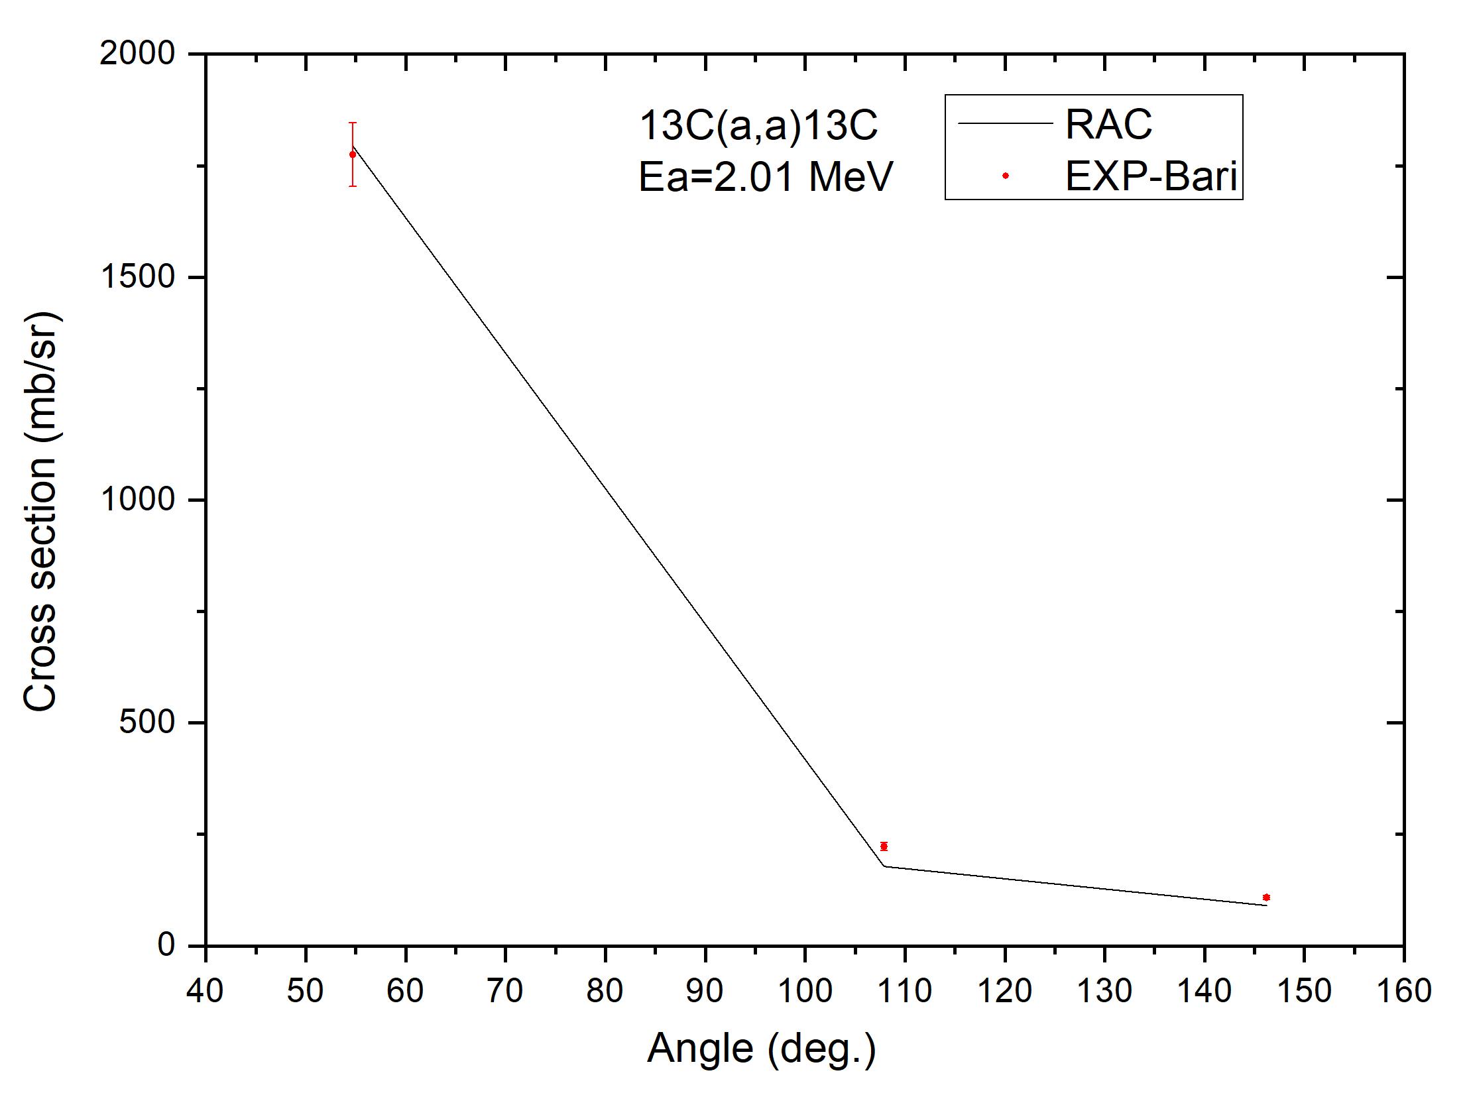
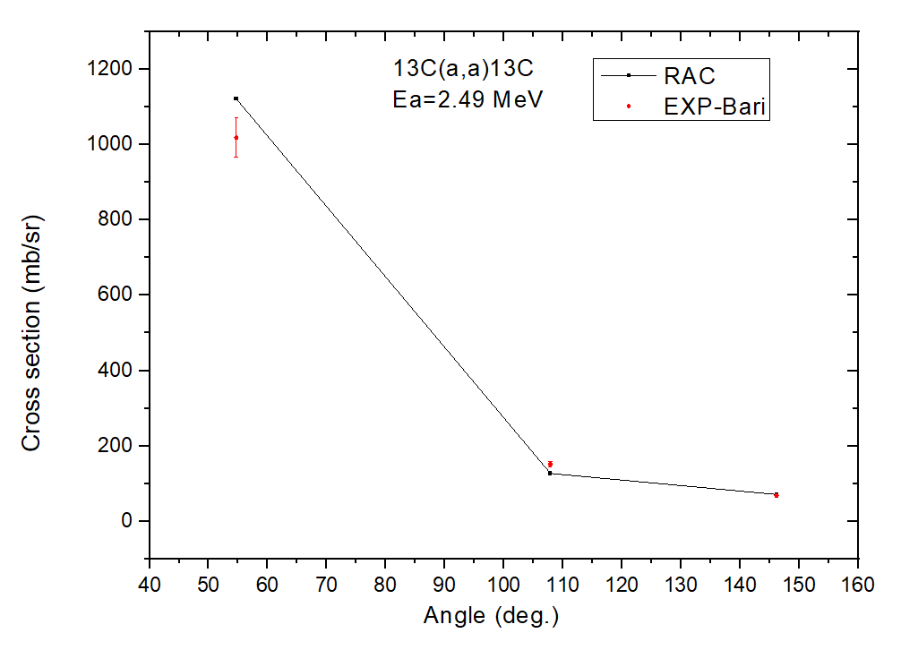
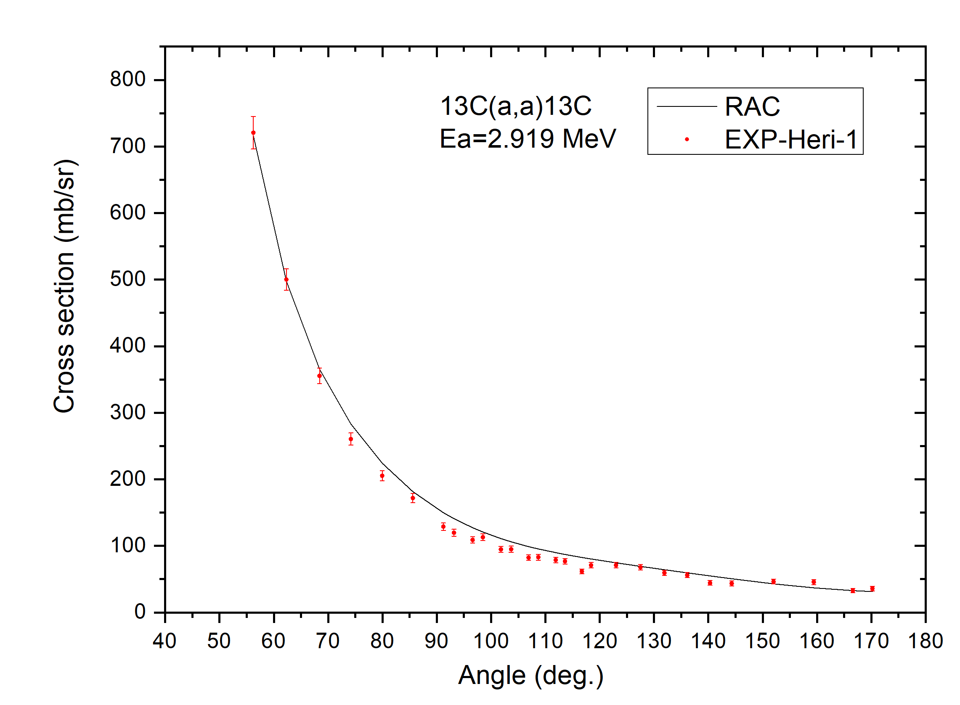
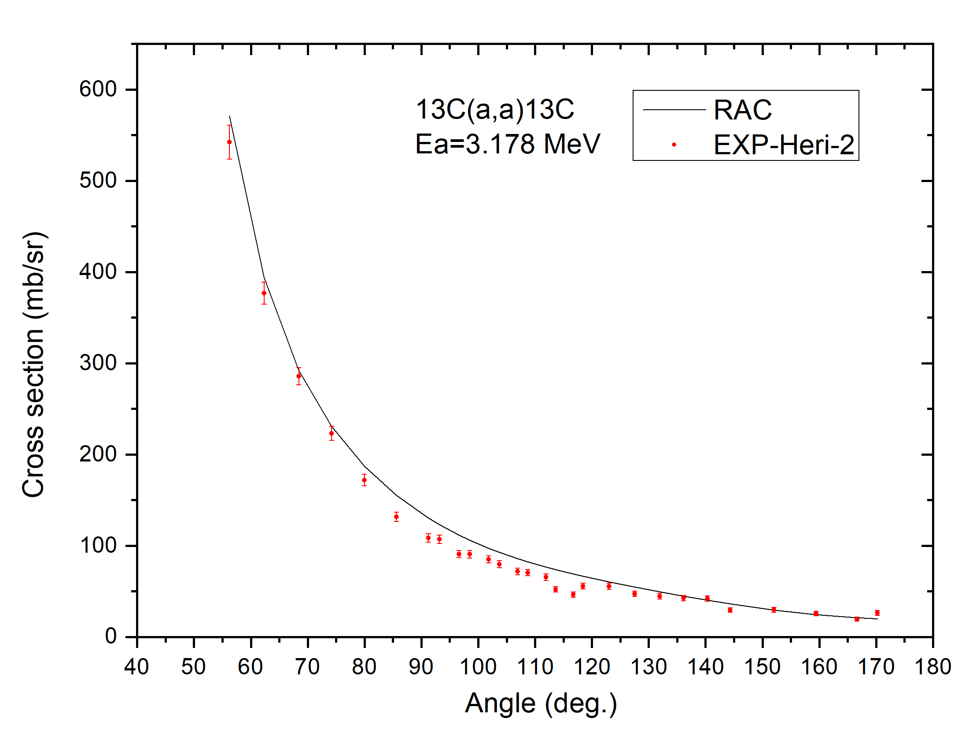
03
¹³C(α,α)
Figure13.
These figures show calculations of differential cross sections for α elastic scattering
We can see that the compliance with the experimental data is still relatively good
26/40

Slide 27
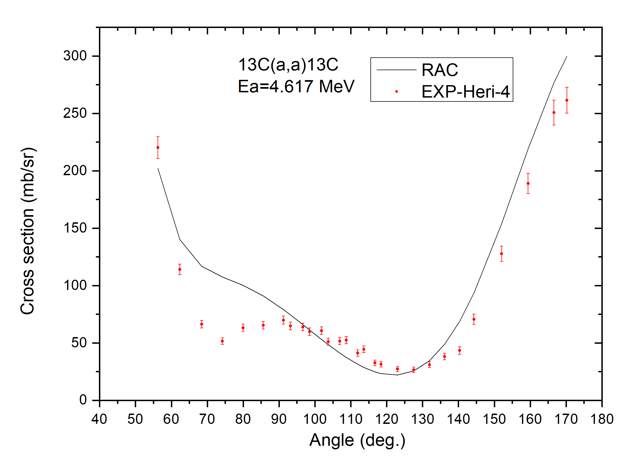
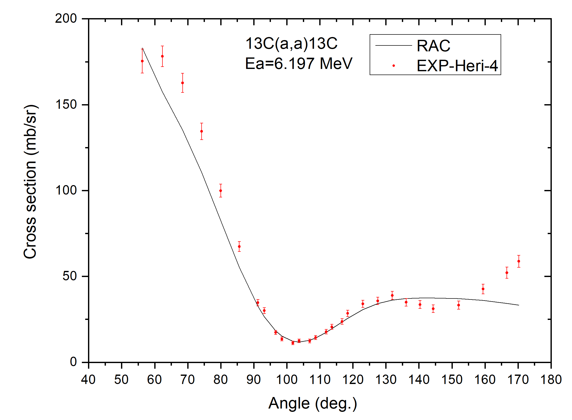
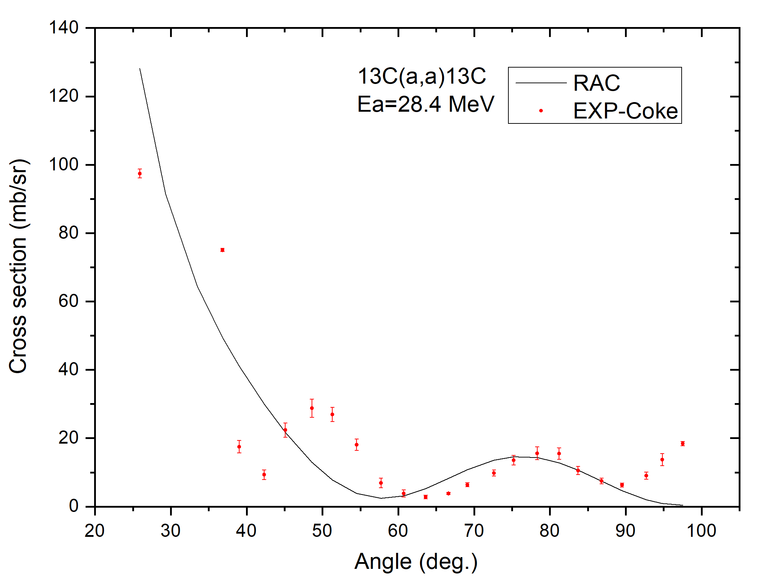
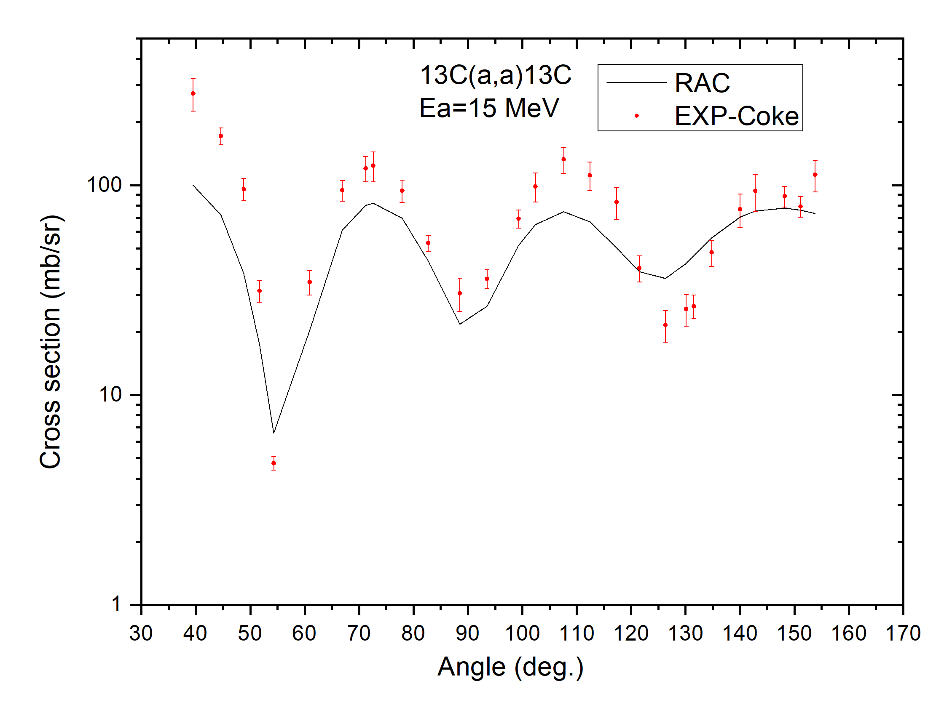
03
¹³C(α,α)
Figure14.
These figures show calculations of differential cross sections for α elastic scattering
We can see that the compliance with the experimental data is still relatively good
27/40

Slide 28
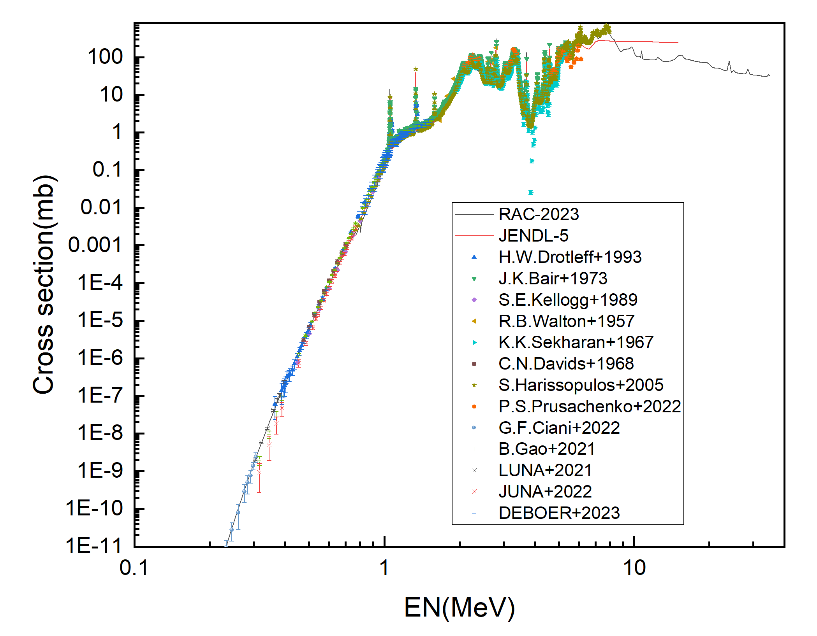
03
¹³C(α,n)
Figure15.
The (α,n) cross section, red line represents JENDL-5,black line represents RAC-2023.
Below 8 MeV, RAC-2023 is close to the experimental value. Above 8 MeV, the (α, n) evaluation depends on other data, especially (n, α) cross section.
The last 6 sets of experimental data in the picture are our latest additions. The new experimental data are mainly in the low-energy section.
28/40

Slide 29
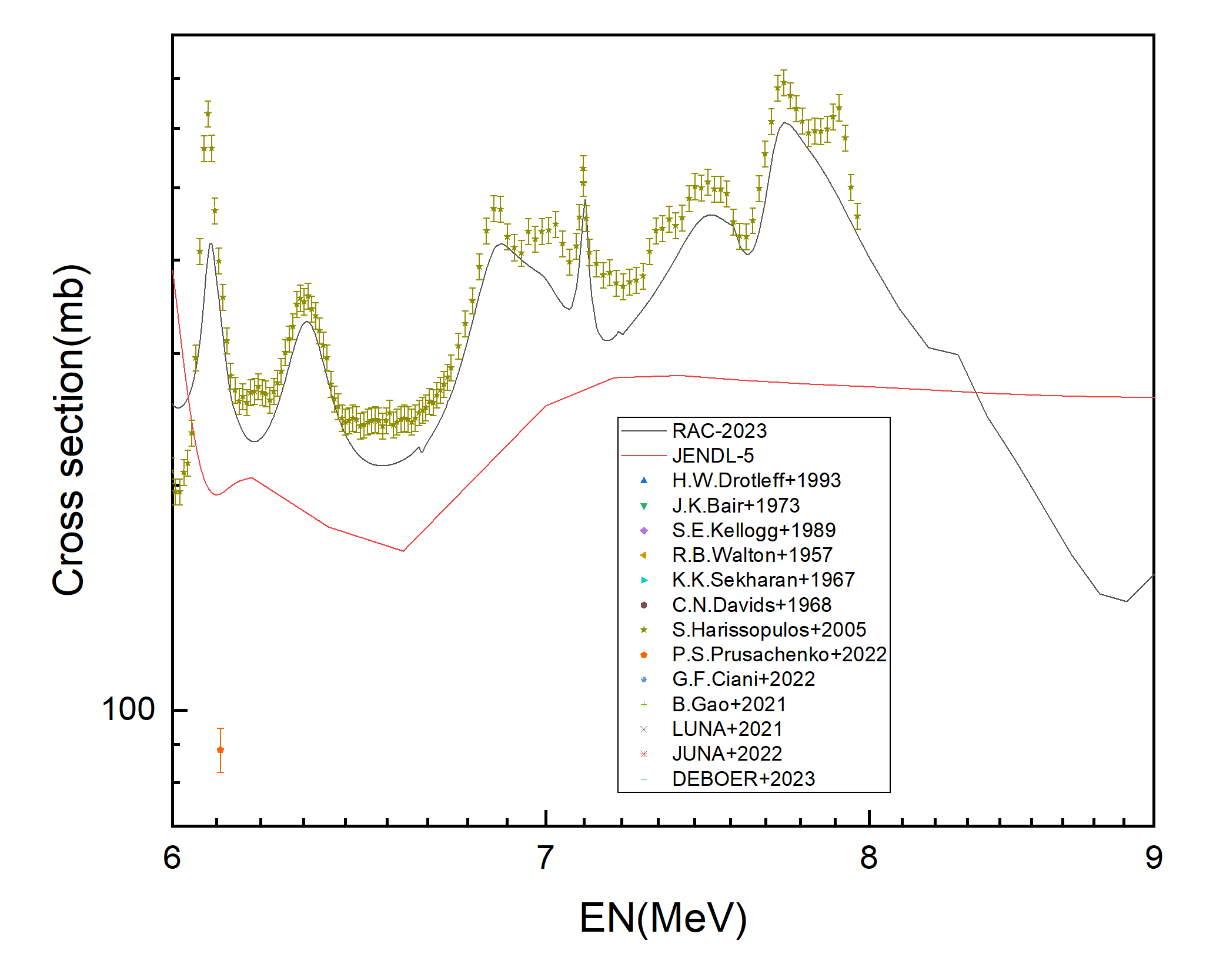
03
¹³C(α,n)
Figure16.
The (α,n) cross section, red line represents JENDL-5,black line represents RAC-2023.
Between 6 and 9 MeV, the RAC calculations improved significantly and conformed well to the experimental values.
29/40

Slide 30
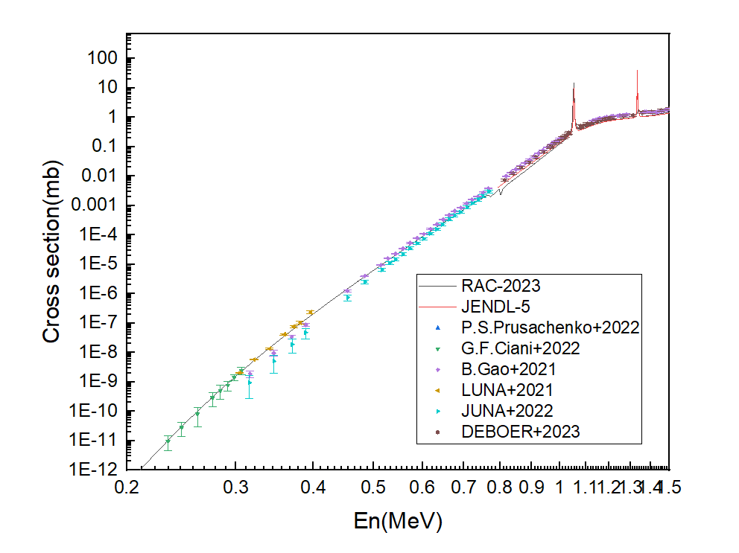
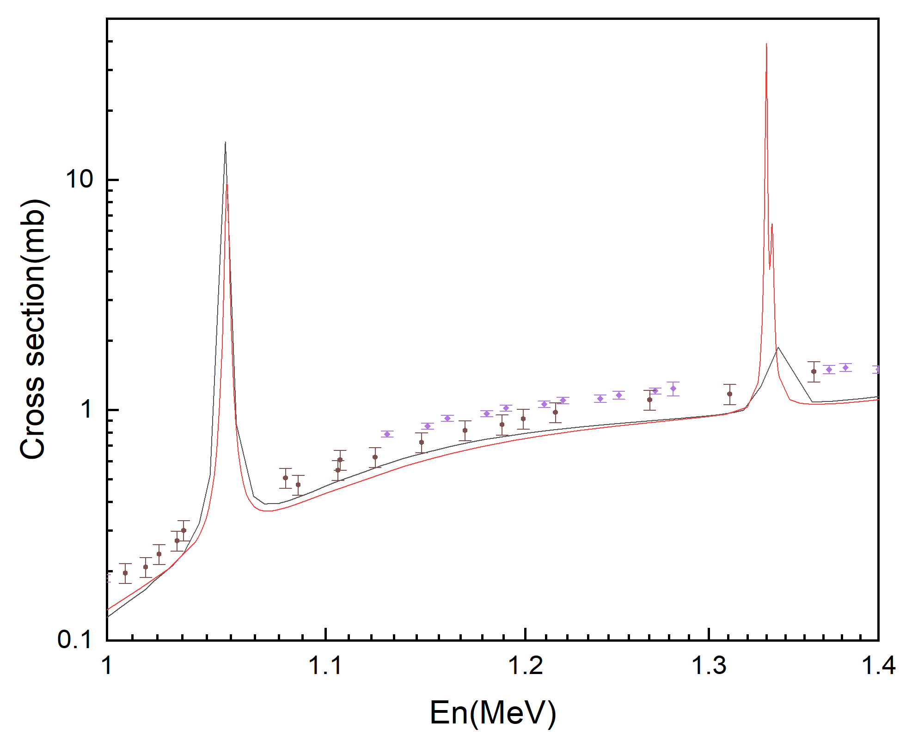
03
¹³C(α,n)
Figure17.
The (α,n) cross section, red line represents JENDL-5,black line represents RAC-2023.
Below 0.8 MeV, The results of the RAC calculations are large compared to the latest experimental data, and the newly added experimental data do not seem to have a good constraining effect, which we continue to optimize.
30/40

Slide 31
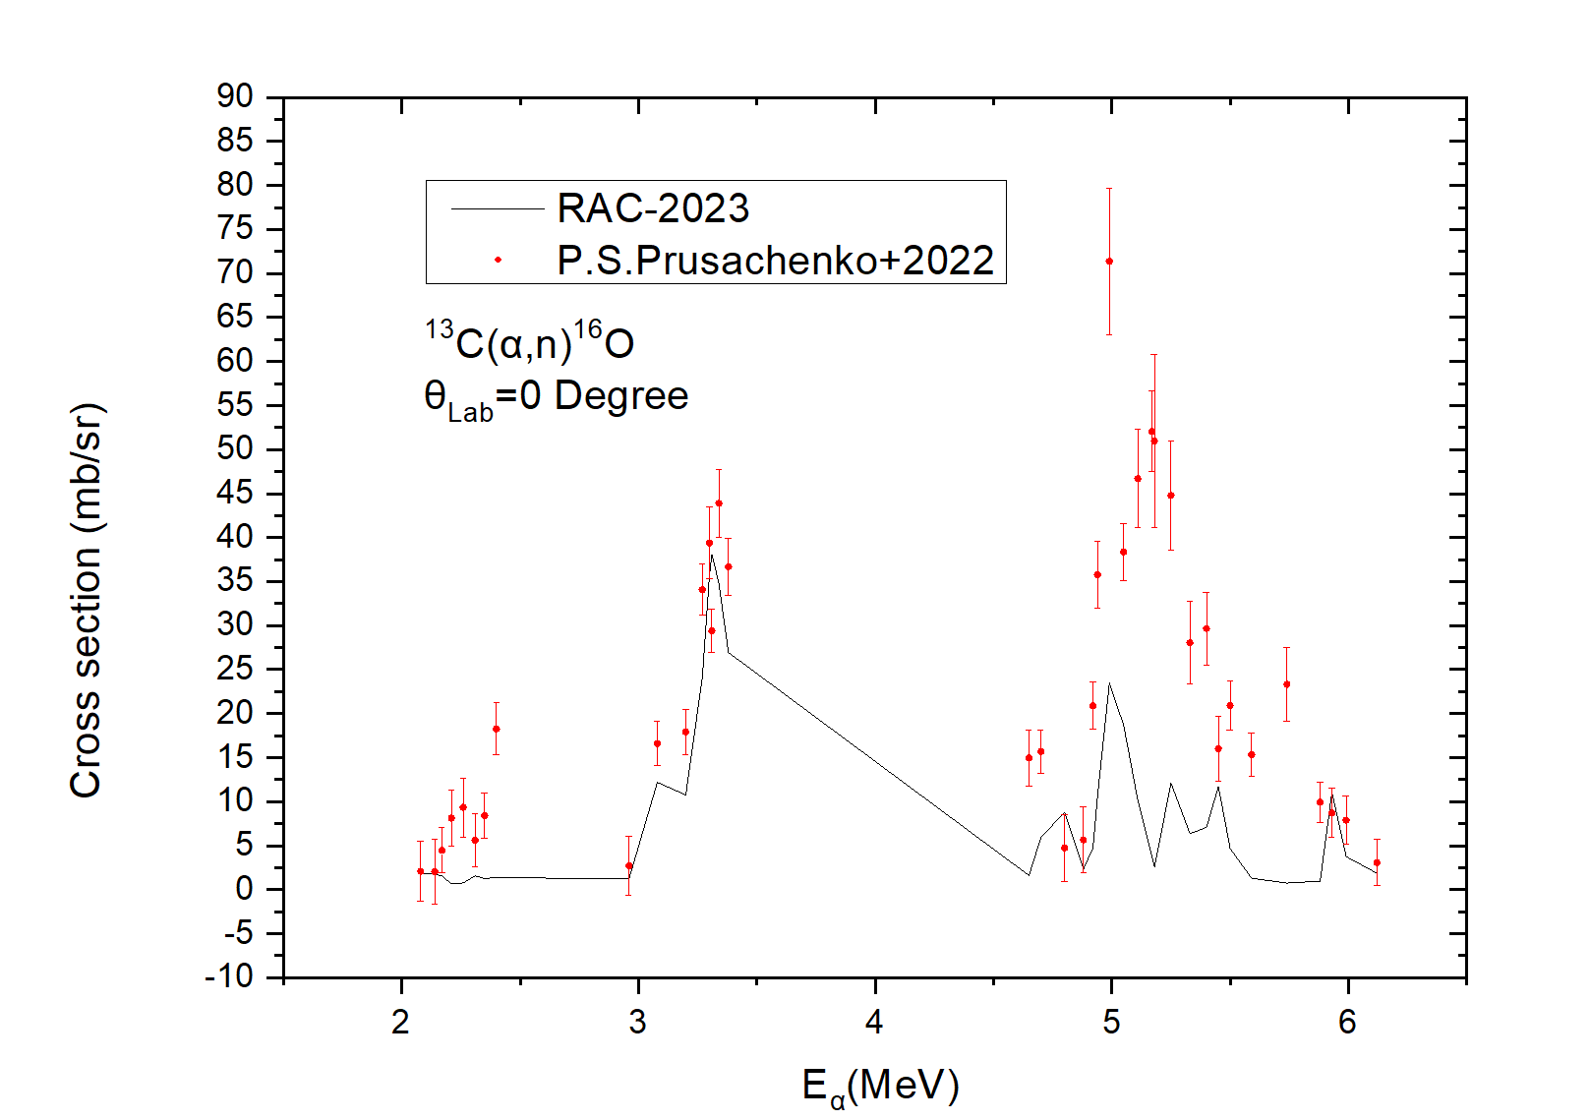
03
¹³C(α,n)
Figure18.
The (α,n) differential cross section,excitation curve of 0 degrees.
Due to time constraints, the new data may not be fully functional in the program, and the current calculated values are somewhat different from the experimental points of the new data.
The current evaluation data still have some peaks and amplitudes close to the experimental data.We're still working on it.
31/40

Slide 32
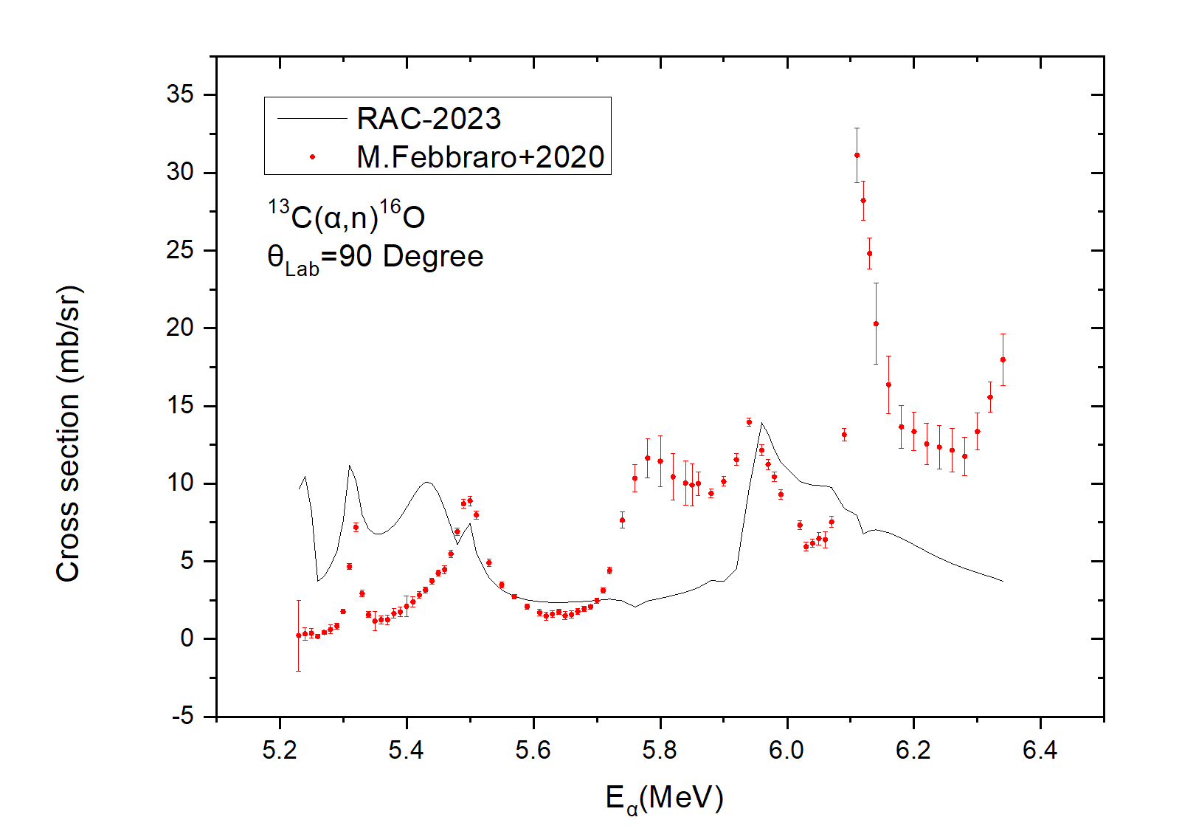
03
¹³C(α,n)
Figure19.
The (α,n) differential cross section,excitation curve of 90 degrees.
The results of the latest evaluation correspond to the experimental points of the two peaks in the low-energy band. They are around 5.3 MeV and 5.5 MeV respectively
Calculations of excitation curves at even higher energies need to be re-optimized
32/40

Slide 33
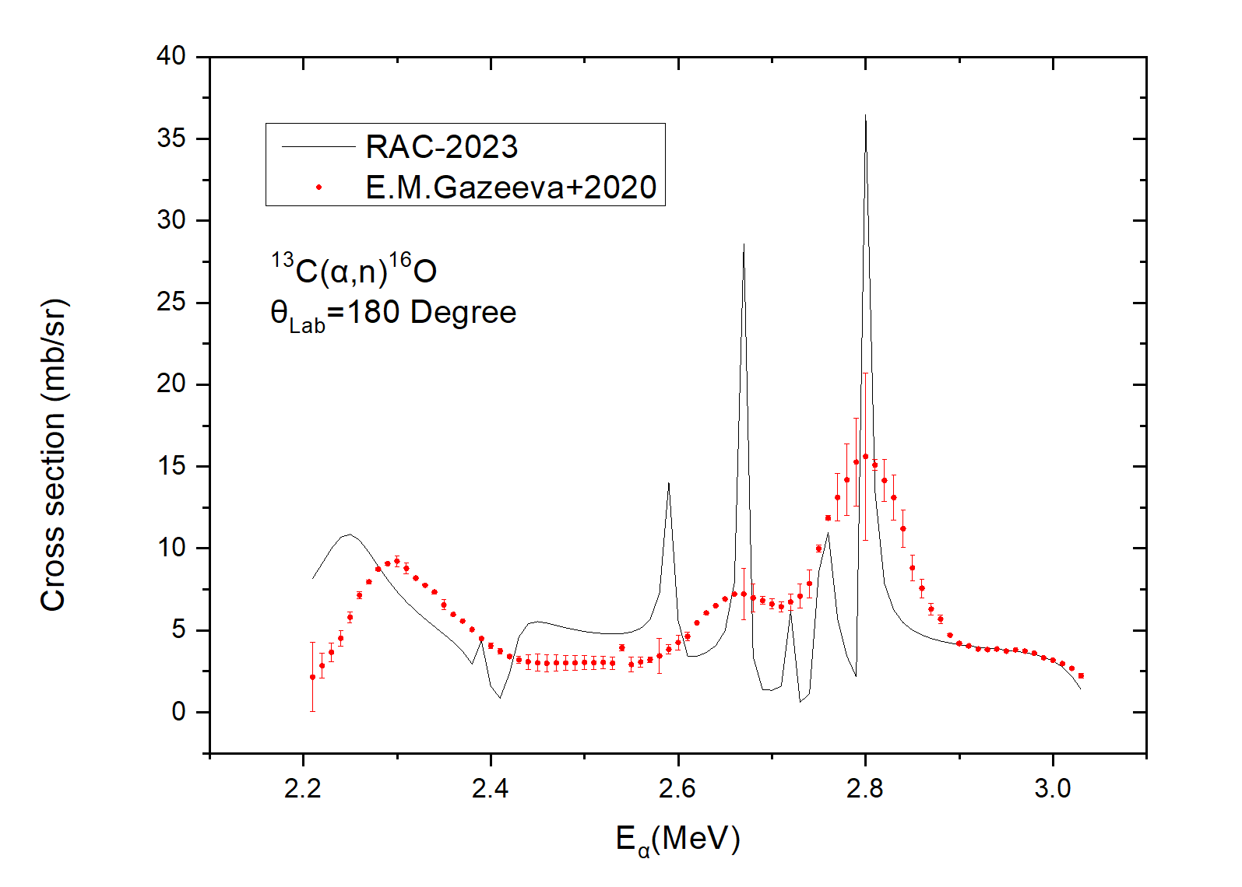
03
¹³C(α,n)
Figure20.
The (α,n) differential cross section,excitation curve of 180 degrees.
For peaks around 2.25 MeV, the RAC calculation is shifted to the left.
The amplitude of the RAC calculations for peaks around 2.65 MeV and 2.8 MeV needs to be improved, and the current calculations are significantly high compared to the latest experimental values.
33/40

Slide 34
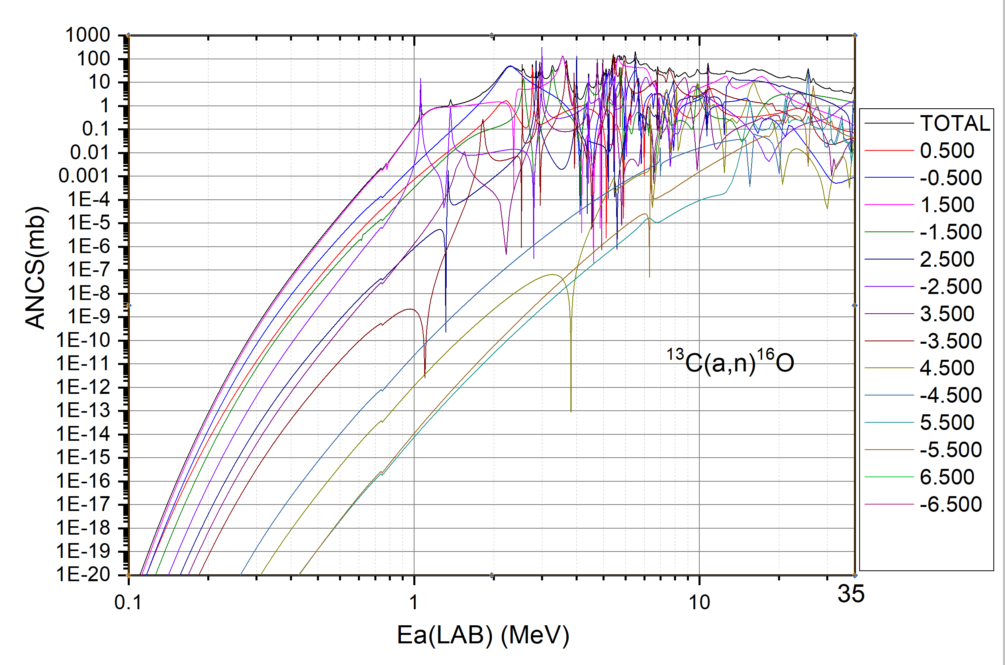
03
¹³C(α,n)
Figure21.
This figure shows the wave splitting of the (α,n) cross section
In the figure, 0.5 represents the level with parity + and total spin 0.5, and -0.5 represents the level with parity - and total spin 0.5. And so on for the other numbers.
In the very low energy region, (a, n) mainly comes from energy level +1.5
34/40

Slide 35
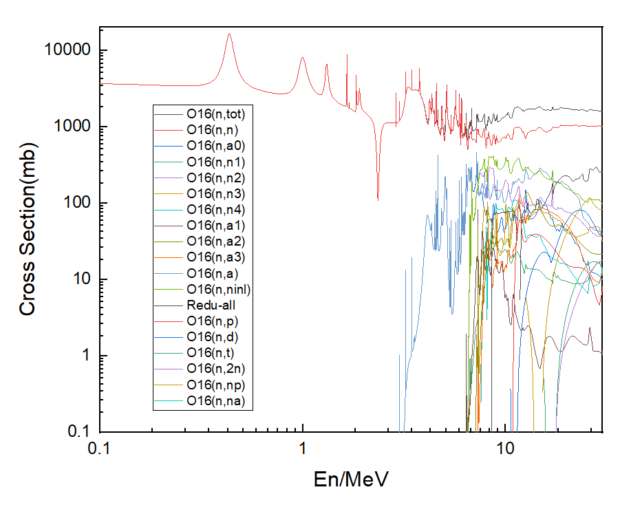
03
¹⁷O system
Figure22.
The calculated neutron incident integral cross section includes: (n, tot), (n, el), (n, inl), (n, n₁), (n, n₂), (n, n₃), (n, n₄), (n, α), (n, α₀), (n, α₁), (n, α₂), (n, α₃), (n, α₄), (n, p), (n, d), (n, t), (n, 2n), (n, np), (n,nα), (n,Redu-all).
This values can be used to make a final file in ENDF-6 format.
35/40

Slide 36
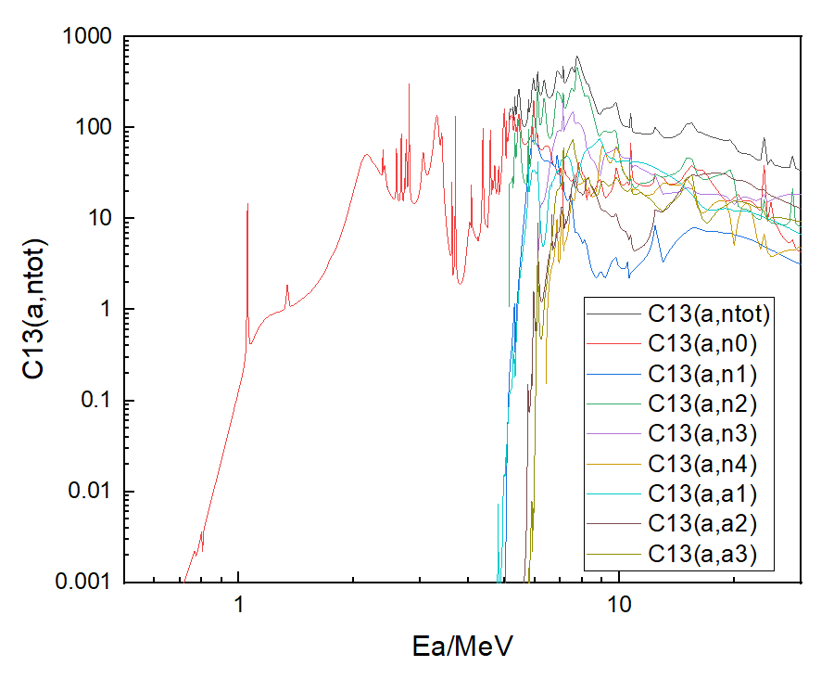
03
¹⁷O system
Figure23.
The calculated α incident integral cross section includes: (α,n_{tot}), (α, n₀), (α, n₁), (α, n₂), (α, n₃), (α, n₄), (α, α₁), (α, α₂), (α, α₃). the (α, n₂) is much bigger than (α, n₁).
This values can be used to make a final file in ENDF-6 format.
36/40

Slide 37
4
CONCLUSION

Slide 38
04
CONCLUSION
Conclusion
In the past few years, some new experimental data about (a, n) and (n, a) have been produced. We added these new data to the original RAC experimental dataset and obtained improved analysis results. In addition to the low energy part of the distinguishable resonance energy region, a better fit is obtained in the higher energy region up to 30 MeV. The practice shows that the reduced R-matrix theory used by RAC is reliable and fully satisfies the unitary property.
We are exploring ways to correctly allocate the contribution of the reduced reaction channel. Our ultimate goal is to build a evaluation files of neutron and charged particle for light nuclear reactions, which may take some years. We are looking for a correct way to give a final files in ENDF-6 format.
38/40

Slide 39
04
CONCLUSION
Conclusion
3.In the evaluation for ¹⁷O,we use a great amount of levels and parameters,so it is difficult to use the parameter file to reproduce the evaluation data file.May be it is better to give out the evaluation results in ENDF-6 format.
39/40

Slide 40
Thanks for your attention！
40/40

