Slide 1




A new evaluation of ¹⁷O system and ¹⁵N system
Zhenpeng Chen¹, Han Xu², Tao Ye³
1 Physics Department, Tsinghua University, Beijing, China
2 Graduate School, China Academy of Engineering Physics, Beijing, China
3 Institute of Applied Physics and Computational Mathematics, Beijing, China
IAEA meeting, 8-29, August，2023

Slide 2
Catalogue
0
Introduction
Simple introduction of improved evaluation for ¹⁷O system
New evaluation for ¹⁵N system
Conclusion

Slide 3
Introduction
1
The classical reduced R-matrix theory^{[1]}, covariance statistics^{[2]} and the corresponding program RAC^{[3]} are used to complete this work. Which has been introduced before, and not be repeated here. The following describes the status of RAC fitting experimental data and compares it with ENDF/B VIII.0 and JENDL-5.
[1] A.M. Lane, R.G. Thomas, Rev. Mod. Phys. 30, 257 (1958)
[2] D.L. Smith, Probability, Statistics, and Data Uncertainties in Nuclear Science and Technology (ANS, Chicago, 1991)
[3] Z.P. Chen, R. Zhang, Y.Y. Sun, T.J. Liu, Science in China (Series G) 46, 225 (2003).

Slide 4
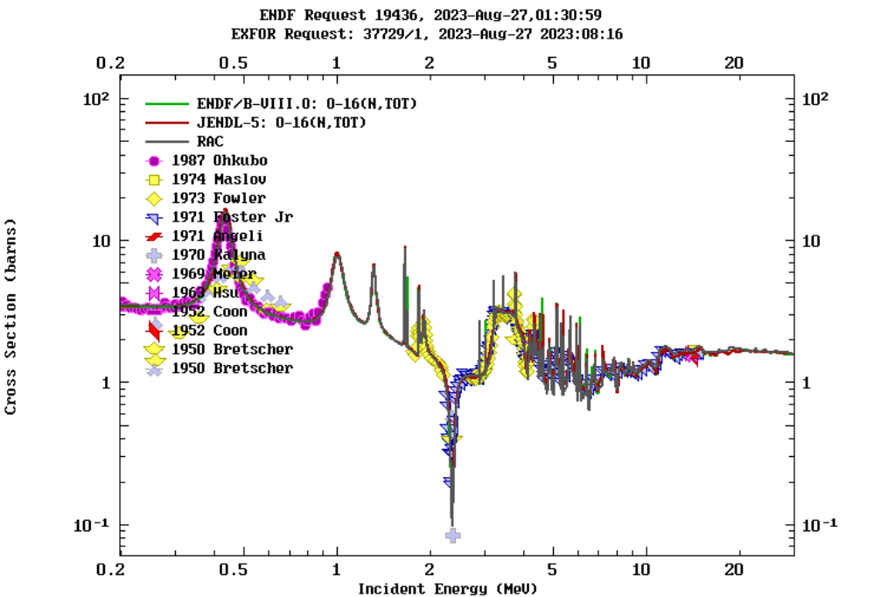
¹⁷O system
2
Figure1. The (n, tot) cross sections. Green line is ENDF,red line is JENDL,gray line is RAC.From 0.2 to 30 MeV, they are very close in this comprehensive fitting, the data of (n, tot) plays a dominant function.

Slide 5
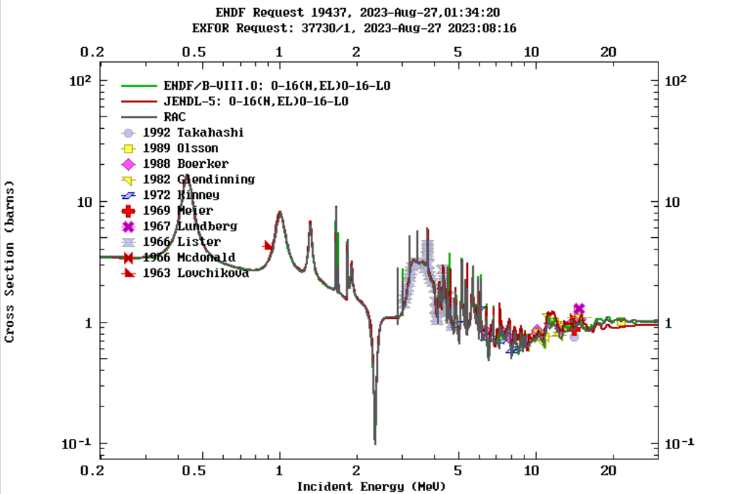
¹⁷O system
2
Figure2. The (n, el) cross section,. Green line is ENDF,red line is JENDL,gray line is RAC.Below 20 MeV, they are very close, In this region, the elastic scattering differential cross section plays the decisive role. Above 18 MeV, JENDL-5 is a little lower, but in this area lacks experimental data constraints.

Slide 6
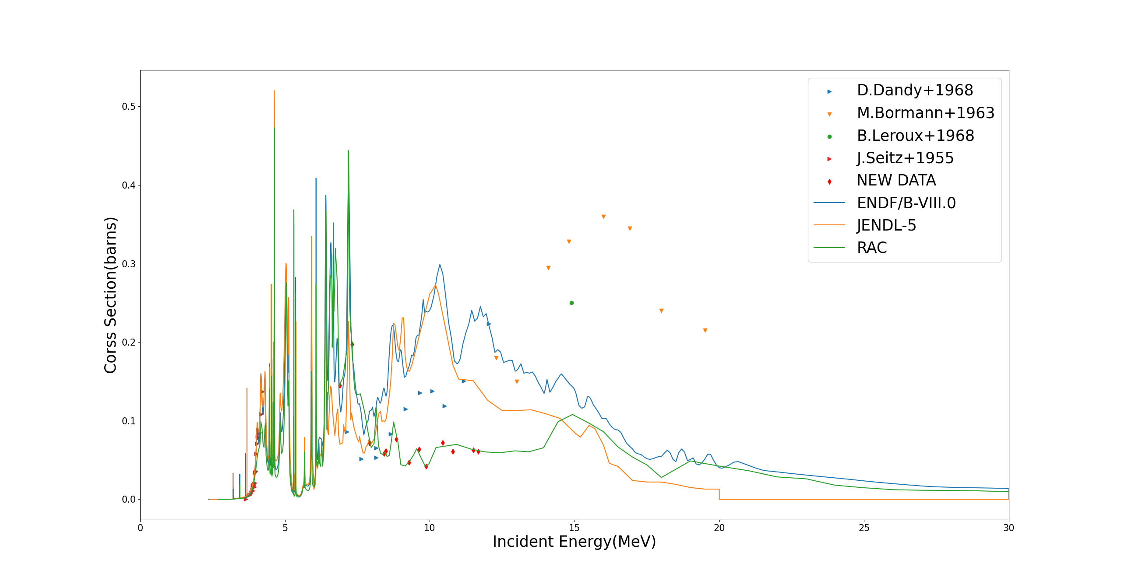
¹⁷O system
2
Figure3. The (n, α) cross section, Below 7 MeV, they are very close. From 7 to 14 MeV, RAC is significantly lower than ENDF/B VIII.0 and JENDL-5, and is closer to the new data from Peking University. From 14 to 15 MeV, RAC, ENDF/B VIII.0 and JENDL-5 have larger difference between them. From 15 to 30 MeV, RAC is closer to ENDF/B VIII.0, and JENDL-5 looks lower. It should be emphasized here that in this kind of comprehensive evaluation, the fitting value of (n,α) of RAC depends on all experimental data instead of (n,α) data merely.

Slide 7
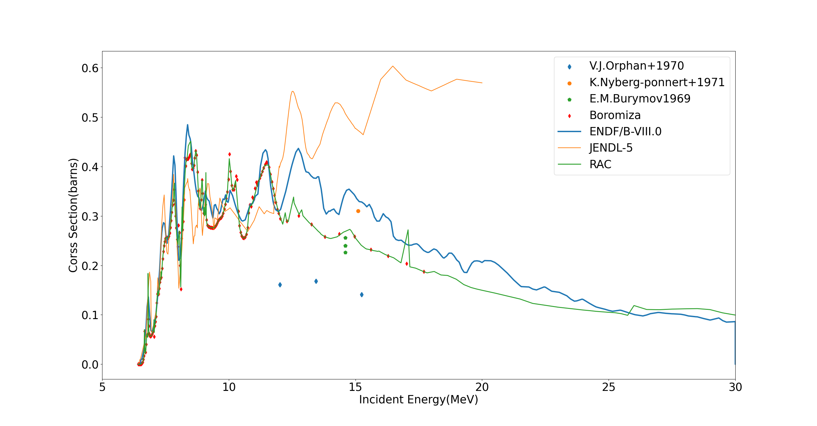
¹⁷O system
2
Figure4. The (n, inl) cross section, Below 12 MeV, they are very close. Above the 12 MeV, there is a significant difference, but RAC is closer to the latest experimental data (red points), that is from Boromiza on (n, inl), which play a positive role of constraint and obvious improvement. It may have a positive effect on (n,α) and (α,n) evaluation improvement.

Slide 8
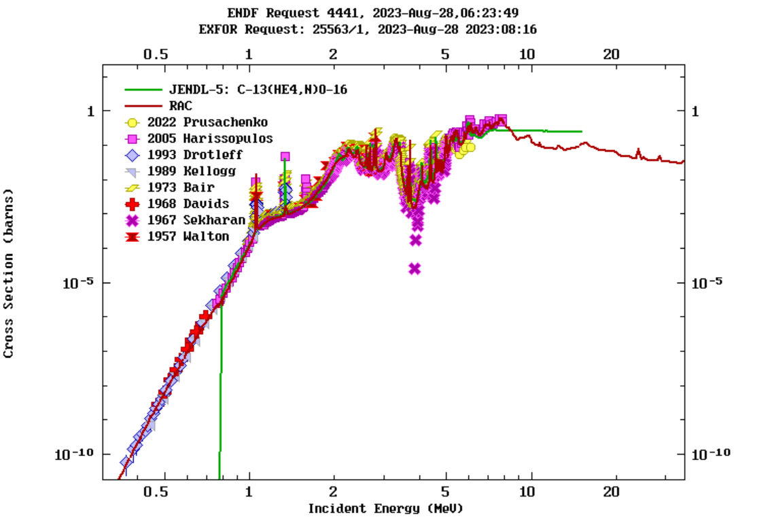
¹⁷O system
2
Figure5.1. The (α, n) cross section.Green line is JENDL,red line is RAC.In the whole energy region, RAC looks good, especially in 6 to 8 MeV, RAC have a significant improvement than the fitting in 2021.

Slide 9
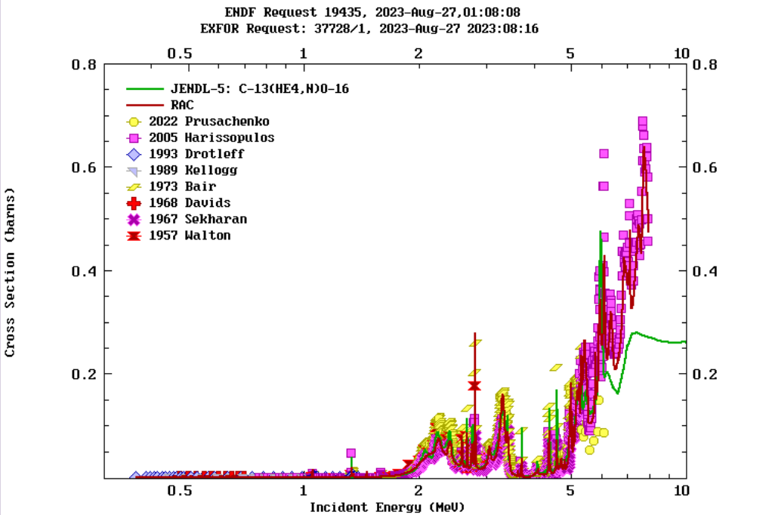
¹⁷O system
2
Figure5.2. The (α, n) cross section, Compared with the previous fitting in 2021, Between 6 to 8 MeV, RAC have a significant improvement.It is closer to the experimental data. JENDL-5 looks lower than the data.

Slide 10
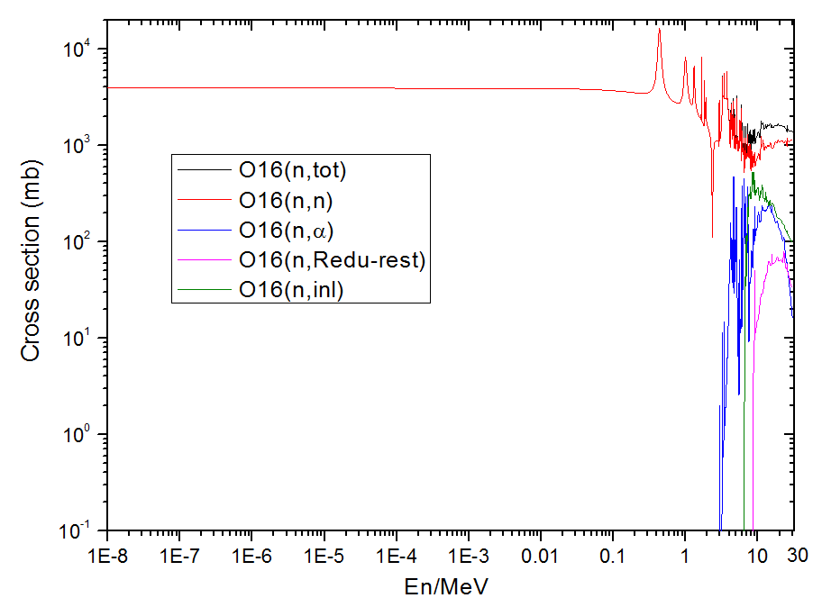
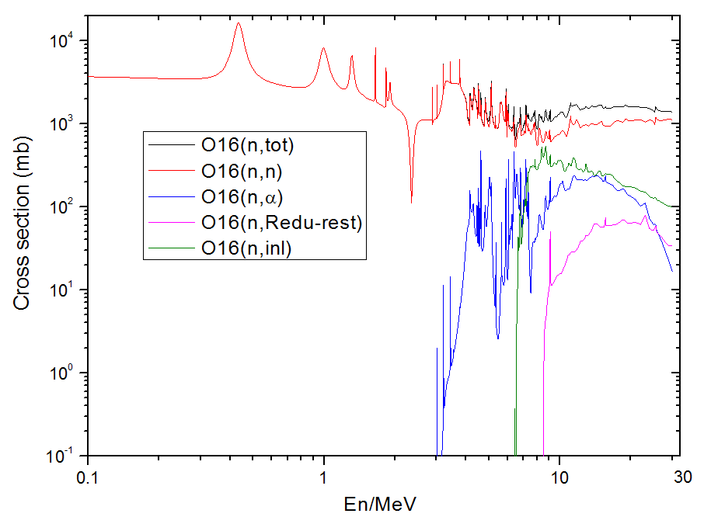
¹⁷O system
2
The calculated integral cross section includes: (n, tot), (n, el), (n, inl), (n, n1), (n, n2), (n, n3), (n, n4), (n, α), (n, α0), (n, α1), (n, α2), (n, α3), (n, α4), (α, n), (α, n0), (α, n1), (α, n2), (α, n3).
Figure6. This values can be used to make a final file in ENDF-6 format.The (n, tot),
(n, el), (n, inl), (n, α), and (n, Redu-rest),
(n, Redu-rest)=(n,p)+(n,d)+(n,t)+(n,2n)+(n,others)

Slide 11
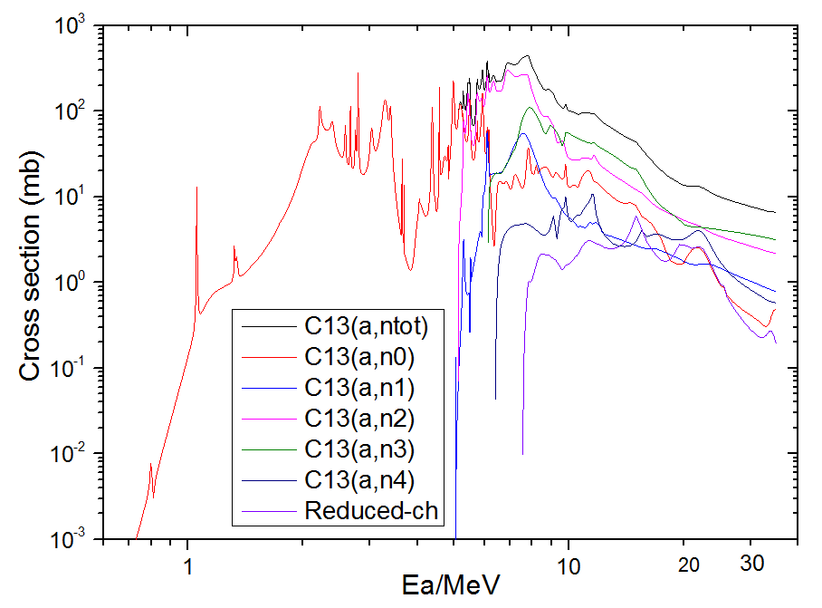
¹⁷O system
2
The calculated integral cross section includes: (n, tot), (n, el), (n, inl), (n, n1), (n, n2), (n, n3), (n, n4), (n, α), (n, α0), (n, α1), (n, α2), (n, α3), (n, α4), (α, n), (α, n0), (α, n1), (α, n2), (α, n3).
Figure7. The (α, n_{tot}), (α, n₀), (α, n₁), (α, n₂), (α, n₃), (α, n₄). the (α, n₂) is much bigger than (α, n₁).

Slide 12
¹⁷O system（new data）
3
Figure8.RAC use new data from Peking University (black line).The new data is significantly higher than the G.Giorginis’s data (black),which is the result of relative measurement, made the normalization to the E.A.Davis’s data (silver red). According to some past evaluations which include David’s, it is found that above 5 MeV David’s data is systematically lower. So, the G.Giorginis’s data will be lower. The new data from Peking University are more reliable.

Slide 13
¹⁷O system
2
The Peking University experimental group continues to carry out new measurements in the resolvable resonance region,which will include more energy points, about (n, α), to form a continuous excitation curve. So, the evaluation of ¹⁷O system will be improved continually.
Next we will introduce the primary evaluation of ¹⁵N system.

Slide 14
¹⁵N system
3
For ¹⁵N system, include 15 retained channels:
  'N14(N,N0)N140' 'N14(N,4HE)11B0 ' 'N14(N,4HE1)11B* '
  'N14(N, N1)N141' 'N14(N, P)C140 ' 'N14(N, D)C130 '
  'N14(N, T)C120' 'N14(N,4HE2)11B2' 'N14(N,4HE3)11B3 '
  'N14(N, N2)N142' 'N14(N, N3)N143' 'N14(N, N4)N144 '
  'N14(N, N5)N145' 'N14(N, N6)N146 ' 'B11(4HE,4HE)B11 '

Slide 15
¹⁵N system
3
  In the present work, which uses the 'Generalized least squares method' and the 'Reduced R-matrix model' to simultaneously analyze all available experimental data on a nuclear system, which has been reported before.The relationship between different channels of the ¹⁵N system is described as follows:
  (n,tot) = (n,el) + (n,inl) + (n,α) + (n,p) +(n,d) +(n,t) +(n,left)
  (n,inl) = (n,n_{1,2,3,4,5,6)} + (n,inl_{else})
  (n,α) = (n,α_{0,1,2,3}) + (n,α_{else})
  (n,all_{else}) = (n,inl_{else}) +(n,α_{else}) +(n,left) = (n,tot) - (n,all_{r})

Slide 16
¹⁵N system
3
  (n, tot) represents the contribution from all channels of the ¹⁵N system. (n, all_{r}) represents the contribution from retained channels , which includes the contribution from (n, n_{0,1,2,3,4,5,6}), (n, α_{0,1,2,3}), (n, p), (n, d) and (n, t),which have some available experimental data.
  (n, inl_{else}) and (n, α_{else}) mean the reduced channel from (n, inl) and (n, α), respectively. (n, left) represents the contribution from all left channels, that is the multibody-reaction.
  (n,tot) = (n,el) + (n,inl) + (n,α) + (n,p) +(n,d) +(n,t) +(n,left)
  (n,inl) = (n,n_{1,2,3,4,5,6)} + (n,inl_{else})
  (n,α) = (n,α_{0,1,2,3}) + (n,α_{else})
  (n,all_{else}) = (n,inl_{else}) +(n,α_{else}) +(n,left) = (n,tot) - (n,all_{r})

Slide 17
¹⁵N system
3
  Next,we describes the preliminary evaluation for ¹⁵N system, which include new data from Peking Univerisity.

Slide 18
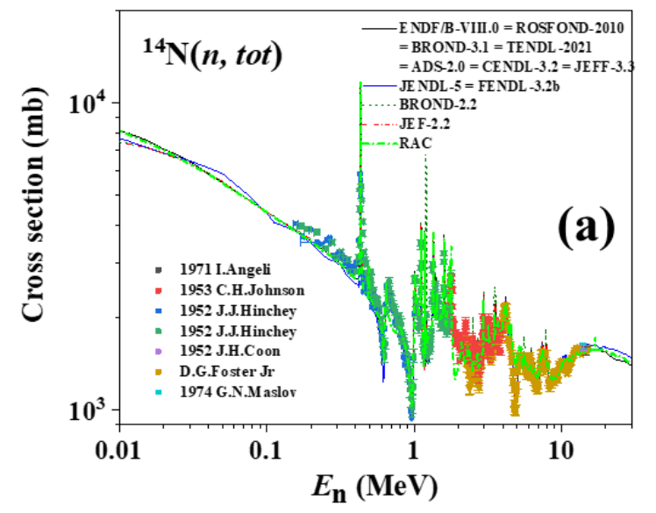
¹⁵N system
3
Figure9. The (n, tot) cross section. Below 20 MeV,RAC(green line),ENDF/B-VIII.0(black line),JENDL-5(blue line) and experimental data are very close,but above 20 MeV,only RAC and ENDF/B-VIII.0 looks close, JENDL-5 looks higher than RAC and ENDF/B-VIII.0.

Slide 19
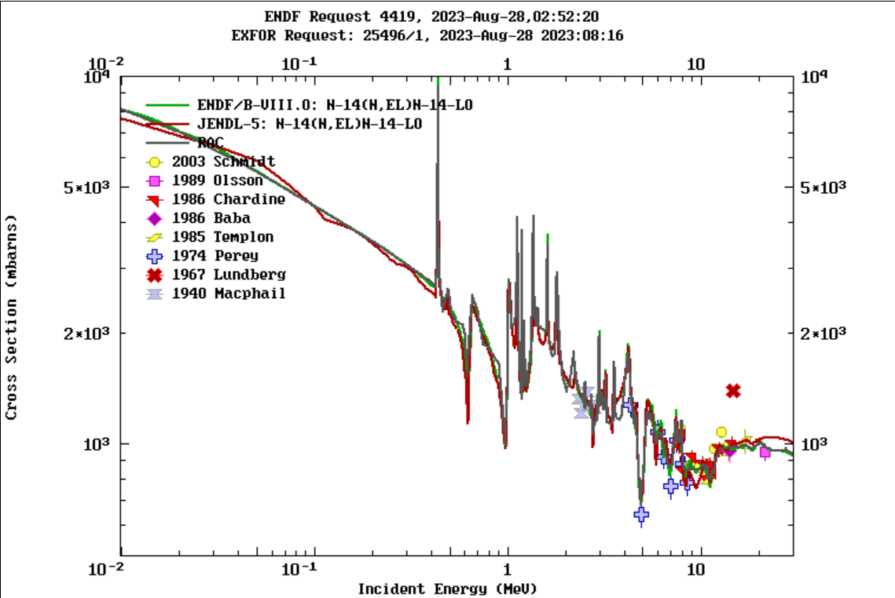
¹⁵N system
3
Figure10.The (n, el) cross section.Green line is ENDF,red line is JENDL,gray line is RAC.it same as (n,tot).A similar trend is shown with a cutoff of 20 MeV

Slide 20
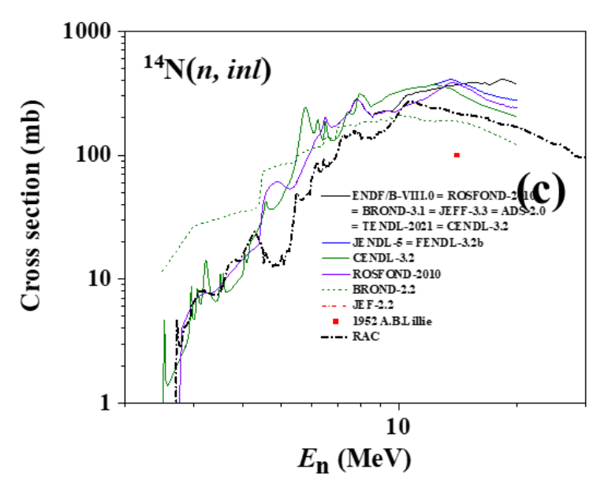
¹⁵N system
3
Figure11.The (n, inl) cross section,There are a lot of evaluation values. Below 4 MeV, they are closed, Above 4 MeV RAC seem to be lower than other values.

Slide 21
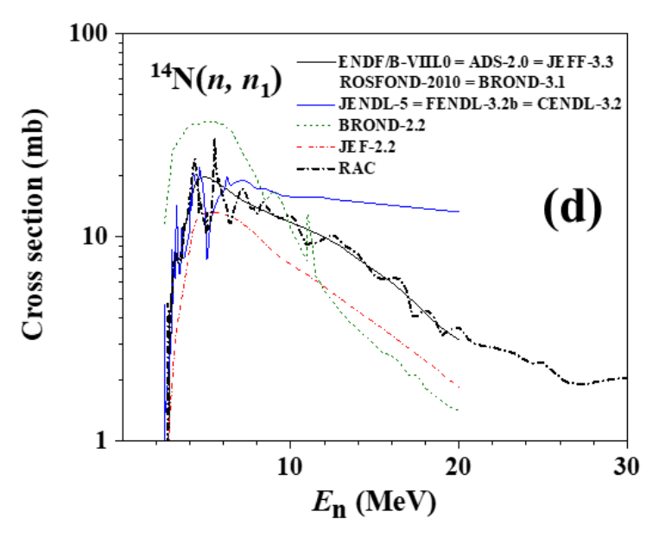
¹⁵N system
3
Figure12.The (n, n₁) cross section,RAC also seem to be in the middle of other values.RAC are very close to ENDF/B-VIII.0.

Slide 22
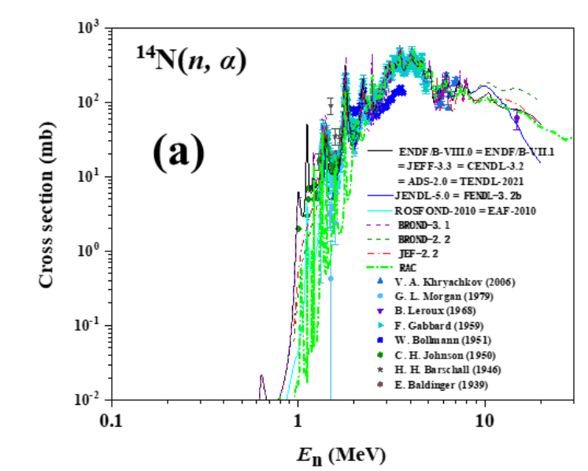
¹⁵N system
3
Figure13.The (n, α) cross section,between 1 to 2 MeV ,the peaks are not well fitted, which need to be improved,between 2 to 8 MeV, RAC looks well,between 8 to 18 MeV, RAC,ENDF/B-VIII.0 and JENDL-5 has a large difference,between 18 to 20 MeV,RAC are close to ENDF/B-VIII.0,More than 20 MeV,RAC looks reasonable.

Slide 23
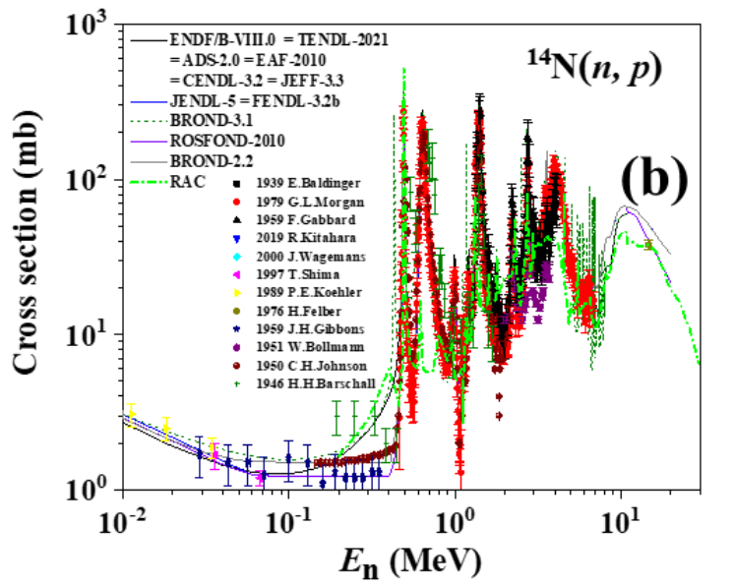
¹⁵N system
3
Figure14.The (n, p) cross section,all the fitting looks good.

Slide 24
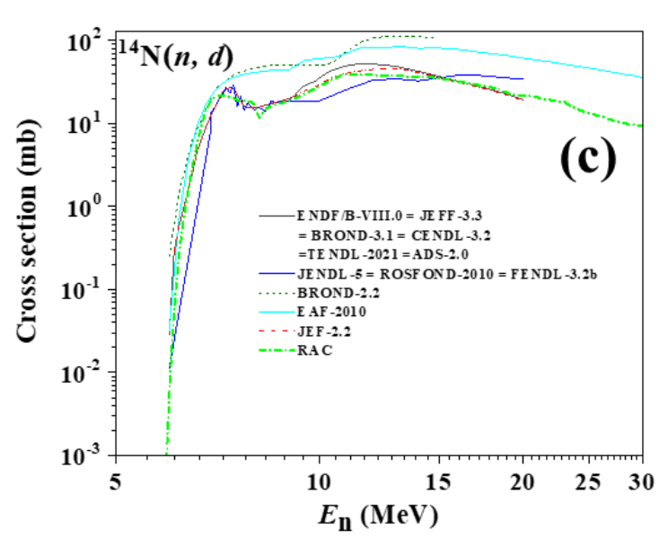
¹⁵N system
3
Figure15.The (n, d) cross section,below 20 MeV,all the evaluation values are closed.Above 20 MeV,RAC (green line) looks reasonable.

Slide 25
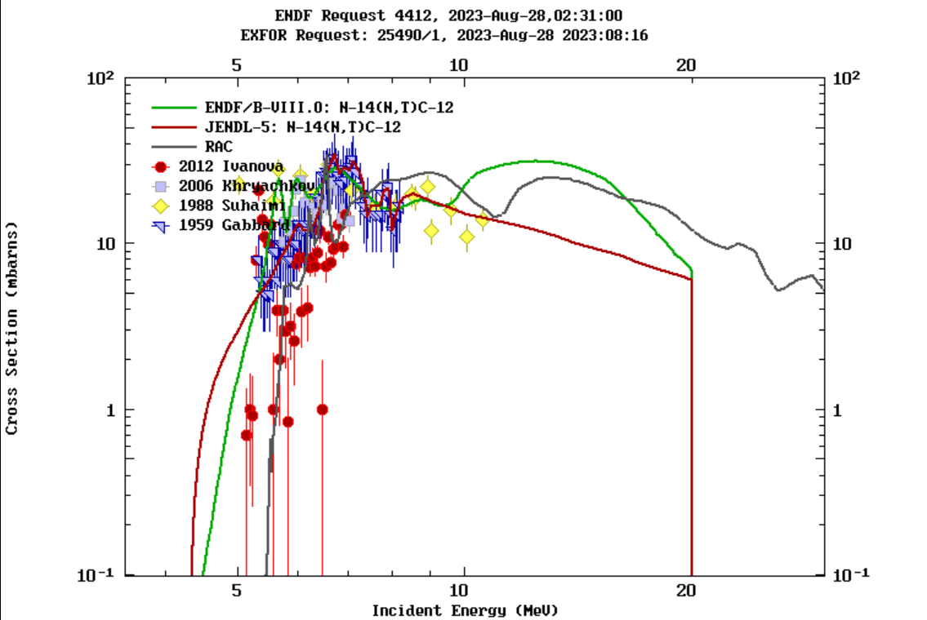
¹⁵N system
3
Figure16.The (n, t) cross section,RAC(gray line) looks reasonable.

Slide 26
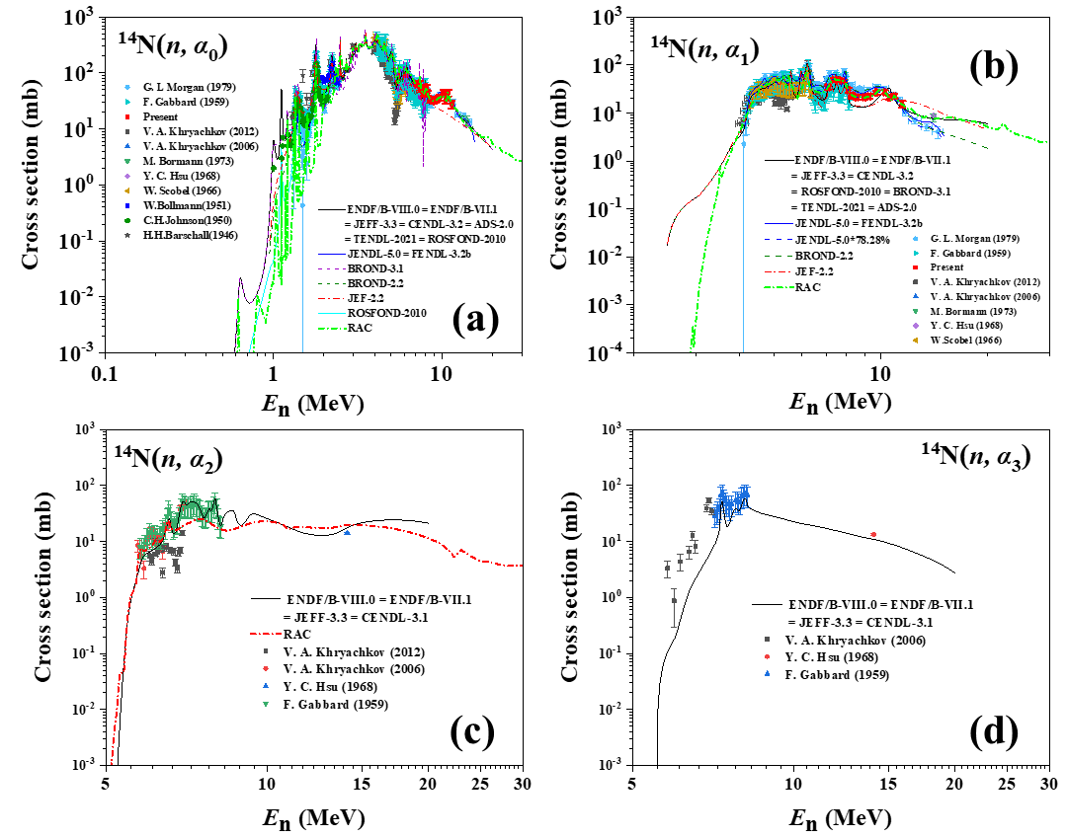
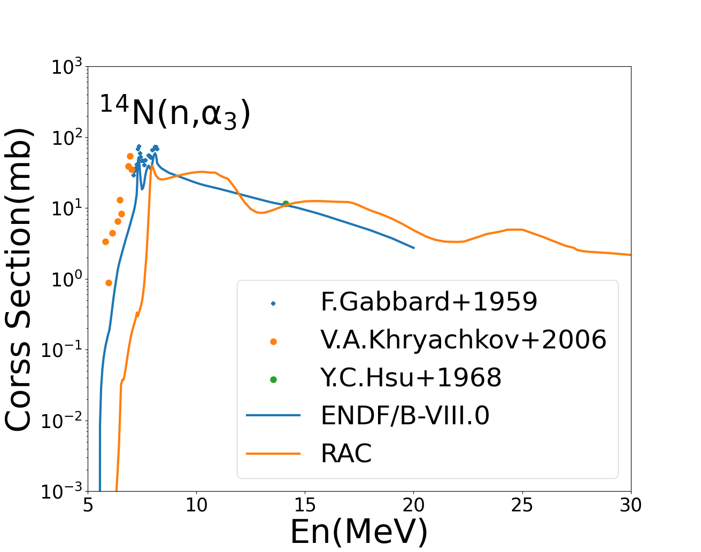
¹⁵N system（new data）
3
Figure17.RAC use new data from Peking University,which has been reported just before.

Slide 27
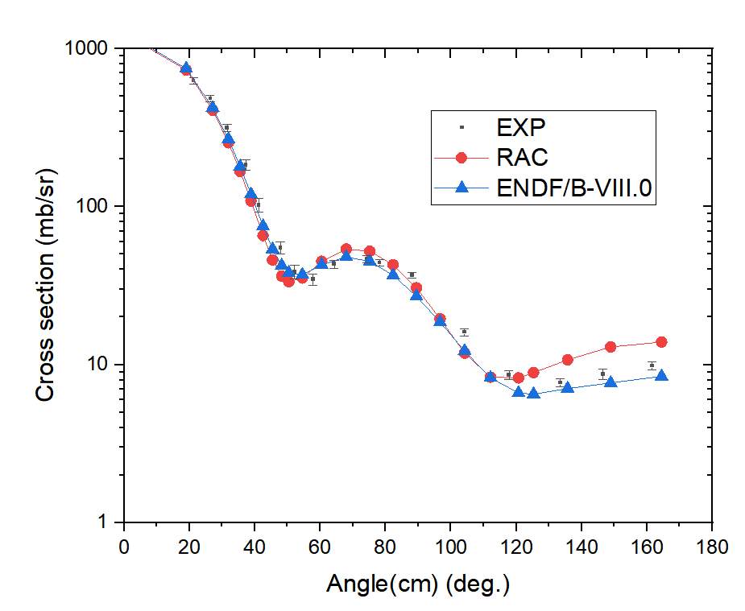
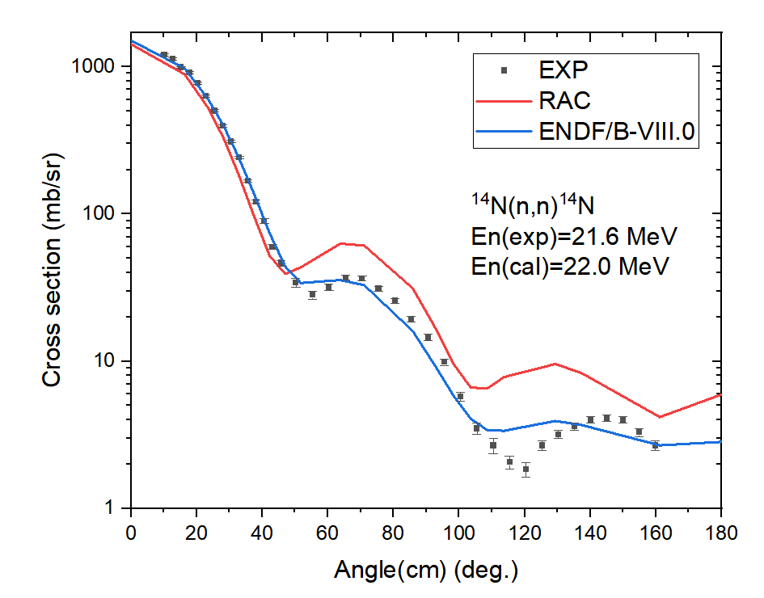
¹⁵N system（new data）
3
Figure18.For ¹⁴N(n,n)¹⁴N,The (n,el) differential cross section is well fitted,but we also need to improve it further.

Slide 28
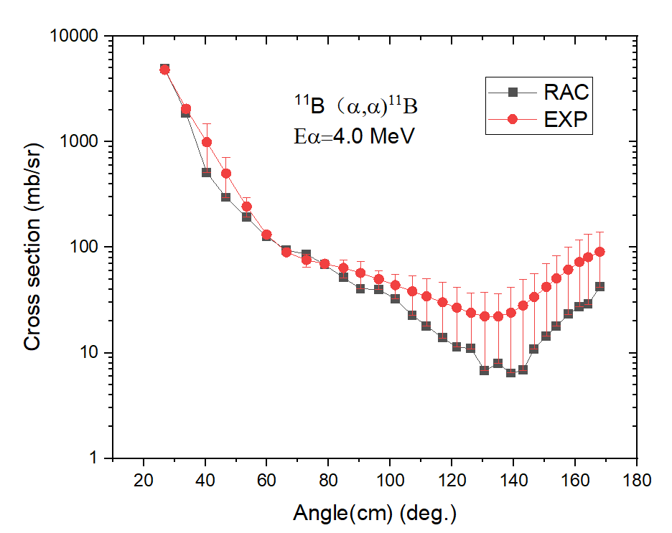
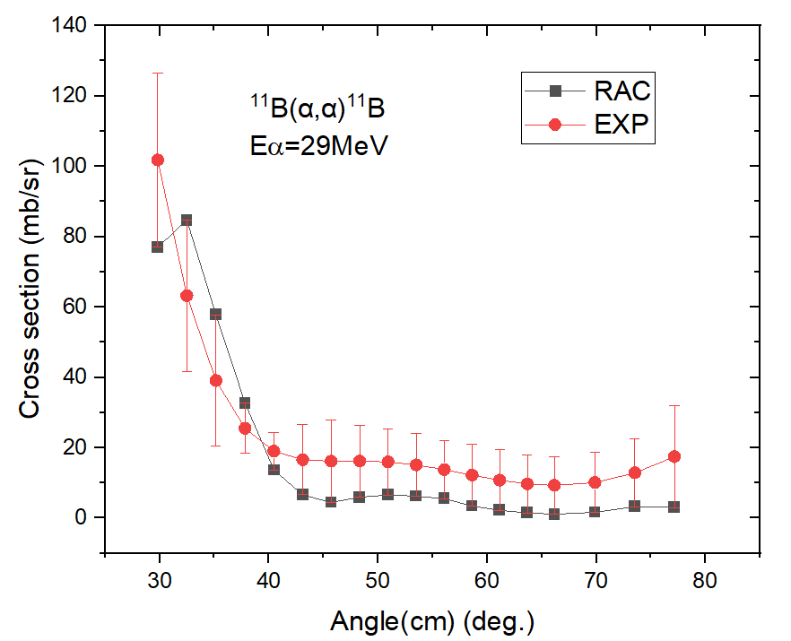
¹⁵N system（new data）
3
Figure18.For differential cross section of ¹¹B(α,α)¹¹B, The elastic differential cross section is well fitted, but we also need to improve it further.

Slide 29
Conclusion
4
In the past two years, the Nuclear experiment research group of Peking University has continuously measured the (n, α) reaction cross sections of n+¹²C, n+¹⁴N and n+¹⁶O from 5MeV to 13.5MeV, and obtained many new experimental data. We added these new data to the original RAC experimental data set and obtained improved analysis results.
In addition to the low energy part of the distinguishable resonance energy region, a better fit is obtained in the higher energy region up to 30 MeV. The practice shows that the reduced R-matrix theory used by RAC is reliable and fully satisfies the unitary property.

Slide 30
Conclusion
4
We are exploring ways to correctly allocate the contribution of the reduced reaction channel. Our ultimate goal is to build a evaluation files of neutron and charged particle for light nuclear reactions, which may take some years. We are looking for a correct way to give a final files in ENDF-6 format.
In the evaluation for ¹³C,¹⁵N,¹⁷O,we use a great amount of levels and parameters,so it is difficult to use the parameter file to reproduce the evaluation data file.May be it is better to give out the calculated cross section in ENDF-6 format directly.

Slide 31
Thanks for your attention!!!

