Slide 1
Update on atomic data and population models for hydrogen and tungsten
Martin O’Mullane and ADAS contributors

Slide 2
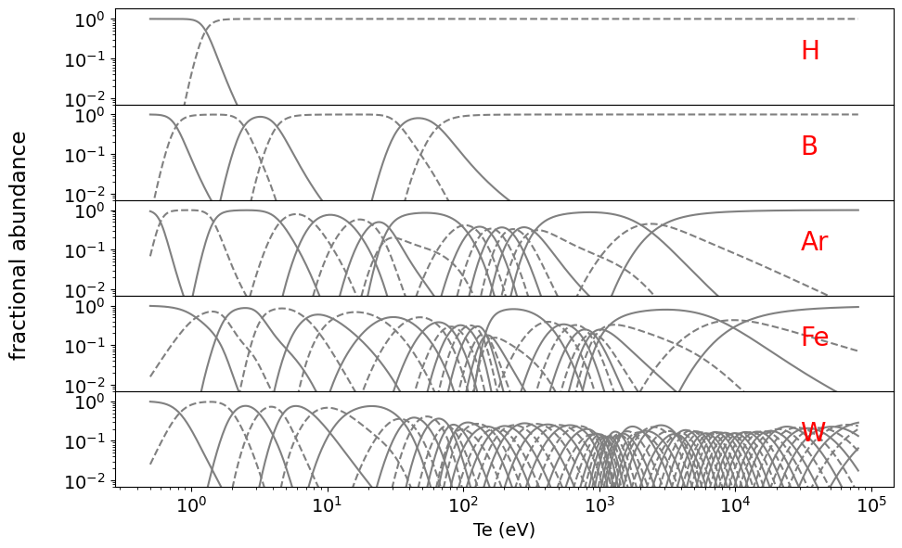
Te-dependence of abundances
Equilibrium balance
effective rate coefficients for ionisation balance
All fundamental atomic data calculated by ADAS group and close collaborators (adf04, adf09, adf48, adf23)
divertor radiation
far SOL
influx
turbulent transport
plasma core
neoclassical accumulation
edge transport barrier
radiative mantle
pedestal
plasma radius (edge to core)

Slide 3
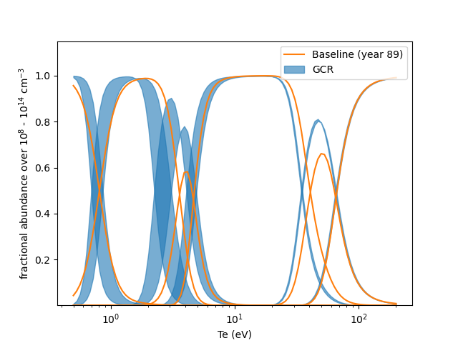
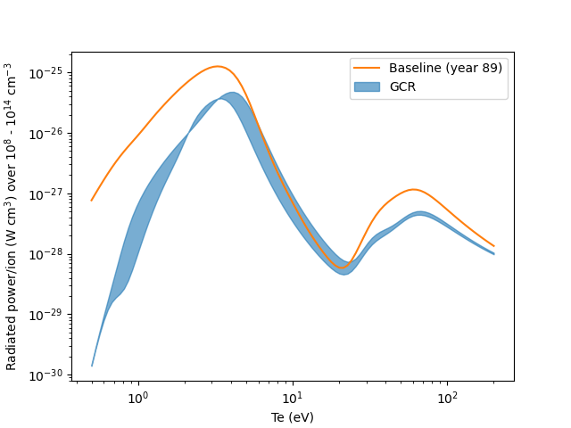
A quick detour to boron
New data exists, based on R-matrix excitation data from QUB with ionization and recombination from ADAS codes.
Simple equilibrium balance – no thermal CX.
The variation with density (from the CR model) may be larger than any uncertainties in the fundamental data.

Slide 4
Outline
Restrict to the atomic domain – molecules and molecular models cover extensively in other presentations
Hydrogen behaviour at low-Te.
e-impact processes at n>1 for hydrogen.
p-impact processes for hydrogen and UQ considerations.
Update on fundamental atomic data for tungsten.
Spectroscopy and modelling of tungsten.

Slide 5
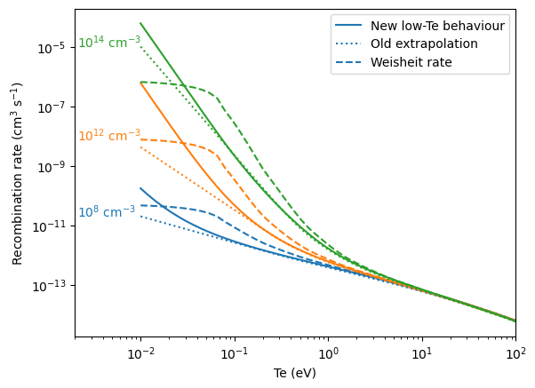
Low Te recombination rate for hydrogen
Te=0.2eV was the lower limit in ADAS adf11 data for hydrogen (acd12_h.dat).
Extrapolation to lower Te assumed a constant slope – reasonable but not when 3-body becomes important.
Weisheit (J Phys B, 1975, vol 8, p2556) data used in B2.5 branch of solps irrespective of what is requested in the input file.

Slide 6
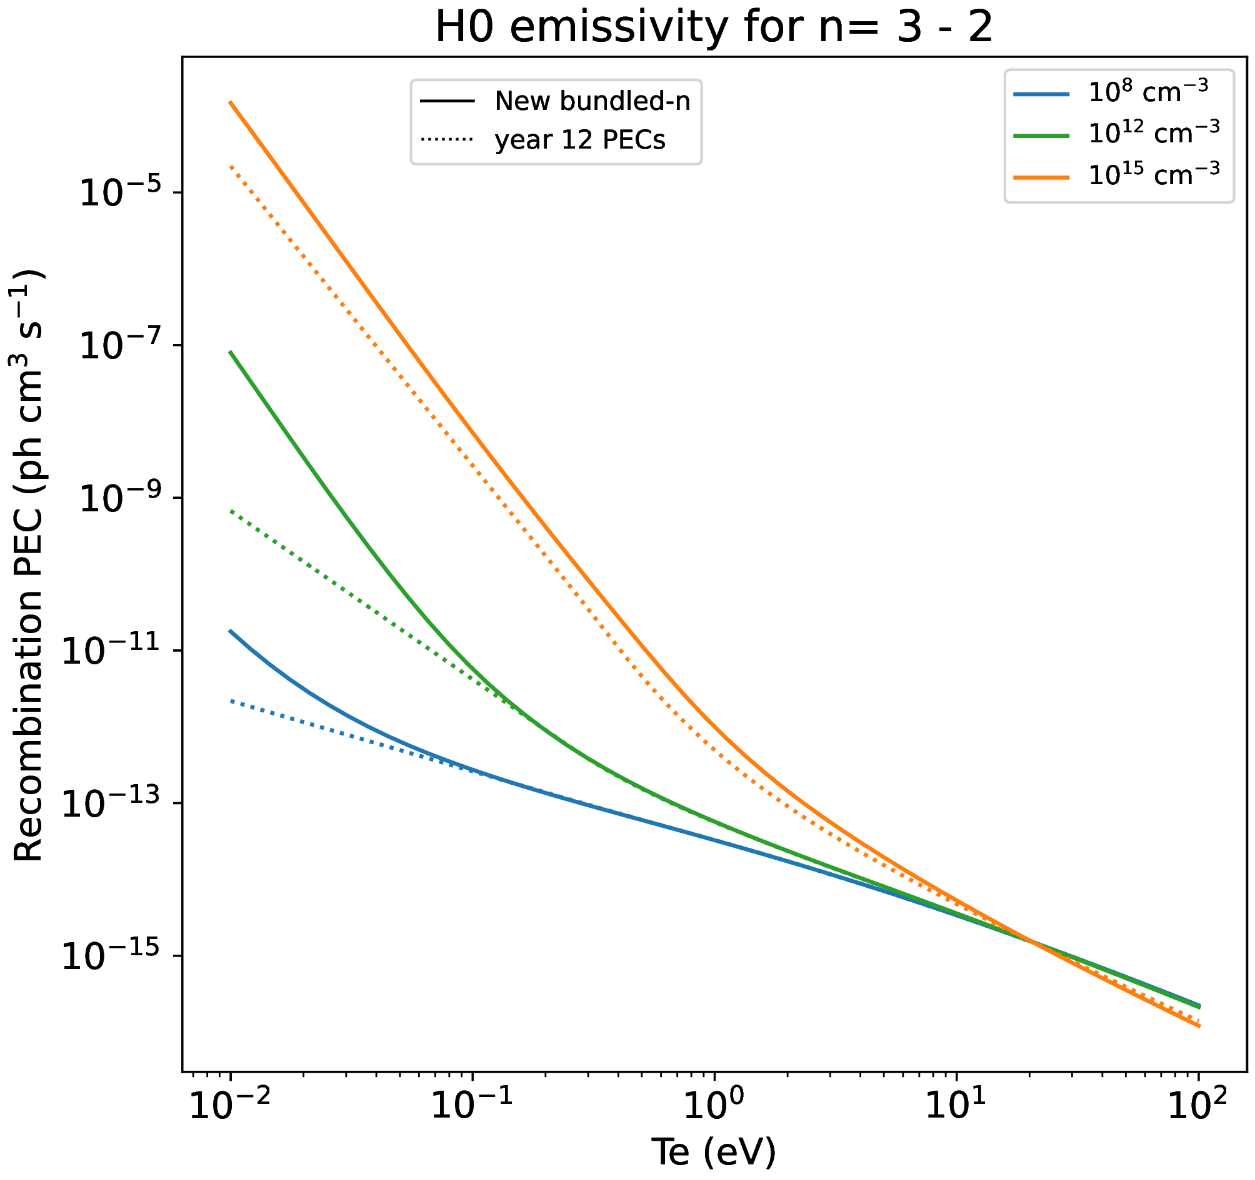
Low Te recombination PECs for hydrogen
Alter the representation of the population enables extension to 100K.
Effect is also seen in the photon emissivity coefficients.

Slide 7
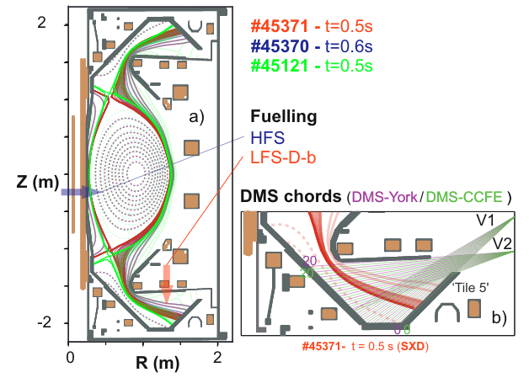
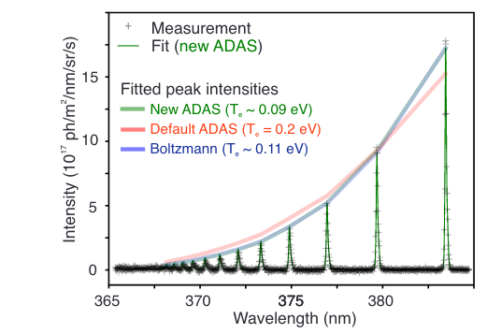
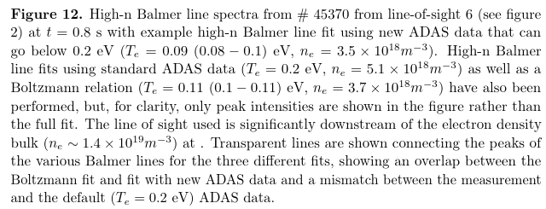
Fit to MAST-U Balmer series
K Verhaegh et al. Nuc. Fus., 126023 (2023)

Slide 8
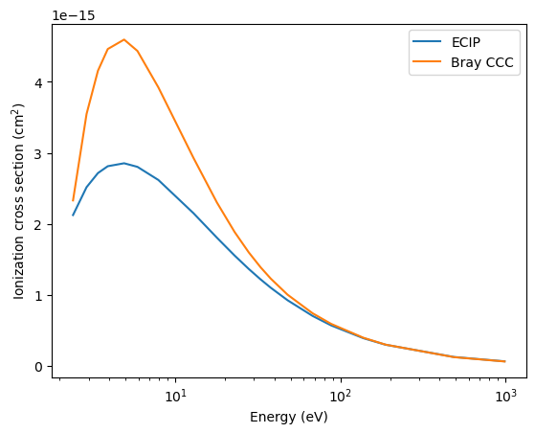
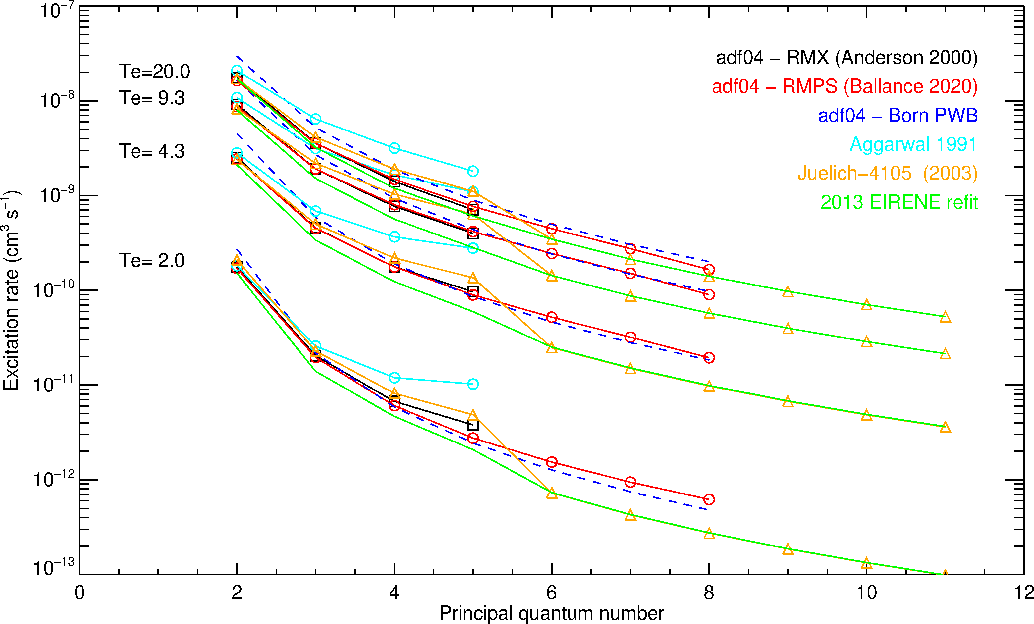
Hydrogen excitation and ionization
R-matrix excitation up to n=8 with RMPS approach.
Can we say the scaling to higher n is established?
ECIP vs CCC for ionization from n=3 excited level.
Does this scale?
To Do: determine the effect on ionization and power balance.

Slide 9
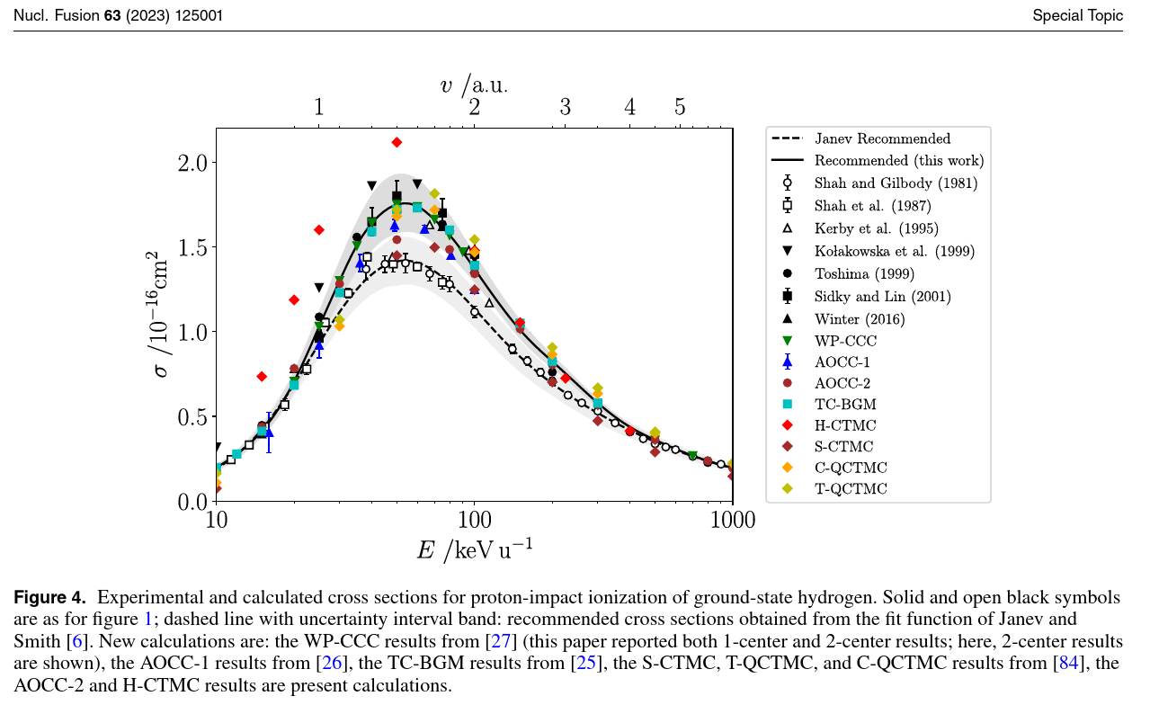
Hydrogen – when do we disbelieve experiment?
p + H⁰ ionization
CRP on atomic data for neutral beams (Hill et al, 2023).
Convergence of sophisticated methods indicate that experimental cross section measurements from the 1980s may not be correct.
How do we incorporate such conclusions into our modelling?

Slide 10
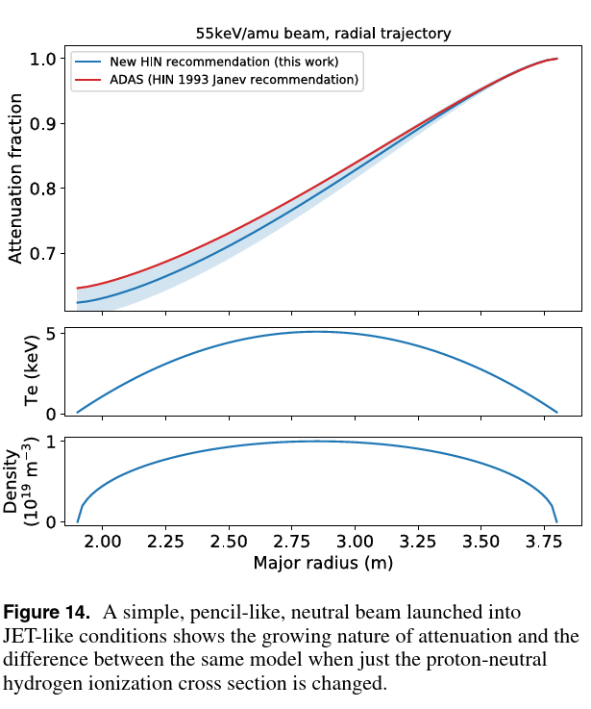
UQ – propagation of uncertainties
Envelope of values can be used to propagate the uncertainty in fundamental data through to measurable quantities.
Tokamaks measurements are rarely good enough to distinguish between competing atomic evaluations.
But we should strive to add an ‘atomic error’ to all predictions from synthetic diagnostics.

Slide 11
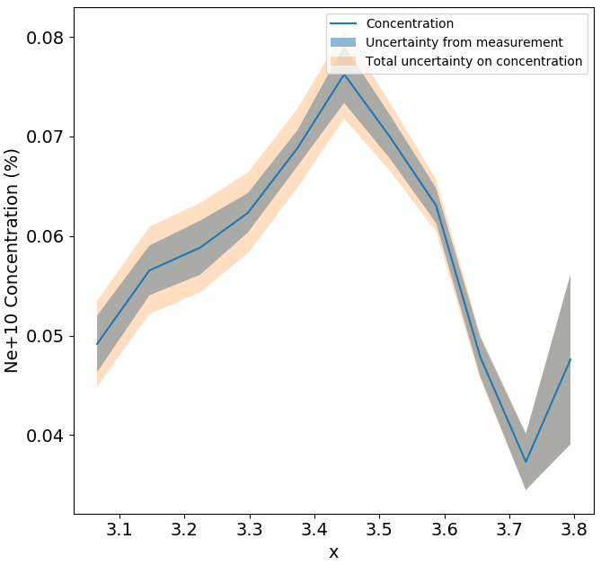
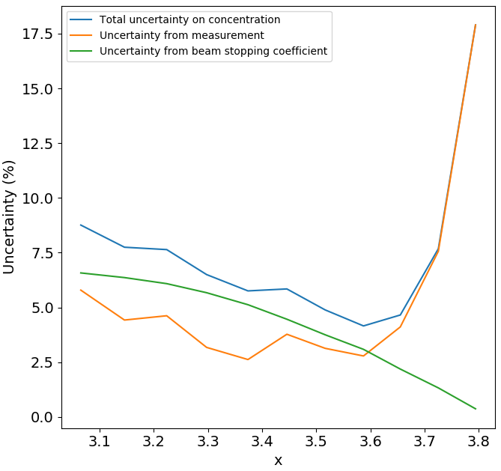
Effect on the concentration
Apply CHEAP to Ne10+ concentration measurement with: bms-sd bms bms+sd
and separate out the new ‘atomic error’
Uncertainties on the diagnosed parameter due to atomic inputs are of same order as measurement errors.
Important to properly determine this uncertainty and to reduce it as much as possible.

Slide 12
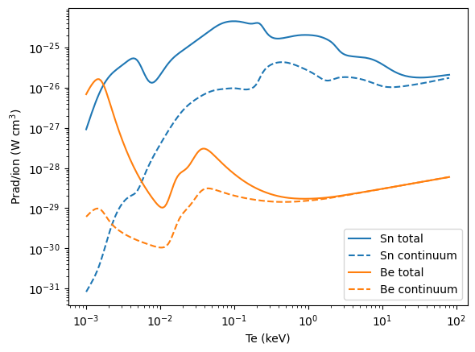
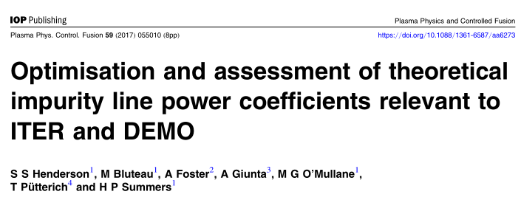
Extending adf11 data format – adding energy-resolution
Two types of ADAS power coefficients – line (PLT) and continuum (PRB)
current adf11 power data are not energy resolved
line power (PLT) is the sum of all the transitions in the adf04 dataset
GCR improves the PLT value by projecting the influence of upper levels onto the adf04 set – these are Rydberg bundle-n levels.
power arising from omitted configurations is absent – but this is a good model for light elements
for higher Z (higher than Mo, 42) including all configurations that contribute a noticeable fraction (~1% or more) to PLT results in extremely large adf04 files.
2 related problems – choosing the set of configurations and bringing the PLT closer to ‘true’ value – were addressed by using configuration-averaged adf04 files.
PLT is topped-up with CA transitions and an algorithmic approach is used to select the set of configurations.
continuum (PRB) is less dominant than line power until all electrons are ionized and bremsstrahlung takes over.
GCR PRB follows the cascade of electrons in an n=999 calculation.
empirical/baseline PRB is empirical for DR. RR and bremsstrahlung are based on Gaunt factors for both GCR and empirical methods.
Line (PLT) vs continuum (PRB) contribution in equilibrium
paper on choosing configurations

Slide 13
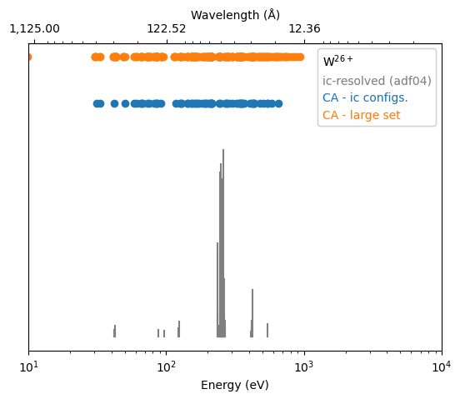
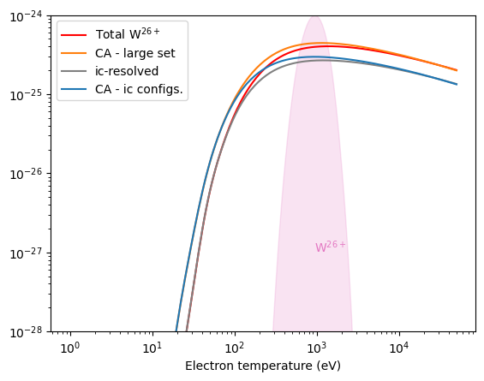
PLT power coefficients – location of radiation
PLT
the energy of the lines are known so any binning scheme can be used
CA top-up adds a little complexity – where to put the CA transitions
W²⁶⁺ shows a top-up correction of x1.5 at Te of peak abundance.
low Te dominated by low level (ic) spectroscopic levels
high Te significant radiation from ‘missing’ configurations
how does this compare to spectroscopy measured at LHD?
Strong lines of W26+ from adf04 file. Ground is 4d¹⁰ 4f².
energies of CA transitions – the set corresponding to intermediate-coupling resolution lines in the adf04 file – PLT ^{ca(cs)}
larger set of configurations – PLT ^{ca(cl)}

Slide 14
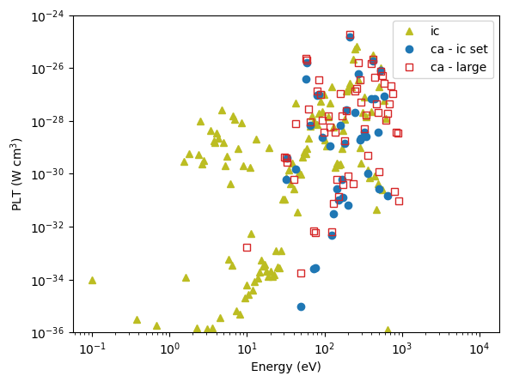
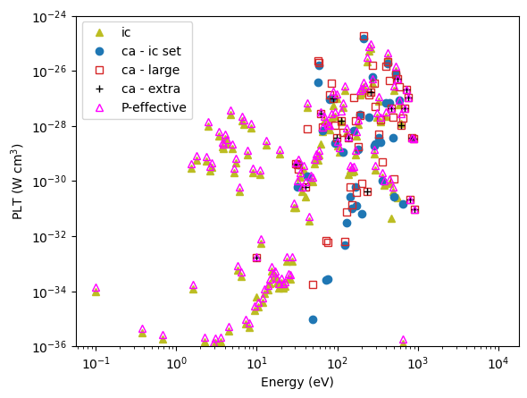
Energy resolved PLT power coefficients
W²⁶⁺
When summed over energy (E) there is < 0.5% difference with the un-resolved effective PLT coefficient.

Slide 15
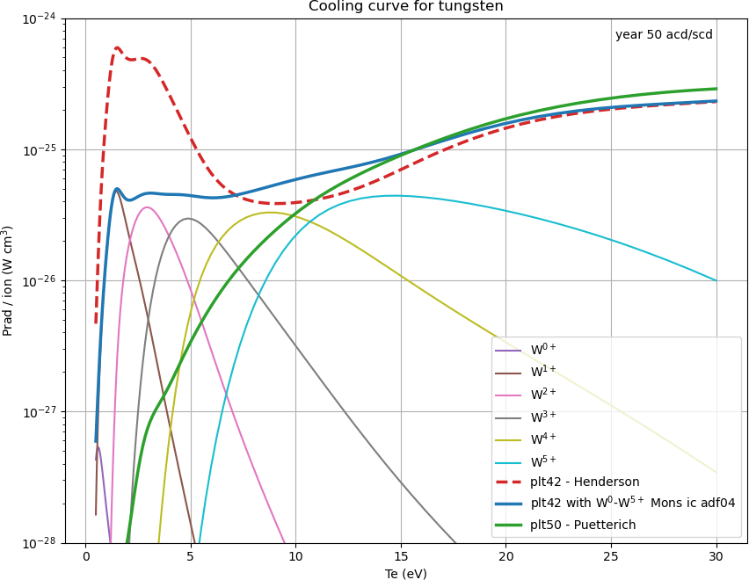
Radiated power from tungsten – different choices at low Te
Cowan data with U Mons polarisation corrections
wlike_mons11#w0ic.dat
talike_mons11#w1ic.dat
hflike_mons11#w2ic.dat
lulike_mons11#w3ic.dat
yblike_mons11#w4ic.dat
tmlike_mons11#w5ic.dat
Comparison with R-matrix collision data is next step.
W⁰ from R T Smyth et al, Phys Rev A, 97, 052705 (2018)
W⁺ from N Dunleavy et al, J Phys B, 55, 175002 (2022)
W²⁺ from M McCann – in preparation
W³⁺ from C P Ballance et al, J Phys B, 46, 055202 (2013)
Is configuration-average top-up essential?

Slide 16
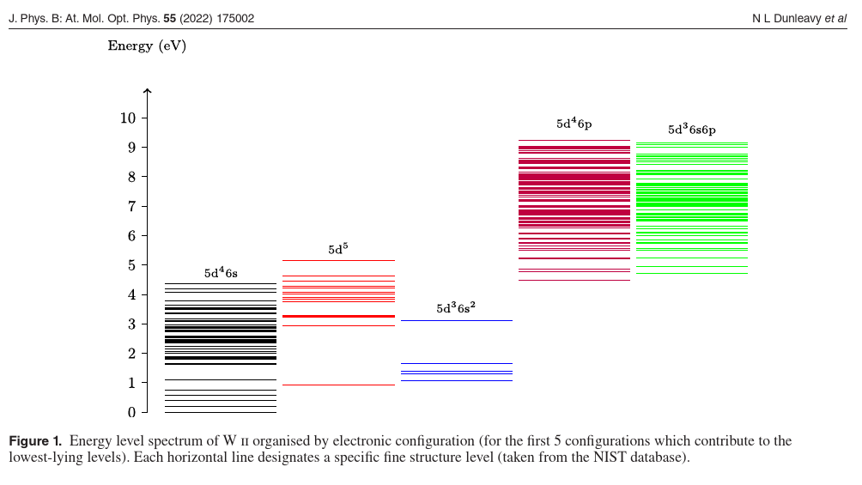
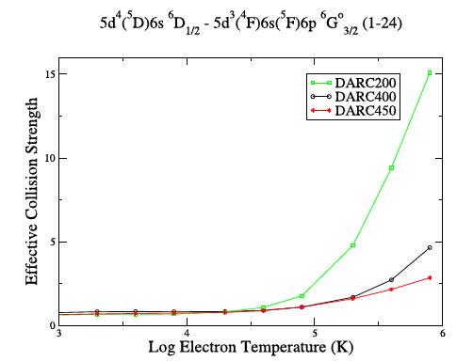
W⁺ R-matrix data and validation
Complex set of lower levels.
It may be impossible to ignore metastables.
Correctness of the excitation collision strengths is determined via convergence of models with increasing number of levels.

Slide 17
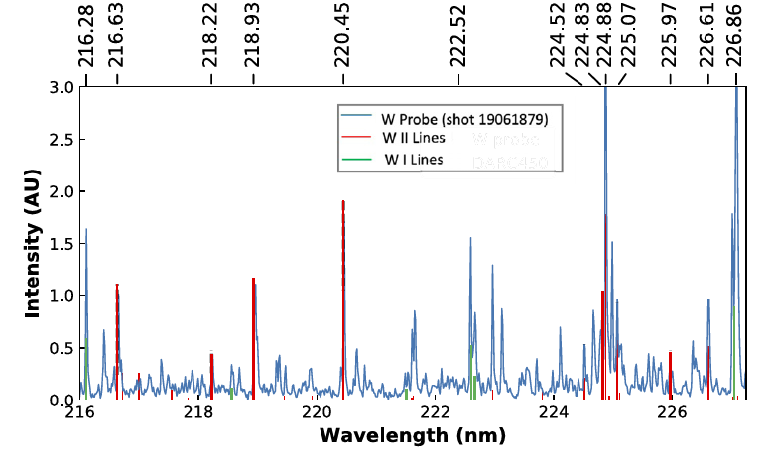
W⁺ R-matrix data and validation
Experimental comparisons to CTH spectra.
Disc of tungsten on a reciprocating probe.

Slide 18
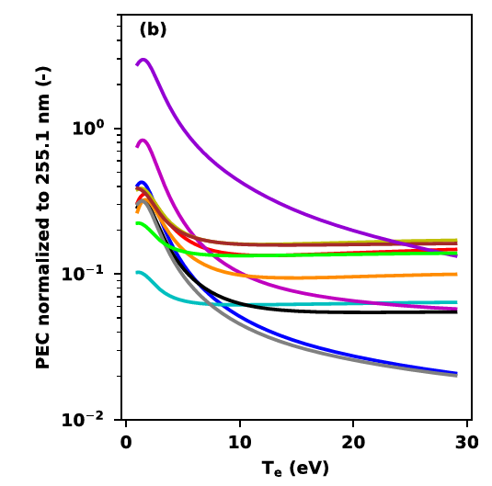
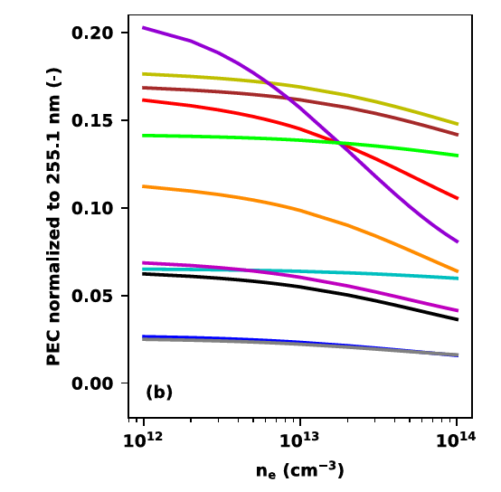
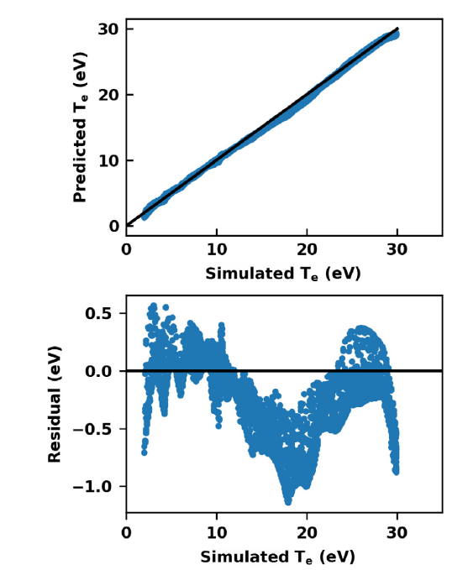
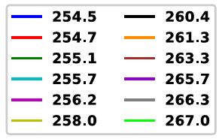
Extending traditional analysis
Machine learning approaches can be applied to spectral measurements.
Test application to using many W⁰ lines simultaneously rather than identifying the prefect pair of lines.
Training set of normalized photon emissivity coefficients.
Successful test of NN-model results against Te from Langmuir probes.
C Johnson et al, Nuc. Mater. Energy, 34 (2023) 101304

Slide 19
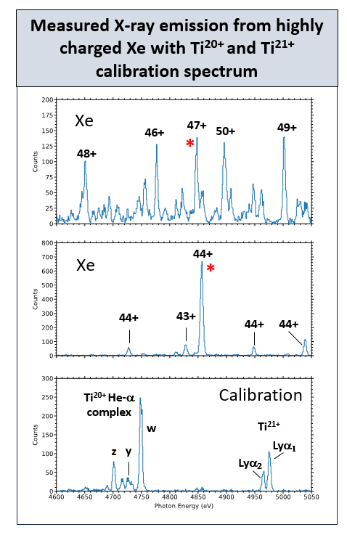
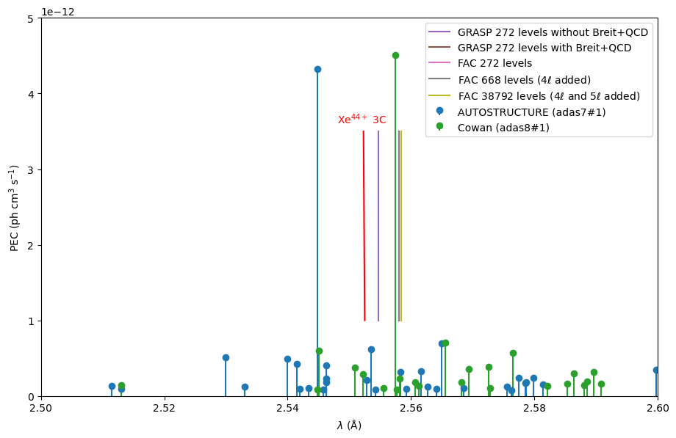
Non-tokamak laboratory experiments are essential
ADAS data for intensity estimations (AUTOSTRUCTURE and Cowan) agree well for emission but not in wavelength.
Convergence between GRASP and FAC atomic structure codes has been reported (see doi:10.1016/j.adt.2009.11.002)
The line adjacent to 3C should be well separated which was confirmed by a recent measurement at EBIT-I at LLNL.
G. V. Brown, N. Hell, A. Fairchild, M. Eckart

Slide 20
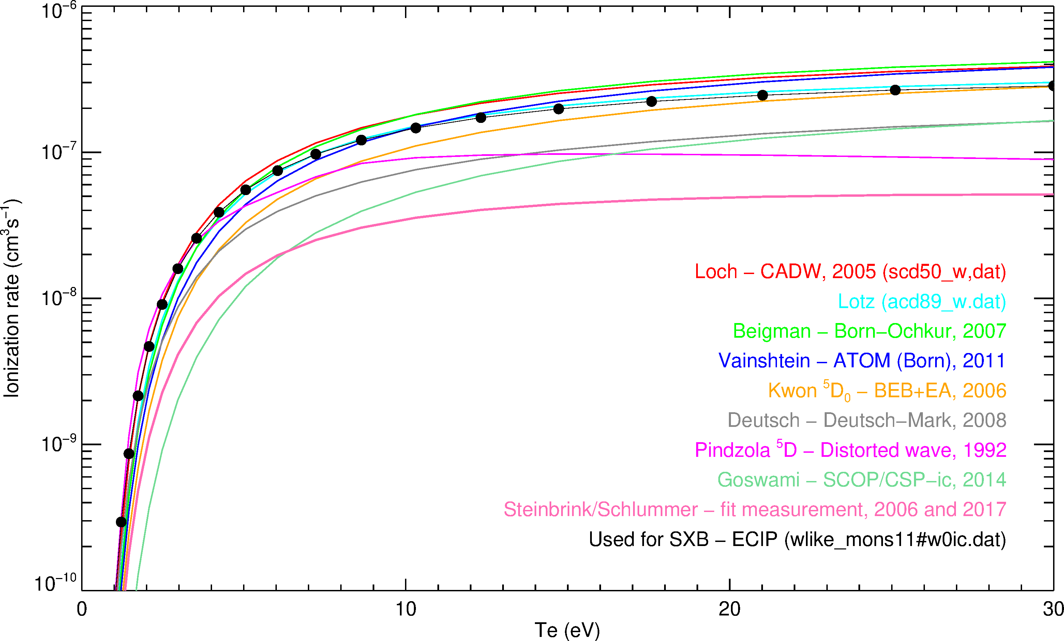
Neutral tungsten ionization – no advance since 1st meeting
Total rate from ground configuration
ADAS uses ECIP (exchange classical impact parameter) for ionization out of excited levels – empirical formula developed by comparing measured ionization cross sections of light elements. But it is robust and is non-divergent.
This pathway may be larger than the rate from ground.
No convergence to a consensus yet and the spread is too wide to use for an uncertainty analysis.
An outstanding challenge for ab initio calculations and experiment.

Slide 21
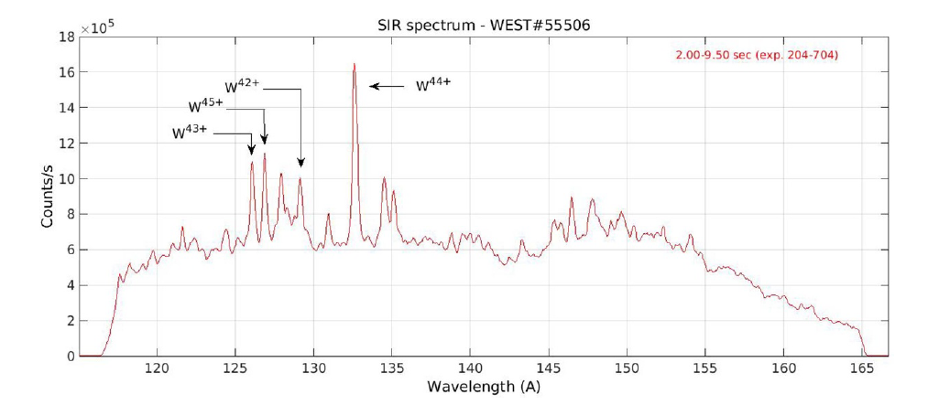
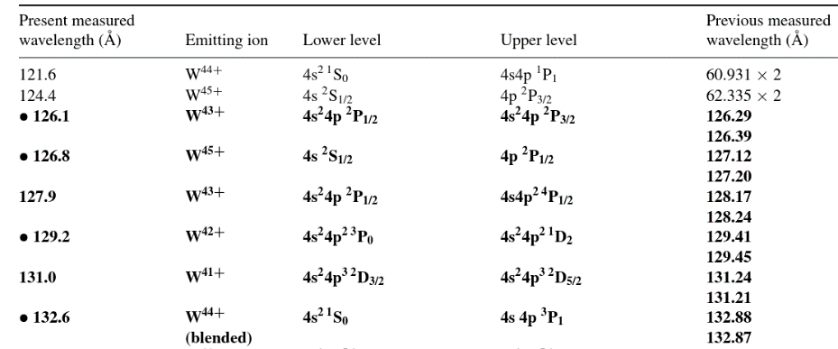
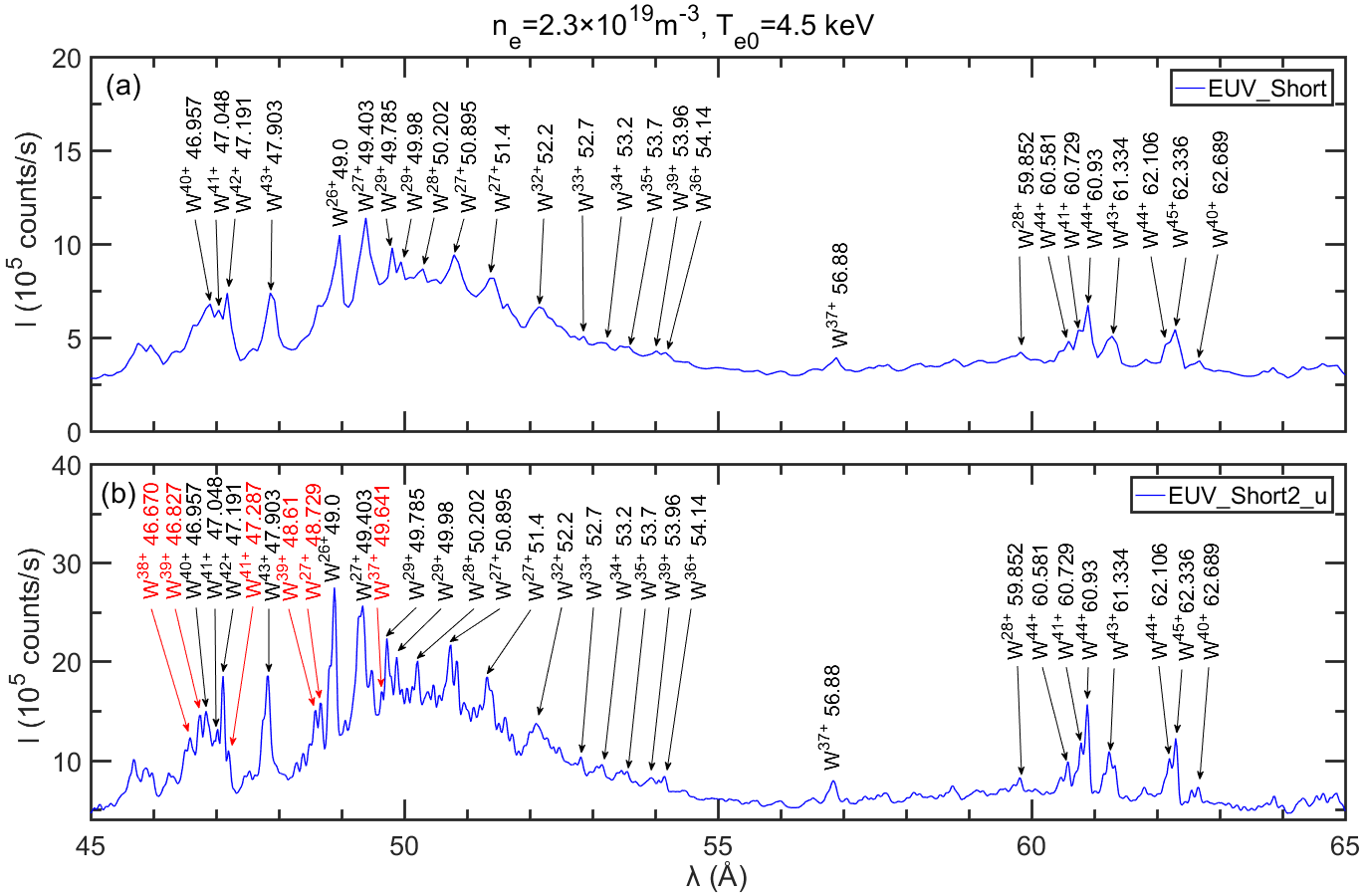
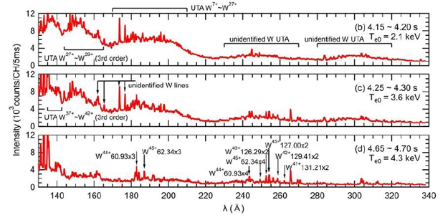
Many high resolution spectra of different W ions
R. Guirlet, PPCF, 24 (2022) 101304
WEST EAST LHD
Y.X. Cheng Rev. Sci. Instrum. 93 (2022)123501
T. Oishi et al, 25th International Conference on Line Shapes

Slide 22
Atomic data for tungsten ions – adf04 files
W⁰ – W³⁺ R-matrix (RMPS).
W⁴⁴⁺, W⁴⁵⁺, W⁴⁶⁺ R-matrix (ICFT).
These are effective collision strengths (Maxwellian EEDF) but cross sections (interval averaged to maintain resonance nature) can be produced.
All stages: distorted wave (AUTOSTRUCTURE) – rates and cross sections.
Desirable to have HULLAC and FAC data.
There are a number of papers on different ions in the academic literature but not easily available.
For ADAS ( ) but also collisionDB.

Slide 23
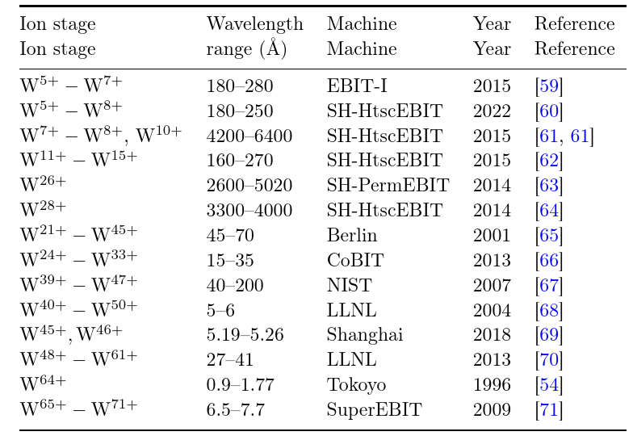
Spectral measurements from EBITs
Individual spectra from various tungsten ions have been measured over the years.
Could act as a fiducial measurement to validate the ab initio atomic calculations of low lying (spectroscopic) transitions.
Do we need more complete coverage to improve our validation effort.
Easily available database of EBIT spectra (IAEA perhaps?) would be helpful.

Slide 24
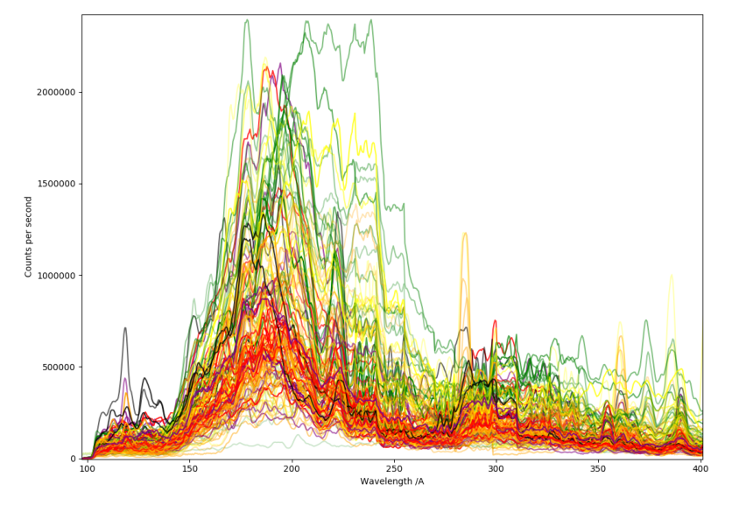
Large variation
The spectral features vary with conditions so an accurate atomic model is essential for understanding and untangling transport effects.
JET VUV W feature, T Kloska
No strong correlations of shape with various plasma parameters

Slide 25
Conclusions and outlook
A lot of progress has been made in measurements, analysis, calculations and models.
To answer the tungsten question for tokamaks input from many other areas was, and is, needed – storage rings, EBITs, linear plasmas, table-top experiments, theoretical advances and high performance computing.
Hydrogen is similar but with a longer history.
Still some missing pieces – DR for a handful of stages, W⁰ ionization, forbidden lines, spectral features.
But tungsten emission can now be used as a quantitative diagnostic in fusion.
Collisional-radiative effective data for modelling is more available.

