Slide 1


Energy, angular and atomic level distribution functions of sputtered tungsten based on spectroscopic investigations
S. Ertmer, O. Marchuk, M. Sackers, S. Brezinsek and A. Kreter

Slide 2
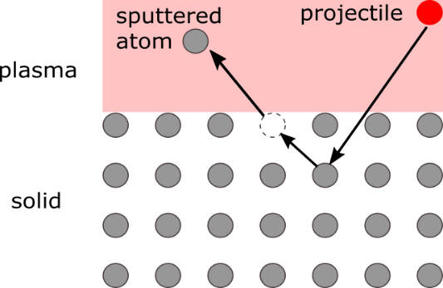
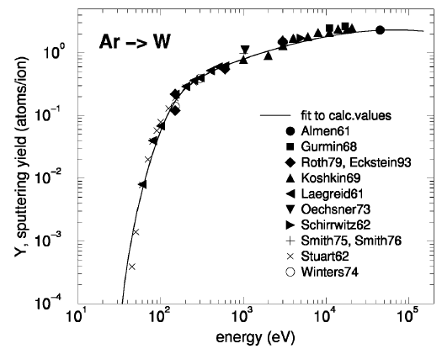
Introduction
Sputtering occurs at solid surfaces at plasma boundary
Sputtering depends on impact energy and incident angle of incoming particles
Different sputtering regimes depending on impact energy
Sputtering at high impact energies well understood
In fusion research impact energy in the range of 100 eV
Energy and angular distribution of sputtered atoms remains open question
Sputtering in ground and/or excited level
Important input parameters
For PWI codes, CRM and S/XB
[2]
[2] R. Behrisch and W. Eckstein "Sputtering by Particle Bombardment", Springer-Verlag (2007)

Slide 3
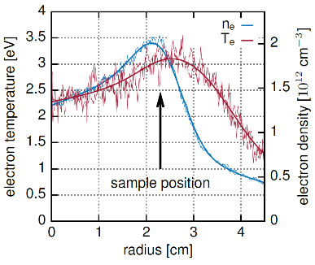
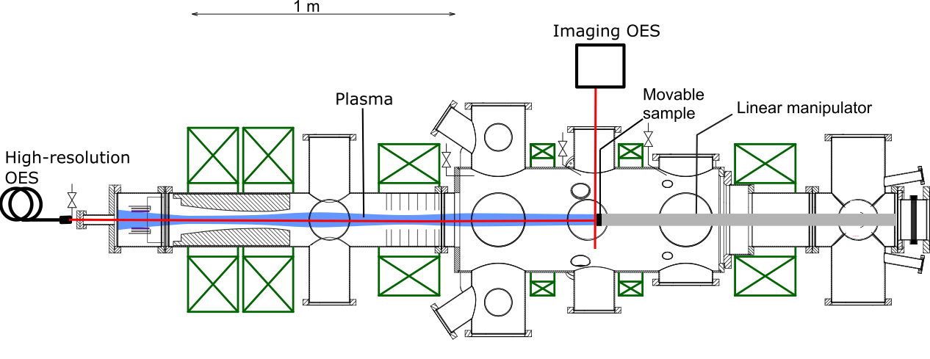

Experimental setup
Passive optical emission spectroscopy in the linear plasma device PSI-2
Energy and angular distribution:
Line shape analysis by high wavelength resolution spectroscopy
($\frac{Δλ_{Spectrometer}}{λ_{0}}$ ≈ 10⁻⁶ vs. $\frac{Δλ_{Doppler}}{λ_{0}}\text{≈}{ 10}^{−5}$ )
Initial atomic level population:
Spectroscopic time-of-flight measurements by imaging spectrometer
with high spatial resolution (50 µm/px)
High resolution OES
or
conditions | argon plasma
T_{e} | ≈ 3 eV
n_{e} | ≈ 2 ∙10¹² cm⁻³
E_{imp} | 70-150 eV
B | ≈ 90 mT
T_{surf} | 300 K

Slide 4
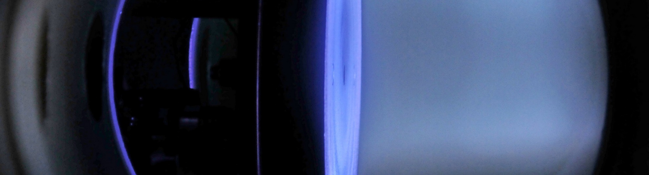
I. Energy and angular distribution

Slide 5
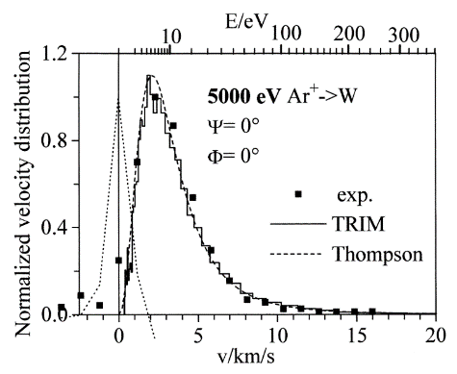
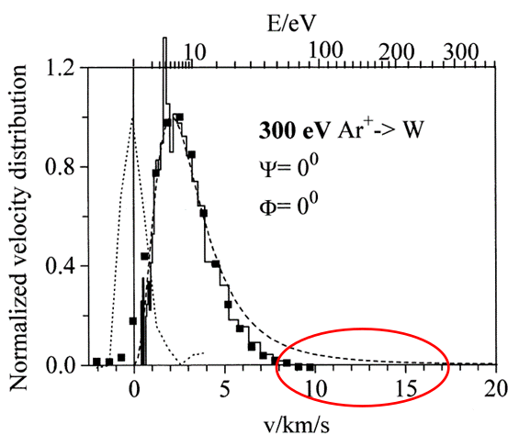
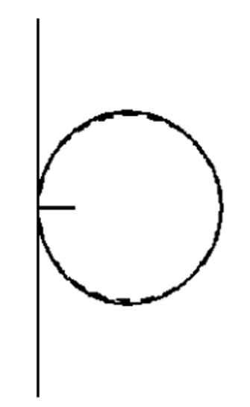
I. Energy and angular distribution
 | Energy distribution | Angular distribution
High impact energies | Thompson energy distribution [7] | Cosine angular distribution [8]
Low impact energies | Deviations from Thompson? | Butterfly angular distribution?!
 | Energy distribution | Angular distribution
High impact energies | Thompson energy distribution [2] | Cosine angular distribution [3]
Experimental results of the energy distribution of sputtered W [4]
Calculated angular distribution
of W sputtered by Ar [5]
Experimentally determined angular distributions of sputtered W atoms from
a smooth surface bombarded by Ar [6]
→ Better understanding of energy and angular distribution needed
[2] M W Thompson Phil. Mag., 1968
[3] R. Behrisch and W. Eckstein "Sputtering by Particle Bombardment", Springer-Verlag, 2007
[4] A. Goehlich et. al. J. Nucl. Mater., 1999
[5] D. Nishijima et al. J. Nucl. Mater., 2011
[6] M. Stepanova et al, J. Vac. Sci. Technol. A, 2001

Slide 6
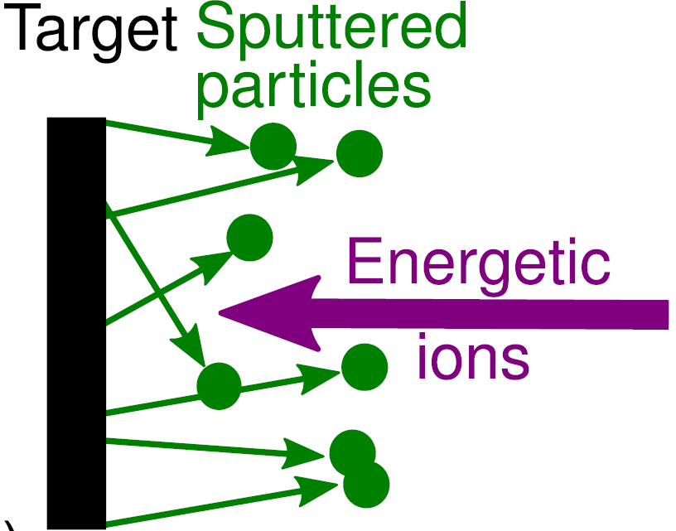
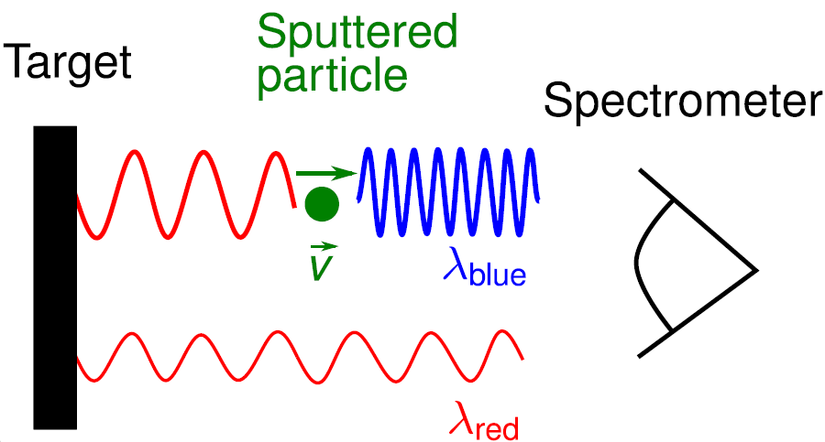
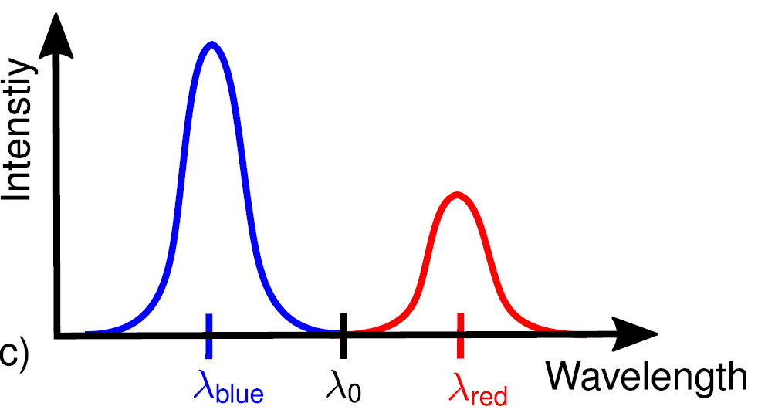
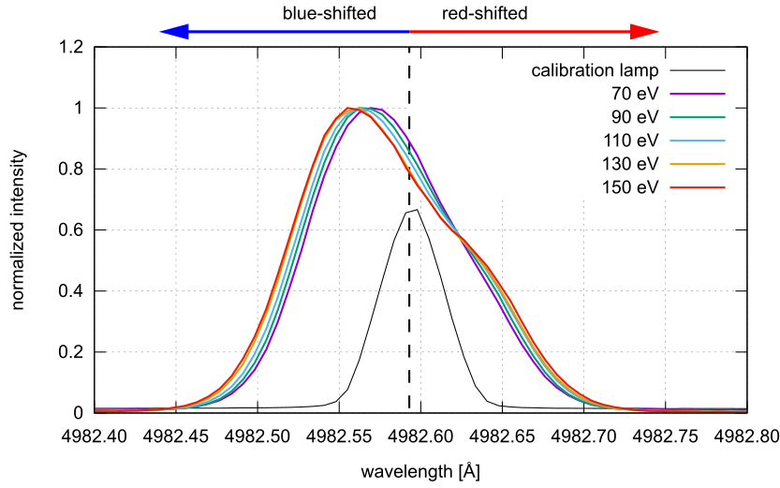
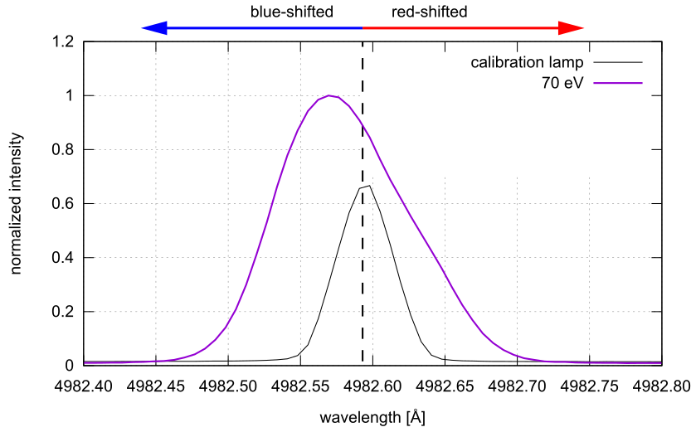
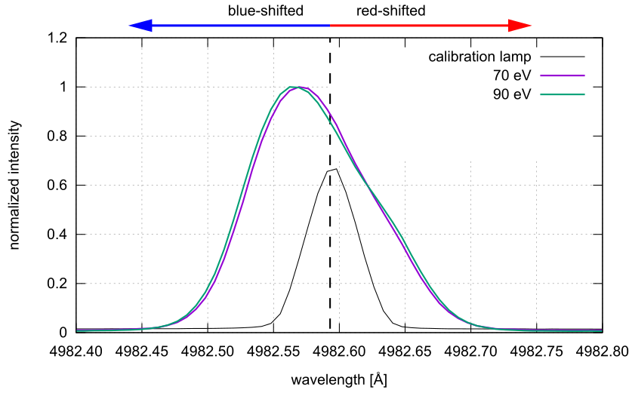
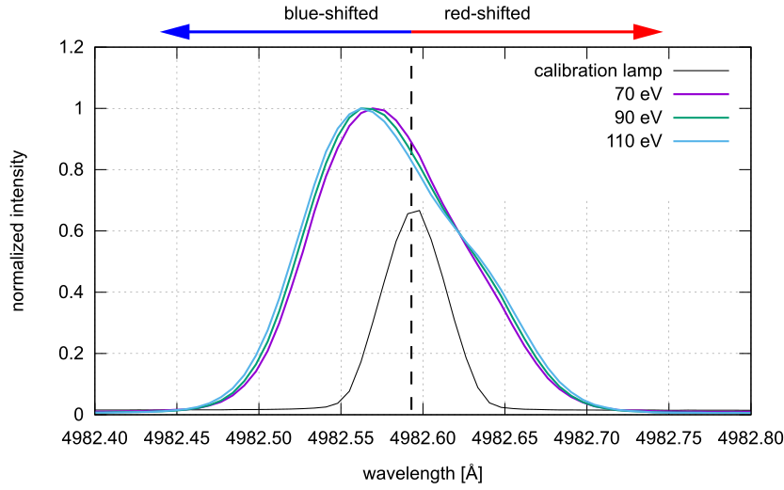
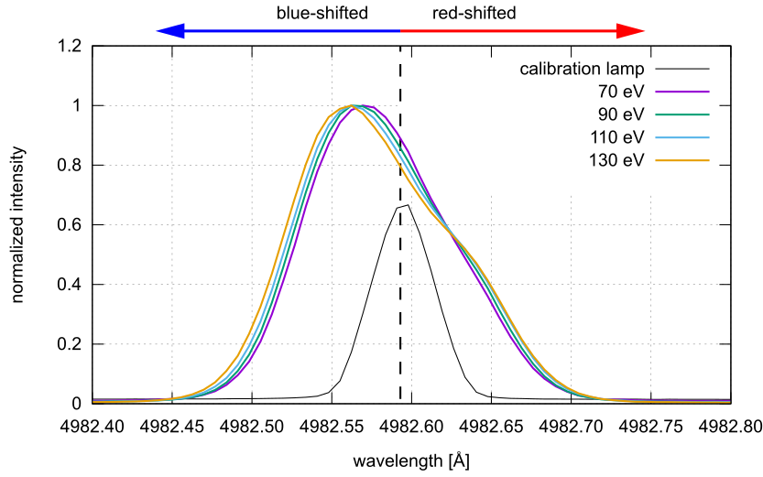
I. Energy and angular distribution
Line broadening effects lead to only one broad peak
Change in line shape with change in impact energy
Modeling becomes necessary

Slide 7
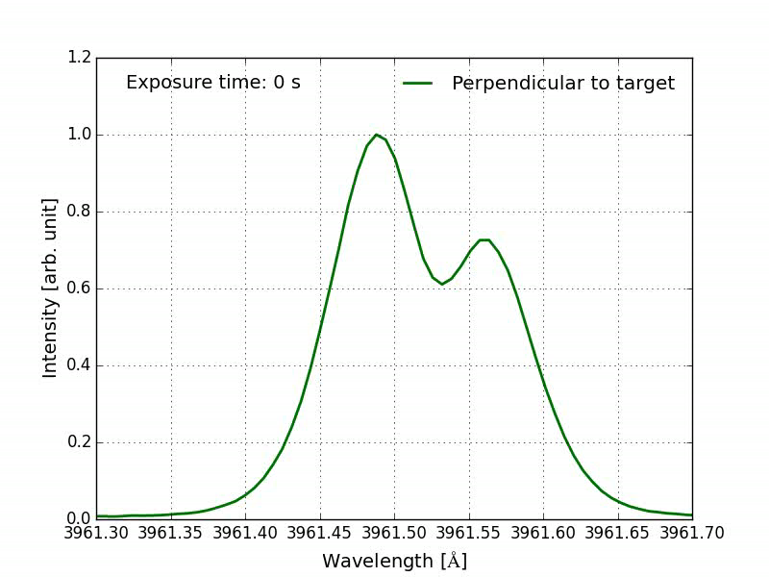
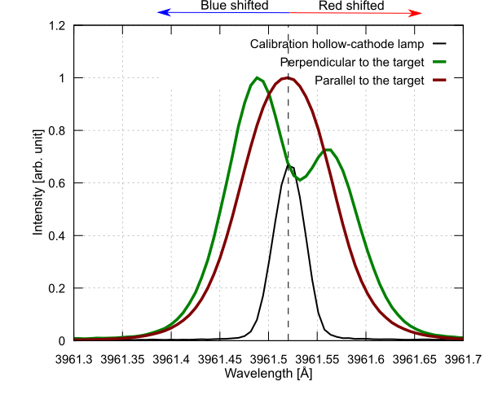
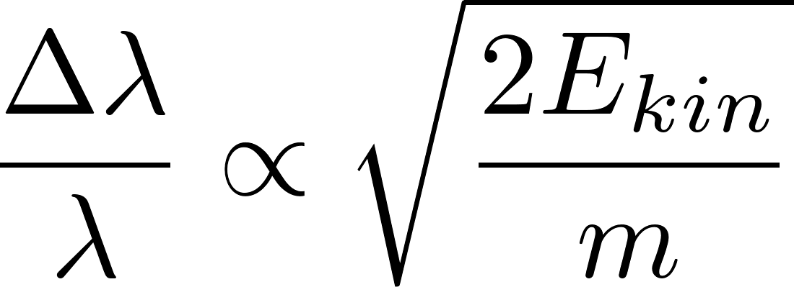
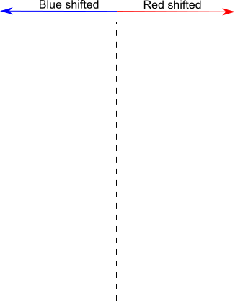
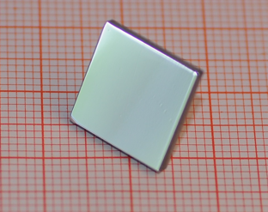
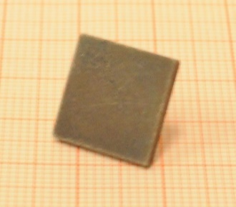
I. Energy and angular distribution
Stronger line shape deformation for Al than for W (proof of principle)
Only explanation is light reflection
Erosion of surface leads to decrease in reflection
Al-target in argon plasma E_{impact} ≈ 110 eV
0° to the normal
0° to the normal
90° to the normal
Al-target before and after exposure

Slide 8
I. Energy and angular distribution
Stronger line shape deformation for Al than for W (proof of principle)
Only explanation is light reflection
Erosion of surface leads to decrease in reflection
Al-target in argon plasma E_{impact} ≈ 110 eV
0° to the normal
0° to the normal
90° to the normal
Al-target before and after exposure

Slide 9
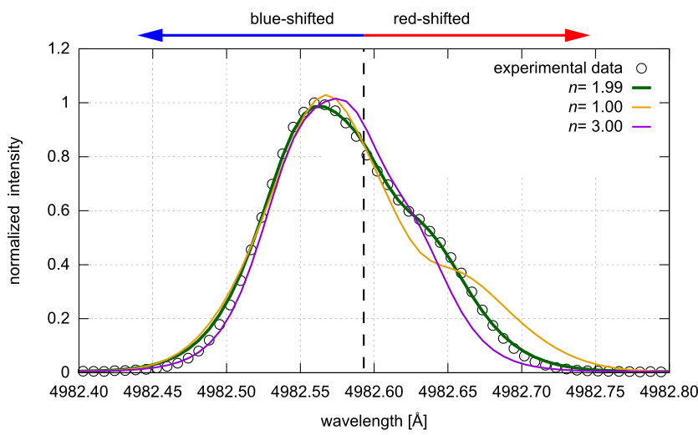
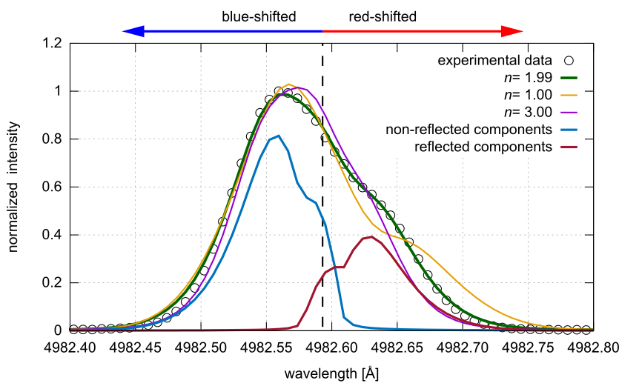
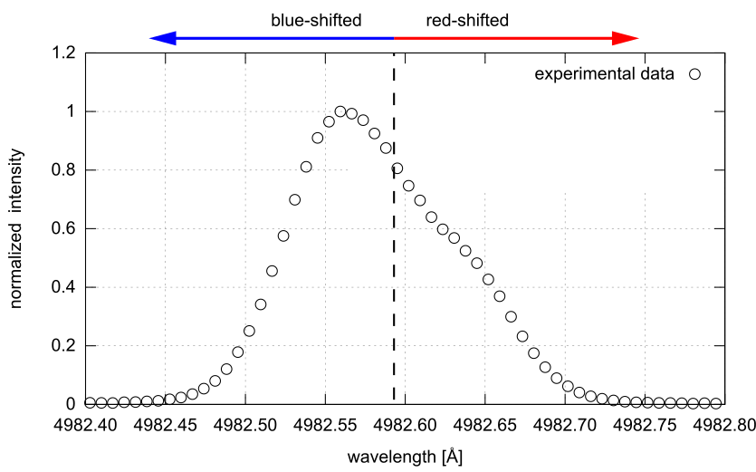
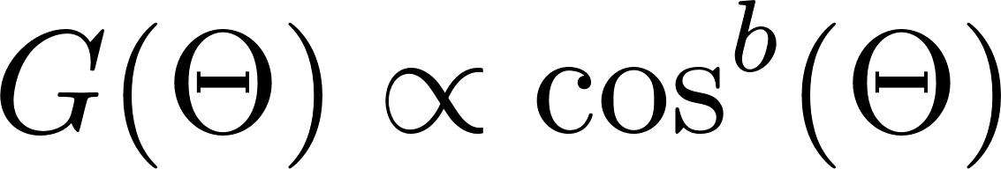
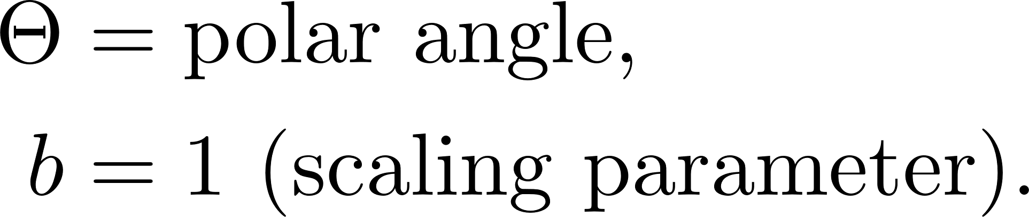
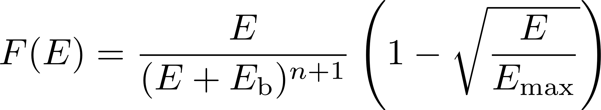
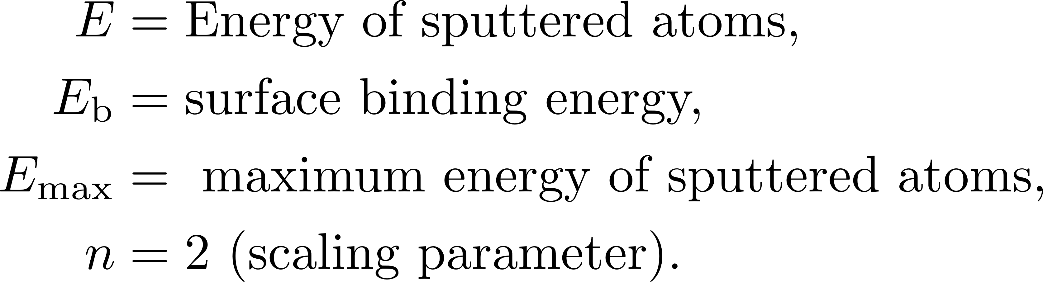

I. Energy and angular distribution
Based on Doppler-shifted-emission model for reflected atoms [7]:
  Infinite target approximation (ITA)
  Cosine angular distribution
  Light reflection at surface (literature: 53%[8])
Adapted:
  Thompson energy distribution
Expanded:
  Zeeman Effect $\frac{Δλ_{Zeeman}}{λ_{0}}=3∙\text{10}\text{−6}$ (@ 90 mT)
  Instrumental broadening
ITA model breaks for 90°!
-> Space-resolved model required!
[7] S. Dickheuer et al. Physics of Plasmas 26, 073513, 2019
[8] W. S. M. Werner et al. J. Phys. Chem. Ref. Data 38, 2009

Slide 10
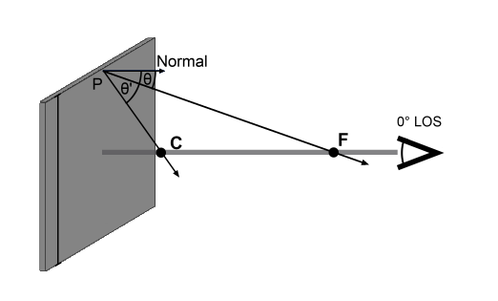

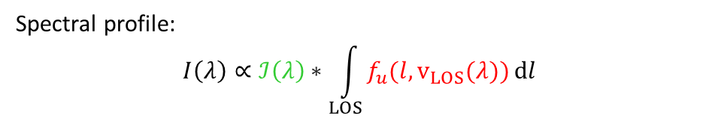
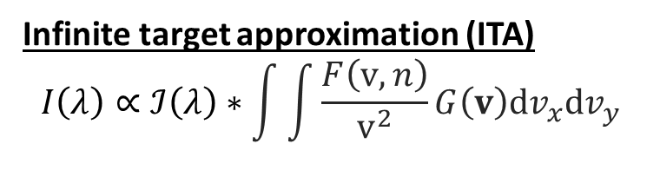
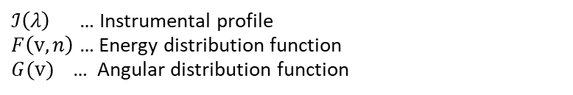

I. Energy and angular distribution
Infinite target approximation (ITA)
$$I\left(λ\right)∝ℐ\left(λ\right)∗\int{\int{\frac{F\left(v,n\right)}{v^{2}}G\left(v\right)dv_{x}dv_{y} }}$$
$ℐ\left(λ\right)$ … Instrumental profile
$F\left(v,n\right)$ … Energy distribution function
$G(v)$ … Angular distribution function
Space-resolved model
Spectral profile:
$$I\left(λ\right)∝ℐ\left(λ\right)∗\int_{LOS}^{ }{f_{u}(l,v_{LOS}(λ))}dl$$
$ℐ\left(λ\right)$ … Instrumental profile
$f_{u}$… Population density of the upper level

Slide 11
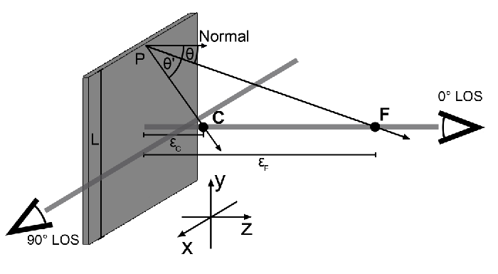
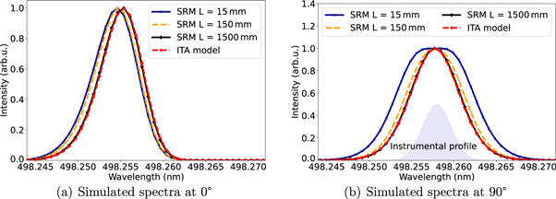
I. Energy and angular distribution
Space-resolved model – solution in cartesian coordinates
$$f_{u}\left(v_{LOS},\overline{x},\overline{y},\overline{z}\right)=\int_{−L/2−\overline{y}}^{L/2−\overline{y}}{\int_{−L/2−\overline{x}}^{L/2−\overline{x}}{F\left({v(v}_{LOS})\right)G\left(r\right)\frac{1}{n_{r}∙n_{LOS}}\frac{\overline{z}}{r^{3}}dxdy}}$$
SRM – space-resolved model/finite size
ITA – infinite target approximation
[9]
[9]
[9] M. Sackers et al. Phys. Scr. 98 115603 (2023)

Slide 12
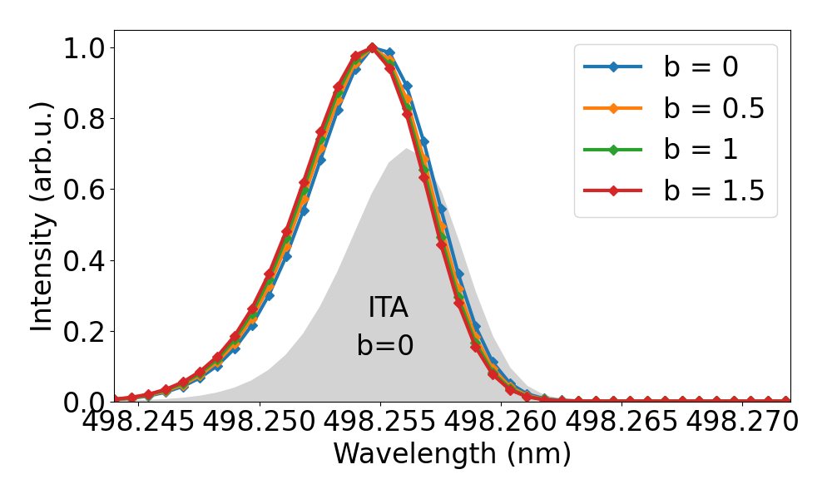
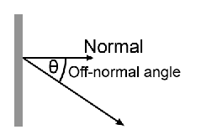
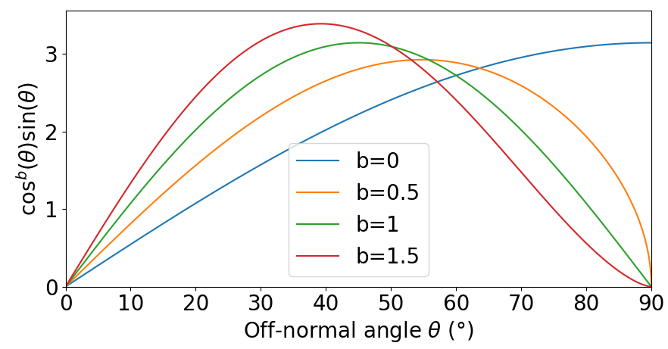
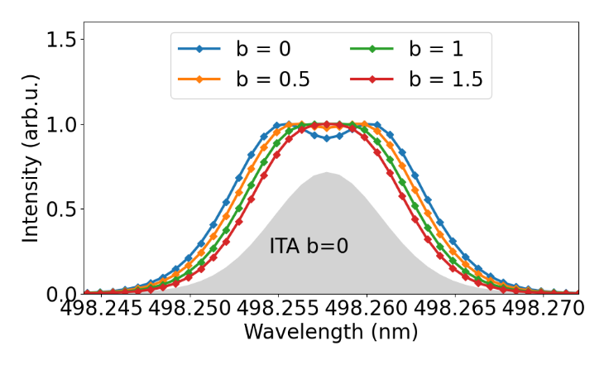
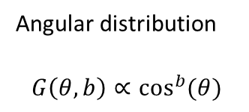

I. Energy and angular distribution
Space-resolved model – angular distribution
0°
Angular distribution
$$G\left(θ,b\right)∝\cos^{b}{(θ)}$$
$$dΩ=\sin\left(θ\right)dθdφ$$
[9]
90°
[9]
[9] M. Sackers et al. Phys. Scr. 98 115603 (2023)

Slide 13
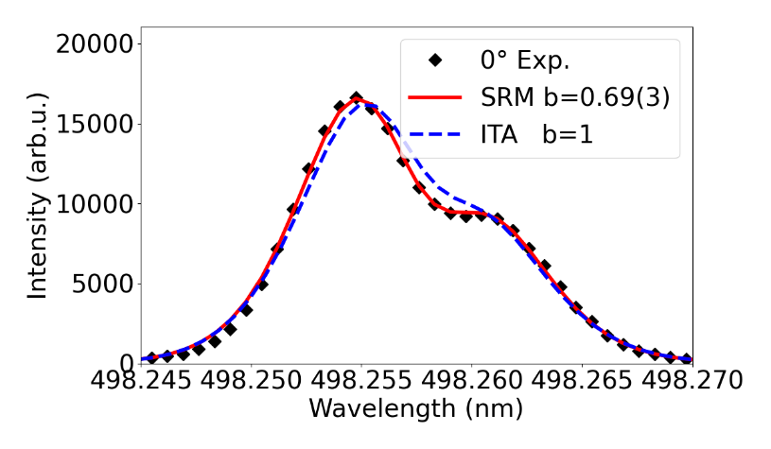
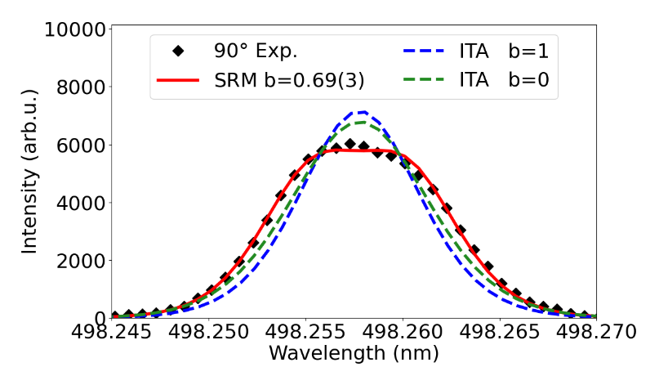
I. Energy and angular distribution
120 eV Ar+
➔ Taking the finite size into account allows to consistently model the spectra
E_{kin} (eV) | 100 eV n b | 120 eV n b | 140 eV n b
ITA | 1.83(19) 1 | 2.31(6) 1 | 2.59(11) 1
SRM | 2.24(2) 0.47(3) | 2.13(3) 0.69(3) | 2.03(3) 0.83(5)
00
[10] A. Mutzke et al. IPP-Report 2019-02, (2019)

Slide 14
II. Initial atomic level population

Slide 15
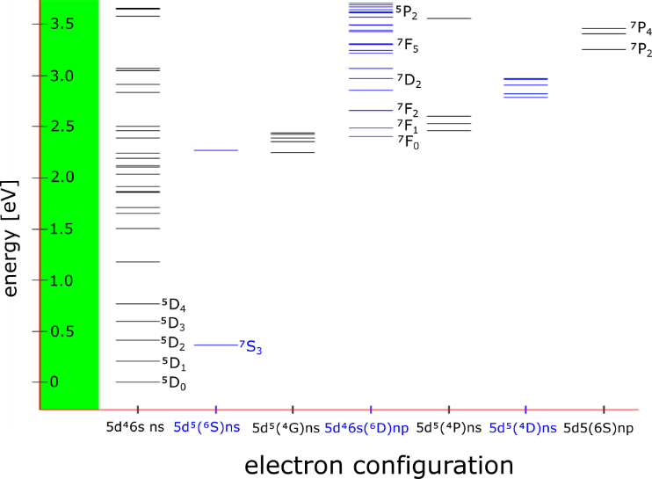
II. Initial atomic level population
Input parameter for Collisional Radiative Models (CRM) and PWI-codes
Not well understood:
TEXTOR experiments: population according to effective temperature
led to unphysical electron temperature T_{e} (1 eV) at a plasma of 30 eV [12]
Grotrian diagram of W
[11]
→ Better understanding of initial atomic level population needed
[11] nist.gov (visited on 24.11.2020)
[12] I. Beigman et al., Plasma Phys. Control. Fusion, 2007

Slide 16
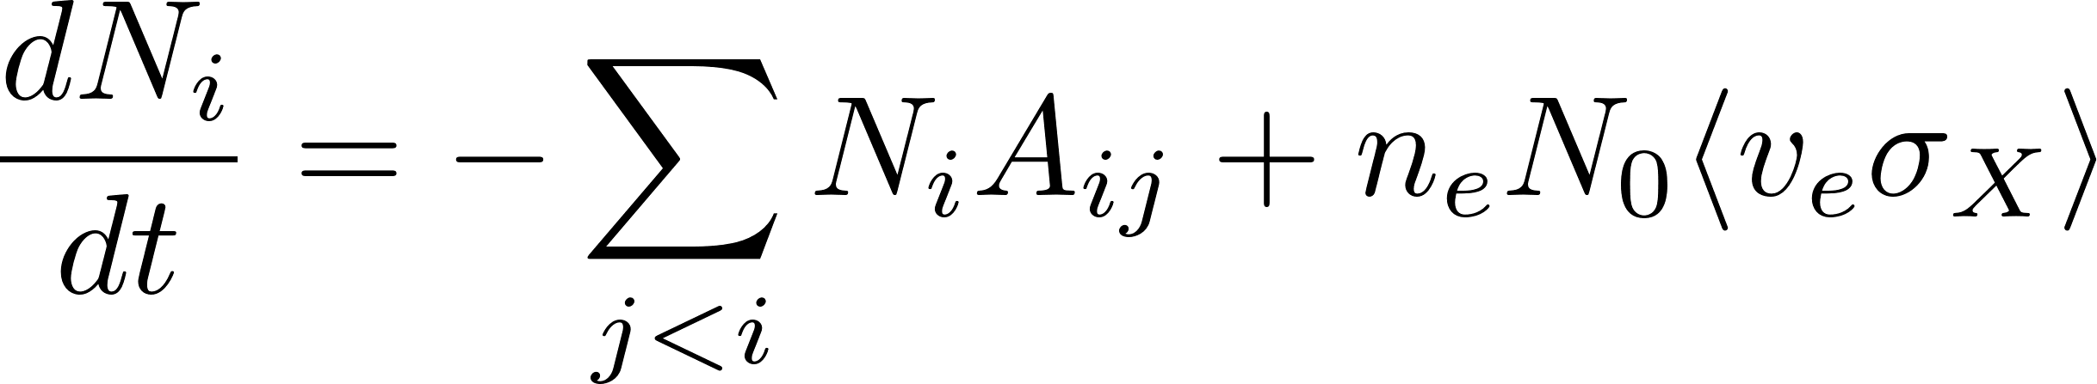
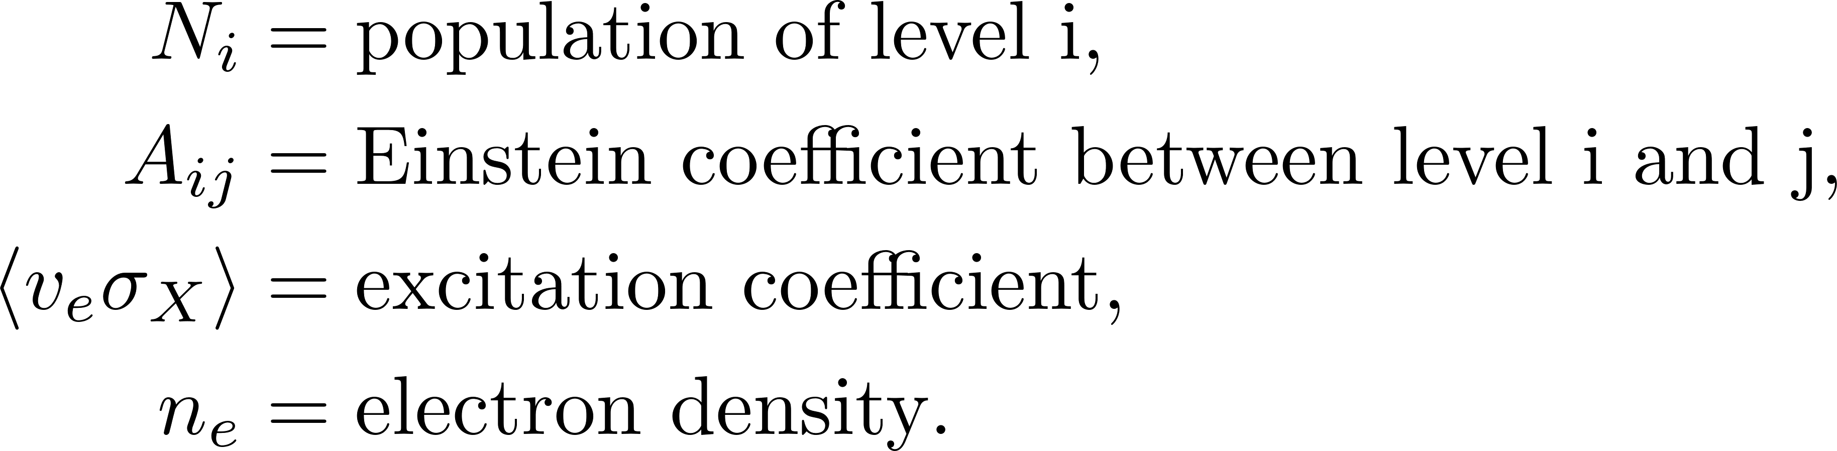
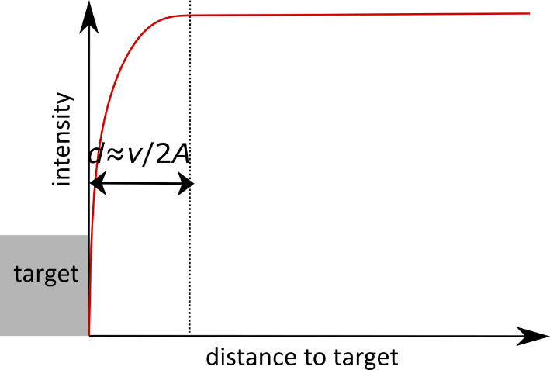
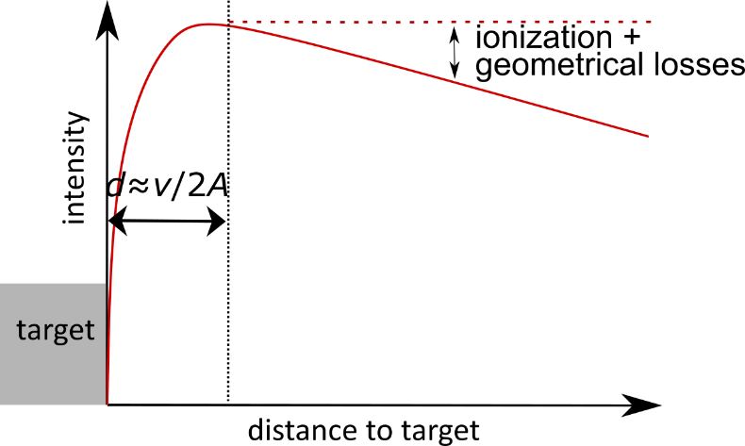
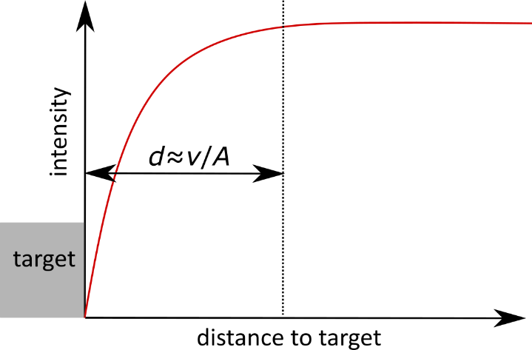



II. Initial atomic level population
Rate equation of level N in corona equilibrium
Position of maximum line intensity is proportional to velocity
and reciprocal Einstein coefficient:
Angular distribution of sputtered particles leads to:
Ionization and geometrical losses lead to decreasing intensity
Spontaneous emission
Electron impact excitation
[13]
[13] O. Marchuk et. al. J. Phys. B: At. Mol. Opt. Phys (2018) Vol.51 025702

Slide 17




II. Initial atomic level population
Experimental data: maximum of both lines at the same position
According to Thompson energy distribution:
Agreement only for ground term ⁵D₀
[11]
Wavelength [Å] | Lower level | ∑ Einstein coefficient upper level [s⁻¹] [9]
4982.593 | ⁵D₀ | 5.31E+5
4008.751 | ⁷S₃ | 1.65E+7
[11] nist.gov (visited on 24.11.2020)

Slide 18


II. Initial atomic level population
Grotrian diagram of W
[11]
Wavelength (Å) | Position maximum (mm) | Einstein coefficient upper level (s⁻¹) [15] | Calculated velocity (m/s) | Relative proportion
4982.593 | 2.34 | 5.31E+5 | 1952 | 0.79
4294.605 | 2.21 | 1.32E+7 | 58212 | 0.94
[11] nist.gov (visited on 24.11.2020)

Slide 19


II. Initial atomic level population
Grotrian diagram of W
[11]
Wavelength (Å) | Position maximum (mm) | Einstein coefficient upper level (s⁻¹) [15] | Calculated velocity (m/s) | Relative proportion
4982.593 | 2.34 | 5.31E+5 | 1952 | 0.79
4843.810 | 1.80 | 3.37E+6 | 12132 | 0.56
[11] nist.gov (visited on 24.11.2020)

Slide 20


II. Initial atomic level population
Grotrian diagram of W
[11]
Wavelength (Å) | Position maximum (mm) | Einstein coefficient upper level (s⁻¹) [15] | Calculated velocity (m/s) | Relative proportion
4982.593 | 2.34 | 5.31E+5 | 1952 | 0.79
4244.367 | 4.05 | 1.44E+6 | 11664 | 0.96
[11] nist.gov (visited on 24.11.2020)

Slide 21


II. Initial atomic level population
[11]
Only ground state transition is in agreement with theory
All other transitions peak to late according to Einstein coefficient
[11] nist.gov (visited on 24.11.2020)

Slide 22
Summary
I. Energy and angular distribution
Proof of light reflection in the line shape of sputtered atoms
In-situ light reflection measurements by modeling
Consistent modeling of optical emission spectra for both line of sights
➔ Simultaneous modeling of energy and angular distribution
II. Initial atomic level population:
High spatial resolution spectroscopy measurements
For a cold target (T_{surf}= 300 K) and mono-energetic energy of the incident ions
in the order of 100 eV, atoms are sputtered in the ground state ⁵D₀
Exited levels ⁷S₃ and ⁵D_{x>0} are not populated during sputtering

Slide 23


Backup- Outlook
0°
Studying energy and angular distribution for different surface morphology, including nano structured ones
Removal of W-Fuzz
Laser absorption on W I to remove instrumental broadening
Laser induced fluorescence on W I for energy, angular and initial level distribution
90°

