Slide 1
The Oslo Method
Energy
Fission
Sn ≈ 5 MeV
Simultaneously extraction of:
nuclear level density (NLD)
γ-ray strength function (γSF)
Quasi-continuum
Millions of states/MeV
Magne Guttormsen
Department of Physics
University of Oslo
Spin

Slide 2
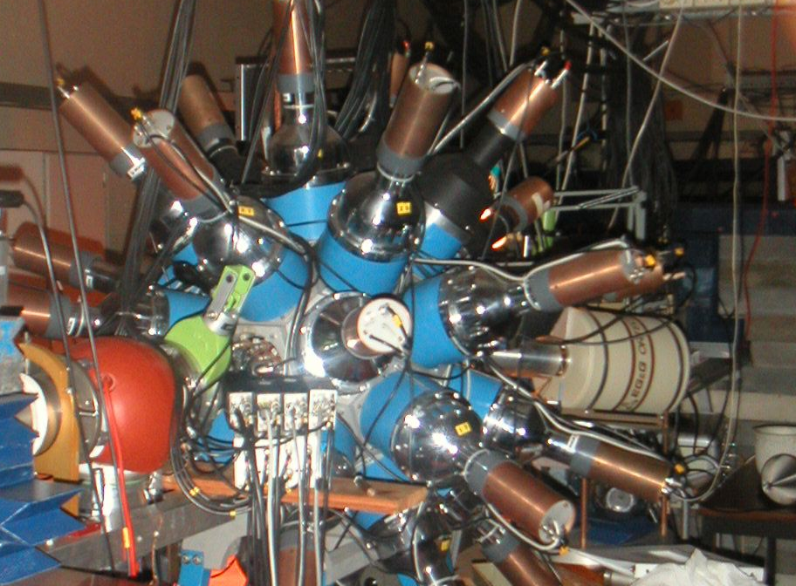
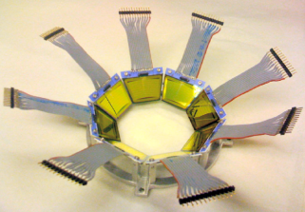
Th and U experiments @ OCL
12 MeV d on ²³²Th
24 MeV ³He on ²³²Th
15 MeV d on ²³⁸U
Backwards:
ϑ = 126º – 140º
5”x5” NaI
γ
³He –beam
³He, α,d,t
∆E-E
^{M.Guttormsen,} A.Bürger, T.E.Hansen, N.Lietaer,
^{NIM A648(2011)168}

Slide 3
Assumption for the extraction of first-generation γ-spectra
(d,p)
γ
E
(d,p)
The γ-energy distribution is the same
if the decay starts at E after γ-emission or
starts after the direct reaction into E.

Slide 4
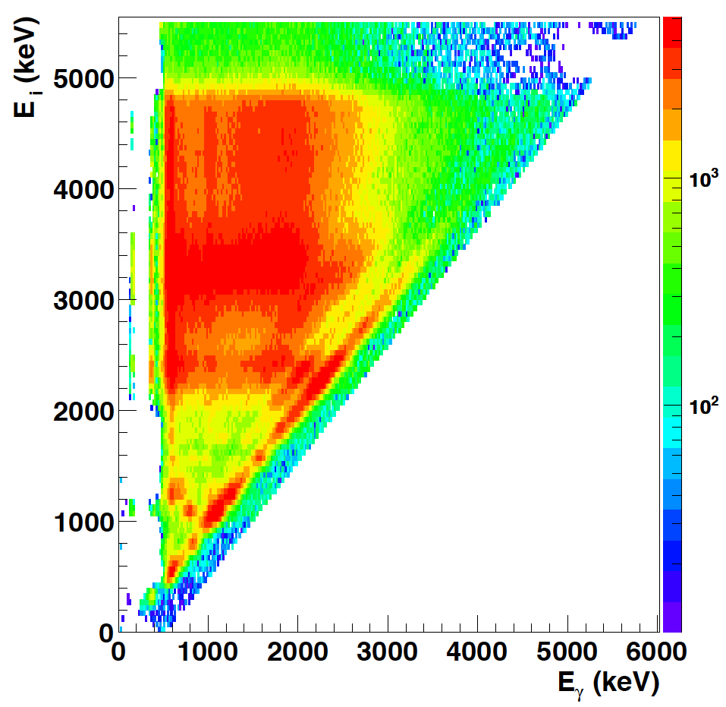
From total to primary matrix
²³²Th(d,p) ²³³Th

Slide 5
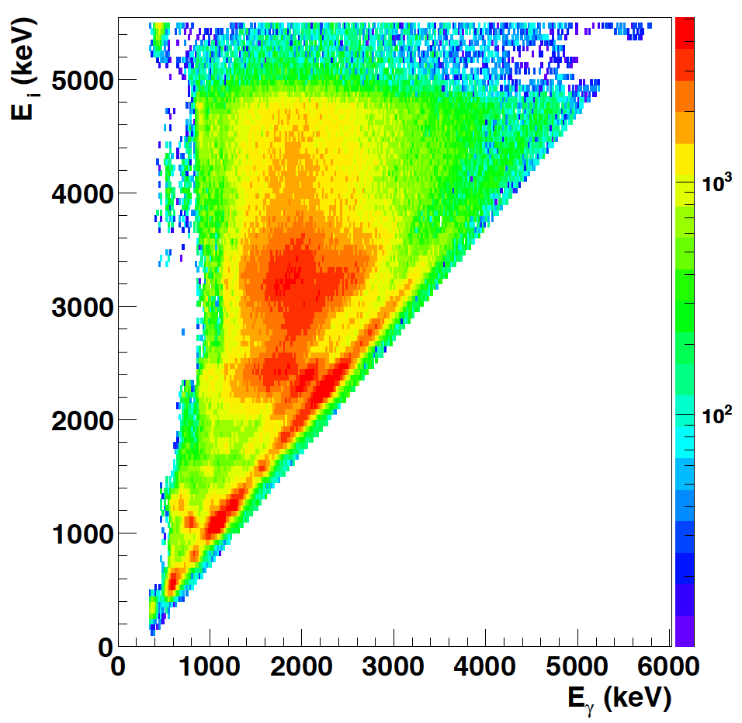
Select an E_{x} – E_{γ} region
P(E_{x},E_{γ})
Level density Trans. coeff.
ρ(E_{f}) T(E_{γ})
Fermi’s golden rule Brink hypothesis
P(E_{x},E_{γ})
70 + 70 = 140 fit-parameters on
70 x 70 / 2 /2 = 1200 data-points

Slide 6
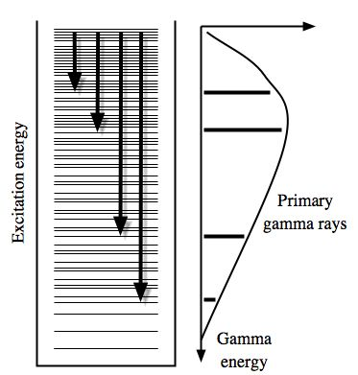
Multiplicative factors
Fermi’s golden rule
Brink hypothesis
A. Schiller et al., NIM A 447, 498 (2000)

Slide 7
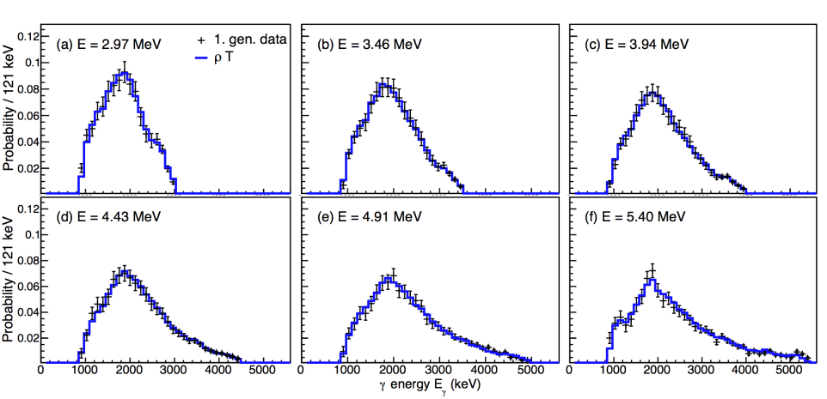
P(E,E_{γ}) = ρ(E) xT(E_{γ}) Does it work?

Slide 8
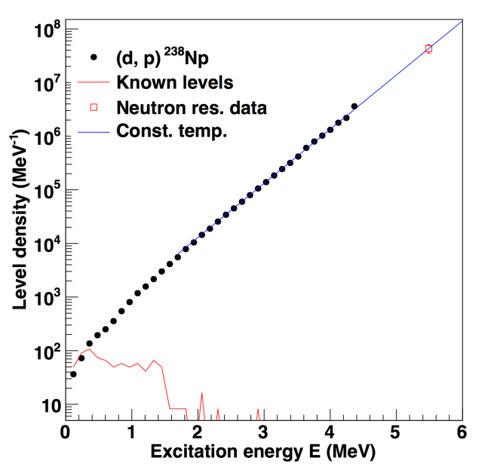
Normalization of NLD
D0
σ
ρ( S_{n} )
Discrete levels

Slide 9
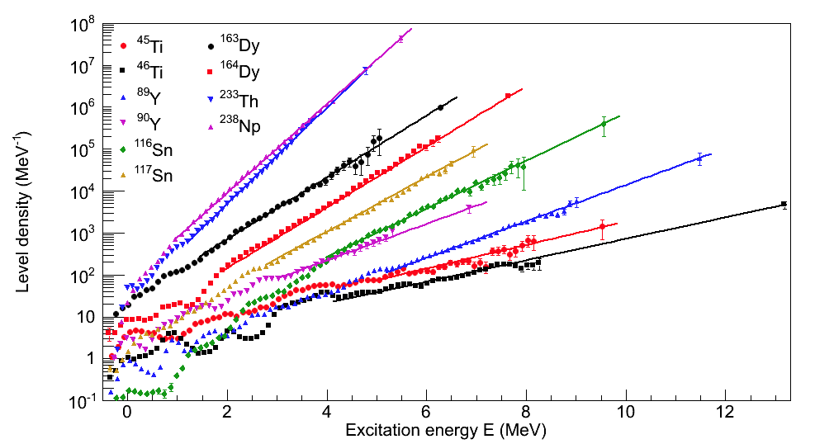
Level densities using the Oslo method
2∆_{n}=2*0.45=
0.9MeV
2∆_{n}=2*2.6=5.2MeV

Slide 10
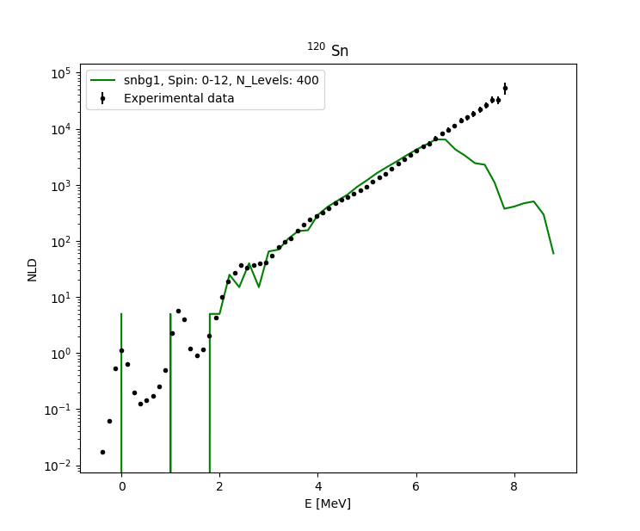
Shell model calculations preliminary, not published
Exp: Maria Markova
Oslo method
(p,pγ’)¹²⁰Sn
Theory: Jenny Finsrud
KSHELL (Noritaka Shimizu)
snbg1-interaction

Slide 11
Thank you !

