Slide 1


A comparative study of event detection methods in fusion devices with an application to edge-localized modes
5th IAEA Technical Meeting on Fusion Data Processing, Validation and Analysis
J. Alhage, C. Haems, M. Van Damme, G. Verdoolaege and JET Contributors*
Department of Applied Physics, Ghent University, Belgium
S-1 13/06/2023
This work has been carried out within the framework of the EUROfusion Consortium, funded by the European Union via the Euratom Research and Training Programme (Grant Agreement No 101052200 — EUROfusion). Views and opinions expressed are however those of the author(s) only and do not necessarily reflect those of the European Union or the European Commission. Neither the European Union nor the European Commission can be held responsible for them. (Please mind the addendum 2019-2020)
Notes:
Hello, my name is Jerome Alhage
Today I will present what my students and I have been working on for the last year, on the detection of events in plasmas called edge-localized modes.

Slide 2
outline
Motivation
ELM distributions
ELM detection
Evaluation of performance
Conclusion and outlook
Notes:
I will talk about my motivation
why detecting these events is important
how probability distributions can capture their information
and then go through how the detection is done and how it was improved

Slide 3
Motivation

Slide 4
Events in fusion plasmas
Fusion plasmas host events (MHD instabilities, disruptions...)
Further events in subsystems outside the plasma
Data with important variety and scale
Automated event detection key for safe and efficient operation
  Robust against variability
  Preserving the most information
Notes:
In fusion plasmas there are various events that require good identification (such as MHD instabilities and disruptions)
and more if we include the other subsystems in the machine
fusion produces a large variety of data at a huge scale
and we cannot go through all this data by hand
we need to automate the detection of events in this data
in a way that is robust against noize, while still preserving as much information as possible

Slide 5
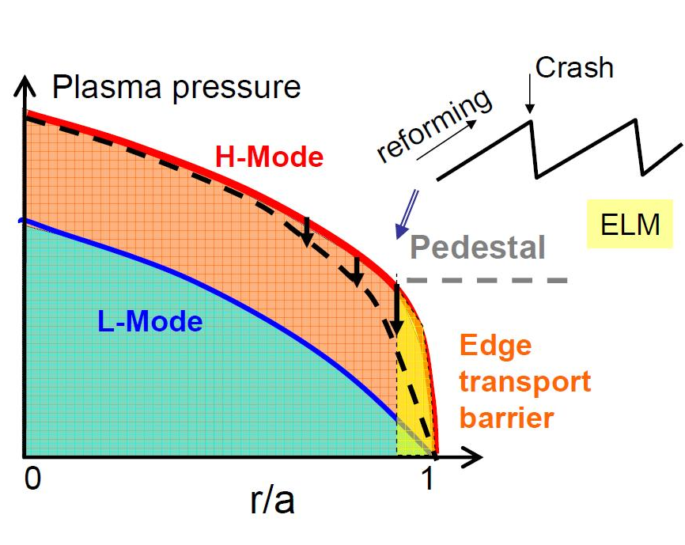
Edge-Localized modes
Recurring releases of heat and particles in H-mode
Loss of confinement, wall damage
Exhausting of impurities
ITER will have ELMs
Notes:
one of these events is edge-localized modes, or ELMs
these are repeating bursts of light and energy
that cause loss in confinement and potential damage
but are important for impurity control
which is one of the reasons iter operate with ELMs

Slide 6
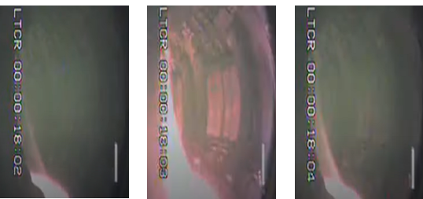
stochasticity in ELMs
ELMs detected from edge light emission
Associated with drop in stored plasma energy
Influenced by plasma conditions
Behavior varies from pulse to pulse
Notes:
ELMs are detected from the light emission coming from the edge of the plasma
and each ELM has an associated with a drop in stored energy
there is a lot variability in ELMs
especially from pulse to pulse
depending on input plasma conditions

Slide 7
Motivation: questions
Which conditions/controls influence ELMs?
How to study a large set of pulses, while preserving information?
How to study rare but violent ELMs?
Notes:
so my main questions are:
- which conditions influence ELMs the most?
- how can we study these effects on a large selection of discharges with varied data?
- can we study the ELMs that have the most risk, those rare but large ELMs?

Slide 8
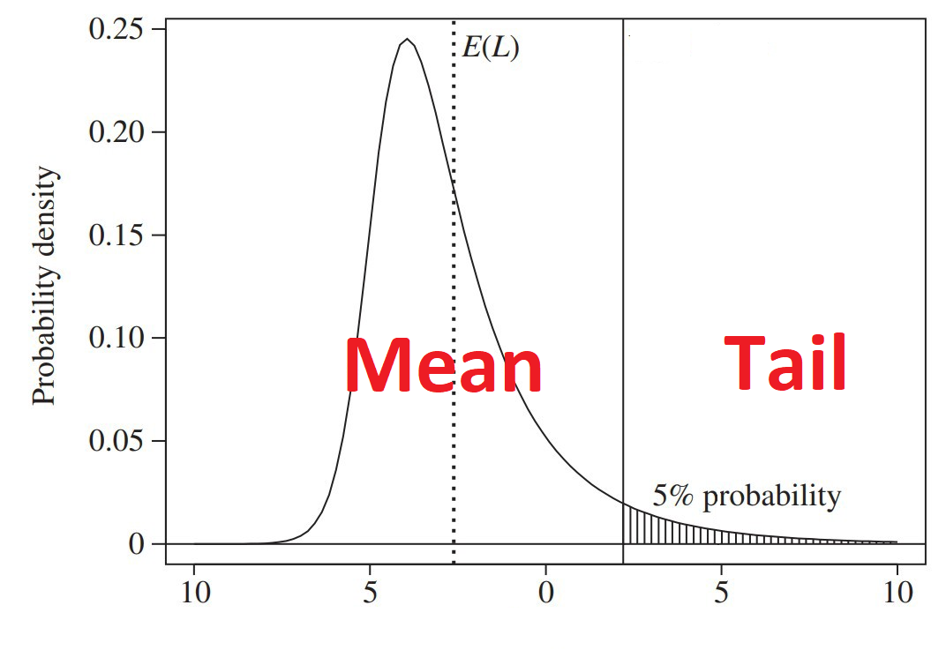
Motivation: Answers
Use data science to:
  Detect ELMs
  Describe their statistical characteristics
  (for timing and energy loss)
  using probability distributions
  Study dependence on plasma conditions
  Study rare events using distributions
Notes:
we answer each of these questions with data science tools
- first to detect ELMs
- and also to summarize their statistical behavior using a probability distribution function
- we check how initial plasma conditions can affect the parameters of the distribution function
- and we study rare ELMs by looking at the behavior of not the average, but the tails of these distributions

Slide 9
ELM distributions
Notes:
I will explain this a bit more concretely

Slide 10
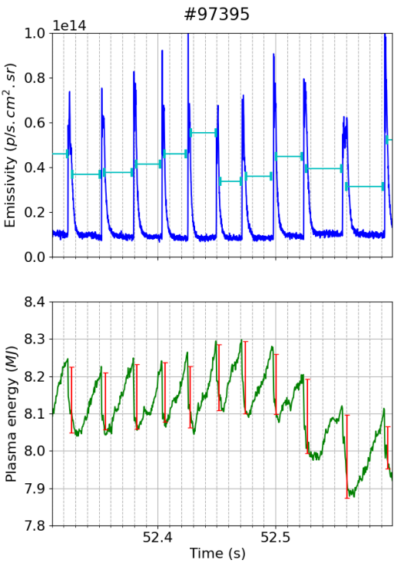
Data description
JET data from M18-01 baseline scenario (2019-2020)
214 shots, 268 windows with stationary plasma conditions
BeII emissivity for ELM timing
W_{p} for ELM size (energy)
13825 ELMs marked manually
Notes:
my dataset is a experiments from JET
there are 214 pulses where 268 time windows with stationary plasma conditions were selected
- we detect when the ELM has happened by looking at peaks of the Berillium emissivity (the signal on top)
- and for each peak, we find the drop in stored energy from the Wp signalp (the bottom in green)
I went through this dataset and manually marked around 14000 ELMs
of course with some tools to speed up the process

Slide 11
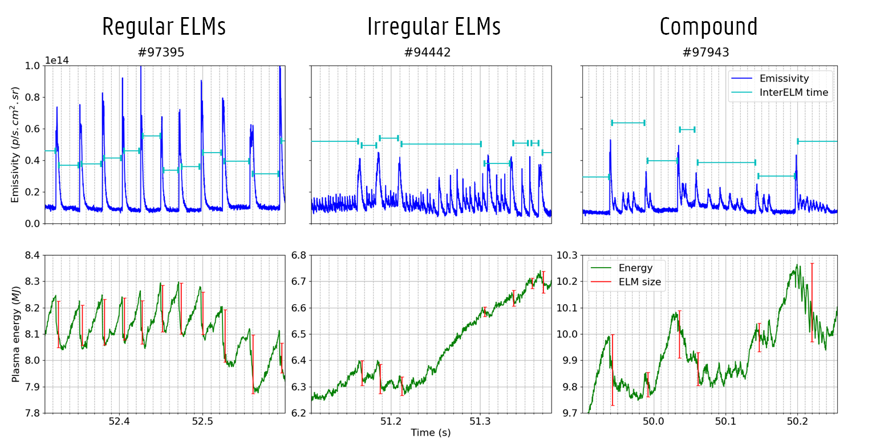
Intra/inter-shot variability
Notes:
the first thing to notice is that ELMs show two types of variability
intra-shot variability, where there is a difference in ELM behavior between different shots (like the case of shots with regular or irregular ELMs)
and inter-shot variability, which is variability within the same shot like the case of compound ELMs

Slide 12
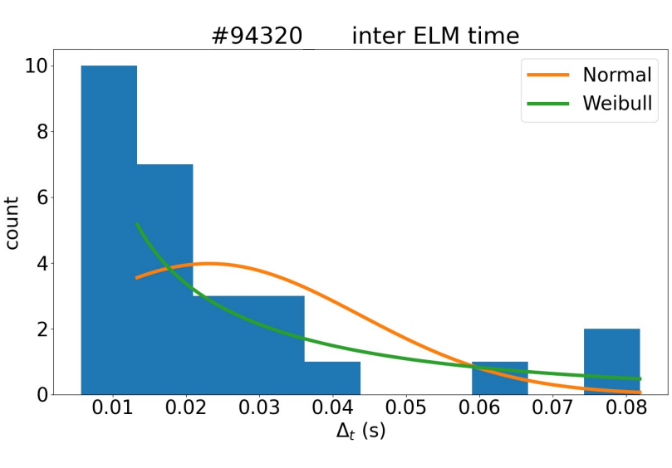
Elm distributions
Fluctuation is information!
Probability distributions summarize and preserve information
Changes in plasma conditions affect distribution parameters
Frequency | → | inter-ELM time (pdf)
Energy | → | ELM size (pdf)
Notes:
we don't want to lose information on those fluctuations
which is why we use distribution functions to summarize it
so all the ELMs in the entire shot become the parameters of the distributions functions we fit to their timing and zie
here for example, instead of ELM frequency, it becomes the distribution of the time between ELMs (Delta T)
and also the average ELM energy becomes the distribution of the size of the ELMs
the figure on the right, we see a histogram of the time between ELMs, delta T
where a weibul distribution has an extra parameter for skewness

Slide 13
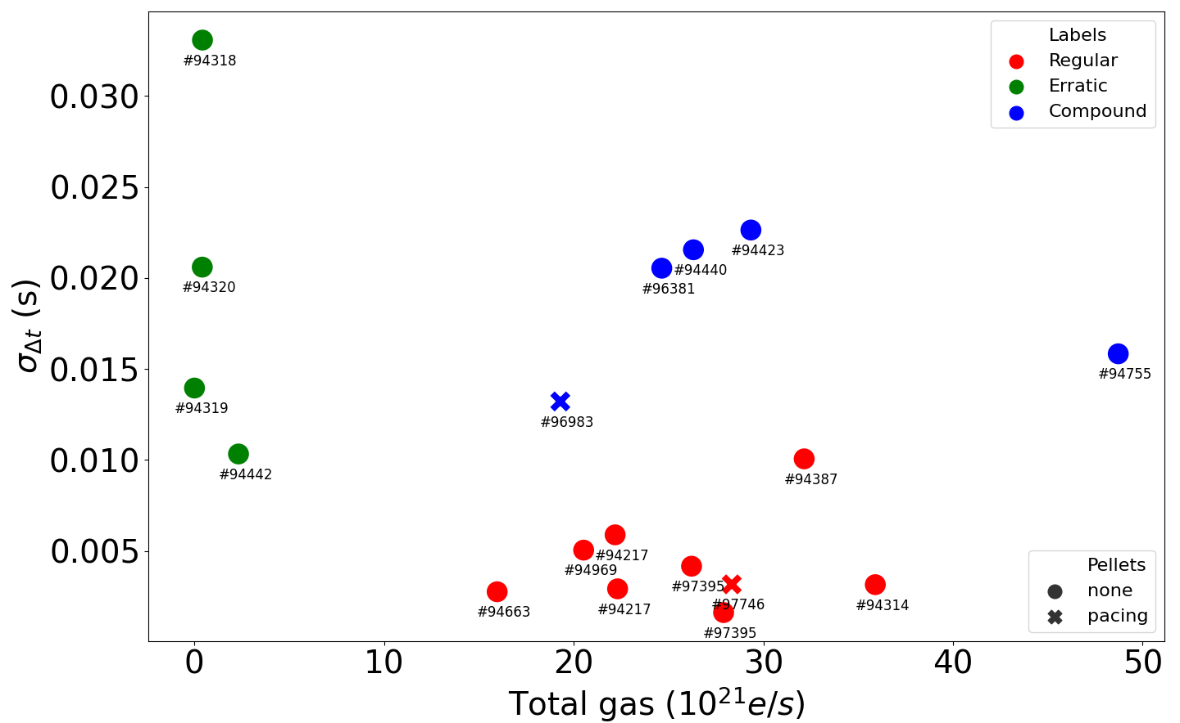
ELM distribution MAPS
Notes:
if we plot one of these parameters versus another, we get distribution maps
like the example here
which can help us identify groups of ELM behavior
in this example, the group on the left at low gas, we have more variability of the time between ELMs

Slide 14
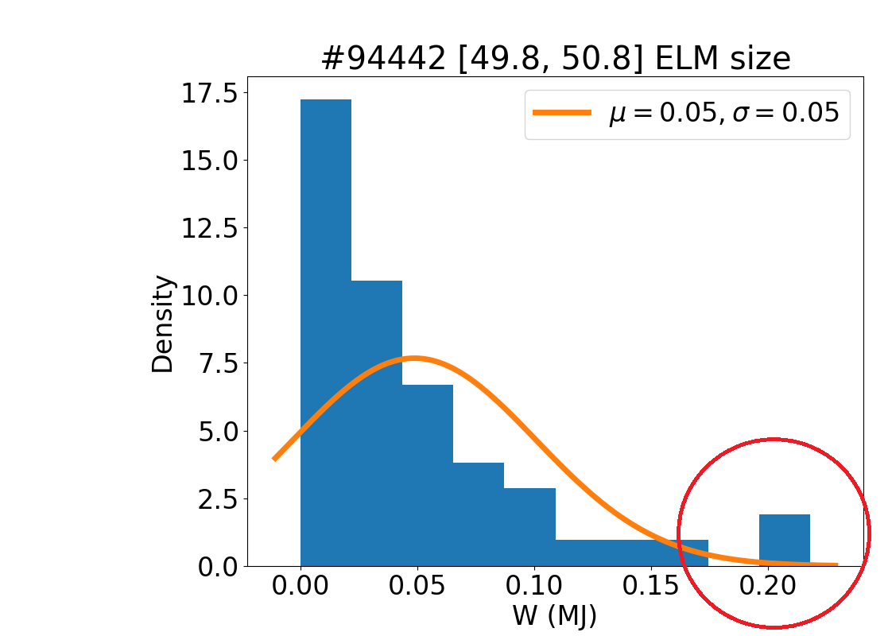
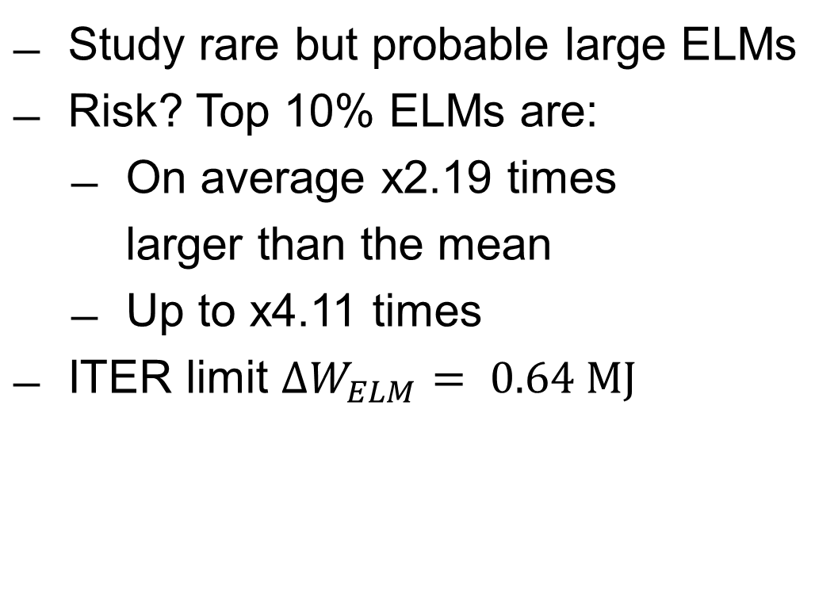
Tail ELM events
Study rare but probable large ELMs
Risk? Top 10% ELMs are:
  On average x2.19 times
  larger than the mean
  Up to x4.11 times
ITER limit $∆W_{ELM}= 0.64 MJ$
Notes:
another application is in risk analysis
for example, the top 10% of ELMs tend to be 2 times larger than the average
and like the figure here, up to 4 times larger than the average
it is important to predict the expected size of those rare ELMs
to make sure we don't exceed safety limits

Slide 15
ELM detection
Notes:
so to make these kind of studies
we need to robustly and reliably detect each individual ELMs
how do we do it?

Slide 16
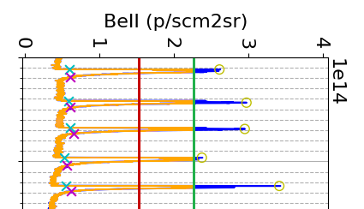
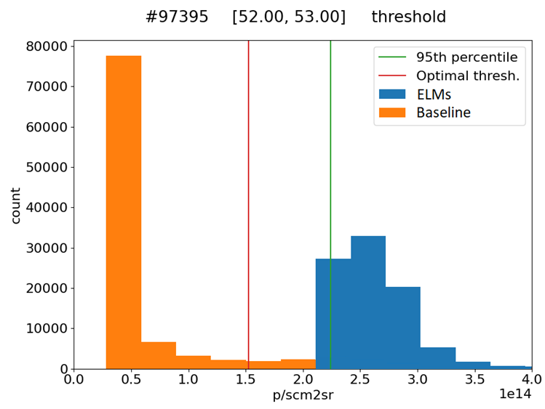
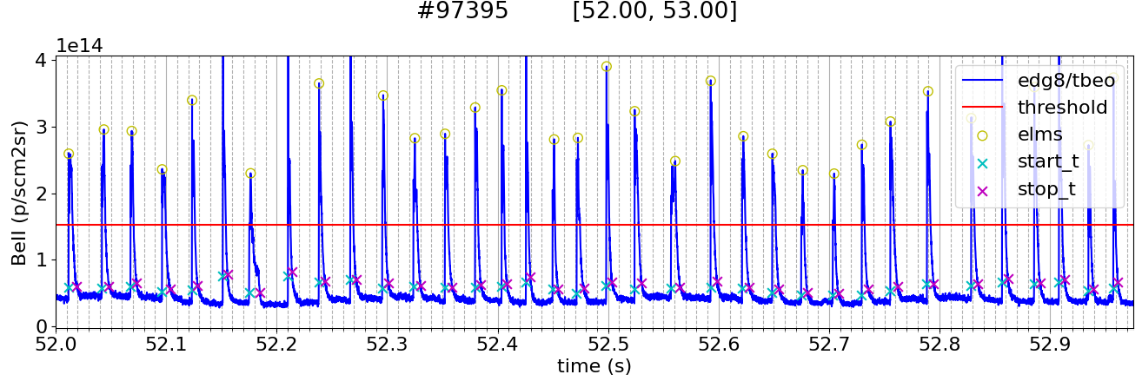

Optimizing a threshold
Events / no events
1st pass (initial guess) top 5%
2nd pass best inter-class separator
Notes:
the most basic way is with a threshold
in my application, I can draw a line on the emissivity signal, and everything above it is an ELM
I can pick this line automatically, by finding the optimal seperator of the two classes
the events, in blue, which are the peaks
and the non events, in orange, which is the baseline

Slide 17
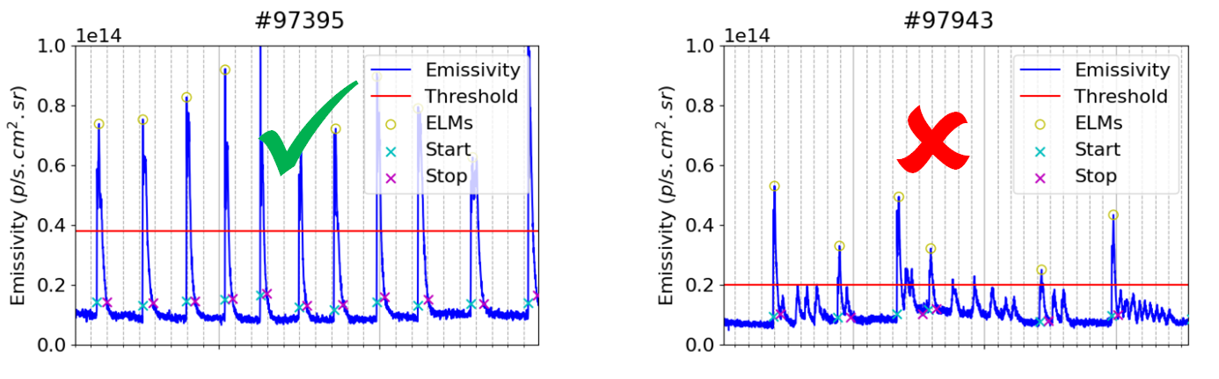
improving ELM detection
Incomplete results versus:
  Compound ELMs
  Small or irregular ELMs
Notes:
the main disadvantage is that, no matter how good the threshold is, it can only seperate between two classes
so it fails when there are different looking ELMs in the same shot, like the window on the right

Slide 18
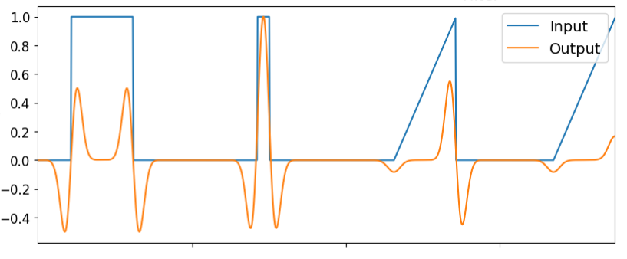
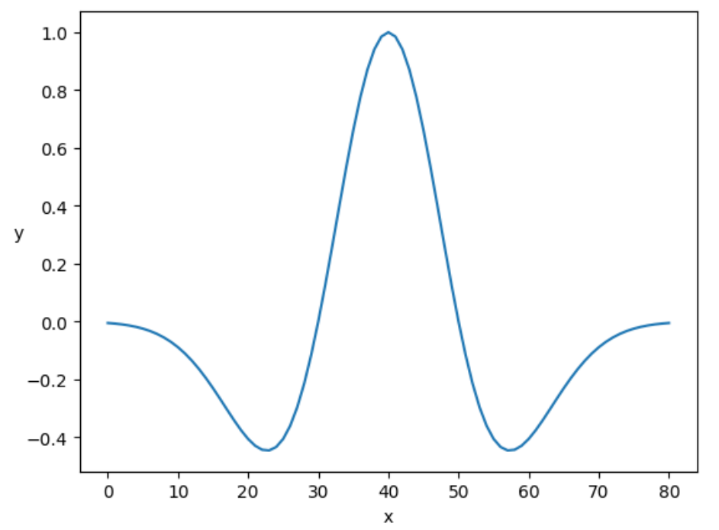
Laplacian of Gaussian filter
Inspired by edge detection in images (SIFT)
2nd order derivative to look for peaks (edges)
Kernel provides scale and translation invariance
Kernel can be optimized for ELMs
Convolution
Kernel (filter)
Notes:
a second idea is inspired from computer vision, from the SIFT
it is a technique used for edge detection
in images edges are just rapid changes in color, in 1D becomes peaks
it works by doing convolution with a Gaussian kernel to do smoothing
then computes something similar to a 2nd order derivative to find peaks
we just need to do a threshold over the output of the filter, the signal in orange
the kernel used for the convolution is the Laplacian of Gaussian, commonly known as the mexican hat shape
a key property is scale invariance
because the integral of the kernel is zero, so it normalizes the signal as it passes through it
and peaks with different amplitudes are no longer a problem
we can optimize this kernel, and tune it specifically to ELMs, with a custom kernel

Slide 19
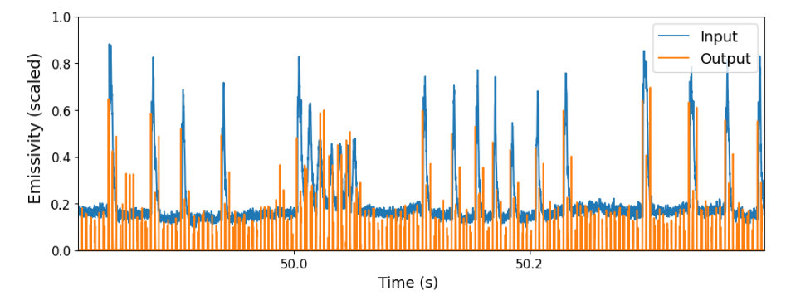
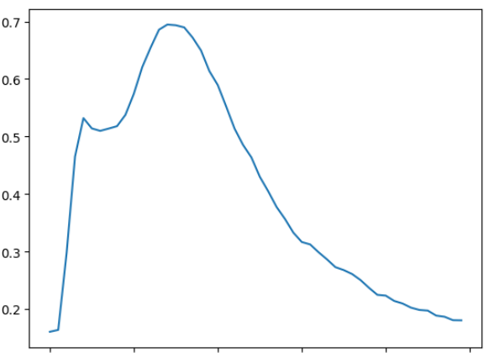
Deconvolution
Signal processing technique
Matching the kernel returns delta function
Needs good estimate of ELM profile
Suffers with multiple shapes / widths
Kernel (BeII emissivity scaled)
Deconvolution
Notes:
third is deconvolution inspired from signal processing
when you convolve a shape with a series of delta functions
you get the kernel shape repeated
the other way around is deconvolving this kernel from the signal, to retreive the original positions
so if I know that in the timeseries, my events have the same distinct shape
and if I can make a good guess for this shape, this kind of method would be very succesful
the kernel below on the left is an average of a few representative peak shapes in the emissivity signal
and in orange, the result of the deconvolution of this kernel from the blue emissvity signal

Slide 20
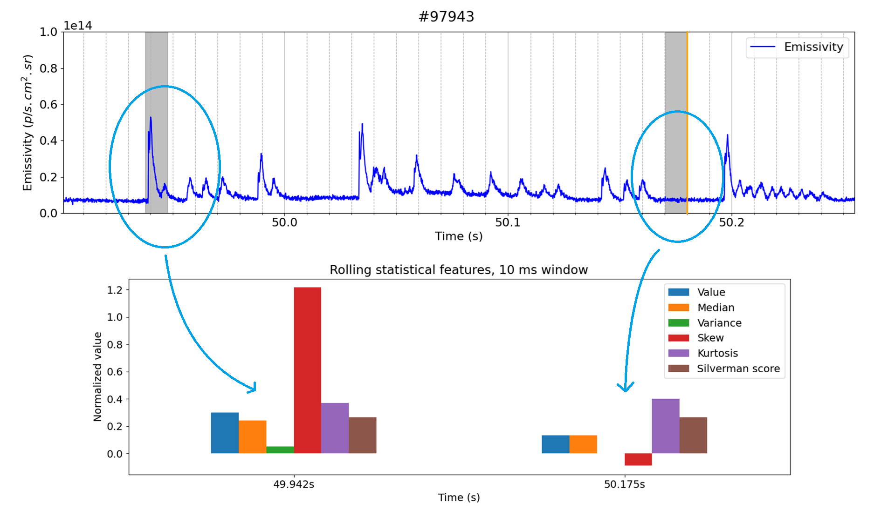
Moving statistical features
Sliding window where statistical features are calculated
Train a custom threshold
Known as "rolling z-score" for variance
Notes:
a fourth method is to scan the signal with a moving buffer of data
so this grey window here, it slides over the signal
and we calculate over it different statistics like mean, variance, kurtosis
then we train a classifier to use all these statistical features to distinguish between two groups: buffers with peaks and buffers without
if we only use the variance, this method is known as "rolling z-score"
but of course the threshold is trained

Slide 21
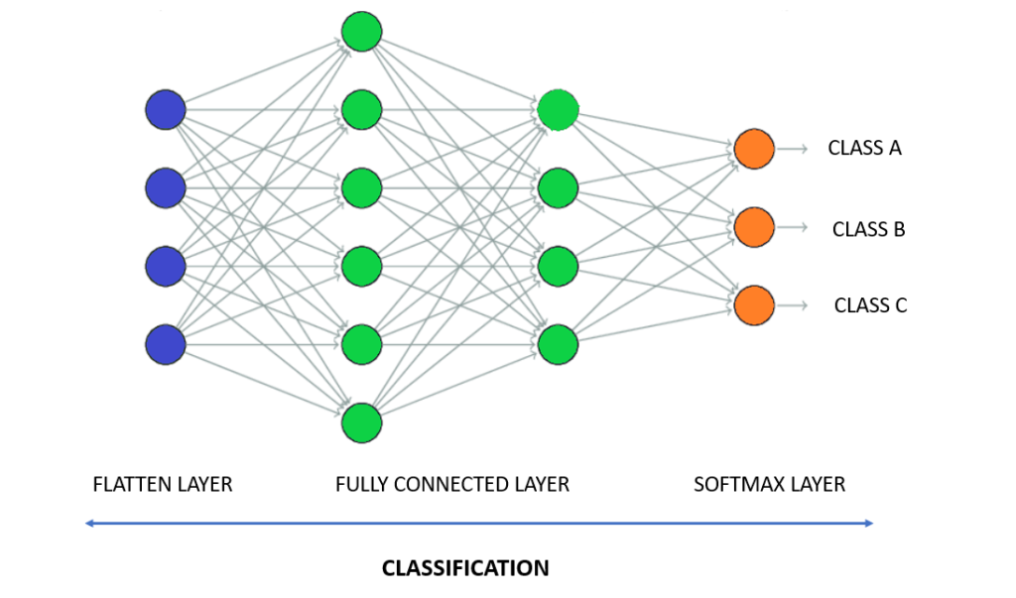
Convolutional neural networks
Sliding window
Successive layers learn more complex features
Input combines raw emissivity and energy signals, and filtered data
Notes:
we also tried neural networks
for convolutional neural networks also work with a sliding window
but each successive convolution layer learns more complex features
In the case of image classifiers
the first layer learns how to detect edges, then combinations of edges into shapes, then combinations of shapes into objects
and we add a final layer to make a single binary decision signal of ELM / noELM
an advantage is that we can just give the network many of the previous filtered signals
and let it decide how to combine them

Slide 22
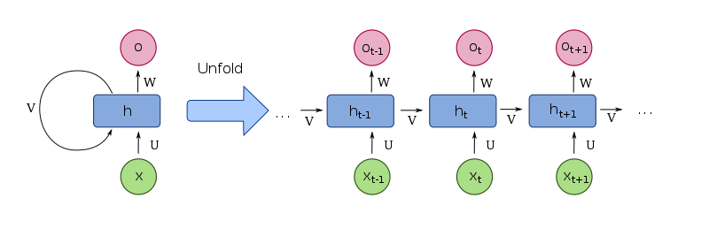
Recurrent neural networks
Interconnected layers for memory between prior inputs
Influenced by how data is ordered in a sequence
Used for speech, music, natural language processing
Notes:
a different type of neural network is called recurrent neural networks
where the output each recurrent layer is actually part of the inputs to the layer itself
you can think like: each recurrent layer will also ask itself, what was the answer of the previous input?
so it takes information from the current and previous sequence
which lets the network maintains an internal state which is a sort of memory
a typical application is the word suggestions on your phone
where if you give a model a sequence of words, it can make a guess for the next word you want
this memory could be suited for events in timeseries which might have hidden patterns

Slide 23
Evaluation
Notes:
okay so, which one is the best?

Slide 24
Evaluation metrics
Accuracy inadequate for imbalanced data
How many of ELMs were detected correctly?
→ True positives, recall
How many ELMs were wrongly detected?
→ False positives
Notes:
to answer that, we cannot use simple accuracy as a metric for performance
because since anomalies are rare events, a detection method that says "NO event" will be accurate most of the time
so for metrics we picked:
- true positive rate, or recall, which is how many of the events were detected correctly?
- false discovery rate, which is which fraction of the total were false positives?

Slide 25
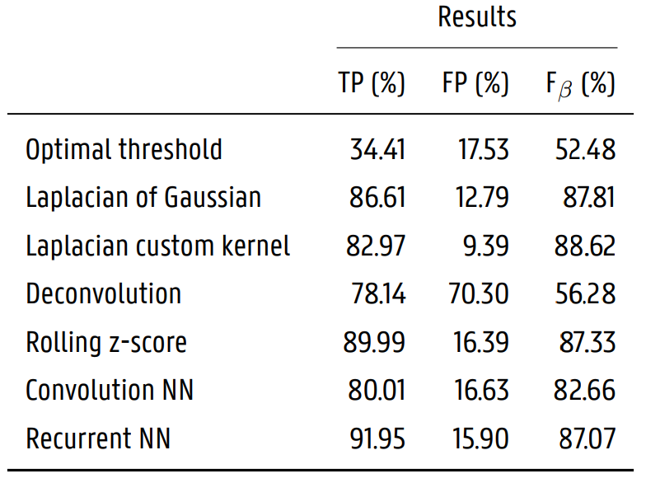
Evaluation
F_{0.5}: F-score where false positives are twice as important as recall
Notes:
we which combines these two previous numbers, an F-beta-score of 0.5
that gives having "less false positives" twice the importance of "detecting all ELMs" correctly
for results we found that most methods were an improvement over a threshold
and the best methods are the laplacian of guassian filter, rolling statistical features, and recurrent neural networks
note for neural networks, due to time constraints, for training we only made two passes over the dataset
but were able to achieve really good results which shows good promise
the recurrent neural network model was also much smaller, 100kb instead of 3mb
but it takes an order of magnitude more time to execute (x90) than the simpler filters with a threshold

Slide 26
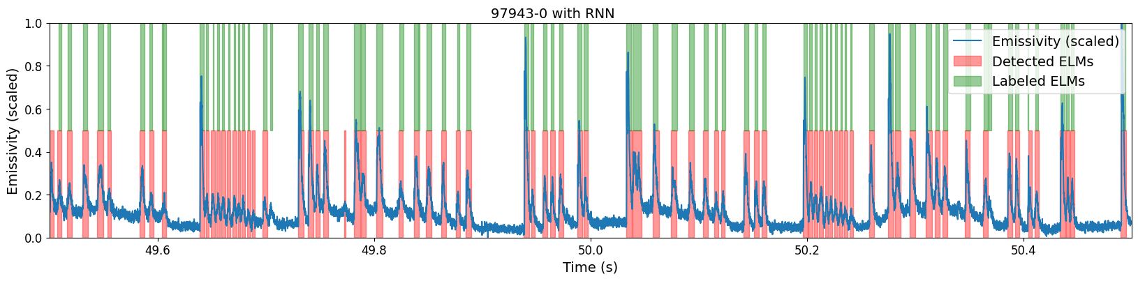
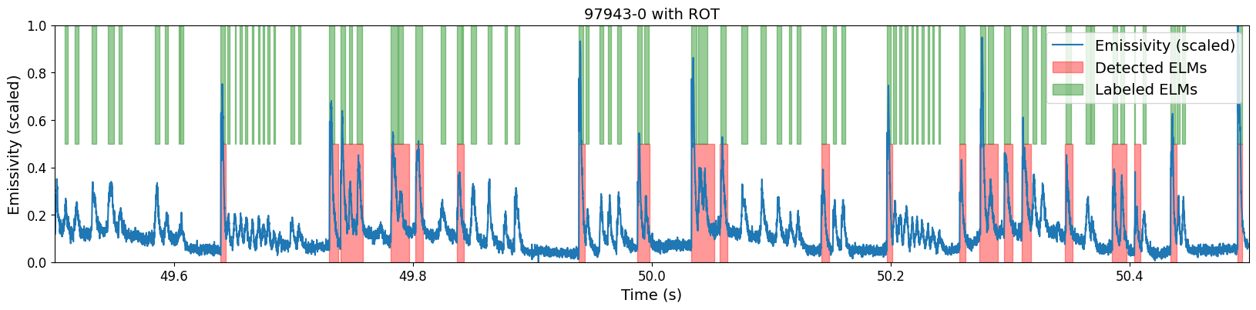
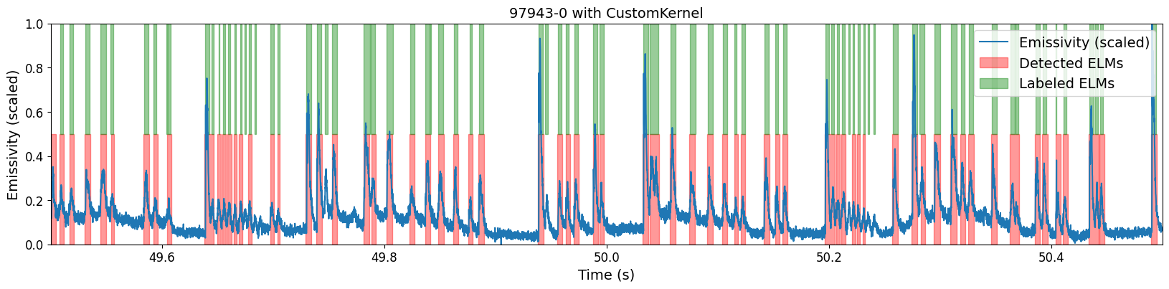
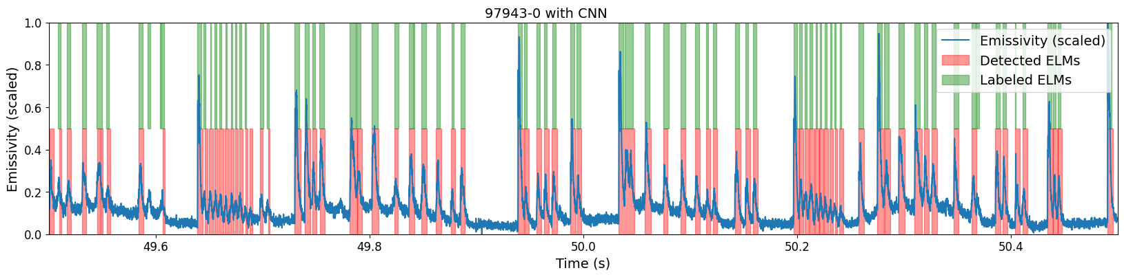
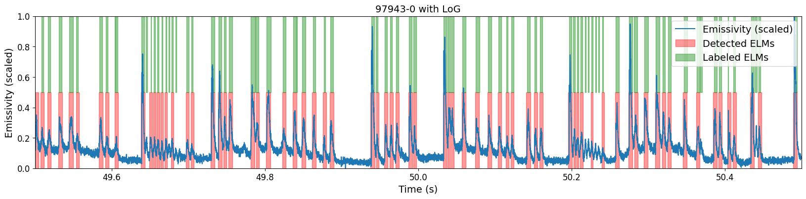
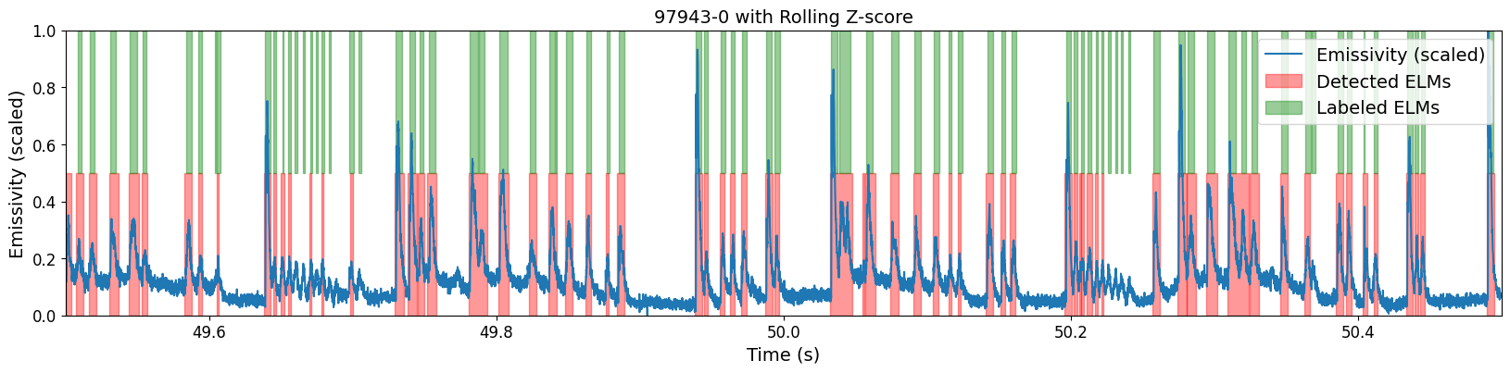
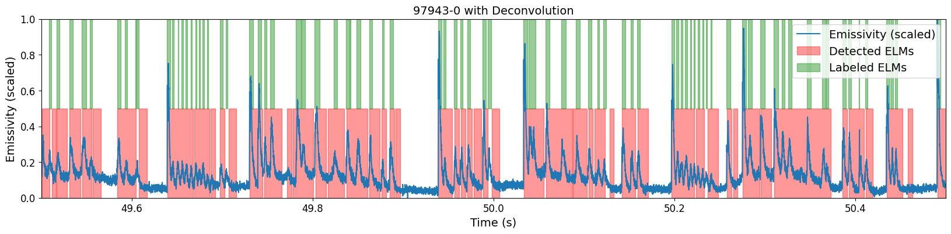
Comparison: #97943
Threshold | Rolling z-score
Laplacian of Gaussian | Conv. NN
Laplacian with custom kernel | Recurrent NN
Deconvolution
Notes:
I will quickly show you two examples
over the plotted signals there are markings in green on top for the manual labels
and in red is what we get from the detection
we see that most methods are an improvement over a threshold in shots with mixed ELM behavior

Slide 27
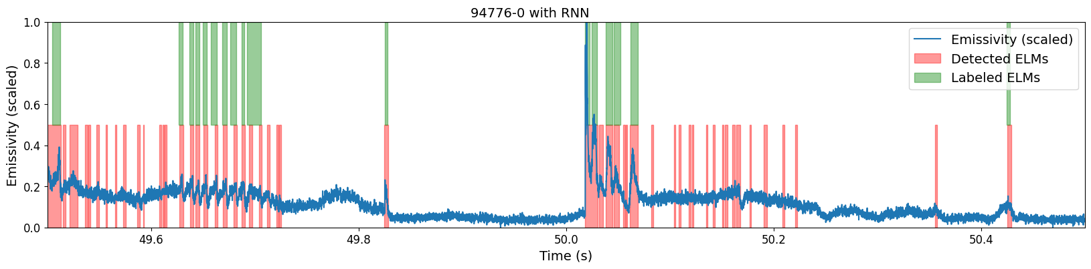
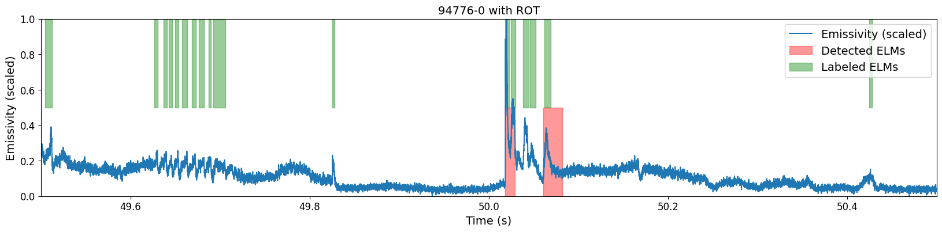
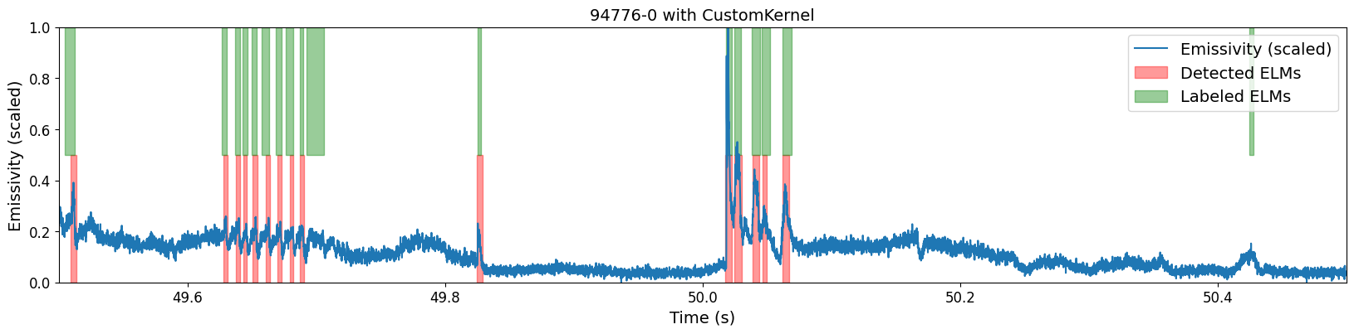
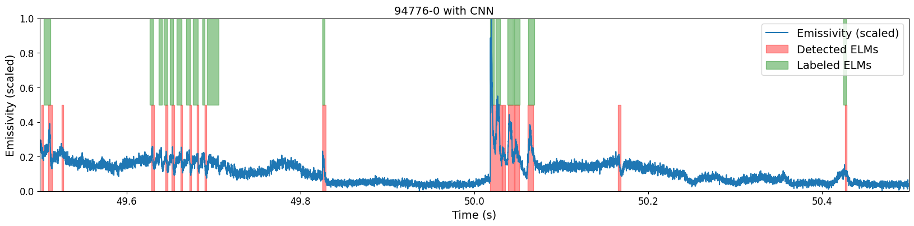
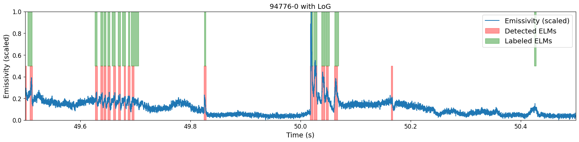
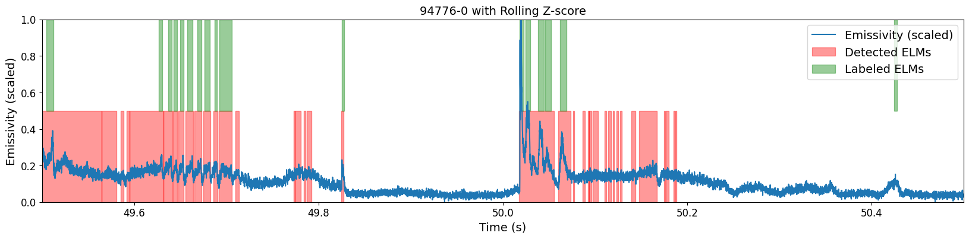
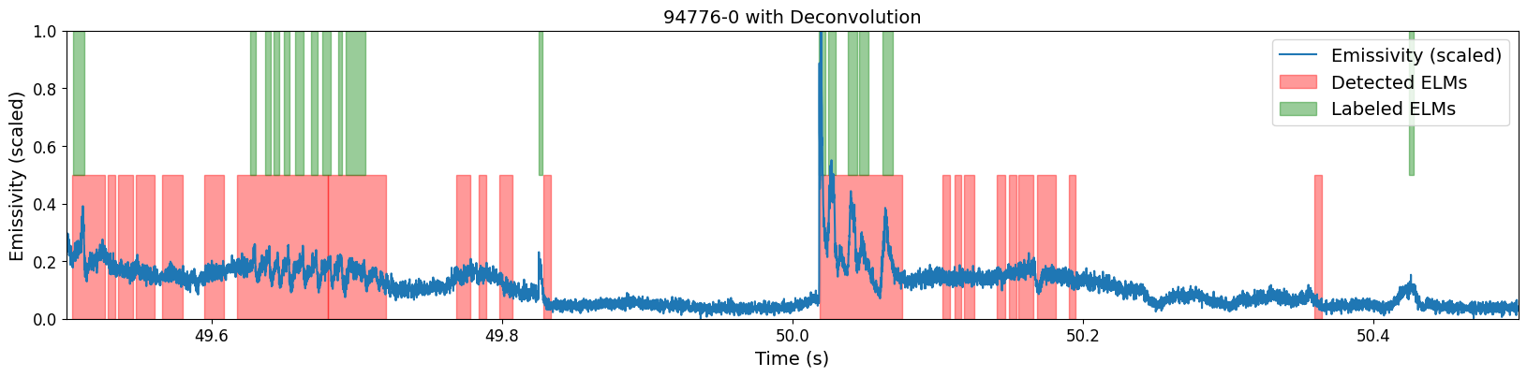
Comparison: #94776
Threshold | Rolling z-score
Laplacian of Gaussian | Conv. NN
Laplacian with custom kernel | Recurrent NN
Deconvolution
Notes:
and in a more extreme case
I will tell you to look at two things
the second and third plots on the left
where using a custom kernel for the laplacian filter let us avoid a false positive, which this dip at around 50.2s
and the last plot on the right
for the recurrent neural network
it was confused, likely because of the internal memory, the model expects a series of ELMs to follow but there were none

Slide 28
Conclusion

Slide 29
Conclusion and outlook
Improved automated detection of ELMs
Study scaling of ELM distribution parameters towards ITER
Study rare events and risk analysis
Expand analysis to larger pulse dataset or historic data
Methods developed useful for condition monitoring for other subsystems surrounding the machine
Notes:
in conclusion, we improved ELM detection with many advanced methods
and neural network models show a lot of promise
I can now run the detection over more data
and study how these distribution parameters scale towards ITER
especially the scaling of rare and large ELMs
this kind of analysis can now be automated at a much larger scale on historic data
possibly with data coming from multiple machines
but more in general
the detection methods shown today can also be used to detect general anomalies or rare events in timeseries
which is important to automate the operation of a future commecial fusion reactor
- by helping monitor the condition of all subsystems surrounding the machine
- and by optimizing needed human intervention in predictive maintenance
the end goal is always, getting electricity from fusion
thank you

Slide 30
backup slides
Notes:
Q/A:
what is the direct output of your work:
i can tell you how ELMs will look like in ITER or DEMO
i can tell you how to avoid rare large ELMs in ITER
i can help ITER monitor all their subsystems

Slide 31
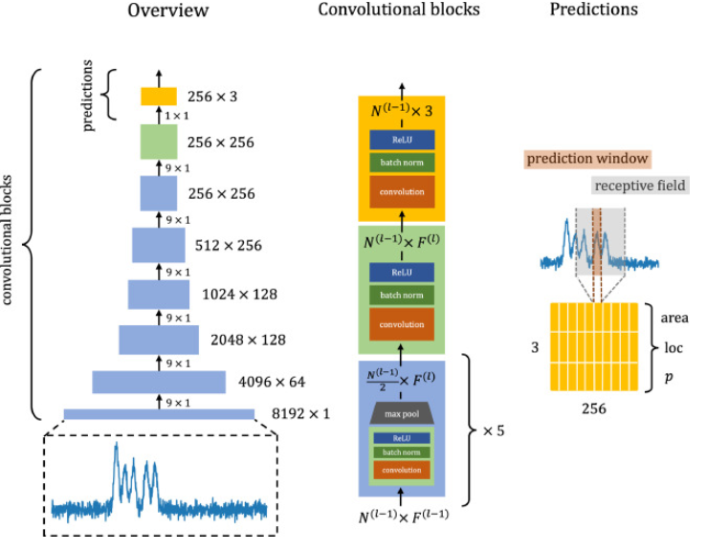
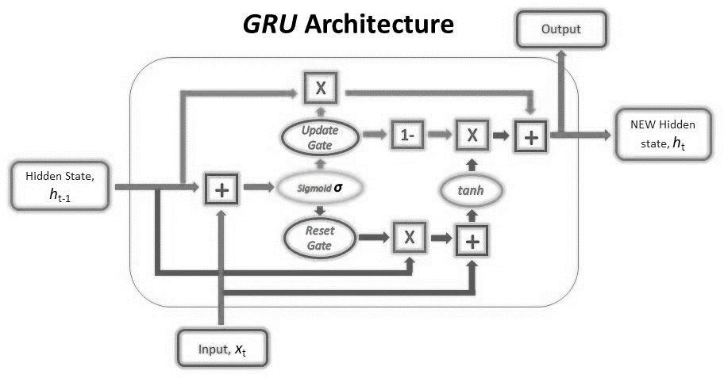
Notes:
what is NN performance:
~60/20/20 split train/test/valid
100kb RNN 3mb CNN
7 hours epoch training time (CPU 6 core)
gated recurrent units

Slide 32
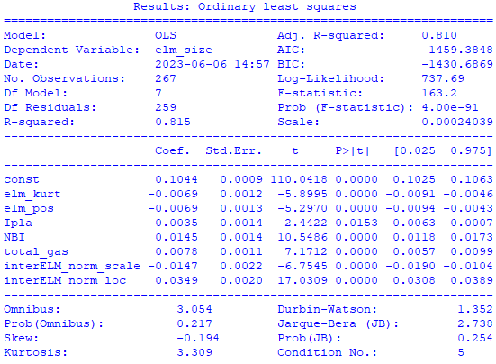
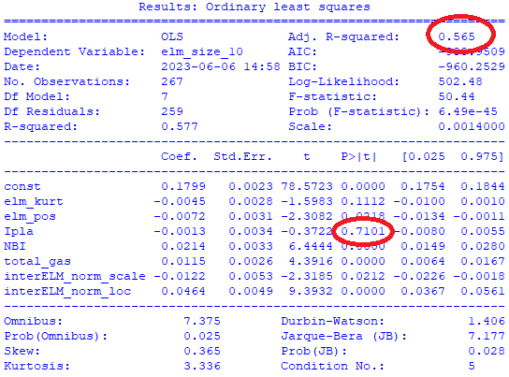

Slide 33
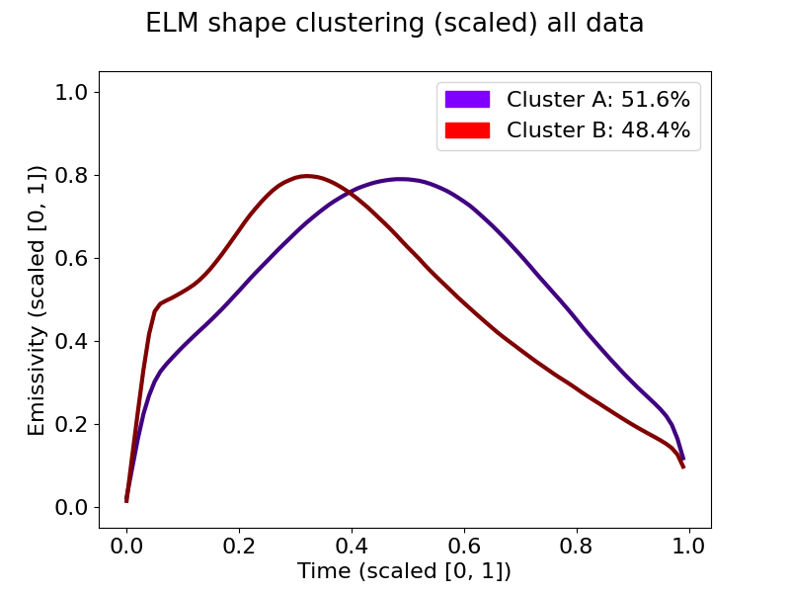
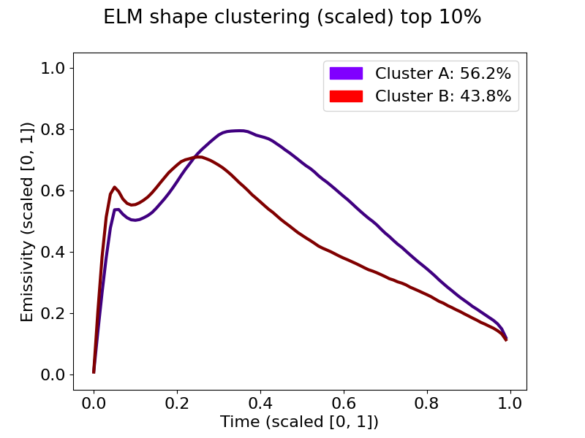

Slide 34
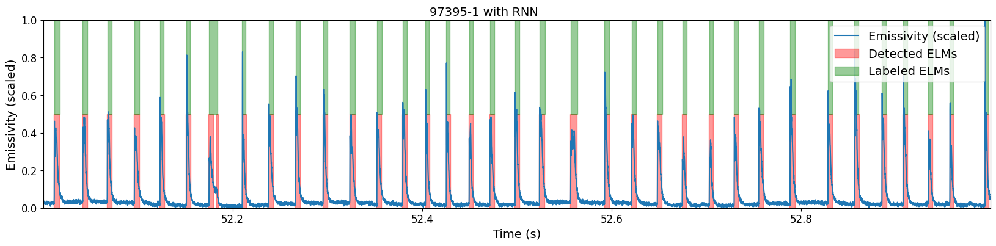
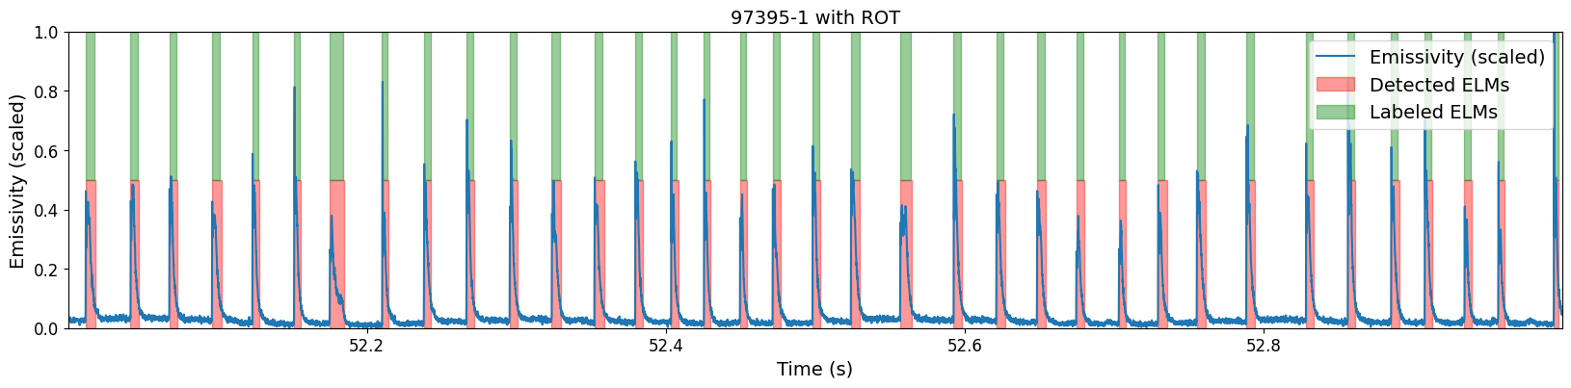
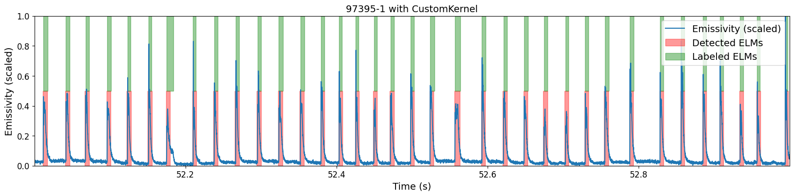
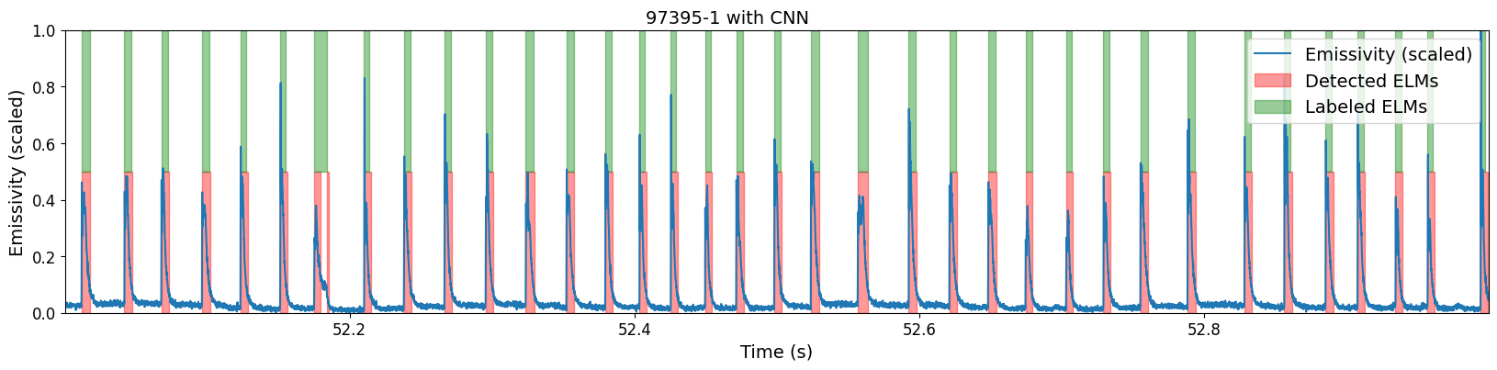
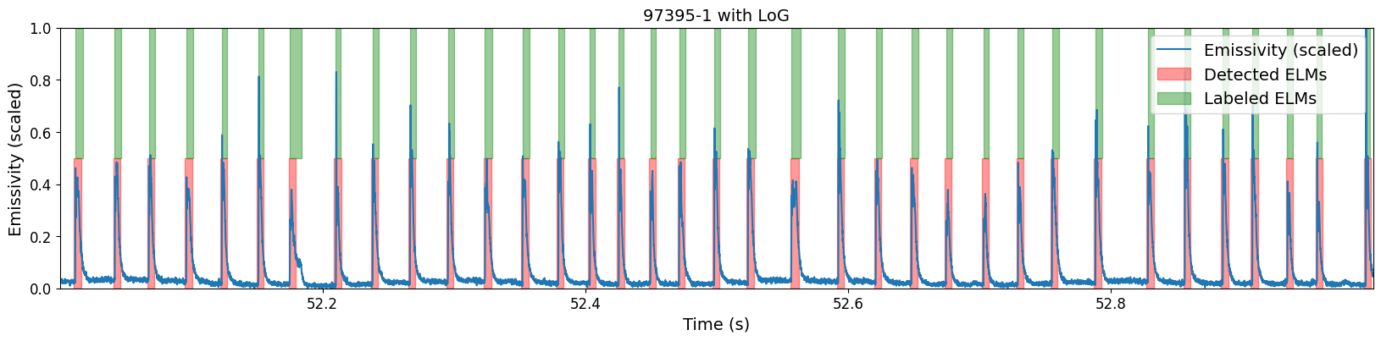
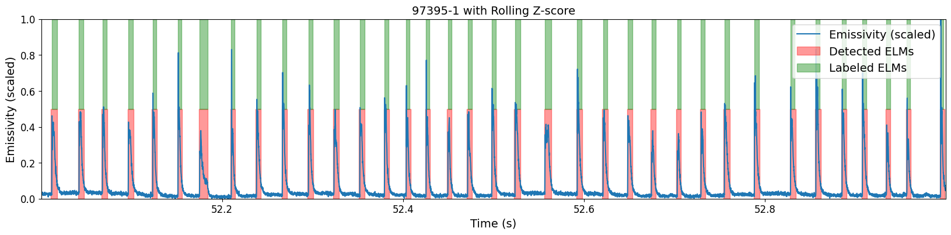
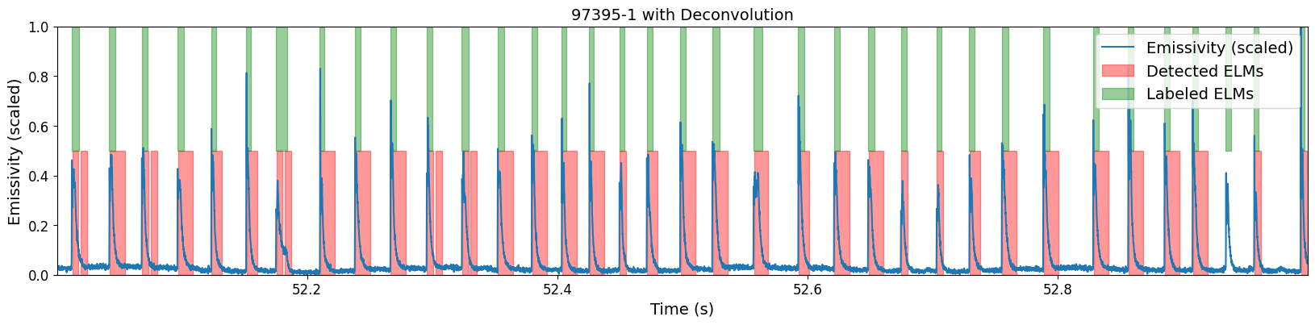
Comparison: #97395
Threshold | Rolling z-score
Laplacian of Gaussian | Conv. NN
Laplacian with custom kernel | Recurrent NN
Deconvolution

Slide 35
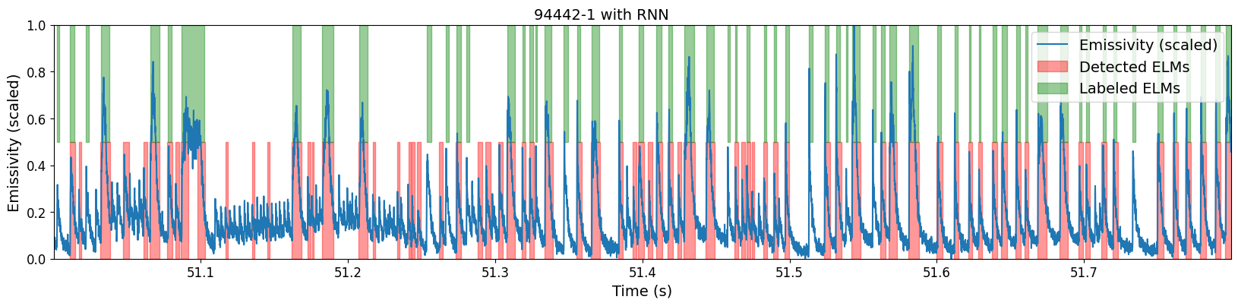
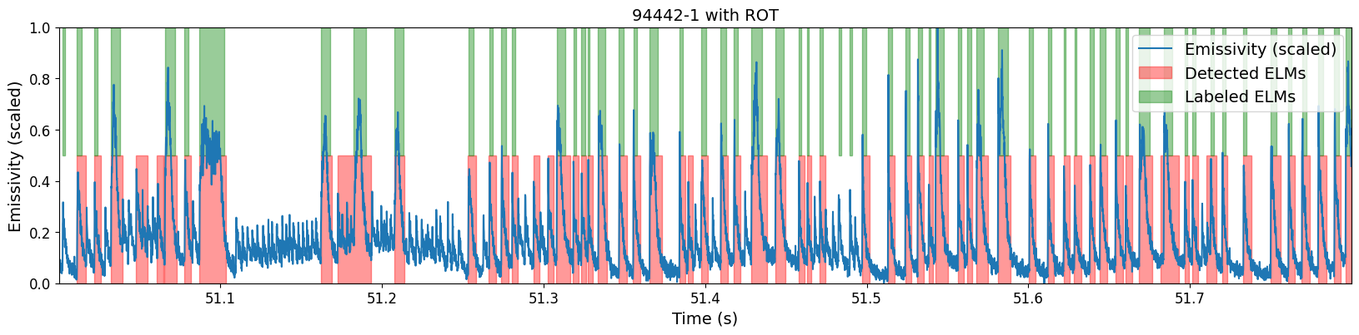





Comparison: #94442
Threshold | Rolling z-score
Laplacian of Gaussian | Conv. NN
Laplacian with custom kernel | Recurrent NN
Deconvolution

Slide 36
Comparison: #94776
Threshold | Rolling z-score
Laplacian of Gaussian | Conv. NN
Laplacian with custom kernel | Recurrent NN
Deconvolution

Slide 37
Comparison: #97943
Threshold | Rolling z-score
Laplacian of Gaussian | Conv. NN
Laplacian with custom kernel | Recurrent NN
Deconvolution

