Slide 1
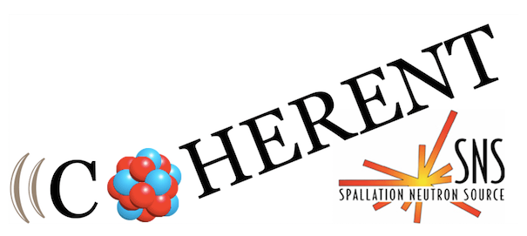
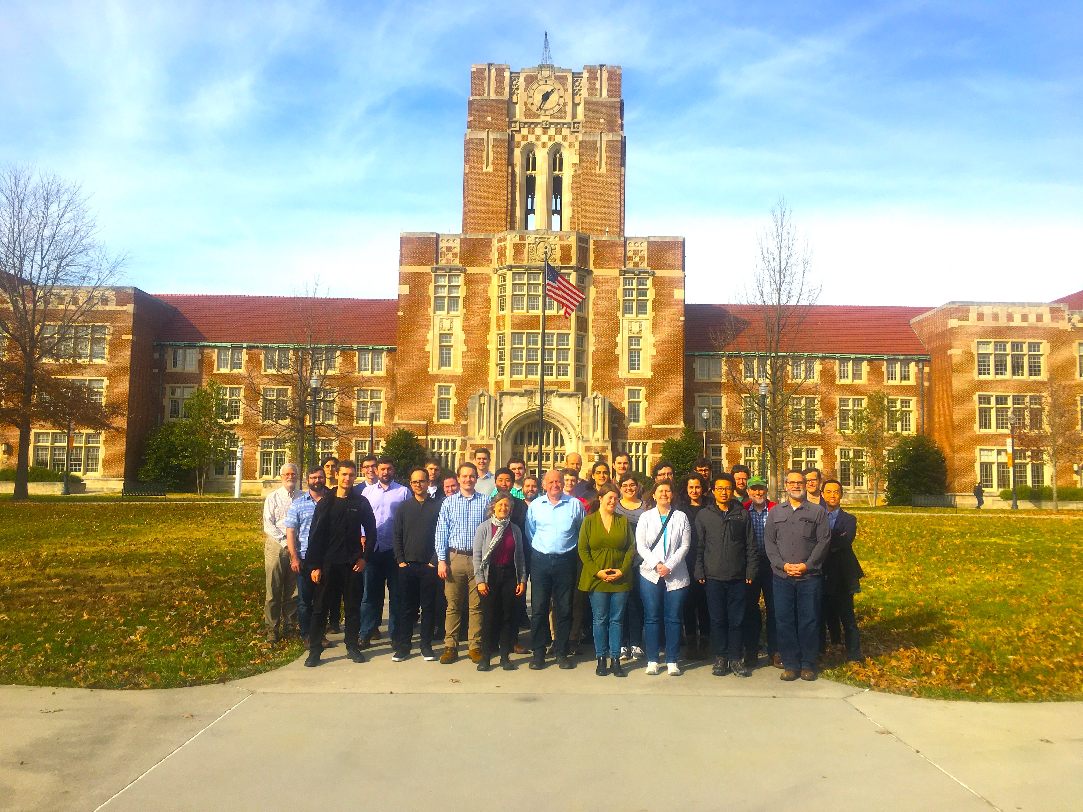
Study of CEvNS by the COHERENT collaboration
Yu. Efremenko
January 17th, Vienna. IAEA
COHERENT collaboration
USA, Canada, Korea, Russia,

Slide 2
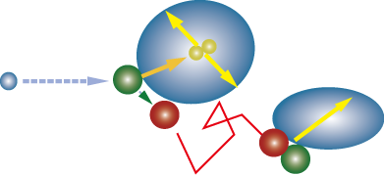
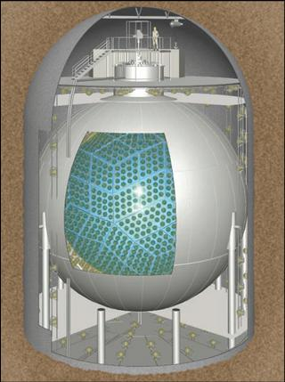
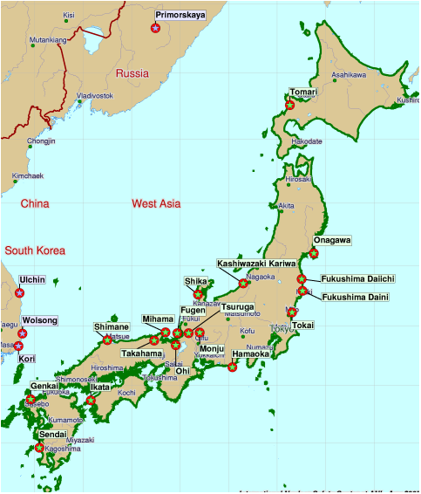
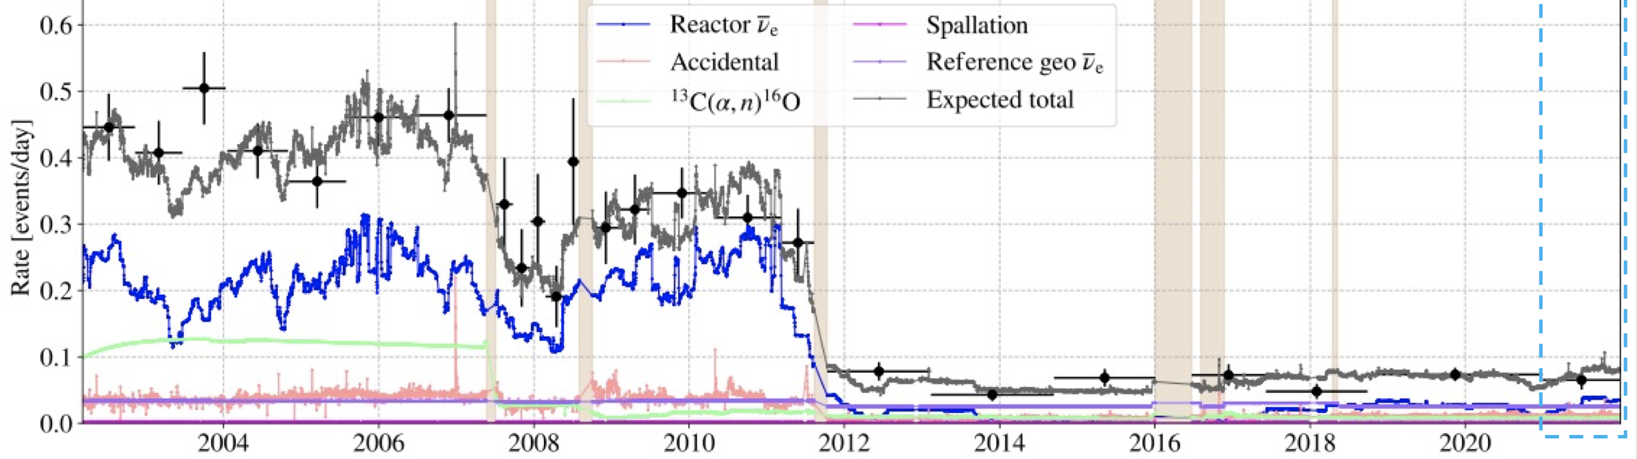

Inverse Beta Decay is a Workhorse for the Reactor Neutrinos
$${\overline{ν}}_{e}$$
Two flashes correlated in time and in space
Threshold is 1.8 MeV
KamLAND as an Example of Global Reactor Monitoring via IBD
1 kt Liq Sci
Drop in atomic power production in Japan after Fukushima
13m
18m

Slide 3
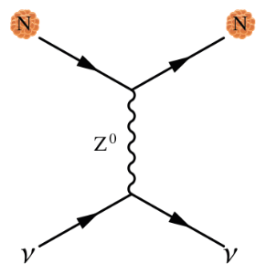
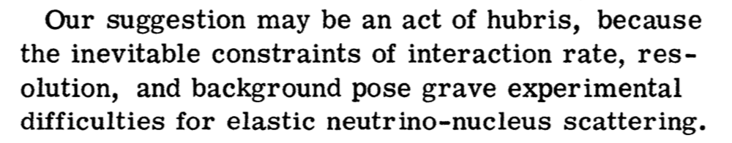
Coherent Elastic neutrino-Nucleus Scattering (CEvNS)
CEvNS cross-section is larger than any other neutrino interaction cross-sections at low energy, but it is hard to detect
D.Z. Freedman PRD 9 (1974)

Slide 4
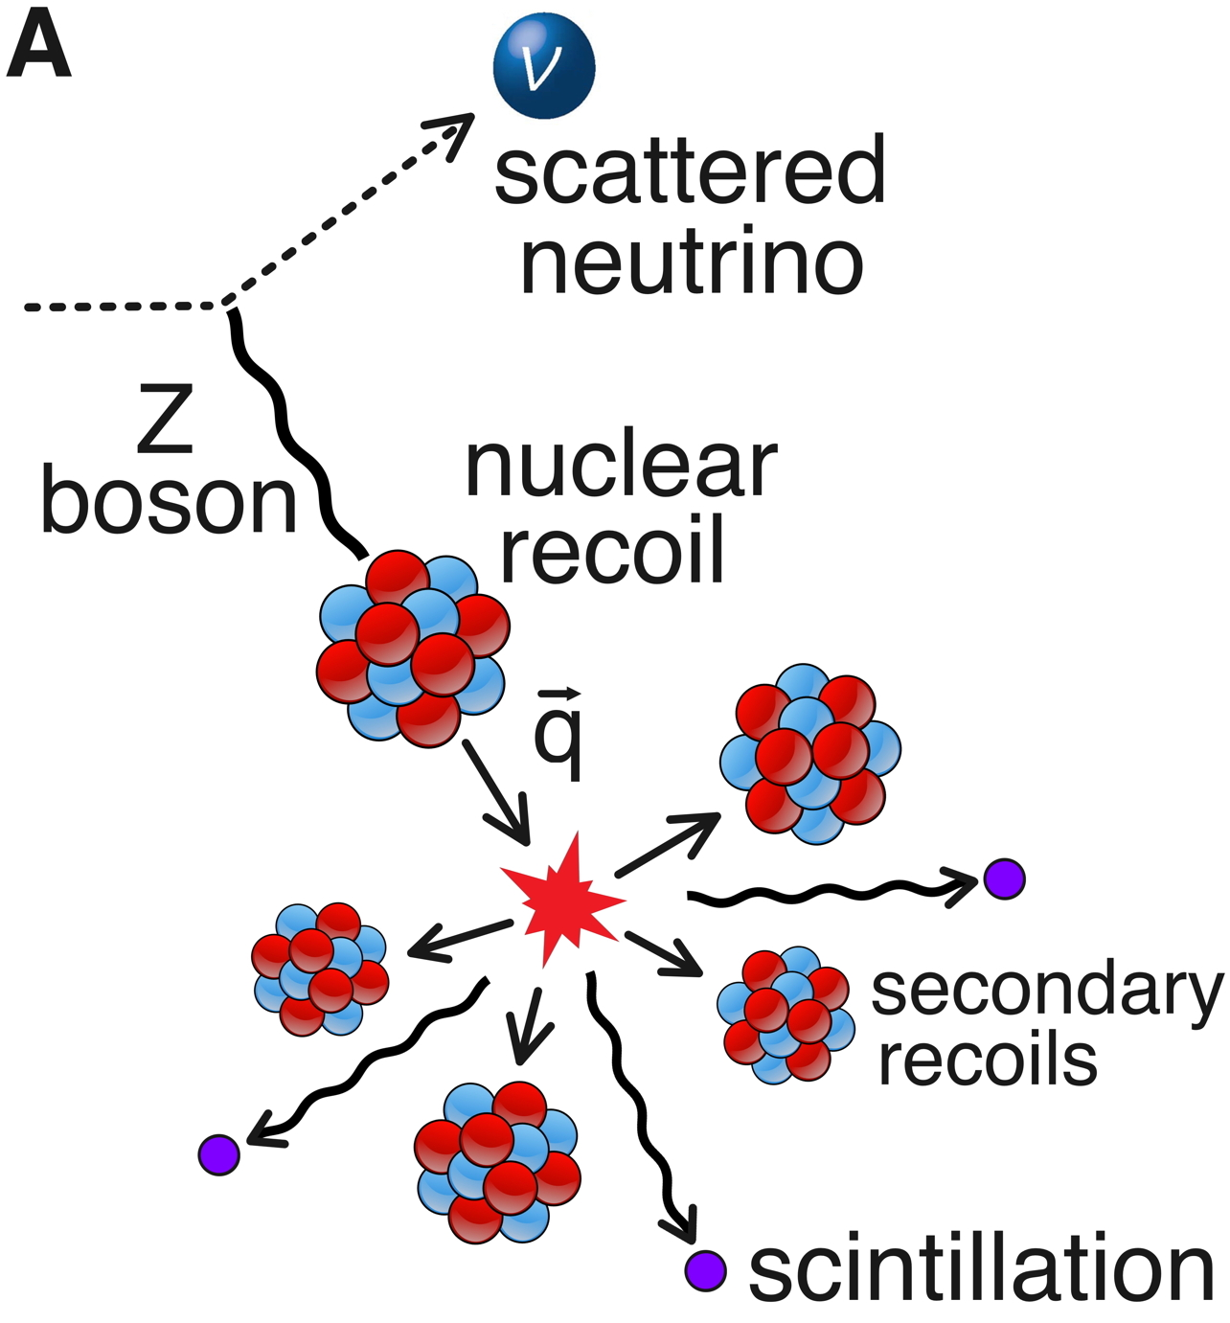

Coherent Elastic Neutrino Nucleus Scattering (CEvNS)
A neutrino scatters on a nucleus via exchange of a Z, and the nucleus recoils as a whole
D.Z. Freedman PRD 9 (1974)
Submitted Oct 15, 1973
V.B.Kopeliovich & L.L.Frankfurt
JETP Lett. 19 (1974)
Submitted Jan 7, 1974
CEvNS cross section is accurately calculated in the Standard Model !!!
Need to add nuclear physics to calculate form factor

Slide 5
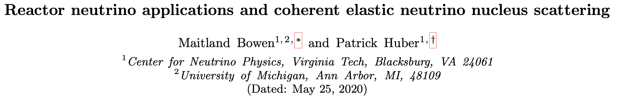
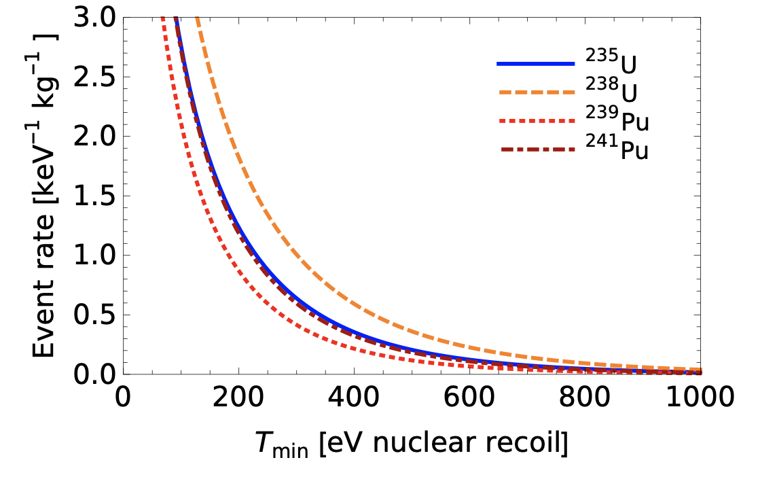
IBD vs. CEvNS at Nuclear Reactors
Phys.Rev.D 102 (2020) 5, 053008, e-Print: 2005.10907 [physics.ins-det]
Example if 1 kg detector 10 m away from 100 MW ²³⁵U reactor number of events per year
IBD
CEvNS for 0.1 keV threshold
Target | CH₂
N. Events | 418
C | Ne | Si | Ar | Ge | Xe
1023 | 1565 | 1954 | 2908 | 3913 | 4623
Ge detector
To take advantage of CEvNS cross section, low threshold is required

Slide 6
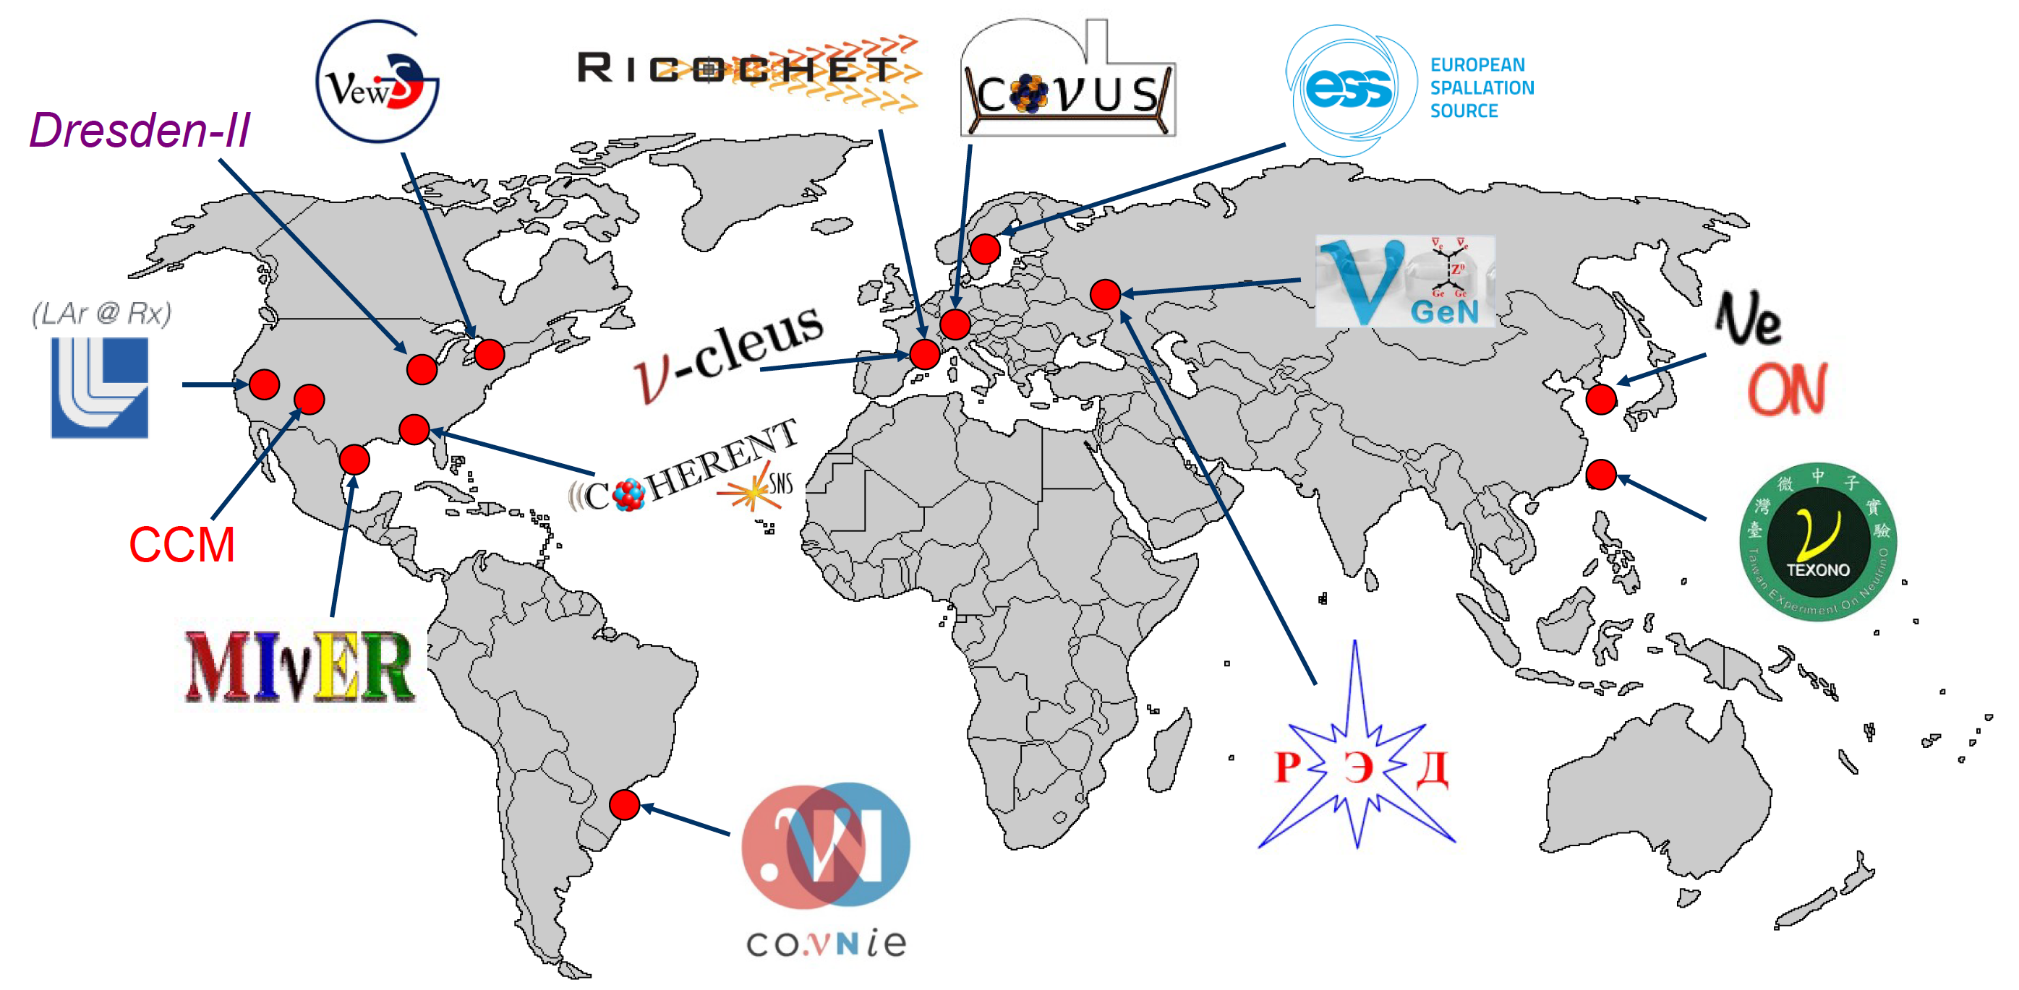
Worldwide efforts to detect CEvNS
Majority of efforts are around Nuclear Reactors
Only two collaborations are using
accelerator produce Neutrinos

Slide 7
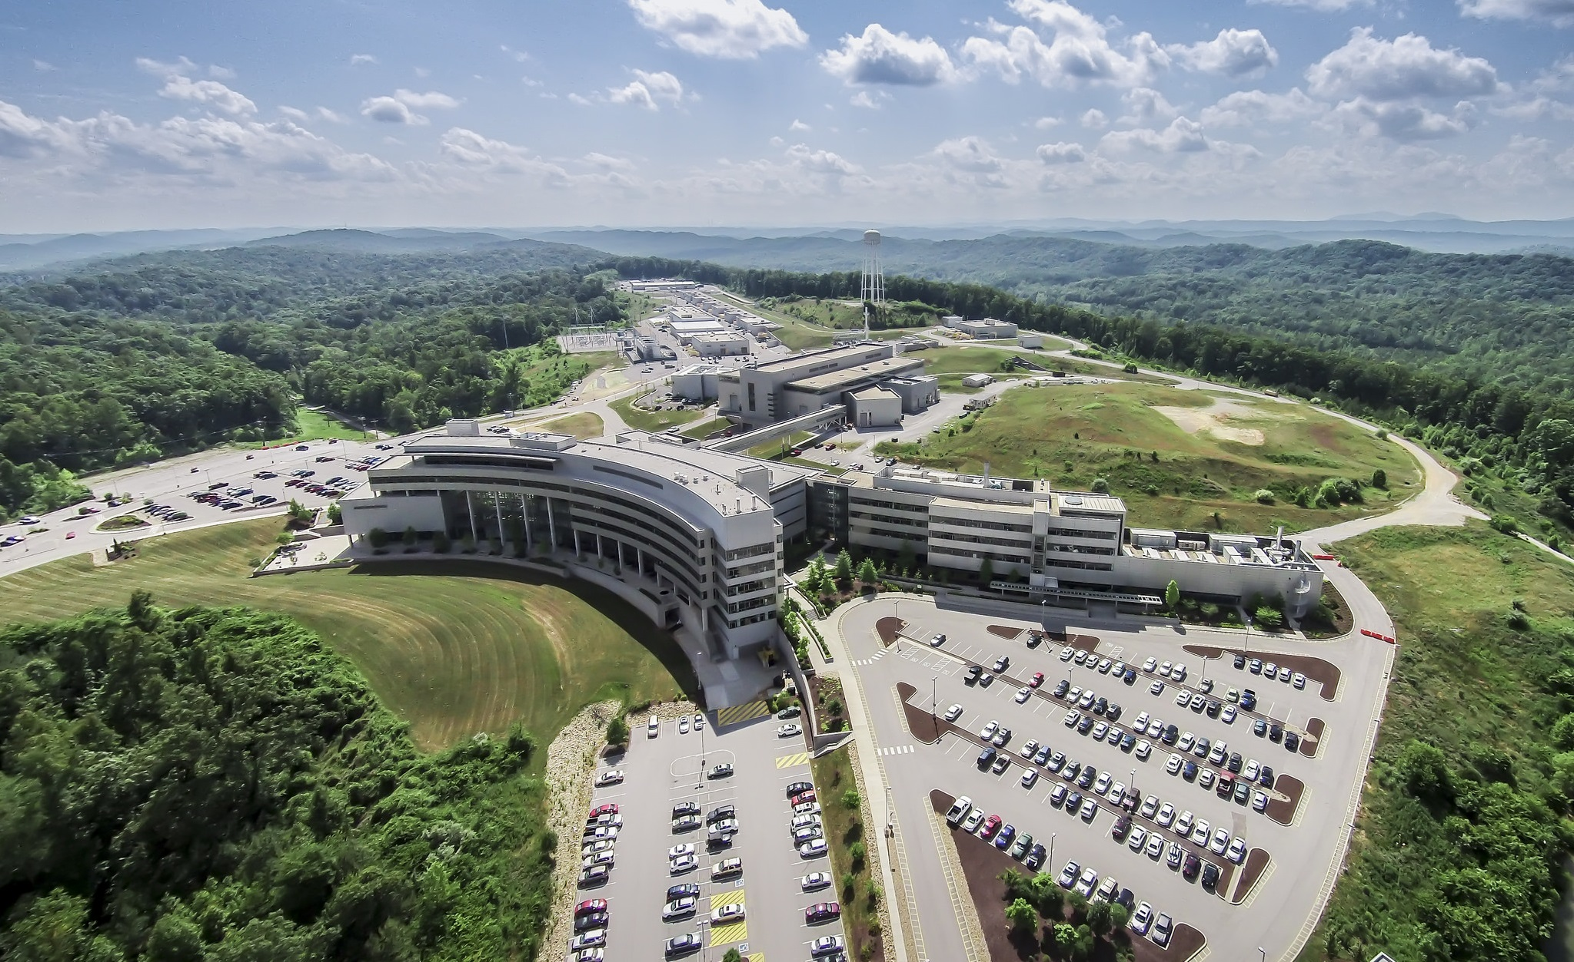
Experimental Program of COHERENT collaboration at the Spallation Neutron Source (SNS) at Oak Ridge
It is world most powerful pulsed neutrino source. Presently it delivers 7・10²⁰ POT daily
~10% of protons produce 3 neutrinos
Neutrino energies at SNS are ideal to study CEvNS.
For 99% of neutrinos E_{ν} < 53 MeV
Decay At Rest from pions and muons (DAR) gives very well-defined neutrino spectra
Fine duty factor of accelerator let suppression of steady background by a factor of 2000.
  It is like being at the 1000 m.w.e underground

Slide 8
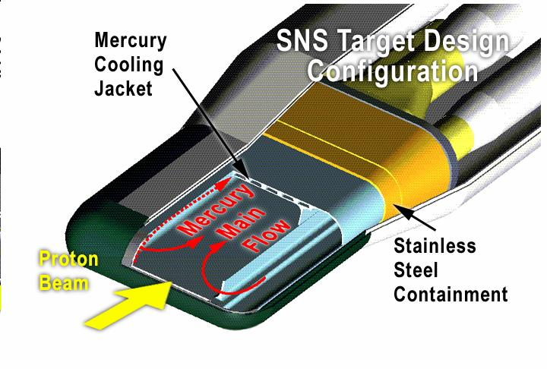
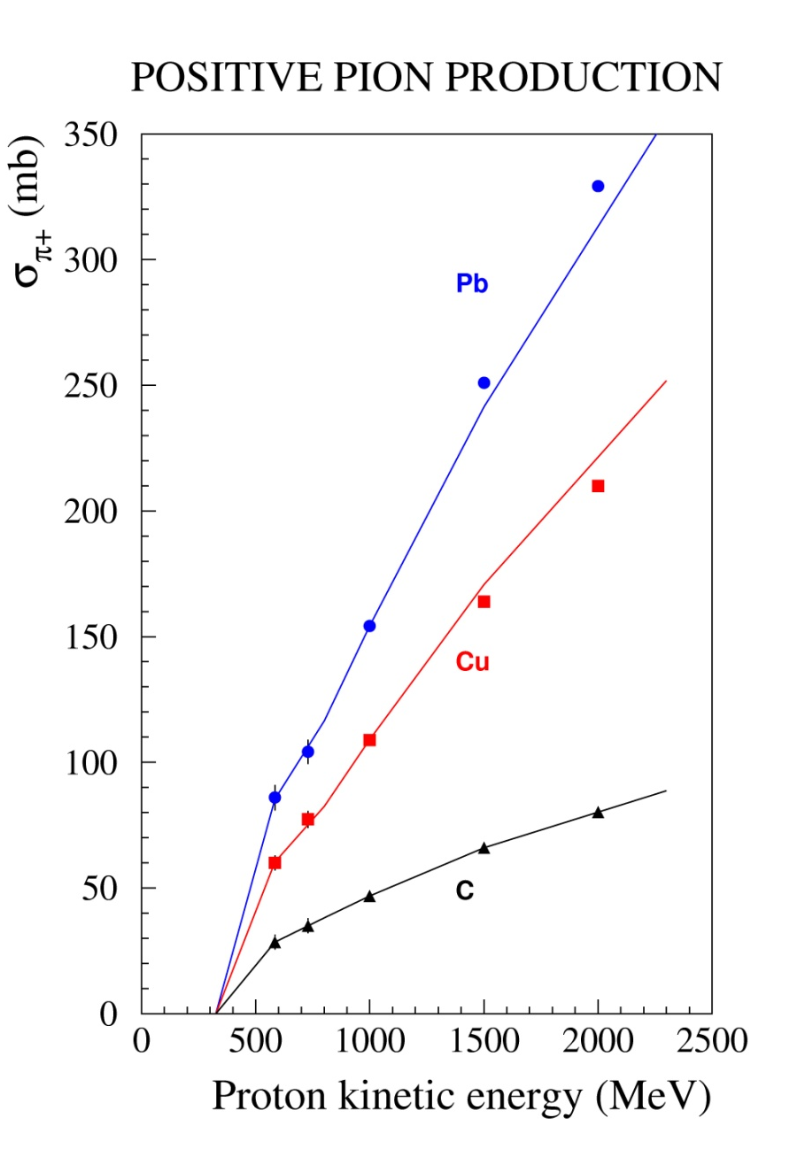
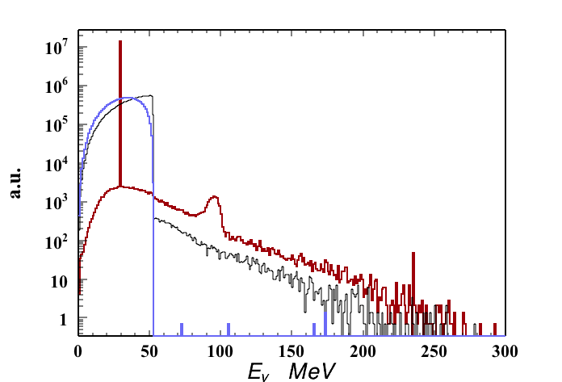
Neutrino Production at the SNS
~99%
CAPTURE
π⁻
ν_{e}
Hg
21 cm
~ 1 GeV
μ⁺
τ ≈ 26 nsec
e⁺
p
π⁺
τ ≈ 2200 nsec
Fragments
ν_{μ}
ν_{μ}
Neutrino Energy
Neutrino Timing
SNS
Present Uncertainties in the neutrino flux is ~10%

Slide 9
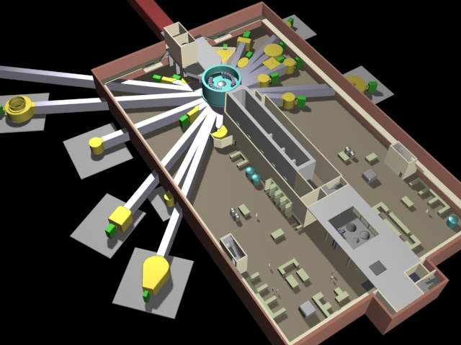
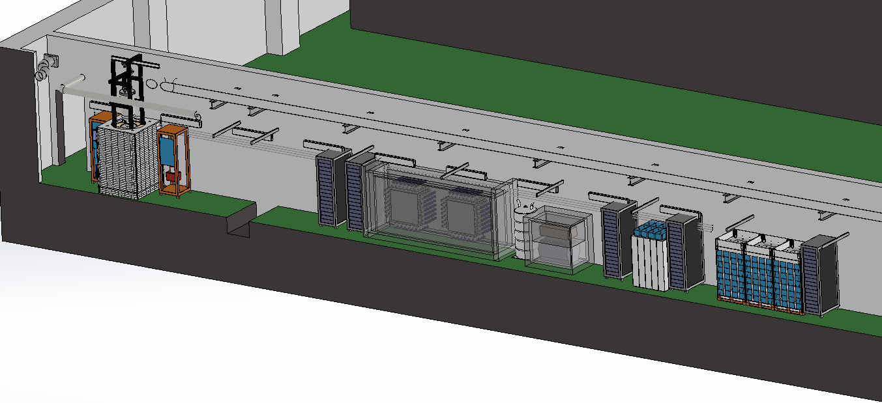
COHERENT is using “Neutrino Alley” at the SNS
After extensive background studies we find a well protected location at the SNS basement
Physicists who are trying to put neutrino detector next to a powerful neutron source should always remember:
The Legend of Icarus
don’t try to fly too close to the sun
Neutrino Alley is 20-30 meters from the target. Space between the target and the alley is completely filled with steel, gravel and concrete. This gives good protection from SNS neutrons.
There are 10 M.W.E. of shielding from above, enough to kill hadronic component of cosmic rays and attenuate muon flux by a factor of 3
Utility tunnel →Neutrino Alley

Slide 10
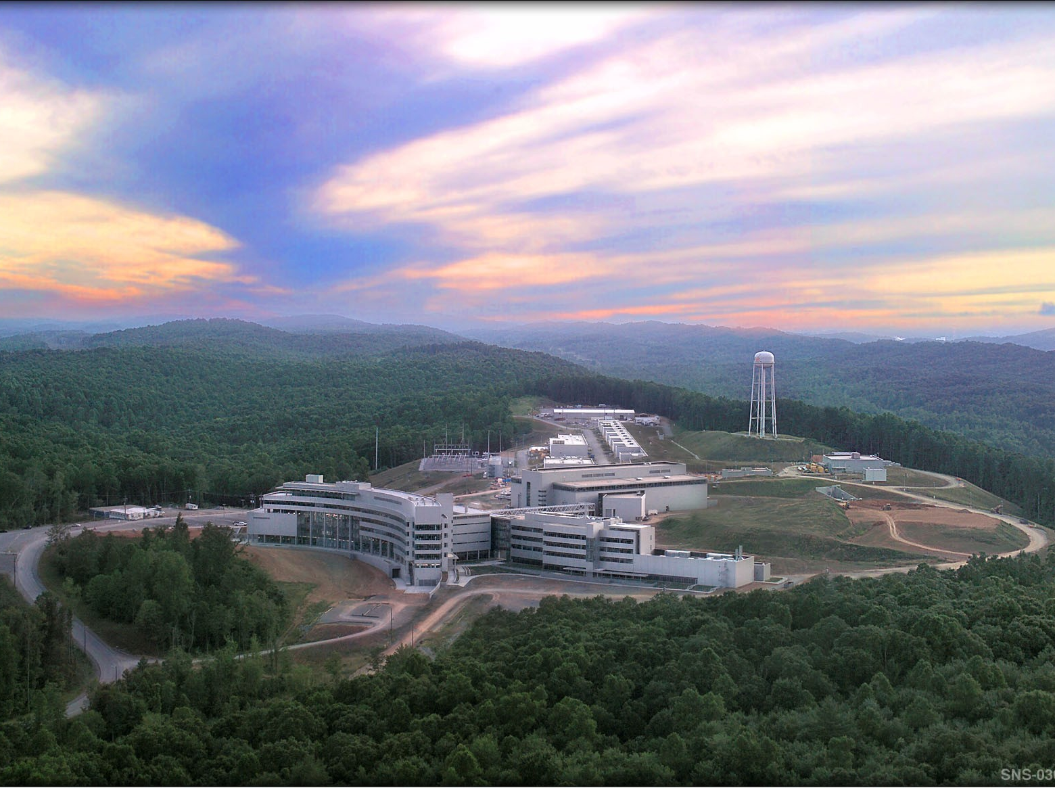
Neutrino Alley Location
1 GeV proton linac
Accumulator ring
Target Building
After extensive background studies, good place for experiment has been located at the SNS basement → Neutrino Alley.
It is 20-30 meters from the target. Space between target and alley is filled with steel, gravel and concrete
There are 10 MWE from above
Neutrino Alley

Slide 11
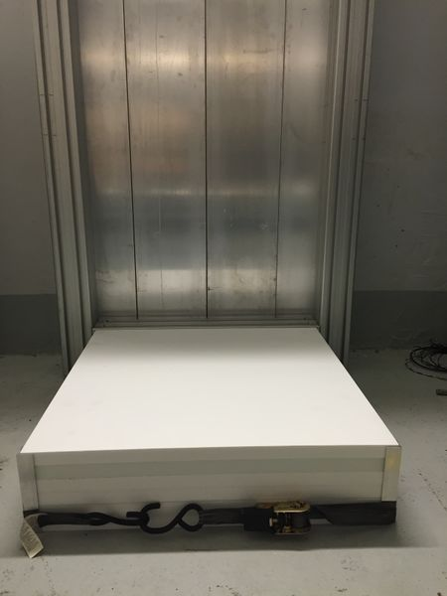
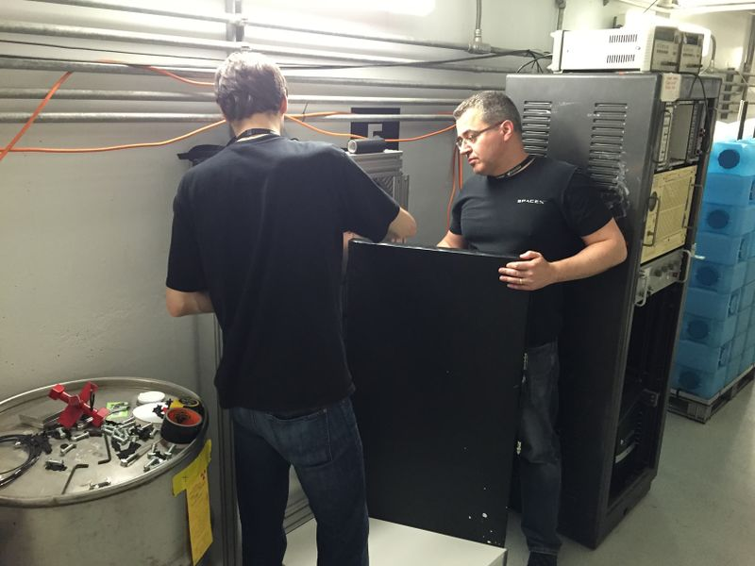
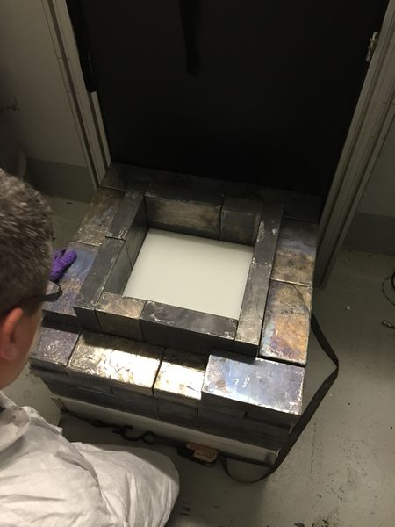
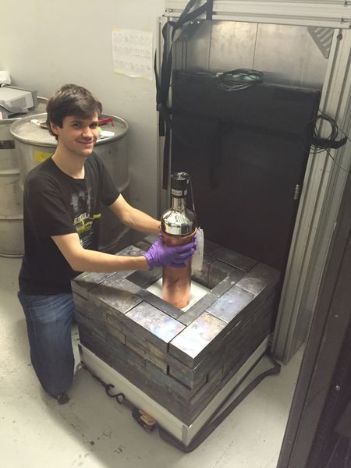
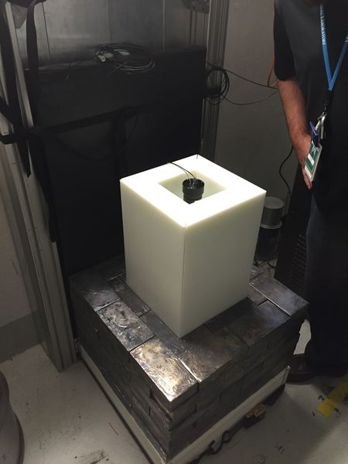
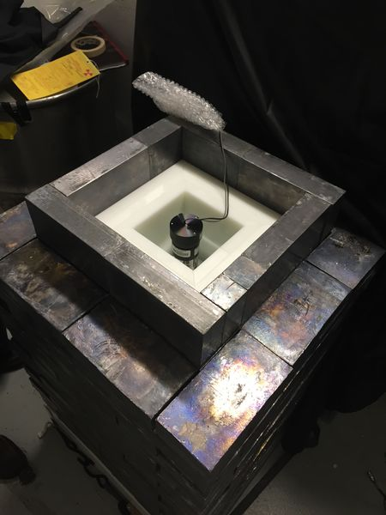
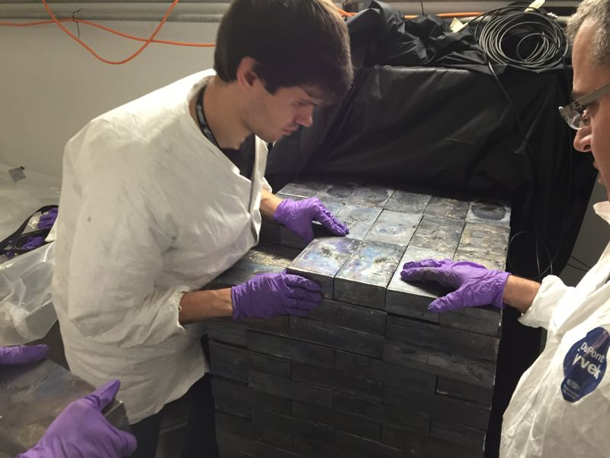
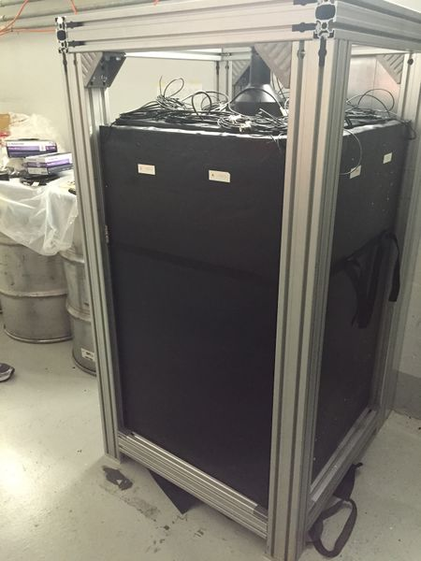
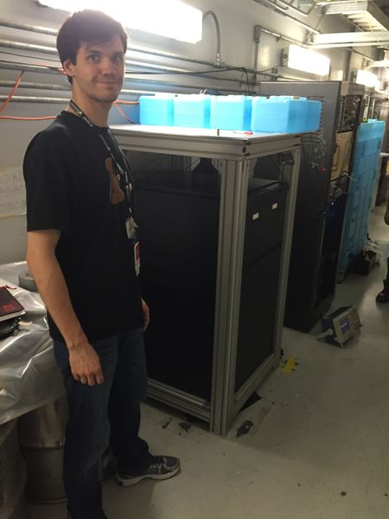
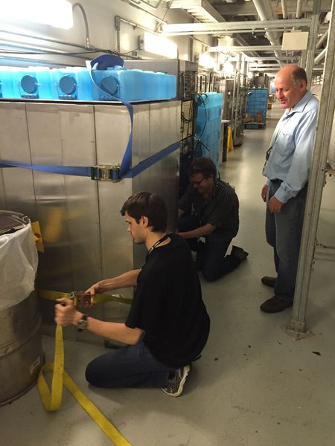
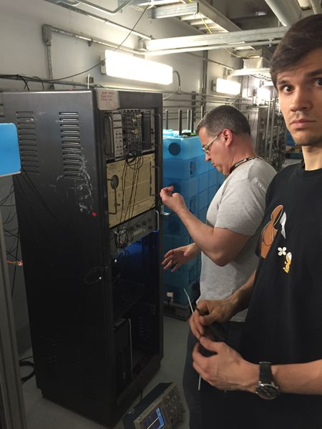
First Deployment: 14 kg CsI Detector
9:00 AM
Single CsI crystal.
It has been custom grown from preselected low background material
Layers of dedicated shielding:
Poly to protect from NINs
Low background lead
Regular good quality lead
Veto system
Water shielding
Base
Muon
Panel
First hand-held neutrino detector
Muon panels all over around
3” HDPE
around
LB lead
Lead Stacking
4:00 PM
Field deployment
was done during
1 day
Water Bricks
On Top
Water Bricks
On Sides
Final Touches

Slide 12
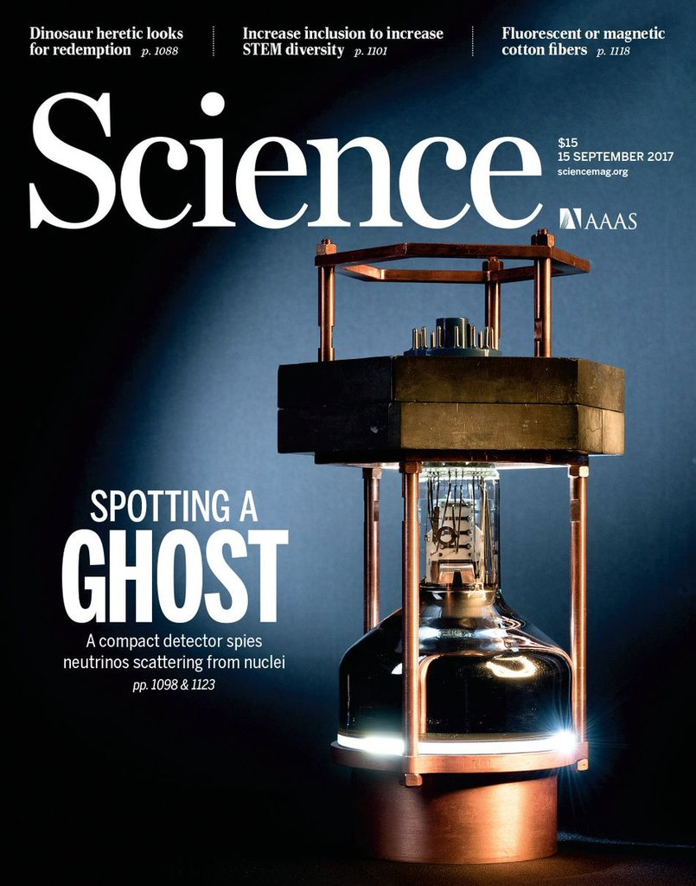
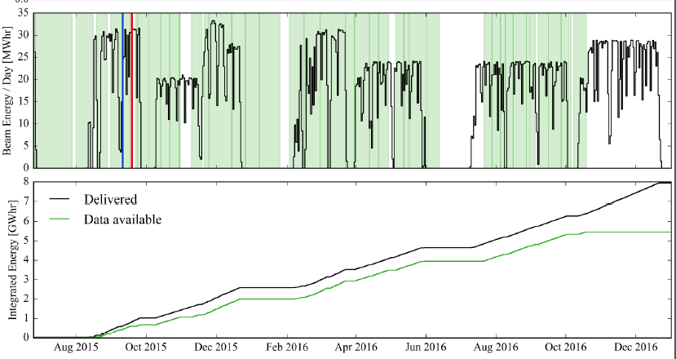
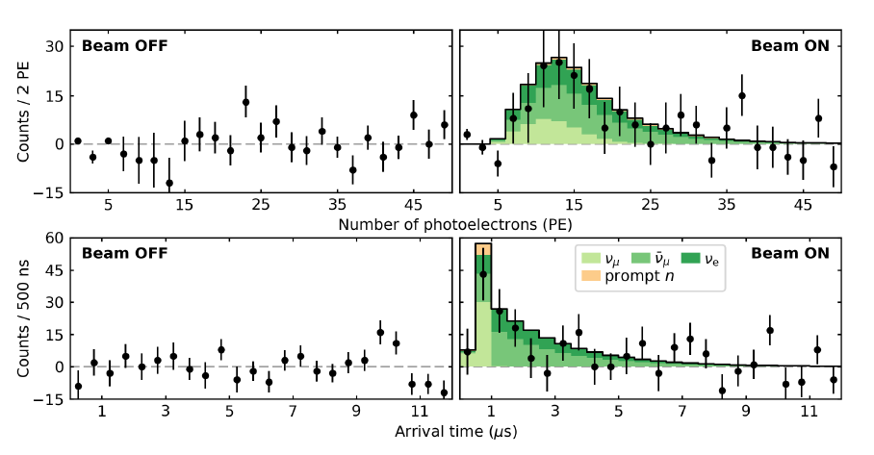
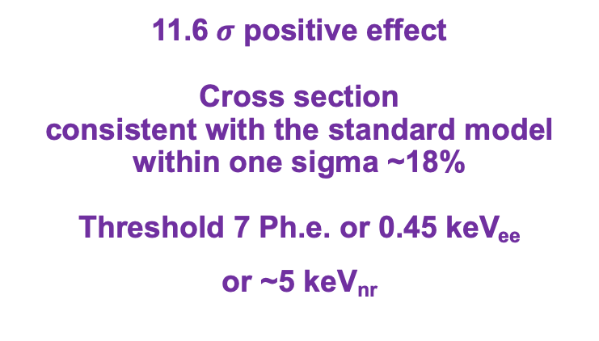
First Detection of CEvNS with CsI detector
16 month of data
1.4*10²³ (~ 0.22g) POT
11.6$σ$ positive effect
Cross section
consistent with the standard model within one sigma ~18%
Threshold 7 Ph.e. or 0.45 keV_{ee}
or ~5 keV_{nr}

Slide 13
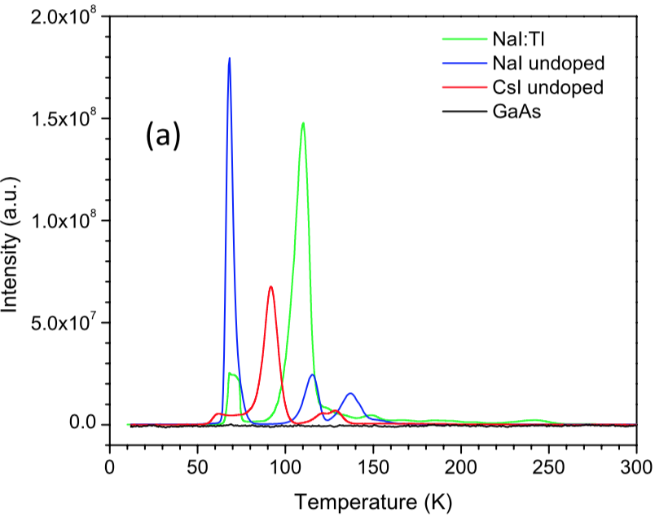
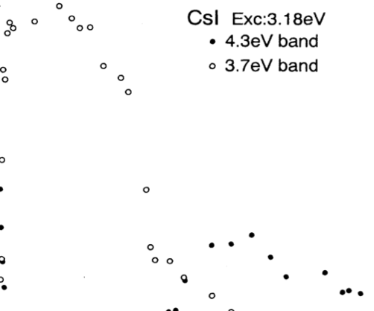
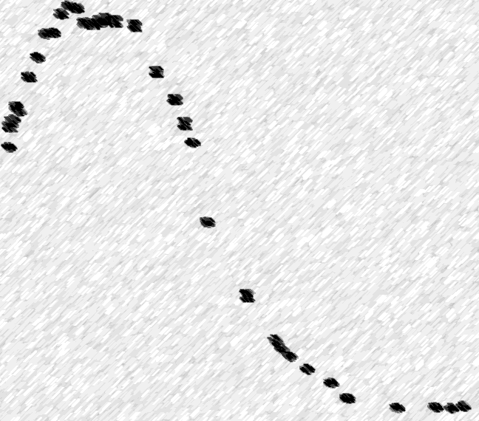
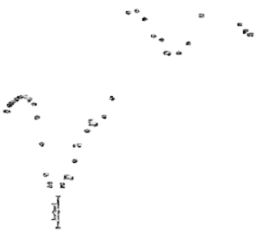
Potential Improvement for CsI technology
COHERENT is running R&D program for Cryogenic CsI crystals
2.0
1.5
1.0
0.5
0.0
More light yield for undoped CSI at 40K
More Photocathode Coverage
Switch to SiPMs instead of PMT
Wave shifting coating
There are indications that nuclear quenching factor getting less at cryogenic temperatures
There is potential is to go from 13.5 Ph.e./keV to 60 Ph.e./keV
~0.4 keV_{nr} threshold is withing a reach
Scintillation:
CsI(undoped)
NaI(undoped)
NaI(Tl)
40 K
Afterglow:
CsI(undoped)
NaI(undoped)
NaI(Tl)
77 K
Scintillation or Afterglow Intensity [A.U.]
Temperature [K]
Eur. Phys. J. C (2012) 72:2061
Phys. Rev. B 5 (1995) 2167
J. App. Phys., 123(11):114501, 2018

Slide 14
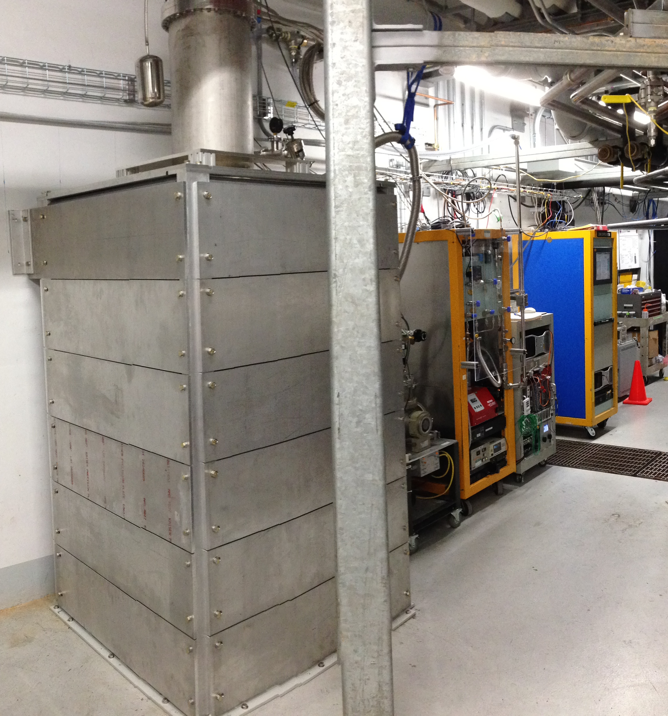
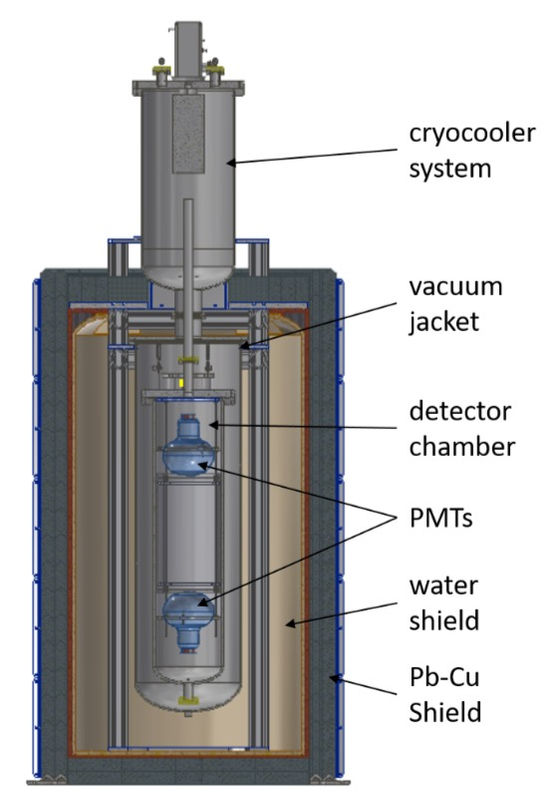
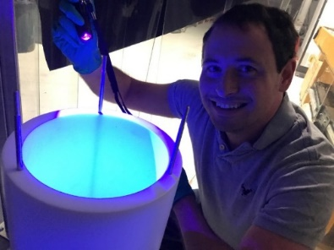
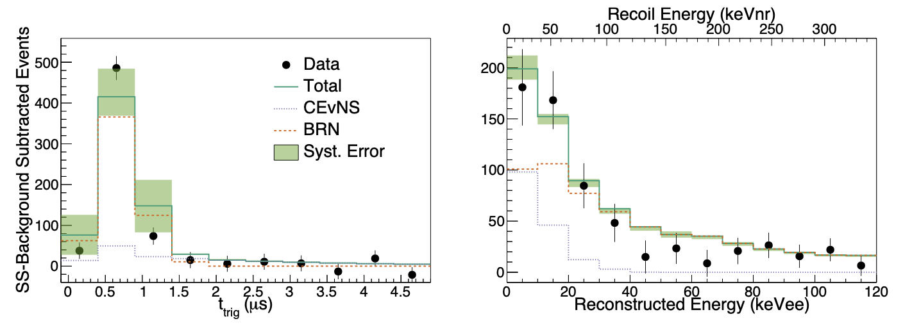

Lq. Argon CENNS-10 Detector
Originally built in 2012-2014 by Jonghee Yoo et al. at Fermilab for CEvNS effort at Fermilab
Moved to the SNS for use by COHERENT in 2016 after upgrades at IU. Rebuild in 2017 at ORNL with new PMTs and TPB coating sputtered in vacuum. L.Y. increased by a factor of 10.
10 cm Pb/ 1.25 cm Cu/ 20 cm H₂O shielding
24 kg fiducial volume
2x 8” Hamamatsu PMTs, 18% QE at 400 nm
Tetraphenyl butadiene (TPB) coated side reflectors/PMTs
Production Run starting July 2017.
4.6 Ph.e./keV_{ee} with two 8” PMT
Phys.Rev.Lett. 126 (2021) 1, 012002
3 $σ positive effect$
17
Notes:
Andrew Lathrop, Rolando Flores, Rich Schmitt, Roberto Davila, David Butler, Leonard Harbacek – Fermilab CENNS-10 team
Ron Davis and Bill Miner (PAB)
Constant purification of boiloff Ar gas via Zr getter
Eng Run was TPB coated acrylic disks and side reflectors
Prod Run was TPB coated Teflon and PMTs

Slide 15
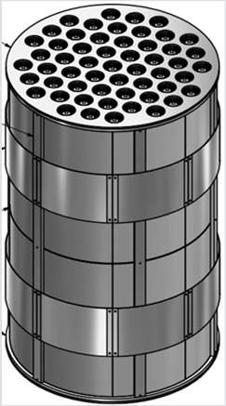
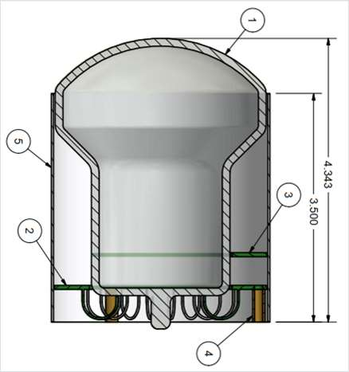
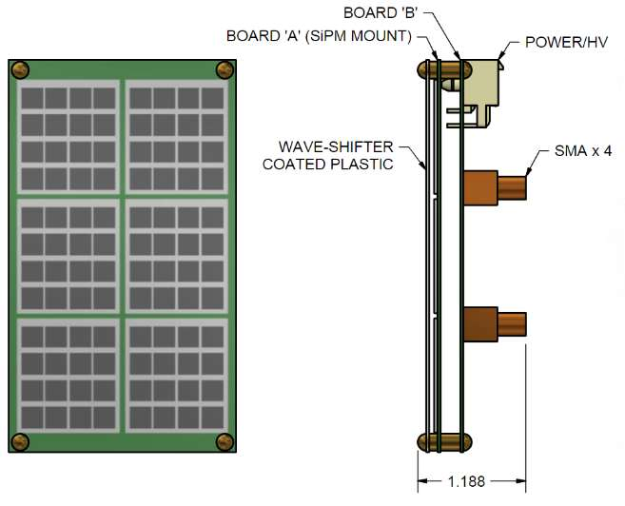
Next step is 750 kg Lar detector (under construction)
Will be deployed at Neutrino Alley instead of CENNS-10 detector
116 3” Hamamatsu cryogenic PMT’s
610 kg fiducial volume
Discussions about underground argon
Ongoing R&D for Xe doping to boost light collection
at CENNS-10
Study of potential of SiPM matrix for future upgrade

Slide 16

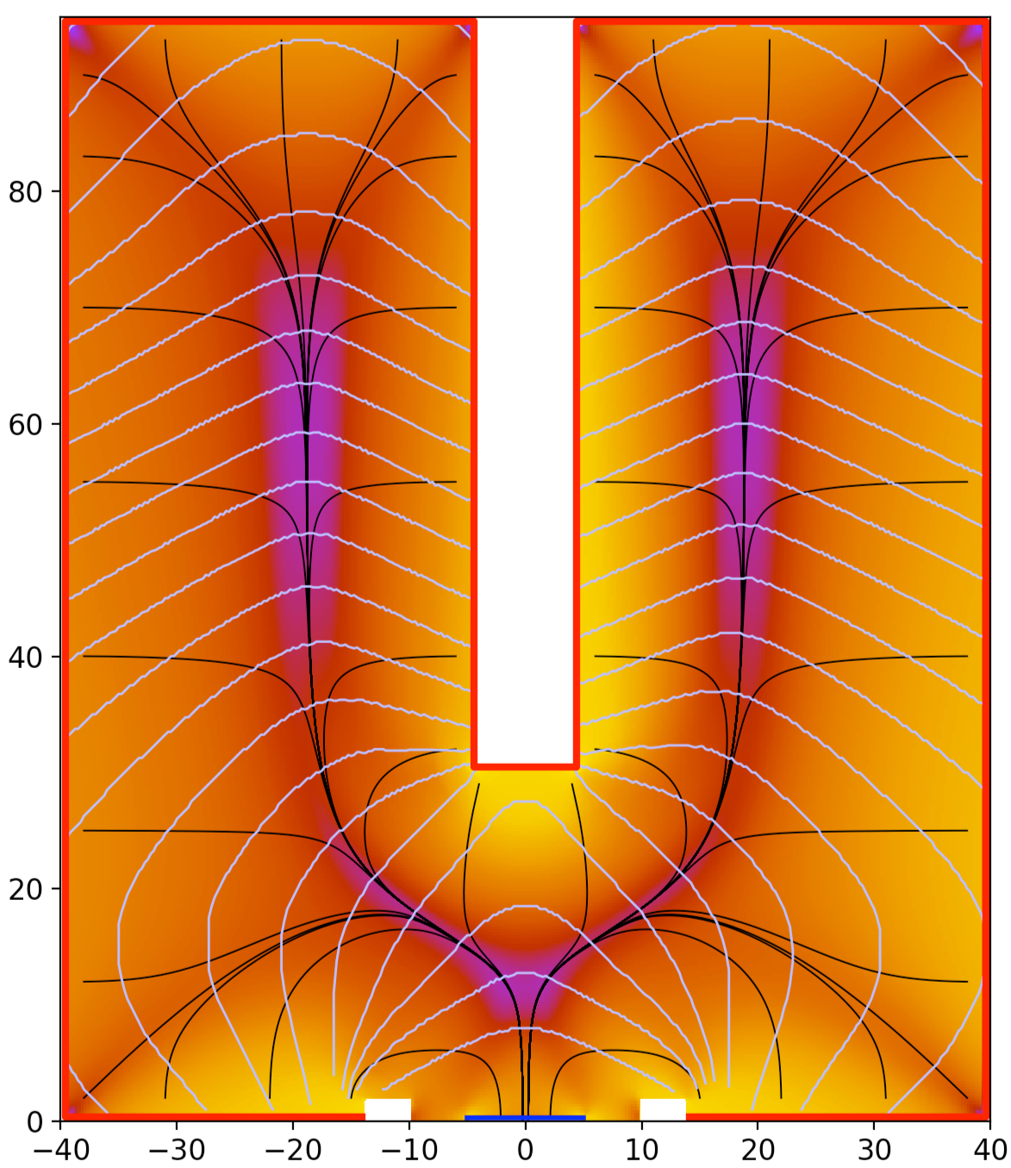
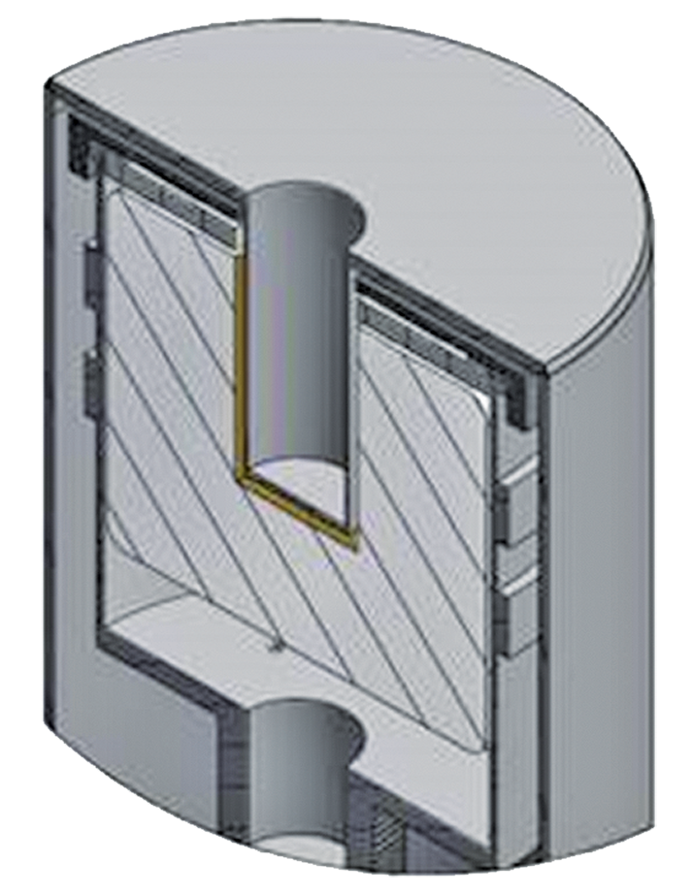
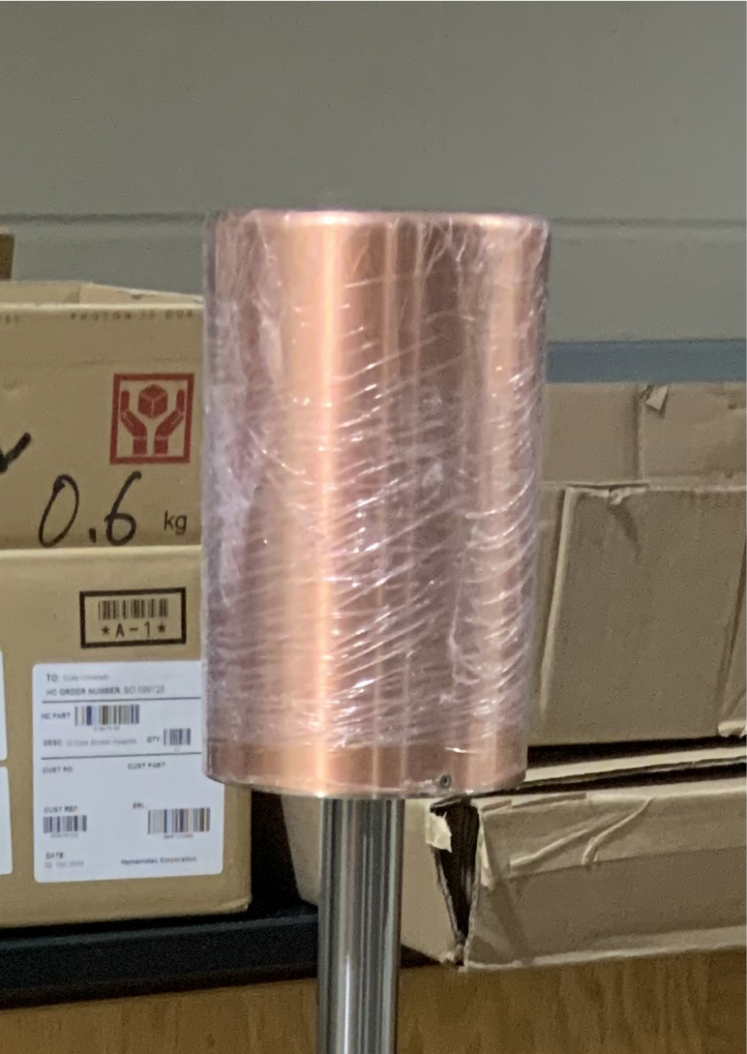
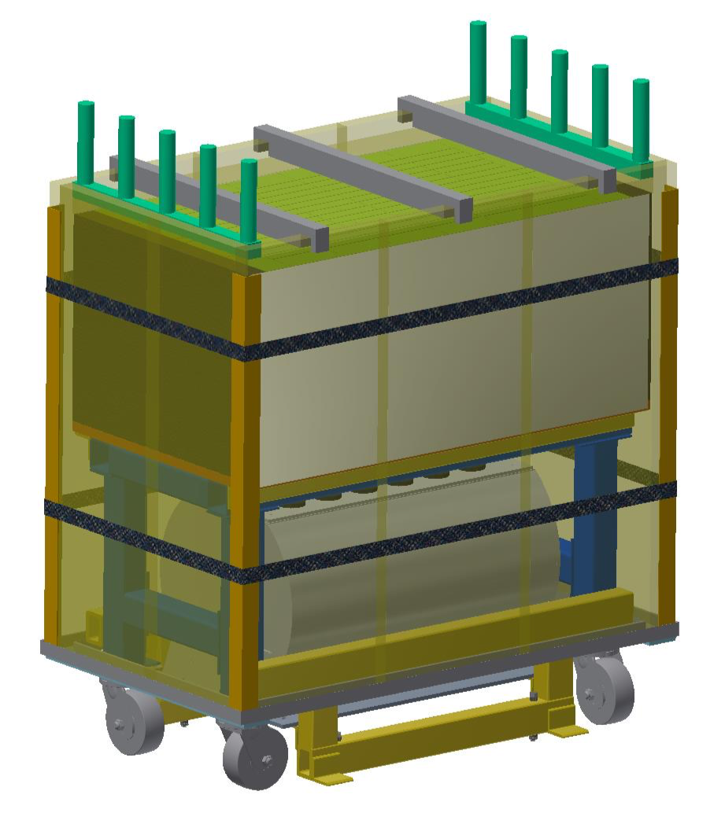
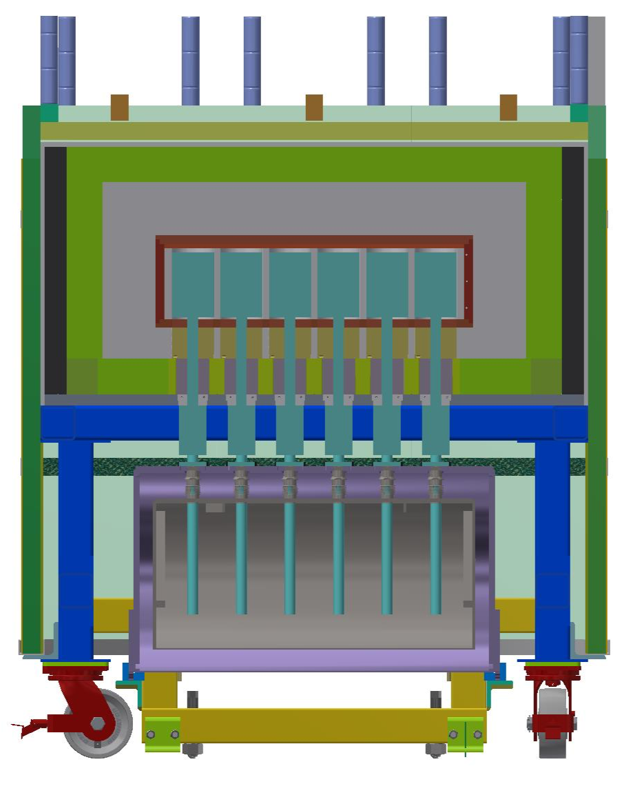


Ge PPC Detectors for COHERENT
Eight detectors with masses about 2.2 kg
Total active mass is 17.3 kg
Estimate ~1000 CEvNS events/year
Electronic noise from detector + preamp between
150 – 100 eV FWHM.
Results in an energy threshold of ~0.4 – 0.25 keV_{ee}, roughly 2-1.5 keV_{nr}.
Funded via MRI
Detector array is at the
final stage of commissioning

Slide 17

Ge Detectors Progress
Adopted from J.Collar
COHERENT
0.3 keV_{nr}.

Slide 18



NaI Array
Sodium has lower cross section than other targets but high recoil energy
Sixty-three 7.7 kg Nai[Tl] crystals
Total sensitive mass is ~500 kg
Surrounded by water bricks to absorb neutrons
and gamma shielding
Specially developed bases to have dynamic
range for both CEvNS and charge current interactions
Started to take data last week.
We have potential for expansion up
to 2500 kg of sensitive mass

Slide 19












NuTOR: Neutrino Induced Nuclear Fission
53 kg Thorium Target
Taking data starting from the last November

Slide 20






Neutrino flux at the SNS is known with 10% accuracy
arXiv:2109.11049 [hep-ex]
At the first approximation:
N $π^{+}$/proton = 0.14*E(GeV)-0.05 For E~0.8-1.5 GeV
Decay at rest
𝛕=2200ns
Average interaction energy is
~1.1 GeV for 1.3 GeV protons.
SNS
Predictions are model dependent

Slide 21

Concept of Heavy Water Detector for Neutrino Flux Measurements
S.Nakamura et. al. Nucl.Phys. A721(2003) 549
Prompt NC ν_{μ} +d → 1.8*10⁻⁴¹ cm²
Delayed NC ν_{eμ-bar}+ d →6.0*10⁻⁴¹ cm²
Delayed CC ν_{e} + d → 5.5*10⁻⁴¹ cm²
100 cm Diameter
Specifications
0.8 tons D2O within acrylic inner vessel
Water Cherenkov Calorimetry
H2O “tail catcher” for high energy e⁻
Outer light water vessel contains PMTs, PMT support structure, and optical reflector.
Outer steel vessel to
Lead Shielding
Hermetic veto system
Detector calibration with
Michel Electrons from cosmic muons
(same energy range)
Will do CC measurement on Oxygen for support of SN detection
220 cm
d₂O
Tyvec
Reflector
Expected events rate per month
CC Deuterium: 67
CC Oxygen: 24
H₂O
21
21

Slide 22






D₂O Detector assembly and top veto panel installation
LED Flashes at the bottom
Top veto panel
Presently is engineering run with light water only. Will fill with D2O during the next few months

Slide 23



SNS Future
Today
2024 after PPU
2028 after STS
900 users
Materials at atomic resolution and fast dynamics
1000+ users
Enhanced capabilities
2000+ users
Hierarchical materials, time-resolution and small samples
STS
0.7 MW
15 Hz
1.4 MW
1 GeV
25 mA
60 Hz
2.0 MW
1.3 GeV
27 mA
60 Hz
2.8 MW
1.3 GeV
38 mA
60 Hz
FTS
1.4 MW
60 Hz
FTS
2 MW
60 Hz
FTS
2 MW
45 pulses/sec
The choice of 15 Hz and 0.7 MW resulted from a detailed analysis of STS design (reviewed by a panel of experts in 2017) and optimizes performance of STS without impacting performance of FTS

Slide 24

Summary
Experimental discovery of CEvNS opened new way to detect neutrinos
COHERENT Collaboration successfully detected CEvNS with two detector technology
COHERENT collaboration is deploying several new detectors for precision tests of CM predictions for CEvNS for various nuclei
Neutrino Alley at the SNS is ideal place to study various detector technologies for CEvNS
CEvNS is the only practical possibility to look into reactor neutrino spectra below 1.8 MeV
CEvNS
CEvNS after
Form factor
correction

