Slide 1
Large Language Models as Tools for Searching and Explaining Tokamak Shot Logs
Joseph Abbate¹, Ian Char², Viraj Mehta², Andy Rothstein¹, Allen Wang³
Darren Garnier³, Egemen Kolemen¹, Cristina Rea³, Jeff Schneider² ¹ Princeton University
² Carnegie Mellon University
³ Massachusetts Institute of Technology Presented by: Allen Wang 2023 IAEA Workshop on AI for Accelerating Fusion and Plasma Science

Slide 2
Overview
Background
Large Language Models (LLMs)
Tokamak shot logs
Demo!
Technical approach
Fine tuning
Retrieval Augmented Generation (RAG)
Data privacy and open source models
Potentially interesting future work

Slide 3
Background Story
Egemen Kolemen’ group hosted an informal “ML Summer Meeting” at Princeton Aug 9 to Aug 11, 2023
Viraj M. and Joe A., convinced we can do something interesting, organized a language model hackathon
At the hackathon (and for a few weeks after), we built chatbots with knowledge of shot logs from DIII-D and Alcator C-Mod
Upcoming workshop paper: Mehta, Viraj, et al. "Towards LLMs as Operational Copilots for Fusion Reactors." NeurIPS 2023 AI for Science Workshop. 2023.

Slide 4
Background: Large Language Models (LLMs)
ChatGPT is a “Large Language Model” (LLM)
GPT-3 has 175 billion parameters [Brown et al., 2020]
GPT-4 is rumored to have >1 trillion parameters
LLMs are generally trained to perform “next word prediction” on a huge dataset of text
Surprise: “smarts” emerge from LLMs good at “next word prediction”
Dataset used to train GPT-3 [Brown et al., 2020]

Slide 5
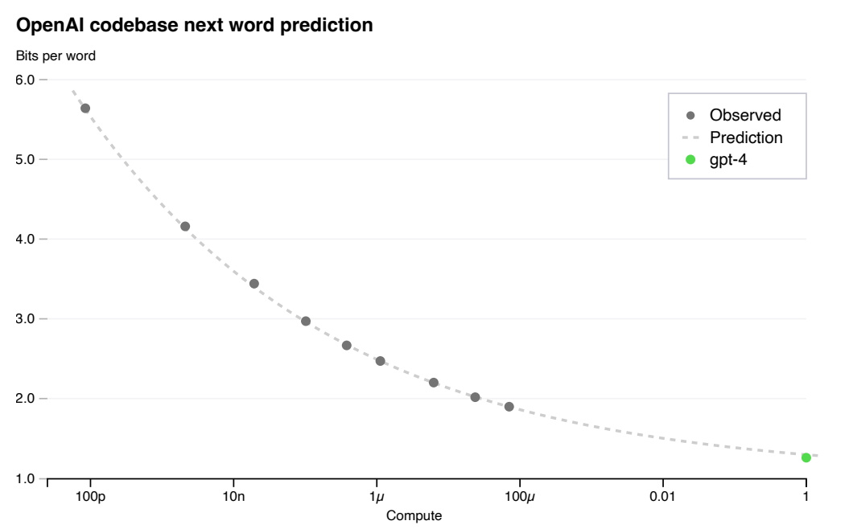
Background: Large Language Models (LLMs)
LLM performance has scaled predictably with dataset size and model parameter count
Massive scale enabled by the “Transformer” architecture [Vaswani et al., 2017]
Overcomes the sequential bottleneck that RNNs suffer in the hidden state
Worse
Better
Kaplan et al., 2020
OpenAI, 2023

Slide 6
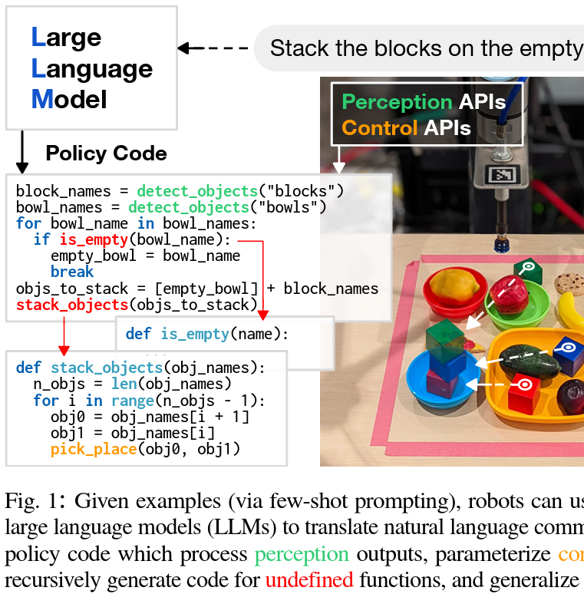
Background: Large Language Models (LLMs)
LLMs have displayed an astounding array of capabilities
A LLM acting as a feedback controller [Mirchandani et al., 2023]
LLM generating code to make a robot accomplish a task [Liang et al., 2023]
LLMs as image compression algorithms [Delétang, 2023]

Slide 7
Background: Tokamak Shot Logs
Tokamak operators usually record text notes recording observations, experimental procedures, etc.
Lots of experimental and institutional knowledge stored in these shot logs
Example Alcator C-Mod shot log recording an observed phenomena

Slide 8
Motivation
Anecdote: information in the shot logs is very important for fusion research:
“In the 2000s, we once ran a shot relevant to this problem, can’t remember which…”
“The data made zero sense until I saw in the shot notes that the sensor was bad”
Our thinking: “maybe we can use LLMs to make this information more accessible”

Slide 9
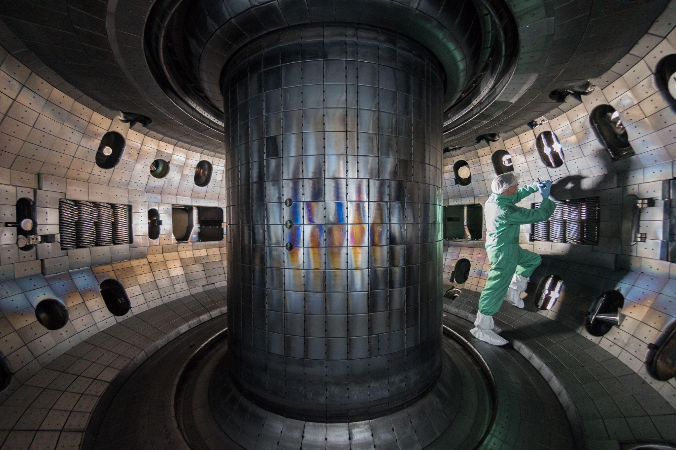
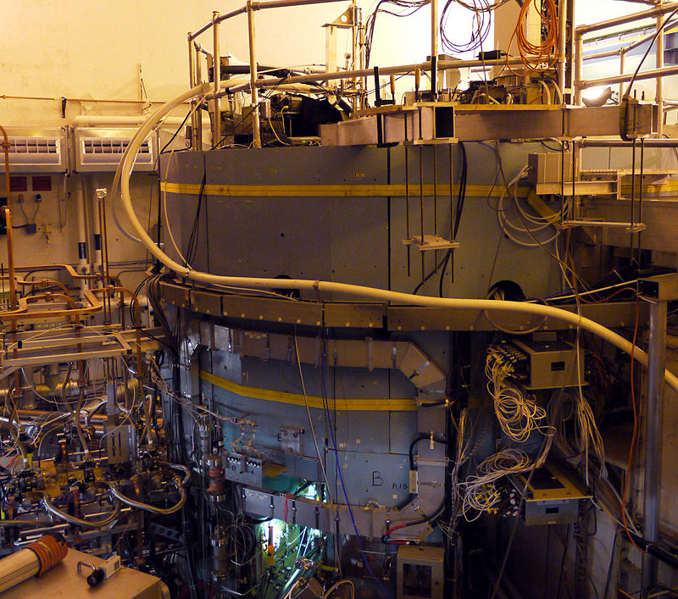
The Database
DIII-D: Logs for 83,882 shots from 1986-2023
Alcator C-Mod: Logs for 44,261 shots from 1993-2016 (Thanks Josh Stillerman for their help)

Slide 10
Demo!

Slide 11
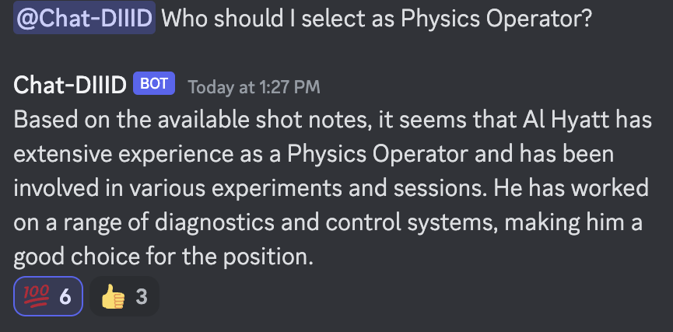
DIII-D Discord Bot

Slide 12
Fine-Tuning
How do we make a LLM “understand” the information in these shot logs?
“Fine-tuning”: take a pre-trained LLM and train it on a new domain
Interactive chatbots like ChatGPT are actually fine-tuned from pre-trained models via. “Reinforcement Learning from Human Feedback” (RLHF)
Issues:
Requires access to model weights => can’t use state-of-the-art GPT models
Requires lots of compute

Slide 13
Retrieval Augmented Generation (RAG)
We found “Retrieval Augmented Generation” (RAG) works great
RAG is a much simpler way to give a LLM domain-specific information that has been quite effective [Lewis et al., 2020]
In a nutshell: “what if we have an algorithm search for relevant information in a database and give it to the model”?
Observation 1: LLMs have very impressive “few-shot learning capabilities”
You can give a LLM some demonstrations of a task, and it can accomplish it without re-training
Brown, Tom, et al. "Language models are few-shot learners." Advances in neural information processing systems 33 (2020): 1877-1901.

Slide 14
Retrieval Augmented Generation (RAG)
Observation 2: LLMs can be used to produce “embeddings models” that enable semantic search
Higher “cosine similarity” => more semantically similar
Embedding Vectors
4 2 3 6⋮
Embedding Model
0.94
User Question
0.83
0.31
Rank by Cosine Similarity
2 4 1 9 ⋮
4 8 7 2 ⋮
3 1 4 2 ⋮
4 2 3 6⋮
4 2 3 6⋮
3 1 4 2⋮
Shot Logs
Embedding Model

Slide 15
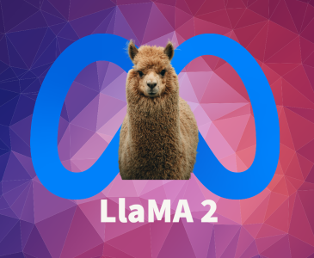
Retrieval Augmented Generation (RAG)
Take the best “N” shot logs and feed them into a prompt with the question
0.94
0.83
0.31
Relevant Shot Log
Relevant Shot Log
2 4 1 9 ⋮
4 8 7 2 ⋮
3 1 4 2 ⋮
Model Prompt
User Question

Slide 16
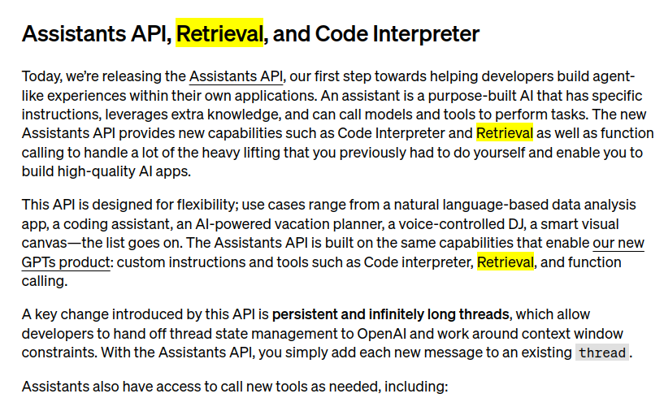
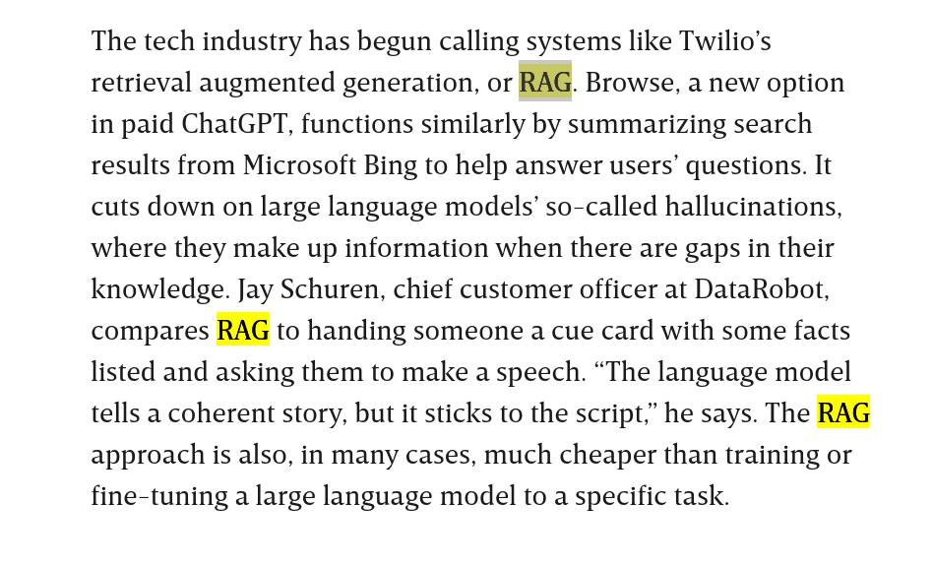
Retrieval Augmented Generation (RAG)
RAG has shown up in a lot of places the past couple of months
Application to the call-center and sales industries
New retrieval tool announced by OpenAI Nov 6th
Fortunately, our paper got accepted Oct 27th :>)

Slide 17
Data Privacy
OpenAI models run on OpenAI servers
They have a data privacy agreement suitable for the decommissioned Alcator C-Mod
Not suitable for DIII-D given their rules
Motivates the use of open source models that can be downloaded and run locally
Open source models are noticeably worse than GPT-4… for now

Slide 18
Dataflow: Alcator C-Mod
Embedding Model text-embedding-ada-002
Embedding Model text-embedding-ada-002
OpenAI Server
Shot Logs
Embedding Database
Local Server
4 2 3 6⋮
Model Prompt Generator
4 2 3 6⋮
Answer
Shot Logs
3 1 4 2⋮
User Question

Slide 19
Dataflow: DIII-D
Embedding Model Sentence Transformers
Internet
Embedding Model Sentence Transformers
Embedding Database
Local GPU Server
4 2 3 6⋮
4 2 3 6⋮
Model Prompt Generator
3 1 4 2⋮
Shot Logs
User Question
Answer

Slide 20
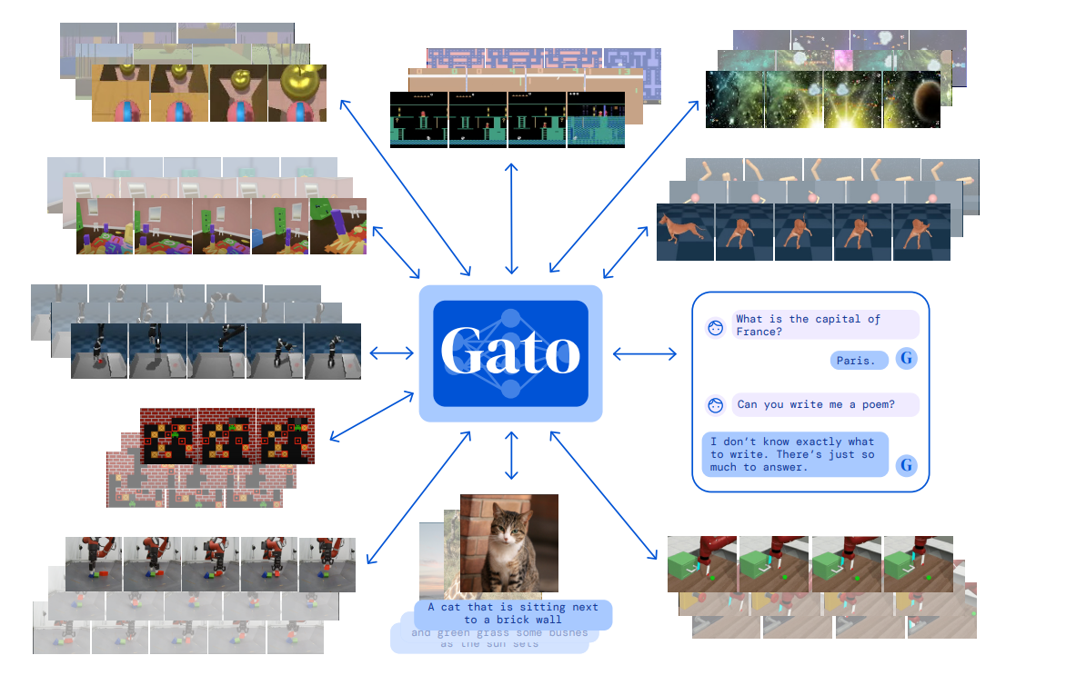
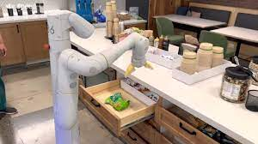
Future Work: Synthesizing Multi-Modal Information
Lots of active research on “multi-modal” models
GPT-4V, for example, combines text and images
Gato: a single model for text, images, and video games [Reed et al., 2023]
RT-2 [Brohan et al., 2023], PALM-E [Driess et al., 2023]: Visual-Language-Action models for robots

Slide 21
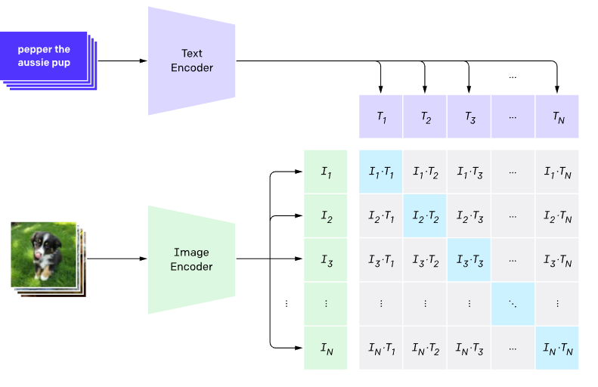
Multi-Modal Concept
What if we can combine text and diagnostic time series?
Perhaps we can make a model analyze and explain shot time series?
We gave it a quick crack, didn’t get interesting results
Interesting area of future research
CLIP from OpenAI [Radford et al., 2021]
Diagnostic Time Series

Slide 22
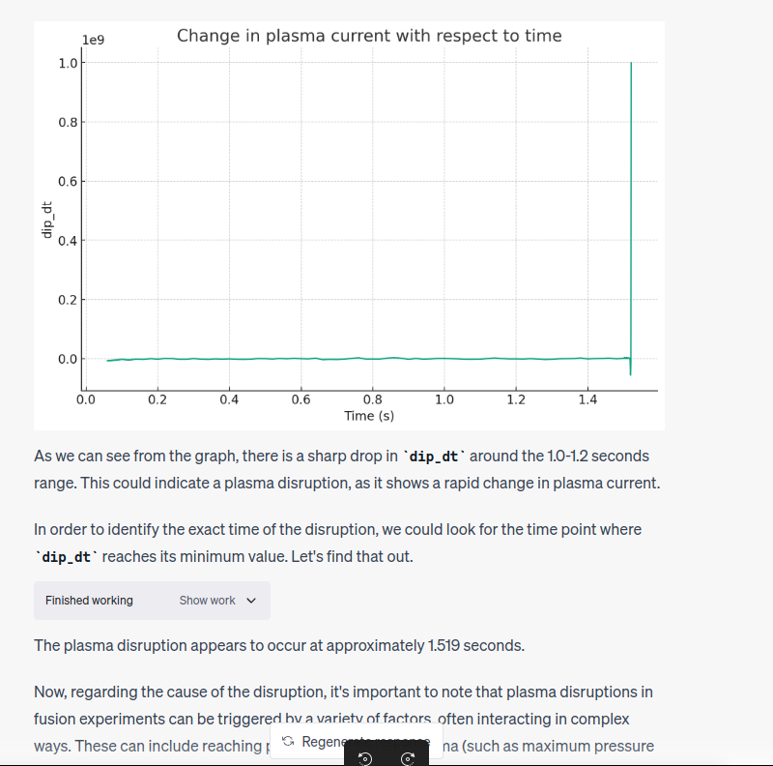
Seems it Should Work in Principle…
I think there is reason to believe multi-modal can work
I uploaded a CSV of publicly available C-Mod shot data to GPT-4 w/ Code Interpreter
Zero-shot identification of a plasma disruption from time-series data
Huh?
Correct

Slide 23
Conclusion
Created “ChatDIII-D” and “ChatCMod” using retrieval augmented generation (RAG) with Llama2 and GPT-4
Use of an open source model shows this can be useful even in data sensitive contexts
ChatDIII-D was available as a discord bot at GA
ChatCMod is available as an internal website at PSFC
Bots query a text database of >80,000 shot logs for DIII-D and >40,000 shot logs for Alcator C-Mod
Utility will only improve over the coming years as LLMs improve further
Synthesizing text with diagnostic time series will be an interesting line of future work

Slide 24
Thanks! Questions?
Mehta, Viraj, et al. "Towards LLMs as Operational Copilots for Fusion Reactors." NeurIPS 2023 AI for Science Workshop. 2023.
Brown, Tom, et al. "Language models are few-shot learners." Advances in neural information processing systems 33 (2020): 1877-1901.
Kaplan, Jared, et al. "Scaling laws for neural language models." arXiv preprint arXiv:2001.08361 (2020).
Mirchandani, Suvir, et al. "Large language models as general pattern machines." arXiv preprint arXiv:2307.04721 (2023).
Liang, Jacky, et al. "Code as policies: Language model programs for embodied control." 2023 IEEE International Conference on Robotics and Automation (ICRA). IEEE, 2023.
Delétang, Grégoire, et al. "Language modeling is compression." arXiv preprint arXiv:2309.10668 (2023).
Touvron, Hugo, et al. "Llama 2: Open foundation and fine-tuned chat models." arXiv preprint arXiv:2307.09288 (2023).
Lewis, Patrick, et al. "Retrieval-augmented generation for knowledge-intensive nlp tasks." Advances in Neural Information Processing Systems 33 (2020): 9459-9474.
Reed, Scott, et al. "A generalist agent." arXiv preprint arXiv:2205.06175 (2022).
Brohan, Anthony, et al. "Rt-2: Vision-language-action models transfer web knowledge to robotic control." arXiv preprint arXiv:2307.15818 (2023).
Driess, Danny, et al. "Palm-e: An embodied multimodal language model." arXiv preprint arXiv:2303.03378 (2023).
Radford, Alec, et al. "Learning transferable visual models from natural language supervision." International conference on machine learning. PMLR, 2021.

Slide 25
Backup
Notes:
Make it clear that OpenAI models are not open source/weights

