Slide 1
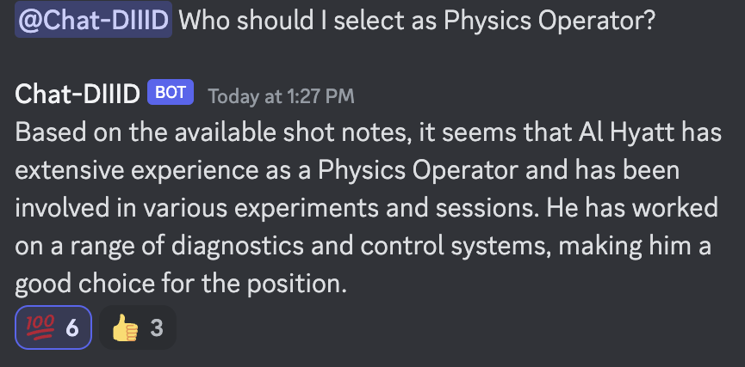
Large Language Models as Tools for Searching and Explaining Tokamak Shot Logs - Allen Wang
Motivations
Lots of experimental, operational, and institutional knowledge is stored in tokamak text logs
In both fusion research and tokamak operations, access to obscure device specific knowledge is critical
Language models may be able to help
Results
We used shot logs from Alcator C-Mod and DIII-D to create chatbots that can answer device specific information using data from shot logs using “retrieval augmented generation”
Deployed the chatbot as a discord bot at General Atomic’s discord and a web interface a MIT PSFC
Challenges
Potential opportunity for multi-modal generative models that can explain diagnostic time series
Note: all usernames for C-Mod shot logs was anonymized to “jas”
IAEA Workshop on AI for Accelerating Fusion and Plasma Science, 2023 11/28 – 12/1

