Slide 1
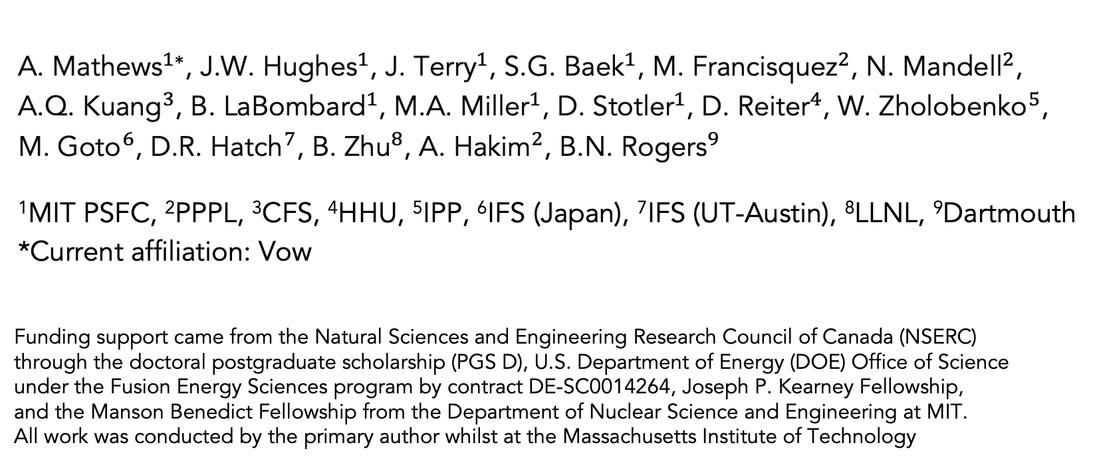
Physics-informed machine learning techniques for edge plasma turbulence modelling in computational theory and experiment
A. Mathew${\text{s}}^{1∗}$, J.W. Hughe${\text{s}}^{1}$, J. Terr${\text{y}}^{1}$, S.G. Bae${\text{k}}^{1}$, M. Francisque${\text{z}}^{2}$, N. Mandel${\text{l}}^{2}$, A.Q. Kuan${\text{g}}^{3}$, B. LaBombar${\text{d}}^{1}$, M.A. Mille${\text{r}}^{1}$, D. Stotle${\text{r}}^{1}$, D. Reite${\text{r}}^{4}$, W. Zholobenk${\text{o}}^{5}$, M. Got${\text{o}}^{6}$, D.R. Hatc${\text{h}}^{7}$, B. Zh${\text{u}}^{8}$, A. Haki${\text{m}}^{2}$, B.N. Roger${\text{s}}^{9}$
¹MIT PSFC, ²PPPL, ³CFS, ⁴HHU, ⁵IPP, ⁶IFS (Japan), ⁷IFS (UT-Austin), ⁸LLNL, ⁹Dartmouth
*Current affiliation: Vow
Funding support came from the Natural Sciences and Engineering Research Council of Canada (NSERC)
through the doctoral postgraduate scholarship (PGS D), U.S. Department of Energy (DOE) Office of Science
under the Fusion Energy Sciences program by contract DE-SC0014264, Joseph P. Kearney Fellowship,
and the Manson Benedict Fellowship from the Department of Nuclear Science and Engineering at MIT.
All work was conducted by the primary author whilst at the Massachusetts Institute of Technology

Slide 2
Contributions and contributors of this research
A. Mathews, J.W. Hughes, J.L. Terry, S.G. Baek, “Deep electric field predictions by drift-reduced Braginskii theory with plasma-neutral interactions based upon experimental images of boundary turbulence” Physical Review Letters 129, 235002 (2022)
A. Mathews, J.L. Terry, S.G. Baek, J.W. Hughes, A.Q. Kuang, B. LaBombard, M.A. Miller, D. Stotler, D. Reiter, W. Zholobenko, M. Goto, “Deep modelling of plasma and neutral fluctuations from gas puff turbulence imaging” Review of Scientific Instruments 93, 6 (2022)
A. Mathews, N. Mandell, M. Francisquez, J.W. Hughes, A. Hakim, “Turbulent field fluctuations in gyrokinetic and fluid plasmas” Physics of Plasmas 28, 112301 (2021)
A. Mathews, M. Francisquez, J.W. Hughes, D.R. Hatch, B. Zhu, B.N. Rogers, “Uncovering turbulent plasma dynamics via deep learning from partial observations” Physical Review E 104, 025205 (2021)
A. Mathews, J.W. Hughes, “Quantifying experimental edge plasma evolution via multidimensional adaptive Gaussian process regression” IEEE Transactions on Plasma Science 49, 12 (2021)
*Special thanks to the Engaging cluster + team at the MGHPCC for their constant support*

Slide 3
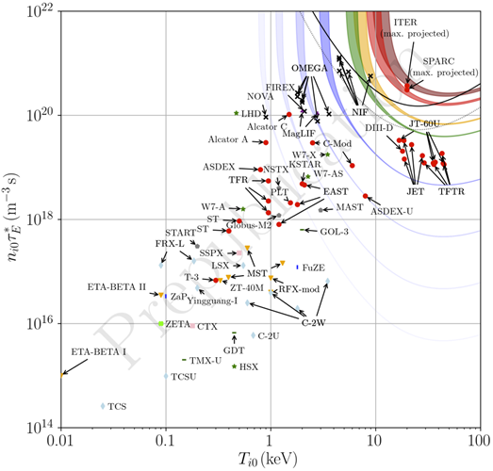
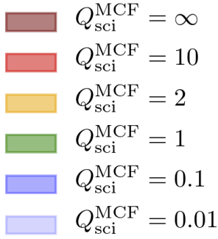
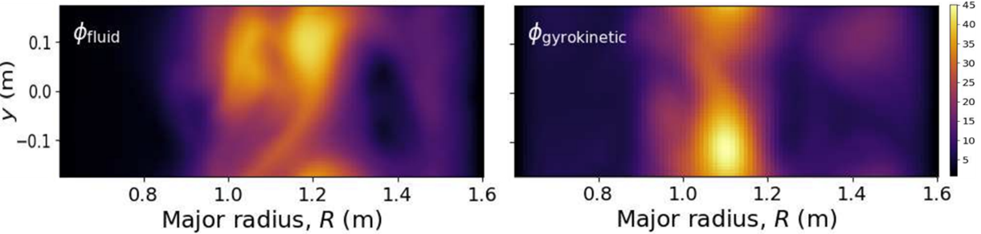
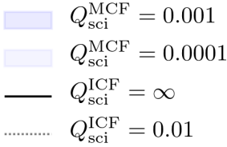


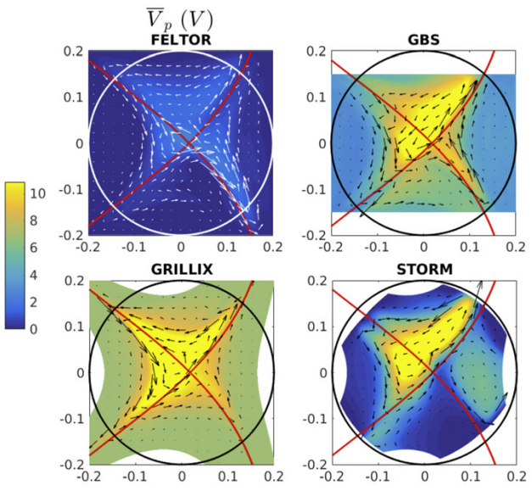
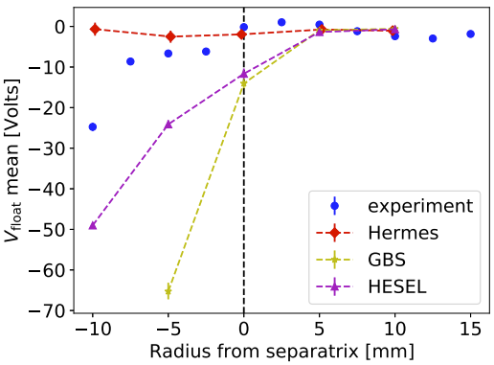
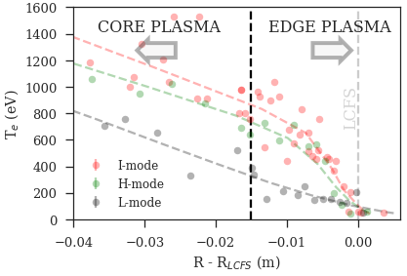
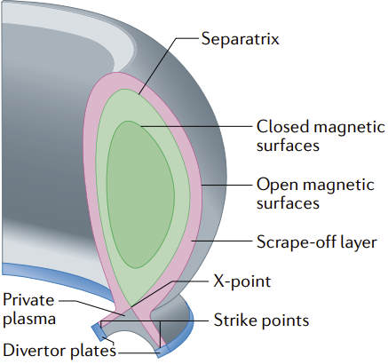

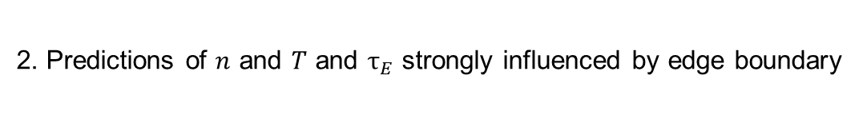
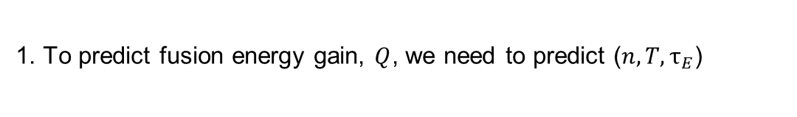
Understanding edge turbulence is essential for fusion devices
1. To predict fusion energy gain, $Q$, we need to predict ($n, T,τ_{E}$)
3. To trust predictions, need to validate self-consistent edge plasma models
Due to vast scales and computational demand, reduced turbulence models (e.g. fluid) are widely applied, but it’s difficult to quantitatively test accuracy
M. Francisquez et al. 2020 PoP 27 082301 → why was this discrepancy in ϕ found?
$$=\frac{fusion power}{external heating power}$$
4. No good ways to precisely compare edge turbulence models in experiment
Even comparing fluid codes against one another can be tough!
2. Predictions of $n$ and $T$ and $τ_{E}$ strongly influenced by edge boundary
*S.E. Wurzel, S.C. Hsu 2022 arXiv:2105.10954
CORE
B. Dudson et al. 2021 PPCF 63 055013 D. Galassi et al. 2022 PoP 29 012501
A. Mathews, J.W. Hughes 2021 IEEE Trans. Plasma Science 49 12 C. Ham et al 2020 Nature Rev. Phys.2 158–167

Slide 4
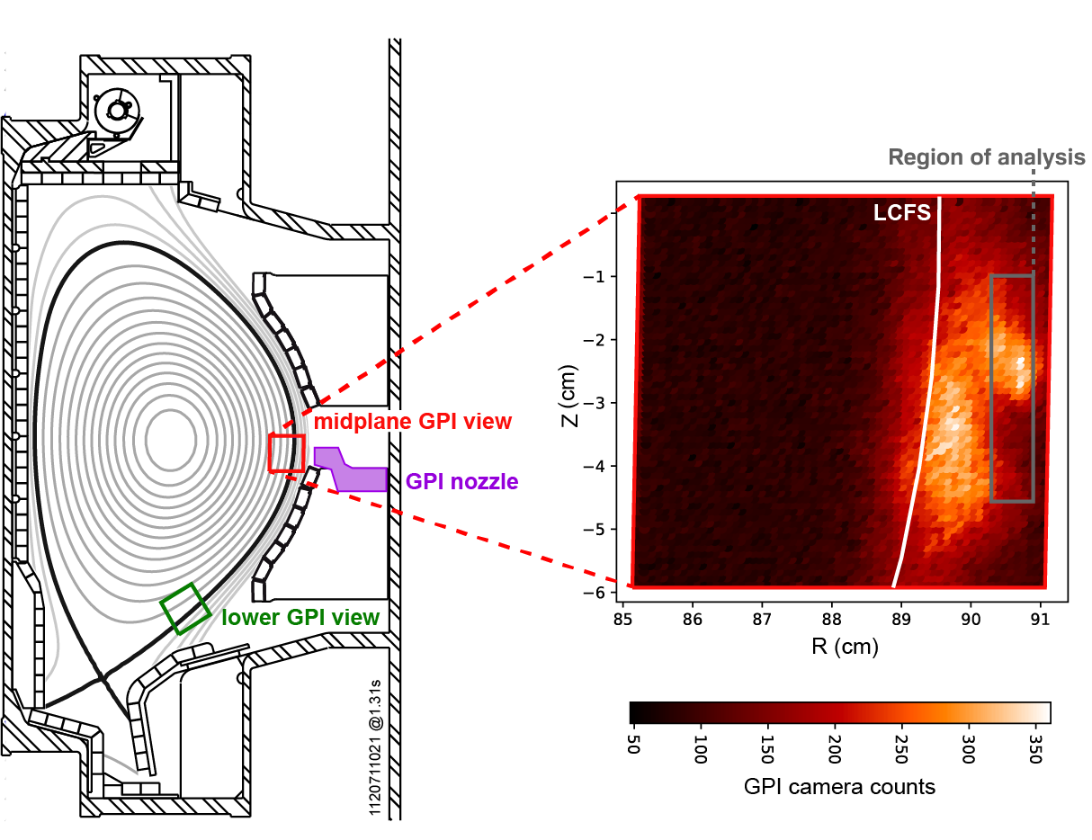

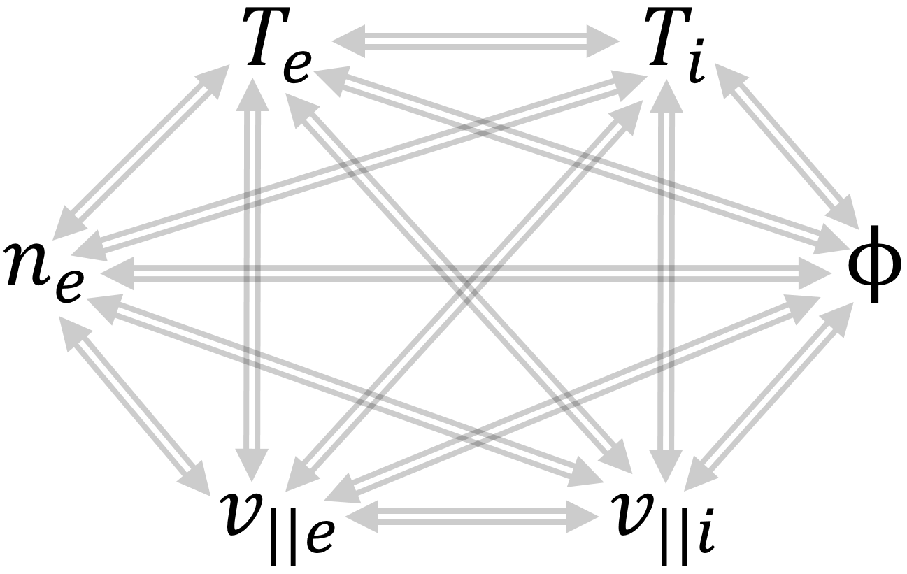
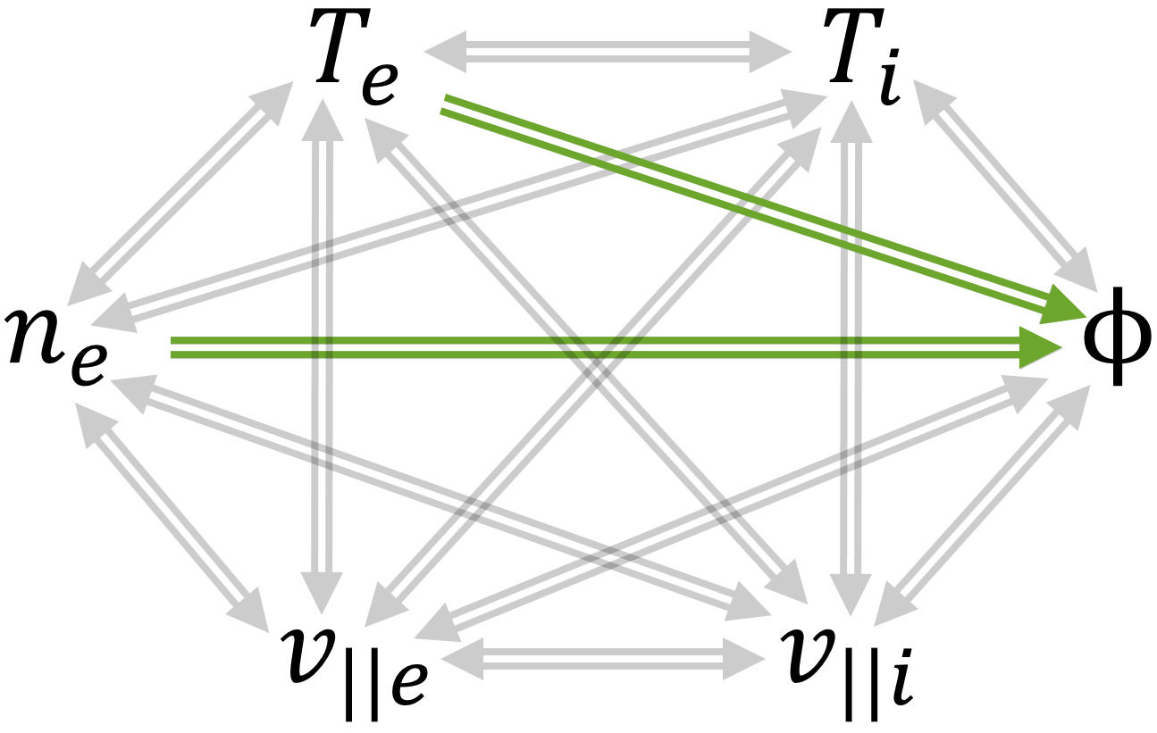
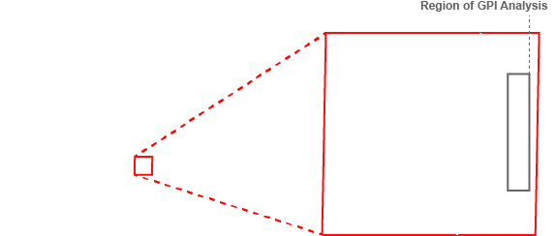
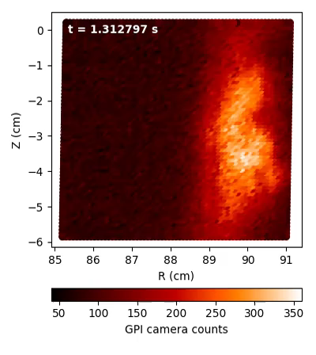
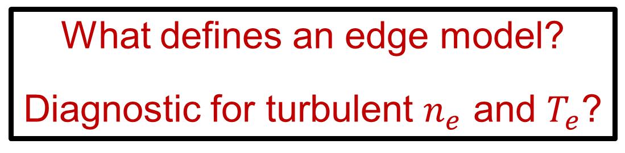
A framework to begin quantitatively testing edge turbulence models
We need a framework to quantitatively test edge turbulence models
What defines an edge model?
Diagnostic for turbulent $n_{e}$ and $T_{e}$?
Nonlinear connections b/w dynamical variables define nonlinear models
A novel analysis of edge turbulence using gas puff imaging (GPI)
Using neural networks informed by theory and experimental data
*Neutral dynamics and impurities are also important for edge turbulence models

Slide 5
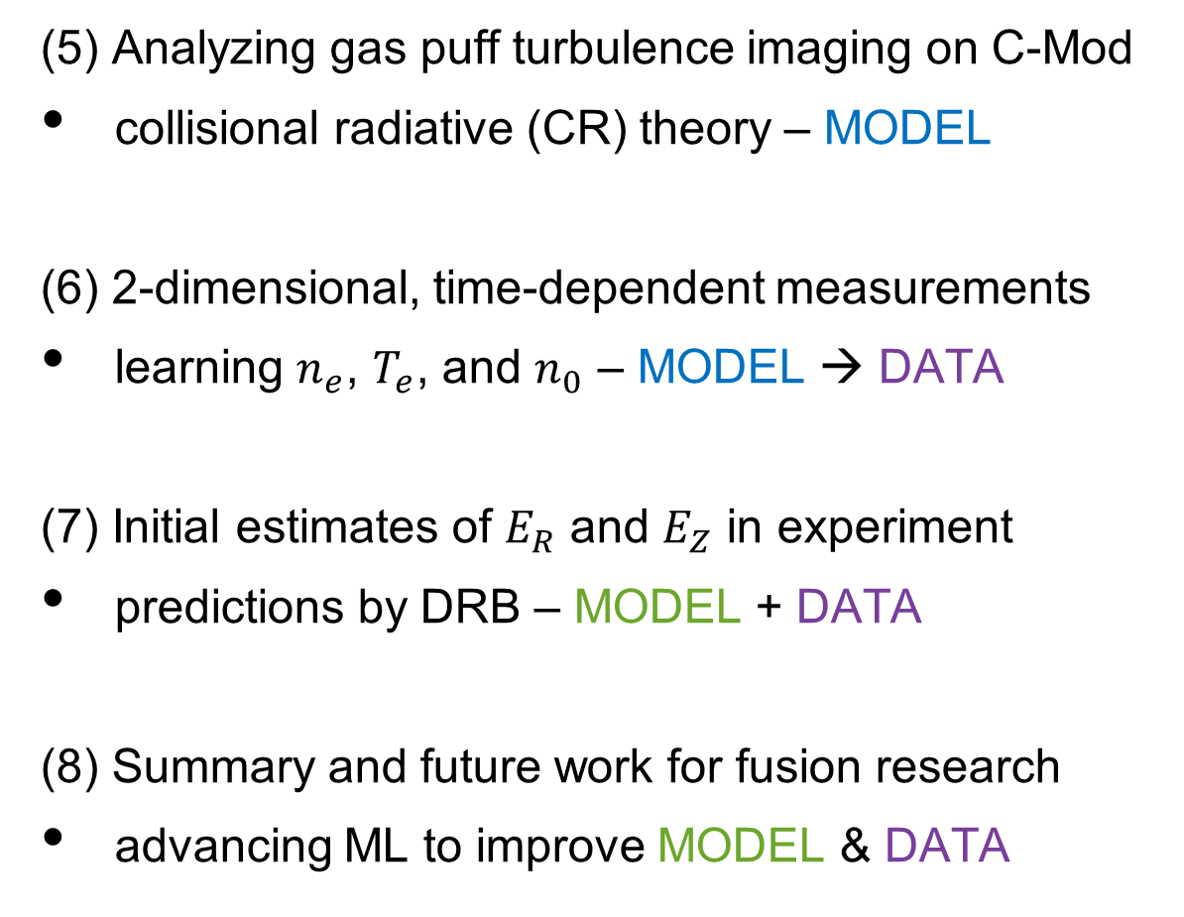

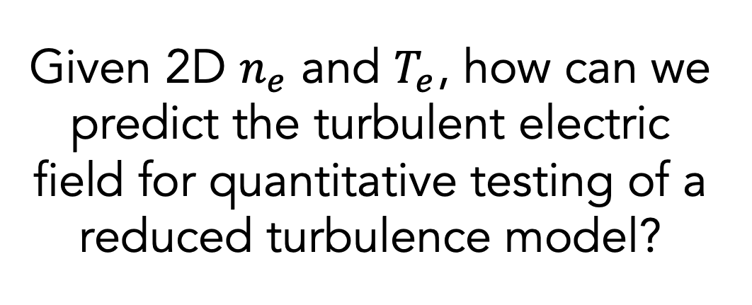
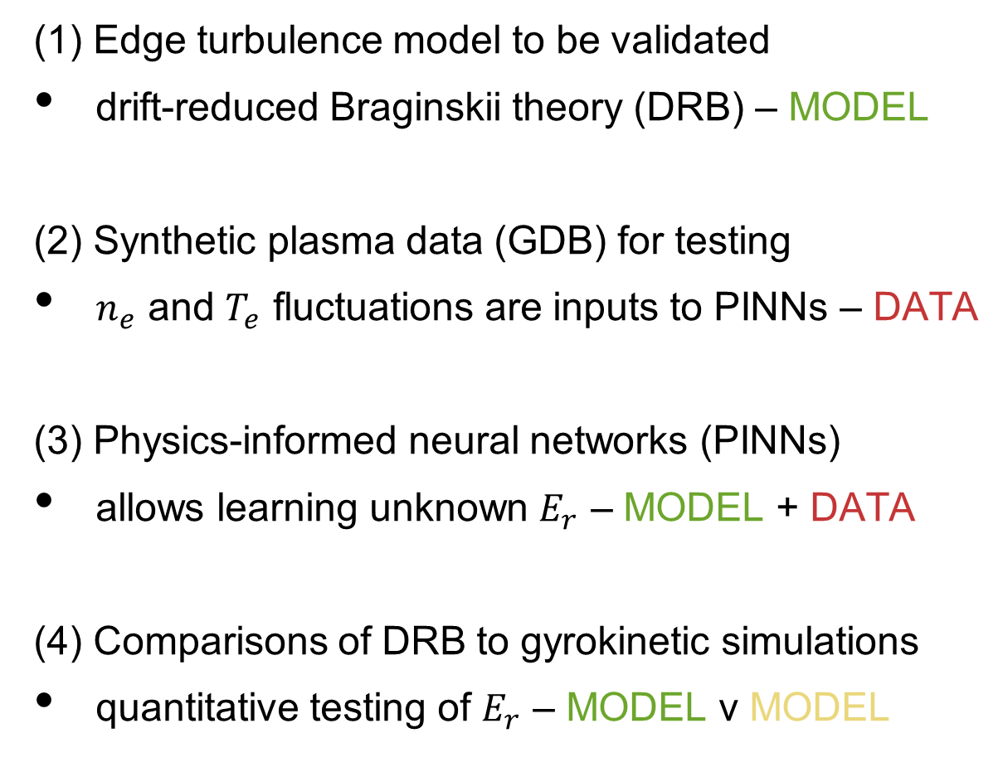
Outline of this presentation
PART I: SYNTHETIC PLASMA
PART II: EXPERIMENTAL PLASMA
(1) Edge turbulence model to be validated
drift-reduced Braginskii theory (DRB) – MODEL
(2) Synthetic plasma data (GDB) for testing
$n_{e}$ and $T_{e}$ fluctuations are inputs to PINNs – DATA
(3) Physics-informed neural networks (PINNs)
allows learning unknown $E_{r}$ – MODEL + DATA
(4) Comparisons of DRB to gyrokinetic simulations
quantitative testing of $E_{r}$ – MODEL v MODEL
(5) Analyzing gas puff turbulence imaging on C-Mod
collisional radiative (CR) theory – MODEL
(6) 2-dimensional, time-dependent measurements
learning $n_{e}$, $T_{e}$, and $n_{0}$ – MODEL → DATA
(7) Initial estimates of $E_{R}$ and $E_{Z}$ in experiment
predictions by DRB – MODEL + DATA
(8) Summary and future work for fusion research
advancing ML to improve MODEL & DATA
Given 2D $n_{e}$ and $T_{e}$, how can we predict the turbulent electric field for quantitative testing of a reduced turbulence model?
How can we get 2D $n_{e}$ and $T_{e}$ in an experimental plasma for reduced model predictions of the turbulent electric field?

Slide 6
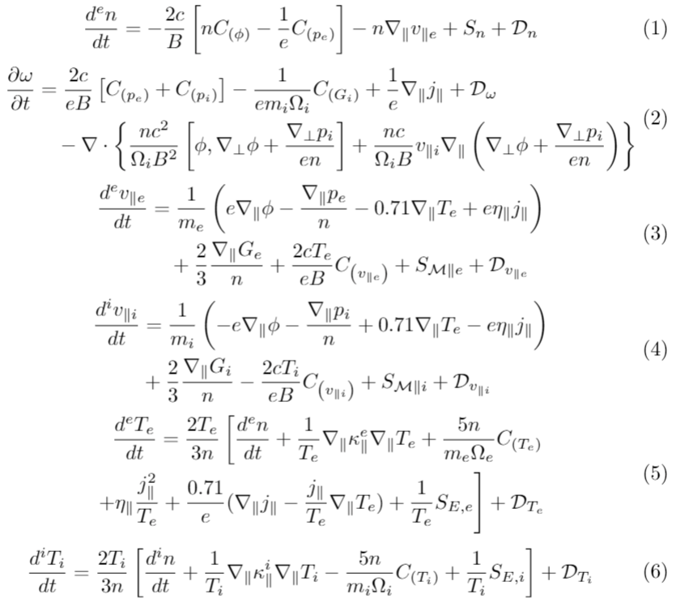
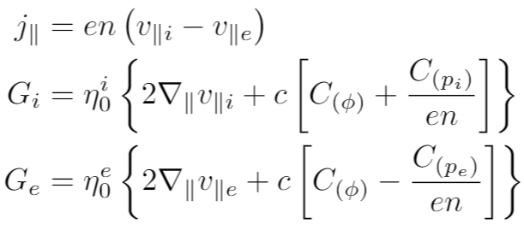
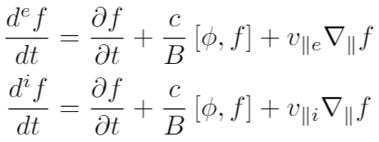
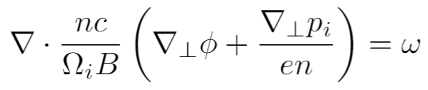

Drift-reduced ($\text{∂}\text{/}\text{∂}t≪Ω_{i}$) Braginskii two-fluid equations
current + gyroviscous terms
For full validation, need to evaluate connection with every dynamical variable, i.e. not just the turbulent electric field, but this is a necessary test and important start
convective derivatives
generalized vorticity
curvature operator

Slide 7
Outline of this presentation
PART I: SYNTHETIC PLASMA
PART II: EXPERIMENTAL PLASMA
(1) Edge turbulence model to be validated
drift-reduced Braginskii theory (DRB) – MODEL
(2) Synthetic plasma data (GDB) for testing
$n_{e}$ and $T_{e}$ fluctuations are inputs to PINNs – DATA
(3) Physics-informed neural networks (PINNs)
allows learning unknown $E_{r}$ – MODEL + DATA
(4) Comparisons of DRB to gyrokinetic simulations
quantitative testing of $E_{r}$ – MODEL v MODEL
(5) Analyzing gas puff turbulence imaging on C-Mod
collisional radiative (CR) theory – MODEL
(6) 2-dimensional, time-dependent measurements
learning $n_{e}$, $T_{e}$, and $n_{0}$ – MODEL → DATA
(7) Initial estimates of $E_{R}$ and $E_{Z}$ in experiment
predictions by DRB – MODEL + DATA
(8) Summary and future work for fusion research
advancing ML to improve MODEL & DATA
How can we get 2D $n_{e}$ and $T_{e}$ in an experimental plasma for reduced model predictions of the turbulent electric field?

Slide 8
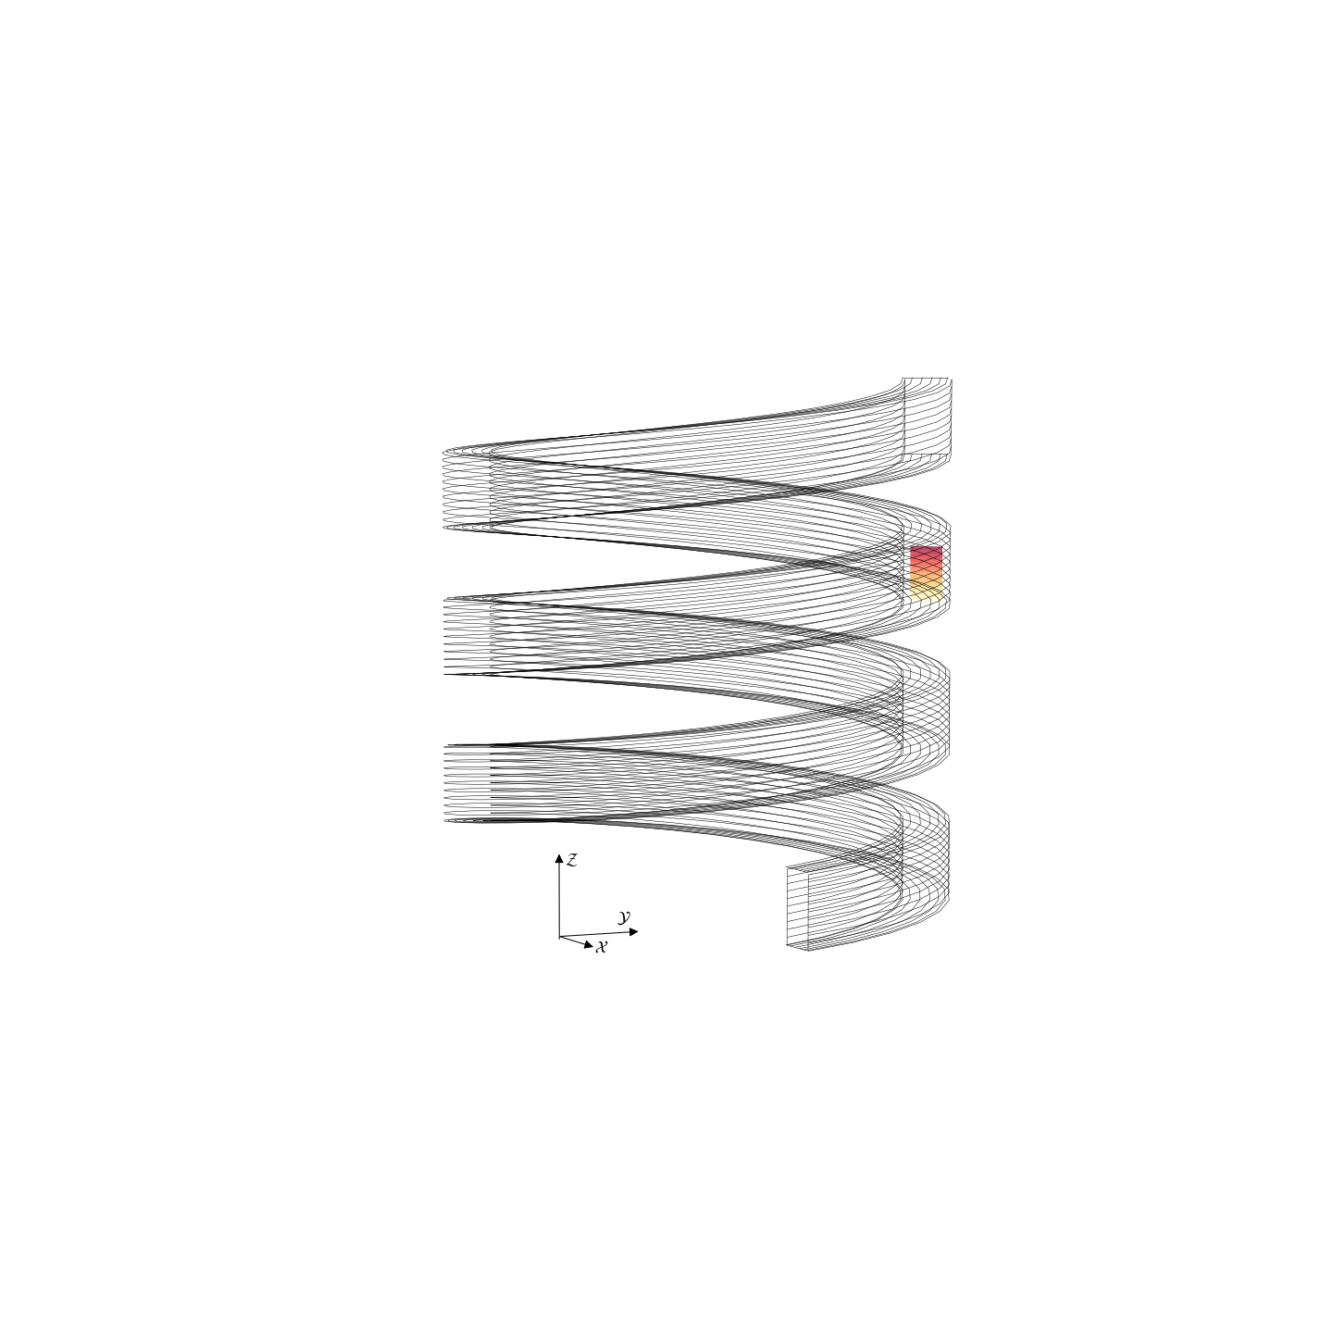
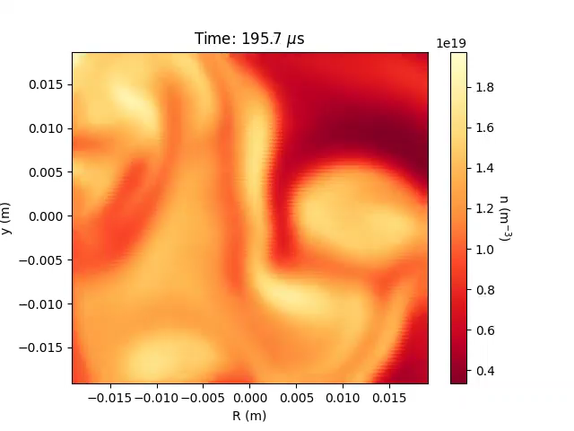
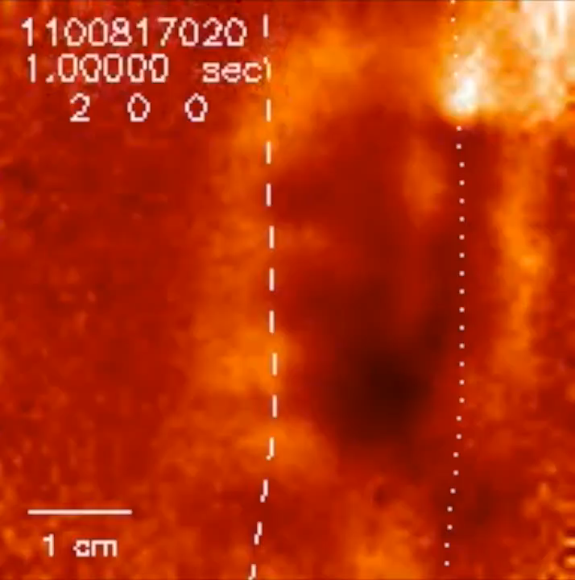
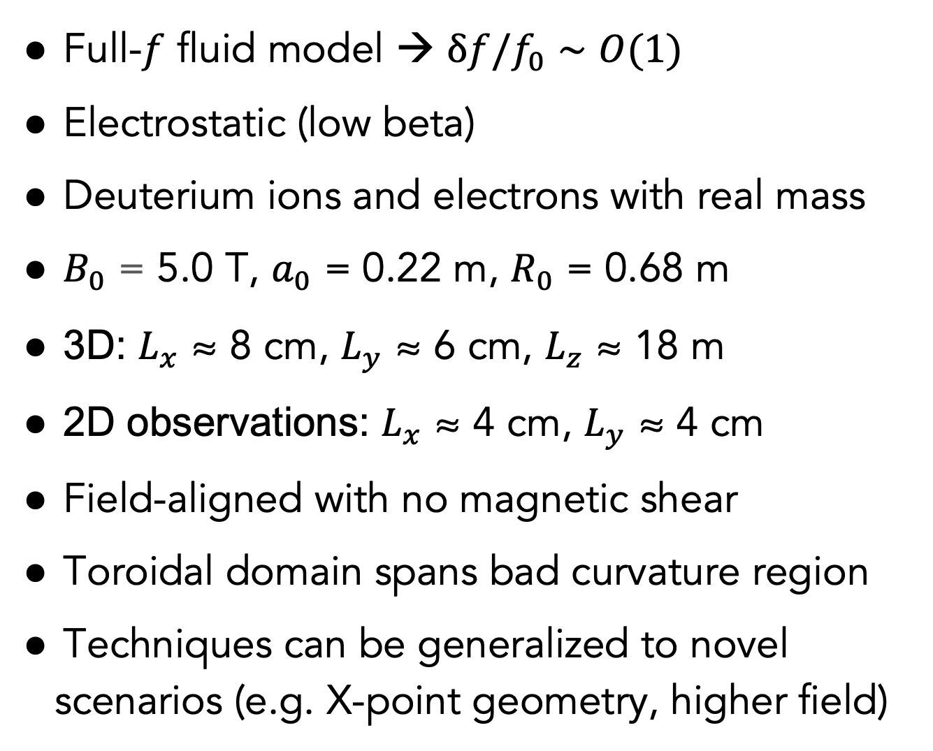
GDB simulations developed for testing in a synthetic C-Mod plasma
Full-$f$ fluid model → δ$f$/$f_{0}∼O(1)$
Electrostatic (low beta)
Deuterium ions and electrons with real mass
$B_{0}$ = 5.0 T, $a_{0}$ = 0.22 m, $R_{0}$ = 0.68 m
3D: $L_{x}$ ≈ 8 cm, $L_{y}$ ≈ 6 cm, $L_{z}$ ≈ 18 m
2D observations: $L_{x}$ ≈ 4 cm, $L_{y}$ ≈ 4 cm
Field-aligned with no magnetic shear
Toroidal domain spans bad curvature region
Techniques can be generalized to novel scenarios (e.g. X-point geometry, higher field)
Gas Puff Imaging
(experimental data)
GDB
(simulated data)
Source: J. Terry (MIT) & S. Zweben (PPPL)
B. Zhu et al 2018 Comp. Physics Comm. 232 46–58
M. Francisquez et al 2020 Physics of Plasmas 27 082301
*GDB is just a numerical solver for the drift-reduced Braginskii equations

Slide 9
Outline of this presentation
PART I: SYNTHETIC PLASMA
PART II: EXPERIMENTAL PLASMA
(1) Edge turbulence model to be validated
drift-reduced Braginskii theory (DRB) – MODEL
(2) Synthetic plasma data (GDB) for testing
$n_{e}$ and $T_{e}$ fluctuations are inputs to PINNs – DATA
(3) Physics-informed neural networks (PINNs)
allows learning unknown $E_{r}$ – MODEL + DATA
(4) Comparisons of DRB to gyrokinetic simulations
quantitative testing of $E_{r}$ – MODEL v MODEL
(5) Analyzing gas puff turbulence imaging on C-Mod
collisional radiative (CR) theory – MODEL
(6) 2-dimensional, time-dependent measurements
learning $n_{e}$, $T_{e}$, and $n_{0}$ – MODEL → DATA
(7) Initial estimates of $E_{R}$ and $E_{Z}$ in experiment
predictions by DRB – MODEL + DATA
(8) Summary and future work for fusion research
advancing ML to improve MODEL & DATA
How can we get 2D $n_{e}$ and $T_{e}$ in an experimental plasma for reduced model predictions of the turbulent electric field?

Slide 10
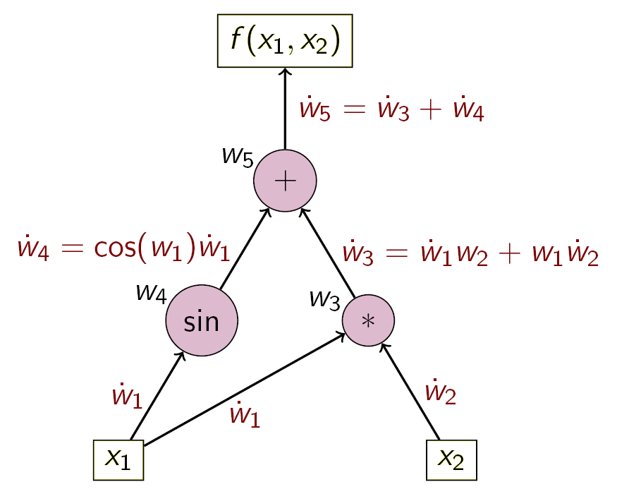
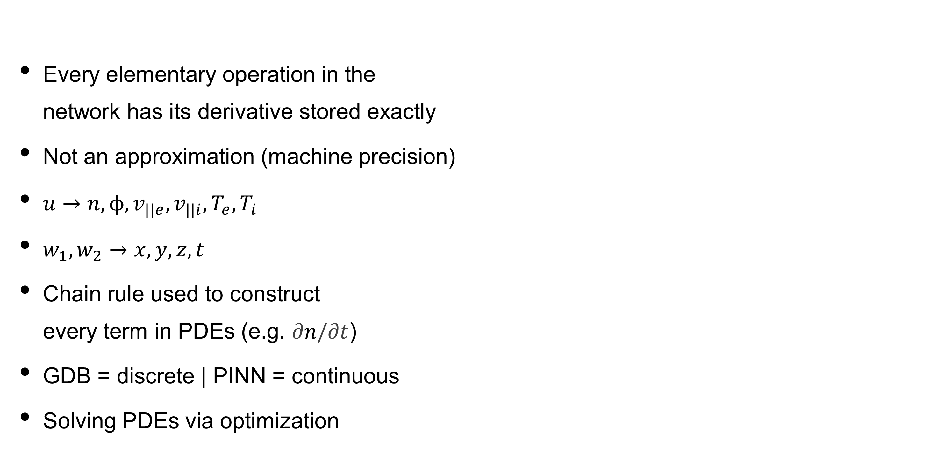



Every elementary operation in the network has its derivative stored exactly
Not an approximation (machine precision)
$u→n,ϕ,v_{||e},v_{||i},T_{e},T_{i}$
$w_{1},w_{2}→x, y, z, t$
Chain rule used to construct every term in PDEs (e.g. $\text{∂}n\text{/}\text{∂}t$)
GDB = discrete | PINN = continuous
Solving PDEs via optimization
PDEs are constructed by aid of automatic differentiation
$$u(w_{1},w_{2})$$
$${ w}_{1}$$
$${ w}_{2}$$

Slide 11
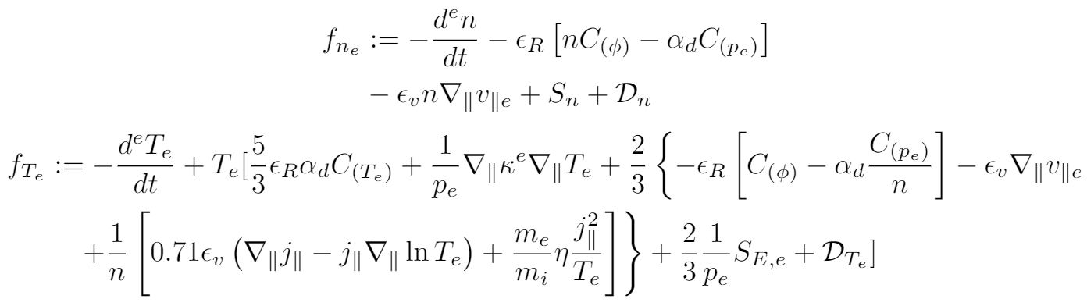


Physics-informed neural networks (PINNs): data-model optimization
GOAL: Make the DATA and MODEL loss terms as close to 0 as possible
DATA
MODEL
$$\frac{1}{N_{u}}\sum_{i=1}^{N_{u}}{{\left|u\left(t_{u}^{i},x_{u}^{i}\right)−u^{i}\right|}^{2}}$$
$$\frac{1}{N_{f}}\sum_{i=1}^{N_{f}}{{\left|f\left(t_{f}^{i},x_{f}^{i}\right)\right|}^{2}}$$
+
LOSS =

Slide 12
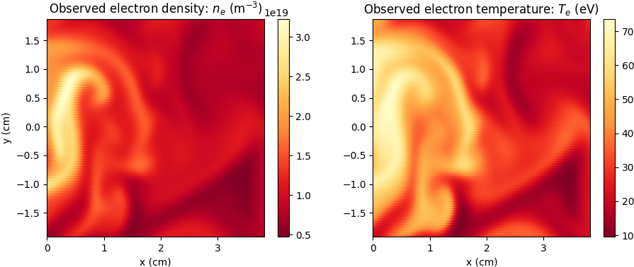
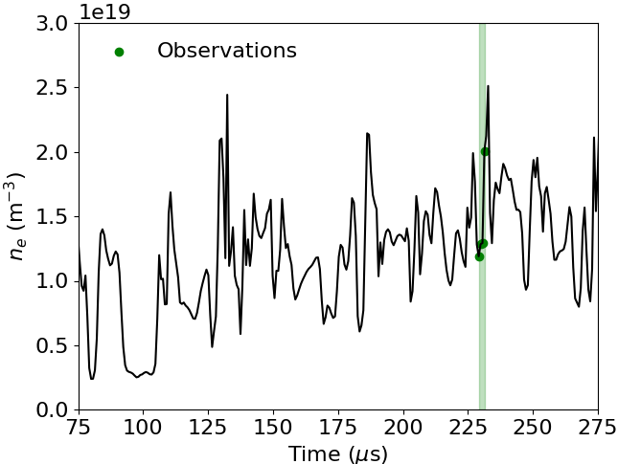

Only 2-dimensional $n_{e}$ and $T_{e}$ of the 3-dimensional plasma observed
DATA THEORY
PINN
+
($n_{e},T_{e}$)
(Braginskii)
Long time series can be easily
handled in the framework
×
#33883059
*No validation nor testing sets – just one plasma discharge*

Slide 13
The PINN is constrained by our sought theory for $\text{∂}n_{e}\text{/}\text{∂}t$ and $\text{∂}T_{e}\text{/}\text{∂}t$
DATA THEORY
+
($n_{e},T_{e}$)
(Braginskii)

Slide 14
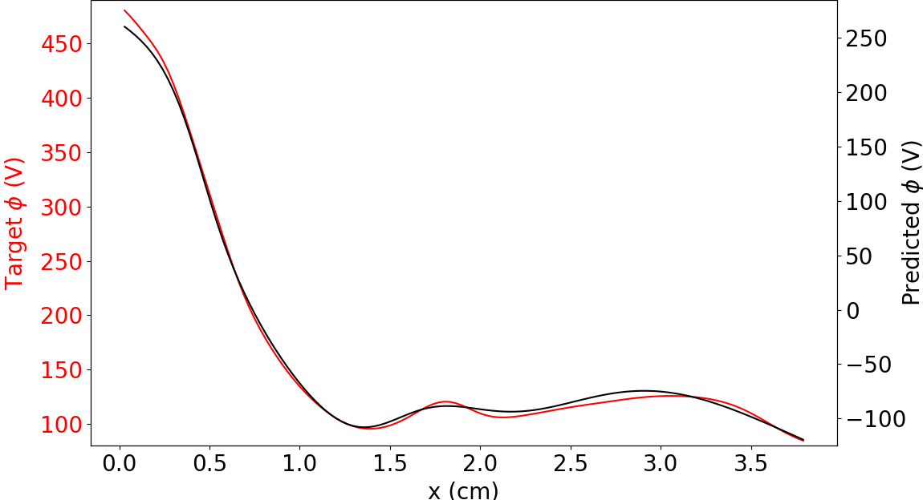
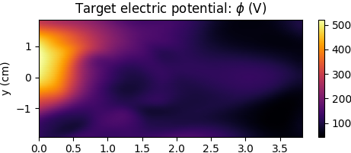
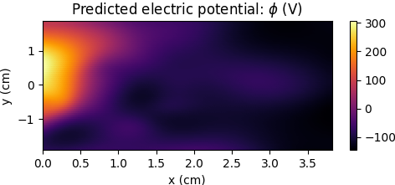

Electric potential is completely unobserved…yet almost fully learned
Electric potential is completely unobserved…
DATA THEORY
PINN
+
($n_{e},T_{e}$)
(Braginskii)
- - - - - - - - - - - - - - - - -
- - - - - - - - - - - - - - - - -
#33883059

Slide 15
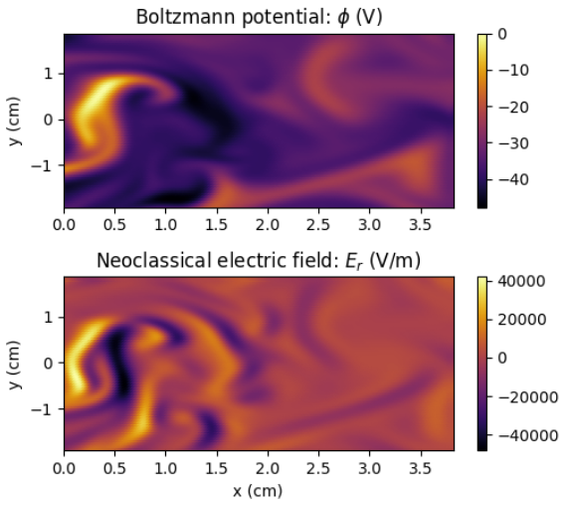
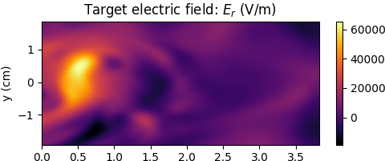
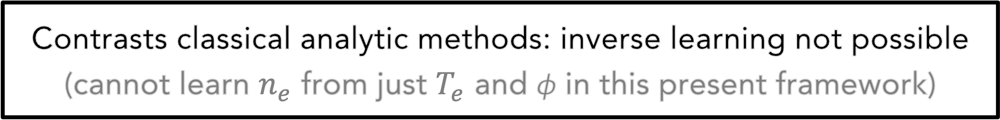
Can a simple equilibrium model predict electric potential & field?
Boltzmann: $n_{e}\left(ϕ_{2}\right)=n_{e}\left(ϕ_{1}\right)e^{{q_{e}(ϕ}_{1}−ϕ_{2})/T_{e}}$ ; Neoclassical: ∇${ϕ=\text{−}\text{∇}p}_{i}/Zn_{i}e$
Contrasts classical analytic methods: inverse learning not possible (cannot learn $n_{e}$ from just $T_{e}$ and ϕ in this present framework)
*Target = synthetic plasma created by GDB ← inputs of $n_{e}$ and $T_{e}$ for calculations come from synthetic plasma

Slide 16
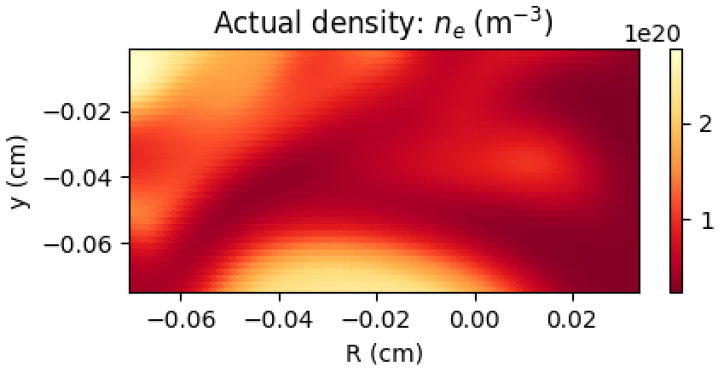
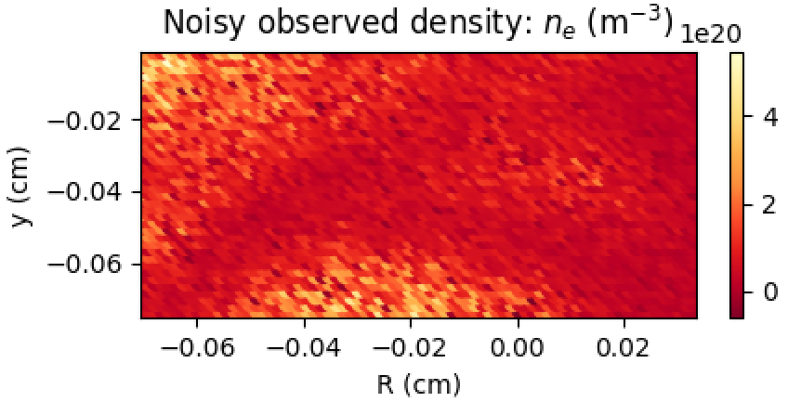
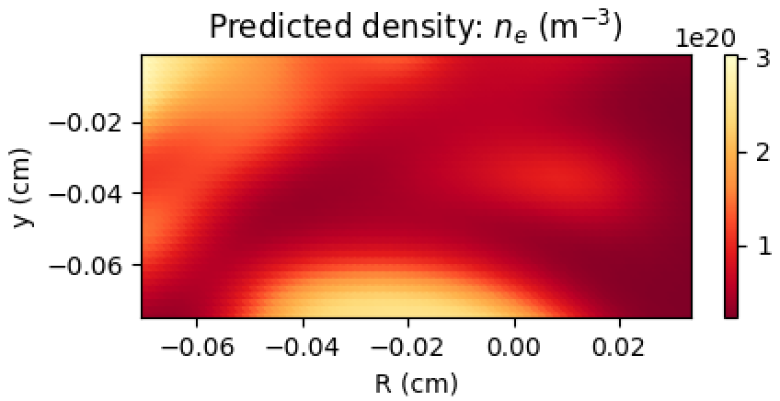
Density fluctuations with strong noise present can still be learned
29926655

Slide 17
Outline of this presentation
PART I: SYNTHETIC PLASMA
PART II: EXPERIMENTAL PLASMA
(1) Edge turbulence model to be validated
drift-reduced Braginskii theory (DRB) – MODEL
(2) Synthetic plasma data (GDB) for testing
$n_{e}$ and $T_{e}$ fluctuations are inputs to PINNs – DATA
(3) Physics-informed neural networks (PINNs)
allows learning unknown $E_{r}$ – MODEL + DATA
(4) Comparisons of DRB to gyrokinetic simulations
quantitative testing of $E_{r}$ – MODEL v MODEL
(5) Analyzing gas puff turbulence imaging on C-Mod
collisional radiative (CR) theory – MODEL
(6) 2-dimensional, time-dependent measurements
learning $n_{e}$, $T_{e}$, and $n_{0}$ – MODEL → DATA
(7) Initial estimates of $E_{R}$ and $E_{Z}$ in experiment
predictions by DRB – MODEL + DATA
(8) Summary and future work for fusion research
advancing ML to improve MODEL & DATA
How can we get 2D $n_{e}$ and $T_{e}$ in an experimental plasma for reduced model predictions of the turbulent electric field?

Slide 18
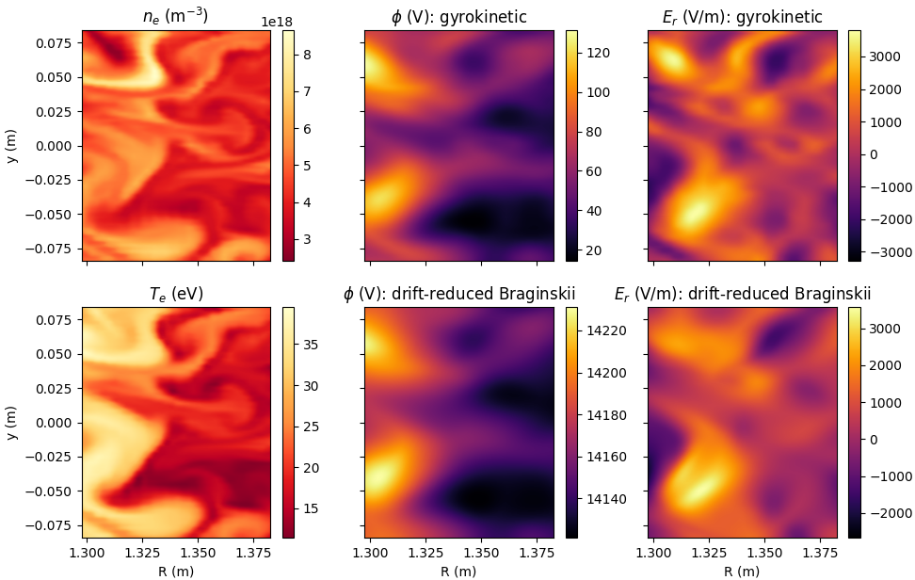
DRB vs. gyrokinetics: electric field in the SOL of NSTX
DRB theory closely matches gyrokinetic $E_{r}$ in low-β helical plasma
Given an electron pressure fluctuation, what is the turbulent ϕ expected from electromagnetic gyrokinetic modelling and electrostatic drift-reduced Braginskii theory?
A. Mathews et al. 2021 Physics of Plasmas 28 112301
M. Francisquez et al. 2020 Physics of Plasmas 27 082301
N. Mandell et al. 2020 Journal of Plasma Physics 86 905860109
#34587378

Slide 19
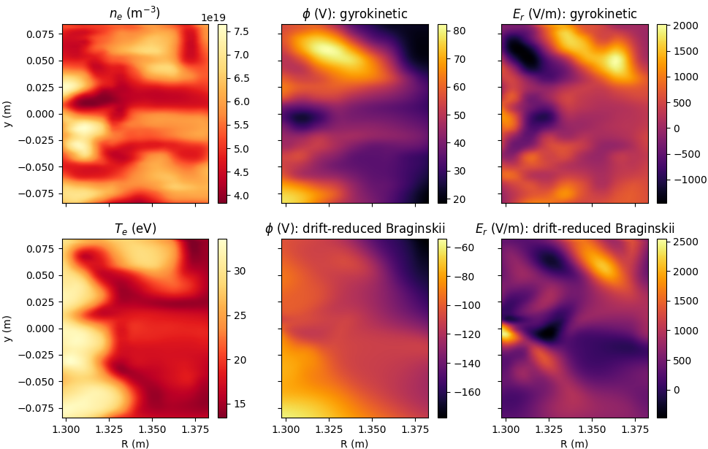
ES DRB theory inconsistent with EM gyrokinetic $E_{r}$ at high-β
#37003300

Slide 20
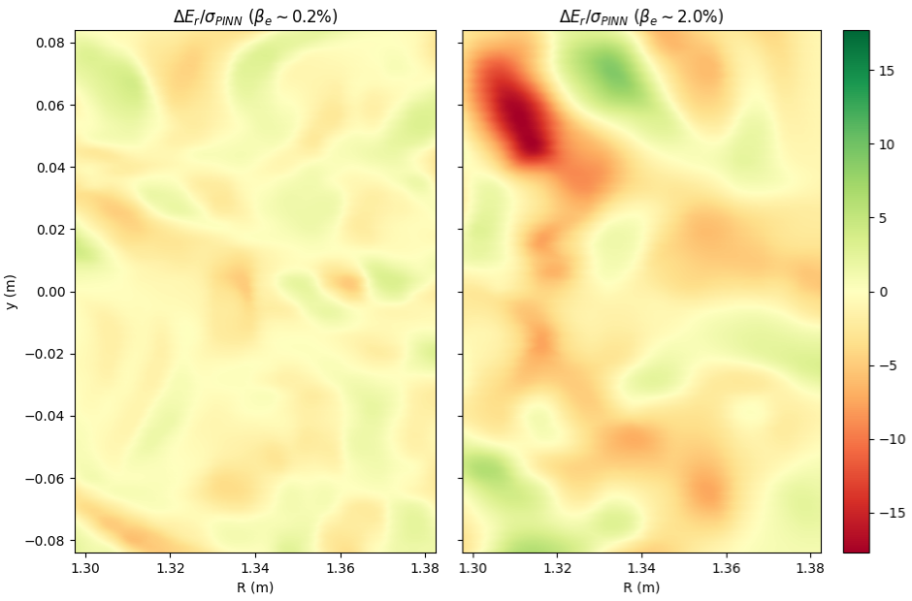




Can now precisely quantify fluid-gyrokinetic model (dis)agreement
As expected, the ES reduced model becomes less accurate as β increases
${\text{β}}_{e}$ ~ 0.2%
${\text{β}}_{e}$ ~ 2.0%
#34587378-37003300

Slide 21
Outline of this presentation
PART I: SYNTHETIC PLASMA
PART II: EXPERIMENTAL PLASMA
(1) Edge turbulence model to be validated
drift-reduced Braginskii theory (DRB) – MODEL
(2) Synthetic plasma data (GDB) for testing
$n_{e}$ and $T_{e}$ fluctuations are inputs to PINNs – DATA
(3) Physics-informed neural networks (PINNs)
allows learning unknown $E_{r}$ – MODEL + DATA
(4) Comparisons of DRB to gyrokinetic simulations
quantitative testing of $E_{r}$ – MODEL v MODEL
(5) Analyzing gas puff turbulence imaging on C-Mod
collisional radiative (CR) theory – MODEL
(6) 2-dimensional, time-dependent measurements
learning $n_{e}$, $T_{e}$, and $n_{0}$ – MODEL → DATA
(7) Initial estimates of $E_{R}$ and $E_{Z}$ in experiment
predictions by DRB – MODEL + DATA
(8) Summary and future work for fusion research
advancing ML to improve MODEL & DATA
How can we get 2D $n_{e}$ and $T_{e}$ in an experimental plasma for reduced model predictions of the turbulent electric field?

Slide 22








What does the HeI GPI diagnostic on Alcator C-Mod measure?
electron impact
spontaneous transition
*$q$˂$p$ means $q$ lies energetically below $p$
Region of GPI analysis
ionization
recombination (three-body, radiative, and dielectronic)
$n(p)$ is the population density of a state ${p= n}^{2S+1}L$ determined by the principal quantum number $n$, spin $S$, and angular momentum quantum number $L$
↔
$$587.6 nm: 3^{3}D →2^{3}P$$
→
collisional radiative theory
→
$N_{P}=1 \text{(}$time-dependent ground state)
M. Goto, Collisional-radiative model for neutral helium in plasma revisited, Journal of Quantitative Spectroscopy and Radiative Transfer, 76(3–4), 331 (2003)
population coefficients
rate coefficients

Slide 23








Constraints from the $N_{P}$ = 1 CR theory on photon emissivity
Einstein A: $1/A(3^{3}D,2^{3}P)$ = $0.05 μs$
→
$v_{x}\sim −900 m/s$ and $v_{y}\sim −20 m/s$
based upon DEGAS2 modelling
favour correlated $n_{e}$ and $T_{e}$
Networks search for solutions where:
${2.5×10}^{18}<n_{e} \left(m^{−3}\right)<{7.5×10}^{19}$;
$2.5<T_{e} (eV)<150$; $0.1<n_{0} (arb.)<10$;
A. Mathews et al. 2022 Rev. Sci. Inst. 93 6

Slide 24




When is the $N_{P}$ = 1 CR theory valid in fusion plasmas?
Probe measurements from plasma discharge 1120711021 on Alcator C-Mod
$τ_{Q}<τ_{GPI}$ $<τ_{n_{e}},τ_{T_{e}}$
$$τ_{n_{e}}=4.2 μs,τ_{T_{e}}=6.1 μs; τ_{n_{e}}=15.6 μs,τ_{T_{e}}=22.9 μs$$
$τ_{GPI}=2.1 μs$; $τ_{Q}≈0.1−0.3 μs$; $τ_{Q}≈0.3−0.7 μs$
P.T. Greenland 2001 Proc. Roy. Soc. London 457 2012
D. Stotler et al. 2007 Journ. Nucl. Mat. 363 686
A. Mathews et al. 2022 Rev. Sci. Inst. 93 6
*gray region corresponds to radial width of GPI analysis

Slide 25
Outline of this presentation
PART I: SYNTHETIC PLASMA
PART II: EXPERIMENTAL PLASMA
(1) Edge turbulence model to be validated
drift-reduced Braginskii theory (DRB) – MODEL
(2) Synthetic plasma data (GDB) for testing
$n_{e}$ and $T_{e}$ fluctuations are inputs to PINNs – DATA
(3) Physics-informed neural networks (PINNs)
allows learning unknown $E_{r}$ – MODEL + DATA
(4) Comparisons of DRB to gyrokinetic simulations
quantitative testing of $E_{r}$ – MODEL v MODEL
(5) Analyzing gas puff turbulence imaging on C-Mod
collisional radiative (CR) theory – MODEL
(6) 2-dimensional, time-dependent measurements
learning $n_{e}$, $T_{e}$, and $n_{0}$ – MODEL → DATA
(7) Initial estimates of $E_{R}$ and $E_{Z}$ in experiment
predictions by DRB – MODEL + DATA
(8) Summary and future work for fusion research
advancing ML to improve MODEL & DATA

Slide 26



Experimental modelling of 2-dimensional turbulent edge dynamics
- - - - - - -
- - - - - - -
- - - - - - -
- - - - - - -
$$DYNAMICS INFERRED$$
$$BY ML FRAMEWORK$$
$$EXPERIMENT$$
- - - - - - -
- - - - - - -
inferred dynamics inferred dynamics inferred dynamics experimental data

Slide 27


Comparison of $n_{e}$ and $T_{e}$ with independent probe measurements
*Radial profiles of GPI are time-averaged for comparison with magnetically disconnected MLP measurements
*MLP scan in the plotted region lasts roughly 6000 𝜇s (i.e. 60× longer than the duration of the GPI analysis)

Slide 28
Outline of this presentation
PART I: SYNTHETIC PLASMA
PART II: EXPERIMENTAL PLASMA
(1) Edge turbulence model to be validated
drift-reduced Braginskii theory (DRB) – MODEL
(2) Synthetic plasma data (GDB) for testing
$n_{e}$ and $T_{e}$ fluctuations are inputs to PINNs – DATA
(3) Physics-informed neural networks (PINNs)
allows learning unknown $E_{r}$ – MODEL + DATA
(4) Comparisons of DRB to gyrokinetic simulations
quantitative testing of $E_{r}$ – MODEL v MODEL
(5) Analyzing gas puff turbulence imaging on C-Mod
collisional radiative (CR) theory – MODEL
(6) 2-dimensional, time-dependent measurements
learning $n_{e}$, $T_{e}$, and $n_{0}$ – MODEL → DATA
(7) Initial estimates of $E_{R}$ and $E_{Z}$ in experiment
predictions by DRB – MODEL + DATA
(8) Summary and future work for fusion research
advancing ML to improve MODEL & DATA

Slide 29


What does the reduced model predict for $E_{R}$ & $E_{Z}$ in experiment?
*DRB predictions presently assume purely toroidal magnetic field*
Can directly test effects (e.g. HeI source scaled to ${10}^{19} m^{−3}$) on nonlinear calculations

Slide 30


HeI sources broaden distribution of turbulent electric field amplitudes

Slide 31

Inclusion of HeI sources is found to increase turbulent $E\text{×}B$flow shear
A new ML-based approach for testing the nonlinear physics of models in experiment
Can directly test effects (e.g. HeI source scaled to ${10}^{19} m^{−3}$) on nonlinear calculations

Slide 32
Outline of this presentation
PART I: SYNTHETIC PLASMA
PART II: EXPERIMENTAL PLASMA
(1) Edge turbulence model to be validated
drift-reduced Braginskii theory (DRB) – MODEL
(2) Synthetic plasma data (GDB) for testing
$n_{e}$ and $T_{e}$ fluctuations are inputs to PINNs – DATA
(3) Physics-informed neural networks (PINNs)
allows learning unknown $E_{r}$ – MODEL + DATA
(4) Comparisons of DRB to gyrokinetic simulations
quantitative testing of $E_{r}$ – MODEL v MODEL
(5) Analyzing gas puff turbulence imaging on C-Mod
collisional radiative (CR) theory – MODEL
(6) 2-dimensional, time-dependent measurements
learning $n_{e}$, $T_{e}$, and $n_{0}$ – MODEL → DATA
(7) Initial estimates of $E_{R}$ and $E_{Z}$ in experiment
predictions by DRB – MODEL + DATA
(8) Summary and future work for fusion research
advancing ML to improve MODEL & DATA

Slide 33

Key results delivered by this collaborative work
Demonstrated system to infer φ($\vec{x},t$) from 2D $n_{e}$ and $T_{e}$ consistent with
drift-reduced Braginskii theory for plasma diagnosis and model validation
ES DRB and EM GK turbulent $E_{r}$ consistent in low-β helical plasmas
ES DRB and EM GK turbulent $E_{r}$ inconsistent in high-β helical plasmas
First estimates of experimental 2D turbulent $n_{e}$, $T_{e}$, ${Cn}_{0}$ in C-Mod SOL
Novel diagnostic analysis of atomic helium using just a single spectral line
Calculated $E_{R}$ and $E_{Z}$ in experiment as predicted by (toroidal) DRB
HeI associated with amplified turbulent electric fields and shearing rates
1) A. Mathews et al. 2021 Physical Review E 104 025205 2) A. Mathews et al. 2021 Physics of Plasmas 28 112301
3) A. Mathews et al. 2022 Rev. Sci. Inst. 93 6 4) A. Mathews et al. 2021 IEEE Trans. Plasma Science 49 12 5) A. Mathews et al. 2022 Phys. Rev. Let. 129 253002

Slide 34

Future work on the path towards developing accurate edge models
Apply GPI analysis across devices (e.g. TCV, W7-X, AUG, DIII-D)
Use time-dependent neutral transport codes (e.g. EIRENE) to infer D and ${\text{Ly}}_{α}$ for further GPI validation and inclusion of sources for testing DRB
Align collimated HeI cloud with local pitch angle of magnetic field line
Learn dynamics beyond electric field (e.g. $T_{i}$, $T_{e},$ $v_{i||}$) in full geometry
Test predictions (e.g. $E_{θ}$) by DRB against independent measurements
Extend domain of analysis towards closed flux surfaces (e.g. pedestal), which may require advancing ML framework (e.g. diagnostic integration)
Accelerate forward turbulence simulation codes with PINNs

Slide 35




Talk summary: physics + ML = better way to study edge turbulence
PART I: SYNTHETIC PLASMA
PART II: EXPERIMENTAL PLASMA
We can predict the turbulent electric field for a widely applied reduced turbulence model given 2D $n_{e}$ and $T_{e}$ observations
We can get 2D $n_{e}$ and $T_{e}$ in an experimental plasma for quantitative testing of a reduced turbulence model’s electric field predictions

