Slide 1
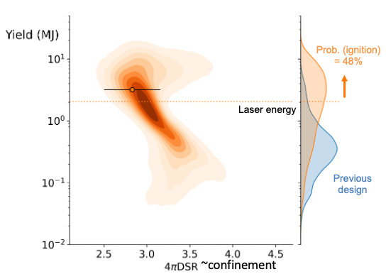
Machine Learning Enabled Quantitative Prediction of the First-Ever Igniting Inertial Confinement Fusion Experiment – Bogdan Kustowski
Motivations
Make physics-informed prediction with data-informed uncertainty
Estimate the variability in new designs before they are tested experimentally
Results
We predicted a high probability of achieving gain > 1 using data-informed uncertainty on the first-even ICF experiment to achieve (NAS) ignition
Challenges
Only ~10 full scale experiments per year
Large ensembles of simulations
Building a statistical model of the variability; transferring it to a new design to make predictions
< insert great picture here >
IAEA Workshop on AI for Accelerating Fusion and Plasma Science, 2023 11/28 – 12/1
LLNL-PRES-857423

