Slide 1

PFNN：Less data and better performance on disruption prediction via predict-first neural network
Zongyu Yang¹，Wulyu Zhong^{1*}，Fan Xia¹, Zhe Gao², Yunbo Dong¹，Yipo Zhang¹，Bo Li¹，Xiaolong Zhang¹，Shuo Wang¹，Xiaobo Zhu¹，Liwen Hu¹ ，Jiyuan Li¹ and Zhaohe Xu¹
Southwestern Institute of Physics
Tsinghua University
1st IAEA Workshop on AI for Accelerating Fusion and Plasma Science, Vienna, Austria, Nov 28th~Dec 1st, 2023
Notes:
Good afternoon, everyone. I am Zongyu Yang from Southwestern Institute of Physics. Today I will represent my group to give this presentation about PFNN, Less data and better performance on disruption prediction via predict-first neural network

Slide 2
1、Introduction
2、PFNN development in HL-2A
3、Challenge of disruption in HL-3
4、PFNN development in HL-3
5、Summary
Notes:
The presentation consists of 5 parts. The first part will introduce the background of disruption prediction and the motivation of this research.

Slide 3
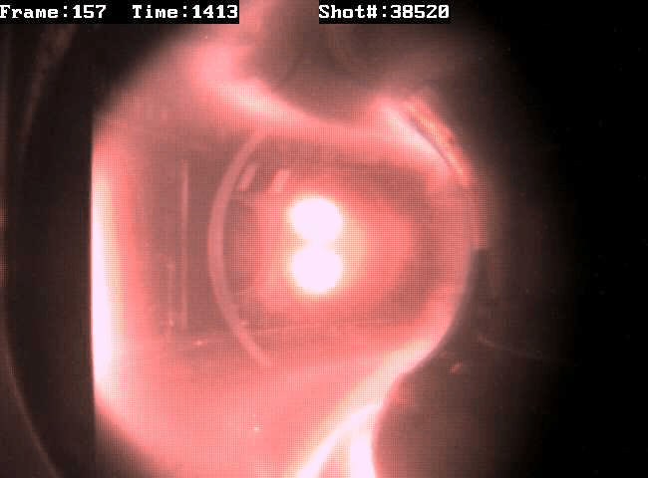
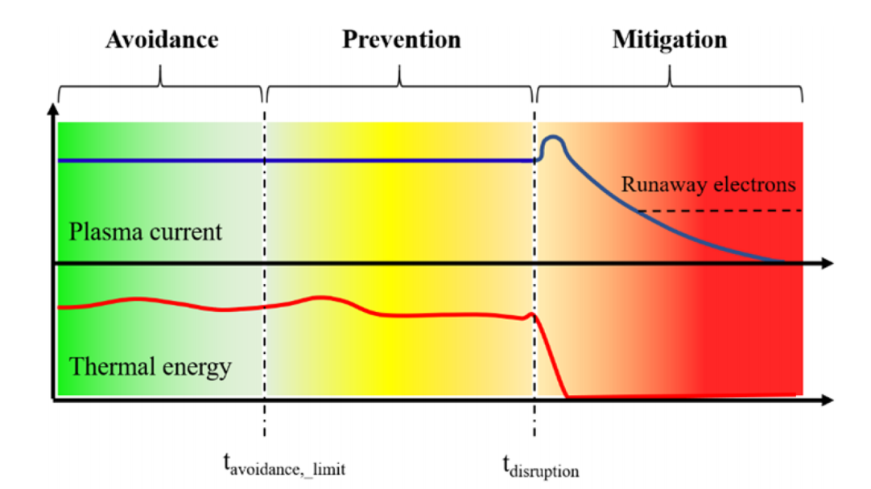
Background
Disruption poses a threat for large-scale tokamaks and fusion reactors
  Thermal loads, halo currents and runaway electrons
  The severity is positively correlated with the size of the device
To handle the risk of disruption: avoidance—prevention—mitigation
  Disruption prediction algorithm provides essential input for prevention and mitigation
A typical disruption process measured by CCD camera in HL-2A
The avoidance, prevention and mitigation paradigm to handle the risk of disruption [A. Murari, et al. NF 60 056003]
Notes:
Disruption means a sudden loss of plasma confinement during tokamak discharges. Since the plasma contains much thermal energy and electromagnetic energy, Its rapid collapse could bring thermal load, halo currents and runaway electrons to the devices. The severities of these events are positively correlated with the size of device. Therefore, it becomes a safety threat for large-scale tokamaks and future devices.
To handle the risk of disruption, a widely accepted paradigm is to avoid, prevent and mitigate the disruptions. And accurate disruption prediction is the precondition of prevention and mitigation.

Slide 4
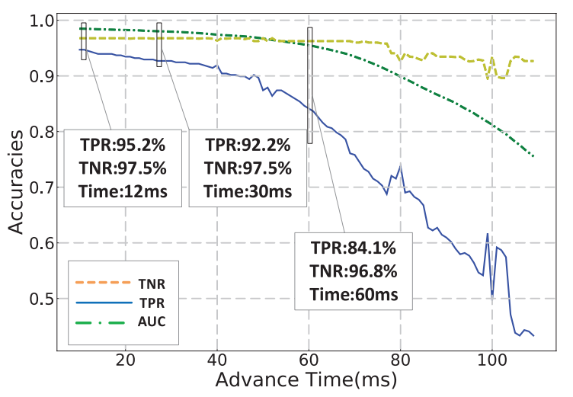
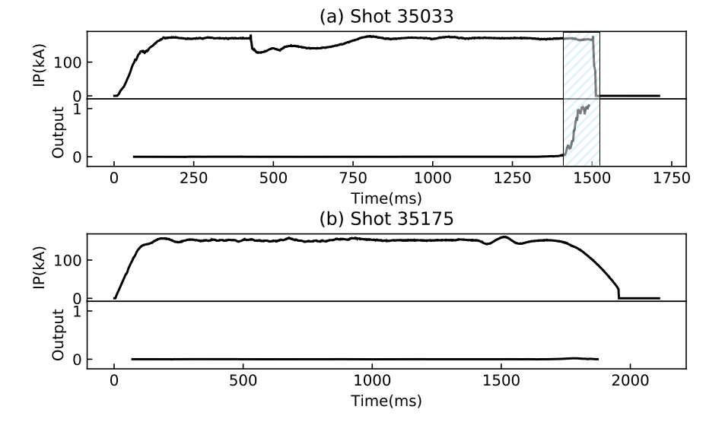
AI-based disruption prediction
Disruption prediction → disruption precursor detection
  By physical criterion? Difficult to handle diverse disruption causes and complex experiment situations.
  Using AI technique to avoid the problem: binary classification on data w/o disruption precursors
Disruption predictor in HL-2A
  1.5D CNN+LSTM: using parallel CNN branch to deal with data from different systems
  AUC/TPR/FPR: 0.979/0.922/0.975
Typical output of HL-2A disruption predictor during disruptive(a) and non- disruptive(b) shots
Accuracies obtained with different requirements for prediction advance time
Notes:
So how to predict the disruptions? The basic principle of these algorithms could be explained as disruption precursor detection. This can be realized by setting some physical criterions, such as the Greenwald density ratio and safety factor on plasma boundary. However, during experiments, disruptions could be triggered by various reasons. It is quite difficult to design concise and accurate criterions to predict all disruptions. So we introduced AI-based methods in HL-2A. We train a binary classification algorithm on two types of data. The first type corresponds to the shadowed area in the left figure, which is a short time window before the disruptions. The data in this window will be considered to contain disruption precursors. The second type corresponds to the other areas, data far from disruptions and data from non-disruptive shots, which should not contain disruption precursors. In HL-2A, we trained a CNN+LSTM neural network to do the binary classification. And after training it can provide output that increases rapidly before the disruptions. In HL-2A this algorithm obtained high accuracies. An AUC of 0.979.

Slide 5
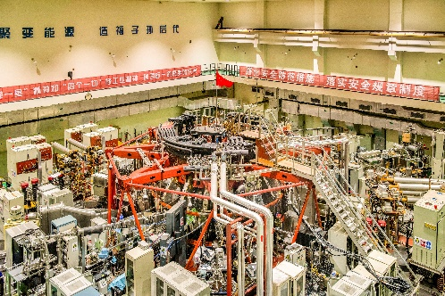
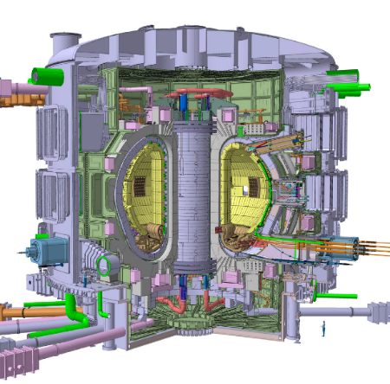
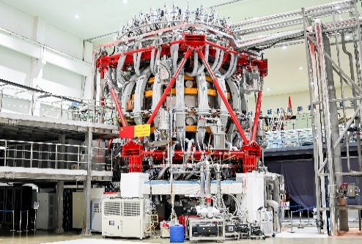
Issue on large-scale tokamaks
Severe results of disruptions → limited training data provided for AI algorithm
  HL-2A algorithm is supported by ~8000 shots generated in 7 years(2013~2020)
  HL-3 tokamak provides only ~1000 shots before it goes into the dangerous parameter space
  For ITER, the training data might be more limited
Our solution: predict-first neural network(PFNN)
  A new paradigm of disruption predictors that utilizing physical information to alleviate the data-hungry problem
HL-2A（Ip~10²kA)
  Disruption is not so dangerous
HL-3（Ip~10³kA)
  Limited disruptions are acceptable
ITER（Ip~10⁴kA)
  A few disruption will damage the device
Notes:
Unfortunately, we can expect an issue when extending this method onto future large-scale tokamaks. Due to the severe result of disruptions on these devices, we can hardly collect enough data to develop the AI-based algorithm. For example, in HL-2A we used 8000 shots to get the disruption predictor we mentioned. While in HL-3 we only have about 1000 shots, and the device has already gone into the dangerous parameter space. We can expect a more stressful situation in future devices like ITER. So, to solve the problem, we proposed PFNN paradigm, which embeds some physical information into the model, to leverage the data-hungry problem.

Slide 6
Paradigm of PFNN
Stage 1: embedding physical information by predict-first tasks
Stage 2: gets better performance on disruption prediction with limited training data
The paradigm PFNN
PFNN is expected to get better performance with limited data
Notes:
The paradigm of PFNN consists of 2 steps. In the first stage, we don’t train on disruption prediction task directly. Instead, we select some predict-first tasks to ‘teach’ the neural network physics. The network will take the current parameters of plasma and control schedules as input. Then it will be trained to predict the evolution of plasma parameters after a while. In the second stage we will turn the algorithm to disruption prediction task. And the knowledge learned during the 1st stage will be carried into the model by methods like inheriting the weights. As a result, we will get a better performance than ordinary models by training with this new paradigm.

Slide 7
1、Introduction
2、PFNN development in HL-2A
3、Challenge of disruption in HL-3
4、PFNN development in HL-3
5、Summary
Notes:
OK, now I will introduce the implementation details in HL-2A

Slide 8
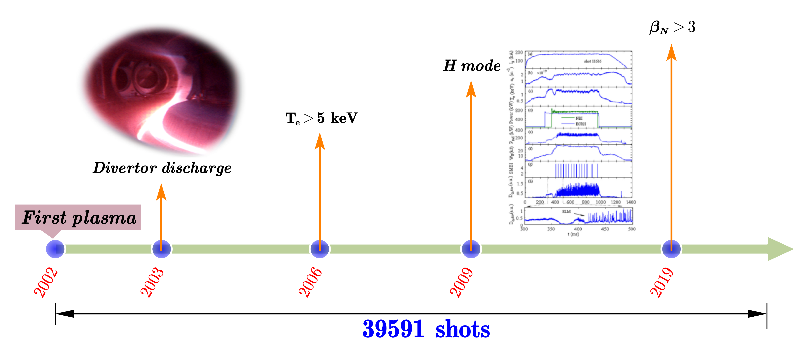
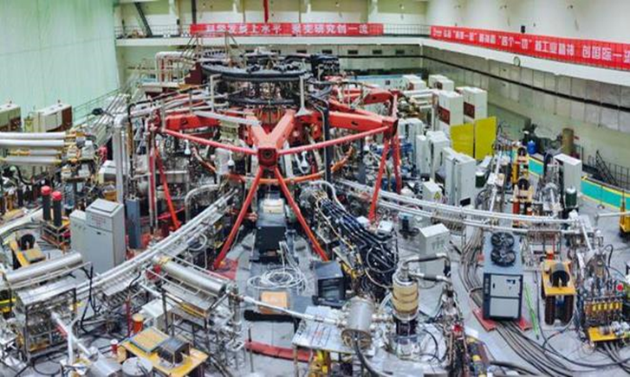
The HL-2A Tokamak
A medium sized tokamak, where disruptions are not so serious
  39351 shots are accumulated during operation of 20 years, supporting a thorough algorithm exploration
  In this research we randomly selected a small subset(~1500 shots) to study the algorithm performance when training data is limited (as in future devices)
The overview of HL-2A tokamak
Several milestones achieved during HL-2A’s operation
Notes:
HL-2A is a medium sized tokamak where disruptions are not so serious. It has accumulated 39351 shots during operation of 20 years. Such a large amount of data can support us to do many algorithm explorations. In this research we randomly selected a small subset, about 1500 shots to study the algorithm performance when training data is limited, as in future devices

Slide 9
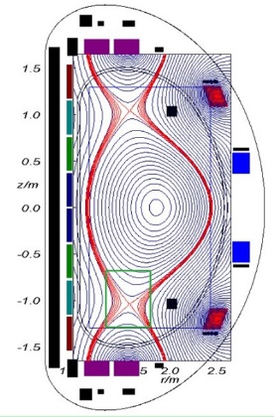
Design of predict-first tasks
Physical knowledge hidden in the input and output of three prediction tasks
  Electron temperature(Te) prediction: energy balance in plasma
  Electron density(ne) prediction: particle balance in plasma
  Horizontal displacement(Dh) prediction: momentum balance in plasma
A key hyper-parameter: prediction interval
  To be in accord with the time-scale of plasma evolution
Te(t=T)
ne(t=T)
Dh(t=T)
Heating powers
NBI, EC, LH, Ohm
Injected density
(gas puffing, NBI, SMBI)
Magnetic field
(Coil currents)
Radiated powers
(bolometer)
Te
t=T+30ms
ne
t=T+30ms
Dh
t=T+10ms
Momentum injection
(gas puffing, NBI, SMBI)
Transport loss
(MHD intensity, Dα, div)
Transport loss
(MHD intensity)
Cold density source
(gas puffing, PWI)
PWI intensity
PWI intensity
Input and output of Te prediction
Input and output of Ne prediction
Input and output of Dh prediction
Notes:
We designed three predict-first tasks on HL-2A, the electron temperature prediction, electron density prediction and horizontal displacement prediction. These tasks are selected according to two considerations. Firstly, the data related to these tasks can be completely collected from our experimental database, since most of them are basic plasma parameters and control signals. Secondly, these tasks correspond to three basic balances in plasma, the energy balance, particle balance and momentum balance, which should be basic principles that is helpful for disruption prediction. In the three figures you can find the input and output lists of three tasks. For example, in the electron temperature prediction branch, we take previous Te, heating powers, radiated losses, transport losses and cold density sources as the input. And the model will be trained to predict the electron temperature with 30ms into the future. Here, we tried different prediction intervals for three parameters, and find the best interval seems to correspond to the time-scale of plasma evolution, such as the energy confinement time.

Slide 10
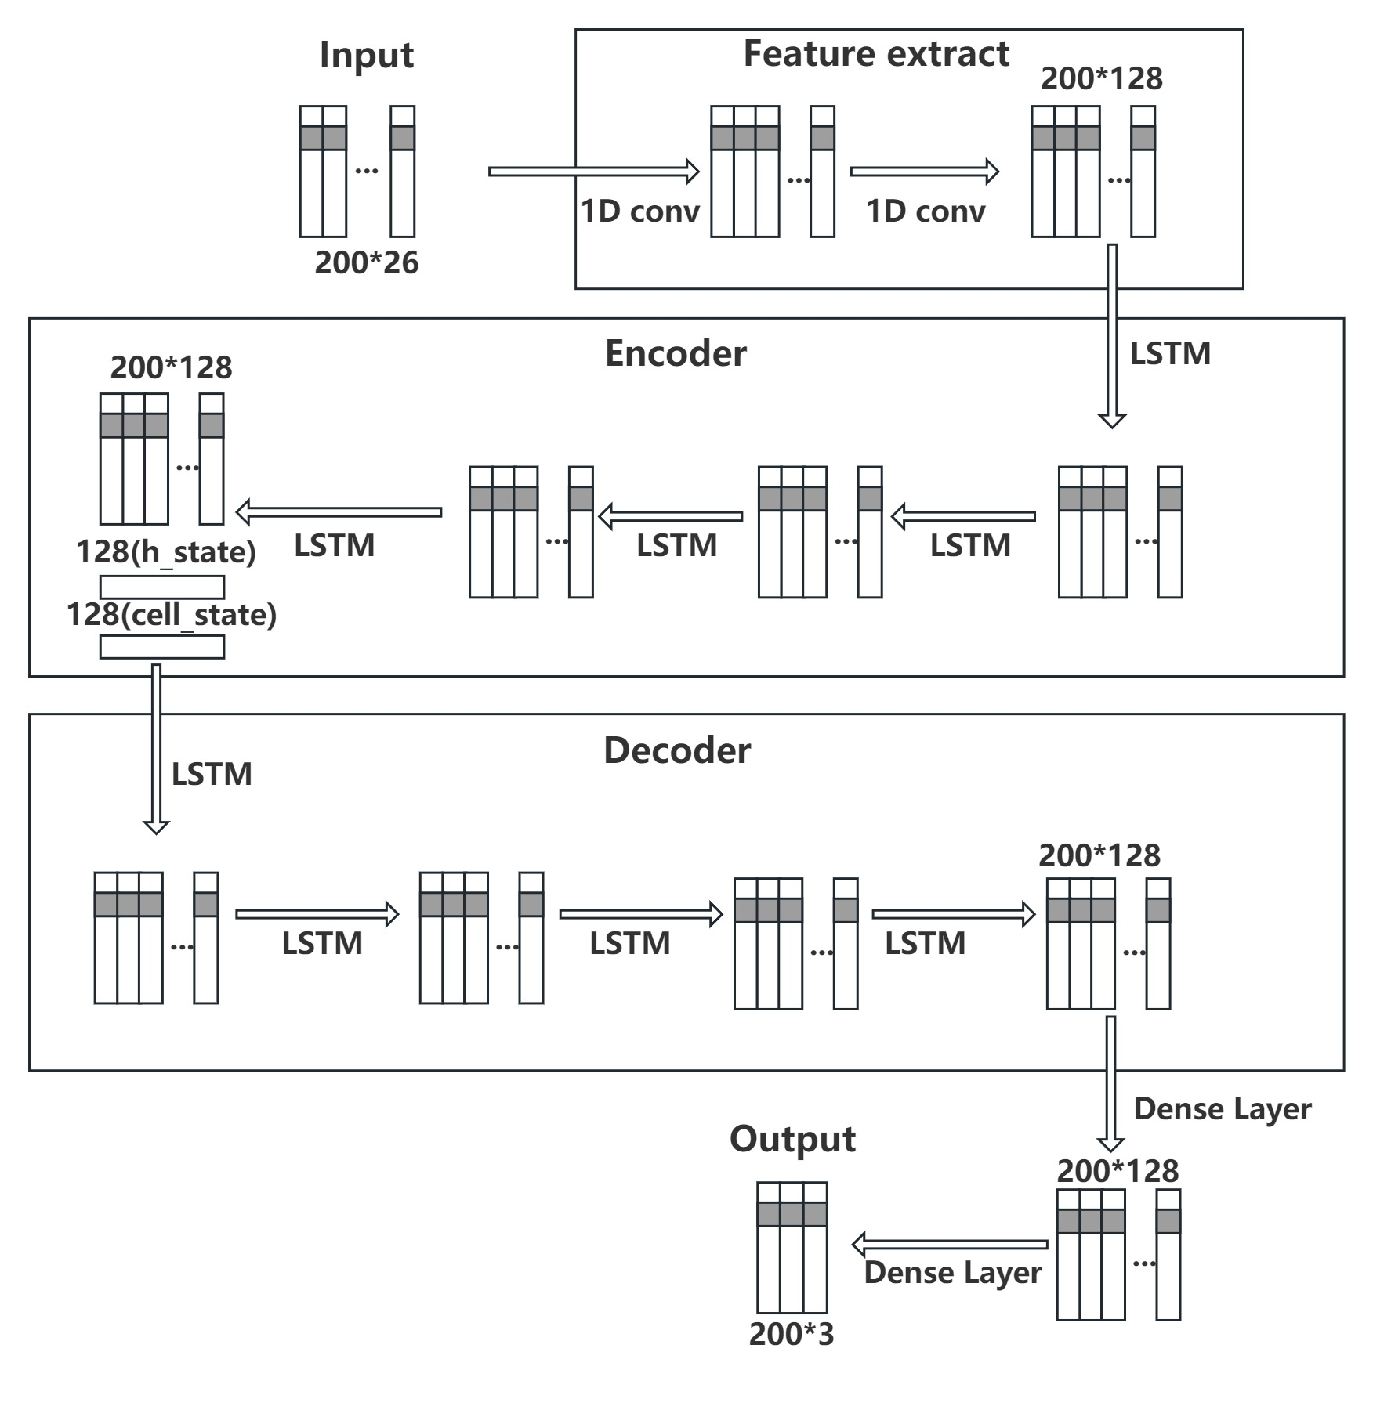
Training data and model
Training data
  All the non-disruptive shots
  Stable part of the disruptive shot (with time to disruption larger than 500ms)
Model: seq2seq structure based on LSTM and TCN
  Using chunk generator as in [J. K. Harbeck, et al. Nature 568]
 | Shot number (non-disruptive) | Shot number (disruptive)
Train | 932 | 351
Validate | 178 | 105
Shot numbers used to train parameter prediction models
Model structure of the parameter prediction algorithm
Notes:
And here is some information about the dataset and model of parameter prediction. We selected 932 ono-disruptive shots and 351 disruptive shots to train the model and reserved about 300 shots to test the model. And the model takes sequence to sequence framework based on LSTM and TCN. The detailed structure of networks is given in the right figure.

Slide 11
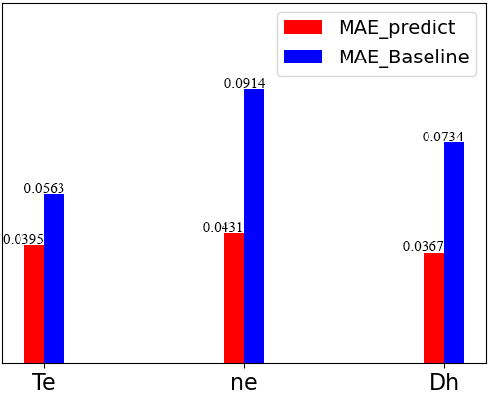
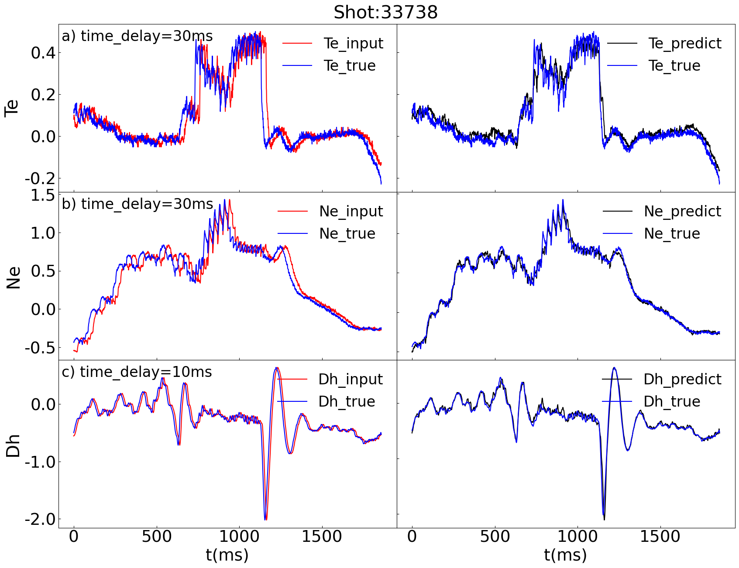
Performance of parameter prediction
The mean absolute error(MAE) of three parameters are obviously lower than baseline
  Baseline: mean absolute difference between the parameters on t=T and t=T+Δt
Rational responds given for the change of control actuators or plasma
  Rising temperature when NBI heating is turned on
  Decreasing temperature and perturbated horizontal position when NBI heating is turned off
MAE comparison between the parameter prediction algorithm and baseline
Left: comparison between parameters on t=T and t=T+Δt
Right: comparison between parameters on t=T+Δt and predicted parameters
Notes:
After training, we find the model successfully predicted the evolution of parameters. We used mean absolute error to evaluate the model, and set a baseline error by computing the MAE between parameters on time of T and T+Δt. In the left figure you can find that the MAE of three parameters are all lower than the baseline error. In the right figure, we give a detailed result of parameter prediction during a shot of HL-2A. The left subfigure compares the parameter before and after the interval of Δt. An obvious legacy can be observed between the two curves. While in the right subfigure, we compared the predicted curves and the experimental results, where the legacies are almost eliminated. We noticed that the model gives rational responds for the change of control actuators. For example, in this shot the NBI heating is turned on during 700-1200ms, and we can find corresponding increasing and decreasing in the predicted Te curve.

Slide 12
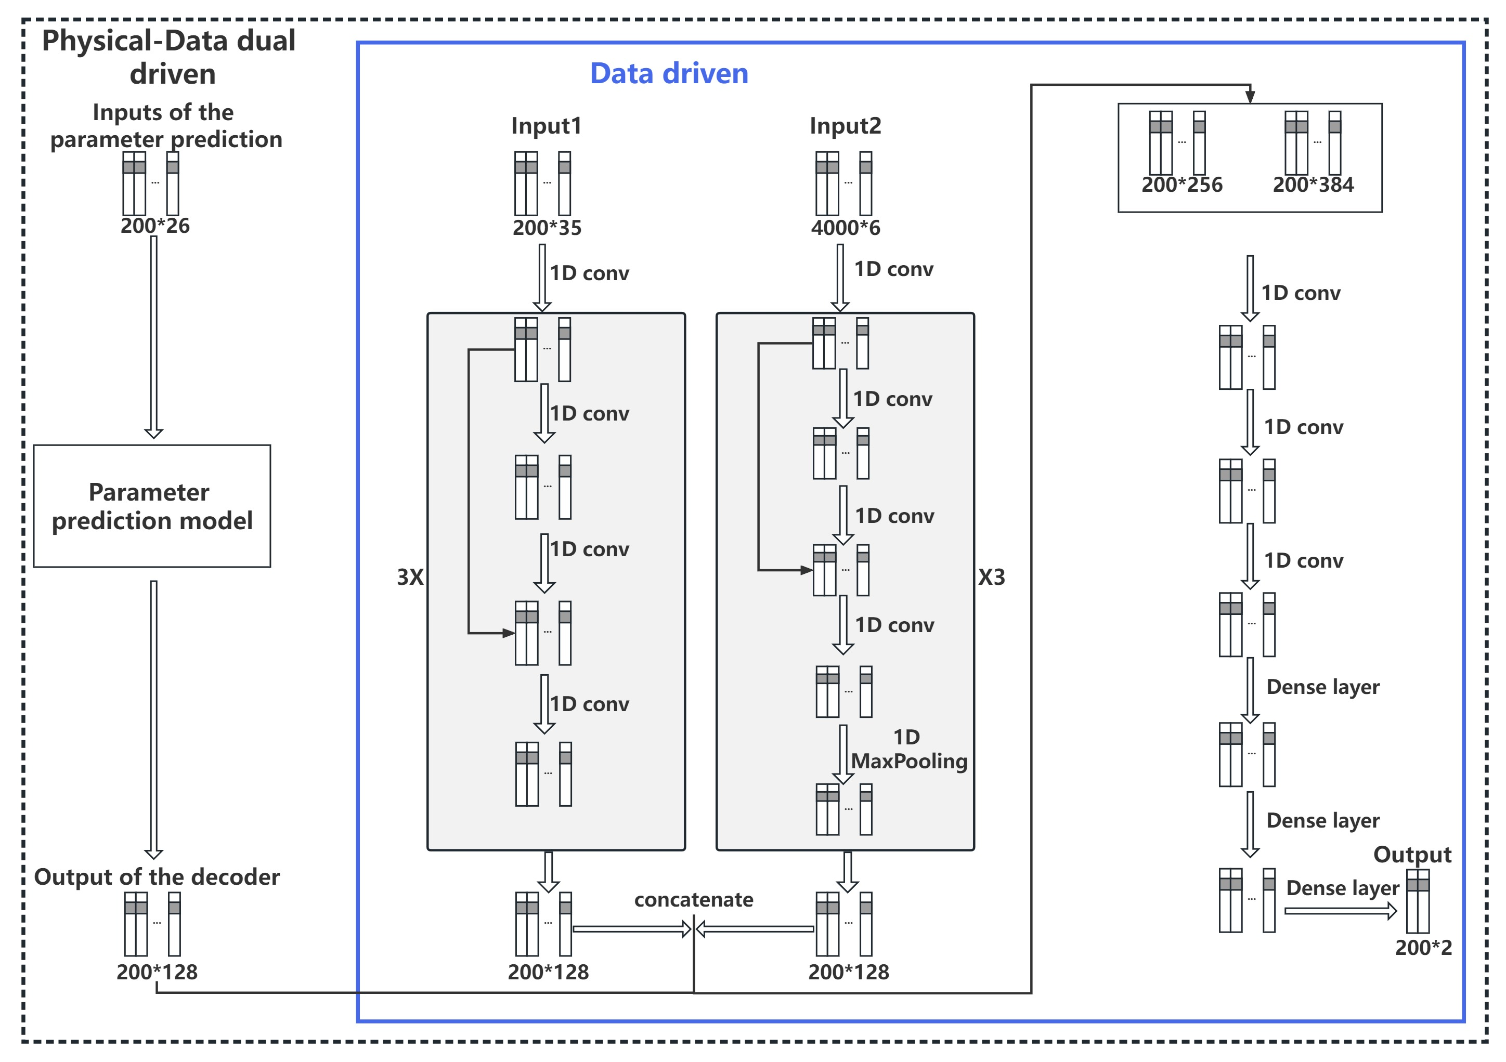
Turn to disruption prediction
A embedding vector given by previous model will be appended to disruption predictor
The rest part will be same as an ordinary disruption predictor
  Temporal convolutional neural network(TCN)
Based on the ordinary disruption prediction model in blue box, we appended the embeddings given by parameter prediction model into the feature vector in middle layer and get the PFNN model in black dotted box
Notes:
Up to now, we have good parameter predictors. Then we should turn these models to disruption prediction. The method to embed the parameter prediction model into disruption prediction model is shown in this figure. Here the part in blue box is the structure of an ordinary model, which takes input data, extracts feature by several neural network layers, and outputs a probability of disruption. In PFNN paradigm, we will append an embedded vector given by parameter prediction into the middle layer of ordinary model, as shown in the black box. Then the whole model will be trained on the same dataset as we mentioned earlier, about 1000 shots.

Slide 13
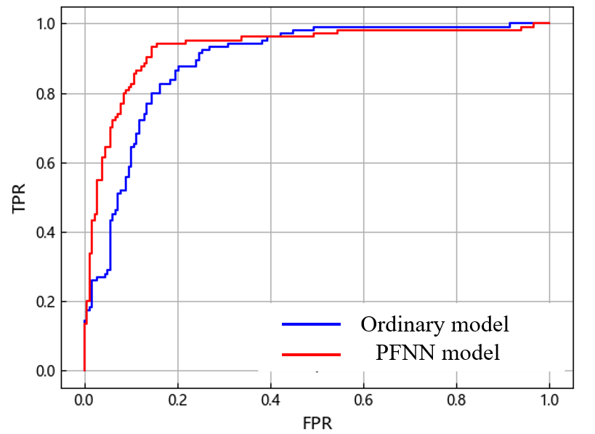
Promotion of accuracy
The appended embedding vector obviously promotes the AUC value
  No extra training data introduced during the whole algorithm
  Should be helpful for disruption prediction on large-scale tokamaks
 | Ordinary model | PFNN model
AUC | 0.895 | 0.927
TPR(FPR=15%) | 82.7% | 90.4%
Comparison of the accuracies between ordinary model and PFNN model
Comparison of the ROC curves between ordinary model and PFNN model
Notes:
Here we got some optimistic results. With the help of PFNN paradigm, we obtained the red ROC curve, which is much higher than the ordinary model. In this figure the x-axis means the False Positive Rate, and the y-axis means the True Positive Rate. From the red curve we can find that PFNN get higher TPRs with almost all the limited FPRs. All the promotion only comes from the change of training strategy and don’t consume any new data. So it should also be helpful when we develop a disruption predictor by limited training data on future large-scale tokamaks.

Slide 14
1、Introduction
2、PFNN development in HL-2A
3、Challenge of disruption in HL-3
4、PFNN development in HL-3
5、Summary
Notes:
Fortunately, we have a real platform to try our PFNN paradigm, HL-3 toakamk

Slide 15
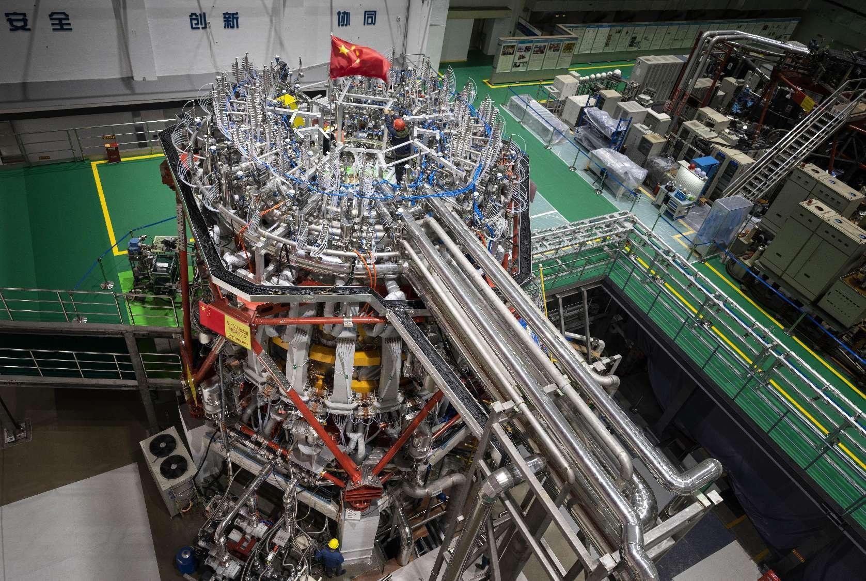
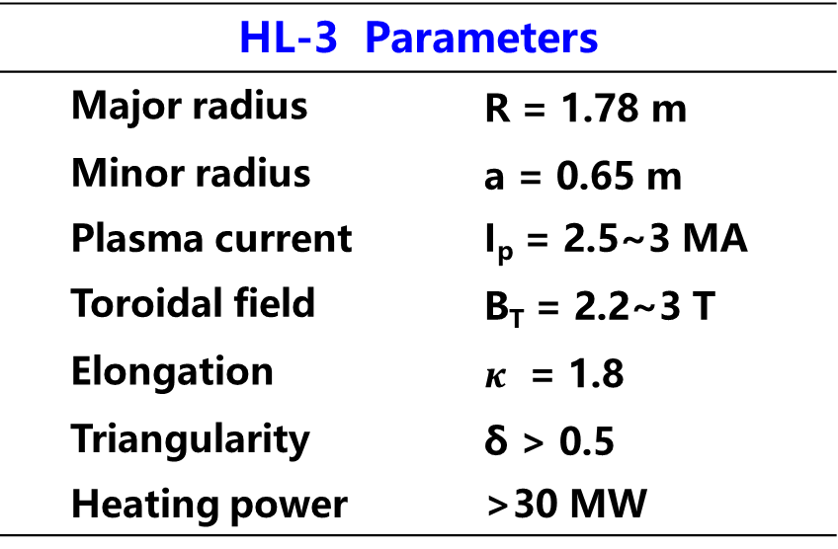
The HL-3 Tokamak
A new tokamak operated since 2020
  2022: 1MA plasma current operation, advanced divertor configurations
  2023: 1MA H-mode operation
HL-3 is already under the risk of disruption induced EM loads
  Shot 3293: a VDE with Ip~700kA brings an instantaneous acceleration of 50g on the vacuum vessel
  However, only ~1000 shots accumulated, and the disruption prediction algorithm is hard to develop
HL-3 Parameters
Major radius | R = 1.78 m
Minor radius | a = 0.65 m
Plasma current | I_{p} = 2.5~3 MA
Toroidal field | B_{T} = 2.2~3 T
Elongation | $κ$ = 1.8
Triangularity | δ > 0.5
Heating power | >30 MW
The overview of HL-3 tokamak
Notes:
HL-3 is a newly built tokamak which starts to operate since 2020. It has made some milestones in recent years, such as the 1MA plasma current operation in last year and the 1MA H mode operation several months ago. As a large scaled tokamak, HL-3 is already under the of disruption induced EM loads. We have observed an acceleration of 50 times of gravitational acceleration recently during a VDE with Ip ~ 700kA. This accident makes us very anxious, and we expects a disruption prediction algorithm right now. But up to now, only about 1000 valid shots are accumulated in HL-3. Such a small dataset makes it very hard to develop a disruption predictor.

Slide 16
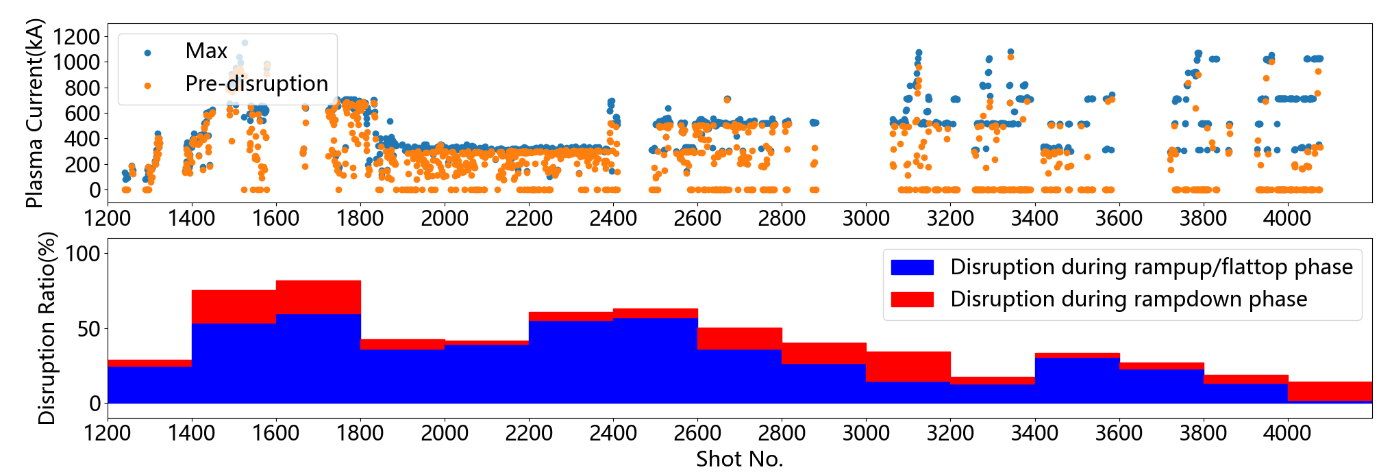
The disruption in HL-3
Disruption ratio decreases with the development of PCS
  Even higher than 50% at first. There is almost no flattop phase then.
  Only 10% at the end of the 2023 campaign.
Three temporal increases induced by adjustments of operation scenarios
  Shot 1400~1800：increasing plasma current
  Shot 2200~2600：increasing plasma elongation
  Shot 3400~3600：abnormal siliconization
Notes:
Here is a detailed view of HL-3’s disruptions. We have an incredibly high disruption ratio at first, due to the incomplete control algorithms. But it deceases to about 10% at the end of the last campaign. You can find three local peaks in the curve of disruption ratio. All of them are introduced by some adjustments on operation scenarios, like increasing plasma current, increasing plasma elongation and an abnormal siliconization.

Slide 17
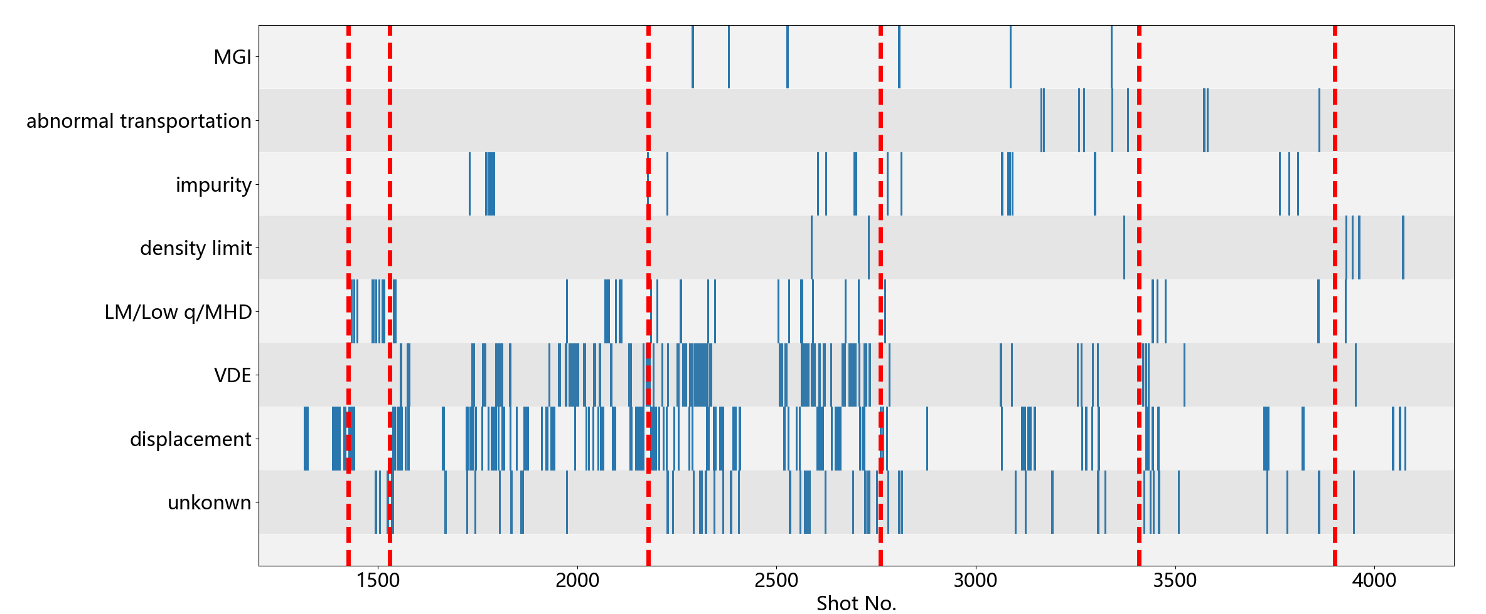
The disruption in HL-3
Disruption causes vary and are becoming more and more complex
  New disruption cause rises after a certain adjustment of operation strategy(red dotted line)
  For example, low q disruption after increasing Ip, VDE after increasing elongation, impurity disruption after advanced divertor configuration
Notes:
We also recorded the disruption reasons for each shot as completely as we can. And here we can notice some issues brought by the new device. For example, we find new disruption causes always rise after a certain adjustment of operation strategy. Which means we might train our algorithms on dataset that doesn’t contain any examples of a certain type of disruption, while this new type might occur very frequently after the strategy adjustment.

Slide 18
The disruption in HL-3
HL-3 is already under the risk of disruption induced EM loads
  Shot 3293: a VDE with Ip~700kA brings an instantaneous acceleration of 50g on the vacuum vessel
  Therefore, we use Shot 1241~3300 (861 valid shots) as the training set of disruption prediction, and try to avoid the risk after Shot 3300
  Other challenges: incomplete diagnostic data, frequently adjusted scenario, etc.
Train disruption predictor here
Handle the disruptions here
Notes:
Although the situation is very tough, we still needs to develop the algorithm, since HL-3 is already exposure to disruption risks. We selected the VDE accident we mentioned before as the split time. About 800 shots before it are used as the training set. And we tries to develop a reliable disruption predictor that can help us to handle the disruptions in the future. There are many challenges to do this on a new device, such as the incomplete diagnostic data, frequently adjusted scenarios.

Slide 19
1、Introduction
2、PFNN development in HL-2A
3、Challenge of disruption in HL-3
4、PFNN development in HL-3
5、Summary
Notes:
And here we adopted PFNN paradigm, it really helps a lot.

Slide 20
Design of predict-first tasks
Changes in predict-first tasks
  Ip & shape prediction (instead of Dh only), since HL-3 has a more flexible configuration
  Te prediction dropped due to incomplete diagnosis
  ne prediction is almost the same as in HL-2A
ne(t=T)
Ip&shape(t=T)
Injected density
(gas puffing, NBI, SMBI)
Magnetic field
(Coil currents)
ne
t=T+20ms
Ip&shape t=T+20ms
Momentum injection
(gas puffing, NBI, SMBI)
Transport loss
(MHD intensity, Dα, div)
PWI intensity
PWI intensity
Input and output of Ne prediction
Input and output of Ip&shape prediction
Notes:
Firstly, we trained similar parameter predictor work as previous. HL-3 has a more flexible configuration, so we predicted the detailed shape of plasma, including the plasma current, position, elongation and triangularity, instead of only horizontal displacement in HL-2A. We dropped the temperature branch due to incomplete diagnosis and reserved the ne branch almost same as in HL-2A

Slide 21
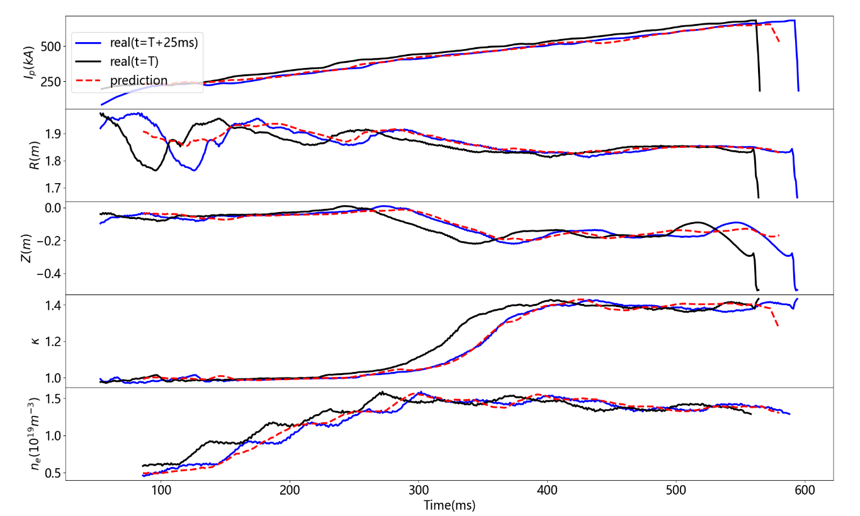
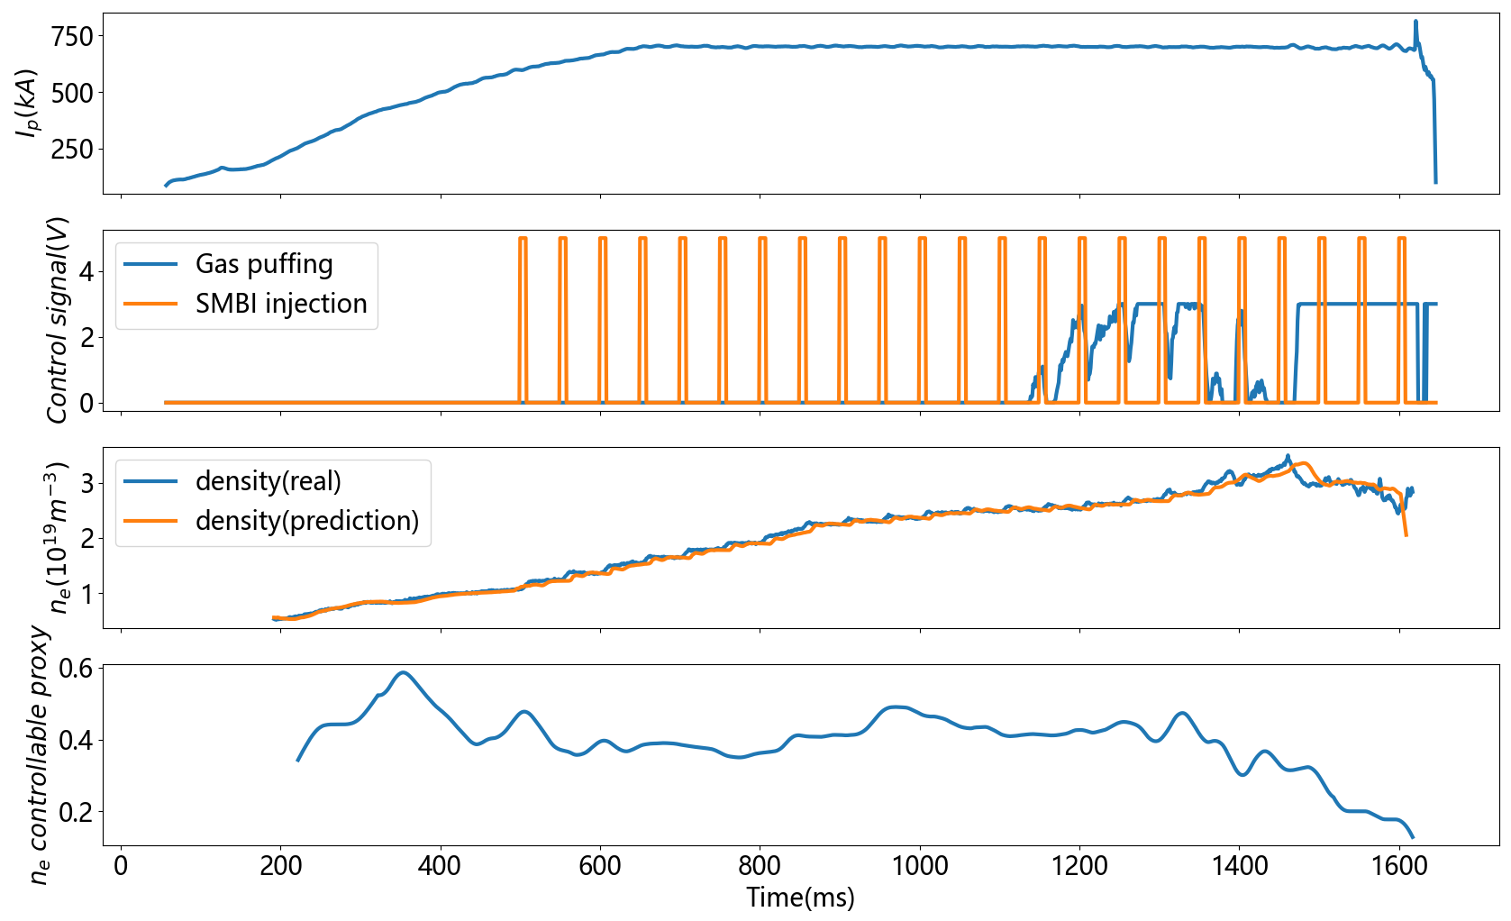
Implementation on HL-3
Ip, shape and ne prediction
  The detailed shape and position can also be predicted, elongation, triangularity, etc.
Useful feature: controllable proxy
  The consistency between predicted and real parameters
  Reflecting if the status of plasma is under control, which is quite important for operators
The ne controllable proxy decreases to almost 0 when ne is limited by an unexpected transportation loss(Shot 3573)
Result of Ip, shape and ne prediction during HL-3 Shot 3341
Notes:
The neural networks can realize similar predict-first performance in HL-3. In the left figure we can see the predicted curve, red dotted line, fits the experimental result well.
In addition, we find a useful function of the parameter prediction model. Let’s see the right figure. In the third subfigure, we compare the real density curve and predicted density curve. They fit well before 1500ms and then become divergent. If we calculate the consistency of the 2 curves, we will get the result in last curve, which is named as ‘ne controllable proxy’. If we compare the density injection actions in second subfigure and the density curve, we can notice that before 1500ms, the density increases as we expected according to the injection action. While after 1500ms, although we keep injecting by SMBI and gas puffing, the density doesn’t increase any more It even decreases obviously. This means that the density of plasma is out of our control due to some unexpected transportation mechanism. And parameter prediction model can accurately evaluate the proxy of controllable, which is quite helpful information for tokamak operators.

Slide 22
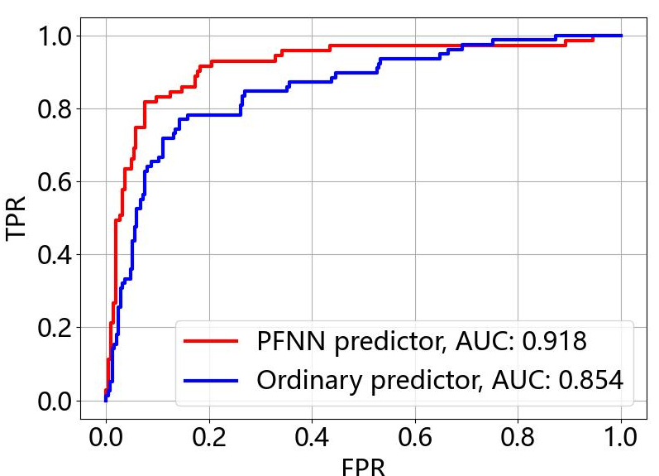
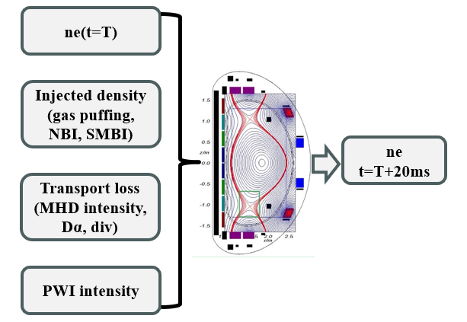
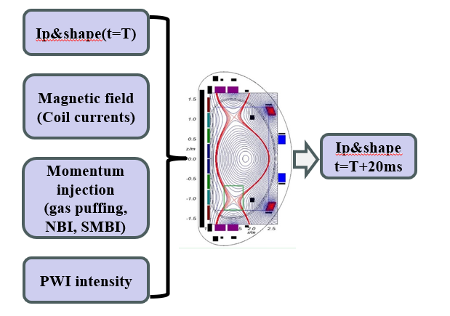
Help to develop a model on new tokamak
HL-3: limited training data
  861 training shots provided by the first several campaigns (Shot No. 1241~3299)
  309 shots reserved for testing (Shot No. 3300~4077)
PFNN plays a vital role when developing the model of HL-3
  The AUC value is promoted by 6.4%
Supplementary features
Ordianry model
Disruption precursors
Disruption predictor
disruptivity
ROC curve comparison between PFNN model and ordinary model in HL-3
The PFNN model structure of HL-3 disruption predictor
Notes:
In the 2nd stage, we appended the vector given by parameter prediction model into the disruption prediction algorithm and get a similar result as in HL-2A. If we use ordinary paradigm to train the model, we can only get an AUC of 0.854. But if we use PFNN, the AUC can be promoted to 0.918. This is the key breakthrough during the development of HL-3 disruption prediction and mitigation system.

Slide 23
1、Introduction
2、PFNN development in HL-2A
3、Challenge of disruption in HL-3
4、PFNN development in HL-3
5、Summary
Notes:
Ok, let me make a brief summary.

Slide 24
Summary
PFNN provides a method to embed physical information into the neural network
  Promotes the accuracy by 3.2% without extra training data (HL-2A)
  Helps to develop disruption predictor(AUC=0.918) in newly built tokamak (HL-3)
  Evaluate if the status of plasma is under control
  Should be helpful for the disruption prediction in future tokamaks like ITER
Future works
  Predict more parameters in HL-3, temperature, rotation, profiles, etc.
  More parameters predicted and more physical information introduced → higher accuracy
  Validate PFNN paradigm on other AI4Fusion tasks
Thanks for your listening!
Notes:
In this research, we proposed a new paradigm to train neural networks, PFNN. It can embed physical information into the neural network to leverage the data-hungry problem. In HL-2A, PFNN promotes the AUC by 3.2% without any extra training data. In HL-3, although we only have 861 shots to support the training of model, PFNN still helps us to develop an algorithm with an AUC of 0.918. This technique should be helpful for large-scale tokamaks, like ITER.
In the future, we would like to predict more parameters in HL-3, such as temperature, rotation, and some profiles. The more parameters we predict, the more physical information embedded. And we expect a higher accuracy in HL-3.

