Slide 1
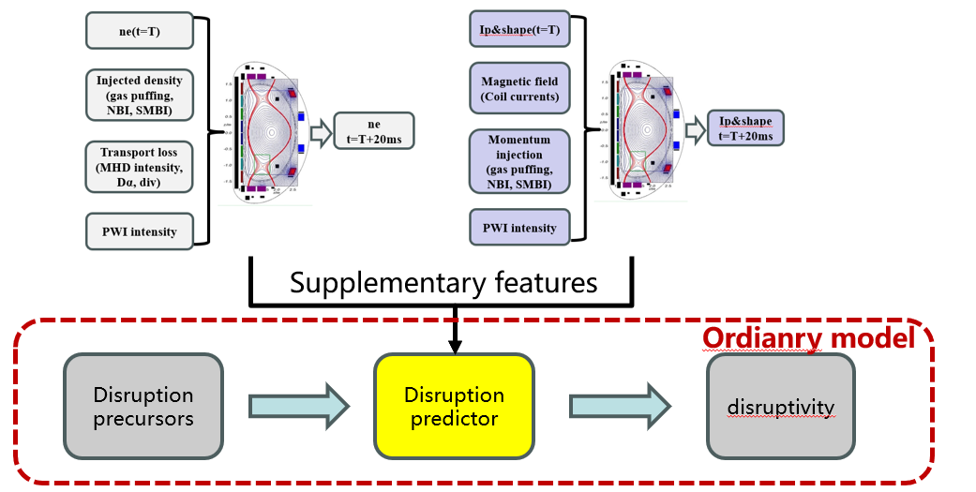
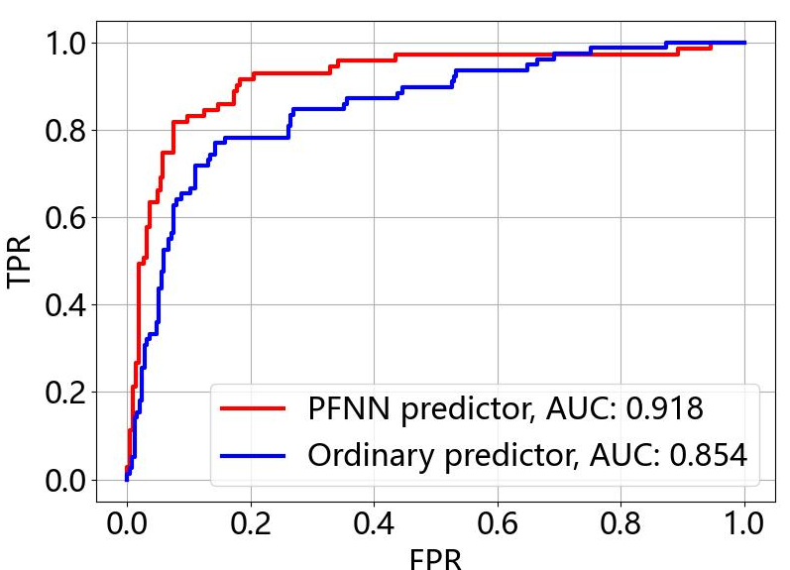
PFNN：Less data and better performance on disruption prediction via predict-first neural network - Zongyu Yang(SWIP)
Motivations
An important issue when developing disruption predictors in newly built devices – limited training data
How can we promote the performance of algorithm without extra training data?
Results
By utilizing PFNN paradigm, we developed a disruption predictor whose AUC is 0.918 in newly built tokamak, HL-3, with only 891 training shots from the first 2 campaigns.
PFNN’s 1st step: embedding physical information by pretraining with predict-first tasks
PFNN’s 2nd step: gets better performance when finetuned to do disruption prediction with limited training data
The PFNN model structure of HL-3 disruption predictor
ROC curve comparison between PFNN model and ordinary model in HL-3
IAEA Workshop on AI for Accelerating Fusion and Plasma Science, 2023 11/28 – 12/1

