Slide 1

IAEA Workshop on AI for Accelerating Fusion and Plasma Science
Machine learning optimization for laser driven implosions towards high gain fusion
Xiao-Hu Yang, Ze Li, Guo-Bo. Zhang, Yan-Yun Ma
National University of Defense Technology
Fu-Yuan Wu, Jie Zhang
Shanghai Jiao Tong University
2023-11-29

Slide 2
Contents
Background
Target designing by random walk method
Laser profile designing by hybrid optimization
Summary
Notes:
This is the contents of we presentation. It contains four parts.
The part one is background,
The part two is Target designing by random walk method,
The part three is Laser profile designing by hybrid optimization,
The part four is summary.

Slide 3
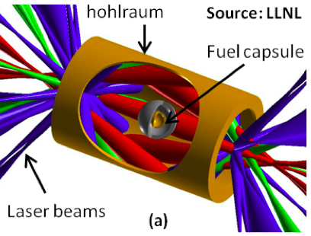
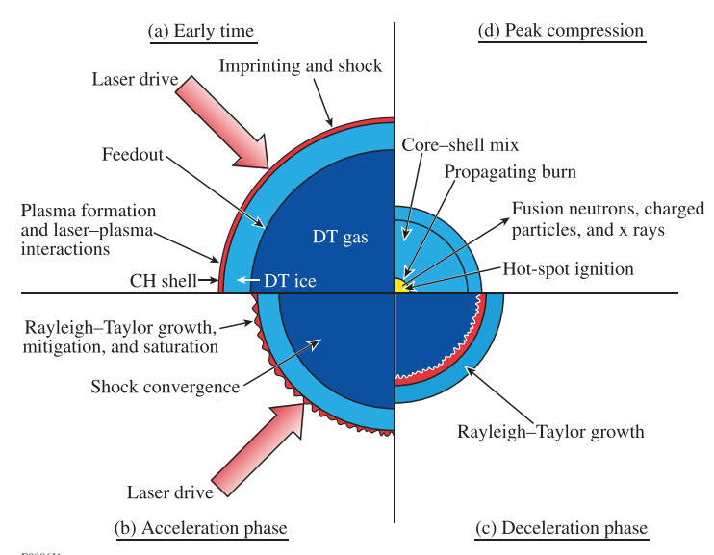
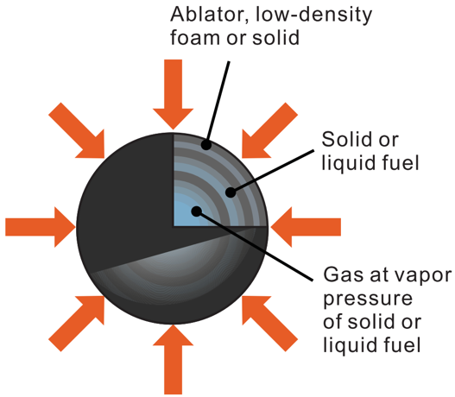
1. Background
Indirect driven fusion
Ignition condition：Lawson criterion
$n($ density $)×τ($time $)×T($temperature$)≃3.3×{10}^{15}(s⋅keV)/cm^{3}$
Laser-driven fusion condition:
P(pressure) ~ ρ(density)×T(temperature) > 10¹² Atm
direct driven fusion
Ablation and compression
Acceleration
Deceleration
Stagnation
R S Craxton et al. Phys. Plasmas 22, 110501 (2015)
Notes:
Laser-driven inertial confinement fusion (ICF) is a promising approachto achieve controlled nuclear fusion. Recently, significant progress has been achieved, that is, the NIF realized the first net energy gain and 3.15 MJ of fusion energy. The main challenge for achieving ignition is to compress the fuel to high enough density and temperature。

Slide 4
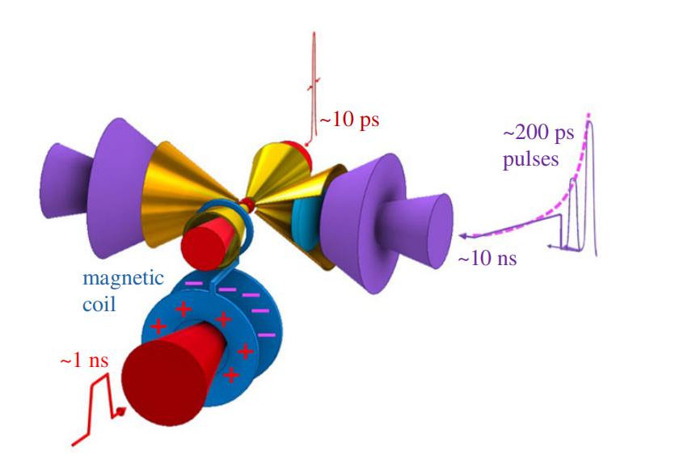
1. Background
Double-cone ignition scheme (DCI):
Isentropic compression
improve the hydrodynamic instability
Acceleration
increase the target kinetic energy
Collision of the targets
  Double the target density, kinetic energy
  transfers to internal energy
For the cone with an opening angle of 100°, it corresponds to a solid angle of Ω=2.2
DCI only requires 2×Ω/4π of the laser energy for a traditional spherical target to achieve a similar implosion
Ignition under the presence of external magnetic fields
ignition by the fast electron beam
Zhang J, Wang W M, Yang X H, et al. Philosophical Transactions of the Royal Society A, 2020, 378(2184): 20200015
Notes:
We propose a double-cone ignition scheme, namely DCI, to significantly reduce the energy requirement for both the compression and heating laser pulses as well as to enhance the robustness of the compression and heating processes.
In the DCI scheme, two head-on gold cones are used to confine target shells.
For the cone with an opening angle of 100° , it corresponds to a solid angle of Ω=2.2. That is, DCI only requires 2×Ω/4π of the laser energy for a traditional spherical target to achieve a similar implosion。

Slide 5
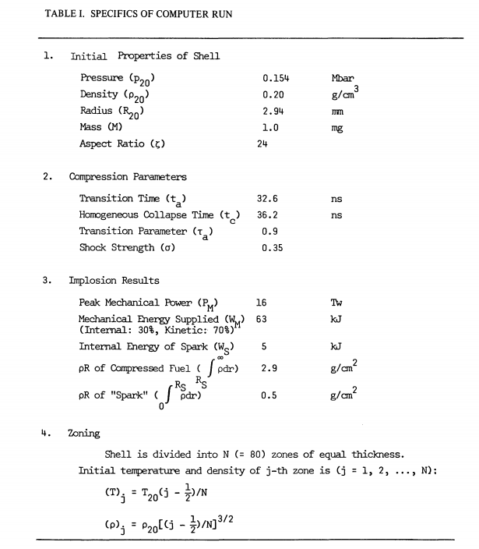
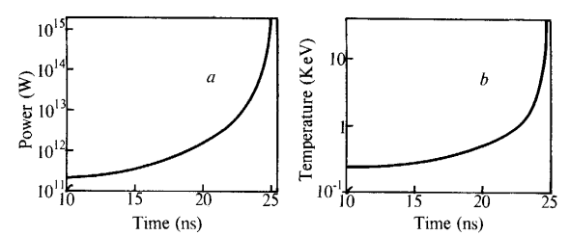
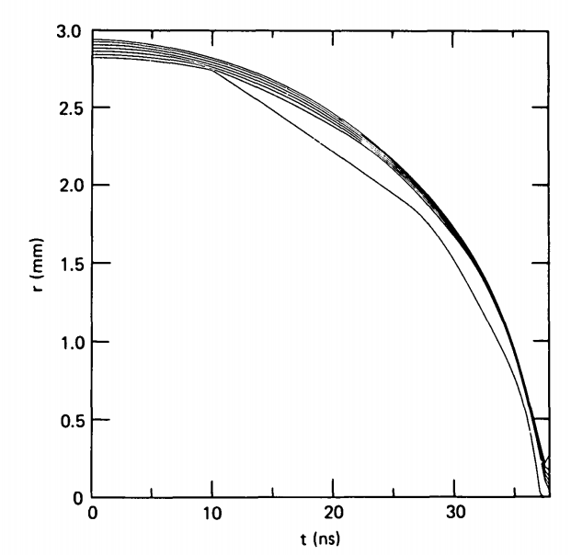
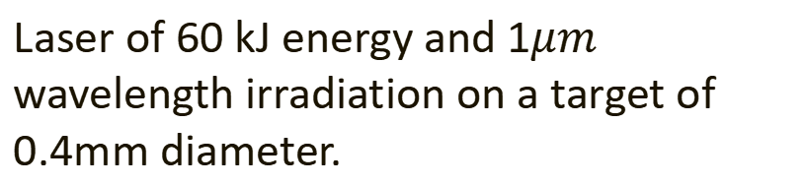
1. Background
Quasi-isentropic compression is the most effective way to achieve high-density compression and reduce the energy requirements.
（1）Nuckolls’s isentropic compression：
（2）Kidder’s homogeneous isentropic compression
Laser power：
is the shock generated by P₀ reaches the center of the target.
Laser of 60 kJ energy and 1$μm$ wavelength irradiation on a target of 0.4mm diameter.
R E Kidder, Nuclear Fusion 14, 53(1974); 14, 797(1974); 19, 223 (1979)
J Nuckolls, et al, Nature 239, 139 (1972)
Notes:
Quasi-isentropic compression is the most effective way to achieve high-density compression and reduce the energy requirements.
When implosion begins, laser power is set so that the initial shock speed in the imploding matter is comparable to sound speed and subsequently so that the compression is near-isentropic; the hydro-dynamic characteristics intersect only near the centre of the sphere.

Slide 6
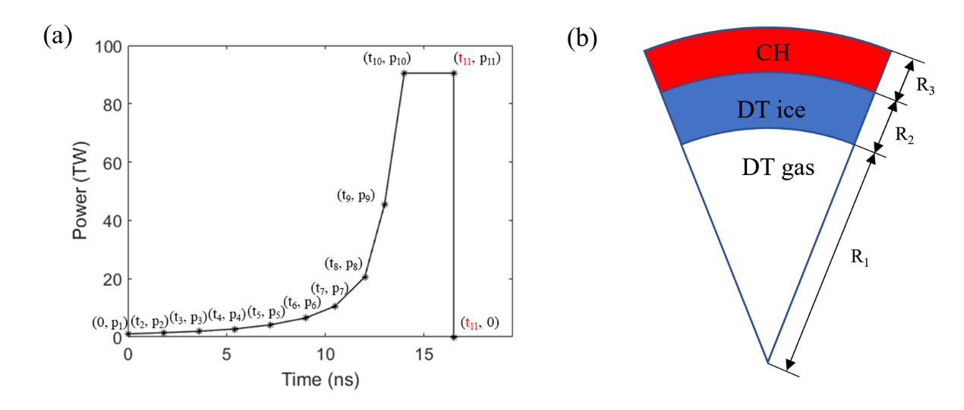
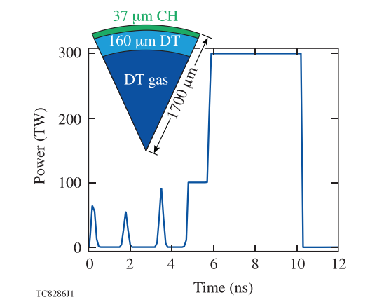
1. Background
To realize an efficient implosion for the ICF, one has to match the laser pulse shape and the target structure as much as possible.
It is not easy to optimize the laser pulse and the target structure under a given laser energy, since many parameters (>20) should be optimized simultaneously.
More parameters are needed after considering adiabat shaping！
E M Campbell et al. Phil. Trans. R. Soc. A 379: 20200011 (2021)
Notes:
To realize an efficient implosion for the ICF, one has to match the laser pulse shape and the target structure as much as possible.
However, it is not easy to optimize the laser pulse and the target structure under a given laser energy, since many parameters should be optimized simultaneously (sɪm(ə)lˈteɪniəsli). And there will be more parameters after considering entropy shaping!

Slide 7
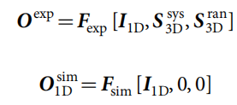


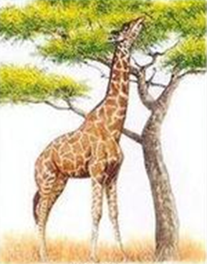

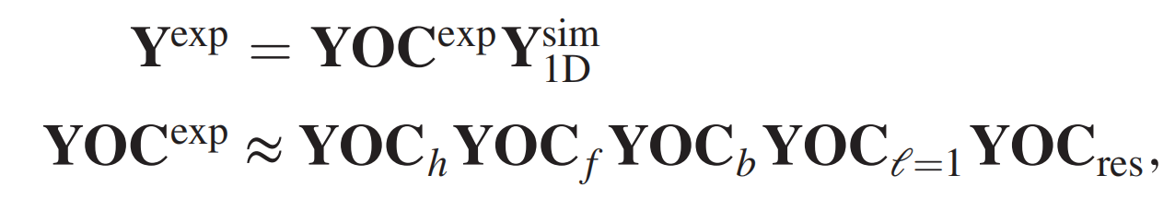
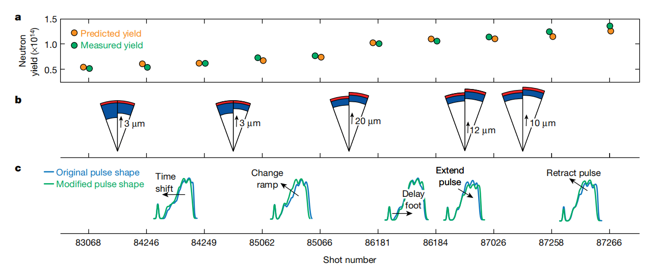
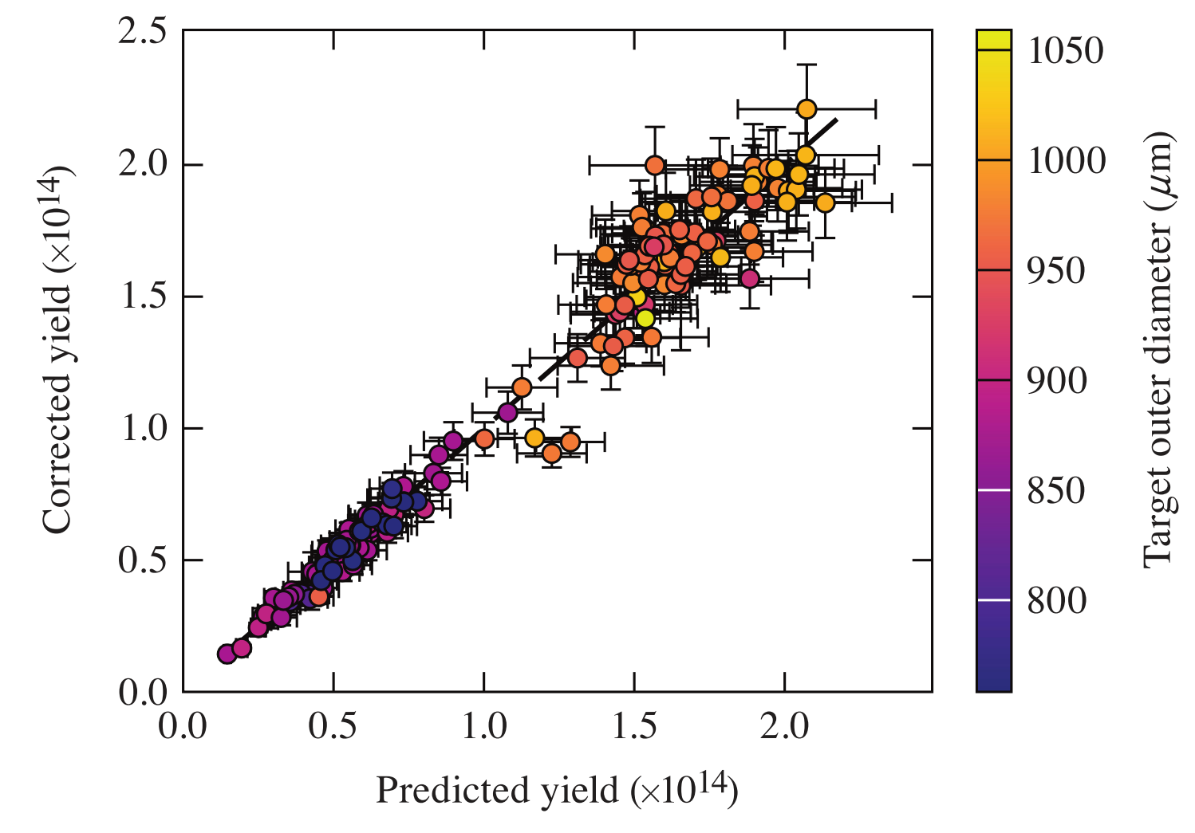
1. Background
Methods for laser-driven fusion target designing:
The neutron production increased by 3 times after optimization.
Refine the factors influencing neutron yield.
Genetic algorithm optimization of laser pulse profile.
F Y Wu, X H Yang, et al., High Power Laser Science and Engineering 10, e12 (2022)
V Gopalaswamy, et al., Nature,565, 581(2019)
A Lees, et al, PRL 127, 105001 (2021)
Notes:
2019 year, researchers applied a statistically driven implosion design to optimize the target and laser pulse shape, increasing the neutron production by three times on OMEGA experiments.
An efficient method to perform laser pulse optimization via hydrodynamic simulations guided by the genetic algorithm and random forest algorithm is proposed.

Slide 8
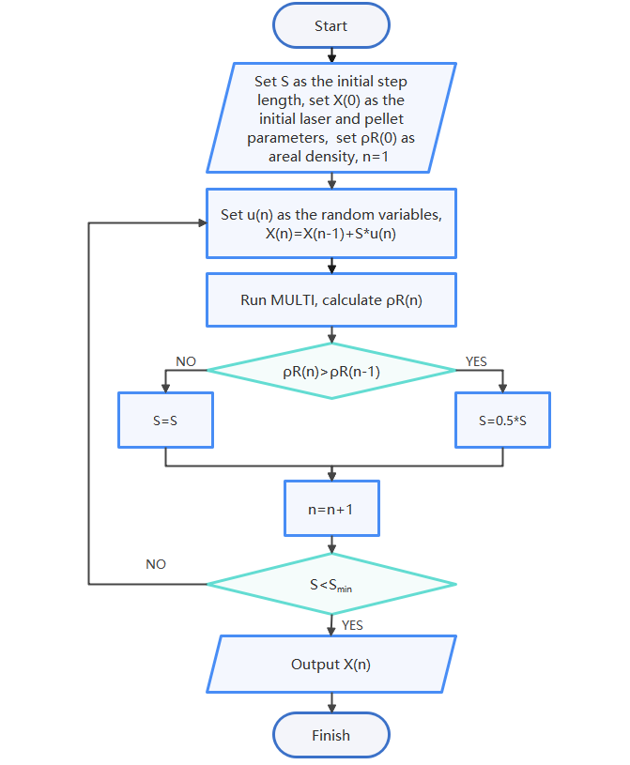
2. Target designing by random walk method
The drive laser pulse and the target structure are designed using a random optimization method for a direct-drive ICF implosion.
Random walk method:
Random numbers: (u₁, u₂,……, u₂₃)
Three steps: (S_{t}, S_{p}, S_{r})
t₁＝t₁+u₁*S_{t}, ……,
p₁=p₁+u₁₀*S_{p}, ……,
R₁＝R₁+u₂₀*S_{R}, …….
MULTI-IFE
Matlab
Correlation analysis
Z Li, X H Yang*, et al., Phys. Plasmas 29, 092705 (2022)
Notes:
We also proposed a random walk method to optimize the target and laser pulse shape.
The maximum areal density of the target is one of the most important parameters for ICF. It directly related to the DT fuel burning efficiency.
So we consider rhoR as a function of the 23 arguments of the laser pulse shape and target structure, and use the random walk algorithm for optimization.
We optimize the laser profile and target structure by combining the radiation hydrodynamic code MULTI-IFE and the random-walk method.
This method can quickly optimize the laser pulse and target structure parameters for an efficient Quasi-isentropic compression of the plasmas.

Slide 9
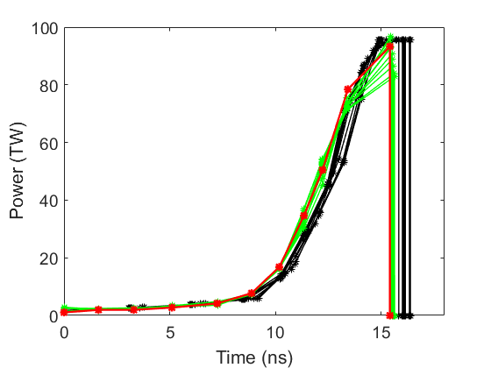
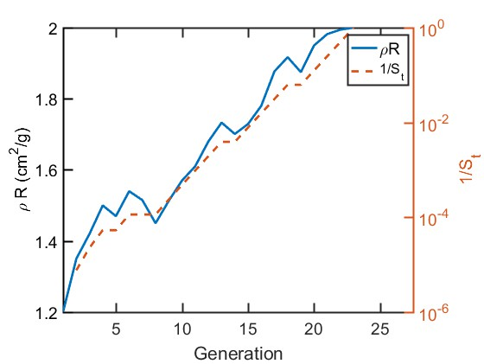
2. Target designing by random walk method
Optimization process:
After 23 generations of optimization, the step size reaches the minimum value and the laser reaches the optimum profile (red line in the figure).
The duration of a flat-top laser profile with constant laser power becomes shorter during the optimization progresses, and approaches to isentropic compression like profile. The maximum area density reaches 2.0 g/cm².
Notes:
One can see that the duration of a flat-top laser profile with constant laser power becomes shorter during the optimization progresses.
Finally, the flat-top laser profile of the laser pulse shape completely disappears and is replaced by a gentler ramp profile, indicating that the laser power slowly rises in the acceleration stage which would be better than the traditional flat-top laser pulse shape.
The ideal isentropic compression laser profile usually has a high peak power, which limits the application of such pulse in ICF implosion. The laser profile here is much closer to the ideal isentropic compression laser profile than the flat top laser profile.

Slide 10
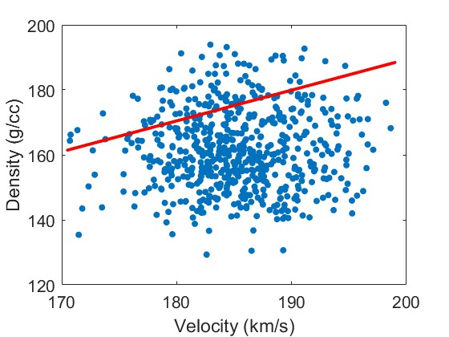
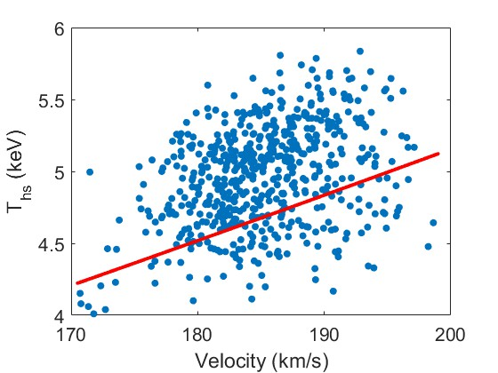
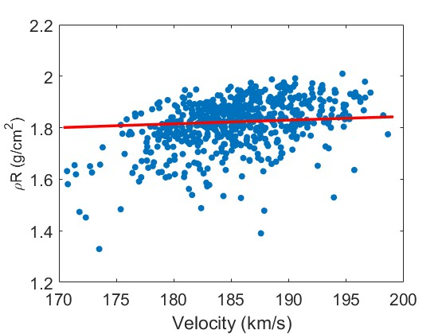
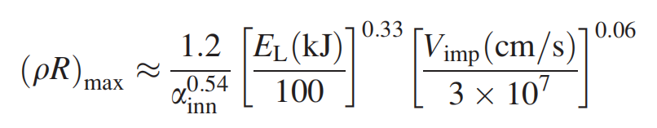
2. Target designing by random walk method
Comparing with the hydro-equivalent implosion theory：
More than 66.5% results in the selected 500 sets of data reach 90% of the hydrodynamic scaling.
R Nora, R Betti, et al., Phys. Plasmas 21, 056316 (2014)
Notes:
The relationship between the peak density, peak areal density, hot spot temperature, and implosion velocity optimization process are shown in the three Figures.
Each point is the calculation result of a new set of target structure and laser pulse shape.
The red lines are from the hydro- equivalent heory.
Since these simulations are performed with the same laser energy, most of the results are not optimal, and there is a certain deviation from the theoretical values given by the theory of hydro-equivalent ignition for inertial fusion.

Slide 11
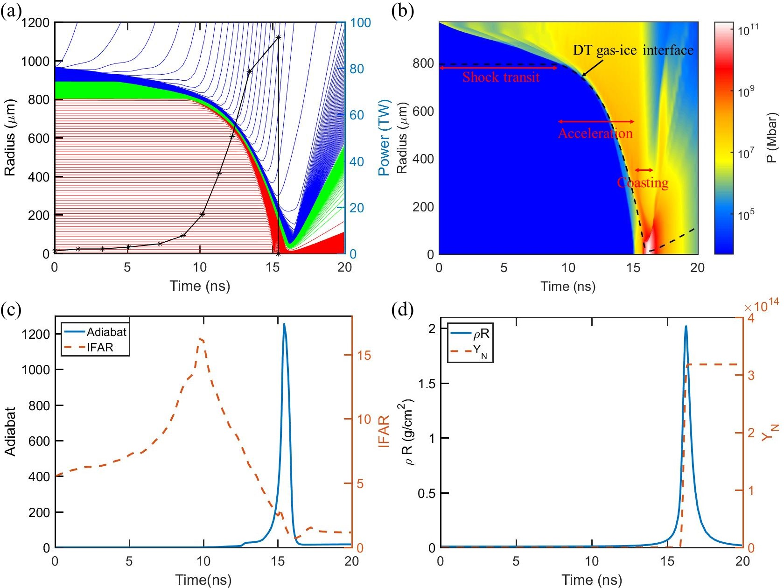

2. Target designing by random walk method
Laser:
Energy: 358.4kJ
Peak power: 93 TW
Duration:15.4 ns
Target:
800μm DT gas
90μm DT ice
80μm CH
Area density:
2.0 g/cm²
Neutron yield:
3.18×10¹⁴
14% higher than the result given by hydrodynamic scaling.
R Nora, R Betti, et al., Phys. Plasmas 21, 056316 (2014)
Notes:
The adiabat of the inner surface of the DT ice has a weak increase in the early stage of implosion process and only increases after the shock wave enters the DT gas.
It can be seen from Figure (b) that the shocks transit the target shell and enter the DT gas in turn.
The IFAR increases from the initial 5 to the maximum value of 17 during the ramp compression duration, then it decreases rapidly during the acceleration process.

Slide 12
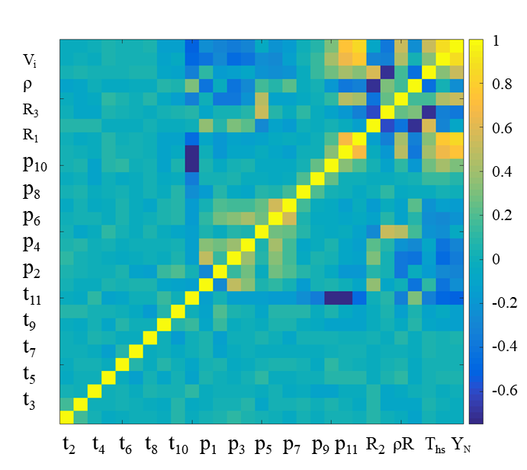
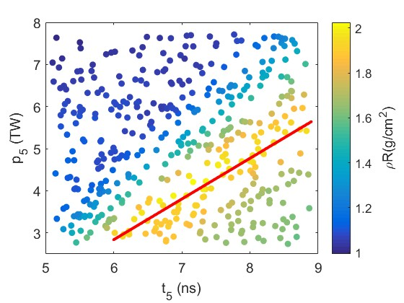
2. Target designing by random walk method
The correlation between the input and output parameters:
Correlation matrix:
The areal density has a strong correlation with p5, (t5, p5) is around the end of the foot duration and the starting point of the ramp duration.
p₅=0.97t₅-2.97
Notes:
In order to investigate the correlation between various parameters and the results in detail, we select the top 500 sets of data with high areal density during the optimization process to construct a correlation matrix.
A correlation matrix can be constructed to analyze the correlation between the parameters. The areal density has a strong correlation with p5, (t5, p5) is around the end of the foot duration and the starting point of the ramp duration.
It is found that a areal density of 1.9 can be obtained as t5 and p5 have a linear relationship.

Slide 13
3. Laser profile designing by hybrid optimization
The defect of the random walk method:
The random walk method is inefficient at the later stages of the optimization.
As the results close to the maximum value, the time step gets small, so that it is not easy to get the optimum value quickly.
Y
X
Y
It may leads to that the results deviates the optimum value.
X
Notes:
We also found that it becomes harder to optimize the parameters as the step size decreases during the optimization process.
As the results close to the maximum value, the time step gets small, so that it is not easy to get the optimum value quickly.
If the step size is directly increased, it may leads to that the results deviates the optimum value.

Slide 14
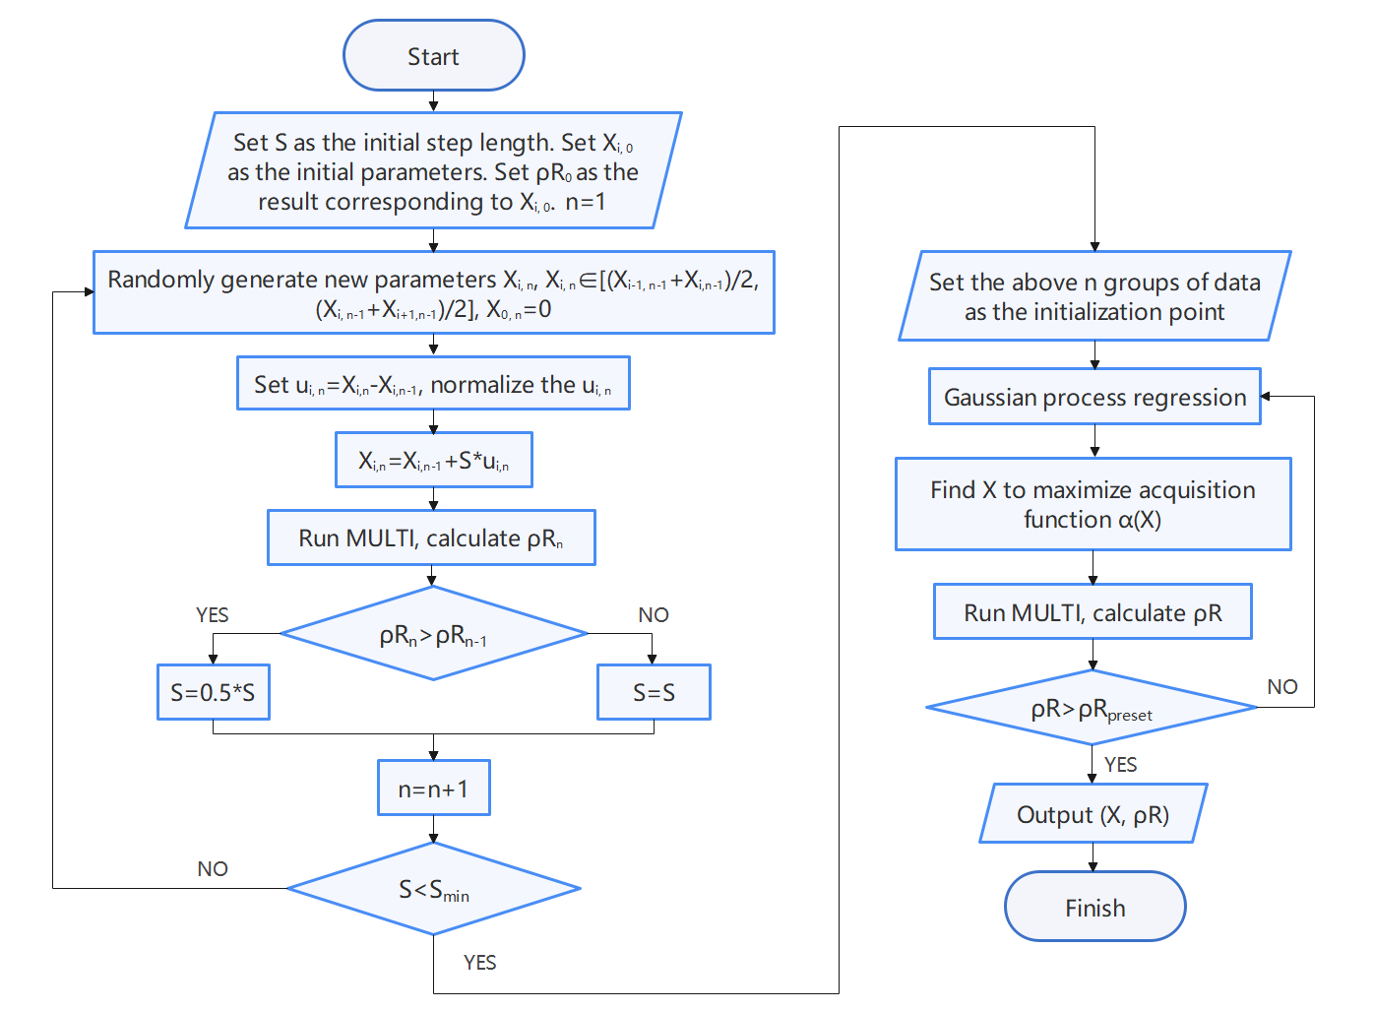
3. Laser profile designing by hybrid optimization
Random walk optimization
Sample of the initial parameters
Bayesian algorithm
The data set of initial parameters obtained from the random walk method is constructed as the optimization parameters for the Bayesian method.
It not only solves the problem of low optimization efficiency in the later stage of the random walk algorithm, but also solves the problem that the sampling range is difficult to fully cover in the early stage for the Bayesian algorithm.
Z Li, X H Yang*, et al., Plasma. Phys. Contr. Fusion
Notes:
Taking the optimization parameters obtained in the random walk optimization as sample of the initial parameters, the Bayesian method can be used to quickly find the optimal parameters.
Moreover, Bayesian optimization overcomes the limitation of the random walk optimization method, that is, it becomes harder to optimize the parameters as the step size decreases during the optimization process.
The hybrid optimization method combines both advantages of the algorithms and is more suitable for optimizing the laser profile and target structure for ICF.

Slide 15
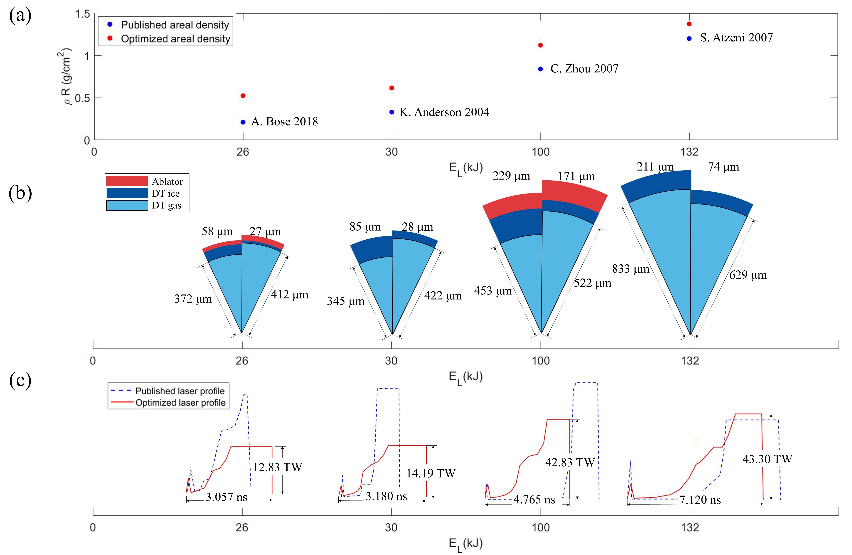
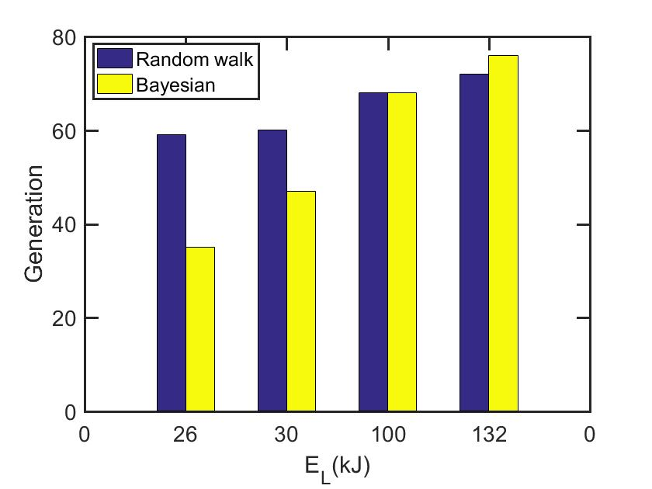
3. Laser profile designing by hybrid optimization
The iteration generations for the random walk optimization and the Bayesian optimization
Target designing by combination of random walk and Bayesian algorithm
Notes:
For fusion schemes with lower laser energy, the computational cost of the random walk method is significantly higher than that of Bayesian optimization during the hybrid optimization process.
The reason for this is that the random walk method need a step size halving process. It takes several generations of calculation for the step size to become small enough, and only then can the optimization process end.

Slide 16
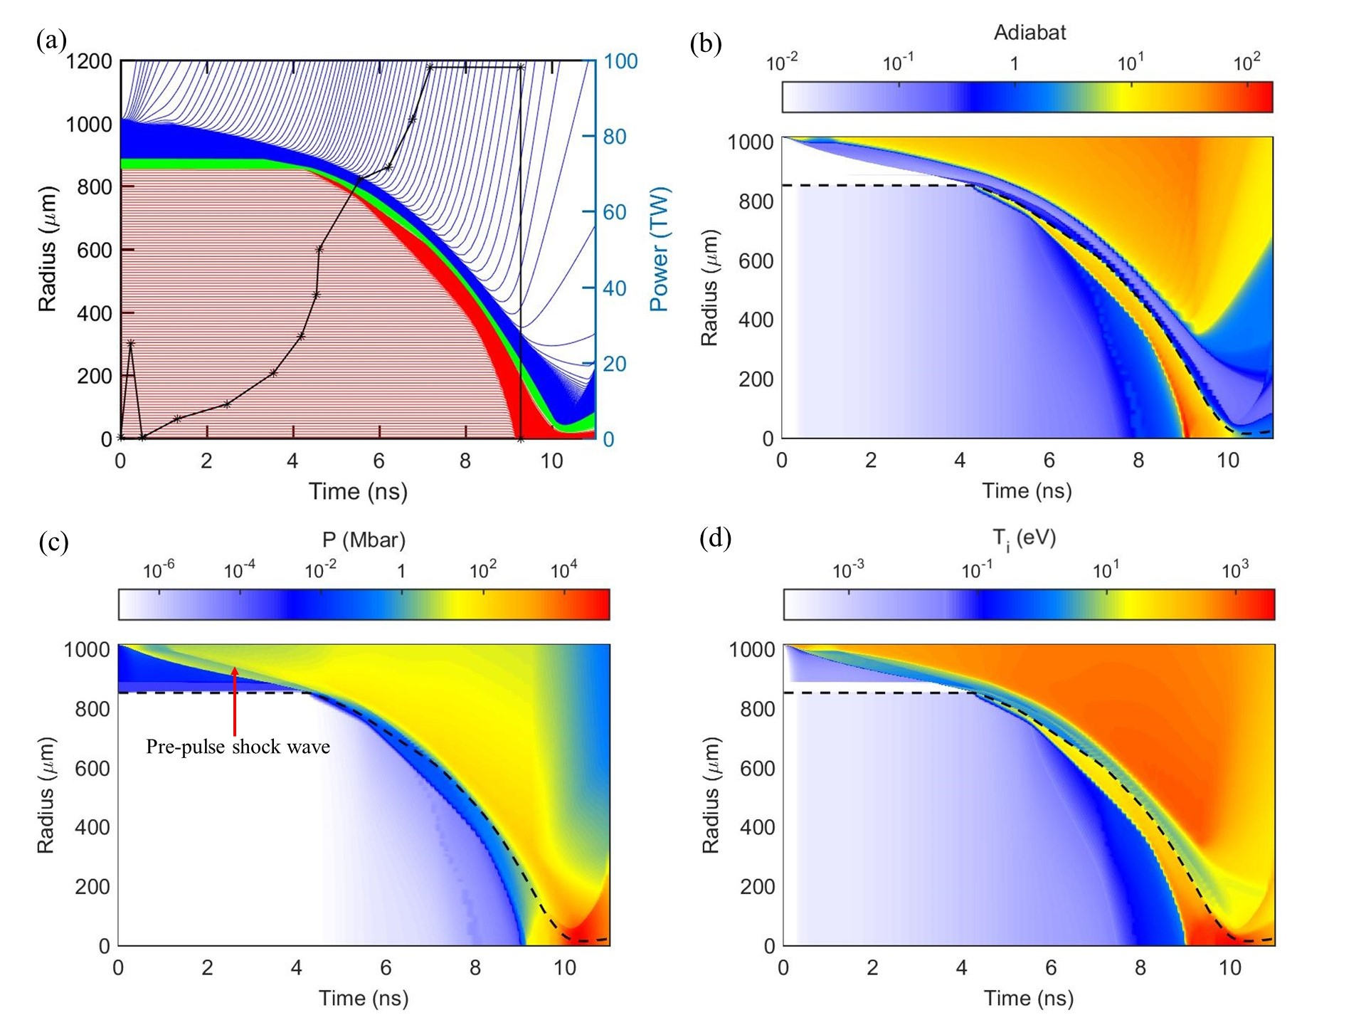
3. Laser profile designing by hybrid optimization
Target：900 μm DT gas
23 μm DT ice
113 μm CH
Laser energy in the double cone：2×80 kJ
Laser energy for the whole spherical target：448 kJ
Peak power：98.26 TW
Laser duration：9.512 ns
Implosion velocity：236 km/s
Hot spot temperature：3.62 keV
Notes:
Figure B shows that the pre-pulse increases the adiabat of the DT ice layer. The internal DT gas is low-adiabat during the pre-pulse, while the adiabat of the ablation layer increases and therefore the ablation rate increases, leading to a reduce of the RTI growth rate.
At 5.5 ns, the adiabat of DT gas near the cold fuel increases to some extent in response to the shock wave, but the DT gas further inside is still in a low-adiabat state.
Figure C shows that the target undergoes a shock wave in the outer layer during the initial compression stage because of the pre-pulse.

Slide 17
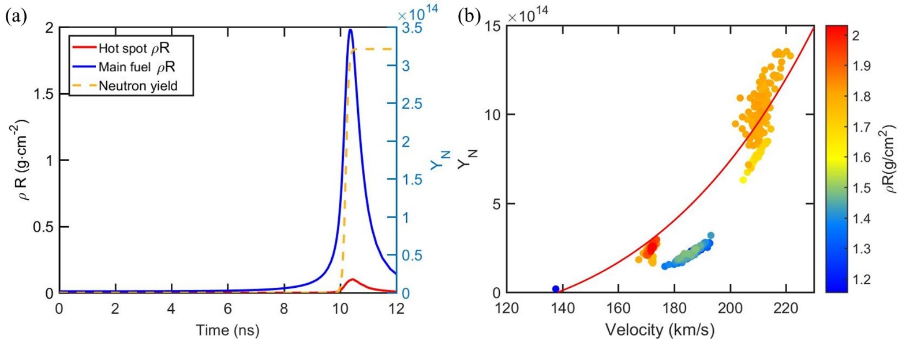
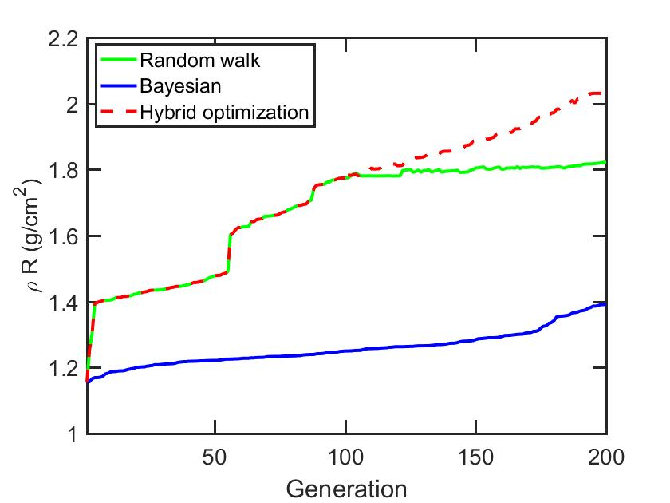
3. Hybrid optimization of laser profiles
Total area density：2.03 g/cm² neutron yield：8.67×10¹⁴
The area density reaches 1.4 g/cm² after 200 generation optimization by Bayesian method to design the laser profile and target.
The optimization efficiency of random walk method decreases as the number of calculations increases.
When the Bayesian optimization is performed based on the data calculated by the random walk method, the areal density reaches a maximum value after only 96 iterations.
Theoretical area density: 1.29 g/cm²
R Betti and C D Zhou, Phys. Plasmas 12, 110702 (2005)
Notes:
Based on 200 sets of laser profile and target structure parameters that are randomly generated, Bayesian method can increase the areal density as the number of iterations increases, but only reaches 1.4 g/cm2. (grams Per square centimeter
For the random walk optimization method, as the number of calculations increases, the increase in areal density decreases, and the optimization efficiency gradually decreases.
When the Bayesian optimization is performed based on the data calculated by the 200 random walk optimization method. After only 96 iterations, the areal density reached a maximum value.
Therefore, the advantages of hybrid optimization are obvious.

Slide 18
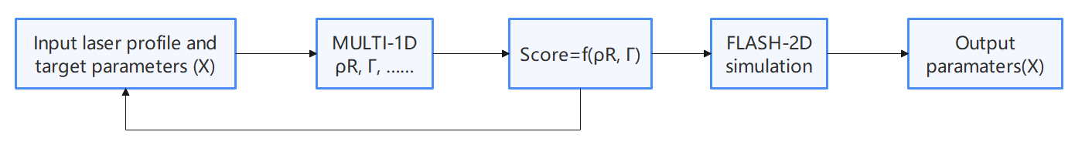
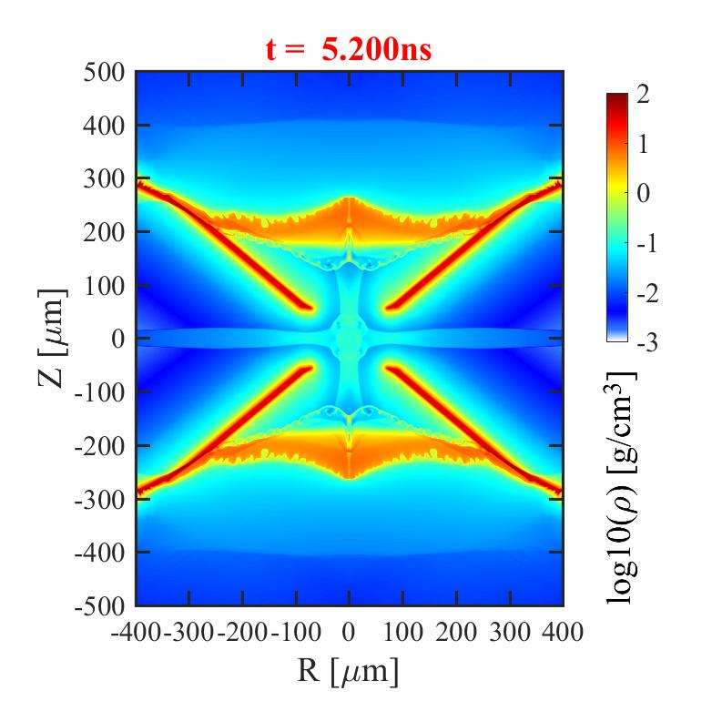

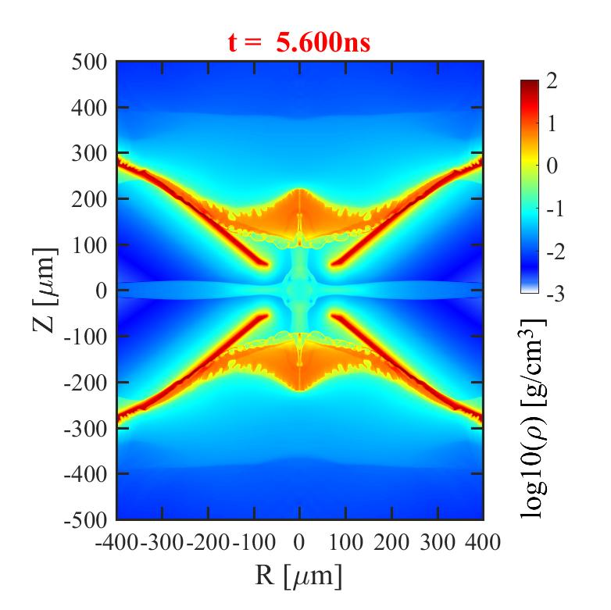
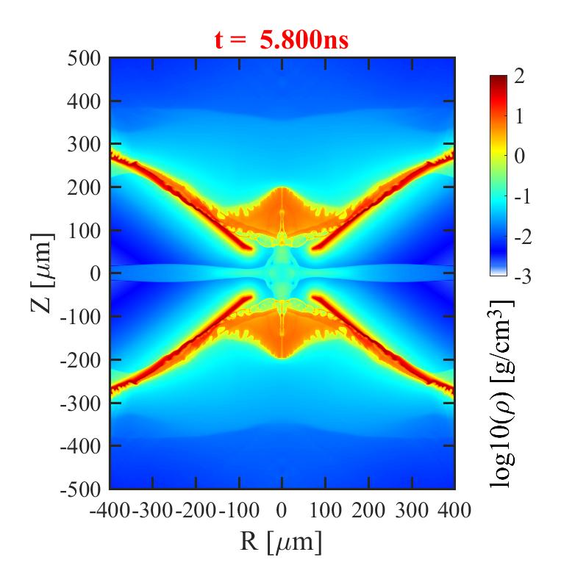
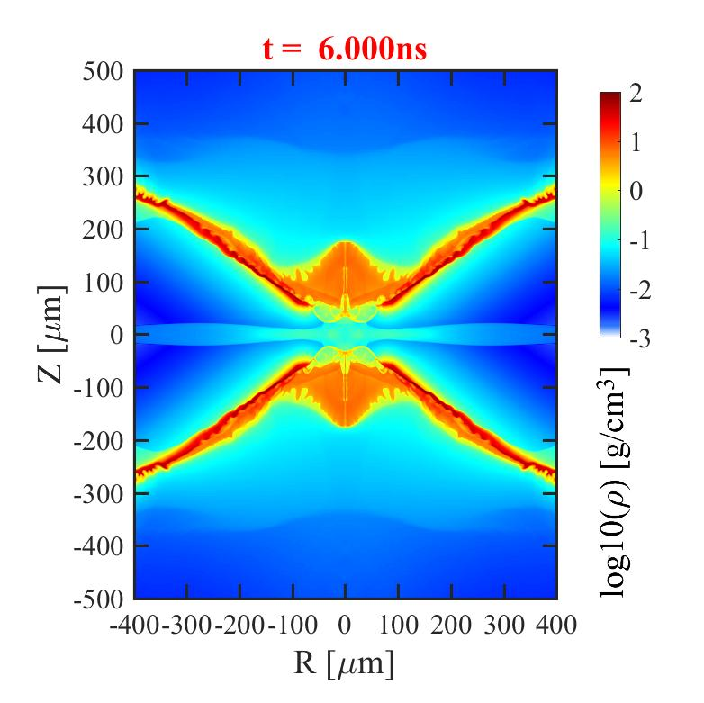
3. Hybrid optimization of laser profiles
Using the hybrid optimization method, optimizing the areal density while also optimizing parameters related to Rayleigh-Taylor instability, such as acceleration and ablation rate.
Input the optimized parameters into the radiation hydrodynamics code FLASH-2D to verify the stability of the implosion compression process.
Notes:
By using a hybrid optimization method, we simultaneously optimize parameters related to areal density and Rayleigh-Taylor instability, such as acceleration and ablation rate, combining the MULTI-1D and FLASH-2D codes.
This has resulted in laser pulse shape and target structures that achieve both high areal density and high stability.

Slide 19
4. Summary
We designed an optimization method of laser profile and target structure for the laser directly driven inertial fusion based on the random walk method, which can quickly obtain the optimal laser profile and target structure under a given laser energy.
In order to further improve the designing efficiency of laser and target, we propose the method that combines random walk and Bayesian algorithm, which can give the ideal laser profile and target structure more efficiently and quickly.
Notes:
a summary of our report.

Slide 20
Thanks for your attentions!
Email :xiaohu.yang@aliyun.com and lize16@nudt.edu.cn

