Slide 1
Overcoming challenges: leveraging machine learnings for efficient modeling of divertor plasmas
Ben Zhu^{1*}, Menglong Zhao¹, Harsh Bhatia¹, Xue-qiao Xu¹, David Eldon², Peer-Timo Bremer¹, William Meyer¹, Thomas Rognlien¹, Hyungho Lee³, and Junghoo Hwang⁴
¹Lawrence Livermore National Laboratory
²General Atomics
³Korean Institute of Fusion Energy
⁴Korea Advanced Institute of Science and Technology
*zhu12@llnl.gov
IAEA Workshop on Artificial Intelligence for Accelerating Fusion and Plasma Science
Vienna, Austria
November 28, 2023

Slide 2
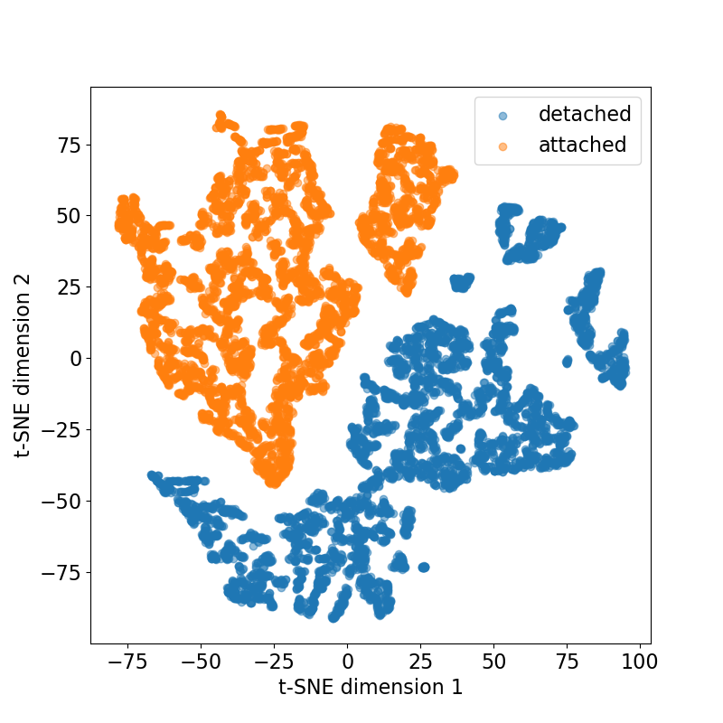
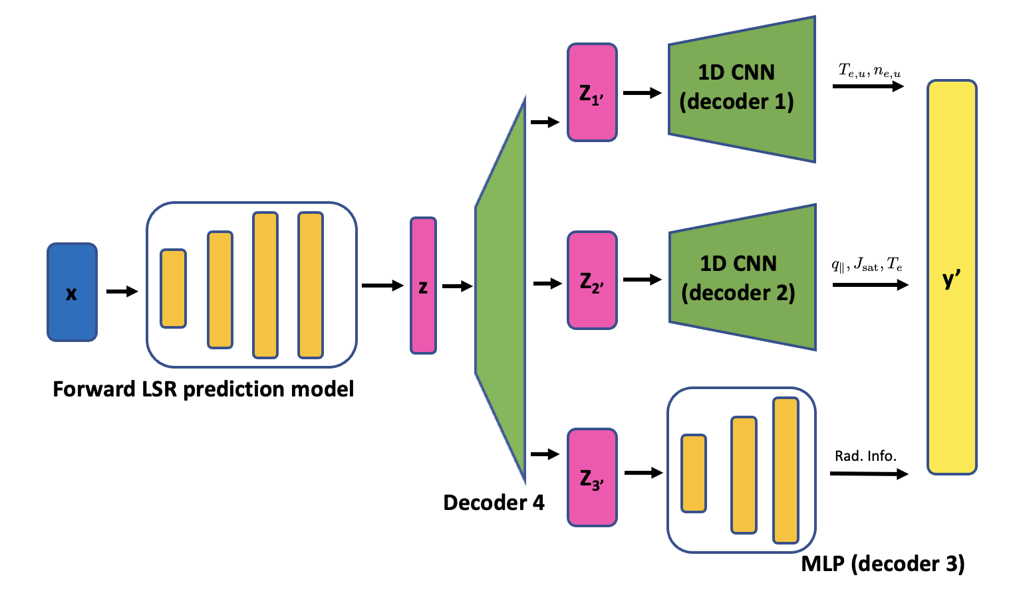
Outline
Motivation
  Why efficient divertor models benefit magnetic confinement fusion (MCF)?
Proof-of-principle study
  Does divertor plasma have low-dimensional latent space representation that can facilitate ML model development?
ML model for detachment control
  How about solving the real-world problems? i.e., to provide a proper model for advancing model-based detachment controller.
Summary and future work

Slide 3
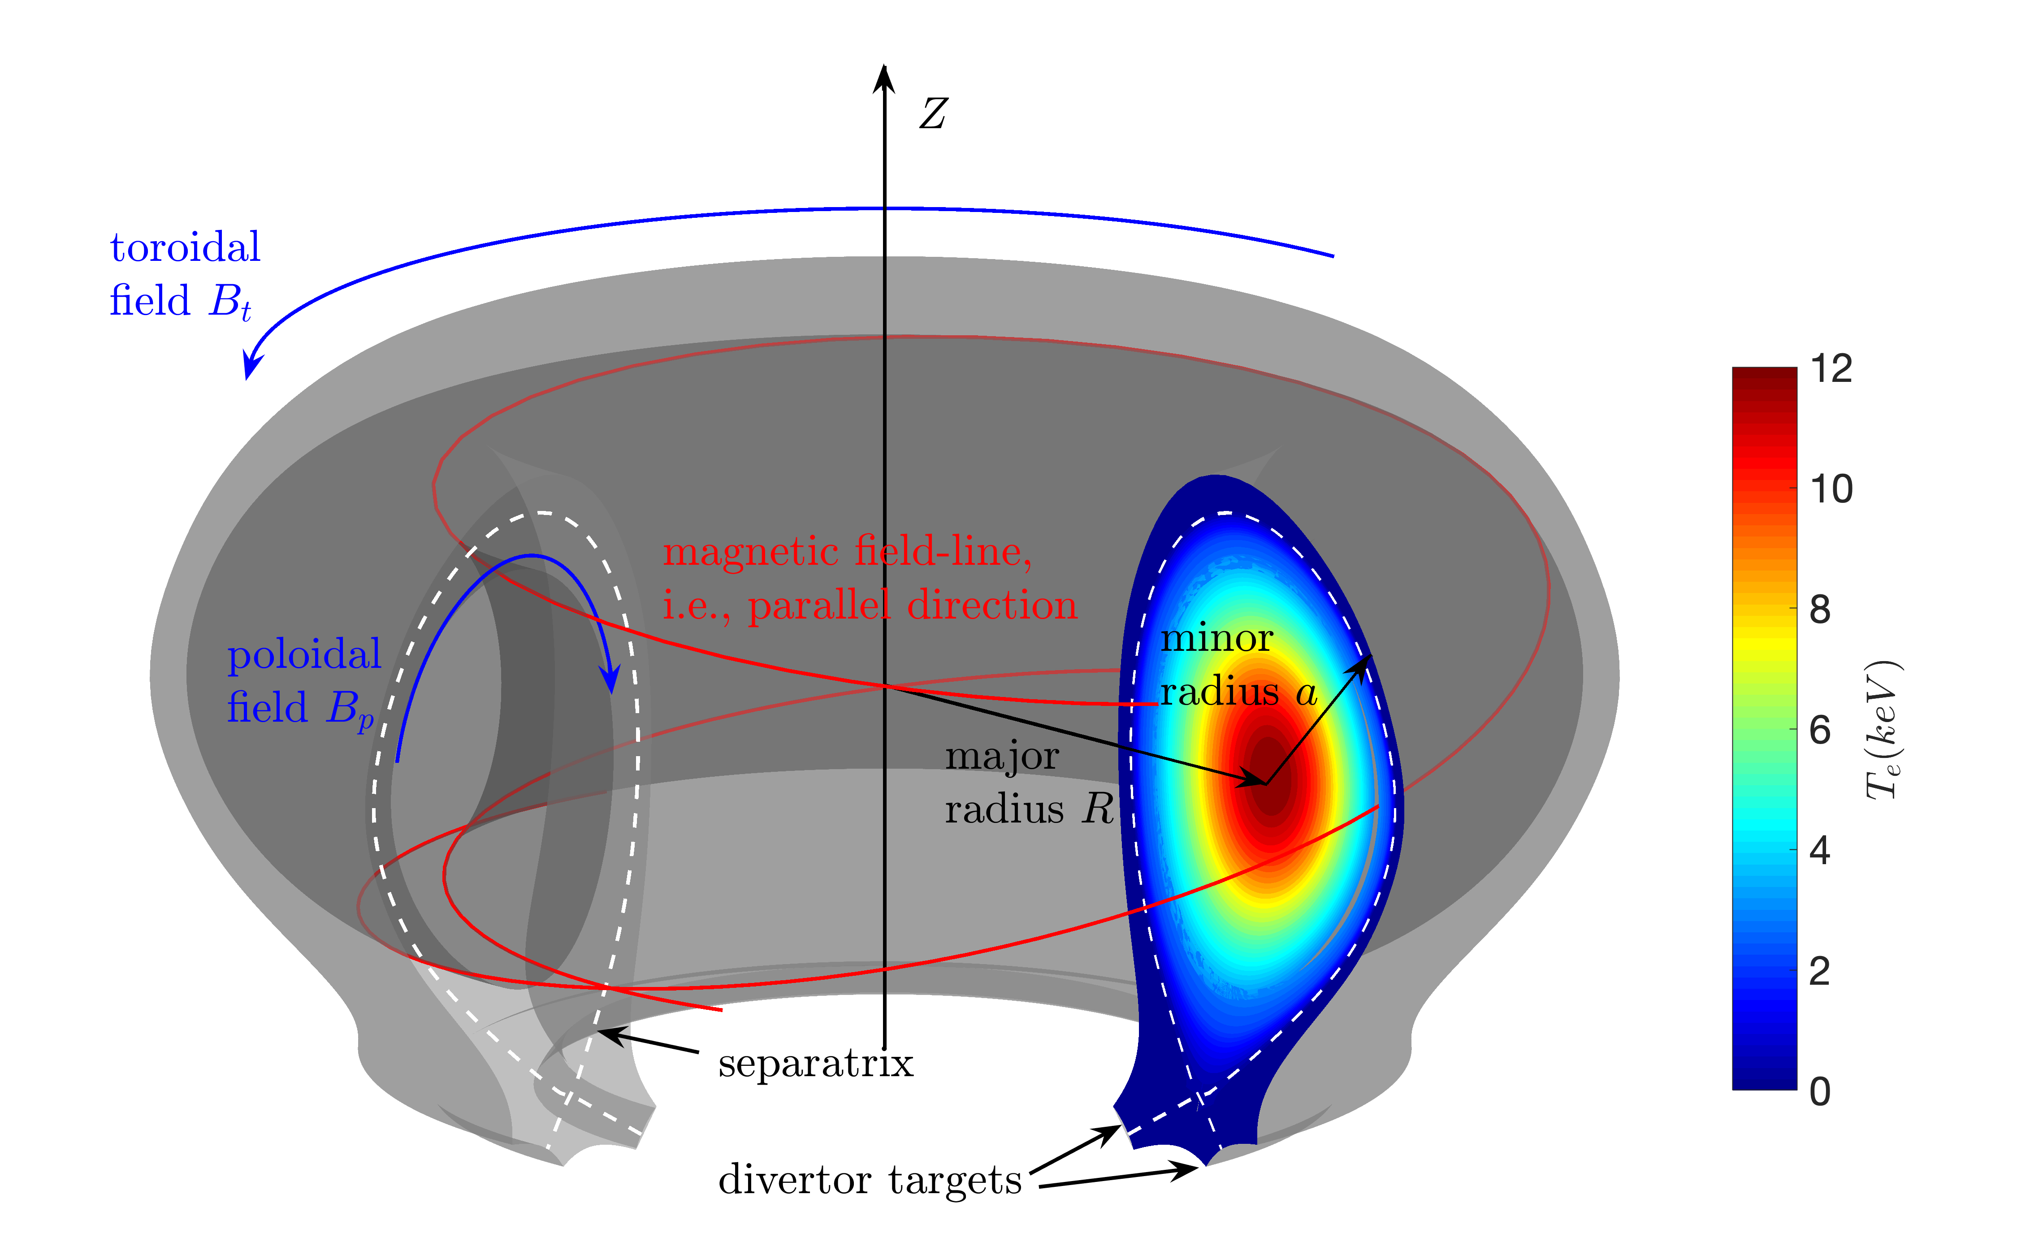
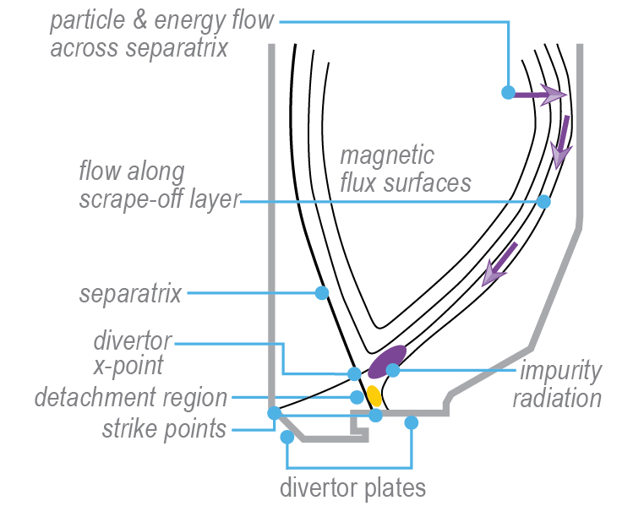
Particle & heat exhaust in magnetic confinement fusion devices
  Divertor plasma is complicated – multi-ion plasma couples atomic, neutral, molecular dynamics.
  In toroidal devices, a substantial amount of fusion power will be deposited to a narrow region on divertors.

Slide 4
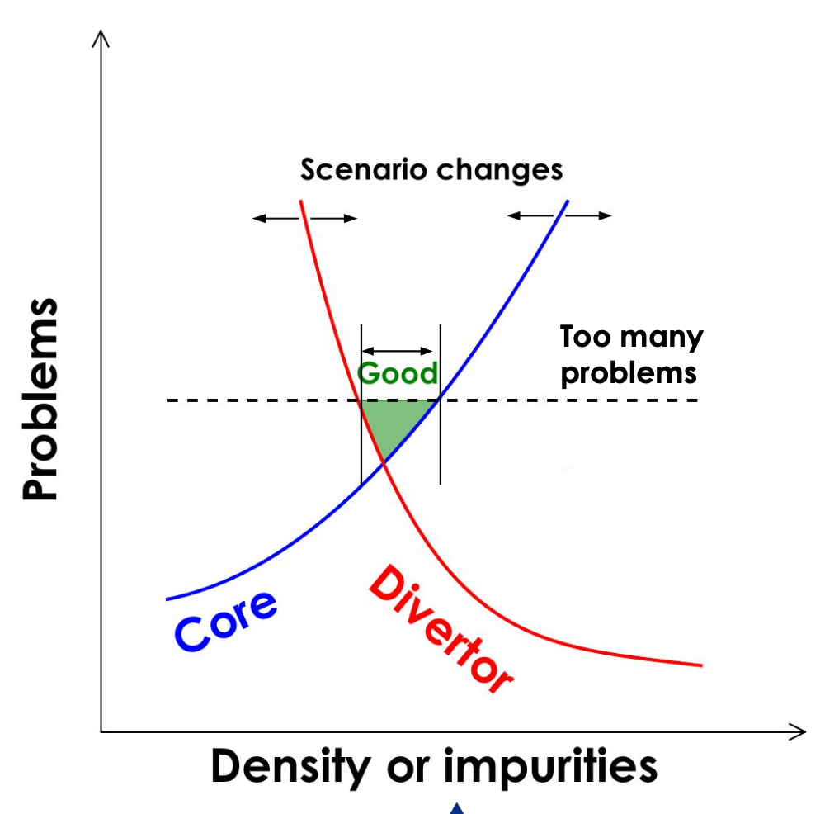
A gap between fusion performance and exhaust
One challenge of reactor-grade MCF devices is to bridge the gap between fusion performance and heat exhaust:
  a large radiative cooling fraction (e.g., 60~90%), or detachment is required to avoid divertor/PFC damage
  impurity seeding degrades core plasma
Integrated core-pedestal-SOL/divertor models are needed to
  identify “sweet spots” in operation space
  demonstrate means to access and maintain in such a desired state
credit to David Eldon (General Atomics)

Slide 5
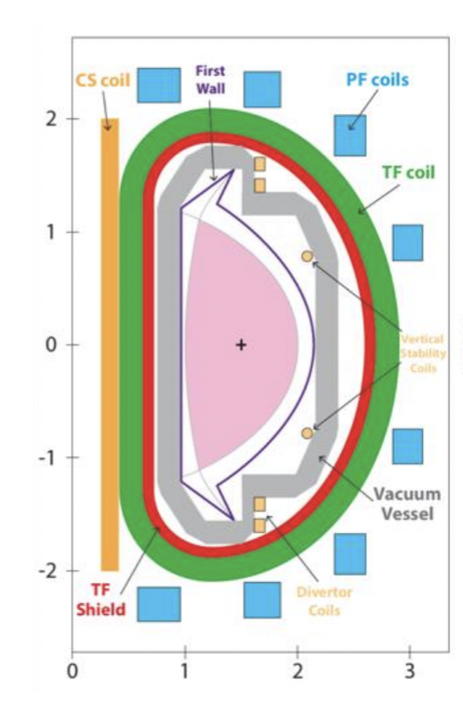
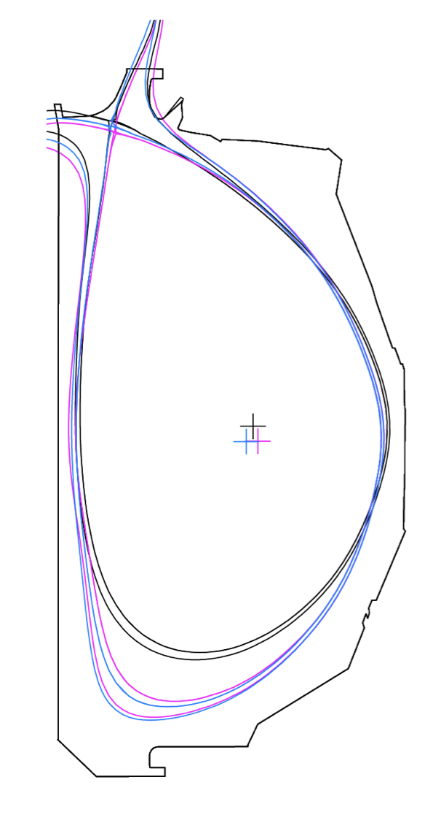
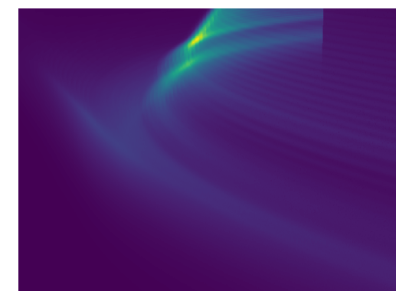
The need of fast, robust and reliable divertor plasma models
Desired divertor model
Speed
Accuracy
Device design
Scenario development
Operation control
Loss of critical in-situ diagnostics in future reactors
mins-hrs
sec-mins
~1-10ms
fairly high
reasonable
Semi-analytical models (e.g., 2PM): fast but not accurate, depends on empirical fitting coefficients
Transport models (e.g., SOLPS, UEDGE): sensitive to initial conditions, takes days to months

Slide 6
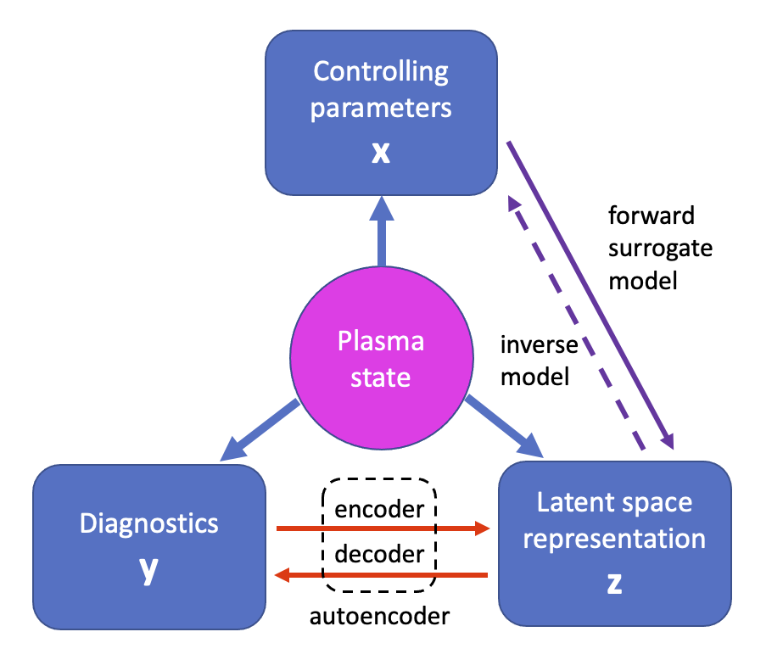
Plasma state has low-dimensional latent space representation
An efficient data-driven surrogate model to
  predict divertor plasma condition without doing actual simulations
  leverage the “latent space” (LS) concept
  obtain projection relation (NNs) between three different descriptions of plasma state
Anirudh et al., “Improved surrogates in inertial confinement fusion with manifold and cycle consistencies”, Prod. National Academy of Sciences, 117 9741 (2020)

Slide 7
Outline
Motivation
  Why efficient divertor models benefit magnetic confinement fusion (MCF)?
Proof-of-principle study
  Does divertor plasma have low-dimensional latent space representation that can facilitate ML model development?
ML model for detachment control
  How about solving the real-world problems? i.e., to provide a proper model for advancing model-based detachment controller.
Summary and future work

Slide 8
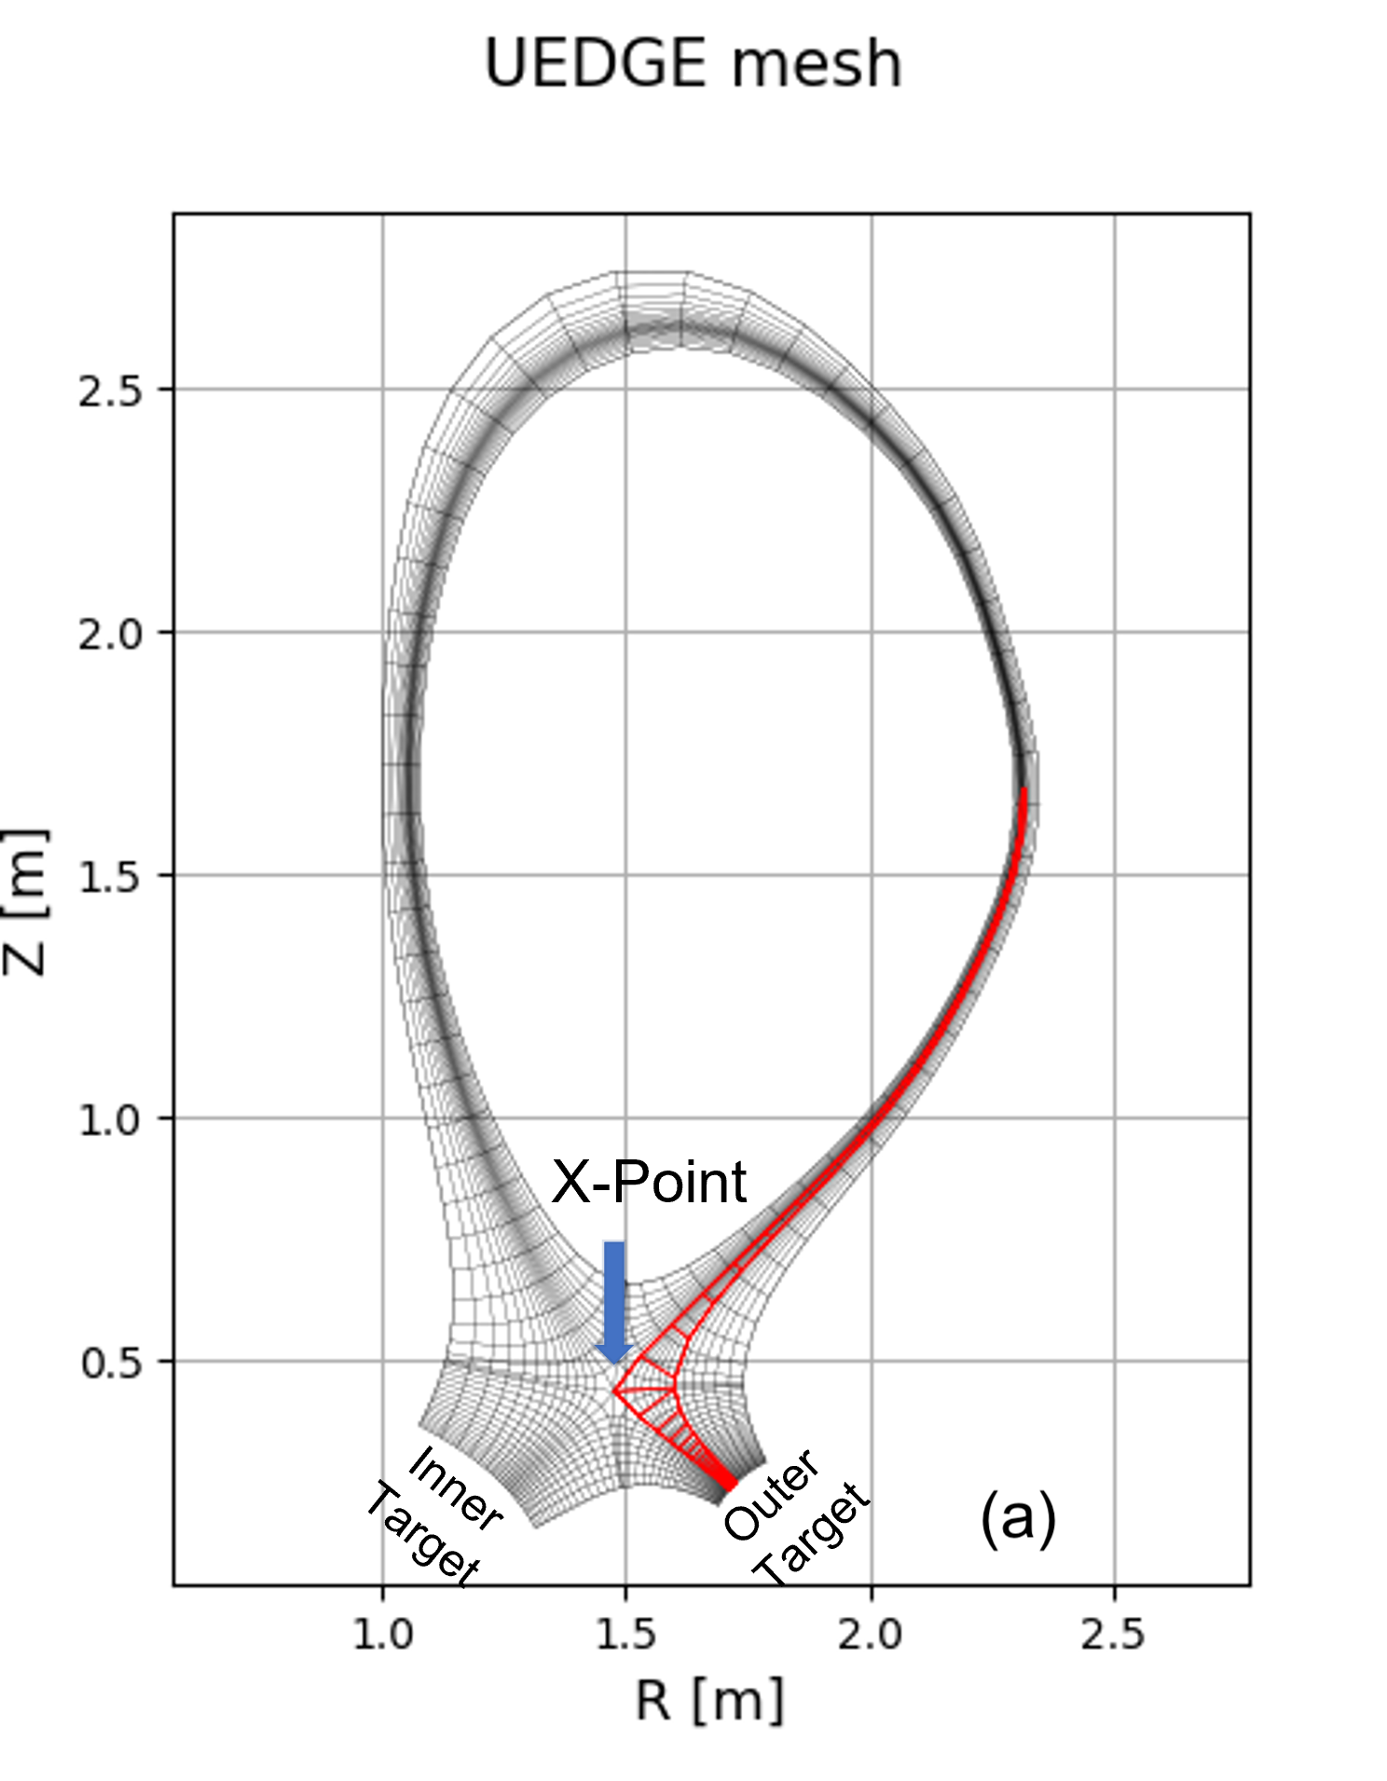
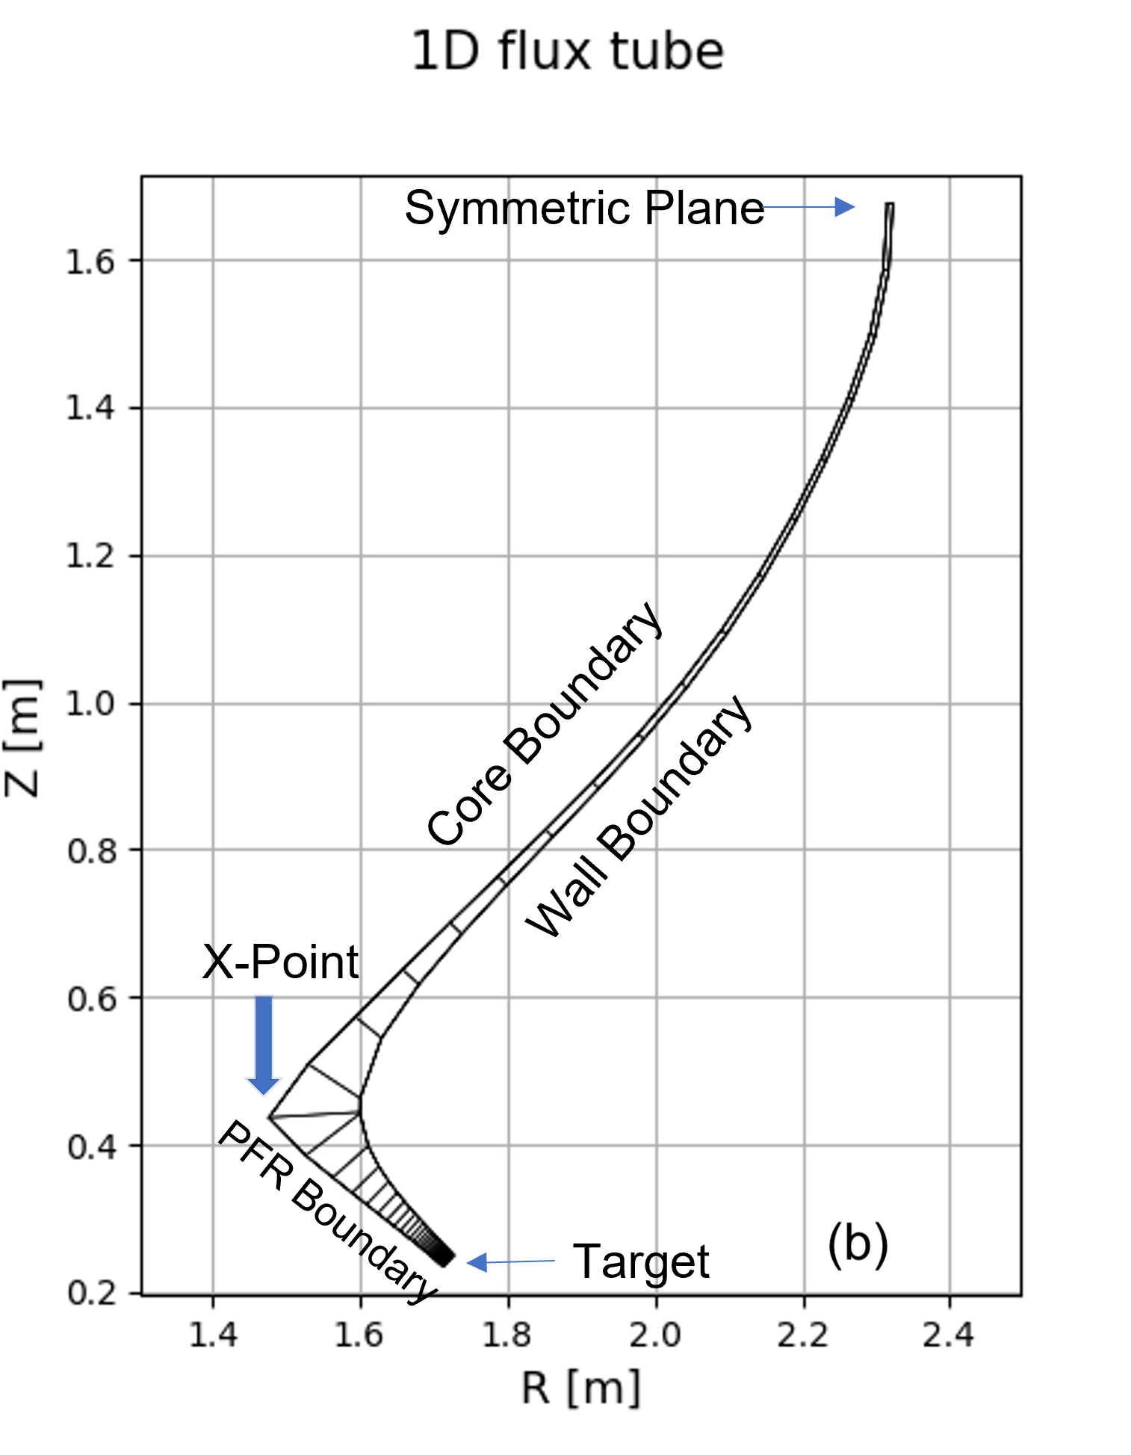
A pilot project based on 1D UEDGE transport model
Proof-of-principle study
simple yet contains essential divertor plasma/neutral physics
efficient – a few mins per run
LLNL’s in-house expertise
Diagnostics set y includes four scalars and one array
radiation profile (30 elements)

Slide 9
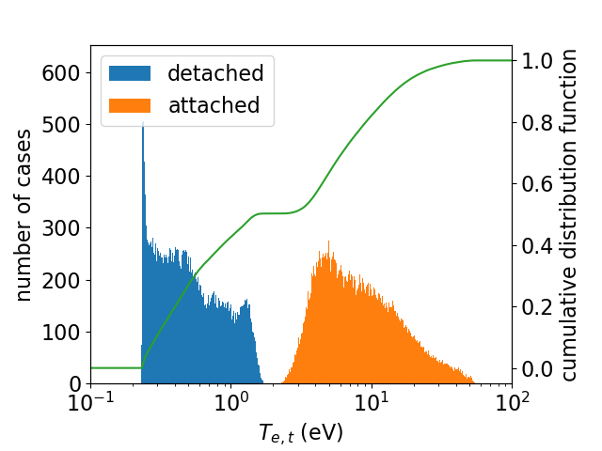
Over one million 1D UEDGE simulations were performed
Results presented here are based on ~170k runs.
data set 1 (111,598 cases): for training and validation of beta-VAE (y->z->y’) and MLP (x->z)
data set 2 (57,655 cases): for validation of combine model (x->z->y’)
DIII-D like configuration with three varying input parameters x
“detached” and “attached” cases are labeled by the electron temperature at divertor
  Labeling won’t affect the model performance.

Slide 10
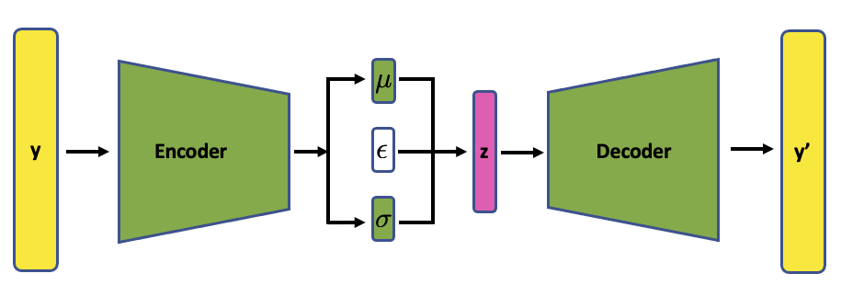

LSRs are identified via 𝛽-variational auto-encoder (𝛽-VAE)
40+4 elements input y to 6 dimensional LSR z, compression rate ~7.
𝛽-VAE is chosen to regularize latent space distributions (for reducing MLP error in next stage).
AE loss
Kullback-Leibler divergence

Slide 11
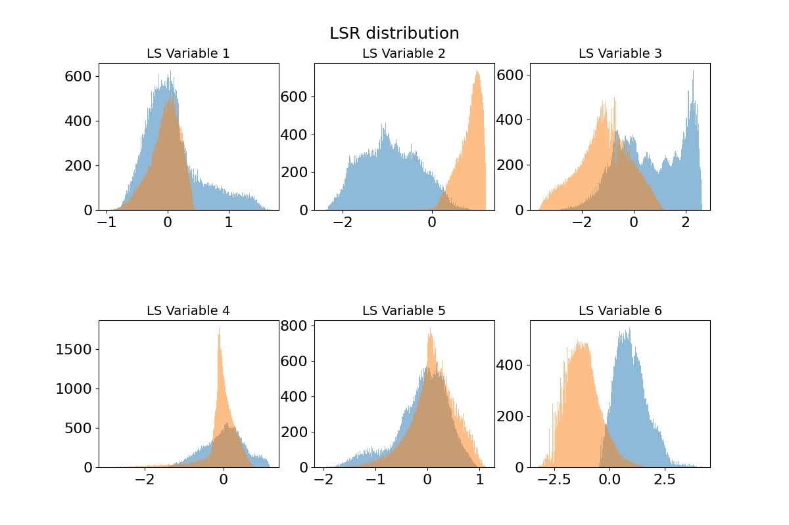
Detached and attached cases are well-separated in latent space
Detached and attached divertor plasmas have different distributions in certain latent space dimension; and are clustered in t-SNE visualization.

Slide 12
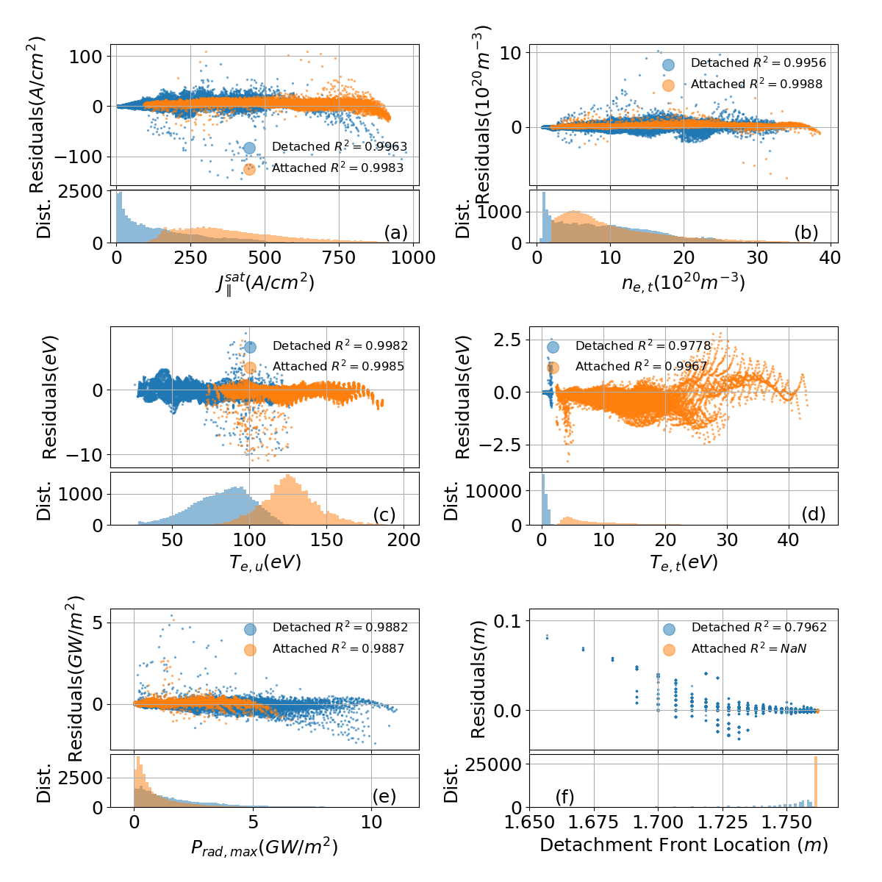
Combined forward prediction model (x->z->y’) works well
The coefficient of determination, R², is between 0.978 to 0.999 for all four scalars and maximum radiation amplitude in both detached and attached plasmas.

Slide 13
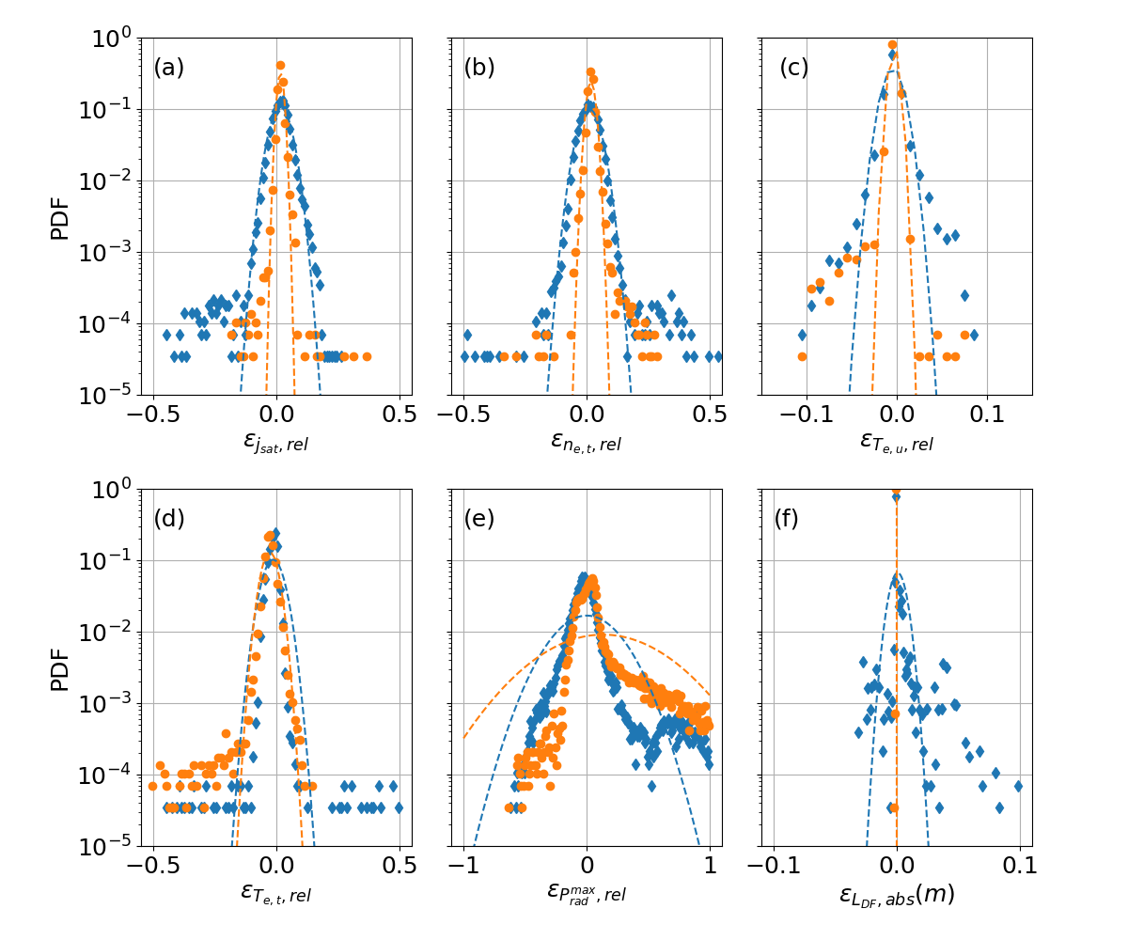
Statistically small relative errors (except for peak radiation amplitude)
Four scalars
  error close to Gaussian distribution
  standard deviation is a few precent
  a few outliers
  attached cases are more accurate
Radiation info
  peak amplitude is least accurate
  location is well predicted
  not follow Gaussian distribution

Slide 14
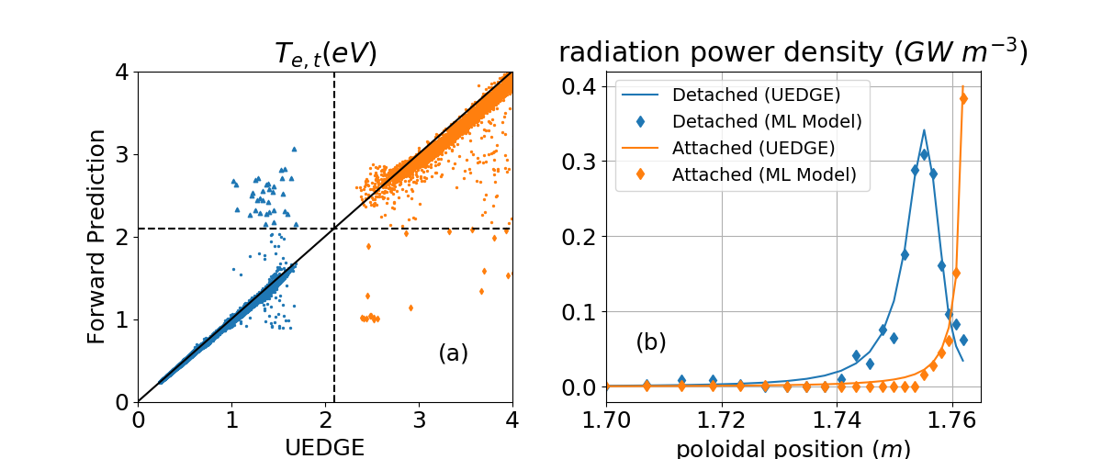
Mis-classification rate is as low as 0.2%
35 out of 28,468
25 out of 29,187
Despite being a proof-of-concept study, this divertor model based on 1D simulations
  contains more physics and provide more info than the semi-analytical 2-Point Model (2PM).
has wrong temperature cliff threshold; over-predicts radiation power density.

Slide 15
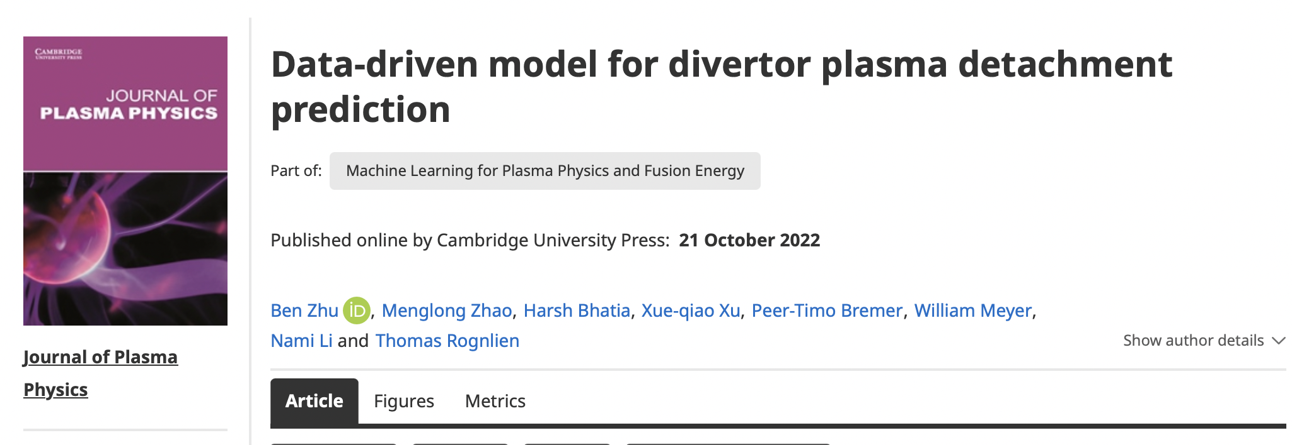
ML model meets the requirements of integrated modeling
Speed: over 10⁴ times faster than simulation even without any optimization
Robustness: not sensitive to initial condition
Accuracy: statistic-wise, predictions of four scalers have a few precents relative error; peak radiation amplitude is less accurate, but the location prediction is good
number of cases | 1 | 10 | 100 | 1,000 | 10,000 | 100,000
speed (ms) | 36 | 37 | 42 | 51 | 178 | 2,259

Slide 16
Outline
Motivation
  Why efficient divertor models benefit magnetic confinement fusion (MCF)?
Proof-of-principle study
  Does divertor plasma have low-dimensional latent space representation that can facilitate ML model development?
ML model for detachment control
  How about solving the real-world problems? i.e., to provide a proper model for advancing model-based detachment controller.
Summary and future work

Slide 17
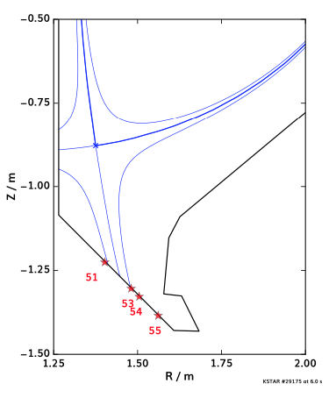
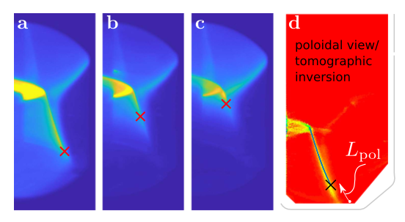
Status and challenges of divertor plasma detachment control
Real-time feedback control of divertor plasma detachment is an active research area.
  [TCV] control C-III emission (detachment) front
  [KSTAR] control attachment fraction
However, reactor-grade devices require more sophisticated detachment control
  loss of in-situ diagnostics
  multiple control objectives
  better to develop a model-based control algorithm instead of using empirical coefs.
Ravensbergen et al., Nature Comm., 12 1105 (2021)
Eldon et al., PPCF, 64 075002 (2022)

Slide 18
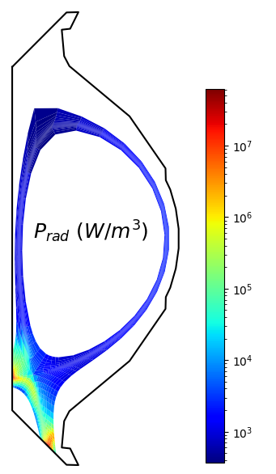
Desired SOL/divertor plasma parameters and NN architectures
Desired plasma condition prediction (y)
  Heat load at inner and outer divertors
  Jsat at inner and outer divertors
  Te at inner and outer divertors
  Radiation info. (divertor radiated power, and the detachment/radiation front location)
  Upstream density and temperature profile
1
heat exhaust
particle exhaust
2
3
3
core/fusion perf.
Key detachment related discharge parameters (x)
  Total power injection (real-time control)
  Core plasma density (real-time diagnostic)
  Impurity species and fraction (estimate → upgrade to seeding rate)
  Diffusion coefficients (empirical estimate on real-time control)
2
1
1

Slide 19
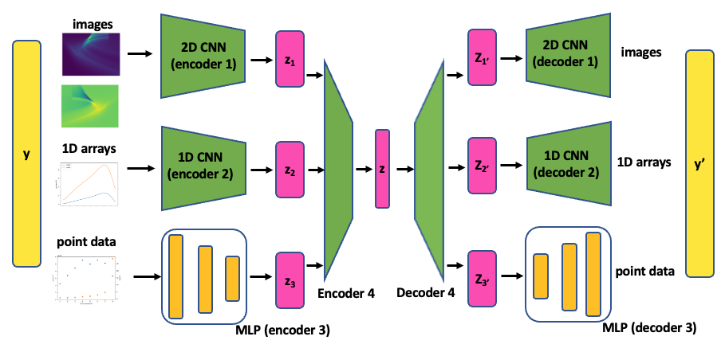
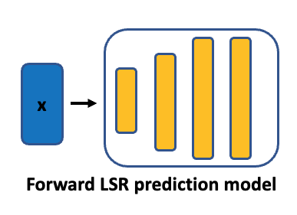
Neural network architectures
Desired plasma condition prediction (y)
  Heat load at inner and outer divertors
  Jsat at inner and outer divertors
  Te at inner and outer divertors
  Radiation info. (divertor radiated power, and the detachment/radiation front location)
  Upstream density and temperature profile
multi-modal encoder
multi-modal decoder
Key detachment related discharge parameters (x)
  Total power injection
  Core plasma density
  Impurity species and fraction
  Diffusion coefficients
Architecture of multi-modal (MM) data-driven surrogate model

Slide 20
Data generation with 2D UEDGE transport model
24,000 2D UEDGE simulations based on KSTAR #22849_5600 equilibrium were preformed with randomly sampled inputs
Synthetic diagnostics then extract desired edge/divertor plasma condition for control purpose, including
  Inner and outer divertor profiles
  Edge and divertor region radiated power fraction, radiation front location, and peak amplitude
  Outboard midplane profiles
x

Slide 21
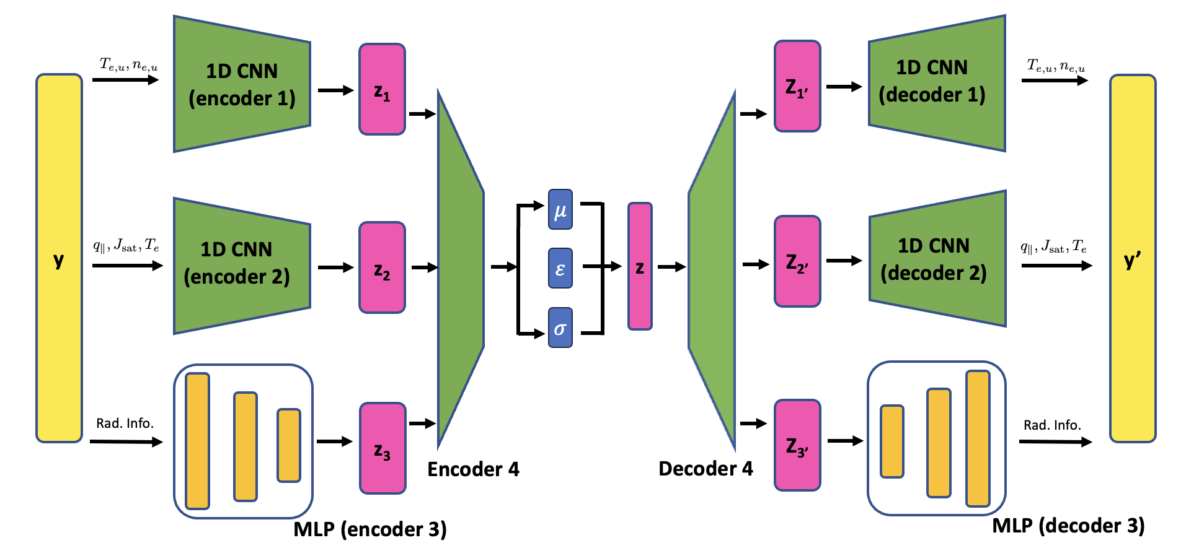
Multi-modal 𝛽-variational auto-encoder
Multi-modal 𝛽-VAE is used to identify reduced LSR.
  upstream and downstream plasma profiles are handled by separated CNNs
  moderate overall compression rate ~ 10: 20x8+5 = 165 DOFs -> 16 LS dimensions
  a small 𝛽 to regularize LSR distribution

Slide 22
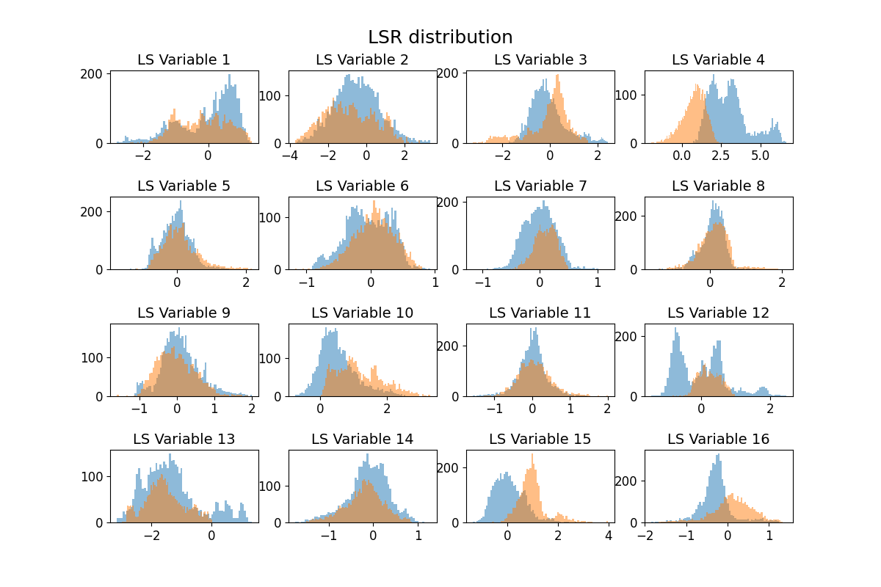
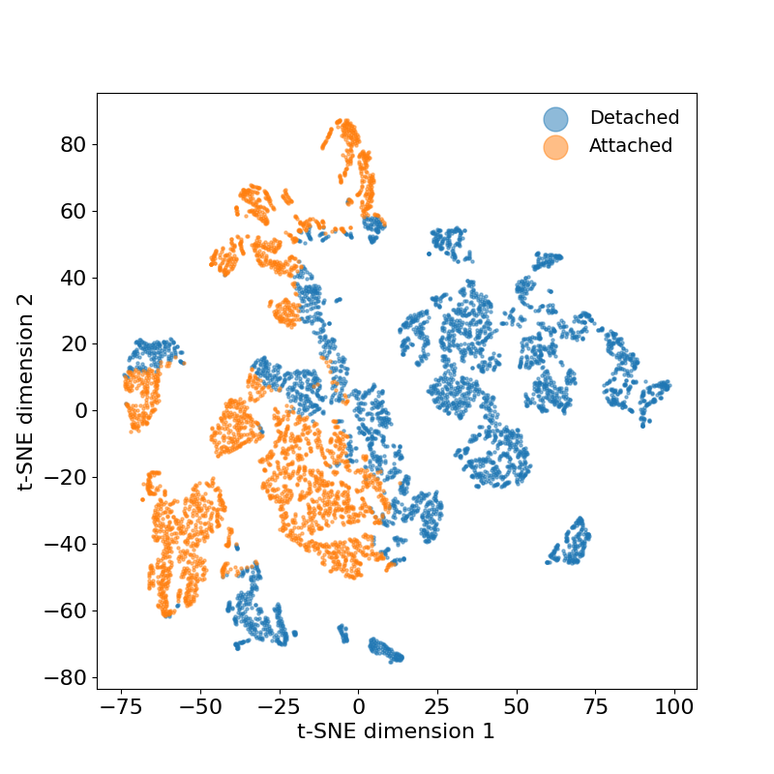
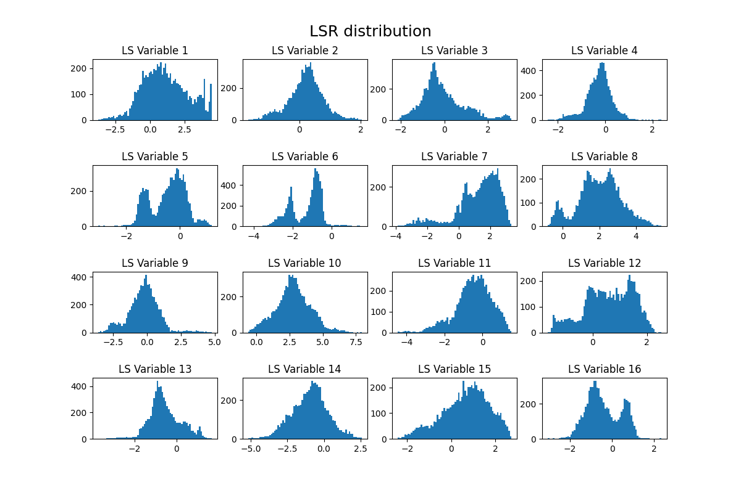
Plasma states in latent space representation
Label cases with Te,osp<5eV as “detached”
Similar to 1D study, detached and attached divertor plasmas have different distributions in certain latent space dimensions; but are less well separated in t-SNE visualization.

Slide 23
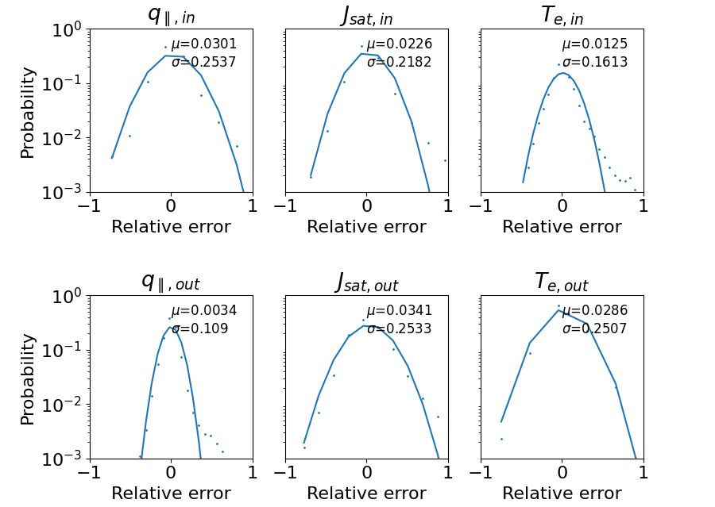
Combined surrogate model performance
Accuracy: most quantities are within 25% relative error margin.
1
3
2
1
1
Speed: 10⁵⁻⁶x speed-up; ~10 ms vs ~1 hour if this simulation converges.

Slide 24
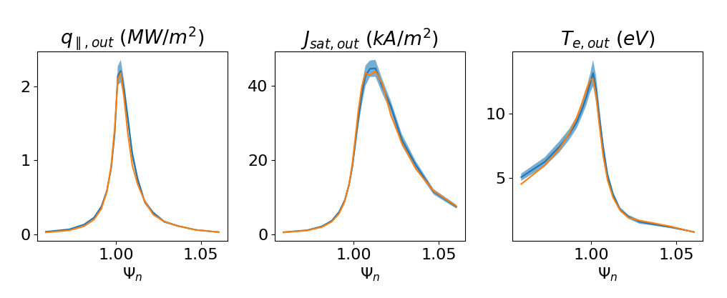
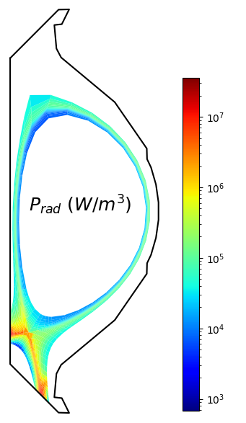
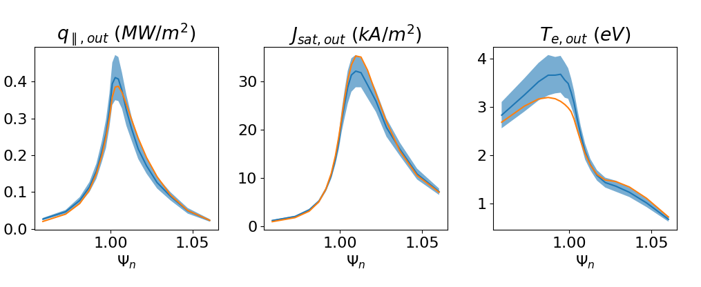
Surrogate model successfully predicts detachment onset
Attached plasma
ML model
UEDGE
Detached plasma

Slide 25
Summary and future work
Efficient divertor models are critical for MFE research.
Divertor plasma has low-dimensional latent space representation (LSR).
  fast and reliable surrogate model via LSR;
  manifold consistent prediction of multi-modal data set (e.g., images, spectra, …) for general MFE applications.
A protype surrogate model for KSTAR detachment control is developed.
  prediction of upper steam and divertor plasma conditions as well as the radiation info.
  quasi-real-time (~10 ms), <25% error margin
  plan for initial deployment/validation on PCS next year
A project on FPP divertor design will start soon.

