Slide 1
AI-driven tokamak control in HL-2A/3
Shuo Wang¹, Zongyu Yang¹, Meihuizi He², Xiaobo Zhu¹, Yifei Zhao^{1,3}, Guohui Zheng², Fan Xia¹ and Wulyu Zhong¹
on behalf of HL-2A/3 Team and collaborators
1 Southwestern Institute of Physics (SWIP), Chengdu, China
2 Nankai university, Tianjin, China
3 Dalian university of technology, Dalian, China
Workshop on Al for Accelerating Fusion and Plasma Science, 28th November -1st December 2023, in Vienna, Austria

Slide 2
Outline
Brief introduction to HL-2A&HL-3
Progresses in HL-2A & HL-3
AI-based disruption prediction
ELM/L-H transition detector
Identification of MHD Instabilities with AI
Plasma reconstruction
Fast prediction of beta limits in HL-3
Summary

Slide 3
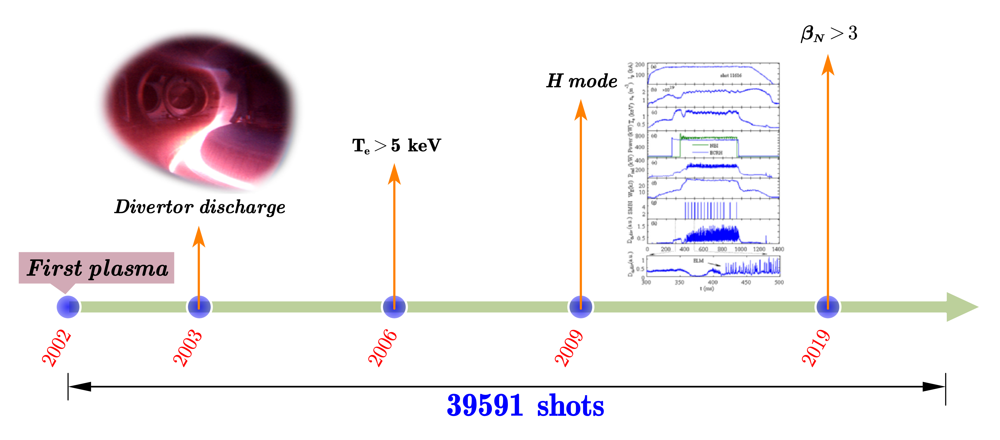
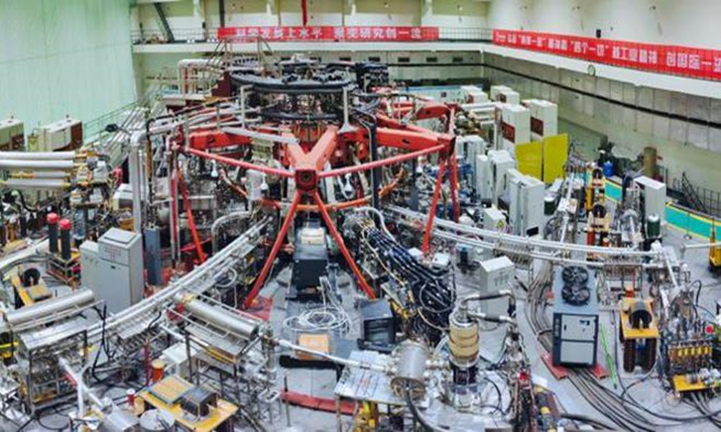
The HL-2A Tokamak
Lots of ML/AI researches can be done with the diagnostic data of HL-2A tokamak
Intelligent operations
Prediction & protection
Plasma modeling

Slide 4
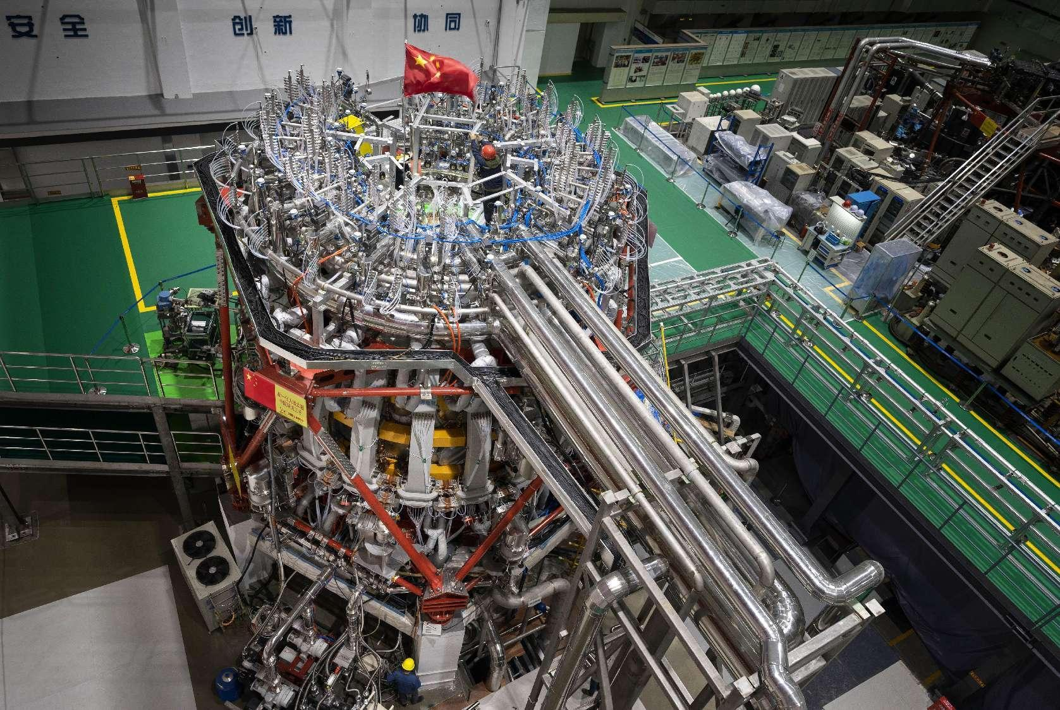
HL-3 Tokamak (formerly known as HL-2M)
Addressing critical physics and technology issues for ITER & fusion reactors
ITER-related scenarios, such as baseline H-mode, hybrid & steady state. Explore high-performce operation regimes toward fusion reactors, such as β_{N} >3, high density with Greenwald fraction >1, etc.
Advanced divertor configuration concept and physics. Test and validate high heat flux PFCs.
Key plasma physics and technologies concernd by ITER, including EP / VDE / NTM / ELM control, disruption alerting & mitigation, etc.
D-T fusion experiments to explore buring plasma physics and technologies.
HL-3 Parameters
Major radius | R = 1.78 m
Minor radius | a = 0.65 m
Plasma current | I_{p} = 2.5~3 MA
Toroidal field | B_{T} = 2.2~3 T
Elongation | $κ$ = 1.8
Triangularity | δ > 0.5
Heating power | >30 MW

Slide 5
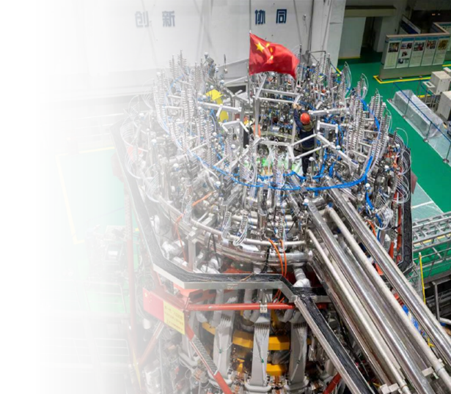
Timeline of HL-3
1MA H mode
1MA divertor configuration
First H-mode
Snowflake
First divertor configuration
1MA limiter configuration
First Plasma
Upgrade
Mar.
Apr.
Jul.
Aug.
Sep.
Nov.
2020
2022
2023

Slide 6
Outline
Brief introduction to HL-2A&HL-3
Progresses in HL-2A & HL-3
AI-based disruption prediction
ELM/L-H transition detector
Identification of MHD Instabilities with AI
Plasma reconstruction
Fast prediction of beta limits in HL-3
Summary

Slide 7
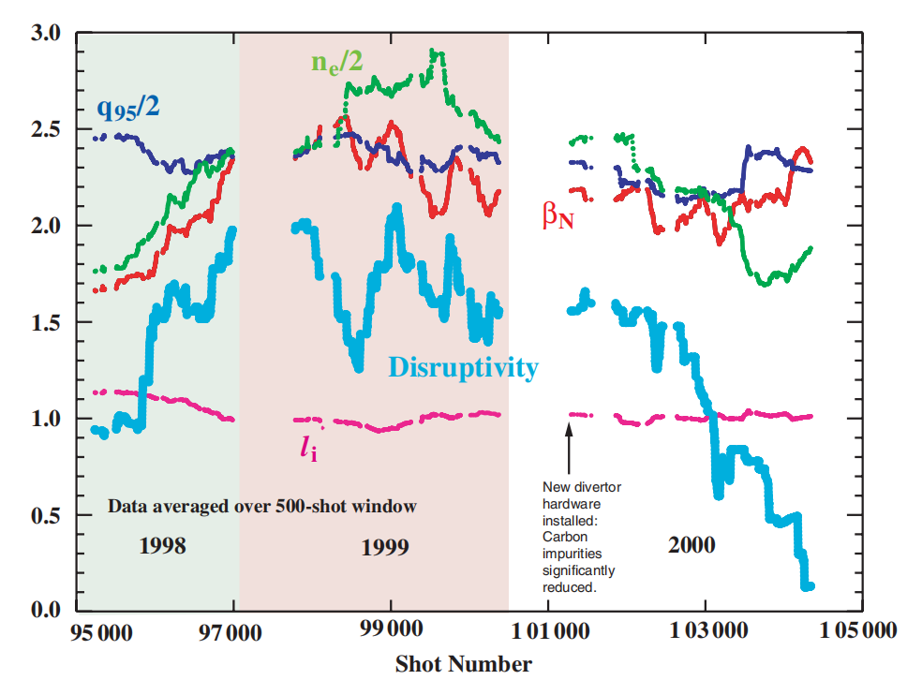
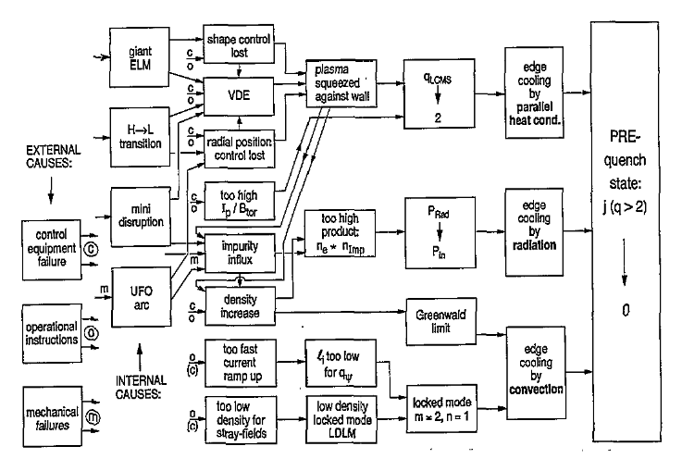
Disruptions in tokamaks
Major disruptions of tokamak plasmas have been the subject of intense investigations
It is not always easy to classify disruptions
The events that lead to a disruption are a complex combination of several factors
Hyatt A.W. et al 2001 Bull. Am. Phys Soc. 45 300
F C Schuller 1995 Plasma Phys. Control. Fusion 37 A135

Slide 8
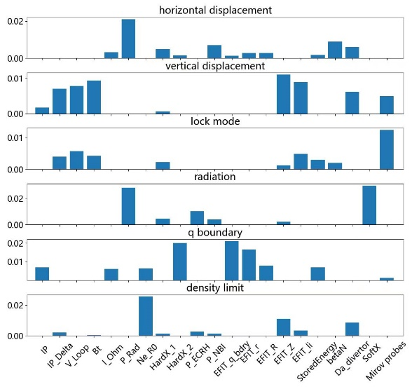
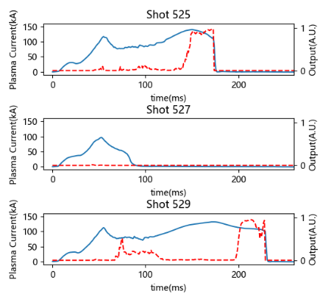
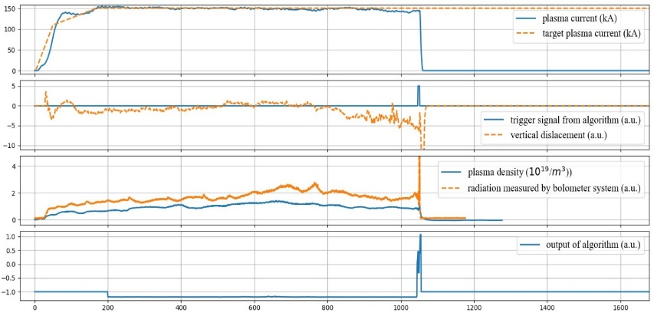
AI Disruption Prediction and Mitigation in HL-2A
Algorithm backbone
NN structure: 1.5D CNN+LSTM（A customized structure that performs well on fusion data)
Performance: 96.1% accuracy with 30ms in advance
Interpretability, transferability and real-time capacity integrated in one framework
Interpretable: significance analysis for 6 disruption causes in HL-2A
Real-time：Vertical displacement induced disruption mitigated by SMBI during closed-loop online testing
Transferable：Output of the cross-tokamak disruption predictor on HL-3
Highly commended for KU Itoh Project Prize in EPS 2022

Slide 9
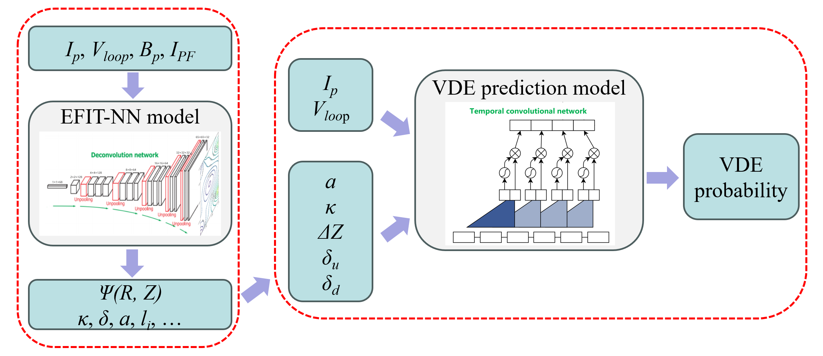
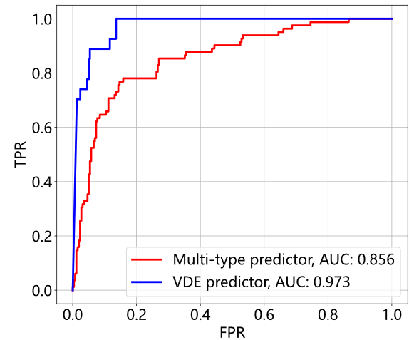
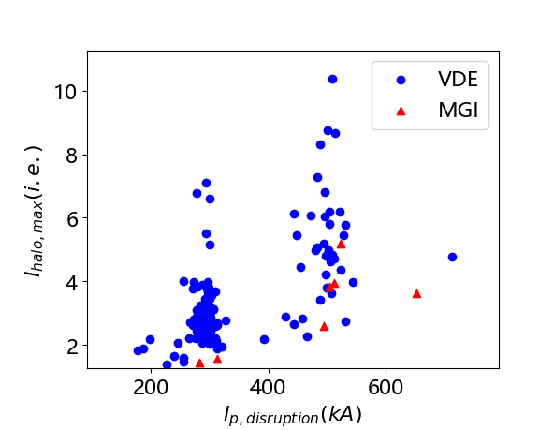
AI Disruption Prediction and Mitigation in HL-3
Developed AI algorithm : VDE predictor (AUC~0.97) and multi-type predictor.
Training set extremely limited: ~600 shots
Implemented closed loop : real-time disruption prediction and mitigation in PCS
Time consumption of a calculation cycle: ~0.6ms
AI-based VDE prediction algorithm
Receiver operator characteristic curves of the VDE predictor and the multi-type disruption predictor
Comparison of halo currents during VDE and MGI induced disruptions
A detailed report will be given in 29 Nov by Dr. Zongyu Yang

Slide 10
Outline
Brief introduction to HL-2A&HL-3
Progresses in HL-2A & HL-3
AI-based disruption prediction
ELM/L-H transition detector
Identification of MHD Instabilities with AI
Plasma reconstruction
Fast prediction of beta limits in HL-3
Summary

Slide 11
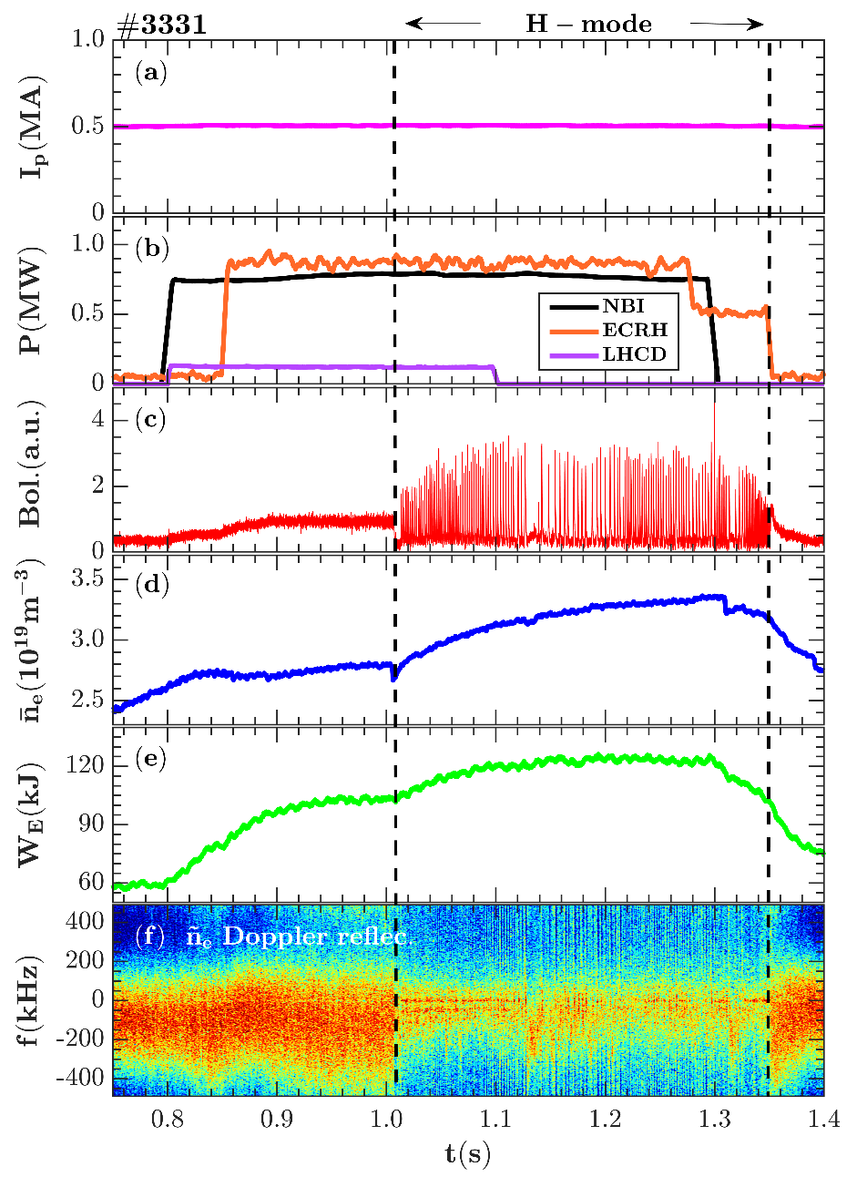
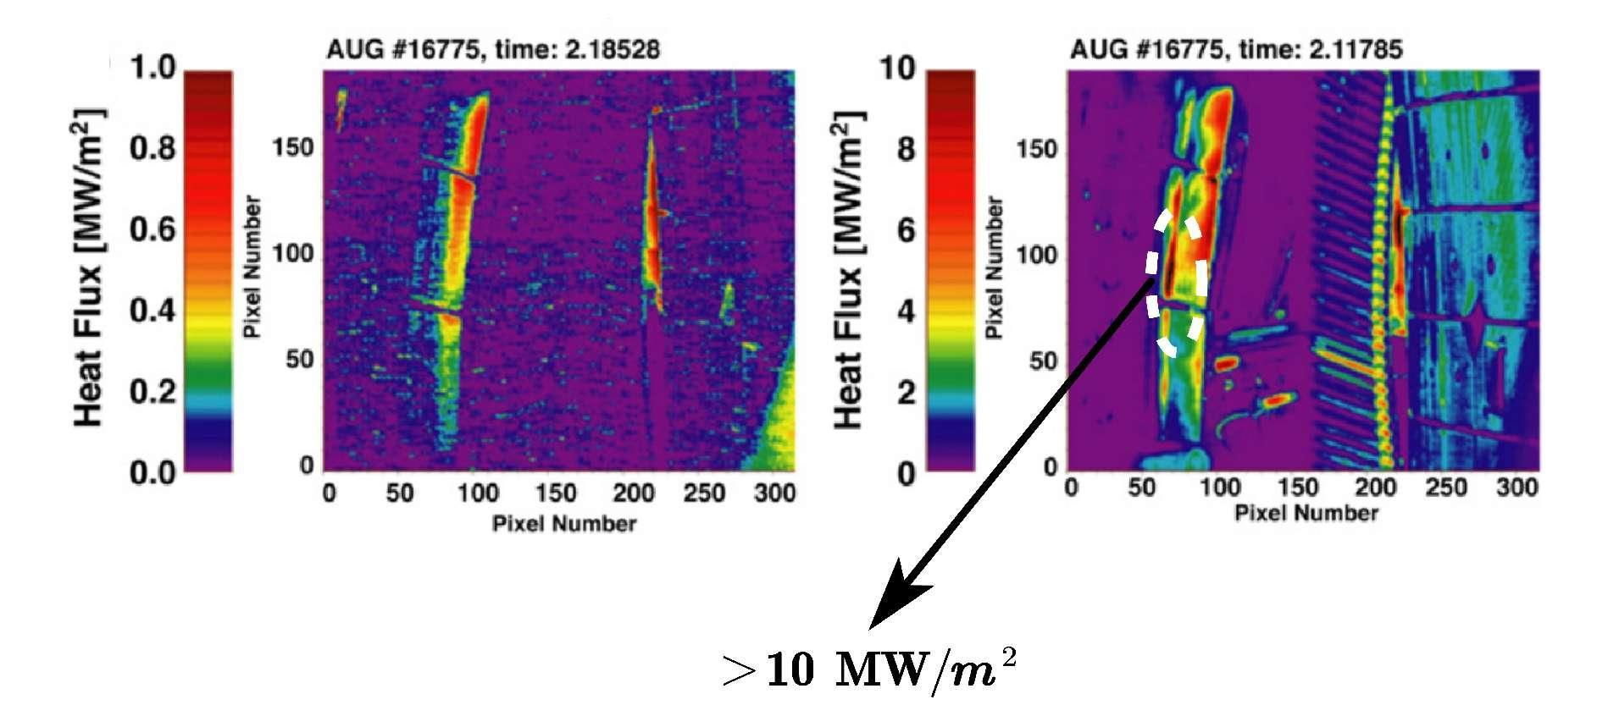
ELM/L-H transition detector
H-mode Operation (Ip=0.5 MA)
Type-I edge localized mode (ELM) is dangorous for ITER & future fusion plants
Energy losses in Type I ELMs can lead to melting, erosion, and evaporation of proposed divertor materials
The type-I ELM should be suppressed or mitigated to small ELMs
How to detect the ELMs in real time?
[IAEA-FEC 10/2023]

Slide 12
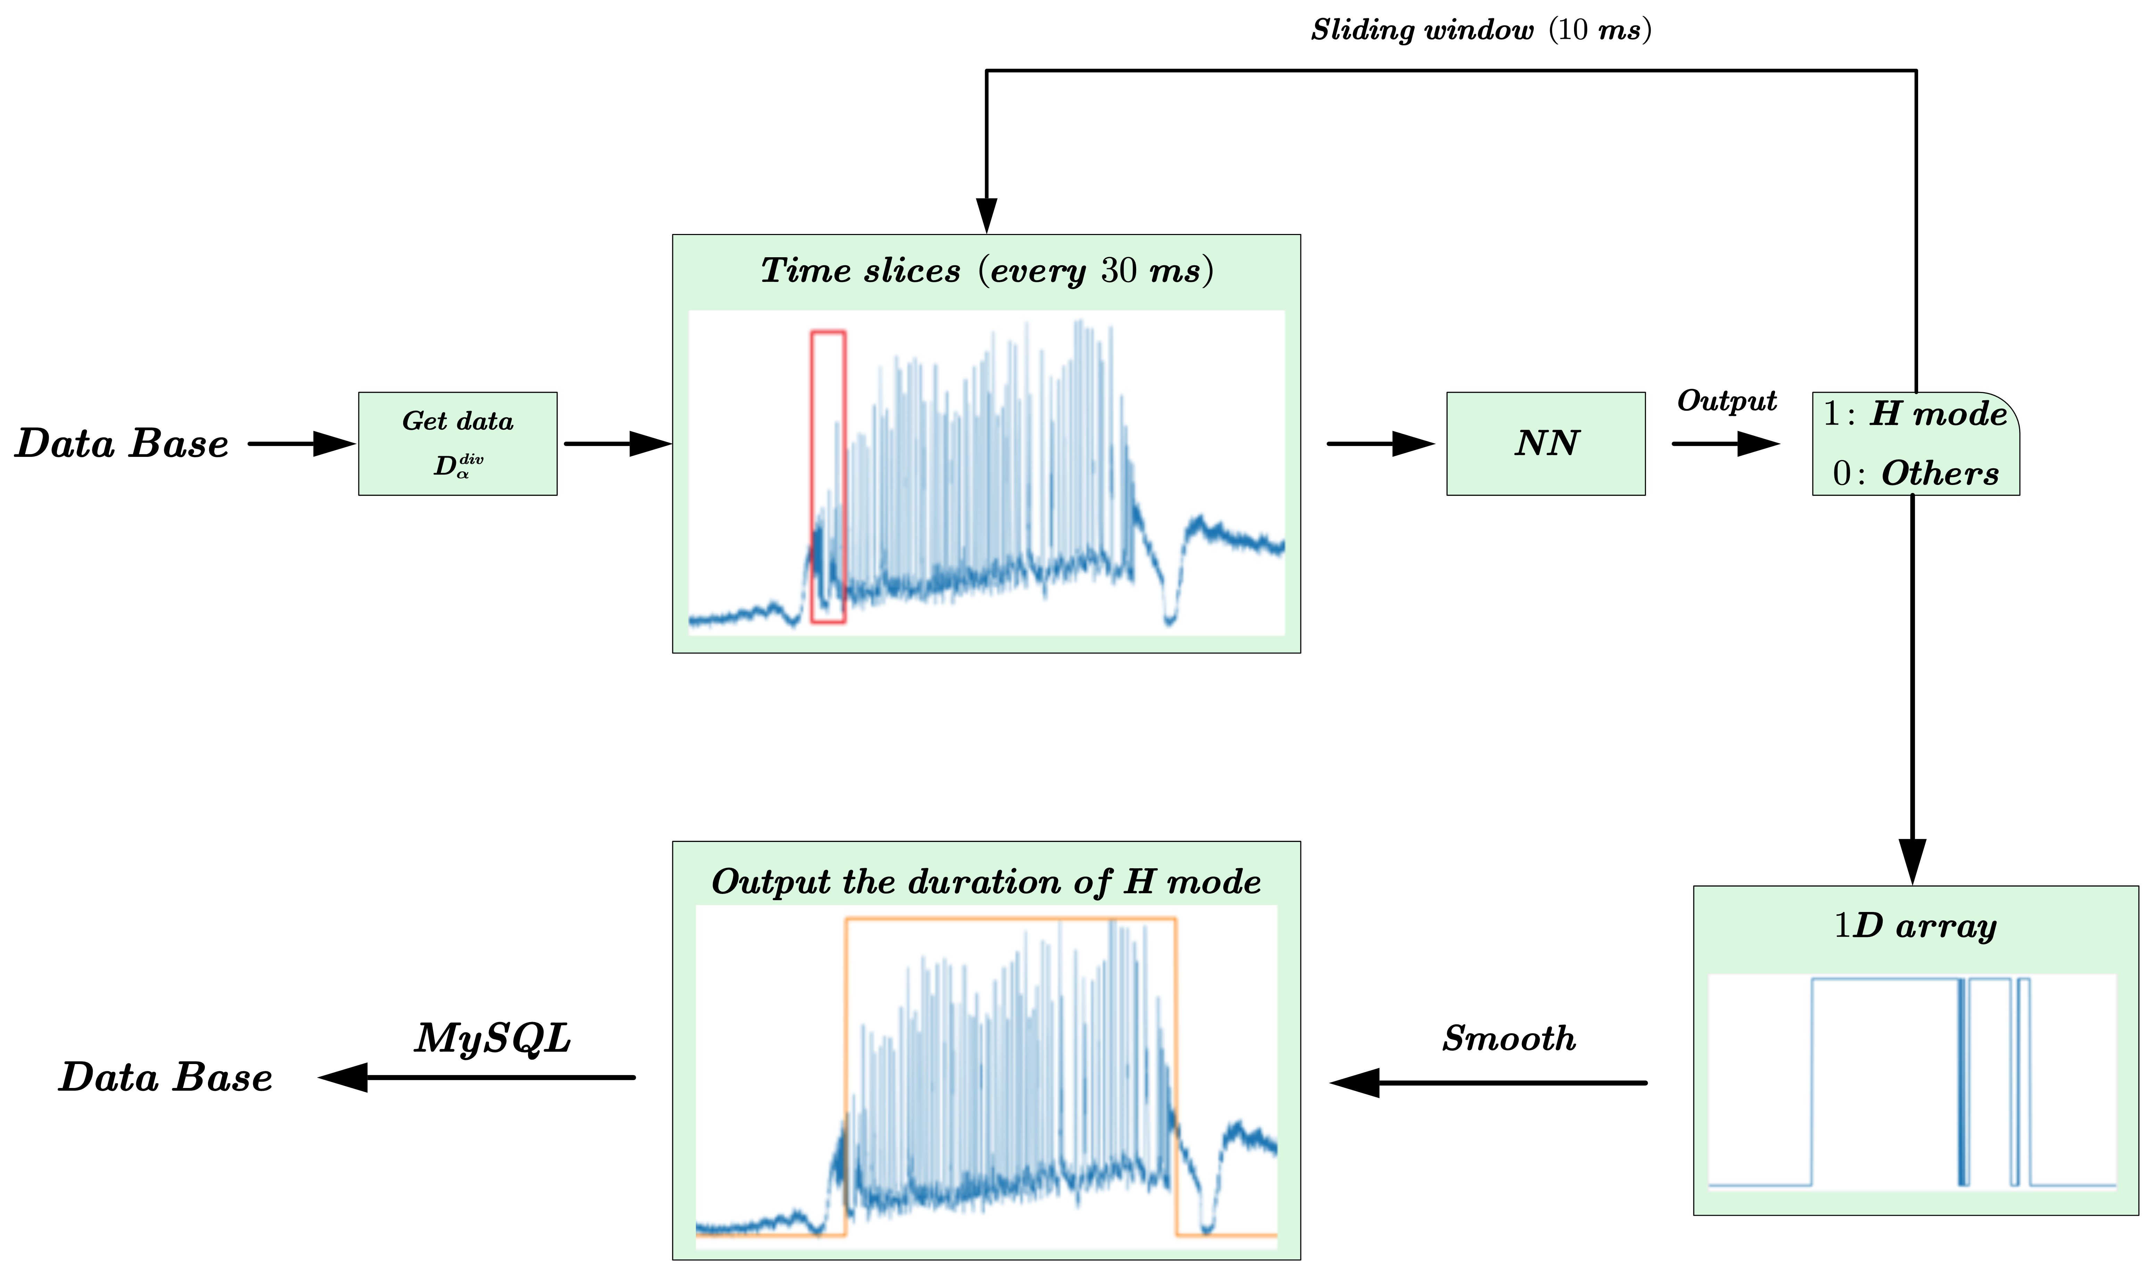
The training process of ELM detection
Input
HL-2A #20000-25200, 760shots
Divertor D_{α} emission
Stored energy W_{E}
Line-average density n_{e}
Plasma current I_{p}
Label
Duration of ELM : 1
Others : 0
Detector Model
Conv1D→LSTM→TCN
Yao Huang et al，Nulcear Fusion & Plasma Physics (in Chinese) 40(4) 300-306

Slide 13
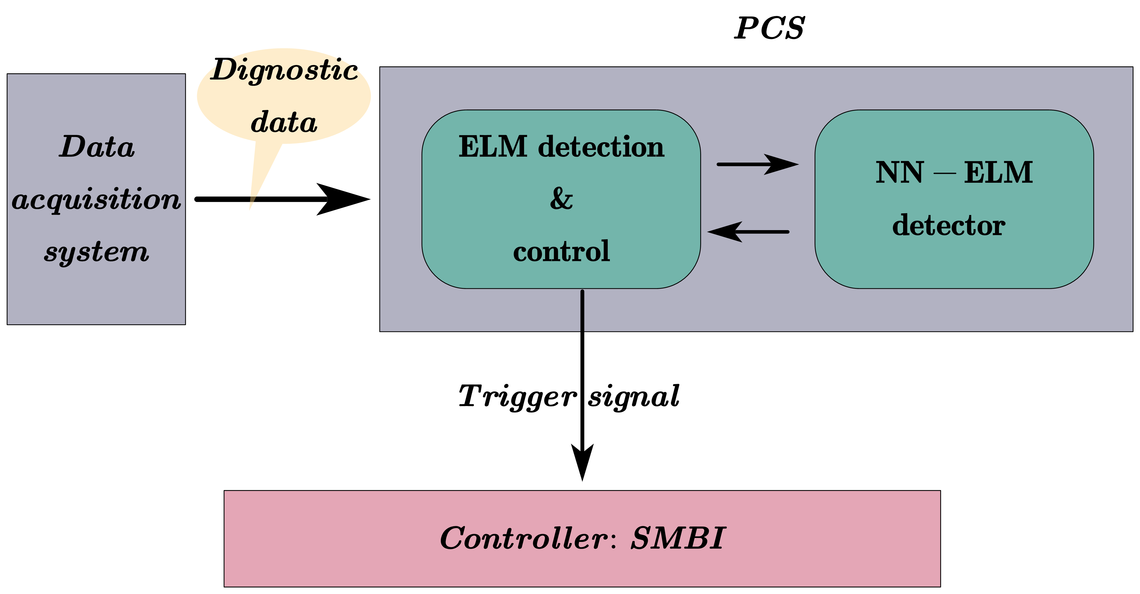
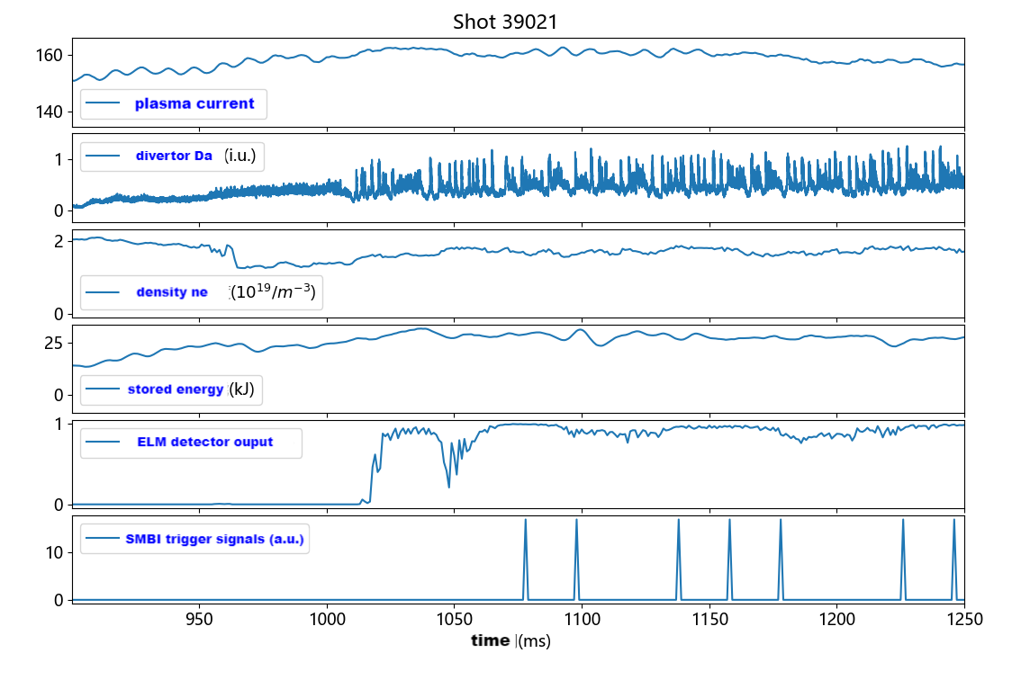
Application of AI-ELM-detector in HL-2A
Yixuan Li et al，Nulcear Fusion & Plasma Physics (in Chinese) , accepted
Disadvantage:
Several ELMs are missed in the beginning of H mode
One possible method: try to find the L-H transition time

Slide 14
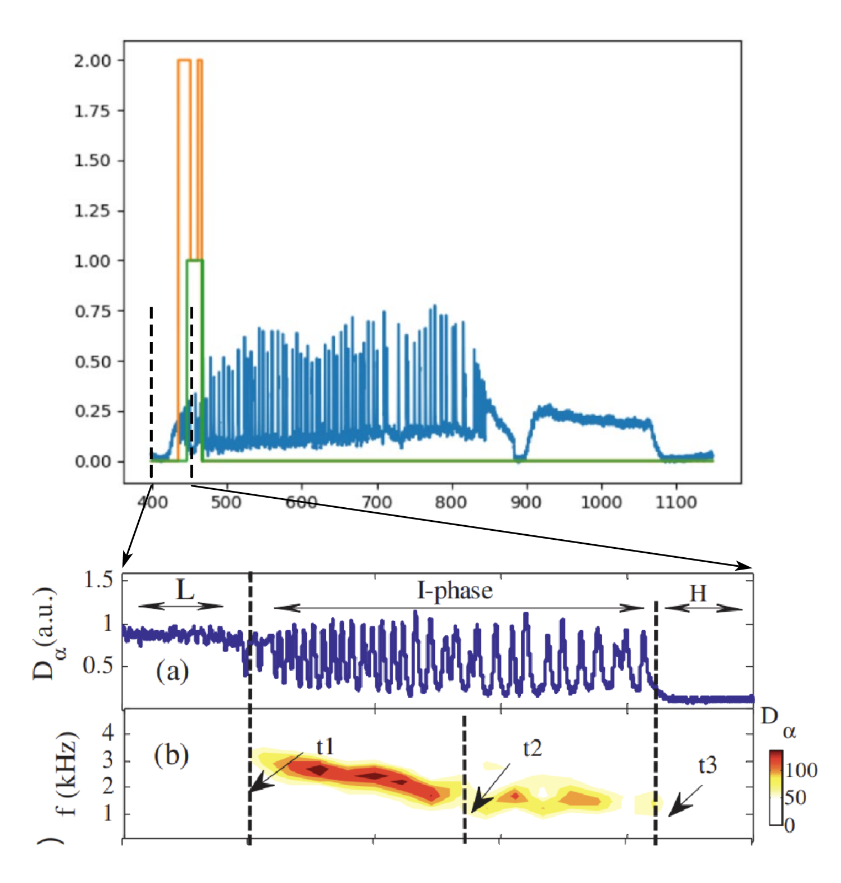
Identification of the L-H transition
Label
Start time of L-H transition: Limit-cycle oscillation (LCO)
End time of L-H transition: The first ELM
L-H transition -> 1
Partial L-H transition -> 2
W/O L-H transition -> 0
Results
73/81 of the L-H transition is achieved by the model
NBI start
LH begin
LH end
NBI end +300ms
? ms
10ms
5ms
0
2
1
2
0
Jun Cheng et al， J. Nucl. Mater. (2015) 463 455-458

Slide 15
Outline
Brief introduction to HL-2A&HL-3
Progresses in HL-2A & HL-3
AI-based disruption prediction
ELM/L-H transition detector
Identification of MHD Instabilities with AI
Plasma reconstruction
Fast prediction of beta limits in HL-3
Summary

Slide 16
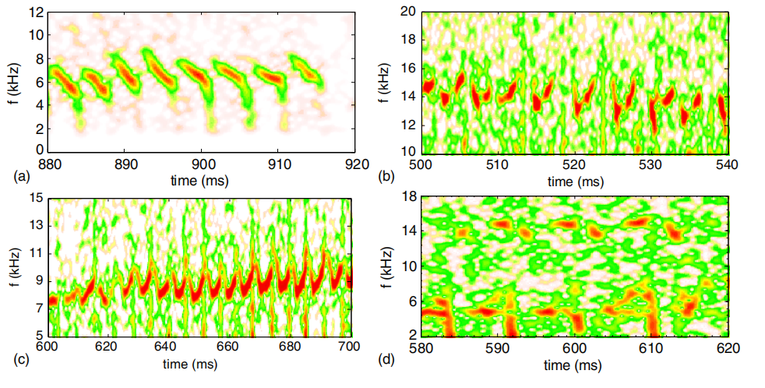
Identification of FB mode in HL-2A
The fishbone (FB) mode can be identified by spectrum analysis
The spectrum varies -> Not easy to identify the mode by programs
Input
780 shots
Mirnov probes signal -> FFT
Time window: 10 ms, 1MHz
Frequency: 5-35 kHz
Label
FB mode : 1
Others : 0
Model
ResNet-like
FB spectrum on HL-2A

Slide 17
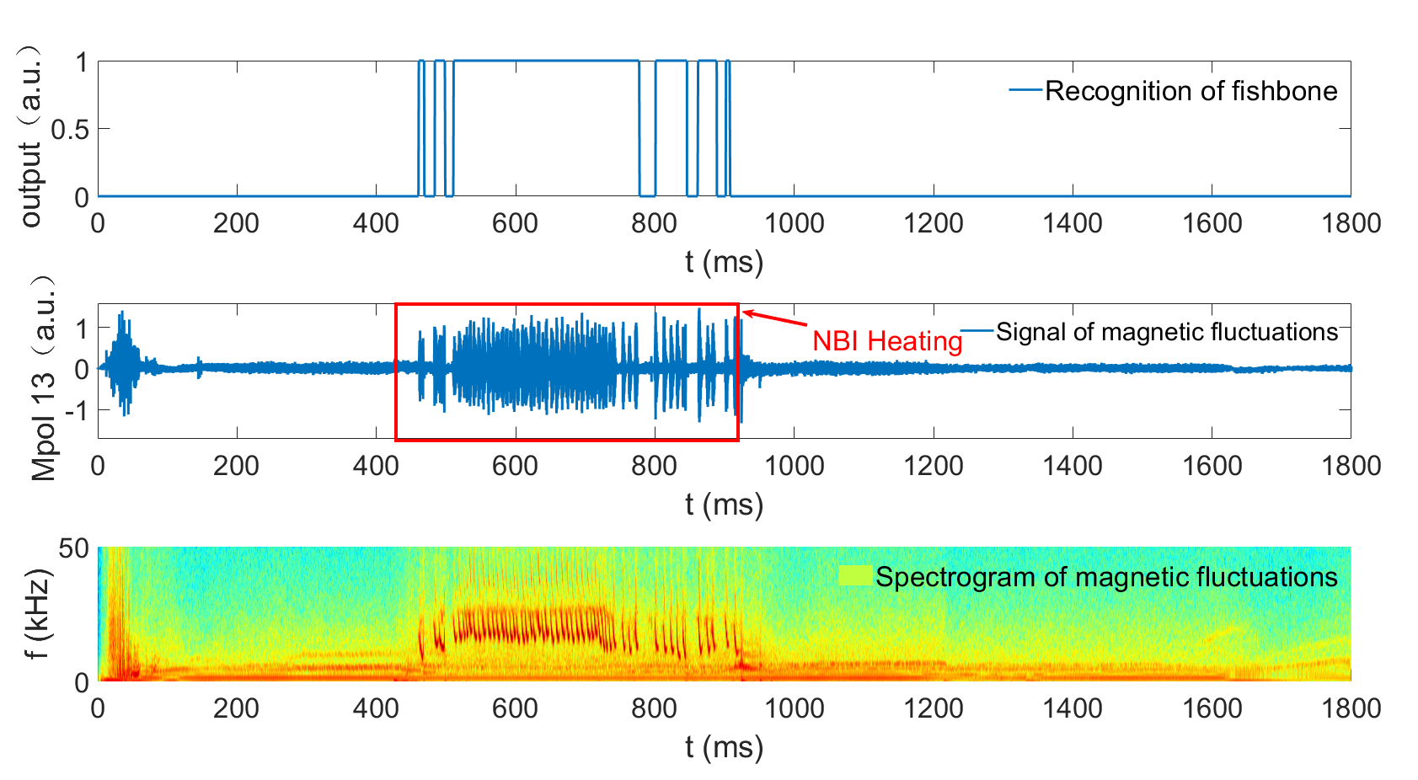
Identification of FB mode in HL-2A
Test results
Accuracy~94.7% for all the data slices

Slide 18
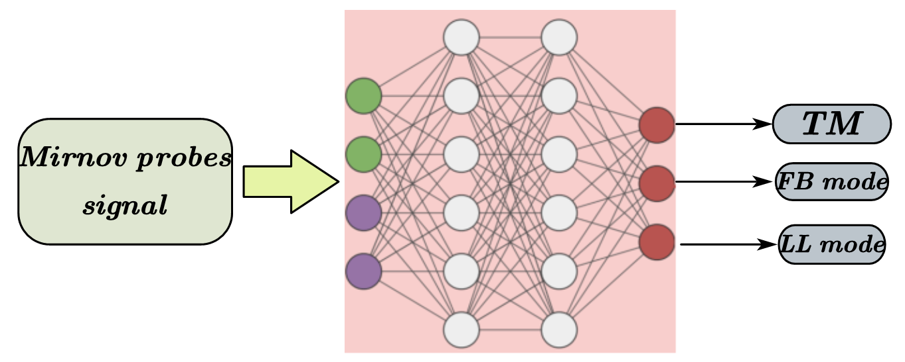
Multi-MHD identification
Jiont identification of fishbone mode, tearing mode and long-live mode
Multi-task learning could improve the accuracy for the identification of each mode
Accuracy | FB mode | TM | LL mode
Single-task learning | 94.7% | 92.7% | 94.1%
Multi-task learning | 95.5% | 93.7% | 95.3%

Slide 19
Outline
Brief introduction to HL-2A&HL-3
Progresses in HL-2A & HL-3
AI-based disruption prediction
ELM/L-H transition detector
Identification of MHD Instabilities with AI
Plasma reconstruction
Fast prediction of beta limits in HL-3
Summary

Slide 20
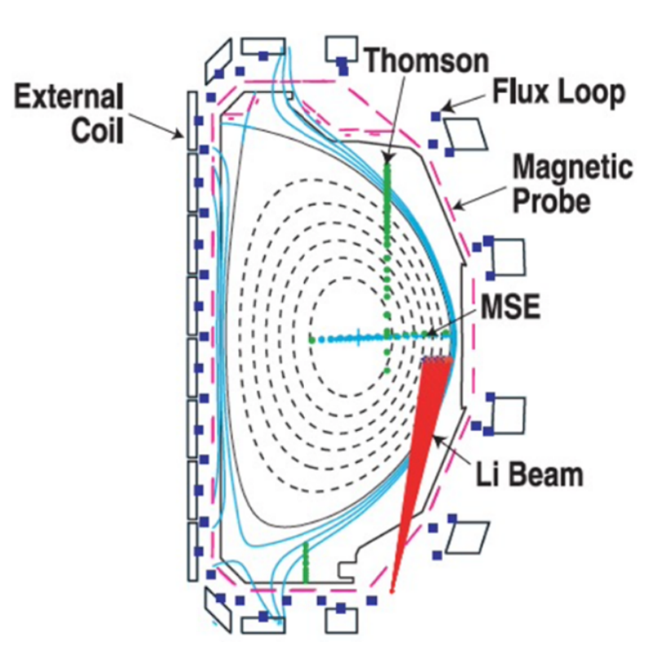
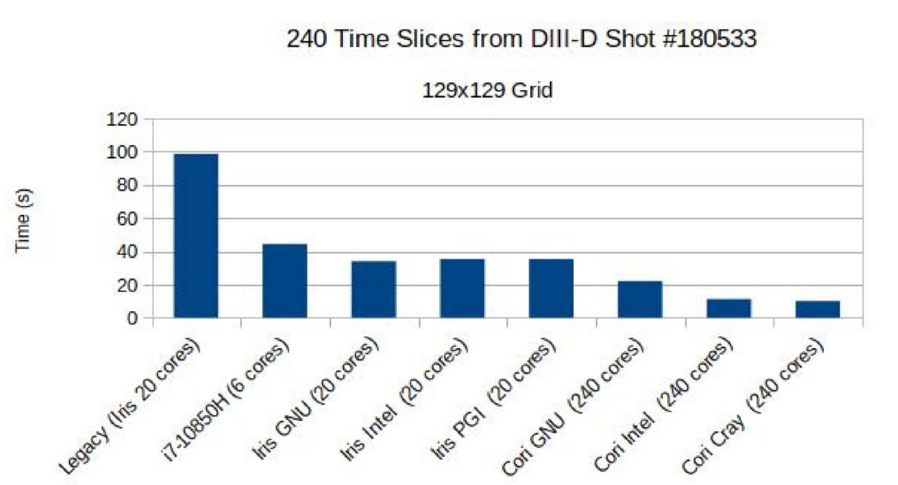
Plasma reconstruction
The plasma reconstruction is important
Fundamental to tokamak research and operation
The important part of fusion data analysis and plasma control
The off-line EFIT cannot be used for plasma control
The RT-EFIT is not sufficient for kinetic control
[L L Lao et al 2022 PPCF 64 074001]

Slide 21
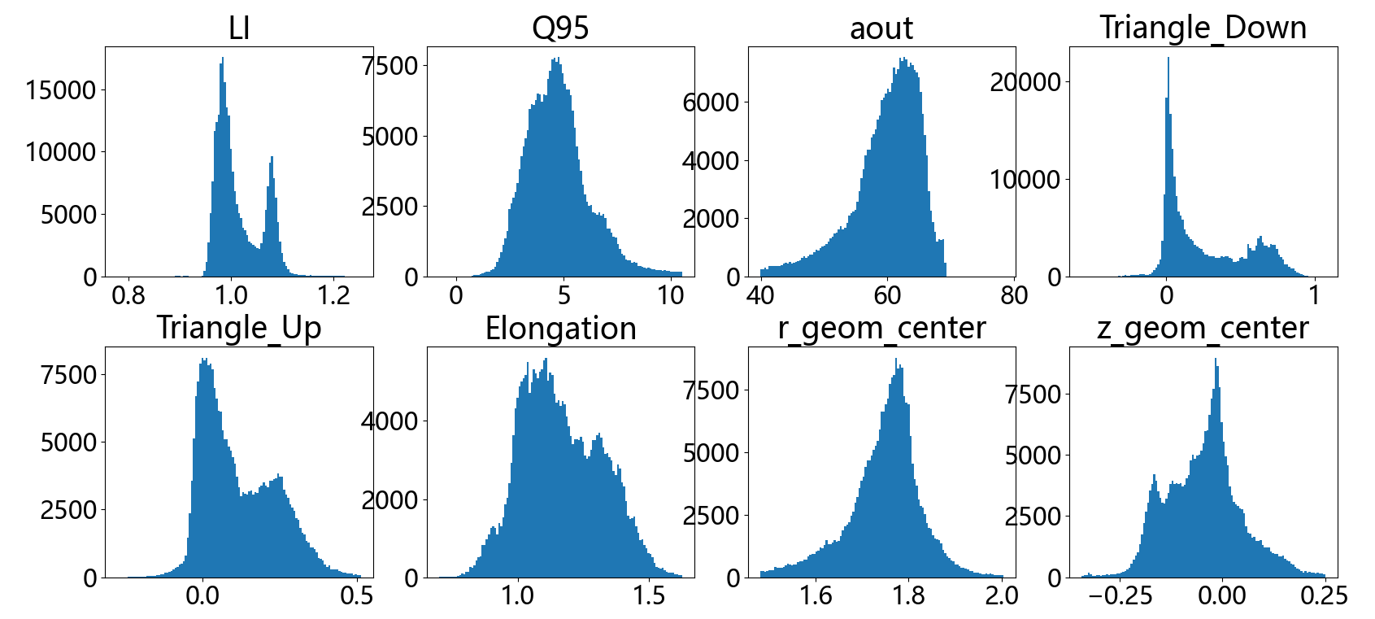
Plasma reconstuction with NN in HL-3
Plasma current（1）
Magnetic pick up probes（39）
FLux loops（10）
PF/CS/TF coils current（18）
The magnetic flux and configuration parameters are generated by off-line EFIT
Multi-task learning model is adopted to train the flux computational model and parameters computational model
EFITNN
Dense+DeConv2D Net
Multi-task learning model
FLux on grid
Configuration parameters

Slide 22
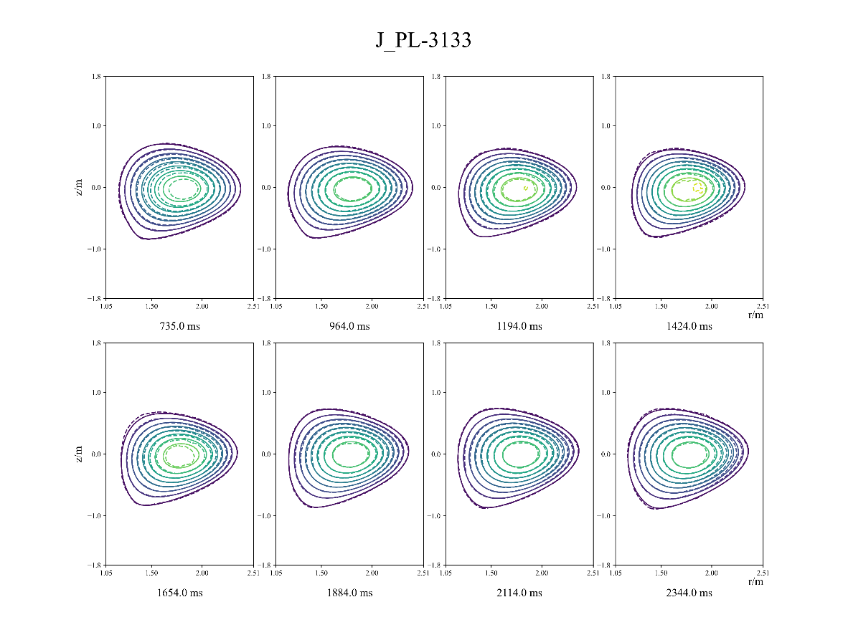
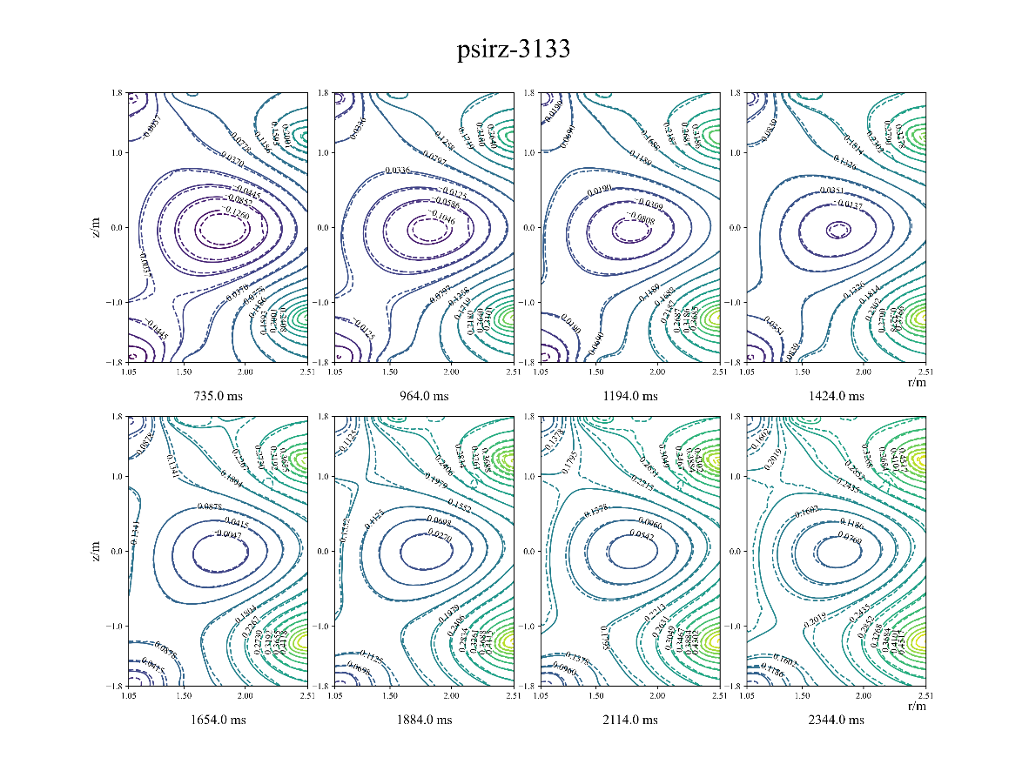
The flux and current density reconstruction
Fully connected NN + DeconvNet
Training set: Shot 1200-3199
Time: grid 33*33 -> 0.4 ms
grid 129*129 -> 2.0 ms
Relative error
Flux -> 0.4%
Current density -> 1.8%

Slide 23
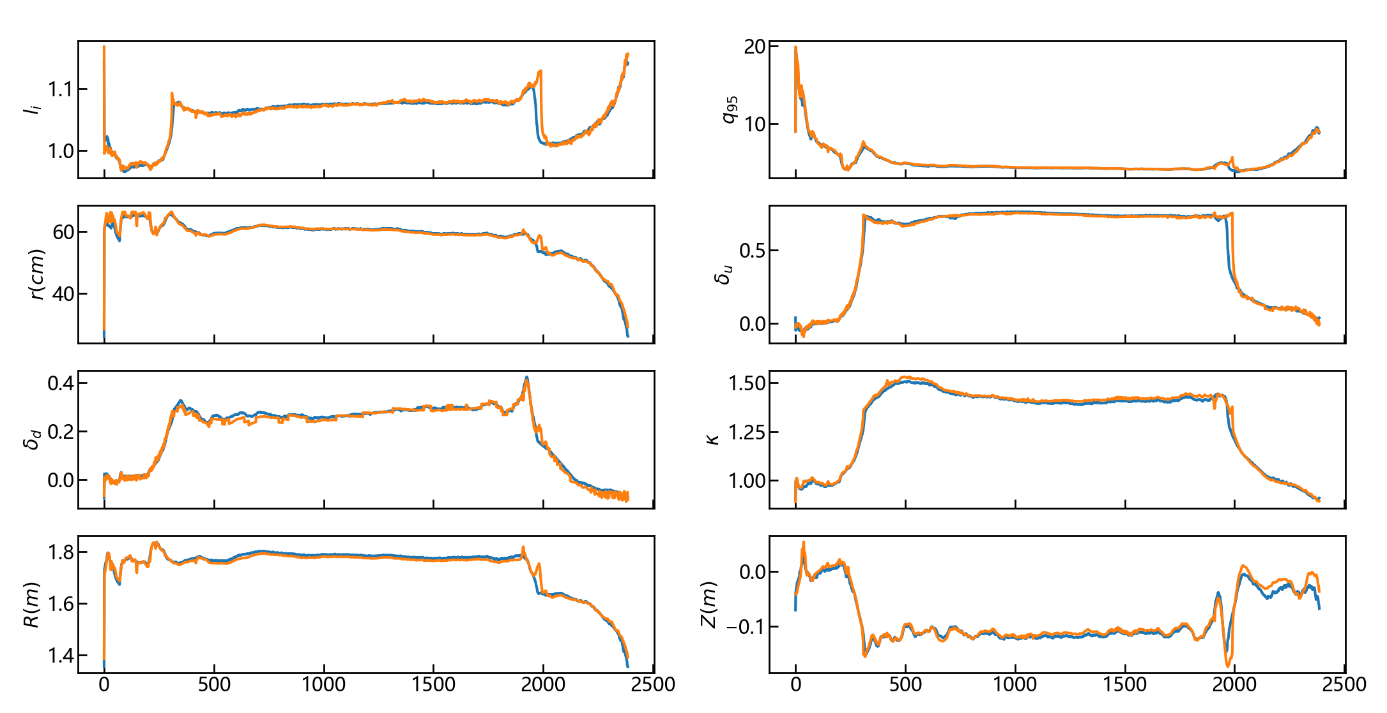
The parameters reconstruction
Fully connected NN
Additional confinement by reconstruction of flux and plasma current density
Training set: Shot 1200 – 3200
Test set: Shot 3201-4077
Results
MRE : 0.12
Absolute error：
li：0.00618
q₉₅：0.200
a：0.782 cm
δ_{u}：0.0203
δ_{d}：0.0161
κ：0.0182
r_{center}：1.17 cm
Z_{center}：0.855 cm

Slide 24
Outline
Brief introduction to HL-2A&HL-3
Progresses in HL-2A & HL-3
AI-based disruption prediction
ELM/L-H transition detector
Identification of MHD Instabilities with AI
Plasma reconstruction
Fast prediction of beta limits in HL-3
Summary

Slide 25
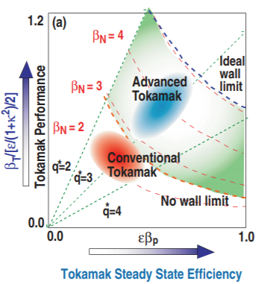
Fast prediction of beta limits in HL-3
The advanced tokamak needs high beta
Fusion power
P_{fus} ~ β²B⁴
Bootstrap current fraction
f_{bs}~β_{p}
High beta will drive MHD disabilities
NTM ➔ soft beta limit
XK ➔ hard beta limit
XK should be suppressed to achieve high performance
How to know the beta limit ?
$β_{N}^{no−wall}$ = 4li

Slide 26
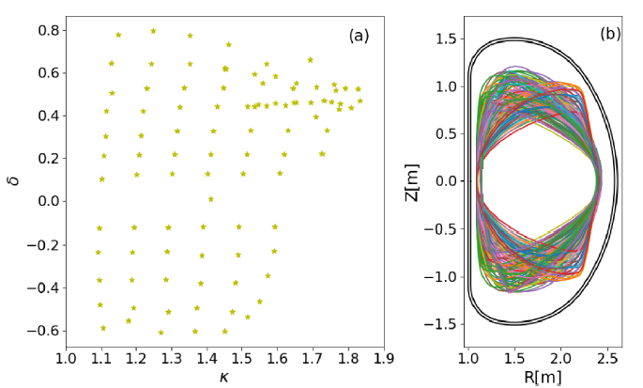
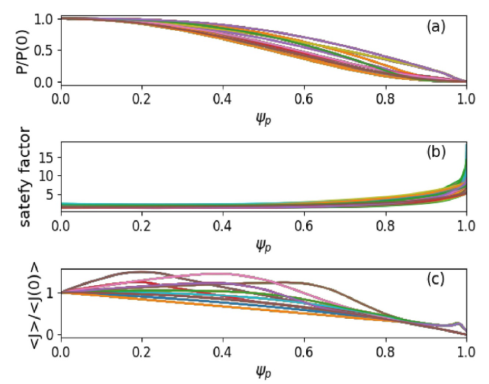
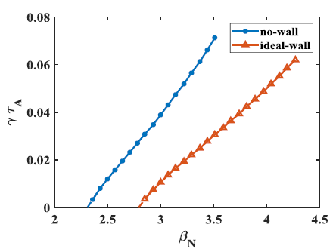
Generation of database in HL-3
The equiliria are built by EFIT code
Elongation:
$$κ=1\sim 1.83$$
Triangularity:
$δ=−0.6\sim 0.8$
$q_{0}=1.16\sim 2.37$
$q_{95}=3.94\sim 8.21$
$q_{min}=1.15\sim 2.13$
Calculate the no-wall and ideal wall beta limit by MARS-F code
The off-line calculation of the beta limit for each equilibrium could cost sevral hours

Slide 27
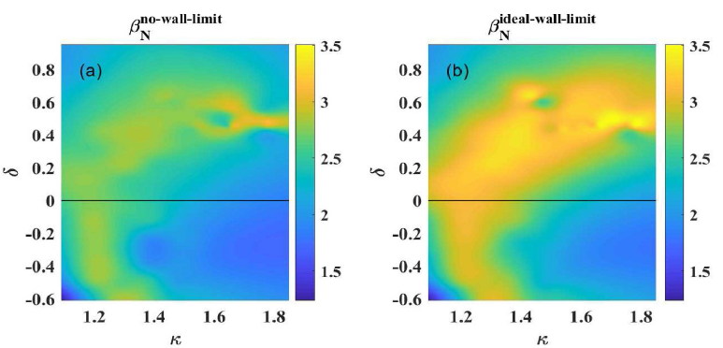
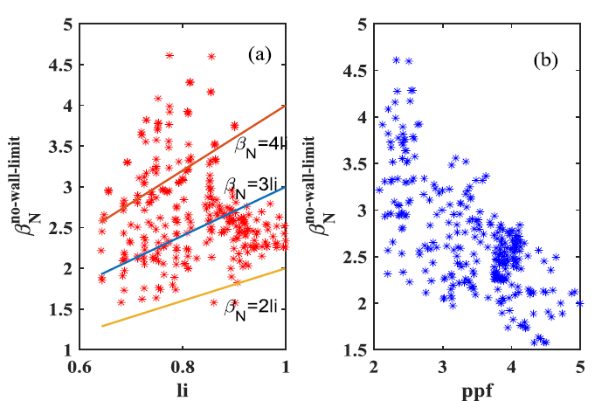
Relationships between beta limit and the parameters
All the trends ensure the reliability of the database
The plasma elongation generally enhances both $β_{N}$ limits
The effect is more pronounced for positive triangularity plasmas ($δ>0)$
$β_{N}^{no−wall}$ = cli
$β_{N}^{no−wall}$ decreases with increasing pressure peaking factor (ppf)

Slide 28
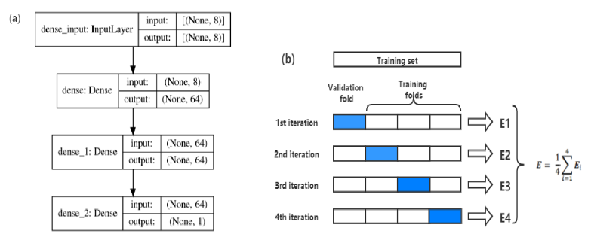
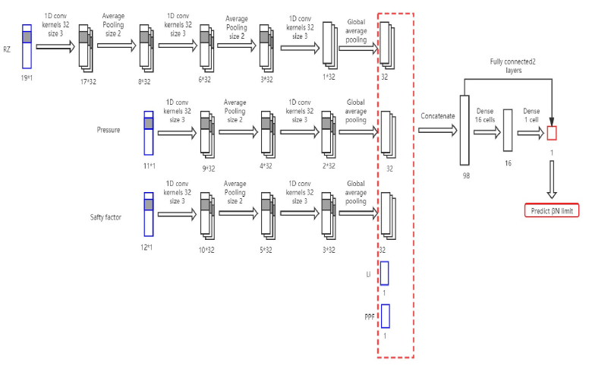
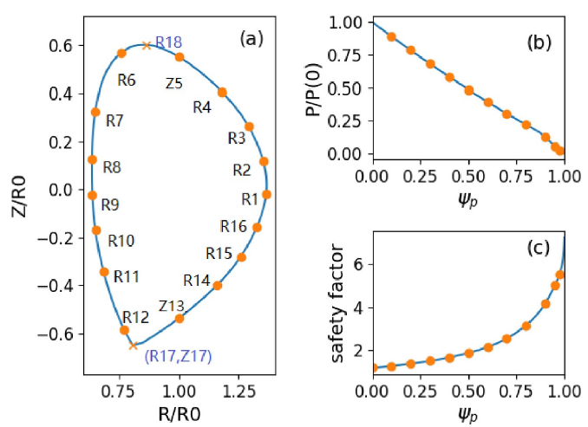
Construction of NN and CNN models
NN and CNN models are selected
Input
 | Plasma boundary | Equilibrium | Other
NN | plasma elongation($κ$) & triangularity($δ$) | $q_{0}$,$q_{a}$,$q_{min}$ | Li, ppf
CNN | RZ(19 points) | pressure profile(11 points) & safety factor profile(12 points) | Li, ppf

Slide 29
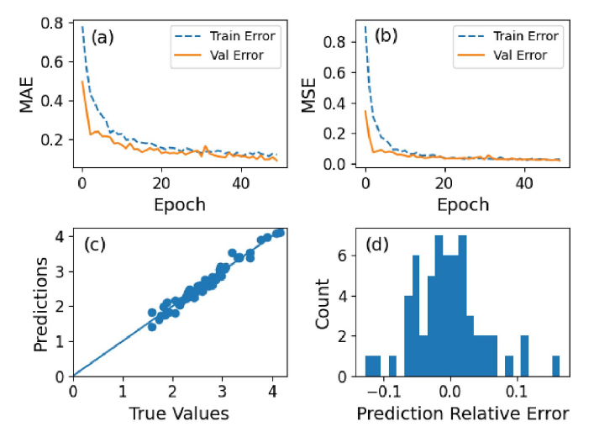
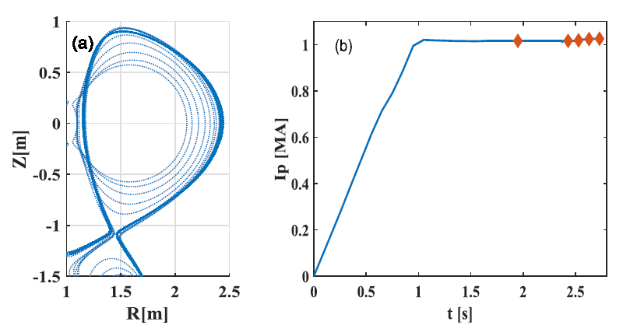
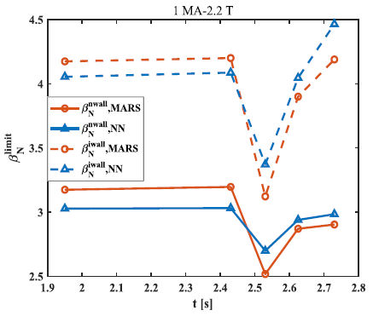
Results of NN and CNN models
Test cases with Tokamak Simulation Code (TSC)
(MRE) | $$β_{N}^{no−wall}$$ | $$β_{N}^{ideal−wall}$$
NN | 0.043 | 0.05
CNN | 0.033 | 0.055
Within 7% → $β_{N}^{no−wall}$limit
Within 10% → $β_{N}^{ideal−wall}$ limit
The trained NNs predict both the no-wall and ideal-wall limits with as high as 95% accuracy
Yifei Zhao, et al 2022 Plasma Phys. Control. Fusion 64(4) 045010

Slide 30
Outline
Brief introduction to HL-2A&HL-3
Progresses in HL-2A & HL-3
AI-based disruption prediction
ELM/L-H transition detector
Identification of MHD Instabilities with AI
Plasma reconstruction
Fast prediction of beta limits in HL-3
Summary

Slide 31
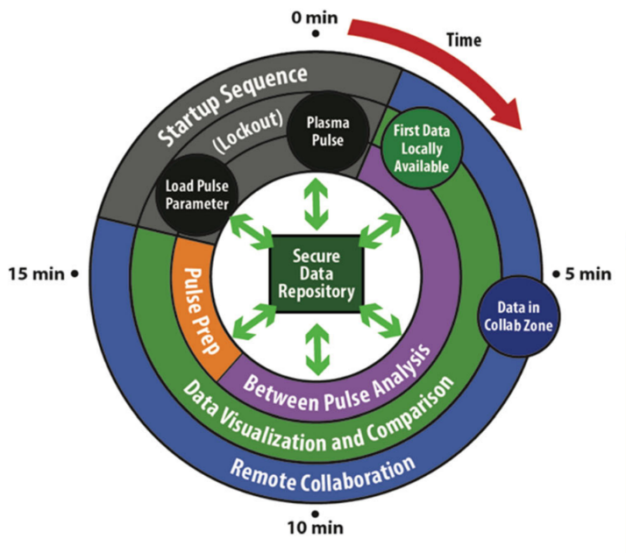
Summary
ML/AI models have been trained for HL-2A/3 tokamak operation:
Disruption prediction: successfully used to provide signal for MGI to mitigate major disruption
Plasma reconstruction: for ISO-flux control in the future
MHD recognition: ELM, TM/NTM, RWM and other instabilities control
What can we do in the future?
AI-models optimization for the works above
AI-PCS
……
[ David Humphreys, et al Journal of Fusion Energy (2020) 39:123–155]

Slide 32
Thank you for your attention !

