Slide 1
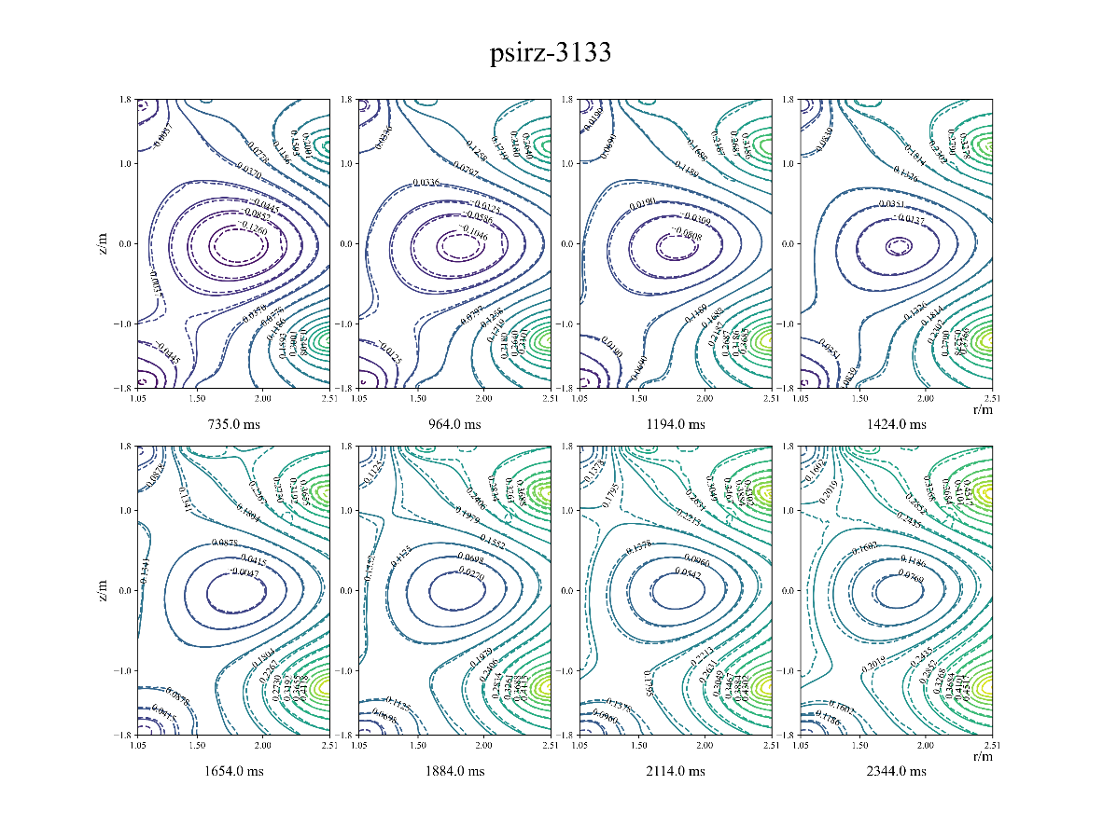
AI-driven tokamak control in HL-2A/3 – Shuo Wang
Motivations
Disruption with high plasma current is dangerous for HL-3
MHD instabilities (ELM, NTM/TM, RWM, etc) should be avoid to achieve high performance operation
A more accurate and real-time equilibrium reconstruction model should be trained for configuration and profile control for HL-3.
Results
1.5D CNN+LSTM algorithm is used to predict disruptions in HL-2A/3 in the closed loop
Several models has been trained to identify the MHD instabilities
A plasma reconstruction model based on NN is ready to be tested in the iso-flux control in HL-3
Challenges
The total shots and scenarios for now cannot cover all the missions HL-3 aims to. So the OOD of the models challenges a lot for the new experiments in HL-3, especially for the shots with more heating power input in the future.
IAEA Workshop on AI for Accelerating Fusion and Plasma Science, 2023 11/28 – 12/1

