Slide 1
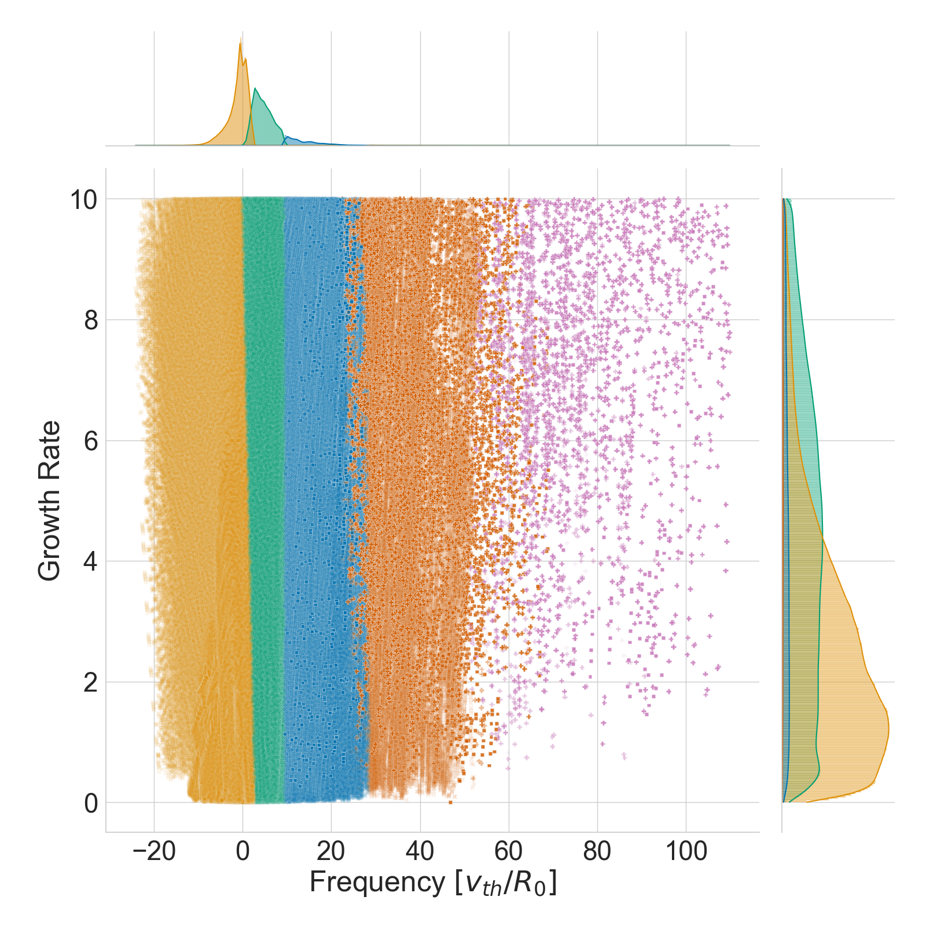
FASTER : IA methods for fast and accurate turbulent transport prediction in tokamaks– Guillaume FUHR
Motivations
The GKDB Project : an open and open-source repository of transport and gyrokinetic simulation data
Results
Demo of the GKDB project
Clustering analysis to classify eigenfunctions growth rates and frequencies of a 20millions eigenfunctions dataset
Challenges
Database architecture for performant queries/storage.
Easy to use interface for python package and website.
IAEA Workshop on AI for Accelerating Fusion and Plasma Science, 2023 11/28 – 12/1

